Slide 1
Spring 2026
CSCI 409 Senior Project II
Zhurek AI
Cardiology Diagnosis Automation
Kymbat Amanova
Amina Aimuratova
Ablay Abdimalinov
Ariana Kenbayeva
Zhazelya Muratkhanova
Project Advisor: Dr. Siamac Fazli
Associate Professor of Nazarbayev University

Slide 2
Glossary
Echocardiography (Echo) — Ultrasound imaging of the heart
Heart View - A standardized, specific angle or orientation used to visualize the heart
DICOM — Standard medical format for storing and sharing imaging data
Ejection Fraction (EF) — Percentage of blood pumped out of the heart with each beat
Cardiac View Classification — Identifying which heart view appears in an echo image or video
EchoPrime — Our AI backend for echocardiography analysis
Grad-CAM — Visualization method showing which image regions influenced the AI result
AUC — Metric showing how well a model separates normal and abnormal cases
HIPAA / GDPR — Privacy regulations for protecting patient data

Slide 3
Problem Statement
7,623
3
The death cases grew
New circulatory cases increased
Cardiovascular Disease is the leading cause of death in Kazakhstan.
Diagnosis requires expert interpretation

Slide 4
Problems
Problem №1
Echo Diagnosis is slow and depends on limited specialists
Problem №2
Measurements are unreliable w/o correct anatomical view selection
Problem №3
Black-box AI is difficult to use in clinical practice

Slide 5
Solutions
Solution №1
Web platform for analysis and draft report in under a minute
Solution №2
Automated view classification and measurement support by EchoPrime
Solution №3
Interpretable AI predictions with Grad-CAM visualization

Slide 6
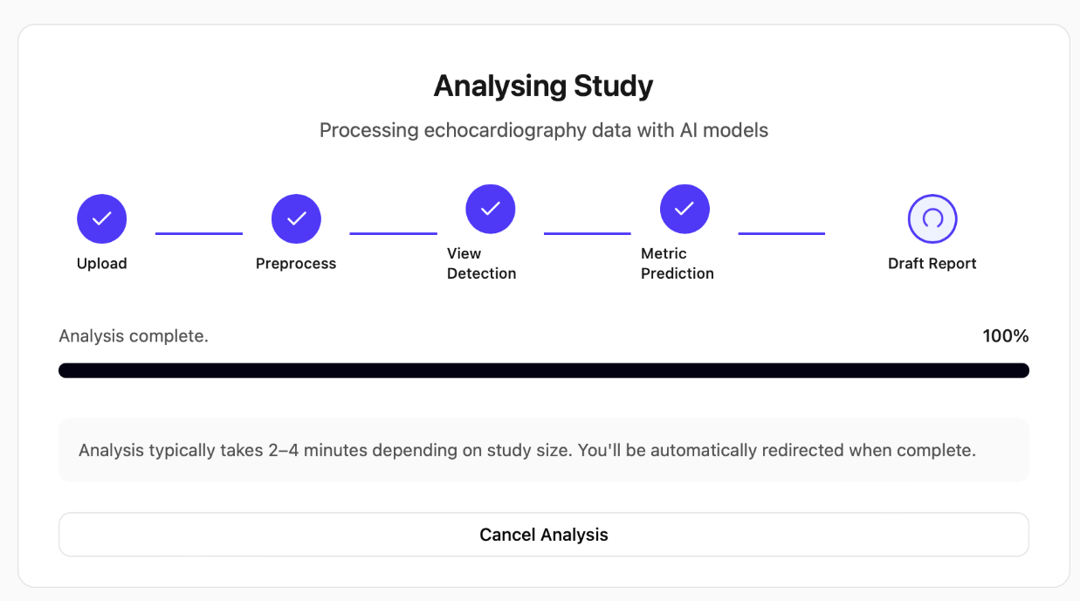
Solution = Zhurek AI
AI-powered echocardiography analysis platform
Combining:
EchoPrime model
Web system
Explainability (Grad-CAM)

Slide 7
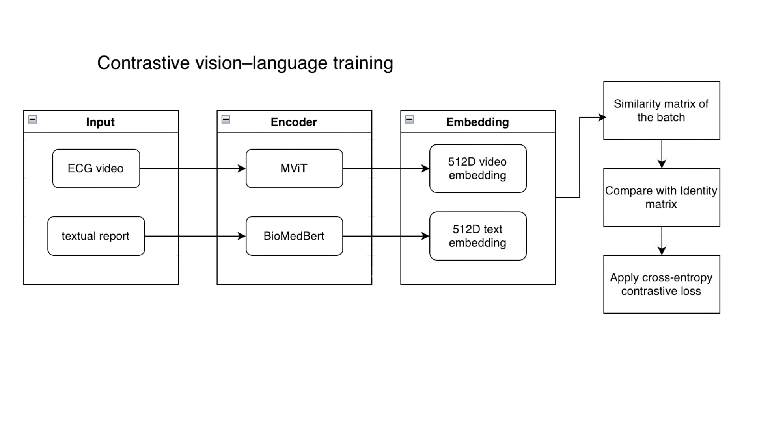
EchoPrime model architecture: Training
Echo

Slide 8
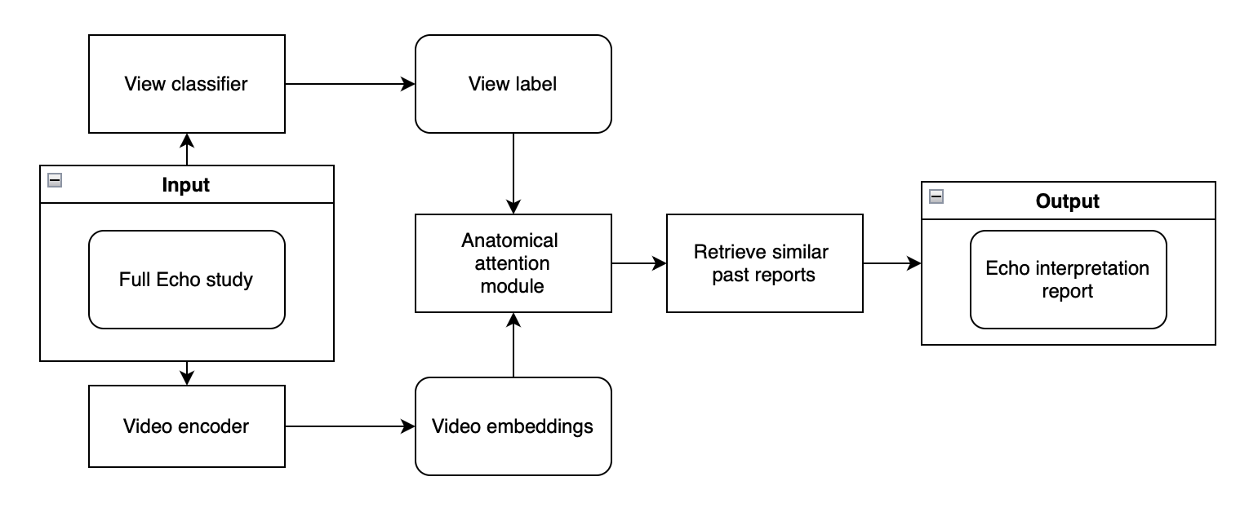
EchoPrime model architecture: Inference

Slide 9
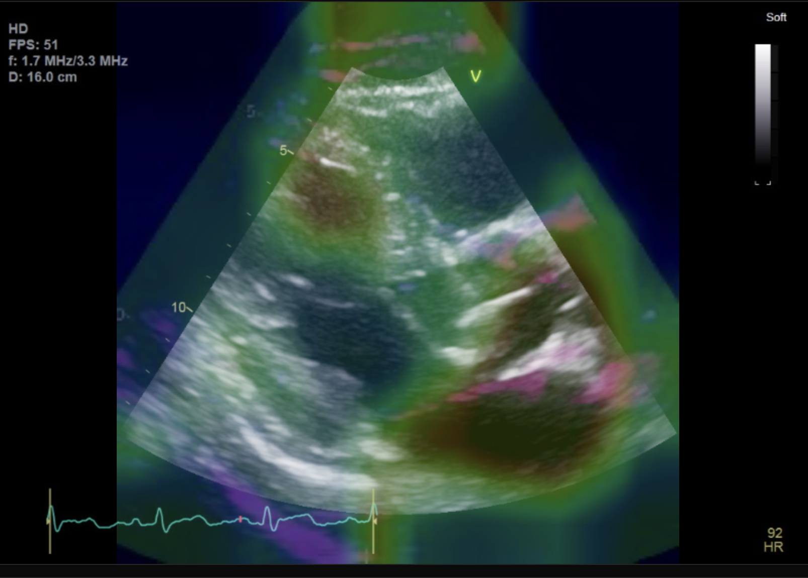
Interpretability - GradCam
Which regions of the heart influenced the result?
Clinicians need to verify AI decisions
Problem: model compresses video → loses spatial detail
Solution: Grad-CAM heatmaps

Slide 10
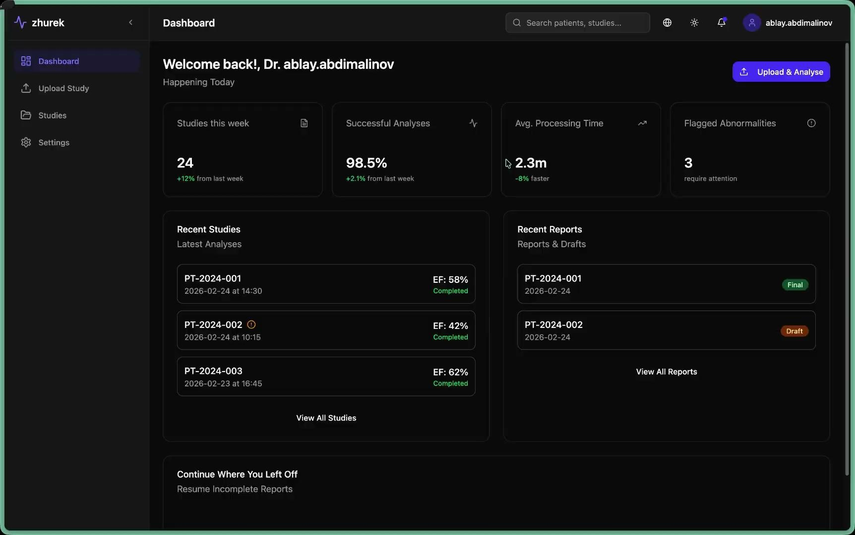

Slide 11
Solution Evaluation
Weekly meetings with the CTO (Chief Technology Officer) of the CheckApp startup.
Invited a sonographer specializing in cardiography for product evaluation.
Elements added as a result:
  Interpretability: visualization of mapping from specific Echo video to report
  Option of manual output text editing
  Exporting the report file into a Word document

Slide 12
Future directions
Model improvements:
Collecting Kazakhstani data for local fine-tuning
Include ICD-10 code recognition for the reports
System additions:
Federated learning
Automatic learning from newly uploaded studies
Additional uses:
Student/intern training

Slide 13
Jurek AI
Turning Echo Data into Early Action
Nazarbayev University
CSCI 409 Senior Project II

Slide 14
Presentation references
[1] N. Glushkova, B. Turdaliyeva, M. Kulzhanov et al., “Examining disparities in cardiovascular disease prevention strategies and incidence rates between urban and rural populations: Insights from Kazakhstan,” Scientific Reports, vol. 13, p. 20917, Nov. 2023, doi: 10.1038/s41598-023-47899-8.
[2] A. Markabayeva, A. S. Kerimkulova, R. Nurpeissova, and A. Ospanova, “Prevalence of cardiovascular diseases in Kazakhstan for 2013–2020,” Journal of Hypertension, vol. 42, suppl. 1, p. e162, May 2024, doi: 10.1097/01.hjh.0001021004.41104.0b.
[3] A. Issanov et al., "Heart failure mortality trends in Kazakhstan 2014-2019: analysis of the Unified National Electronic Healthcare System," [Internal citation based on project materials]
[4] M. Vukadinovic, I.-M. Chiu, X. Tang, N. Yuan, T.-Y. Chen, P. Cheng, D. Li, S. Cheng, B. He, and D. Ouyang, “Comprehensive echocardiogram evaluation with view primed vision language AI,” Nature, vol. 650, pp. 970–977, Feb. 2026, doi: 10.1038/s41586-025-09850-x.
[5] R. R. Selvaraju, M. Cogswell, A. Das, R. Vedantam, D. Parikh, and D. Batra, “Grad-CAM: Visual Explanations from Deep Networks via Gradient-based Localization,” arXiv preprint arXiv:1610.02391, 2016.

Slide 15
Appendix
Below this slide is additional information that can be reviewed if needed

Slide 16
Pipelines explored throughout the project
EchoCV
PanEcho (view agnostic)
Input: Echo videos
Input: Echo videos
View classification (averaging predictions over each frame)
Spacial encoder
Temporal frame transformer
Image segmentation
Task-specific output heads
Output: measurements and disease detection (seperate CNN trained for each disease)
Output: report-style answer

Slide 17
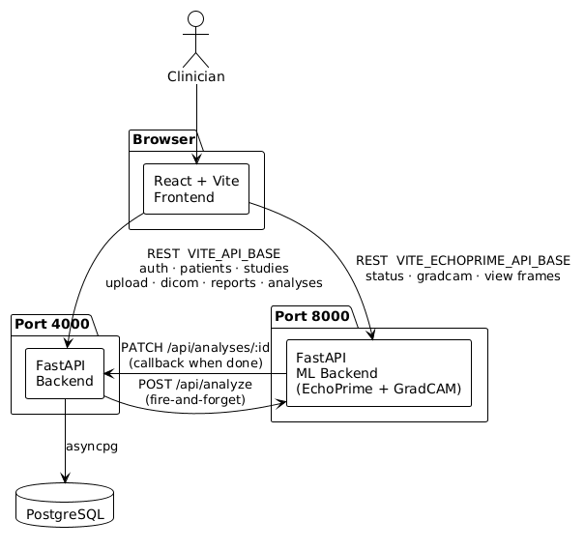
System Context
3 independent services: React frontend, FastAPI backend (Render), ML backend (HF Spaces)
DICOM files: browser memory → HF directly, never touch the backend
Backend handles metadata only, no file storage

Slide 18
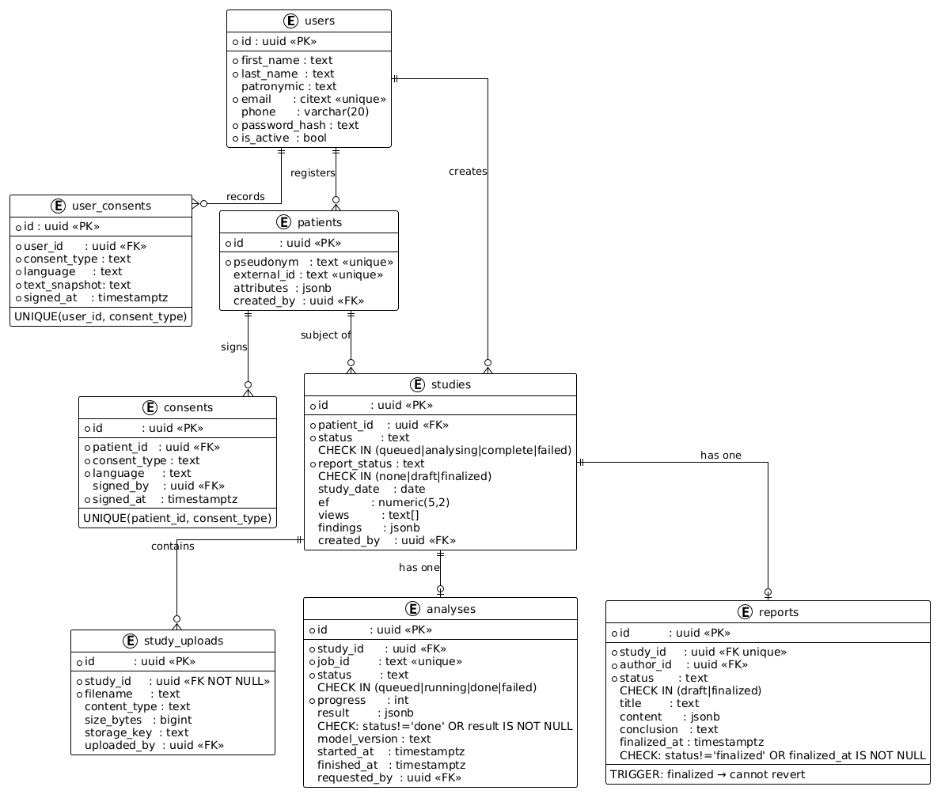
DB Schema
Central entity: studies – links patient, analysis, report
Status columns enforced at DB level with CHECK constraints
Report finalization irreversible via DB trigger

Slide 19
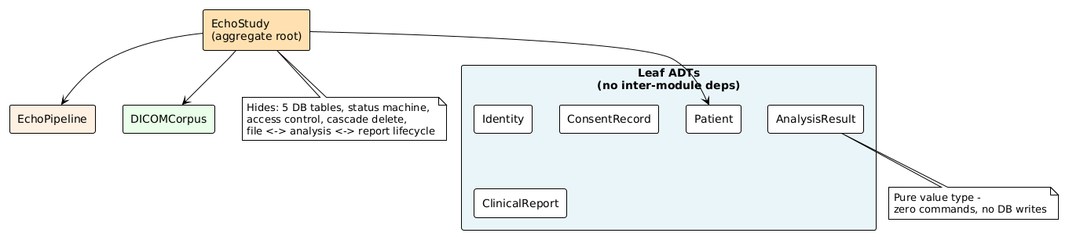
ADT Dependency Graph
EchoStudy is the only aggregate root — single entry point for all study operations
All other modules are leaves: no cross-dependencies
Enables isolated development and testing of each module

Slide 20
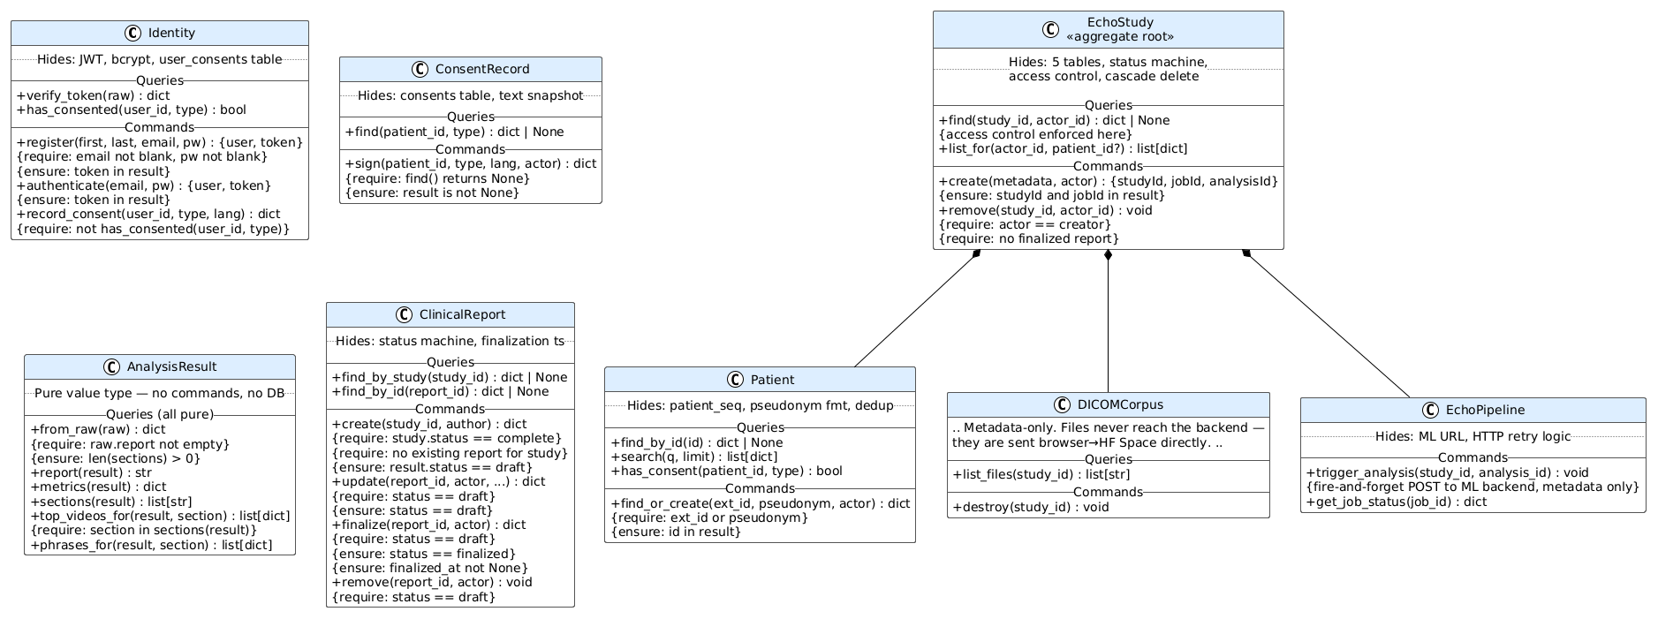
ADT Class Diagram

Slide 21
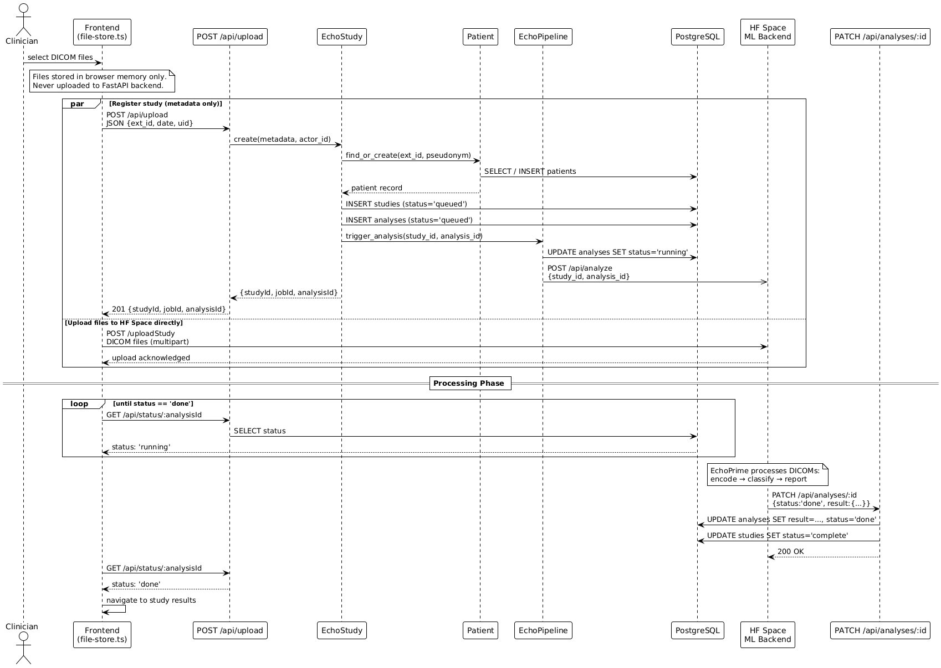
Upload + Analysis Sequence

Slide 22
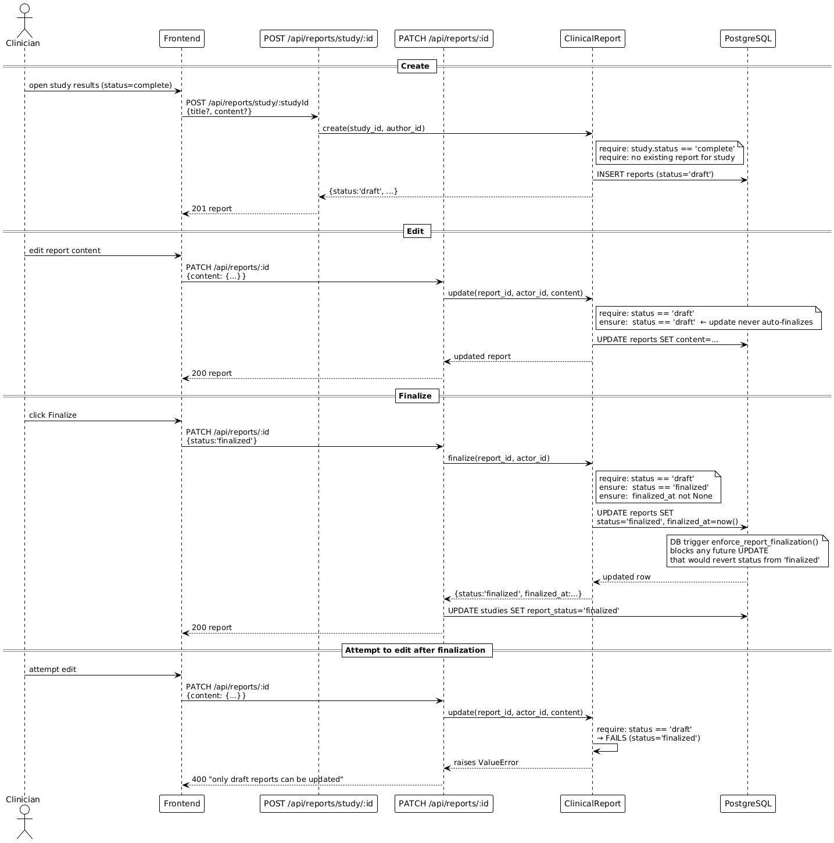
Report Lifecycle
Draft → editable, Finalized → immutable
Precondition check at app layer + DB trigger as safety net
Finalization enforced at two independent levels

Slide 23







Technology Stack

Slide 24
Render Deployment
Zhurek-frontend connected to backend through VITE_API_BASE
Zhurek-backend working with the database through DATABASE_URL
EchoPrime backend processes the input and returns the analysis results

Slide 25
Model Evaluation
Evaluated across 5 hospitals dataset in 3 countries — mean AUC 0.85–0.92
Outperforms previous foundation models and matches task-specific models
More consistent than human cardiologists (accuracy 0.89 vs 0.82)
Detects diseases not labeled in training data — amyloidosis AUC 0.96, STEMI AUC 0.92

Slide 26
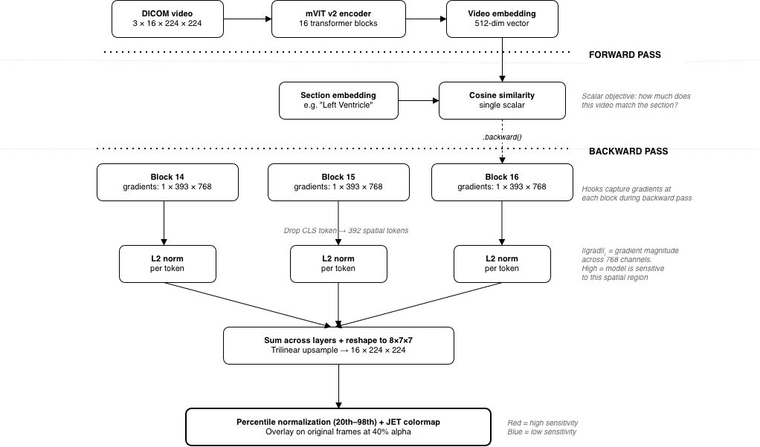
GradCAM
Why: Clinicians need to verify which image regions drive each assessment
Problem: mVIT v2 encoder collapses video into a single 512-dim vector — spatial info is lost
Method: Gradient-based spatial attribution
Backpropagate cosine similarity to section embedding
Capture gradients at last 3 transformer blocks
Per-token gradient L2 norm → reshape 8×7×7 → upsample to 16×224×224

Slide 27


Ethical Considerations
CITI ethics training completed
Authorized, de-identified uploads only
HIPAA/GDPR-compliant privacy
Decision support
Uploaded data not used for model training
Encryption, access control, and audit logs

Slide 28
Jurek AI
Turning Echo Data into Early Action
Nazarbayev University
CSCI 409 Senior Project II

