Slide 1

Comparison of Kazakhstani and European codes of practice for shallow and deep foundation design
Assel Zhanabayeva
Master Thesis Defense Presentation
Civil and Environmental Engineering Department
Supervisor: Professor Sung-Woo Moon
Co-supervisor: Professor Jong Kim

Slide 2

Introduction | 03
Methodology | 06
Research problem and hypothesis | 07
Research process | 08
Design problem in Nur-Sultan city | 10
Research results | 11
Discussion | 13
Conclusion | 14
Reference list | 17
Thesis Presentation Outline

Slide 3
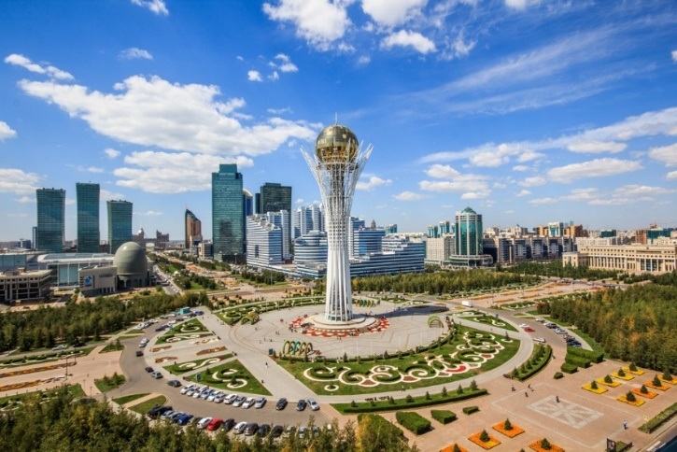


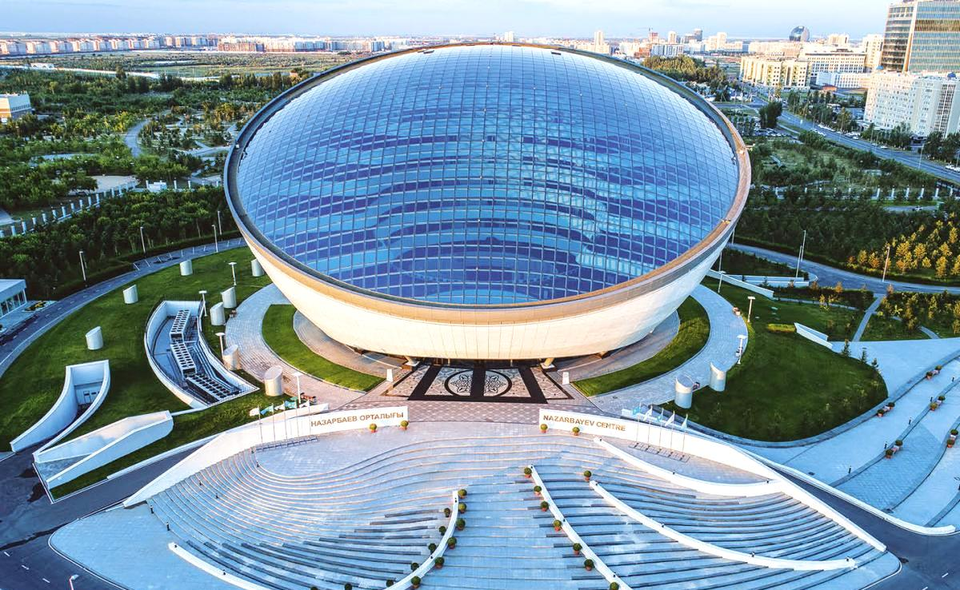
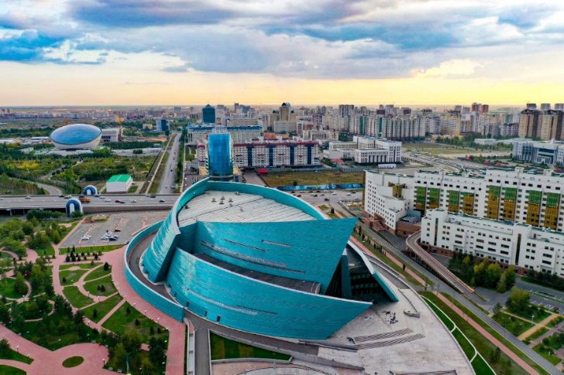
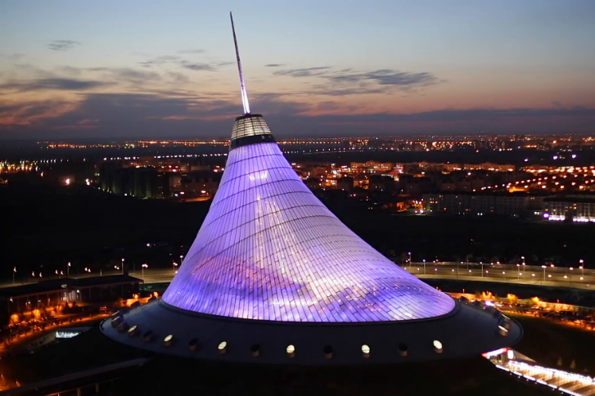
Construction sector in Kazakhstan

Slide 4
Introduction
1
2
3
4
Introduction of Eurocode in Kazakhstan
In accordance with the national “100 steps” plan, Eurocode was introduced in Kazakhstan in 2011.
Technical regulations and standards
Since 2014, Eurocode has been applied in parallel with the existing design code in Kazakhstan as a
method of alternative solutions.
Advantages of the application of Eurocode
The harmonization with Eurocode contributes to the inflow of foreign investments, stimulates collaboration, and allows application of identical design methods.
Objective of the Thesis
The proposed thesis work is intended to promote and advance knowledge on the
application of Eurocode 7 among geotechnical engineers in Kazakhstan.

Slide 5
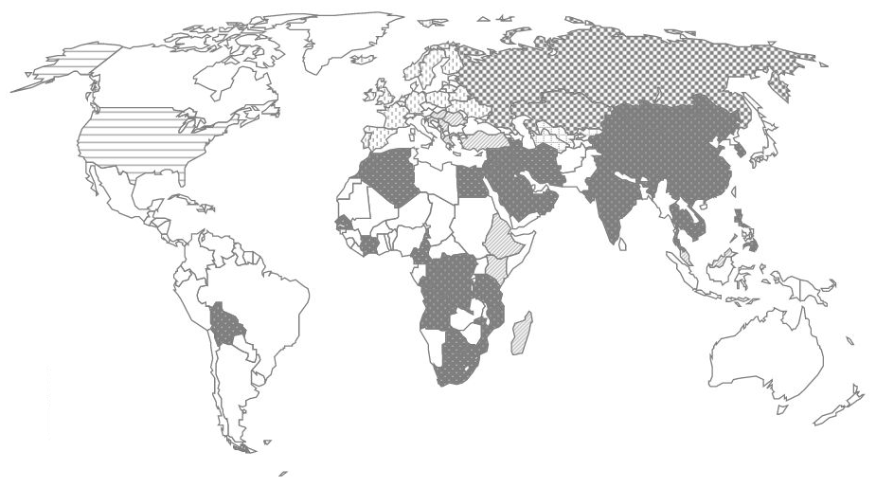
Design code distribution around the world
EUROCODE
EU-countries
EUROCODE adopted
CIS-countries
AASHTO
The USA
Interested in EUROCODE
Interested in EUROCODE
Interested in EUROCODE

Slide 6
Methodology
Phase 1
Phase 2
Phase 3
Phase 4
Study of Eurocode 7 (EC7) and Kazakhstani building regulation (SP RK) for the design of shallow and deep foundations
Literature review and data collection on code comparison in EU and CIS countries
Geotechnical design of shallow and deep foundations for the Nur-Sultan case adhering to EC7 and SP RK for a long-term
design situation
Analysis of the obtained results of bearing resistance, elastic settlement, and over-design factor for shallow and deep foundations in Nur-Sultan

Slide 7
Research problem and hypothesis
Research problem
Reveal the differences and compare the main requirements for geotechnical design of shallow and deep foundations provided in Kazakhstani construction regulations and Eurocode 7 (EN 1997).
Research hypothesis
SNiP-based technical regulations for geotechnical design existing from the times of the Soviet Union could be less conservative than Eurocode and require some modifications to conform with international standards.

Slide 8
Research process
Step 1
Introduction of the design problem in Nur-Sultan, Kazakhstan.
Step 3
Raft, pile, and piled raft foundations design performance.
Step 5
Conclusions on the conservativeness of the Kazakhstani and European approaches.
01
03
05
02
04
Step 4
Comparative analysis of the obtained results of bearing resistance, elastic settlement, and over-design factor for shallow and deep foundations.
Step 2
Shallow foundation (i.e., pad and strip) design performance.

Slide 9

2
1
3
Zoning of the territory of Nur-Sultan city

Slide 10
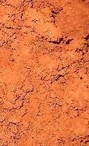
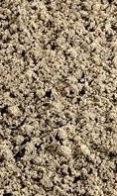



Design problem in Nur-Sultan city
LL = 0.25DL
LL = 0.25DL
LL = 0.25DL
LL = 0.25DL
Type 1
Type 2
Type 3
2 m
2 m
G.W.T.
Loam
6 m
Sandy gravel
Loam
γ = 19.42 kN/m³
φ' = 22°
Clay
6 m
Sandy gravel
$γ_{sat}$ = 21.57~22.07 kN/m³
φ = 35~36.5°
(a) Shallow foundation
(b) Raft foundation
(c) Pile foundation
(d) Piled raft foundation
Clay
$γ_{sat}$ = 19.85 kN/m³
φ = 29°

Slide 11
Research results

Slide 12
Research results

Slide 13
Discussion
Finding
01
As the design problem involves the consideration of cohesive soil, the Kazakhstani approach determines the bearing resistance based on liquidity index, whereas the European approach calculates it by considering undrained shear strength of the soil.
Finding
02
The calculation of the elastic settlement of a piled raft foundation is performed by the application of the stiffness method for both the Kazakhstani and European approaches.
Finding
03
The Kazakhstani approach applies a reduction factor when calculating the bearing resistance of a pile foundation. By contrast, the European approach directly calculates the factored geotechnical resistance of pile foundation by using the factored strength parameters.
Finding
04
The conservativeness of the European approach is explained by the fact that EC7 synthesizes the design traditions and construction practices of various European countries, so the integration process led to a more conservative and detailed geotechnical design approach than that in Kazakhstan.

Slide 14
Conclusions
Investigation of soil profiles and determination of soil properties in Nur-Sultan
Comparative analysis of geotechnical approaches for the design of different types of foundation adhering to EC 7 and SP RK
Identification of the conservativeness of European design code compared to Kazakhstani building regulation

Slide 15
Limitations of the study
Fixed groundwater table
The groundwater table is assumed as the average value (i.e., 2 m) for the territory of Nur-Sultan city.
1
Undrained shear strength
As this value has not been identified empirically, the undrained shear strength value was obtained from the literature review.
Limitations of the study
4
Uniform soil profile
The soil profile of Nur-Sultan is mainly presented by loam, sandy gravel, and clay soils.
2
Limited number of design cases
The conclusions on conservativeness of Eurocode and SP RK for shallow and deep foundation design are made based on a limited number of design cases. Further comparative study is required.
5
Standard structure design condition
The ratio of variable load to permanent load is assumed to be 0.25 (Live Load = 0.25 * Dead Load).
3

Slide 16
Suggestions for the future research
Suggestion 1
Comparative analysis of the Kazakhstani and European approaches for deep foundation design considering negative skin friction.
Suggestion 2
Design of the retaining structures adhering to the Kazakhstani and European design approaches.
Suggestion 3
Comparative analysis of the Kazakhstani approach with international codes of practice (i.e., Australian, American, and Canadian codes) for geotechnical design.

Slide 17
Reference list
Orr, T. Eurocode 7–a code for harmonized geotechnical design. In Proceedings of the International Workshop on Foundation Design Codes and Soil Investigation in view of International Harmonization and Performance Based Design. 2002, 3-15.
1
Alibekova, N.T.; Zhussupbekov, A.Z. GIS Technology for Engineering and Geological Surveys; LAP LAMBERT Academic Publishing: Saarbrücken, Germany, 2018. (In Russian)
5
Shaldykova, A.; Moon, S.-W.; Kim, J.; Lee, D.; Ku, T.; Zhussupbekov, A. Comparative Analysis of Kazakhstani and European Approaches for the Design of Shallow Foundations. Appl. Sci. 2020, 10, 2920.
2
Eurocode 7: Geotechnical Design–Part 1: General Rules. In British Standards; The European Union: Brussels, Belgium, 1997.
6
3
Lambla, V. Construction sector in Kazakhstan 2019. In Market Analysis and Development Forecasts for 2019–2024; PMR Market Insight: Krakow, Poland, 2019.
7
Schuppener, B. Eurocode 7 Geotechnical design. Part 1: General rules and its latest developments, Georisk, 4:1. 2010, 32-42. .
Zhanabayeva, A.; Sagidullina, N.; Kim, J.; Satyanaga, A.; Lee, D.; Moon, S.-W. Comparative Analysis of Kazakhstani and European Design Specifications: Raft Foundation, Pile Foundation, and Piled Raft Foundation. Appl. Sci. 2021, 11, 3099.
4
Makhmutova, E.V. Central Asia in Search for Its Own Way of Integration. Mgimo Rev. Int. Relat. 2018, 78–91.
8

Slide 18
THANK YOU
Assel Zhanabayeva
Master Thesis Defense Presentation
Civil and Environmental Engineering Department
Supervisor: Professor Sung-Woo Moon
Co-supervisor: Professor Jong Kim

Slide 19
QUESTIONS

