Slide 1
Contemporary Issues in Public Administration in Azerbaijan
Bahram Khalilov, Deputy Chairman of the Board of Directors of the State Examination Center of the Republic of Azerbaijan
5-6 October 2018 Astana, Kazakhstan

Slide 2
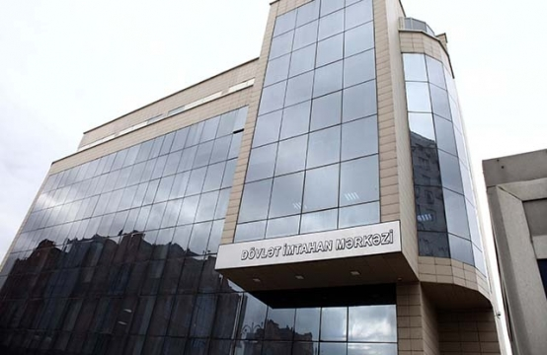
State Examination Center of the Republic of Azerbaijan
The Center was established by the decree of the President of the
Republic of Azerbaijan dated on April 11, 2016.
Main duties of the Center are as follows:
Takes part in the formation of state policy in the field
of civil service and provides implementation of this policy;
Holds test exams for recruitment and continuation of work at
civil service;
Studies the situation and summarizes information about follow of the rules of ethical behavior by civil servants;
Provides awareness about civil service and rules of ethics conduct of civil servants;
Maintains a register of civil servants and provides inclusion of information about performance appraisal to the Register, etc.

Slide 3

Inefficient structure of state bodies
It shows itself:
In organizational instability of the apparatus;
In existence of state bodies with identical functions;
In bureaucracy.
Optimization of the organizational structure of management on the basis of excluding unnecessary links and minimizing the costs of exercising managerial functions, access to one-stop services, development of quality standards and accessibility of public services, improvement activity of “Electronic government” and other actions are held in Republic.

Slide 4

Motivation in public administration
The main aim is:
Ensuring equal admission and promotion
in civil service;
Improving performance appraisal system;
Improving payment system in public administration, connecting payment system with the results of performance appraisal;
Improving non-material motivation system.

Slide 5

Anti – corruption policy
The following acts were adopted in this field:
State program on struggle against corruption (2004-2006) was
adopted in 2004;
National strategy on increasing transparency and struggle against
corruption was adopted in 2007;
- National Action Plan on encouraging Open Government (2012-2015) was adopted in 2012;
- National Action Plan on struggle against corruption (2012-2015) was adopted in 2012;
- National Action Plan on encouraging Open Government (2016-2018) was adopted in 2016.
The main aim is achieving:
Development and implementation of effective anti-corruption measures;
Ensuring transparency and accountability in public administration;
Improving activity of a supervisory body for corruption.

Slide 6

Ethics in public administration
Normative legal base, control mechanism,
coordination body, ethical commissioners
were established.
The main aim is:
Increasing the level of organizational culture in public administration;
Development the activity of Ethical Commissioners.

Slide 7
Thank you for your attention
Contact information: b.khalilov@dim.gov.az; +994124658797

