Slide 1
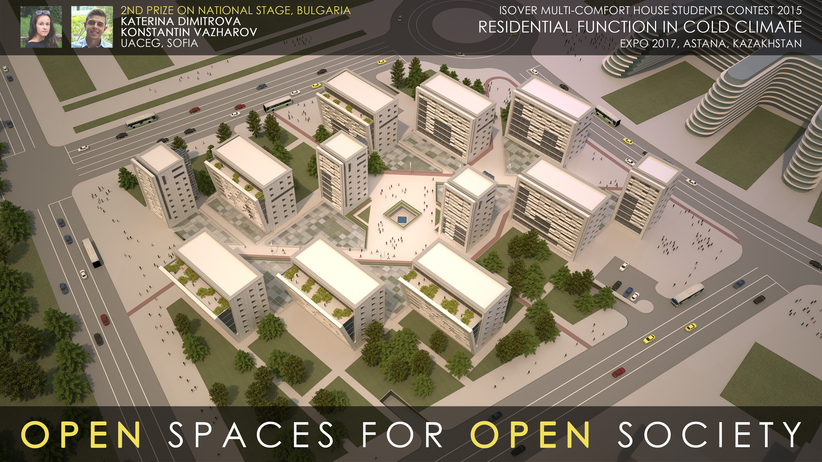


Slide 2
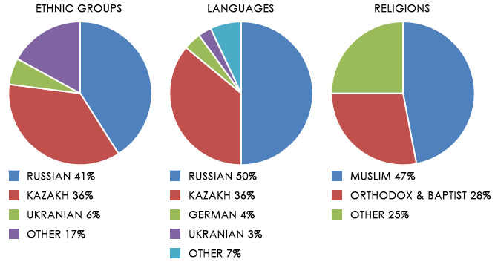
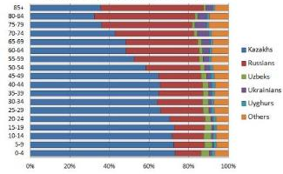
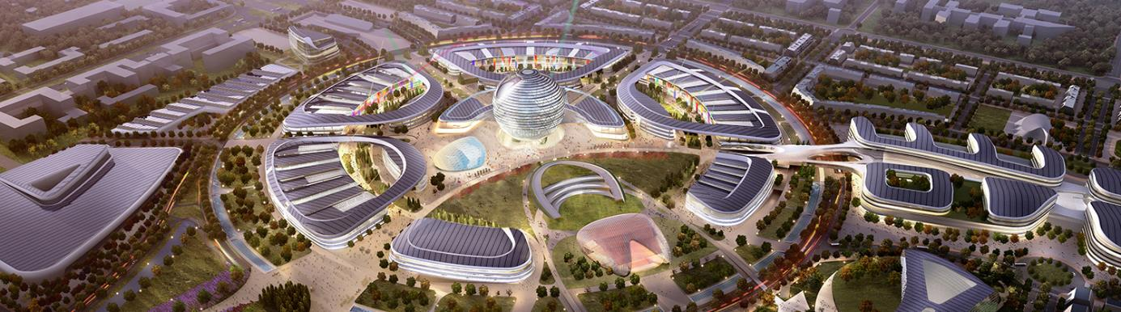
RESEARCH

Slide 3
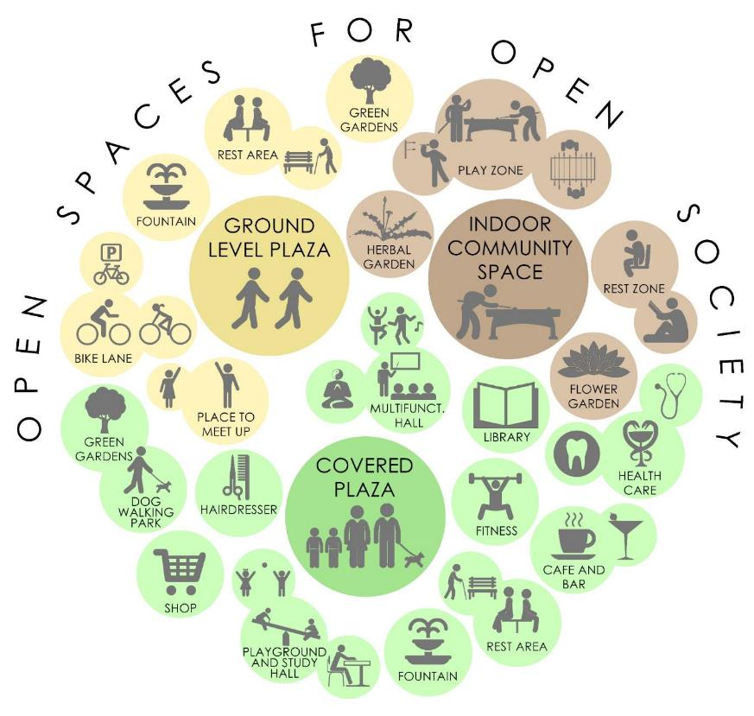

Slide 4
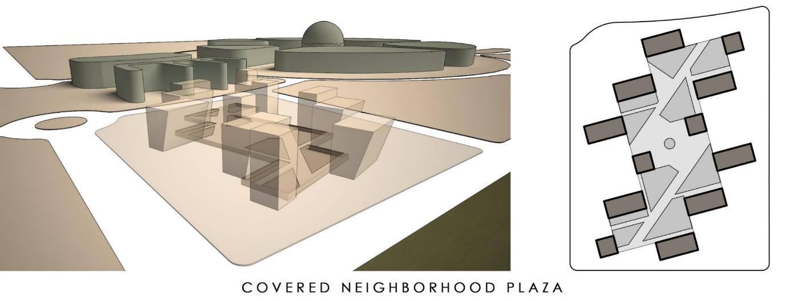
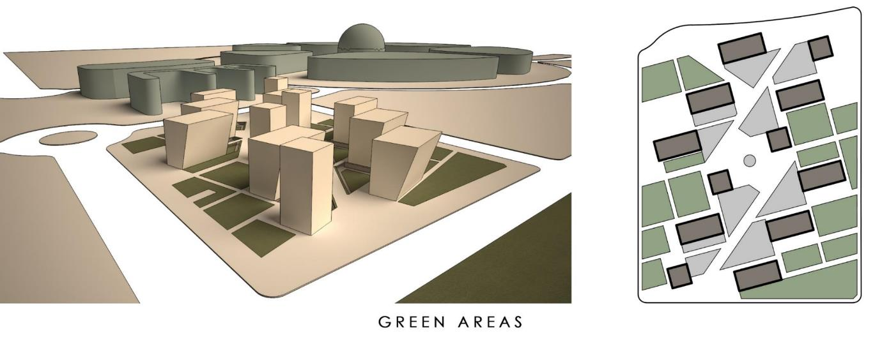
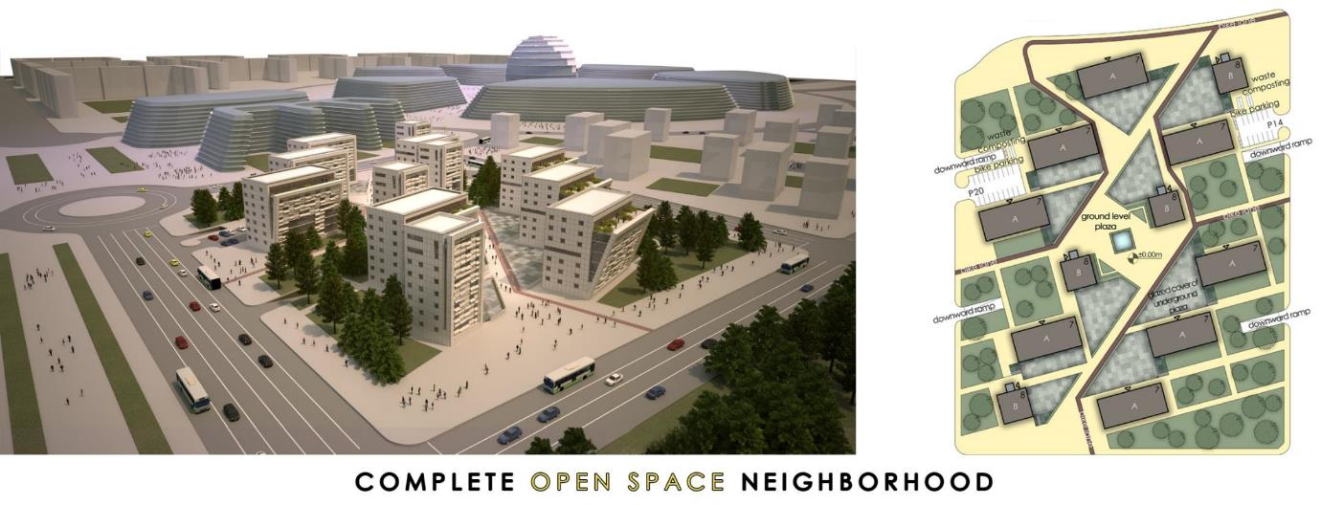
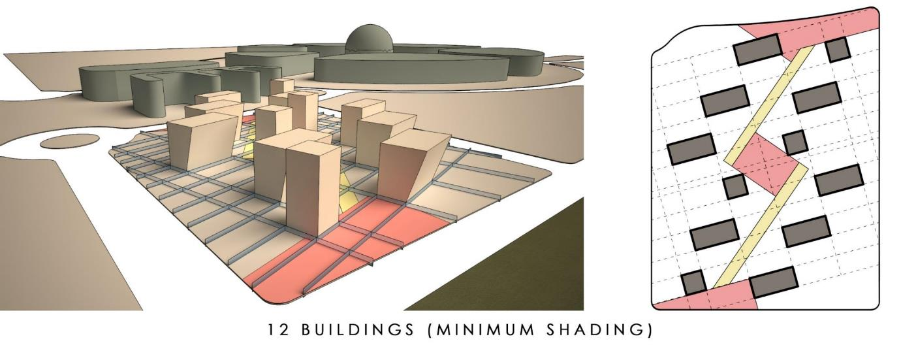
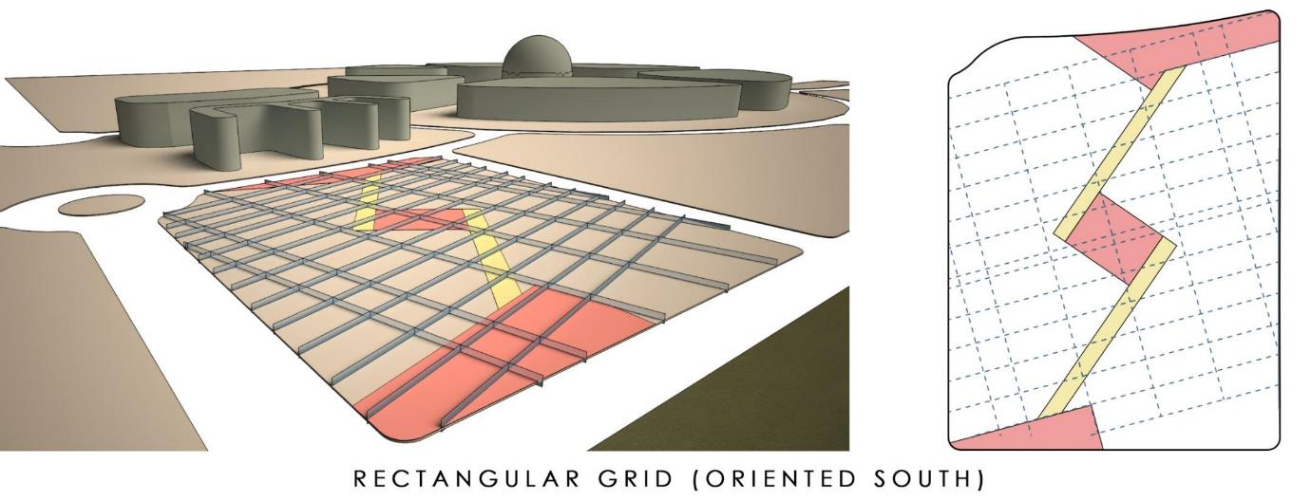
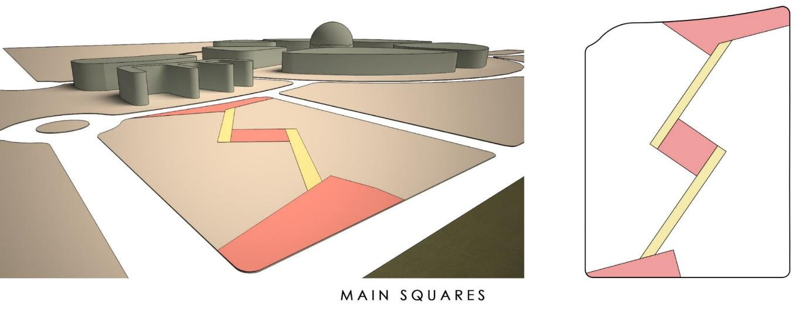
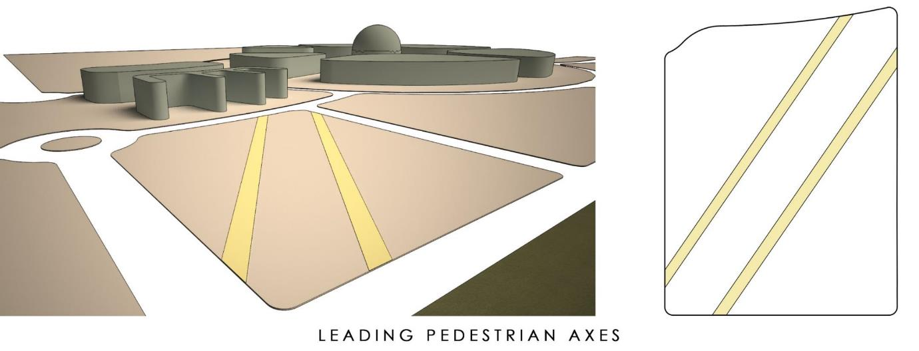
SITE MORPHOLOGY CONCEPT

Slide 5

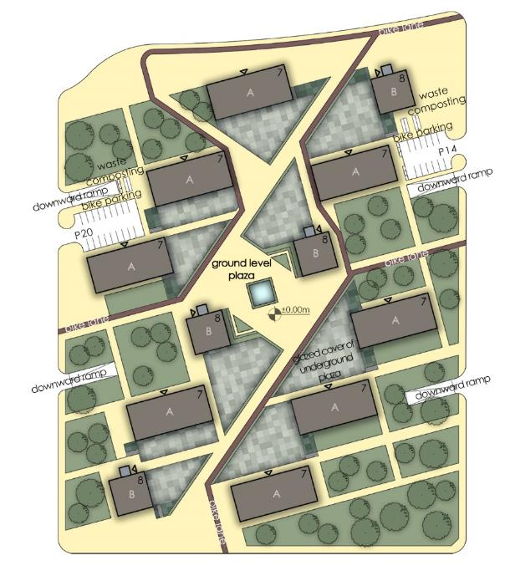
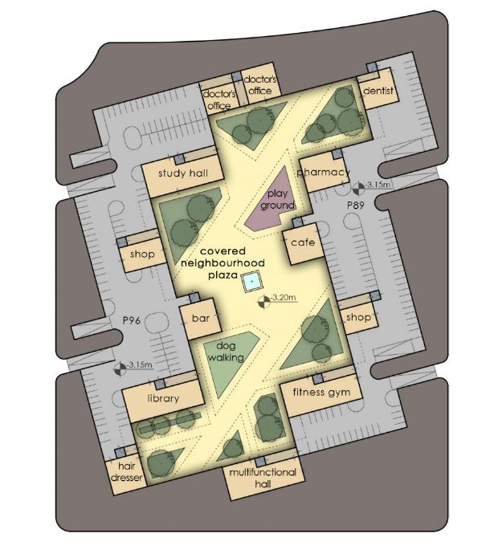
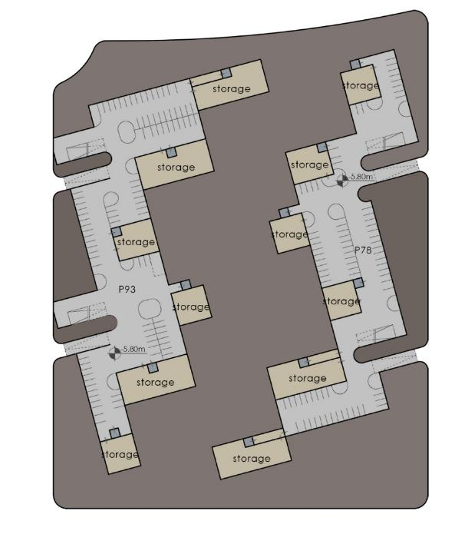
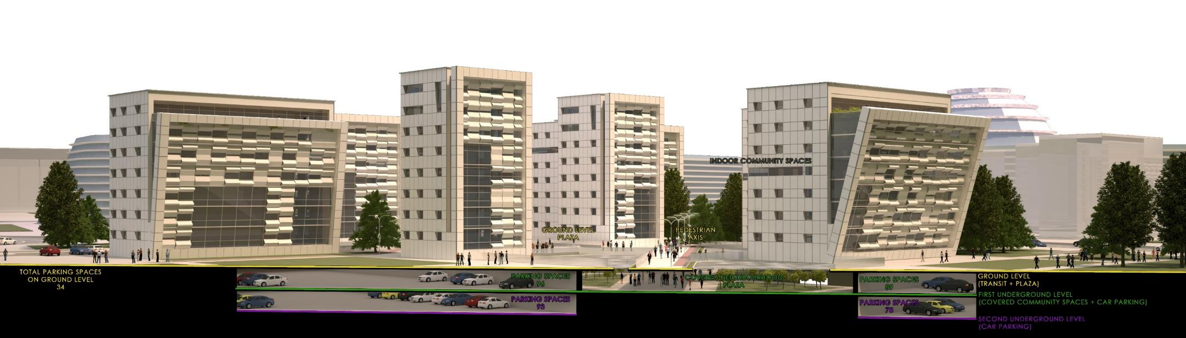
NEIGHBORHOOD VERTICAL SECTION
SITE PLAN, GROUND LEVEL ±0,00 M
COVERED PLAZA, UNDERGROUND LEVEL 1 - 3,20 M
PARKING, UNDERGROUND LEVEL 2 -5,80 M

Slide 6
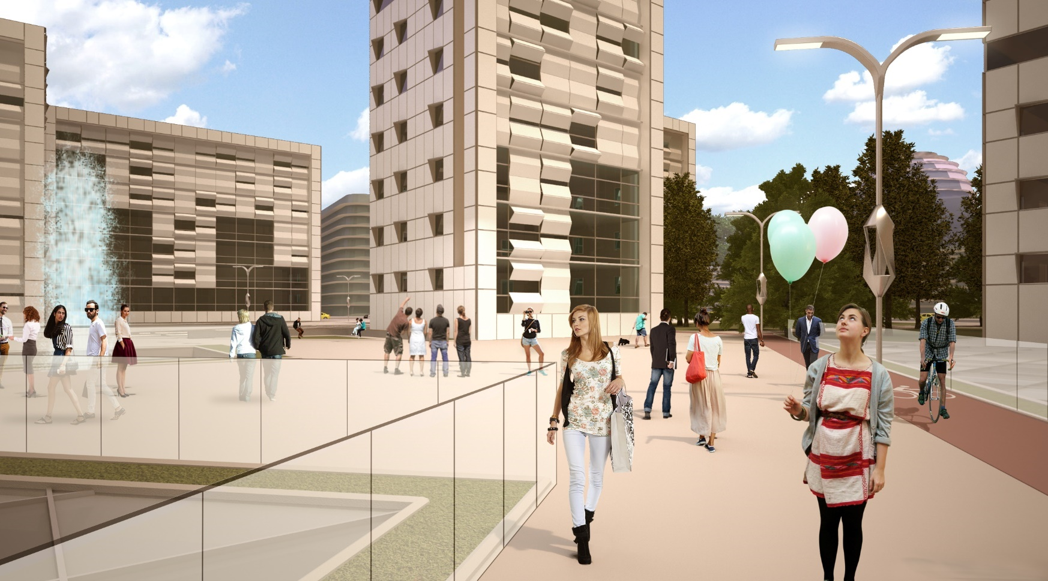
GROUND LEVEL PLAZA IN SUMMER

Slide 7
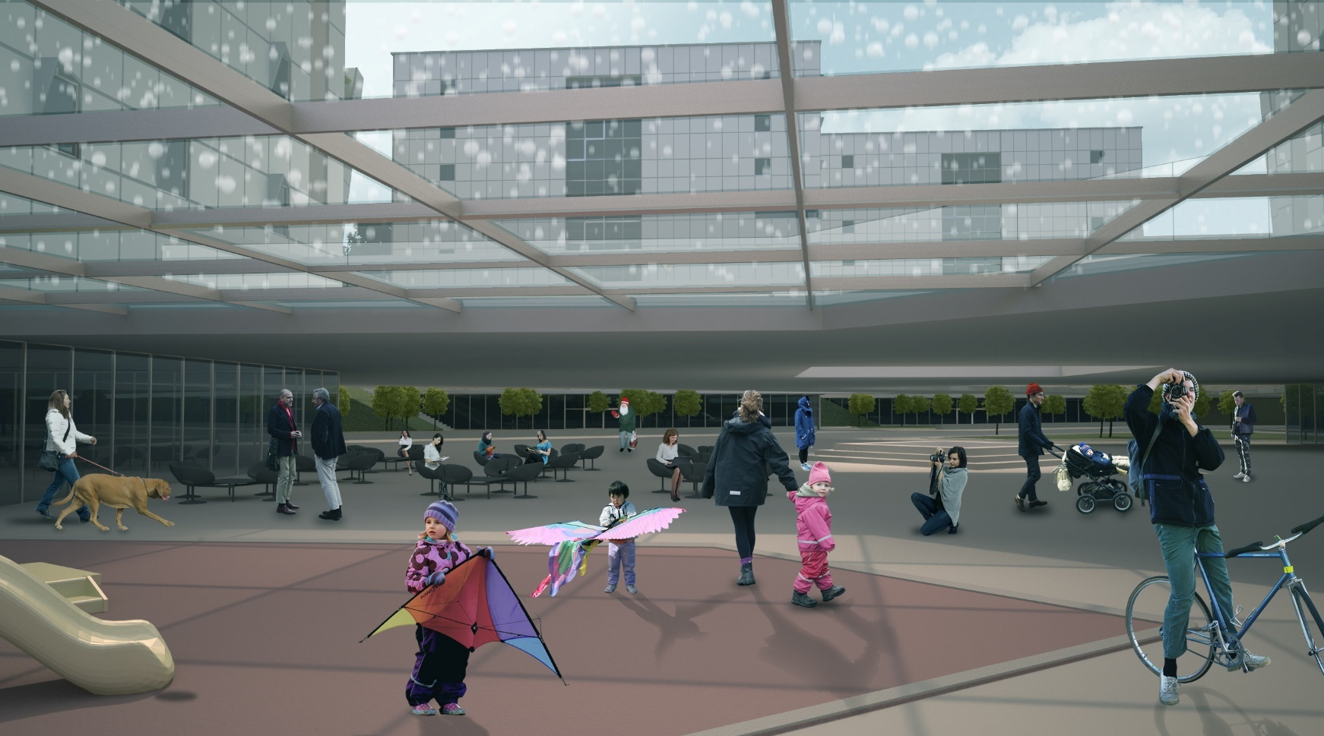
COVERED NEIGHBORHOOD PLAZA IN WINTER

Slide 8

MULTI-COMFORT HOUSE CONCEPT

Slide 9
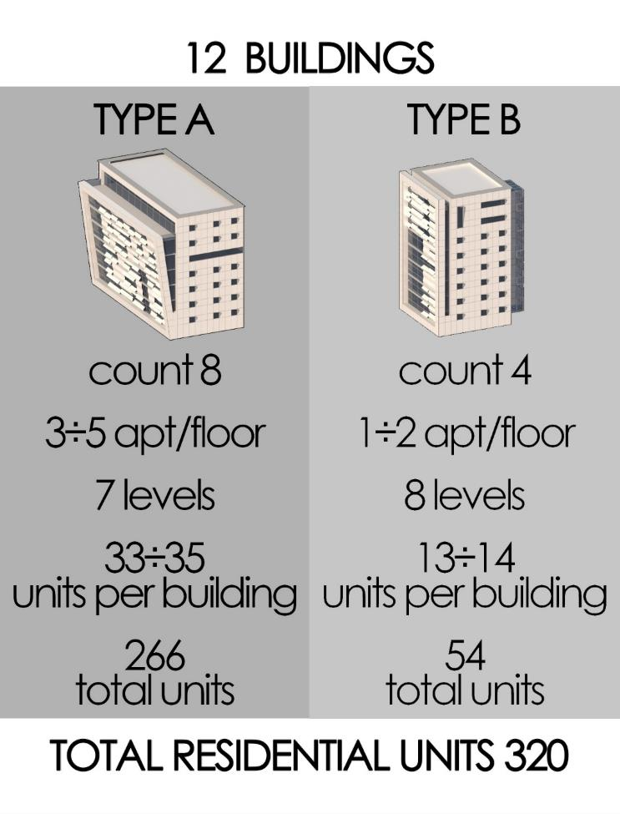
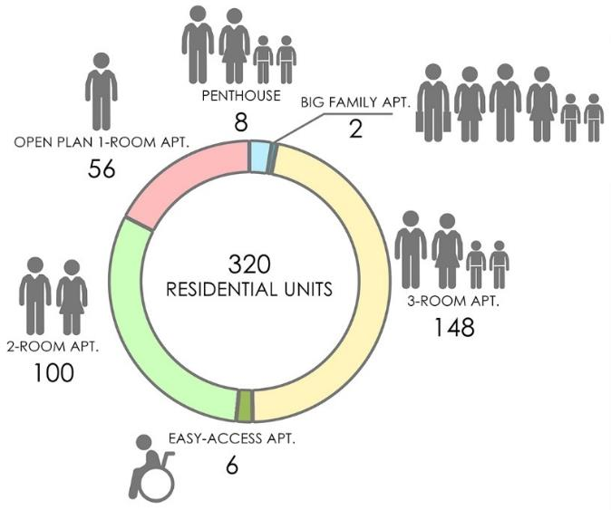
BUILDING AND RESIDENCE TYPOLOGY

Slide 10
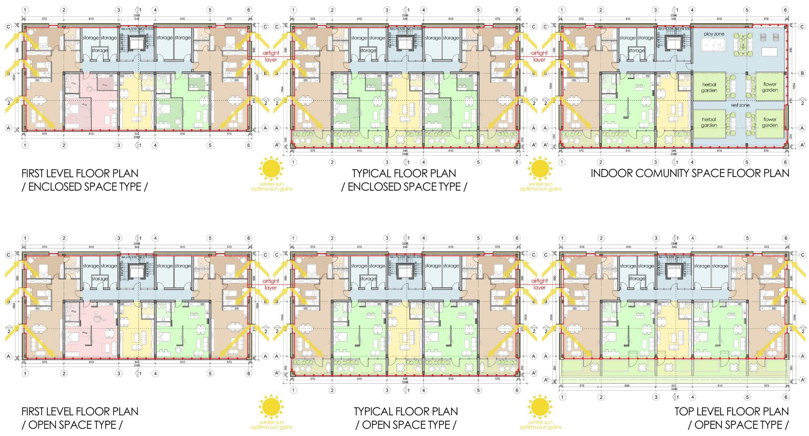
BUILDING TYPE A FLOOR PLANS

Slide 11
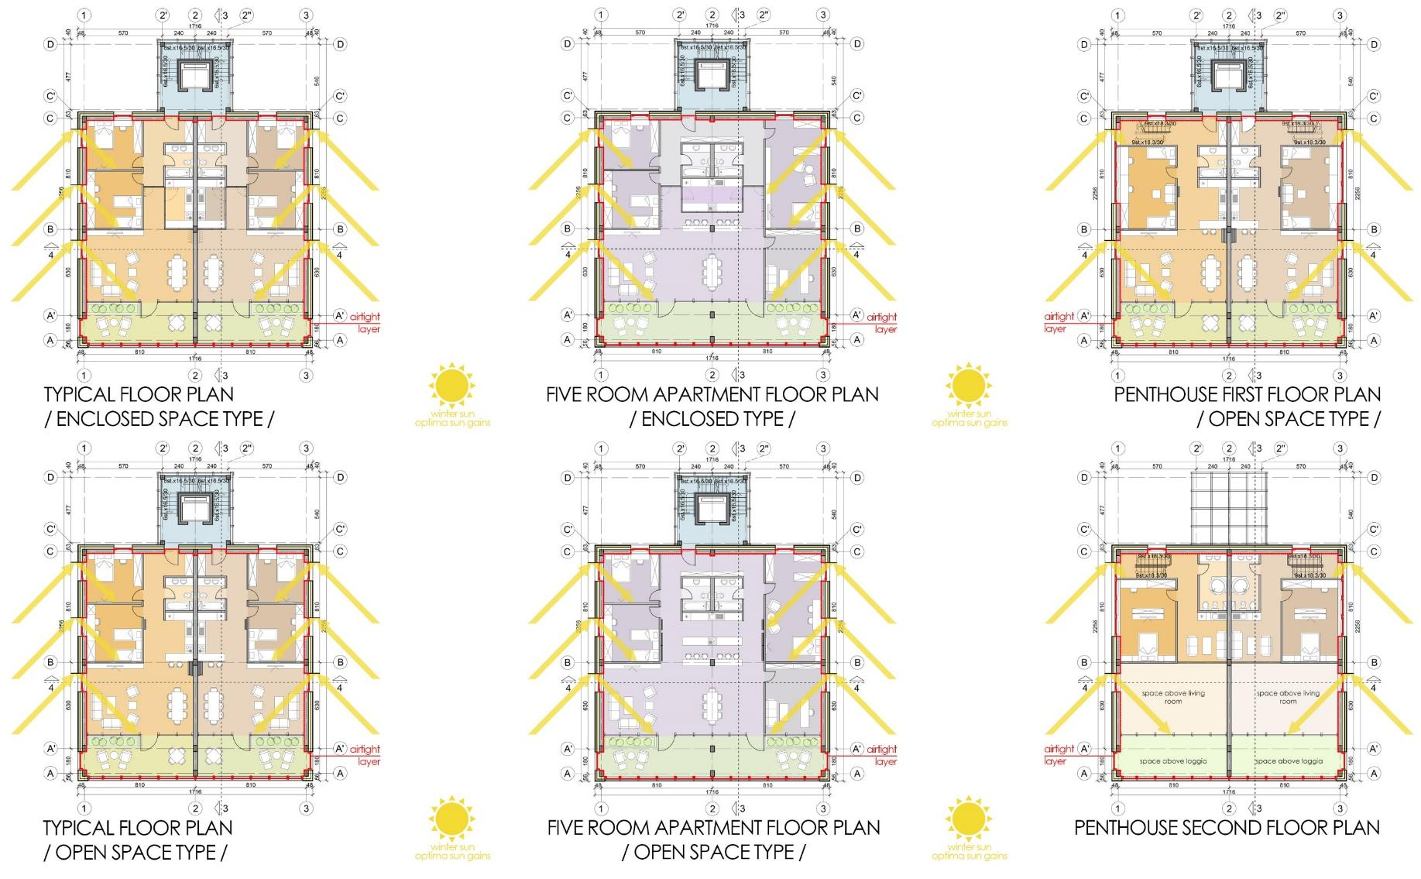
BUILDING TYPE B FLOOR PLANS

Slide 12
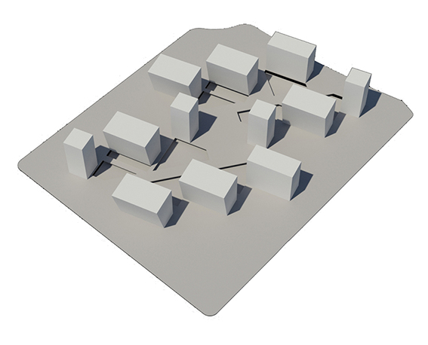
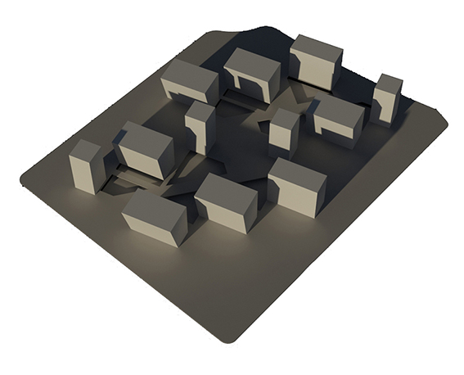
SHADING STUDY
21 June, 2015
13:16 PM
Sunrays angle: 62.3°
21 December, 2015
13:12 PM
Sunrays angle: 15,5°

Slide 13
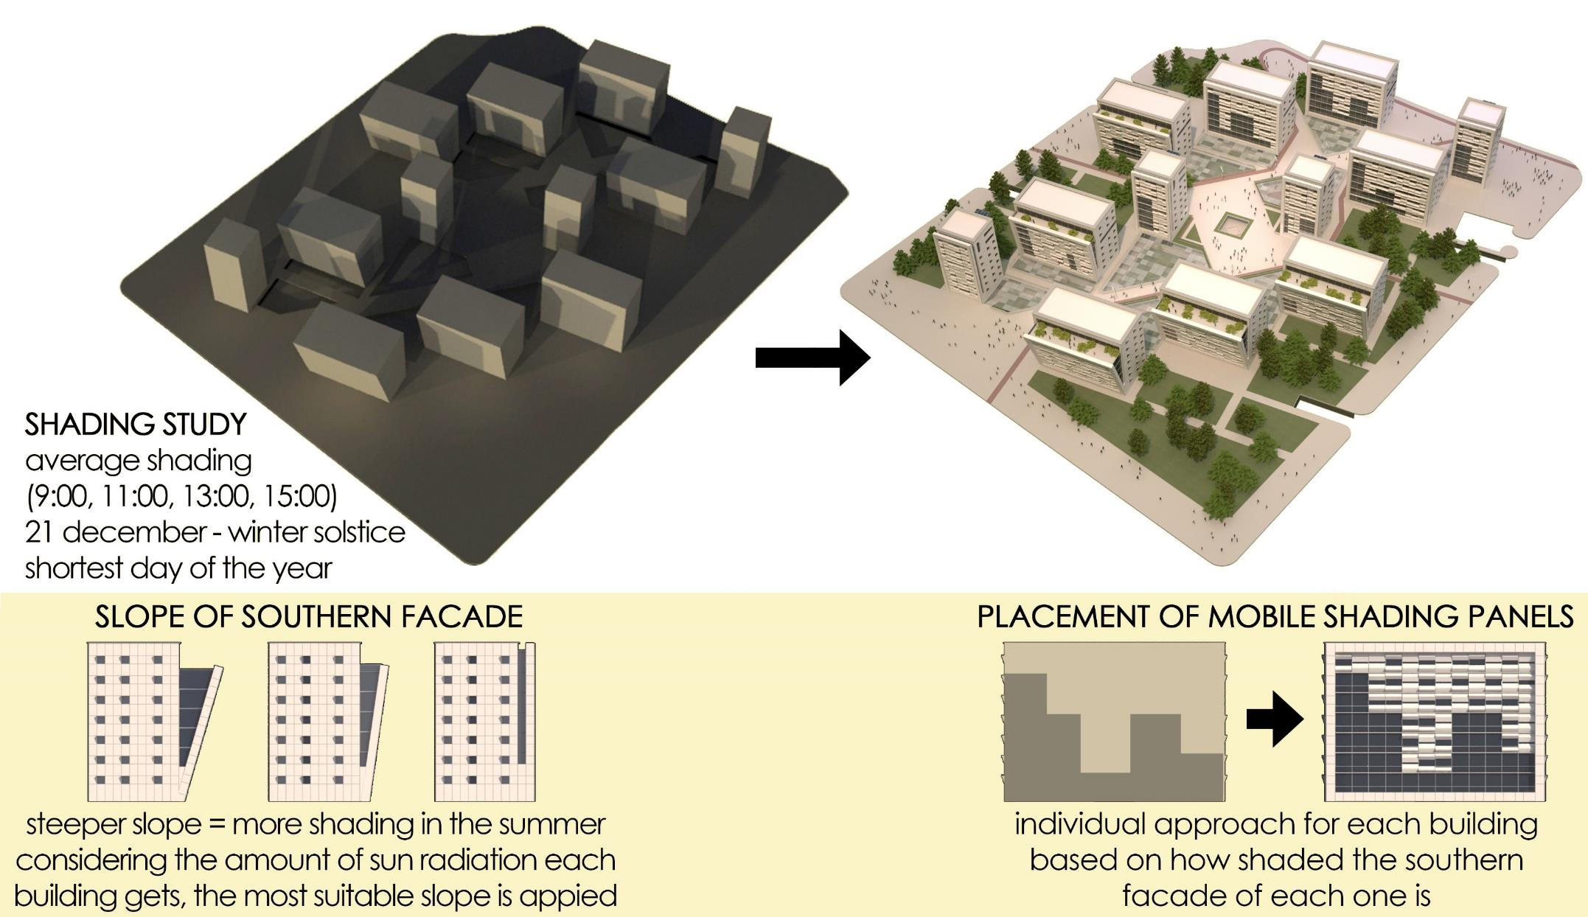
FACADE FORMATION CONCEPT

Slide 14
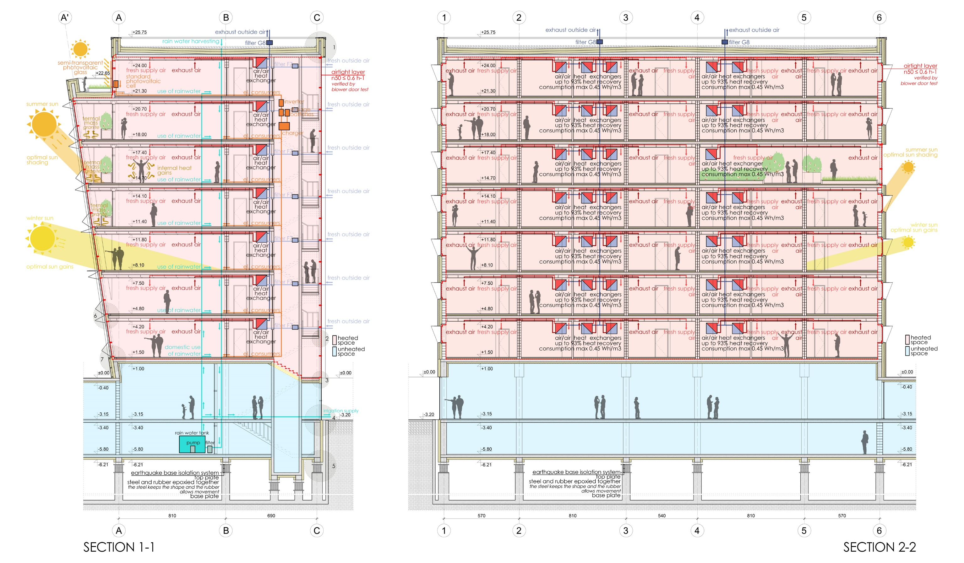
BUILDING A SECTIONS

Slide 15
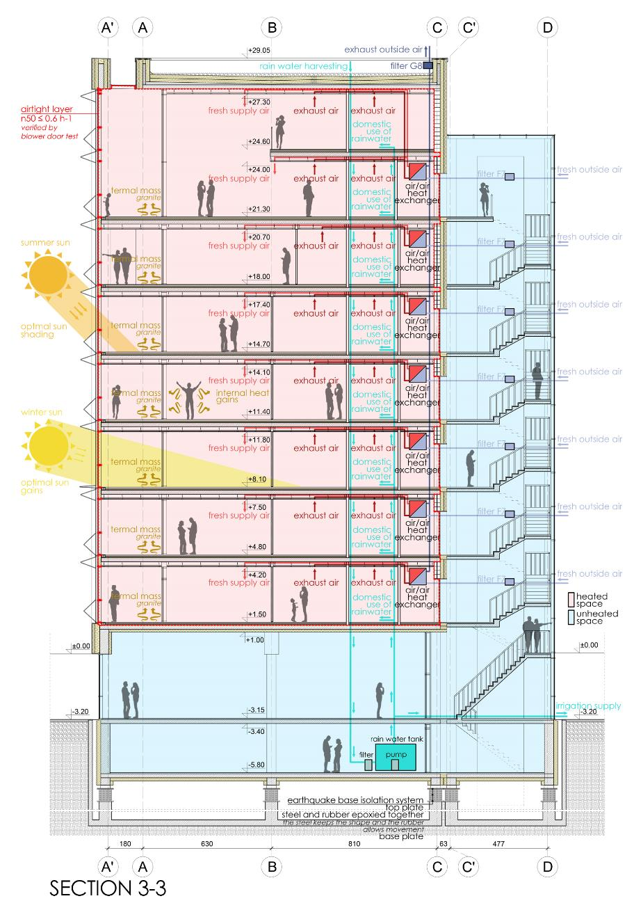
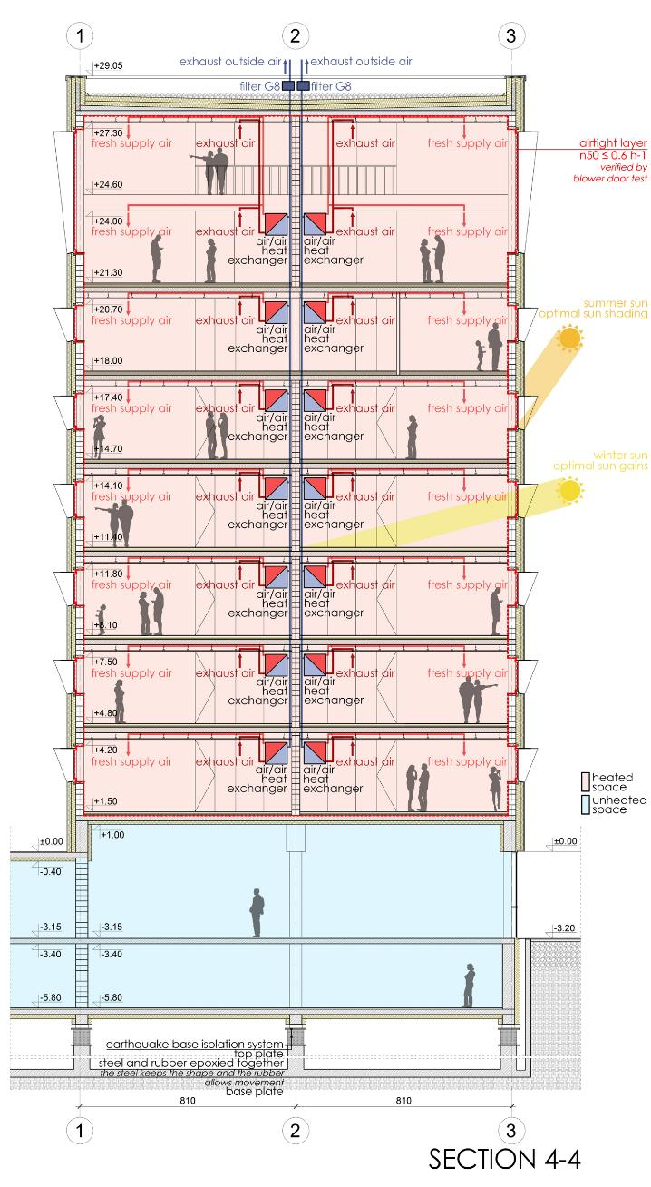
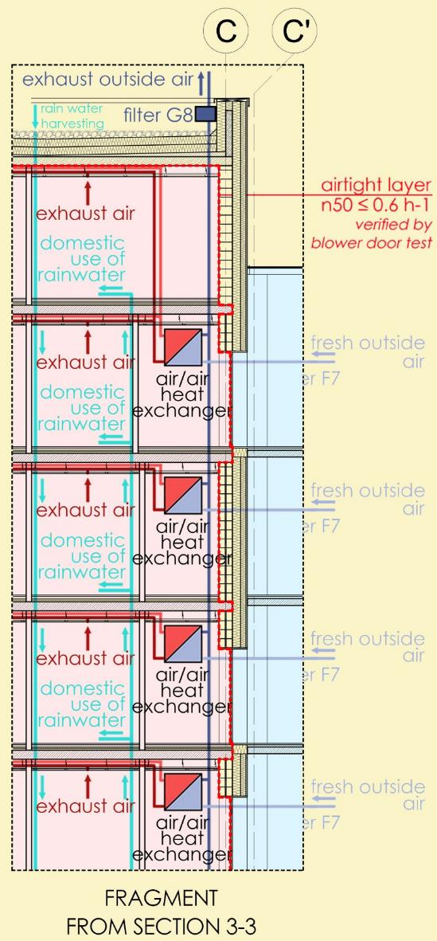
BUILDING B SECTIONS

Slide 16
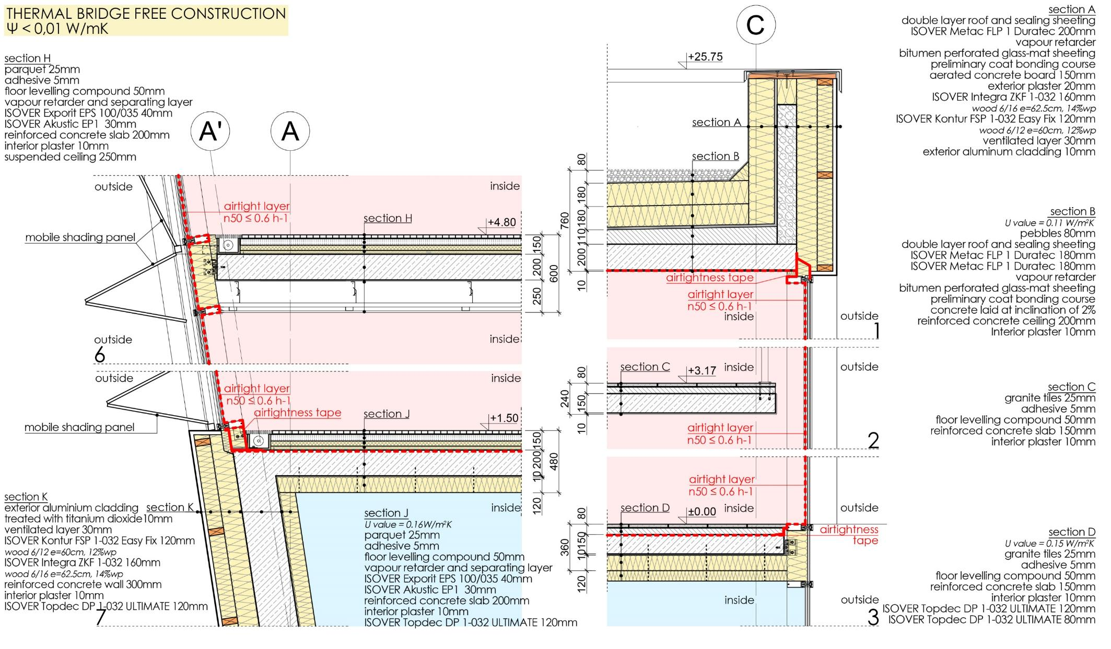
THERMAL ENVELOPE DETAILS: EXTERIOR DETAILS

Slide 17
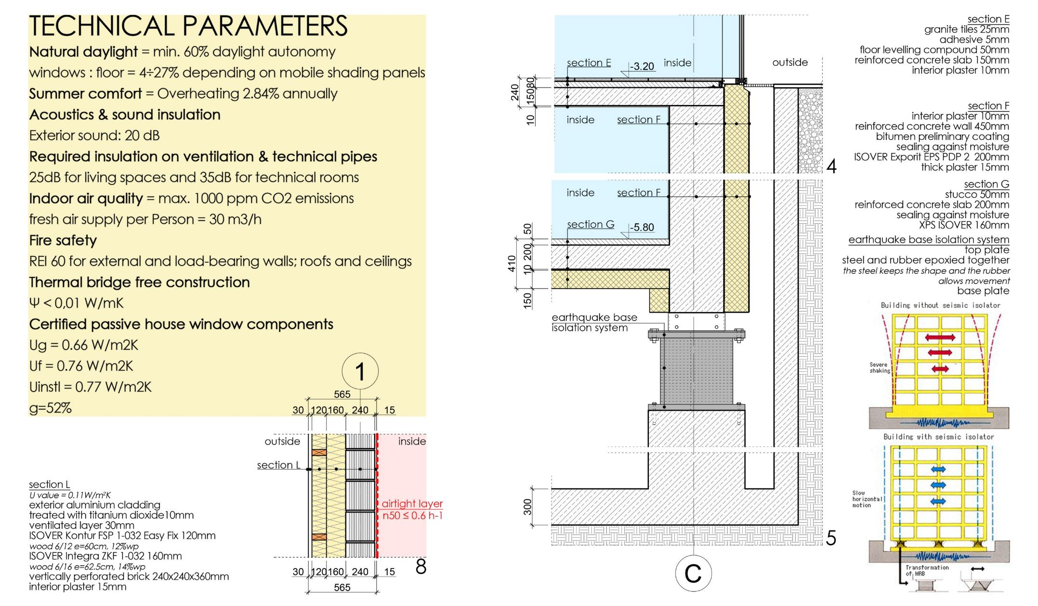
EXTERIOR DETAIL + EARTHQUAKE ISOLATION

Slide 18
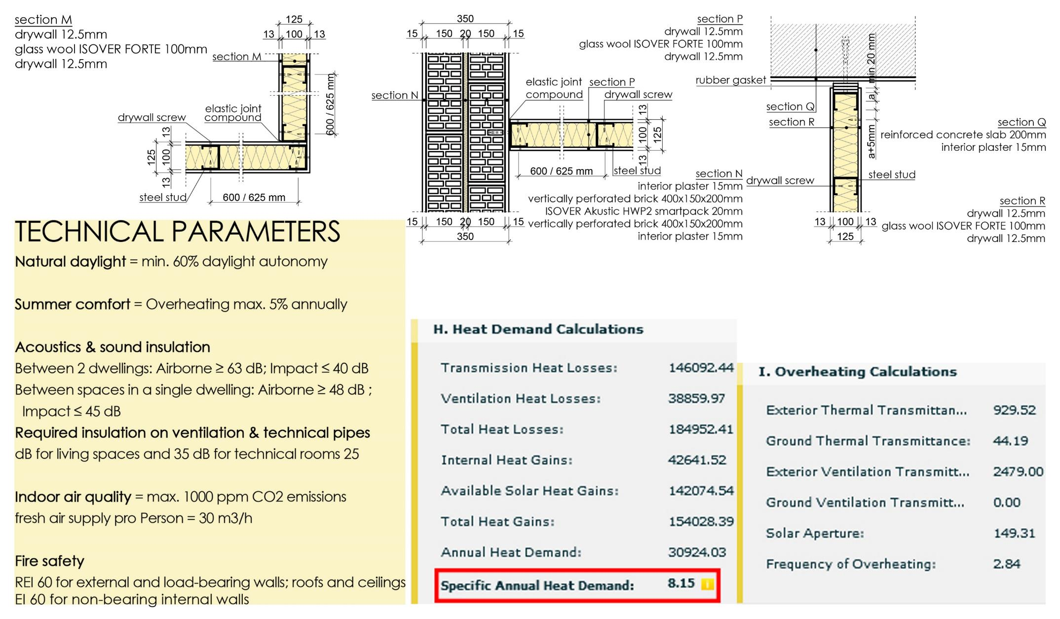
INTERIOR DETAILS + CALCULATIONS

Slide 19
