Slide 1
Fabrication of metal powder for additive manufacturing using ultrasonic atomizer
Isaac Iwediba
2nd Year Master in Mechanical and Aerospace Engineering
Supervisor: Prof. Didier Talamona
Co-Supervisor: Prof. Asma Perveen

Slide 2
Outline
Introduction
Research Objectives
Literature review
Method
Results
Conclusion/Future work

Slide 3





Overview
Step 1
Step 2
Step 3
Step 4
Step 5
Review literature
&
research gap
Identification
Application of
ultrasonic atomization
technique
Characterization of fabricated and commercial powders
SLM 3D
Printing &
mechanical testing
Results, conclusion & Future work

Slide 4
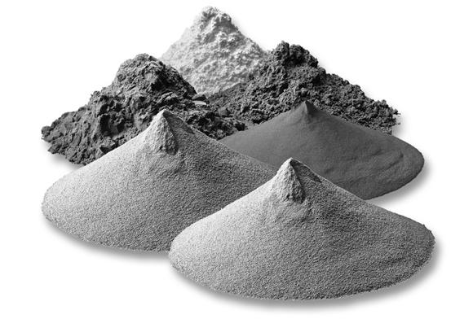
Introduction (1)
Reduction of metals to powder form e.g Al, Fe, Mg,W, Mo, Ni, Ti and Cu etc.
Base material for the production of metallic components through
additive manufacturing, Powder Metallurgy, Casting, etc.
Flexibility, reduced waste, speed, customization, cost effective.

Slide 5
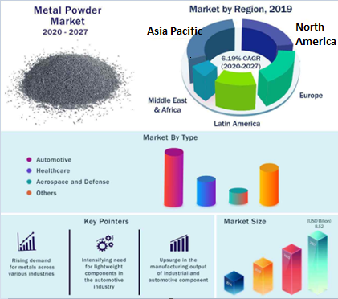
Introduction (2)
Report highlights | Details
Market size | USD 8.52 Billion by 2027
Growth rate | CAGR 6.19% from 2020 -2027
Largest market | North America
Fastest growing market | Asia Pacific
.
Metal powder market research [2]

Slide 6
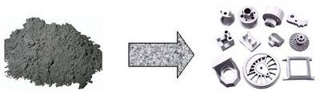
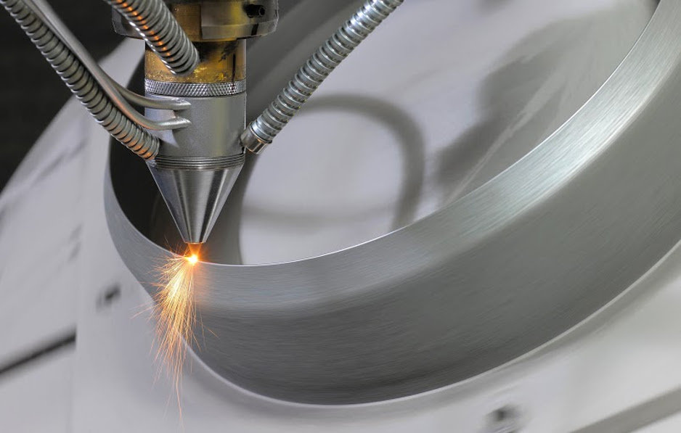
Applications of metal powder
Fabrication techniques
Powder metallurgy
Additive manufacturing
surface coating
chemical reactions(reducing agents), etc.

Slide 7


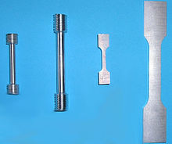
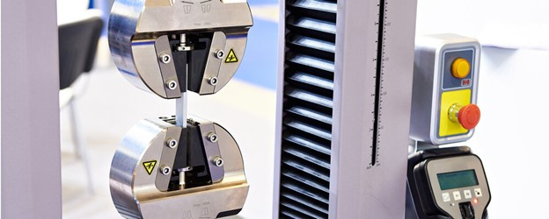
Research objectives
Investigation & Optimization
Benchmark
To benchmark the commercially produced Stainless steel 316L powder with the ultrasonic fabricated Stainless steel 316L.
Investigate & optimize the ultrasonic atomization process for stainless steel 316L.
Printability
Mechanical Testing
To investigate the printability characteristics of the fabricated powder.
To test the printed part for hardness and tensile strength

Slide 8
Literature review (1)
Production process | Material | Range of particle size µm | Advantages | Disadvantages | references
Rotating electrode plasma process | Tungsten wire | 160-500 | More spherical, ultra-clean particles. | Inefficient production at high cost, Broad particle size range | [16, 17]
Gas atomization | Ti Alloy | 0-250 | More spherical shape, Used for a variety of alloy metals with reactive qualities that are available as ingots, spherical particles. | Broad particle size range. | [18]
Plasma atomization | Ti Alloy | 25 - 125 | Presence of spherical particles | Expensive wire or powder-based feedstock is required. | [19]
Water atomization | AlSi316L | 44-106 | Large range of particle sizes, high manufacturing speeds, ingredients in ingot form. | Wide distribution of particle sizes and irregularly shaped particles are all removed by a separate procedure. | [20]
Centrifugal atomization of plasma | HSS, Ti Alloy, 45 steel | 0-385 | Round particles that are easily manufactured | The distribution of particle size’s fractional content is highly diverse. | [21]
Centrifugal Atomization | Magnesium Alloy | 50-800 | There is a wide variety of particles sizes, although the distribution is restricted. | Creating high-quality powder is difficult. Higher particle size | [22]

Slide 9
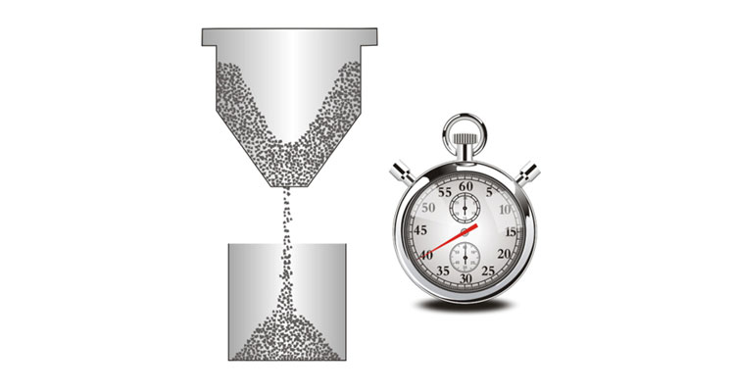

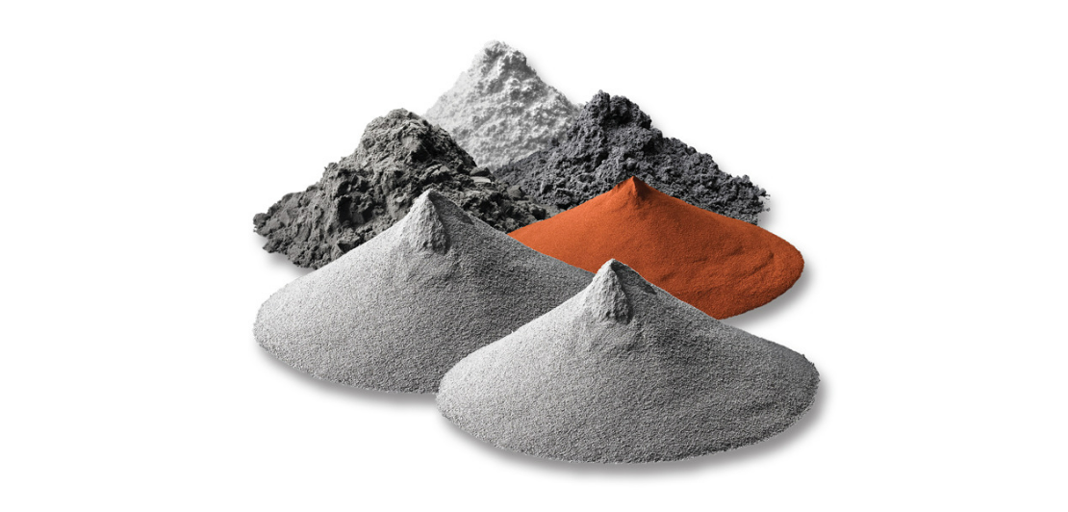
Research Gap
WHY?
Flowability
Inconsistent Size, Shape, and Surface characteristics
Costly to produce: especially when high-purity powders are needed for specialized applications.

Slide 10
Scope & constraints
Constraints
Scope
High consumption rate of Argon
Powder fabrication
Powder Characterization
Low production rate
Powder benchmark
SLM 3D Printing
Mechanical Testing

Slide 11
Methodology (1)
Powder fabrication
Optimization process parameters
Amplitude
Current
Feed rate
Characterization measurements:
Particle size distribution ‘PSD’ (mastersizer)
Rheological properties/test (FT4 Powder Rheometer)
Stability and variable flow
  Permeability
  Shear cell
  Aeration
  Compressibility
Flow rate(Hall Flowmeter)
Angle of repose (Hall Flowmeter)
Printability of the produced powder (SLM)
Mechanical Testing
Tensile
Hardness
(SEM) Analysis
Particle shape
Particle size
chemical composition

Slide 12
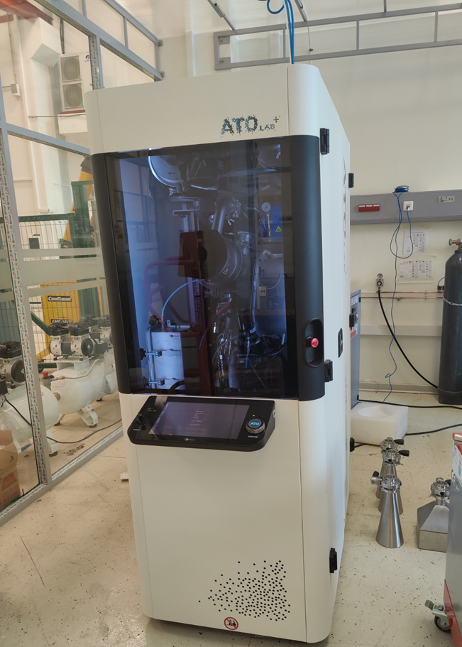
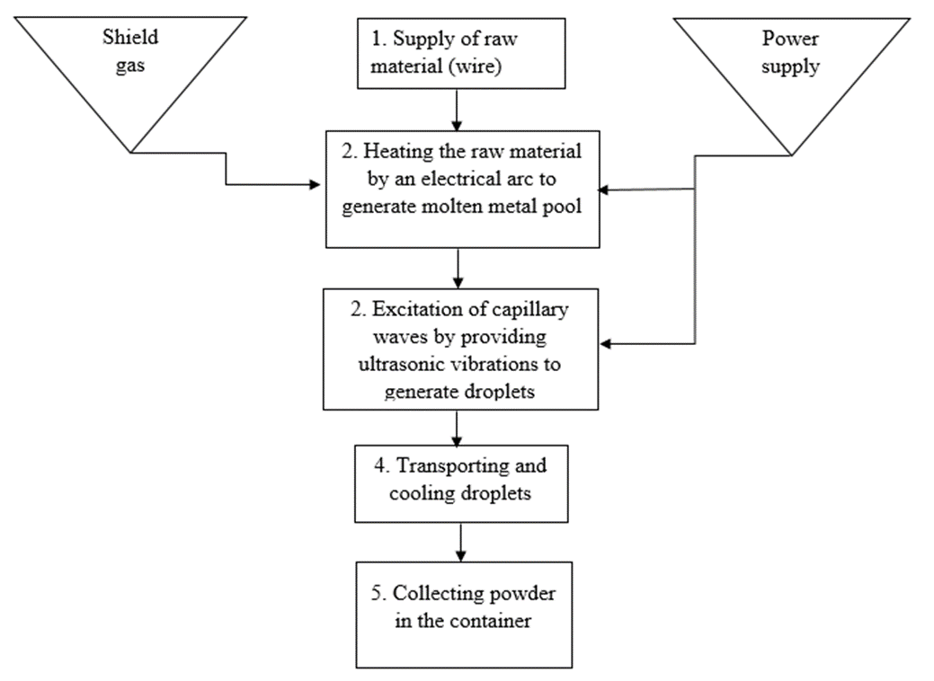
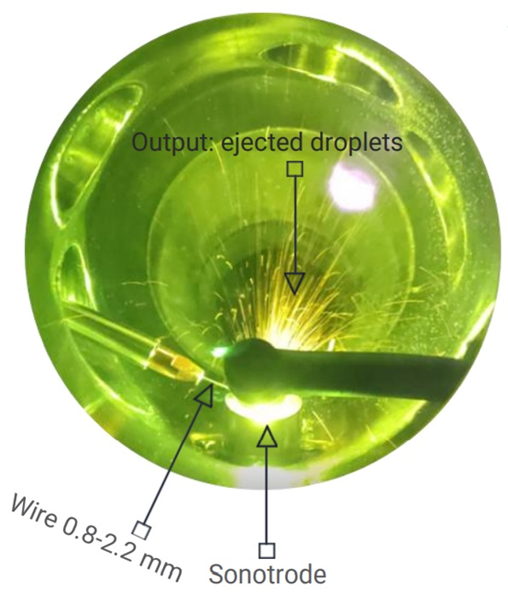
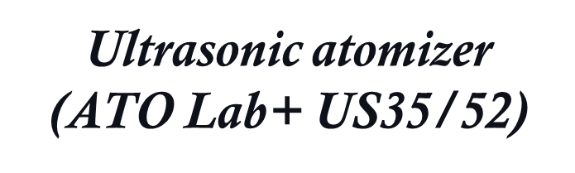
Methodology (2)

Slide 13
Atomizer process condition
Orthogonal Arrays (Taguchi Designs) for the fabrication of steel 316L (Wire Ø 1.2mm)
Experiment Number | Electrical current, A | Ultrasonic vibration amplitude, % | Main circuit pump flow, % | Argon flow, l/min | Feeder speed (%) | Voltage (V)
1 | 110 | 70 | 65 | 10 | 25 | 22.20
2 | 120 | 75 |  | 15 | 45
3 | 130 | 80 |  | 20 | 50

Slide 14
Fabrication rate
Fabrication of Stainless steel 316L at 0°
Exp. no | Time (hr) | Consumption of Argon (bar) | Amount of Powder in powder container (g) | Amount of sieved powder(g) 63µm | Amount of sieved powder(g) 100µm | Productivity Sieved Powder 63 µm (g/hr) | Amount of un-sieved powder(g/hr)
1 | 19 | 320 | 1458 | 1000 | 134 | 53 | 77
2 | 24 | 700 | 2086 | 1400 | 260 | 58 | 87
3 | 5 | 150 | 1100 | 800 | 110 | 160 | 220
Total | 48 | 1170 | 4644 | 3200 | 505

Slide 15
Effect of Current and Amplitude
 | Current (A) | Time | Constant Parameter | Manipulator Position
 |  |  |  | X | Y | Z
Effect of Current | 120 | 1hr | 120 A | 10.00 | 16.00 | 9.50
 | 130 | 1hr
Effect of Amplitude | 75% | 1hr | 80%
 | 80% | 1hr
Ultrasonic Atomization Fabrication Optimum parameters
Electrical current, A | Ultrasonic vibration amplitude, % | Main circuit pump flow, % | Argon flow, l/min | Feeder speed (%) | Voltage (V)
130 | 80 | 65 | 20 | 50 | 22.50

Slide 16
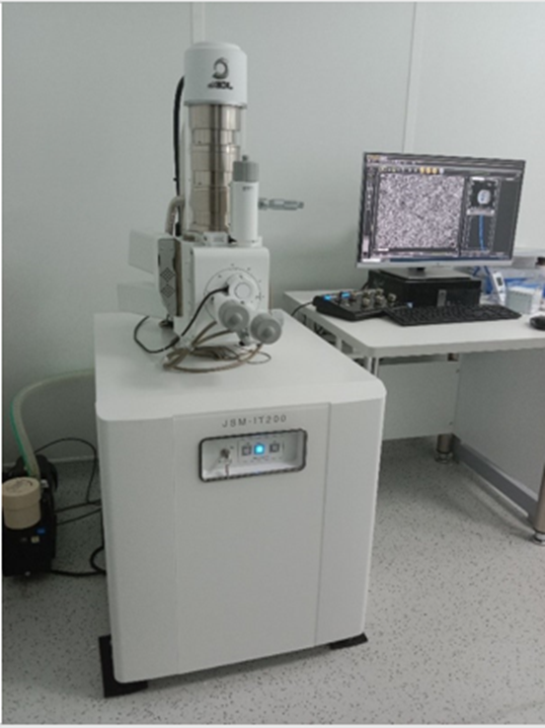
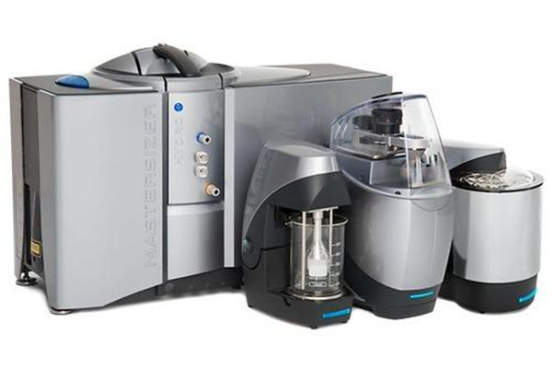
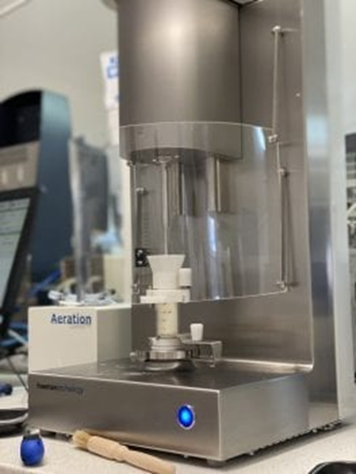
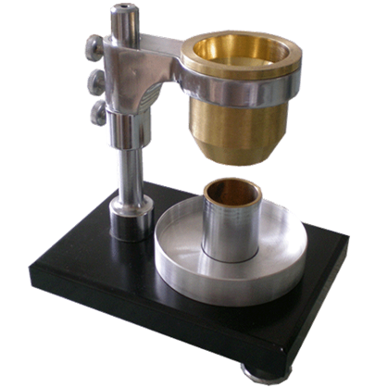
Characterization techniques
Master sizer
Hall Flow meter
SEM
FT4 Powder Rheometer

Slide 17
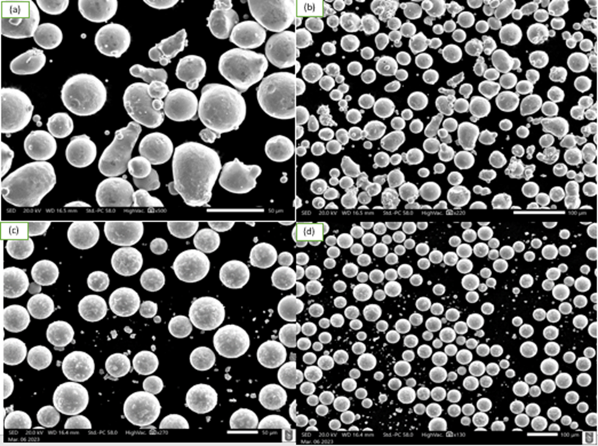
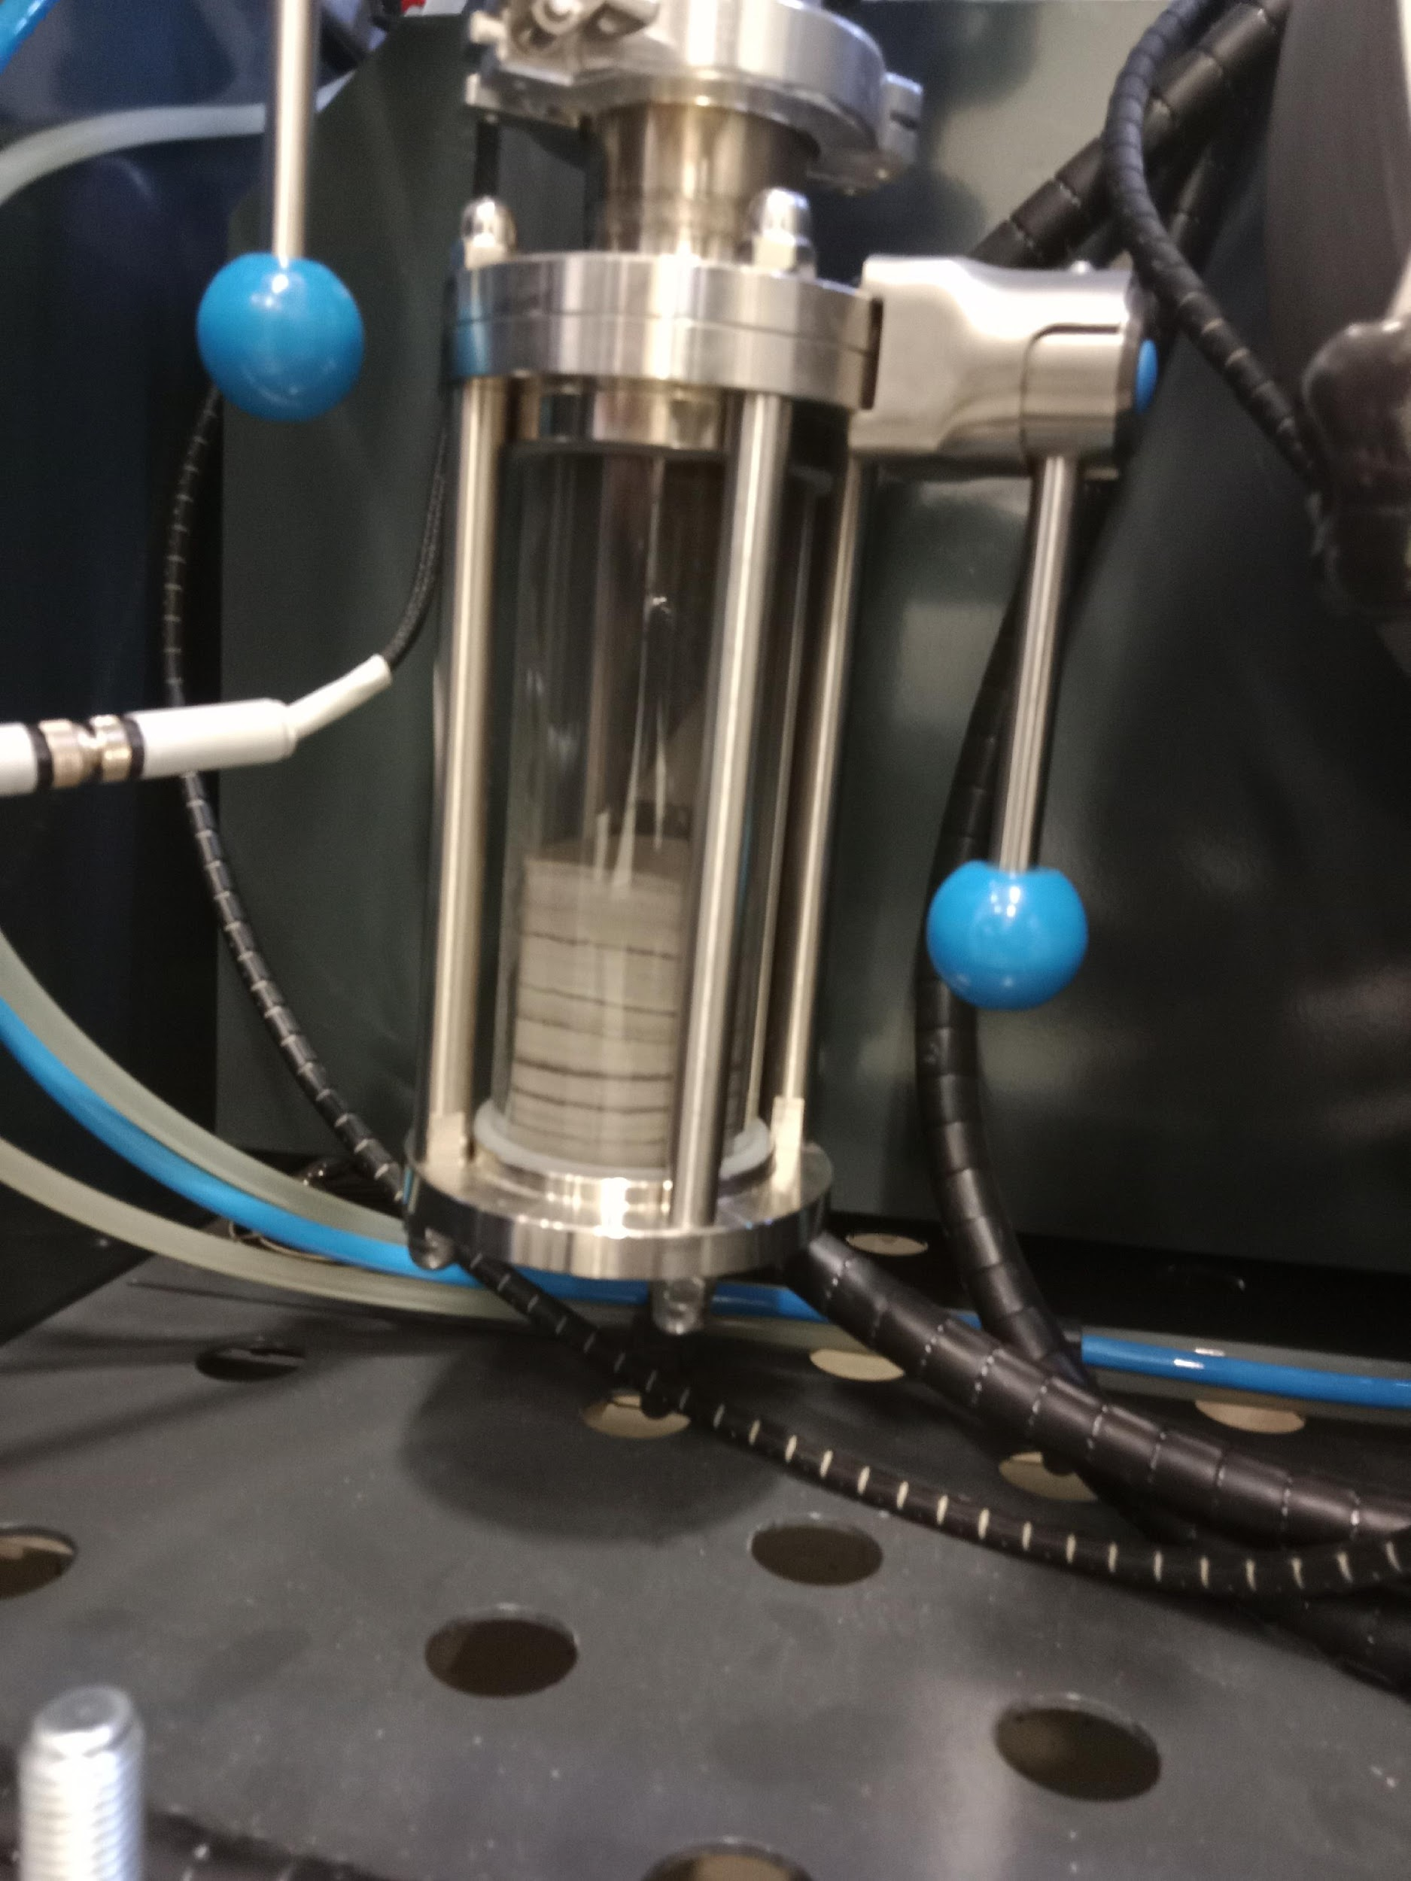
SEM Images
SEM images
(a) and (b) commercially produced stainless steel powder at a scale of 50 and 100µm
(c) and (d) ultrasonic fabricated stainless steel powder at a scale of 50 and 100µm

Slide 18
Chemical Compositions
Atomized SS 316L
Commercial SS 316L
Element | Mass% | Atom%
Si | 0.50±0.04 | 1.00±0.09
Cr | 19.43±0.17 | 20.81±0.18
Mn | 2.58±0.09 | 2.62±0.09
Fe | 63.21±0.35 | 63.05±0.35
Ni | 11.47±0.19 | 10.89±0.18
Mo | 2.81±0.11 | 1.63±0.06
Total | 100.00 | 100.00
Element | Mass% | Atom%
Si | 0.58±0.04 | 1.15±0.07
Cr | 18.37±0.15 | 19.67±0.16
Mn | 2.03±0.07 | 2.06±0.08
Fe | 64.55±0.32 | 64.35±0.31
Ni | 11.89±0.18 | 11.27±0.17
Mo | 2.58±0.09 | 1.50±0.05
Total | 100.00 | 100.00

Slide 19
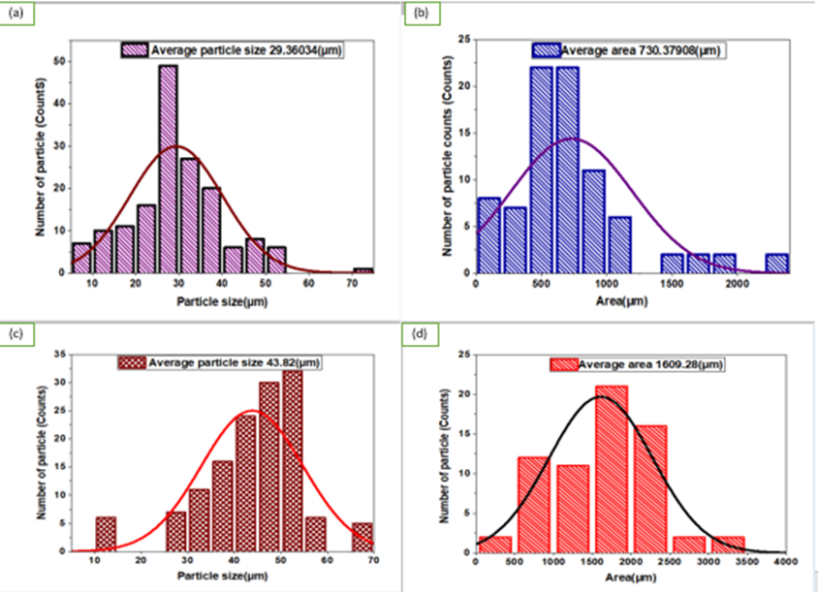
Average Particle Diameters
Average particles diameters and areas of Stainless Steel 316L
²
Powder sample | no of particles | Average particle diameters (µm) | Average areas (µm²)
Commer- cial steel | A 84 D 161 | 29.36 | 730.37
Ultrasonic fabricated steel | A 66 D 133 | 43.82 | 1609.28
²
²
²
& (b) diameter and area of commercial Stainless steel powder
(c) & (d) diameter and area of ultrasonic fabricated Stainless steel powder.

Slide 20
Rheological properties
Test name | Commercial Stainless steel powder 316L | Ultrasonic fabricated Stainless steel 316L
Conditioned bulk density (g/cm³⁾ | 4.77 | 4.73
Compressibility index (%) | 2.85 | 3.00
Pressure drop (mBar) | 5.87 | 3.26
Specific energy (mJ/g) | 2.43 | 2.35
Aeration energy (mJ) | 11.49 | 12.47
Basic flow energy (mJ) | 845.69 | 828.4
Cohesion coefficient (kPa) | 0.36 | 0.23

Slide 21
Rheological properties
The Rheological properties was used to calculate the Additive Manufacturing suitability (AMS) factor of the powders[5,38].
The smaller the AMS values, the more suitable the powder is for the additive manufacturing process.
Powder Sample | AMS Factor
Ultrasonic fabricated SS 316L | 0.87
Commercial SS 316L | 0.98

Slide 22
AOR & Flowrates
AOR and Flowrate readings for the sample powders
The AOR classification of flow characteristics[81]
Powder sample | Commercial Stainless steel powder 316L | Ultrasonic fabricated Stainless steel 316L
AOR (degree) | 28.1 ± 0.2 | 24.6 ± 0.1
Flowrate (minutes) | 1.22 ± 0.1 | 1.14 ± 0.1
AOR | Properties of flow
20° < Φ <30° | Very unconstrained
30° < Φ <39° | unconstrained
39° < Φ <44° | Acceptable to fair flow
44° < Φ <54° | adhesive
554° <Φ <69° | Very adhesive

Slide 23
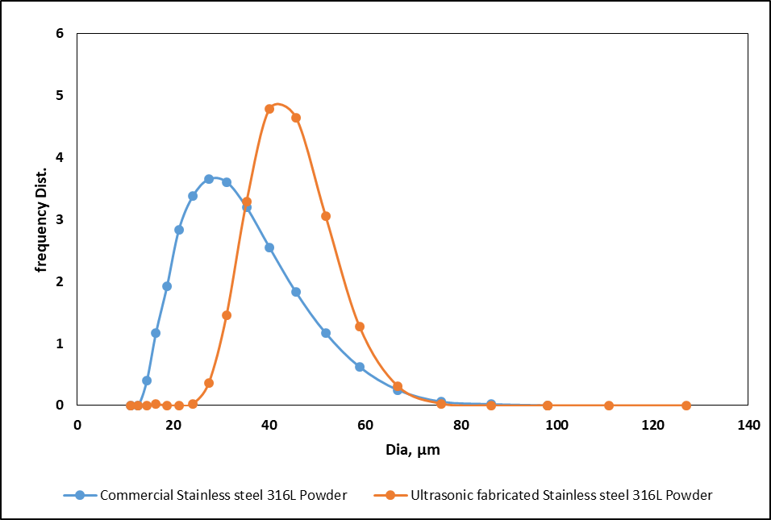
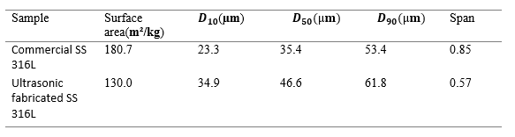
Particle size distribution

Slide 24
Physical characteristics
Sample powder | Tap density (g/cm³) | 𝑃𝚙,а (g/cm³) | 𝑃𝚙,а(g/cm³) literature | Hausner ratio | Carr’s index | Porosity
Commercial SS 316L | 4.92 | 7.0 | 8.0 [9] | 1.10 | 9.20 | 0.33
Ultrasonic fabricated SS 316L | 5.0 | 8.0 | 8.0 [9] | 1.11 | 10.0 | 0.44

Slide 25
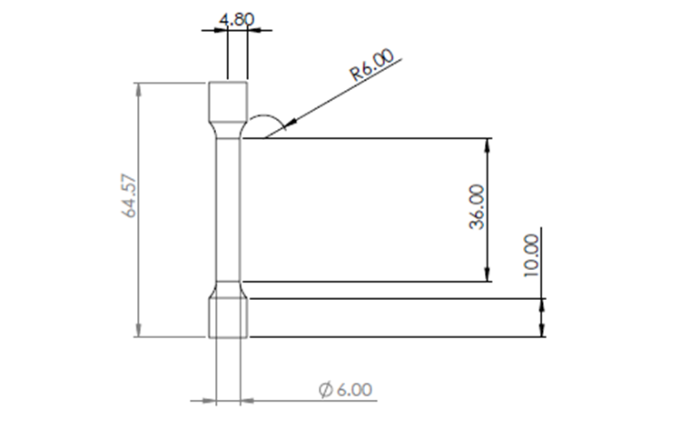
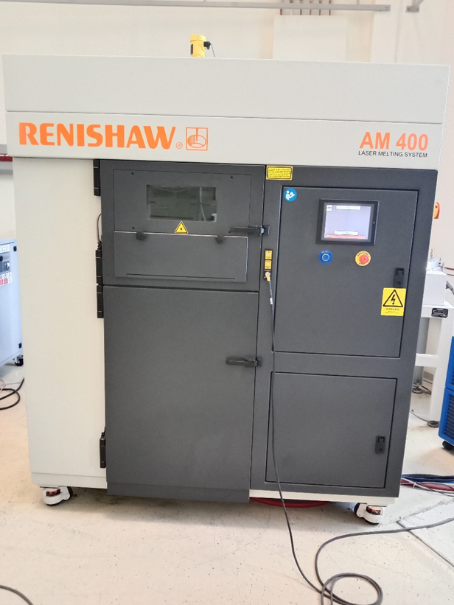
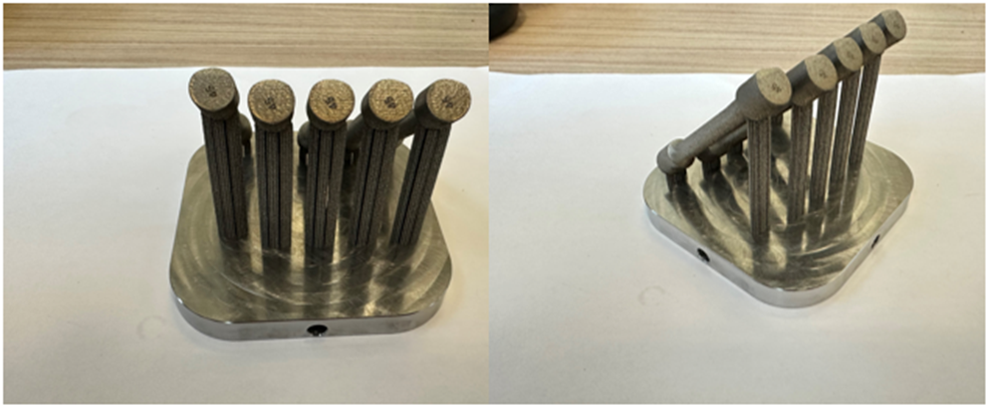
SLM 3D Printing
Standard Tensile Samples
AM 400 Renishaw view

Slide 26
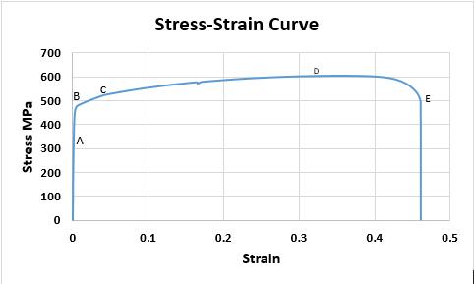
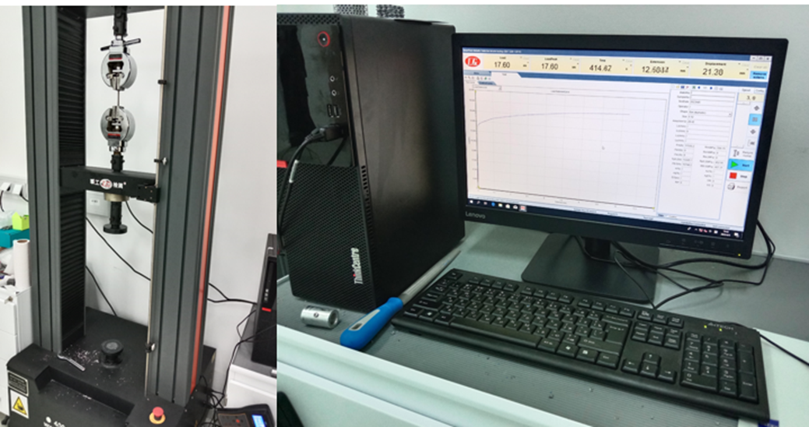
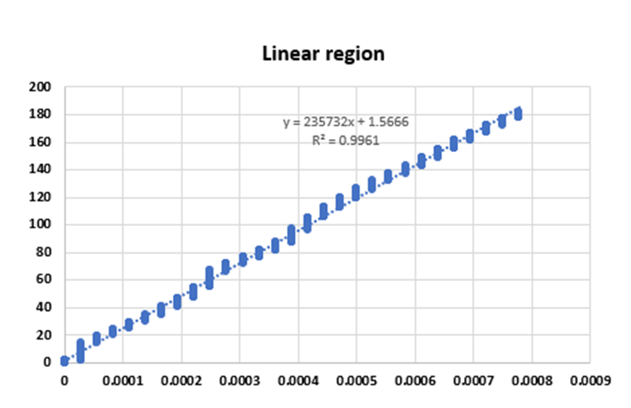
Tensile Test
Tensile Test for the standard tensile sample

Slide 27
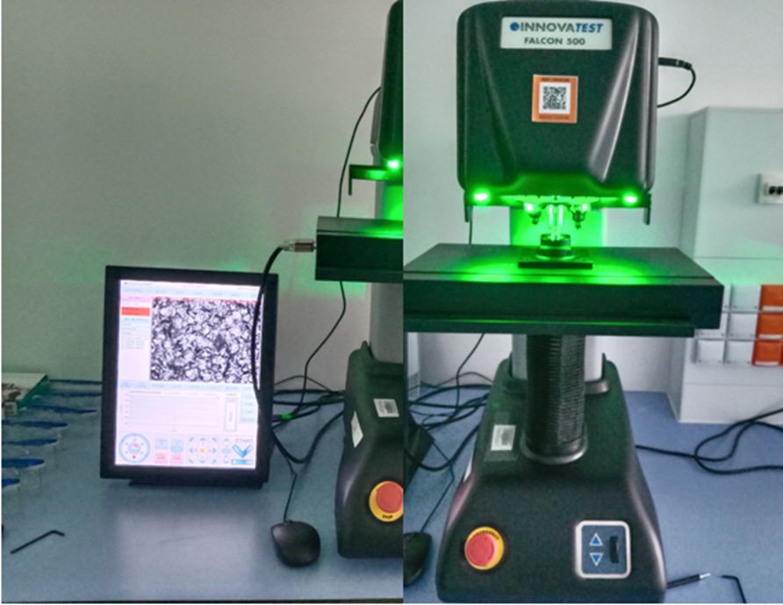
Vickers Hardness Test
Exp no. | Vickers | Load | Dwelling time (sec)
1 | 200.99 HV/1 | 9.8N | 10
2 | 201.87 HV/1 | 9.8N | 10
3 | 204.07 HV/1 | 9.8N | 10
4 | 207.32 HV/1 | 9.8N | 10
5 | 198.98 HV/1 | 9.8N | 10

Slide 28
Mechanical Properties
Grade | SS 316L | SS 316L Literature [93]
Yield strength, MPa | 464 | 519.0
Tensile strength, MPa | 597 | 633
Ductility | 6.6
%Elongation after fracture | 48 | 32.45
Young’s modulus, GPa | 235.7 | 207.2
Hardness maximum | 207.32 HV/1 | 247 HV [94]

Slide 29
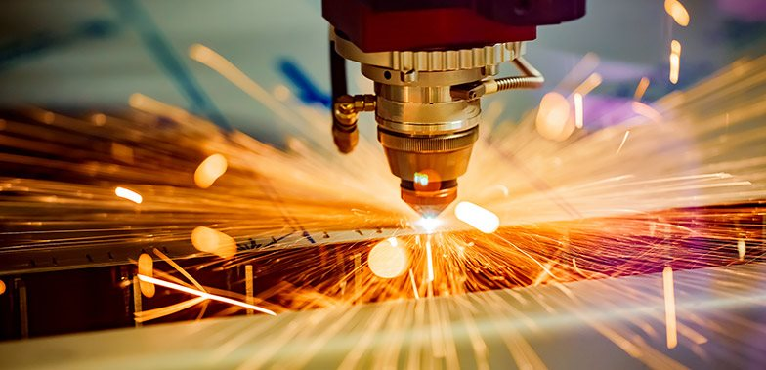

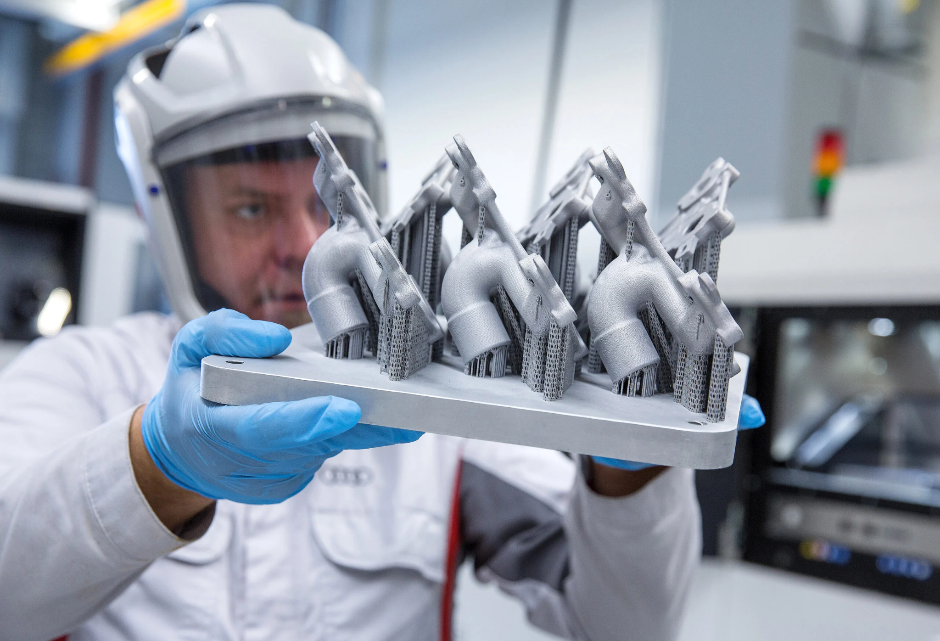
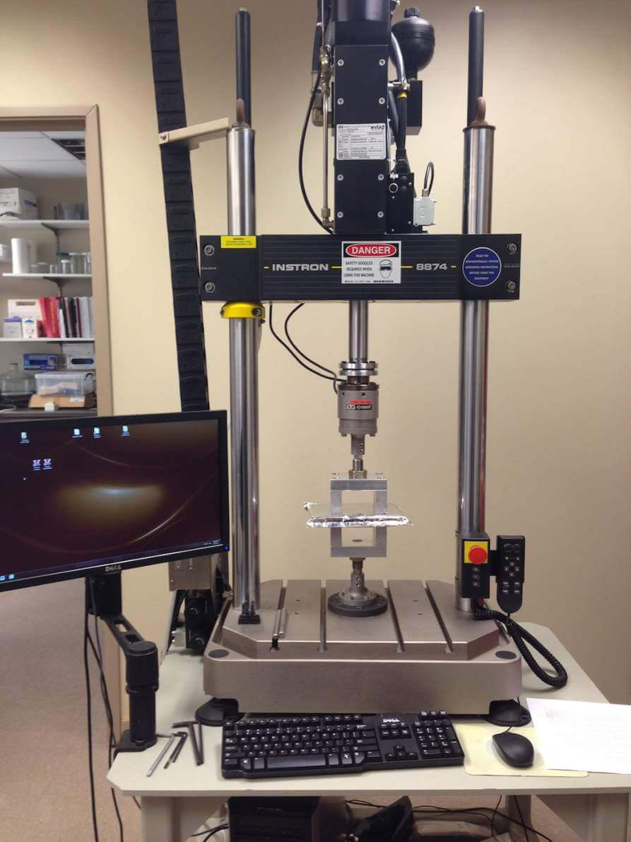
Conclusion
Fabrication Optimum parameter
Current of 130A, amplitude of 80%, and feeder speed rate of 50%.
Benchmark
Commercially available powder is a lower grade powder
Both powders have rheological characteristics that are advantageous for additive manufacturing methods.
Printing
High-quality metal components with superior mechanical qualities as observed in the printed standard tensile sample.
Mechanical Testing
Tensile and hardness tests on the printed standard samples revealed that its mechanical characteristics fell within the allowed range.
Higher young’s modulus of elasticity indicates that the SS 316L is suitable for load bearing structures.

Slide 30
Future work
Further study of stainless steel 316L fabrication using ultrasonic atomizer is required to enhance its mechanical and corrosion resistant qualities given the rising demand for high-performance materials across a variety of industrial sectors.
Exploring the usage of different manipulator angles
The fabricated powder should also be analyzed to make sure it has a nearly perfect spherical shape
Printing of the powder can be carried out to further test the final product’s mechanical qualities.

Slide 31
References
[1] V. N. Korzhyk et al., "New Equipment for Production of Super Hard Spherical Tungsten Carbide and other High-Melting Compounds Using the Method of Plasma Atomization of Rotating Billet," Materials Science Forum, vol. 898, pp. 1485-1497, 06/01 2017, doi: 10.4028/www.scientific.net/MSF.898.1485.
[2] https://www.precedenceresearch.com/metal-powder-market (accessed 15 April 2023).
[3] https://www.beamler.com/3d-printing-capabilities/processes/slm-selective-laser-melting/ (accessed 15th April, 2023).
[4] A. Alagheband and C. Brown, "Plasma Atomization goes commercial," Metal Powder Report, vol. 53, pp. 26-28, 11/01 1998, doi: 10.1016/S0026-0657(99)80007-1.
[5] S. E. Brika, M. Letenneur, C. A. Dion, and V. Brailovski, "Influence of particle morphology and size distribution on the powder flowability and laser powder bed fusion manufacturability of Ti-6Al-4V alloy," Additive Manufacturing, vol. 31, p. 100929, 2020/01/01/ 2020, doi: https://doi.org/10.1016/j.addma.2019.100929.
[6] S. Bogdanov, "Prospects of Production of Granular Composite Materials by Method of the Plasma-Centrifugal Atomization," Metallurgist, vol. 61, 04/13 2018, doi: 10.1007/s11015-018-0615-0.
[7] C. Labrecque, R. Angers, R. Tremblay, and D. Dub, "Inverted Disk Centrifugal Atomization of AZ91 Magnesium Alloy," Canadian Metallurgical Quarterly, vol. 36, pp. 169-175, 07/01 1997, doi: 10.1016/S0008-4433(97)00007-4.
[8] W. Gao et al., "The status, challenges, and future of additive manufacturing in engineering," Computer-Aided Design, vol. 69, pp. 65-89, 2015/12/01/ 2015, doi: https://doi.org/10.1016/j.cad.2015.04.001.
[9] G. Çakmak, M. B. Donmez, A. R. Cuellar, Ç. Kahveci, M. Schimmel, and B. Yilmaz, "Additive or subtractive manufacturing of crown patterns used for pressing or casting: A trueness analysis," Journal of Dentistry, vol. 124, p. 104221, 2022/09/01/ 2022, doi: https://doi.org/10.1016/j.jdent.2022.104221.
[10] M. Lalegani Dezaki et al., "A review on additive/subtractive hybrid manufacturing of directed energy deposition (DED) process," Advanced Powder Materials, vol. 1, no. 4, p. 100054, 2022/10/01/ 2022, doi: https://doi.org/10.1016/j.apmate.2022.100054.
[11] M. Akbari and N. Ha, "Impact of additive manufacturing on the Vietnamese transportation industry: An exploratory study," The Asian Journal of Shipping and Logistics, vol. 36, no. 2, pp. 78-88, 2020/06/01/ 2020, doi: https://doi.org/10.1016/j.ajsl.2019.11.001.
[12] S. Junk and N. Rothe, "Lightweight design of automotive components using generative design with fiber-reinforced additive manufacturing," Procedia CIRP, vol. 109, pp. 119-124, 2022/01/01/ 2022, doi: https://doi.org/10.1016/j.procir.2022.05.224.
[13] V. Madhavadas et al., "A review on metal additive manufacturing for intricately shaped aerospace components," CIRP Journal of Manufacturing Science and Technology, vol. 39, pp. 18-36, 2022/11/01/ 2022, doi: https://doi.org/10.1016/j.cirpj.2022.07.005.
37. Source: https://www.polarismarketresearch.com/industry-analysis/metal-powder-market
[38] https://3dprintingindustry.com/news/new-research-proposes-am-suitability-factor-for-metal-powder-selection-202992/ (accessed 16th April, 2023)

Slide 32
Thank you for your attention!

