Slide 1
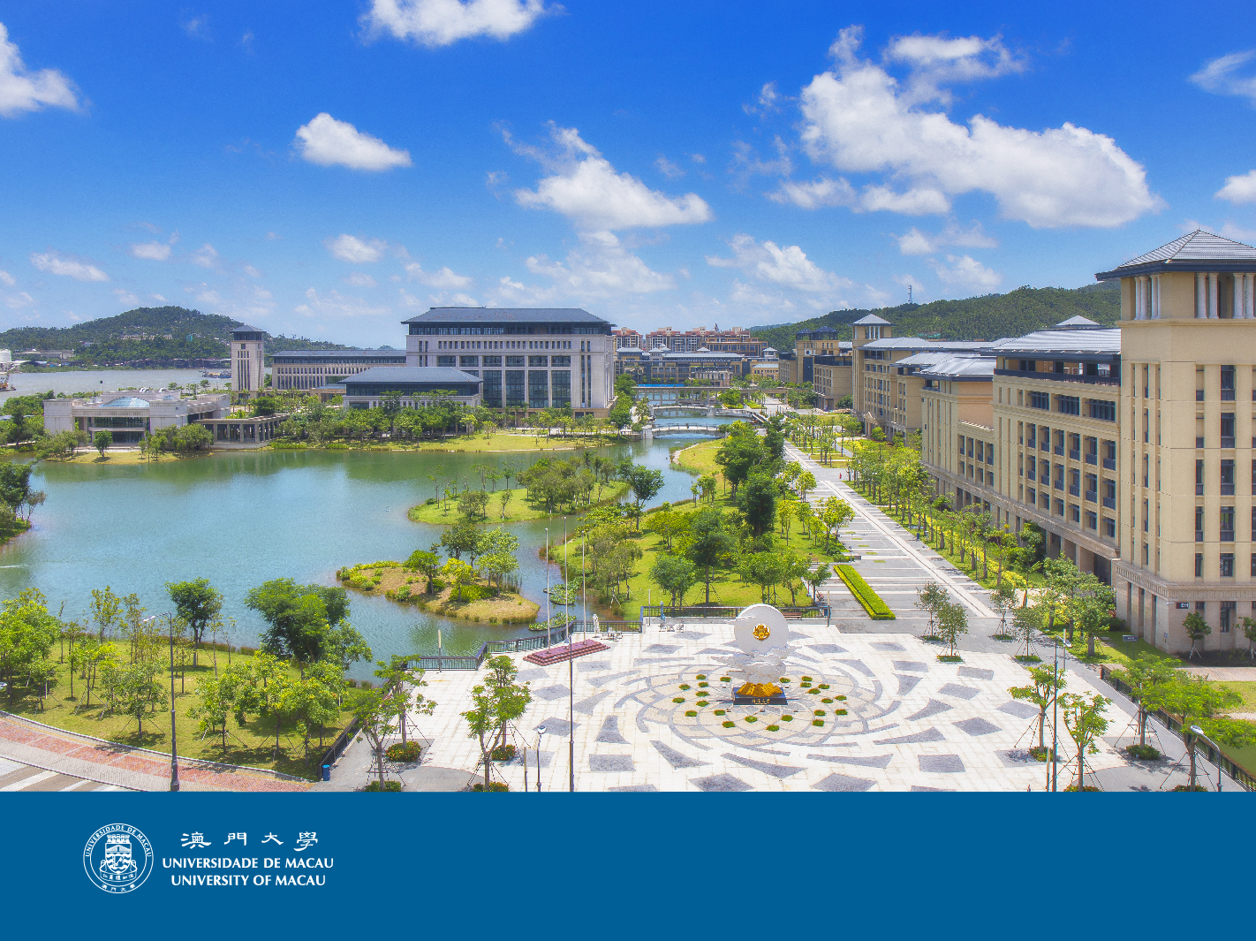


Integrating and Leveraging Metadata
in a Shared Environment :
the University of Macau Library Experience
Priscilla Pun
Head of Technical Process
University of Macau Library
29 June 2021

Slide 2
Libraries store the energy that fuels the imagination.
They open up windows to the world and inspire us to explore and achieve, and contribute to improving our quality of life.
-- Sidney Sheldon
(1917-2007 American writer and producer)

Slide 3
Table of Contents
Background
The UM Library Development & Metadata Standards
Library Metadata in a Shared Environment
Future Challenges

Slide 4
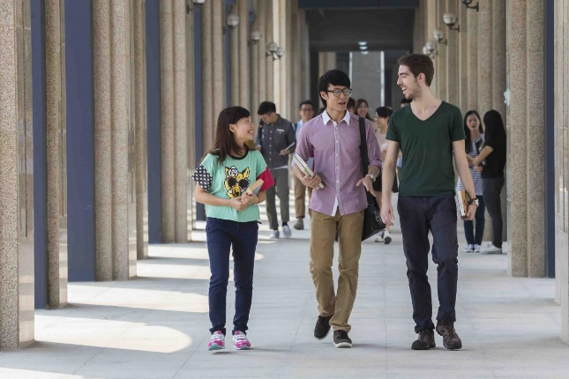
Background

Slide 5


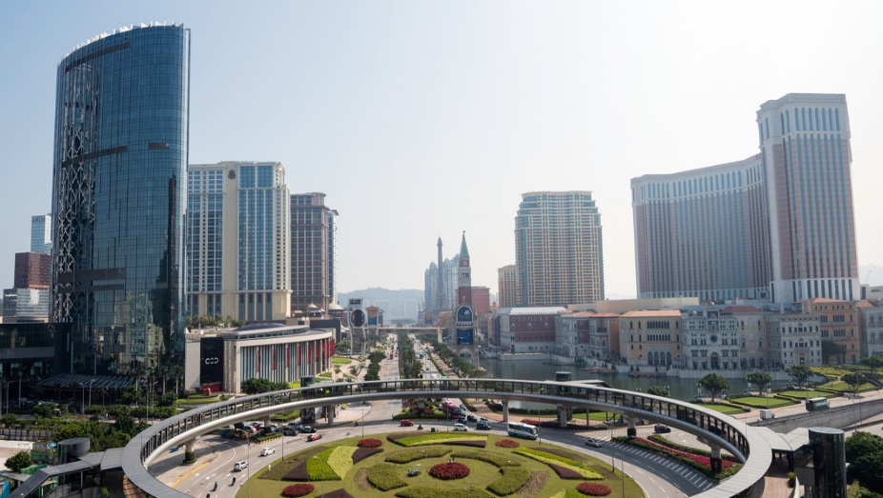
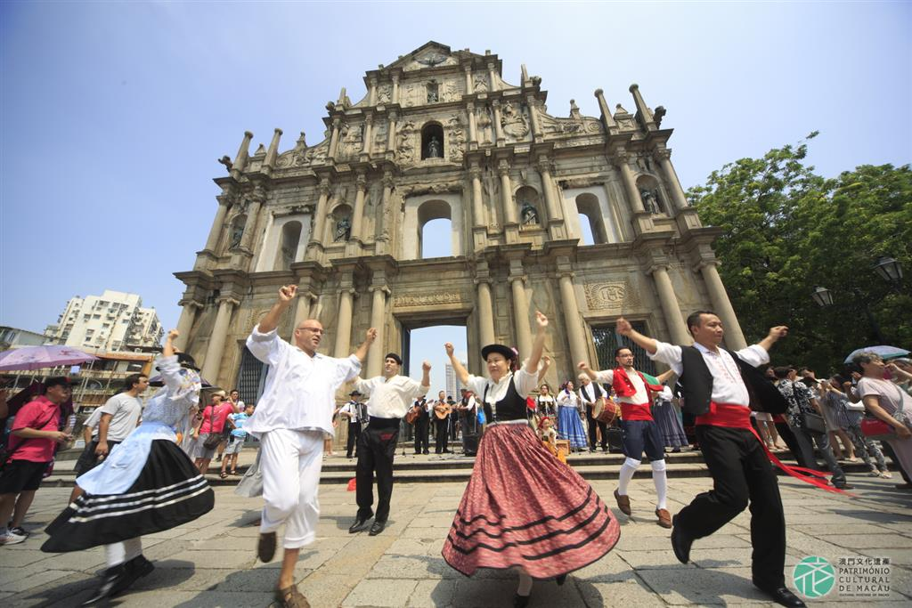
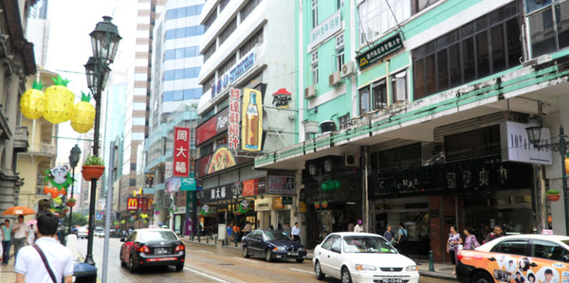
Macao Special Administrative Region
Area:
~33 km²
Population:
682,500
Density: 21,000 ppl/km²
Macao
Language:
Chinese (96%),
Portuguese (2%),
English
Economy:
Tourism

Slide 6
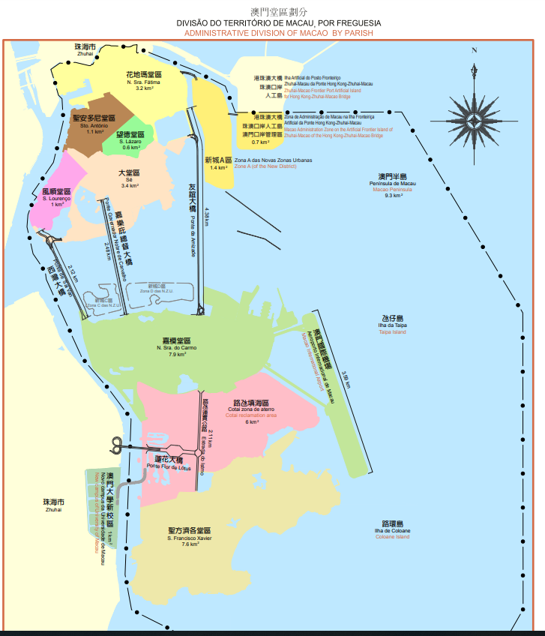
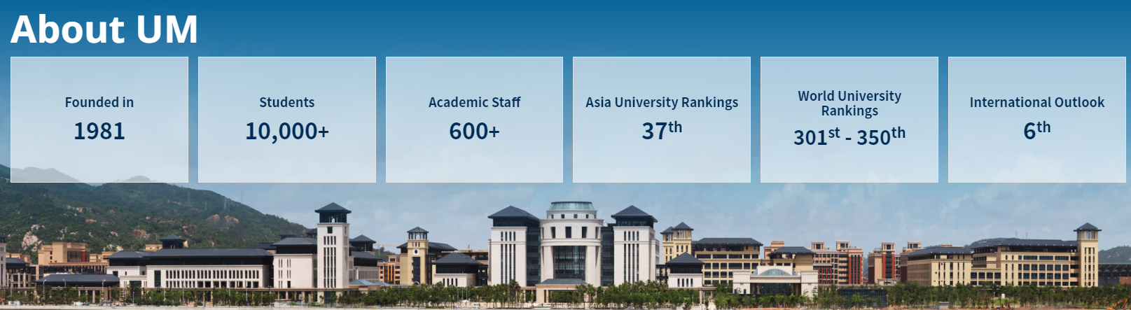
University of Macau
The only internationalized public comprehensive university in Macao
Main medium of instruction:
English; Some programs in Chinese or Portuguese
80% of its faculty members from outside Macao
Mainland China | Portugal | U.S.A. | Canada | Australia | Singapore | Others
60.8% | 15.2% | 8.2% | 3.2% | 2.0% | 1.5% | 9.1%
University of Macau

Slide 7






UM Library resources at a Glance
E-Journals
eBooks
Print Books
Databases
Print Journals
E-theses
100,000
760,000
Titles
790,000
Volumes
260
Volumes
6,000
Items
11,100,000
Titles
Titles
Total stocks of 12.6 million items/vols
Open Access Resources

Slide 8
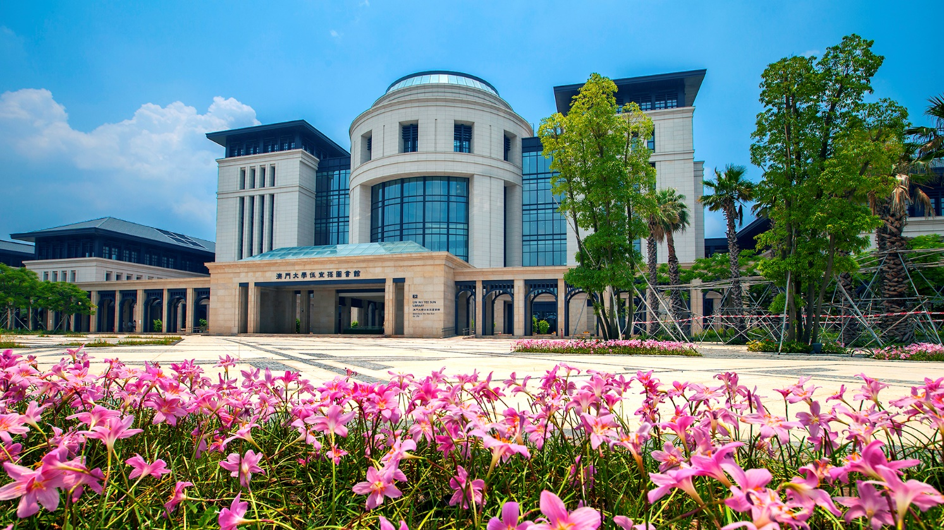
The UM Library Development
& Metadata Standards

Slide 9



Transition of Libraries as Enterprises
Prior to 1990
Early & Middle 1990s
Late 1990s to Early 2000
Early 2000 --
Information management focused on stand-alone isolated functions
Individual solutions for common problems
Business Process Reengineering focused on improving processes within functions or business units
Cross-functional process integration, but the organizational boundaries were firm
Cross-functional process integration
Dependencies
Inter-relationship
Information system formally linked to cross-functional process
Cloud-based Enterprise Resource Planning (ERP) began in 1998
Cloud ERP develops and collects real time data, with AI enhancements, to empower better decision-making
Enterprises
Early 1990
Mid 1990s
Early 2000
Computerized Catalog adoption
Cloud-based Library Services Platforms (LSPs) in 2010s, commercial or open source
The next generation of library management systems that has beyond all inbuilt features of an ILS, built on multi-tenant SaaS platform, taking advantage of cloud computing, web technologies and discovery service to provide capabilities to manage physical, digital & electronic materials, and other services in a single unified system.
Libraries
Integrated and automated library systems
Formally Integrated Library Systems (ILSs)
User-oriented electronic libraries
Abundant electronic resources and ICT technolgoy enhanced
Traditional
Smart
Gulledge, T. et al. (2003) The Information Technology Enabled Organization : A Major Social Transformation in the U . S . A . Management of Social Transformation: Discussion Paper Series, no.14.
Pradhan, Pallab. (2019). Library Services Platform (LSP): An Overview. 26. 12-22.

Slide 10
Transition of the UM Library in 5 Phases
Early & Middle 1990s
Phase 2
2010s--
Prior to 1990
In 1993, adoped Dynix as its initial automatic library system.
In 1994, connected to the Internet and started to surf websites.
Started to access the bibliographic data from libraries in Hong Kong.
2004 – 2010s
Phase 4
2010s - current
Phase 5
Early 2000
Adopted Discovery Service
EDS 2013-2019
Primo(VE) 2019- current
In 2020, migrated to the LSP Alma.
In 2004, adopted Innovative Millennium, a highly integrated library system, which made an one-stop-search hybrid library for UM.
Integrated and redesigned the business processes of acquisition and cataloging.
Late 1990s to Early 2000
Early 1990
Phase 3
Phase 1
Mid 1990s
During late 1990s, the Internet, search engines, paperless prediction, etc.
In 1996, introduced CD-ROM tower. Then commenced subscribing to e-journals on CD-ROM and web-based resources.
Bibliographic data of a library’s collection is the legacy of a library
In 1982, equipped with a mainframe computer and converted most of its English card catalog into computerized data, which is the first computeriezed library catalog in Macao.
Macau Academic Library Alliance (MALA)
since 2014e
Growth Through Creativity
Growth Through Direction
Growth Through Delegation
Growth Through Coordination
Growth Through Collaboration
Growth
Through
Alliances
Greiner’s Organization Growth Model

Slide 11
4M1E Analysis
Staff professional knowledge and workplace training
Staff work attitude, adaptability, shared values
Work motivation and job engagement
Organizational culture and ways of communication
Library Metadata Creation, Integration and Management
Man
Machine
Material
Method
Environment
Related emerging technologies: 5G, 6G, AI, Extended Reality (XR), big data, semantic web, knowledge graphs, linked data, & etc.
International and local concerns and influences
User Demand-Oriented
Library Services Platforms
(commercial vs open sources; flexible vs lock-ins)
LSPs to integrate with other cataloging platforms, cataloging data sources, data processing software and tools, etc.
Interactive UX
Apply international standards and guidelines, best practices, shared experiences, etc.
Workflows optimization and cost-effectiveness
Collaboration within and beyond the organization (library)
Library cataloging data sources (OCLC, regional union catalogs, identity management records, etc.)
Metadata from commercial or non-commercial digital content providers, including OER/OA resources
Local and in-house metadata
International and local cataloging standards documents and guidelines

Slide 12
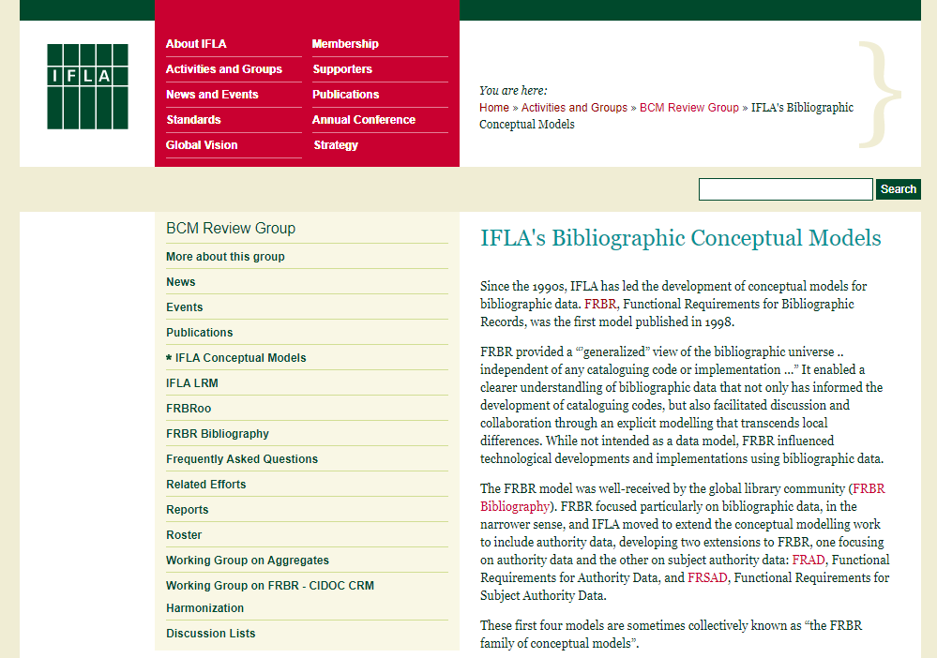
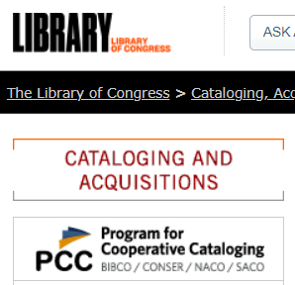


Think Globally, Act Locally
Globe
Country
City
Library
Global/country development, standards and policies to be translated into policies and practices at the city/library levels.
Country/city/library level projects and initiatives to drive development and policy changes at the city/country/global levels.
https://www.ifla.org/node/4953
The IFLA Cataloguing Section has published a list including conventions for 105 countries in 1996. Work to update the Names of Persons document has been carried out in 2009 and 2010.
UM Library’s
Cataloging Policies and Procedures
https://library.um.edu.mo/lib_services/catalog/cat_procedures_en

Slide 13
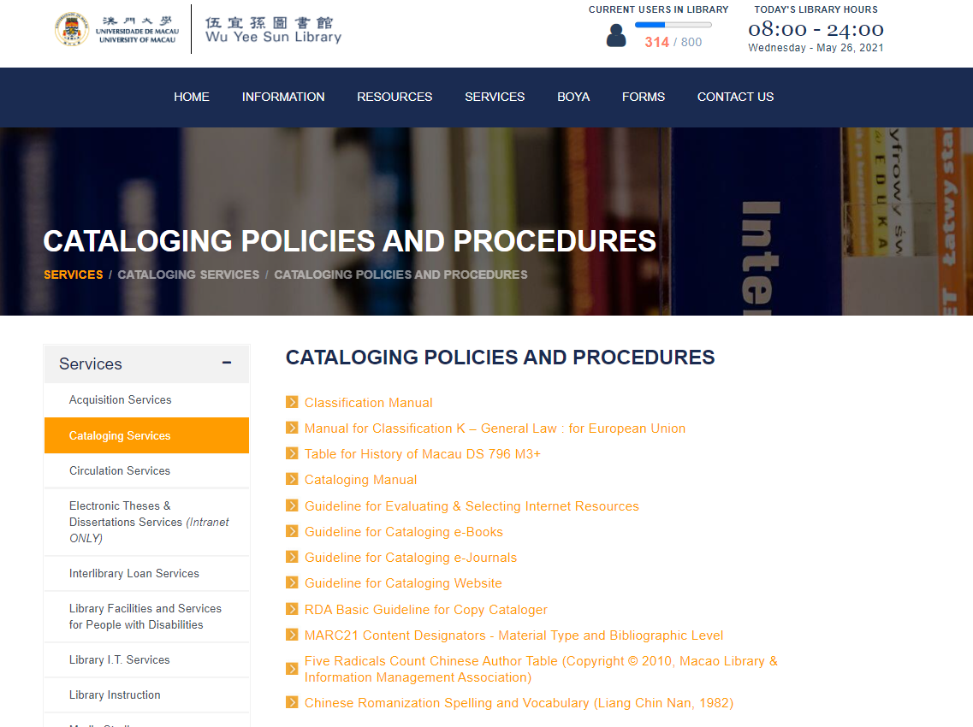
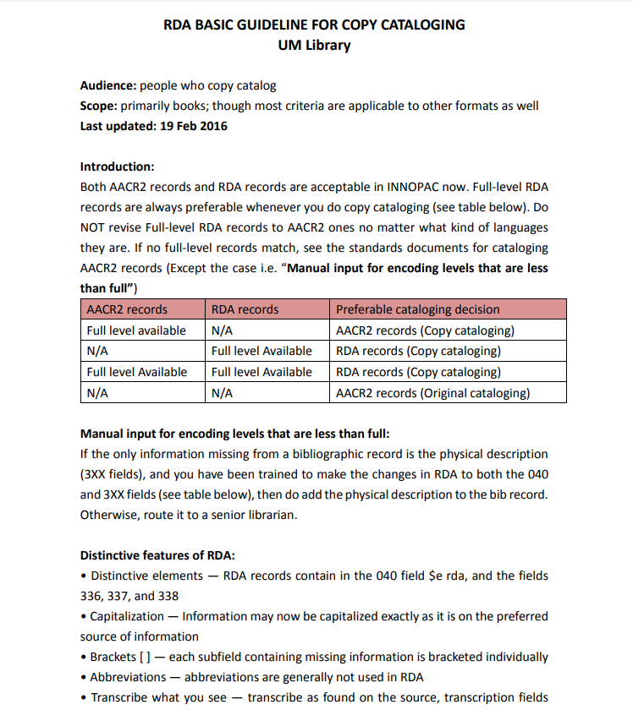

Slide 14
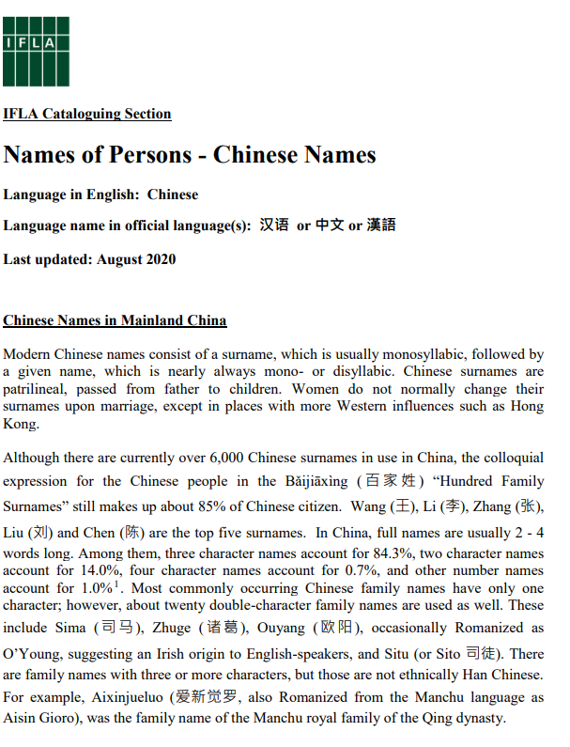
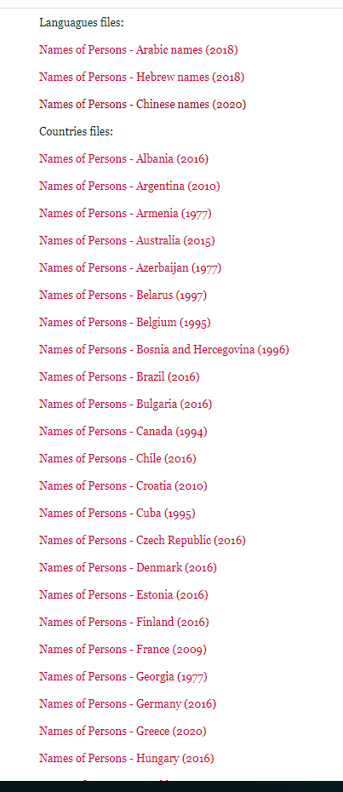
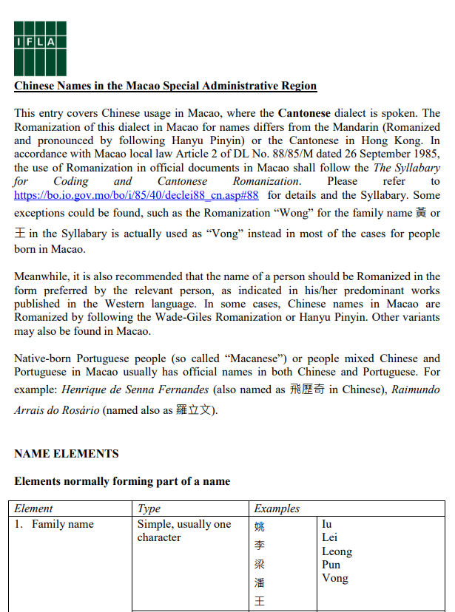
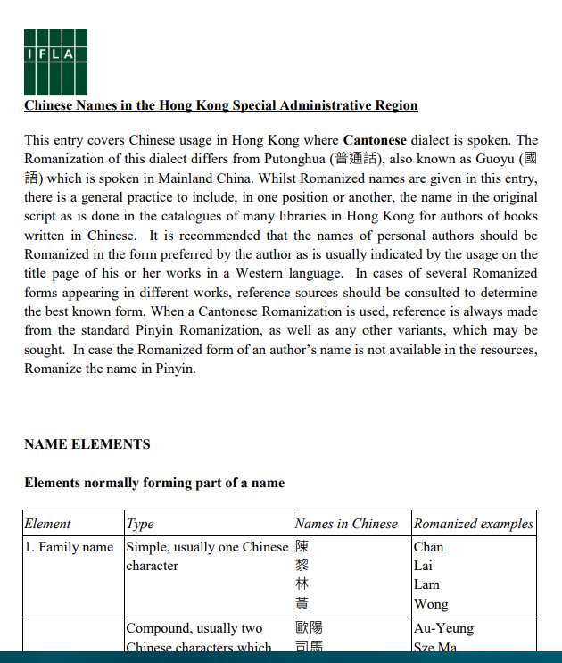

Slide 15
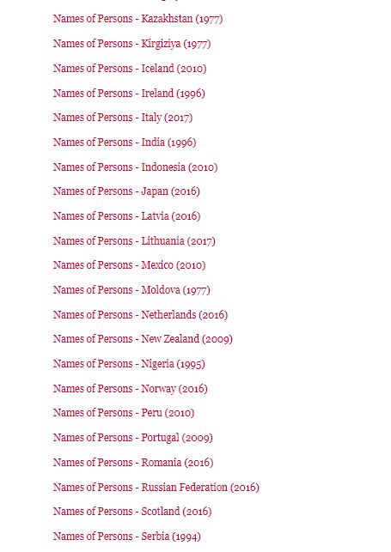
Consider to update the file for Kazakhstan?

Slide 16
Emerging Metadata Standards and Guidelines
Current Action Plan of CATS Section
The current action plan covers the span 2019-2021, with 4 focus areas:
Maintaining consistency between standards (Structural revision of ICP)
Identify key-competences for metadata librarians
Promoting section’s key-documents in a international scale
A focus on authority control and ID management
Action Plan: https://www.ifla.org/cataloguing/action-plan (chaired by Vincent Boulet)
Recent Virtual Event:
New horizons: emerging metadata standards and practices in the 21st century
https://www.youtube.com/channel/UCUrrt_nxhc4rYlDYfkO93-Q
Sponsored by the IFLA Bibliography, Cataloguing, and Subject Analysis & Access Sections.

Slide 17
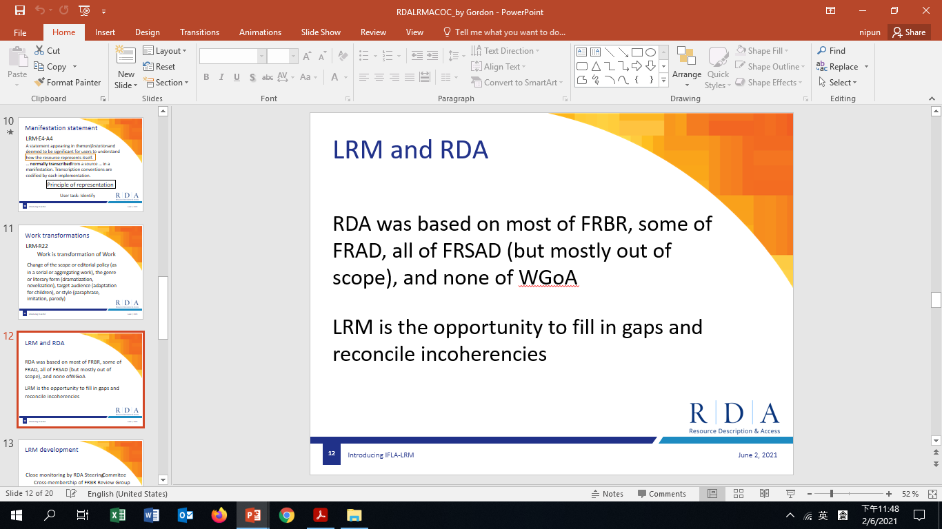
Emerging Metadata Standards and Guidelines
Library Reference Model is IFLA’s conceptual model/data model;
ISBD is IFLA’s content standard
UNIMARC is IFLA’s encoding format
--By Gordon Dunsire, Chair of RDA Steering Committee
IFLA generally uses the term 'standards' to refer to the following types of documents:
Conceptual models
Rules for resource description
Digital format codes
Guidelines (documents consisting of instructions, advice and models of preferred practices)
Best practice (documents consisting of procedures and techniques based on experience and research)
IFLA Standards: https://www.ifla.org/node/8750

Slide 18
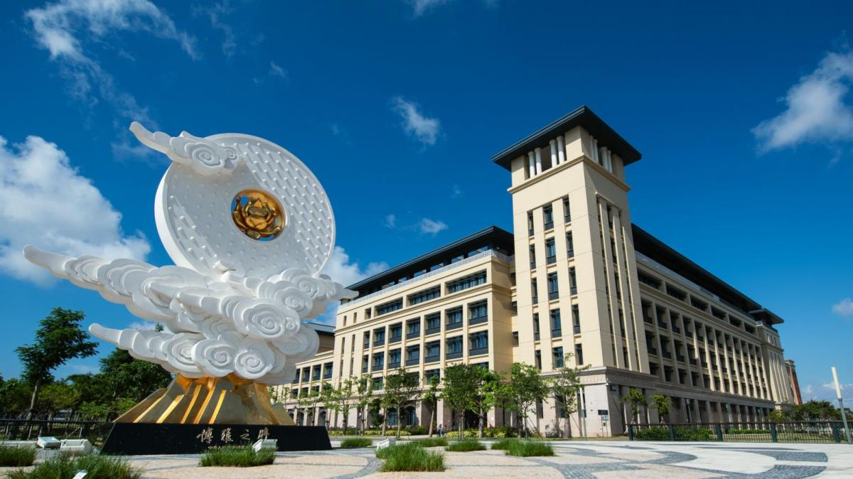
Library Metadata
in a Shared Environment

Slide 19
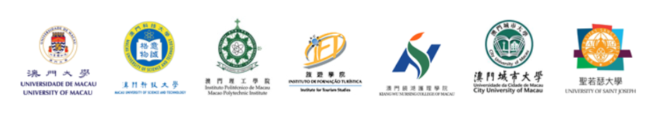
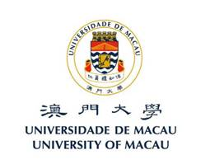



MALA Hub Project
A region-wide academic resource-sharing project initiated in 2019, with the sponsorship of Education and Youth Development Bureau, Macau SAR Government (merged with Higher Education Bureau in 2021)
Benefits:
Library resources sharing among members
To promote the usage of library resources
  (by providing discovery platforms via this projects)
To support and enhance teaching, learning and research activities at city level
Increase collaborations among members

Slide 20
MALA Hub Project
MALA Hub (Central Portal) + 7 Discovery Portals for Individual Institutions + Subject Portals
1 + 7 + N
## 2 members are small in scale and request for no individual portals

Slide 21
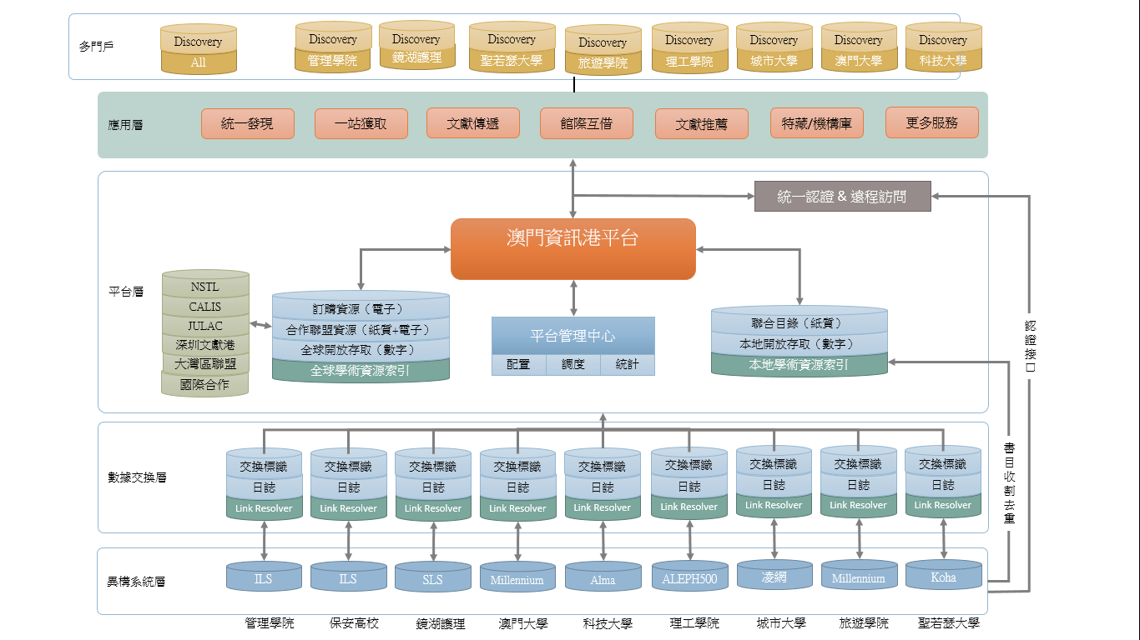
System Framework of MALA Hub Project
Individual Portals
Central Portal
Different library systems

Slide 22
MALA Hub as Central Portal
Central Portal of the 9 MALA members
MALA Hub as a Union Catalog (completed Jan 2020)
MALA Hub as an ILL Platform (completed Jun 2020)
MALA Hub as Subject Portals

Slide 23
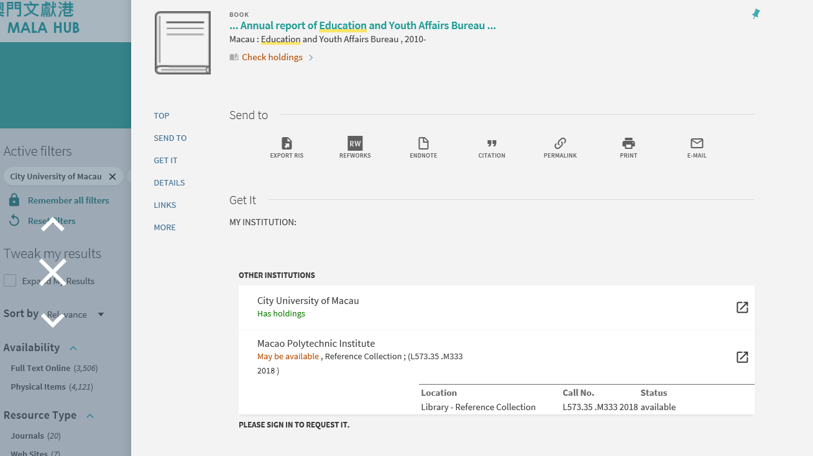
澳門文獻港 MALA Hub (Union Catalog + ILL Platform)
Over 200,000 PNX records
MALA Hub provides one stop search from the nine academic libraries in Macau for all of their academic resources, as well as for raising book loans and article requests.

Slide 24
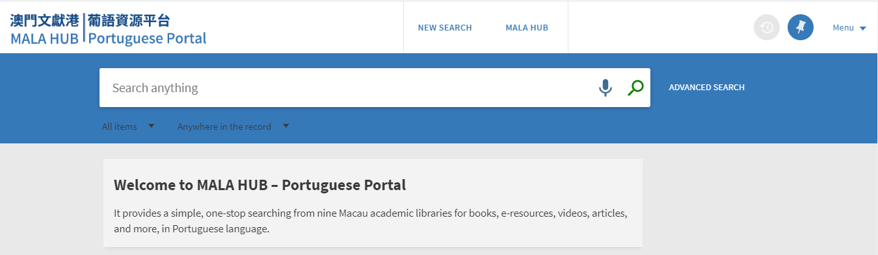
MALA Hub – Portuguese Portal
Derived from the Hub, several topic-specific resource portals are suggested by the Government and the community.
The first topic-specific portal, Portuguese Portal, launched at the end of 2019.

Slide 25
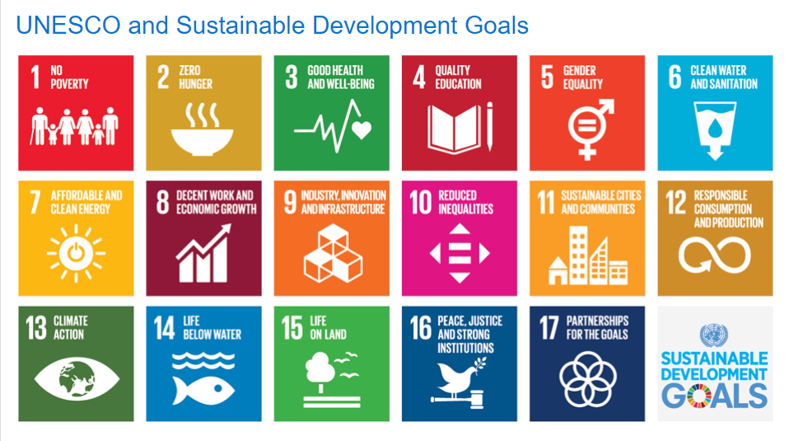

Slide 26

Future Challenges

Slide 27
Future Challenges
Impact of emerging technologies on library metadata creation and management, data analytics, indexing and discovery, and so forth.
Changing roles of metadata librarians
-- Identity Management, Research Information System, Open Data, etc.
Continuing education and professional skill development for staff
– get ready to LEARN and CHANGE
Integrating across various sectors, such as archives, museums, cultural/memory projects, digital humanities projects, etc.
Do Curriculum designs and development of the library information schools meet the potential needs of libraries and users’ growing expectations?

Slide 28









THANK YOU FOR LISTENING!
Eurasian Academic Libraries Conference – 2021
“Contemporary Trends in Information Organization in the Academic Library Environment”
June 29-30, 2021
Contact information:
Priscilla Pun
Head of Technical Process, University of Macau
CATS Corresponding Member, IFLA
E-mail: nipun@um.edu.mo

