Slide 1
Master Thesis
School of Engineering and Digital Sciences
Department of Electrical and Computer Engineering
Convolutional Decoders Based on Quantum Annealing
Ilyas Rysbekov
ID: 201562321
Supervisor: Refik Kizilirmak
Co-supervisor: Farzad Salmasi
April, 2021

Slide 2
Outline
Introduction
Background
Convolutional encoders
Viterbi Decoder
Quantum Annealing
Convolutional Decoders based on Quantum Annealing
Results
Conclusion
References

Slide 3
Introduction
Proposed method obtains maximum likelihood (ML) estimate of the transmitted codeword using quantum annealing (QA).
Performance is assessed by its rate error and compared with the conventional Viterbi decoder on classical computers

Slide 4
Background (1/2)
Convolutional codes are type of error-correcting codes which enable reliable data transmission over communication channels
Error correcting codes detect errors and correct them.
To detect and correct appeared errors additional bits are added before transmission stage.

Slide 5
Background (2/2)
Quantum computing:
  Qubits instead of bits
  Superconducting QUantum Interference Device (SQUID) is the main building block inside quantum computers
  D-Wave 2000Q quantum computer with 2000 qubits available

Slide 6
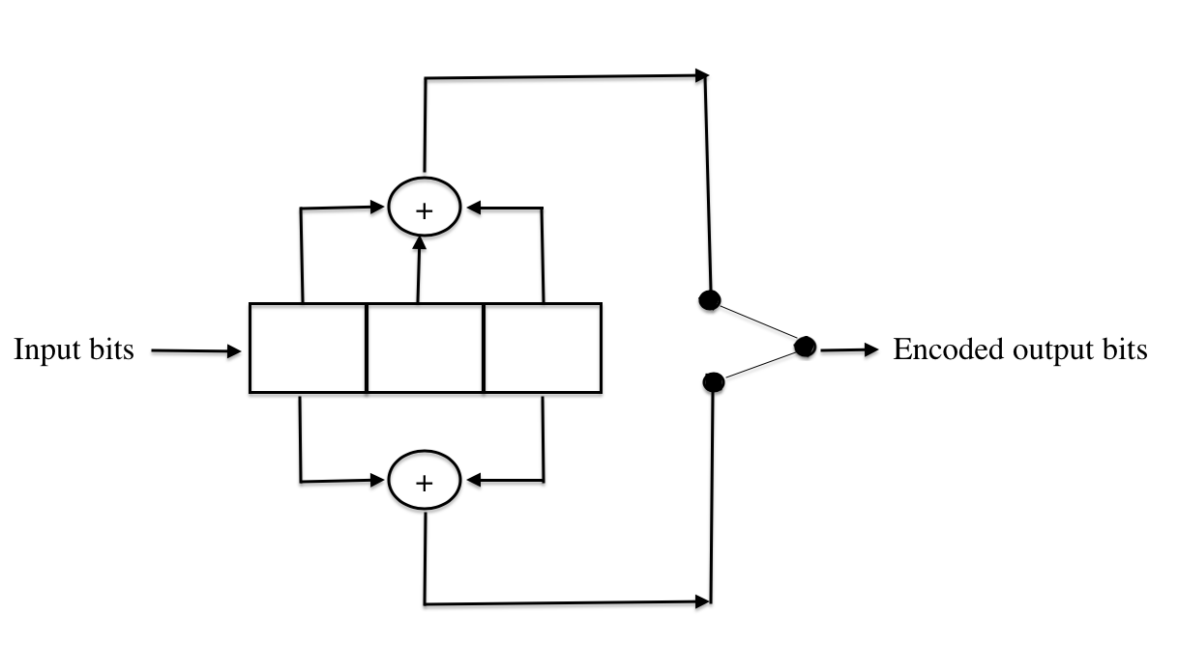
Convolutional encoders (1/6)
Convolutional coding based on the output code bits determined by logic operations on the current and previous bits in the stream, instead of using block of bits.
Fig.1 Example of convolutional encoder

Slide 7
Convolutional encoders (2/6)
Convolutional coding based on the output code bits determined by logic operations on the current and previous bits in the stream, instead of using block of bits.
1
Fig.1 Example of convolutional encoder

Slide 8
Convolutional encoders (3/6)
Convolutional coding based on the output code bits determined by logic operations on the current and previous bits in the stream, instead of using block of bits.
0
1
Fig.1 Example of convolutional encoder

Slide 9
Convolutional encoders (4/6)
Convolutional coding based on the output code bits determined by logic operations on the current and previous bits in the stream, instead of using block of bits.
1
0
1
Fig.1 Example of convolutional encoder

Slide 10
Convolutional encoders (5/6)
Convolutional encoders representation methods:
  Graphical
  Tree diagram
  Trellis diagram

Slide 11
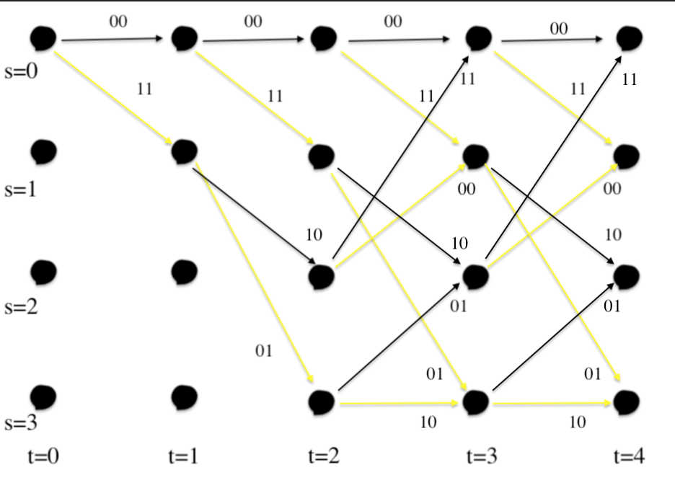
Convolutional encoders (6/6)
Trellis’s nodes are characterized as encoder states
States of trellis diagram are on vertical axis and transitions from one state to another denoted on the diagram (Fig. 2)
Fig. 2 Example of trellis diagram

Slide 12
Viterbi Decoder
Viterbi decoder:
  Optimal decoding method
  Bits interpreted as input to a shift register of length k
  Viterbi decoder is part of maximum likelihood (ML) estimation

Slide 13
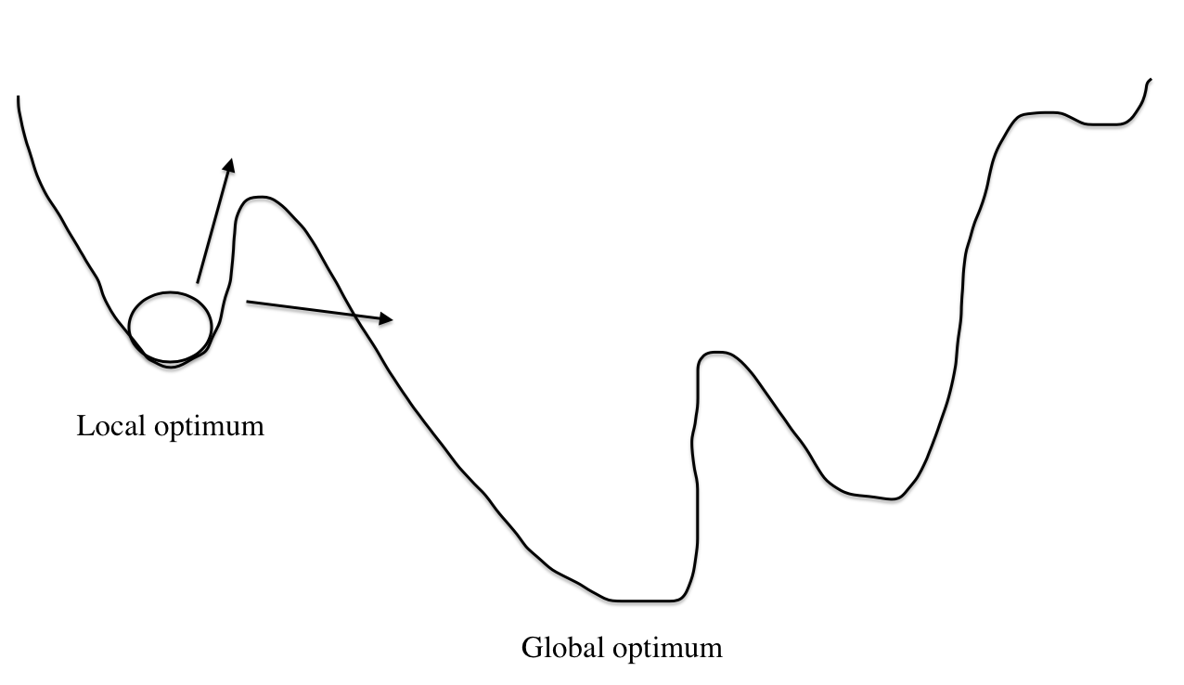
Quantum Annealing (1/3)
Quantum Annealing (QA) - method to find the global minimum of a given objective function over a given set of candidate solutions (candidate states), by a process using quantum fluctuations (Fig. 3).
QA avoids finding local minima
Fig. 3 Quantum annealing searches global minimum

Slide 14
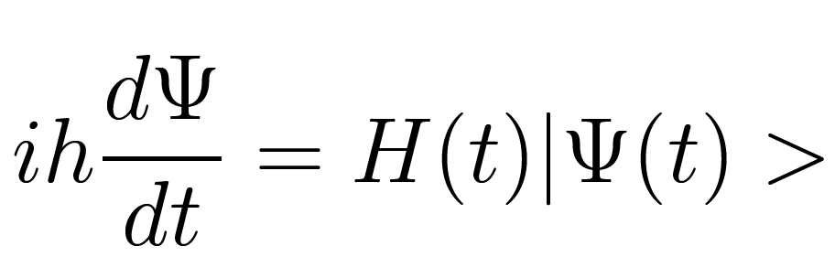
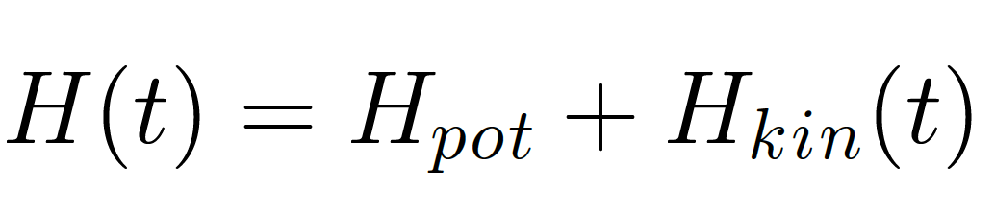
Quantum Annealing (2/3)
QA is structured as sum of potential and quantum kinetic energies [15]
The evolution of quantum machines could be described by time-dependent Schrodinger equations as
(1)
(2)

Slide 15
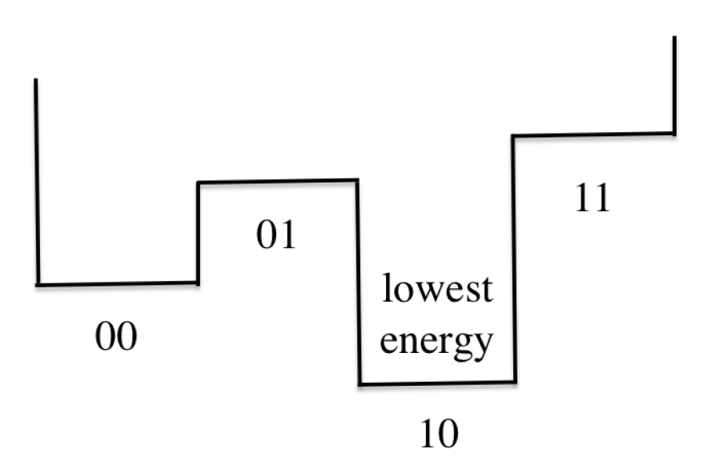
Quantum Annealing (3/3)
When QA is finished qubits representing the solution are expected to be at the lowest energy state of the solution
Fig. 4 Lowest energy state gives the best solution

Slide 16
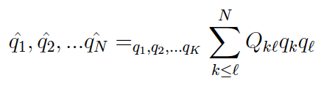
Convolutional Decoders based on QA (1/3)
Reformulate problem into one of the following:
  Quadratic Unconstraint Binary Optimization (QUBO)
  Ising function
And could be expressed as
(3)
  where N stands for number of qubits, Q_kl and Q_ll stand for quadratic linear coefficients.

Slide 17

Convolutional Decoders based on QA (2/3)
  Decoding convolutional codes with ML estimate with additive white Gaussian noise can be expressed as:
  C* stands for the estimated codeword from the received message with length N
  C is transmitted codeword [c_1, c_2, …, c_N] where each entry c_n is either +1 or -1
  r is the received bits that are corrupted by additive white Gaussian noise
(4)

Slide 18
Convolutional Decoders based on QA (3/3)
QUBO model in (3) valid for binary variables, i.e q_n is either 1 or 0.
Transform of c_n = 2q_n – 1, with q_k = (q_k)^2 = q_k*q_k, can be applied to (4) in order to obtain the linear and quadratic coefficients, Q_kl and Q_ll, of the objective function in (3).
(3)
(4)

Slide 19
Results (1/4)
10 000 trials with Viterbi decoder on local CPU
1000 trials with quantum annealing on Amazon’s D-Wave 2000Q
White Gaussian noise was generated at each trial and added to encoded messages.

Slide 20
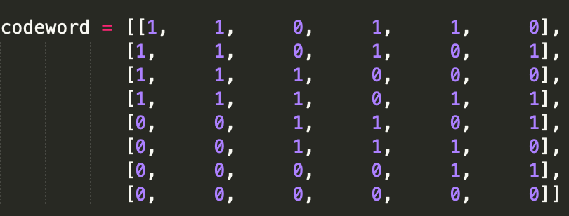
Results (2/4)
During experiments convolutional encoder with generator polynomials [1 1 1] and [1 0 1] for rate ½ were used.
Codewords were thansmitted through Additive white Gaussian noise (AWGN) channel.
Fig. 5 Example of codewords

Slide 21
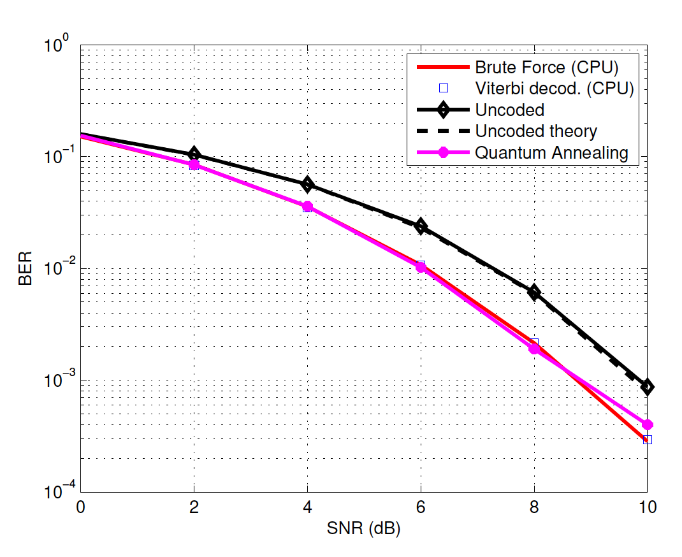
Results (3/4)
Fig. 6 shows us bit error rate comparison between implemented methods
QA shows close results to optimal Viterbi decoder
Fig. 6 BER Comparison of Viterbi, Brute Force and QA methods.

Slide 22
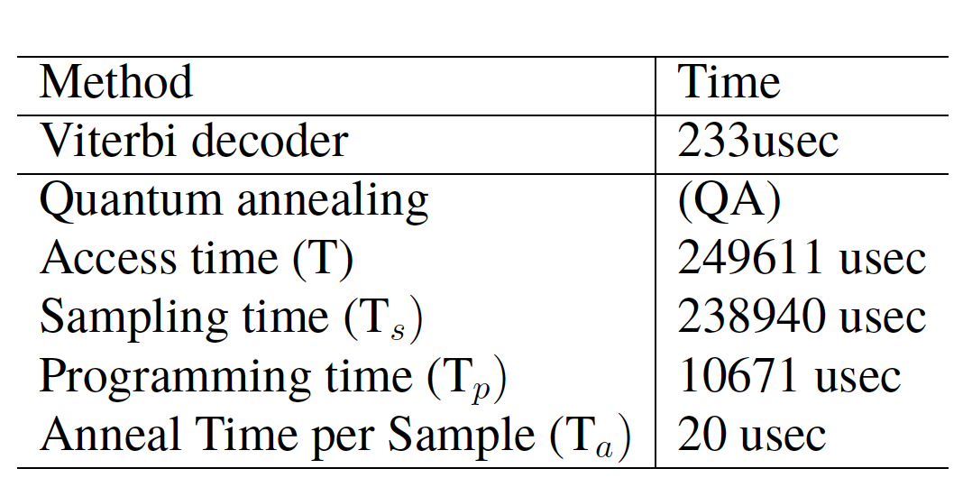
Results (4/4)
Signal detection with QA takes 249611 usec (excluding internet connection)
Access time (T) includes both sampling time T_s and programming time T_p.
Sampling time splits into anneal time per sample which is actual computation time for each trial
Anneal time is 20 usec, the data preparation overhead still makes the QA machines slower than classical computing with Viterbi decoder
Table 1. Execution time for each method

Slide 23
Conclusion
Amazon’s cloud quantum computer DWAVE 2000Q was used to demonstrate successful problem solving with QA and it was compared with Viterbi decoder
This research could be extended by using different convolutional encoders with varying constraint length.
Next step could be implementing this project with Advantage QPU

Slide 24
References
[1] D-Wave., Inc. (n.d.). Reformulating a problem. Retrieved March 18, 2021, from https://docs.dwavesys.com/docs/latest/chandbook3.html
[2] J. Cai, B. Macready, A. Roy, “A practical heuristic for finding graph minors”, https://arxiv.org/abs/1406.2741
[3] Hamming, R. W. (1950). Error detecting and error correcting codes. The Bell system technical journal, 29(2), 147-160.
[4] Rieffel, E. G., Polak, W. H. (2011). Quantum computing: A gentle introduction. MIT Press.
[5] D-Wave System Inc. (2011). Introduction to D-Wave Quantum Hardware. Retrieved October 09, 2020, from
https:/www.dwavesys.com/tutorials/background-r ading-series/introductiondwave-quantum-hardware
[6] Wayner, P. (2009). Disappearing cryptography: information hiding: steganography and watermarking. Morgan Kaufmann.
[7] Randall, M., McMahon, G., Sugden, S. (2002). A simulated annealing approach to communication network design. Journal of Combinatorial Optimization, 6(1), 55-65.
[8] T. Kadowaki, H. Nishimori, “Quantum Annealing in the Transverse Ising Model”, Phys. Rev. E 58, 5355 – Published 1 November 1998
[9] Davis, J., Lin, A., Njuguna Njoroge, A. T. (2002). Viterbi Algorithms as a Stream Application. signal, 1, 2.
[10] Viterbi, A. (1967). Error bounds for convolutional codes and an asymptotically optimum decoding algorithm. IEEE transactions on Information Theory, 13(2), 260-269.
[11] Forney, G. D. (1973). The viterbi algorithm. Proceedings of the IEEE, 61(3), 268-278.
[12] de la Fuente Ruiz, A. (2014). Quantum annealing. arXiv, arXiv-1404.
[13] Finnila, A. B., Gomez, M. A., Sebenik, C., Stenson, C., Doll, J. D. (1994). Quantum annealing: a new method for minimizing multidimensional functions. Chemical physics letters, 219(5-6), 343-348.

Slide 25
References
[14] Kim, M., Venturelli, D., Jamieson, K. (2019). Leveraging quantum annealing for large MIMO processing in centralized radio access networks. In Proceedings of the ACM Special Interest Group on Data Communication (pp. 241-255).
[15] Cao, Y., Zhao, Y., Dai, F. (2019, July). Node Localization inWireless Sensor Networks Based on Quantum Annealing Algorithm and Edge Computing. In 2019 International Conference on Internet of Things (iThings) and IEEE Green Computing and Communications (GreenCom) and IEEE Cyber, Physical and Social Computing (CPSCom) and IEEE Smart Data (SmartData) (pp. 564-568). IEEE.
[16] Cruz-Santos, W., Venegas-Andraca, S. E., Lanzagorta, M. (2019). A QUBO formulation of Minimum Multicut problem instances in trees for D-Wave Quantum Annealers. Scientific reports, 9(1), 1-12.
[17] H. Nishimori, “Statistical Physics of Spin Glasses and Information Processing”, Oxford University Press, 2001
[18] Ide, N., Asayama, T., Ueno, H., Ohzeki, M. (2020). Maximum- Likelihood Channel Decoding with Quantum Annealing Machine. arXiv preprint arXiv:2007.08689.
[19] Kizilirmak, R. C. (2020, July). Quantum Annealing Approach to NOMA Signal Detection. In 2020 12th International Symposium on Communication Systems, Networks and Digital Signal Processing (CSNDSP) (pp. 1-5). IEEE.
[20] Bensky, A. (2019). Short-range wireless communication. Newnes.
[21] Forney, G. (1970). Convolutional codes I: Algebraic structure. IEEE Transactions on Information Theory, 16(6), 720-738.
[22] Hu, S., KrЪll, H., Huang, Q., Rusek, F. (2017). Optimal channel shortener design for reduced-state soft-output Viterbi equalizer in single-carrier systems. IEEE Transactions on Communications, 65(6), 2568-2582.
[23] Grami, A. (2015). Introduction to digital communications. Academic Press.
[24] Berber, S. M., Kecman, V. (2004, July). Convolutional decoders based on ar- tificial neural networks. In 2004 IEEE International Joint Conference on Neural Networks (IEEE Cat. No. 04CH37541) (Vol. 2, pp. 1551-1556). IEEE.

Slide 26
Acknowledgements
First, I would like to thank my supervisor professor Refik Caglar Kizilirmak and co-supervisor Farzad Salmasi for all those hours spent explaining me every detail of our master thesis.
Many thanks to my family and close friends for supporting me during the whole project, especially my roommate Rinat Khalimov

Slide 27
Thank you for attention!

Slide 28
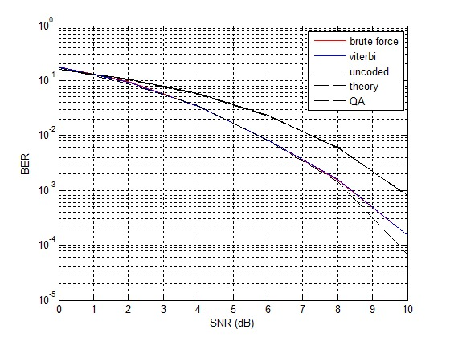
Results
Generator polynomials were used:
  g1 = [110101]
  g2 = [1001011]
  code rate = ½
Fig. 7 BER Comparison of Viterbi, Brute Force and QA methods.

