Slide 1
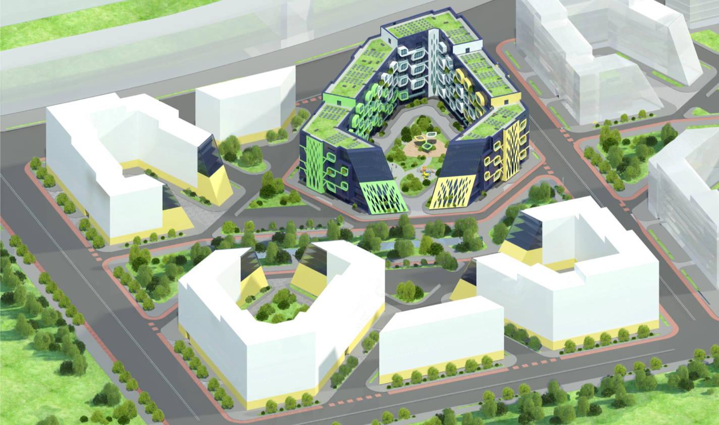



"ENERGY TREE"
MULTICOMFORT HOUSE
UKRAINE
KNUCA KIEV
ALINA HOLOVATIUK

Slide 2
HIGH QUALITY ENVIRONMENT FOR PEOPLE
ERGONOMICS
INTIMACY
ECOLOGY
COMFORT
CREATIVITY
BEAUTY
IDEA

Slide 3

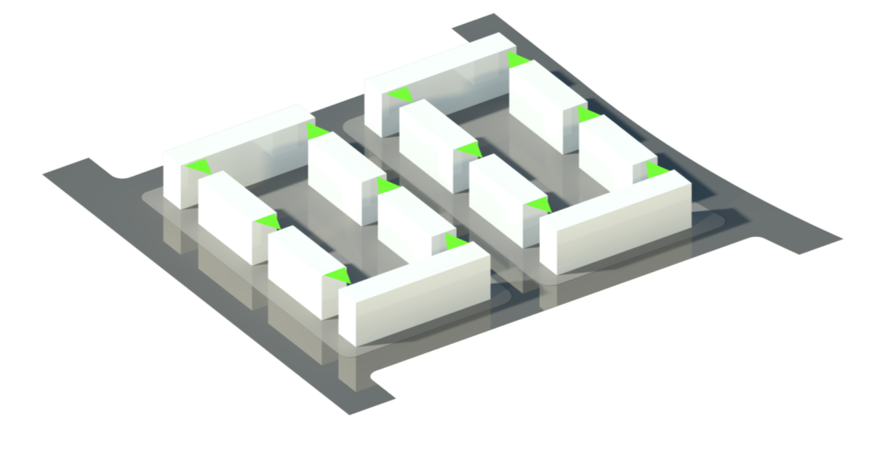
AREA FOR THE DEVELOPMENT - 3.1 HECTARES, RESIDENTIAL BUILDINGS 10-12,
HEIGHT 6 – 8 STORIES
ORIGINAL TASK

Slide 4
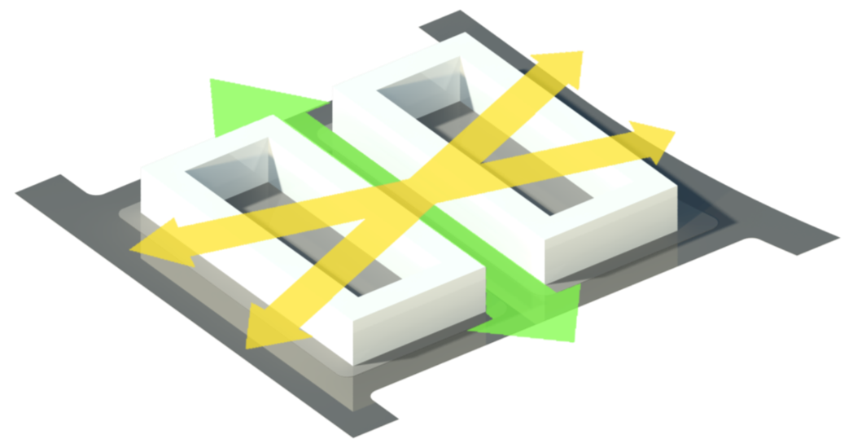
LINKS BETWEEN SHOPPING STREET IN THE NORTH AND BUFFER PARK IN THE SOUTH
CONVENIENT AND SAFE MOVEMENT WITHIN QUARTERS
ORGANIZATION OF INTERQUARTER PARK
PEDESTRIAN CONNECTIONS

Slide 5
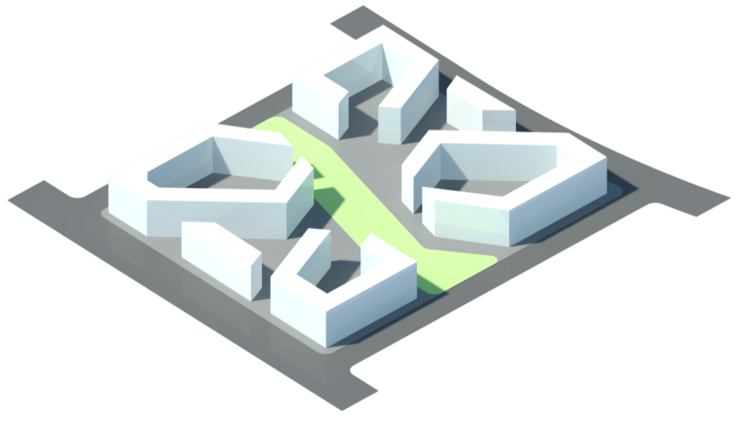
BUILDINGS FORM COZY QUARTERS
INTIMACY

Slide 6
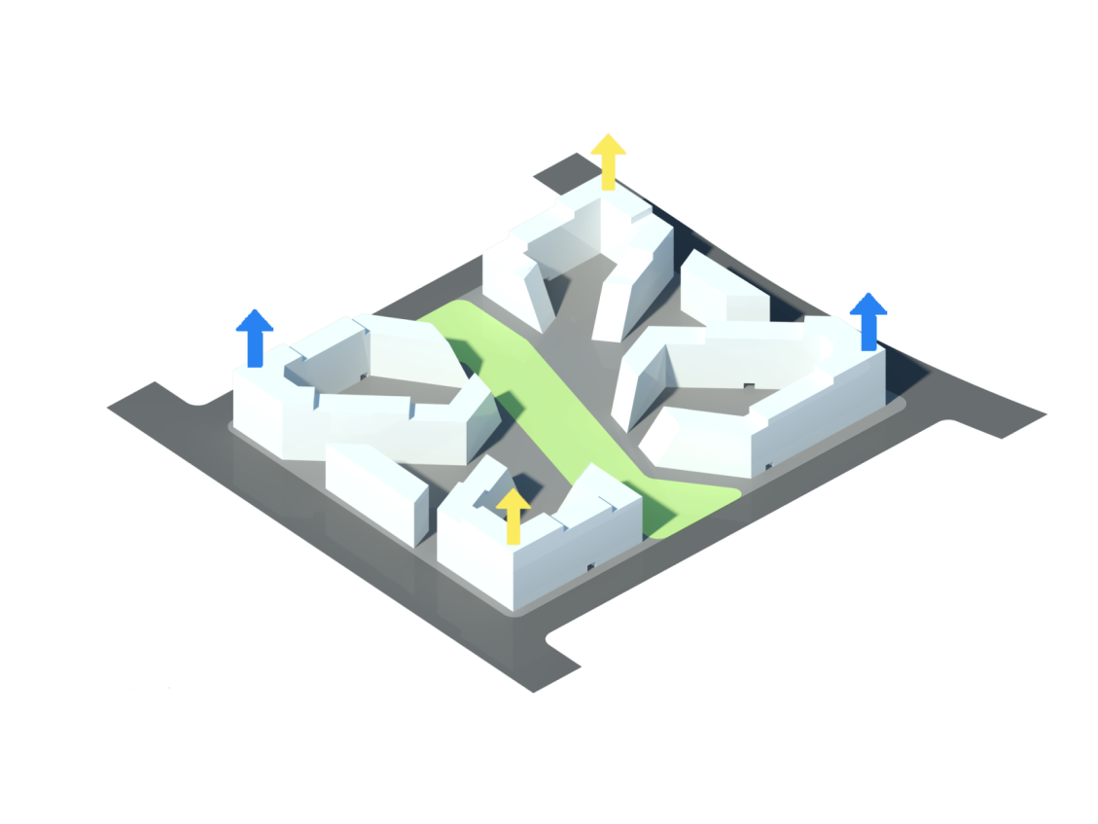
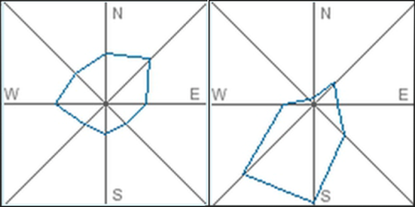
WS
NE
SCAPE ACCENTS AND HEIGHT INCREASE AGAINST THE DOMINATING WINDS
WIND PROTECTION. SPATIAL COMPOSITION

Slide 7
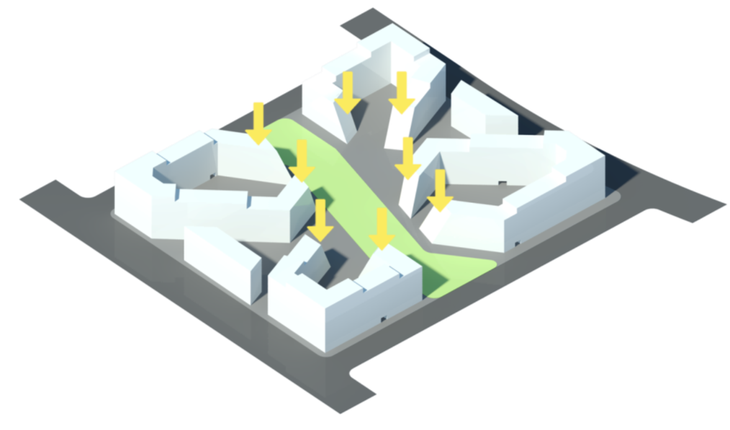
DISCLOSURE OF BUILDINGS TO THE PARK BY LOWERING THE NUMBER OF STOREYS
NICE VIEW FROM EVERY APARTMENT
ORIENTATION

Slide 8
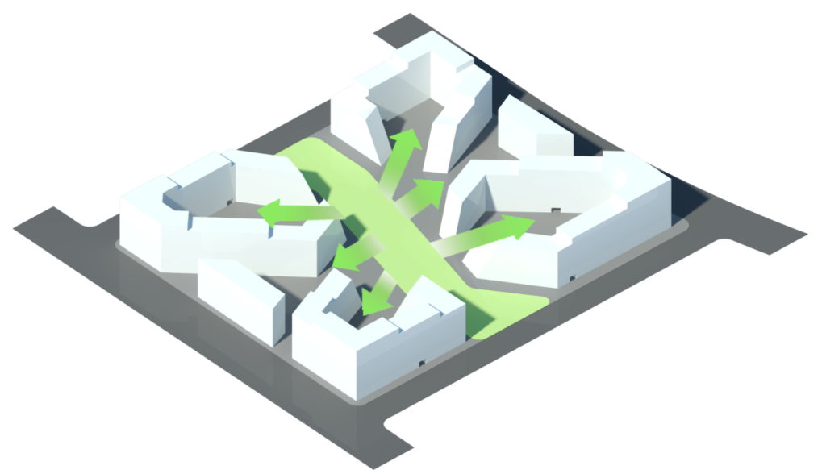
PARK FLOWED INTO INTERQUARTER SPACE AND FORMED A SYSTEM OF GREEN YARDS
ECOLOGY. SYSTEM OF GREEN YARDS

Slide 9
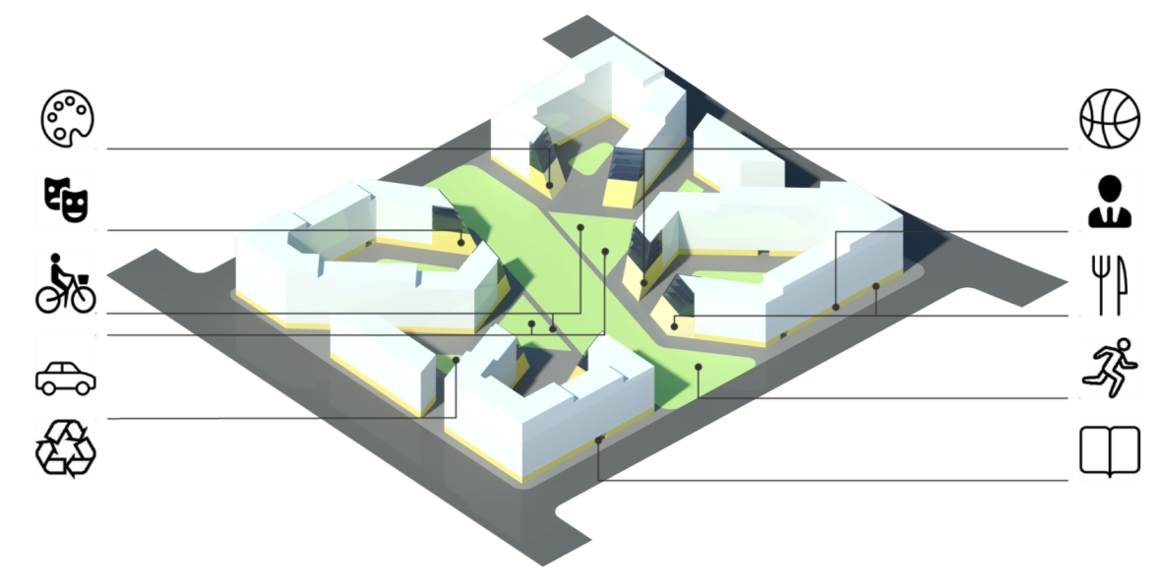
MULTIFUNCTIONAL SPACE – “ALL AT YOUR FINGERTIPS”
COMFORT LIVING

Slide 10





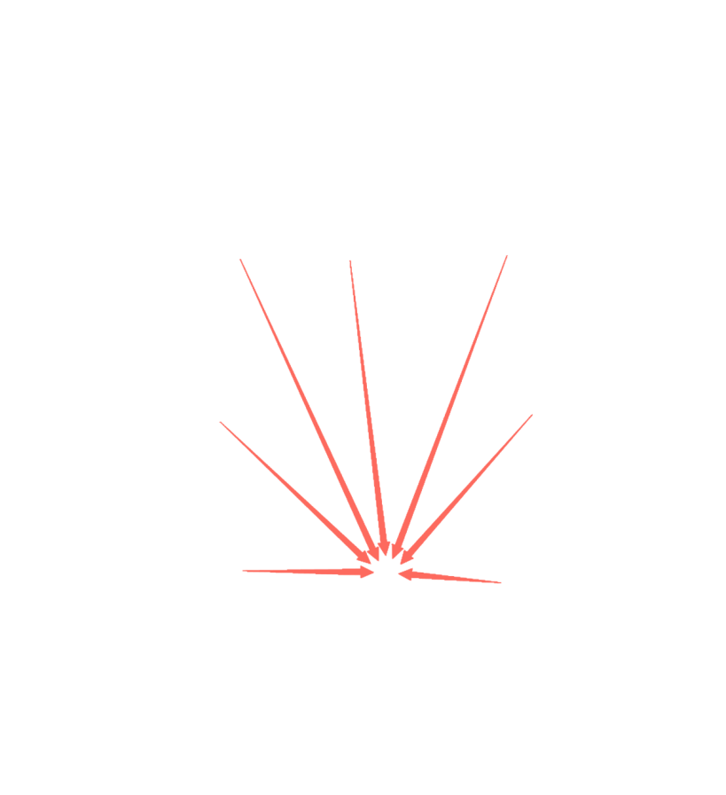

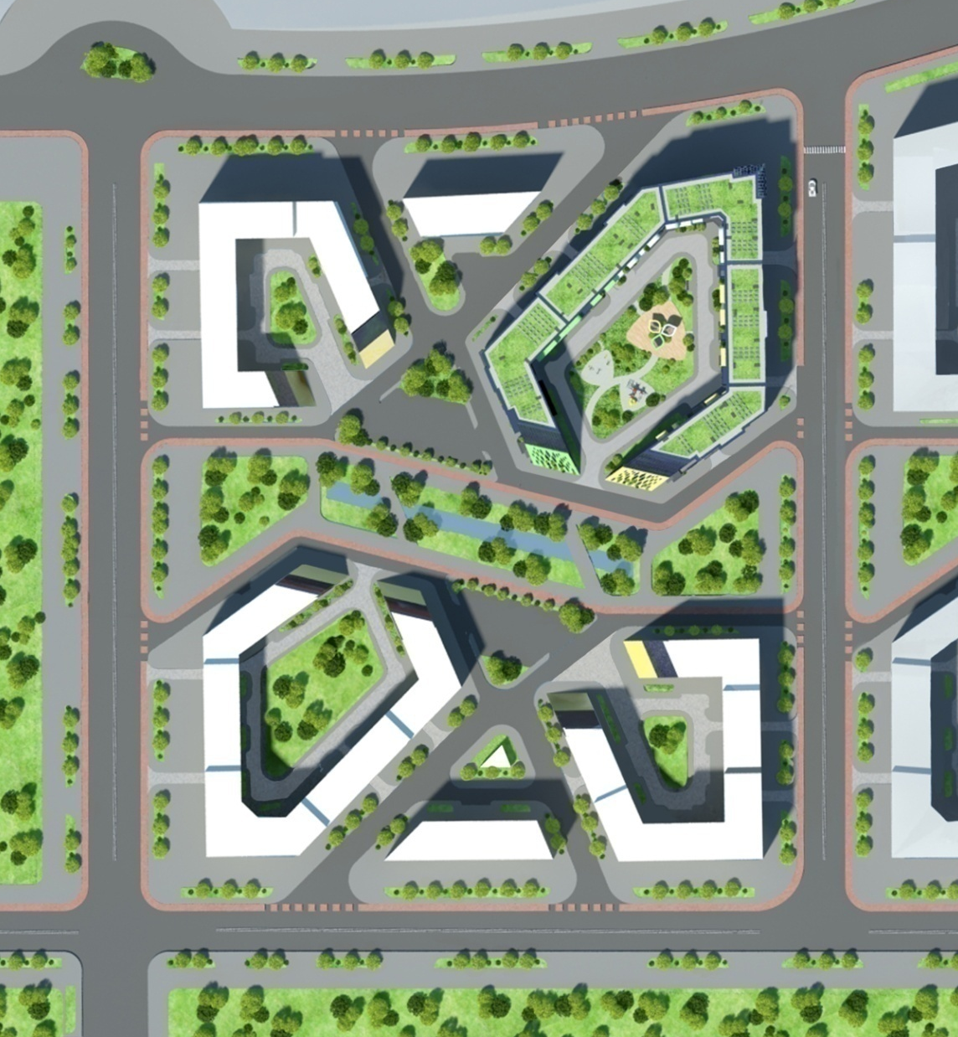

N
INTERQUARTER PARK AND A SYSTEM OF GREEN YARDS
GUEST PARKINGS AND UNDERGROUND PARKINGS
WASTE COLLECTION POINTS
BICYCLE PARKINGS
12
BUILDINGS

Slide 11
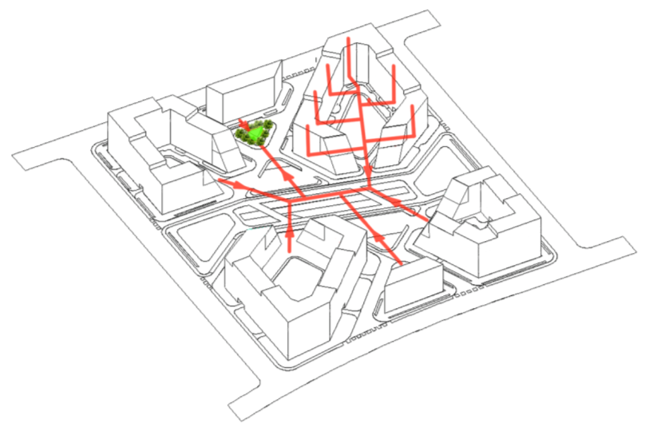
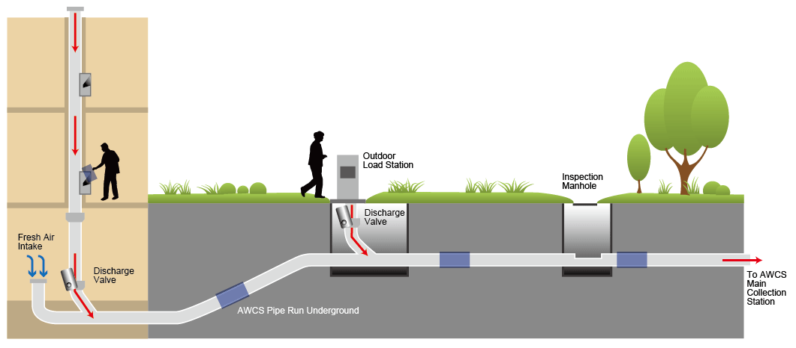
VACUUM WASTE DISPOSAL SYSTEM

Slide 12
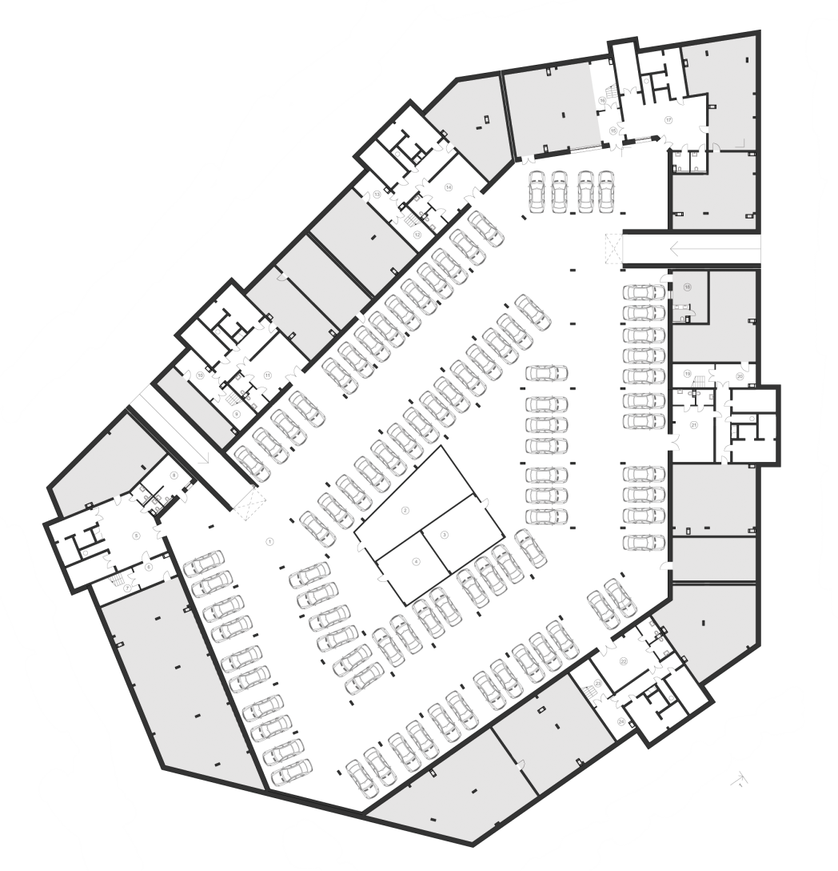

UNDERGROUND PARKING

Slide 13


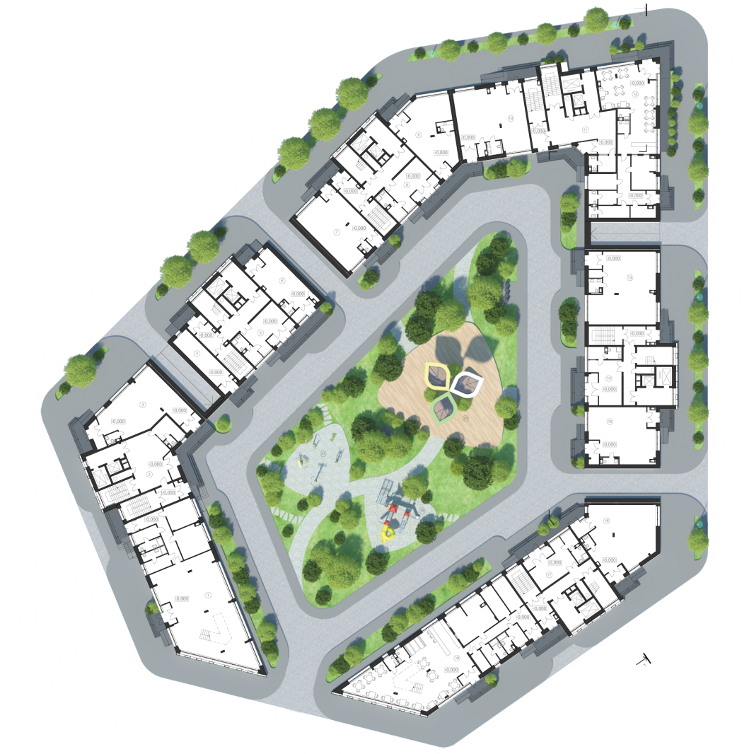


TO
THE QUARTER
TO UNDERGROUND PARKING
TO UNDERGROUND PARKING
TO
THE QUARTER
OFFICES
CAFES
SHOPS
GROUND FLOOR

Slide 14
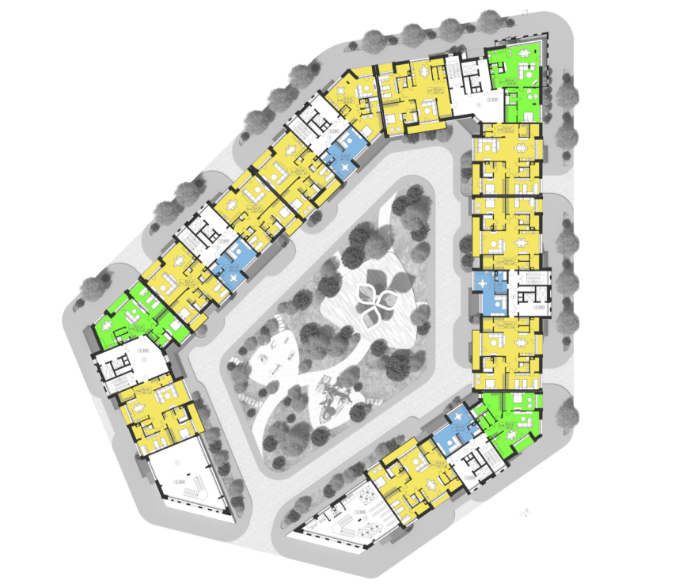

1 R
2 R
3 R
FIRST FLOOR

Slide 15
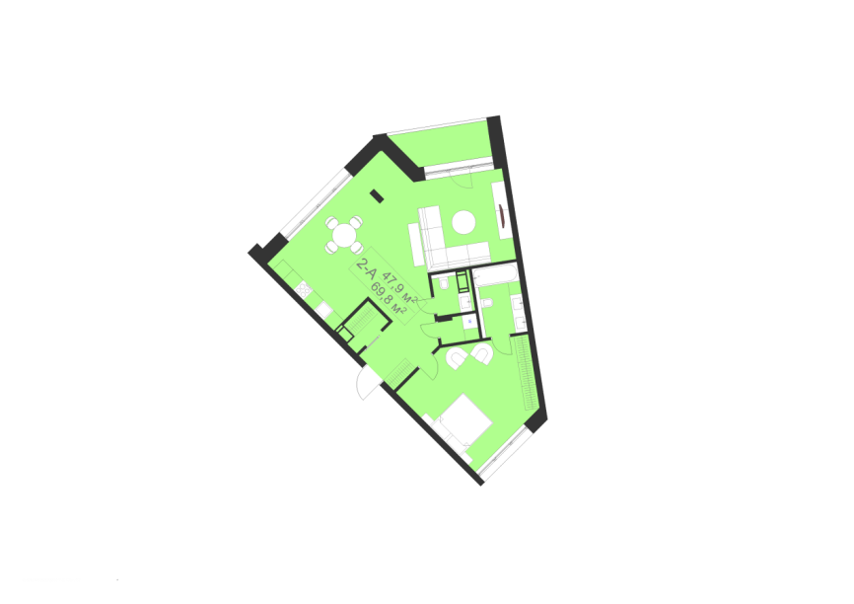
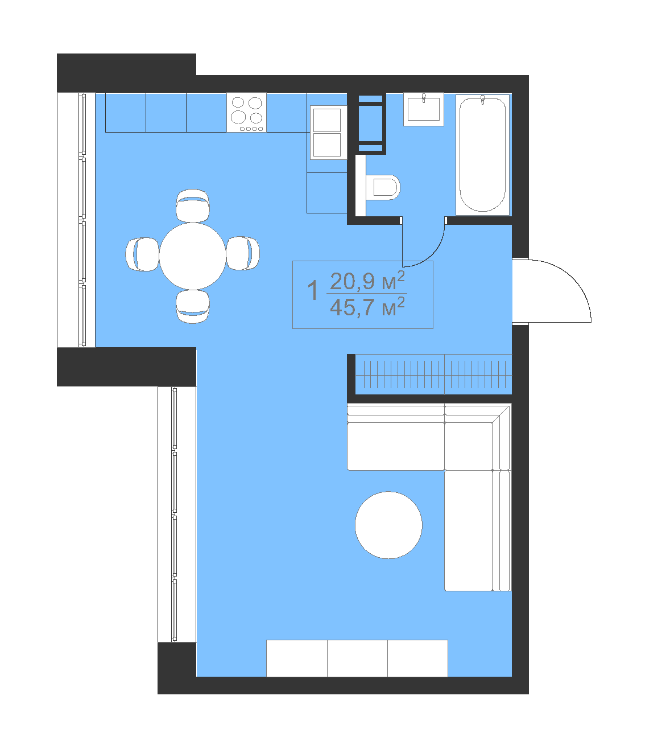
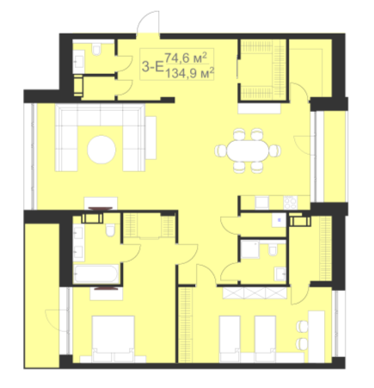
1 R
2 R
3 R
APARTMENTS

Slide 16

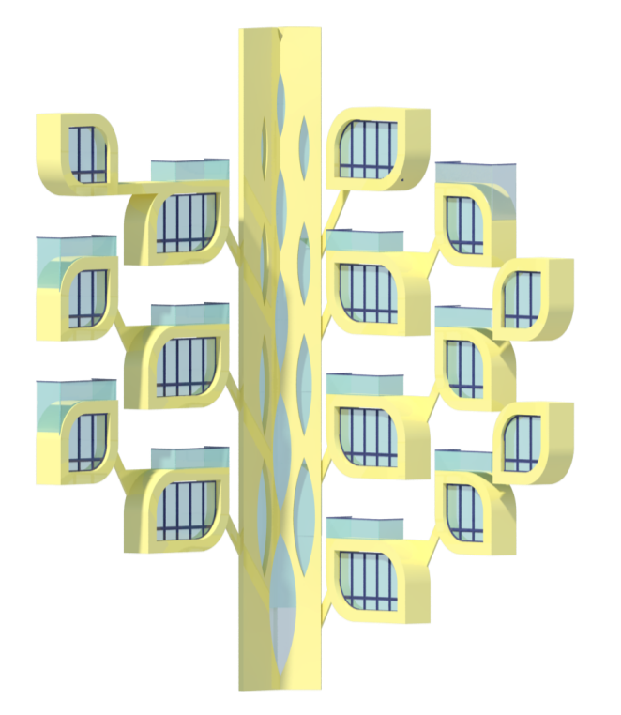
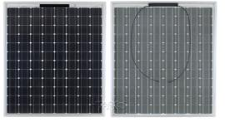

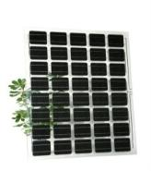
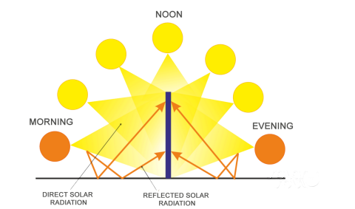
DOUBLE-SIDED SOLAR CELLS
TRANSPARENT PHOTOVOLTAIC
PANEL
FACADE’S ARCHITECTONIC. ENERGY TREE

Slide 17
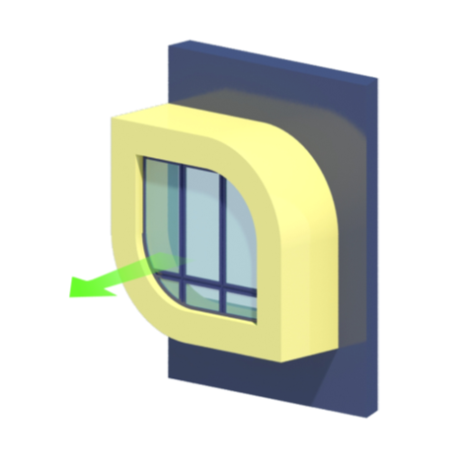
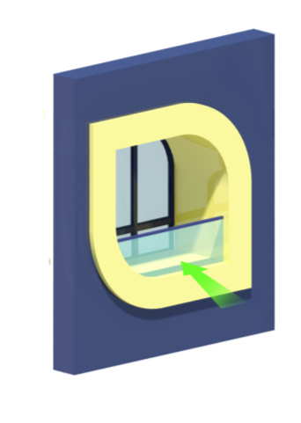
PUSH OUT
PUSH IN
YARD FACADE
STREET FACADE
FACADE’S ARCHITECTONIC. “LEAFS-LOGGIAS”

Slide 18
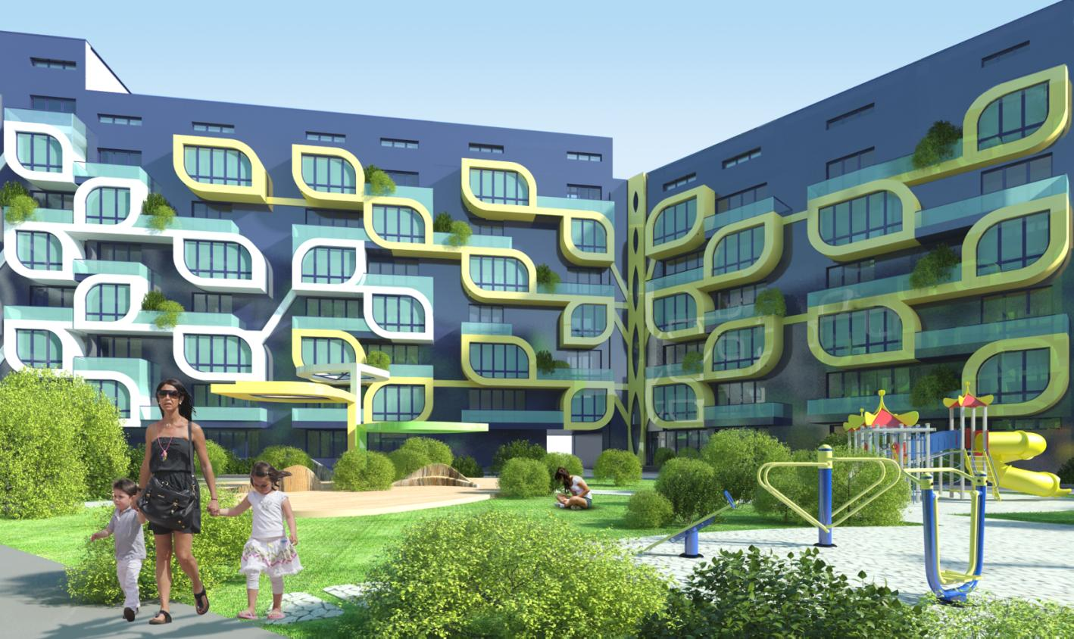
COURTYARD

Slide 19
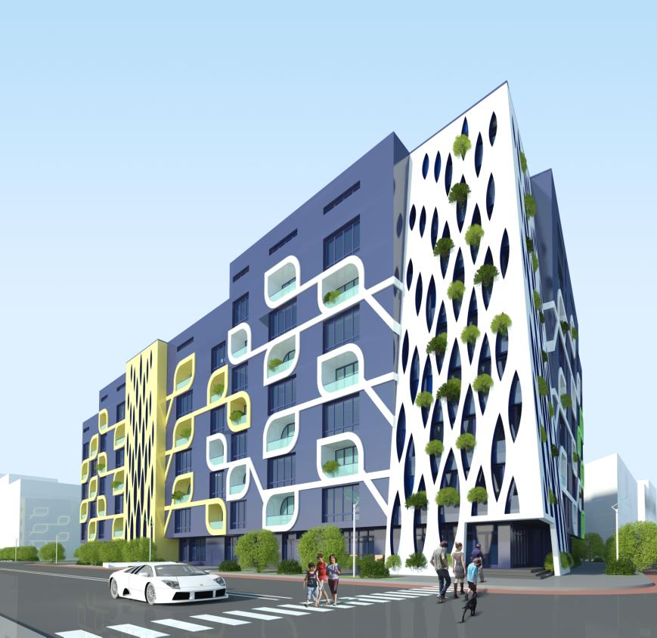

Slide 20
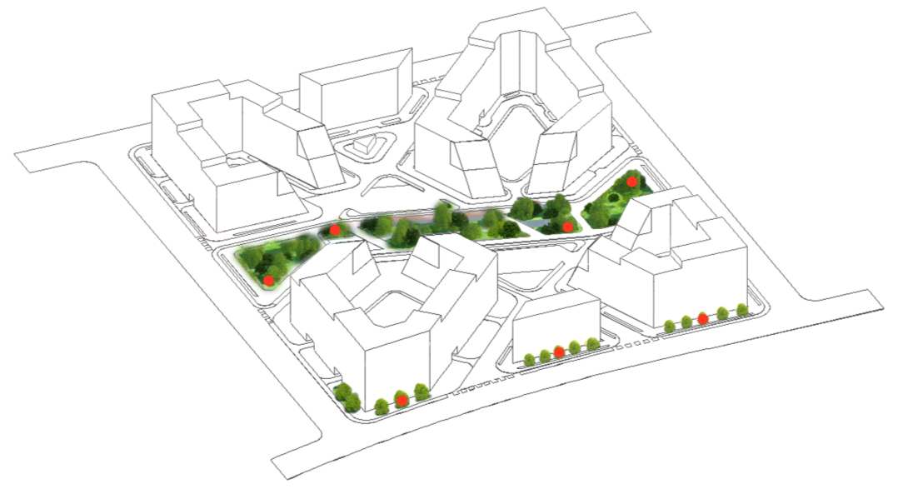

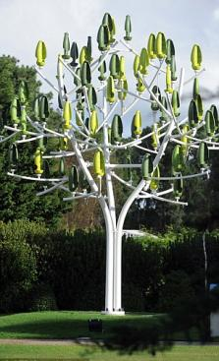
«SILENT WIND TREE TURBINES»
ARE INSTALLED IN THE PARK AND IN THE STREET
ON THE WIND SIDE
WIND ENERGY

Slide 21
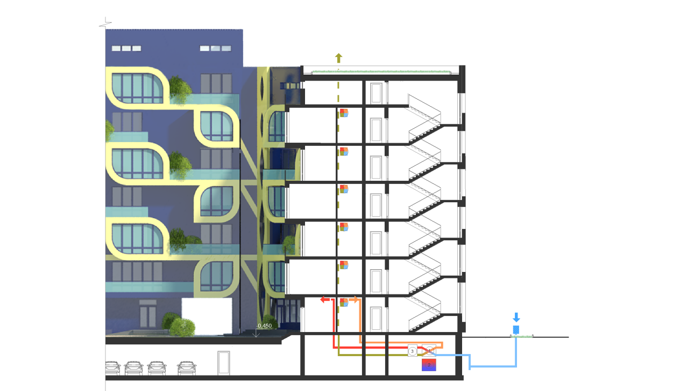
+23,400
+0,000
-0,450
EARTH ENERGY

Slide 22
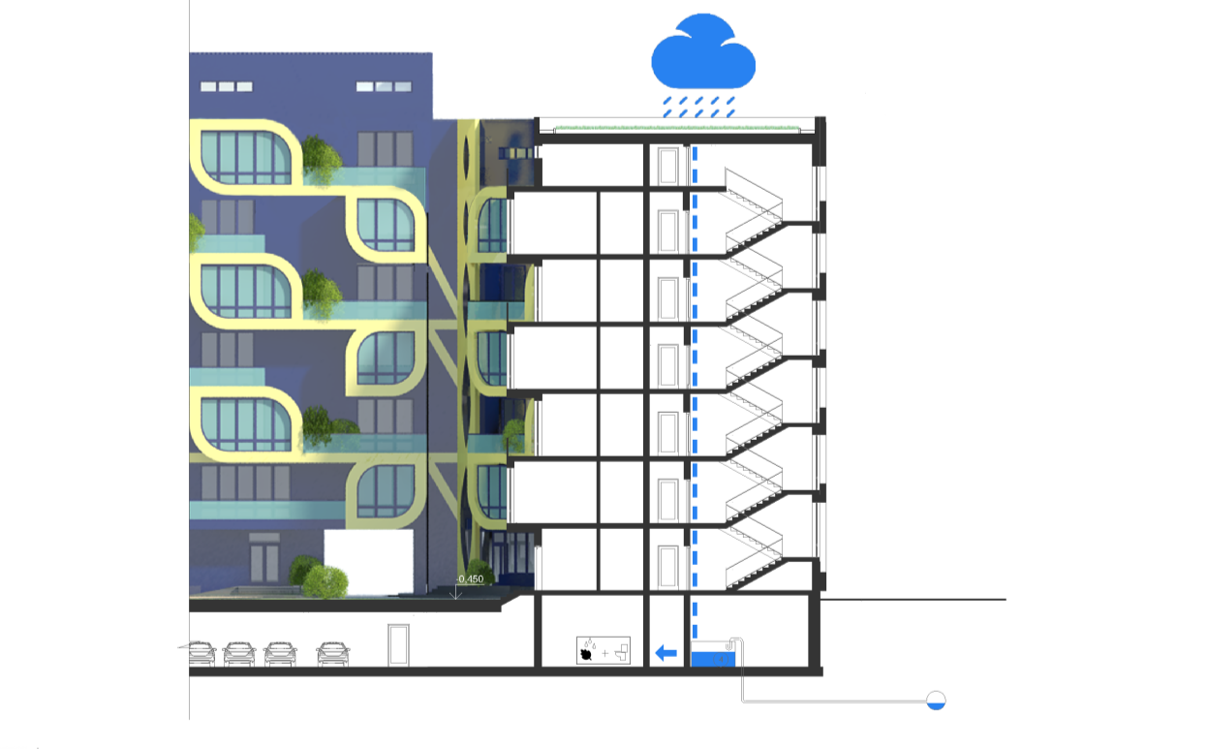

+23,400
+0,000
-0,450
WATER ENERGY

Slide 23

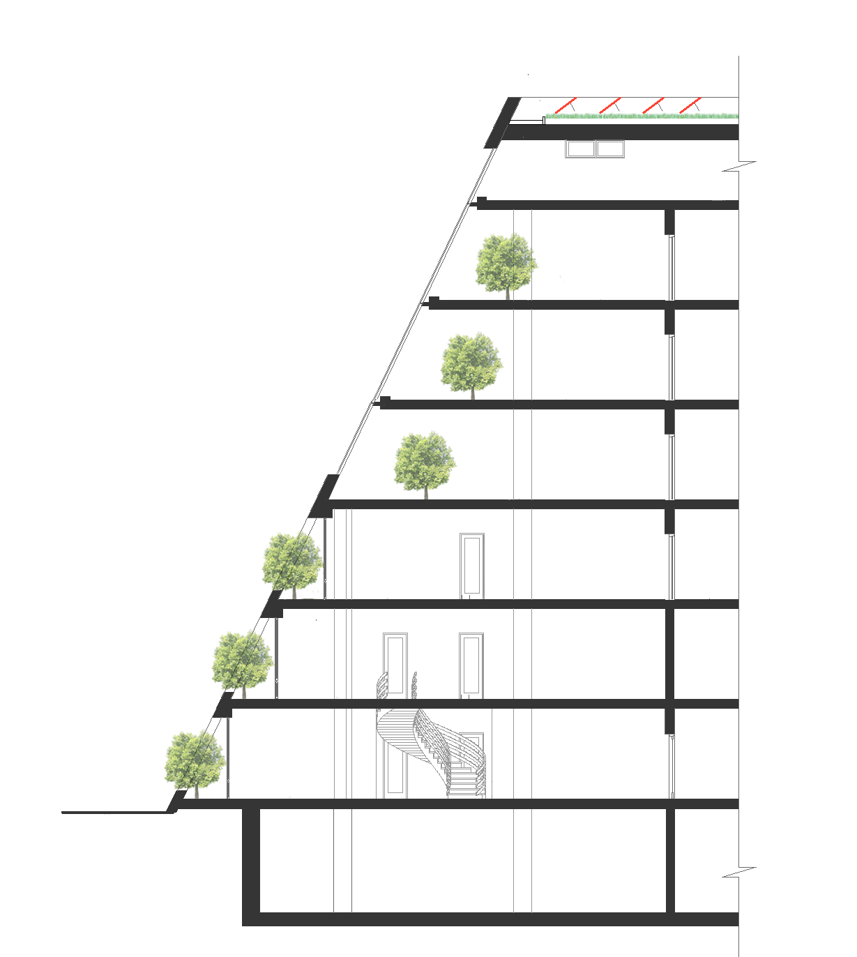
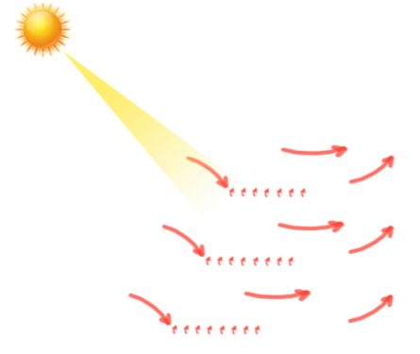
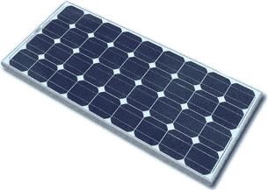
SUMMER
WINTER
+23,400
+0,000
SOLAR ENERGY

Slide 24
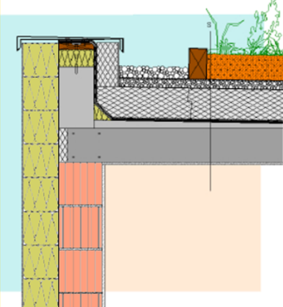
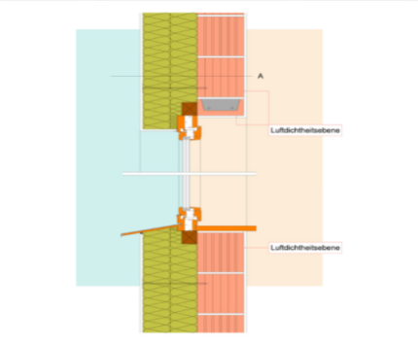
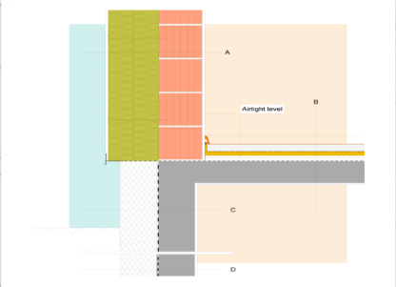
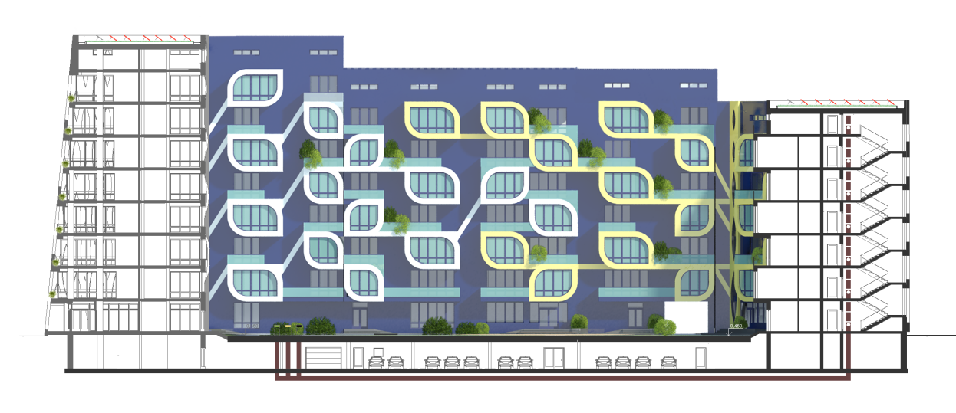
INVERTED ROOF WITH GREENING
Composition S in cm
15.0 Plant substraction for intensive greening
Filter layer (geotextil fibrous web, non-decaying)
5.0 Drinage layer, expanded concrete
aggregate 8/16
18.0 XPS-Extruded Polystyrene foam board
EXTERNAL WALL,
WINDOW
Build-up A in cm
1.5 Interior plaster
24.0 Vertically perforated brick HLzW
14.0 ISOVER Sillatherm WVP 1-035
14.0 ISOVER Sillatherm WVP 1-035
1.5 Thick plaster
SOLID CONSTRUCTION WITH
CIS BASEMENT CEILING
Build-up A in cm
1.5 Interior plaster
20.0 Concrete wall
0.1 Bitumen preliminary coating
0.5 Sealings against moisture
20.0 ISOVER Exporit EPS PDP 1
Backfill with drainage tube
0.6 Roof confinement layer
0.8 Double-layer roof skin
20.0 Reinforced concrete slap
with XPS-Extruded polystyrene
as thermal bridge insulation
1.5 Interior plaster
+29,900
+23,400
+0,000
+0,000
CONSTRUCTION DETAILS

Slide 25
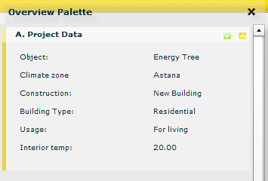
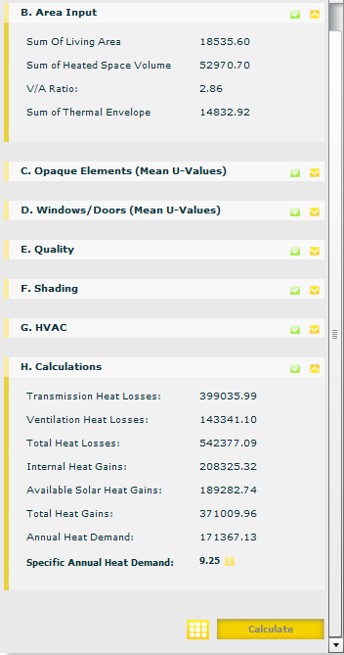
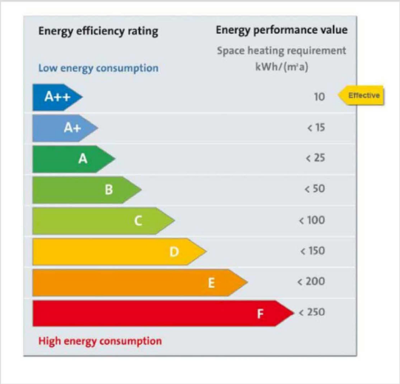
MULTI COMFORT DESIGNER

Slide 26
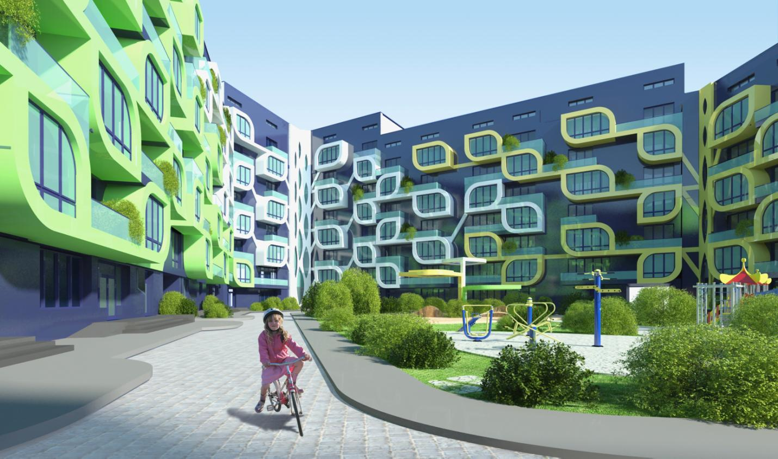

Slide 27
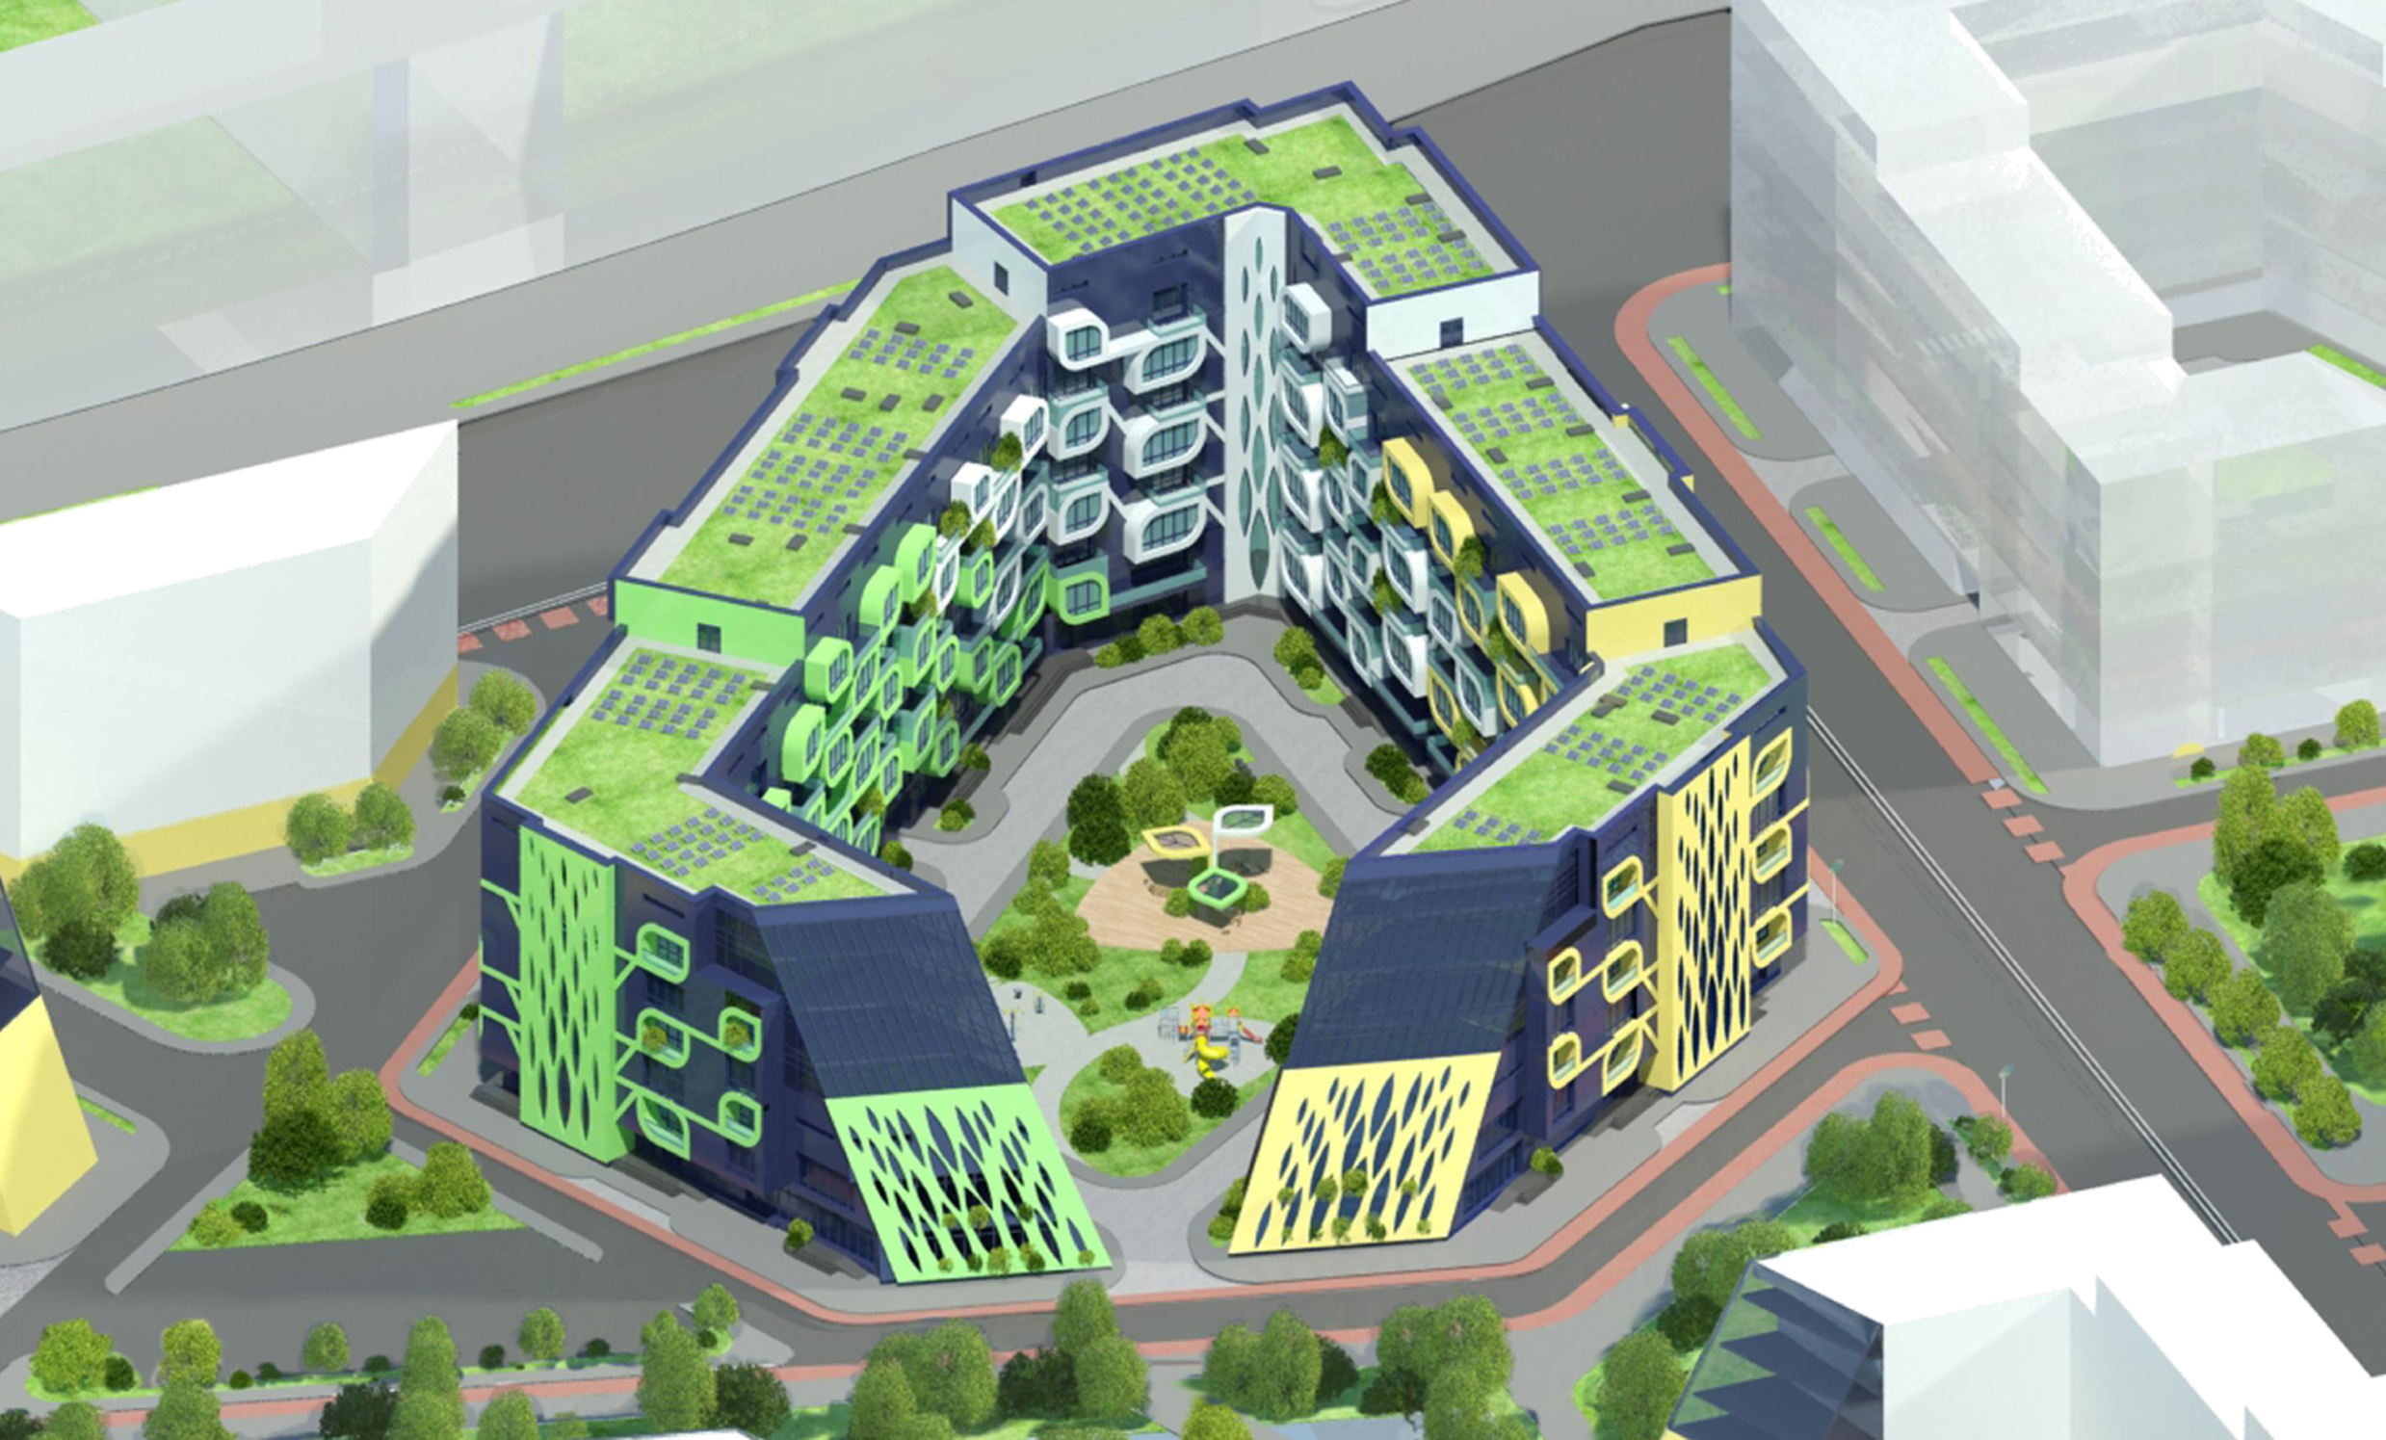
"ENERGY TREE"

Slide 28
"ENERGY TREE"
THANK YOU FOR ATTENTION!

