Slide 1

Can Geopolymer Concrete become a key Material to utilize Basic Oxygen Furnace Slag (BOFS) as a Construction Material?
Presenter: Gulfairuz Kareken 2nd year Master’s student in Civil & Environmental Engineering
Lead Advisor: Professor Chang-Seon Shon

Slide 2
Table of content
Introduction
Problem statement
Possible solution
Research objectives
Experimental program
Test Results
Conclusion

Slide 3
Introduction

Slide 4



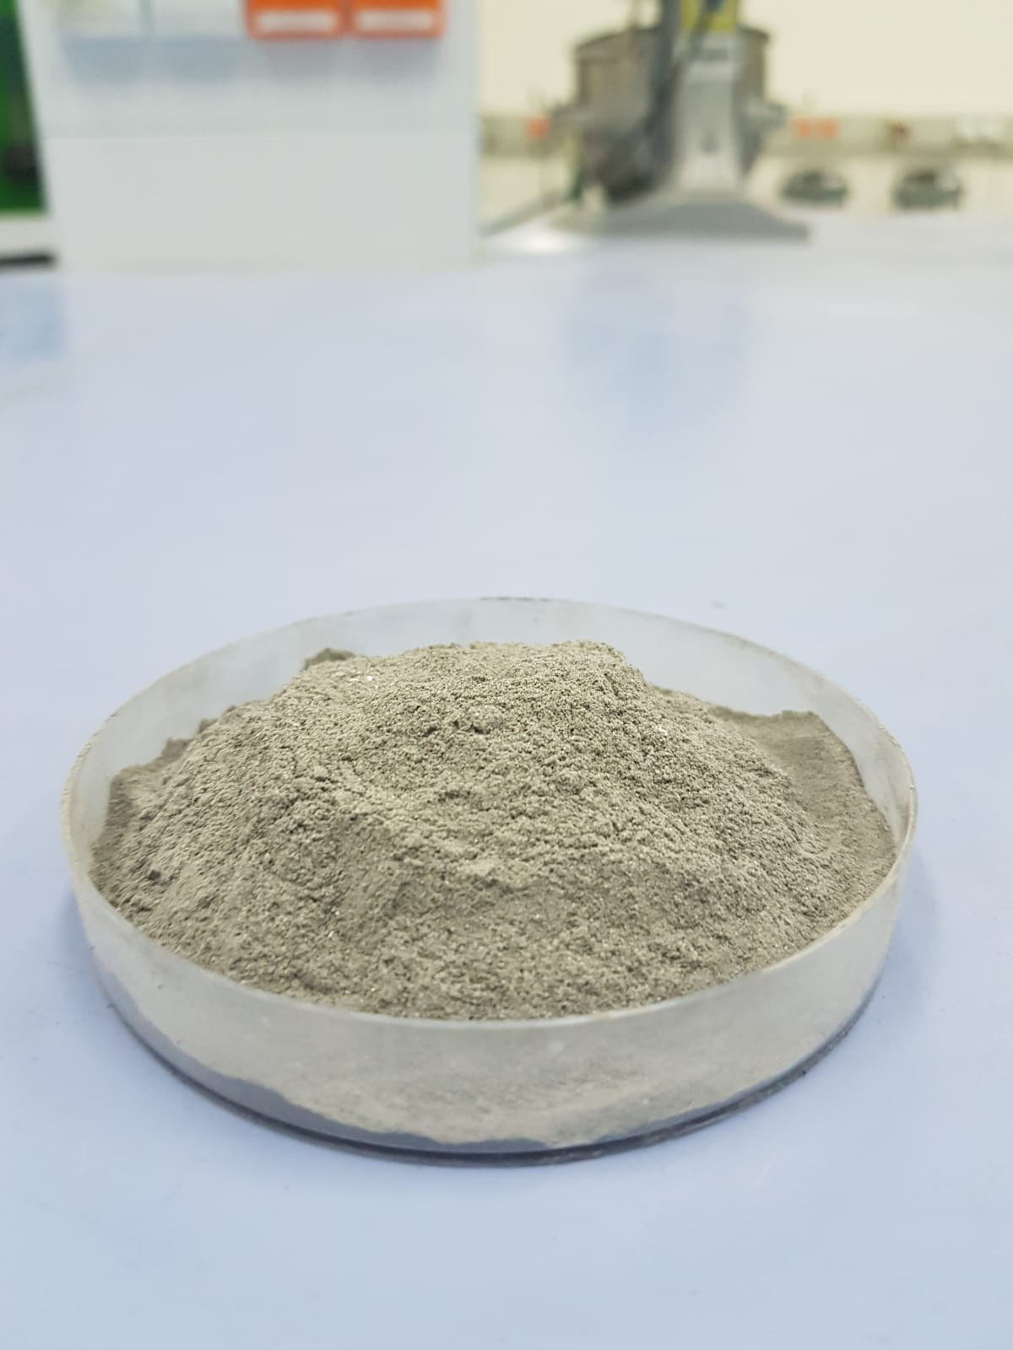
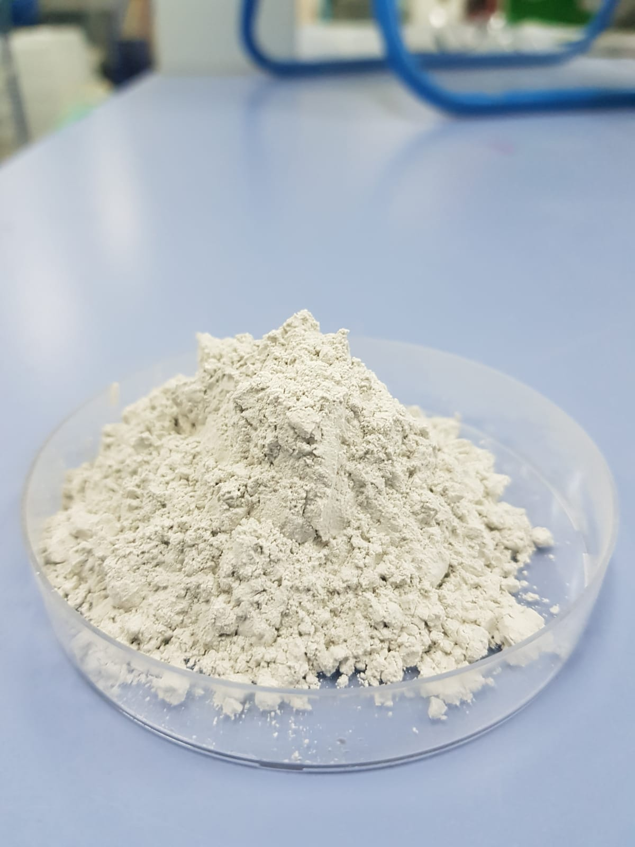
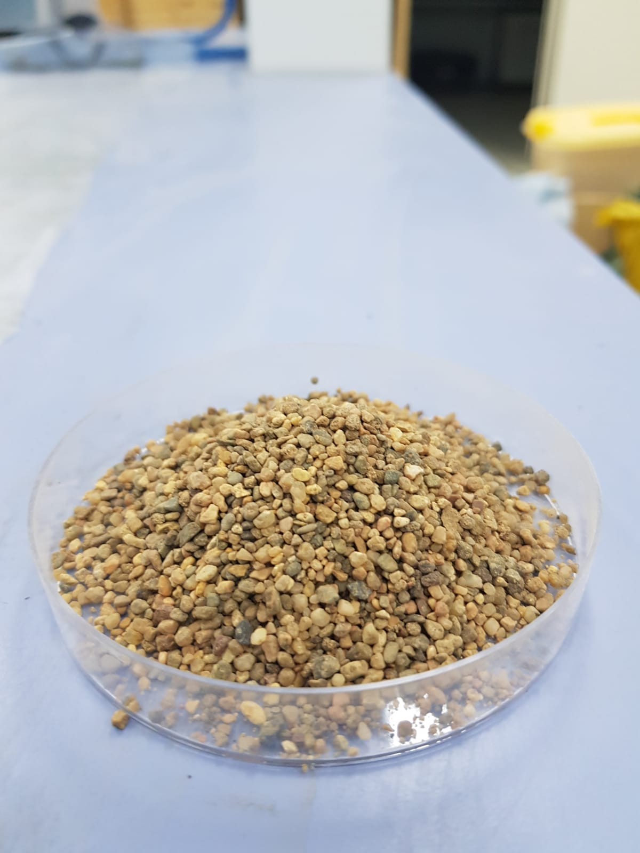
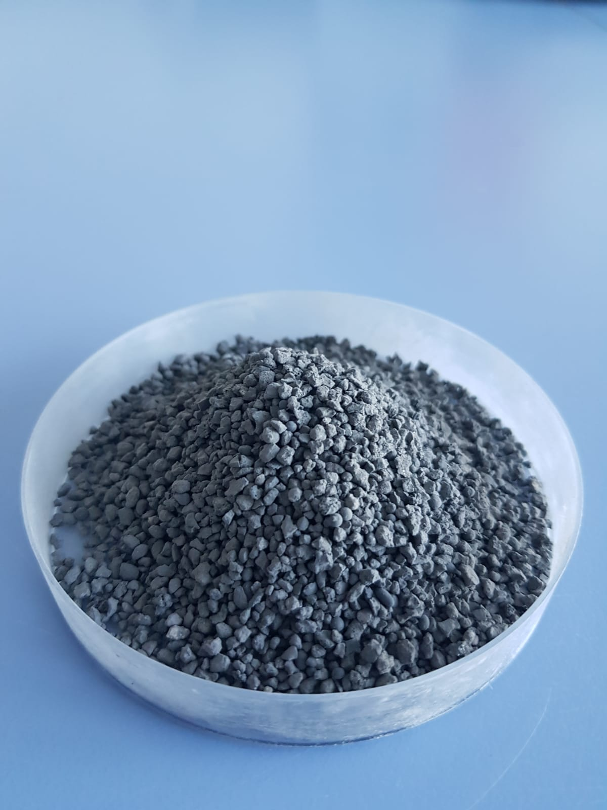
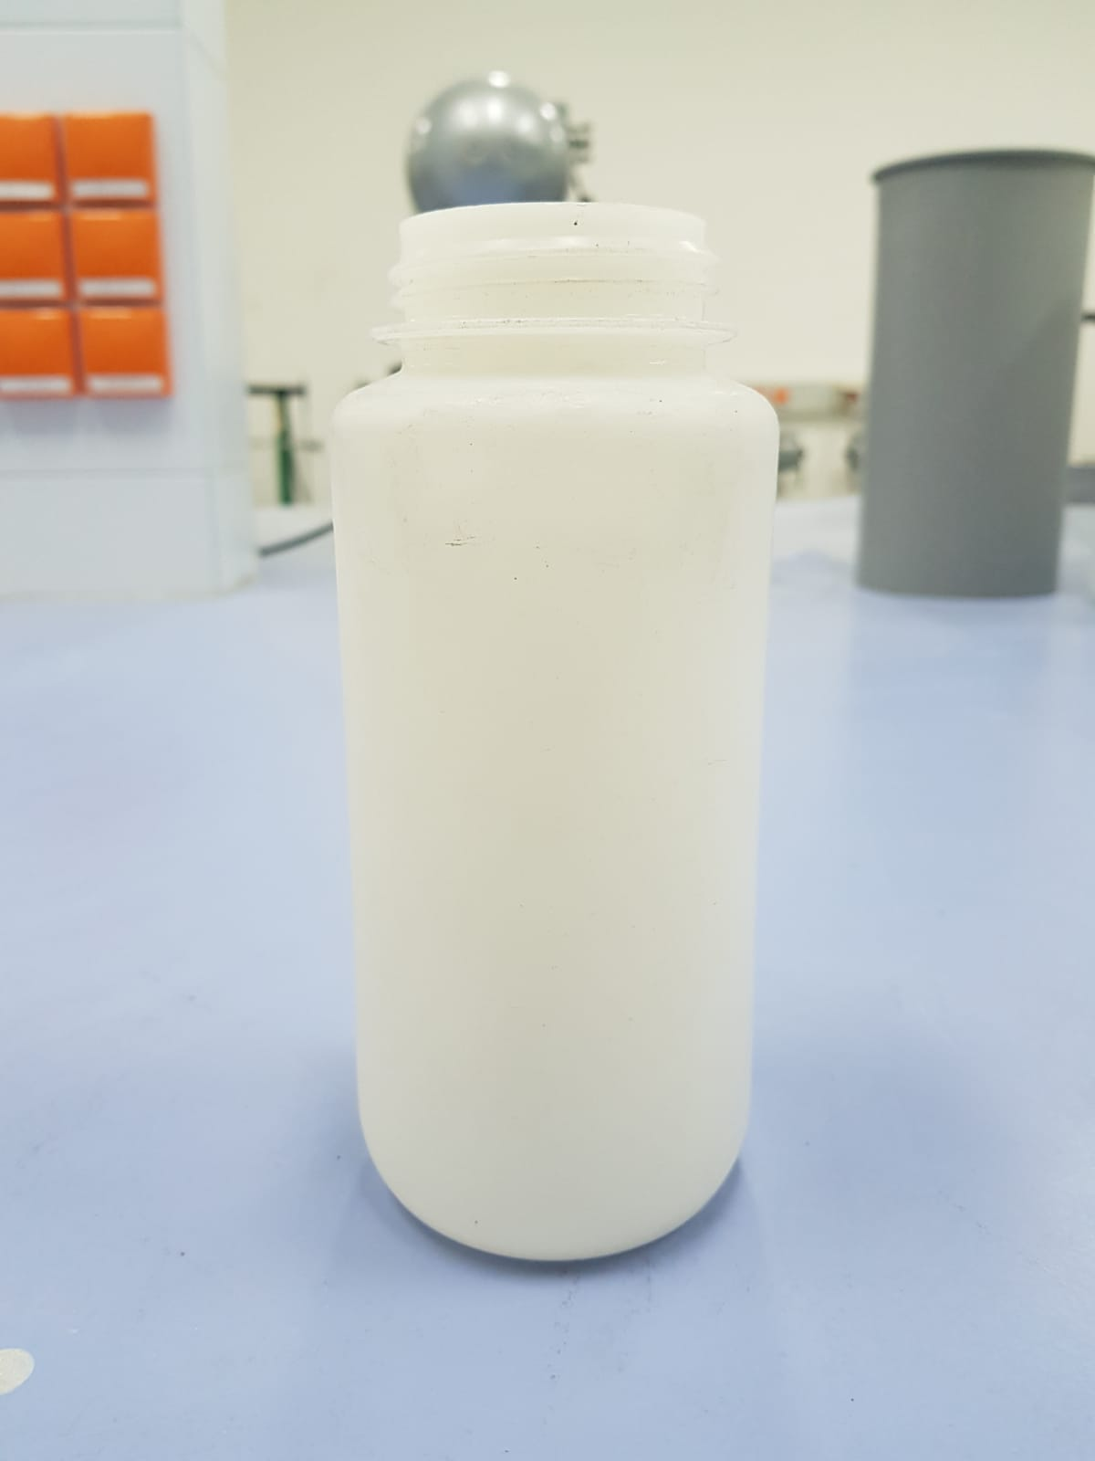
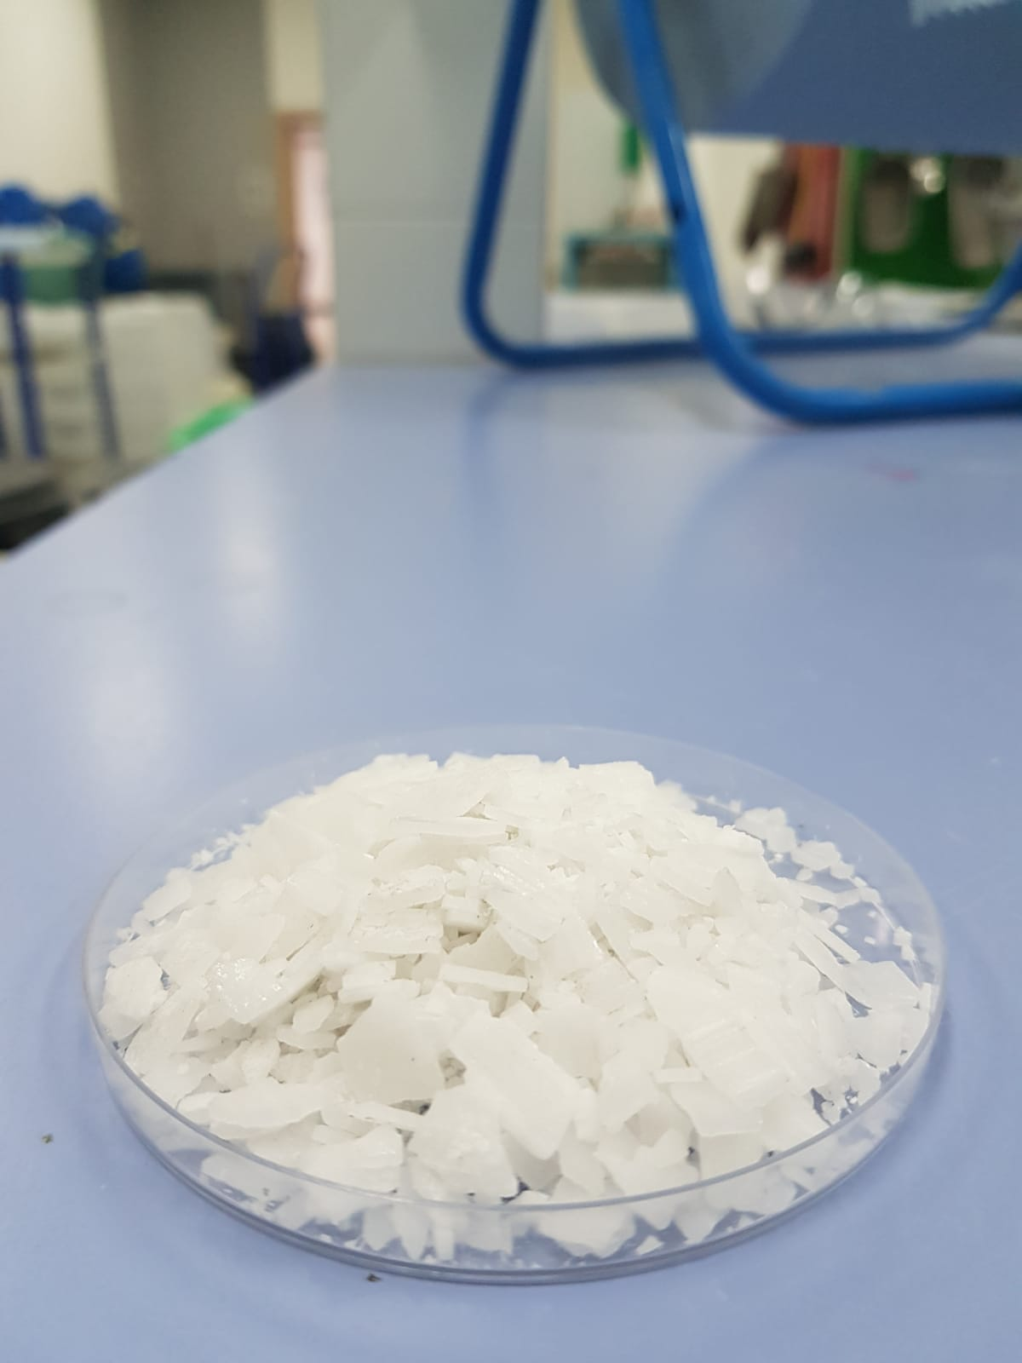
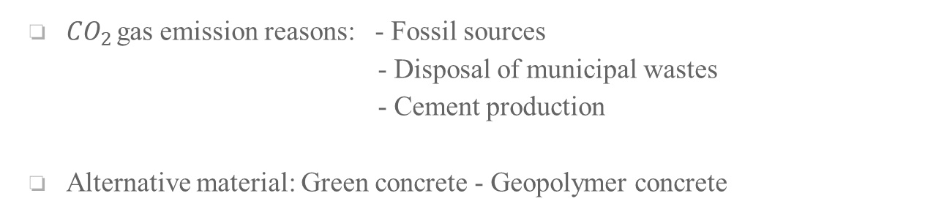

Introduction
${CO}_{2 }$gas emission reasons: - Fossil sources
- Disposal of municipal wastes
- Cement production
Alternative material: Green concrete - Geopolymer concrete
aluminosilicate minerals
fine and coarse aggregates
alkali activators
Fly Ash
GGBFS
River sand
BOFS
$${Na}_{2}{SiO}_{3}$$
NaOH

Slide 5
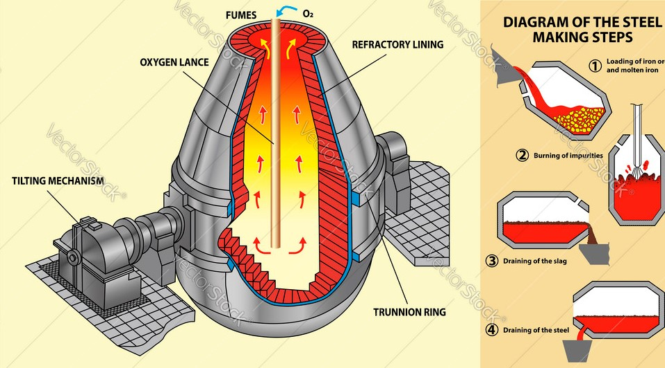
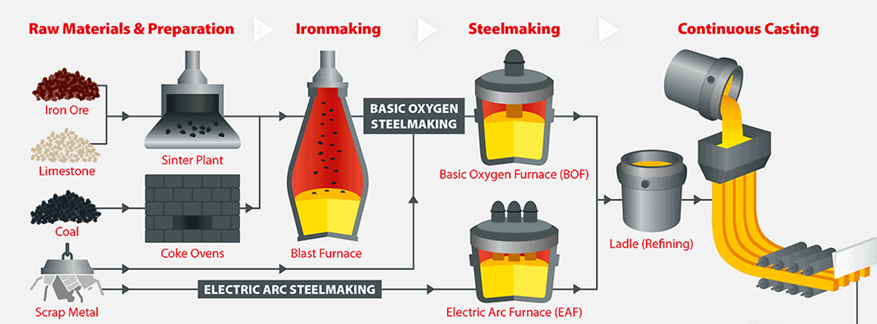
Introduction
By-product of the steelmaking process:
Basic Oxygen Furnace Slag
Ana P. M. Diniz, Patrick M. Ciarelli, Evandro O. T. Salles, Klaus F. Coco , Heat Transfer in Steel Ladles: Models and Applications DOI: 10.48011/asba.v2i1.1368

Slide 6
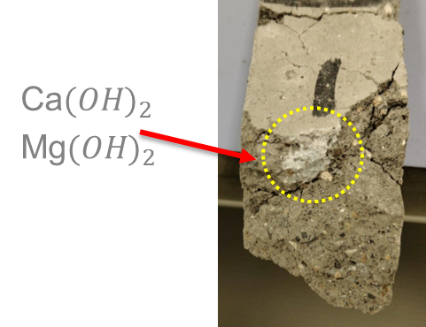

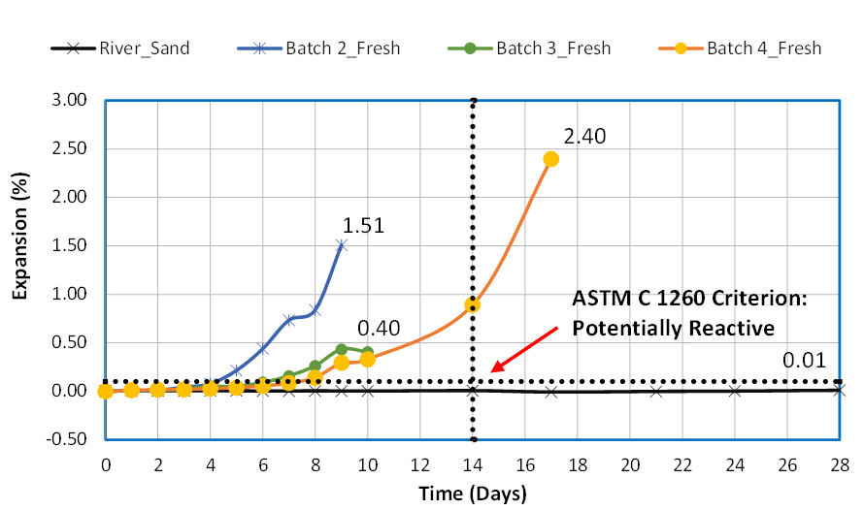
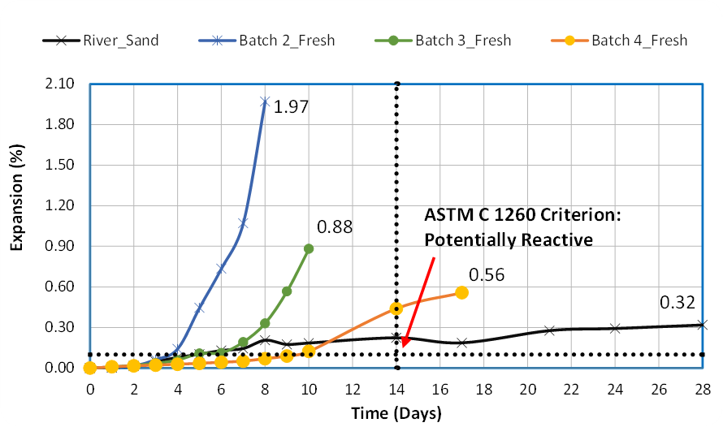

Problem of BOF slags as aggregate
BOFS limits: f-CaO and f-MgO
f-CaO+$H_{2}O$→${Ca(OH)}_{2}$ (1)
f-MgO+$H_{2}O→{Mg(OH)}_{2}$ (2)
Water expansion
ASR expansion

Slide 7
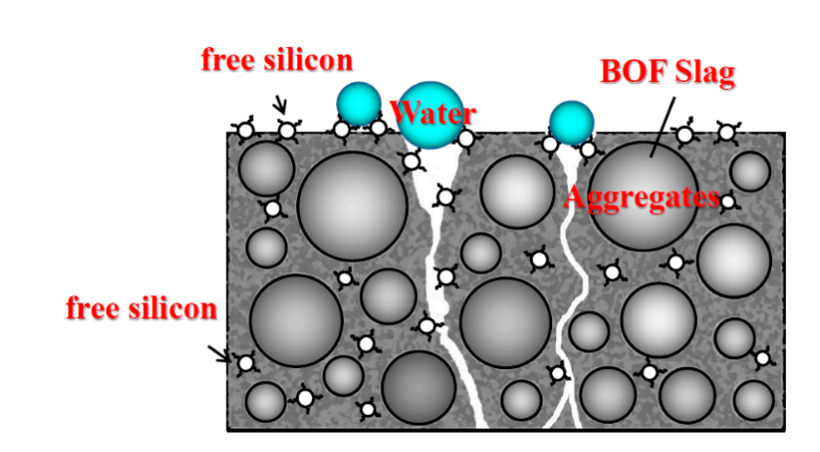
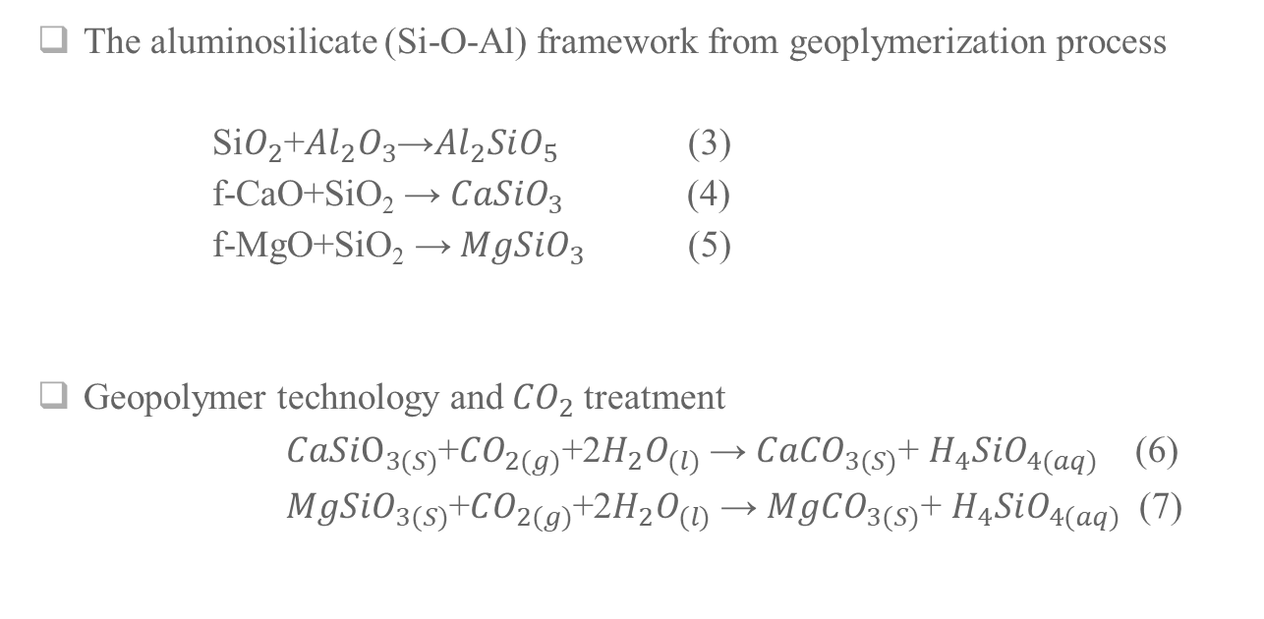
Possible solutions
The aluminosilicate (Si-O-Al) framework from geoplymerization process
Si$O_{2}$+${Al}_{2}O_{3}$→${Al}_{2}SiO_{5}$ (3)
f-CaO+SiO₂ → ${CaSiO}_{3}$ (4)
f-MgO+SiO₂ → ${MgSiO}_{3}$ (5)
Geopolymer technology and ${CO}_{2}$ treatment
${CaSiO}_{3(S)}$+${CO}_{2(g)}$+2$H_{2}O_{(l)}$ → ${CaCO}_{3(S)}$+ $H_{4}SiO_{4(aq)}$ (6)
${MgSiO}_{3(S)}$+${CO}_{2(g)}$+2$H_{2}O_{(l)}$ → ${MgCO}_{3(S)}$+ $H_{4}SiO_{4(aq)}$ (7)
Lee W.-H., Cheng T.-W., Lin K.-Y., Lin K.-L., Wu C.-C., Tsai C.-T. Geopolymer technologies for stabilization of basic oxygen furnace slags and sustainable application as construction materials, Sustainability, Sustainability 12 (2020) 5002. https://www.mdpi.com/2071-1050/12/12/5002

Slide 8
Research objectives
Utilize BOFS as an aggregate source and develop an optimum user-friendly mix design
Stabilize BOFS with geopolymerization process without expansion problems
Use carbonation (CO2) curing technique to characterize the expansion behavior of BOFS-based GPC
Provide potential solutions for environmental problems listed in Kazakhstan 2050 strategy: reduction of CO₂ emission, the scarcity of land, and the high costs of management and treatment of industrial waste materials

Slide 9
Experimental Program

Slide 10
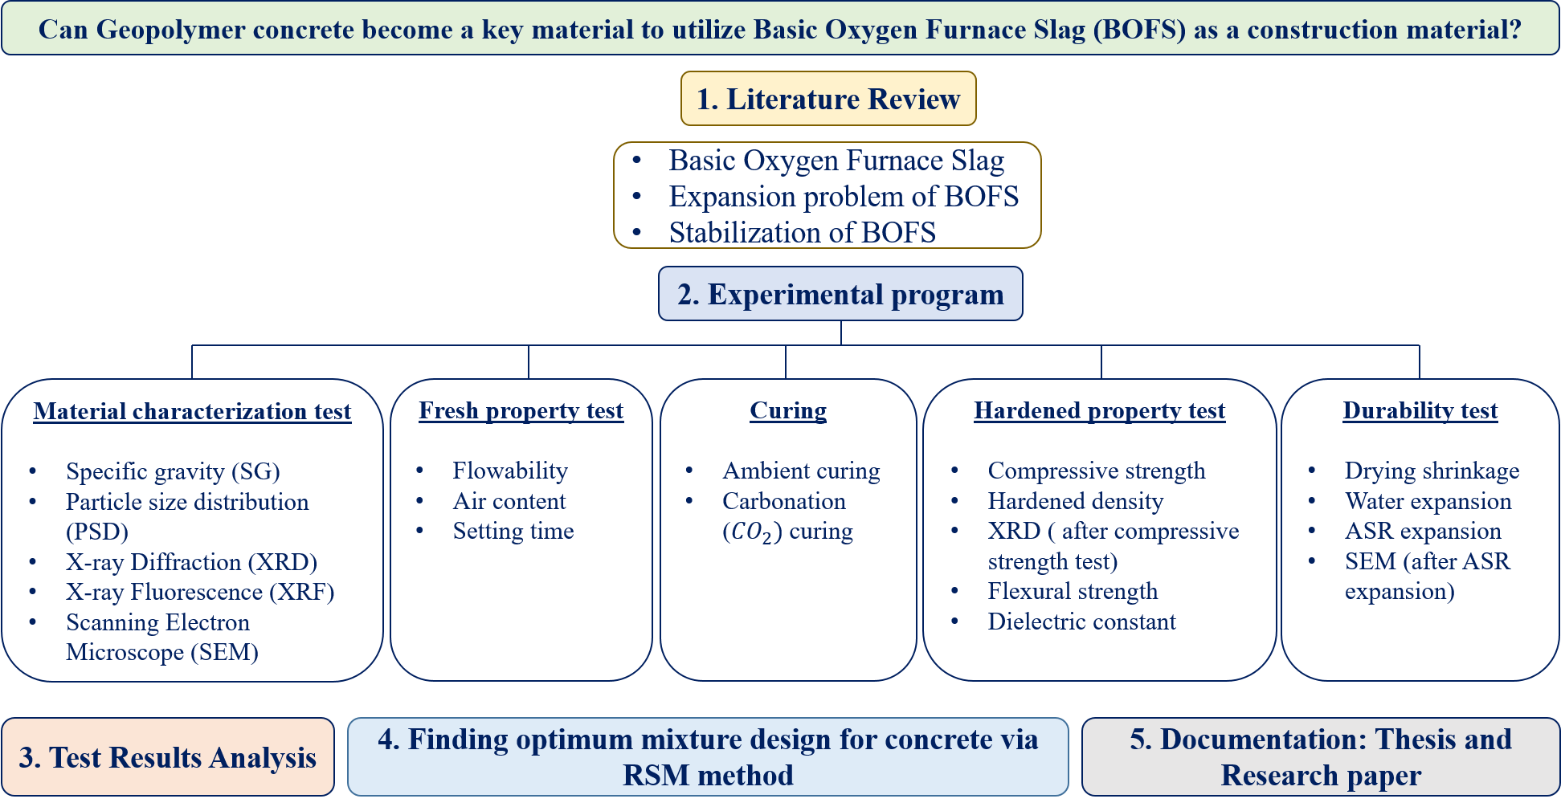
Flow Chart of Experimental Program

Slide 11
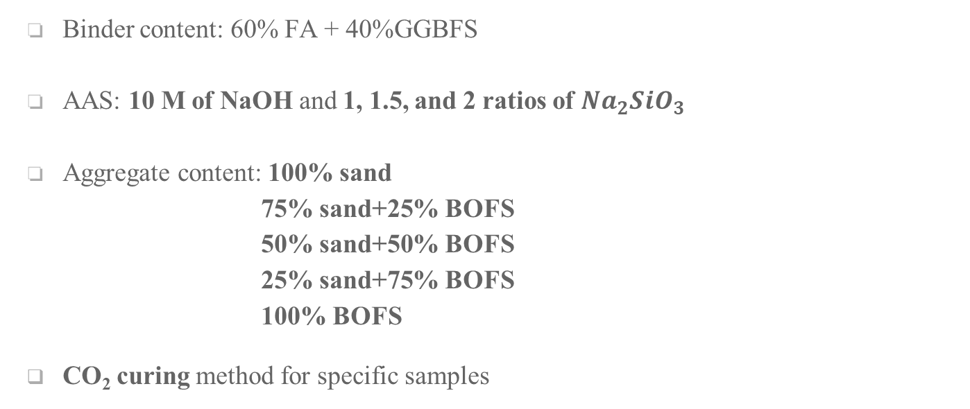
Mixture Design Parameters
Binder content: 60% FA + 40%GGBFS
AAS: 10 M of NaOH and 1, 1.5, and 2 ratios of ${Na}_{2}{SiO}_{3}$
Aggregate content: 100% sand
75% sand+25% BOFS
50% sand+50% BOFS
25% sand+75% BOFS
100% BOFS
CO₂ curing method for specific samples

Slide 12
Mix Design
Mixture Group | Mixture No. | Mixture ID | NS (ratio) | BOFS (%) | River Sand (%) | Fly-Ash (kg/m^3) | GGBFS (kg/m^3) | BOFS (kg/m^3) | River Sand (kg/m^3) | NaOH (kg/m^3) | Na2SiO3 (kg/m^3) | Pre-Mix Water (kg/m^3) | Water (kg/m^3) | Total volume (kg/ m^3)
Group 1 | M-1 | 1NS+0%BOFS | 1 | 0 | 100 | 545.01 | 363.34 | - | 605.57 | 51.91 | 181.67 | 129.77 | 106.21 | 1
 | M-2 | 1.5NS+0%BOFS | 1.5 | 0 | 100 | 545.01 | 363.34 | - | 605.57 | 41.52 | 218.01 | 103.81 | 111.58 | 1
 | M-3 | 2NS+0%BOFS | 2 | 0 | 100 | 545.01 | 363.34 | - | 605.57 | 34.6 | 242.23 | 86.51 | 115.03 | 1
Group 2 | M-4 | 1NS+25%BOFS | 1 | 25 | 75 | 548.72 | 365.81 | 152.42 | 457.26 | 52.26 | 182.91 | 130.65 | 110.86 | 1
 | M-5 | 1.5NS+25%BOFS | 1.5 | 25 | 75 | 548.72 | 365.81 | 152.42 | 457.26 | 41.81 | 219.49 | 104.52 | 116.06 | 1
 | M-6 | 2NS+25%BOFS | 2 | 25 | 75 | 548.72 | 365.81 | 152.42 | 457.26 | 34.84 | 243.87 | 87.10 | 119.53 | 1
Group 3 | M-7 | 1NS+50%BOFS | 1 | 50 | 50 | 552.47 | 368.31 | 306.93 | 306.93 | 52.62 | 184.16 | 131.54 | 115.37 | 1
 | M-8 | 1.5NS+50%BOFS | 1.5 | 50 | 50 | 552.47 | 368.31 | 306.93 | 306.93 | 42.09 | 105.23 | 220.99 | 120.61 | 1
 | M-9 | 2NS+50%BOFS | 2 | 50 | 50 | 552.47 | 368.31 | 306.93 | 35.08 | 245.54 | 248.95 | 87.69 | 124.10 | 1
Group 4 | M-10 | 1NS+75%BOFS | 1 | 75 | 25 | 556.24 | 370.83 | 463.53 | 154.51 | 52.98 | 185.41 | 132.44 | 119.94 | 1
 | M-11 | 1.5NS+75%BOFS | 1.5 | 75 | 25 | 556.24 | 370.83 | 463.53 | 154.51 | 42.38 | 222.50 | 105.95 | 125.21 | 1
 | M-12 | 2NS+75%BOFS | 2 | 75 | 25 | 556.24 | 370.83 | 463.53 | 154.51 | 35.32 | 247.22 | 88.29 | 128.73 | 1
Group 5 | M-13 | 1NS+100%BOFS | 1 | 100 | 0 | 560.13 | 373.42 | 622.36 | - | 53.35 | 186.71 | 133.36 | 124.58 | 1
 | M-14 | 1.5NS+100%BOFS | 1.5 | 100 | 0 | 560.13 | 373.42 | 622.33 | - | 42.68 | 224.05 | 106.69 | 129.89 | 1
 | M-15 | 2NS+100%BOFS | 2 | 100 | 0 | 560.13 | 373.42 | 622.33 | - | 35.564 | 248.945 | 88.909 | 133.43 | 1
Mixture design parameters

Slide 13
Test methods
Test method | Test specification code | Specimen dimension | No. of the test specimen or trial | Testing age (day)
Flowability | ASTM C1437 / C230 | A high of 50 ± 0.5 mm, inside bottom Ø of 100 ± 0.5 mm, and at the bottom, inside top Ø of 70 ± 0.5 mm. | 3 | Immediately after mixing
Air content | ASTM C185 | 400 ± 1 mL | 3 | Immediately after mixing
Setting time | ASTM C191 | A high of 40 ± 1 mm, inside bottom Ø of 70 ± 3 mm, and at the bottom, inside top Ø of 60 ± 3 mm. | 3 | Immediately after mixing
Compressive strength | ASTM C109 | 50 x 50 x 50 mm | 4 | 3, 7, 28, 56 days
Flexural strength | ASTM C348 | 40 x 40 x 160 mm | 4 | 3, 7, 28, 56 days
Drying shrinkage | ASTM C157 | 25 x 25 x 285 mm | 4 | 3- and 4-day intervals (6 months)
Expansion* | ASTM C1260 | 25 x 25 x 285 mm | 4 | 3- and 4-day intervals (28 days)
Dielectric constant | - | 70x70x70 mm | 2 | 3- and 4-day intervals (6 months)
*Note: The expansion test was conducted using the modified ASTM C1260 test method: water and 1M NaOH solution submersion for up to 28 days.

Slide 14
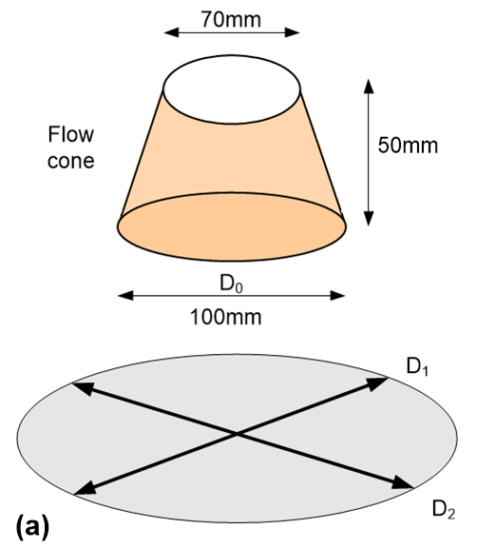
Fresh properties
Test standard: ASTM C1437 / C230
Purpose: determine the flowability of mortar
Test age: Immediately after mixing
Dimension of samples: a height of 50 ± 0.5 mm, bottom Ø of 100 ± 0.5 mm in a cone, and top Ø of 70 ± 0.5 mm in a cone
Relative flowability (Γ_{m}) test setup

Slide 15
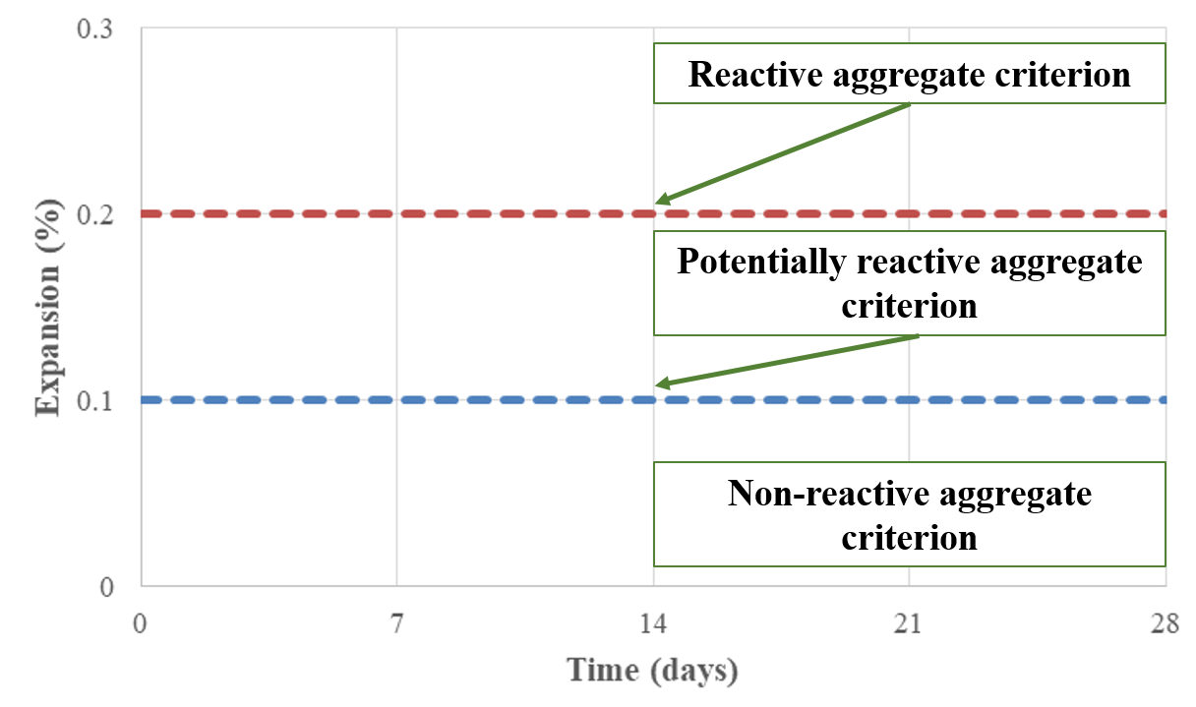
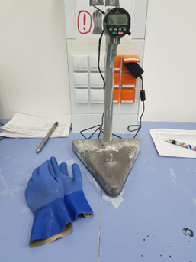
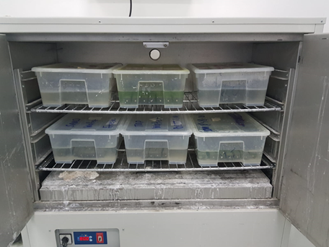
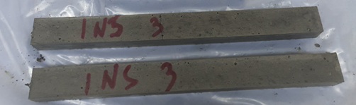

Durability test
Test standard: ASTM C1260
Purpose: determination of the aggregate expansion potential for water and the alkali-silica reaction
Dimension of mortar samples: 25x25x285mm
Number samples: 4
Test conditions
  Test solution: water & 1M NaOH solution
  Test age: 3- and 4-day intervals up to 28 days
Chamber at ${80}^{0}C$

Slide 16
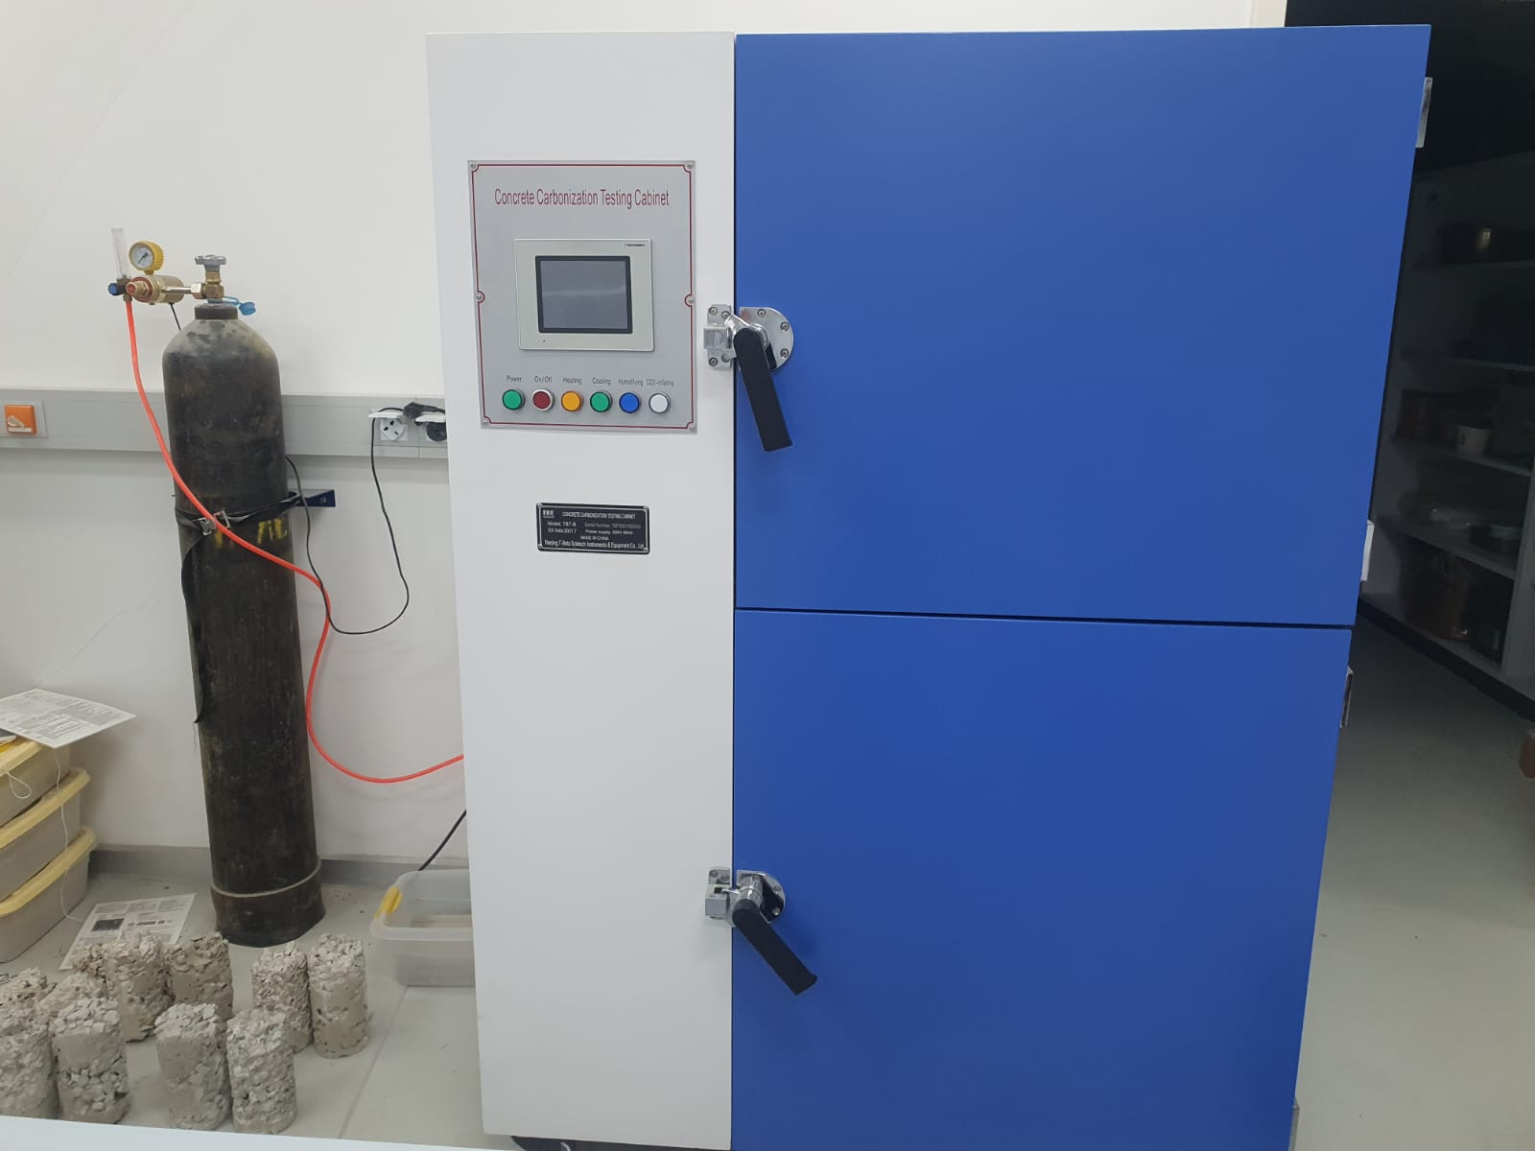
Carbonation (CO₂) curing of samples
The curing condition:
CO₂ concentration: 20%
The relative humidity (RH): 65% ± 5%
The temperature: 23◦C
CO₂ curing (exposure) time: 24 hours

Slide 17
Test Results

Slide 18
Material Characterization
Material | Specific gravity
FA | 1.9
GGBFS | 2.9
BOFS | 3.1
RS | 2.7
Specific gravity of materials
Particle size distribution of binders

Slide 19
Material characterization
Chemical Composition (W_{t} %)
 | Na₂O | MgO | Al₂O₃ | SiO₂ | SO₃ | K₂O | CaO | TiO₂ | MnO | Fe₂O₃ | ZnO
FA | 1.03 | 0.53 | 24.85 | 65.34 | 0.31 | 0.68 | 1.86 | 1.10 | 0.07 | 4.01 | 0.04
GGBFS | 1.08 | 12.07 | 12.43 | 35.84 | 2.67 | 0.69 | 33.06 | 1.34 | 0.37 | 0.34 | -
BOFS* | 0.00 | 11.26 | 1.66 | 8.73 | 1.65 | 0.11 | 47.95 | 0.38 | 1.88 | 24.82 | 0.82
RS | 2.97 | 2.29 | 11.83 | 55.85 | 0.67 | 1.88 | 16.13 | 0.77 | 0.85 | 6.53 | -
*Note: free CaO content: 4.47%
Aggregate Gradation
 |  | Passing | Retained | Passing | Retained | Passing | Retained | Passing | Retained | Passing | Retained
Sieve size |  | 4.75 mm | 2.36 mm | 2.36 mm | 1.18 mm | 1.18 mm | 600 μm | 600 μm | 300 μm | 300 μm | 150 μm
Mass (%) |  | 10 |  | 25 |  | 25 |  | 25 |  | 15
X-ray Fluorescence of aggregates and binders

Slide 20
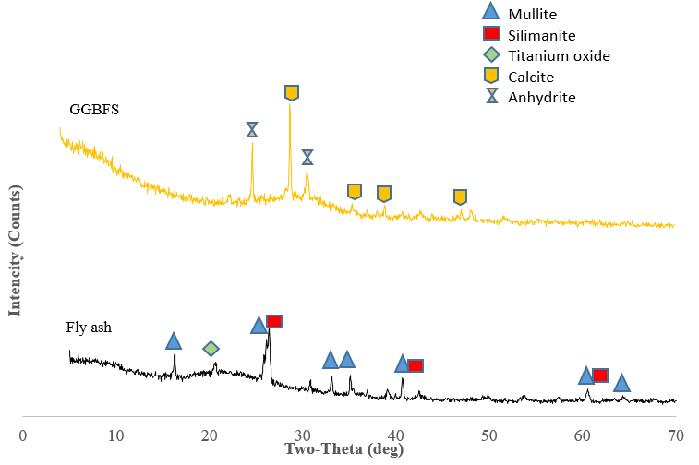
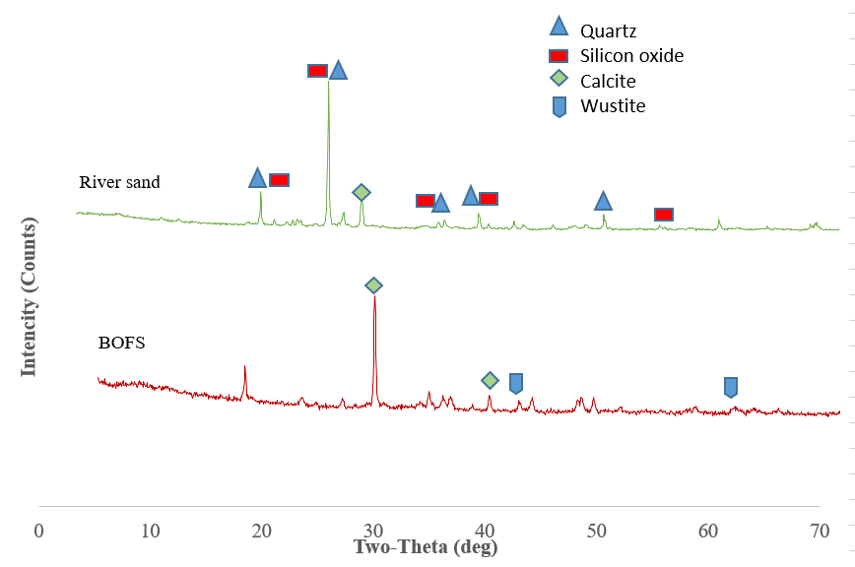
Material characterization
(a)
(b)
X-ray Diffraction of binders (a) and fine aggregates (b)

Slide 21
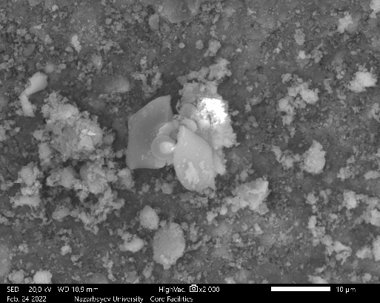
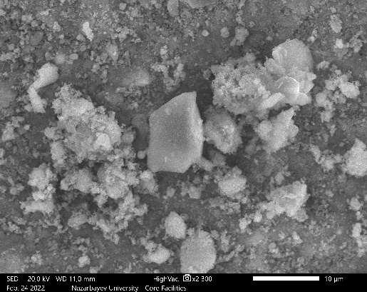
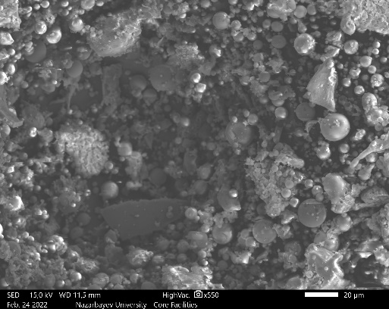
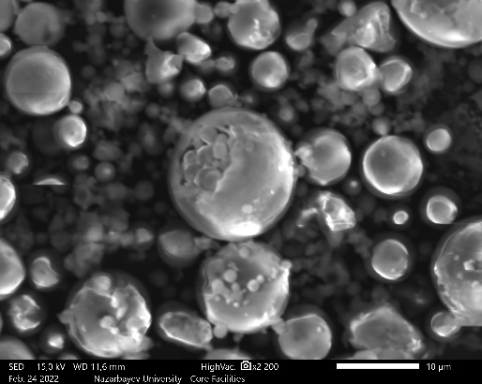
Material characterization
a) b)
c) d)
SEM of BOFS ((a) and (b)) and Fly Ash ((c) and (d))

Slide 22
Fresh properties
Flowability of GPM

Slide 23
Fresh properties
Air content of GPM

Slide 24
Fresh properties
Setting time of GPM

Slide 25
Hardened properties
Compressive Strength of BOFS based geopolymer mortar at 3, 7, 28 and 56 days

Slide 26
Compressive strength test w/ and w/o CO₂ curing
Ambient cured GPM
CO₂ cured GPM

Slide 27
Hardened properties
Hardened Density of BOF slag-based geopolymer mortar at 3, 7, 28 and 56 days

Slide 28
Hardened density w/ and w/o CO₂ curing
Ambient cured GPM
CO₂ cured GPM

Slide 29
Hardened properties
Flexural Strength of BOFS based geopolymer mortar at 3, 7, 28 and 56 days

Slide 30
Flexural strength test w/ and w/o CO₂ curing
Ambient cured GPM
CO₂ cured GPM

Slide 31
Hardened properties
Dielectric constant test results of BOF slag-based geopolymer mortar

Slide 32
Dielectric constant w/ and w/o CO₂ curing
Ambient cured GPM
CO₂ cured GPM

Slide 33
Durability properties
Drying shrinkage of BOFS based GPM

Slide 34
Drying shrinkage w/ and w/o CO2 curing
Ambient cured GPM
CO₂ cured GPM

Slide 35
Durability properties
Water expansion of BOF slag-based geopolymer mortar compared to river sand

Slide 36
Water expansion w/ and w/o CO2 curing
Ambient cured GPM
CO₂ cured GPM

Slide 37
Durability properties
ASR Expansion of BOF slag-based geopolymer mortar compared to river sand

Slide 38
ASR expansion w/ and w/o CO2 curing
Ambient cured GPM
CO₂ cured GPM

Slide 39
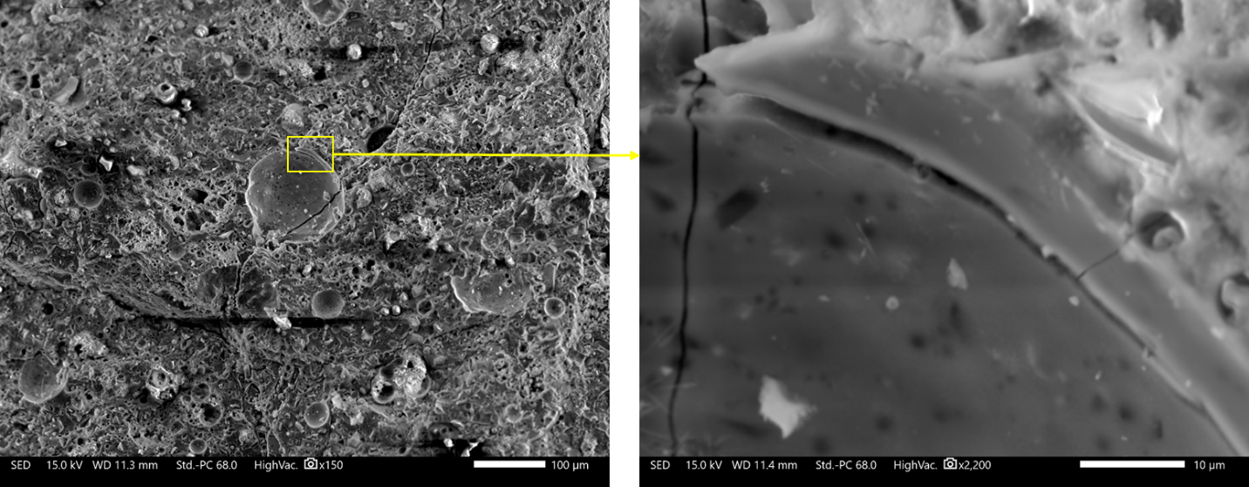
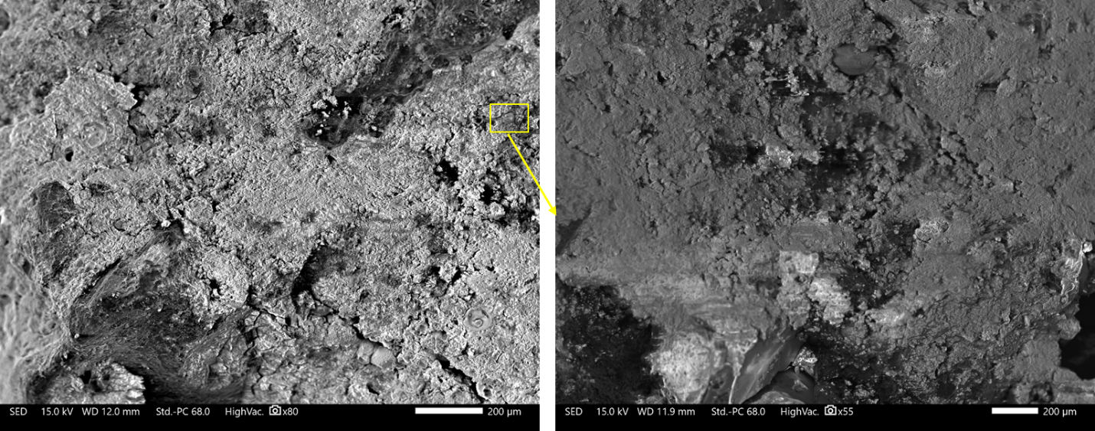
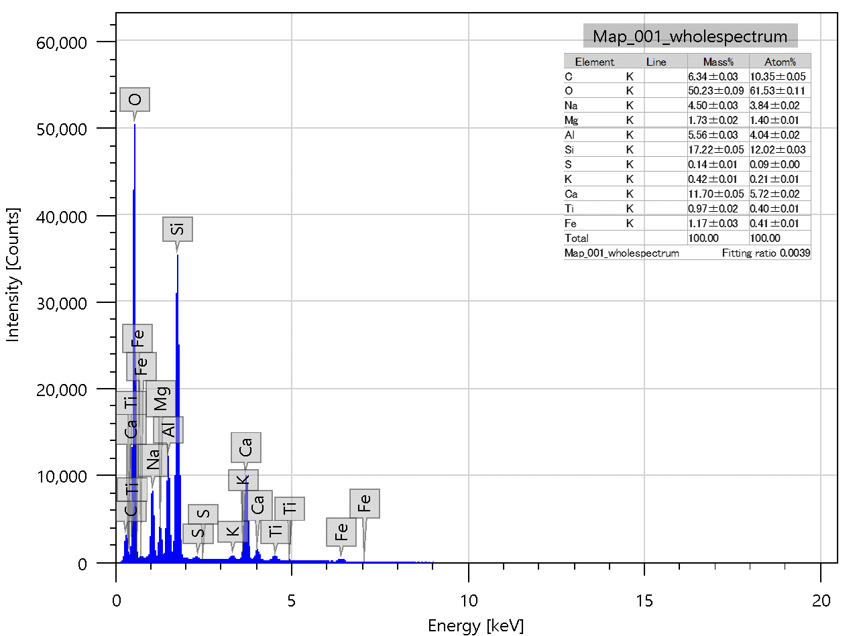
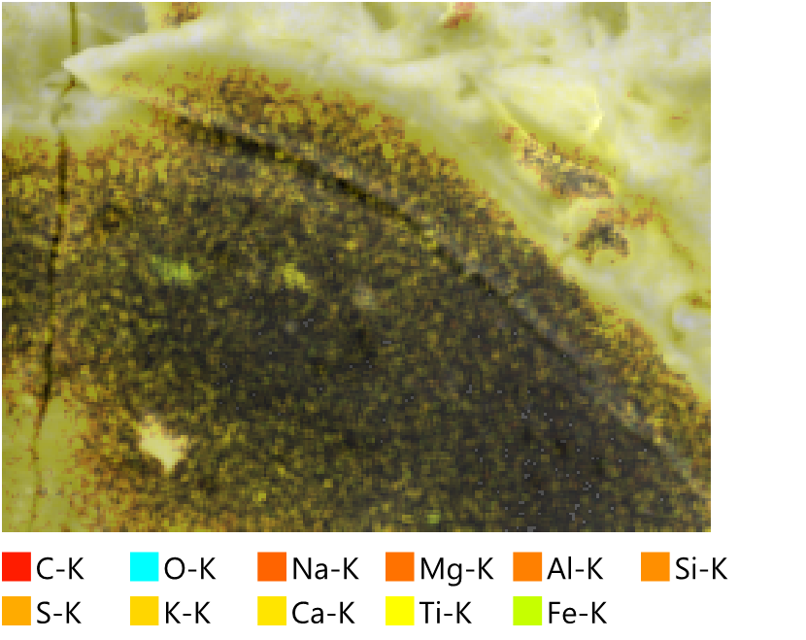
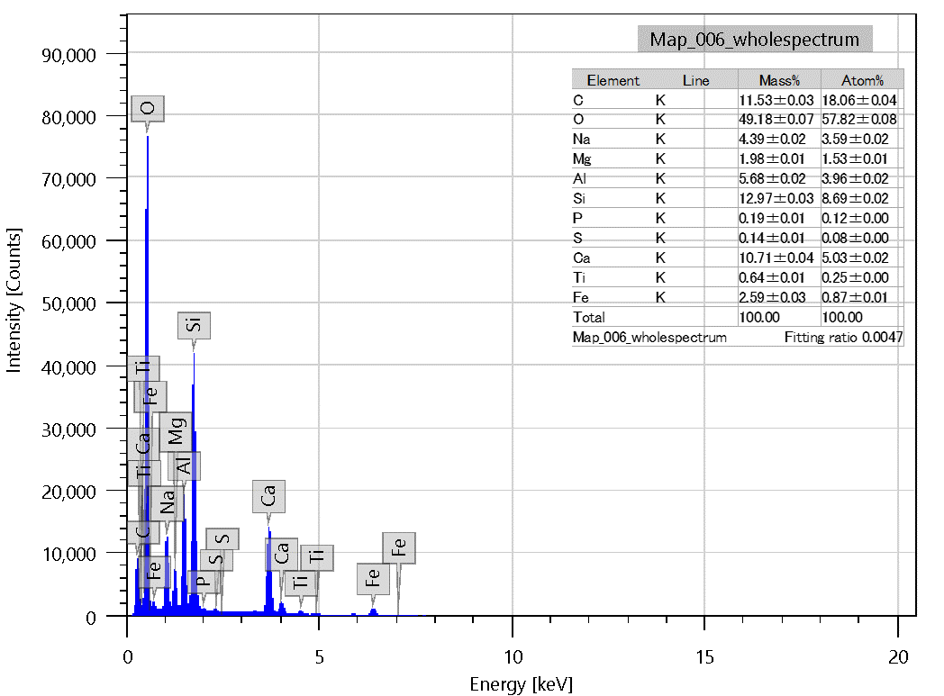
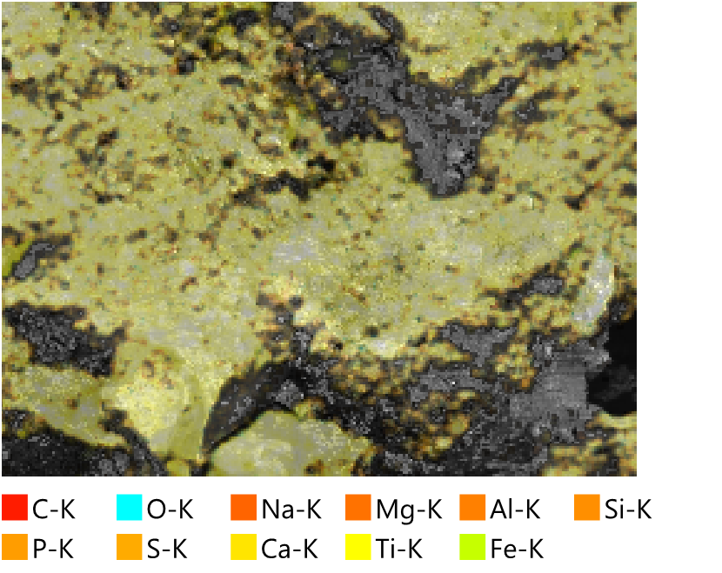
SEM (after ASR expansion test)
1NS+75% BOFS (ambient cured)
1NS+75% BOFS (CO₂ cured)

Slide 40
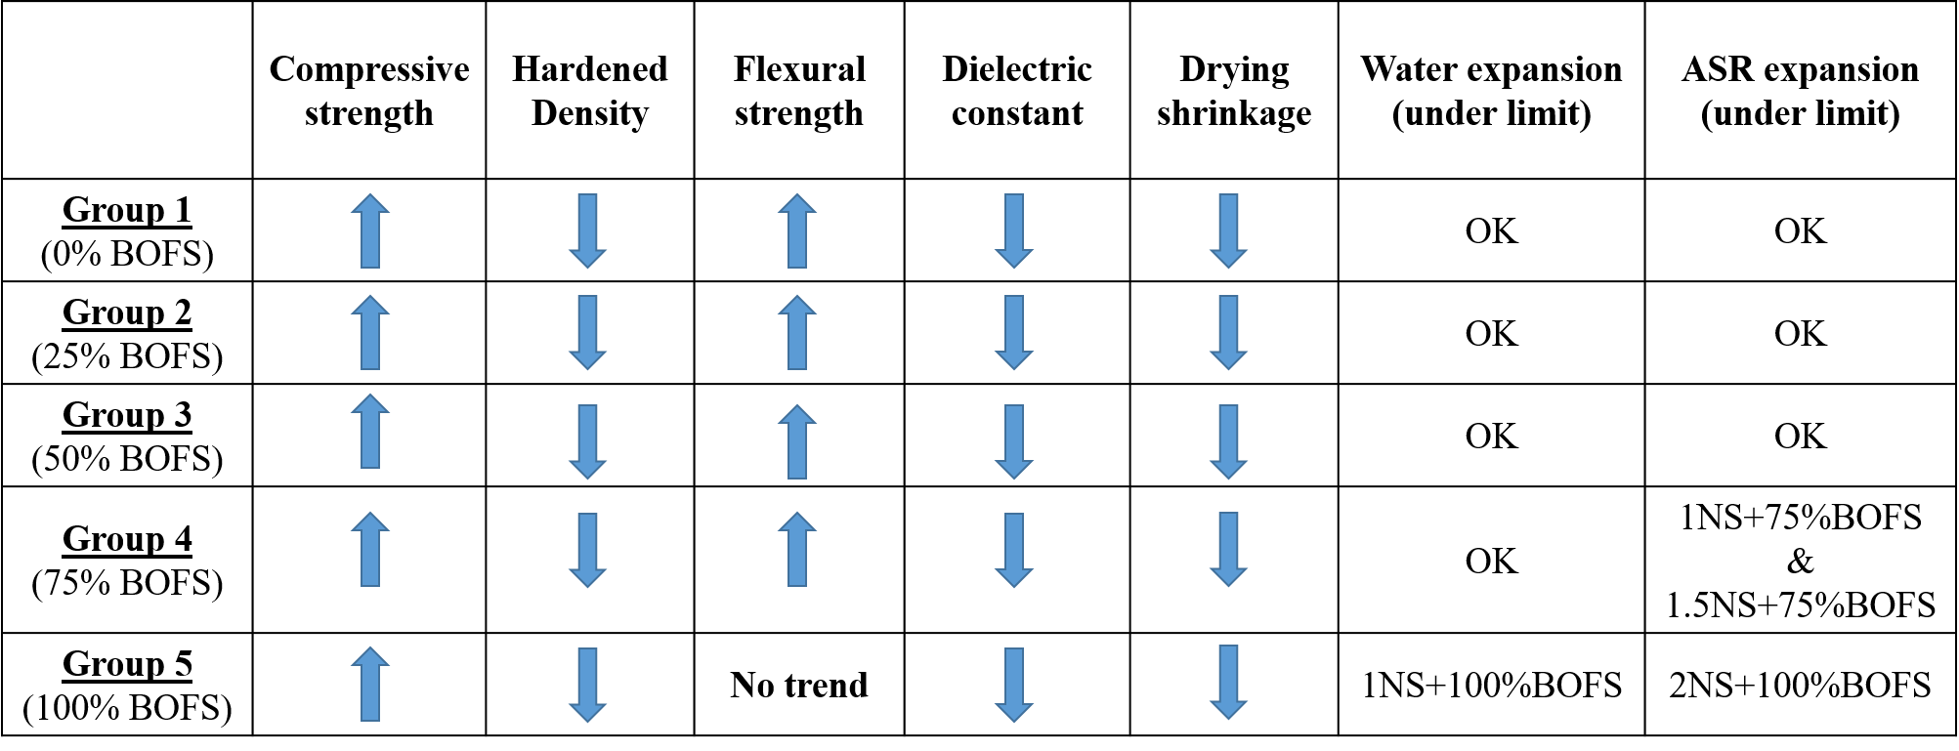
Summary of Hardened Properties & Durability

Slide 41
Response surface methodology
Group A.
25%, 50%, and 75% BOFS-based GPM
Compressive strength = 26.967 - 8.508 Na₂SiO₃ + 5.377 BOFS - 1.213 (Na₂SiO₃)² + 11.882 (BOFS)² + 0.583 Na₂SiO₃*BOFS
ASR expansion = 0.03403 - 0.02300 Na₂SiO₃ + 0.03433 BOFS - 0.0176 (Na₂SiO₃)² + 0.0324 (BOFS)² - 0.02800 Na₂SiO₃ *BOFS

Slide 42
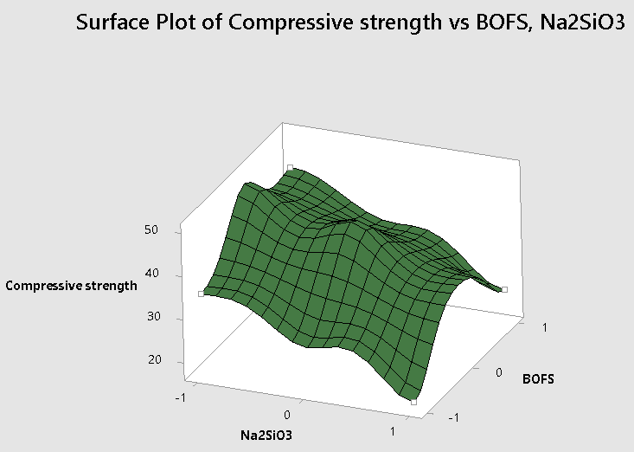

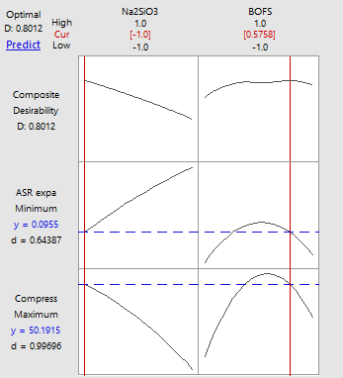
Response surface methodology
Group B.
50%, 75%, and 100% BOFS aggregate-based GPM
Compressive strength = 45.046 - 8.937 Na2SiO3 + 3.585 BOFS -1.796 (Na₂SiO₃)² - 13.671 (BOFS)² - 0.820 Na2SiO3*BOFS
ASR expansion = 0.1141 + 0.0052 Na2SiO3 + 0.0495 BOFS - 0.0037 (Na₂SiO₃)² -0.0357 (BOFS)² + 0.0457 Na2SiO3*BOFS

Slide 43
Conclusion
For compressive and flexural strengths, the GPM mixtures containing BOFS aggregate had comparative strength or higher strength than that containing 100% RS.
Regardless of water and 1M NaOH solution submersions, all GPM mixtures have less than 0.1% expansion value except for the mixture having 75% BOFS and 100 % BOFS aggregate submersed in NaOH solution.
It has been effectively demonstrated that geopolymer technology can stabilize BOFS because GPM mixture’s matrix contains a significant quantity of free silicon (Si), which reacts with free CaO or free MgO to generate stable silicate compounds, solving the problem of BOFS expansion.
CO2 cured samples showed less expansion and less shrinkage than ambient cured samples, but strength performance decreased.

Slide 44
References
Kuo. W, Gao, Y, C. Juang (2019). Influence of BOF and GGBFS Based Alkali Activated Materials on the Properties of Porous Concrete. “Materials”
W. Lee, T. Cheng, K. Lin, K. Lin, C. Wu, C. Tsai (2020) Geopolymer Technologies for Stabilization of Basic Oxygen Furnace Slags and Sustainable Application as Construction Materials. Sustainability
M. Mastali, A. Alzaza, K. Shaad, P. Kinnunen, Z. Abdollahnejad, Bethany Woof, M. Illikainen (2019). Using Carbonated BOF Slag Aggregates in Alkali-Activated Concretes. “Materials”
A. Krishna Rao, D. Rupesh Kumar (2020). Comparative study on the behaviour of GPC using silica fume and fly ash with GGBS exposed to elevated temperature and ambient curing conditions. “Materials Today: Proceedings”
P. Azarsaa , R. Gupta (2020). Durability and leach-ability evaluation of K-based geopolymer concrete in real environmental conditions. “Case Studies in Construction Material”
M. Ma, H. Mehdizadeh, M. Guo, T. Ling (2021). Effect of direct carbonation routes of basic oxygen furnace slag (BOFS) on strength and hydration of blended cement paste. “Construction and Building Materials” A. Karthik, K. Sudalaimani, C.T. Vijaya Kumar (2017). Investigation on mechanical properties of fly ash-ground granulated blast furnace slag based self curing bio-geopolymer concrete. “Construction and Building Materials”
L. Yunxia, Z. Mingkai, C. Xia, X. Fang(2008). Methods for Improving Volume Stability of Steel Slag as Fine Aggregate. “Journal of Wuhan University of Technology-Mater”
Y. Ding, T. Cheng, P. Liu, W. Lee (2017). Study on the treatment of BOF slag to replace fine aggregate in concrete. “Construction and Building Materials”
M.S.H. Khan, A. Castel, A. Noushini. CARBONATION OF A LOW CALCIUM FLY ASH GEOPOLYMER CONCRETE. “Centre for Infrastructure Engineering and Safety, School of Civil and Environmental Engineering, The University of New South Wales, Sydney, NSW 2052, Australia.”
W. Kuo, C. Shu (2013). Application of high-temperature rapid catalytic technology to forecast the volumetric stability behavior of containing steel slag mixtures. “Construction and Building Materials”
N. Kabay, N. Miyan, H. Ozkan (2021). Basic oxygen furnace and ground granulated blast furnace slag based alkali-activated pastes: Characterization and optimization. “Journal of Cleaner Production

Slide 45
Thank you for your attention!

