Slide 1
Speech Emotion Recognition using Deep Neural Networks
A Data Augmentation Study

Slide 2
Outline
Introduction
Background
Research Methods
Results
Discussion
Conclusion

Slide 3
Abstract
Three databases
One universal model
12 experiments
Data augmentation
Focus:
  simple vs. complex methods
Results:
  IEMOCAP – improved accuracy
  EMO-DB – outperform SRHA
  IEMOCAP – outperform VTLP

Slide 4
INTRODUCTION

Slide 5
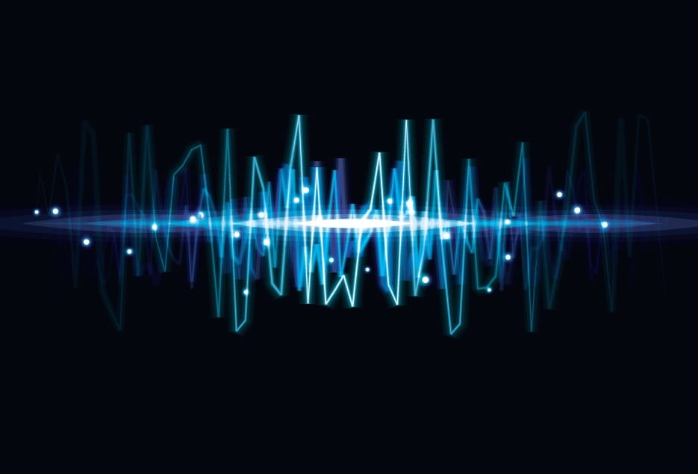

What is SER?
  Interdisciplinary Field
  Recognize human emotion
  Source: voice/audio
  Applications:
    Healthcare
    Human-Computer Interaction
    Surveillance
    E-learning
  Solutions: ML
Notes:
Applications. It can be utilized in healthcare where emotional state of the patient is beneficial. For example, while providing services through phone where only medium is the voice.
Next is usage in human-computer interactions, provide emotional context to a intelligent system. One possibility is smart cars which adjusts speed depending on emotional state of the driver.
In surveillance, it can be used to determine intentions of subjects through emotions. And finally, in e-learning providing better feedback from student that not only incorporate the grades but also emotional information during tests in exams.

Slide 6
Challenges
Languages & Accents
  Chinese tonal emphasis
Complex emotions
  Irony, sarcasm, “British humor” etc.
Performance of humans
Loose definition of some emotions
  Boredom vs Neutral
Limited data
Notes:
Languages: There are over 6000 languages in the world. While most of them similar, some of them differ drastically form majority. One of such language is Chinese where tonal dynamics to the word may change the meaning.
Complex: Some emotions is hard to differentiate. For example, sarcasm is hard to differentiate for some individuals let alone neural nets.
Poor: There are datasets where human performance is lower than the models. It indicates that assessment of the emotion can be sometimes subjective.
It comes from loose definition of some emotions. Volume of the available data is not optimal for training decent sophisticated deep neural nets.

Slide 7
BACKGROUND

Slide 8
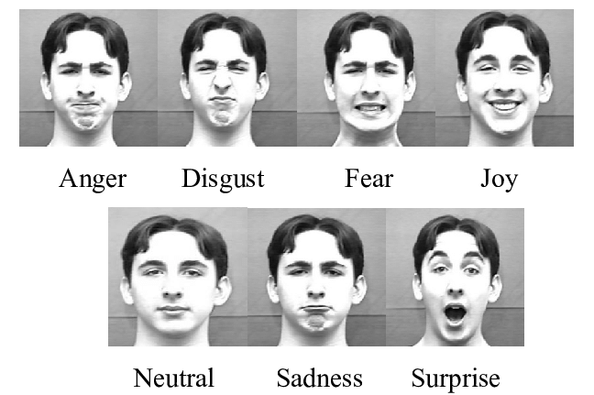

Emotion
never going to give you up
never going to let you down
never going to run around
and desert you
Prosodic
Visual
Semantic
Notes:
So how emotion is expressed? Emotion propagates itself in three dimensions. It is present in Prosodic level, or simply in audio or sound. Pitch, amplitude, tone are the data that can be extracted for this sound, also called prosodic features. Next is the visual dimension. Facial expressions images or recordings, and also motion data of face can be extracted from this level. Finally, emotion propagates itself in semantic level, in other words in words (pun indented) in the context of sentences. In this research we focus on Prosodic level or sound.

Slide 9
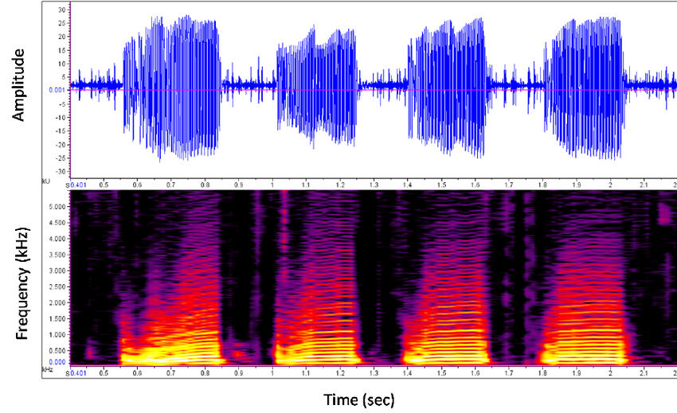
Features & Extraction
Features:
  Mel-frequency cepstral coefficients (MFCCs)
  Linear predictive cepstral coefficients (LPCCs)
  Teager energy operators(TEO)
  GEMAP
  Mel-scaled spectrogram
  Chromagram
  Spectral contrast
  Tonnetz representation
Single feature vs Combined
Local & Global features
Notes:
There are many features that can be extracted and used to train model. It ranges from standard spectrograms and contrstat, to hand crafted ones such as GEMAP and TEO. The are various models that use different strategies in terms wrt to features. There are models that use single feature, most popularly MFCCs, and others that combine several features and feed them to model. The next possibility is to divide audio into windows and extract features form each window, called local features, or just extract it from the whole audio, also called global features. It is ongoing debate on which feature contains most information on emotion an what combination to use, as there are many of them.

Slide 10

Databases
Datasets:
  IEMOCAP: The Interactive Emotional Dyadic Motion Capture
  EMO-DB: Berlin Emotional Database
  SAVEE : Surrey Audio-Visual Expressed Emotion Database
  CHEAVD : Chinese natural emotional audio–visual database
  CASIA: Chinese Emotional Speech Corpus
  RAVDESS : The Ryerson Audio-Visual Database
  of Emotional Speech and Song
Multimodal Databases
Limited samples
Different languages
Notes:
Currently, there are quite many datasets available in the field to experiments with. They differ by content, language and size.
Regardless of diversity, sample size usually suboptimal for training sophisticated deep neural nets.
That’s the reason that almost all research done with these datasets include one or another form of data augmentation.

Slide 11
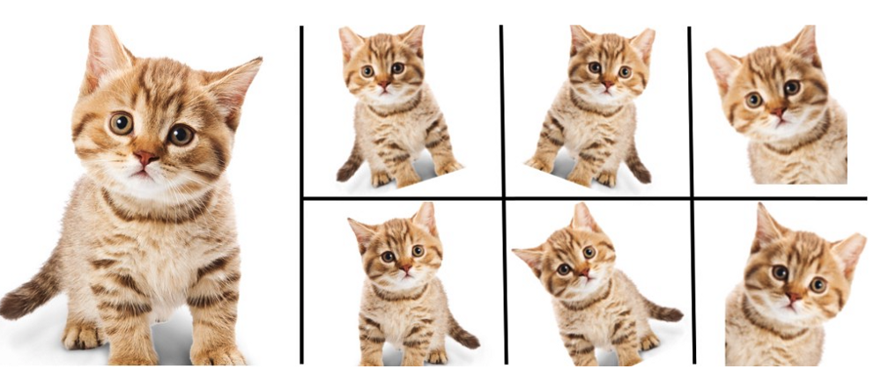

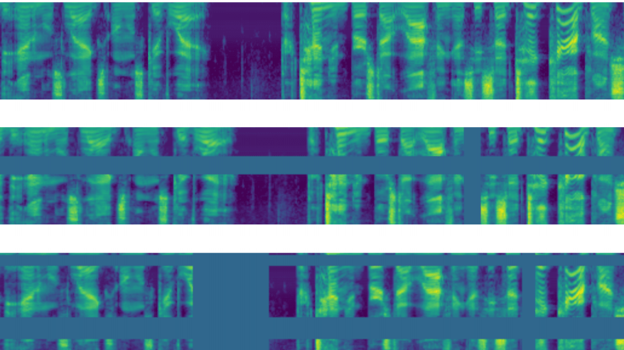
Data Augmentation
Image Recognition
Sound augmentation:
  Pitch
  Amplitude
  Speed
  Noise
  VTLP
  SRHA
  Generative Models (GAN)
Conversion to image
Notes:
Data augmentation is set of techniques that increases the amount of samples in the dataset exploiting the existing ones. These techniques utilize label-invariant transformation of inputs. So, by level invariant we mean transformation of sample without changing its label. Data augmentation proven its effectiveness in image recognition.
VTLP - vocal tract length perturbation, normalization technique to reduce variance between speaker.
SRHA - segment repetition based on the high amplitude, augmentation of existing audio with the segment with the highest amplitude
One of the ingenious methods of data augmentation is image transformation of spectral image of a sound.

Slide 12
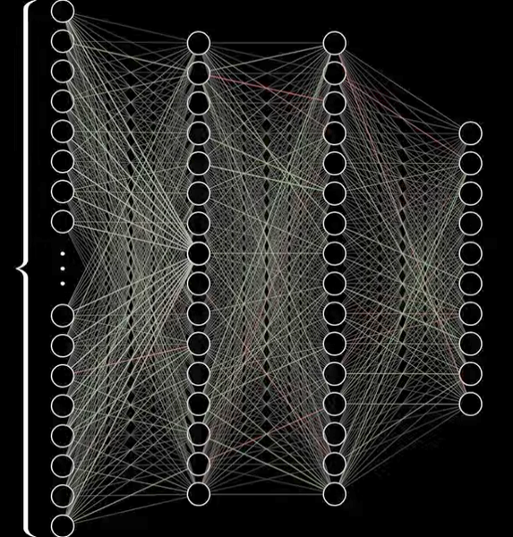
Classification
Models:
  Support Vector Machines (SVM)
  k-st Nearest Neighbour (k-NN)
  Hidden Markov Model (HMM)
  Gaussian Mixture Model (GMM)
  Convolutions Neural Networks (CNN)
  Recurrent Neural Networks (RNN)
  Deep Belief Networks (DBN)
Combined:
  CNN-LSTM
  CNN-SVM
  k-NN-SVM
Notes:
Models that are utilized in SER are very diverse. It ranges from simple machine learning models such as SVM and Neurest Neighbors, to deep convolutiona and reccurent networks. Moreover, architectures including two different models are used in the field.

Slide 13
RESERCH METHODS

Slide 14
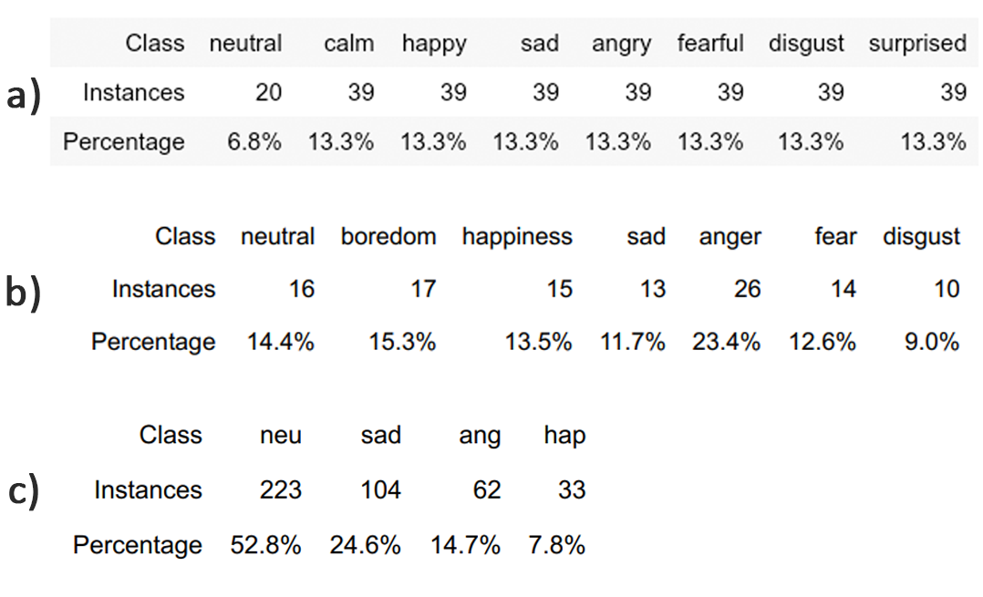
Datasets
RAVDESS (a)
  8 classes
  24 participants
  1440 samples
EMO-DB (b)
  7 classes
  535 utterances
IEMOCAP (c)
  10 classes (4 used)
  Audio and video
  2110 samples

Slide 15
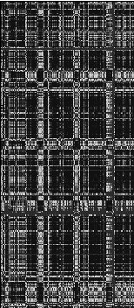
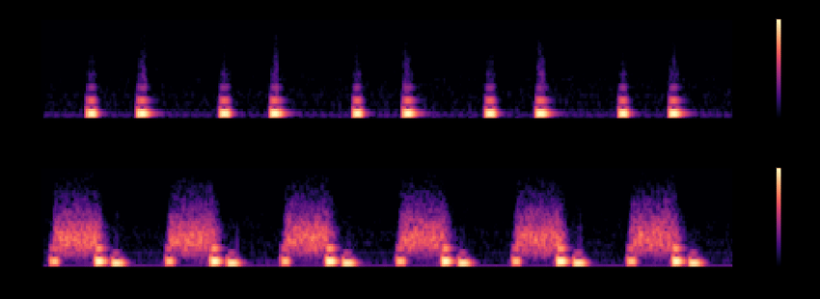
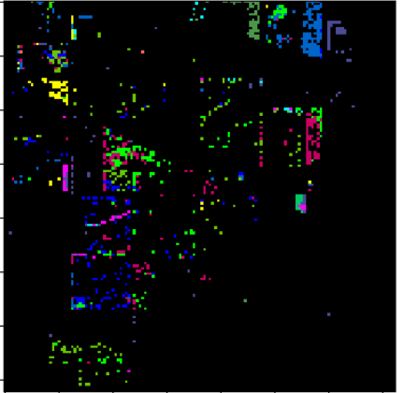
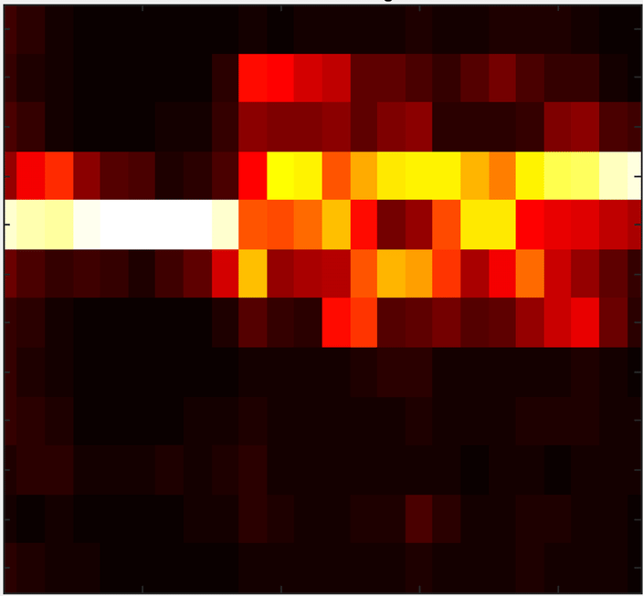

Feature extraction
MFCC
Mel-scaled spectrogram
Chromagram
Spectral contrast feature
Tonnetz representation

Slide 16
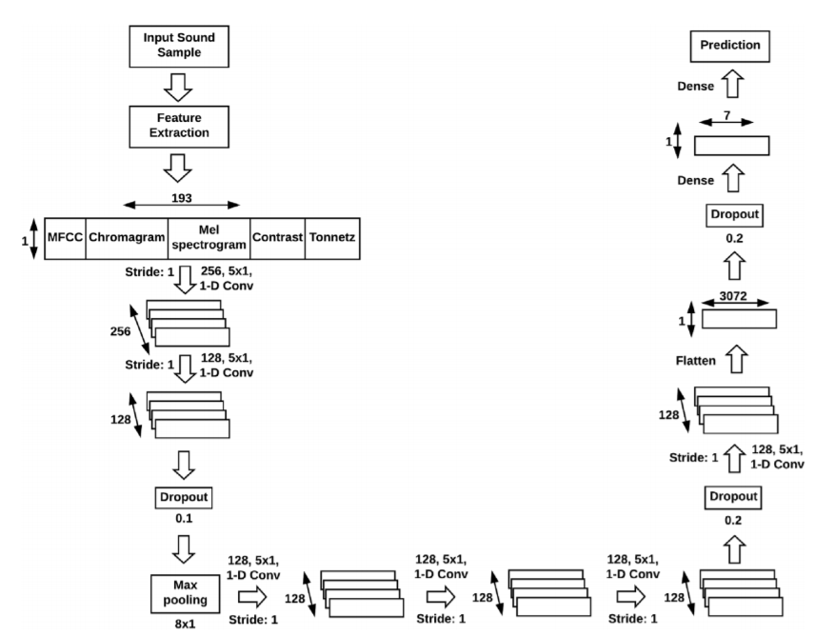
Architecture
  Base for all models
    Reason: accurate comparison
  Input: 1D (193 x 1)
  6 Convolution Layers
    Kernel: 5x5
  Dropout
  Batch Normalization

Slide 17
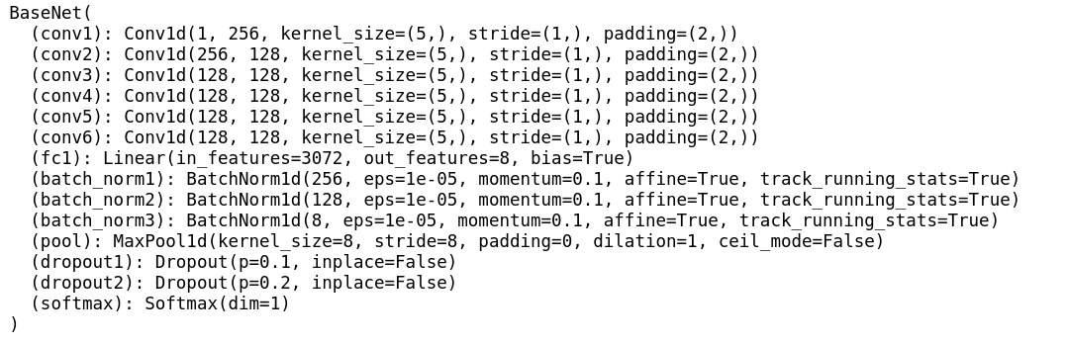
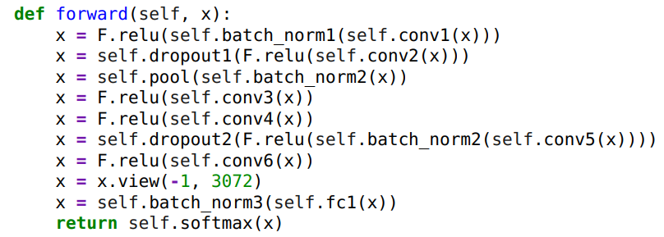
Architecture cont.
  Pyton
  PyTorch Library
  Jupyter Notebook
  Anaconda Environment

Slide 18
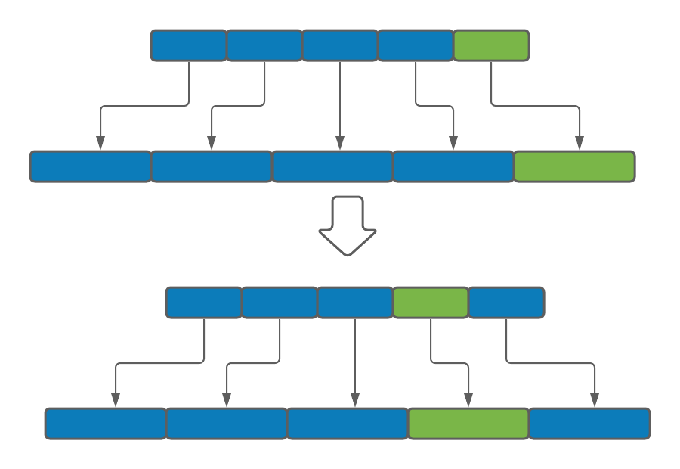
Experiment Setup
12 experiments (4 for each database)
3 databases
5 fold cross-validation
In-fold augmentation
Training
  RMSProp optimizer
  LR: 0.0001, D: 10^-6
  700 epochs
Testing
  Original and Augmented
Experiments
  Ex 1 – Baseline
  Ex 2 – Pitch Augmentation
  Ex 3 – Speed Augmentation
  Ex 4 – Combined Augmentation

Slide 19
Experiments
Ex 1 – Baseline
  No data augmentation
Ex 2 – Pitch Augmentation
  Pitch Up 4.5 steps
  Pitch Down 4.5 steps
  Samples x3
Ex 3 – Speed Augmentation
  Speed Up 25%
  Slow Down 25%
  Samples x3
Ex 4 – Combined
  Pitch Up 1.5, 3.0, 4.5 steps
  Pitch Down 1.5, 3.0, 4.5 steps
  Speed Up 25%
  Slow Down 25%
  Trim silence before and after speech
  Samples x10
Notes:
Pitch: steps of 4.5 have been chosen as it changes speech the most. For example, speech of an adult moved up for 4.5 steps resemble speech of a child.

Slide 20
RESULTS

Slide 21
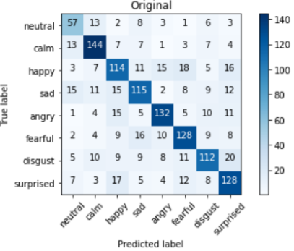
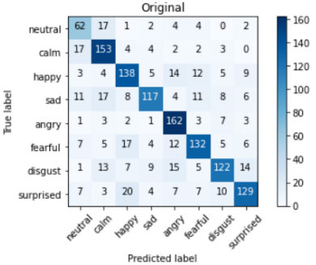
RAVDESS

Slide 22
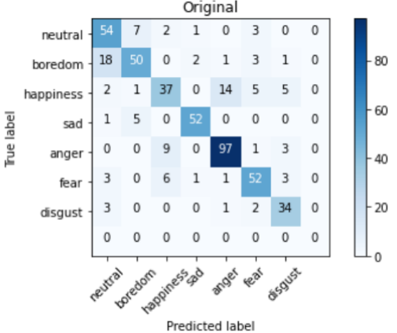
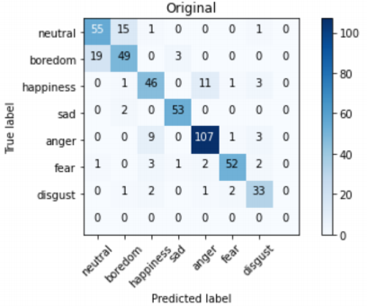
EMO-DB

Slide 23
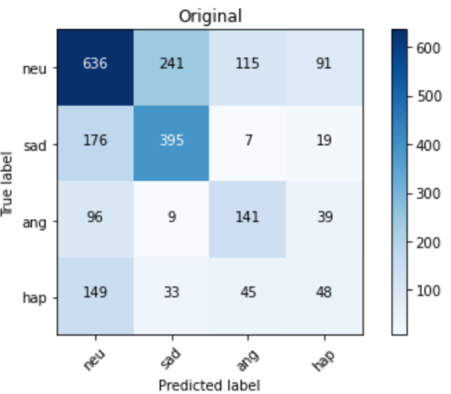
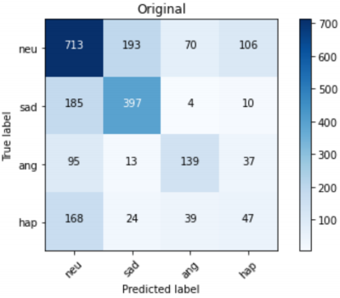
IEMOCAP

Slide 24
DISCUSSION

Slide 25

Metrics
Confusion Matrix analysis
Dynamics of accuracy
True Positive Rate (TPR)
  TP – True Positives
  FN – False Negative
Sum
Mean
Notes:
TPR indicate the portion of correctly recognized labels among all true labels.

Slide 26
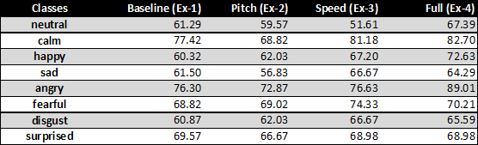
RAVDESS
Baseline:
  Lowest: disgust
  Highest: calm, angry
Pitch is detrimental
Speed:
  Happy class benefits most
  Neutral class drops
Combined:
  Best outcomes
  Almost all classes benefit
Human accuracy: 67%
Higher than previously reported
  71.6% (+1.3%)

Slide 27
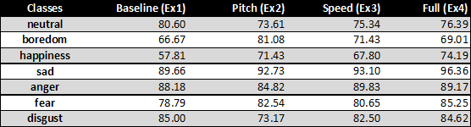
EMO-DB
Baseline:
  Lowest: happiness
  Highest: sad, anger
Pitch:
  Detrimental to disgust and neutral
  Boredom affected the most
Speed is similar to Pitch augmentation
Combined:
  Best outcomes
  Almost all classes benefit
Higher than SRHA:
  SRHA – 2.3%
  Combined – 4.0%
Notes:
It shows that simple augmentation methods can compete with sophisticated augmentation algorithms with less effort.
segment repetition based on the high amplitude

Slide 28

IEMOCAP
Least balanced set
Baseline:
  Lowest: happy
  Highest: sad
Pitch:
  Minimal impact on least represented class
  Not much sensitive to balance
Speed:
  Affected only neutral
  Less than 1% others
  Sensitive to overrepresented class
Combined:
  Inferior to both pitch and speed in isolation
  Increased gap between classes
Higher than VTLP:
  VTLP – 1.1%
  Speed – 3.5%
Notes:
vocal tract length perturbation

Slide 29
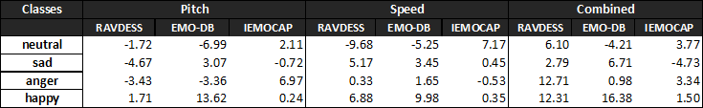
Common Class Analysis
Neutral:
  Most confused class
  Best: Combined (5.7%, 1.9%)
  Speed (least) & Pitch – both negative
Sad:
  Best: Speed (9.1%, 3.0%)
  Speed - uniformly positive
Anger:
  Best: Combined (17.0%, 5.7%)
  All (sum & mean) positive
  Pitch negligible (0.1 < x < 0.2)
Happiness:
  Best: Combined (30.2%, 10.1%)
  Uniformly positive
  Most affected
Notes:
One of the reasons might be that happiness and anger class are quite clearly pronounced in the voice and speech.

Slide 30
CONCLUSION

Slide 31
Conclusion
We tested simple augmentation methods on three datasets
RAVDESS: Managed to improve overall performance of the model
EMO-DB & IEMOCAP:
  Proved competency of simple augmentation methods in comparison to complex counterparts
  Identified beneficial augmentation method for each dataset
Discovered sensitivities of common classes towards certain augmentation techniques for selective augmentation

Slide 32
Future work
Apply accumulated knowledge with selective augmentation
Increase resolution/variation of augmentations
  For Pitch test smaller steps
  For Speed greater range
  Add amplitude alterations
  Add noise
Incorporate more quantitative metrics to get deeper insight

Slide 33
Thanks for your attention!

