Slide 1
A SUCCESS STORY OF AN ACADEMIC LIBRARY CONSORTIUM
ANKOS
Ertuğrul ÇİMEN, Tuba Akbaytürk ÇANAK, Sami ÇUKADAR
7th International Conference on Emerging Global Trends in University Library Development (Library Connect 2018), The Nazarbayev University Library, National Academic Library of Kazakhstan,
3-24 May 2018, Astana, Kazakhstan

Slide 2
Turkish Higher Education (2016 – 2017)
Number of Institutions (2016-2017)
Number of Students (2016-2017)

Slide 3
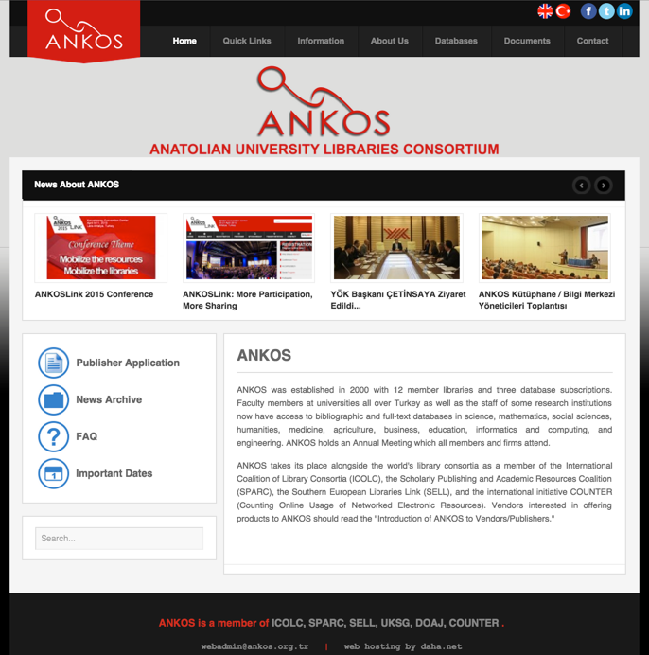
ANKOS General Overview
Founded in 2000 as a volunteer organisation
7 Executive Board members
6 permanent study groups
50+ Volunteer Librarians
Main Characteristic : Diversity & Volunteer
Products
  Electronic Resource Management System (ERM)
  Publisher Application Form (PAF)
  ILL Monitoring System (KITS)
  ANKOSLink
Lifelong Training & Sustainability
  Academy
  Staff Exchange Program (APDP)

Slide 4
ANKOS International Collaboration
SELL
  Southern European Libraries Link
SPARC-
  The Scholarly Publishing and Academic Resources Coalition
ICOLC-
  International Coalition of Library Consortia
COUNTER-
  Counting Online Usage of Networked Electronic Resources
IFLA

Slide 5
Subscribed databases by years figure 1
ANKOS members by years figure 2
Table 1
ANKOS with numbers
Table 2

Slide 6
ANKOS is managed by a board of seven academic library directors, elected every two years.
Key tasks of the board a) Preparation and maintenance of common policies for the rational utilization of electronic resources that also include concerns for the educational and research needs of member institutions. b) Development of the strategic plan; preparation of the annual budget and the annual report; management of the staff and the budget. c) Leading negotiation of subscriptions to databases and e-resources with publishers and vendors. d) Assuring that license agreements are compatible with Turkish National Site License. f) Developing and delivering training programes for ANKOS voluntaries related to their personal and professional development. g) Representing ANKOS nationally and and internationally h) Developing projects to support research activities of Turkish academicians.
ANKOS Organization Structure
Organisation Structure of ANKOS

Slide 7
License Agreements Group
Public Relations Group
Statistics Group
OA & Institutional Repositories Group
Collaboration Group
ANKOS Academy Group
ANKOS Study Groups

Slide 8
Turkish National Site License (TRNSL)
ANKOS License Agreements Group
Methodology
Examination of the firm's license agreement and comparison with TRNSL
Initiate the negotiation / negotiation process
Acceptance and signing of the license agreement
Copyrights in License Agreements

Slide 9
ANKOS Public Relations Group
Target Groups:
Internal Target Group: ANKOS volunteers
External Target Group:
ANKOS member institutions,
existing and potential firms,
all domestic and international universities,
libraries,
interested in electronic information resources,
similar consortia and organizations operating on the same field

Slide 10
ANKOS Statistics Group
1. For members;
Budget,
Number of FTE (undergraduate, graduate and doctoral students and teaching staff),
Total population,
The number of subscribed databases of member isntitution thgrough ANKOS,
Number and list of members' subscriptions for subscription-based models,
Total number and list of publications in each database,
The amount each member pays for each database,
Collecting data about the usage of each database,
  2. For ANKOS ;
To present the collected and edited data to ANKOS Executive Board

Slide 11
ANKOS
OA & Institutional Repositories Group
Goal:
To inform all the ANKOS members about OA activities all around the world and Turkey,
To ensure that member institutions have access to and use of the Open Access movement on the Consortium level,
To create opportunities for dissemination and implementation within their institutions of the member institutions, to show methods for establishing the relevant archives of the relevant institutions,
To cooperate for the sustainability of the work in coordination,
To keep instructions and training documents on the ANKOS website and to ensure that they are up-to-date and reliable.

Slide 12
ANKOS Collaboration Group
ANKOS Staff Exchange Program,
National Resource Sharing Instruction,
Online Resource Sharing Platform (KITS)

Slide 13
ANKOS Academy Group
Lifelong Learning & Professional Development
  Online Training Platform
  Virtual classrooms
  Elected professionals as instructor
  15 webinar
  450+ participants

Slide 14
550+ international participants from 30+ countries
170+ institutions
32 company presentations
60 publishers
4 panels, 5 presentations, posters session

Slide 15
ANKOS Trademarks & Homegrown Tools
Trademarks
  ANKOSLink
  ANKOS Academy
Homegrown Tools
  KITS (Interlibrary Loan Tacking System)
  PAF (Publisher Application Form)
  ERM (Electronic Resource Management)

Slide 16
ANKOS Challenges
Number of HEIs in Turkey
Different conditions of the institutions (State / Foundation)
Differences in budgets and FTEs
Usage, size of the institutions
Currency loss & its effect on budgets
3 years # of subscribed institutions opt in-out
Intitutions with holdings continues to be a major issue
Pricing gets complicated; based on the usage or the size of the institution or both
Negotiating for open access related articles in license agreements
New model / new cost sharing
Tax for e-books and e-Journals

Slide 17
Ertuğrul Çimen (cimene@mef.edu.tr)
Tuba Akbaytürk Çanak (takbayturk@ku.edu.tr)
Sami Cukadar (sami.cukadar@bilgi.edu.tr
Q U E S T I O N S
7th International Conference on Emerging Global Trends in University Library Development (Library Connect 2018), The Nazarbayev University Library, National Academic Library of Kazakhstan,
3-24 May 2018, Astana, Kazakhstan

