Slide 1
Topology Optimization in Additive Manufacturing
Onyekachi Okorie
2nd Year Master in Mechanical and Aerospace Engineering
Supervisor: Associate Professor Konstantinos Kostas
Co-Supervisor: Assistant Professor Asma Perveen

Slide 2
Outline
Background
Problem statement
Aim and objectives
Methodology
Result and Analysis
Conclusion
Future Direction
References

Slide 3
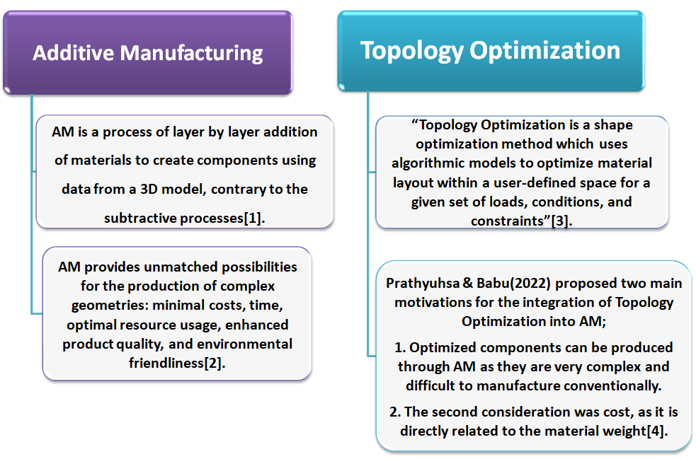
Background [1/2]

Slide 4
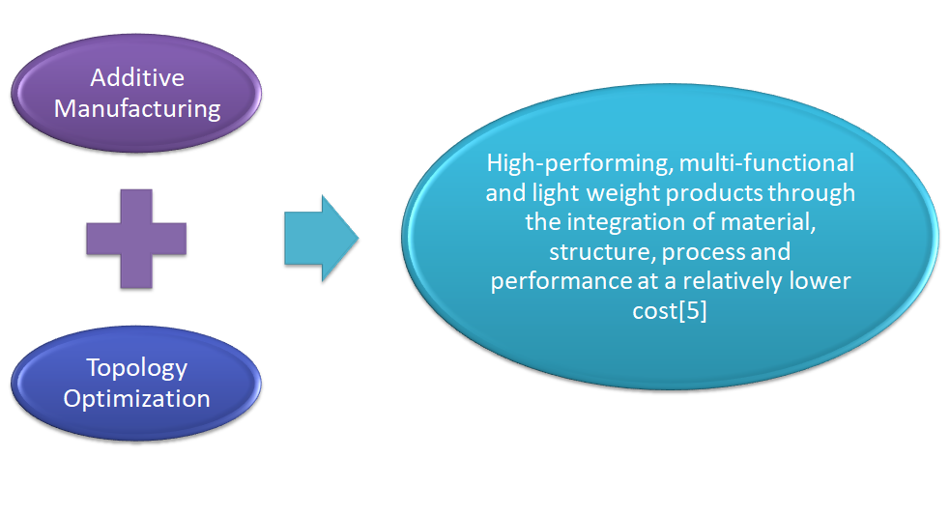
Background 2/2]

Slide 5
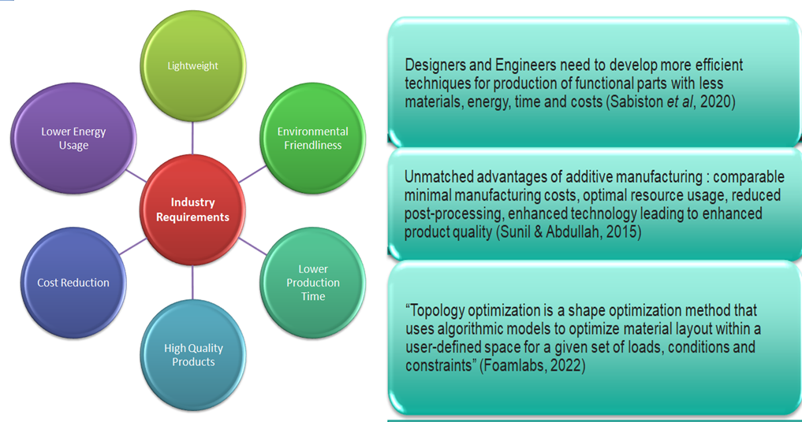
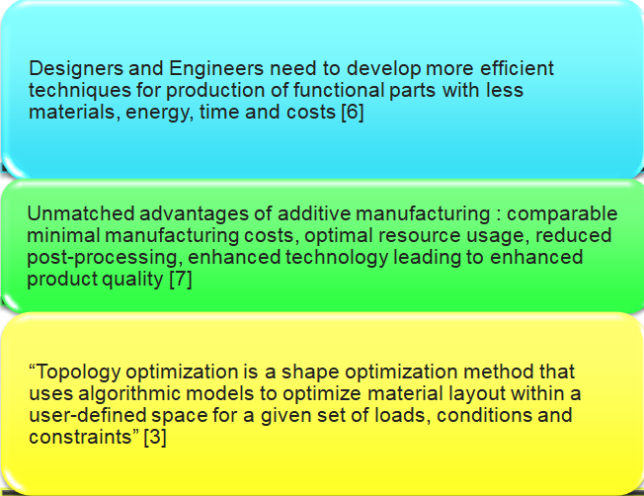
Problem statement

Slide 6
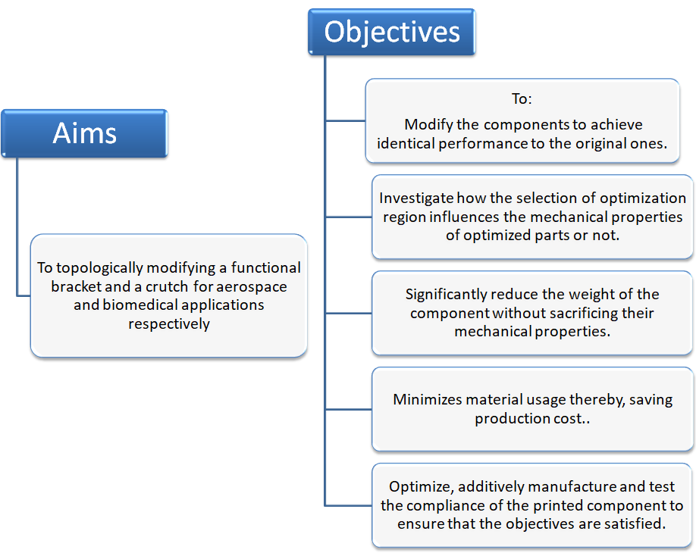
Aims and Objectives

Slide 7
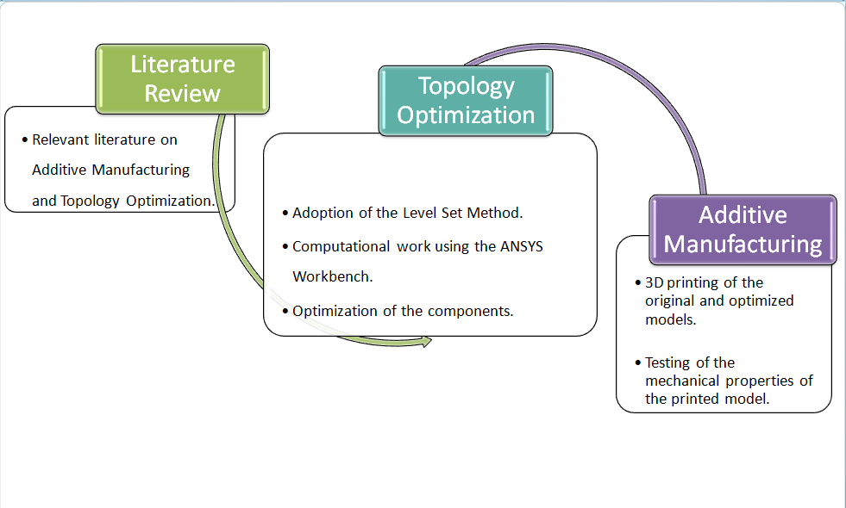
Research Methodology

Slide 8
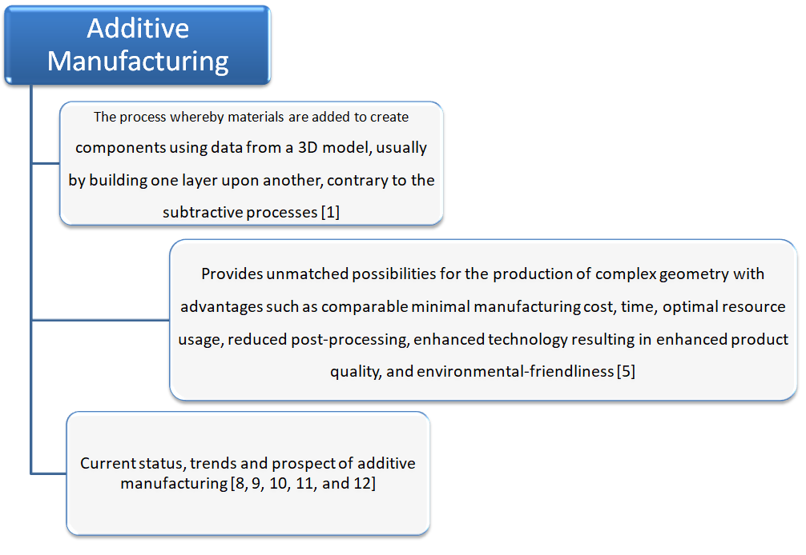
Relevant Literature

Slide 9
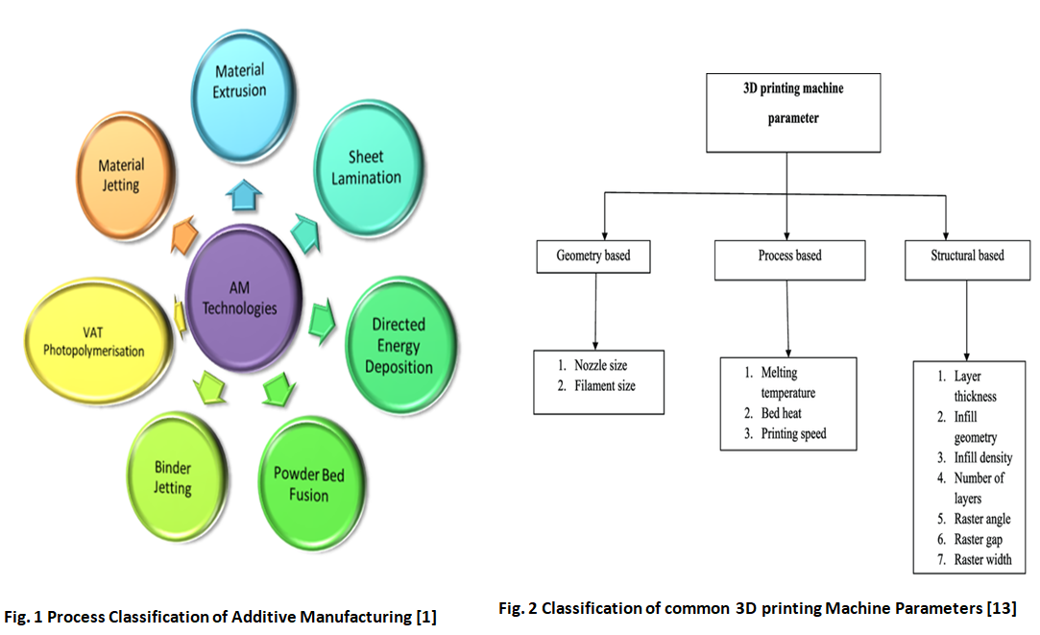
AM Classification and Printing Parameters

Slide 10
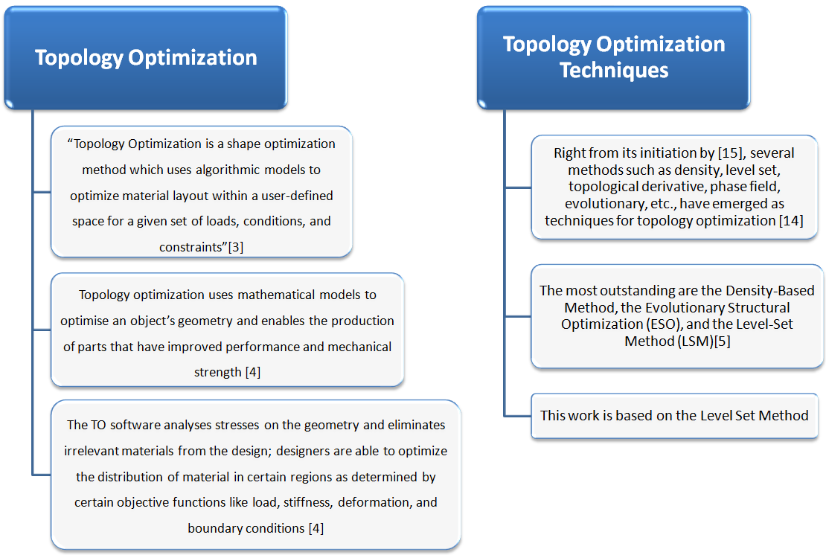
Topology Optimization

Slide 11
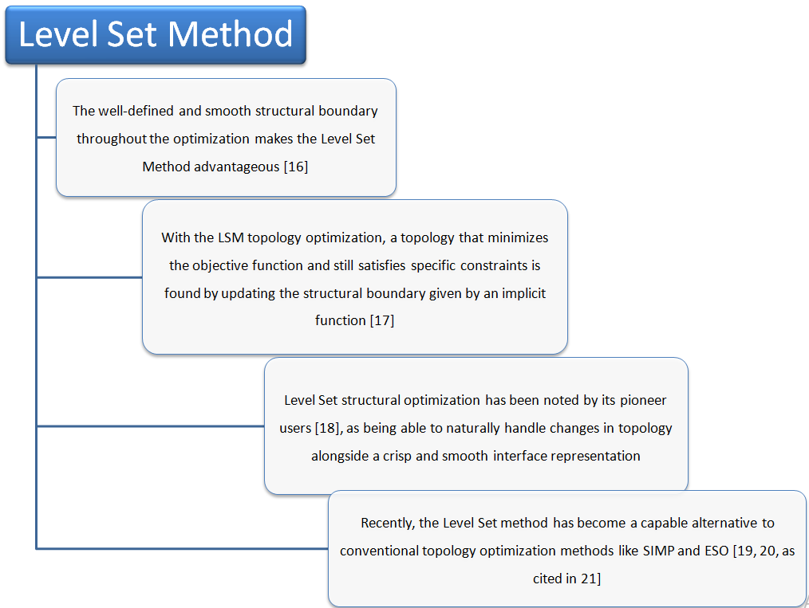
Level Set Method of Topology Optimization

Slide 12
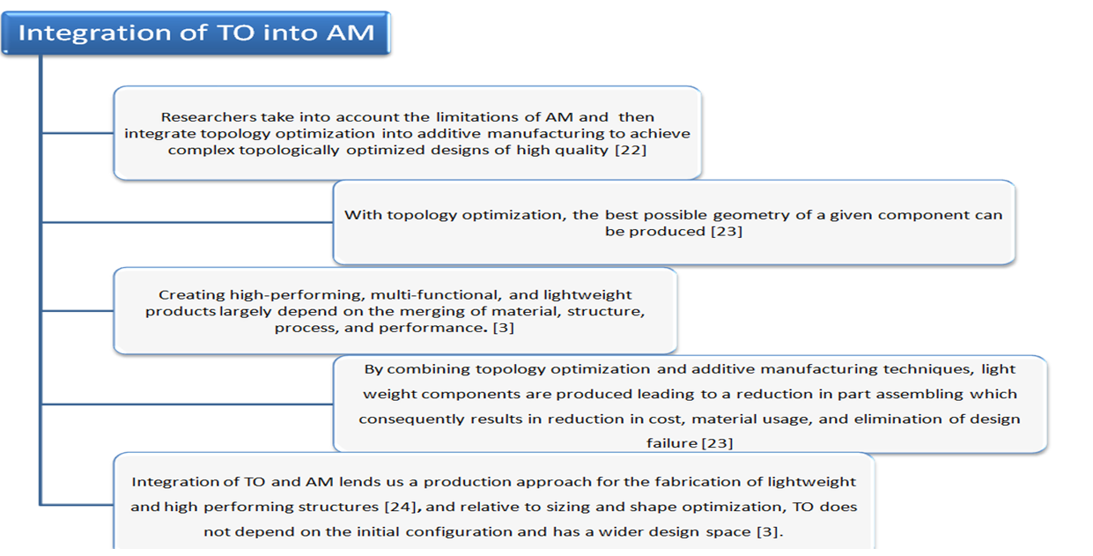

Topology Optimization in Additive Manufacturing

Slide 13
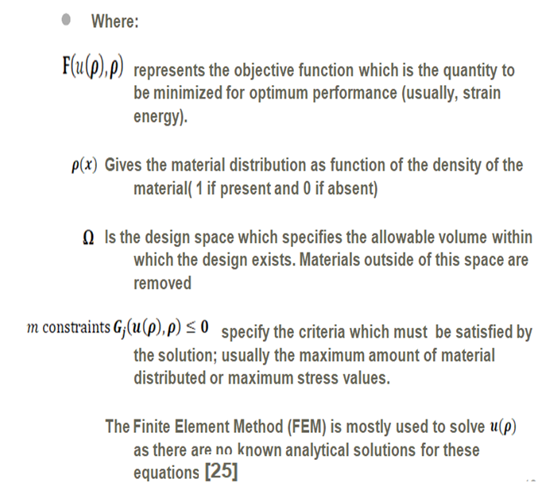


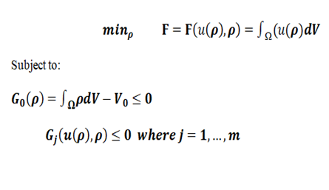
Computational Framework of Topology Optimization
Topology Optimization Problem Statement:
From [4,5], typical topology optimization problem can be written as:

Slide 14
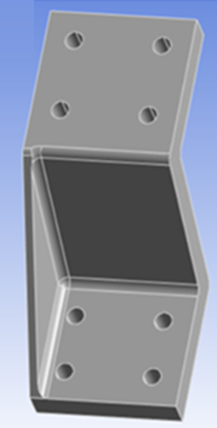
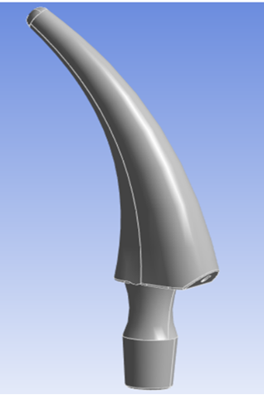
Computational Work and Simulations
Here the Goal is:
To significantly reduce the weight of the components without sacrificing their mechanical properties.
This is achieved by material redistribution which implies:
Placing materials on regions with higher stress values within the design domain, and
Removing materials from regions with low or no stress concentration.
This shall be implemented using the Level Set Method of Topology optimization module in ANSYS Workbench[26]
Fig.3 Original Bracket and Crutch

Slide 15
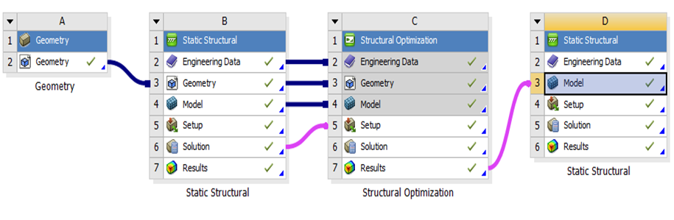
ANSYS Structural Setup and Procedure
Procedure:
From the ANSYS workbench, the Geometry, Static Structural, and Structural Optimization were set up as shown in figure ****2 on the left.
The model was predesigned and then imported into the workbench through the Geometry import function.
It was then transferred to Static Structural and Structural Optimization, for meshing, structural analysis, and subsequent topology optimization.
After a successful meshing analysis and optimization, the optimized model was transferred back to the Static Structural for design validation
Fig.4 ANSYS Module Setup

Slide 16
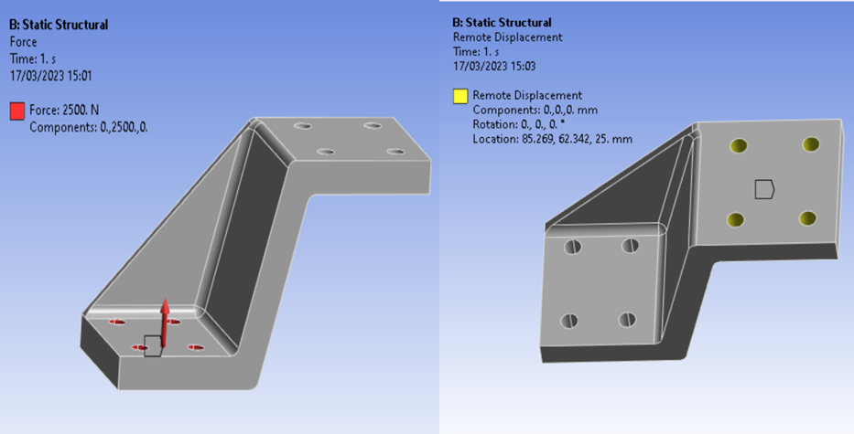
Structural Analysis [1/2]
Boundary Condition:
A compressive force of 2.5kN was applied on the y-direction at the lower end of the bracket.
A remote displacement was applied on the upper end of the bracket.
The bracket set for discretization has a volume of 77425 and weighs 0.608kg (Assuming Structural Steel)
Fig. 4a Applied Compressive force of 2.5kN
Fig. 4b Fixed Boundary Condition

Slide 17
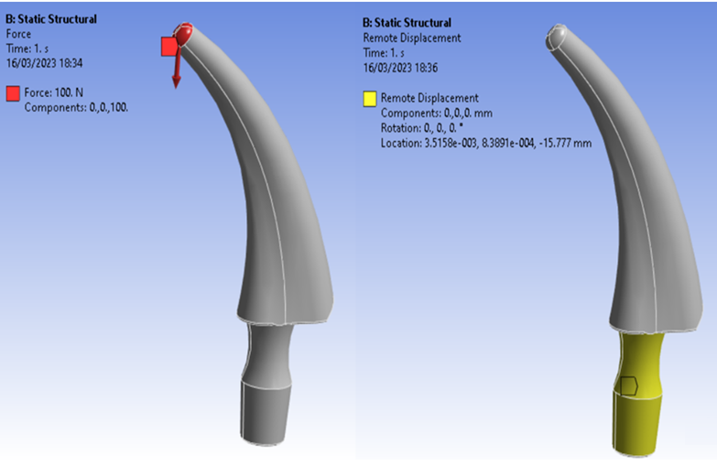
Structural Analysis [2/2]
Boundary Condition:
A compressive force of 0.1kN was applied on the at the tip of the crutch.
A remote displacement was applied at the lower section of the crutch.
The crutch the crutch has a volume of 17443 and a weight of 0.137Kg (Assuming Structural Steel)
Fig. 5a Applied Compressive force of 0.1kN
Fig. 5b Applied Compressive force of 0.1kN

Slide 18
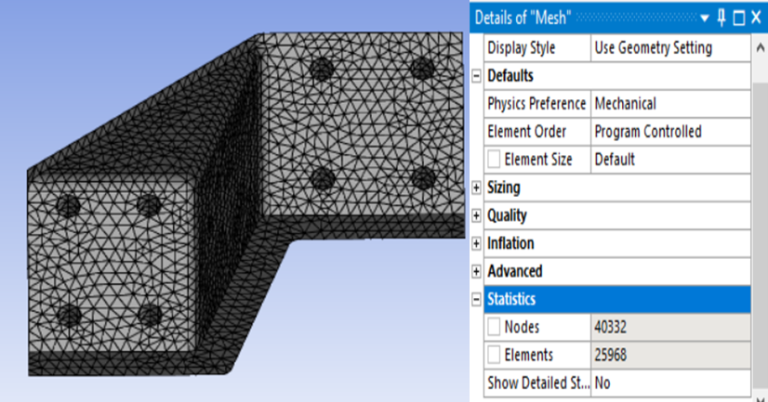
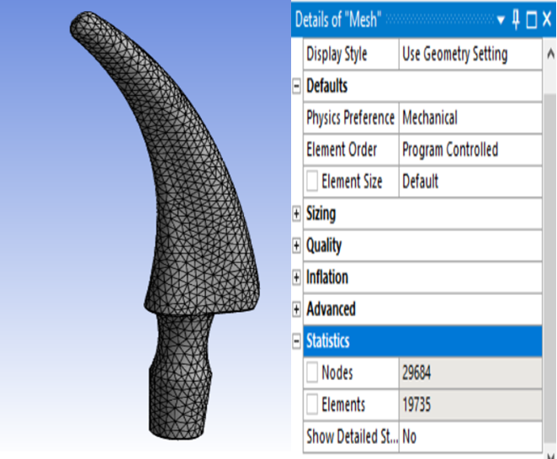
Structural Analysis Results [1/2]
Fig. 6a Meshed Model of the Bracket (Element size= 3mm)
Fig. 6b Meshed Model of the Crutch (Element size= 2mm)

Slide 19
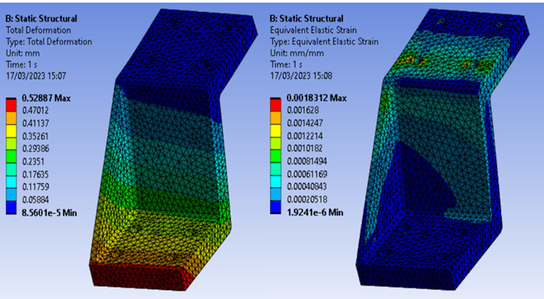
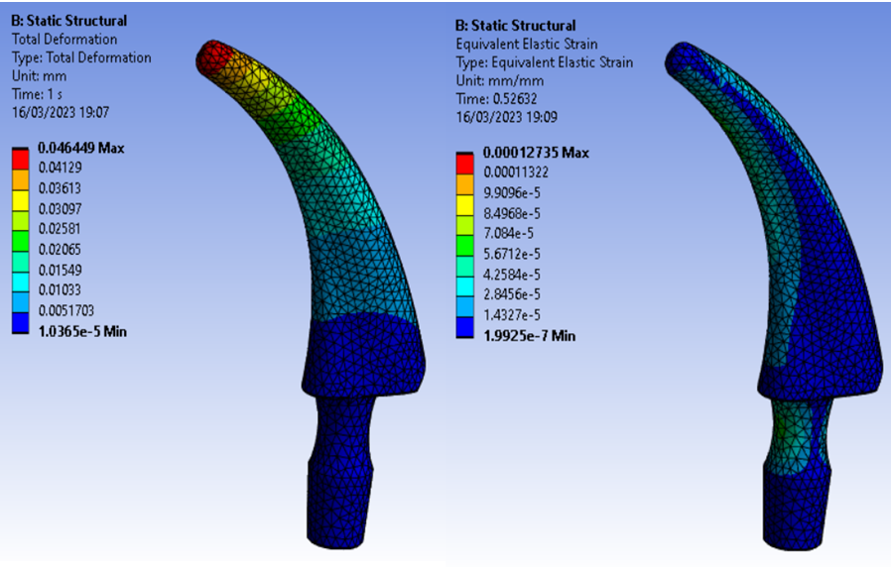
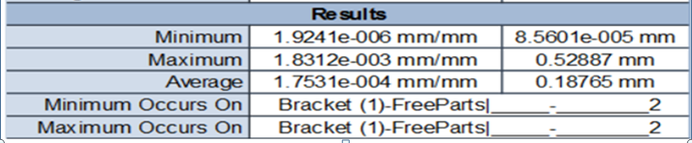
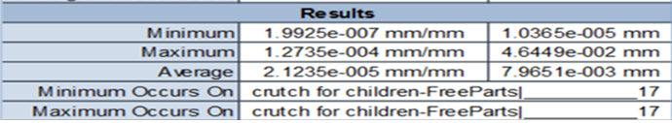
Structural Analysis Results [2/2]
Fig. 7a Total Deformation & von-Mises Strain (Bracket)
Fig. 7b Total Deformation & von-Mises Strain (Crutch)

Slide 20
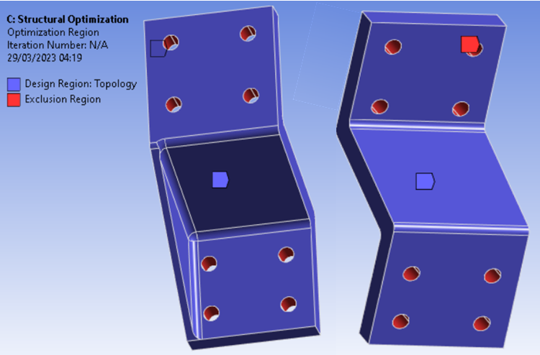
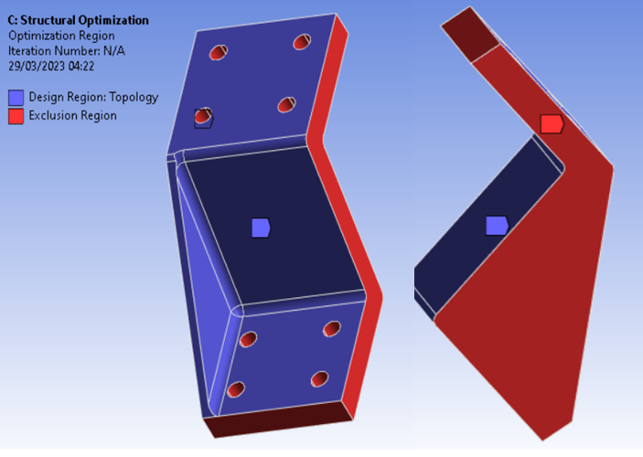
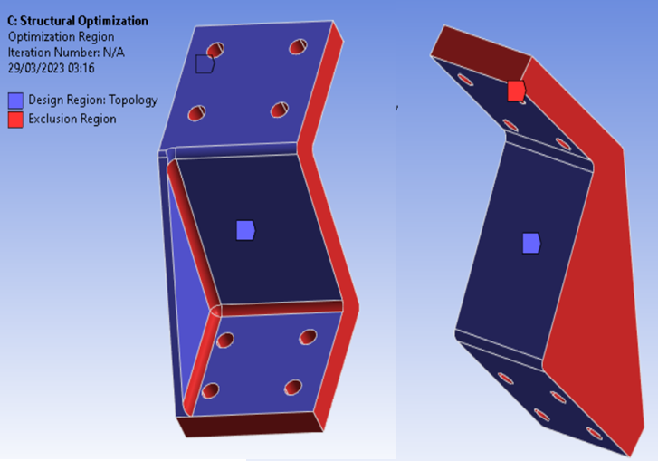
Topology Optimization Setup
Case 1
Case 2
While the blue regions represent the design region of the topology, the exclusion regions is depicted by the red colour.
Three different cases of exclusion regions were considered to ascertain the effect of the optimization region on the mechanical performance of the optimized component.
Case 3
Fig. 8 Different Optimization Exclusion Regions

Slide 21
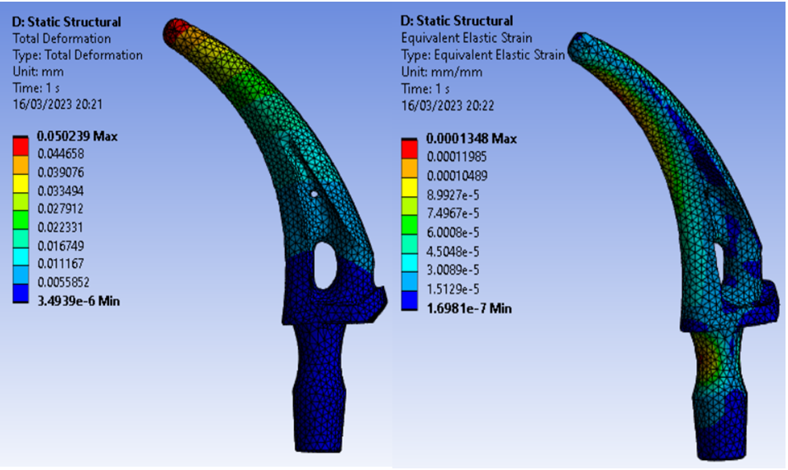
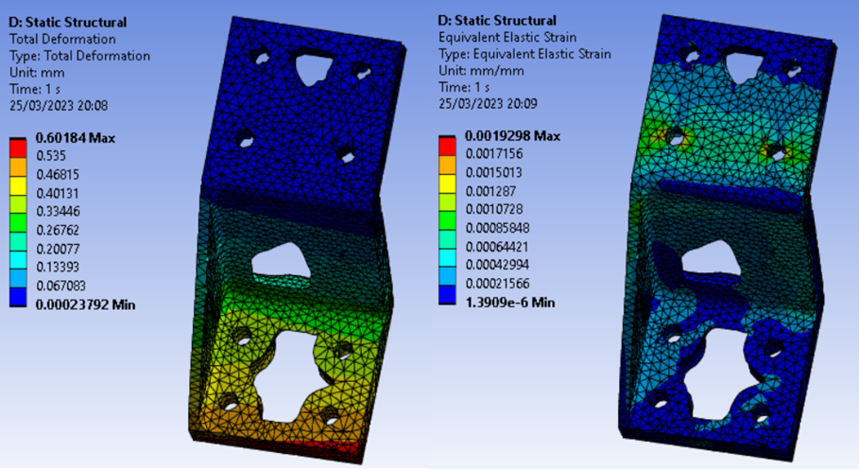
Optimization Results [1/3]
During the optimization, a 20% weight reduction was achieved for both the bracket and crutch.
After the successful optimization, the optimized topology density was transferred back to static structural for validation .
Fig. 9 ANSYS Validation of the Optimized Bracket & Crutch

Slide 22
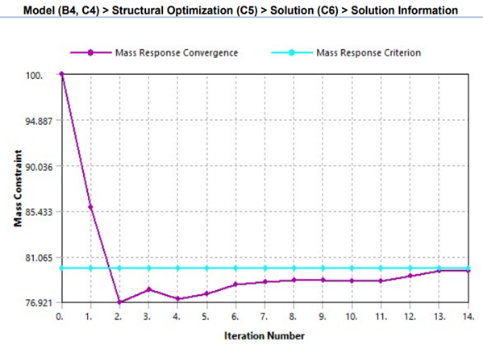
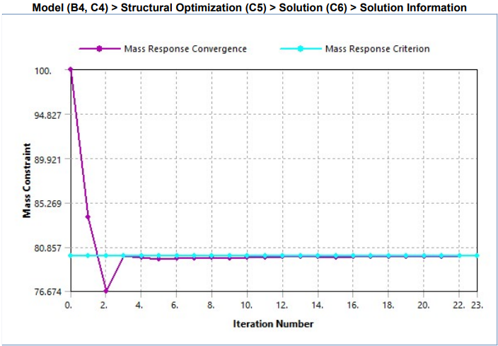
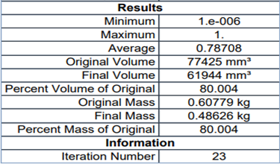
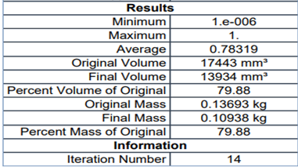
Optimization Results [2/3]
Fig. 10a Mass Response Convergence and Mass Response Criterion (Bracket)
Fig. 10b Mass Response Convergence and Mass Response Criterion (Crutch)

Slide 23
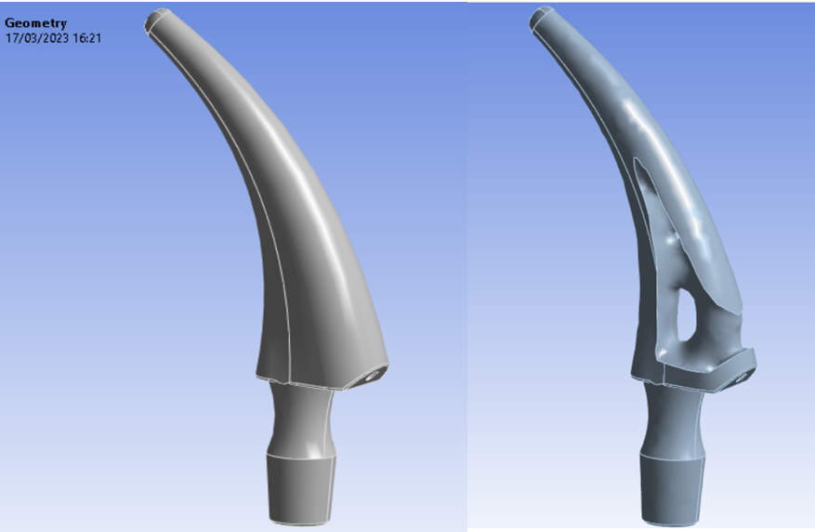
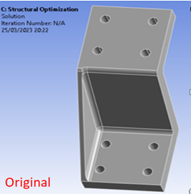
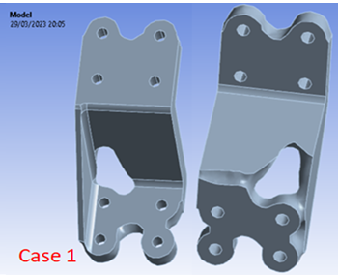
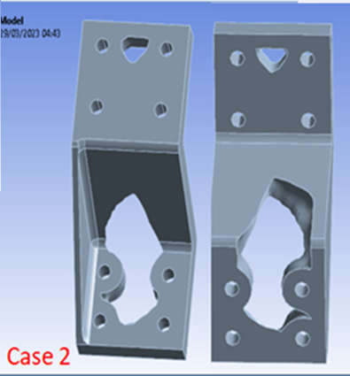
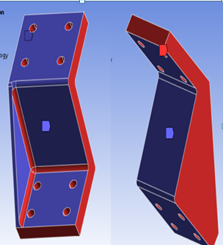
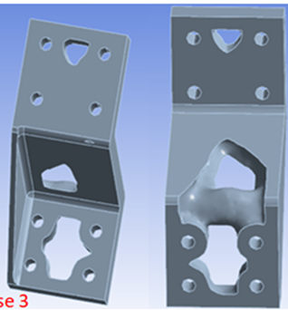
Optimization Results [3/3]
Case 1
Case 2
Case 3
Fig. 11 Optimization Results of Different Exclusion Regions

Slide 24
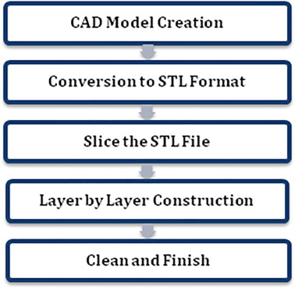
Process flow of a typical FDM Printer [38]
Process flow of a typical FDM Printer [38]
Additive Manufacturing (FDM)
The authors in [27, 28,29,30] noted that the FDM additive manufacturing technique which finds applications in such important areas as aerospace, biomedical, education, fashion, design industries, etc, has been described as one of the most widely and frequently used AM technology especially for non-commercial applications due to its:
Versatility in the production of functional parts which have complex geometry in reasonable production time
Process simplicity,
Low operational cost,
Relatively higher printing speed,
Readily available 3D printers, and
Wide range of availability of thermoplastics.
Fig. 12 FDM Printing Steps [31]

Slide 25
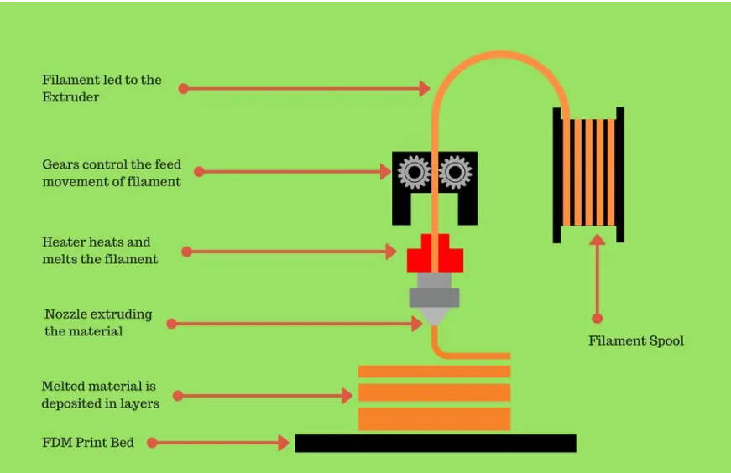
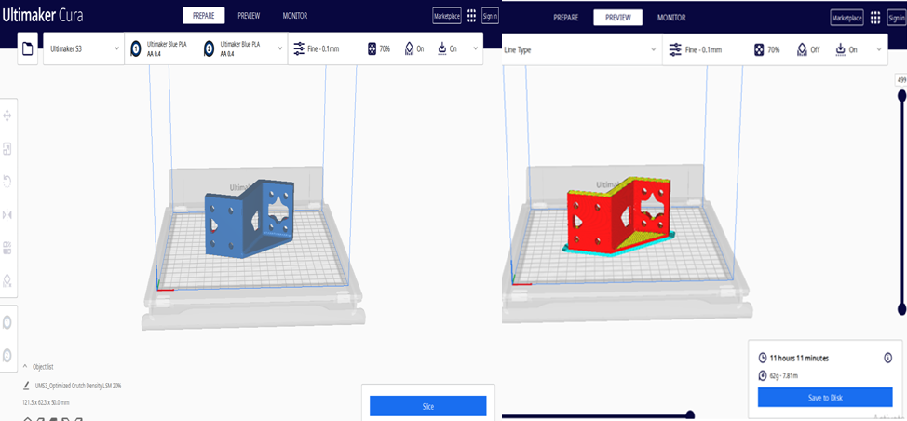
Additive Manufacturing (FDM) [1/2]
Fig. 13 Ultimaker Cura [32]
Fig. 14 Process flow of a typical FDM Printer [33]

Slide 26
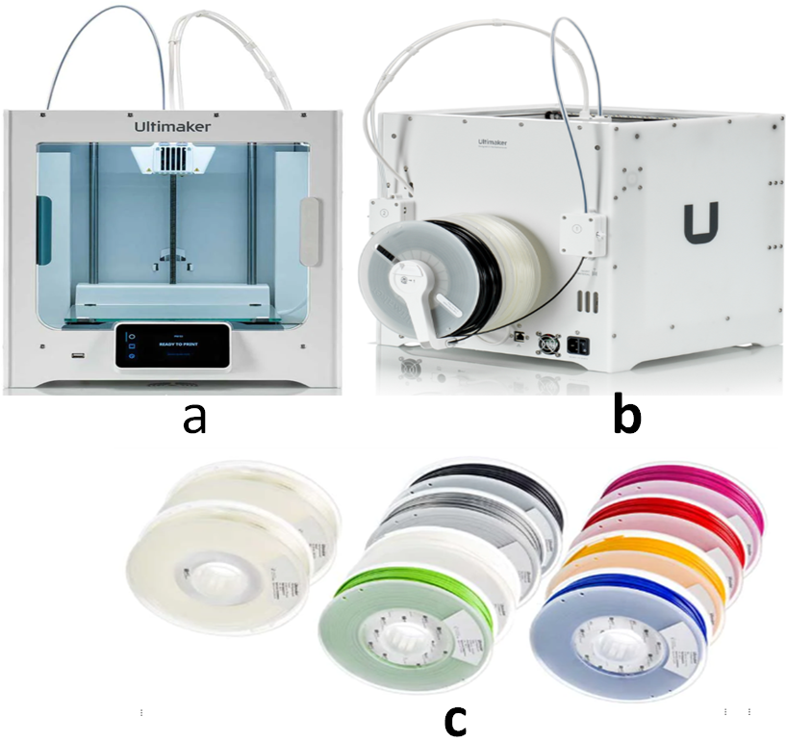
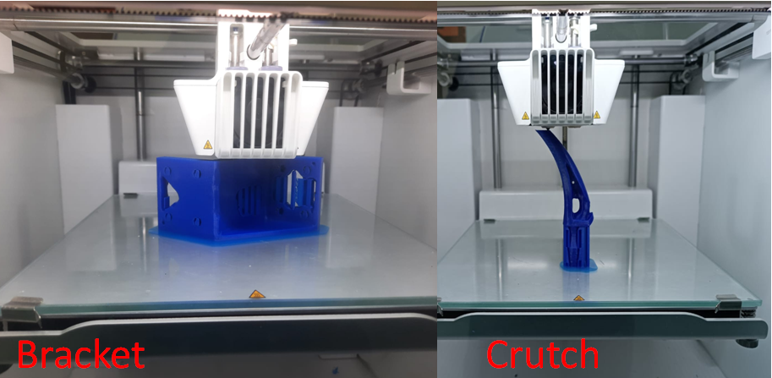
Ultimaker 3D Printer and Spools [49, 50]
Ultimaker 3D Printer and Spools [49, 50]
Ultimaker 3D Printer and Spools [49, 50]
Ultimaker 3D Printer and Spools [49, 50]
Ultimaker 3D Printer and Spools [49, 50]
Ultimaker 3D Printer and Spools [49, 50]
Additive Manufacturing [2/2]
Fig. 15a Ultimaker 3D Printer and Spools [34, 35]
Fig. 15b 3D Printing work in Progress
Printing parameters used:
Printing speed of 65 mm/s
70% infill density, overhang angle of 85 degree for the support material (in the case of the crutch).
Triangle infill pattern, and layer height of 0.1mm.
The extrusion temperatures were 60 and 200°C for the build plate and printing temperatures respectively.

Slide 27
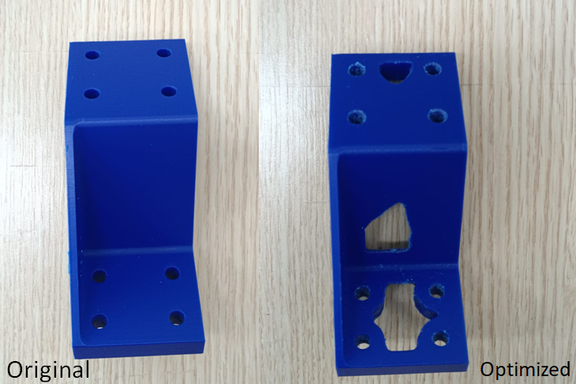
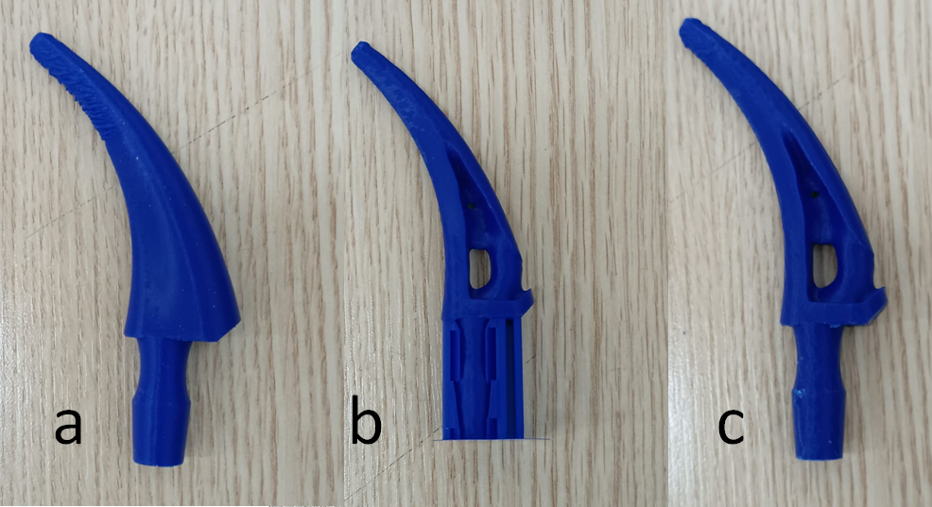
Additive Manufacturing Results
Fig. 16a 3D Printed Bracket
Fig. 16b 3D Printed crutch

Slide 28
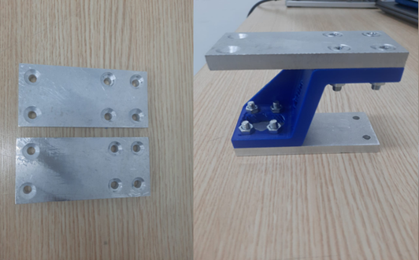
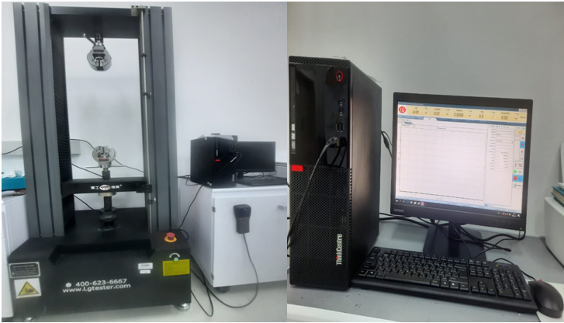
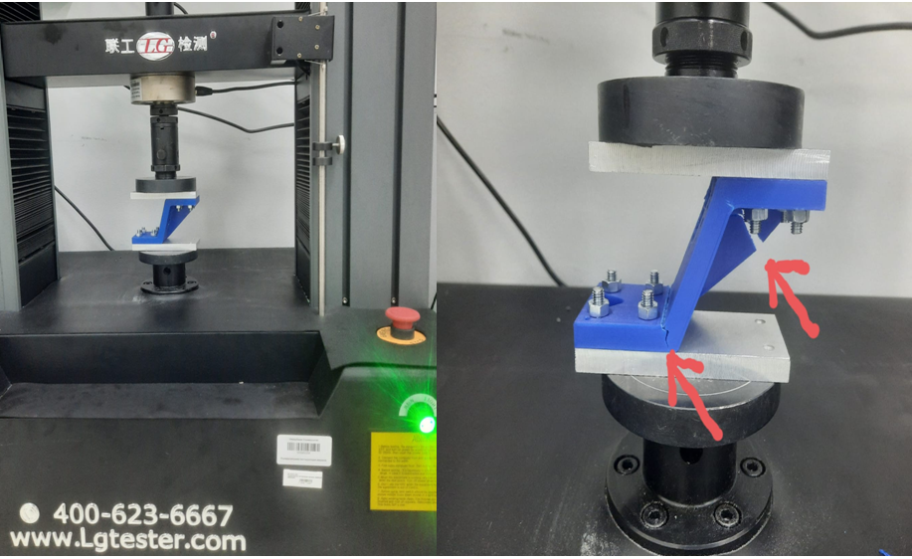
Ultimaker 3D Printer and Spools [49, 50]
Mechanical Compression Testing
Fig. 17b Bracket Fastened to the Fixtures
Fig. 17a LGTester Compression & Tensile Machine[36]
Fig.17c Bracket under Compression

Slide 29
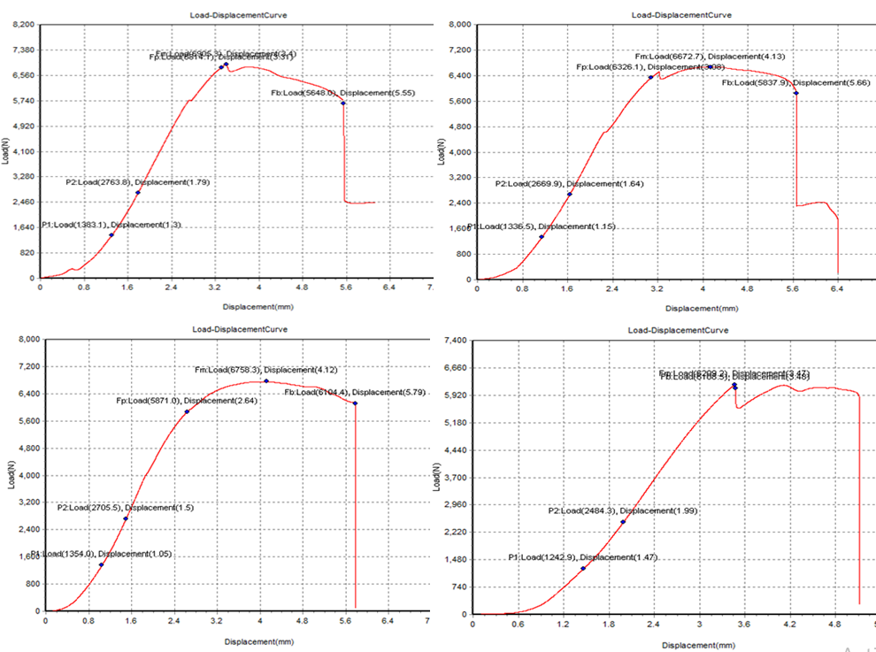

Mechanical Compression Testing Result [1/2]
Fig. 18a Load-Displacement Curve of 3D-printed Original Bracket
Fig. 18a Load-Displacement Curve of 3D-printed Optimized Bracket (Case 2)

Slide 30

Mechanical Compression Testing Result [2/2]
Fig. 19 Load-Displacement Curve of 3D-printed Optimized Bracket (Case3)

Slide 31


Mechanical Compression Testing

Slide 32



Slide 33
The following recommendation is proposed for future direction in the area of topology optimization in additive manufacturing:
Given that in this work, a more optimum optimized model was obtained by carefully adjusting and specifying the optimization region on the software, it therefore becomes of interest to seek more robust and efficient techniques for predicting the stress concentration regions within the design domains so as to eliminate manual input in selecting the optimization regions during the process.

Slide 34
References
1. SME, “Additive Manufacturing Glossary”, Retrieved on the 14 November, 2022 from https://www.sme.org/technologies/additive-manufacturingglossary/#:~:text=ASTM%20F2792%2D12a%20generically%20defines,Sheet%20Lamination%2C%20and%20Vat%20Photopolymerization.
2. Sunil C. Joshi & Abdullah A. Sheikh (2015) 3D printing in aerospace and its long-term sustainability, Virtual and Physical Prototyping, 10:4, 175 185, DOI: 10.1080/17452759.2015.1111519.
3. Formlabs: Topology Optimization 101: How to Use Algorithmic Models to Create Lightweight Design. Retrieved 5th September 2022, from https://formlabs.com/blog/topology-optimization/.
4. A.L.R. Prathyusha, G. Raghu Babu, A review on additive manufacturing and topology optimization process for weight reduction studies in various industrial applications, Materials Today: Proceedings, Volume 62, Part 1, 2022, Pages 109-117, ISSN 2214-7853, https://doi.org/10.1016/j.matpr.2022.02.604.
5. Jihong ZHU, Han ZHOU, Chuang WANG, Lu ZHOU, Shangqin YUAN, Weihong ZHANG, A review of topology optimization for additive manufacturing: Status and challenges, Chinese Journal of Aeronautics, Volume 34, Issue 1, 2021, Pages 91-110, ISSN 1000-9361, https://doi.org/10.1016/j.cja.2020.09.020.
6. Sabiston, Graeme & Kim, Il Yong. (2020). 3D topology optimization for cost and time minimization in additive manufacturing. Structural and Multidisciplinary Optimization. 61. 1-18. 10.1007/s00158-019-02392-7.
7. Ali, M.H., Batai, S. and Sarbassov, D. (2019), "3D printing: a critical review of current development and future prospects", Rapid Prototyping Journal, Vol. 25 No. 6, pp. 1108-1126. https://doi.org/10.1108/RPJ-11-2018-0293
8. Diegel, O. Kristav, P. Motte, D. Kianian B. Additive manufacturing and its effect on sustainable design Handbook of Sustainability in Additive Manufacturing, vol. 1 (2016), pp. 73-99.
9. M Bhuvanesh Kumar, P Sathiya, Methods and materials for additive manufacturing: A critical review on advancements and challenges, Thin-Walled Structures, Volume 159, 2021, 107228, ISSN 0263-8231, https://doi.org/10.1016/j.tws.2020.107228
10. Thomas, Douglas. (2016). Costs, Benefits, and Adoption of Additive Manufacturing: A Supply Chain Perspective. The International Journal of Advanced Manufacturing Technology. 85. 10.1007/s00170-015-7973-6.
11. Pérez, Mercedes & Carou, Diego & Rubio, Eva & Teti, Roberto. (2020). Current advances in additive manufacturing. 88. 439-444. 10.1016/j.procir.2020.05.076.
12. Prabhakar, M. & Saravanan, A.K. & Lenin, A. & leno, I. & Mayandi, K. & Piramanayagam, Sethu Ramalingam. (2020). A short review on 3D printing methods, process parameters and materials. Materials Today: Proceedings. 45. 10.1016/j.matpr.2020.10.225.
13. Sigmund O, Maute K. Topology optimization approaches. Structural and Multidisciplinary Optimization. 2013;48(6):1031-1055
14. Bendsoe, M.P. and Kikuchi, N. (1988) Generating Optimal Topologies in Structural Design Using a Homogenization Method. Computer Methods in Applied Mechanics and Engineering, 71, 197-224.
https://doi.org/10.1016/0045-7825(88)90086-2
15. van Dijk, N.P., Maute, K., Langelaar, M. et al. Level-set methods for structural topology optimization: a review. Struct Multidisc Optim 48, 437–472 (2013). https://doi.org/10.1007/s00158-013-0912-y.
16. Lopes, C.G., Novotny, A.A. Topology design of compliant mechanisms with stress constraints based on the topological derivative concept. Struct Multidisc Optim 54, 737–746 (2016). https://doi.org/10.1007/s00158-016- 1436-z.

Slide 35
References
17. Stanley Osher, James A Sethian. Fronts propagating with curvature-dependent speed: Algorithms based on Hamilton-Jacobi formulations. Journal of Computational Physics, Volume 79, Issue 1, 1988, Pages 12-49, ISSN 0021-9991, https://doi.org/10.1016/0021-9991(88)90002-2.
18. Bendsøe, M. P., & Sigmund, O. (2007). Topology optimization. In Optimization of Structural and Mechanical Systems (pp. 161-194).
19. Huang, X., Xie, YM. A further review of ESO type methods for topology optimization. Struct Multidisc Optim 41, 671–683 (2010). https://doi.org/10.1007/s00158-010-0487-9
20. Dunning, P.D., Kim, H.A. Introducing the sequential linear programming level-set method for topology optimization. Struct Multidisc Optim 51, 631–643 (2015). https://doi.org/10.1007/s00158-014-1174-z
21. A.W. Gebisa, H.G. Lemu, A case study on topology optimized design for additive manufacturing, IOP Conf. Ser.: Mater. Sci. Eng. 276 (2017) 012026, https://doi.org/10.1088/1757-899X/276/1/012026
22. Kambampati, Sandilya, Du, Zongliang, Chung, Hayoung, Kim, Hyunsun A. , Jauregui, Carolina, Townsend, Scott, Picelli, Renato, Zhou, Xiao-Yi and Hedges, Lester 2018. OpenLSTO: Open-source software for level set topology optimization. Presented at: 2018 Multidisciplinary Analysis and Optimization Conference,Atlanta, GA, USA, 25-29 June 2018. -. 10.2514/6.2018-3882
23. G.A. Haveroth, C.-J. Thore, M.R. Correa, R.F. Ausas, S. Jakobsson, J.A. Cuminato, A. Klarbring, Topology optimization including a model of the layer-by-layer additive manufacturing process, Computer Methods in Applied Mechanics and Engineering, Volume 398, 2022, 115203, ISSN 0045-7825, https://doi.org/10.1016/j.cma.2022.115203.
24. Guanghui SHI, Chengqi GUAN, Dongliang QUAN, Dongtao WU, Lei TANG, Tong GAO, An aerospace bracket designed by thermo-elastic topology optimization and manufactured by additive manufacturing, Chinese Journal of Aeronautics, Volume 33, Issue 4, 2020, Pages 1252-1259, ISSN 1000-9361, https://doi.org/10.1016/j.cja.2019.09.006.
25. Querin OM, Victoria M, Gordoa CA, Ansola R, Martí P. Topology Design Methods for Structural Optimization. London: Academic Press; 2017.
26. ANSYS: https://www.ansys.com/.
27. Monzon, Mario & Ortega, Zaida & Martínez, A. & Ortega, F.. (2014). Standardisation in additive manufacturing: Activities carried out by international organizations and projects. The International Journal of Advanced Manufacturing Technology. 76. 1111-1121. 10.1007/s00170-014-6334-1.
28. Rayegani, F. and Onwubolu, G.C. (2014) Fused Deposition Modelling (Fdm) Process Parameter Prediction and Optimization Using Group Method for Data Handling (Gmdh) and Differential Evolution (De). The International Journal of Advanced Manufacturing Technology, 73, 509-519.https://doi.org/10.1007/s00170-014-5835-2.
29. Pooja Patil, Dharmendra Singh, Sunil J. Raykar, Jaiprakash Bhamu, Multi-objective optimization of process parameters of Fused Deposition Modeling (FDM) for printing Polylactic Acid (PLA) polymer components, Materials Today: Proceedings, 2021, ISSN 2214-7853. https://doi.org/10.1016/j.matpr.2021.01.353.
30. Przemysław Siemiński, Chapter 7 - Introduction to fused deposition modeling, Editor(s): Juan Pou, Antonio Riveiro, J. Paulo Davim, In Handbooks in Advanced Manufacturing, Additive Manufacturing,Elsevier, 2021, Pages 217-275,ISBN 9780128184110, https://doi.org/10.1016/B978-0-12-818411-0.00008-2.
31. UltiMaker Cura 5.3.0-beta.1. 2023. Retrieved on 30th March, 2023 from https://github.com/Ultimaker/Cura/releases/tag/5.3.0-beta.1.
32. Ultimaker Material, PLA. Retrieved on the 30th March, 2023 from https://ultimaker.com/materials/pla.
33. Ultimaker 3D printers. Retrieved on the 30th March, 2023 from https://ultimaker.com/3d-printers.
34. Ultimaker. The Wildest Material choice on the Market. Retrieved on the 30th March, 2023 from The widest material choice on the market | Ultimaker.
35. LGTester: http://www.lgtester.com/

Slide 36
Thank you for your attention!

