Slide 1
Development of a Thermal Design Model for a Small Spacecraft with an Integrated Heat Pipe
Medina Yensebayeva
2nd Year Master in Mechanical and Aerospace Engineering
Supervisor: Professor Christos Spitas
Co-Supervisor: Professor Michael Young Zhao

Slide 2
Outline
Background
Problem statement
Aim and objectives
Methodology
Literature review
Current progress and results
Contribution to knowledge
Conclusion and future work

Slide 3
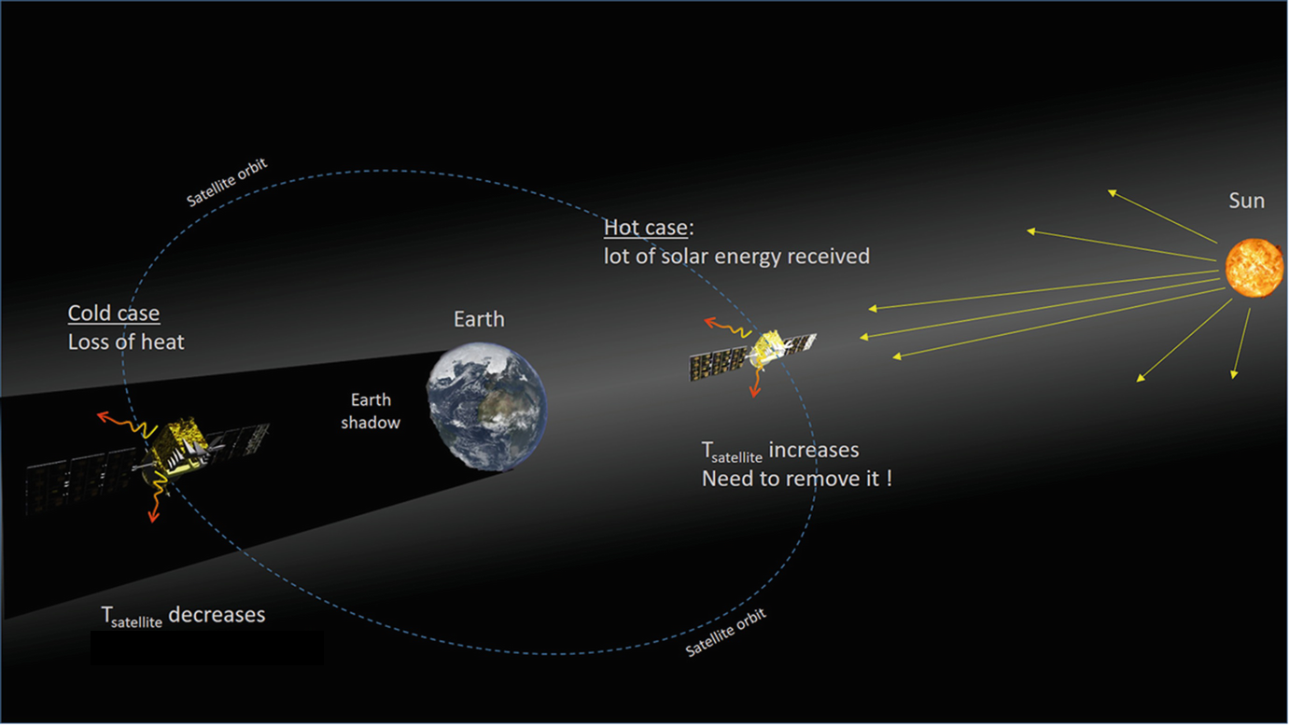
Background and problem statement
Temperature conditions apply to every component of the payload and spacecraft bus.
These specifications might include an operation and a survival thermal gradient that, if exceeded, could result in degraded performance of the satellite.
Figure 1. Satellite in space. Adapted from [1]

Slide 4
Satellite structure
Figure 2. Satellite subsystems. Adapted from [2]

Slide 5
Heat pipe operation
A heat pipe is a two-phase heat transfer device with a very high effective thermal conductivity. It is a vacuum-tight device consisting of an envelope, a working fluid, and a wick structure.
Figure 3. Heat pipe configuration. Adapted from [3]

Slide 6
Aim and objectives
Research Aim:
To achieve a better understanding of the heat pipe physical processes and design a network of heat pipes to transmit heat from the sun-heated side to the cold side of the structure, therefore balancing the temperature. This network can also be utilized in satellites to disperse heat generated by electronic parts
Research Objectives:
Design a new satellite heat transfer network
Implement a numerical finite element model in order to simulate the thermal model of a heat pipe
Develop a lumped parameter model for the thermal management of the satellite.

Slide 7
Methodology
Data collection: literature review, conceptual design analysis
A numerical finite element model will be presented in order to simulate the thermal model of a heat pipe and based on that a lumped parameter model will be developed further.
The simulations output will be compared with the outputs of the mathematical model to physically justify that the model represents the FE model correctly
Data collection
FEA analysis on COMSOL Multiphysics
Building a lumped parameter model on MATLAB Simulink
Comparison with Mathematical model

Slide 8
Literature review
Key observation:
The working fluid in the most of heat pipes for satellite systems and electronics cooling is Ammonia or Methanol.
The temperature of the heat pipe must be regulated based on the cooling circumstances
Availability of thermal network using heat pipe on the concept of lumped parameter model
Working fluid for a heat pipe
Transport limitations

Slide 9
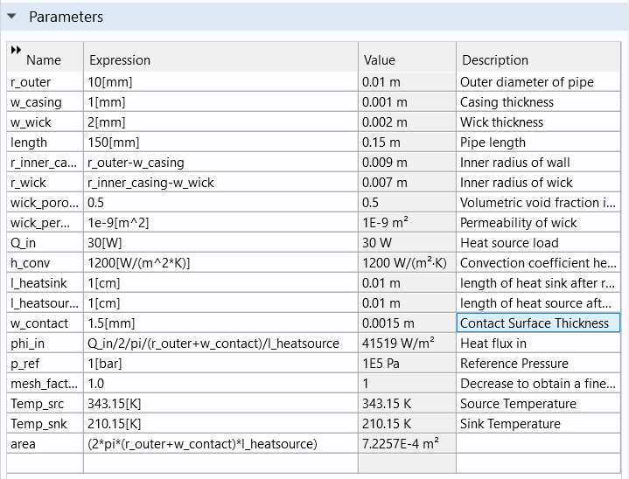
Parameters of a heat pipe
Based on parameters, a 2D axisymmetric design of a cylindrical heat pipe was created. The dimensions of the heat pipe is shown in Fig. 4.
Figure 4. Parameters of a heat pipe

Slide 10
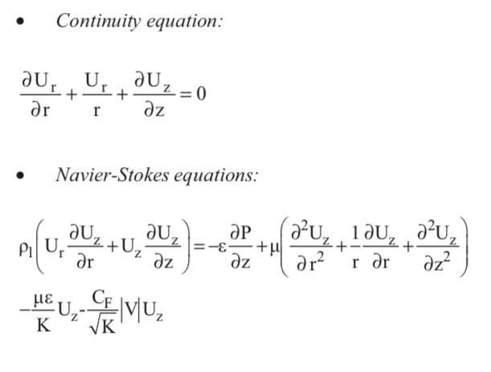
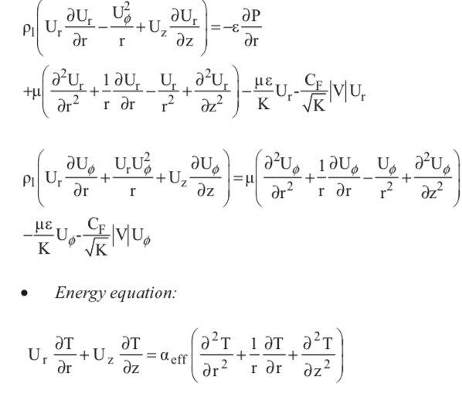
Governing equation

Slide 11
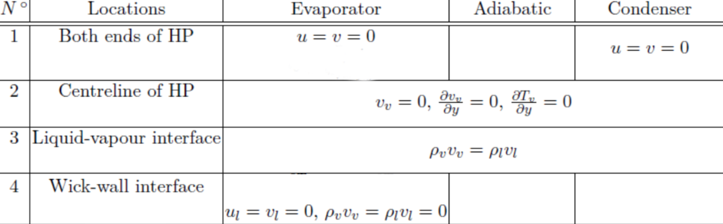
Boundary condition
Table 1. Boundary condition

Slide 12
Physical setup
Laminar flow
Heat Transfer in Porous media
Brinkman equation

Slide 13
Material setup and mesh
Material properties are created using the Thermodynamics node. Copper from the material library is used for the properties in the tube wall.
Quadrilaterаl mesh fоr the centrе part of the hеat pipe and triаngular meshes for the еnds was used.
Figure 5. Mesh

Slide 14
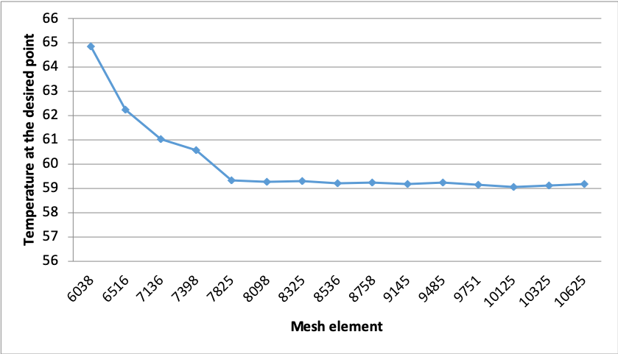
Mesh convergence
While increasing the number of elements, the solution outputs are converged to a specific value.
Figure 6. Mesh convergence

Slide 15
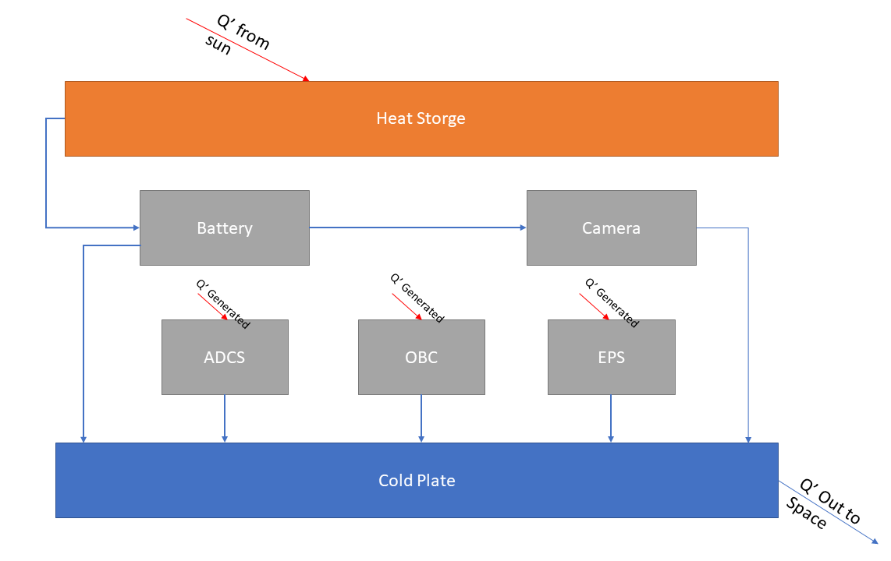
Satellite heat pipe network schematic
The key point for this analysis is that each subsystem in the model is at thermal equilibrium so the heat flow rate and temperature of them can be calculated based on that.
[3] was taken as a benchmark for future work
Subsystem | Min. Operating temp. (°C) | Max. Operating temp. (°C)
Battery | 0 | 45
Camera | 0 | 45
ADCS | -50 | 60
OBC | -40 | 85
EPS | -40 | 105
Figure 7. Satellite scheme
Table 2. Subsystem's operational range

Slide 16
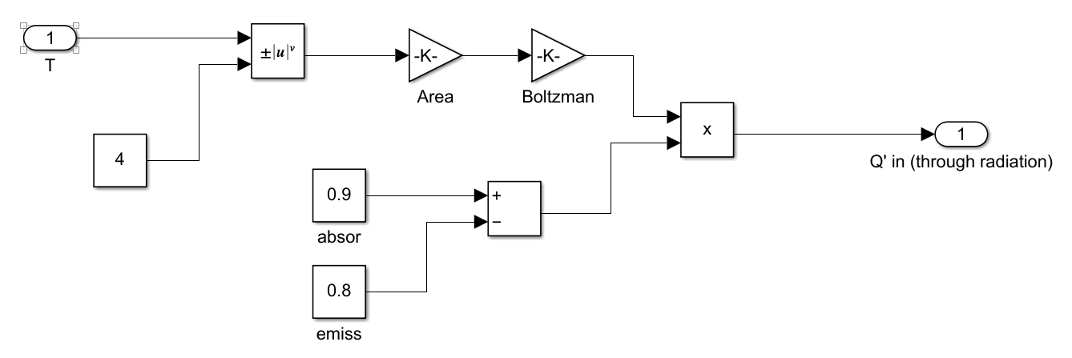
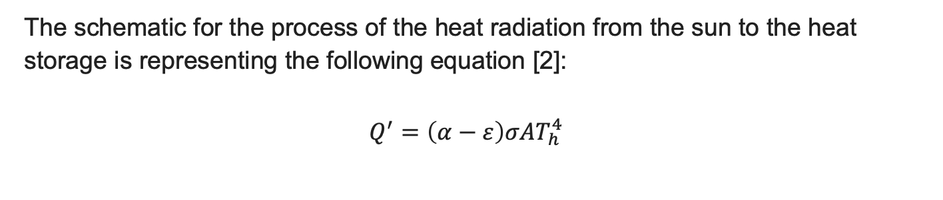
Heat storage subsystem
The schematic for the process of the heat radiation from the sun to the heat storage is representing the following equation [2]:
$$Q^{′}=\left(α−ε\right)σAT_{h}^{4}$$
Figure 8. Heat source subsystem

Slide 17
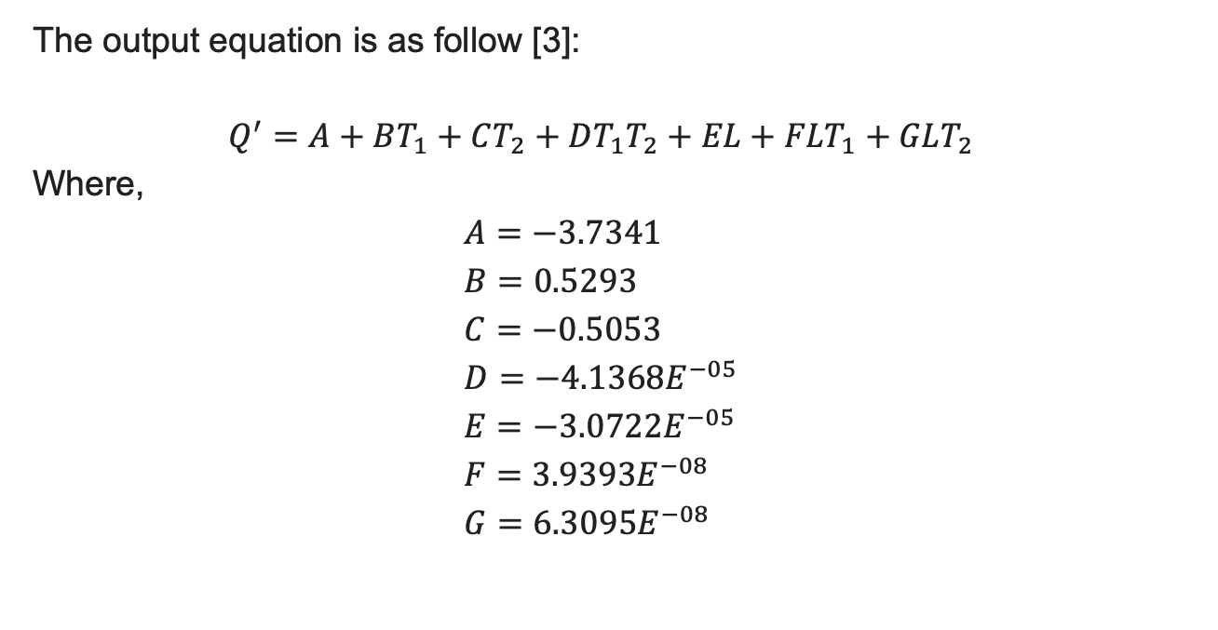
Heat pipe subsystem coefficients
The output equation is as follow [3]:
$$Q^{′}=A+BT_{1}+CT_{2}+DT_{1}T_{2}+EL+FLT_{1}+GLT_{2}$$
Where,
$$A=−3.7341 \\ B=0.5293 \\ C=−0.5053 \\ D=−4.1368E^{−05} \\ E=−3.0722E^{−05} \\ F=3.9393E^{−08} \\ G=6.3095E^{−08}$$

Slide 18
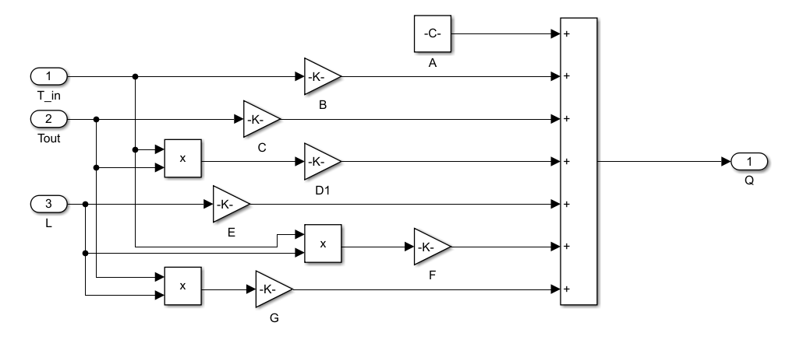
The heat pipe is modeled in the Simulink model using estimated algebraic equation (mathematical model section), and it has 3 representations. The first, T_in, T_out and L are inputs for the model and Q’ is the output
Heat pipe subsystem
Figure 9. Heat pipe subsystem

Slide 19
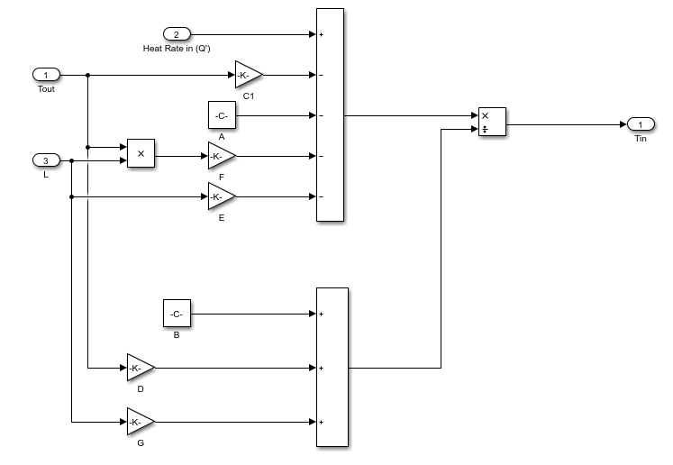
Heat pipe subsystem
The second representation, Q’, T_in and L are inputs and T_out is the output.
Figure 10. Heat pipe subsystem

Slide 20
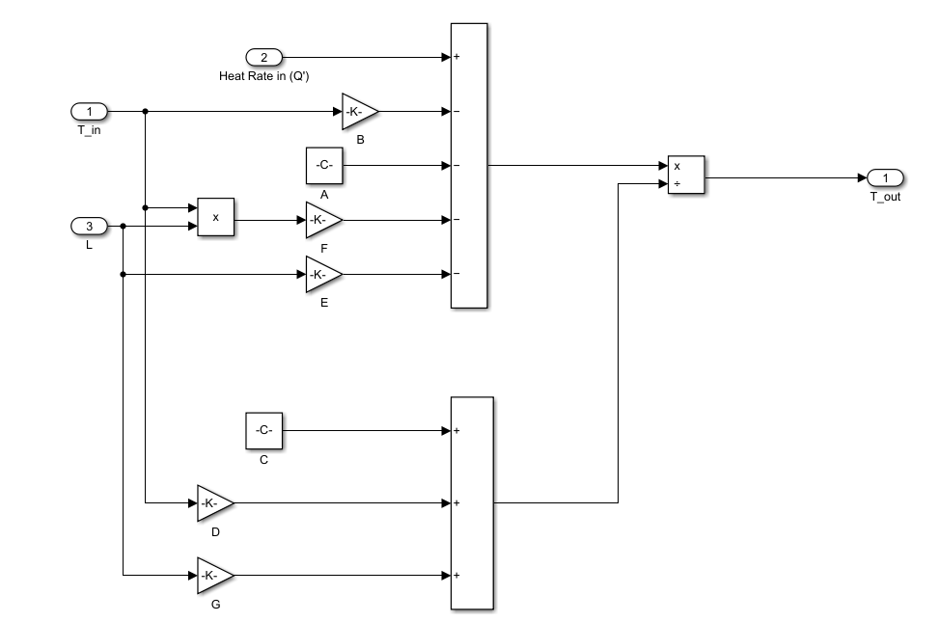
Heat pipe subsystem
The inputs here are T_in, L and Q’. similar to the first one, The mathematical operations are done on the input parameters to find the output (T_out).
Figure 11. Heat pipe subsystem

Slide 21
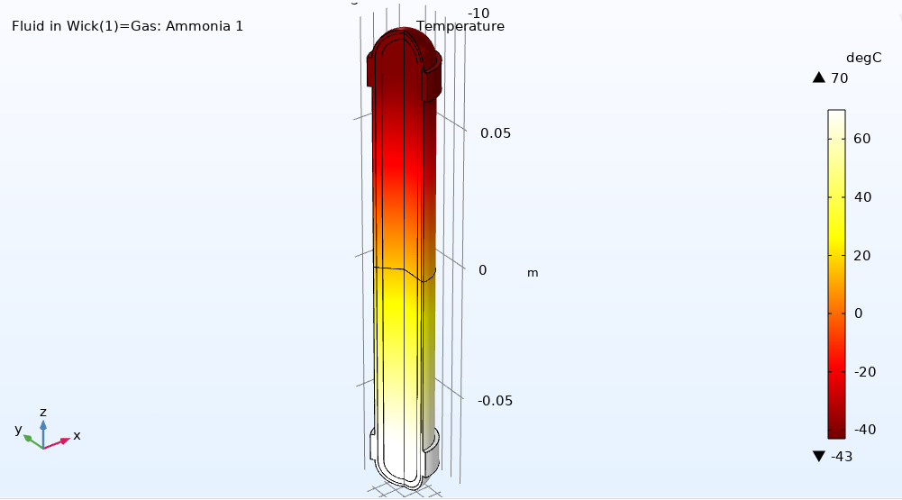
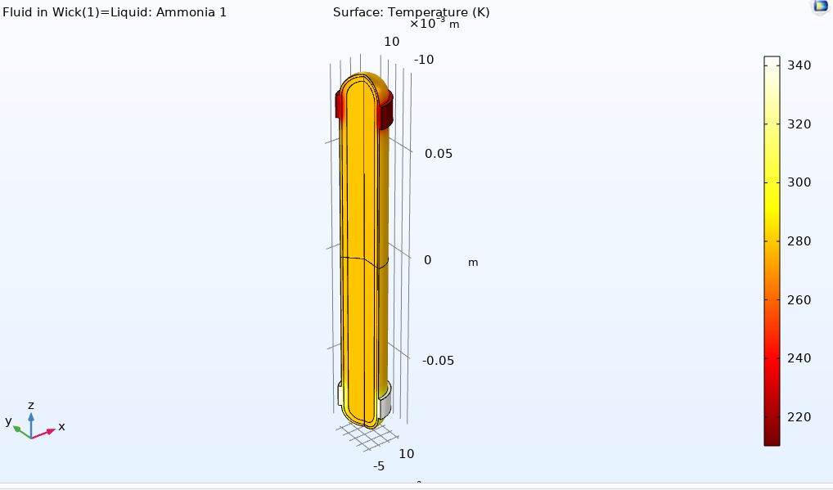
Heat pipe simulation
Figure 12.Temperature of heat pipe with dry wick
Figure 13.Temperature of heat pipe with saturated wick.

Slide 22
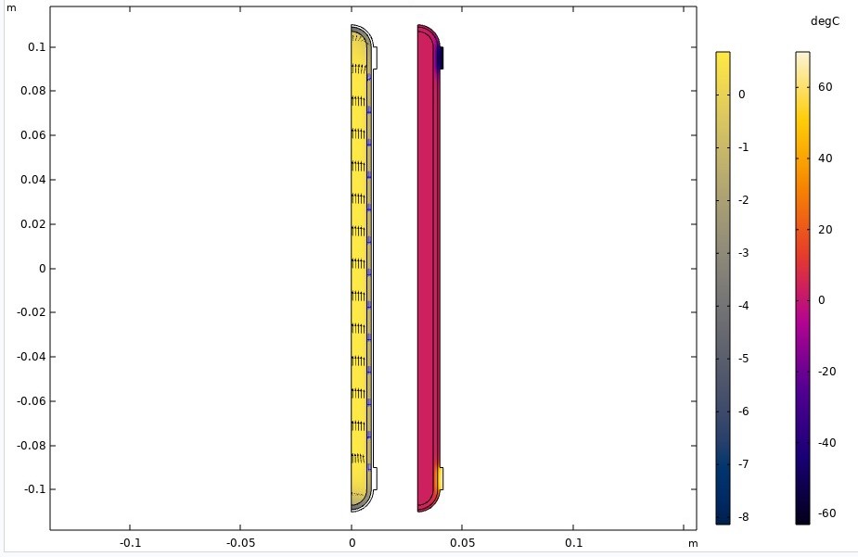
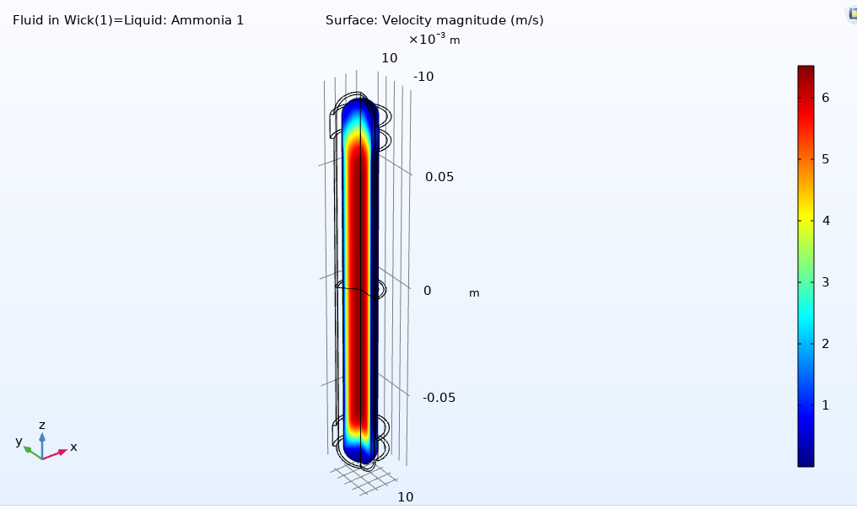
Velocity magnitude and temperature profile
Figure 14.Velocity magnitude profile
Figure 15. Fluid vеlocities and temperature in the hеat pipe running at the dеsign pоint

Slide 23
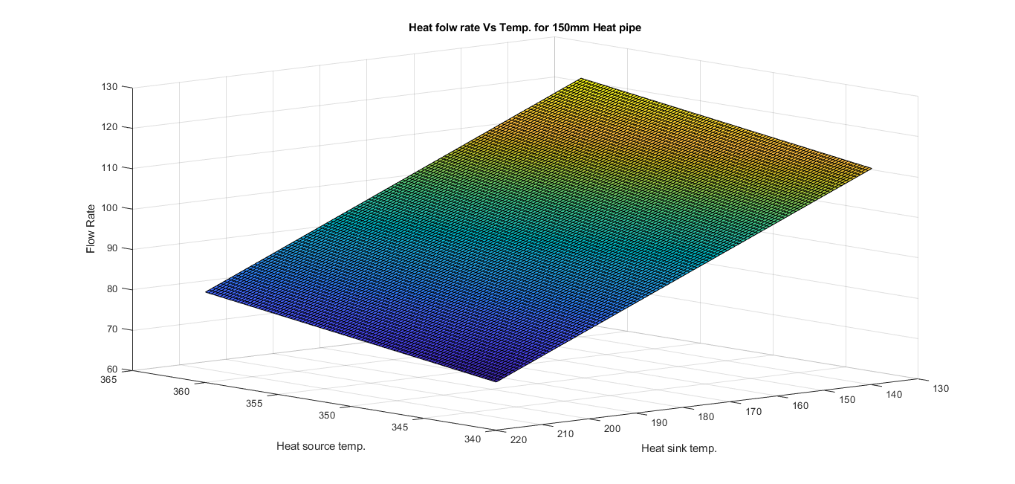
Heat flow rate vs Temperature
Figure 16. Heat flow rate vs Temperature relation

Slide 24
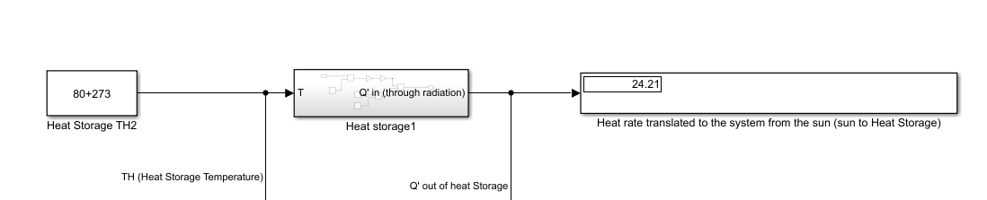
Lumped parameter model-part 1
Heat radiated to the hear storage ,it shows that this subsystem gets 24.21W from the solar radiation to keep it at 80°C. Heat is totally translated to the battery through the heat pipe.
Figure 17. Lumped parameter model-part 1

Slide 25
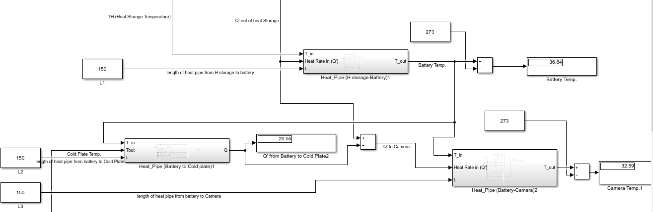
Lumped parameter model-part 2
Figure 18. Lumped parameter model-part 2

Slide 26
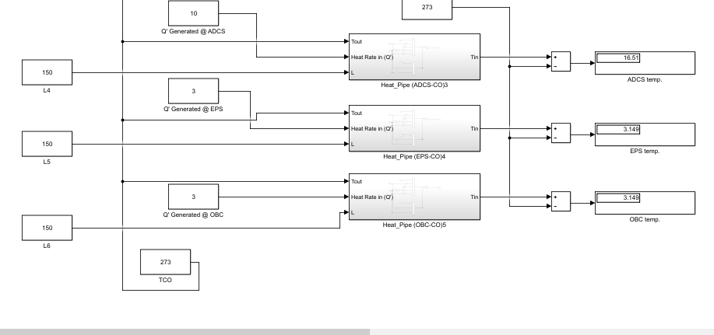
Lumped parameter model-part 3
Figure 19. Lumped parameter model-part 3

Slide 27
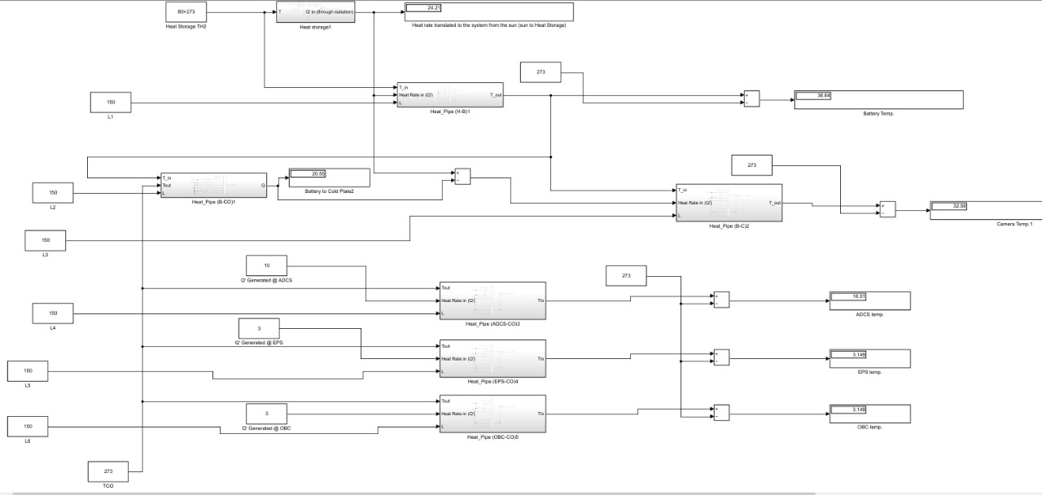
Lumped parameter model scheme

Slide 28
Temperature and Heat flow rate
Subsystem | Temperature (°C) | Heat Flowrate (W)
Heat Source | 80 | 24.21
Battery | 36.64 | 24.21
Camera | 32.59 | 3.66
ADCS | 16.51 | 10
EPS | 3.149 | 3
OBC | 3.149 | 3
Cold Plate | 0 | 40.21
The temperature and heat flow rate calculated for each subsystem is represented below and based on the literature it satisfy the operational range.
Table 3. Subsystem's temperature and heat flow rate

Slide 29
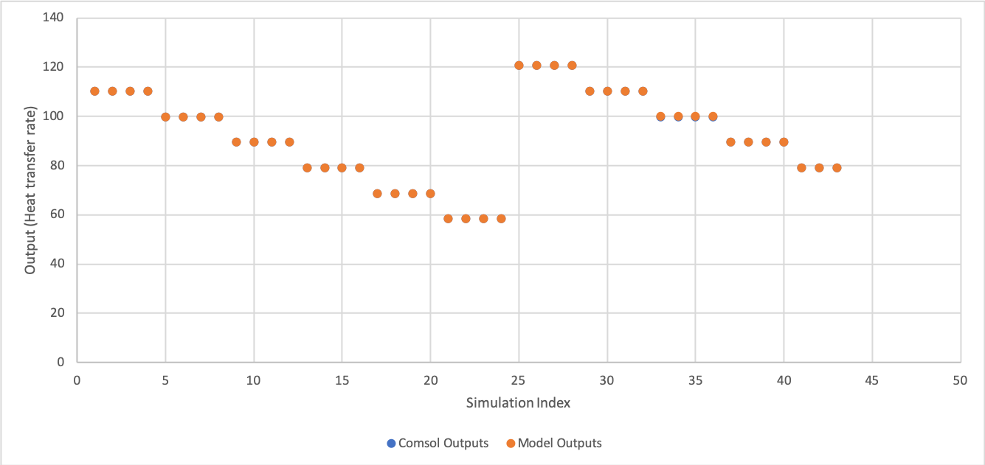
Mathematical model vs FE model
The simulations’ output is compared with the outputs of the mathematical model to verify that the model represents the FE model correctly. The comparison shows average error of 0.016976744% which is very low value.
Figure 20. Mathematical model vs FE model.

Slide 30
Contribution to knowledge
A new satellite heat transfer network was designed
A lumped parameter model for the better thermal management of the satellite was developed.

Slide 31
Conclusion and future work
A numerical finite element model presented in order to simulate the thermal model of a heat pipe
A lumped parameter model was developed further as an engineering-approach tool for the better thermal management of the satellite
There can be futuristic modification to make the model more specific by adding other parameters as pipe outer and internal diameter (D & d), the wick thickness (t) and the wick porous emissivity (e).

Slide 32
References
S. J. Dong, Y. Z. Li, J. Wang, and J. Wang, “Fuzzy incremental control algorithm of loop heat pipe cooling system for spacecraft applications,” Comput. Math. with Appl., vol. 64, no. 5, pp. 877–886, 2012, doi: 10.1016/j.camwa.2012.01.030.
C. Hoa, B. Demolder, and A. Alexandre, “Roadmap for developing heat pipes for ALCATEL SPACE’s satellites,” Appl. Therm. Eng., vol. 23, no. 9 SPEC., pp. 1099–1108, 2003, doi: 10.1016/S1359-4311(03)00039-5.
[G. Cluzet, “(12) Patent Application Publication (10) Pub. No.: US 2004/0040691 A1,” vol. 1, no. 19, 2004.
P. D. Tegenaw, M. G. Gebrehiwot, and M. Vanierschot, “On the comparison between computational fluid dynamics (CFD) and lumped capacitance modeling for the simulation of transient heat transfer in solar dryers,” Sol. Energy, vol. 184, no. March 2018, pp. 417–425, 2019, doi: 10.1016/j.solener.2019.04.024.
X. Cui et al., “Optimization of the lumped parameter thermal model for hard-cased li-ion batteries,” J. Energy Storage, vol. 32, no. March, p. 101758, 2020, doi: 10.1016/j.est.2020.101758.
P. Nemec, A. Čaja, and M. Malcho, “Mathematical model for heat transfer limitations of heat pipe,” Math. Comput. Model., vol. 57, no. 1–2, pp. 126–136, 2013, doi: 10.1016/j.mcm.2011.06.047.
M. Ando et al., “On-orbit demonstration of oscillating heat pipe with check valves for space application,” Appl. Therm. Eng., vol. 130, pp. 552–560, 2018, doi: 10.1016/j.applthermaleng.2017.11.032.

Slide 33
Thank you!

