Slide 1

Properties of Geopolymer Mortar Containing Waste Glass Aggregates and Glass Bubbles
Student: Nurtay Kozhageldi Research Supervisor: Professor Chang-Seon Shon

Slide 2
Outline
Introduction
Research Objectives
Research Methodology
Results and Discussion
Conclusion
Limitations and Recommendations
References

Slide 3
Introduction
Sustainability
Economy
Society
Environment
Environmentally friendly
Cost-effective
Accepted by people
Figure 1. Sustainability definition

Slide 4
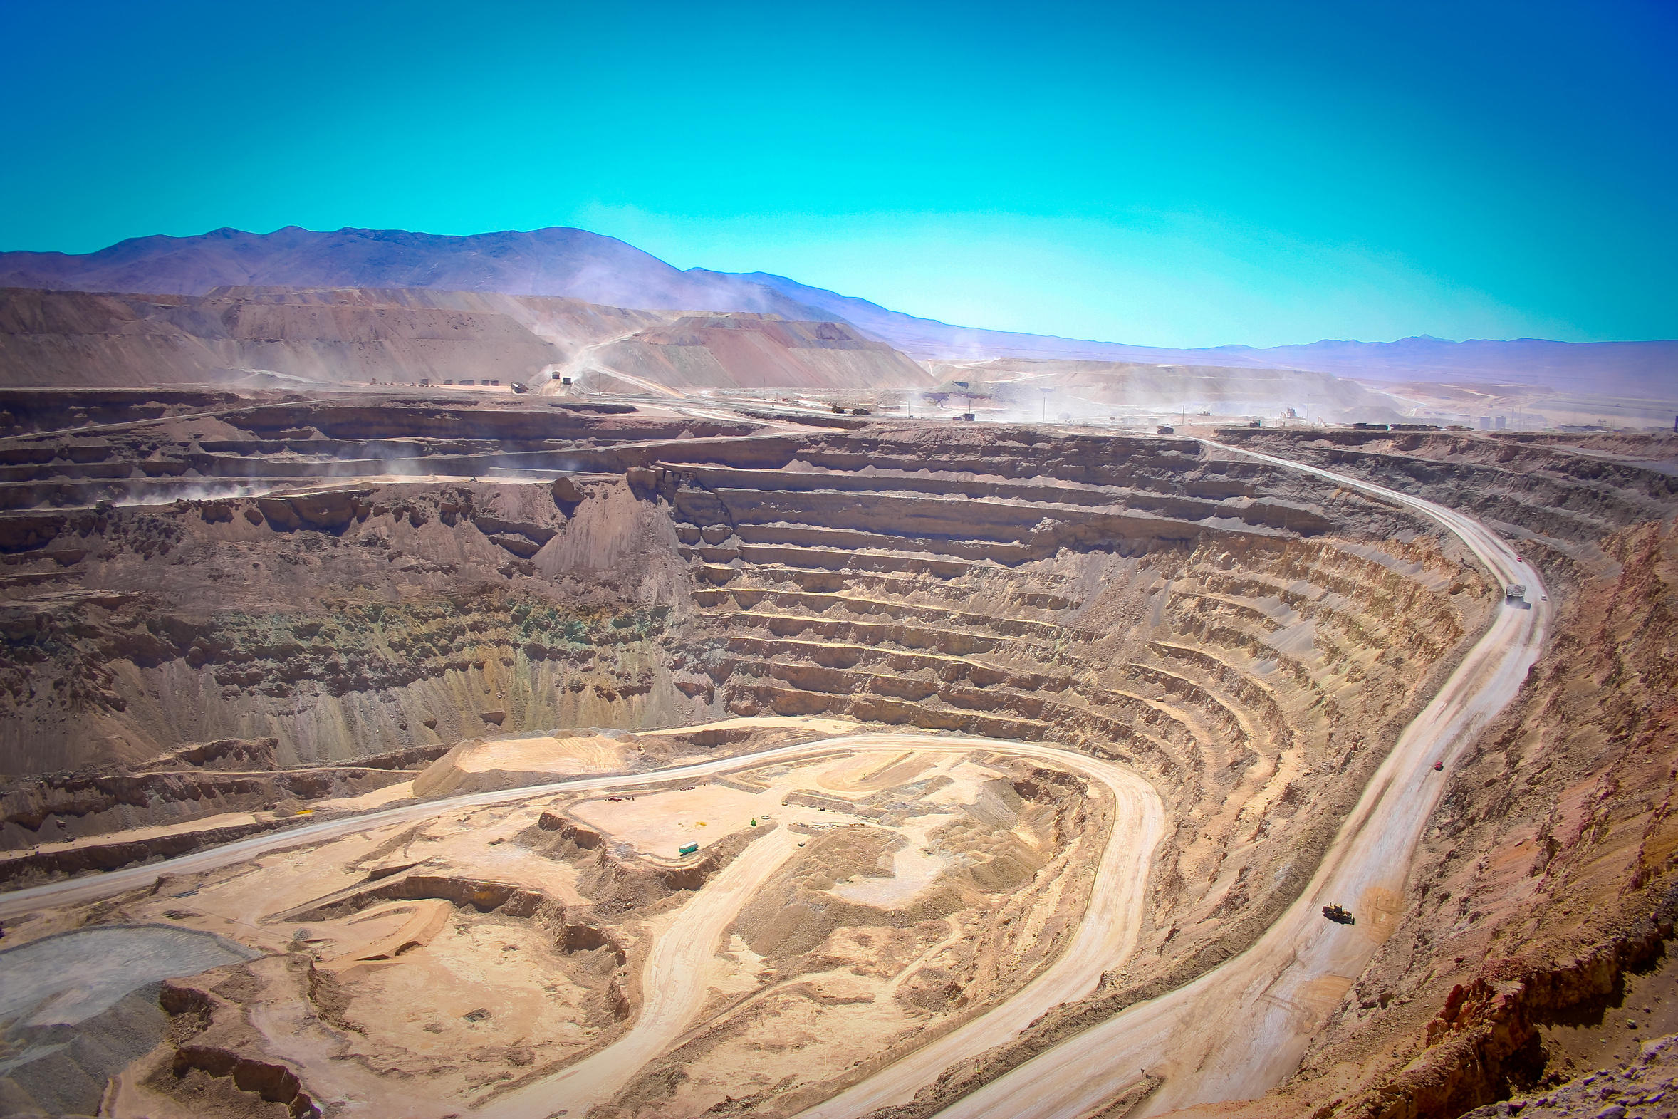
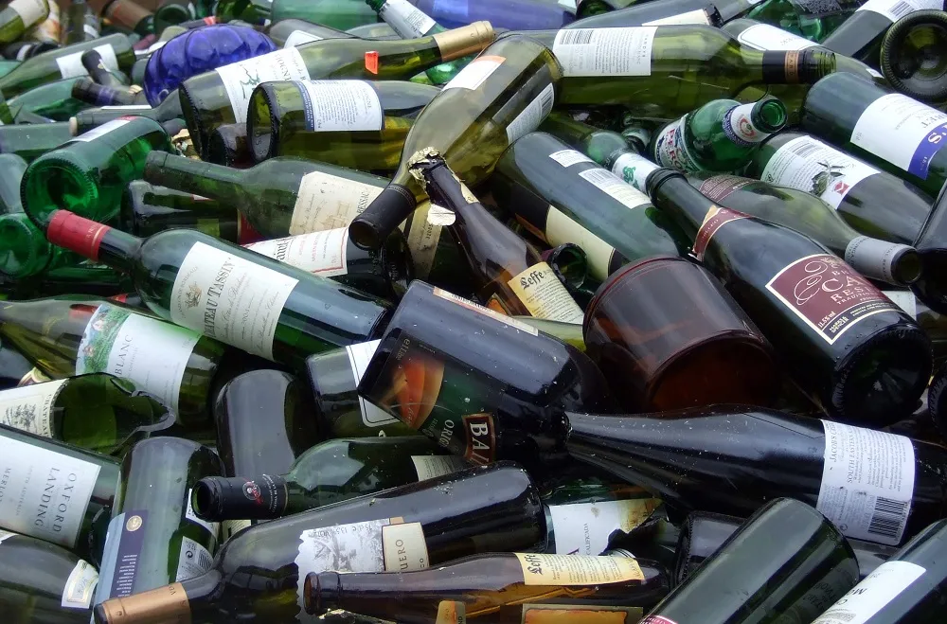
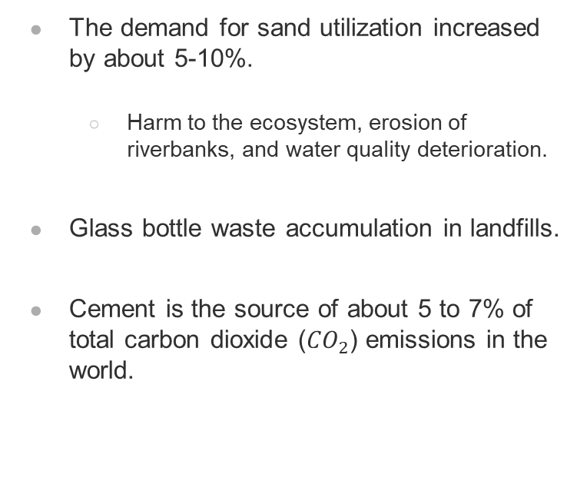
Introduction
The demand for sand utilization increased by about 5-10%.
  Harm to the ecosystem, erosion of riverbanks, and water quality deterioration.
Glass bottle waste accumulation in landfills.
Cement is the source of about 5 to 7% of total carbon dioxide (${CO}_{2}$) emissions in the world.
Figure 2. Extraction of raw materials
Figure 3. Glass bottle waste

Slide 5
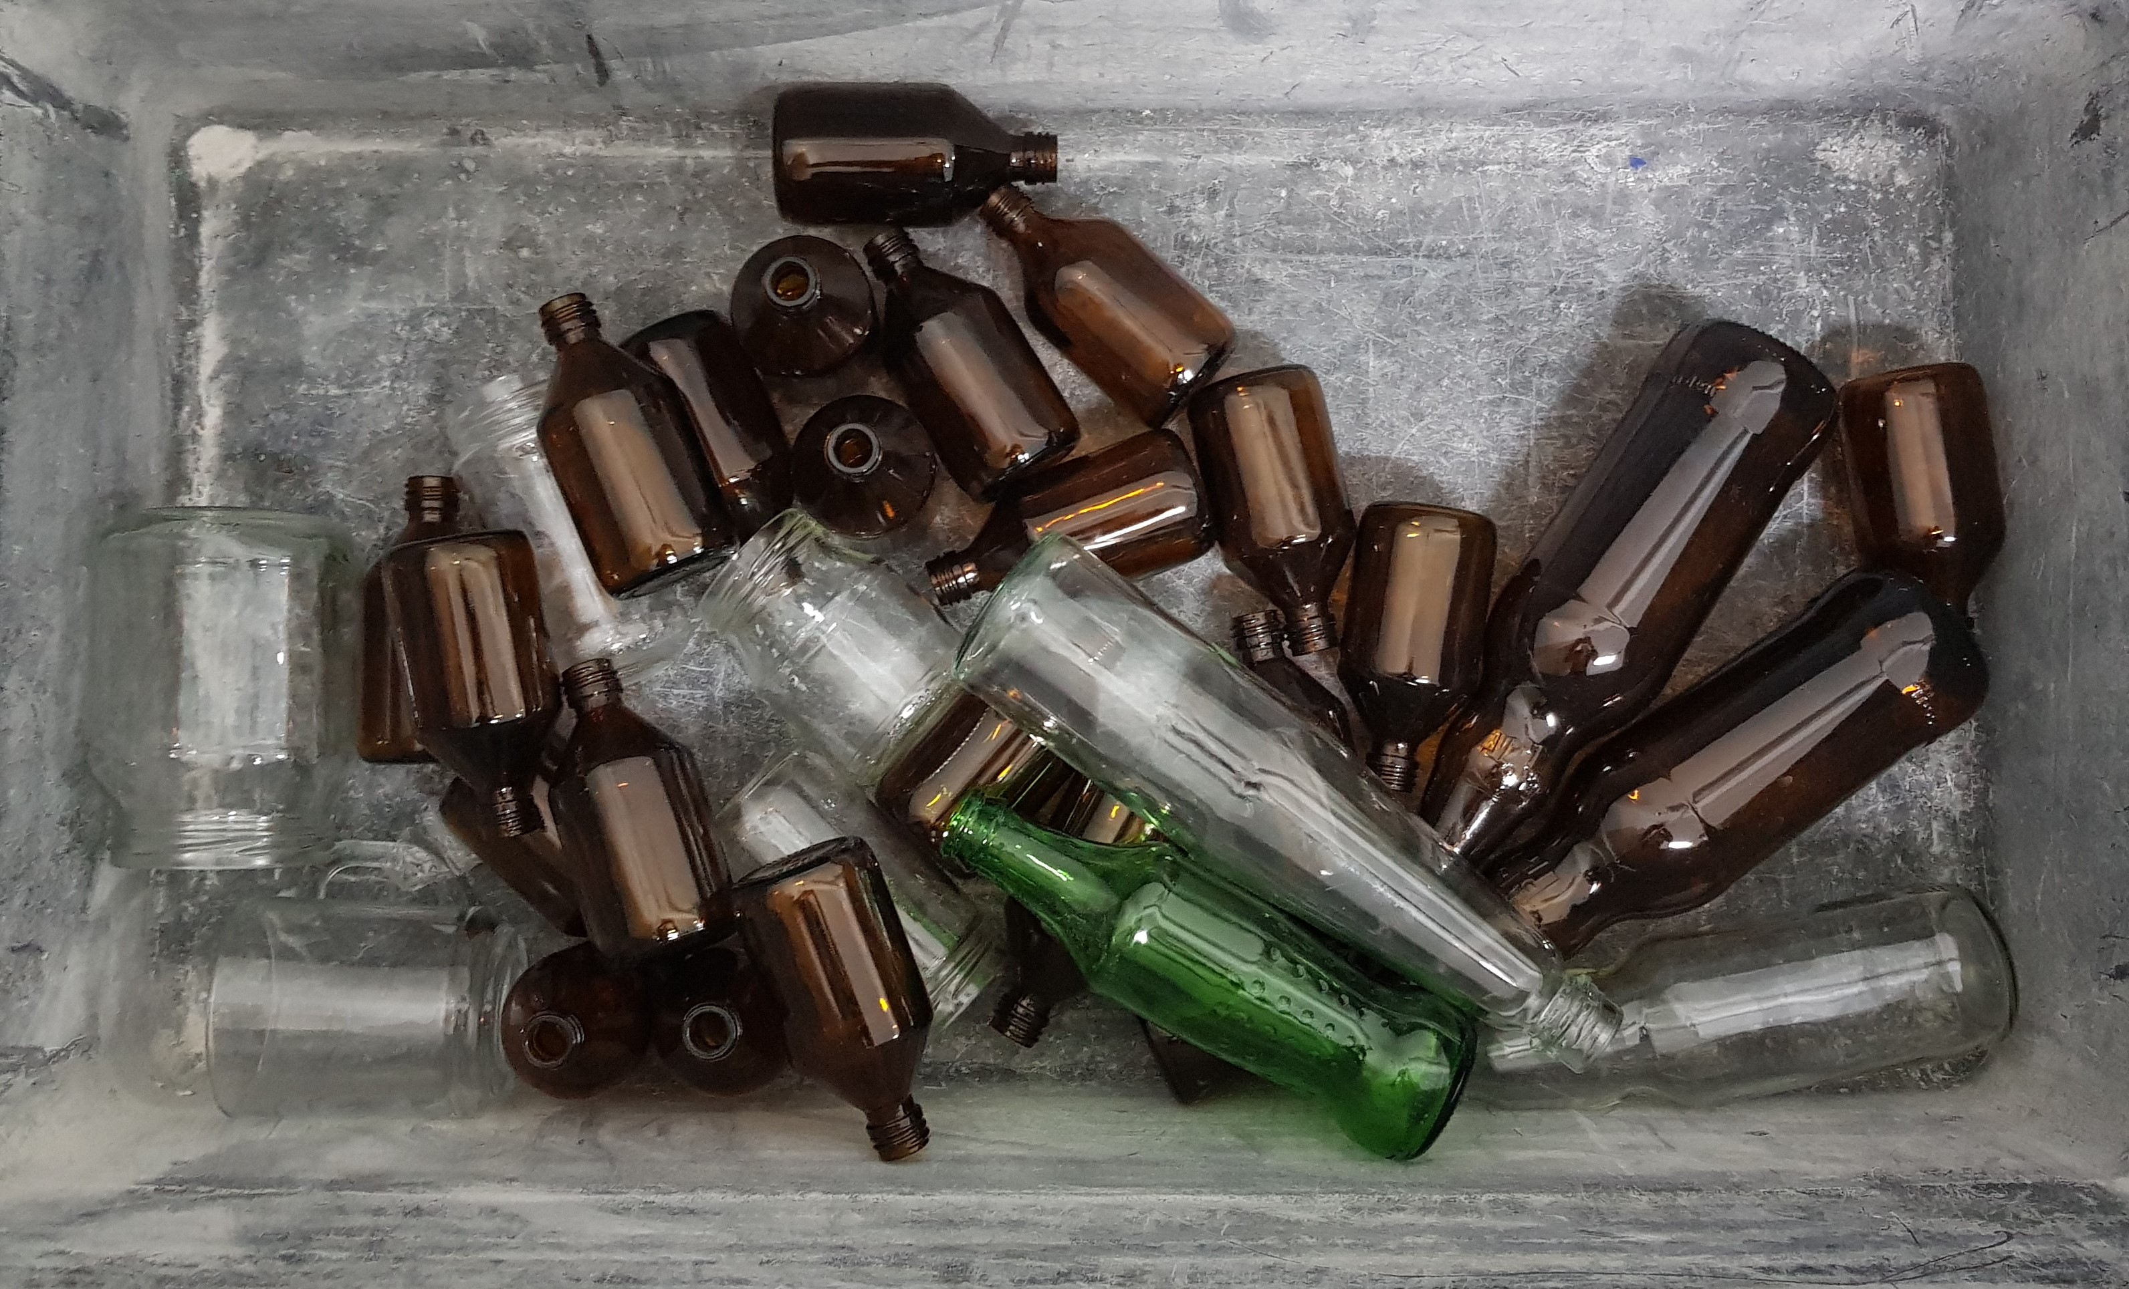
Introduction
Waste glass sand:
Glass is single use material, for example glass bottle.
Glass is silica-rich material and has similar chemical composition and physical properties as sand.
Concrete expansion due to the Alkali-Silica Reaction (ASR) between alkalis in cement and reactive silica in glass.
Figure 4. Glass bottle waste

Slide 6
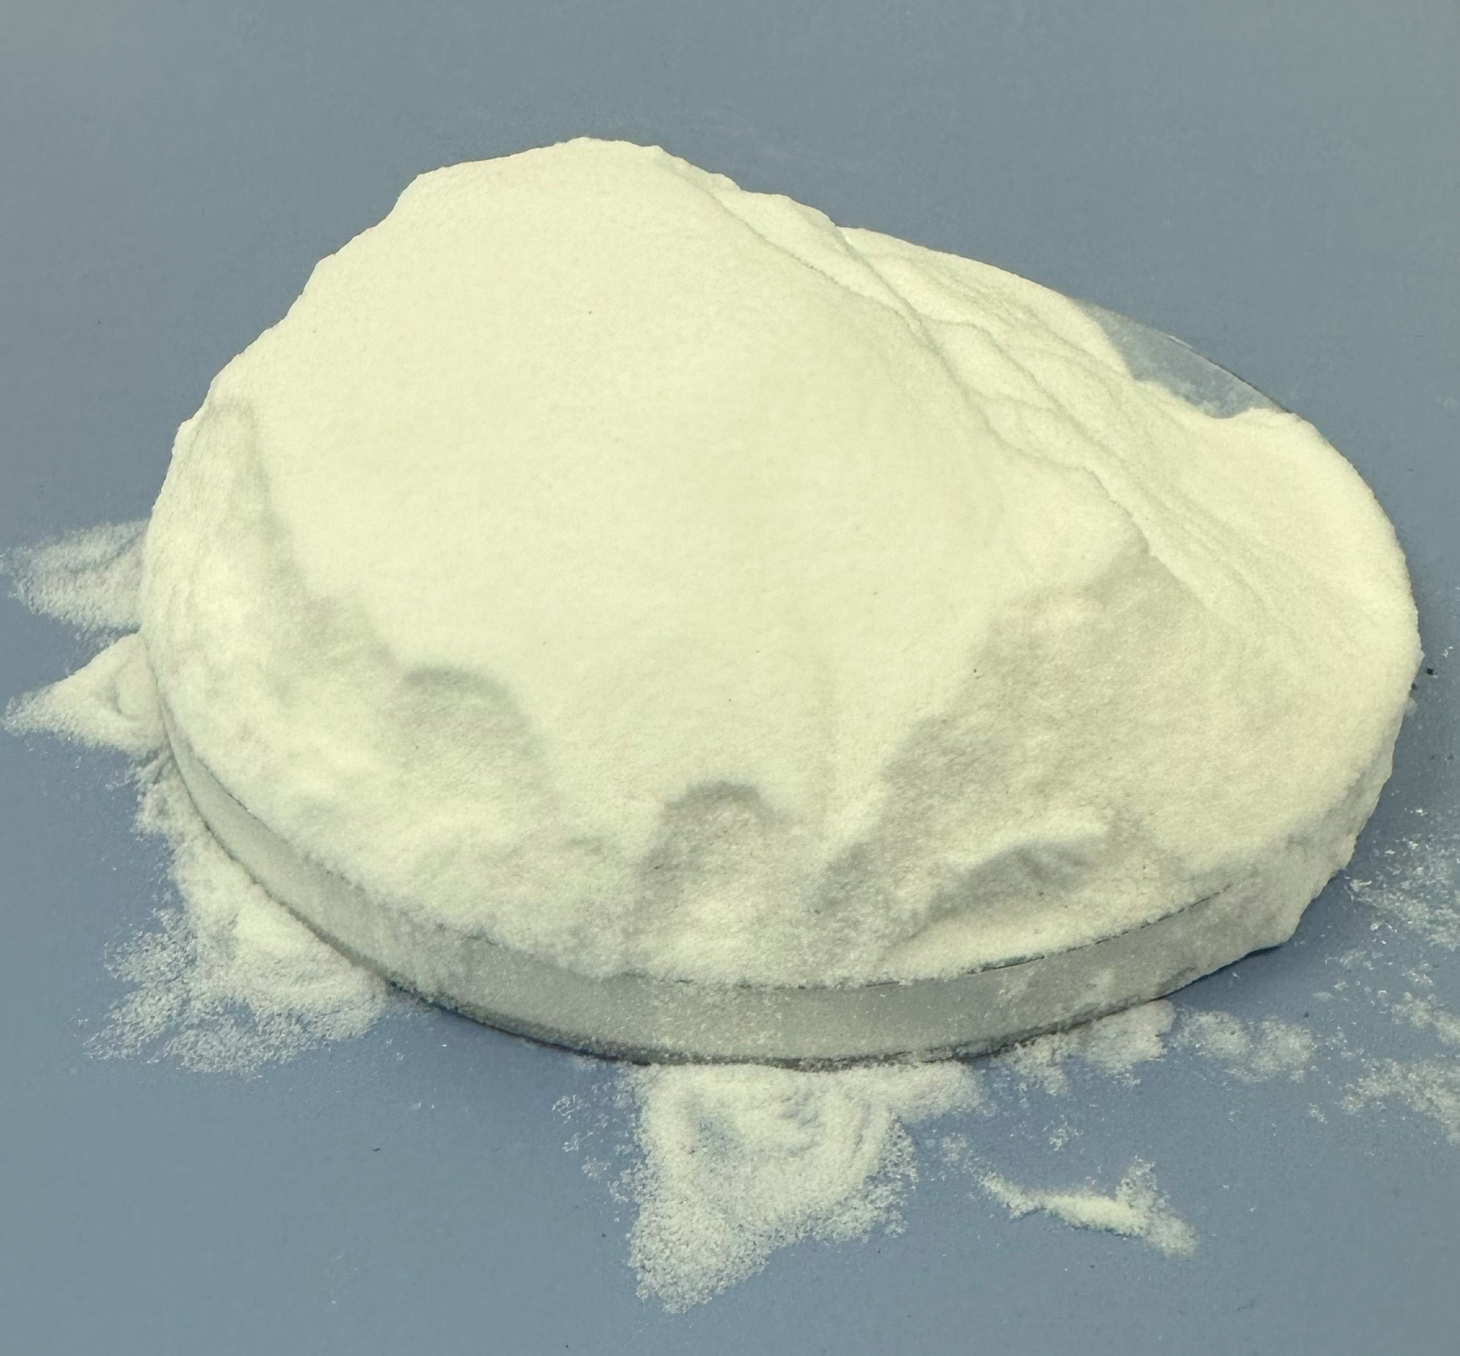
Introduction
Glass bubble:
Very lightweight white powder made from chemically stable soda-lime-borosilicate glass
High crush strength, low thermal conductivity and low density.
Figure 5. Glass bubbles

Slide 7
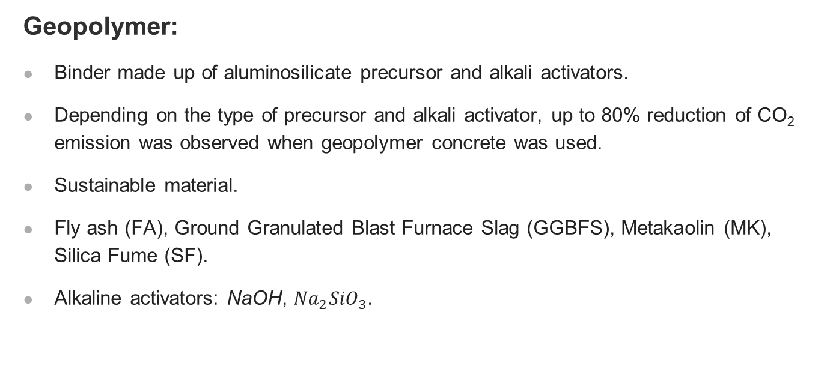
Introduction
Geopolymer:
Binder made up of aluminosilicate precursor and alkali activators.
Depending on the type of precursor and alkali activator, up to 80% reduction of CO₂ emission was observed when geopolymer concrete was used.
Sustainable material.
Fly ash (FA), Ground Granulated Blast Furnace Slag (GGBFS), Metakaolin (MK), Silica Fume (SF).
Alkaline activators: NaOH, ${Na}_{2}{SiO}_{3}$.

Slide 8
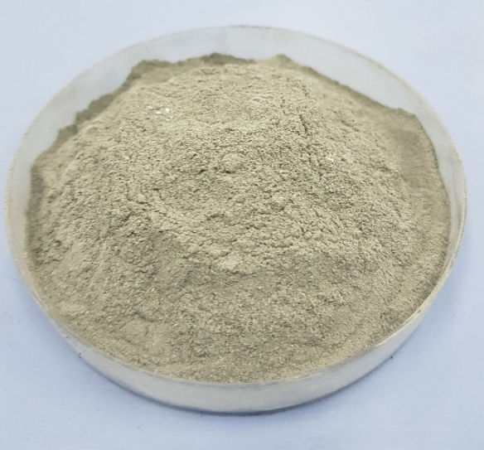
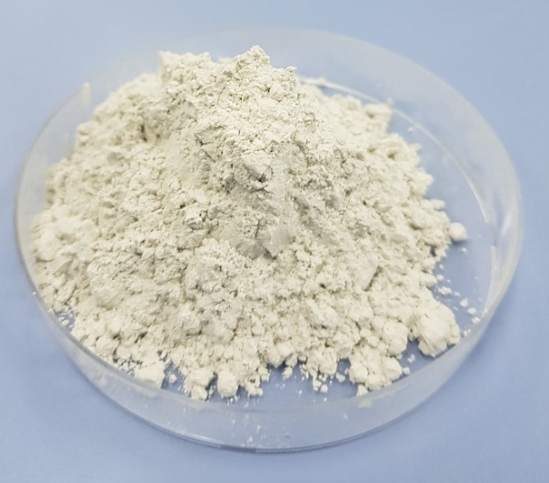
Introduction
FA
By-product generated from coal combustion plants for electricity and heat production.
Produces less heat during the hydration and suppresses reactions in concrete which may help to reduce alkali-silica reactions
Low calcium and high calcium FA
GGBFS
By-product from steel-making processes or iron extraction from its ore in the blast furnace.
Approximately 300 kg of slag is produced per ton of iron extracted.
The chemical composition of GGBFS is same as OPC including compounds like lime, silica, and alumina.
Figure 6. FA
Figure 7. GGBFS

Slide 9
Research Objectives
To prove the efficiency of using waste glass sand (WGS) in geopolymer concrete for thermal insulation purposes
To investigate whether geopolymer concrete can mitigate alkali-silica reaction (ASR) expansion for the mixture containing waste glass sand (WGS)
To examine whether glass bubbles can decrease the thermal conductivity of the geopolymer concrete

Slide 10
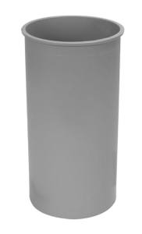
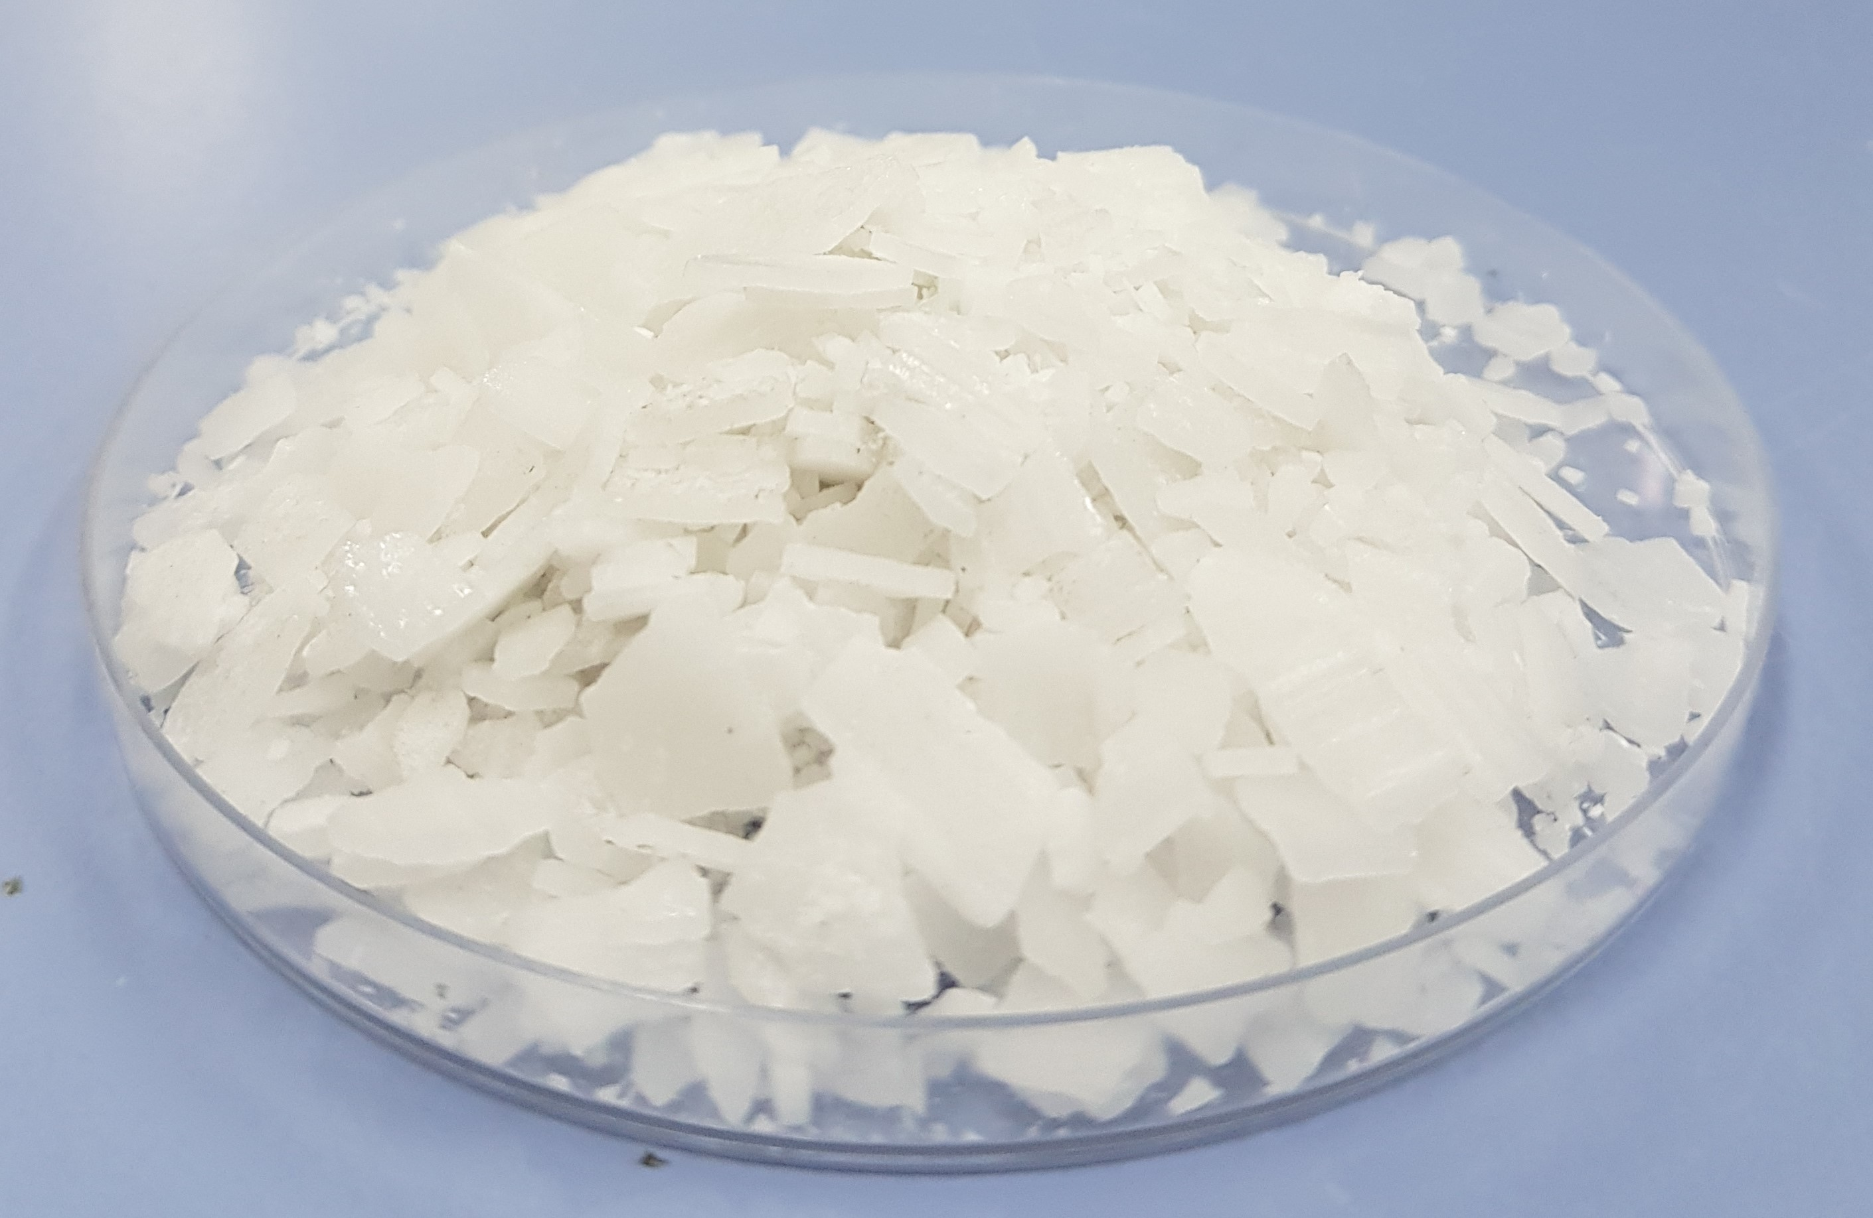
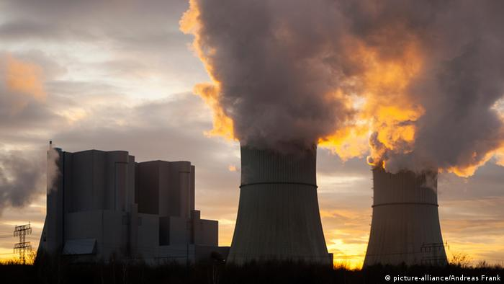
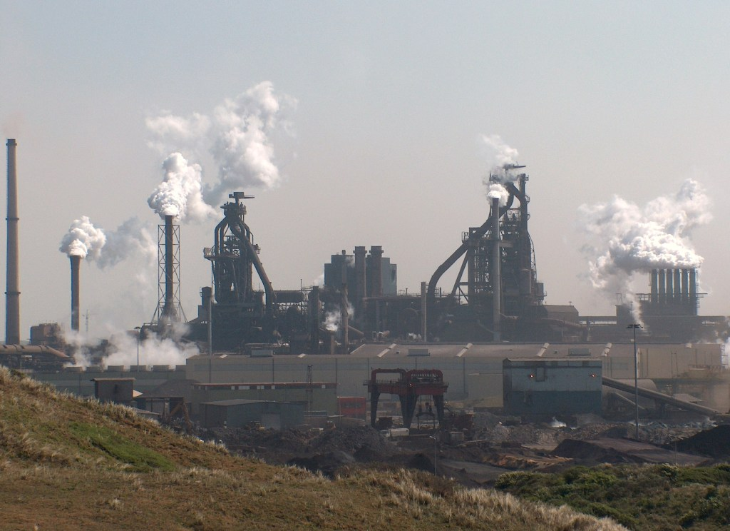
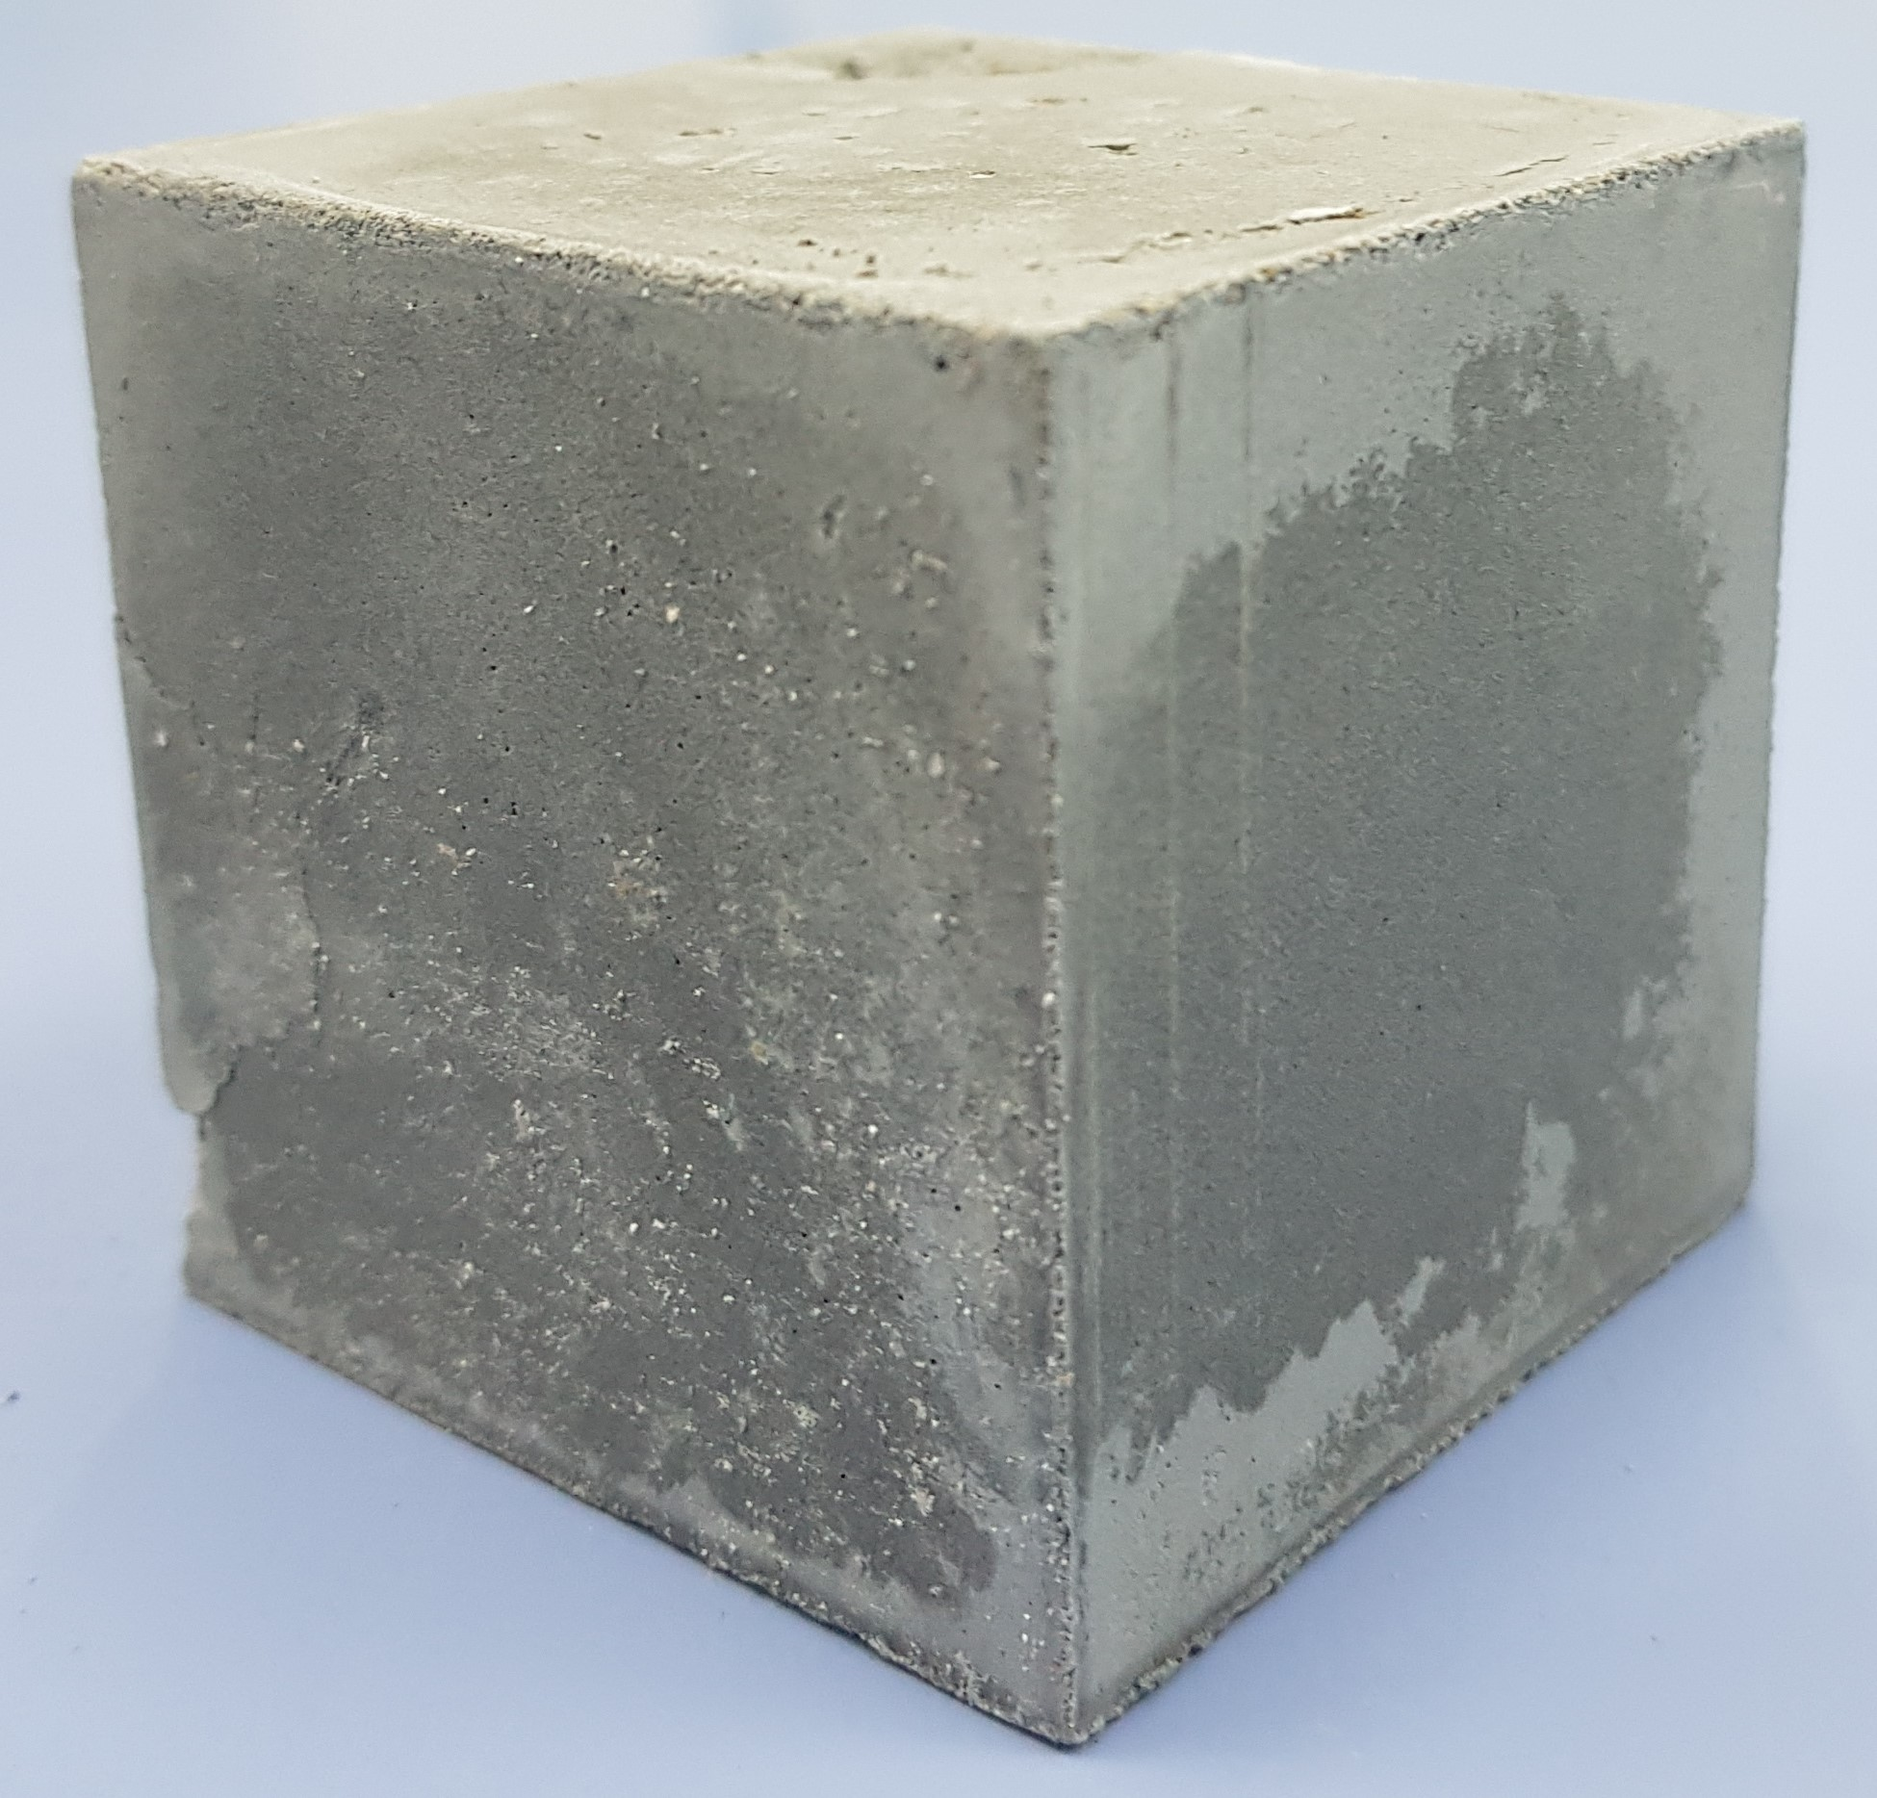
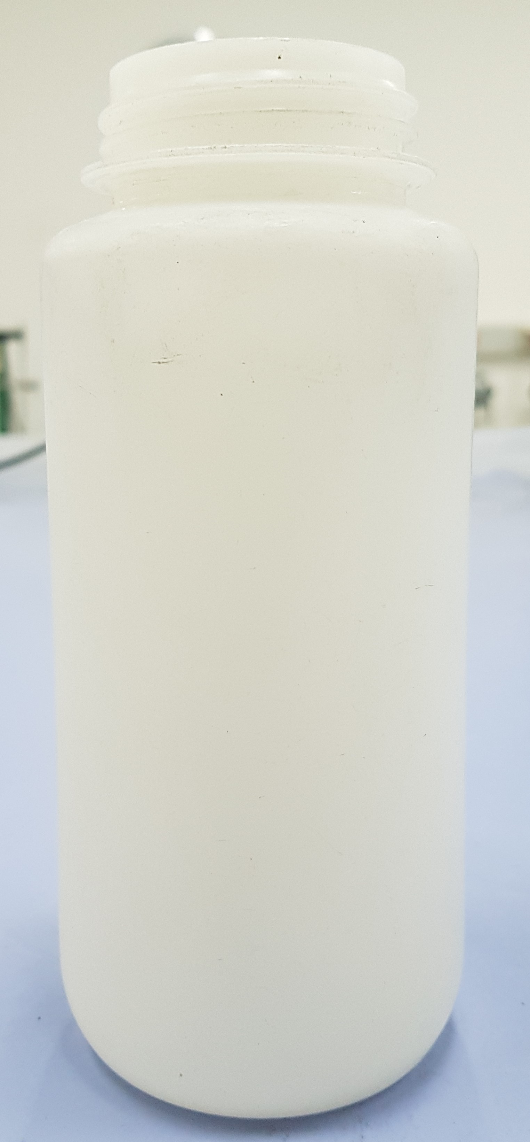
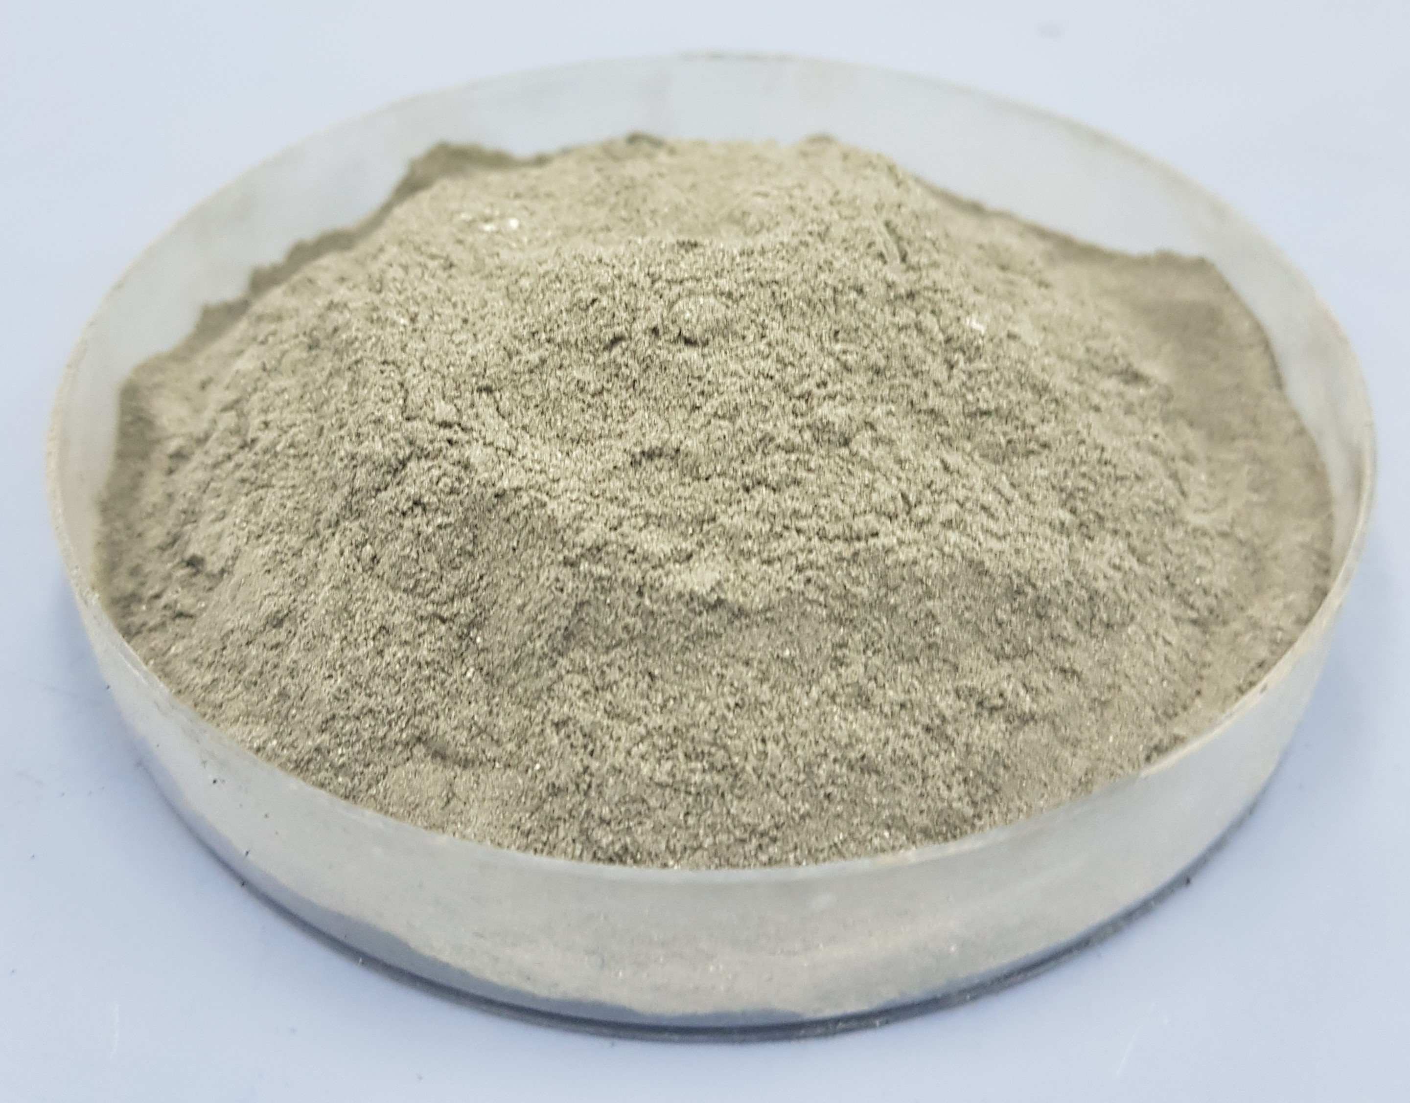
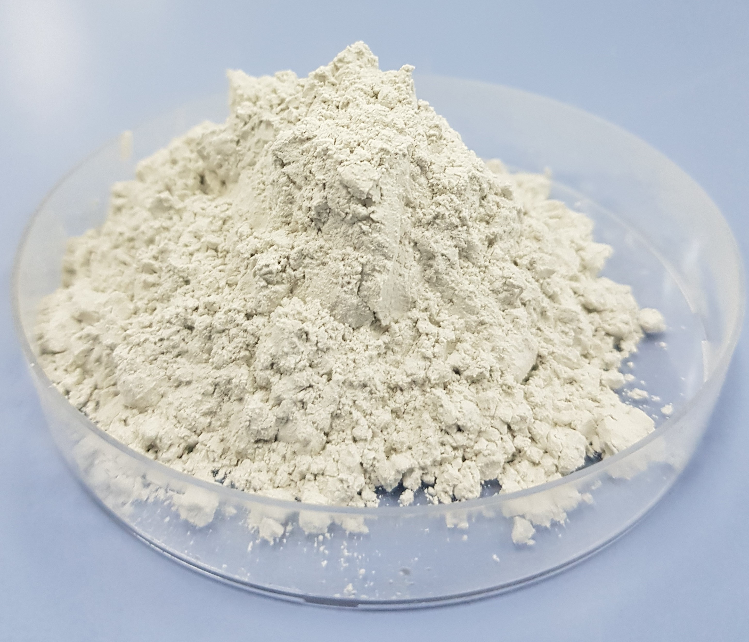
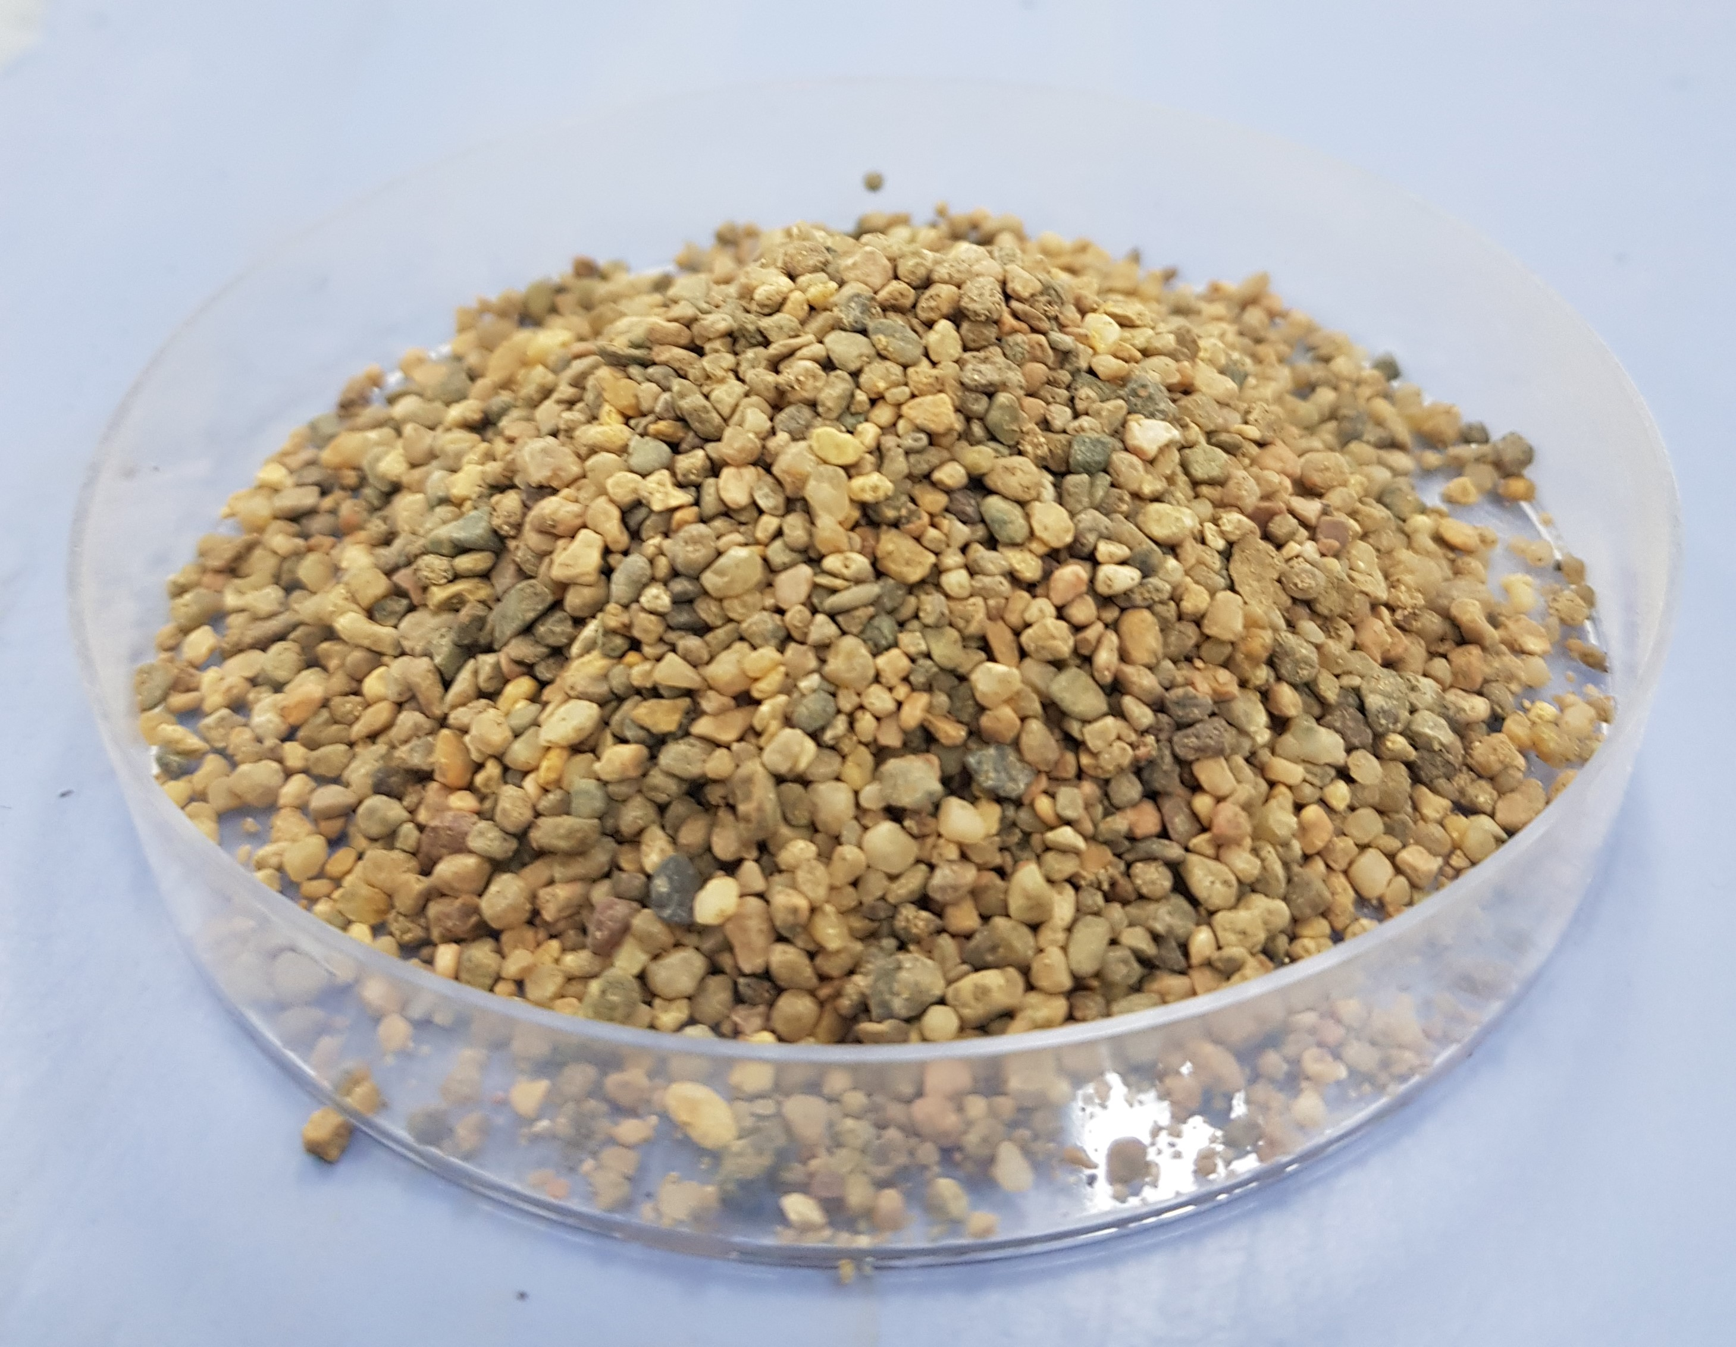
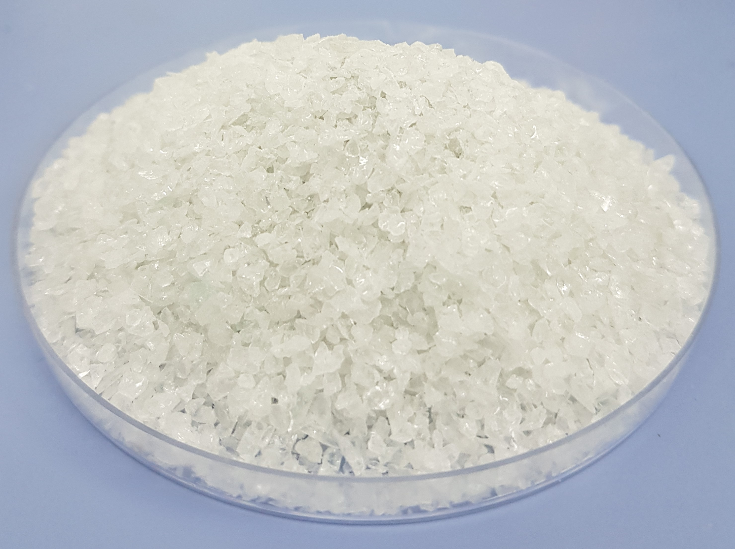



Research Methodology
$${Na}_{2}{SiO}_{3}$$
NaOH
Coal combustion
Steel processing
Glass bottles
FA
GGBFS
RS
WGS
Geopolymer mortar
(a)
AAS
(b)

Slide 11
Cementitious materials properties
The specific gravities of FA and GGBFS are 1.87 and 2.99 respectively.
Table 1. Chemical composition of FA and GGBFS (%).
 | SiO₂ | Al₂O₃ | Fe₂O₃ | CaO | SO₃ | MgO | TiO₂ | Na₂O | K₂O | BaO | MnO
FA | 62.75 | 23.87 | 3.85 | 1.78 | 0.29 | 0.51 | 1.06 | 0.50 | 1.30 | 0.11 | 0.07
GGBFS | 33.52 | 11.63 | 0.31 | 30.93 | 2.50 | 11.29 | 1.25 | 0.45 | 1.28 | - | 0.35
Figure 8. XRD of FA and GGBFS
Figure 9. PSD of FA and GGBFS

Slide 12
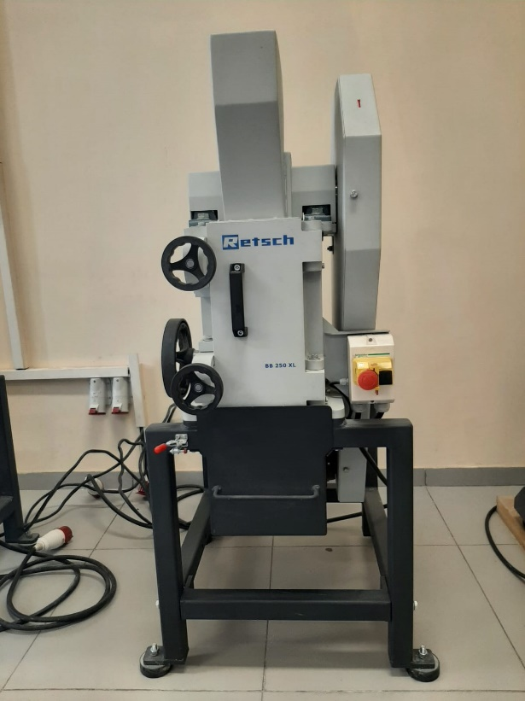
Fine aggregate properties
Table 2. Gradation (%) of fine aggregates
Sieve # (size) | Weight (%)
#8 (2.36 mm) | 10
#16 (1.18 mm) | 25
#30 (600 μm) | 25
#50 (300 μm) | 25
#100 (150 μm) | 15
Figure 10. Jaw crusher

Slide 13
Fine aggregate properties
Table 3. SG and AC of fine aggregates
Fine aggregate | Specific gravity (SG) | Absorption capacity (AC)
RS | 2.77 | 2.68
WGS | 2.54 | 0.83
Table 4. Chemical composition of FA, GGBFS, and WGS (%).
 | SiO₂ | Al₂O₃ | Fe₂O₃ | CaO | SO₃ | MgO | TiO₂ | Na₂O | K₂O | BaO | MnO
RS | 47.08 | 9.97 | 5.50 | 13.60 | 0.56 | 1.93 | 0.65 | 1.27 | 3.16 | 0.13 | 0.72
WGS | 66.20 | 1.78 | 0.66 | 8.45 | 0.44 | 2.48 | 0.06 | 12.27 | 1.20 | 0.02 | 0.02
Figure 11. XRD of RS
Figure 12. XRD of WGS

Slide 14
Mix Design
 | Table 5. Mixture Proportion of Geopolymer Mortar
Mix | Mix ID | FA (%) | GGBFS (%) | Sand (%) | WGS (%) | Glass bubbles (%) | AAS/b | w/b
1A | Control 1 | 60 | 40 | 100 | 0 | 0 | 0.4 | 0.35
1B | Control 2 | 60 | 40 | 0 | 100 | 0 | 0.4 | 0.35
2A | S85WGS15GB0 | 60 | 40 | 85 | 15 | 0 | 0.4 | 0.35
2B | S70WGS30GB0 | 60 | 40 | 70 | 30 | 0 | 0.4 | 0.35
2C | S55WGS45GB0 | 60 | 40 | 55 | 45 | 0 | 0.4 | 0.35
3A | S85WGS15GB0 | 60 | 40 | 85 | 15 | 0 | 0.4 | 0.40
3B | S70WGS30GB0 | 60 | 40 | 70 | 30 | 0 | 0.4 | 0.40
3C | S55WGS45GB0 | 60 | 40 | 55 | 45 | 0 | 0.4 | 0.40
4A | S85WGS15GB0 | 60 | 40 | 85 | 15 | 0 | 0.3 | 0.35
4B | S70WGS30GB0 | 60 | 40 | 70 | 30 | 0 | 0.3 | 0.35
4C | S55WGS45GB0 | 60 | 40 | 55 | 45 | 0 | 0.3 | 0.35
5A | S80WGS15GB5 | 60 | 40 | 80 | 15 | 5 | 0.4 | 0.35
5B | S77.5WGS15GB7.5 | 60 | 40 | 77.5 | 15 | 7.5 | 0.4 | 0.35
5C | S65WGS30GB5 | 60 | 40 | 65 | 30 | 5 | 0.4 | 0.35
5D | S62.5WGS30GB7.5 | 60 | 40 | 62.5 | 30 | 7.5 | 0.4 | 0.35
 | Note: AAS-alkali activator solution
Molarity of the NaOH is 10M
Ratio of Na₂SiO₃ to NaOH is 1.5
Waste glass (15%, 30%, and 45%) and glass bubbles (5% and 7.5%)

Slide 15
Experimental Program
1. Mix Design
FA/GGBFS
Activator (NaOH, Na₂SiO₃)
Water to binder ratio
Normal river sand
Waste glass sand
Glass bubbles
2. Evaluation
Material Characterization
Fresh Properties
Hardened Properties
Durability
1) Particle size distribution
2) Mineralogical analysis: X-ray diffraction (XRD)
3) Chemical composition analysis: X-ray fluorescence (XRF)
4) Microstructure analysis: Scanning electron microscope (SEM)
5) Aggregate properties
1) Workability
2) Fresh density
3) Air content
1) Hardened density
2) Compressive strength
3) Modulus of rupture
4) Thermal conductivity
5) Dielectric constant
6) Ultrasonic Pulse Velocity
1) Alkali-silica reaction (ASR)
2) Drying shrinkage
3. Test Result Analysis
4. Documentation
Figure 13. Experimental program

Slide 16
Research Methodology
Table 6. Samples’ testing plan
Test name | Test methods | Testing ages | No. of samples | Sample dimensions
ASR | ASTM C1567 | 3- and 4- day interval | 4 | 25x25x285
Drying shrinkage | ASTM C596 | 3- and 4- day interval | 4 | 25x25x285
Compressive strength | ASTM C109 | 7/14/28 day | 12 | 50x50x50
Flexural strength | ASTM C348 | 7/14/28 day | 12 | 40x40x160
Thermal conductivity | ASTM E1530 | 7/14/28 day | 3 | 150x150x30
Dielectric constant |  | 3- and 4- day interval | 2 | 70x70x70
Ultrasonic pulse velocity | ASTM C597 | 7/14/28 day | 4 | 50x50x50
Hardened density | ASTM C642 | 7/14/28 day | 4 | 50x50x50

Slide 17
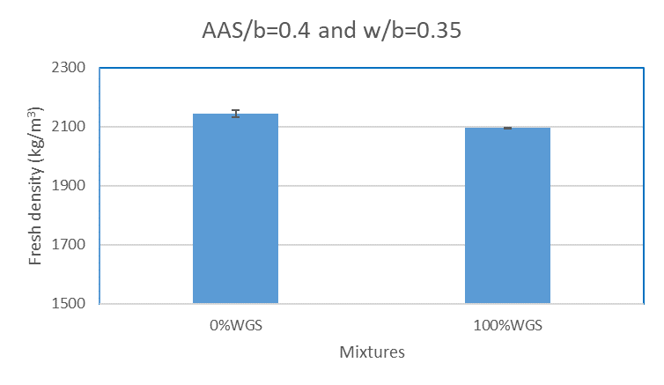
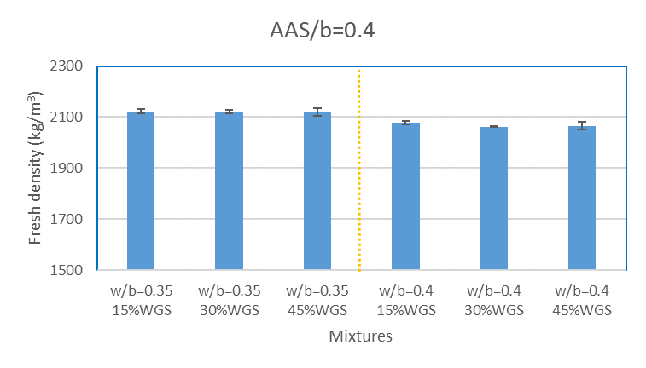
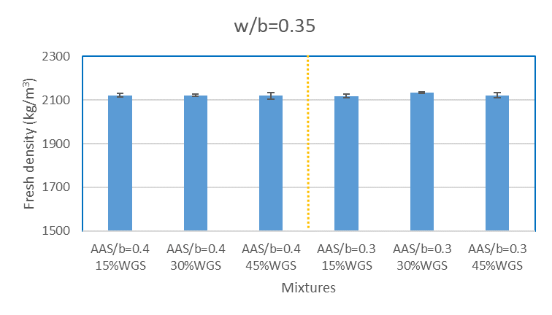
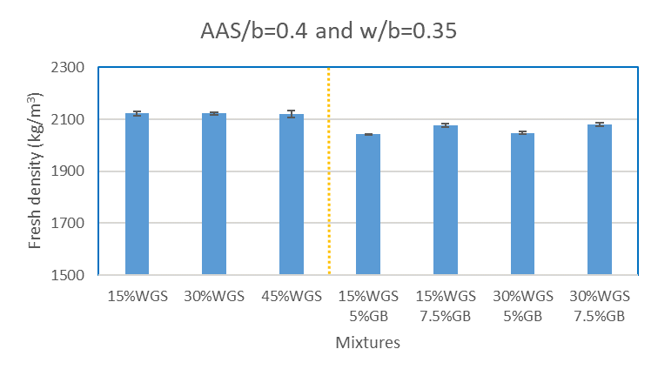
Results and Discussion: Fresh density
(a)
(b)
(c)
(d)
Figure 14. Fresh density

Slide 18
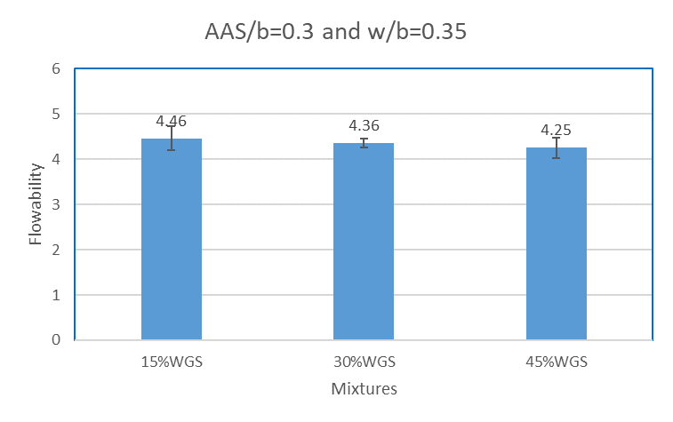
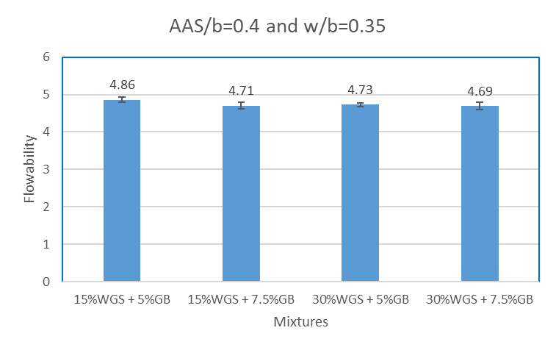
Results and Discussion: Flowability
(a)
(b)
Figure 15. Flowability

Slide 19
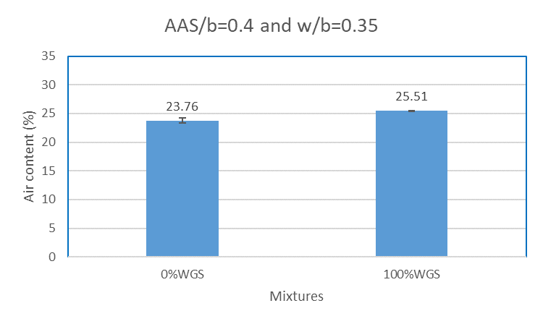
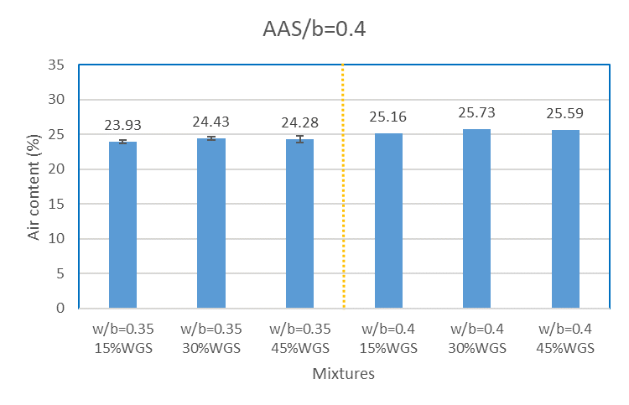
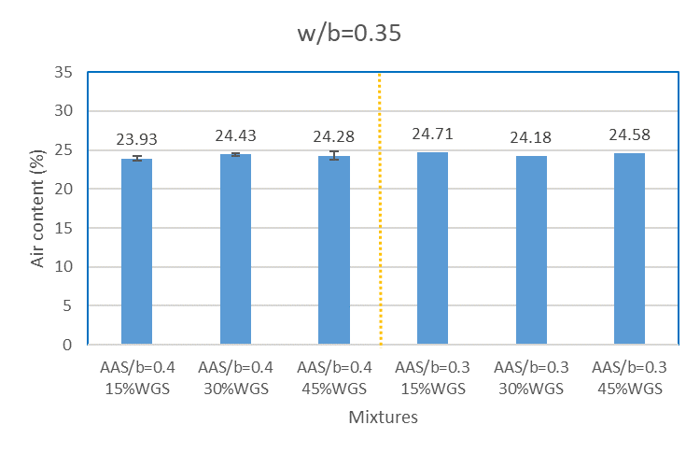
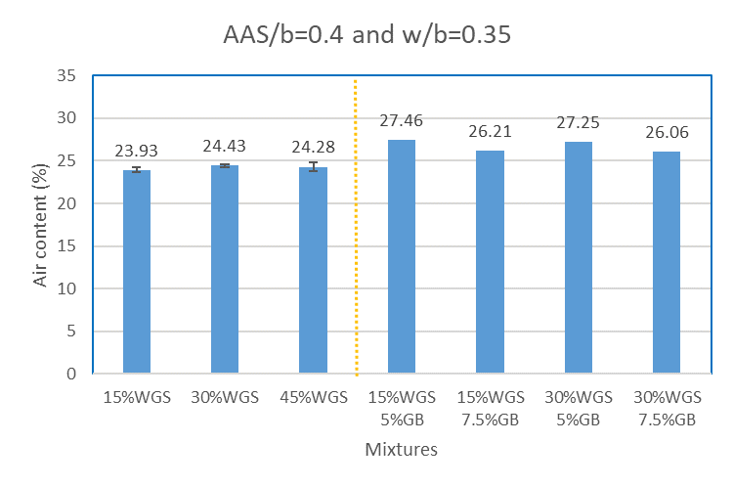
Results and Discussion: Air content
(a)
(b)
(c)
(d)
Figure 16. Air content

Slide 20
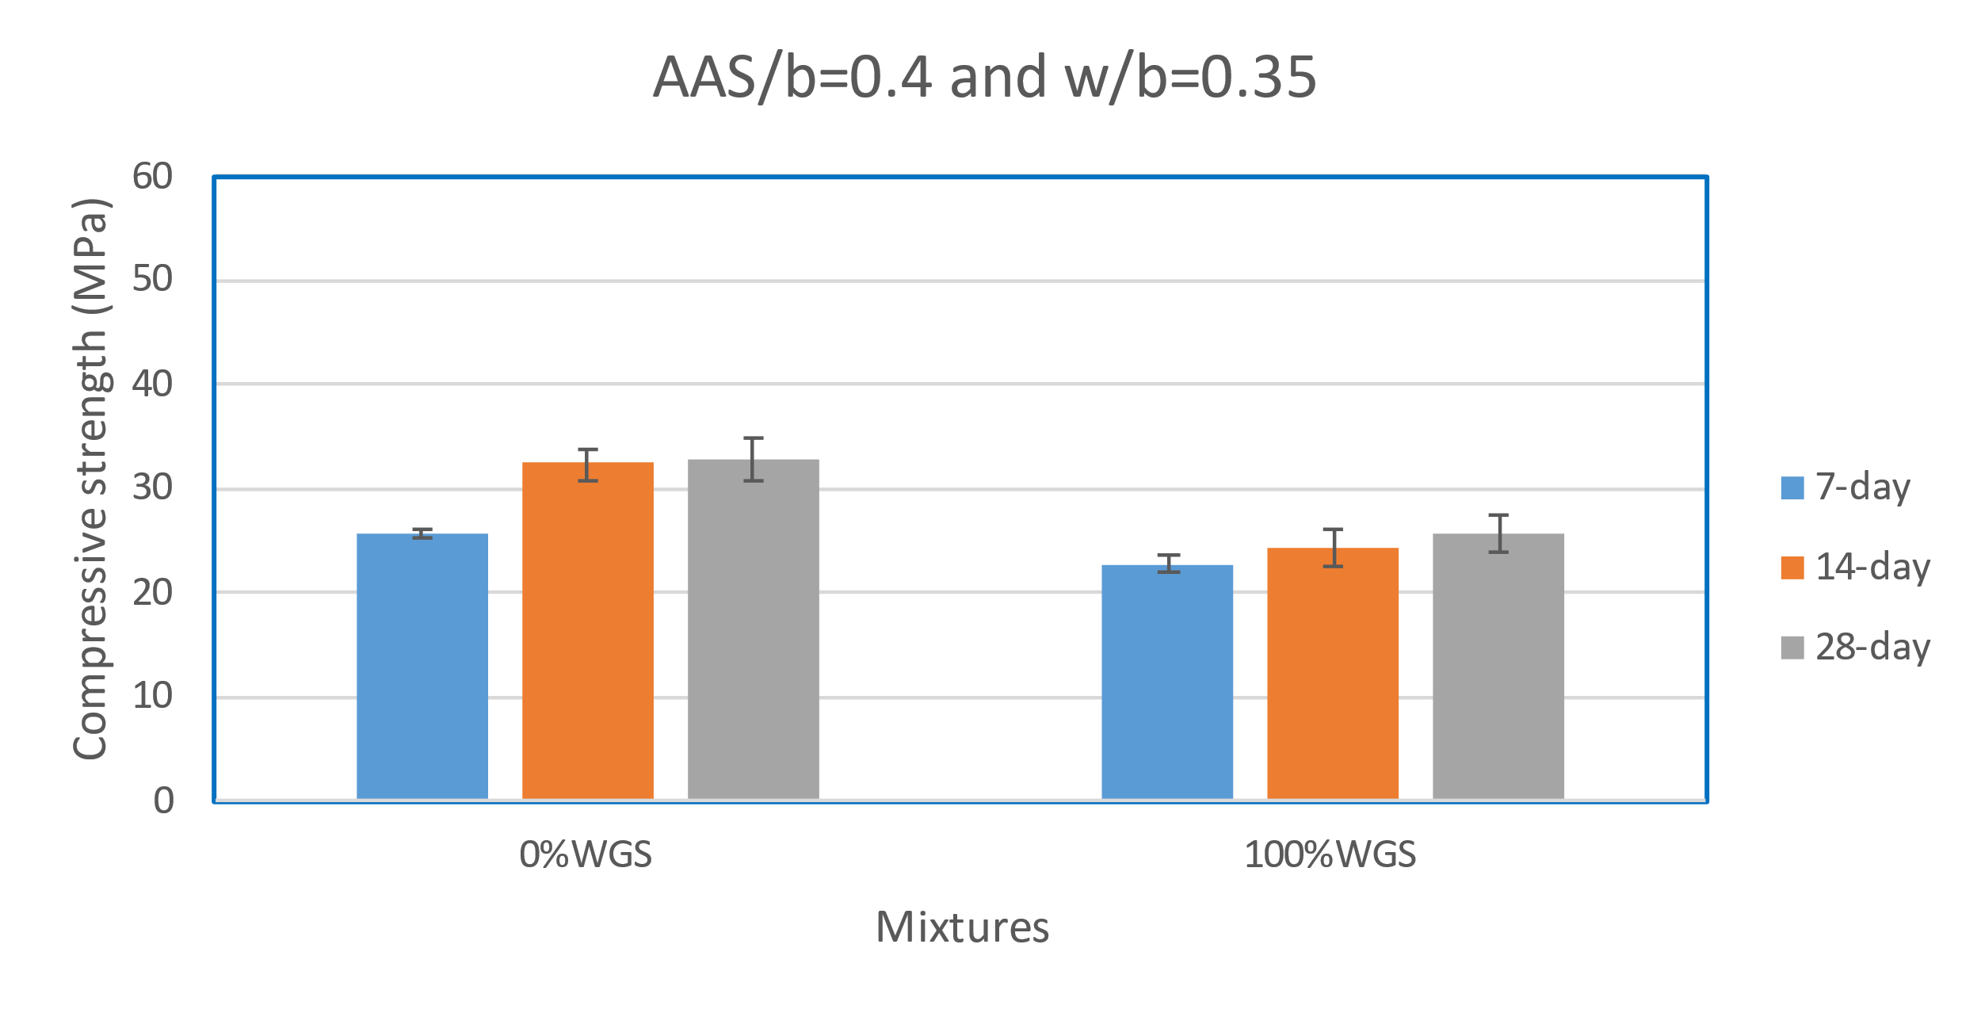
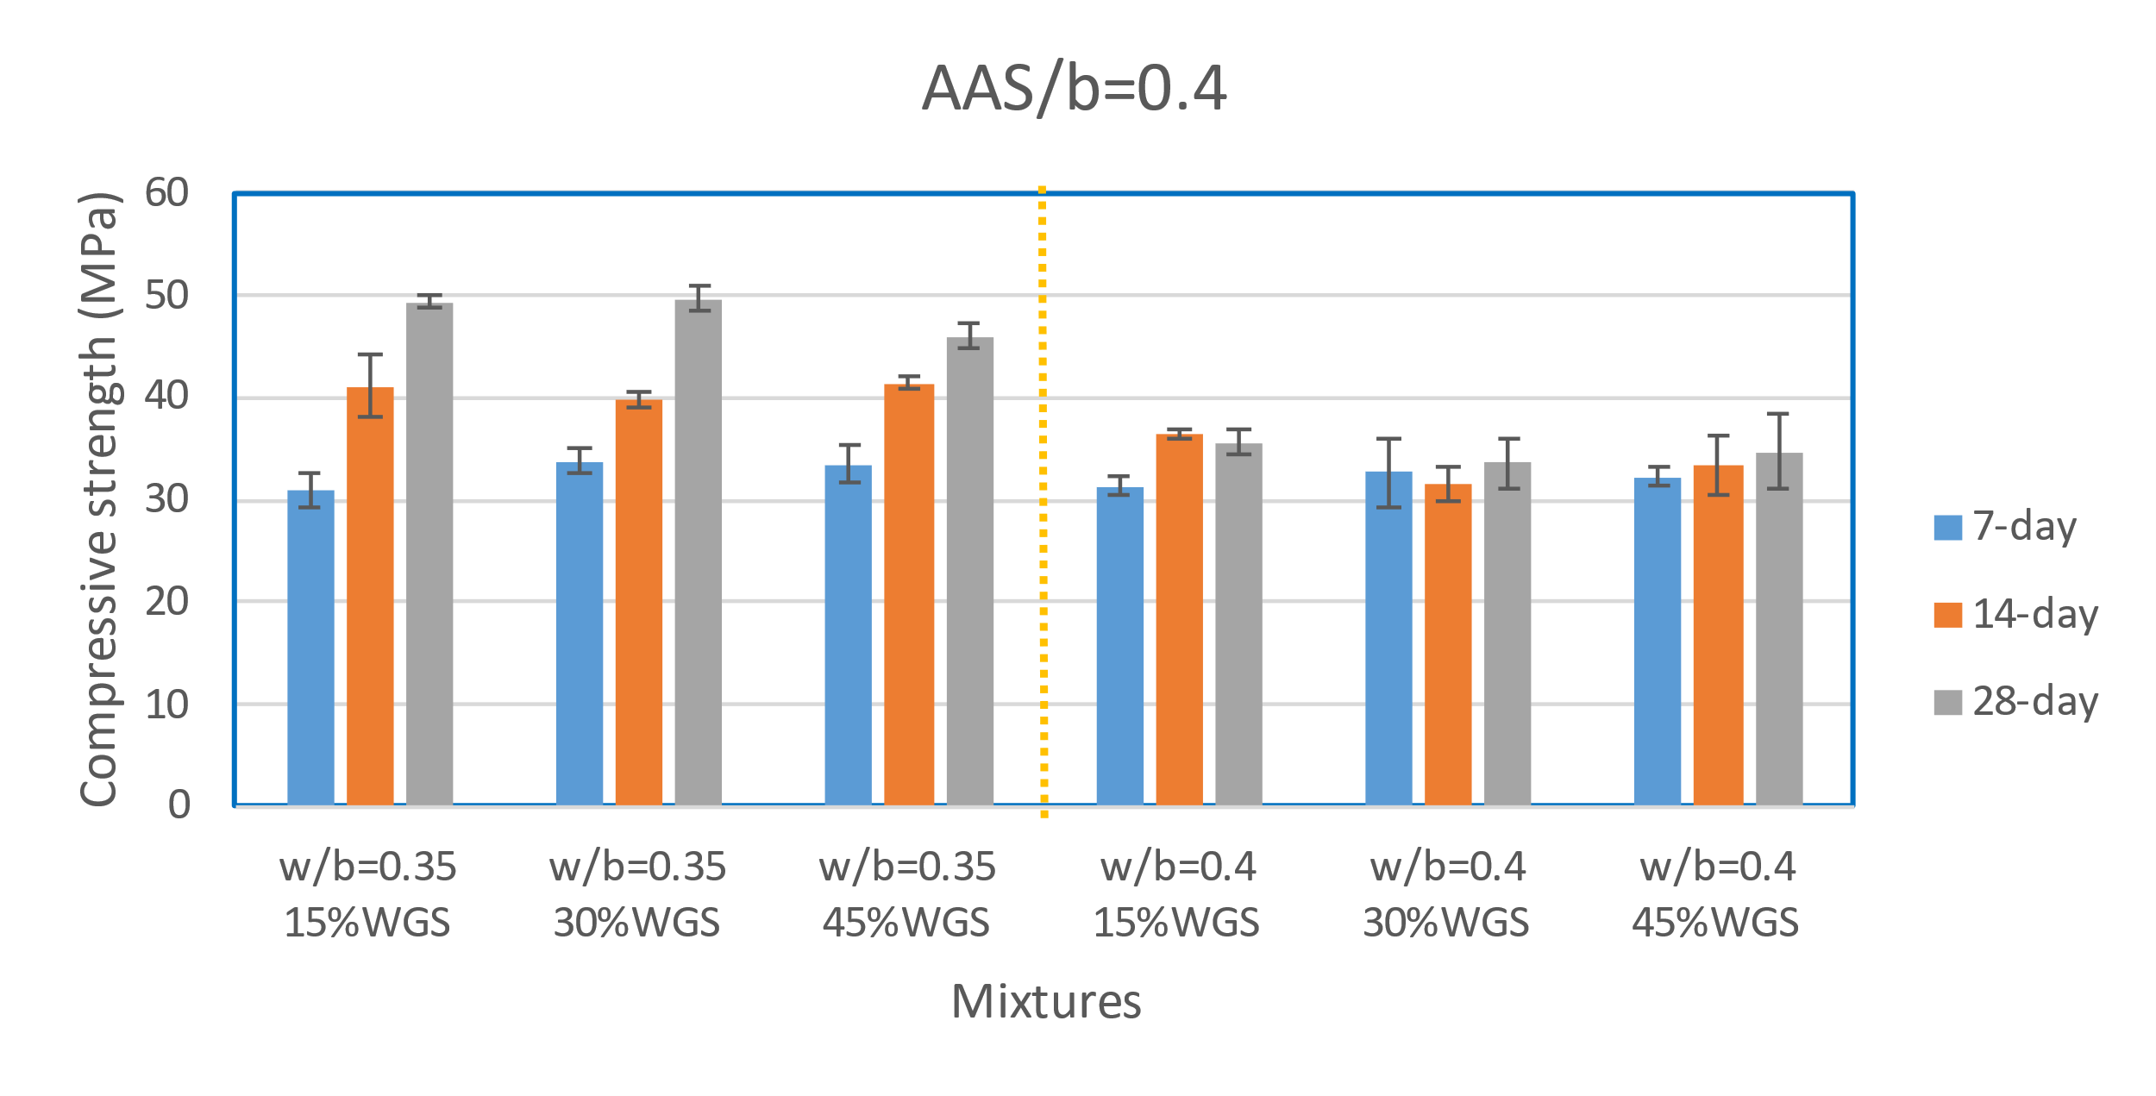
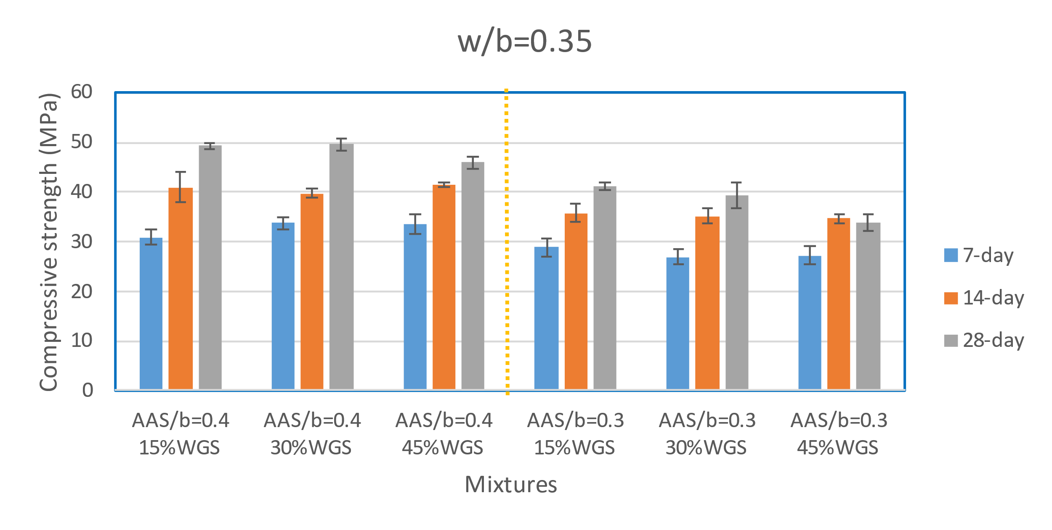
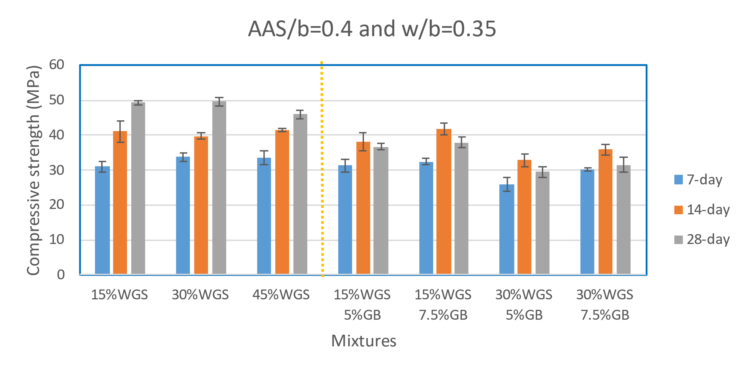
Results and Discussion: Compressive Strength
(a)
(b)
(c)
(d)
Fig. 17. Compressive strength

Slide 21
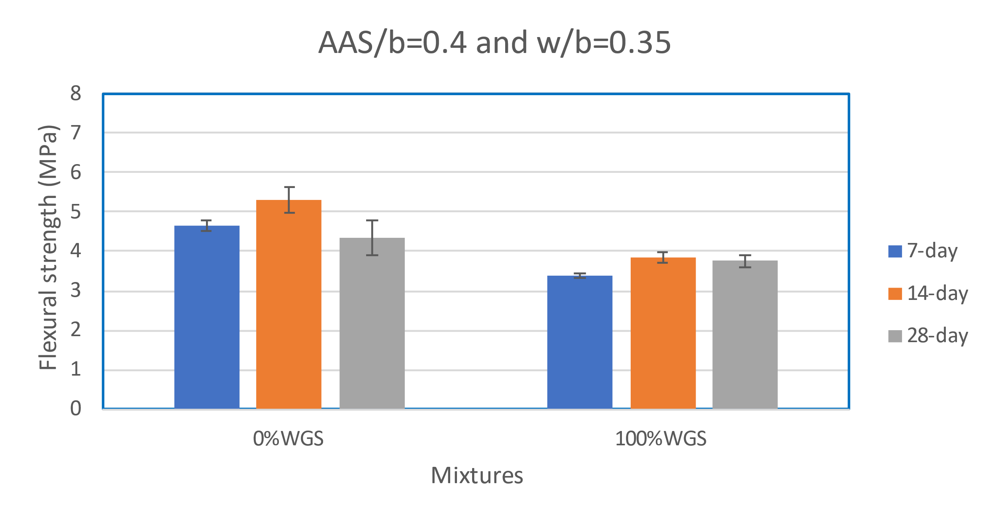
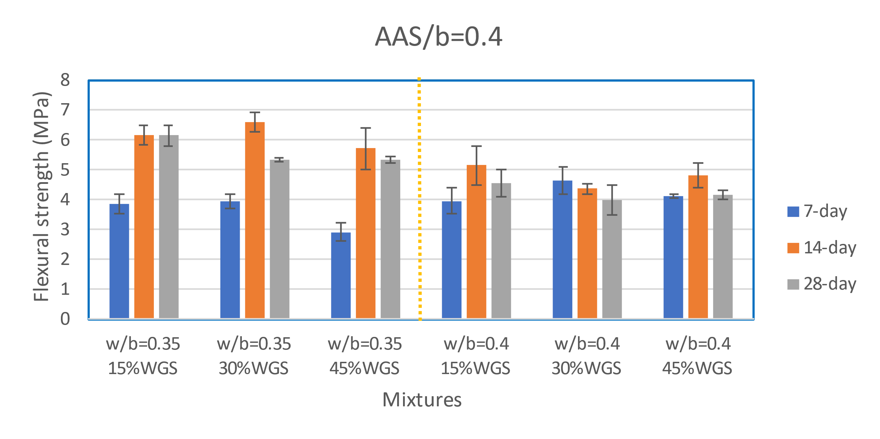
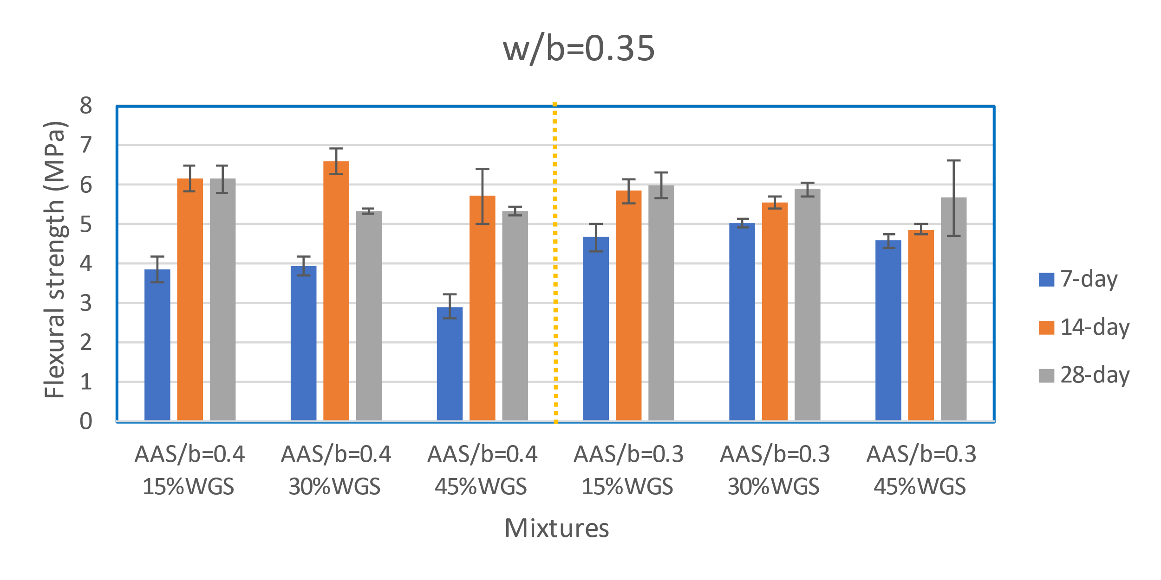
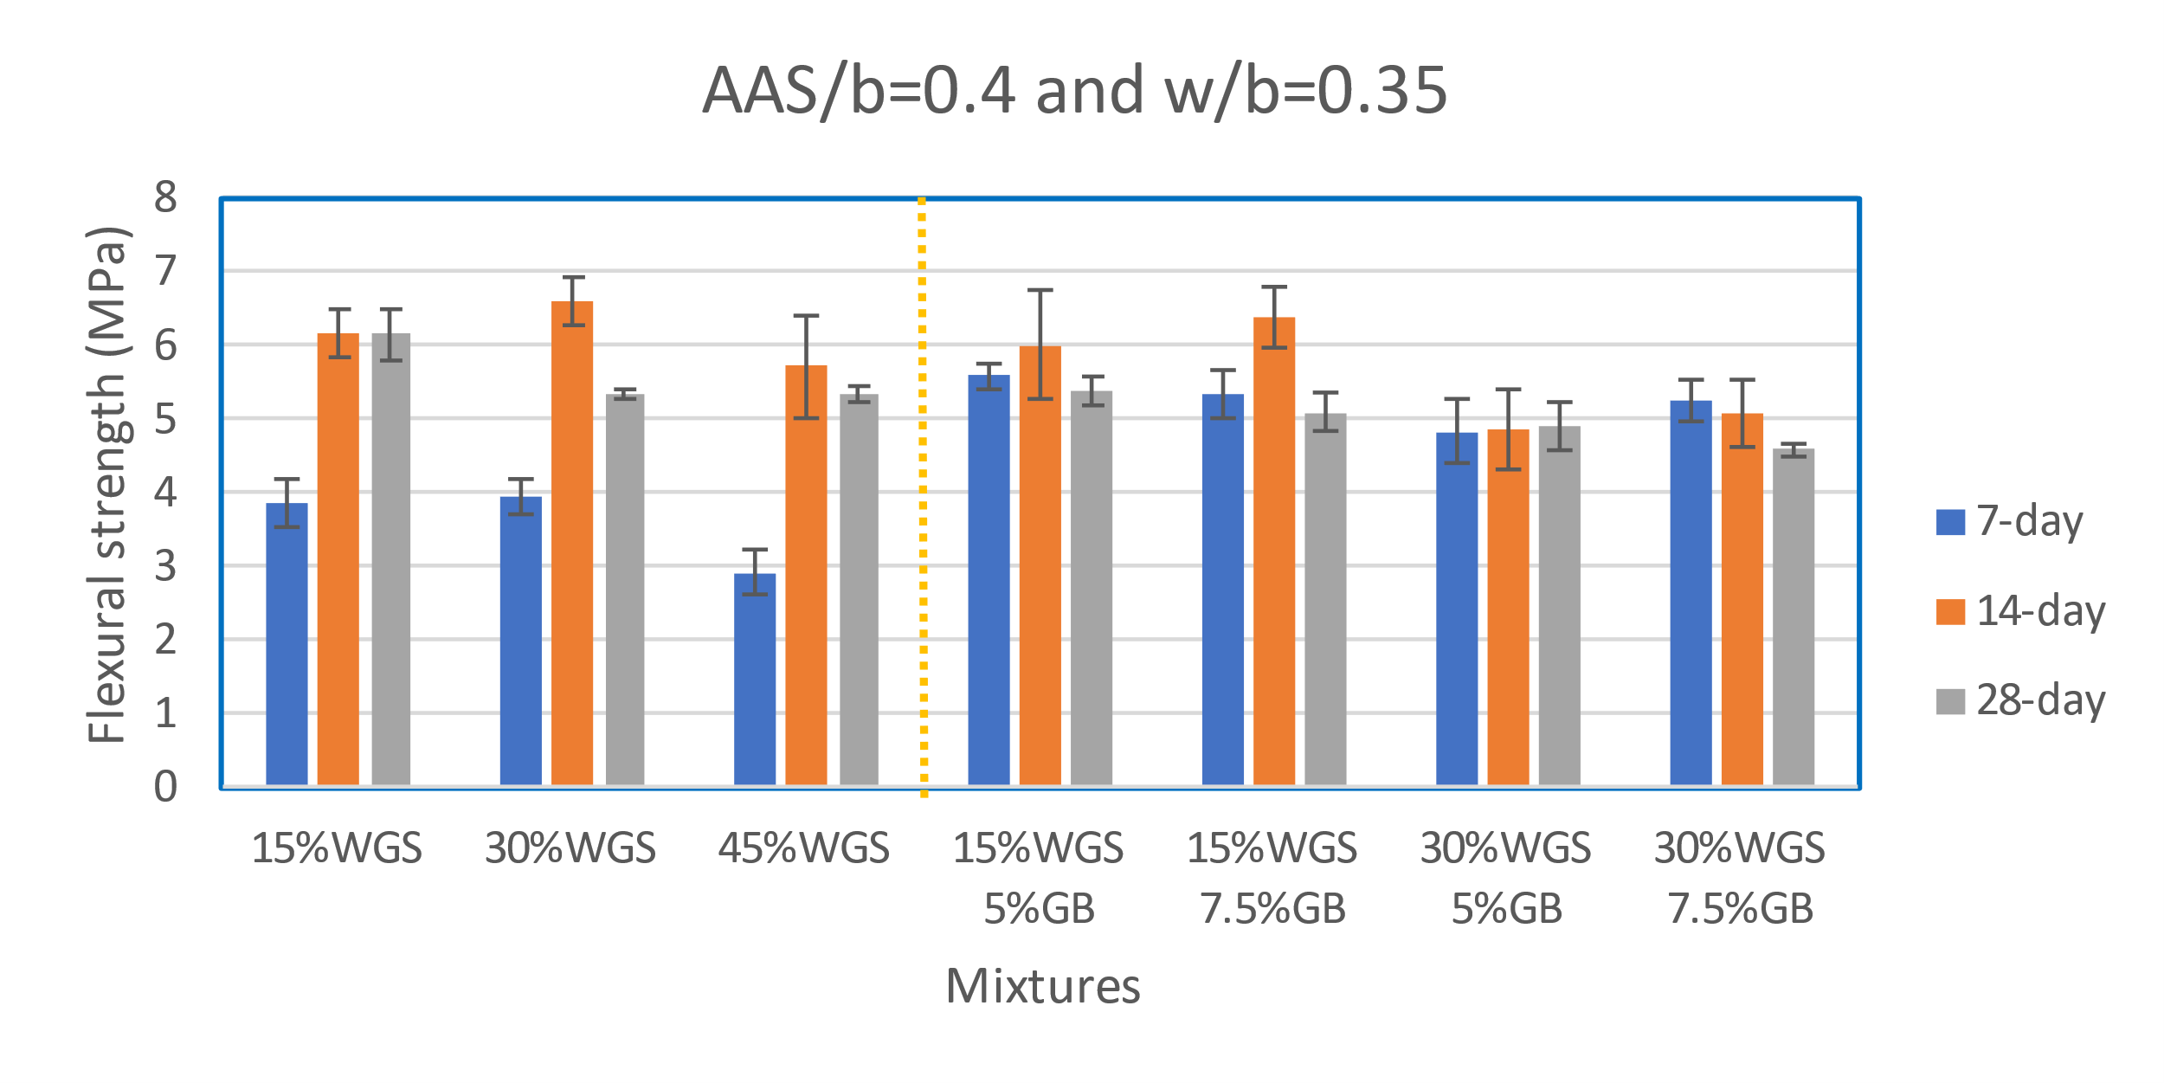
Results and Discussion: Flexural Strength
(a)
(b)
(c)
(d)
Fig. 18. Flexural strength

Slide 22
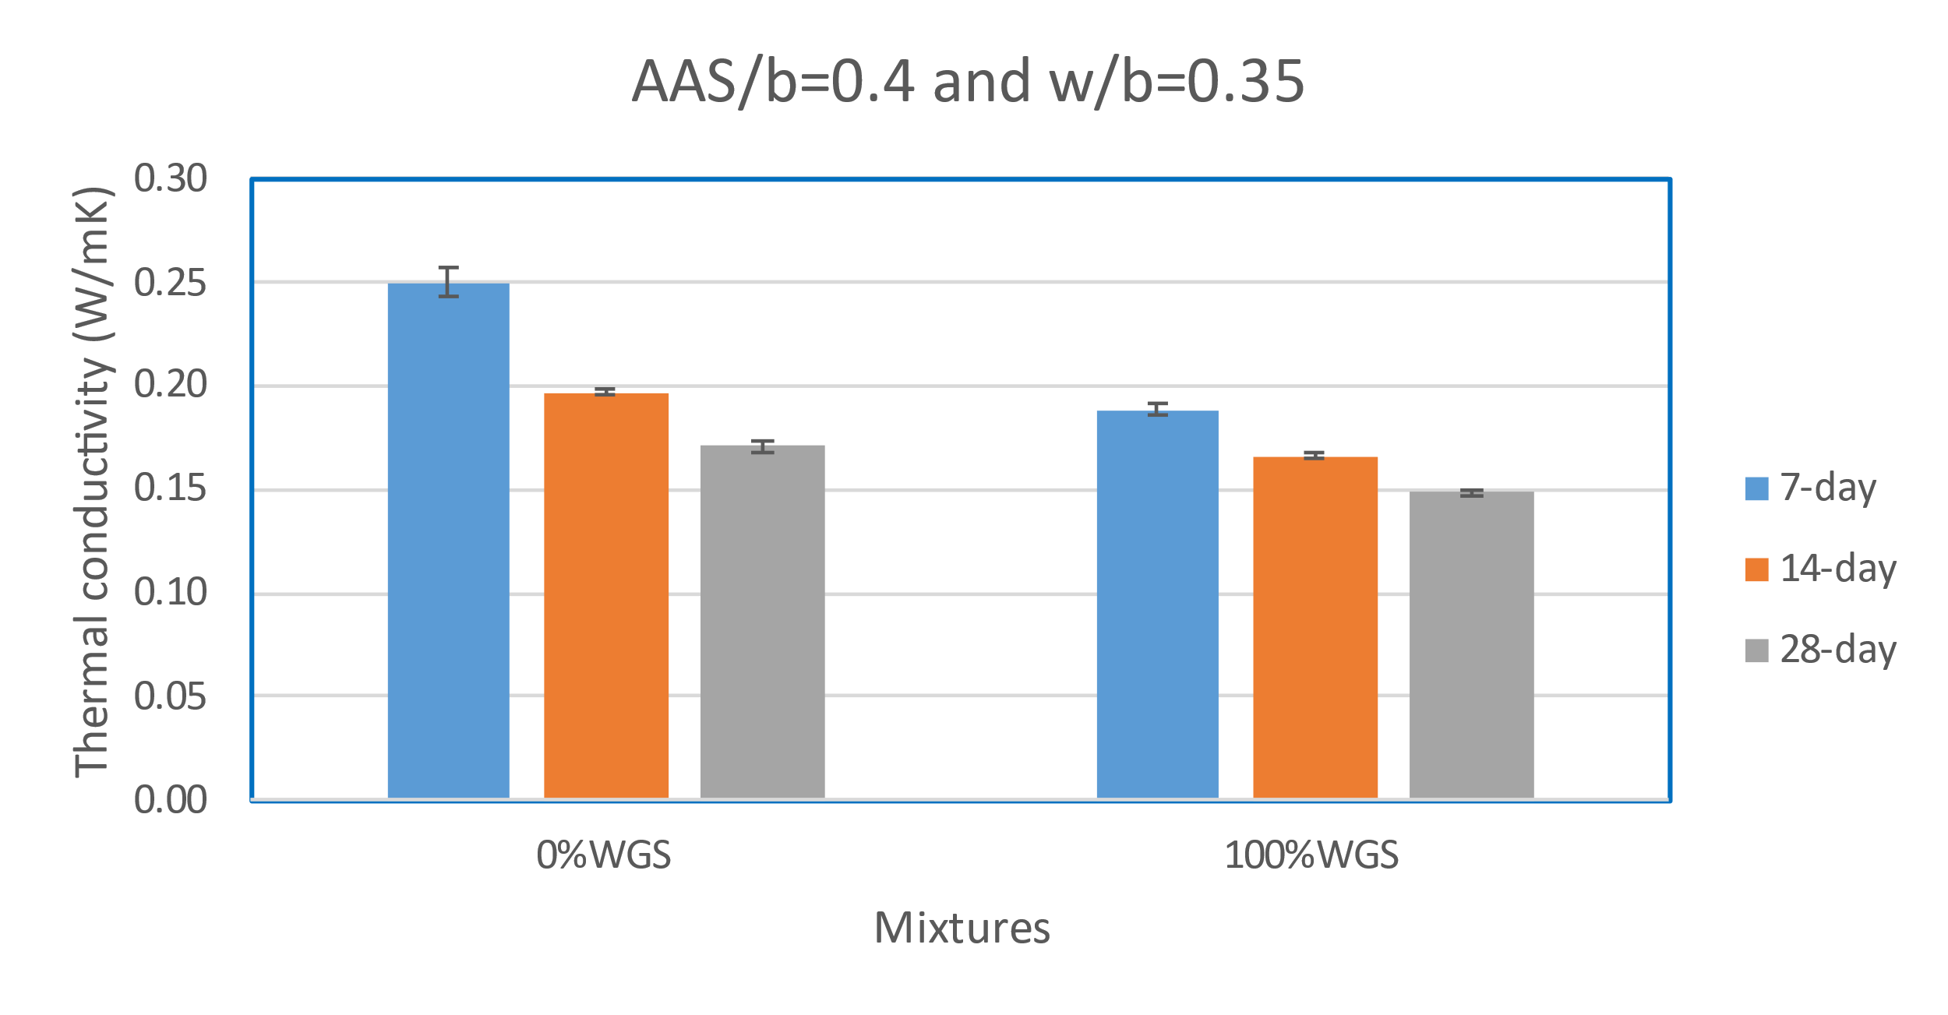
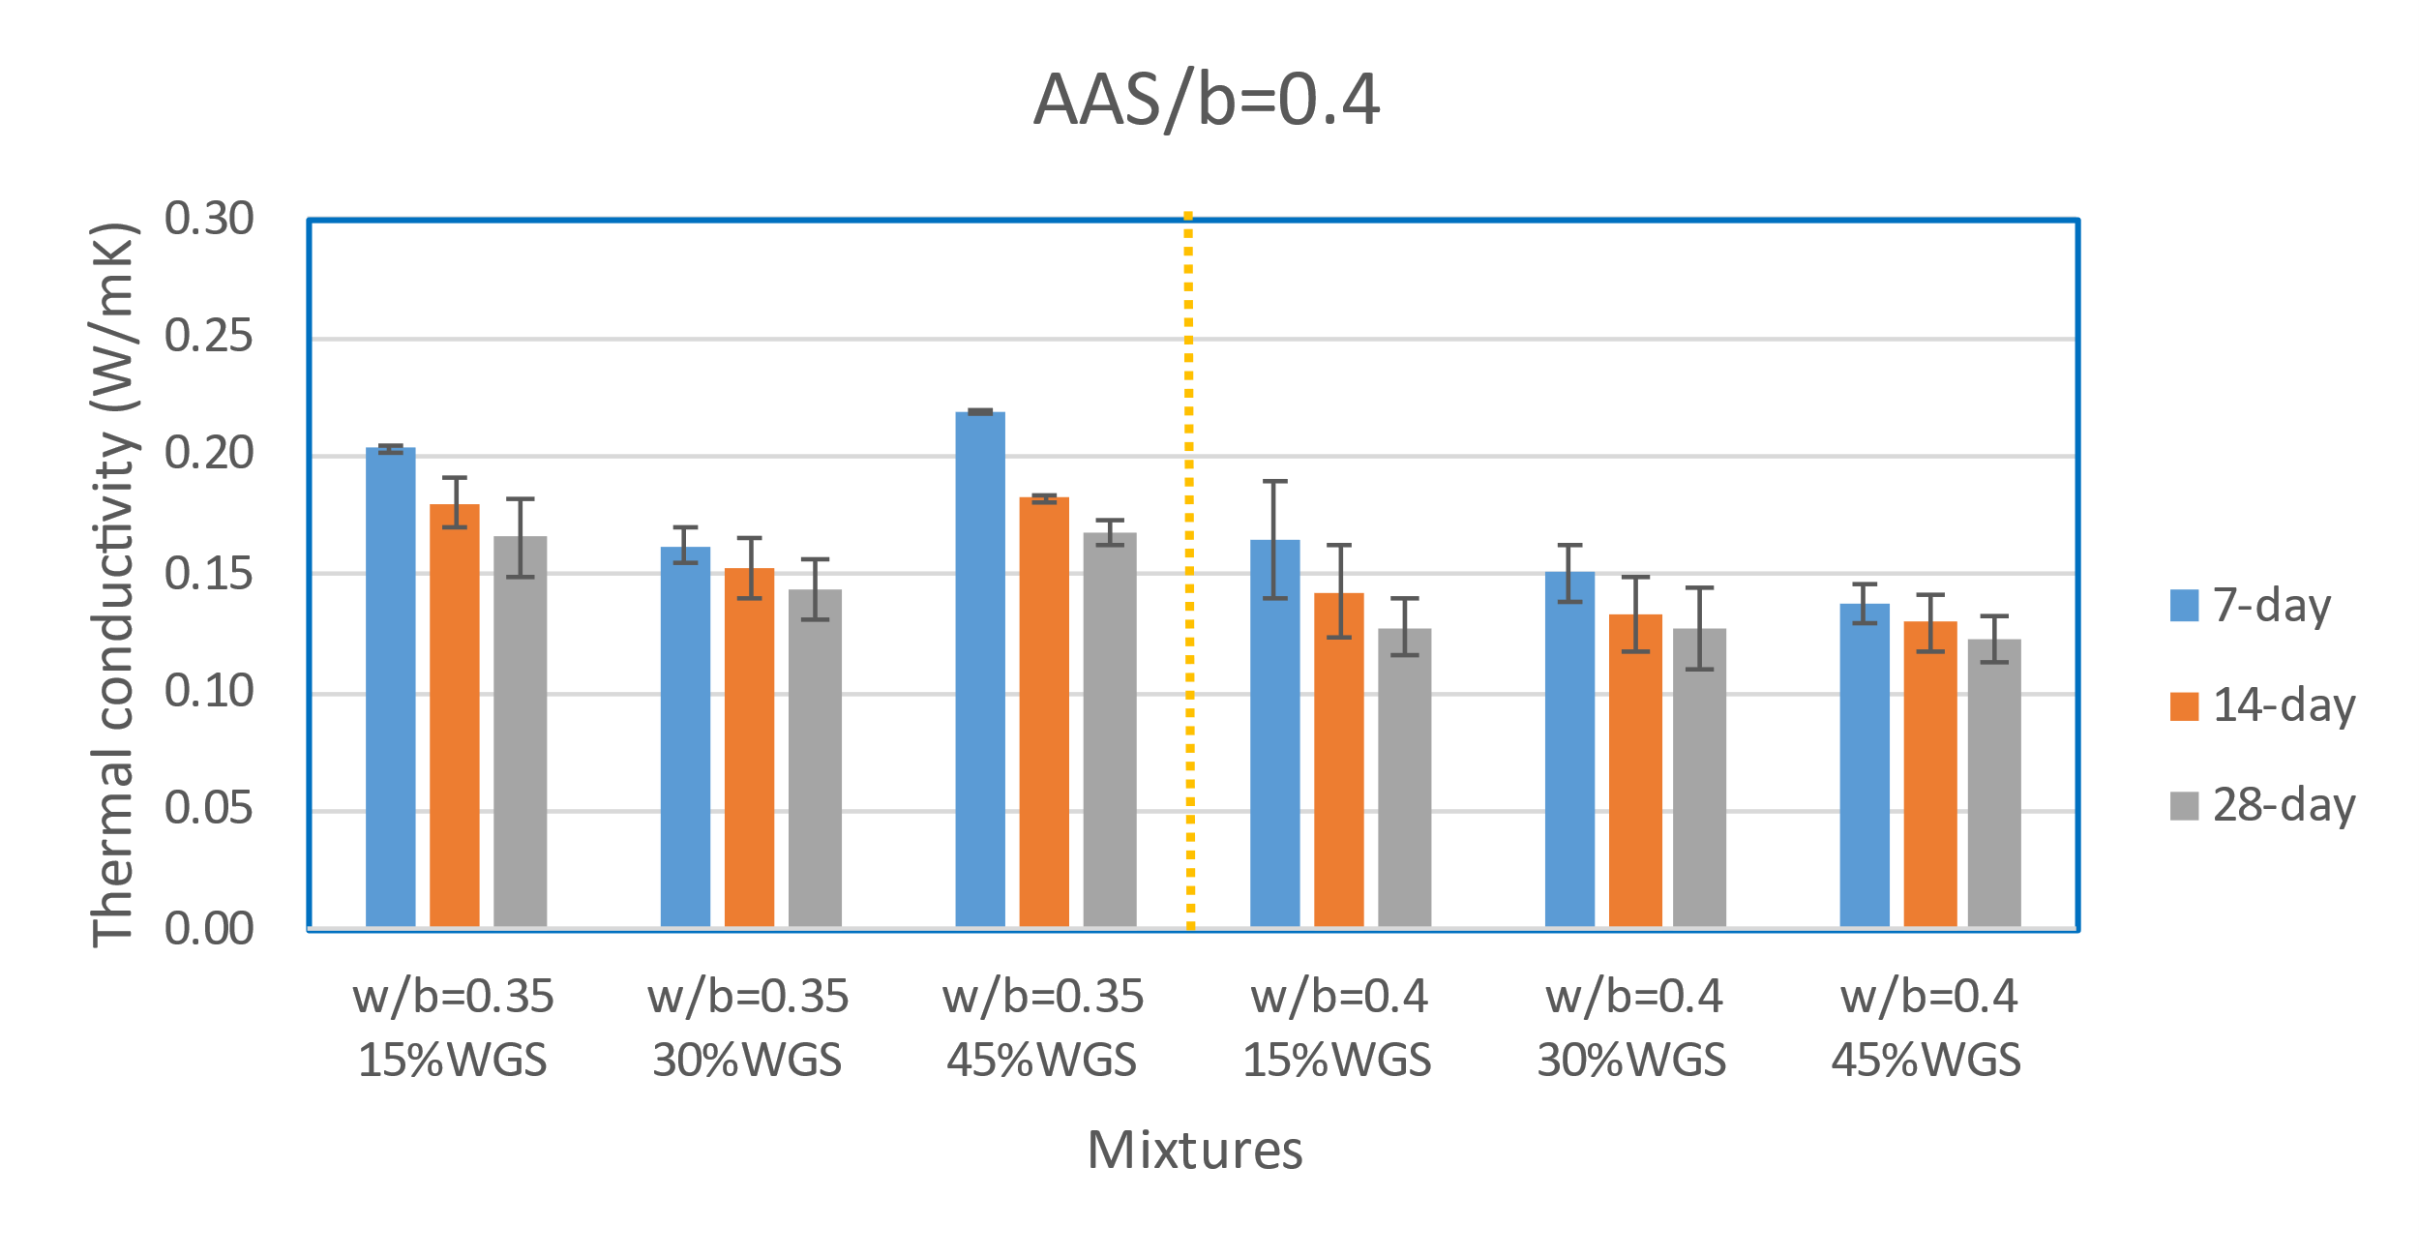
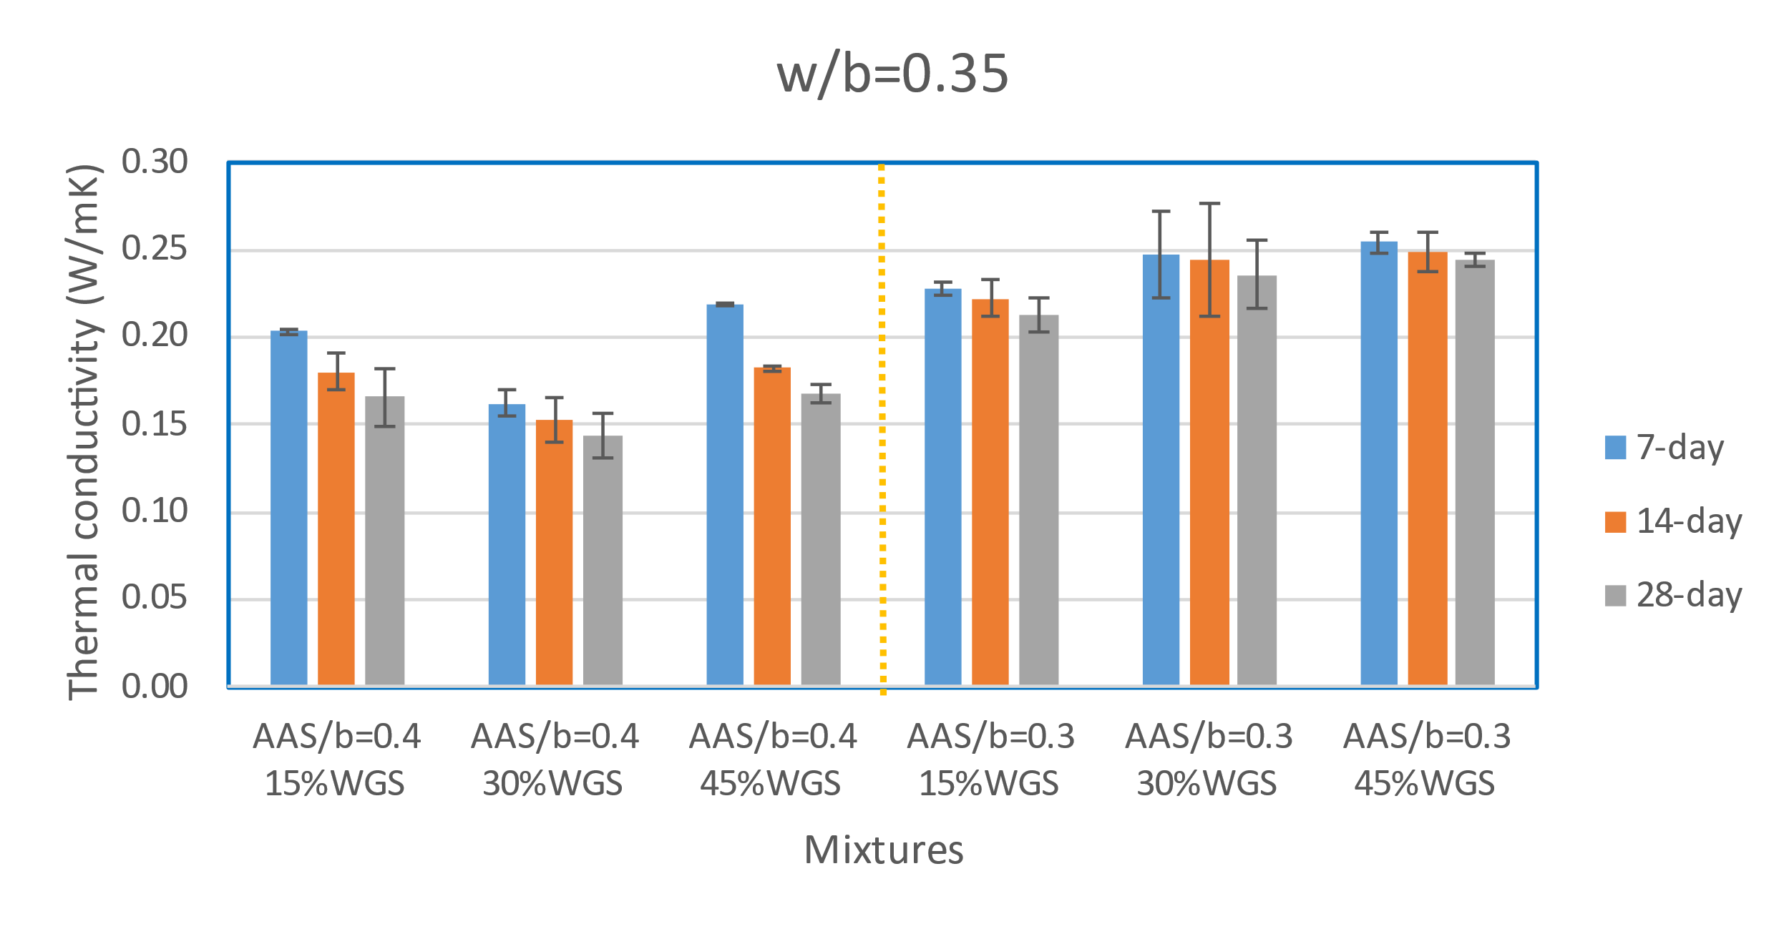
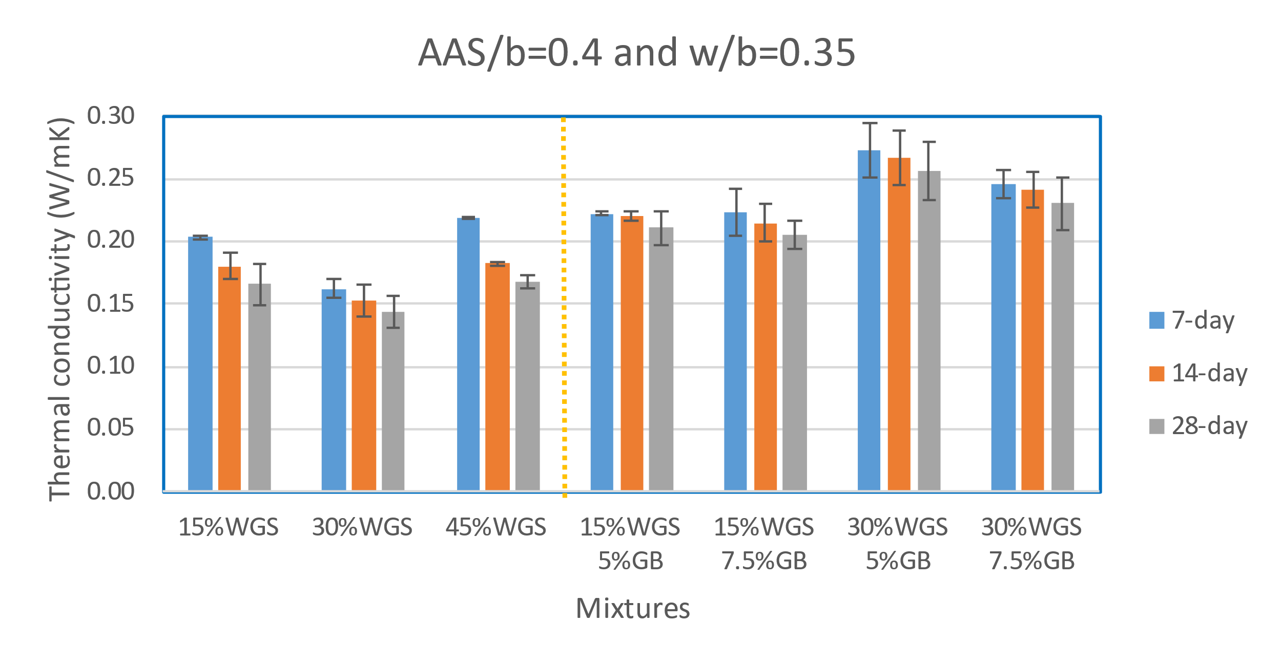
Results and Discussion: Thermal conductivity
(a)
(b)
(c)
(d)
Figure 19. Thermal conductivity

Slide 23
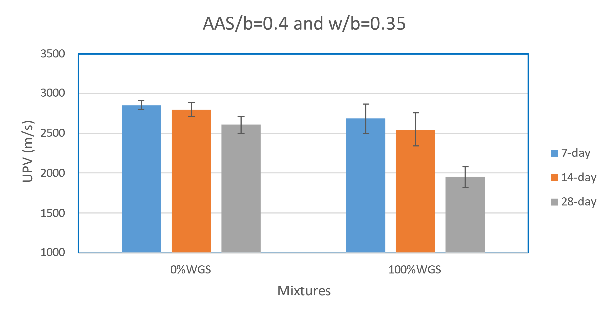
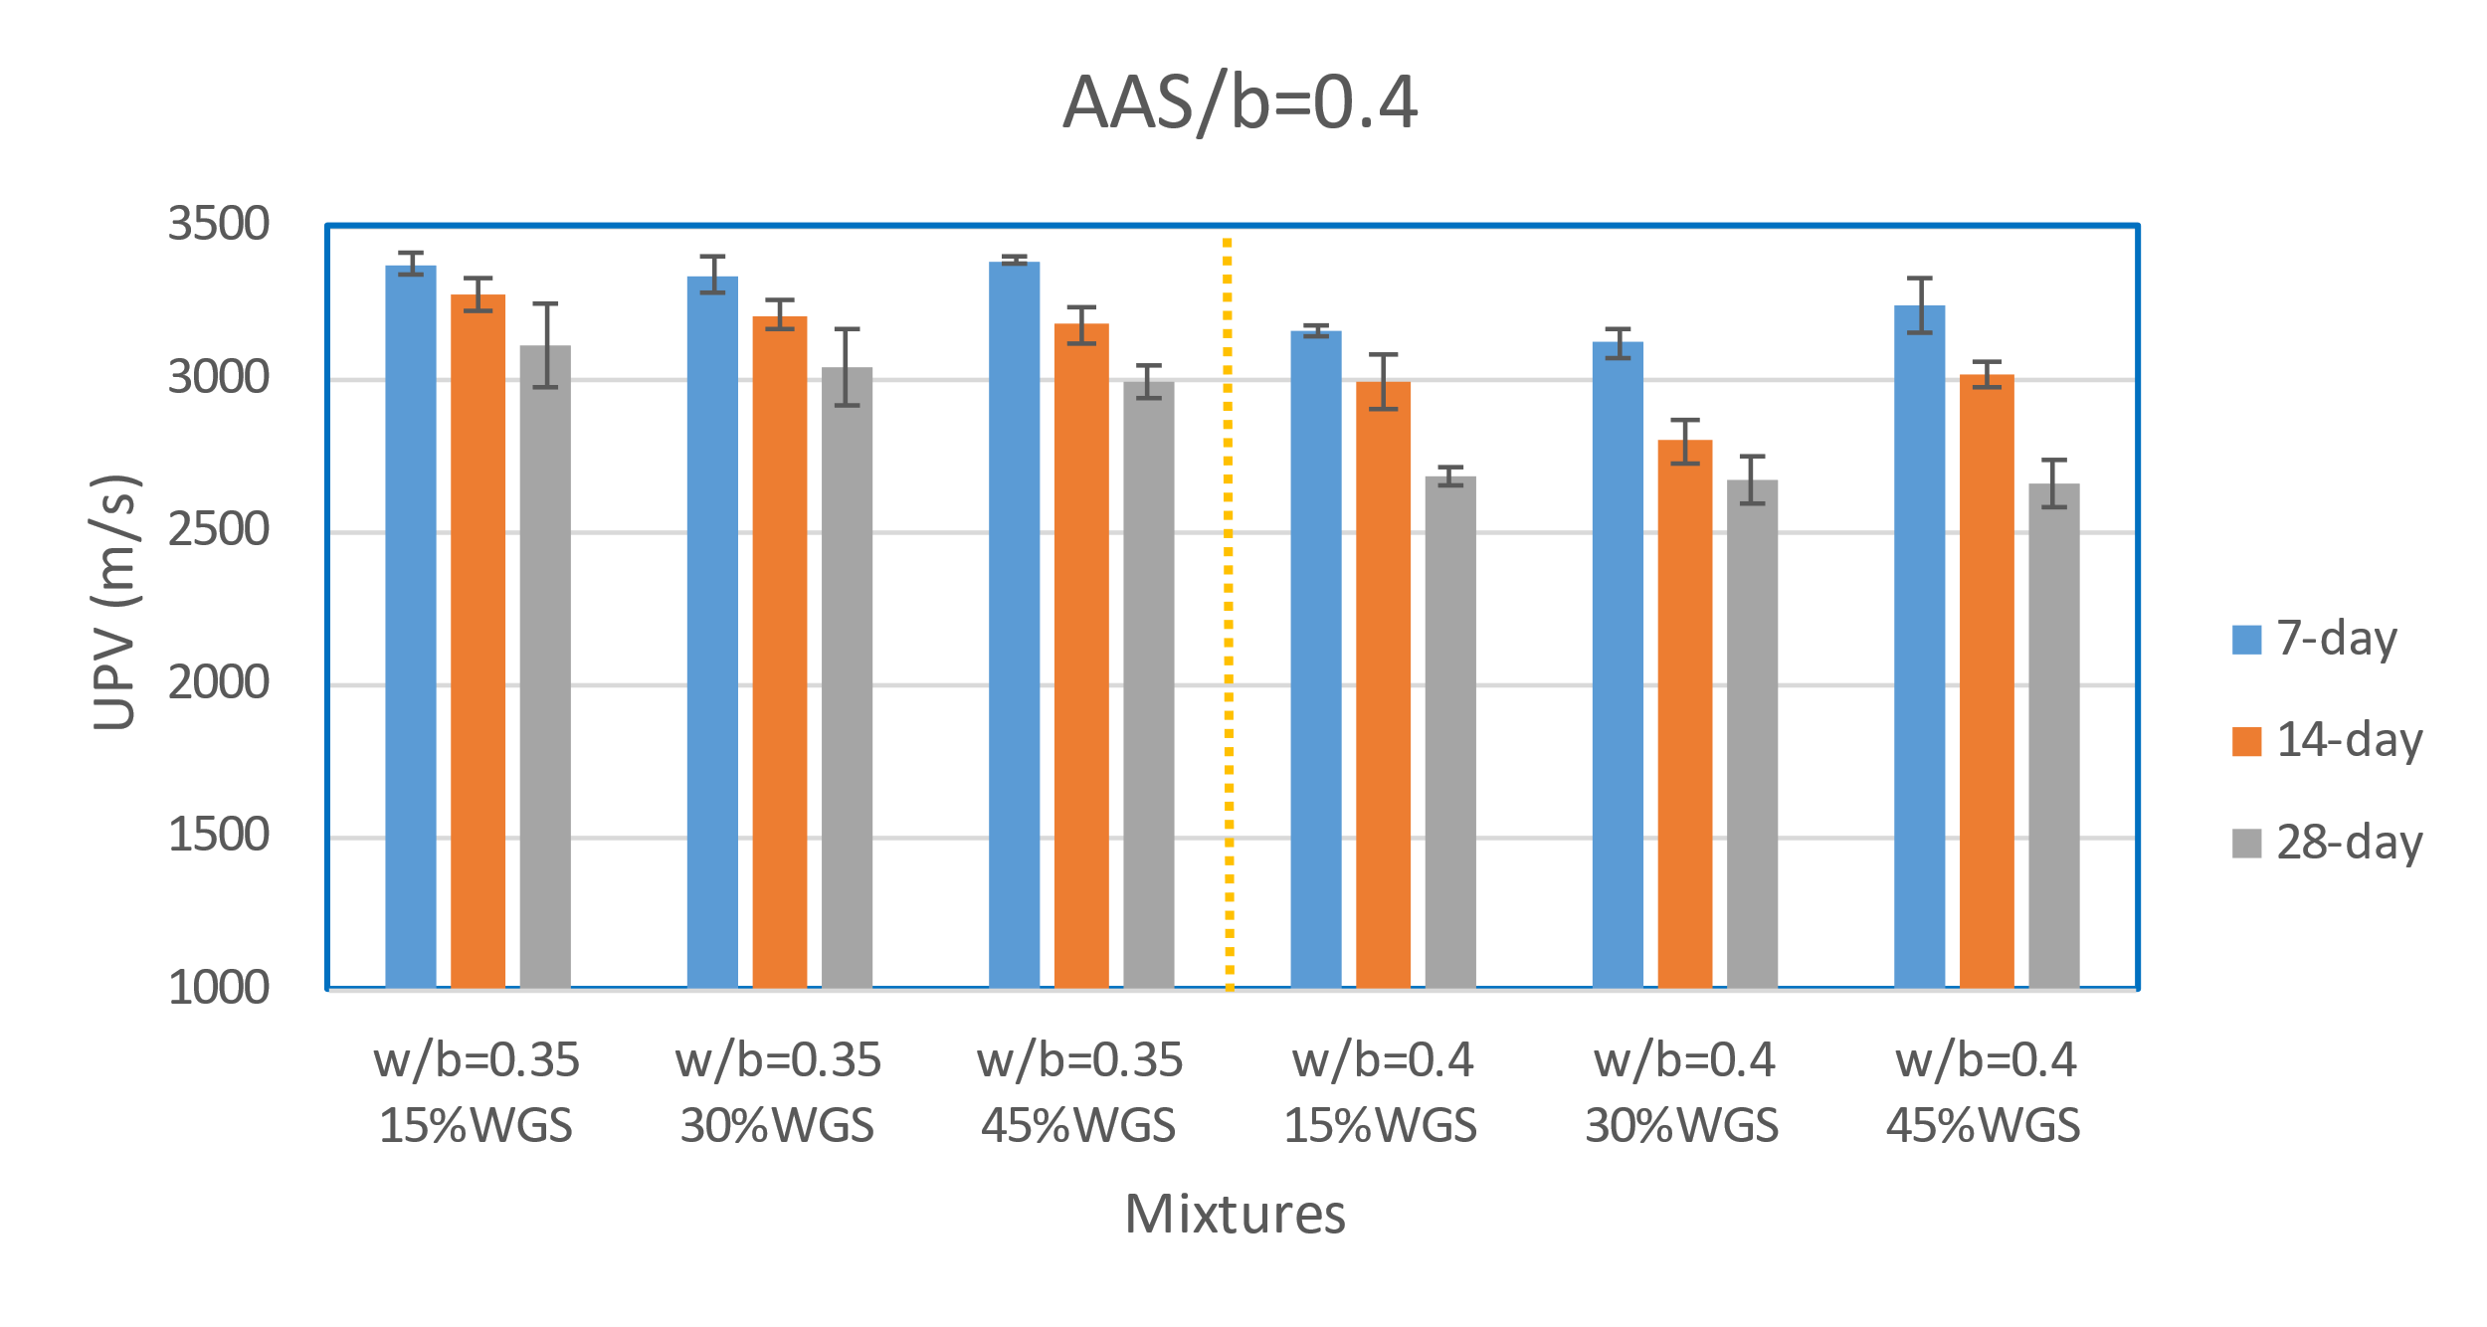
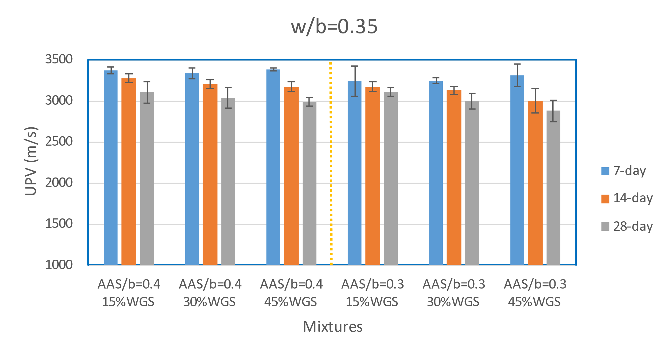
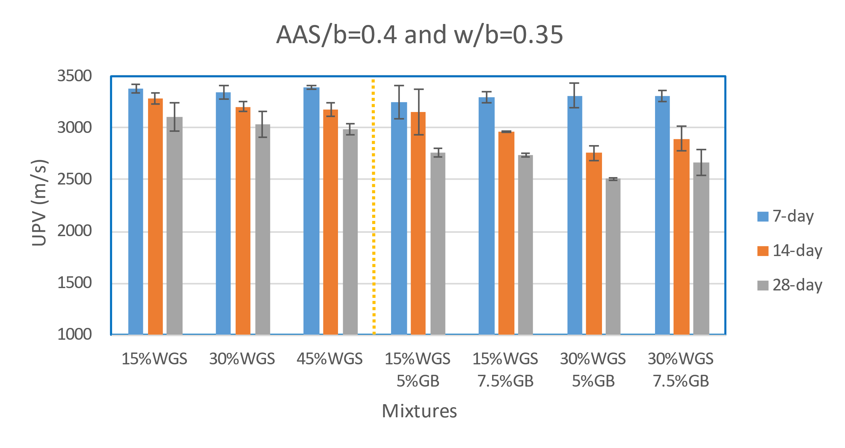
Results and Discussion: UPV
(a)
(b)
(c)
(d)
Figure 20. UPV

Slide 24
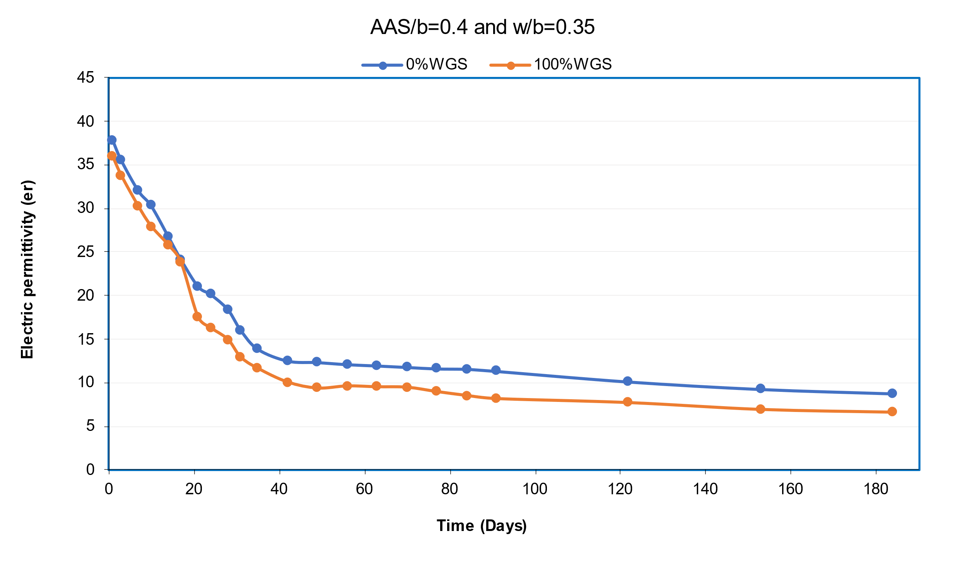
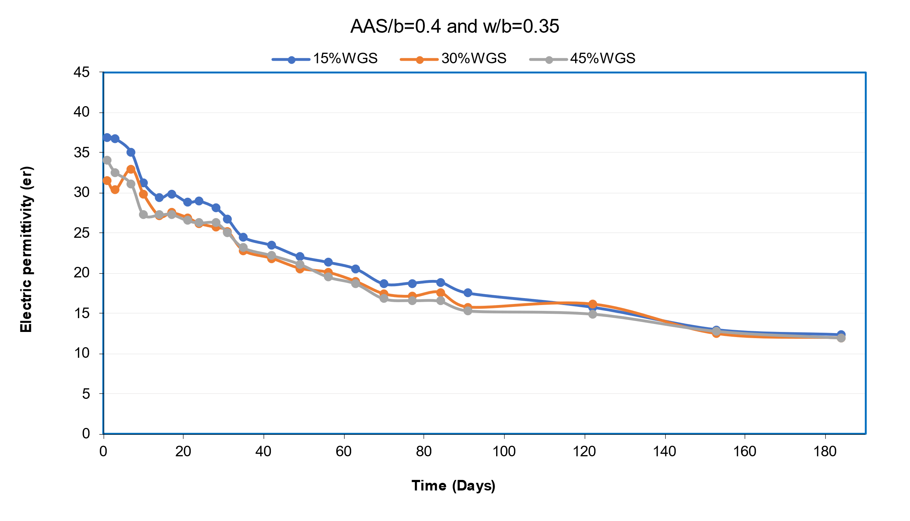
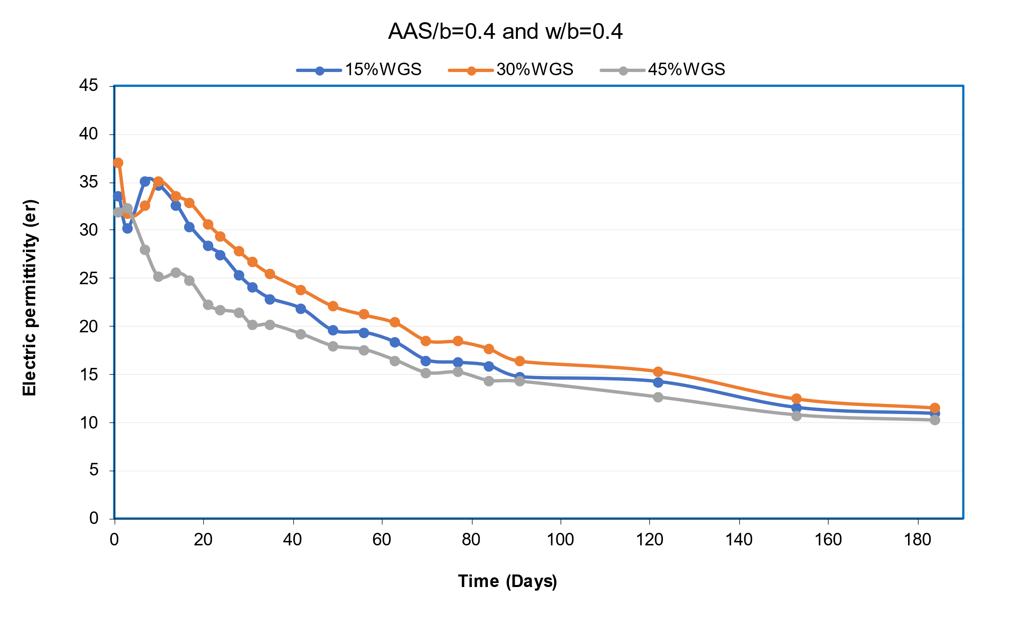
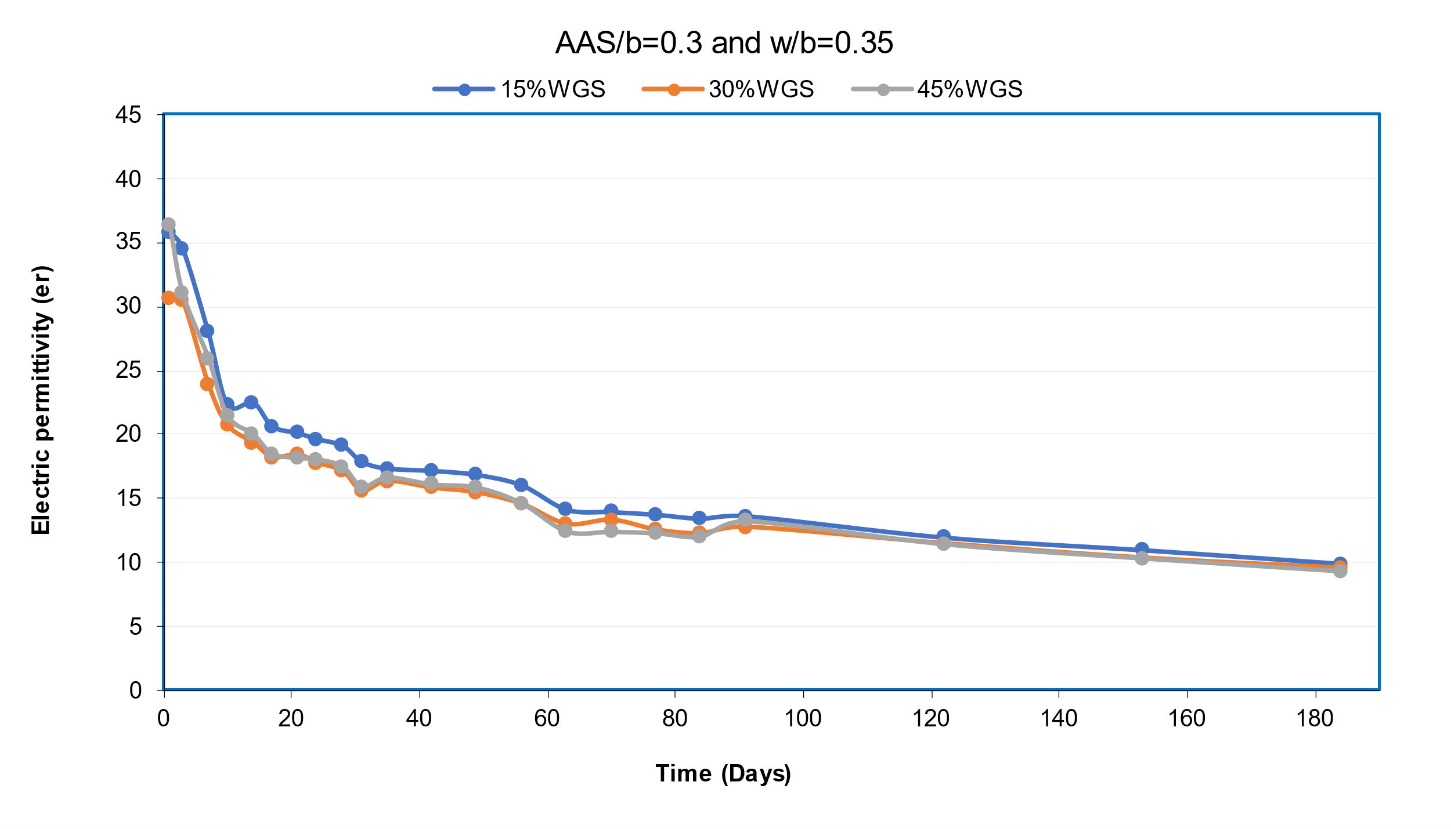
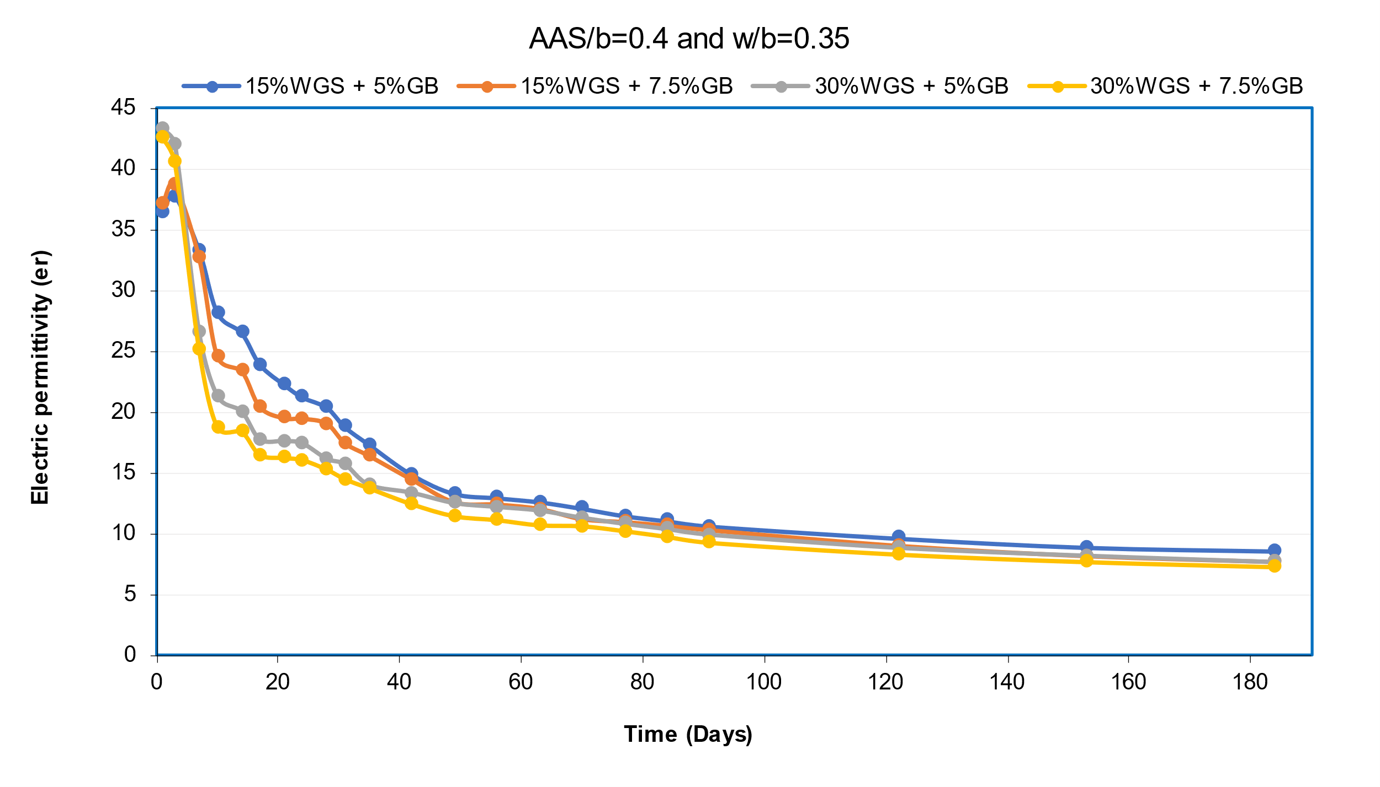
Results and Discussion: Dielectric constant
(a)
(b)
(c)
(d)
(e)
Figure 21. Dielectric constant

Slide 25





Results and Discussion: ASR Expansion
(a)
(b)
(c)
(d)
(e)
Figure 22. ASR test

Slide 26





Results and Discussion: Drying Shrinkage
(a)
(b)
(c)
(d)
(e)
Figure 23. Drying shrinkage

Slide 27
Results and Discussion: Summary
 | Compressive strength | Flexural strength | Thermal conductivity | UPV | Dielectric constant | ASR expansion | Drying shrinkage
Group 1 (C1 C2) |  |  |  |  |  | OK
Group 2 (partial WGS) |  |  |  |  |  | OK
Group 3 (w/b increase) |  |  |  |  |  | OK
Group 4 (ASS/b decrease) |  |  |  |  |  | OK
Group 5 (GB addition) |  |  |  |  |  | OK
Figure 25. Summary

Slide 28
Conclusion
The high glass content caused detrimental result on the strength growth, but the partial replacement of RS by WGS increased the strength of the mortar compared to the mortar without WGS.
The partial replacement by WGS decreases the drying shrinkage and thermal conductivity of the geopolymer mortar even though the w/b and AAS/b were changing.
The rise of the w/b ratio in the geopolymer mixture declines the strength and increases the drying shrinkage, but it enhances the thermal insulation properties.
The application of the glass bubbles reduced the strength and increased the thermal conductivity even though it was expected that the conductivity will decrease.
All geopolymer mortars have low expansion due to the ASR despite aggregate replacement by WGS and glass bubbles, AAS concentration, and water content change. Therefore, the application of the FA and GGBFS helps to mitigate the expansion behavior.
Application of geopolymer helps to reduce ASR because part of the reactive silica from aggregates is consumed during the alkali activation process

Slide 29
Limitations and Recommendations
Only 1 curing method was used (air curing at room temperature).
One combination of FA and GGBFS was used. Response surface method (RSM) can be used to determine optimum mix combination.
It is recommended to conduct Scanning Electron Microscope (SEM) and Fourier Transform Infrared (FTIR) spectroscopy tests to evaluate the phases and compounds in microstructure of mortar samples.
Further investigation of glass bubble is required.

Slide 30
References
al Bakri, A. M. M., Kamarudin, H., Bnhussain, M., Khairul Nizar, I., Rafiza, A. R., Zarina, Y., Mustafa, A. M., Bakri, A., & al Bakri, A. M. M. (2012). THE PROCESSING, CHARACTERIZATION, AND PROPERTIES OF FLY ASH BASED GEOPOLYMER CONCRETE.
Chen, W., Shen, P., & Shui, Z. (2012). Determination of water content in fresh concrete mix based on relative dielectric constant measurement. Construction and Building Materials, 34, 306–312. https://doi.org/10.1016/j.conbuildmat.2012.02.073
Cong, P., & Cheng, Y. (2021). Advances in geopolymer materials: A comprehensive review. In Journal of Traffic and Transportation Engineering (English Edition) (Vol. 8, Issue 3, pp. 283–314). Chang’an University. https://doi.org/10.1016/j.jtte.2021.03.004
Dineshkumar, M., & Umarani, C. (2020). Effect of Alkali Activator on the Standard Consistency and Setting Times of Fly Ash and GGBS-Based Sustainable Geopolymer Pastes. Advances in Civil Engineering, 2020. https://doi.org/10.1155/2020/2593207
Du, H., & Tan, K. H. (2014). Effect of particle size on alkali-silica reaction in recycled glass mortars. Construction and Building Materials, 66, 275–285. https://doi.org/10.1016/j.conbuildmat.2014.05.092
Figueira, R. B., Sousa, R., Coelho, L., Azenha, M., de Almeida, J. M., Jorge, P. A. S., & Silva, C. J. R. (2019). Alkali-silica reaction in concrete: Mechanisms, mitigation and test methods. In Construction and Building Materials (Vol. 222, pp. 903–931). Elsevier Ltd. https://doi.org/10.1016/j.conbuildmat.2019.07.230
Hassan, A., Arif, M., & Shariq, M. (2019). Use of geopolymer concrete for a cleaner and sustainable environment – A review of mechanical properties and microstructure. In Journal of Cleaner Production (Vol. 223, pp. 704–728). Elsevier Ltd. https://doi.org/10.1016/j.jclepro.2019.03.051
He, Z., Zhu, X., Wang, J., Mu, M., & Wang, Y. (2019). Comparison of CO 2 emissions from OPC and recycled cement production. Construction and Building Materials, 211, 965–973. https://doi.org/10.1016/j.conbuildmat.2019.03.289
Khan, M. N. N., & Sarker, P. K. (2020). Effect of waste glass fine aggregate on the strength, durability and high temperature resistance of alkali-activated fly ash and GGBFS blended mortar. Construction and Building Materials, 263. https://doi.org/10.1016/j.conbuildmat.2020.120177
Lima, L., Trindade, E., Alencar, L., Alencar, M., & Silva, L. (2021). Sustainability in the construction industry: A systematic review of the literature. In Journal of Cleaner Production (Vol. 289). Elsevier Ltd. https://doi.org/10.1016/j.jclepro.2020.125730
Oreshkin, D., Semenov, V., & Rozovskaya, T. (2016). Properties of Light-weight Extruded Concrete with Hollow Glass Microspheres. Procedia Engineering, 153, 638–643. https://doi.org/10.1016/j.proeng.2016.08.214
Salim, M. U., & Mosaberpanah, M. A. (2022). The mechanism of alkali-aggregate reaction in concrete/mortar and its mitigation by using geopolymer materials and mineral admixtures: a comprehensive review. In European Journal of Environmental and Civil Engineering (Vol. 26, Issue 14, pp. 6766–6806). Taylor and Francis Ltd. https://doi.org/10.1080/19648189.2021.1960899
Shahedan, N. F., Abdullah, M. M. A. B., Mahmed, N., Kusbiantoro, A., Tammas-Williams, S., Li, L. Y., Aziz, I. H., Vizureanu, P., Wysłocki, J. J., Błoch, K., & Nabiałek, M. (2021). Properties of a new insulation material glass bubble in geo-polymer concrete. Materials, 14(4), 1–17. https://doi.org/10.3390/ma14040809
Xu, G., & Shi, X. (2018a). Characteristics and applications of fly ash as a sustainable construction material: A state-of-the-art review. In Resources, Conservation and Recycling (Vol. 136, pp. 95–109). Elsevier B.V. https://doi.org/10.1016/j.resconrec.2018.04.010

Slide 31
Thank You!

