Slide 1




SITE PLAN
CROATIA, 1st prize, Valentina ŠTIVIČIĆ, Ivan VOJNIĆ

Slide 2
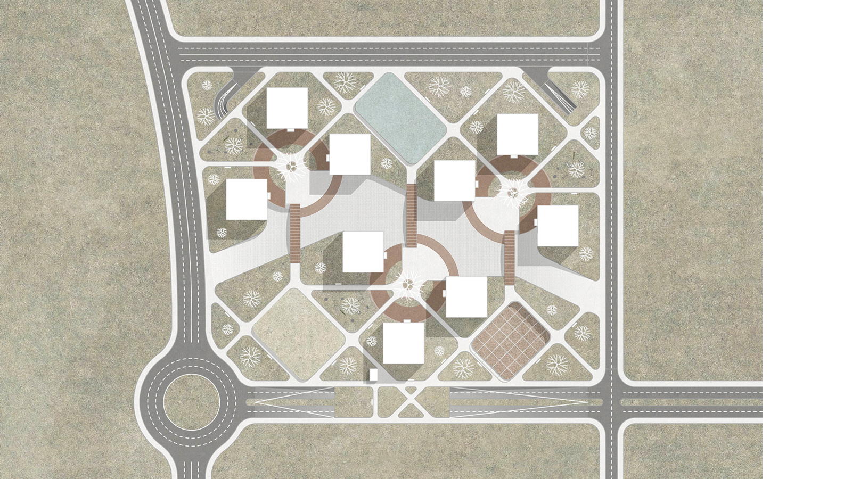


SITE PLAN

Slide 3

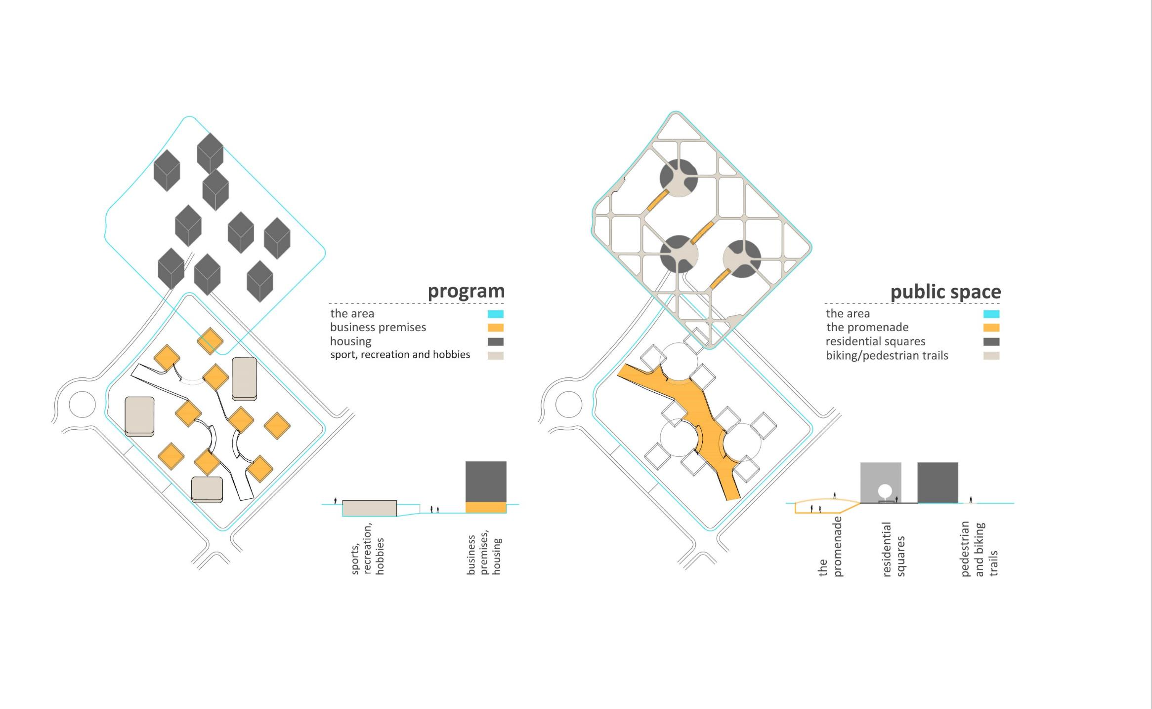
PROGRAM

Slide 4

PUBLIC SPACE

Slide 5
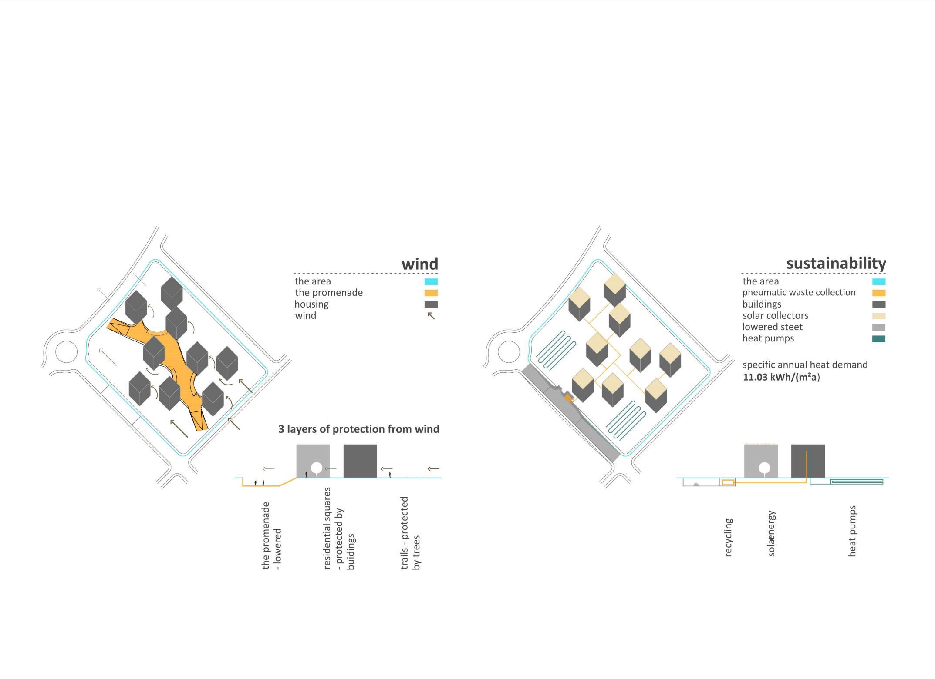
WIND

Slide 6
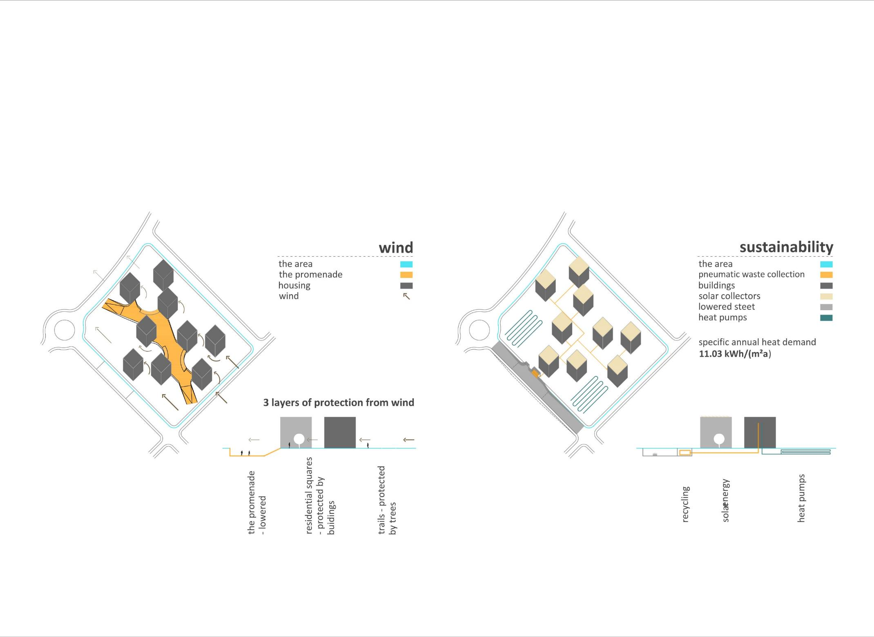
SUSTAINABILITY

Slide 7
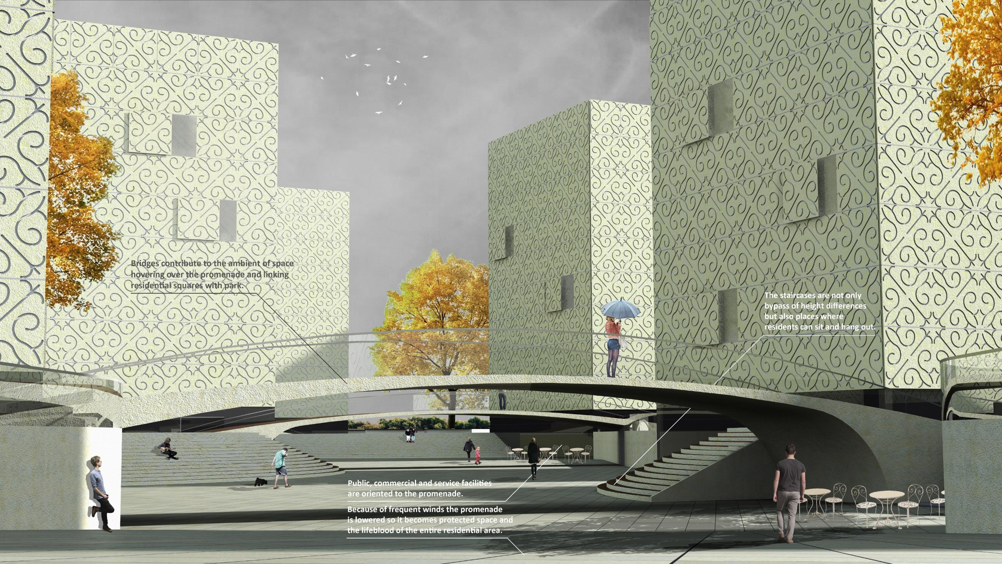

Slide 8
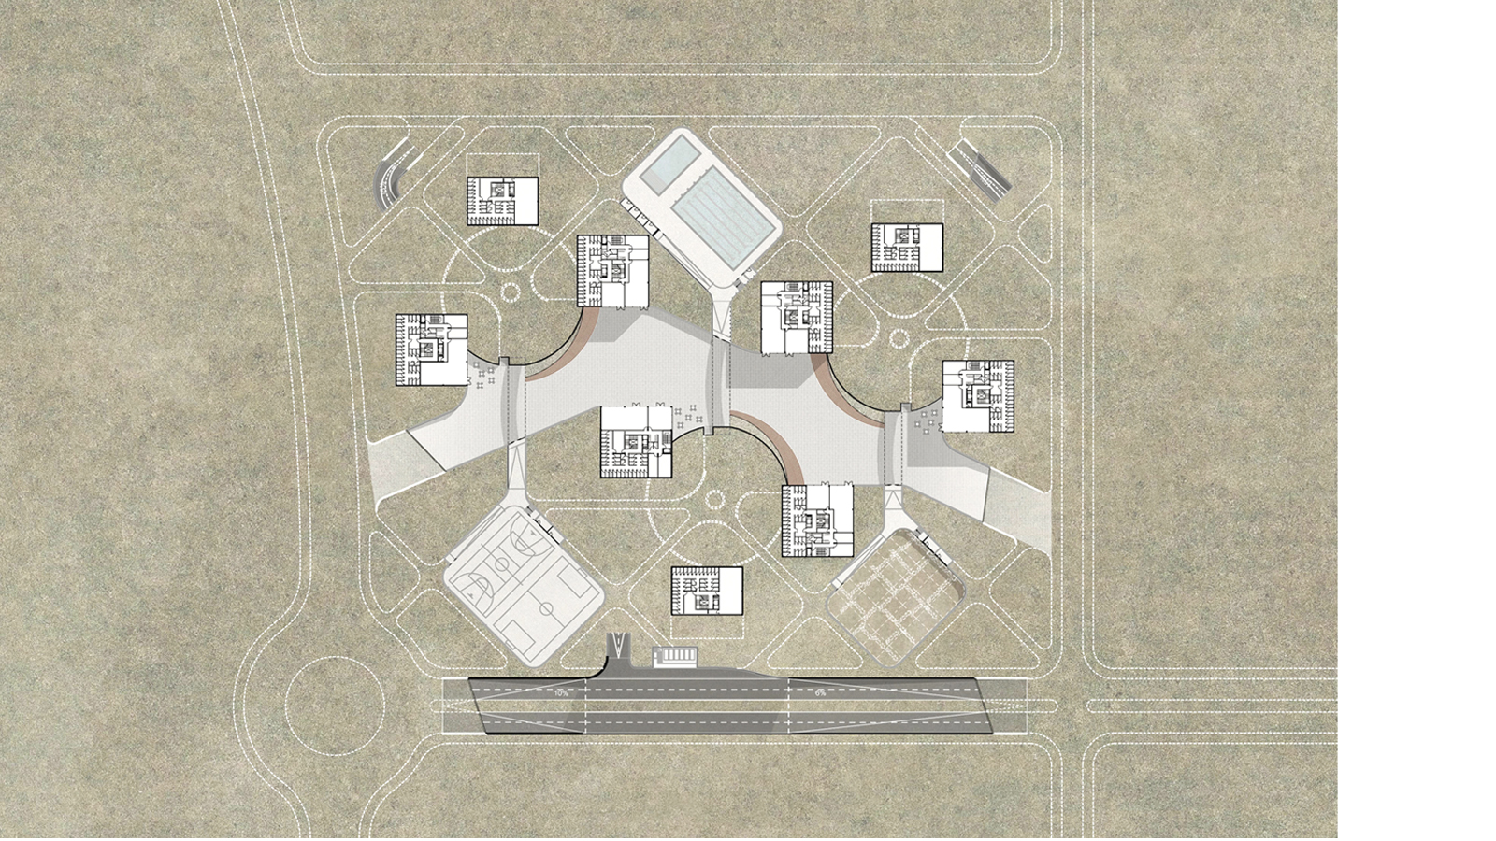
THE PROMENADE LEVEL

Slide 9
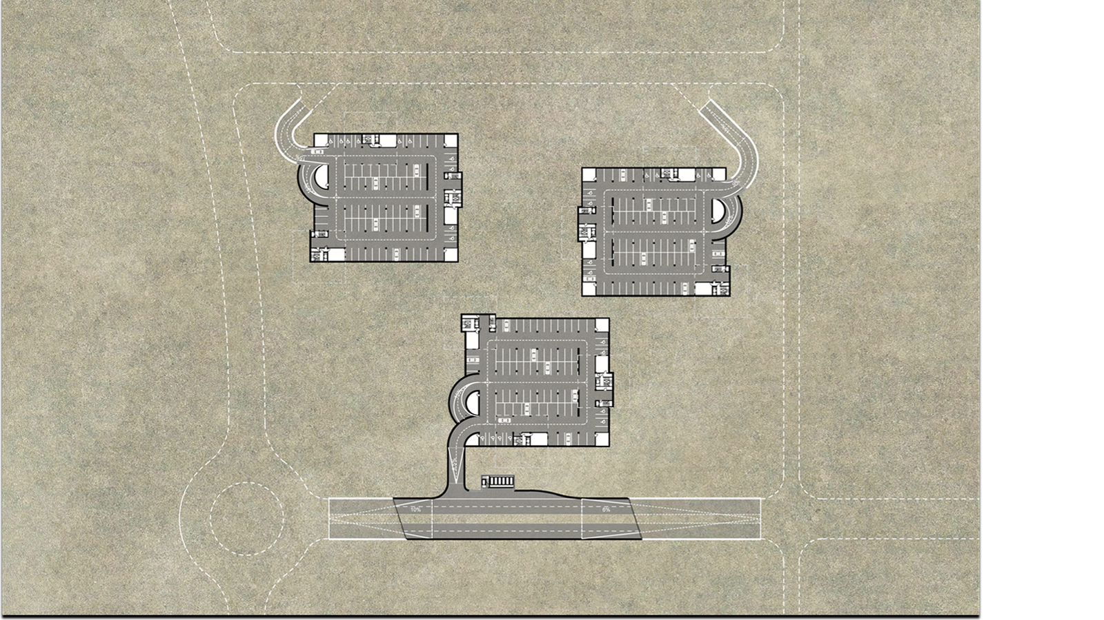
GARAGES

Slide 10
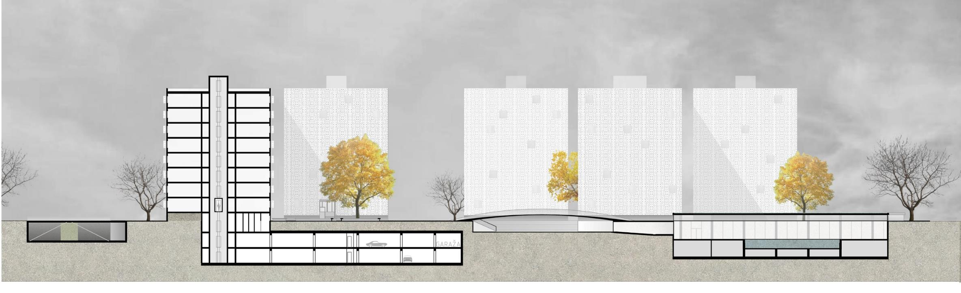
SITE PLAN
SECTION

Slide 11
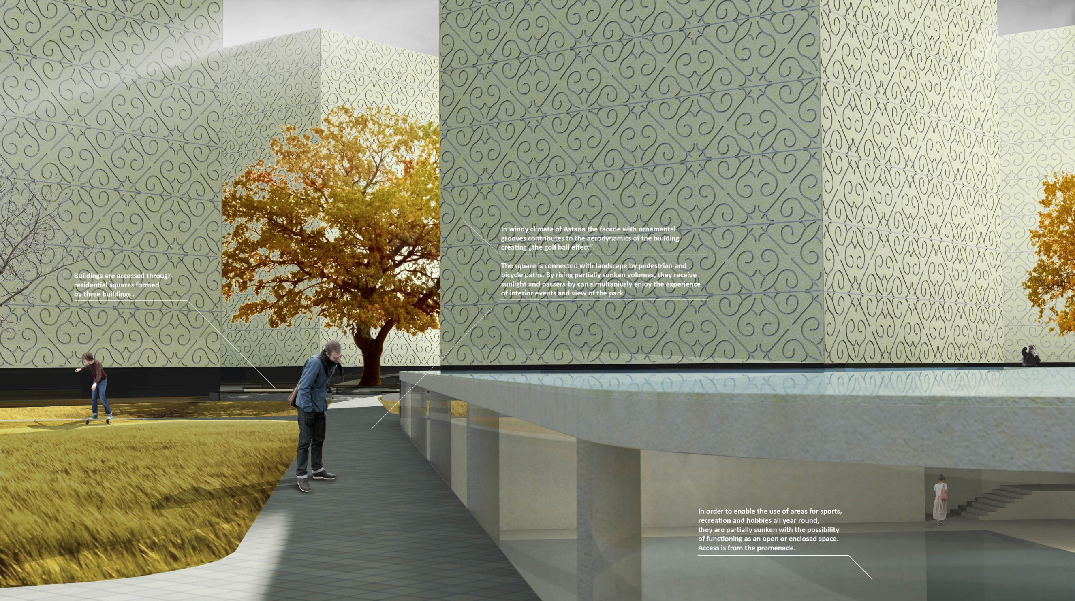

Slide 12
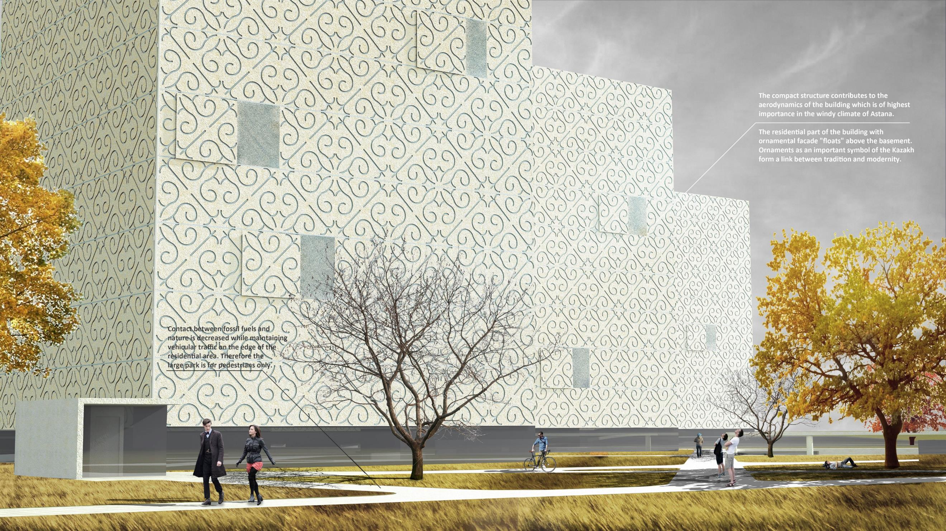

Slide 13
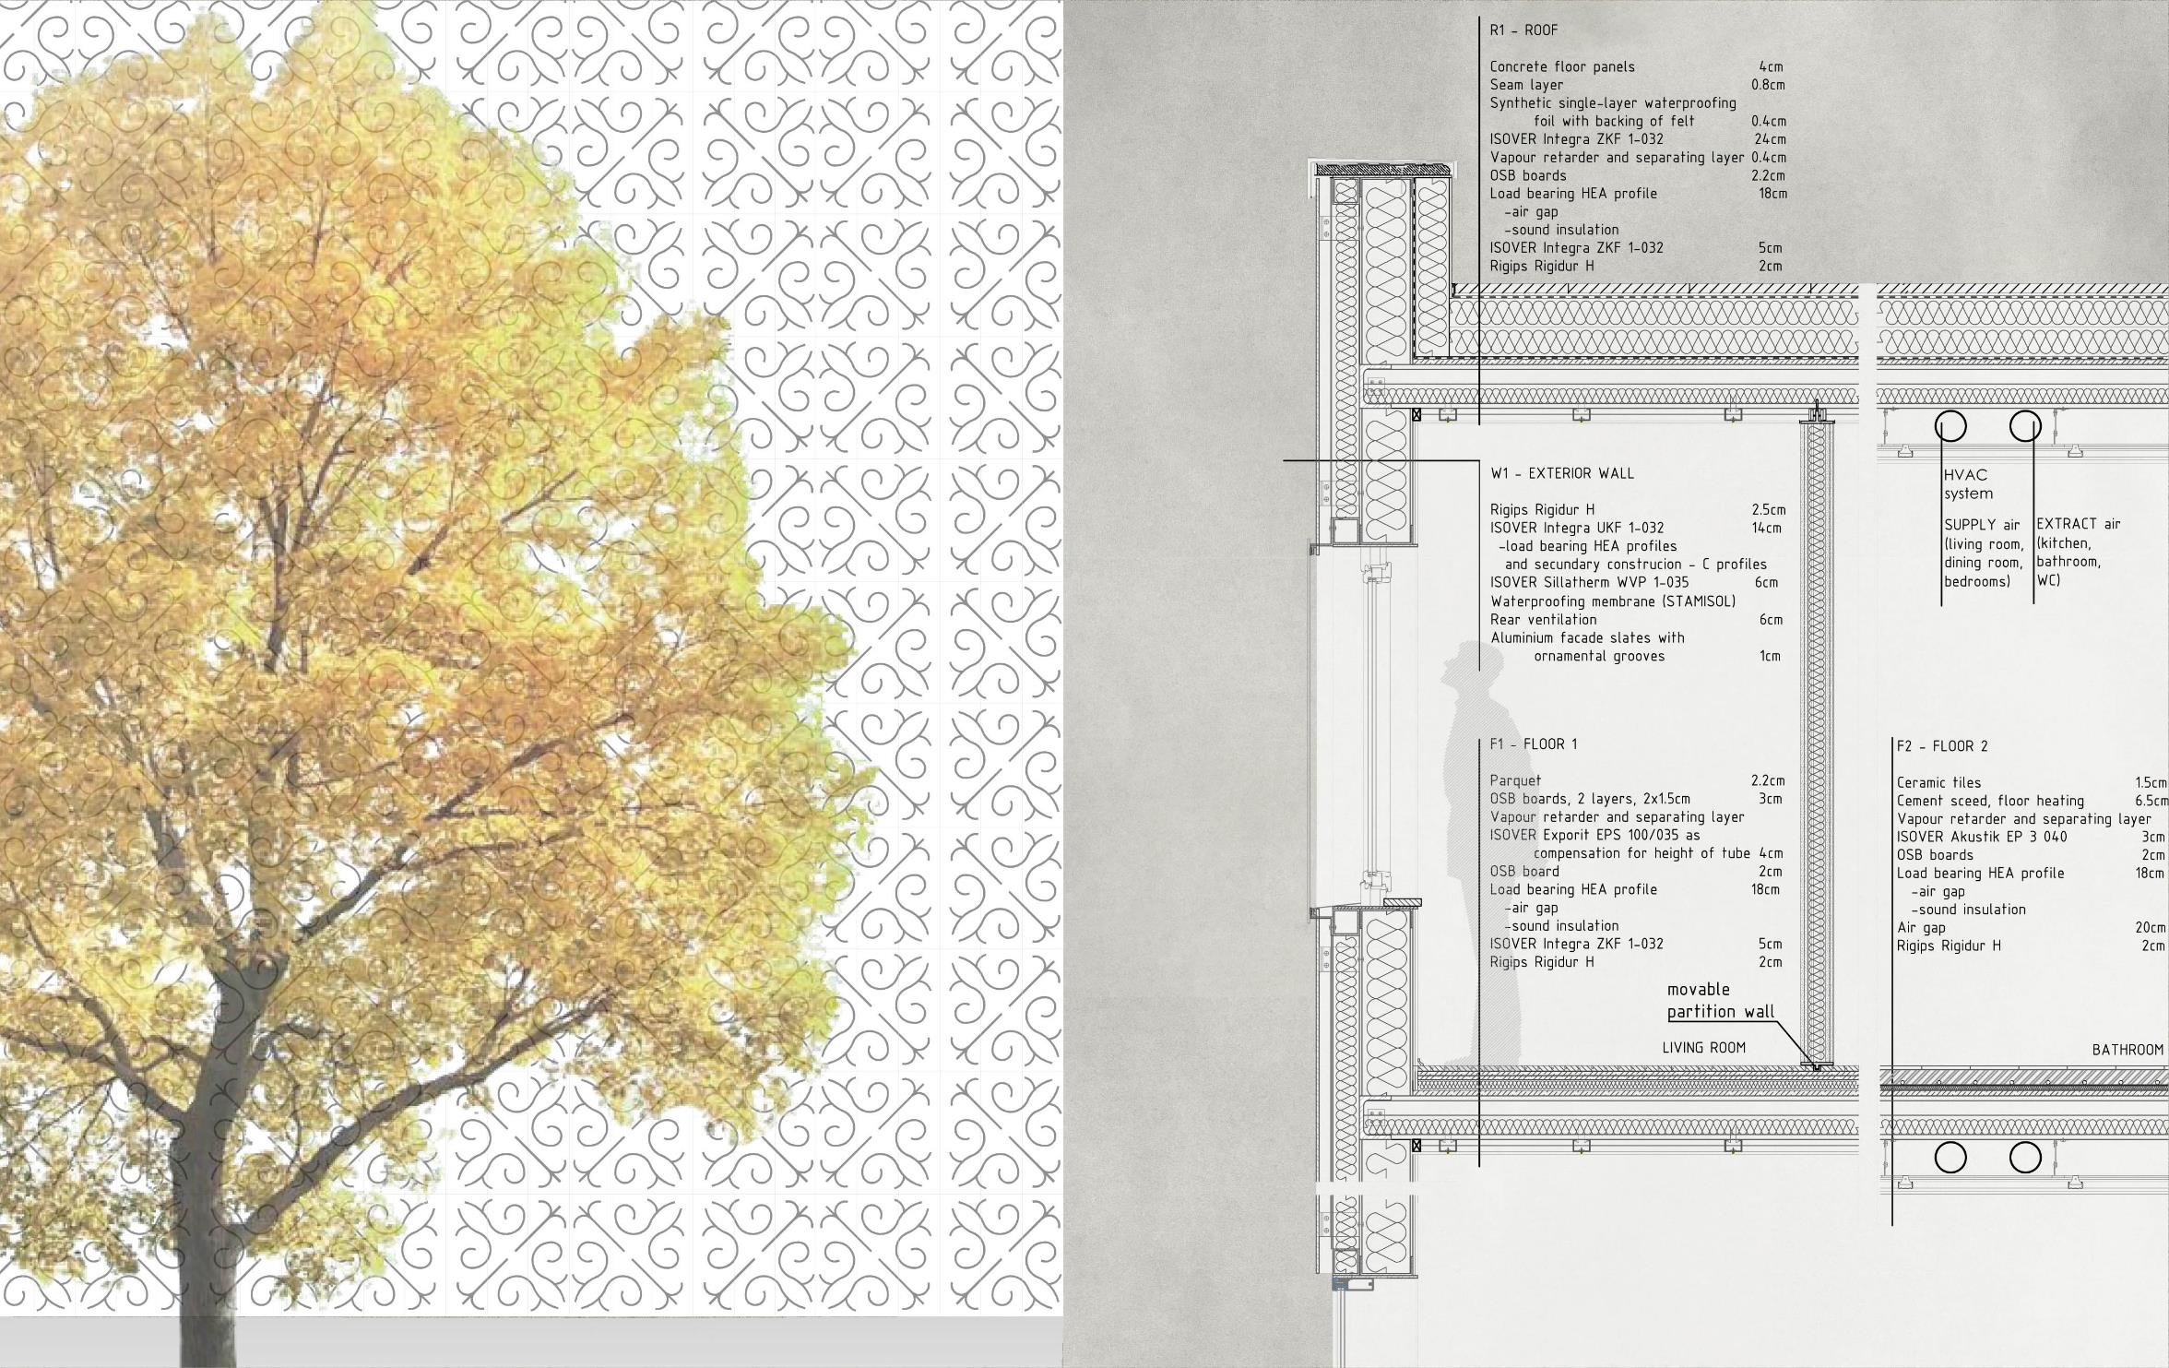
SECTION

Slide 14
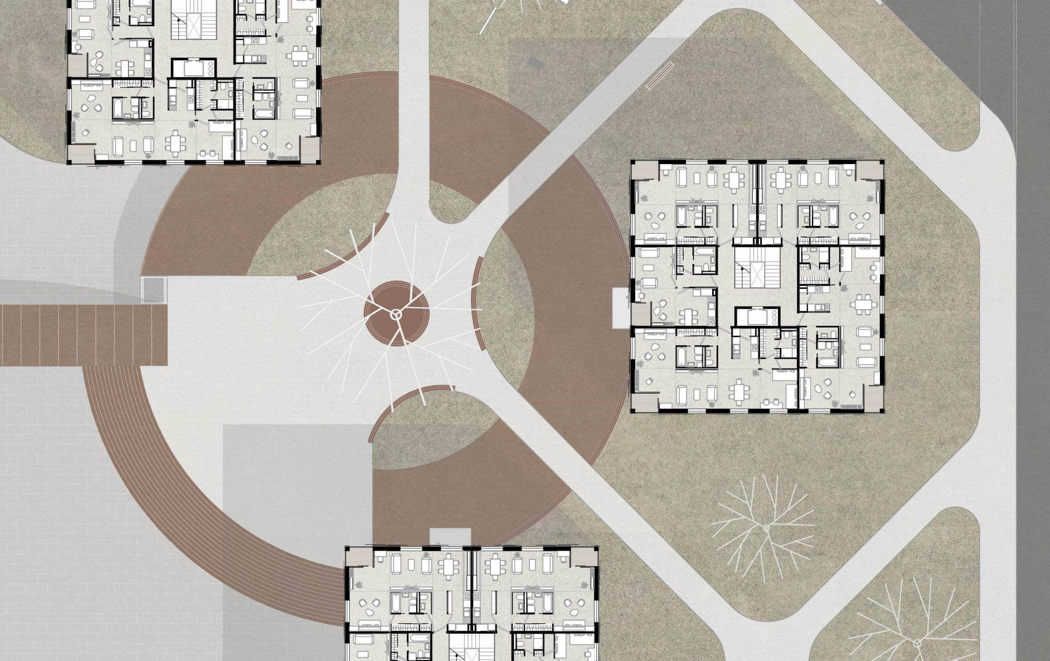
RESIDENTIAL SQUARE

Slide 15
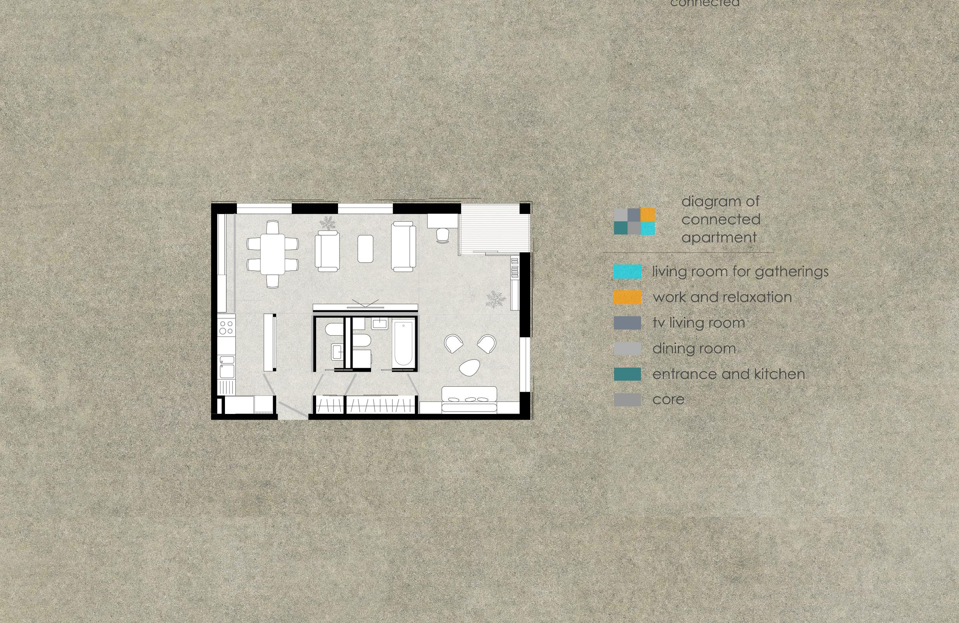
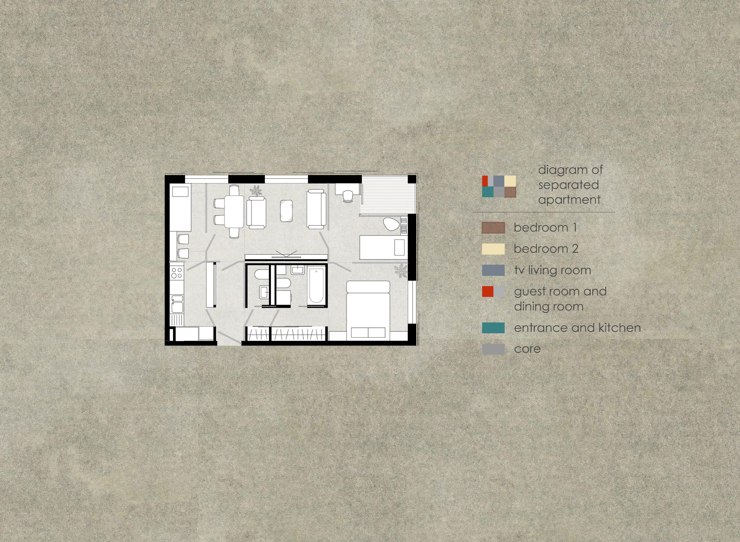
FLEXIBLE APARTMENT

Slide 16
FLEXIBLE APARTMENT

Slide 17
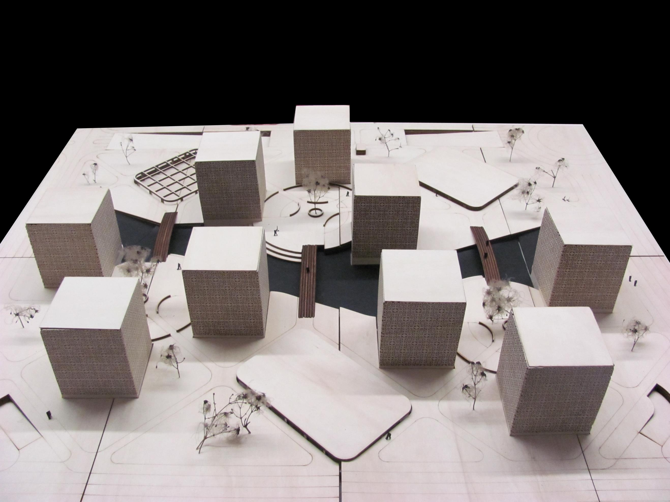
Stanovanje u ekstremnim klimatskim uvjetima
Astana, Kazakstan

