Slide 1




IX Eurasian Academic Libraries Conference “Alive to Changes: Engage. Embrace. Ensure”
30 September - 2 October | 2020
Digital Humanities and the Role of the Library: Experiences from the Sussex Humanities Lab
Suzanne Tatham
Associate Director
University of Sussex Library
Brighton, UK
@suzannetatham
s.tatham@sussex.ac.uk
Notes:
Abstract:
The Sussex Humanities Lab is a thriving community of researchers from across a wide range of disciplines. It facilitates a rich culture of research and knowledge exchange, and delivers innovative, interdisciplinary digital humanities projects. Through membership of both the Executive and the wider Research Group, the Library has been a core element of the Lab since its creation in 2015. The Library also has its own Research Fellow, funded by the Lab and based in the Library. We see this partnership as providing an important example of an academic library moving beyond the traditional role of supporting research to playing a contributory role. The Library is invested in this partnership. It is an area where we feel we have much to offer - not only through our collections and archives but also through our skills and expertise. We are able to contribute to research bids and share our understanding of institutional priorities, technical infrastructure and community engagement. This partnership role within digital humanities research has challenged us to think about how we define the Library, to the extent that we feel confident in exploring the Library as a Lab and carry out our own research.
This presentation will provide examples of how the Library is working with the Sussex Humanities Lab and will offer some reflections on the partnership.

Slide 2
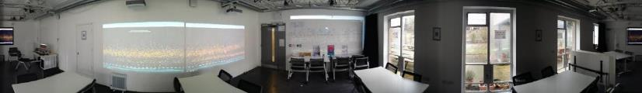
Sussex Humanities Lab
Facilitates a rich culture of research and knowledge exchange.
Designs and delivers critical, innovative, interdisciplinary research projects.
Captures major funding to expand our research capacity.
Ensures these gains become sustainably rooted in the University.
www.sussex.ac.uk/research/centres/sussex-humanities-lab

Slide 3
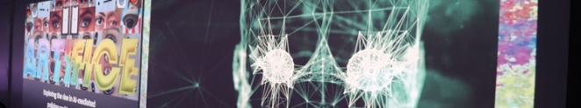
Research projects
BBC Connected Histories
Capturing & Preserving the Copts' intangible cultural heritage in Egypt
Curatorial Voice: Legacy description of art objects & their contemporary uses
Digital Forensics in the Historical Humanities: Hanif Kureishi, The Mass observation Archive, Glyn Moody
Identity, Representation and Preservation in Community Digital Archives and Collections
Sonic Writing: Technologies of Musical Expression, Notation and Encoding
The Poor Law: Small Bills and Petty Finance

Slide 4
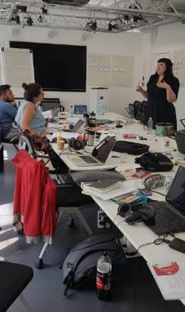
Library relationship
“When we set up the Sussex Humanities Lab, we recognised that unless we had the library at the centre of our project, we were never going to be able to achieve the transformation that we hoped.”
Prof Tim Hitchcock, Lab Director
The Library’s potential to collaborate with digital humanities scholars and contribute to research
Involvement at the right level (Harvell & Ball 2017)
Increasing the visibility of both our collections and our expertise (Kamposiori 2017)

Slide 5
From support to partnership
Involvement in research bids:
  Expertise on archiving policy and practice
  Research data management – reviewing plans and consultation
  Knowledge of the Mass Observation Archive and its research potential
Collaboration to tackle institutional issues:
  Championing the Lab at an institutional and strategic level
  Bringing in digital humanities researchers to contribute to projects and steering groups
Joint delivery of seminars and training:
  Research data workshops
  Digital preservation training
  Library Carpentry

Slide 6
Changing Library culture
“In libraries we design and deliver tightly managed projects and are accountable for their success. In contrast, within academia experimentation and failure are integral to the research process, and offer constructive ways of formulating questions and problem solving.
Our involvement with this different approach brings us closer to researchers’ working methods and provides the opportunity to transfer some of these practices into our Library work.”
Harvell & Ball 2017

Slide 7
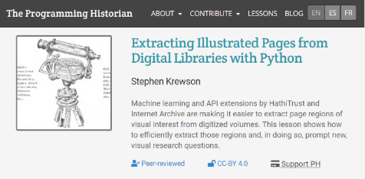
Library expertise
Capitalising on the expertise of Library staff
Our Cataloguer:
  Minting DOIs for the open access resource, Programming Historian.
Our Teaching Librarian:
  Joint delivery of Library Carpentry workshop with data-cleaning tools and GitHub
  Undergraduate student workshops on AntLab and Voyant tools (Groves 2018)

Slide 8
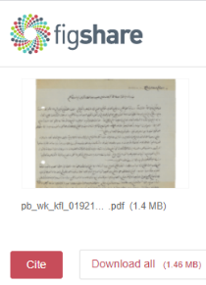
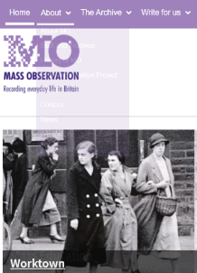
Library expertise
Digital forensics project using the Mass Observation Archive
Consultation on research data management and digital preservation
Publishing datasets in Figshare data repository
Setting up Atom instance for teaching on Digital Archiving module

Slide 9
Library as Lab
Opening up our digital resources to researchers for text and data mining
Making data available from Library systems for MSc Data Science students to answer research questions:
  Predictive modelling for Library occupancy
  Library Search: what's the use?
Creating open datasets from our Talis Aspire reading list system and making them available on our data repository

Slide 10
Promoting open practice
Working alongside Digital Humanities scholars provides insights for us into their requirements around open access publication and more broadly, open research practice.
Leading on the Lab’s Open Publishing working group.
Organising research seminars to explore open practice for the digital humanities.
Exploring internal and external solutions to support research projects with open publication.

Slide 11
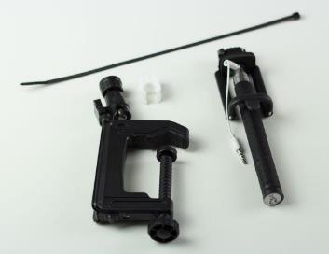
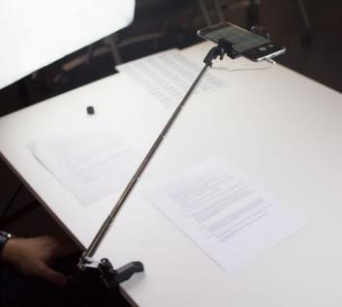
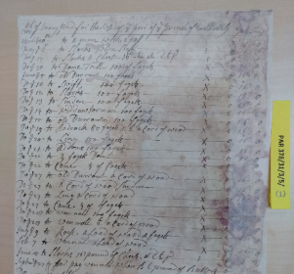
An engineer in the archives
The Poor Law document capture application:
Small bills and petty finance

Slide 12
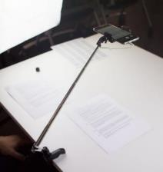
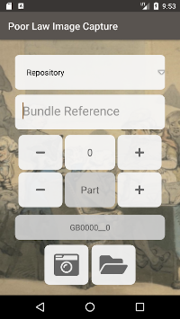

Bulk image capture workflow
Images taken with mobile phone and selfie stick document digitisation equipment
Android metadata encoder adds the catalogue reference to the file name
Cloud based photo manager
Bulk image upload
Capture API

Slide 13
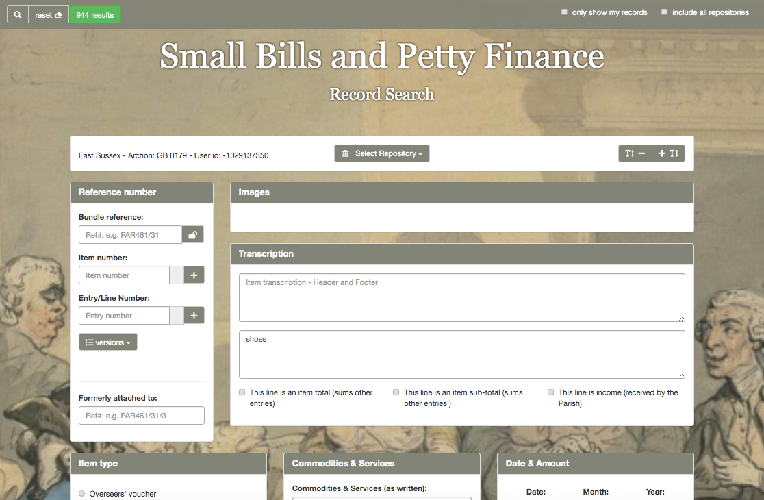
Record search

Slide 14
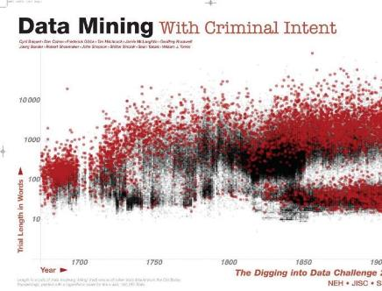
Macroscope technology
Working with transcriptions of Old Bailey proceedings, a rich dataset recording nearly 200,000 trials from 1697 to 1913.
Records presented using an interactive graph based on a project called “Data Mining with Criminal Intent”.
Each point in the graph is interactive and when clicked, loads a set of data about one of the trials.

Slide 15
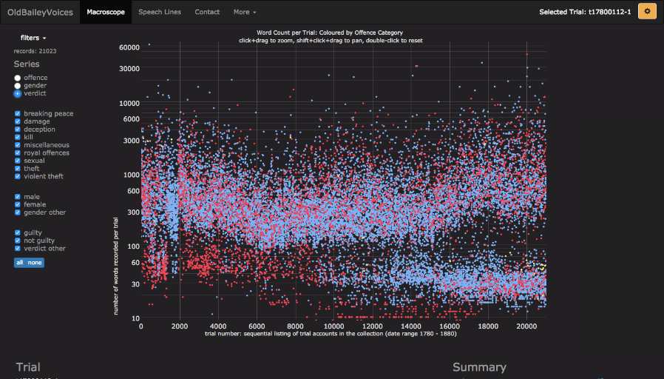
Word Count per trial

Slide 16
Final reflections
Libraries have much to offer the Digital Humanities
We need to work towards a partnership model of engagement
We need to have confidence in our skills and expertise
We need to think creatively about our collections
We need to commit time and resource to ensure success

Slide 17
References
Video interview with Prof Tim Hitchcock: https://doi.org/10.1629/uksg.377.s1
Harvell, J. and Ball, J. (2017). Why we need to find time for digital humanities: presenting a new partnership model at the University of Sussex. Insights, 30(3).
Kamposiori, C. (2017). The Role of Research Libraries in the Creation, Archiving, Curation, and Preservation of Tools for the Digital Humanities. http://www.rluk.ac.uk/wp-content/uploads/2017/07/Digital-Humanities-report-Jul-17.pdf
Baker, J. (2017). Library Carpentry at the University of Sussex. https://librarycarpentry.org/blog/2017/07/Sussex/
Groves, A. (2018). An introduction to text mining with AntLab and Voyant Tools. https://mmitblog.wordpress.com/2018/05/14/an-introduction-to-text-mining-with-antlab-and-voyant-tools/

Slide 18
IX Eurasian Academic Libraries Conference “Alive to Changes: Engage. Embrace. Ensure”
30 September - 2 October | 2020
THANK YOU FOR LISTENING!
Suzanne Tatham
Associate Director
University of Sussex Library
Brighton, UK
@suzannetatham
s.tatham@sussex.ac.uk

