Slide 1
Check Point INFINITY
BUILDING THE SECURITY STRATEGY FOR THE FUTURE
Alexey Zubarev, CISSP, CISA, CISM
Security Engineer, Check Point Software Technologies

Slide 2
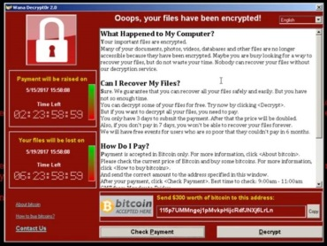




WHAT HAPPENED IN 2017?
THE MOST
DANGEROUS TOOLS
EVERYTHING IS CONNECTED
ATTACKS
EVERYWHERE
MOBILE
ATTACKS
WANNACRY RANSOMWARE HITS HUNDREDS OF COMPANIES GLOBALLY
Was 2017 a Cyber Security WAKE-UP-CALL?
RANSOMWARE ATTACK KEEPS HOTEL GUESTS IN AUSTRIA LOCKED OUT OF ROOMS
1M GOOGLE ACCOUNTS BREACHED BY GOOLIGAN
NSA HACKING TOOLS LEAKED AND SOLD ONLINE

Slide 3


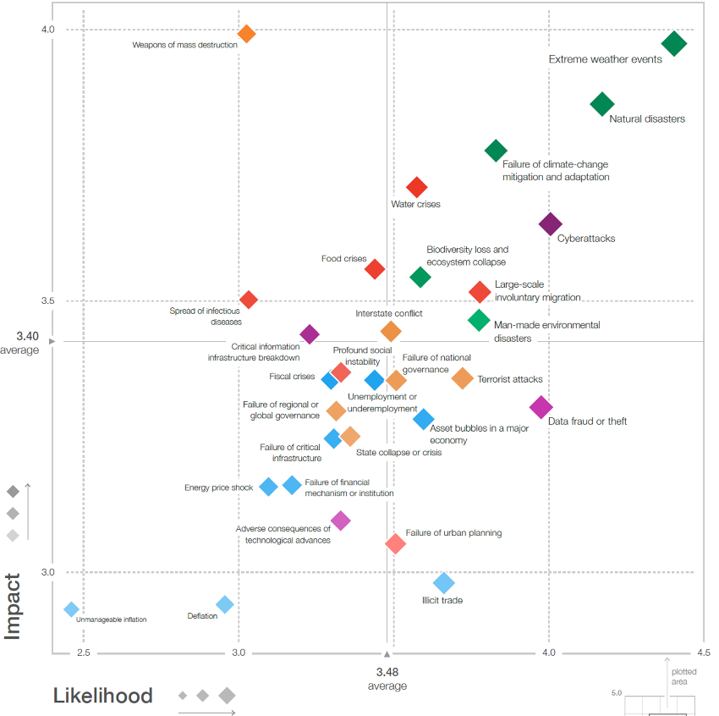
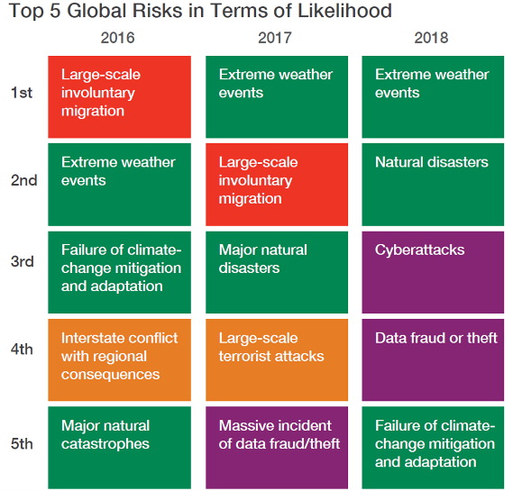
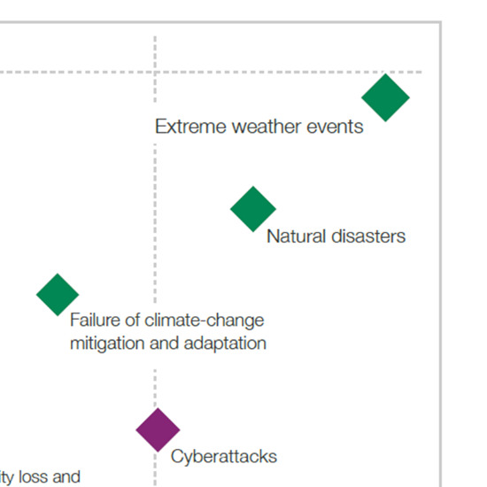
The Global Risks Report 2018

Slide 4
LET’S LOOK AT THE GENERATIONS OF ATTACKS…

Slide 5





Generations of Attacks and Protections
Late 1980s –
PC attacks - standalone
The Anti Virus
Gen I
Virus
Mid 1990s –
Attacks from the internet
The Firewall
Gen II
Networks
Early 2000s -
Exploiting vulnerabilities
in applications
Intrusion Prevention (IPS)
Gen III
Applications
2010 -
Polymorphic Content
SandBoxing
and Anti-Bot
Gen IV
Payload

Slide 6









Where are we ?
THREATS
Gen V
Gen IV
Gen III
Mega
Gen II
Payload
Enterprises are between Gen 2-3
Gen I
Applications
2.8
PROTECTIONS
Networks
PROTECTIONS
Virus
1990
2000
2010
2015
2017

Slide 7

Gen V Market Survey
Market research N=300 conducted during 2018
  Fielded by Dimensional Research
  IT and Security decision makers
  500+ employees
  Representing all industry scope
Source: Cyber Security Generations Survey among IT Professionals, March 2018, N=300

Slide 8
Only 3% of IT Security Professionals Are at Gen V
Source: Cyber Security Generations Survey among IT Professionals, March 2018, N=300

Slide 9
What parts of your organization's infrastructure were attacked?
Source: Cyber Security Generations Survey among IT Professionals, March 2018, N=300

Slide 10
76% Experienced Attacks In Multiple Vectors
(More than one vector**)
** Vectors- PC, On-premise data Center, Cloud, Mobile, IoT
Source: Cyber Security Generations Survey among IT Professionals, March 2018, N=300

Slide 11
THE EXPLANATIONS
IT’S TOO COMPLICATED
I DIDN’T REALIZE IT WAS
SUCH A PROBLEM
TOO MANY POINT PRODUCTS
NOT ENOUGH TRAINED PEOPLE
I DIDN’T THINK IT COULD HURT US

Slide 12

HOW ARE WE APPROACHING CYBER SECURITY TODAY ?
ARE WE READY FOR THE FUTURE OF CYBER THREATS?

Slide 13




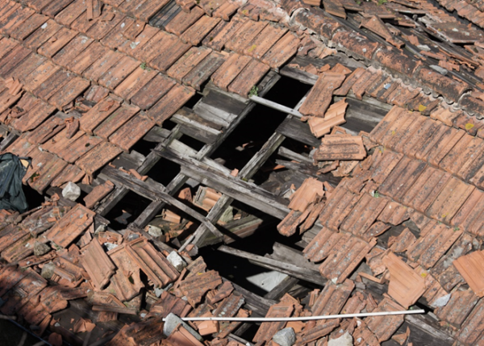
WHAT SHOULD WE DO WHEN THE ROOF IS LEAKY?
Focus on remediation?
Focus on incident response?
Pretend it isn't happening?
Patch with point solutions?

Slide 14
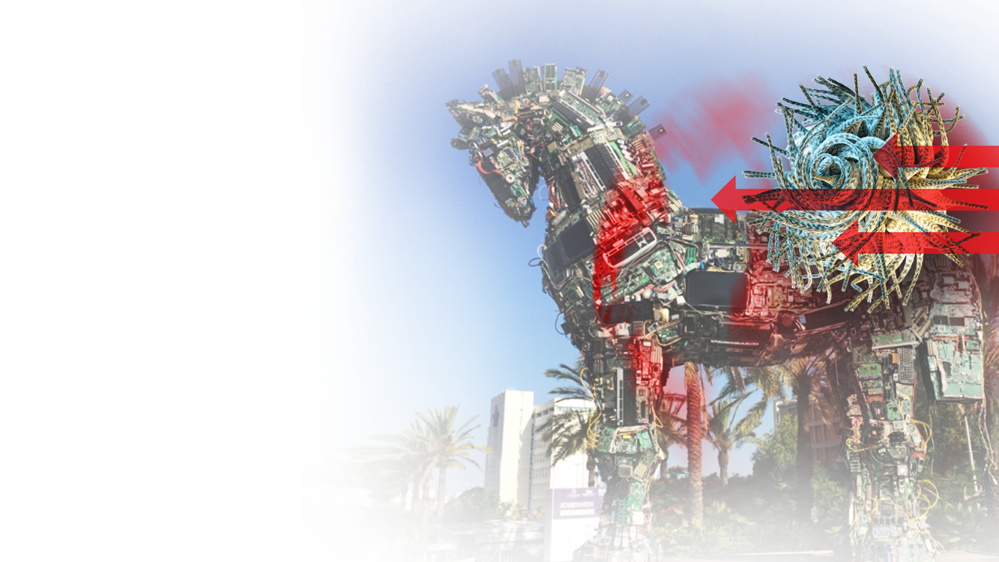
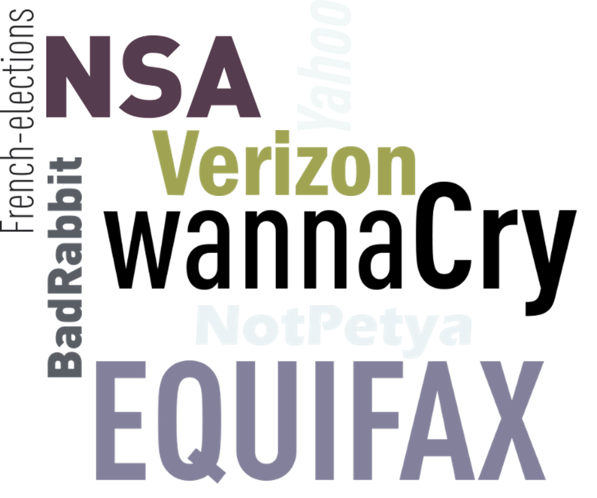
Gen V Mega Attacks
Large scale (across country and industry)
Multi-vector (network, cloud, mobile)
PROTECTIONS
State-sponsored technologies

Slide 15
WE MUST STEP FORWARD!

Slide 16
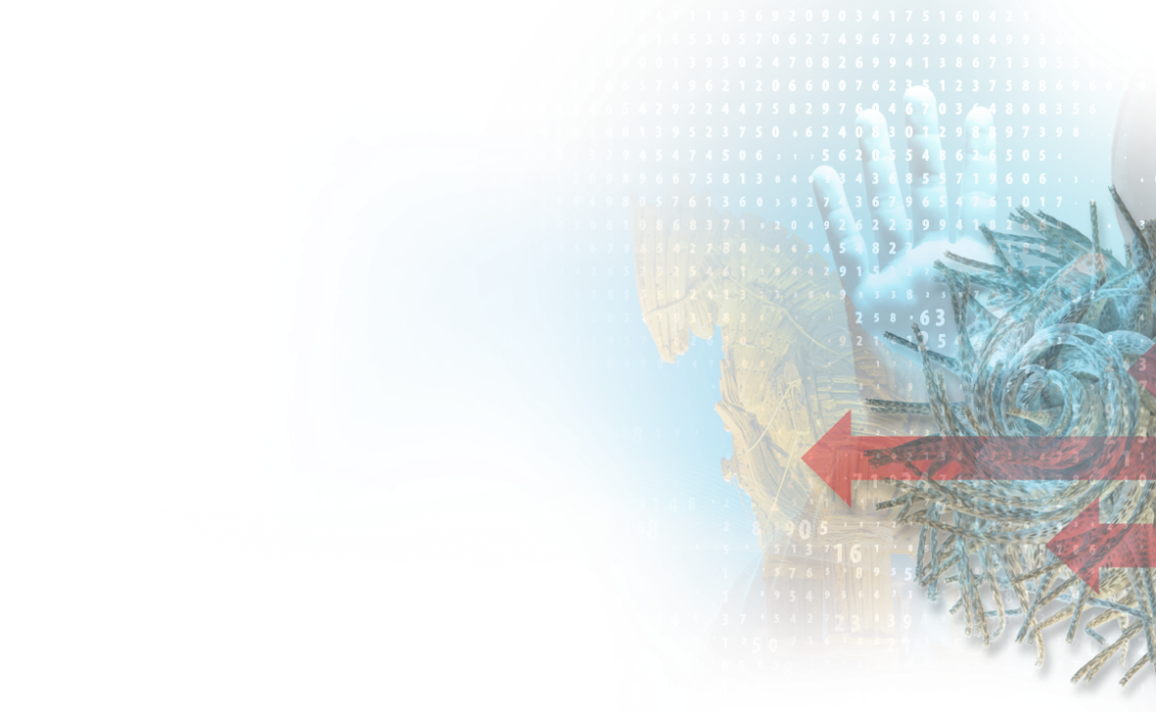

GEN IV PROTECTION IS NO LONGER ENOUGH!
2010 -
Polymorphic Content
SandBoxing
and Anti-Bot
Gen IV
PAYLOAD
WE NEED PREVENTION (NOT-JUST DETECTION)
REAL-TIME ACTION
COVERING OUR WEAKEST POINTS – CLOUD, MOBILE
PROTECTIONS

Slide 17
Introducing GEN V PROTECTION
Against MEGA ATTACKS
PROTECTIONS
Notes:
Using

Slide 18

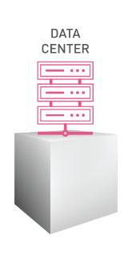
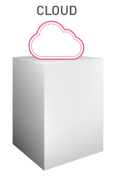
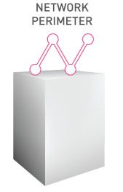

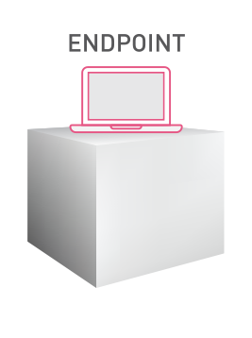
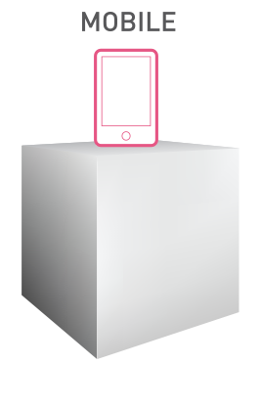
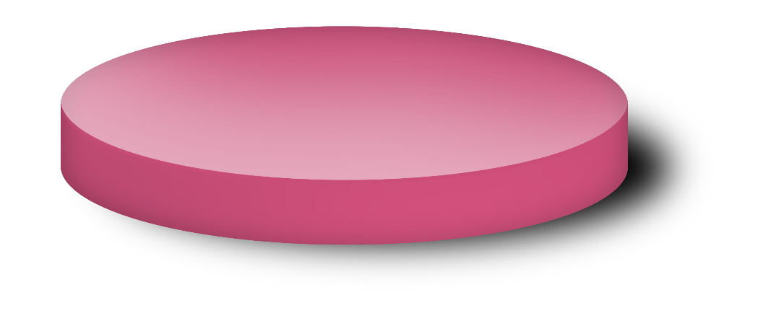






WHAT INGREDIENTS DO WE NEED ?
Consolidated Management
BEST SECURITY TECHNOLOGIES
REAL-TIME THREAT PREVENTION TECHNOLOGIES
SHARED THREAT INTELLIGENCE

Slide 19
LET’S LOOK AT AN EXAMPLE…

Slide 20
File hash: 4931c1259863e1ba59201e…
C&C server: pwnown.hack.evil
…
Incoming email with PDF attachment blocked
Access to web site on mobile device was blocked
Virtual machine on public cloud was quarantined
11:30
11:32
11:35
Zero-day malicious PDF detected by Check Point Sandbox
Address of remote C&C identified in malicious PDF
Exposed indicator shared
with ThreatCloud
Malicious link identified by the exposed indicators
Detected infection (bot) on cloud virtual machine.
Communication with C&C identified by indicators
CAN’T DO IT WITH SEPARATE SYSTEMS!

Slide 21
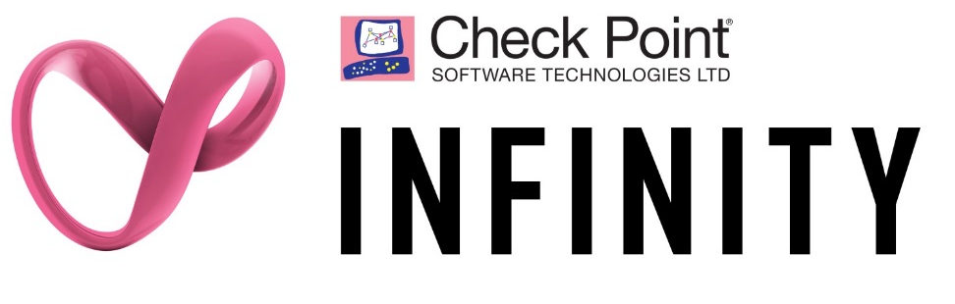
Incoming email with PDF attachment blocked
Access to web site on mobile device was blocked
Virtual machine on public cloud was quarantined
11:30
11:32
11:35
Shared intelligence and threat prevention across networks, mobile, cloud
One consolidated system to fully block the attack

Slide 22


THE CYBER SECURITY ARCHITECTURE OF THE FUTURE
ONE SECURITY PLATFORM
PREEMPTIVE
THREAT PREVENTION
CONSOLIDATED SYSTEM
Leveraging unified threat intelligence
& open interfaces
Blocking the most sophisticated attacks before they happen
Single Management, Modular Policy Management & integrated threat visibility
ACROSS ALL NETWORKS, CLOUDS AND MOBILE

Slide 23
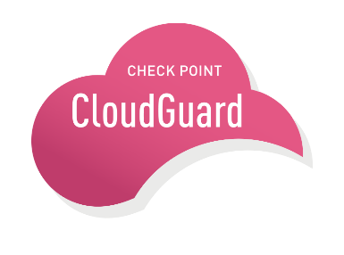



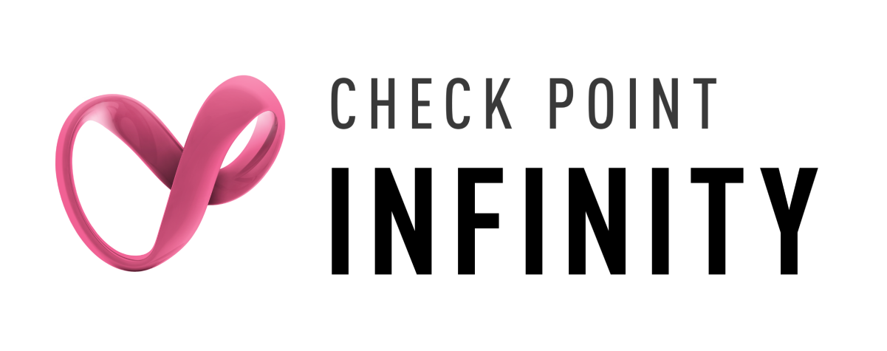



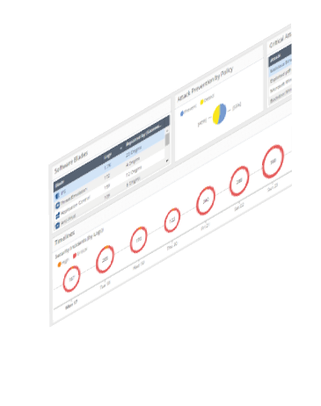




Check Point Infinity Architecture
Best Threat Prevention across entire enterprise
CLOUD
MOBILE
Shared Threat Intelligence
Hybrid Cloud
NETWORK
ENDPOINT
Perimeter & Data centers
Consolidated Security Management

Slide 24
TO SUMMARIZE…

Slide 25
WE ARE AT AN INFLECTION POINT !
THREATS
Gen V
Gen IV
Gen III
Mega
Gen II
Payload
Gen I
Applications
PROTECTIONS
Networks
PROTECTIONS
Virus
1990
2000
2010
2017
Notes:
Using

Slide 26

ARE WE SETTLING FOR A LEAKY ROOF?
CYBER PROTECTIONS ARE AVAILABLE
BUT NOT ADOPTED BY OVER 93% OF COMPANIES
PREVENTION IS POSSIBLE!
DETECTION OF THE BREACH IS TOO LITTLE, TOO LATE
THE NEXT ATTACK
CAN BE PREVENTED!

Slide 27

We must step up to….
BEST SECURITY, REAL-TIME PREVENTION

Slide 28

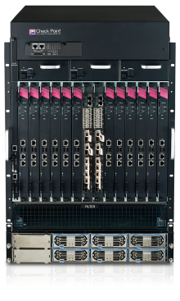
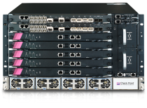
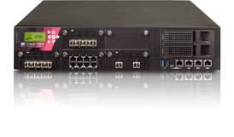
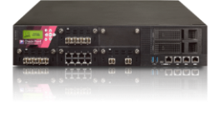
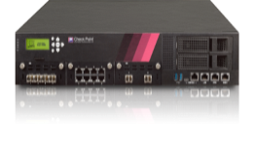






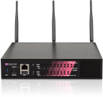


Gen-V Threat Prevention Security Gateways
64000
Data Centers
44000
Large Enterprise
2,500-5,000 users
NEW!
23900
23800
Medium Enterprise
650-2,500 users
23500
Up to
22.7 Gbps
Gen-V
Security
Max Ideal Threat Prevention Throughput:
> 60 Gbps
15600
15400
Small Enterprise
100-650 users
5900
Max Ideal Threat
Prevention Throughput:
18.6 Gbps
5800
5600
Max Ideal Threat
Prevention Throughput:
13 Gbps
Branch Office
5-100 users
5400
5200
5100
Max Ideal Threat Prevention Throughput:
6 Gbps
3100
3200
1400
Max Ideal Threat Prevention Throughput: 1,700 Mbps
Max Ideal Threat
Prevention Throughput:
740 Mbps

Slide 29
THANK YOU
Alexey Zubarev, CISSP, CISA, CISM
azubarev@checkpoint.com, +7 707 300 08 38
Security Engineer, Check Point Software Technologies

