Slide 1
CHALLENGES OF INTERNATIONAL LIBRARIANS
7th International Conference on Emerging Global Trends in University Library Development (Library Connect 2018)
23-24 May 2018
Astana, Kazakhstan
KNOWLEDGE SHARING FROM FILIPINO LIBRARIANS WORKING ACROSS ASIA
Ricardo Cruz III
Karen Cruz
Joseph Yap
Notes:
Good afternoon ladies and gentlemen. My sincere apologies as you will always see me for the rest of the conference. This presentation will share the experiences of Filipino librarians working abroad and specifically how they were able to create programs – as such an IL program while they were hired as an international librarian.

Slide 2
OFWs
The 2016 statistical report of the Philippine Overseas Employment Administration (POEA), informs the reader of more than 2 million Overseas Filipino Workers (OFWs) around the world (POEA, 2016a).
The 2010 data from POEA shows 16 librarians, archivists and curators working abroad while the 2009 data records 24 of them deployed overseas (POEA, 2016b).
Notes:
The paper will discuss the experiences of a non-native librarians working in a multi-culturally diverse environment. OFW stands for Overseas Filipino Workers.

Slide 3
Expatriates
Opportunity to travel and work in new and exciting places (Davies, 2012).
Make a difference by using the previous experience one gained (Davies, 2012).
Financially attractive (Shortland, 2015).
Excellent chances to develop personally and professionally (Davies, 2012).
Notes:
Expats were hired because of their knowledge and experience and their capacity to train local workers. Expats accept this noble duty because they see an opportunity for them to travel and work in a new and exciting places.
Shortland, S. (2015). The ‘expat factor’: the influence of working time on women's decisions to undertake international assignments in the oil and gas industry. International Journal Of Human Resource Management, 26(11), 1452-1473. doi:10.1080/09585192.2014.938681
Davies, J. (2012). A taste for expat life. Nursing Standard (Royal College Of Nursing (Great Britain) : 1987), 26(52), 61.

Slide 4
To move forward with their careers, look for greener pastures and build a name for themselves (Presbitero & Quita, 2017).
Finding your global path since there are many more options abroad.

Slide 5
Objectives
How do they initiate collaboration with the faculty members and teachers to introduce an IL program?
What were the cultural challenges and factors before and during the implementation of an IL program and how were they able to cope with it?
What IL standards or models are they following to make their IL programs effective?
How supportive are the administration in their programs?
Notes:
This presentation will have four objectives.

Slide 6
Faculty-Librarian Collaboration
Collaboration is an essential practice in order to determine the content based on identifying the desired learning objectives and curriculum mapping (Mindi & Linda, 2016).
Working closely together to achieve the same goal of developing the IL skills of the students (Keyes & Barbier, 2013)
Notes:
Collab is an essential practice….. There is a shared commitment between the faculty and the librarian and it improves student success.
Keyes and Barbier mentioned that Working closely…. This is an opportunity to encourage strong relationships to support research and instruction sessions.
Unfortunately, in local setting, some librarians are less appreciated and has poor recognition among peers. This results to low success and low self-esteem due to the low status referred to them.

Slide 7
Challenges
Research have shown that librarians in some countries have lower status level compared to academic staff (Dorner, 2017).
Weak faculty-librarian collaboration (Bombaro, 2018).
Faculty members may be not aware of such available programs (probably due to lack of promotion by the library).

Slide 8
Methodology
Case studies from three different Asian institutions representing South East Asia, East Asia, and Central Asia where Filipino librarians are employed.
Narrative inquiry of best practices of teaching IL with foreign students.

Slide 9
Asian Countries
China | Indonesia
No program currently exists for teaching information literacy skills in the Secondary Department (Grade 6 to 12) but the Librarian approached the Head of English Department to discuss the need for developing an information literacy program for the Secondary Department. | In 2010, the IL program was already running in the library, however the approach implemented was not as extensive as the management would like.
Tools for Real-time Assessment of Information Literacy Skills, also known as TRAILS | Association of College and Research Libraries (ACRL) standard for information literacy
Supportive administration | The Office of the Vice Rector for Operation and Resources, is very supportive to the library programs and initiatives
China
Notes:
TRAILS: Tool for Real-time Assessment of Information Literacy Skills, a product of Kent State University Libraries, free and online, aims to evaluate information literacy skills of elementary and high school students. https://academicworks.cuny.edu/cgi/viewcontent.cgi?article=1204&context=yc_pubs
TRAILS is a knowledge assessment with multiple-choice questions targeting a variety of information literacy skills based on 3rd, 6th, 9th, and 12th grade standards. The assessment items are based on the American Association of School Librarians' Standards for the 21st-Century Learnerand those from the Common Core State Standards Initiative that have been adopted by most states. http://www.trails-9.org/about2.php?page=about

Slide 10
Kazakhstan
King, Dowding & Pflager (2013) pointed out that NU students had difficulty identifying specific e-resources provided by the library. This was mainly due to lack of proper exposure to the exact library terminologies used. As mentioned by the authors, it has something to do with language barrier as English is not their vernacular.

Slide 11
Collaboration among the departments and schools were implemented (Karjanto, Kairatbekkyzy & Agee, 2015).
Information literacy sessions were expanded, including workshops about academic integrity, plagiarism, citations and copyright (Alenzuela, Groen, Kamilova, Terzi & Zvonareva, 2017).

Slide 12
Librarian’s per School
Librarian | School
Librarian 1 | Center for Preparatory Studies
Librarian 2 | Graduate School of Public Policy
 | Graduate School of Business
Librarian 3 | Graduate School of Education
Librarian 4 | School of Engineering
 | School of Mining and Geosciences
Librarian 5 | School of Humanities and Social Sciences
Librarian 6 | School of Medicine
Librarian 7 | School of Science and Technology

Slide 13
In 2017, the Nazarbayev University Library started planning on how to strategize the IL framework to be used in the university.
In January 2018, a proposed set of Learning Outcomes was disseminated to all subject librarians in order to seek their comments.

Slide 14
The University Library Committee discussed and approved the IL Learning Outcomes in February 2018. It is composed of faculty representatives from each school, the Vice Provost for Academic Affairs, Library Deputy General Director, Library General Expert, and a Senior Expert from the library that serves as the secretary.

Slide 15
ACRL Framework for Information Literacy for Higher Education
Authority Is Constructed and Contextual
Information Creation as a Process
Information Has Value
Research as Inquiry
Scholarship as Conversation
Searching as Strategic Exploration

Slide 16
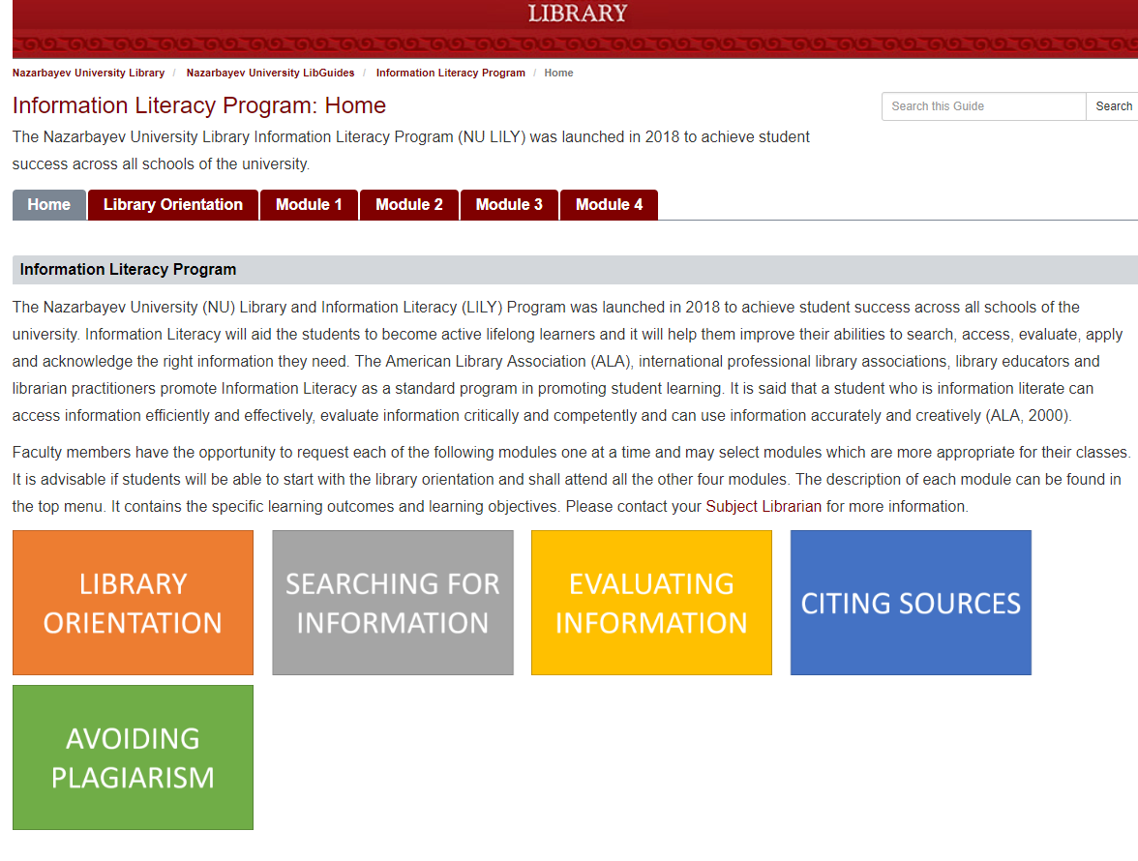
The Library and Information Literacy (LILY) Program

Slide 17
Initiating Collaboration
Be smart and keep on suggesting ideas which were already built from previous experiences.
Continuous coordination with the stakeholders and faculty.
‘Sell’ what you have and what you can offer.

Slide 18
Cultural challenges (As a librarian)
May not be branded as a native English speaker.
Building your reputation as a librarian.
Lack of peer support during stressful times.

Slide 19
Cultural challenges (With regard to the teaching IL)
Communication gap and lack of understanding of terminologies.
Plagiarism may be widespread and use of an illegal site is an open-secret.

Slide 20
Conclusions
As an overseas employee, Filipinos are known to be visionary, flexible, patient and as having good interpersonal skills (Roberto, 2015).
They can establish a good working relationships and rapport that allows for collaboration with the faculty members in building an information literacy program.

Slide 21
All of their IL programs are still being integrated into the whole academic curriculum. Although there were no indications of discrimination at work, two libraries are still seeking for faculty-status recognition.
In addition, committee memberships are also important for librarians so they can participate in academic issues. Continuous communication with the faculty members will help build a strong partnership between the library and the entire academic community.

Slide 22
Recommendations
Embrace and study the local culture.
Effectively teach the students about the right terminologies.
Be patient and flexible in teaching IL to the students.

Slide 23
References
Alenzuela, R. (2017). Professional mobility and institutional cooperation in Kazakhstan: a model for dynamic library services in Asia. PAARL Research Journal, 4, 58-66. Retrieved from http://www.paarl.org.ph/sites/default/files/PAARL%20Research%20Journal%202017.pdf#page=31
Alenzuela, R., Groen, C., Kamilova, Y., Terzi, P., & Zvonareva, D. (2017). Building a culture of integrity through library initiatives, academic collaboration and administrative support. Astana: KAZGUU University / Nazarbayev University.
Badawy, M., El-Aziz, A. A., Idress, A. M., Hefny, H., & Hossam, S. (2016). A survey on exploring key performance indicators. Future Computing and Informatics Journal, 1(1-2), 47-52. doi:10.1016/j.fcij.2016.04.001
Bombaro, C. (2018). It takes a campus: Successful collaboration strategies for teaching information literacy. Retrieved from http://blog.credoreference.com/it-takes-a-campus
Cabigon, M. (2018). State of English in PH: Should we be concerned? Retrieved from http://opinion.inquirer.net/90293/state-of-english-in-ph-should-we-be-concerned
Credo. (2018). Information literacy. Retrieved from https://cdn2.hubspot.net/hubfs/2569500/2018%20FYE%20Guide/Credo%20FYE%20Guide_Chapter%203_Information%20Literacy.pdf?__hssc=91477573.2.1522501051933&__hstc=91477573.f0ab8f65f541cda1504e17f8444cc0bb.1515551481062.1522147572828.1522501051933.7&__hsfp=2293363858&hsCtaTracking=5abc570e-307a-4b92-b8df-76eacce7007d%7Cf8cab063-c95e-497d-beb4-116f296190d5
Dorner, D. G. (2017). [Untitled]. In ACRL Student Learning and Information Literacy Committee (Ed.), Global perspectives on information literacy: fostering a dialogue for international understanding. Retrieved from http://www.ala.org/acrl/sites/ala.org.acrl/files/content/publications/whitepapers/GlobalPerspectives_InfoLit.pdf
Halsema, L. V. (2015). Google vs. library databases: Which is better for research? Retrieved from http://www.sirsidynix.com/blog/2014/09/29/google-vs-library-databases-which-is-better-for-research
Karjanto, N., Kairatbekkyzy, M., & Agee, J. (2015). Embedded librarianship and problem-based learning in undergraduate mathematics courses. Retrieved from https://nur.nu.edu.kz/handle/123456789/1432
Keyes, A., & Barbier, P. (2013). Librarian–faculty collaboration on a library research assignment and module for college experience classes. Community and Junior College Libraries, 19(3-4), 93-103. doi:10.1080/02763915.2014.949197
King, E. A., Dowding, H. E., & Pflager, J. T. (2013). User-centered design and reference services in international librarianship: a case study of Nazarbayev University Library. Internet Reference Services Quarterly, 18(3-4), 211-226. doi.org/10.1080/10875301.2013.856368
Lake, L. (2017). How do key performance indicators affect company success? Retrieved from https://www.thebalance.com/what-are-key-performance-indicators-2296142
Mindi, M., & Linda, N. (2016). Mapping information literacy and written communication outcomes in an undergraduate nursing curriculum: A case study in librarian-faculty collaboration. Pennsylvania Libraries: Research & Practice, 4(1), 22-34. doi:10.5195/palrap.2016.121
Nazarbayev University. (2017a). Nazarbayev University students win a gold medal on iGEM 2017 competition. Retrieved from
https://nu.edu.kz/news/nazarbayev-university-students-win-gold-medal-igem-2017-competition
Nazarbayev University. (2017b). Students of Nazarbayev University are the finalists of the 19th Inter-Varsity tournament of Stockholm School of Economics in Riga, Latvia. Retrieved from https://nu.edu.kz/news/students-nazarbayev-university-finalists-19th-inter-varsity-tournament-stockholm-school-economics-riga-latvia

Slide 24
Nititham, D. S. (2011). Migration as cultural capital: The ongoing dependence on overseas Filipino workers. Malaysian Journal of Economic Studies, 48(2), 185-201.
Presbitero, A., & Quita, C. (2017). Expatriate career intentions: Links to career adaptability and cultural intelligence. Journal of Vocational Behavior, 98, 118-126. doi:10.1016/j.jvb.2016.11.001
POEA. (2016a). Deployed overseas Filipino workers by country/destination. Retrieved from http://www.poea.gov.ph/ofwstat/compendium/2015-2016%20OES%202.pdf
POEA. (2016b). OFW statistics. Retrieved from http://www.poea.gov.ph/ofwstat/ofwstat.html
Quezzaire, P. (2018). Libraries in the 21st century: the struggle between perception and reality [Web log post]. Retrieved from http://blogs.ibo.org/blog/2018/02/23/libraries-in-the-21st-century-the-struggle-between-perception-and-reality/
Roberto, E. (2018). Top five (5) qualities you need to have to be an OFW. Retrieved from
http://pinoythaiyo.com/2015/04/12/top-five-5-qualities-you-need-to-have-to-be-an-ofw/
Simons, A. (2017). Librarians, faculty, and the writing center partnering to build an interdisciplinary course: A case study at the University of Houston, USA. New Review of Academic Librarianship, 23(1), 28-41. doi:10.1080/13614533.2016.1185020
UNESCO Institute of Statistics. (2018). Data for the sustainable development goals. Retrieved from http://uis.unesco.org/

Slide 25
Thank you for your attention!
R. Cruz (China)
K. Cruz (Indonesia)
J. Yap (Kazakhstan)

