Slide 1
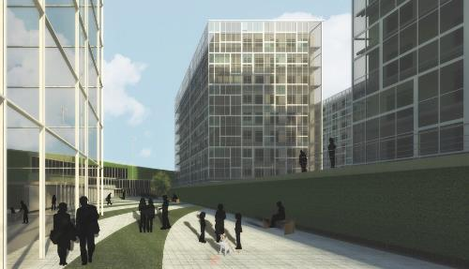

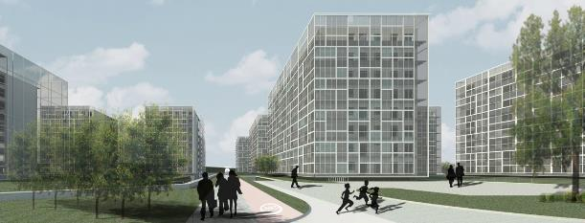

ISOVER Multi-Comfort House Students Contest Edition 2015
Residential function in cold climate – Astana, Kazakhstan
UNITED KINGDOM
Andrea Parra
Maresa Muñoz
Mariana Goyarzu
Notes:
Este Esta presentación, que se recomienda ver en modo de presentación, muestra las nuevas funciones de PowerPoint. Estas diapositivas están diseñadas para ofrecerle excelentes ideas para las presentaciones que creará en PowerPoint 2010.
Para obtener más plantillas de muestra, haga clic en la pestaña Archivo y después, en la ficha Nuevo, haga clic en Plantillas de muestra.

Slide 2
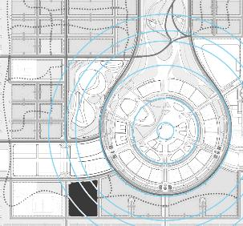
CONCEPT
“EVERYTHING CHANGES, NOTHING PERSISTS… METAMORPHOSIS”
RELATION TO URBAN PLANNING
EXPO 2017 PROJECT - DESIGN REFERENCE
GEOMETRIC CONTINUITY

Slide 3
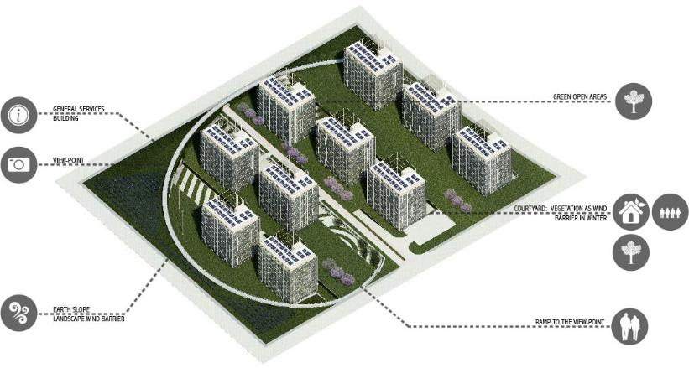
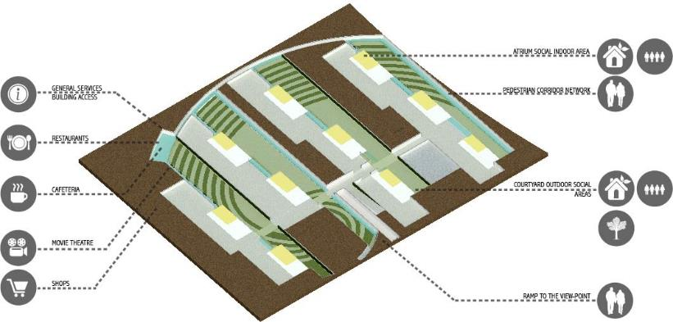
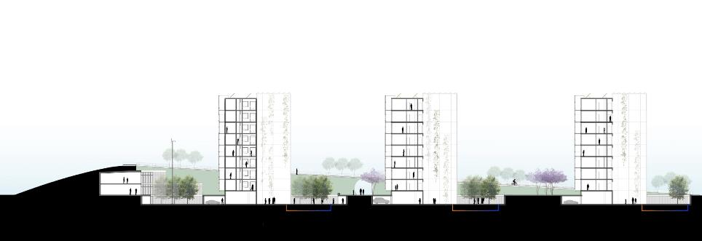
Renewable Energy
Efficient Sytems
Main Access & Roads
Social and Public Areas
Ground Level
Underground Level
Connection to the covered street
School pedestrian connection
PROJECT LAYOUT
MAIN ENTRANCE Connection to the Expo urban plan

Slide 4
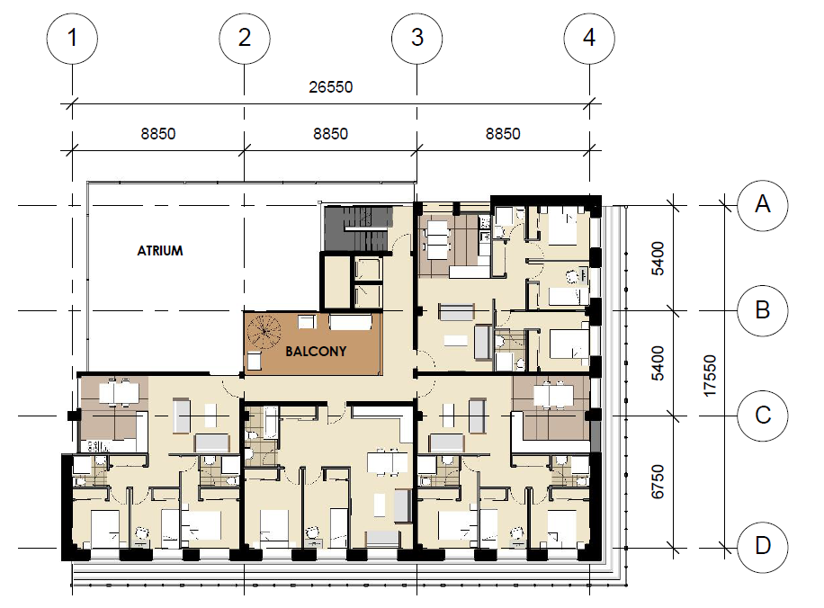
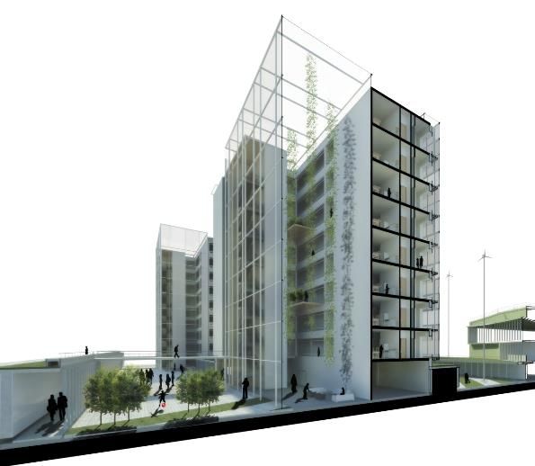
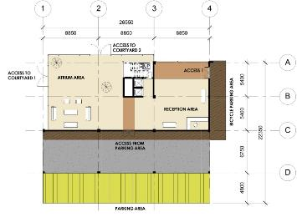
Building’s Distribution
32 Apartments
Total Capacity: 176 persons
TYPICAL PLAN
SECTION 1-1
1
UNDERGROUND LEVEL
1
Atrium
Courtyards
Underground Pedestrian Network

Slide 5


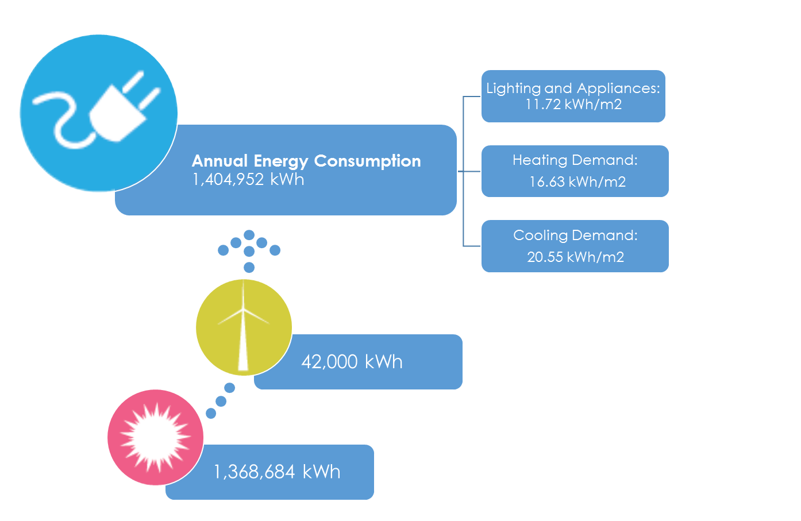
Basic Building Design
Site design, Orientation, Landscaping
Construction Materials, Insulation, Air Tightness (ISOVER, SAINT-GOBAIN)
Exterior Shading
Passive Systems
Heating: Direct solar gain, ground-air heat exchanger, double façade closed circulation.
Cooling: Natural ventilation in atrium and double façade, ground-air heat exchanger.
Efficient Systems & Renewable Energy Generation
Heat Recovery System, Air conditioners, Fans
Wind Turbines
Active Solar Domestic Hot Water
Photovoltaics Panels

Slide 6
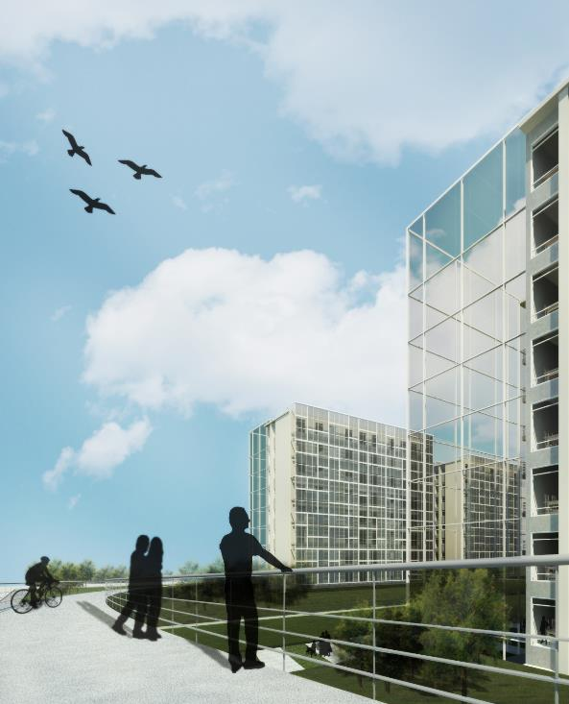
"It is not the strongest of the species that survives, nor the most intelligent that survives. It is the one that is most adaptable to change"
-Charles Darwin

