Slide 1

FUNDAMENTALS OF CATALOGING
Venera Niyazbayeva and Aigerim Shurshenova
Consultants, Department of Registration and Cataloging of Library Collection
«Nazarbayev University Library & IT Services»
Address: 53 Kabanbay batyr ave.,
Astana, 010000, Republic of Kazakhstan
Tel: + 7 (7172) 70 61 96
Tel: + 7 (7172) 70 92 36
www.nu.edu.kz

Slide 2
ALA Fundamentals of Cataloging Syllabus
Module 1. Cataloging and Catalogs
Module 2. Description and Access with AACR2
Module 3. Subjects
Module 4. Reading MARC 21
Module 5: New Frontiers: Description and Access with Resource Description and Access

Slide 3
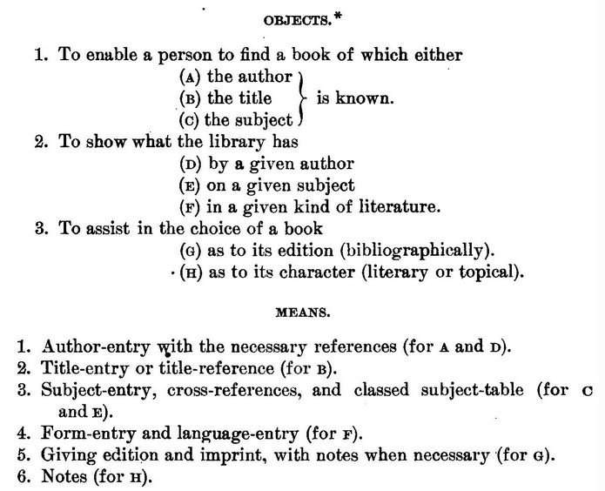
First Principles - Charles A. Cutter
Notes:
The principles of differentiation and collocation included by Cutter in his objects and means, are at the very center of cataloging. Cutter advises the bending of the rule, rather than ignoring the public. In closing his Preface, he reinforces his view of the proper place for rules in cataloging practice:
Cataloging is an art, not a science. No rules can take the place of experience and good judgment, but some of the results of experience may be best indicated by rules. -- Charles A. Cutter

Slide 4
STATEMENT OF INTERNATIONAL CATALOGUING PRINCIPLES
Its goal: serving as a basis for international standardization in cataloguing.
It covers:
1. Scope
2. General Principles
3. Entities, Attributes, and Relationships
4. Objectives and Functions of the Catalogue
5. Bibliographic Description
6. Access Points
7. Foundations for Search Capabilities
Notes:
This statement builds on the great cataloguing traditions of the world , It is hoped this statement will increase the international sharing of bibliographic and authority
data and guide cataloguing rule makers in their efforts to develop an international cataloguing code

Slide 5
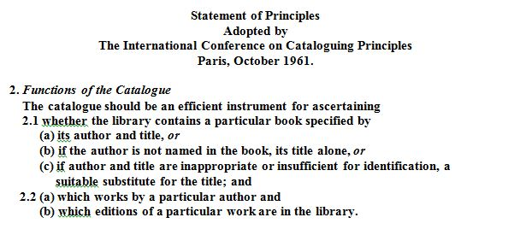
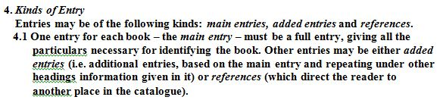

Slide 6
Descriptive principles.
International Standard Bibliographic Description (ISBD)
The description consists of eight areas, and within areas there can be several elements. The areas are:
1) Title and statement of responsibility area
2) Edition area
3) Material (or type of publication) specific area
4) Publication, distribution, etc. area
5) Physical description area
6) Series area
7) Note area
8) Standard number (or alternative) and terms of availability area

Slide 7
Prescribed Sources for Information
Each of the areas of a description has a required or a prescribed source for the information that goes into that area (AACR2 1.0A4), and the prescribed sources are specific to a format. Information from outside the prescribed source for the area is enclosed in square brackets. For a printed monograph, the area and the prescribed sources are shown in the table below (AACR2 2.0B2).
Area | Prescribed Sources of Information
Title and statement of responsibility | Title page
Edition | Title page, other preliminaries, colophon
Publication, distribution, etc. | Title page, other preliminaries, colophon
Physical description | The whole publication
Series | Series title page, monograph title page, cover, rest of the publication
Note | Any source
Standard number and terms of availability | Any source

Slide 8
Elements of the statement of responsibility area
As an example of elements, the elements listed for the Title and statement of responsibility area are:
1) Title proper
2) General material designation
3) Parallel title
4) Other title information
5) Statements of responsibility
Definitions, punctuation, notes and examples are provided at the element level for each element. Below is the section for the Title proper element from ISBD(G).

Slide 9
An International Cataloging Code—AACR2
The structure of AACR2 is fundamental to understanding how it is used as a cataloging code. AACR2 (and the later revisions) is divided into two parts. The first part is based on the ISBD(G) structure for description and concentrates on the descriptive portion of a bibliographic record, the second part, based on the Paris Principles is about the choice and form for entries and headings.
Notes:
Chapters for headings are divided into headings for persons, geographic names, corporate bodies and uniform titles. Instructions concerning references make up the final chapter of Part Two. The four appendices cover capitalization, abbreviations, numerals, and finally there is a glossary.

Slide 10
Form of Descriptive Access Points. Authority Control
AACR2 specifies how to choose between many forms of the same name for the same person (AACR2 22) or corporate body (AACR2 24)
The goal is to provide a consistent and unique form to represent a particular name.
Name Authority Cooperative Program (NACO) - a Program for Cooperative Cataloging (PCC)
More information on SACO may be found at <URL http://www.loc.gov/catdir/pcc
Notes:
Many catalogers construct access points at local institutions, and add access points to bibliographic records or verify existing access points against an authority file

Slide 11
LCSH and subdivisions
URI(s)
http://id.loc.gov/authorities/subjects
http://id.loc.gov/authorities#conceptscheme
Instance Of
MADS/RDF MADSScheme
SKOS ConceptScheme
Scheme Members
LCSH Collection - Authorized Headings
LCSH Collection - General Collection
LCSH Collection - Children's Headings
LCSH Collection - Term Permitted to be Indirectly Subdivided Geographically LCSH Collection - May Subdivide Geographically
LCSH Collection - Term Permitted to be Directly Subdivided Geographically
LCSH Collection - Subdivisions
LCSH Collection - Topic Subdivisions
LCSH Collection - GenreForm Subdivisions
LCSH Collection - Temporal Subdivisions
LCSH Collection - Geographic Subdivisions
LCSH Collection - Language Subdivisions
Notes:
1898, internationally, includes: analysis, assighning

Slide 12
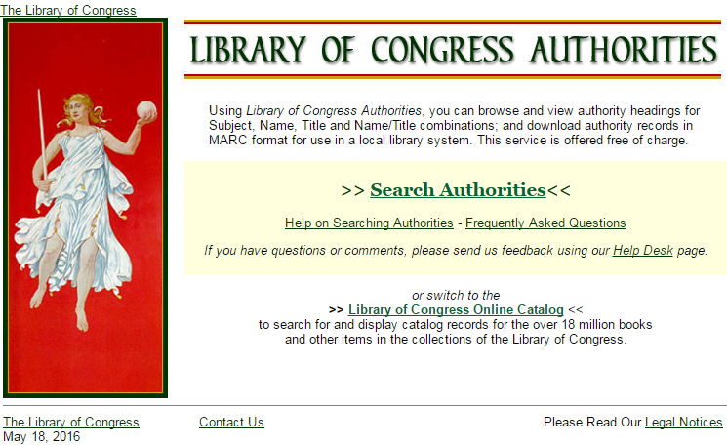
http://authorities.loc.gov/

Slide 13
MARC 21
There are 5 MARC 21 formats:
Bibliographic data
Authority data
Classification data
Holding data
Community information

Slide 14
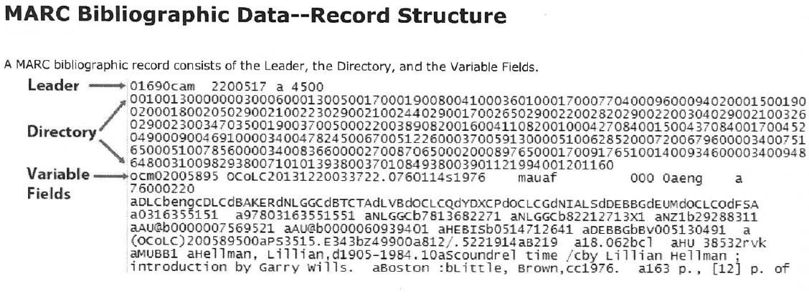

Slide 15
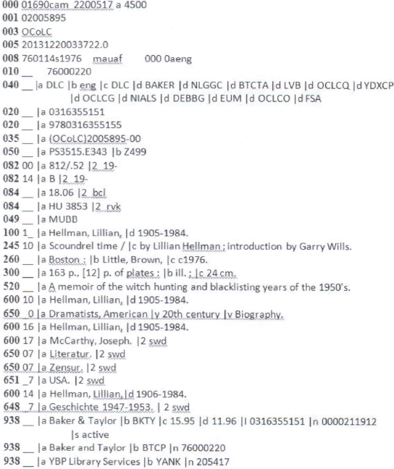

Slide 16
MARC 21 Authority data
contains detailed descriptions of every data element, along with examples, input conventions, and history sections.
MARC record is composed of three elements: the record structure, the content designation, and the data content of the record

Slide 17
Bibliographic description using RDA in MARC
RDA: Resource Description and Access
is a new standard for resource description and access designed for a digital world
Advantages:
RDA focuses on the information needed to describe a resource NOT how to display that information
RDA is adaptable and flexible
RDA has identified and added elements, not included in AACR2, that are commonly used in descriptions for digital resources

Slide 18
Fundamentals of Cataloging Bibliography
Baga, John, Lona Hoover, and Robert E. Wolverton. 2013. “Online, Practical, and Free Cataloging Resources: An Annotated Webliography.” Library Resources & Technical Services 57 (2): 100–117.
Bowman, J.H. 2003. Essential Cataloging. London: Facet Publishing.
Broughton, Vanda. 2004. Essential Classification. New York: Neal-Schuman.
Carpenter, Michael, and Elaine Svenonius, eds. 1985. Foundations of Cataloging : A Sourcebook. Littleton, Colo.: Libraries Unlimited.
Chan, Lois Mai. 1999. Guide to the Library of Congress Classification. 5th ed. Englewood, Colo.: Libraries Unlimited.
———. Library of Congress Subject Headings : Principles and Application. 4th ed. Westport, Conn.: Libraries Unlimited.
Chan, Lois Mai, and Theodora Hodges. 2007. Cataloging and Classification: An Introduction. 3rd edition. Lanham, Maryland: Scarecrow Press.
Chan, Lois Mai, Phyllis A. Richmond, and Elaine Svenonius, eds. 1985. Theory of Subject Analysis: A Sourcebook. Littleton, Colo.: Libraries Unlimited.
Cole, Timothy W., and Myung-Ja Han. 2013. XML for Catalogers and Metadata Librarians. Santa Barbara, Calif.: Libraries Unlimited.
Cutter, Charles A. 1904. Rules for a Dictionary Catalog. 4th ed., rewritten. Washington, D.C.: GPO. https://archive.org/stream/rulesforadictio06cuttgoog#page/n0/mode/2up.
El-Sherbini, Magda. 2013. RDA : Strategies for Implementation. Chicago: ALA.

Slide 19
Thank you!

