Slide 1

The Combined Effect of Cement and Limestone Powder on the Stabilization of Sulfate Bearing Saline Soil in Pavement Construction
Thesis Defense by Ayazhan Bazarbekova, Dept. of Civil and Environmental Engineering
Supervisor: Professor Shon Chang-Seon, Dept. of Civil and Environmental Engineering
Co-supervisor: Professor Jong Ryeol Kim, Dept. of Civil and Environmental Engineering
April 2021

Slide 2
Content
Overview and Problem Statement
Research Objectives and Tasks
Literature Review
Methodology
Test Results
Conclusion & Recommendations

Slide 3
Overview and Problem Statement
Sulfate-bearing saline soil (about 41% of Kazakhstan)
Formation of salt whiskers
Increase in crystallization pressure
Increase in localized stresses
Excessive heave and breaking up of pavements constructed on saline soils
Non-uniform movement of structures

Slide 4
Research Objectives and Tasks
Objective:
Tasks:
[Sustainability] Use limestone powder as an alternative soil stabilizing agent combined with traditional cement.
Evaluate the combined effect of cement and limestone powder on the mitigation of salt crystallization, improvement of geotechnical properties, and enhancement of long-term durability of sulfate-bearing saline soils.
Literature review: (i) soil stabilization, (ii) soil stabilizing materials, and limestone powder as an alternative stabilizer, and (iii) soil stabilization mechanism.
Development of an integrated experimental program.
Test result analysis: (i) soil and materials characterization, (ii) geotechnical properties of stabilized soil, and (iii) durability of stabilized soil.

Slide 5
Literature Review: Soil Stabilization
Soil Stabilization
Physical
Mechanical
Modification of soil particle size distribution and/or plasticity by addition or subtraction of different soil fractions
Modification of soil porosity, mitigation of free swelling of the soil, and improvement of mechanical properties of soil and soil stability by compaction, wetting-drying cycles, and fiber reinforcement
Chemical
Modification of engineering properties of soil by addition of chemical stabilizers

Slide 6
Literature Review: Stabilizing Materials
Soil Stabilizing Materials
Traditional
Non-traditional
Cement
Lime
Calcium chloride
Fly ash
Limestone powder
Cement kiln dust
Blast furnace slag

Slide 7
Literature Review: Mechanism
Soil-Stabilizer Mixing
Cation Exchange
Flocculation & Agglomeration
Negatively charged ions surrounding soil surface attract and derive positively charged ions from stabilizer
Strong cations from stabilizer replace weak cations from soil surface, increasing electrolyte concentration in soil and reducing DDL in soil-water interface
Neutralization of negatively charged soil surface and compression of DDL lead to formation of flocculated and agglomerated soil particles
Hydration & Pozzolanic Reaction
Soil-stabilizer mixing in aqueous phase promote hydration of cementitious material and pozzolanic reaction that produce CAH and CSH

Slide 8

Literature Review: Mechanism [Cont’d]
Stabilizer
Ettringite
Aluminum
Sulfate
Calcium
Water
Soil
Volumetric expansion

Slide 9
Methodology
Determination of basic soil and stabilizer characterization
Soil
Stabilizer
Gradation: Tex-110-E
Minerology: XRD
Chemical composition: XRF
Ion chromatography
pH: Tex-128-E
Atterberg limits: Tex-105-E,
104-E, and 106-E
OMC & MDD: ASTM D698-12e2
USC: ASTM D1633-17
DST: ASTM D3080
Mix design and sample preparation
PSD: Mastersizer 3000
Minerology: XRD
Chemical composition: XRF
Material characterization of the stabilized soil
Evaluation
Geotechnical properties
Durability
Atterberg limits: Tex-106-E
OMC & MDD: ASTM D698-12e2
USC: ASTM D1633-17
DST: ASTM D3080
M_{R} and CBR: empirical relation
3-D swelling: TTI 3-D swell test
Tube suction: Tex-144-E

Slide 10
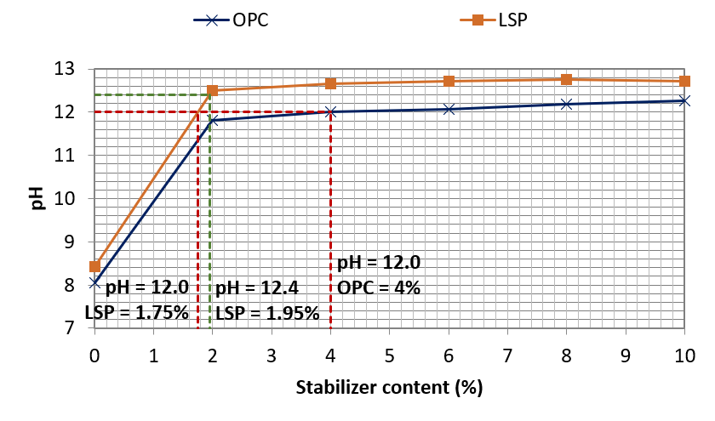
Methodology: Mix Design
Mis Design:
Edge-Grim Test results:
No. | OPC | LSP | Notes
1 | - | - | Control (soil only)
2 | 2% | 2%
3 | 2% | 4%
4 | 2% | 6%
5 | 4% | -
6 | 4% | 2%
7 | 4% | 4%
8 | 6% | -
9 | 6% | 2%
10 | 8% | -

Slide 11
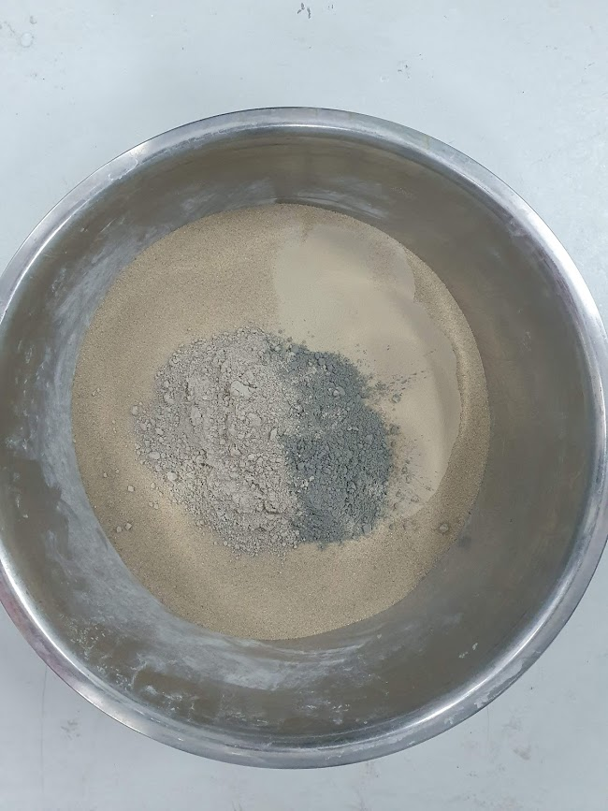
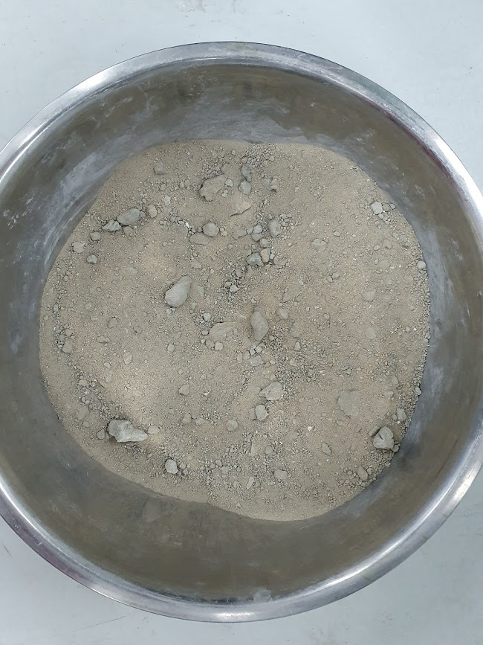
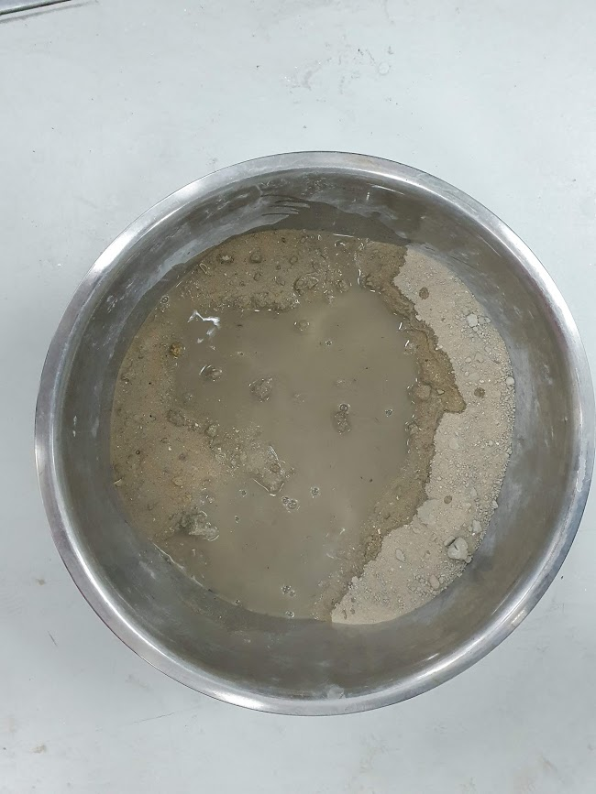
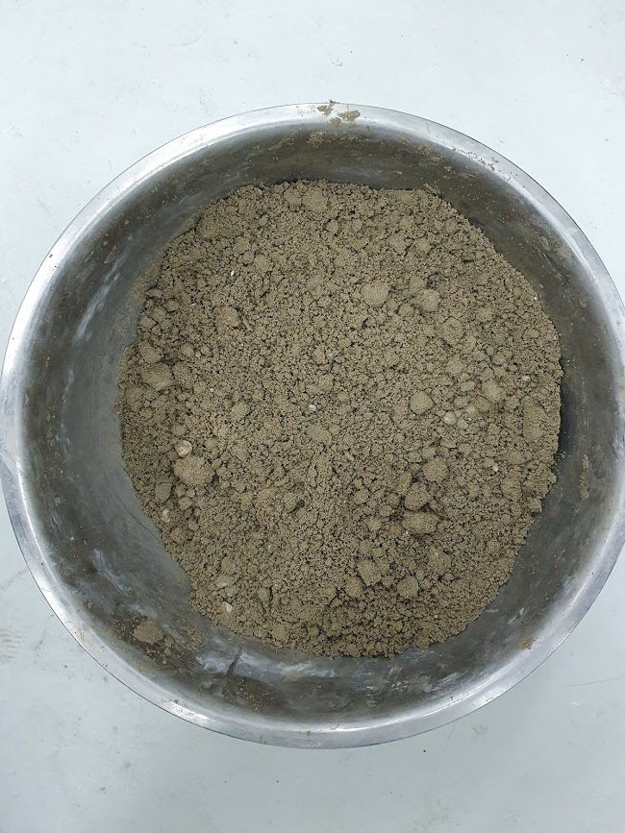
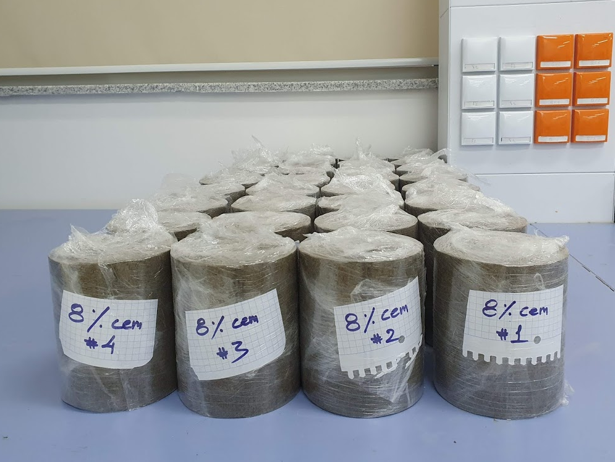
Methodology: Mix Design [cont’d]

Slide 12
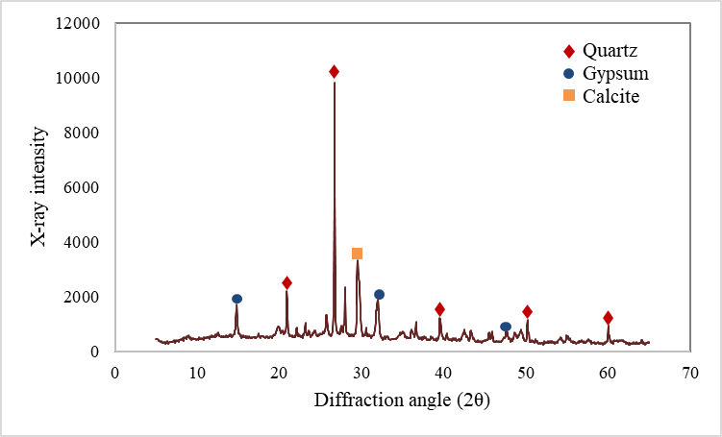
Test Results: Soil Characterization
Basic Soil Characterization:
Soil Mineralogy:
Geotechnical properties
Property | Value | Value | Property | Property |  |  | Value
AASHTO classification | A-2-4(0) | A-2-4(0) | Liquid limit (%) | Liquid limit (%) |  |  | 19.16
Optimum moisture content (%) | 10.80 | 10.80 | Plastic limit (%) | Plastic limit (%) |  |  | 16.67
Maximum dry density (kg/m³) | 1941.00 | 1941.00 | Plasticity index (%) | Plasticity index (%) |  |  | 2.49
Chemical properties
Cations (ppm) | Calcium |  | Sodium |  | Potassium | Magnesium
 | 6983.81 |  | 6682.37 |  | 801.37 | 664.87
Anions (ppm) | Sulfate |  |  |  | Chloride
 | 16931.00 |  |  |  | 10681.98
pH | 6.32
Chemical Composition:
Compound | Value (%) | Compound | Value (%) | Compound | Value (%)
SiO₂ | 20.22 | K₂O | 4.16 | TiO₂ | 1.61
Al₂O₃ | 4.55 | MgO | 1.66 | SO₃ | 10.60
Fe ₂O₃ | 11.68 | CaO | 39.78 | Cl | 3.70

Slide 13
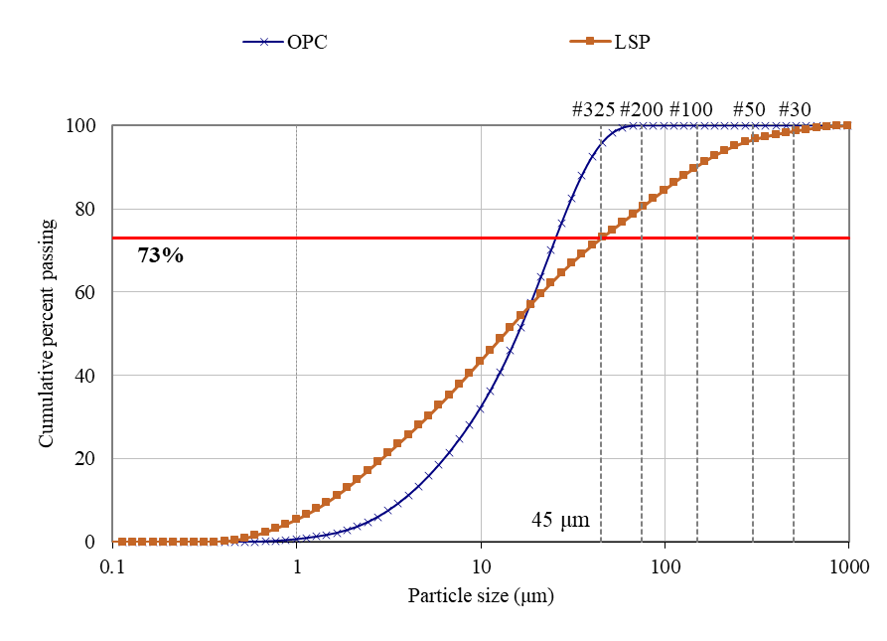
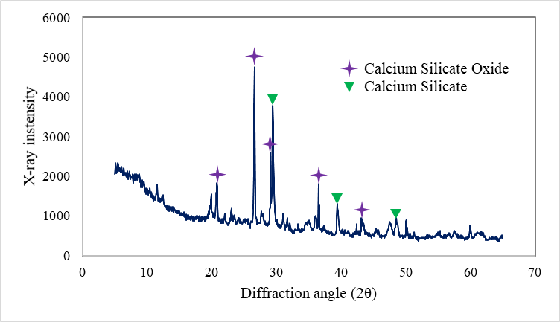
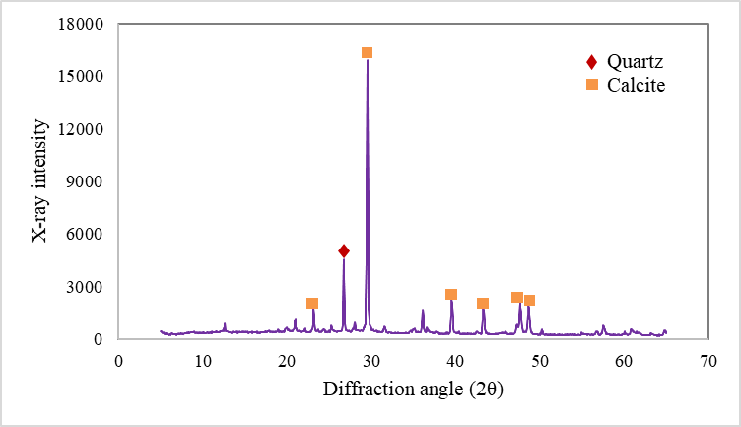
Test Results: OPC & LSP Characterization
Particle Size Distribution:
OPC Mineralogy:
LSP Mineralogy:
Chemical Composition:
Compound | OPC (%) | LSP (%) | Compound | OPC (%) | LSP (%) | Compound | OPC (%) | LSP (%)
SiO₂ | 21.05 | 11.16 | Na₂O | 0.43 | 0.60 | CaO | 64.48 | 68.54
Al₂O₃ | 3.79 | 3.62 | K₂O |  | 2.58 | TiO₂ | - | 1.23
Fe ₂O₃ | 4.47 | 9.44 | MgO | 1.77 | 1.00 | SO₃ | 2.88 | 0.70

Slide 14
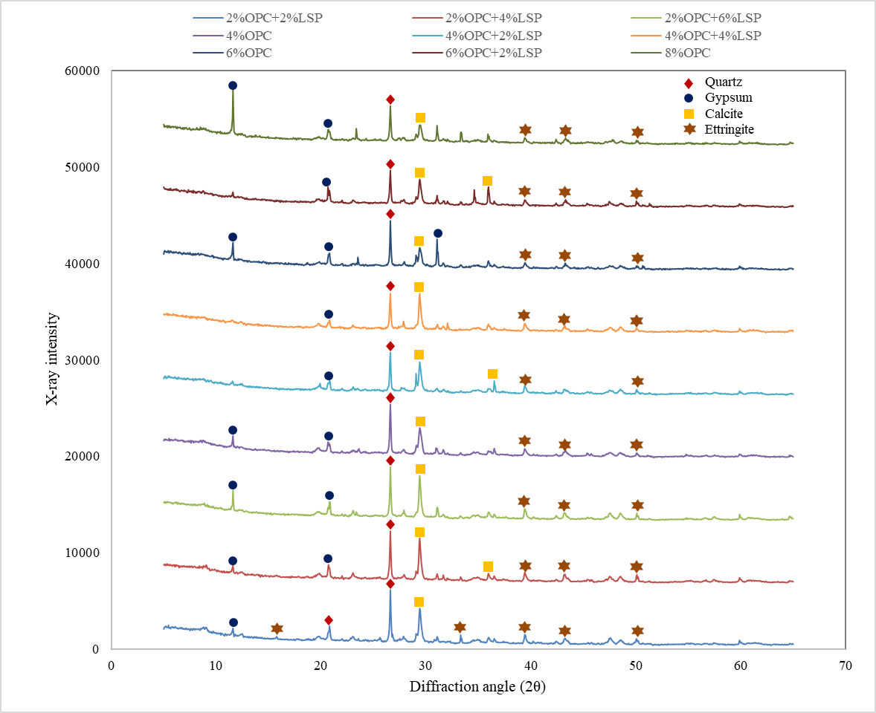
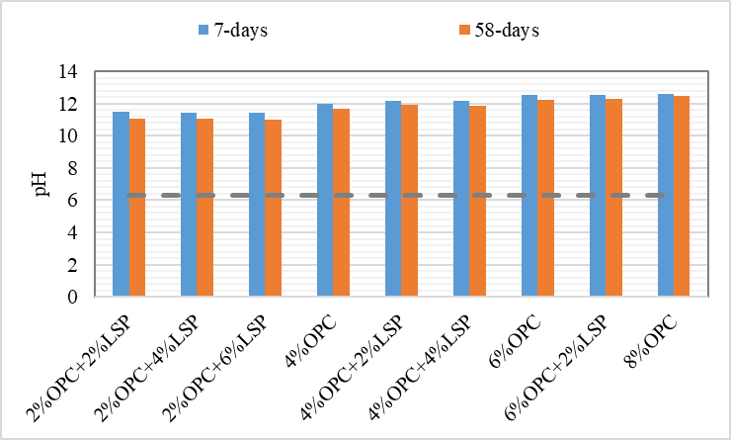
Test results: material characterization
Stabilized Soil pH
Stabilized soil Mineralogy

Slide 15
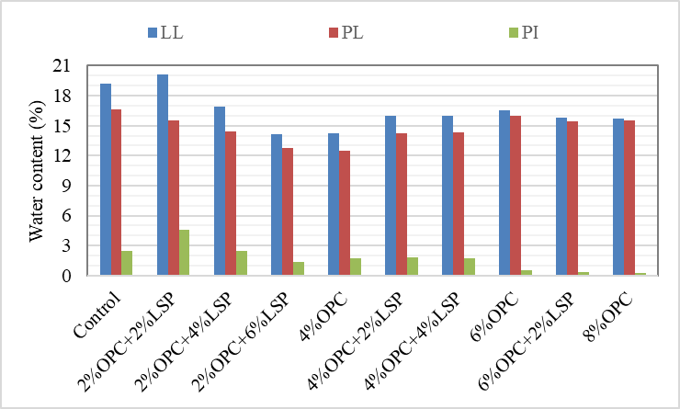
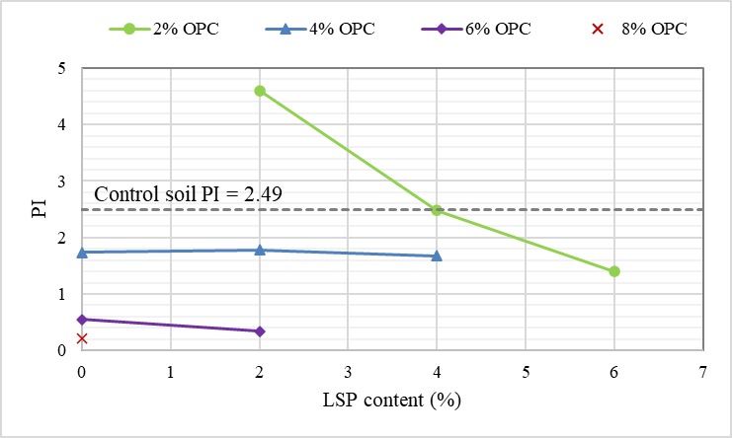
Test Results: Atterberg Limits
Atterberg Limits
Effect of LSP on PI

Slide 16
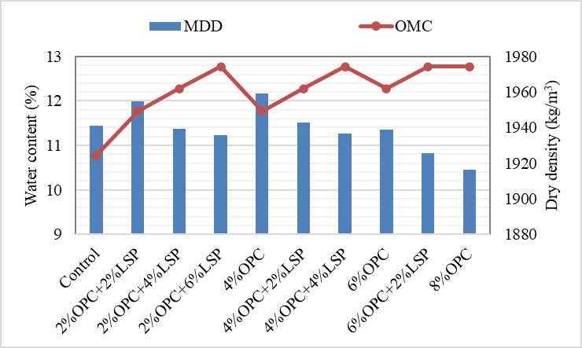
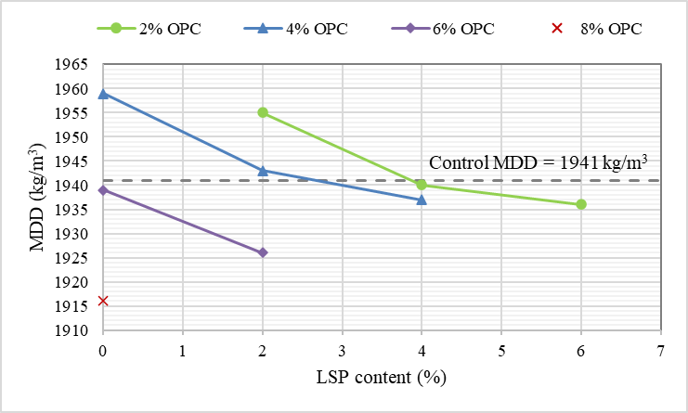
Test Results: OMC-MDD
OMC-MDD
Effect of LSP on MDD

Slide 17
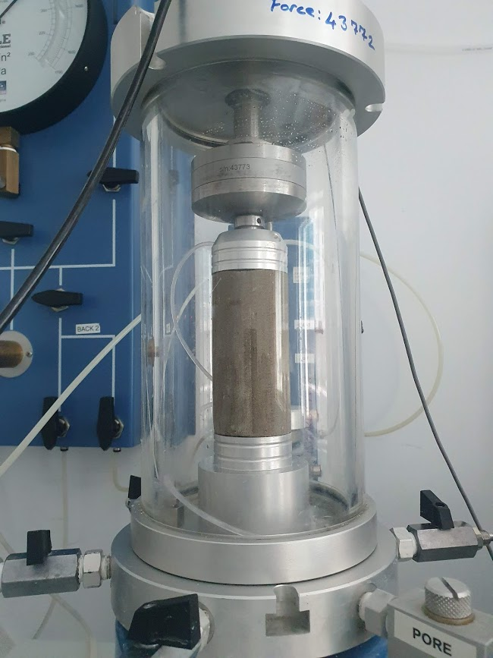
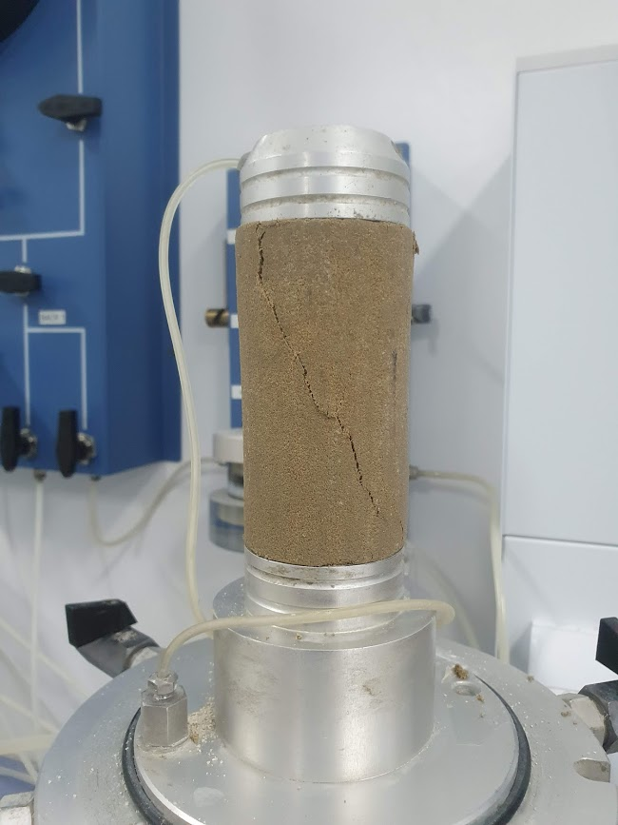
Test Results: UCS

Slide 18
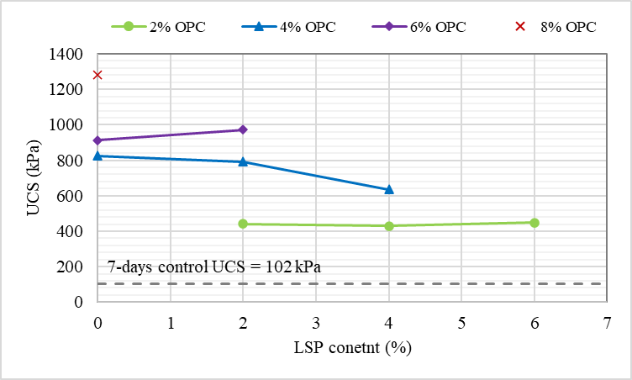
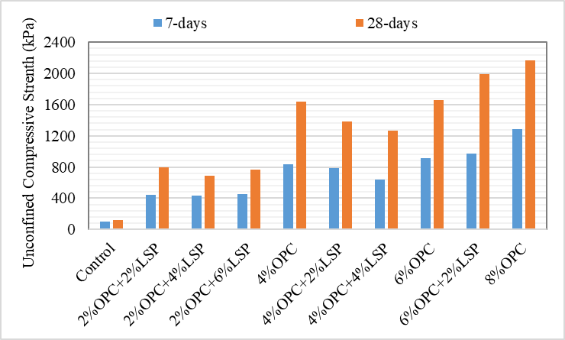
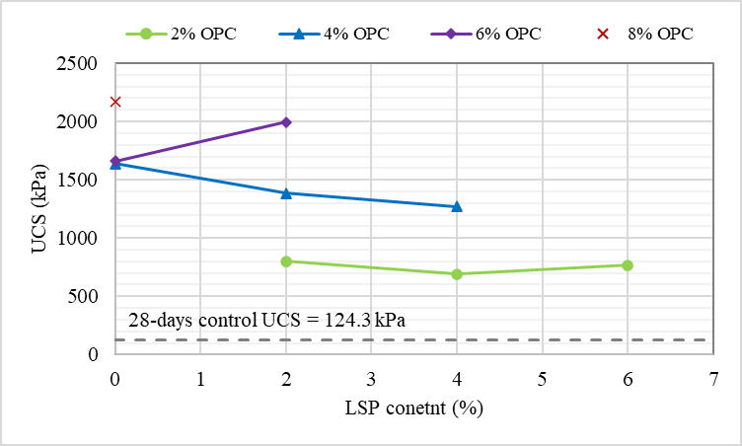
Test Results: UCS
Effect of LSP on 7-d UCS:
UCS:
Effect of LSP on 28-d UCS:

Slide 19
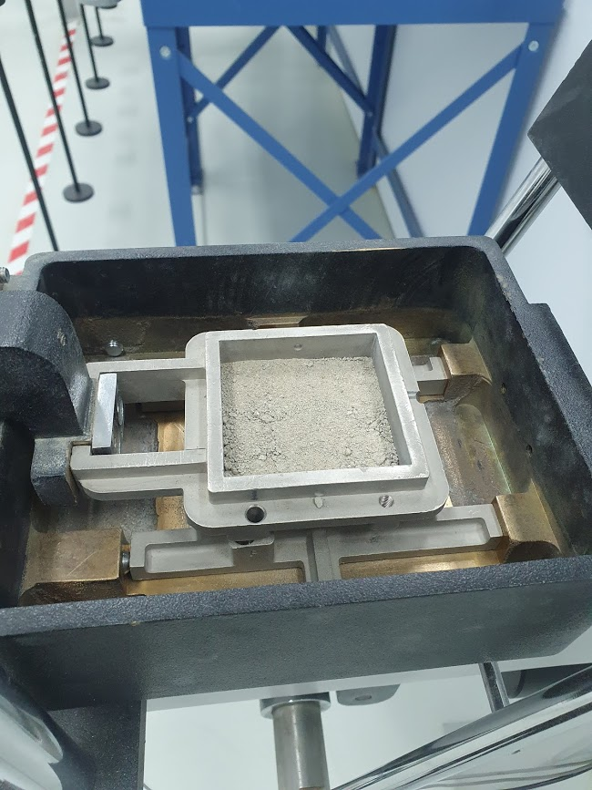
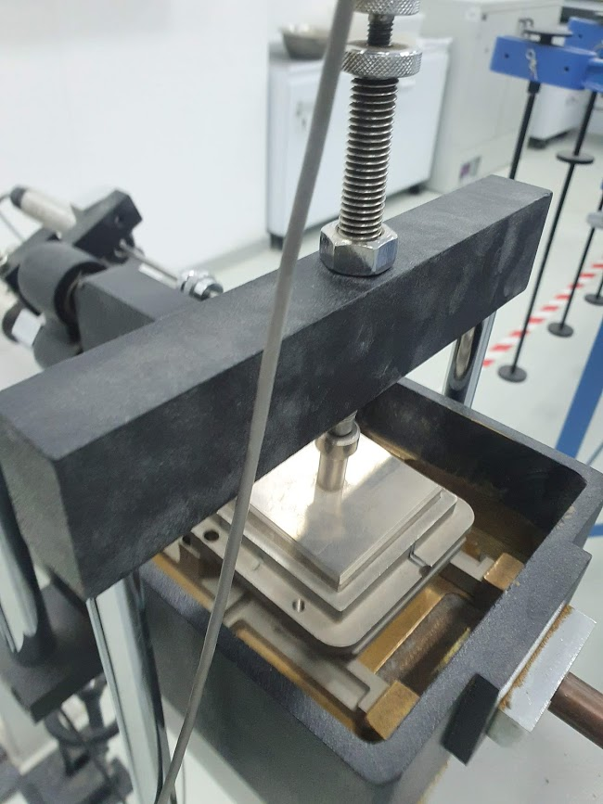
Test Results: Shear Strength

Slide 20
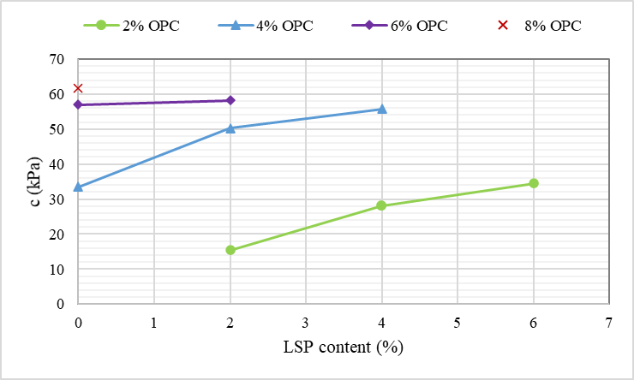
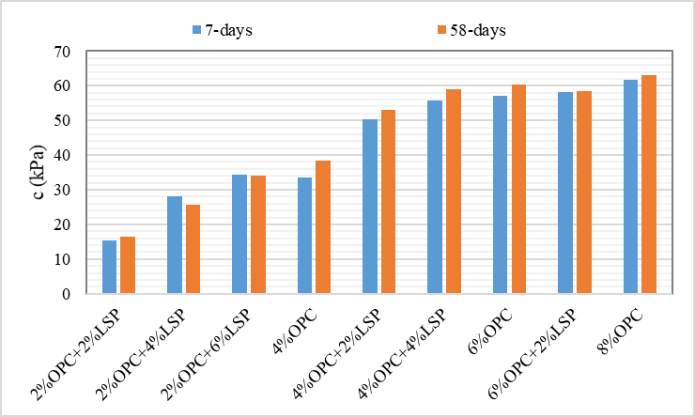
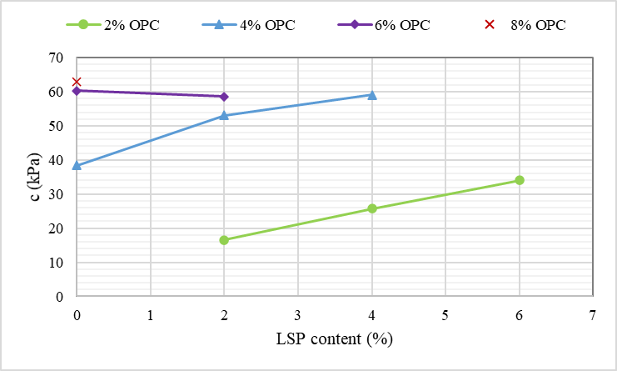
Test Results: Shear Strength
Effect of LSP on 7-d cohesion:
Cohesion:
Effect of LSP on 58-d cohesion:

Slide 21
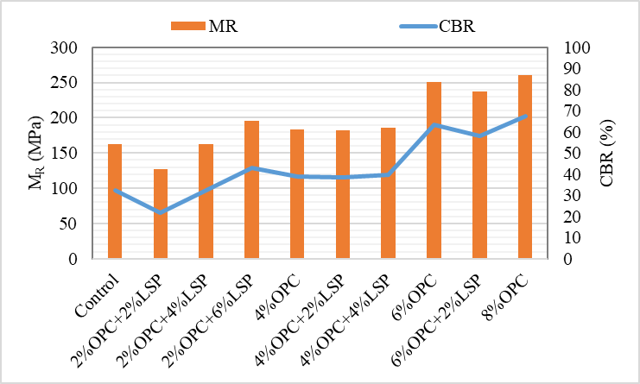
Test Results: M_{R} And CBR
M_{R} and CBR

Slide 22
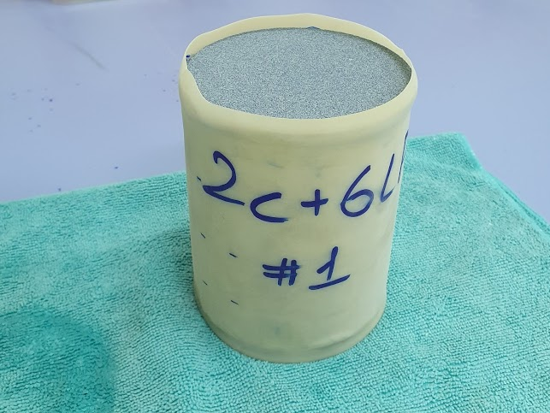
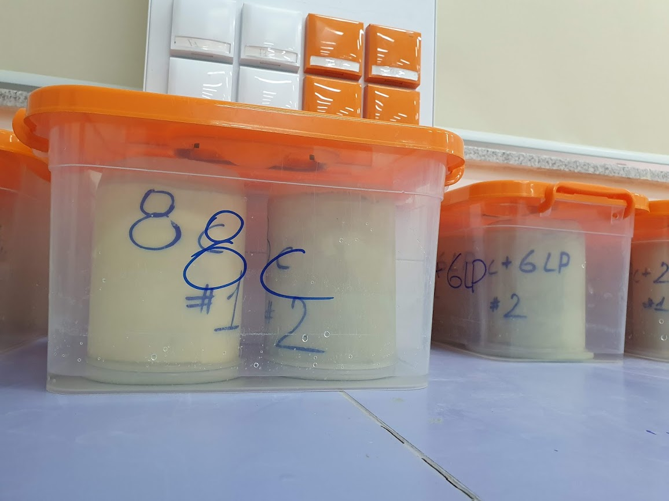
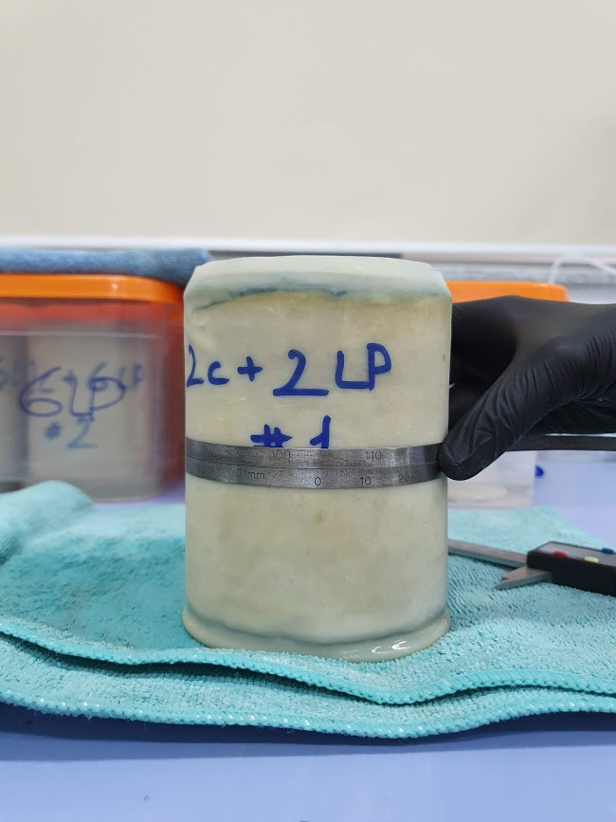
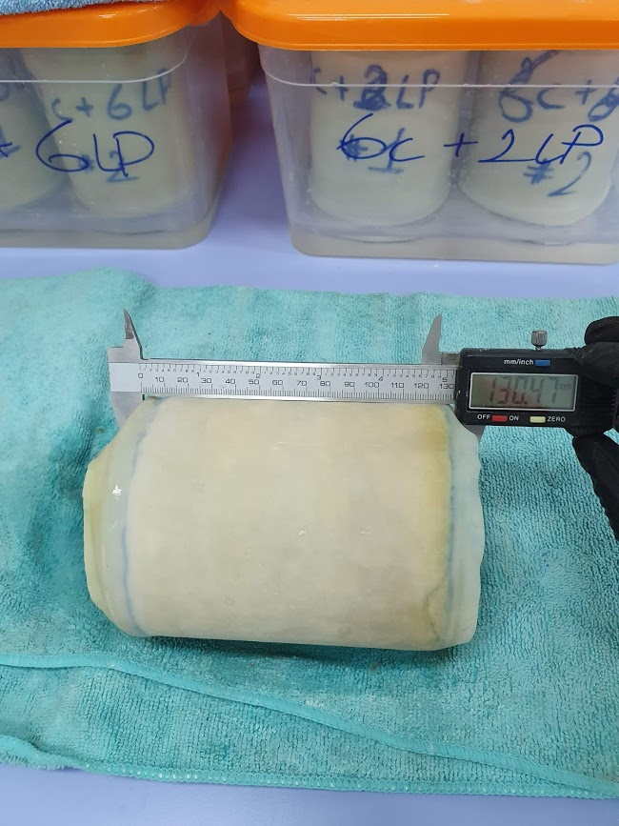
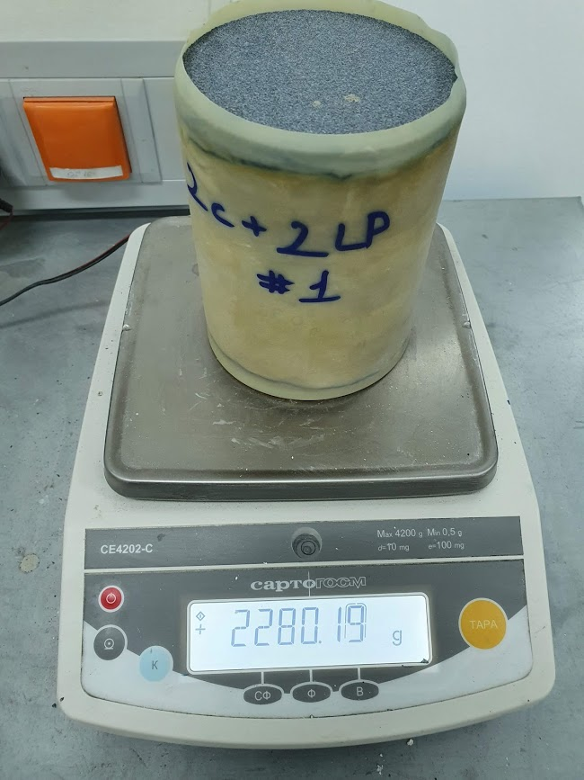
Test Results: 3-D Swelling

Slide 23
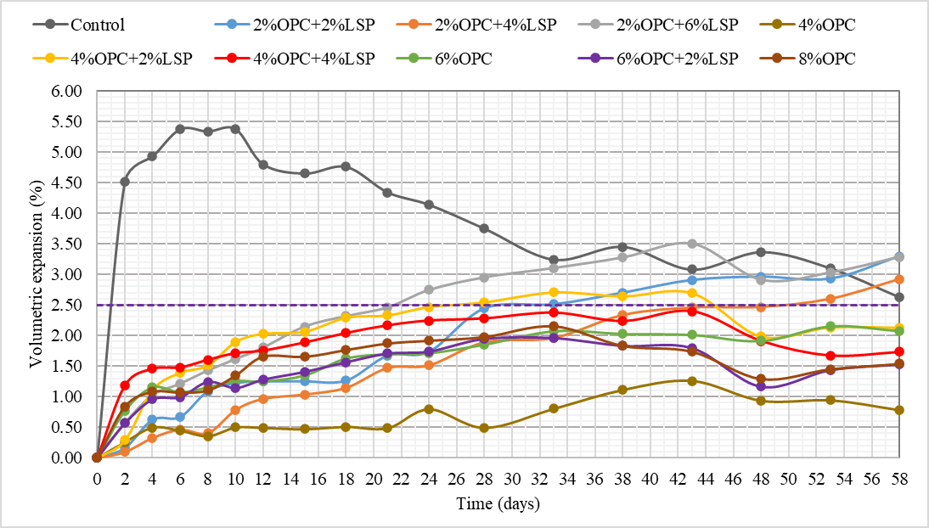
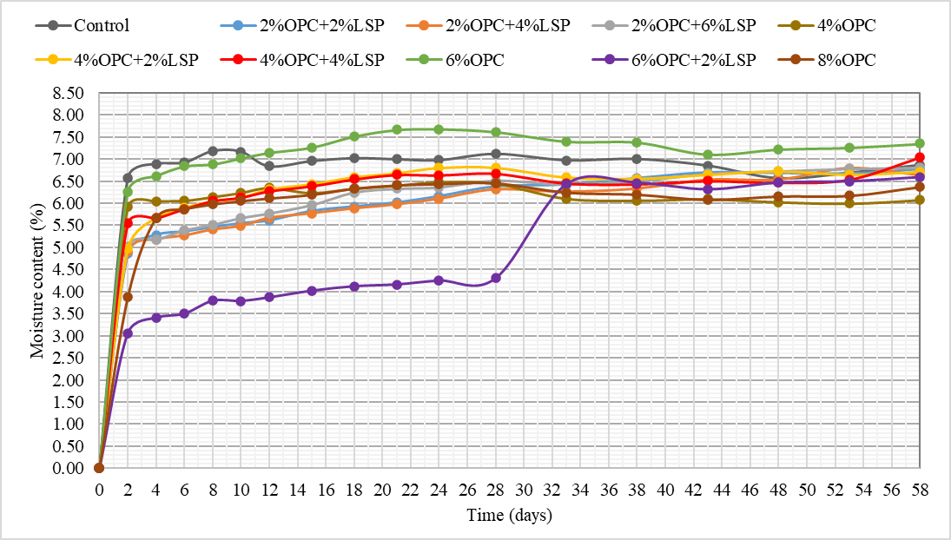
Test Results: 3-D Swelling
3-d swelling
Moisture Content change

Slide 24
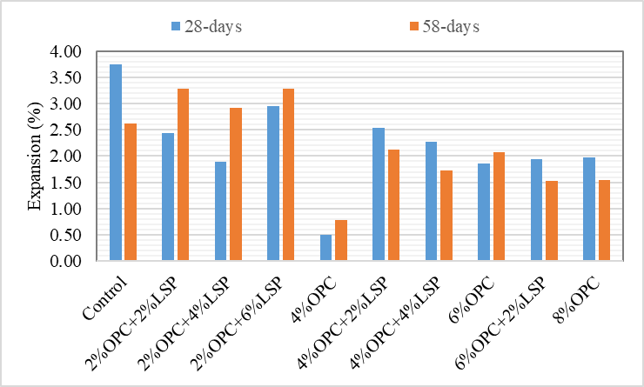
Test Results: 3-D Swelling [cont’d]
28-d and 58-d 3-d swelling
Residual strength
Sample | UCS (kPa) |  | Residual strength (%)
 | 7-days | 58-days
Control | 102.0 | 97.0 | 95.0
2%OPC+2%LSP | 440.5 | 768.4 | 174.4
2%OPC+4%LSP | 429.2 | 534.2 | 124.5
2%OPC+6%LSP | 449.3 | 503.2 | 112.0
4%OPC | 835.4 | 1237.2 | 148.1
4%OPC+2%LSP | 790.9 | 1128.7 | 142.7
4%OPC+4%LSP | 635.6 | 935.2 | 147.1
6%OPC | 913.9 | 1450.0 | 158.7
6%OPC+2%LSP | 971.2 | 1325.5 | 136.5
8%OPC | 1281.8 | 2408.1 | 187.9

Slide 25
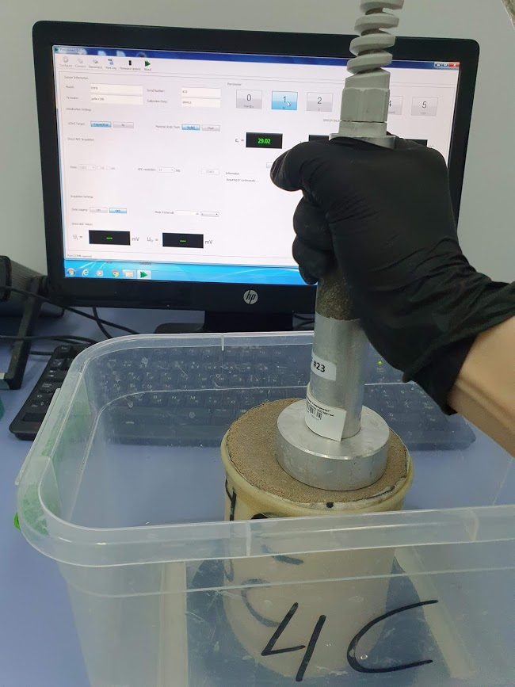
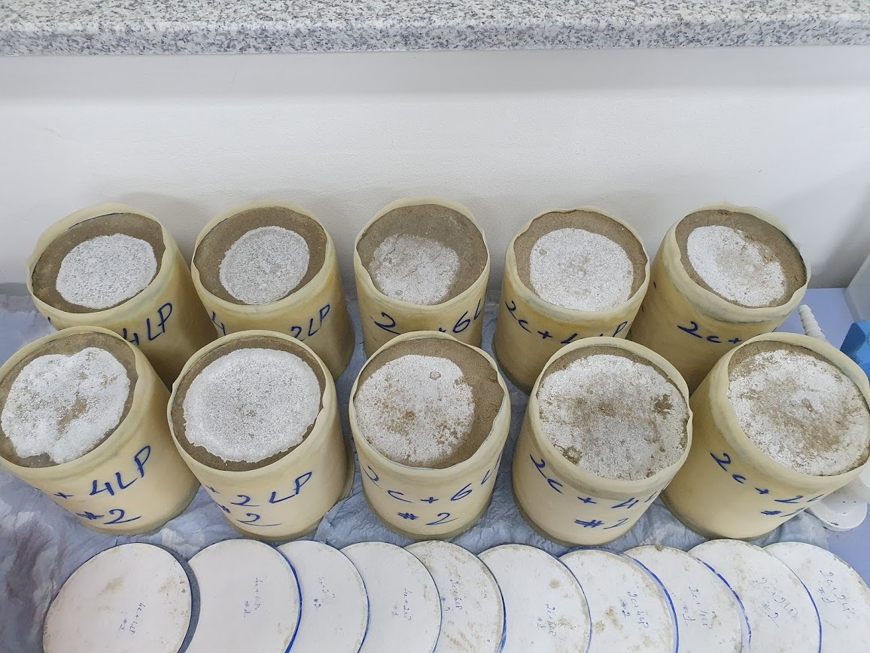
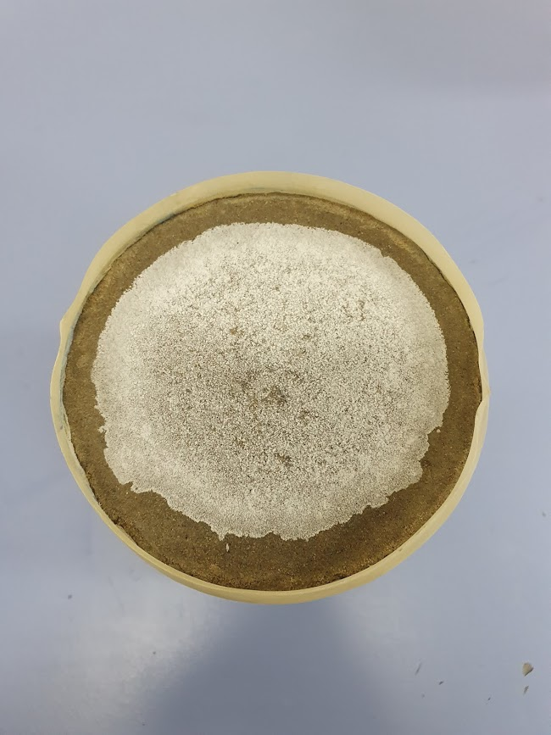
Test Results: Dielectric Constant

Slide 26
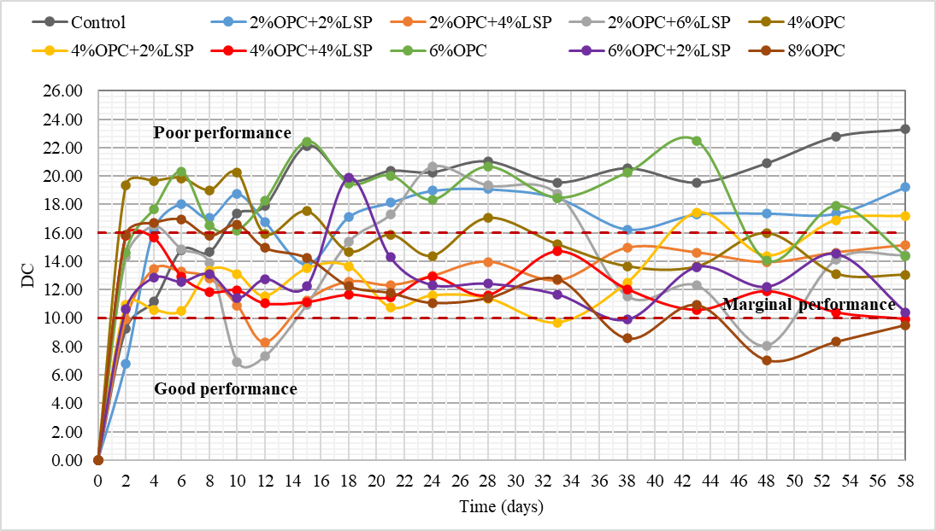
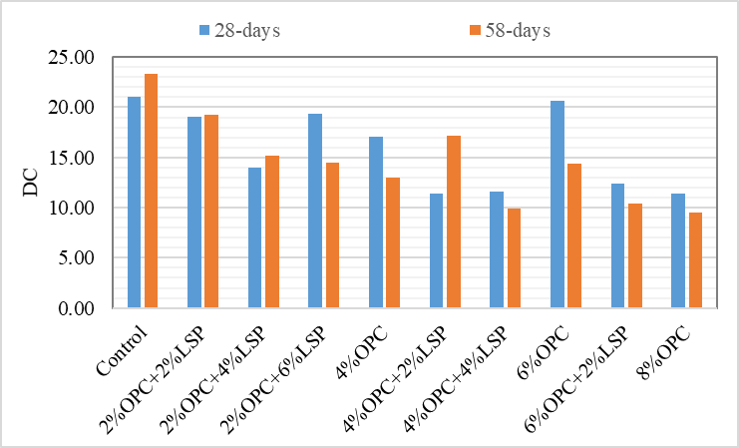
Test Results: Dielectric Constant
DC
28-d and 58-d DC

Slide 27
Research Schedule
 | 2019 |  |  |  | 2020 |  |  |  |  |  |  |  |  |  |  |  | 2021
 | 9 | 10 | 11 | 12 | 1 | 2 | 3 | 4 | 5 | 6 | 7 | 8 | 9 | 10 | 11 | 12 | 1 | 2 | 3 | 4
Literature Review
Material Preparation
Material Characterization
Sample Preparation
Testing of Samples
Analysis of Test Results
Documentation / First Draft
Revision / Final Version
Thesis Submission

Slide 28
Conclusion
The combined use of OPC and LSP is as effective in decreasing soil plasticity as the single OPC use at higher content.
There is an increase in optimum moisture content and corresponding decrease in maximum dry density with increase in total stabilizer content.
The introduction of LSP to the OPC-stabilized soil system is not effective in promoting both the instant and prolonged strength of the soil sample.
The cohesion of the stabilized soil rises significantly, as the stabilizer content increases. In the long-term perspective, the combination of lower OPC and higher LSP contents can be more effective in enhancing shear strength parameters, namely cohesion.
The introduction of LSP to the single OPC-treated system negatively correlates with the resilient modulus and California bearing ratio of the system.
The use of OPC and LSP in the sulfate-bearing saline soil inhibits volumetric expansion due to formation of ettringite minerals.
The use of OPC as of single additive promotes the lower volumetric expansion of the soil compared to the use of its combination with LSP.
The residual strength values of all designed mixtures exceeded the threshold value of 80% recommended by the TxDOT.
OPC and LSP stabilization increases the moisture susceptibility resistance of sulfate-bearing saline soil. The utilization of the lower OPC content in combination with higher LSP content is as effective in deteriorating moisture susceptibility of soil as the use of higher OPC content combined with lower LSP content or used alone.
Overall, based on the combined analysis of the geotechnical properties and the durability parameters of the stabilized soil samples, the soil mixture stabilized with 4% OPC and 4% LSP has the best performance in terms of the mechanical properties and durability parameters.

Slide 29
Recommendations
To perform the full comparison of OPC and LSP as of stabilizing materials, the mixtures of the same fixed and alternating stabilizers contents can be designed: for example, 2% OPC + 2% LSP, 2% OPC + 4% LSP, 2% OPC + 6% LSP can be better compared with 4% OPC + 2% LSP, 4% OPC + 4% LSP, 4% OPC + 6% LSP.
The introduction of the triaxial test into the experimental procedure can allow to obtain more accurate data and perform a more comprehensive analysis of strength parameters of the tested soil mixtures.
The relationship between the stabilizer content and the improvement of soil properties can be investigated more deeply to derive the mathematical model.
The addition of alternative stabilizers, such as waste glass powder, fly ash, and blast furnace slag, can be proposed and studied.

Slide 30

Thank you for your attention!
ayazhan.bazarbekova@nu.edu.kz

