Slide 1

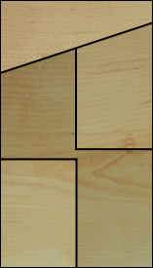

MODULE HOUSE
ASTANA 2017
BELARUS
Alexandra Kotova, Maxim Martynov
Brest State Polytechnic University

Slide 2













biocenose
population
organism
organ
fabric
cage
molecule
MODULE HOUSE
ASTANA-2017

Slide 3




Cell
Bionic system
Dwelling unit
Residential structure
MODULE HOUSE
ASTANA-2017

Slide 4
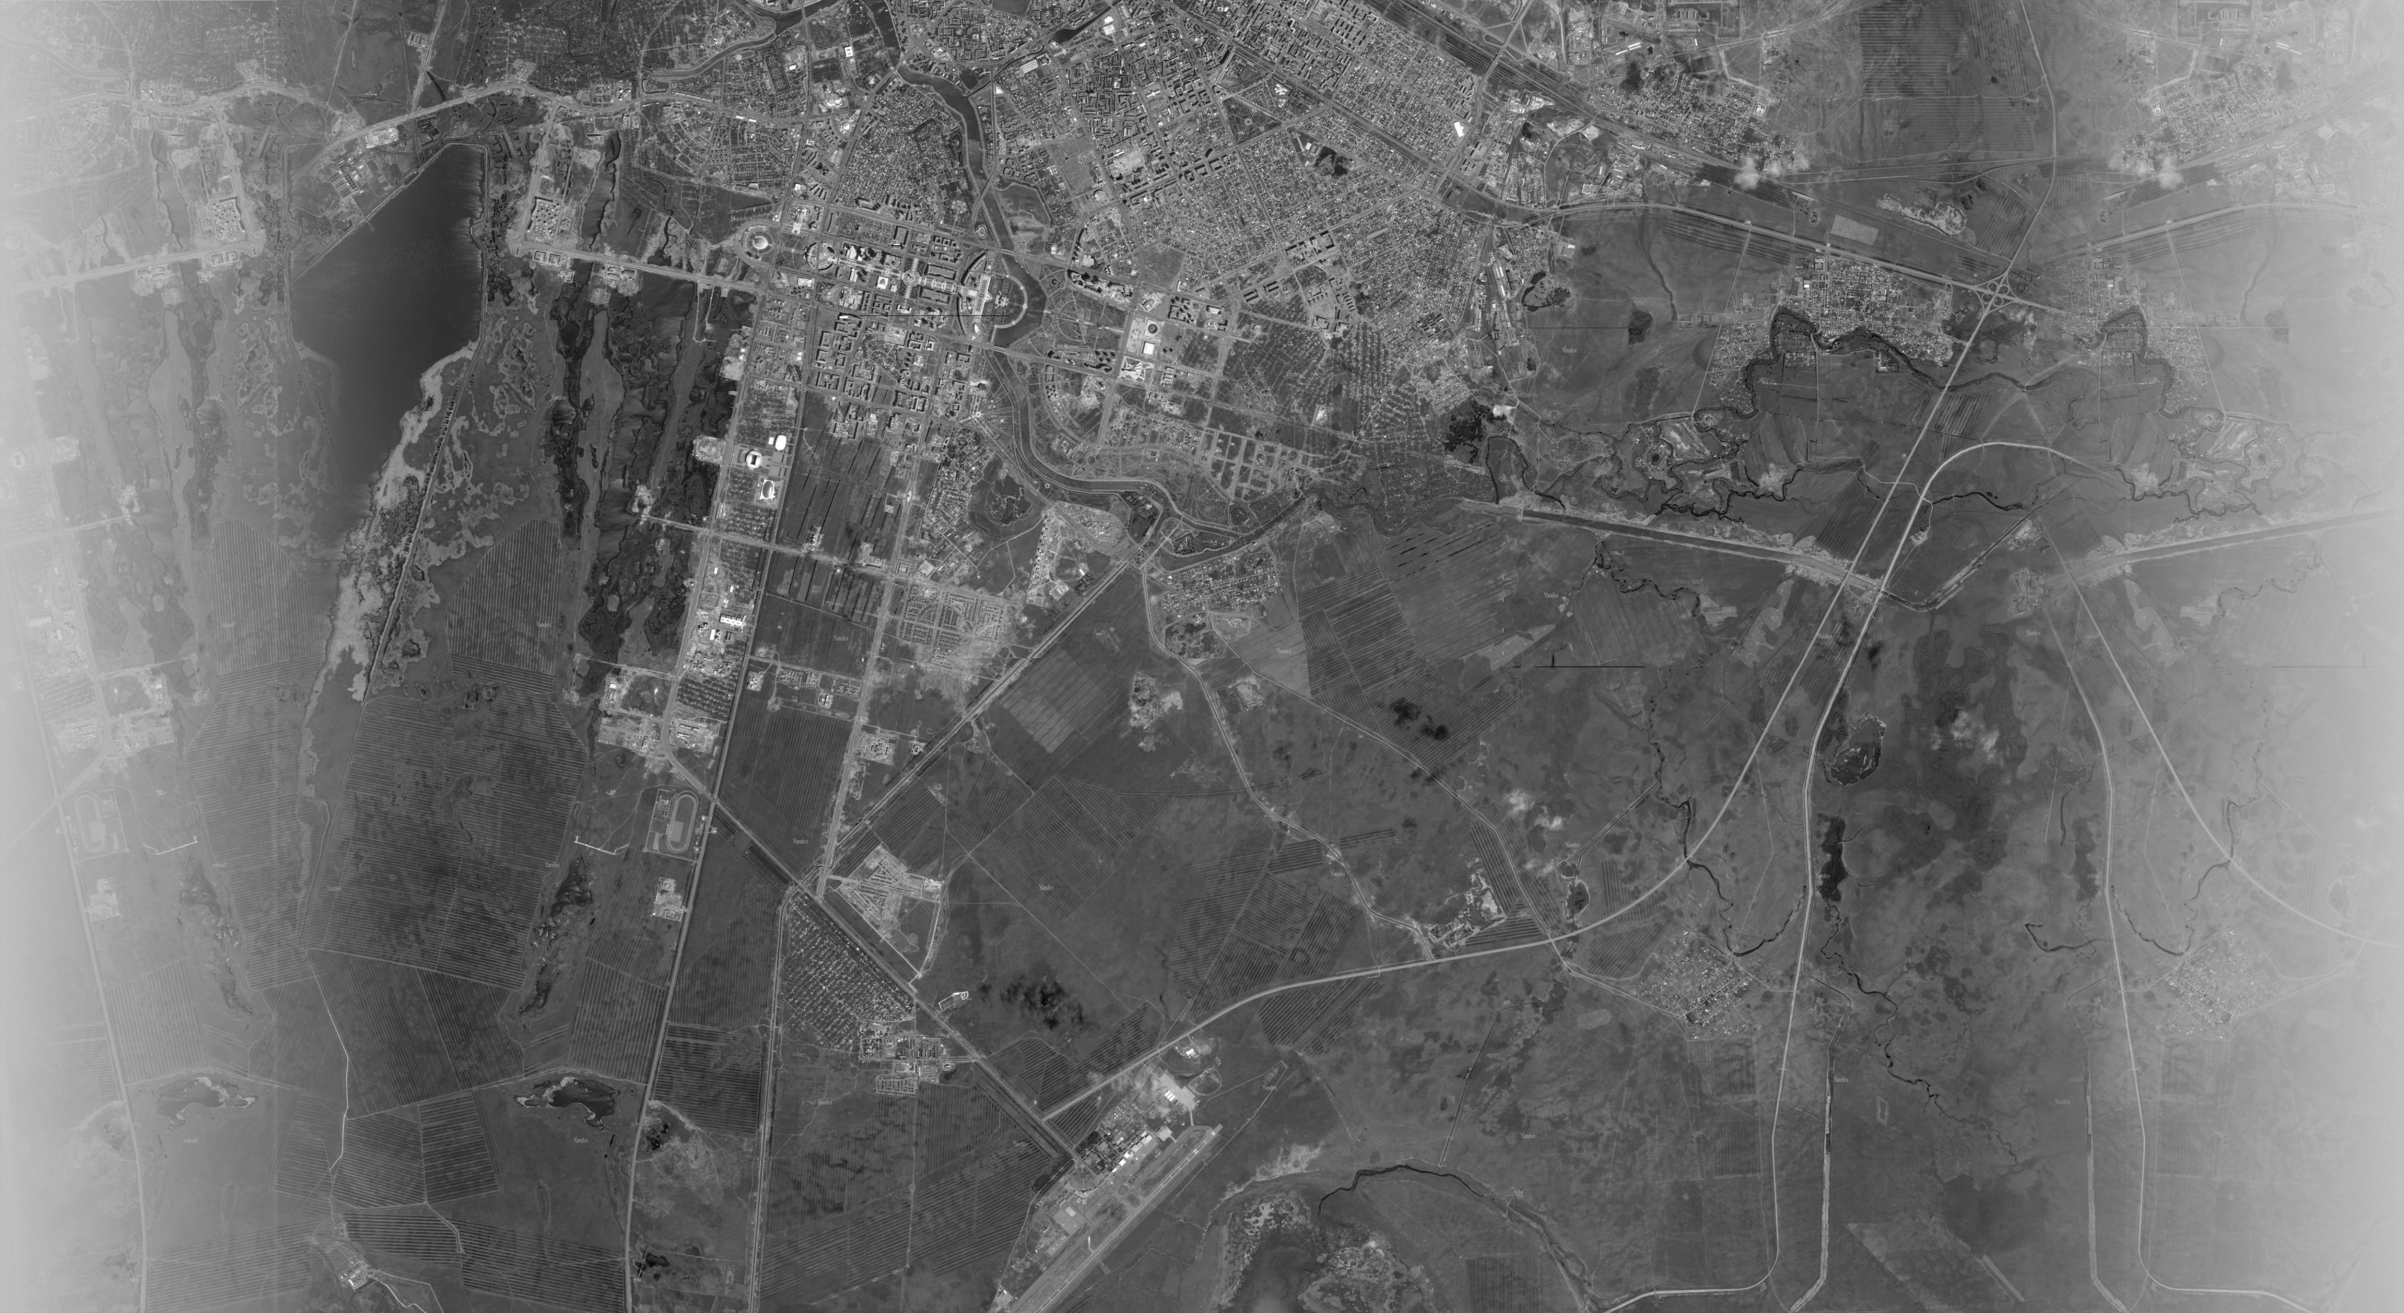
City Center
Nazarbayev
University
EXPO Complex
Guarder
Airport
MODULE HOUSE
ASTANA-2017

Slide 5



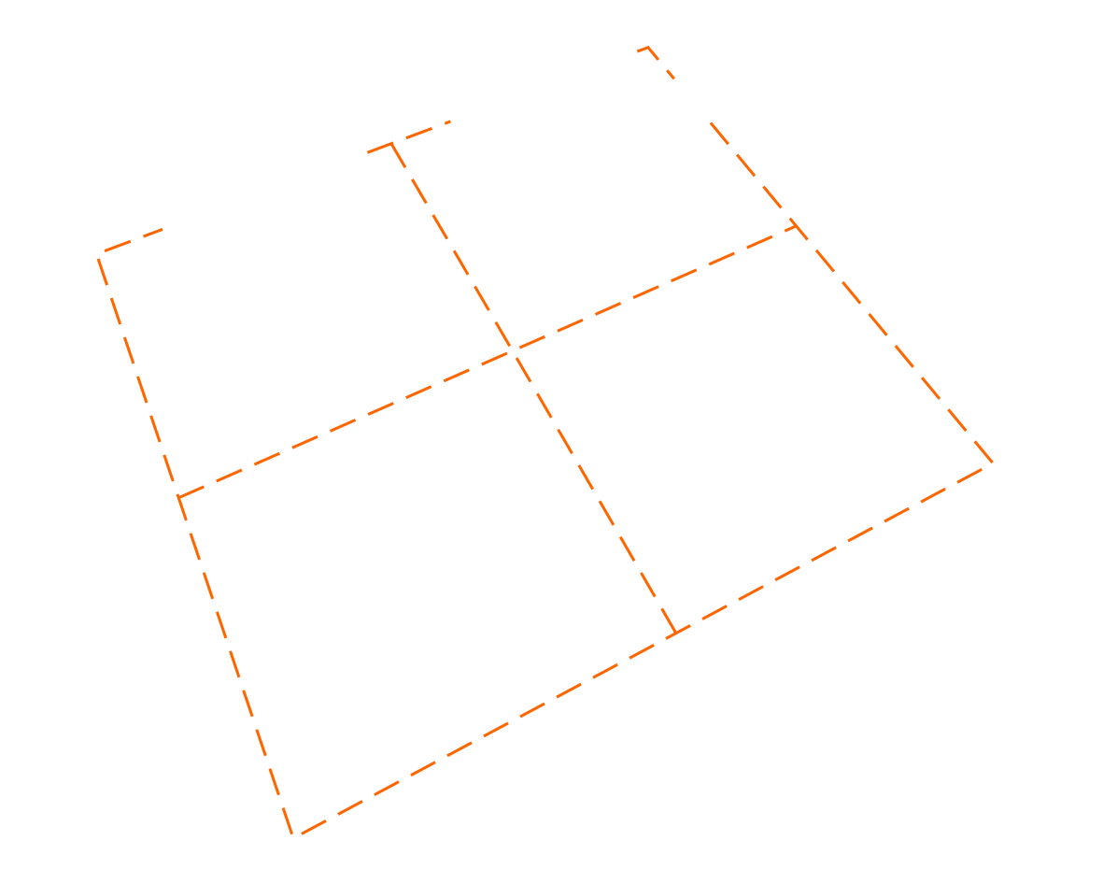
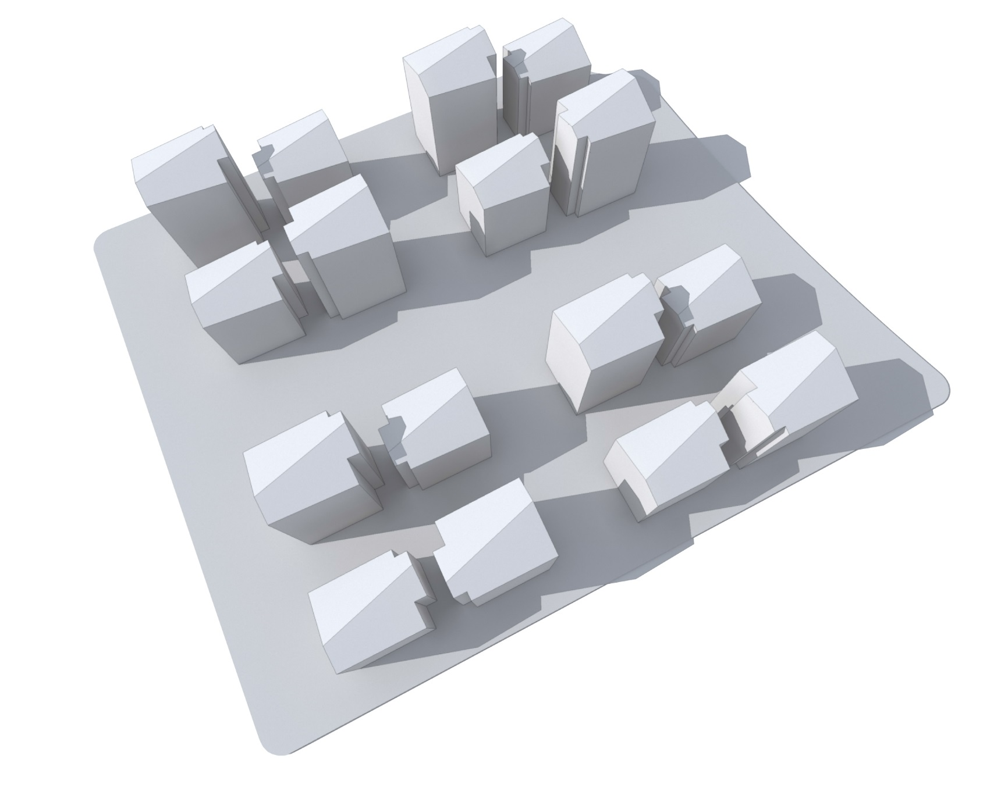
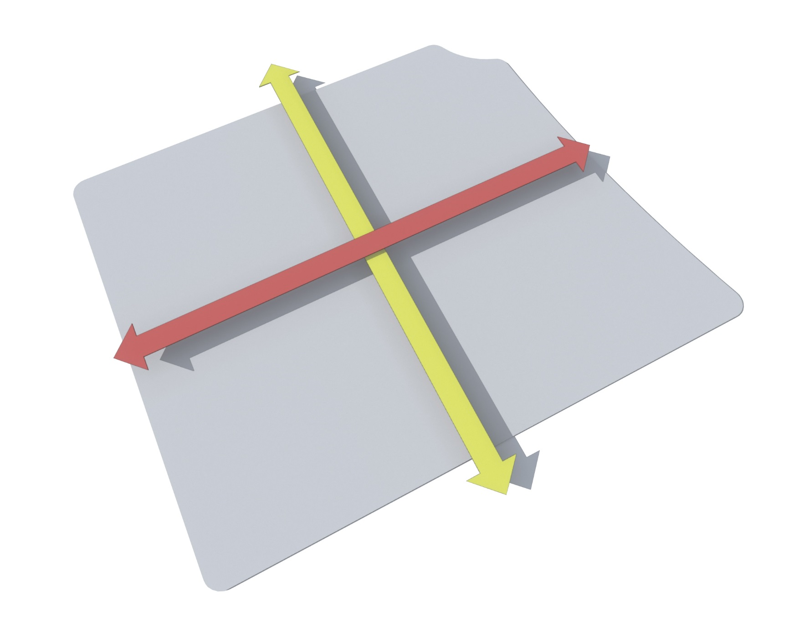
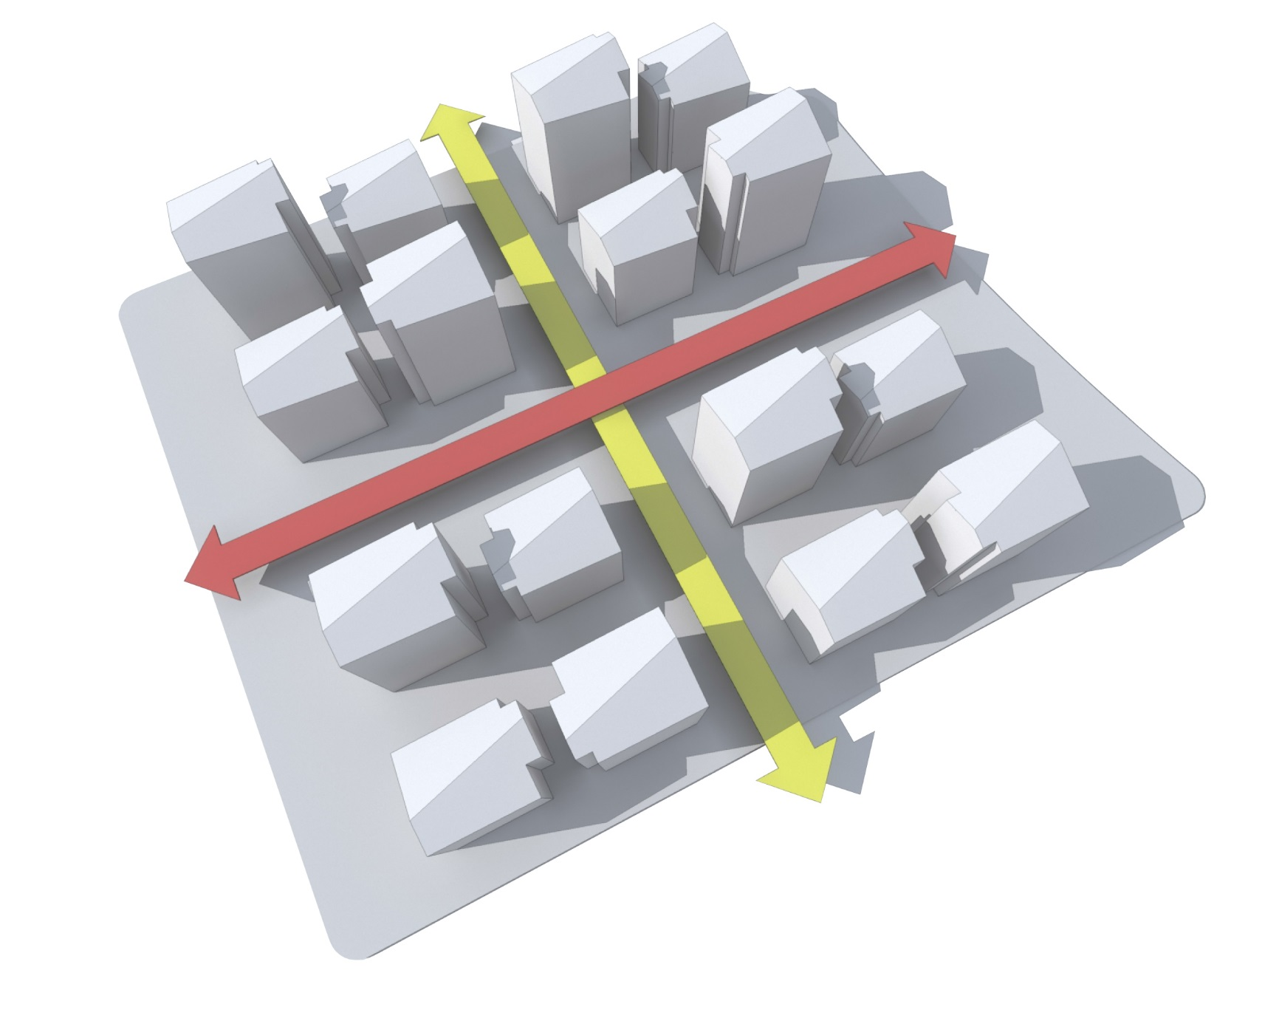
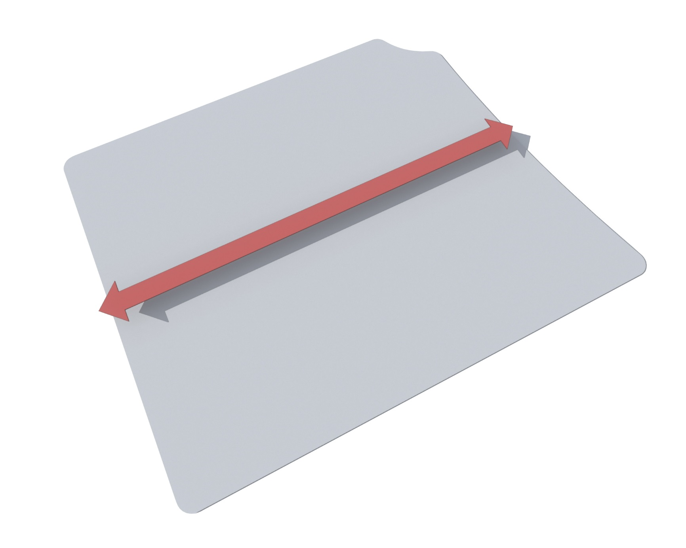




The main pedestrian
connection
School
The covered
street
4 equal parts
4 polyfunctional
residential groups
Buffer park
Module quarter
Residential
quarter
MODULE HOUSE
ASTANA-2017

Slide 6
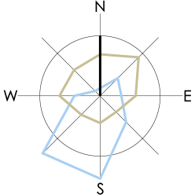
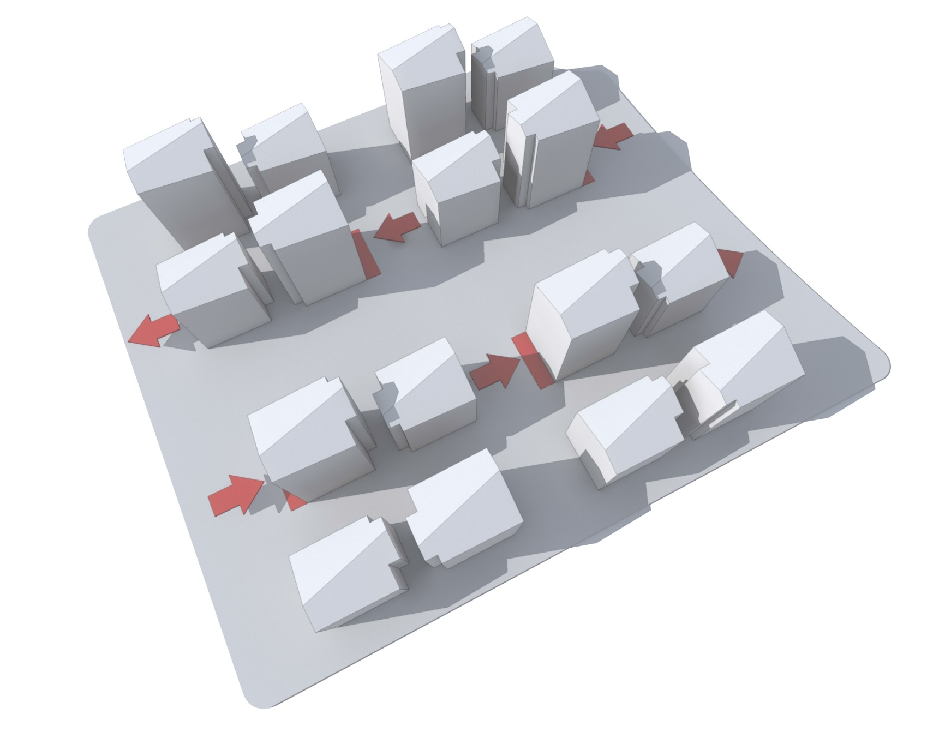
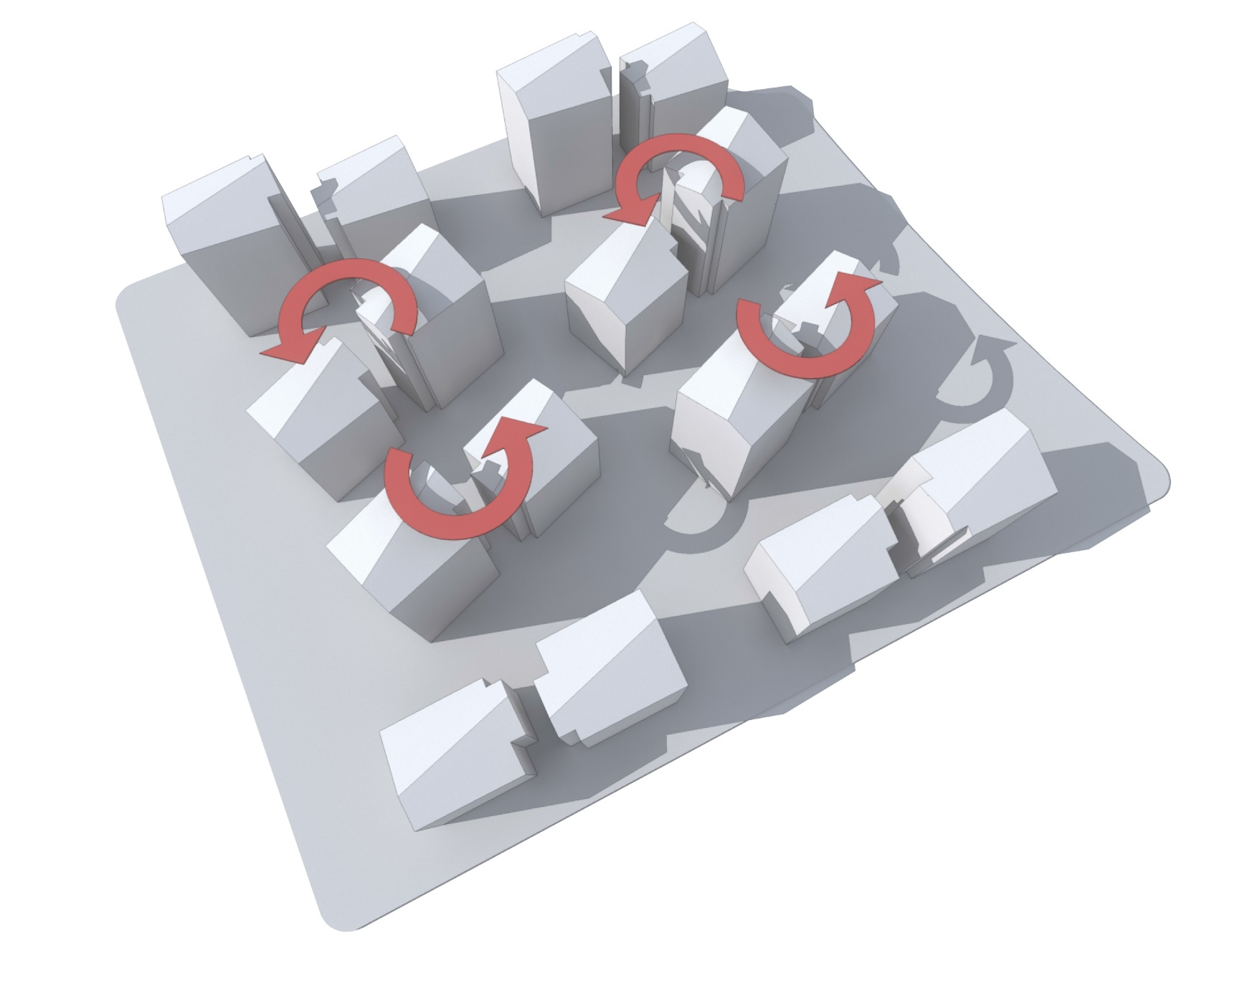
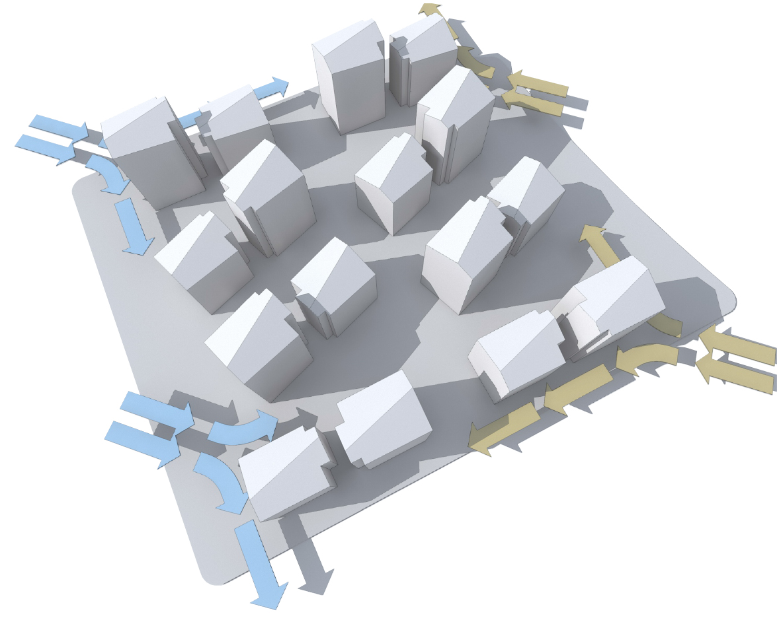
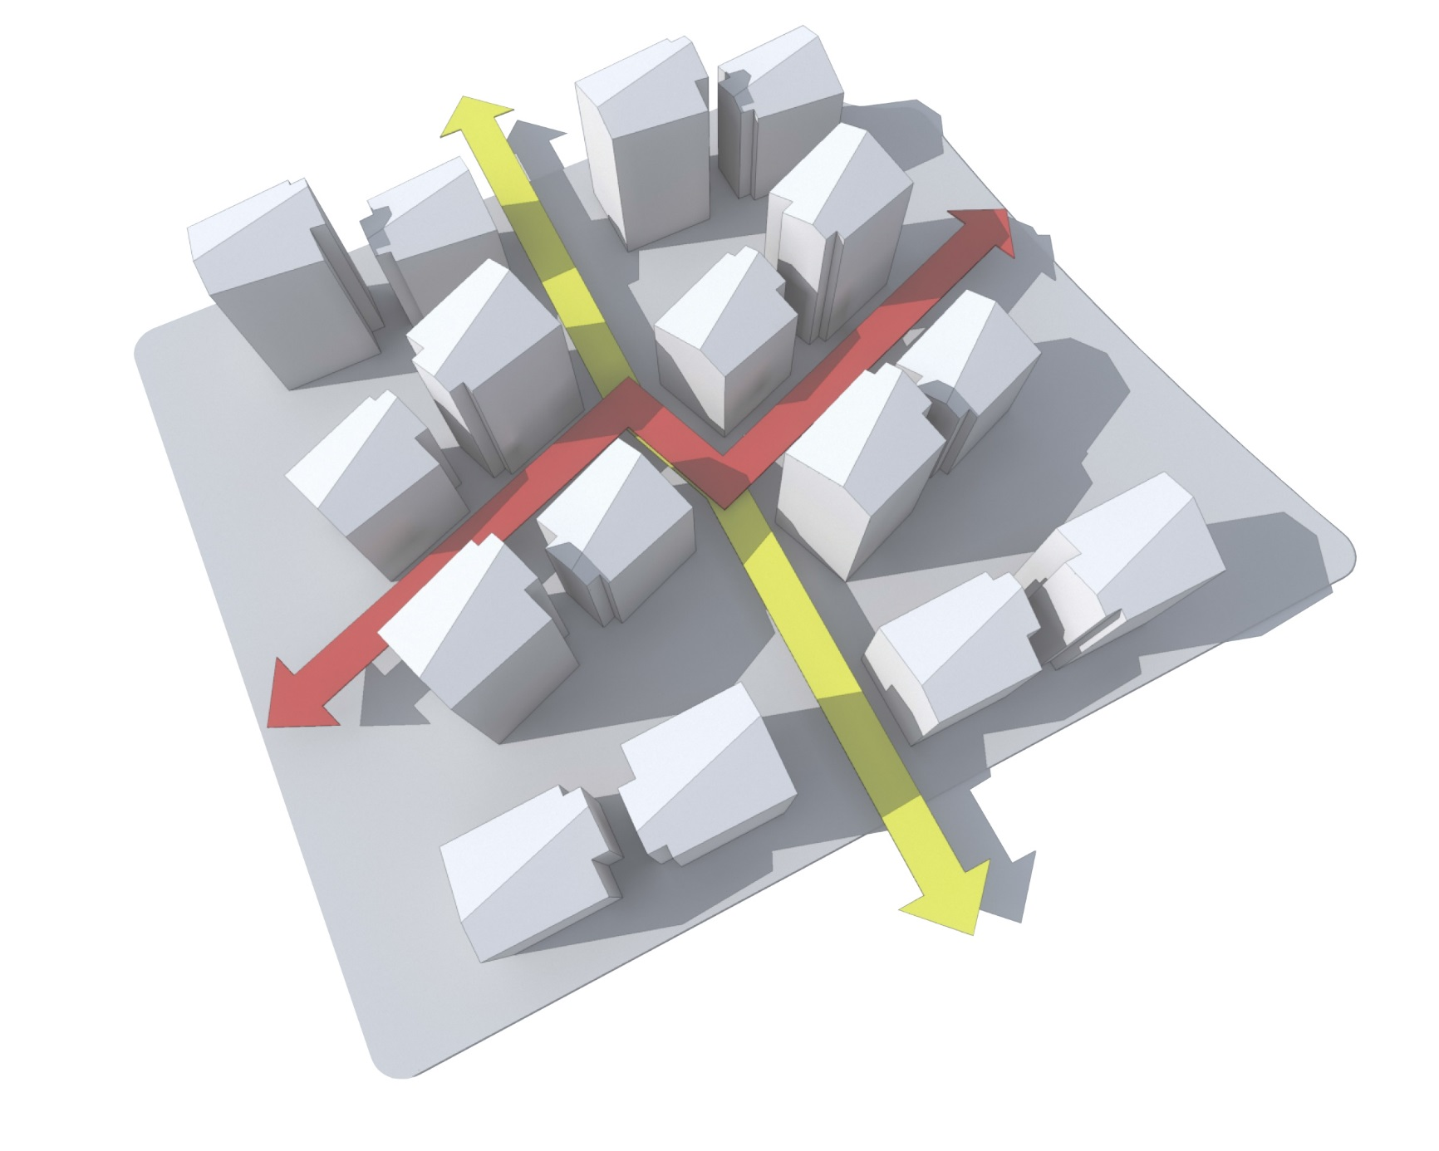
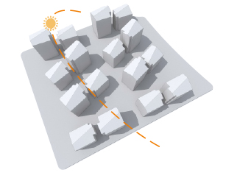
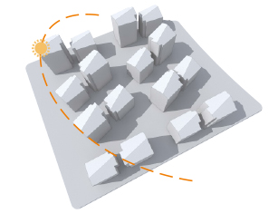
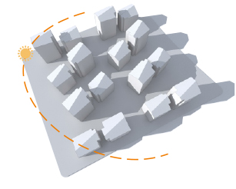
INSOLATION
June
September
December
MODULE HOUSE
ASTANA-2017

Slide 7
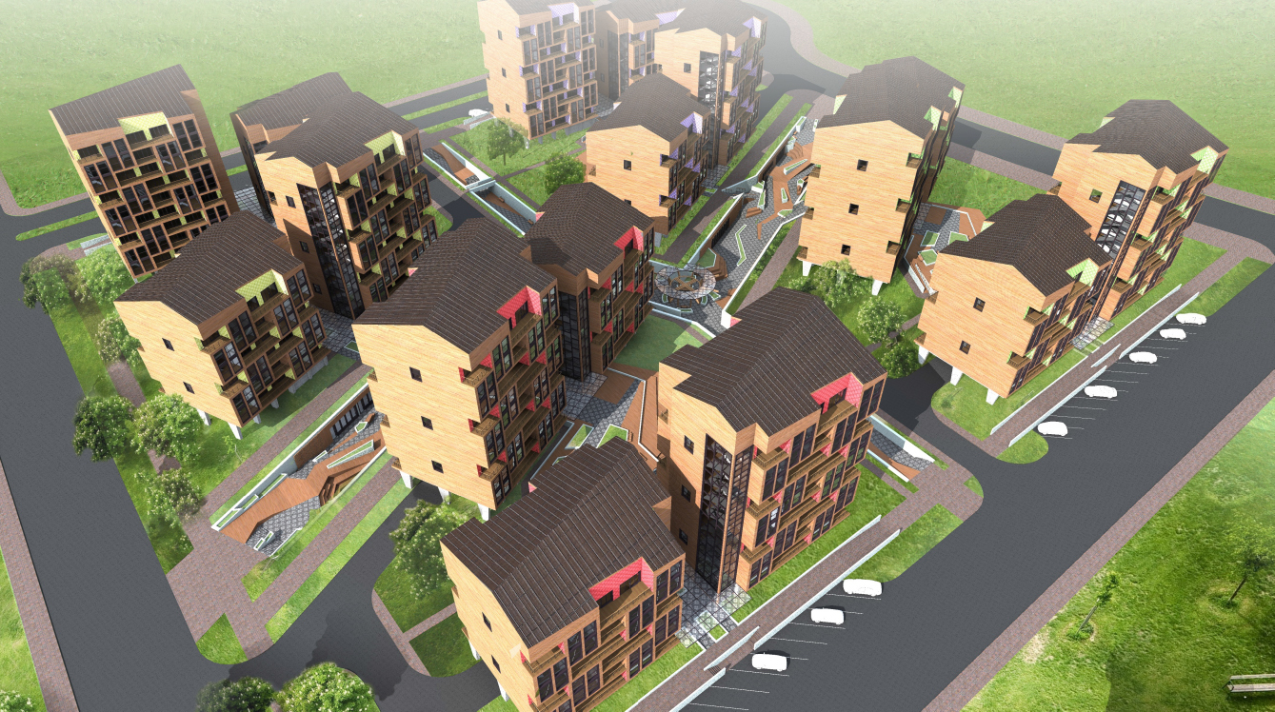
MODULE HOUSE
ASTANA-2017

Slide 8
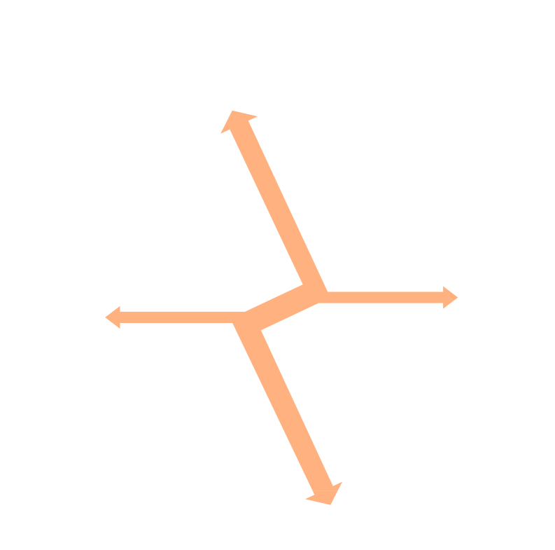
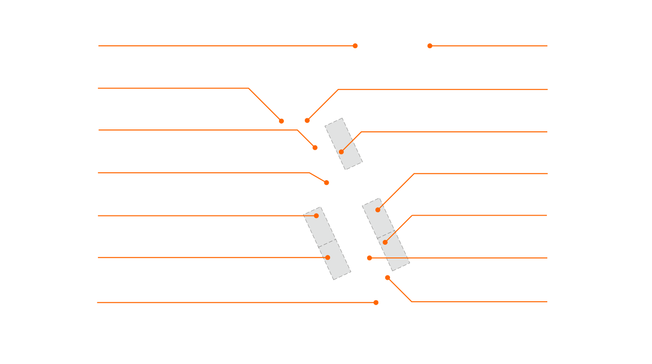

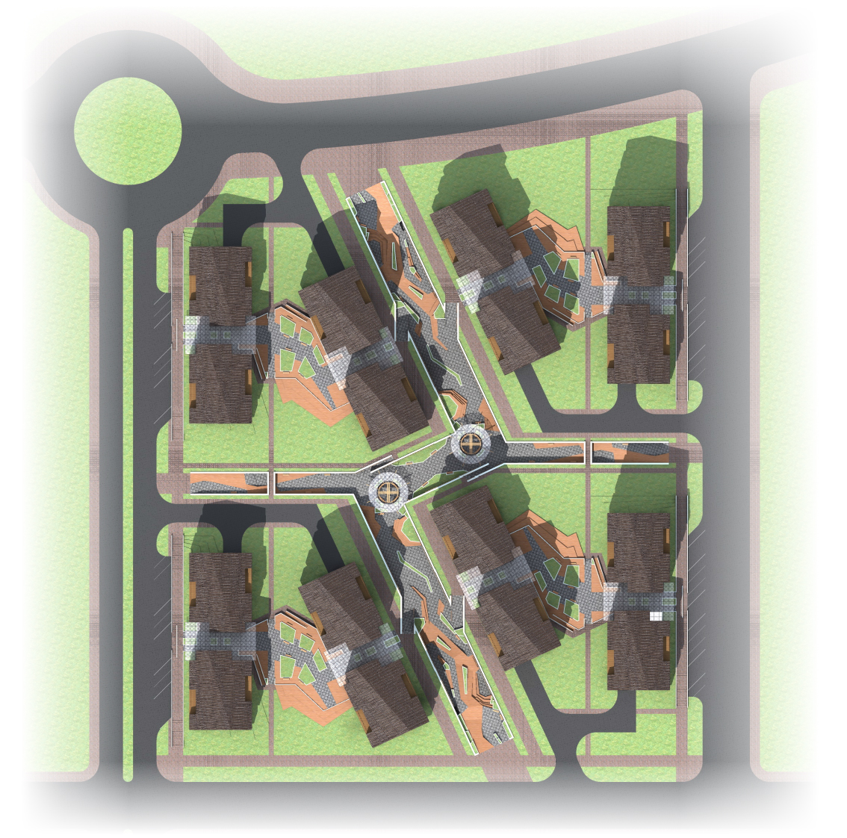
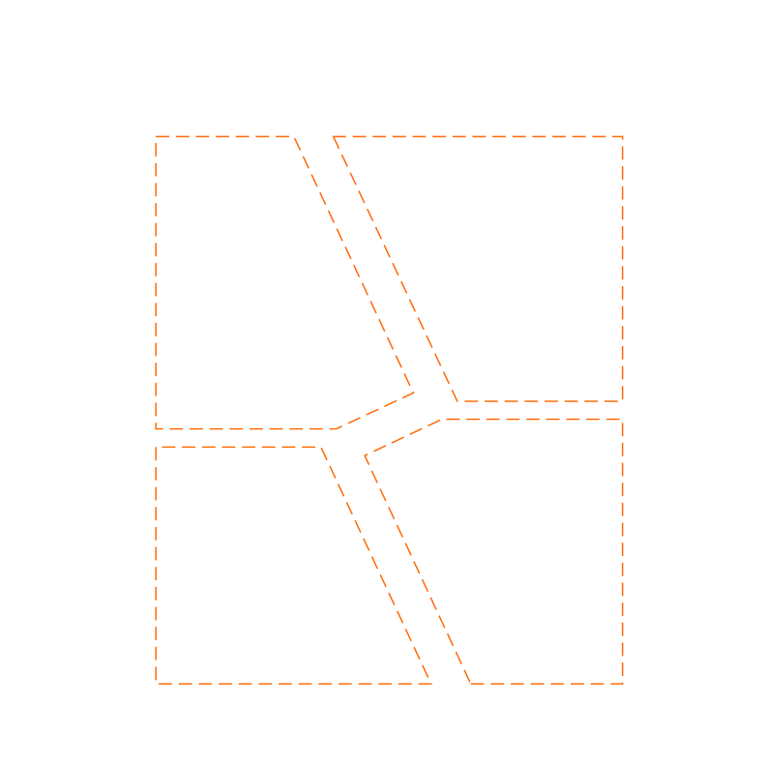


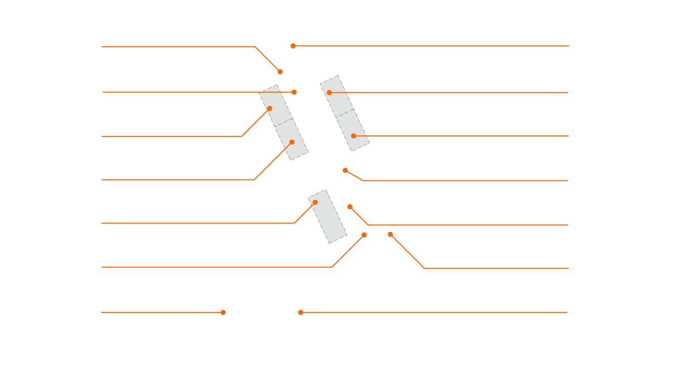












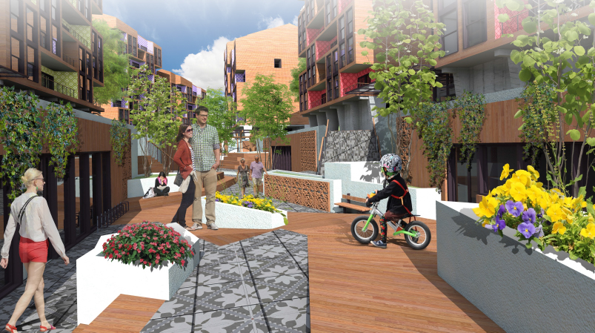

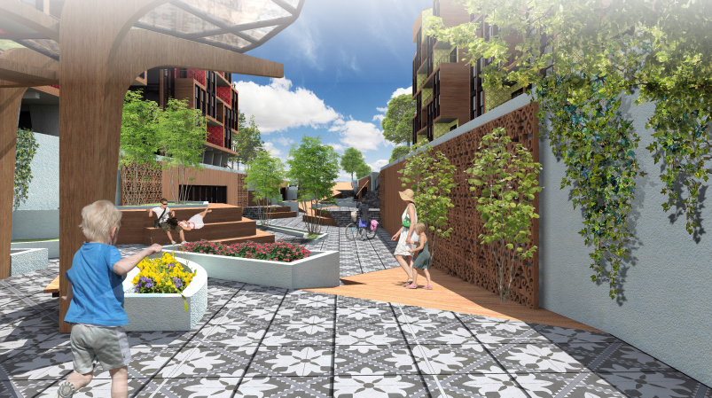



MODULE HOUSE
ASTANA-2017

Slide 9

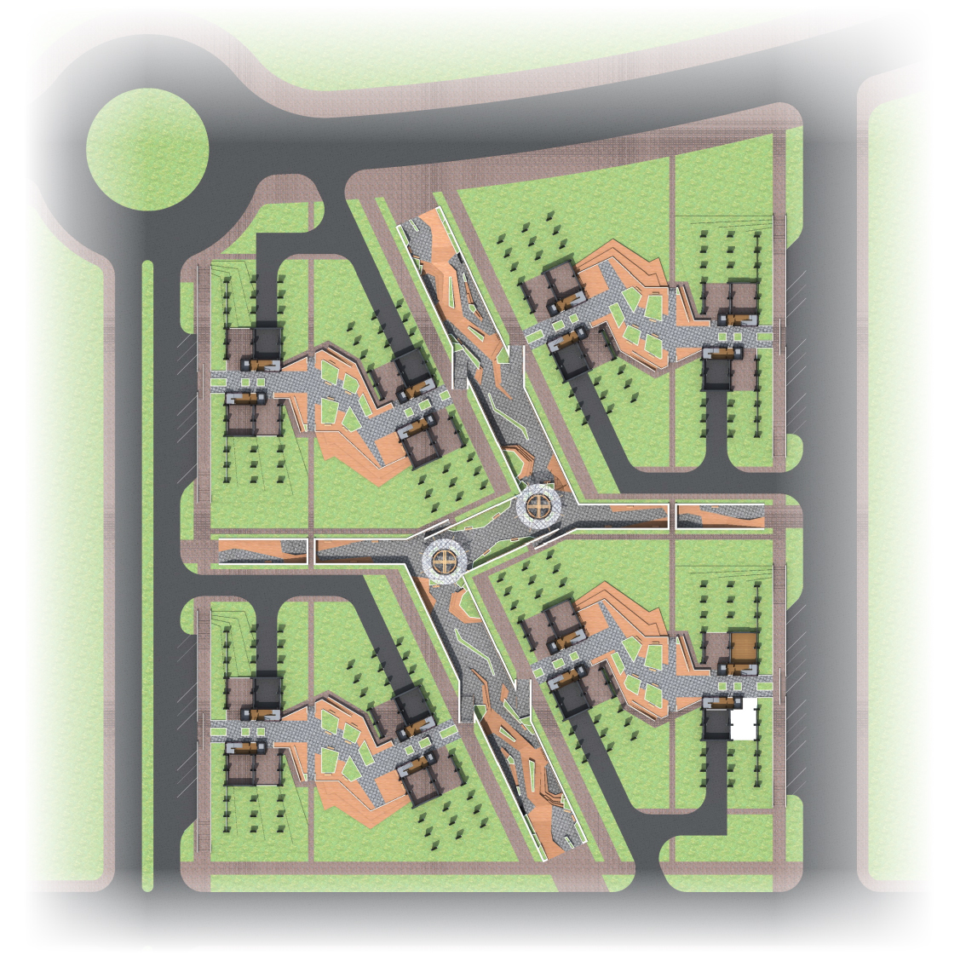
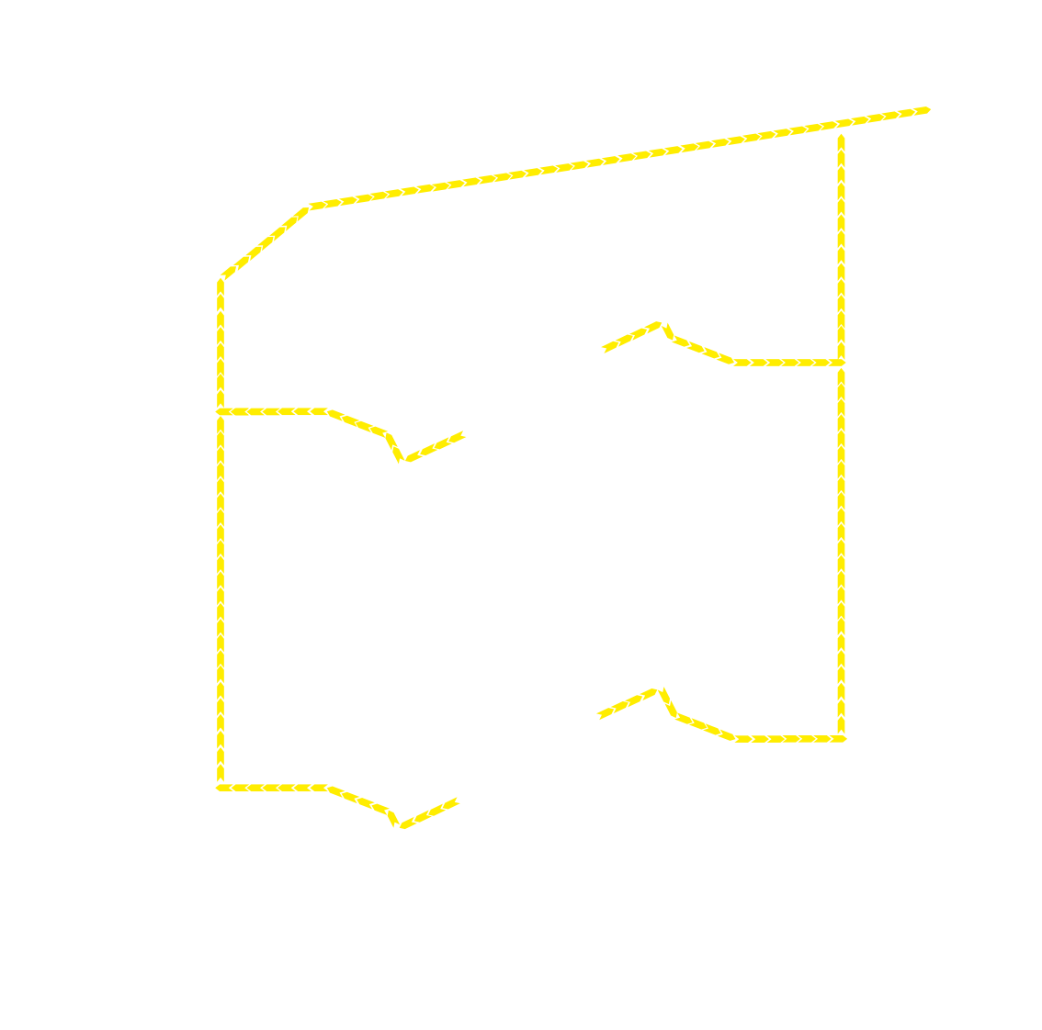

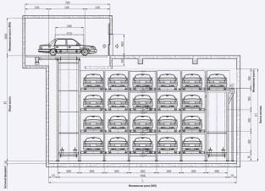







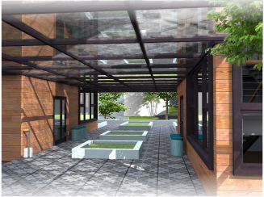

Center isledovanija
energy
AUTOMATIC PARKING
=
= 320
GUEST PARKING PLACES
Separate waste collection
= 55
MODULE HOUSE
ASTANA-2017

Slide 10


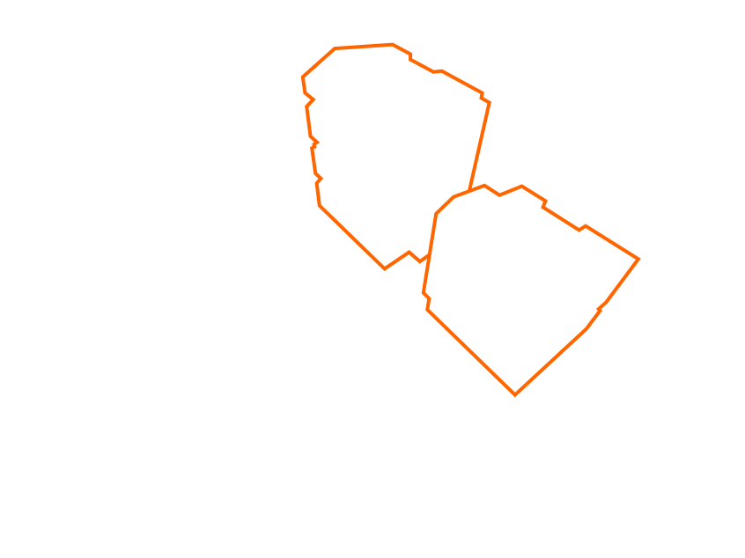
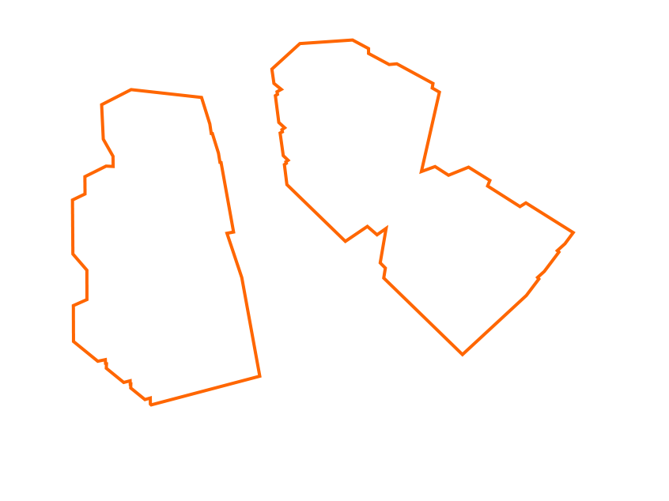
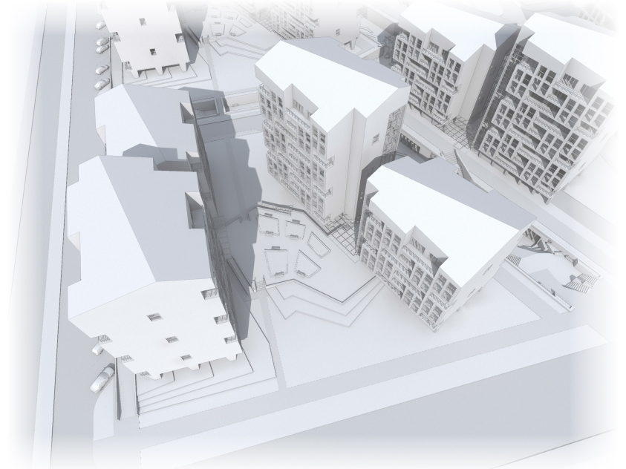

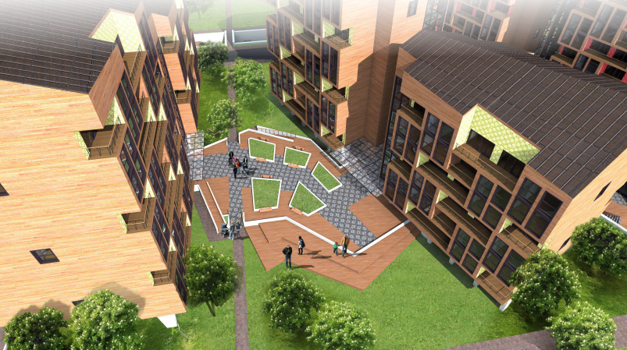

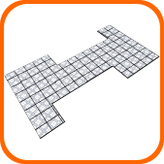
1
2
Module group
Two houses
1
2
Two sections
Common platform
Canopy
Thematic pattern
MODULE HOUSE
ASTANA-2017

Slide 11
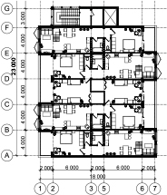


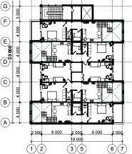



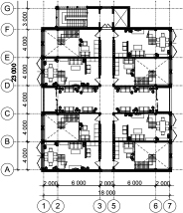

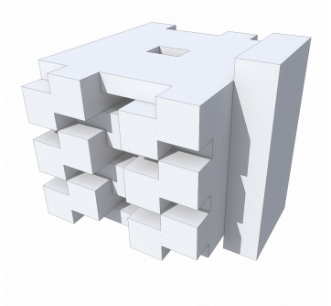
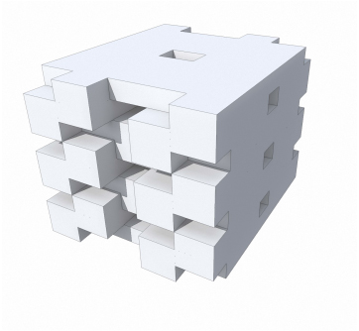
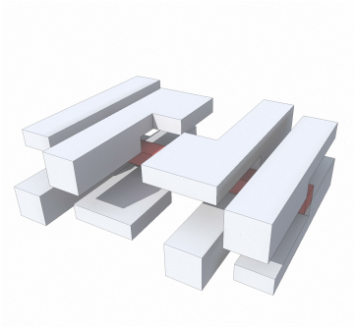
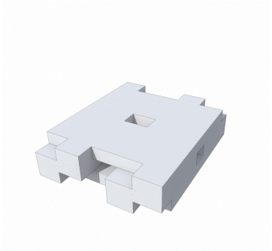
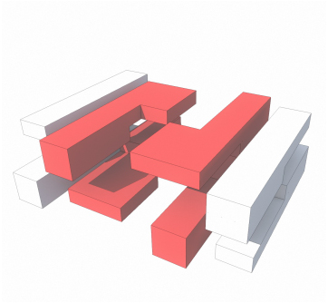
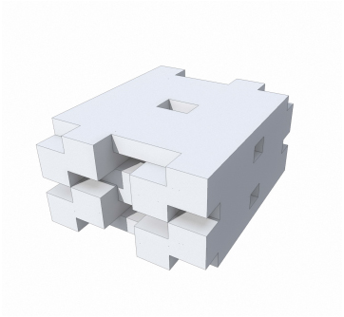
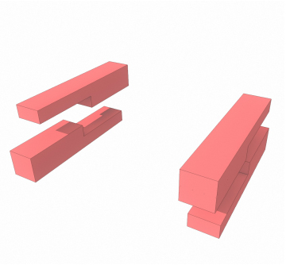


1 FLOOR PLAN
2 FLOOR PLAN
3 FLOOR PLAN
= 65,5 m2 = 160
= 320 (51,552) m2
= 95,5 m2 = 160
= 65,5 m2 = 80
= 95,5 m2 = 80
= 320 (51,552) m2
= 161 m2 = 160
MODULE HOUSE
ASTANA-2017

Slide 12
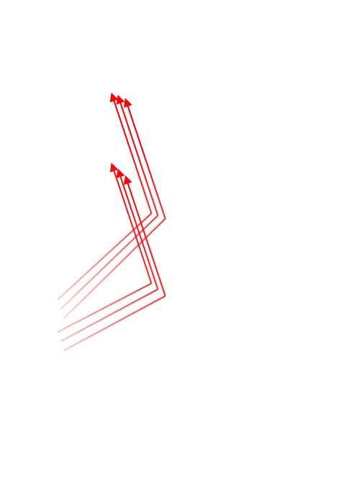


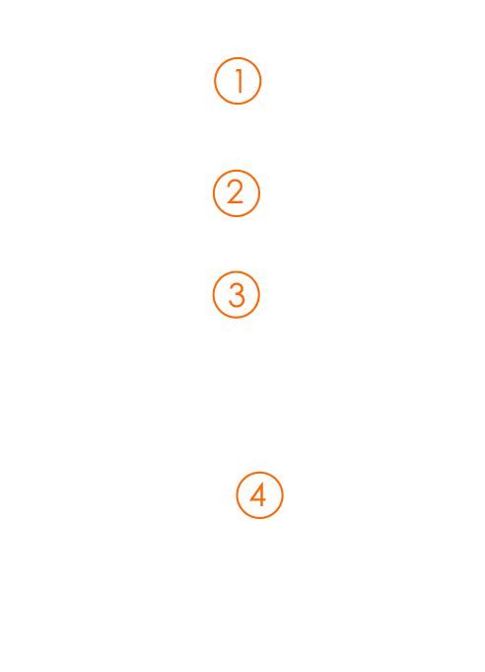
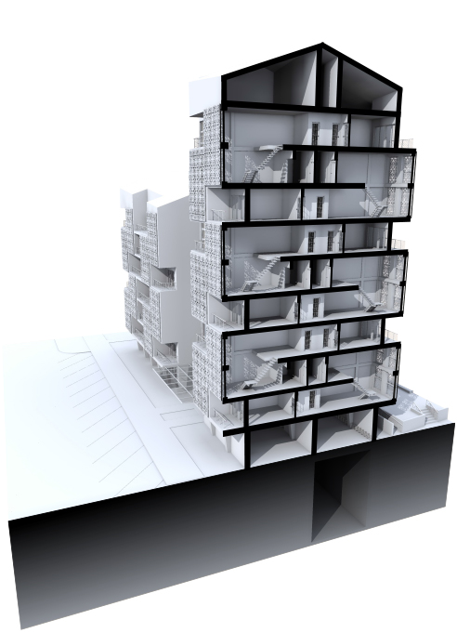


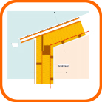
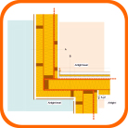


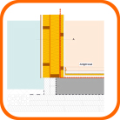
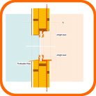



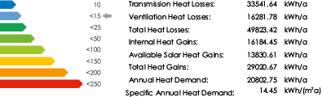
Protecting constructions building
Finishing tile of balconies
1
2
3
4
Heat Demand Calculations
MODULE HOUSE
ASTANA-2017

Slide 13








System solar cells
Water treatment
system
Wind generator
system
Air handling system
MODULE HOUSE
ASTANA-2017

Slide 14

MODULE HOUSE
ASTANA-2017

Slide 15



MODULE HOUSE
ASTANA-2017

Slide 16
Thank
you for your attention

