Slide 1

Modification of the Apex Seal Design
in a Rotary Engine
using Computational Fluid Dynamics
and Stress Analysis
Ayan Raikhan
Sagyndyk Bolat
Sanzhar Daniyarov
2023-24 ENG 400 Capstone Project in Mechanical and Aerospace Engineering
Supervisor: Desmond Adair
Co-Supervisor: Yong Zhao
Thursday, 02/05/2024

Slide 2
Outline
1
Introduction/Background
2
Problem statement
3
Aim and objectives
4
Methodology
5
Results & Limitations
6
Future Work & Conclusion

Slide 3
Team Composition & Distribution of Tasks
Team member | Task description
Ayan Raikhan | Literature Review, CAD, Stress Analysis Calculations
Sagyndyk Bolat | Literature Review, CAD, Computational Fluid Dynamics
Sanzhar Daniyarov | Literature Review, Design Calculations, Computational Fluid Dynamics

Slide 4
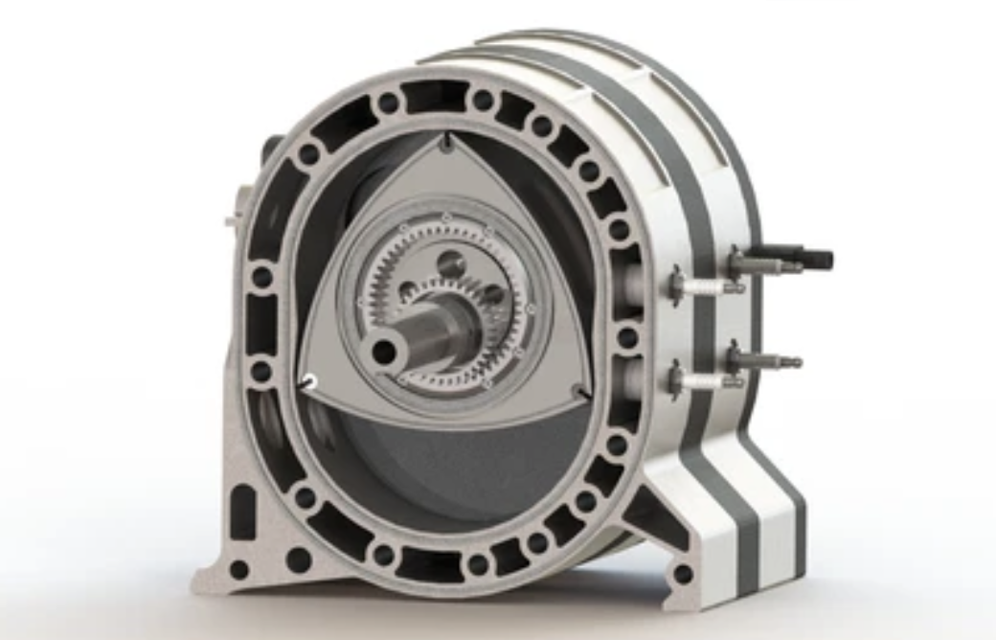
The Concept of the Rotary Engine
A rotary engine is an internal combustion engine that uses a unique design, replacing traditional pistons with a triangular rotor within an oval-shaped housing.
Figure 1. Wankel Rotary Engine (Shutterstock, n.d.)
Advantages:
High Power
Fuel Efficiency
Lightweight and Compact Design
Smooth Operation with Fewer Vibration
Applications:
Sport Cars
Motorbikes
Small, Propeller-Driven Aircrafts

Slide 5
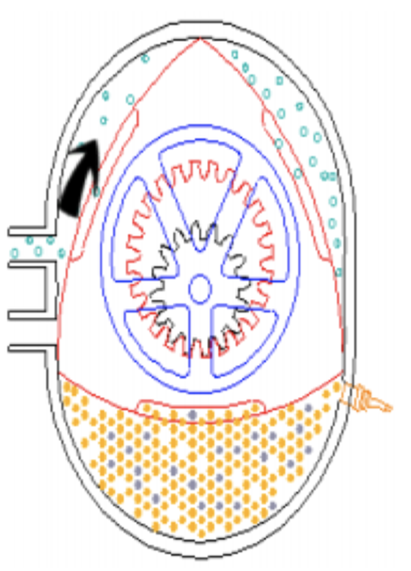
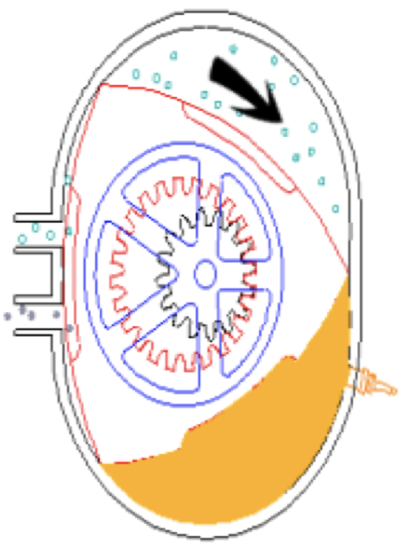
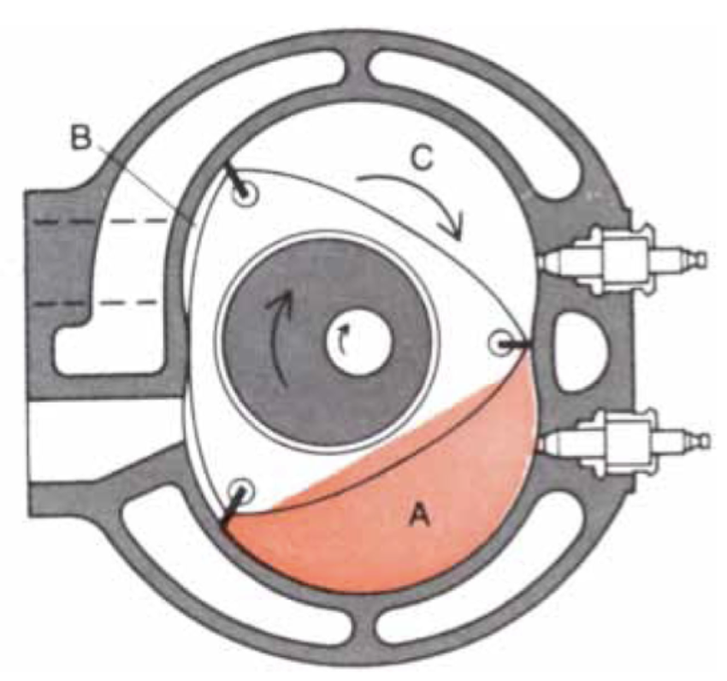
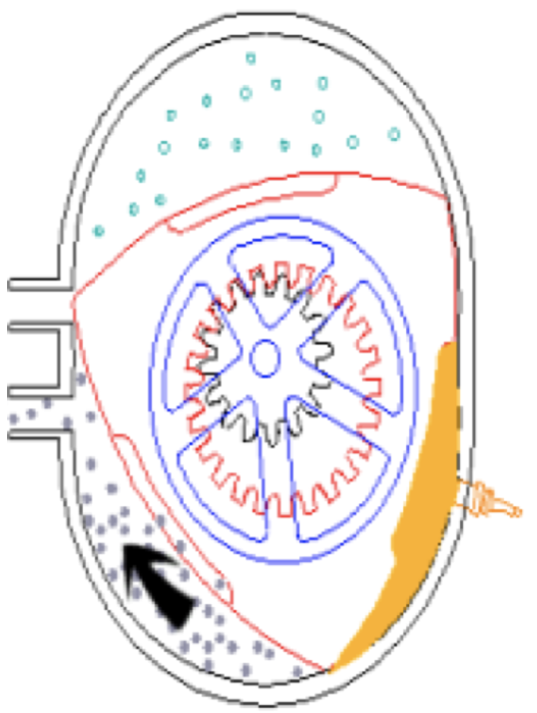
Basic working principle of the Wankel rotary engine
Intake: Fuel-air mixture enter the inside chamber.
Compression: Fuel is squeezed by moving from large volume to low volume
Ignition: The compressed fuel is exploded due to spark.
Exhaust: Almost all the combusted mixture passes through the exhaust port.
(a)
(b)
(c)
(d)
Figure 2. Intake (a), Compression (b), Ignition (c), and Exhaust (d) (Aravindan and Pamkumar, 2019 and Cole, 1972)

Slide 6
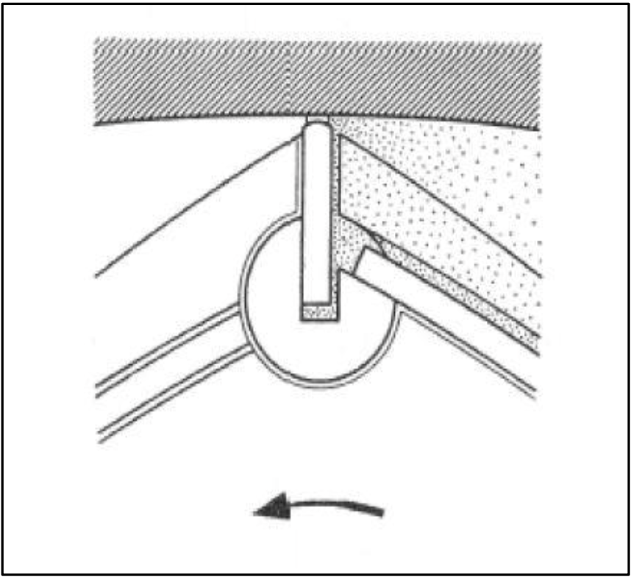
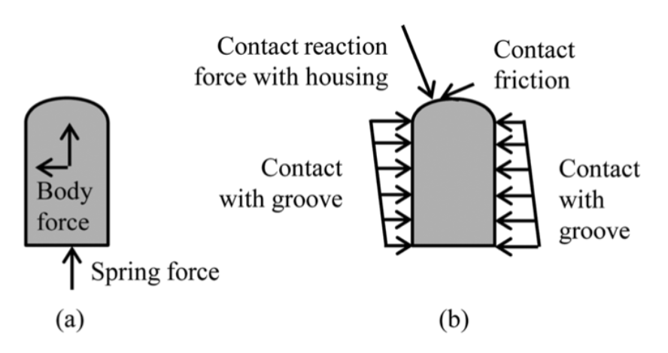
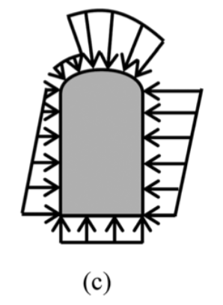
Conventional Apex Seal
Main functions:
Prevent the Stages of the Cycle from Mixing
Working Principle:
Create separation with the help of dominant forces acting on it
Figure 3.1. Conventional Apex Seal Design (Puranik & Akotkar, 2019)
Figure 3.2. The dominant forces acting on a conventional apex seal: (a) spring force and body force, (b) contact reaction forces,
and (c) gas pressure (Picard et. al, 2016)

Slide 7
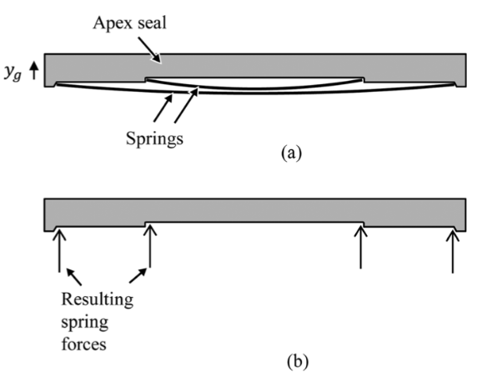
Conventional Apex Seal
In shape of parallelepiped with cuts at bottom for springs
Mainly have two springs for support
Figure 4. Apex seals with two springs: (a) springs and (b) spring forces (Picard et. al, 2016)

Slide 8
Problem Statement
Wear due to constant contact of apex seals with the surface of chamber forces the user of the rotary motor to replace them frequently. High rate of oil consumption and its negative effect on the environment due to its combustion makes it unavailable because of not being suitable for environmental standards.

Slide 9
Aim Objectives
To modificate the design of apex seals and lubrication system of Wankel rotary engine in order to increase apex seal wear resistance and improve the overall performance of the engine.
Review literatures that has an information about apex seals
Analyse shapes that can be replacement for the conventional apex seals
Create CAD model of the Wankel engine with the conventional and new apex seal
Create Ansys analysis for the conventional and new apex seal
Compare them and show its effectiveness

Slide 10
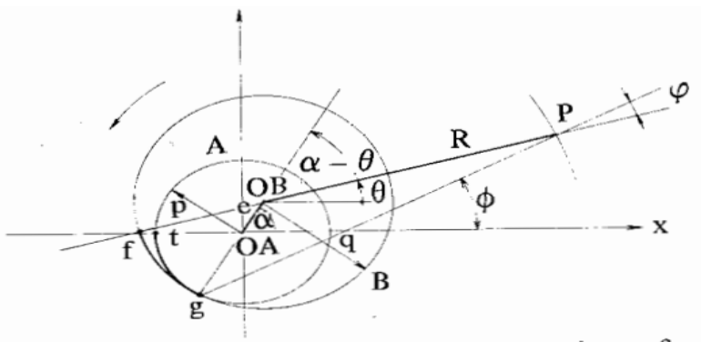
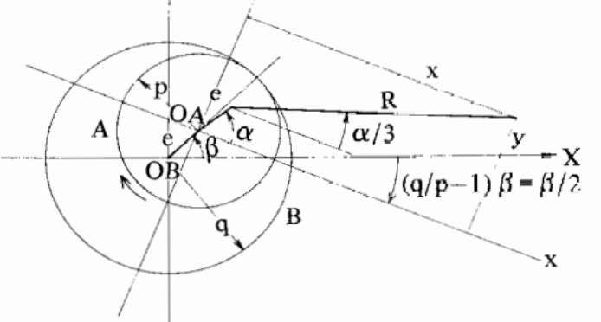
Methodology
Equation of peritrochoid.
Inner envelope of peritrochoid.
GSD_PointSplineLoftFromExcel.
Figure 5.1 Coordinate expression of the peritrochoid (Yamamoto, 1971)________
Figure 5.2 Coordinate expression of the peritrochoid inner envelope (Yamamoto, 1971)________

Slide 11

Equation of Peritrochoid
x = e*cos(α) + R*cos(α/3)
y = e*sin(α) + R*sin(α/3)
The distance (e) between the center of base circle A and that of the revolving circle B, is referred to as “eccentricity”.
The arm length R on the revolving circle B is referred to as the “generating radius” of the peritrochoid.
e and R were determined to be e=15 and R=105.
The angle α was set to go from 0 to 6π.
These values were taken from the standard dimensions of a Mazda 13B Wankel rotary engine. Equation of Peritrochoid is taken from the Yamamoto book (1971).

Slide 12
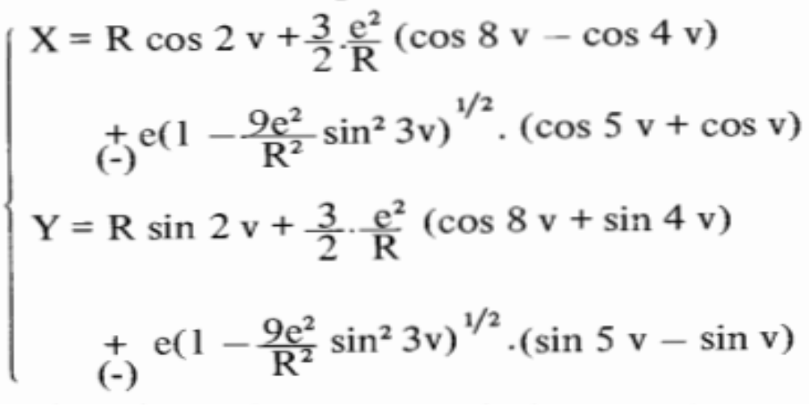
Inner Envelope of Peritrochoid
Figure 6. The equation of the envelope (Yamamoto, 1971)
The function represents a cyclic function with a period of 2π.

Slide 13
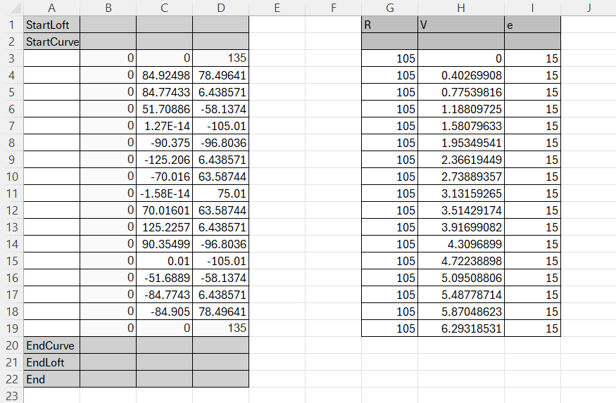
GSD_PointSplineLoftFromExcel
Figure 7. GSD_PointSplineLoftFromExcel

Slide 14
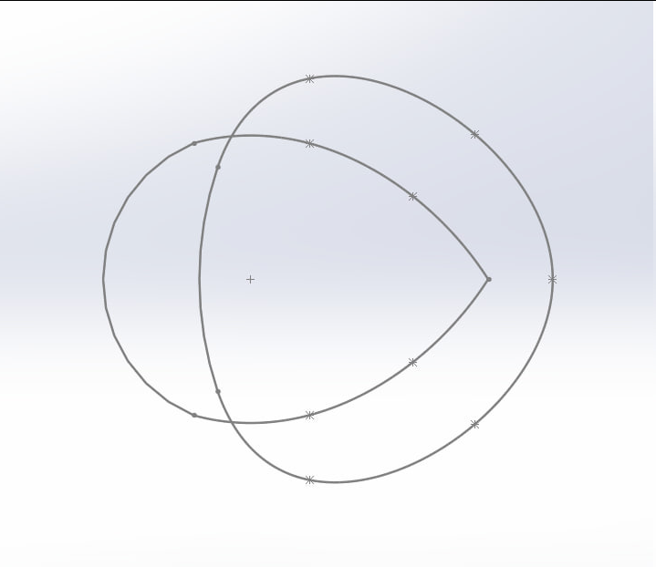
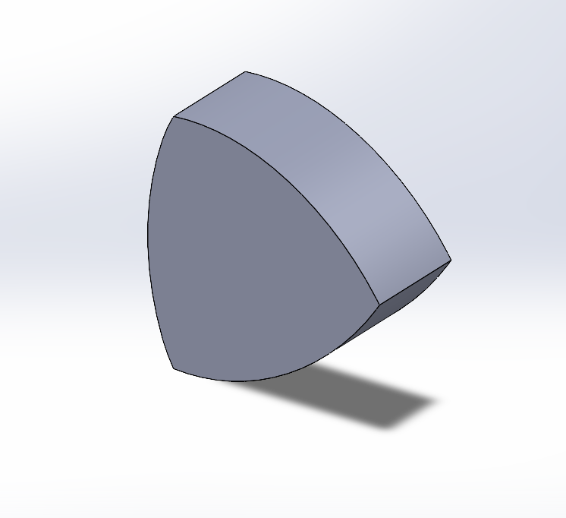
The Sketch and Boss Extrude of Rotor
Figure 8. Boss extrude of the rotor

Slide 15
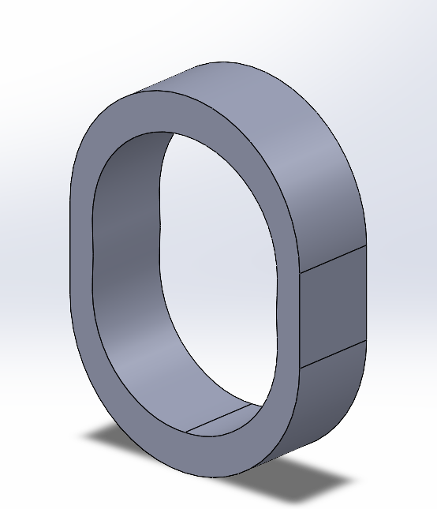
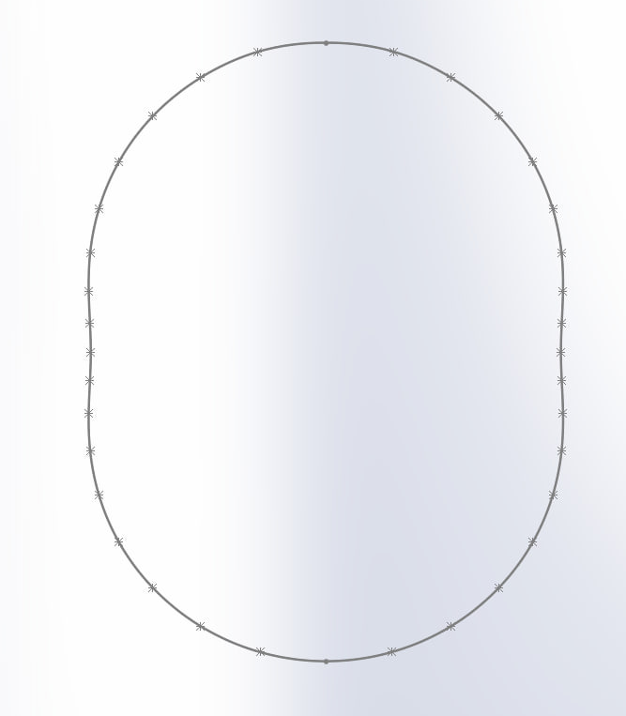
The Sketch and Boss Extrude of Housing
Figure 9. Boss extrude of the housing

Slide 16
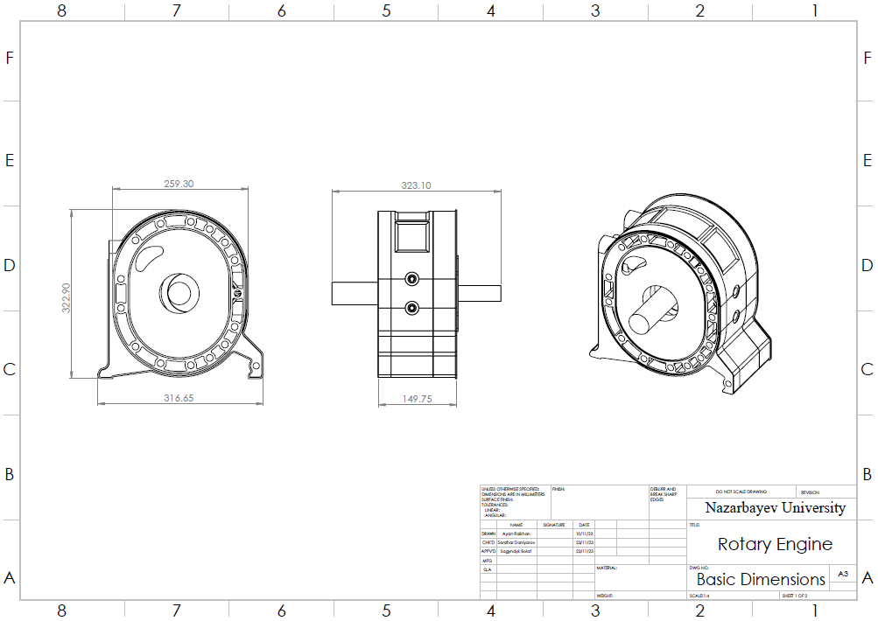
Results
Figure 10. CAD model.

Slide 17
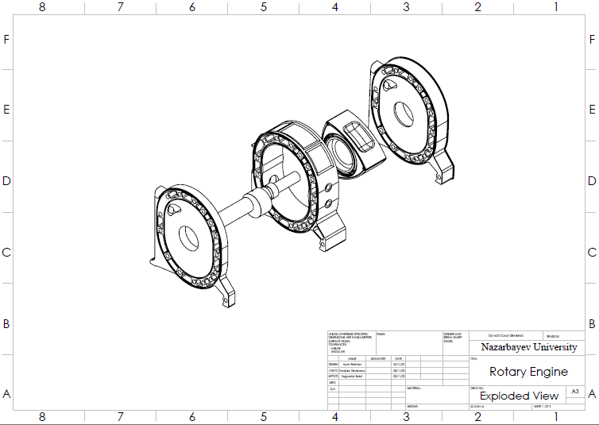
Results
Figure 11. Assembly of CAD model

Slide 18
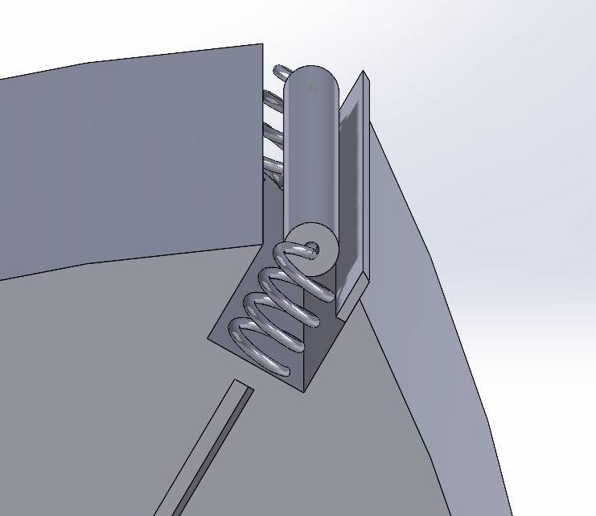
New Apex Seal Design
Figure 12. New Apex Seal Design

Slide 19
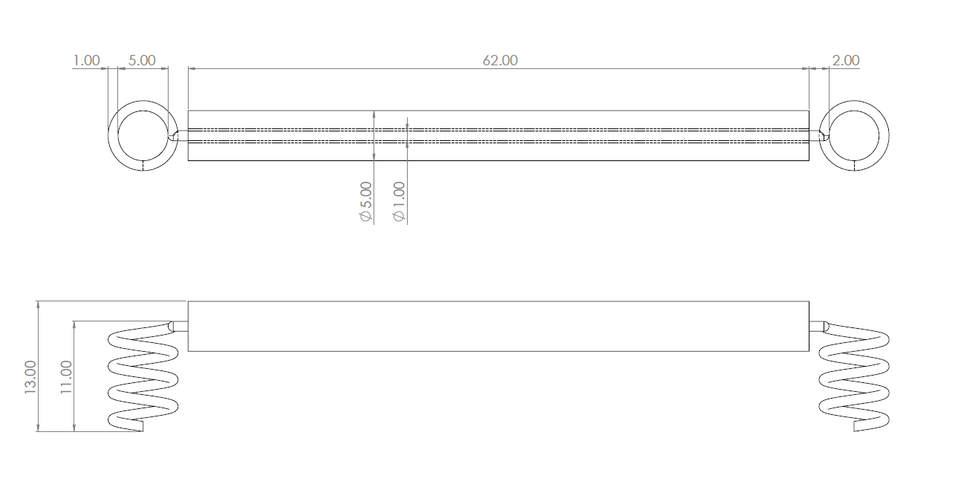
New Apex Seal Design
Figure 13. New Apex Seal Design dimensions

Slide 20
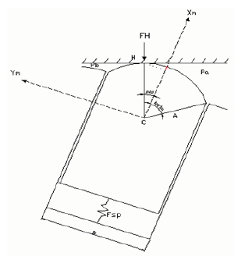
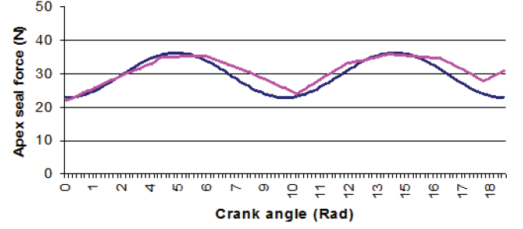
Stress Analysis of the New Apex Seal Design
Figure 14.2 Apex seal force vs. Crank angle (Gerami et al., 2010)
Figure 14.1 Major acting Force (Gerami et al., 2010)

Slide 21
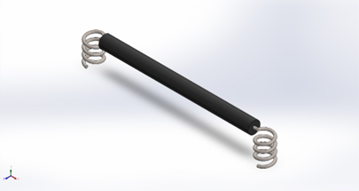
Stress Analysis of the New Apex Seal Design
Case #1 - Maximum Force
Applied Force - 35N
Fixtures - At the two loose ends
Roller Material - Cast Iron
Spring Material - Stainless Steel
Figure 15. Mesh of the proposed apex seal (35 N)

Slide 22
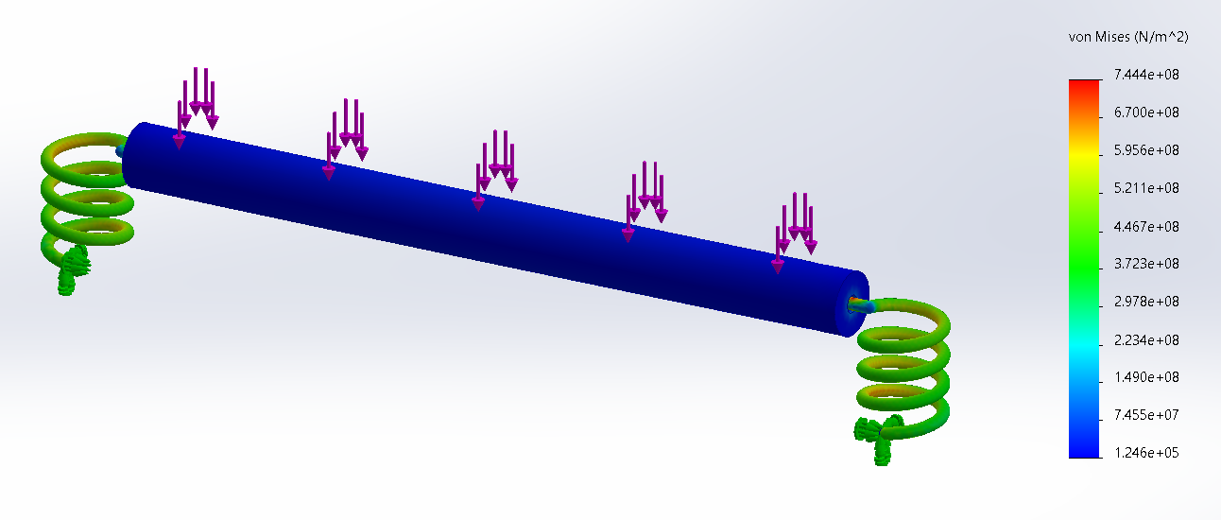
Stress Analysis of the New Apex Seal Design
Figure 16. Stress distribution (35 N)

Slide 23
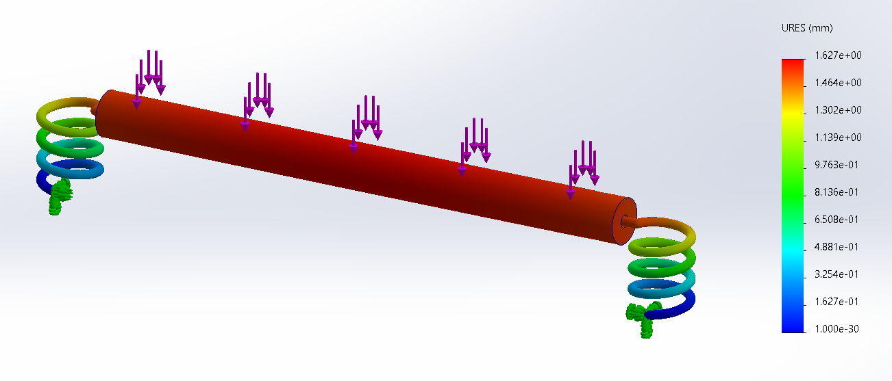
Stress Analysis of the New Apex Seal Design
Figure 17. Displacement distribution (35 N)

Slide 24
Stress Analysis of the New Apex Seal Design
Case #2 - Maximum Compression
Applied Force - 100N
Fixtures - At the two loose ends
Roller Material - Cast Iron
Spring Material - Stainless Steel
Figure 18. Mesh of the proposed apex seal (100 N)

Slide 25
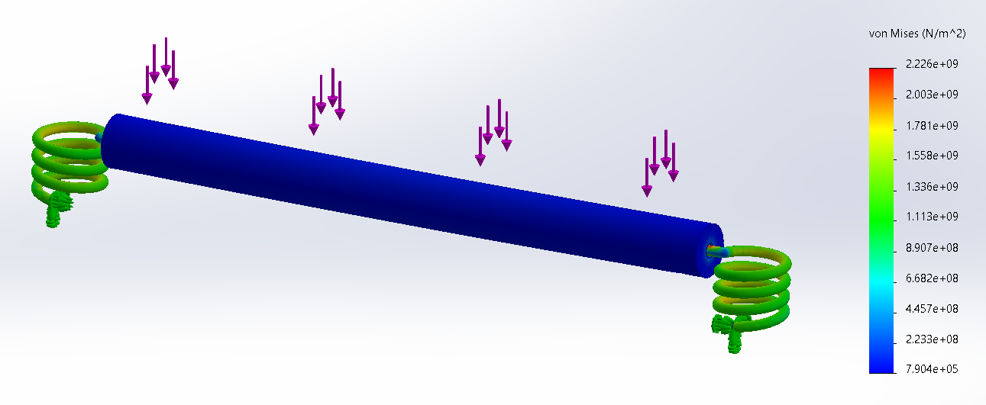
Stress Analysis of the New Apex Seal Design
Figure 19. Stress distribution (100 N)

Slide 26
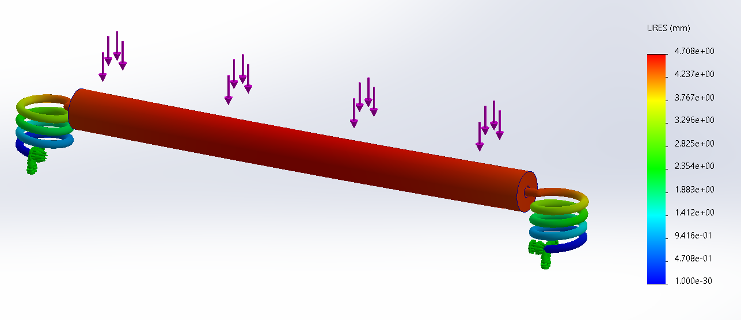
Stress Analysis of the New Apex Seal Design
Figure 20. Displacement distribution (100 N)

Slide 27
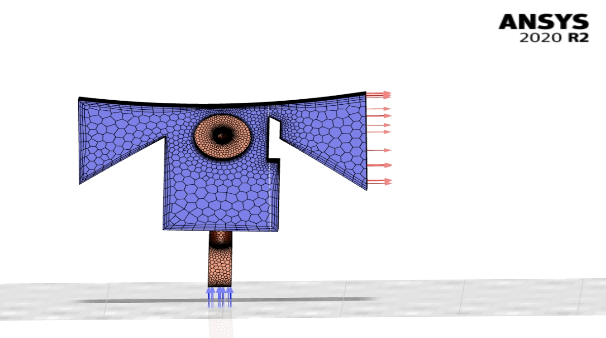
Computational Fluid Dynamics of the New Apex Seal Design
Figure 21. Mesh of the Tip of the Rotor

Slide 28
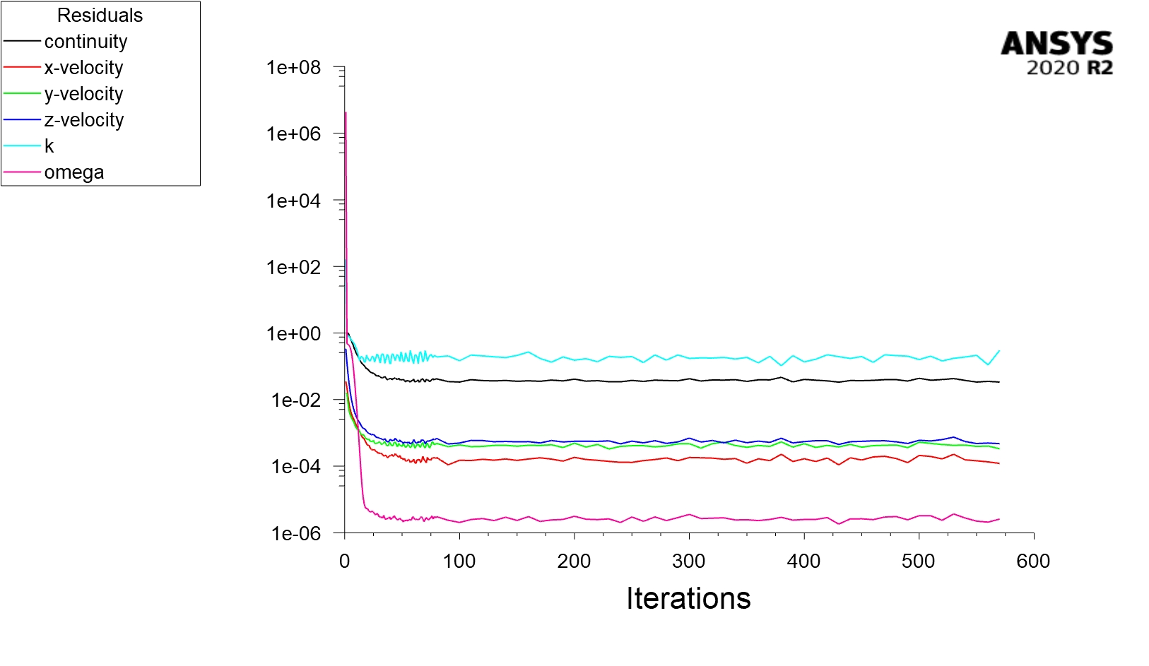
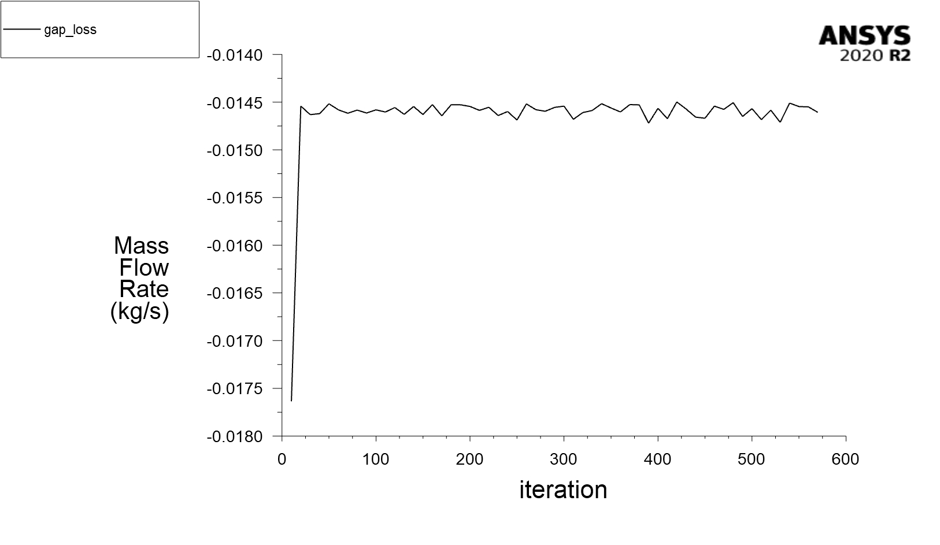
Computational Fluid Dynamics of the New Apex Seal Design
Figure 22.1. Residuals
Figure 22.2. Gap Loss Graph

Slide 29
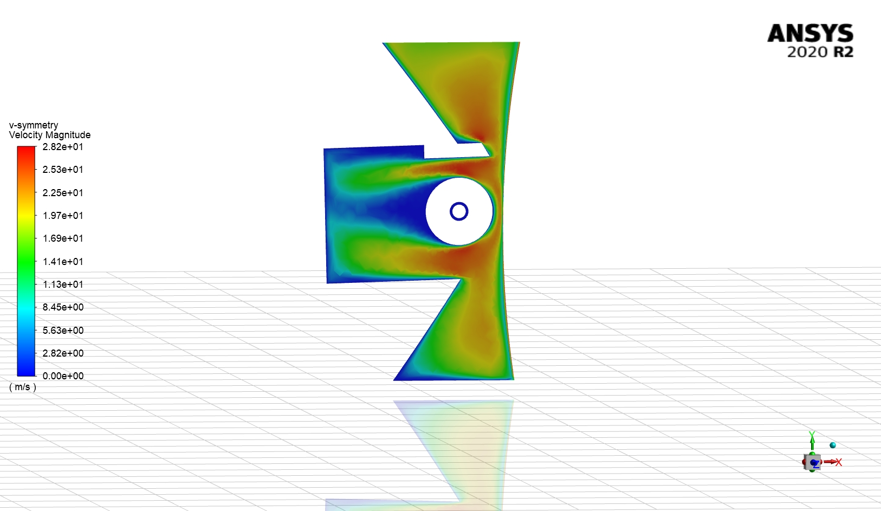
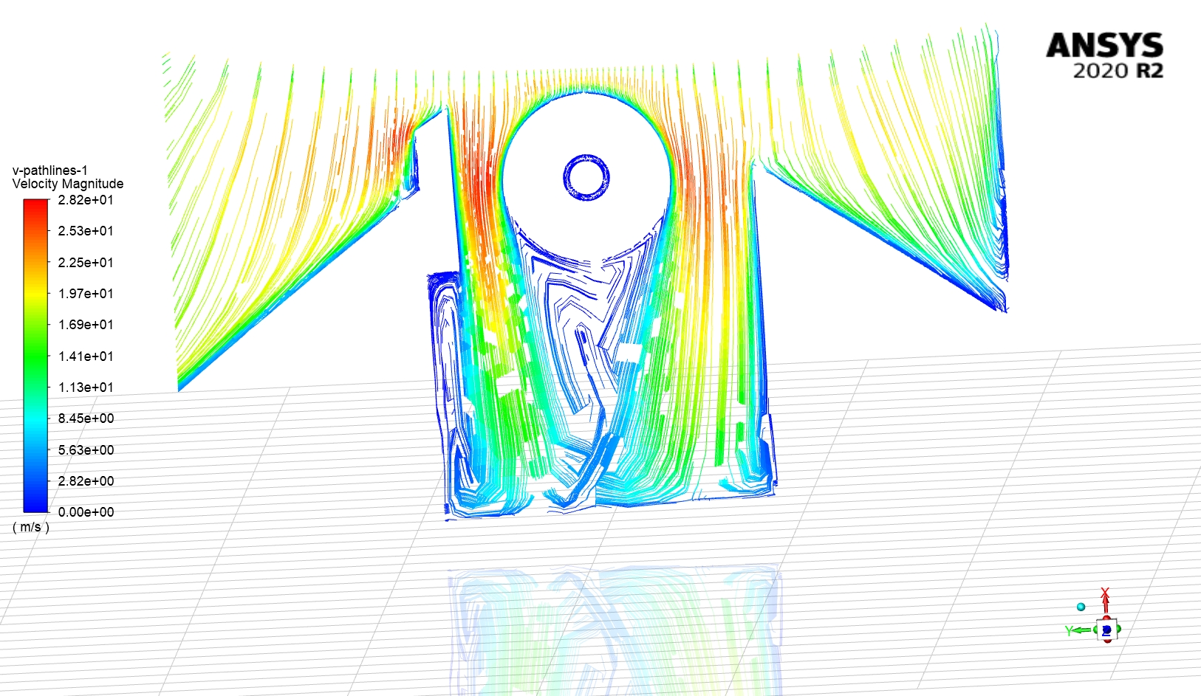
Computational Fluid Dynamics of the New Apex Seal Design
Figure 23.1. Velocity Magnitude
Figure 23.2. Velocity Streamlines

Slide 30
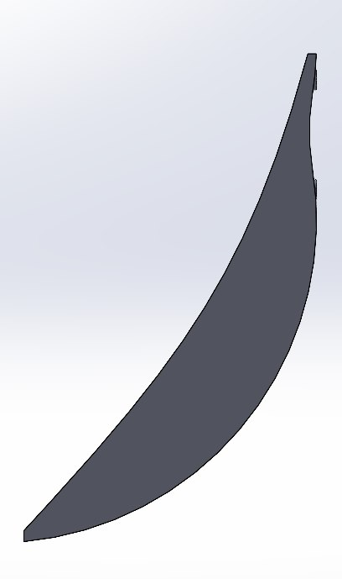
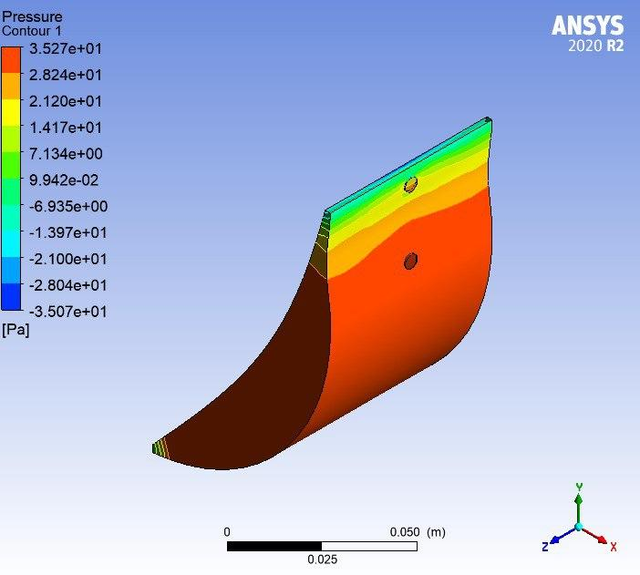
Performance of the engine with the new apex seals
Figure 24.1 Mesh of the part where ignition happens
where combustion starts
Figure 24.2. Pressure distribution of the part of the inner

Slide 31
Limitations
Lack of experience working with real automotive engines
No rotary engine itself for practical implementation

Slide 32
Future work & Conclusion
The seal inside the Wankel engine is very essential and responsible part for better fuel efficiency, proper utilization of fuel power and emission.
This project shows the possible improvement in the design of the seal for Wankel engine rotor which will serve better fuel efficiency with proper utilization of oil and thus it will help to reduce the emission of the rotary engine. According to the CFD analysis the proposed lubrication system saves 80% of oil and the apex seal design is capable of withstanding significant stresses.

Slide 33
References
Aravindan, M. K., Ramkumar, N. P. (2019) “A Research Paper on Wankel Engine”. Journal of Emerging Technologies and Innovative Research (JETIR). https://www.jetir.org/papers/JETIREV06086.pdf
Cole, D. E. (1972). “The wankel engine: The demands of emission control and cost reduction are making this rotary power plant increasingly attractive for the us. automobile. its proper use probably calls for a redesign of the entire vehicle,” SCIENTIFIC AMERICAN. doi:10.1038/scientificamerican0872-14
Gerami, A.K.N., Shadloo, M., Ghasempour, M., Kimiaeifar, A. (2010). “Analysis of the Forces Acting on Apex Seal of A Wankel Engine,” Australian Journal of Basic and Applied Sciences.
Puranik, R., Akotkar, A. (2019). Dynamic sealing Design for Wankel Engines. International Journal of Advance Research and Development, 4(6), 17-21. http://dx.doi.org/10.13140/RG.2.2.27538.81606
Picard, M., Tian, T., Nishino, T. (2016). “Predicting gas leakage in the rotary engine - part 1: Apex and corner seals”. Journal of Engineering for Gas Turbines and Power. doi:10.1115/1.4031873
Shutterstock [Online image]. (n.d.). https://www.shutterstock.com/image-illustration/rotary-wankel-engine-spark-plug-piston-1609239667
Yamamoto K. (1971). Rotary Engine. Toyo Kogyo CO. LTD. https://www.academia.edu/45641685/Rotary_Engine_by_K_Yamamoto_version_of_1971_

