Slide 1


Libraries and Women Empowerment:
Advancing Women and their Stories for
Planet 50–50 by 2030
Yelizaveta Kamilova

Slide 2
Objectives
to increase awareness on the role and achievement of women;
discuss ways to champion causes for achieving gender equality and promoting women’s rights
promote inclusive and quality education for all sharing ideas on how to forge women’s advancement
to provide insights on programming related to SDG 4 and 5 that can be replicable for other libraries
to encourage more academic libraries to participate and advocate for socially conscious roles

Slide 3

17 Goals to transform our world

Slide 4


Slide 5

Agenda:
Panel Discussion with Mother Scholars
A Tale of Women
Celebrating Women’s Achievement: Book Display and Book Talk
Paint-Her-a-Picture

Slide 6
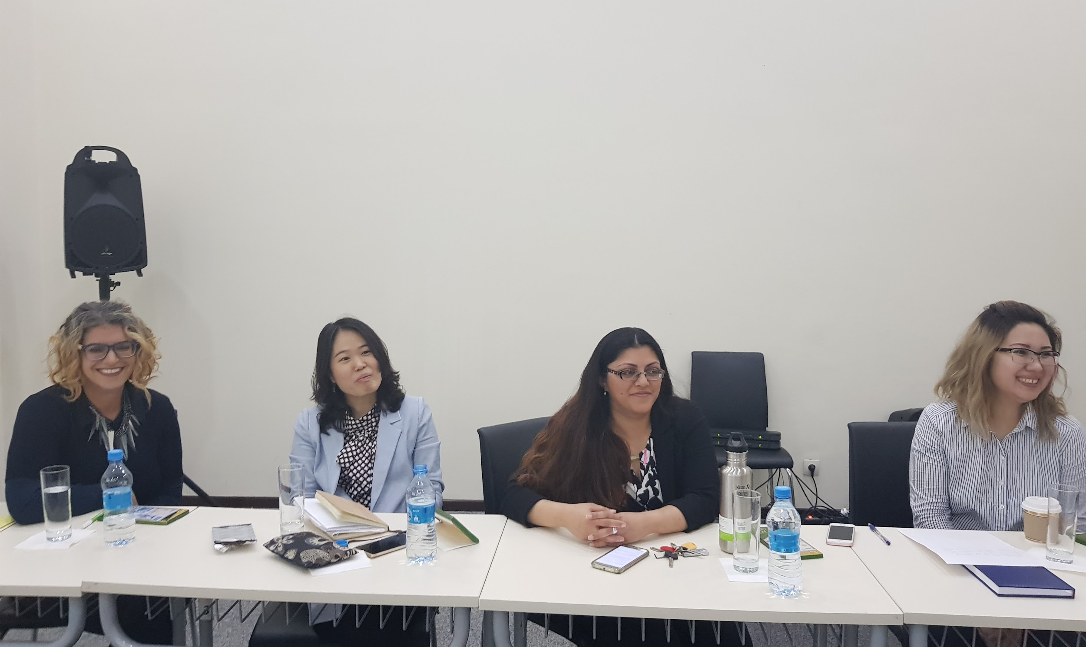
Panel Discussion with Mother Scholars

Slide 7
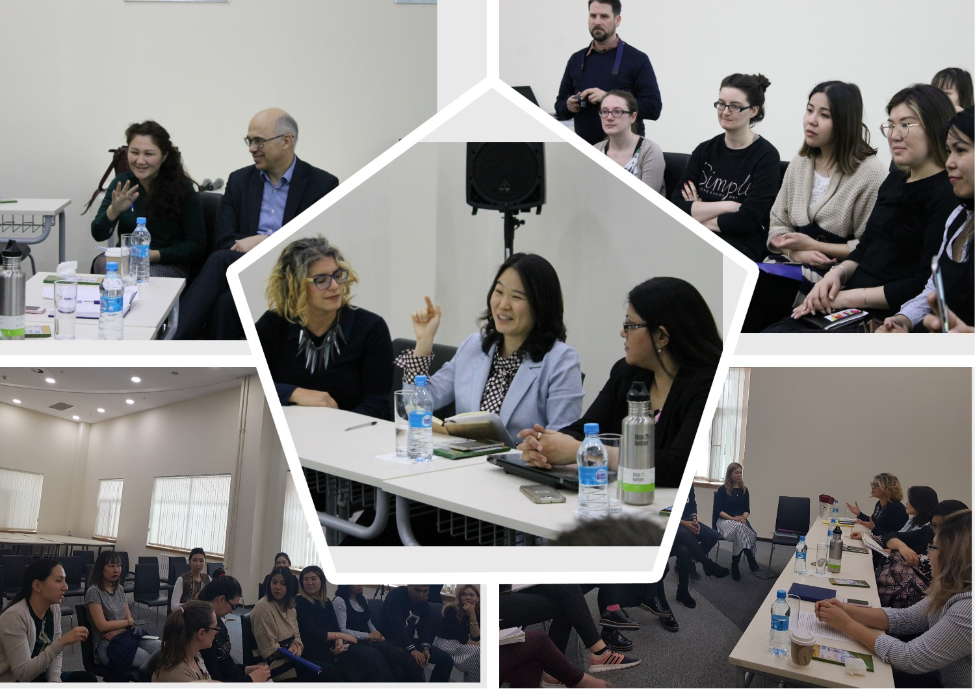

Slide 8
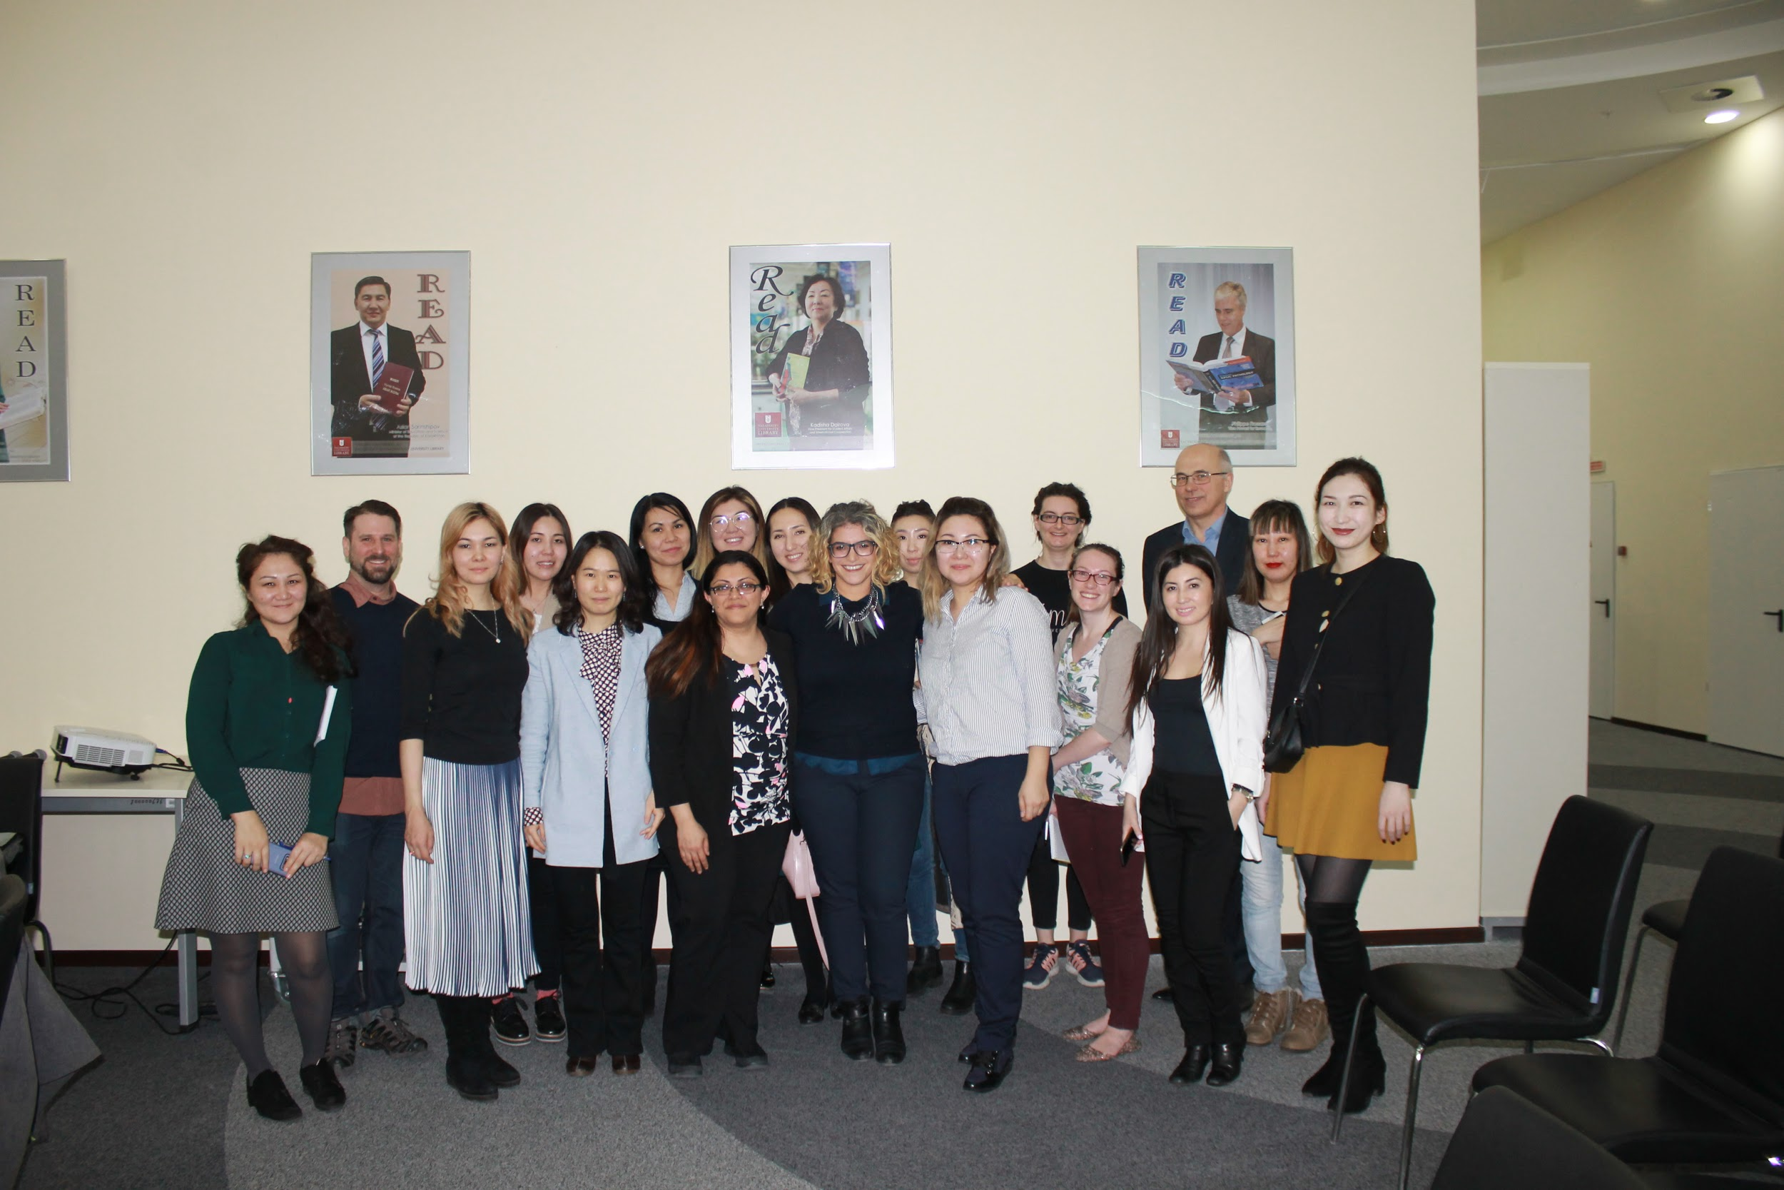

Slide 9
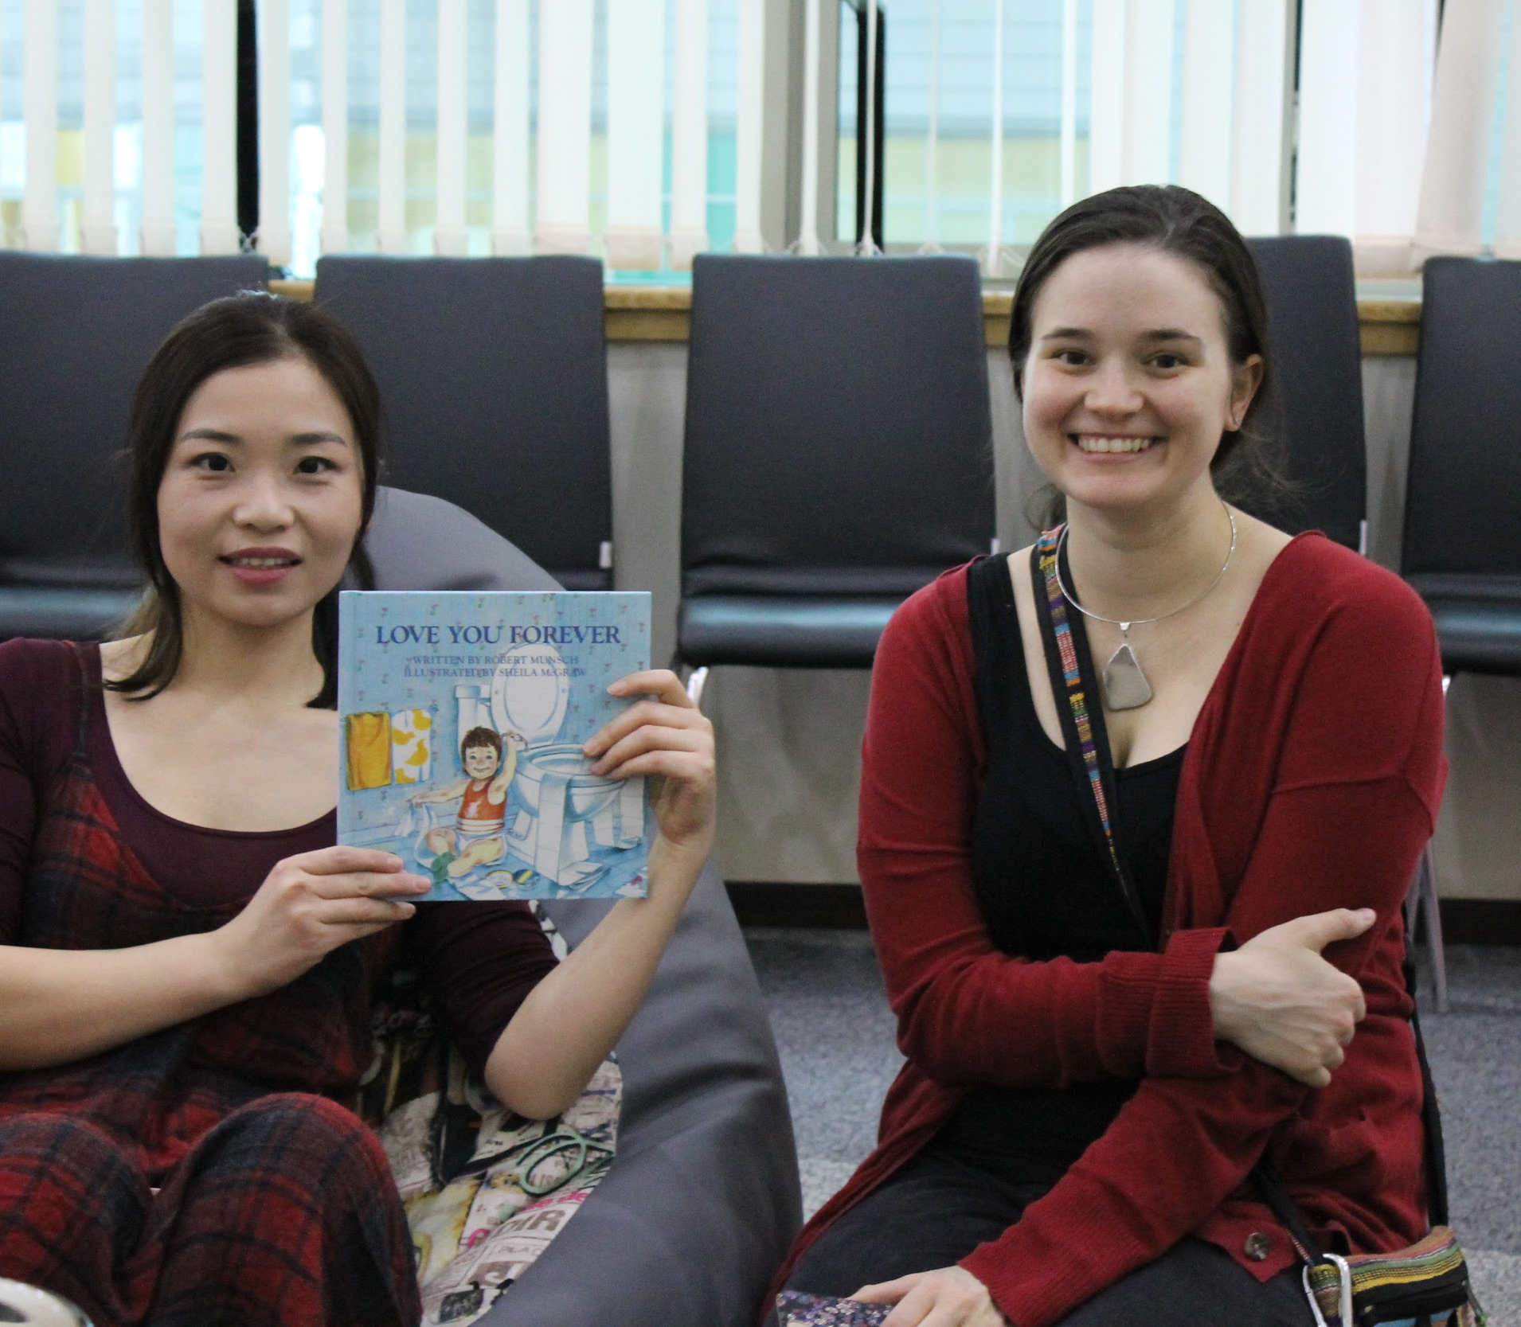
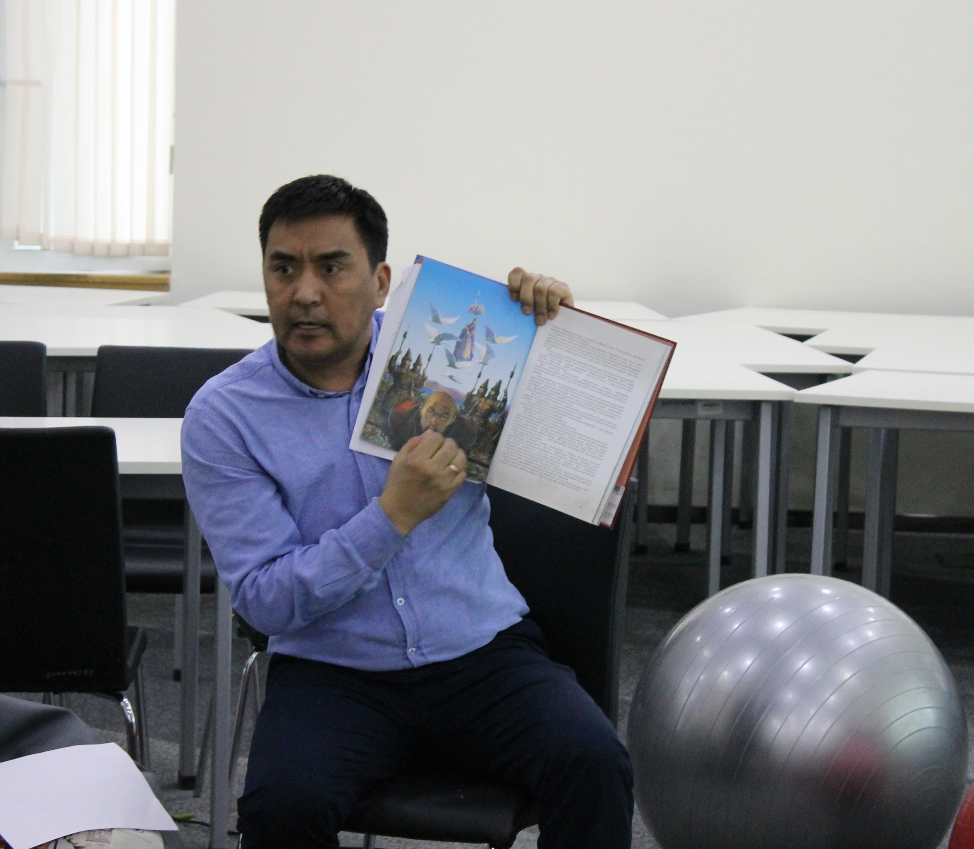
Storytelling: A Tale of Women

Slide 10
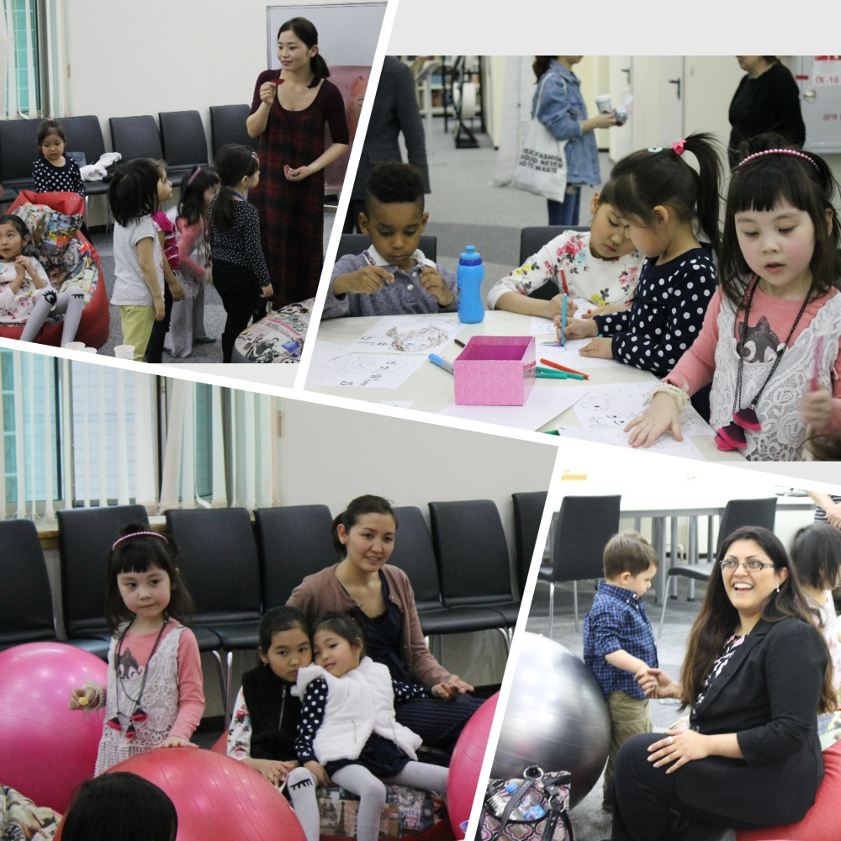

Slide 11
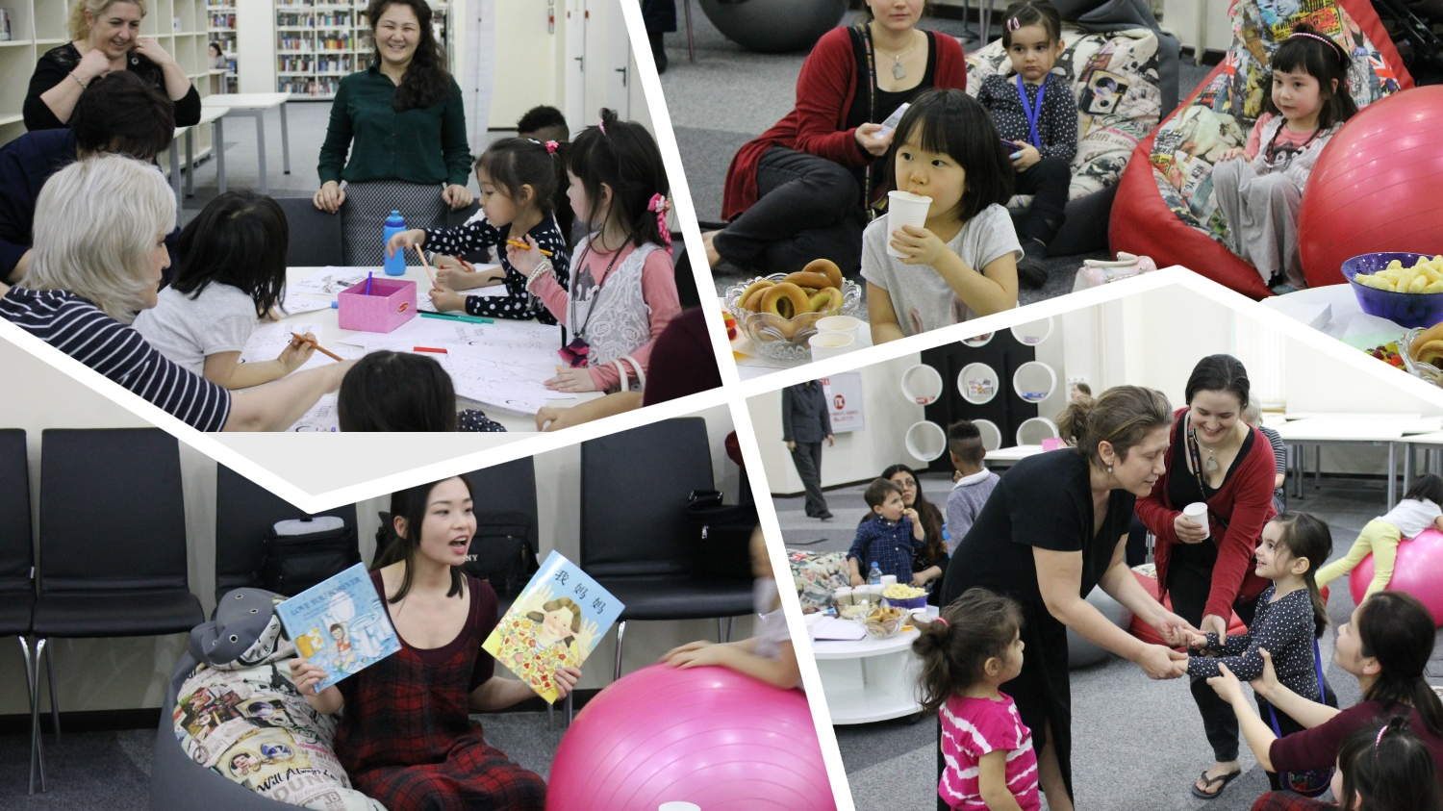

Slide 12

Celebrating Women’s Achievement

Slide 13
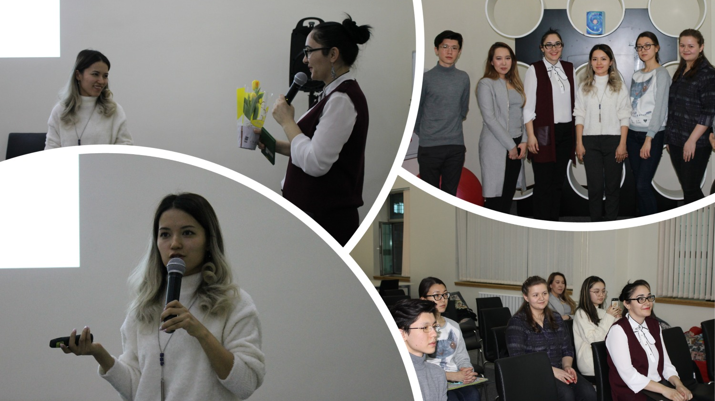

Slide 14
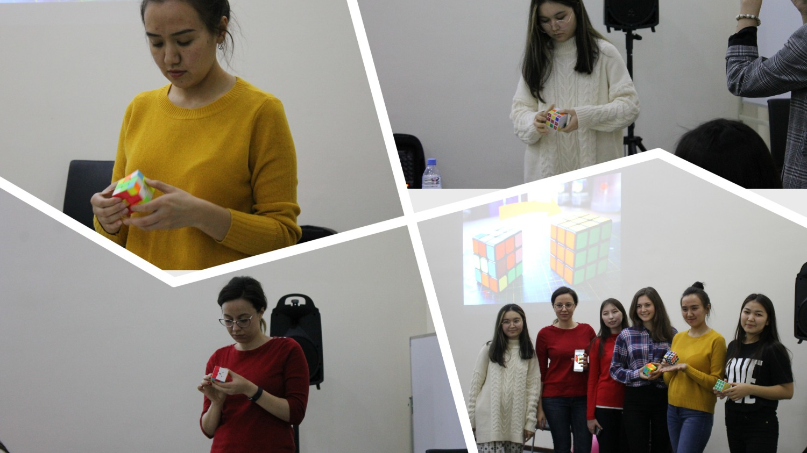

Slide 15


Slide 16
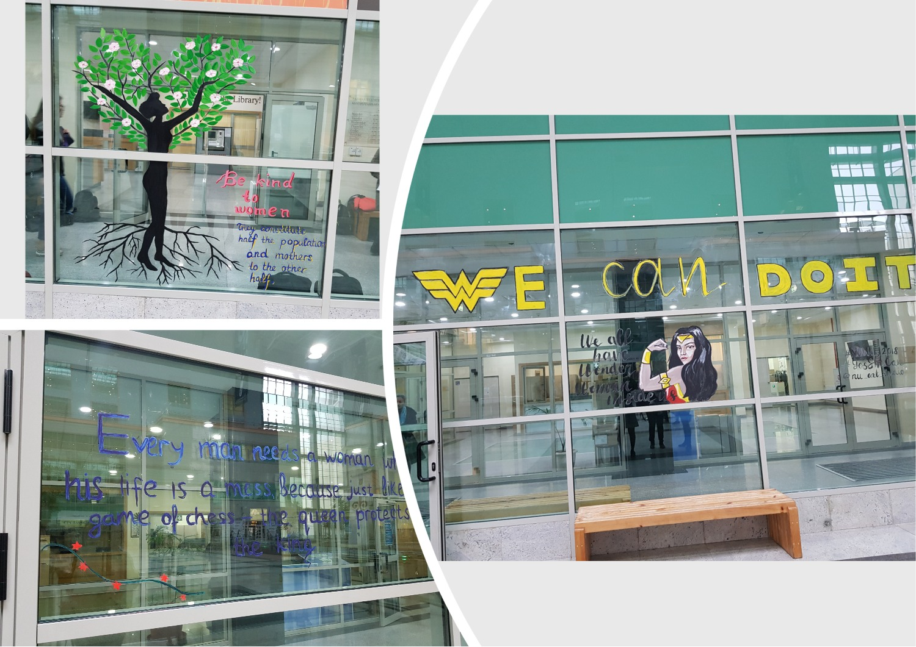

Slide 17
Contest rules
The painting must convey the theme “Women and their Stories: Advancing Progress for Planet 50–50 by 2030”
No limit on images and words but the hashtags #YesSheCan #NUWoW2018 may also be used.
Judging Criteria
Entries must meet all rules and submission criteria as stated herein to be eligible. Entries will be evaluated by a panel of judges based on the following criteria:
● Message (how it conveys the theme) – 70%
● Originality – 20 %
● Design – 10%

Slide 18
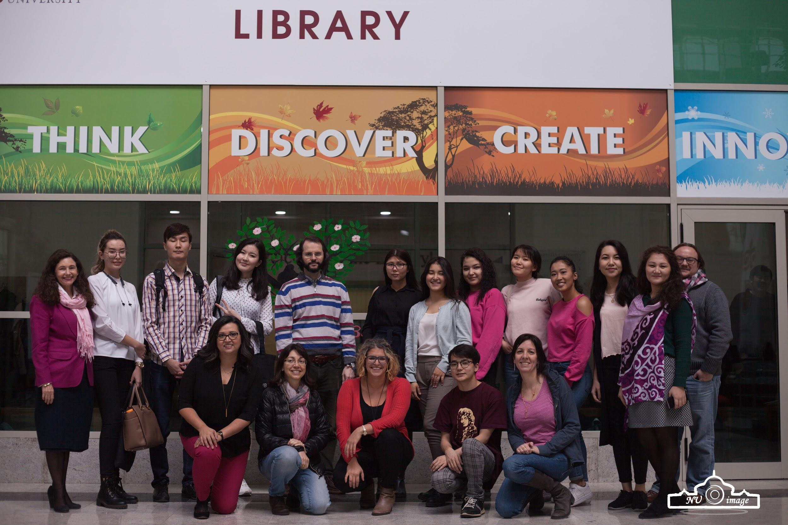

Slide 19
Letter of appreciation
Dear Liza,
Thank you for the opportunity to comment about the Week of Women and the Library’s participation. Your work with the Library provided an integral component for the week being a success. Each of the different activities, ranging from the book display and talk, to the motherscholar discussion, to the Paint Her a Picture, provided direct means to increase awareness of the role and achievement of women, seek ways to address gender equality, and promote teaching and learning relating to gender parity. As the discussant for the Motherscholar discussion, your leadership in organizing the event brought together men and women across campus to think about, to learn, and to find solutions to supporting work-life balance and university policies.
As the Library can play a central role in the University, your participation and leadership in Week of Women sends an important message throughout the campus and beyond. After two years of working with the Library for WoW we look forward to the next steps, garnering more attention and establishing additional activities and promotional events to promote gender equity.
Thank you again for all your help and we look forward to working with you soon!
All my best,
Anna

Slide 20
Thank you for your attention!
Any Questions?

