Slide 1
CRIME PREDICTION: FEATURE SELECTION AND VULNERABLE REGION DETECTION MODELS
Bekmaganbet Galym
2nd year MS student
School of Engineering and Digital Science

Slide 2

MOTIVATION
The main types of challenges are:
Crimes are investigated post-factum whereas proactive measures are VITAL.
There is not one universal ML prediction and classification technique.
No research in this field have been made regarding Kazakhstani data.

Slide 3

AIM AND PROPOSED SOLUTIONS
Compare existing solutions
Make parameter tuning of models to increase efficiency
Apply statistical methods to define thresholds for classification
Collect data from Kazakhstan officials and form a dataset
Determine best model for new dataset

Slide 4

EXISTING SOLUTIONS
Main prediction models based on:
Classification
Regression
Clustering techniques.

Slide 5

BASE MODELS
Decision Tree Classification
Random Forest Classification
Naïve Bayesian
K-means
Support Vector Machine

Slide 6

METRICS
Accuracy - measure the performance of every model give percentage of features that are forecasted properly among total number of features
Precision - that is calculated as number of positive features classified by the model that are positive
Recall - that gives number of positive features classified correctly by the model
F1 score - that is harmonic mean of mentioned Precision and Recall.

Slide 7
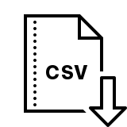
DATA SET
UCI Repository materials about crime: Community Crimes Data:
”communities-crime” (104 columns x 1993 rows)

Slide 8
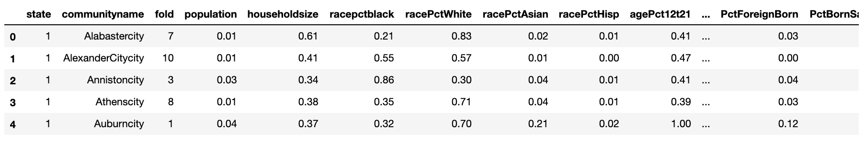
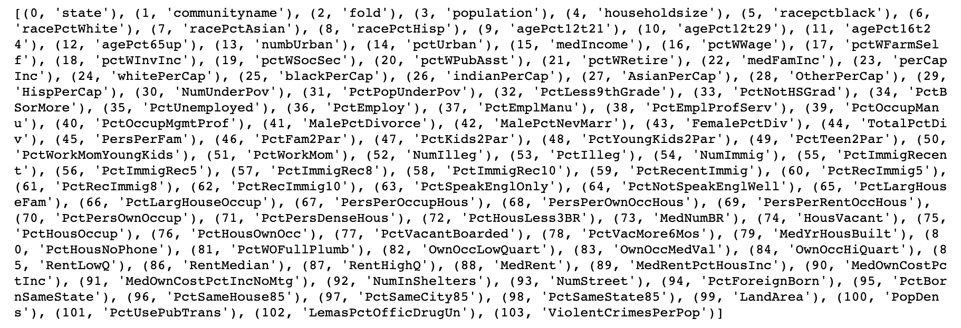
DATA EXPLORATION

Slide 9
DATA PREPROCESSING
Set a column in dataset ‘highCrime’ :
if ViolentCrimePerPopulation is > 0.1 ‘highCrime’ = True
else ‘highCrime’ = False
False 37.280482
True 62.719518
Percentage Positive Instance = 62.719518314099346
Percentage Negative Instance = 37.280481685900654

Slide 10
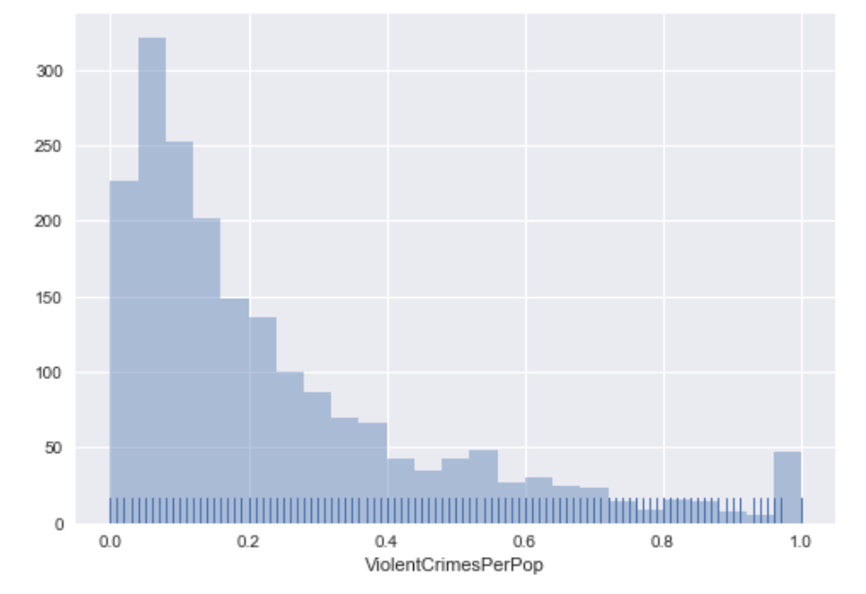
THRESHOLD DEFINING
Distribution of ‘ViolentCrimesPerPop’ displayed that:
data is not normally distributed
data is turned out to be more saturated towards 0
taking mean as threshold is not a solution
it was decided to declare median =0.15 as a threshold value

Slide 11
DATA PREPROCESSING
Set a column in dataset ‘highCrime’ :
if ViolentCrimePerPopulation is > 0.15 ‘highCrime’ = True
else ‘highCrime’ = False
False 38.380681
True 61.619319
Percentage Positive Instance = 61.619319
Percentage Negative Instance = 38.380681

Slide 12
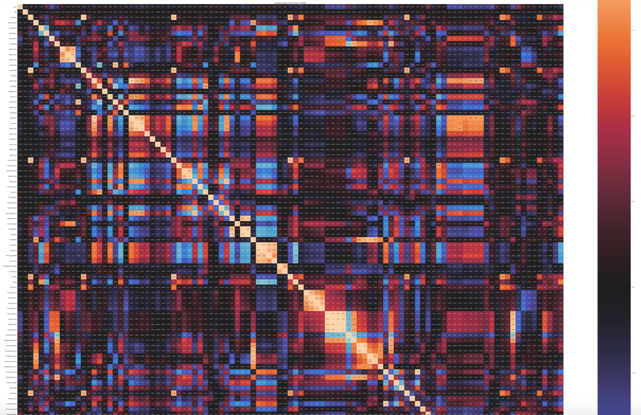
DATA PREPROCESSING
Optimal depth of TREE = 3
Analyze correlation matrix:

Slide 13
DECISION TREE CLASIFIER
dt_clf = DecisionTreeClassifier(max_depth=3)
dt_clf.fit(X,y)
#Predicting
pred_dt= dt_clf.predict(X)
dt_accuracy= metrics.accuracy_score(communities_crime_df['highCrime'], pred_dt)
dt_precision= metrics.precision_score(communities_crime_df['highCrime'], pred_dt)
dt_recall= metrics.recall_score(communities_crime_df['highCrime'], pred_dt)
Baseline model
Accuracy for DT = 75.9%
Precision for DT = 80.62%
Recall for DT = 81.53%
F1 for DT = 81,07%
After parameter tuning
Accuracy for DT = 79,8%
Precision for DT = 84,3%
Recall for DT = 83,9%
F1 for DT = 83,6%

Slide 14
DECISION TREE CLASIFIER
FEATURE RANKING
Baseline Feature ranking:
PctKids2Par
RacePctWhite
RacePctHisp
PctFam2Par
PctNotSpeakEnglWell
TotalPctDiv
MalePctDivorce
PctWorkMomYoungKids
PctIlleg
PctKids2Par (Top main feature),
FEATURE RANKING
Feature ranking after tuning:
PctKids2Par,
'racePctWhite’,
'racePctHisp’,
'HousVacant’,
'LemasPctOfficDrugUn’,
'PctEmplProfServ’,
'NumUnderPov’,
'PctPopUnderPov’,
'PctLess9thGrade’,
'PctNotHSGrad’

Slide 15
GAUSSIAN NB
Baseline model metrics
Accuracy : 77.64 %
Recall : 69.82 %
Precision : 92.53 %
F1: 79.58 %
Metrics after tuning
Accuracy : 77,8 %
Recall : 70,2 %
Precision : 92,6 %
F1: 79,85 %

Slide 16
GAUSSIAN NB
BASELINE MODEL FEATURE RANKING
Feature ranking:
NumUnderPov:
LandArea
NumbUrban:
HousVacant:
RacePctHisp:
LemasPctOfficDrugUn:
PctNotSpeakEnglWell:
RacePctAsian:
PctPersDenseHous:
FEATURE RANKING AFTER TUNING
Feature ranking:
'PctKids2Par',
'PctFam2Par',
'racePctWhite',
'PctIlleg',
'FemalePctDiv',
'TotalPctDiv',
'PctYoungKids2Par',
'pctWInvInc',
'PctTeen2Par',
'MalePctDivorce',

Slide 17
RANDOM FOREST CLASSIFIER
BASELINE MODEL METRICS
Accuracy: 88.30%
Precision: 88.30%
Recall: 84.86%
F1: 86,54%
METRICS AFTER PARAMETER TUNING
Accuracy: 87,7%
Precision: 88,4%
Recall: 87,2%
F1: 86,83%

Slide 18
RANDOM FOREST CLASSIFIER
FEATURE RANKING
Baseline model feature ranking:
PctFam2Par:
FemalePctDiv:
PctPersDenseHous
PctKids2Par:
TotalPctDiv:
Racepctblack:
PctWInvInc:
racePctWhite:
PctPopUnderPov:
MedIncome:
FEATURE RANKING
Feature ranking after tuning:
'PctKids2Par’,
'PctIlleg’,
'racePctWhite’,
'PctPersDenseHous’,
'FemalePctDiv’,
'TotalPctDiv’,
'PctFam2Par’,
'NumUnderPov’,
'NumIlleg’,
'PctTeen2Par’

Slide 19
K-MEANS
Accuracy: 53,67 %
Precision: 72,07 %
Recall: 52,24 %
F1 score: 43,91 %
NON-LINEAR SVM
Accuracy 73,85 %
Precision 79,80 %
Recall 79,35 %
F1 score 78,84 %

Slide 20
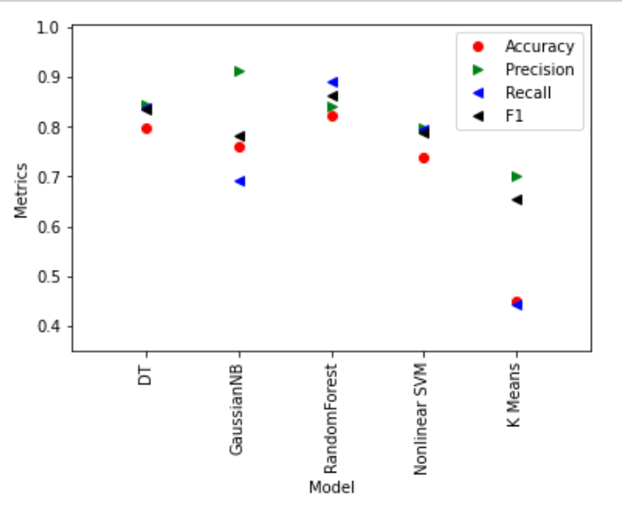
COMPARISON OF MODELS
Random Forest has optimal metrics

Slide 21
IMPORTANT FEATURES
COMMON FOR ALL MODELS IMPORTANT FEATURES:
‘PctKids2Par’,
‘racePctWhite’
COMMON FOR MORE THAN ONE MODEL IMPORTANT FEATURES:
‘NumUnderPoverty’,
‘MalePctDivorce’,
‘PctFam2Par’, ‘FemPctDiv’,
‘PctIlleg’

Slide 22
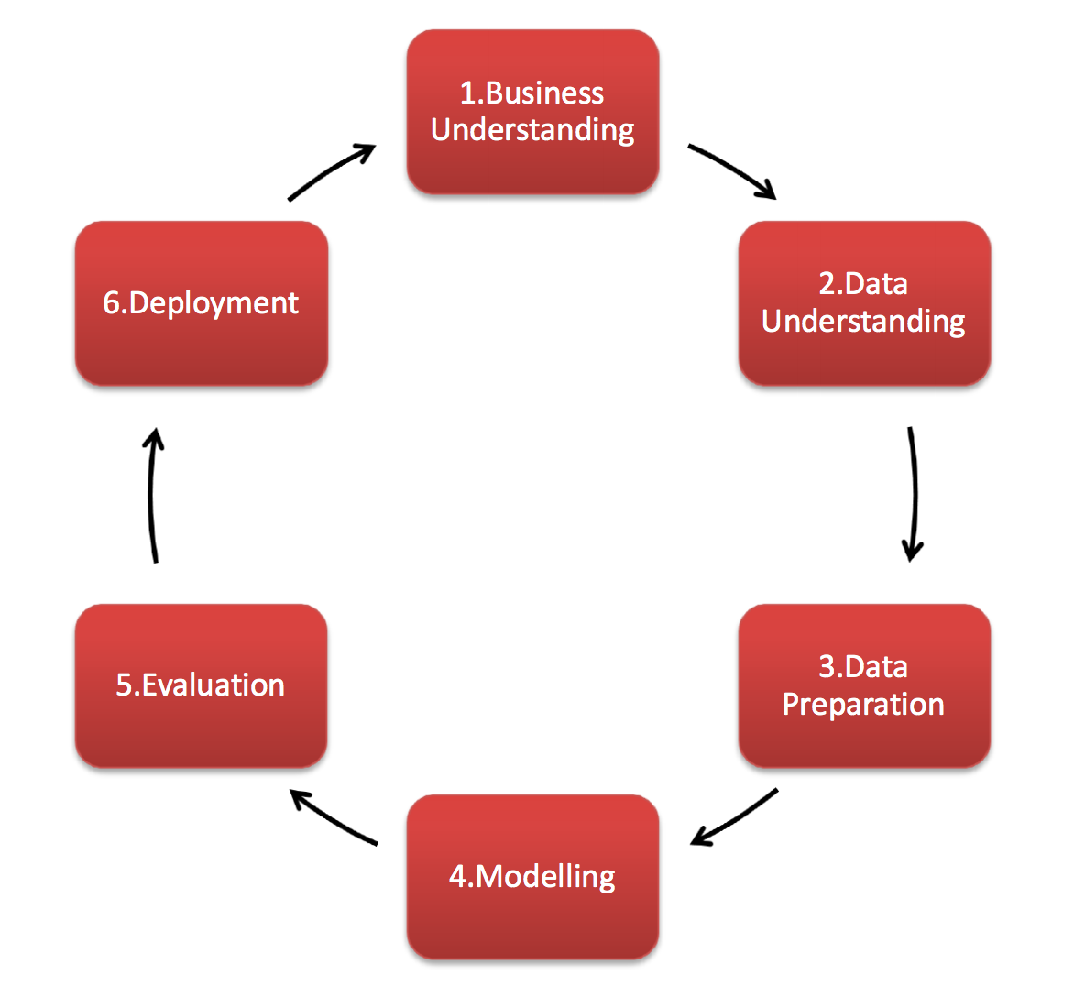
CRISP-DM

Slide 23
BUSINESS UNDERSTANDING
STATE BODIES:
1) Ministry of Healthcare
2) Ministry of Education
3) Ministry of Labor and Social Care
4) Ministry of Economics and Industrial Development
5) Ministry of Transport and Communications
6) Attorney-General's office
7) Justice Ministry
8) Statistics Committee

Slide 24
CHALLENGES
Same indicators were differently named
Some regions and periods had missing data
Databases were stored in different ways
    MS Word, Excel, CSV files
  on regular or occasional basis
  downloaded from databases (Oracle dumps)
  stored in papers in archives
  published in media
Due to COVID-19 pandemic situation many responsible people were not available
Contained wrong or incorrect information (outliers)

Slide 25
DATA PREPARATION
Replace missing values by mean value of a certain attribute (column).
Replace missing values by mean value of closest three regions.
Replace missing values by median of a certain attribute (column).
Replace missing values by median of closest three regions.
In some cases filled null values with the value of subsequent or preceding year.
Determining outliers and replacing them according to above described principle.

Slide 26
DATA SET
Kazakhstan social, economic and crime data:
”Kazakhstan Crime Data” (62 columns x 498 rows)

Slide 27
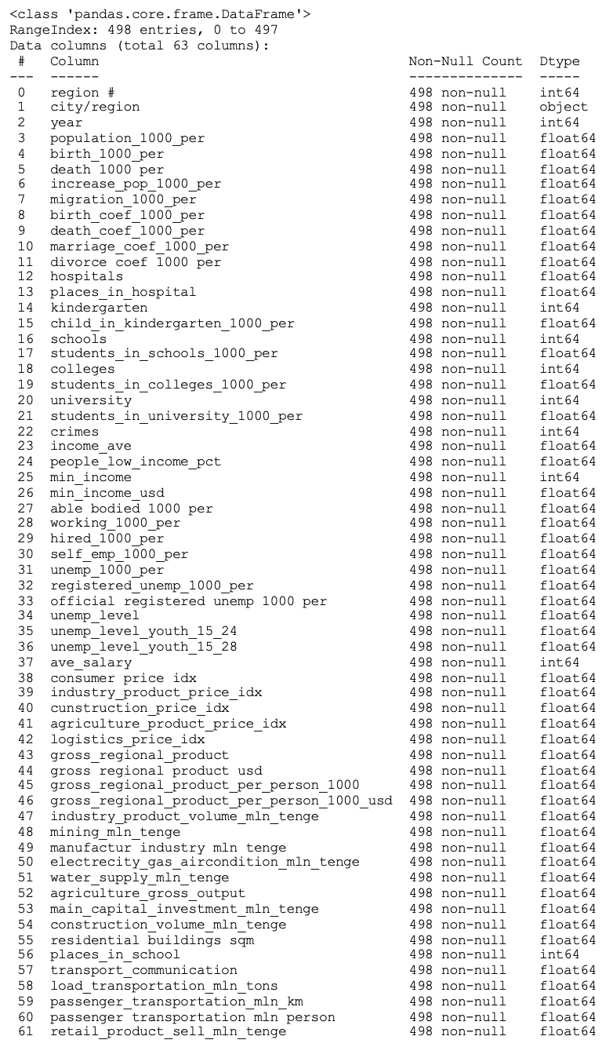
Cleaned data
(62 columns x 498 rows)

Slide 28
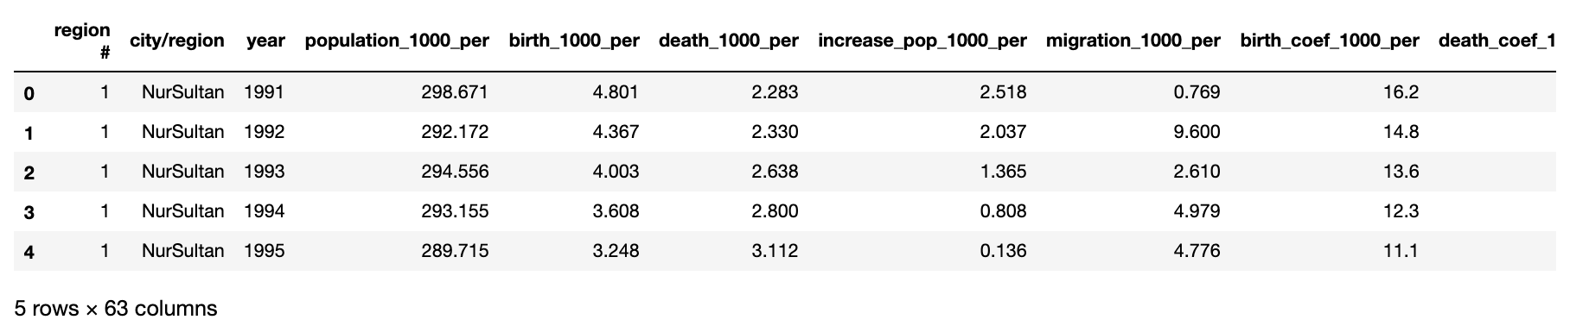
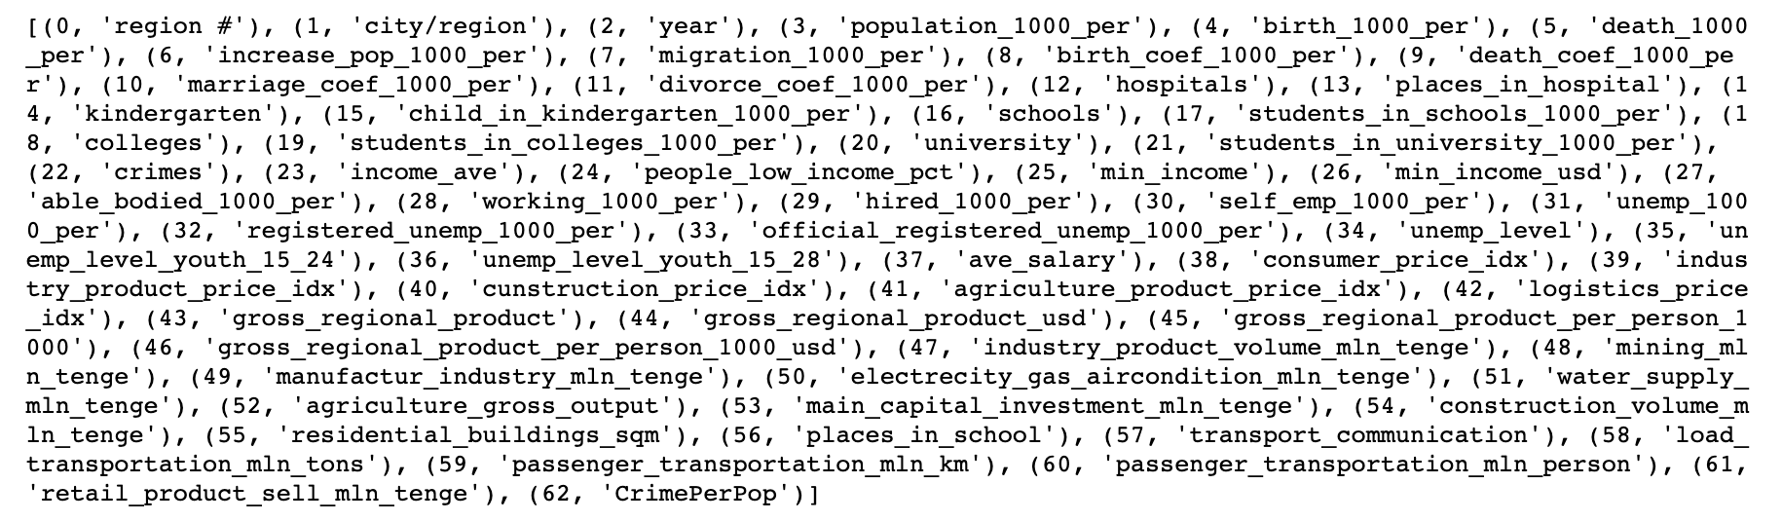
DATA EXPLORATION

Slide 29
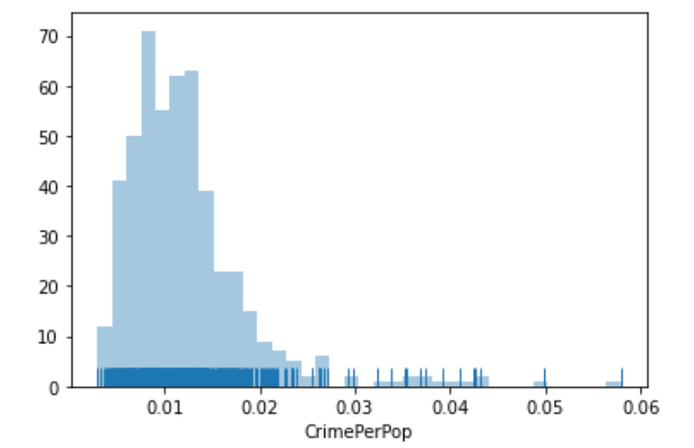
THRESHOLD DEFINING
Distribution of ‘CrimesPerPop’ displayed that:
data is not normally distributed
data is turned out to be more saturated towards 0
taking mean as threshold is not a solution
it was decided to declare median =0.109 as a threshold value

Slide 30
DATA PREPROCESSING
Set two new columns in dataset:
‘CrimePerPop’, ‘highCrime’
if CrimePerPop is > 0.109 ‘highCrime’ = True
else ‘highCrime’ = False
False 48.19
True 51.8
Percentage Positive Instance = 51.80722891566265
Percentage Negative Instance = 48.19277108433735

Slide 31
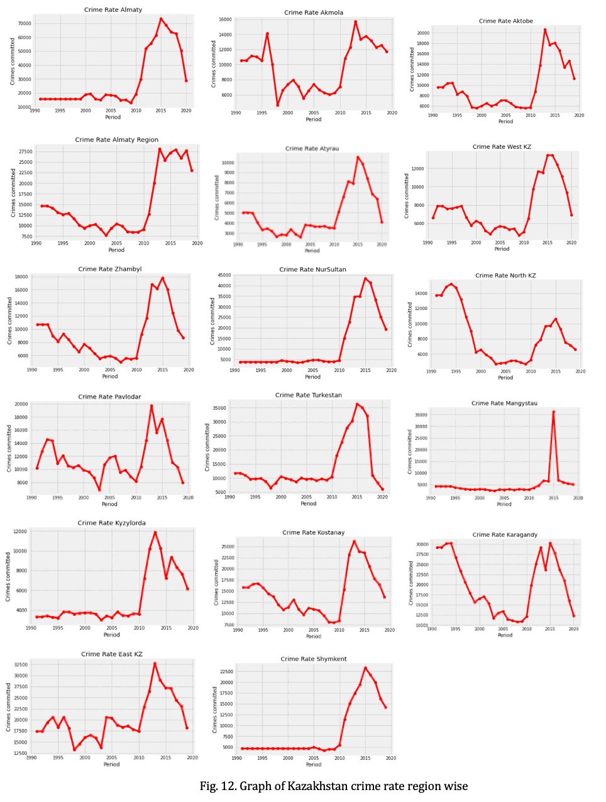
CRIME RATE DURING 1991-2020

Slide 32
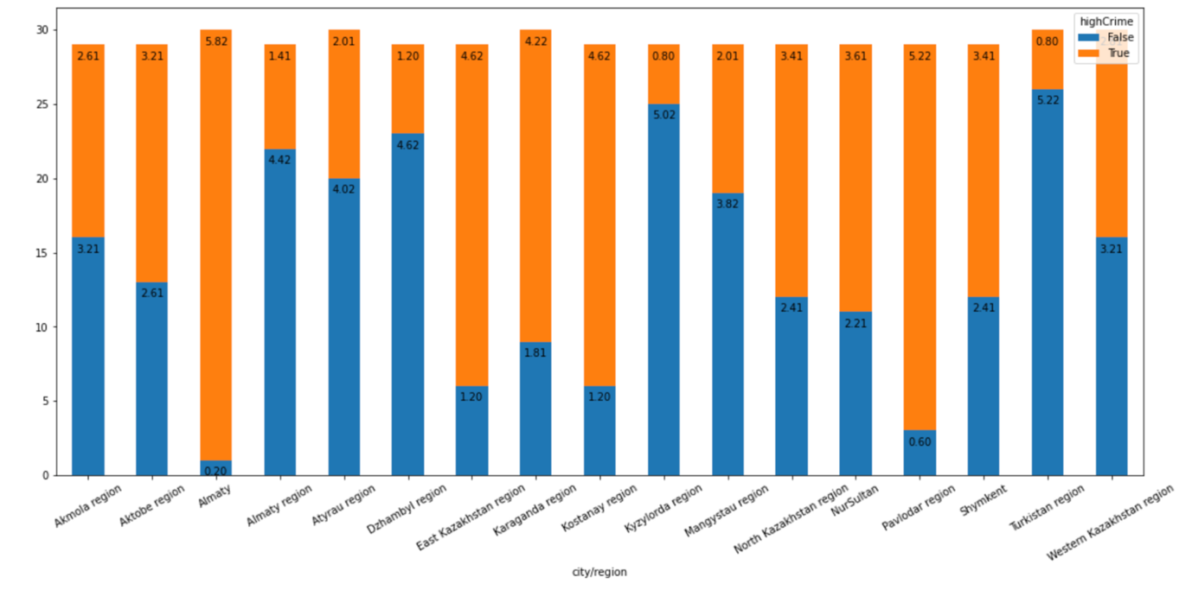
TRUE/FALSE REGION WISE DISTRIBUTION

Slide 33
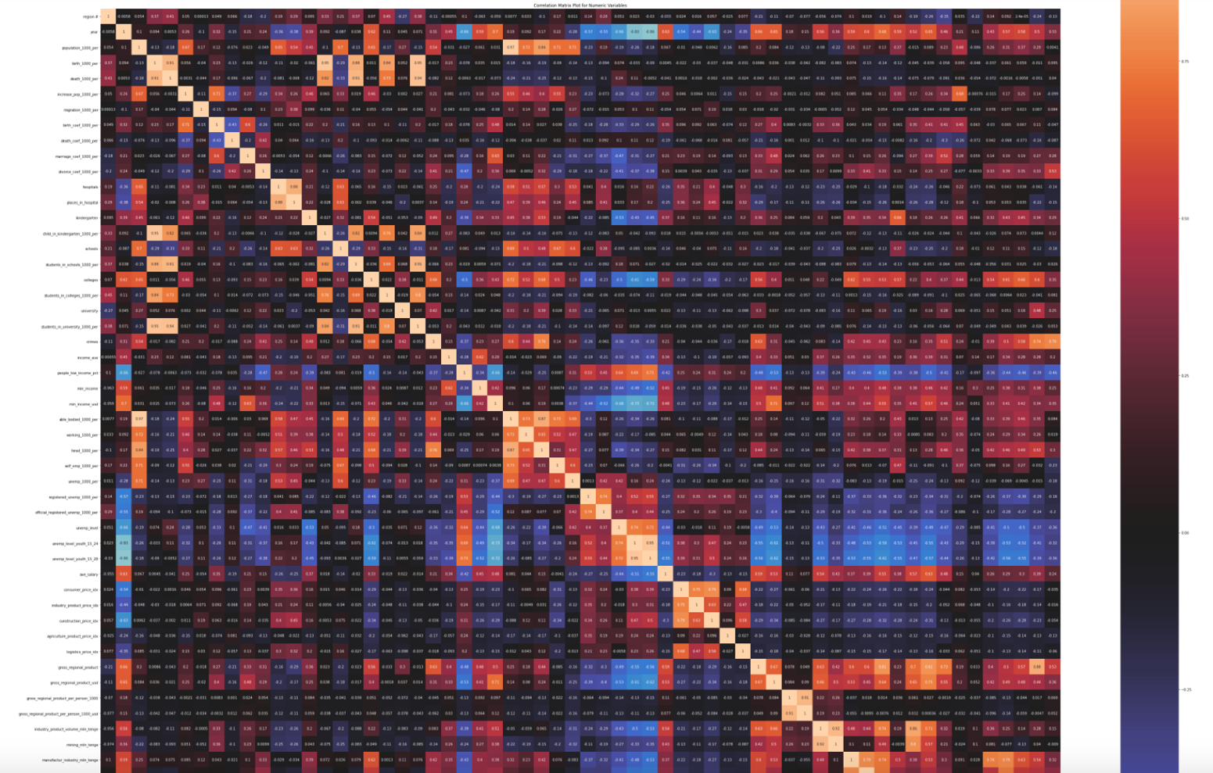
CORRELATION MATRIX

Slide 34
DECISION TREE CLASIFIER
dt_clf = DecisionTreeClassifier(max_depth=1)
dt_clf.fit(X,y)
#Predicting
pred_dt= dt_clf.predict(X)
dt_accuracy= metrics.accuracy_score(communities_crime_df['highCrime'], pred_dt)
dt_precision= metrics.precision_score(communities_crime_df['highCrime'], pred_dt)
dt_recall= metrics.recall_score(communities_crime_df['highCrime'], pred_dt)
DT metrics:
Cross Validation Accuracy DT: 0.7589387755102041
Cross Validation Recall DT: 0.7810915908741995
Cross Validation Precision DT: 0.771076923076923
Cross Validation F1 DT: 0.766483814673516

Slide 35
DECISION TREE CLASIFIER
FEATURE RANKING
'divorce_coef_1000_per',
'retail_product_sell_mln_tenge',
'students_in_schools_1000_per',
'self_emp_1000_per',
'hired_1000_per',
'working_1000_per',
'able_bodied_1000_per',
'min_income_usd',
'min_income',
'people_low_income_pct'

Slide 36
GAUSSIAN NB
GNB MODEL MATRICS
Accuracy for gaussian : 0.5677551020408165
Recall for gaussian: 0.4023076923076923
Precision for gaussian: 0.6655441840767928
Precision for F1: 0.4780096841868794

Slide 37
GAUSSIAN NB
BASELINE MODEL FEATURE RANKING
Feature ranking:
('gross_regional_product', 0.28727327787321716)
('water_supply_mln_tenge', 0.29189384283055375)
('passenger_transportation_mln_person', 0.29244806547784546)
('manufactur_industry_mln_tenge', 0.30308209883069925)
('passenger_transportation_mln_km', 0.32536553839393806)
('electrecity_gas_aircondition_mln_tenge', 0.32596664463290403)
('retail_product_sell_mln_tenge', 0.35184198607029726)
('kindergarten', 0.387368629522203)
('people_low_income_pct', 0.4781637426743349)
('divorce_coef_1000_per', 0.6057519237372865)

Slide 38
RANDOM FOREST CLASSIFIER
RF model metrics
Accuracy for RandomForestClassifier is 0.7187346938775511
Precision for RandomForestClassifier is 0.7570846344969767
Recall for RandomForestClassifier is 0.6778461538461539
F1 for RandomForestClassifier is 0.7099345390756124

Slide 39
RANDOM FOREST CLASSIFIER
FEATURE RANKING
'divorce_coef_1000_per',
'child_in_kindergarten_1000_per',
'year',
'people_low_income_pct',
'retail_product_sell_mln_tenge',
'increase_pop_1000_per',
'min_income',
'income_ave',
'kindergarten',
'birth_coef_1000_per'

Slide 40
K-MEANS
Accuracy is for KMeans(Clean data) 0.5473469387755102
Precision is for KMeans(Clean data) 0.593998778998779
Recall is for KMeans(Clean data) 0.2226501504886654
F1 is for KMeans(Clean data) 0.24116606069098112
NON-LINEAR SVM
Accuracy for polynomial(Clean Data) is 0.5902448979591836
Precision for polynomial(Clean Data) is 0.7425019425019426
Recall for polynomial(Clean Data) is 0.306
f1 for polynomial(Clean Data) is 0.426837732956154

Slide 41
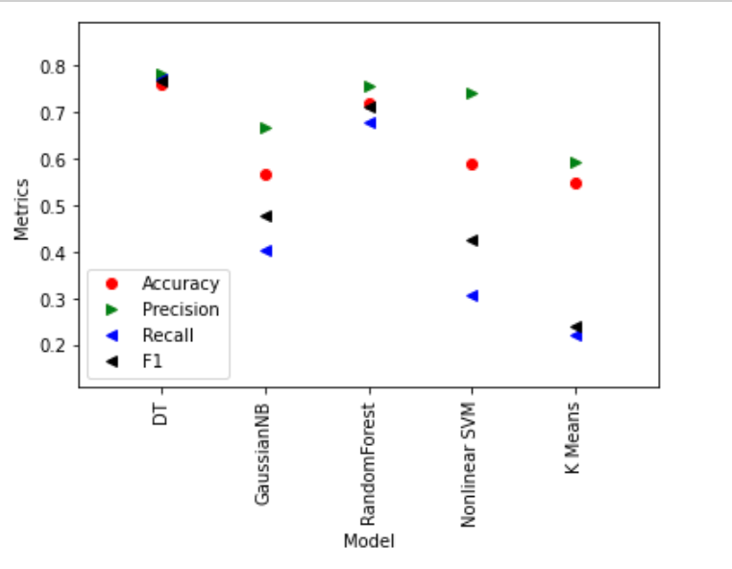
COMPARISON OF MODELS
Decision Tree has optimal metrics

Slide 42
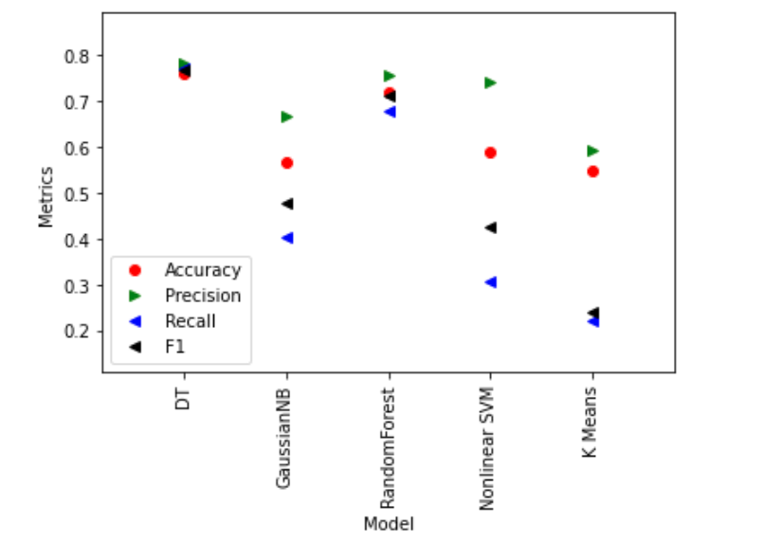
COMPARISON OF MODELS
Kazakhstan Crime data models
UCI Crime data models

Slide 43
COMPARISON OF RESULTS
‘community crimes data’ demonstrated:
highCrime
False 37.280482
True 62e.719518
dtype: float64
------------------
Percentage Positive Instance = 62.719518314099346
Percentage Negative Instance = 37.280481685900654
‘Kazakhstan crime data’ consisted of:
highCrime
False 48.192771
True 51.807229
dtype: float64
------------------
Percentage Positive Instance = 51.80722891566265
Percentage Negative Instance = 48.19277108433735

Slide 44
HYPOTHESIS TEST
STEP 1: Add a new attribute: ‘number_of_imprisoned’
STEP 2: Reset data set
STEP 3: Apply model
STEP 4: Analyze metrics:
STEP 5: Feature selection:
'divorce_coef_1000_per', 'retail_product_sell_mln_tenge','students_in_schools_1000_per', 'self_emp_1000_per', 'hired_1000_per', 'working_1000_per', ‘number_of_imprisoned’, 'able_bodied_1000_per', 'min_income_usd', 'min_income'
EVALUATING MEASURE DECISION TREE CLASSIFIER | 10-FOLD CROSS-VALIDATION (%)
ACCURACY | 78,12% (FORMERLY 78,11%)
PRECISION | 80,17% (FORMERLY 80,16%)
RECALL | 76,74% (FORMERLY 76,74%)
F1 SCORE | 78,41% (FORMERLY 78,41%)

Slide 45
CONCLUSIONS
PARAMETERS TUNING:
Determining new threshold
Finding optimal depth
Implementation of cross validation
Excluding effect of multicollinearity
BASE MODEL AFTER TUNING:
Random Forest model - the most accurate
Data set: UCI Repository materials Accuracy: 0.877 (formerly 0.883)
Precision: 0.884 (formerly 0.883)
Recall: 0.872 (formerly 0.848)
F1 score: 0.868 (formerly 0.865)
BASE MODEL AFTER TUNING
Decision Tree model - the most accurate
Data set: Kazakhstani data
Accuracy: 0.781
Precision: 0.801
Recall: 0.767
F1 score: 0.784

Slide 46
CONCLUSIONS
Hypothesis testing proved:
Possibility of enhancing the performance by collaboration with experts
Efficiency of the model for Kazakhstan data set
Feasibility of feature selection algorithm

Slide 47
FUTURE WORK
By maintaining dynamic databases with the criminal records across various fields, this technique can be implemented widely.
The present dataset consists of all types of crimes, this type of analysis can be narrowed down to a single category of crime.

Slide 48
Thank you for your attention!

