Slide 1

Effect of Curing Regime on Properties of Geopolymer Mixtures Containing Basic Oxygen Furnace Slag (BOFS) Aggregates
Student: Zarina Onopriyenko Research Supervisor: Professor Chang-Seon Shon

Slide 2
Outline
Introduction
Research Background
Research Objectives
Research Methodology
Results and Discussion
Conclusion
Limitations and Recommendations
References

Slide 3
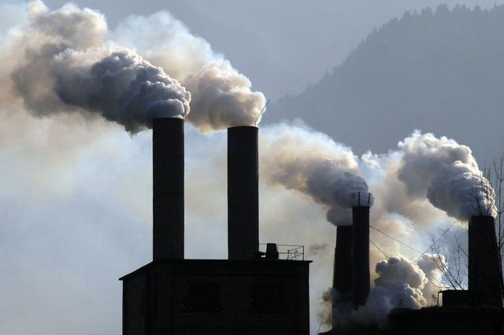

Introduction
OPC (Ordinary Portland cement) concrete-widely used construction material.
  It consists of cement, water and fine and coarse aggregate.
Cement manufacture generate an overall 1.25 tons of CO₂ per ton of cement [1]. It devotes up to 7% of entire CO₂ emission to the atmosphere worldwide [2].
The cause of global warming is greenhouse gases, one of them is the emission of carbon dioxide (CO₂).
Figure 1. OPC production
Figure 2. Global warming

Slide 4
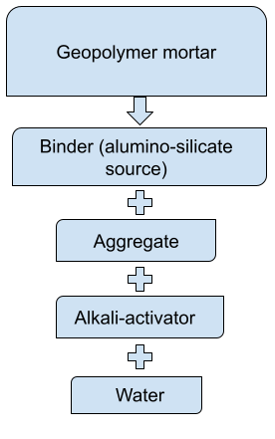
Introduction
Geopolymer material:
Alternative construction material for OPC.
Environmentally friendly in terms of limiting greenhouse gas emissions (cementless) and utilizing industrial by-product materials.
Figure 3. Geopolymer

Slide 5
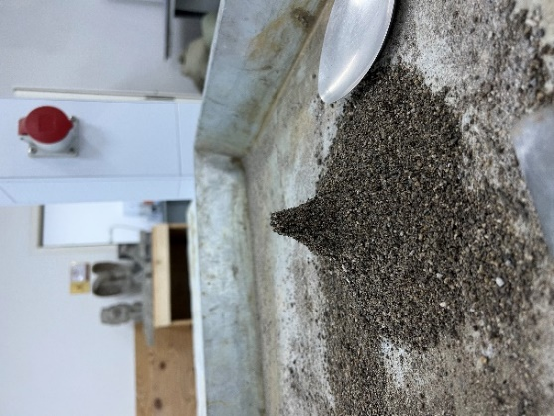
Introduction
Basic oxygen furnace slag (BOFS):
BOFS is a by-product of steel industry.
Over 160 million tons of by-products from the steel industry originate annually [3].
BOFS can be utilized as a binder and aggregate in geopolymer manufacture if the problem of BOFS is solved.
Figure 4. BOFS

Slide 6
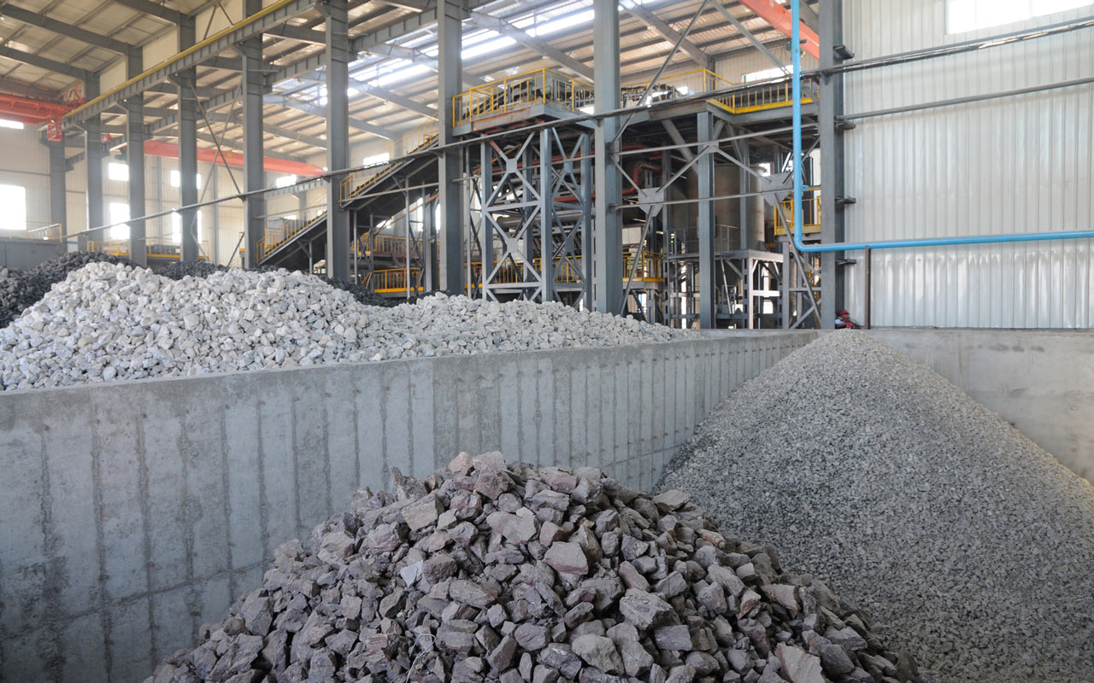
Research Background
The utilization of by-products in construction materials sphere solve two problems:
Environmental/Ecological;
Economical [4].
Basic Oxygen Furnace Slag (BOFS) usage as an aggregate in concrete composition develops:
Mechanical properties;
Microstructural properties;
Durability properties.
Figure 5: By-products of steel and iron industry. Source: Diproinduca

Slide 7
Research Background: Problem Statement
Free Calcium oxide and Magnesium oxide in the components of steel slag causes expansion of concrete structure during its utilization [6].
f-CaO and f-MgO have low reactivity, thus their hydration occurs after a long period of time.
It causes soundness problems, as the hydration of f-CaO and f-MgO causes internal stress in the matrix of concrete, thus the pores merge into one causing volume instability [7].
f-CaO + H₂O → Ca(OH) ₂
f-MgO + H₂O → Mg(OH) ₂
According to Wang et al. (2010), the volume increase of concrete ranges from 91.7% to 119.6% as a result of the f-CaO and f-MgO hydration process [5].
How to control the volumetric expansion of BOFS?
How to minimize CO₂ emission (How to utilize CO₂)?

Slide 8
Research Background: Solution for Problem
f-CaO + SiO₂ →CaSiO₃
f-CaO + CO₂ → CaCO₃
f-MgO + SiO₂ →MgSiO₃
f-MgO + CO₂ → MgCO₃
During the geopolymerization reaction, vast amount of free silica leaves unreacted.
Sodium silicate and binder are the source of free silica.
Thus, f-CaO and f-MgO react with free silica to form stable compounds, as a result the volume expansion is inhibited [8].
Ca(OH)₂ + CO₂ → CaCO₃ + H₂O
Reaction of f-CaO and f-MgO with CO₂ during carbonization process forms stable and insoluble compound such as calcium carbonate (CaCO₃) [9].

Slide 9
Research Objectives
Vast amount of research are conducted on:
Studying the properties of BOFS-based geopolymer.
However the number of research on the effect of different curing regimes on the properties of BOFS-based geopolymer are limited.
Curing Regimes:
Steam curing (6hr and 12hr);
Water curing;
Ambient curing;
Steam curing(6hr and 12 hr) + CO₂ curing (6hr, 12hr and 24hr).
Aggregate combination:
100% BOFS;
75% BOFS+25% Sand;
50% BOFS + 50% Sand.
Aim of this work is to study:
The effect of curing regime;
The effect of specific curing regime duration;
The effect of aggregate combination;
on the properties of BOFS-based geopolymer

Slide 10
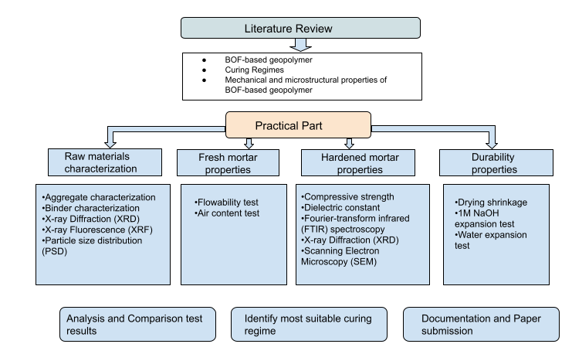
Overall Experimental Program
Figure 6. Experimental program

Slide 11
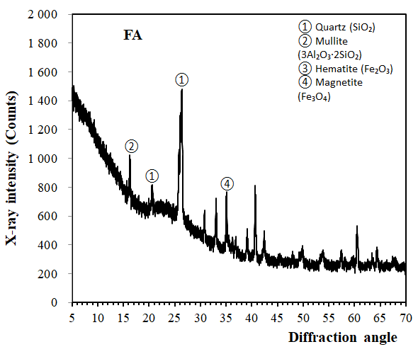
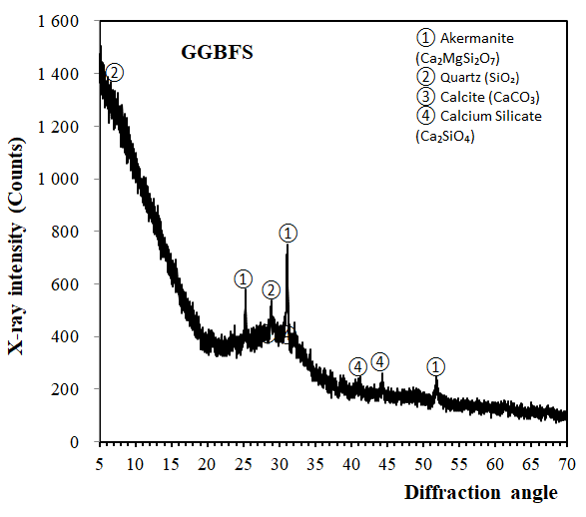
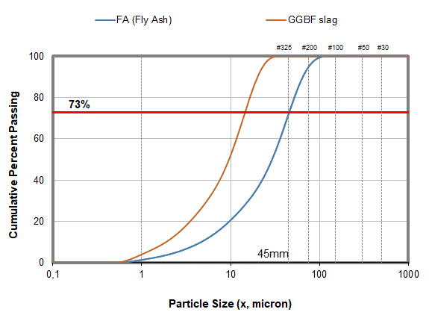
Cementitious materials properties
The specific gravities of FA and GGBFS are 1.80 and 2.94 respectively.
Table 1. Chemical composition of FA and GGBFS (%).
 | SiO₂ | Al₂O₃ | Fe₂O₃ | TiO₂ | CaO | MgO | Na₂O | K₂O | P₂O₅ | SO₃
FA | 62.15 | 20.39 | 10.53 | - | 3.72 | 0.1 | - | 1.31 | 0.99 | 0.24
GGBFS | 23.97 | 5.9 | 0.88 | 2.74 | 57.99 | 3.75 | - | 1.12 | - | 2,47
Figure 7. XRD of FA and GGBFS
Figure 8. PSD of FA and GGBFS

Slide 12
Fine aggregate properties
Table 2. Grading Requirement
Passing, sieve # | Retained, sieve # | Weight, %
4 | 8 | 10
8 | 16 | 25
16 | 30 | 25
30 | 50 | 25
50 | 100 | 15

Slide 13
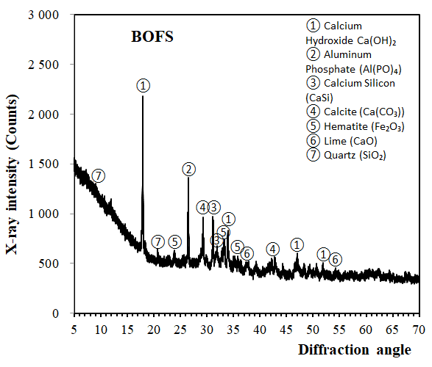
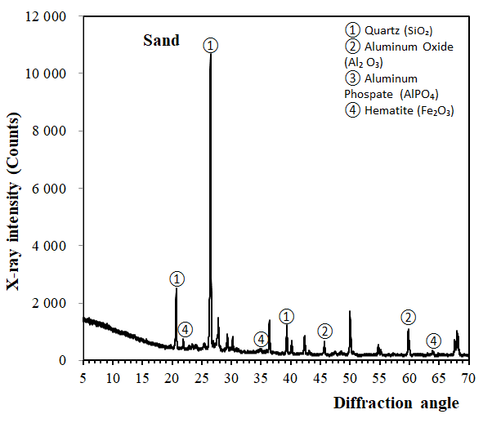
Fine aggregate properties
Table 3. SG and AC of fine aggregates
Fine aggregate | Specific gravity (SG) | Absorption capacity (AC)
BOFS | 2.7 | 8.91%
Sand | 3.3 | 1.84%
Table 4. Chemical composition of BOFS and RS (%).
 | CaO | Fe₂O₃ | SiO₂ | MnO | MgO | Al₂O₃ | SO₃ | TiO₂ | K₂O | P₂O₅
BOFS | 52.38 | 29.39 | 7.39 | 4.33 | 3.13 | 1.53 | 0.23 | - | - | -
Sand | 16.27 | 13.81 | 54.51 | 1.51 | 0.78 | 5.71 | 0.51 | 1.73 | 3.65 | 0.63
Figure 9. XRD of BOFS
Figure 10. XRD of Sand

Slide 14
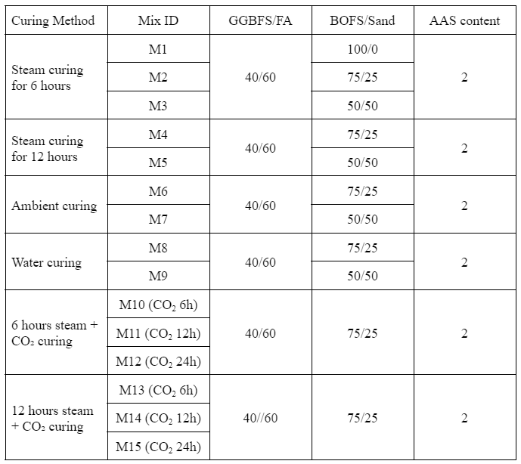
Mixture Design
Table 5. Mix design parameters
Variables:
Curing method/duration
BOFS to Sand ratio
Fixed:
GGBFS to FA ratio
Alkali activated solution (AAS) content

Slide 15
Samples preparation
Table 6. Quantity of samples and mixture volume calculation
Description | Tests
 | Compressive strength | Dielectric constant | Drying shrinkage | 1M NaOH and water expansion
Size (mm) | 50×50×50 | 70×70×70 | 25×25×285 | 25×25×285
Number of specimens | 16 | 2 | 4 | 8
Testing age | 3, 7, 28 and 56-day | 3, 7, 31-day interval | 3, 7, 31-day interval | 3 and 7-day interval
Volume (m³) | 2.000×10⁻³ | 0.686×10⁻³ | 0.712×10⁻³ | 1.425×10⁻³
Total volume (m³) | (4.823×10⁻³) × 10%=5.305×10⁻³

Slide 16
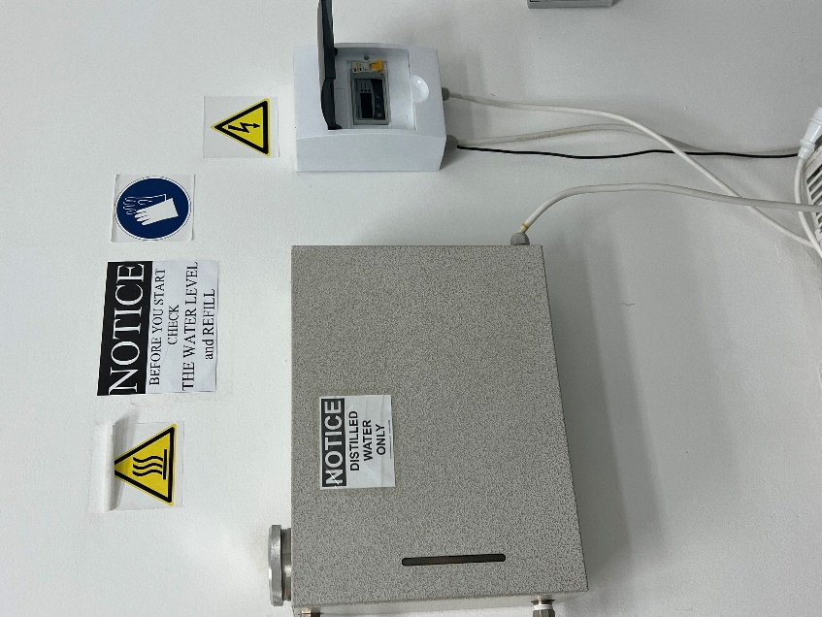
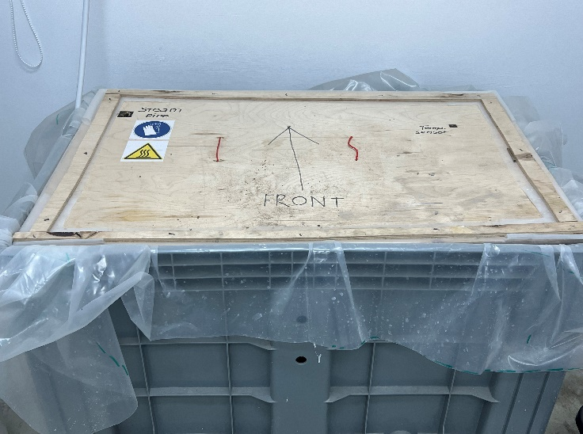
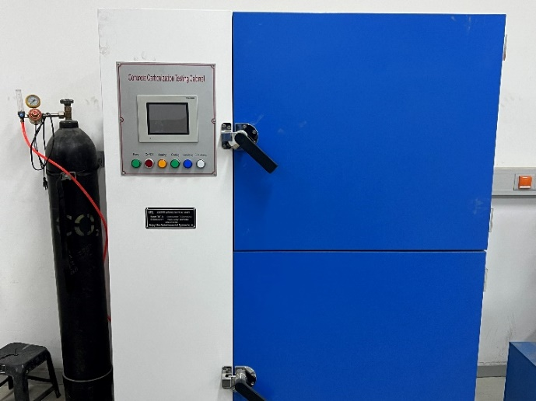
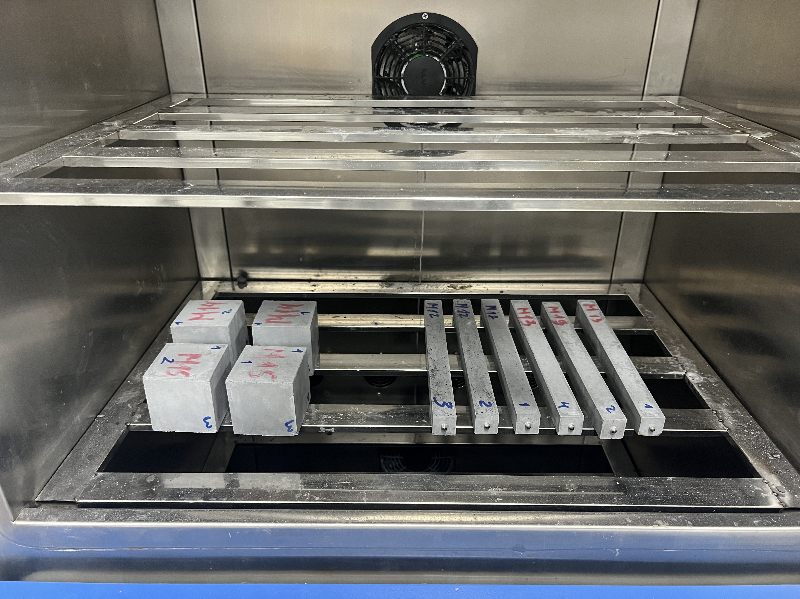
Research Methodology
Curing regimes:
Steam curing
Vapor curing method under atmospheric pressure conditions.
Usually carried out at a temperature from 40 to 100℃
In the current work curing is carried out at 80 ℃.
CO₂ curing
Is carried out in a special storage tank under specific temperature, humidity, and CO₂ concentration.
The temperature is set up at 23℃, humidity at 50%, and CO₂ concentration at 20%.
Figure 11. Steam curing
Figure 12. CO₂ curing

Slide 17
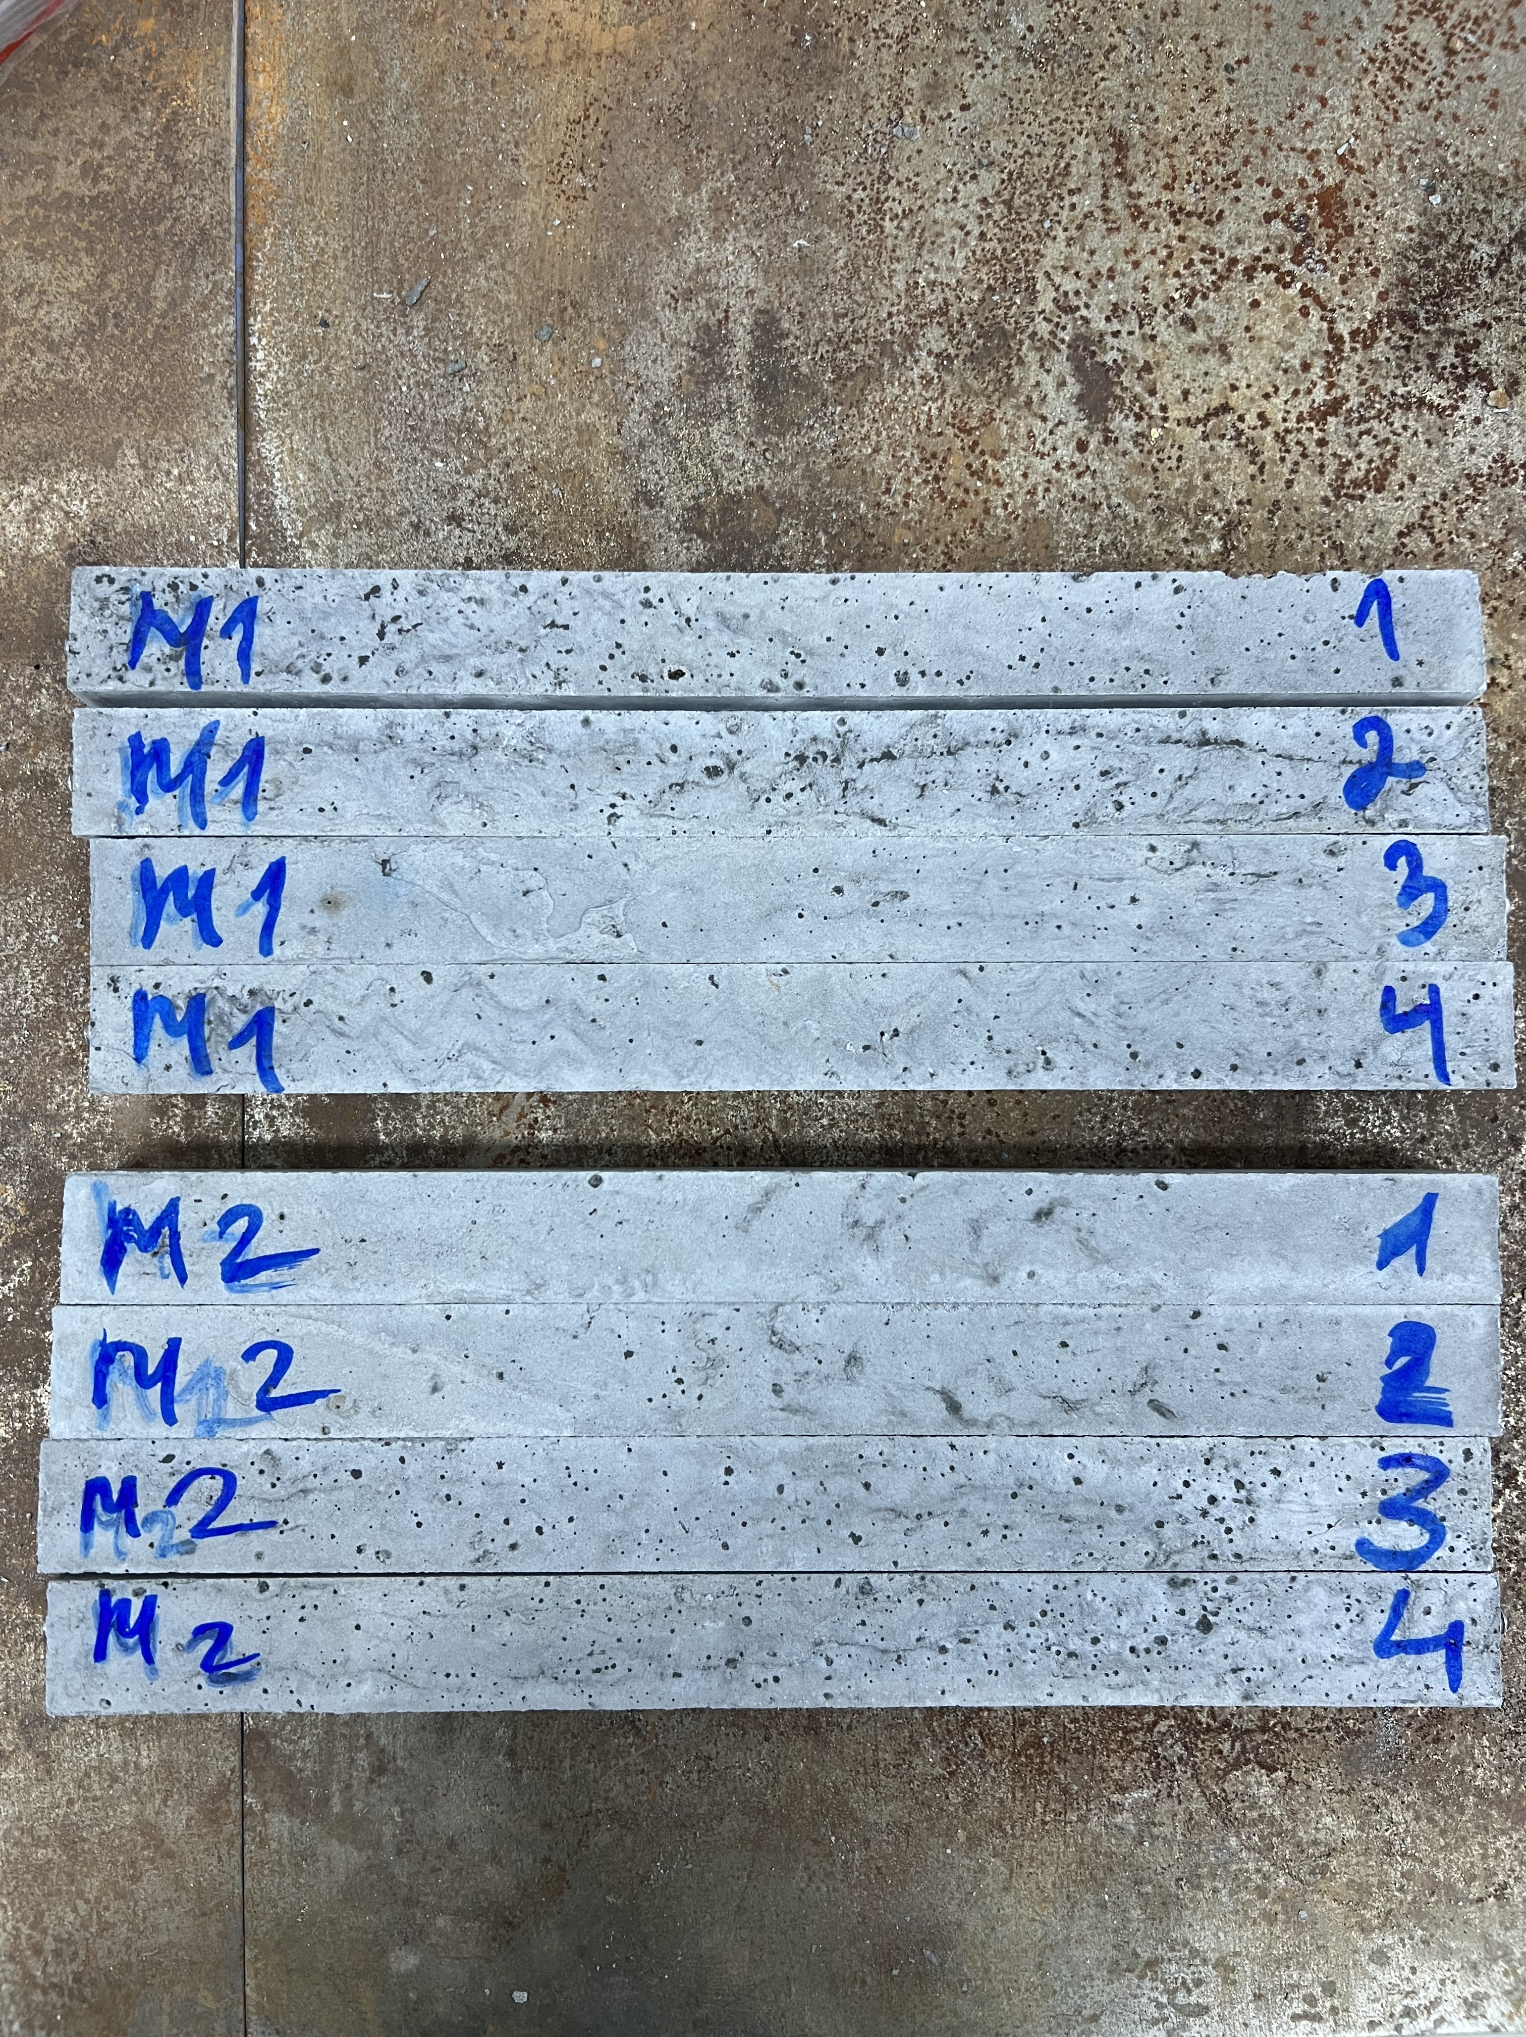
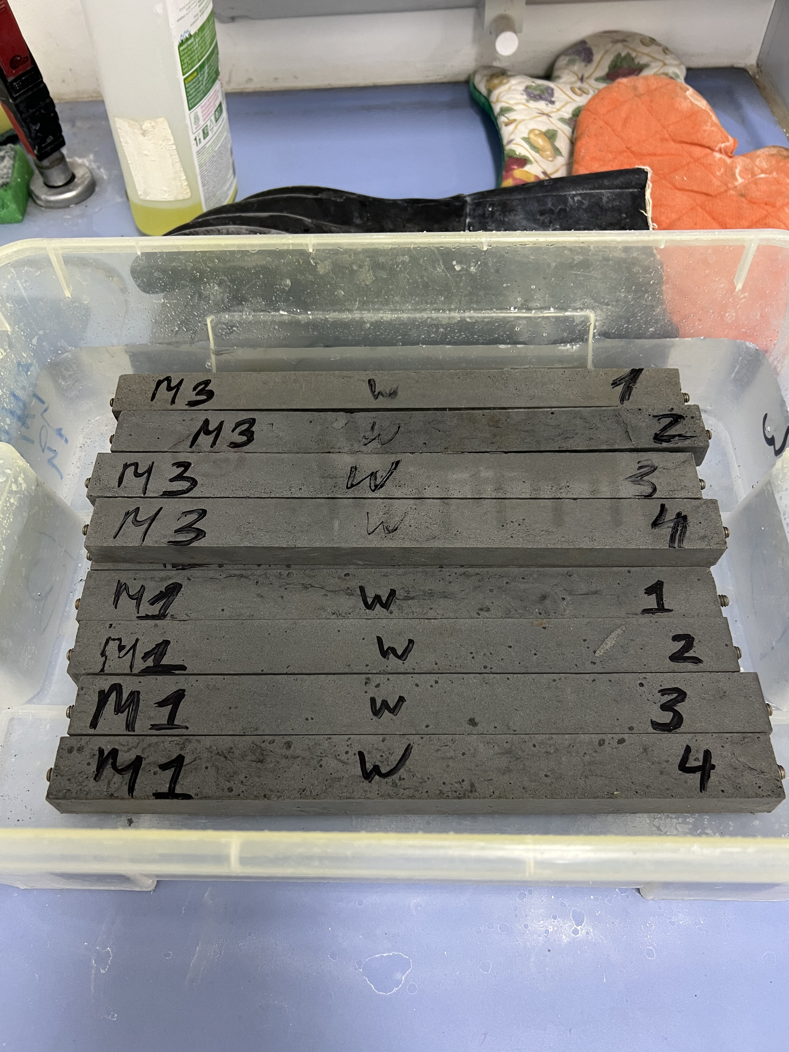
Research Methodology
Curing regimes:
Ambient air curing
Curing under room temperature and normal atmospheric pressure.
Water curing
Carried out by following the ASTM C511 [10] standard specification.
Lime added to the potable water to prevent the washout of calcium hydroxide.
Figure 13. Ambient and water curing

Slide 18
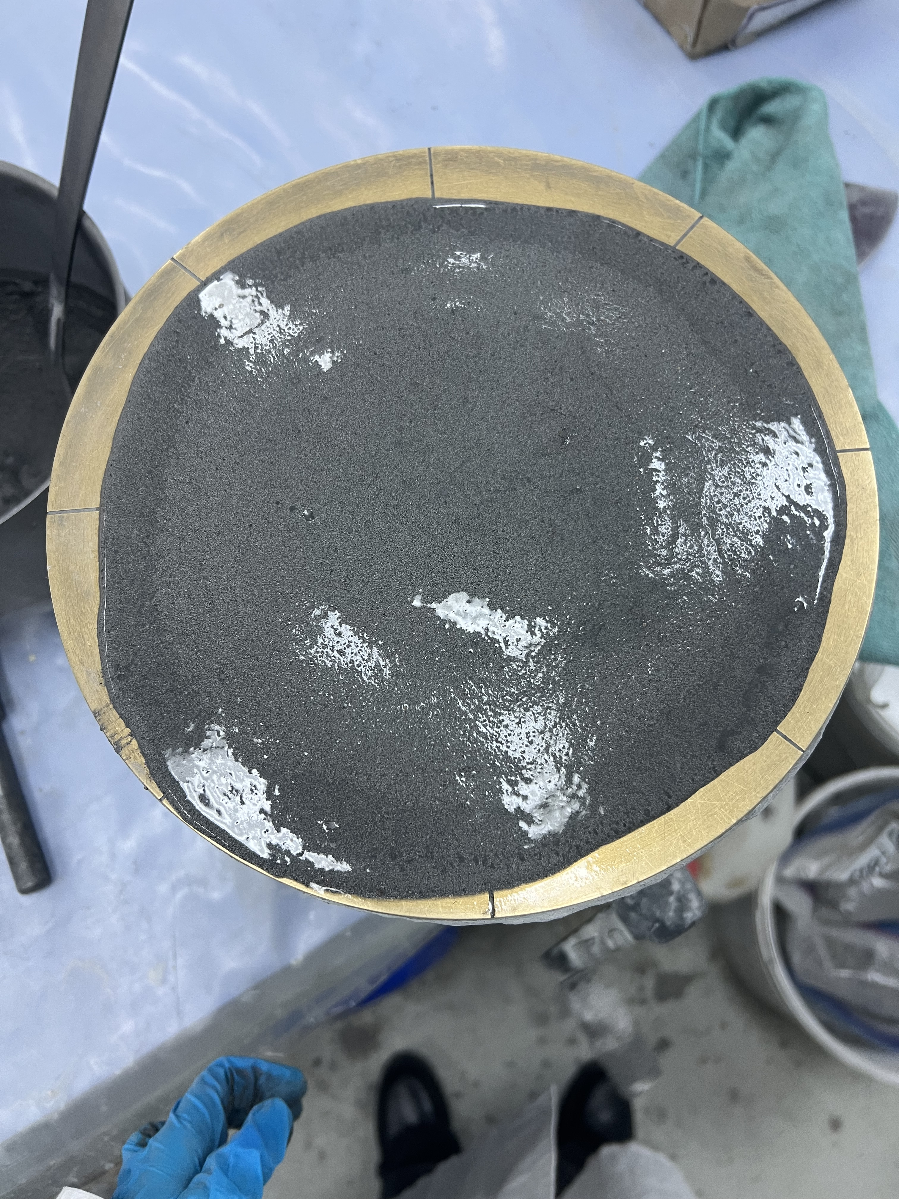
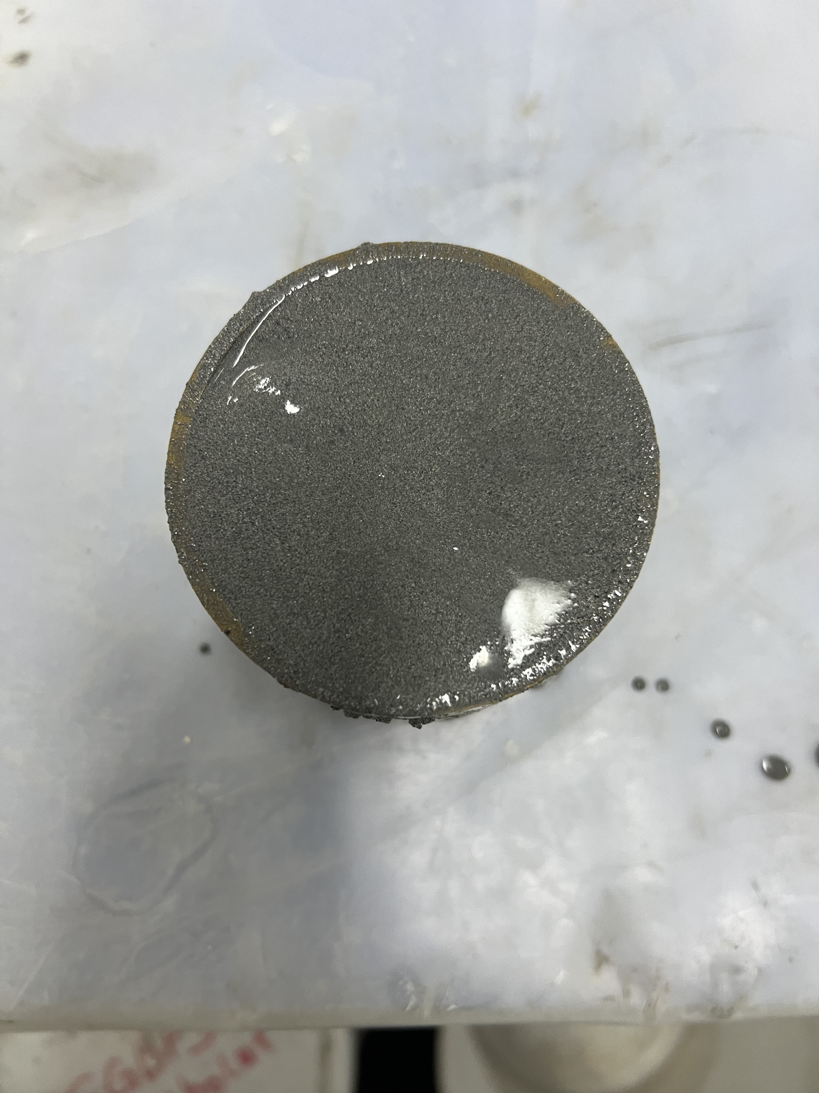
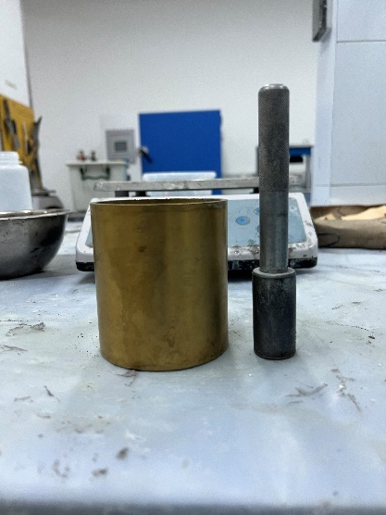
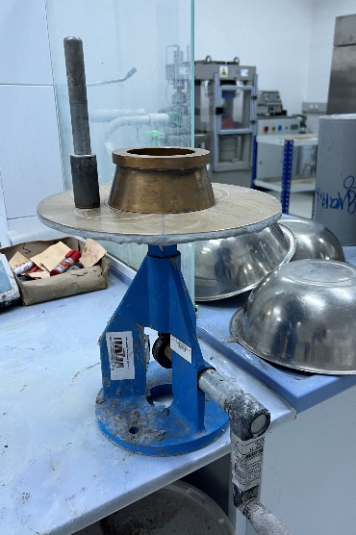
Test Methods: Fresh Properties
Figure 14. Flowability test
Figure 15. Air content test

Slide 19
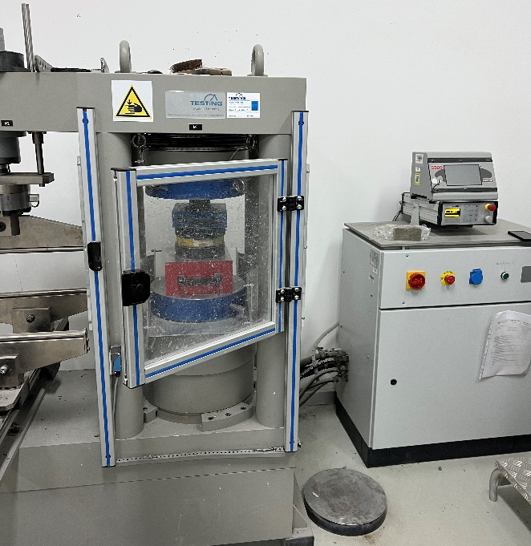
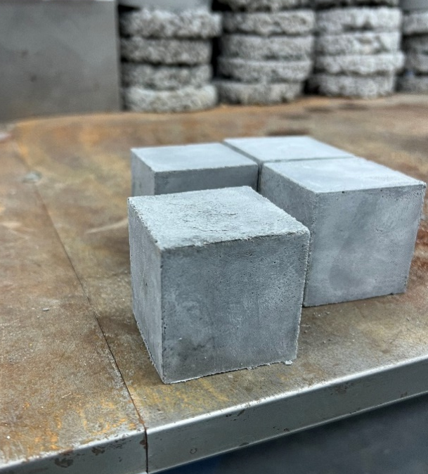
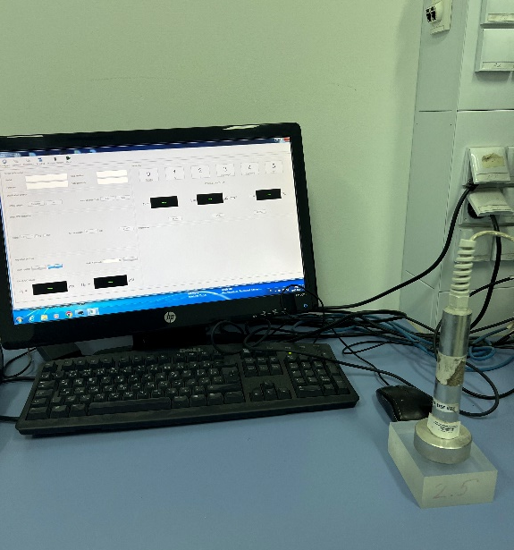
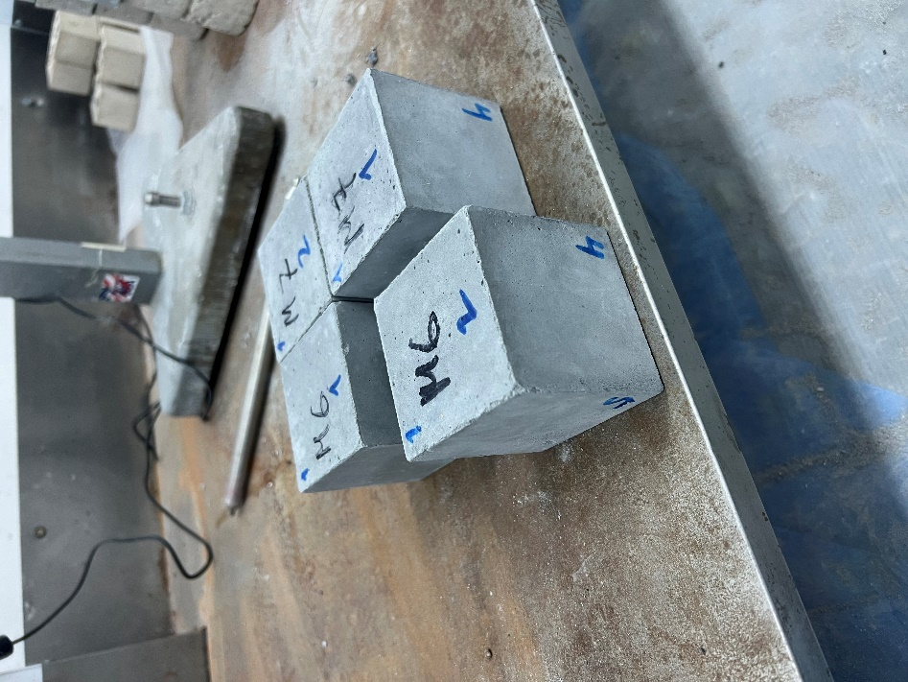
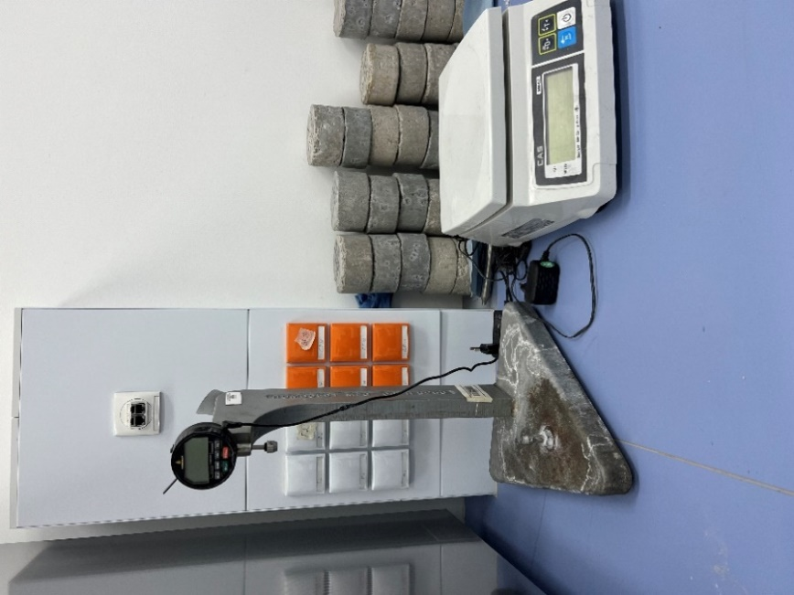
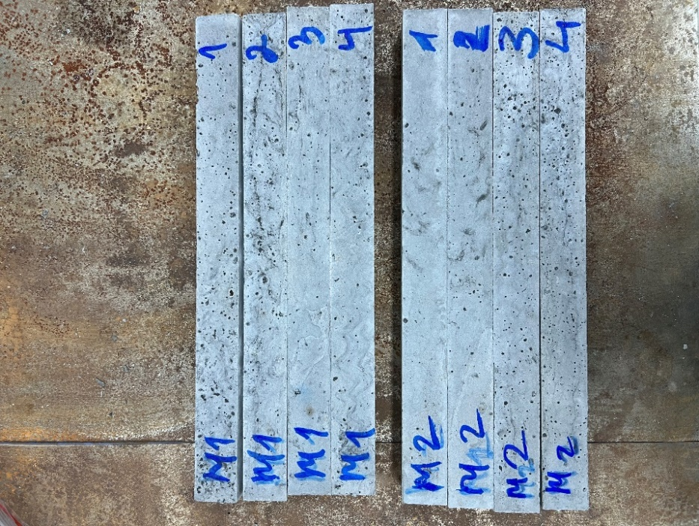
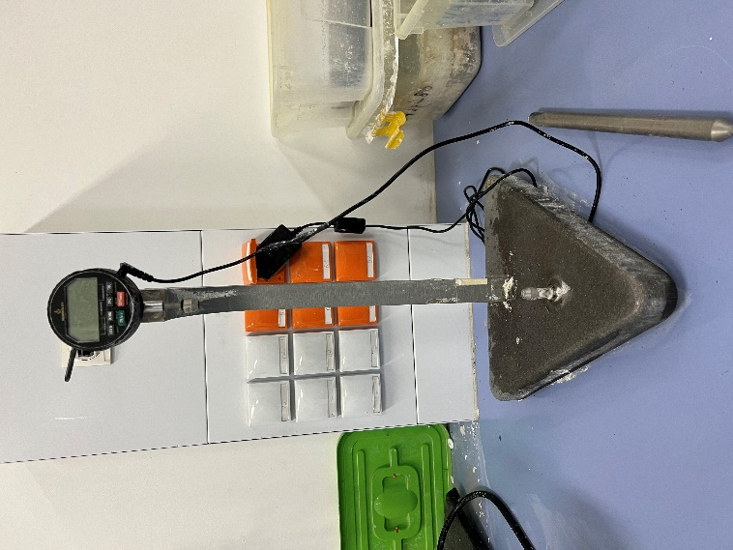
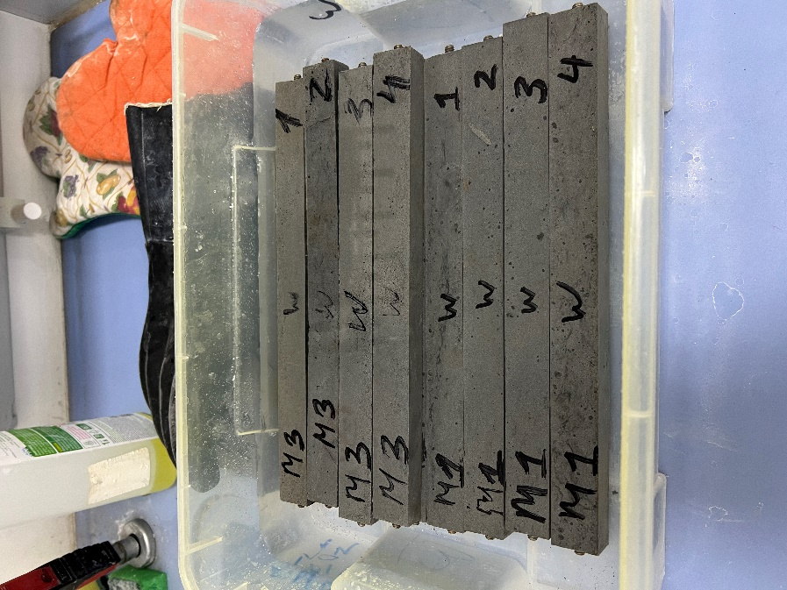
Test Methods: Hardened & Durability Properties
Figure 16. Compressive strength test
Figure 17. Dielectric constant test
Figure 18. Drying shrinkage test
Figure 19. 1M NaOH and water expansion test

Slide 20
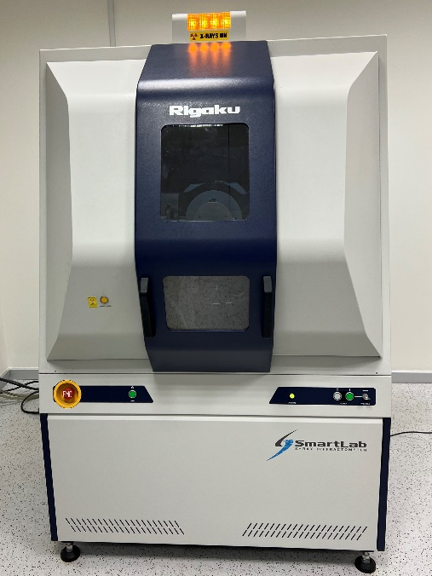
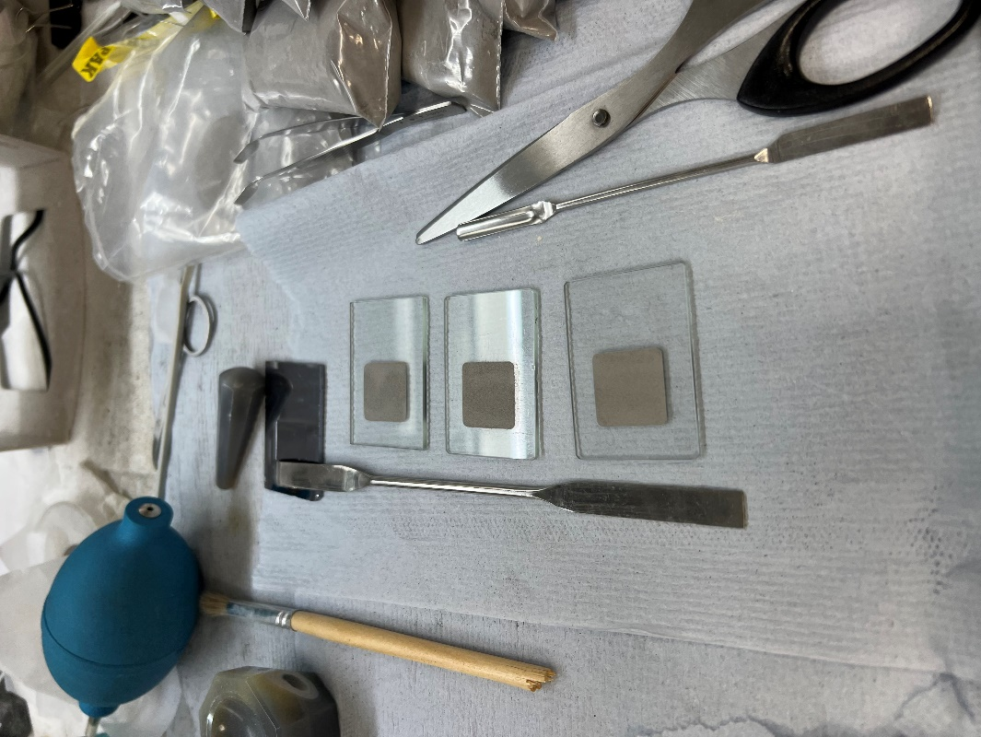
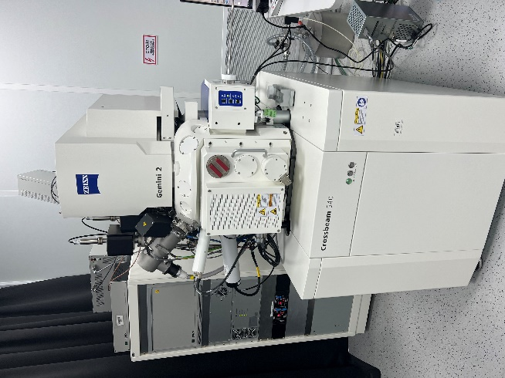
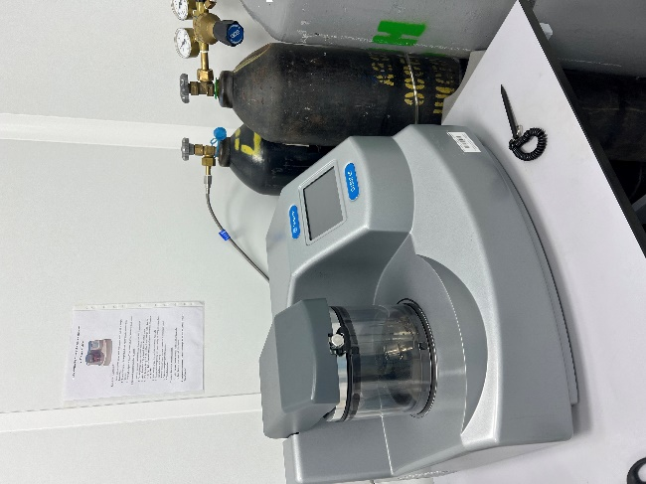
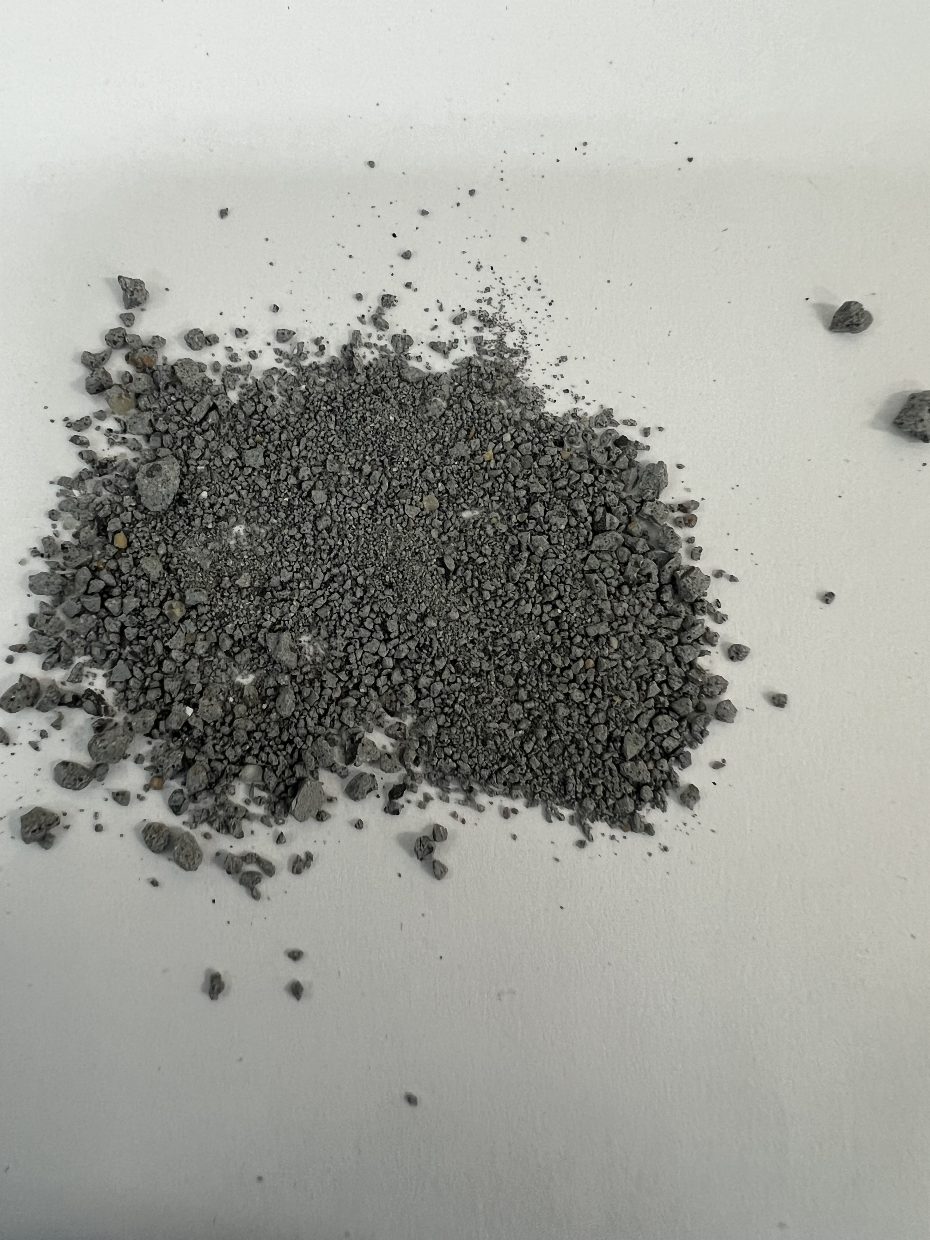
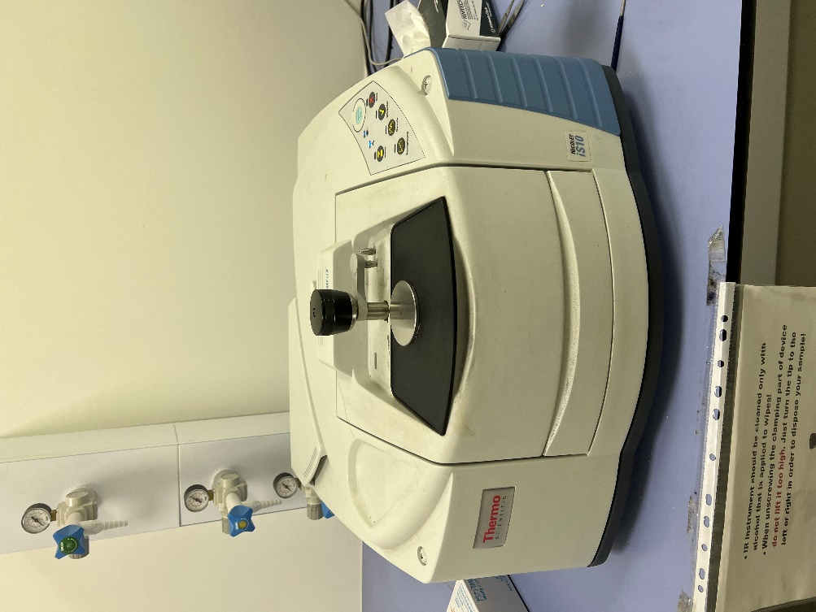
Test Methods: Microstructural Properties
Figure 20. XRD
Figure 21. SEM
Figure 22. FTIR

Slide 21
Test Results & Discussion

Slide 22
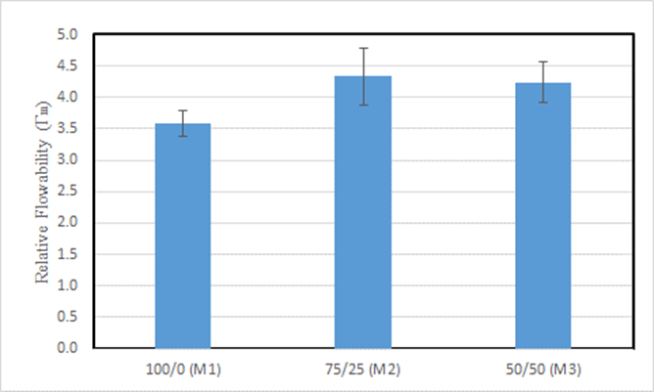
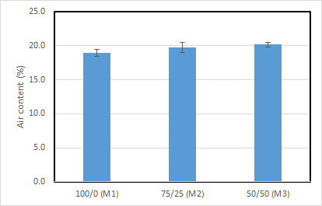
Flowability and Air content
Figure 23. Flowability
Figure 24. Air content

Slide 23
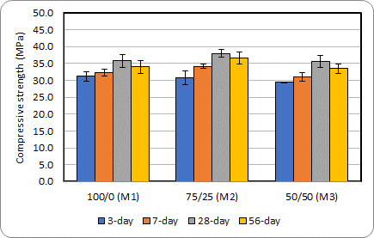
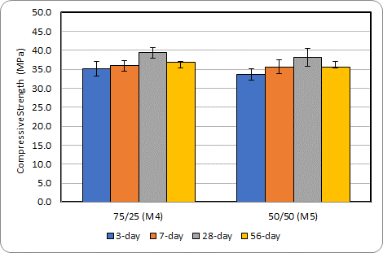
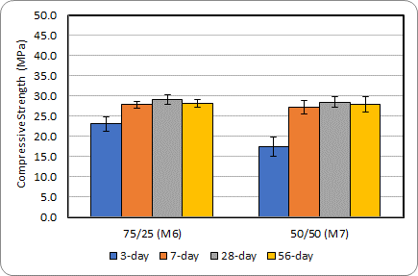
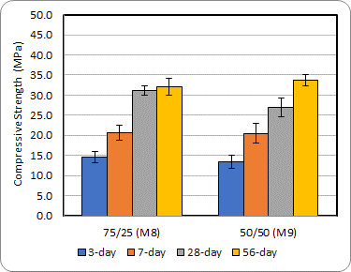
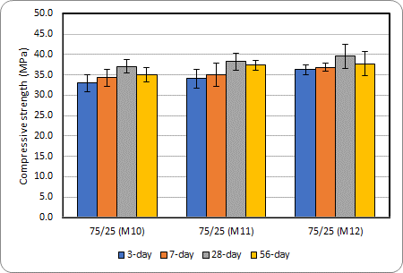
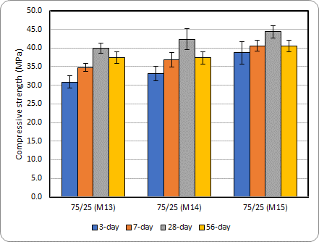
Compressive Strength
(a) Steam curing 6hr
(b) Steam curing 12hr
(c) Ambient air curing
(d) Water curing
(e) Steam curing 6hr + CO₂(6,12,24hr)
(f) Steam curing 12hr + CO₂(6,12,24hr)
Figure 25. Compressive strength

Slide 24
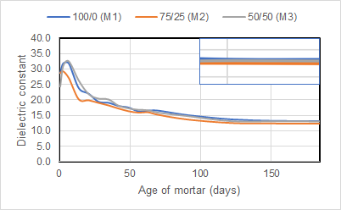
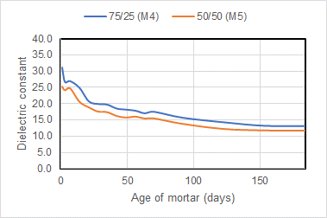
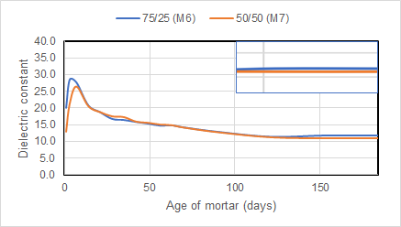
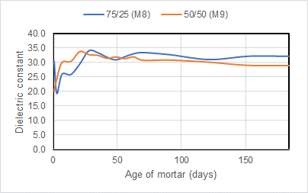
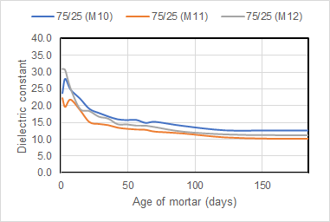
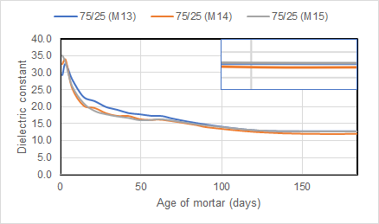
Dielectric constant
(a) Steam curing 6hr
(b) Steam curing 12hr
(c) Ambient air curing
(d) Water curing
(e) Steam curing 6hr + CO₂(6,12,24hr)
(f) Steam curing 12hr + CO₂(6,12,24hr)
Figure 26. Dielectric constant

Slide 25
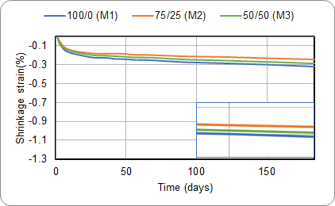





Drying Shrinkage (length)
(a) Steam curing 6hr
(b) Steam curing 12hr
(c) Ambient air curing
(d) Water curing
(e) Steam curing 6hr + CO₂(6,12,24hr)
(f) Steam curing 12hr + CO₂(6,12,24hr)
Figure 27. Drying shrinkage (length loss)

Slide 26






Drying Shrinkage (mass)
(a) Steam curing 6hr
(b) Steam curing 12hr
(c) Ambient air curing
(d) Water curing
(e) Steam curing 6hr + CO₂(6,12,24hr)
(f) Steam curing 12hr + CO₂(6,12,24hr)
Figure 28. Drying shrinkage (mass loss)

Slide 27


Expansion
Figure 29. 1M NaOH expansion test
Figure 30. Water expansion test

Slide 28



X-ray Diffraction (XRD)
Figure 31. Crystalline phases

Slide 29
Scanning Electron Microscope (SEM)
C-A-S-H
Figure 32. SEM image steam cured sample (M2)
C-A-S-H
FA
Figure 33. SEM image ambient cured sample (M6)

Slide 30
Scanning Electron Microscope (SEM)
C-A-S-H
FA
Figure 34. SEM image water cured sample (M8)
Table 7. EDS analysis
 | С | O | Na | Mg | Al | Si | K | Ca | Ti | Total
Mass, % | 13.44±0.15 | 50.83±0.29 | 3.38±0.07 | 1.33±0.04 | 6.79±0.08 | 17.36±0.13 | 0.33±0.02 | 6.30±0.08 | 0.23±0.02 | 100.00
Atom, % | 20.21±0.23 | 57.37±0.33 | 2.66±0.06 | 0.99±0.03 | 4.55±0.05 | 11.16±0.08 | 0.15±0.01 | 2.84±0.04 | 0.09±0.01 | 100.00

Slide 31

Fourier-transform infrared spectroscopy (FTIR)
Figure 35. FTIR

Slide 32
Conclusion
The highest relative flowability was obtained for the geopolymer mixture with a BOFS/Sand ratio of 75/25, and the lowest value was obtained for the mixture with a BOFS/Sand ratio of 100/0.The air content of mixtures increases with the decrease of BOFS aggregate content.
Steam curing and the combined steam and CO₂ curing enhanced the compressive strength, prevented the shrinkage strain and 1M NaOH expansion of the BOFS-based geopolymer mixture compared to water and ambient curing regimes. The water expansion characteristic was not affected by the curing regime. Water curing curing supported the dielectric constant value with the time, while the CO₂, steam and ambient curing decreased the dielectric constant value.
Steam curing duration only affected the early-age compressive strength, longer duration is preferable. The longer duration of steam curing results in less drying shrinkage and less expansion fluctuation.
The longer CO₂ curing duration promoted the formation of stable calcium carbonate compounds, thus enhancing the compressive strength, stabilizing the expansion curve fluctuation and reducing the shrinkage strain of only 6-hour steam cured samples. The duration of steam and CO₂ curing do not affect the dielectric constant value.

Slide 33
Conclusion
The SEM image of steam and CO₂ cured samples demonstrated the homogeneously packed and dense geopolymer structure, and XRD results revealed the reduction of quartz and mullite peaks intensity, the FTIR analysis showed that the Si-O-Si and Si-O-Al bonds shifted to a higher wavenumber.
The steam and CO₂ curing duration do not significantly affect the microstructural properties of the geopolymer.

Slide 34
Limitations and Recommendations
Determining the effect of BOFS/sand ratio on the setting time of BOFS-based geopolymer mortar;
  Setting time affect the compressive strength and durability of the mortar. It provides control of hydration process.
Determining the effect of curing on flexural and tensile strength of geopolymer mortar;
  Flexural strength controls the ability of mortar to bear loads and withstand external forces
  Tensile strength control the failure occurrence, arise due to unsound aggregate, weathering action.
Conducting the SEM, FTIR, and XRD analysis on expanded mortar samples that emerged in 1M NaOH to determine the reason for expansion.
  The expansion of bar samples in 1M NaOH occurred, the formation of what compounds caused the expansion?

Slide 35
References
[1] D. Babor, D. Plian, and L. Judele, “ENVIRONMENTAL IMPACT OF CONCRETE.” Available: https://www.bipcons.ce.tuiasi.ro/Archive/161.pdf.
[2] P. K. Mehta, “Reducing the environmental impact of concrete,” Concrete international, vol. 23, no. 10, pp. 61-66.Available: https://ecosmartconcrete.com/docs/trmehta01.pdf.
[3] J. Liu and D. Wang, “Influence of steel slag-silica fume composite mineral admixture on the properties of concrete,” Powder Technology, vol. 320, pp. 230–238, Oct. 2017, doi: https://doi.org/10.1016/j.powtec.2017.07.052.
[4] J. Guo, Y. Bao, and M. Wang, “Steel slag in China: Treatment, recycling, and management,” Waste Management, vol. 78, pp. 318–330, Aug. 2018, doi: https://doi.org/10.1016/j.wasman.2018.04.045.
[5] G. Wang, Y. Wang, and Z. Gao, “Use of steel slag as a granular material: Volume expansion prediction and usability criteria,” Journal of Hazardous Materials, vol. 184, no. 1–3, pp. 555–560, Dec. 2010, doi: https://doi.org/10.1016/j.jhazmat.2010.08.071.
[6] Q. Wang, D. Wang, and S. Zhuang, “The soundness of steel slag with different free CaO and MgO contents,” Construction and Building Materials, vol. 151, pp. 138–146, Oct. 2017, doi: https://doi.org/10.1016/j.conbuildmat.2017.06.077.
[7] A. S. Brand and J. R. Roesler, “Steel furnace slag aggregate expansion and hardened concrete properties,” Cement and Concrete Composites, vol. 60, pp. 1–9, Jul. 2015, doi: https://doi.org/10.1016/j.cemconcomp.2015.04.006.
[8] W. H. Lee, T. W. Cheng, K. Y. Lin, K. L. Lin, C. C. Wu, and C. T. Tsai, “Geopolymer Technologies for Stabilization of Basic Oxygen Furnace Slags and Sustainable Application as Construction Materials,” Sustainability, vol. 12, no. 12, pp. 5002–5002, Jun. 2020, doi: https://doi.org/10.3390/su12125002.
[9] S. Y. Pan, P. C. Chiang, Y. H. Chen, C. D. Chen, H. Y. Lin, and E. E. Chang, “Systematic Approach to Determination of Maximum Achievable Capture Capacity via Leaching and Carbonation Processes for Alkaline Steelmaking Wastes in a Rotating Packed Bed,” Environmental Science & Technology, vol. 47, no. 23, pp. 13677–13685, Nov. 2013, doi: https://doi.org/10.1021/es403323x.
[10] ASTM C511, “Standard specification for mixing rooms, moist cabinets, moist rooms, and water storage tanks used in the testing of hydraulic cements and concretes,”, 2013.

Slide 36
Thank You!

