Slide 1

Civil Service Reform in Georgia
Maia dvalishvili

Slide 2
CIVIL SERVICE BUREAU
Independent Legal Entity of Public Law
Leading Agency Coordinating and implementing the Civil Service Reform
Supporting implementation of the anti-corruption policy through ensuring publicity of assets declaration, monitoring and providing guidance on ethics

Slide 3
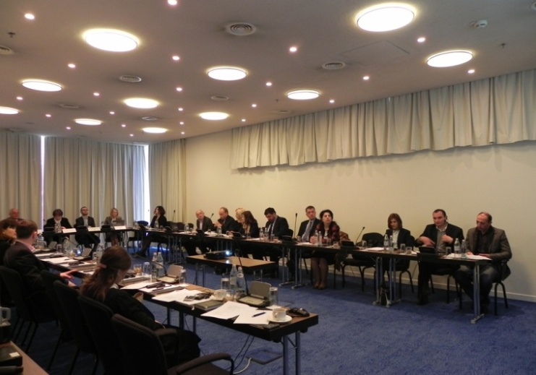
Civil Service Reform Concept
Creation of the Governmental working group
Regular meetings
Analyzes of the existed situation
Reflection of the recommendations to the draft

Slide 4
Adoption of the Concept
Governmental decree N627, 19th of November, 2014
Strategic document indicating concrete steps for reforming the Georgian Civil Service based on the EU categorization, which was used in other countries of transition

Slide 5
Categories of the Concept
List:
Definition and the scope of the CS
Centralized system for the management, coordination and oversight over the CS
The classification system
The remuneration system
Recruitment in civil service
Managing civil servants
Rights and duties of civil servants
Training and professional development
Equal opportunities for men and women

Slide 6
Civil service legislation
Civil Service Bureau started implementation of the concept by drafting the New Law on Civil Service
Same approach of drafting, meaning:
  Creation of working group
  Internal discussion
  SIGMA involvement
  Updating draft according the recommendations
  Public discussions
  Submission of the draft to the Government of Georgia

Slide 7
Transitional period before the enactment of the law
  Decrees of the Government of Georgia proceeding from the laws
  Law of Georgia on Remuneration in Civil Service
  Law of Georgia on Legal Entities of Public Law
  Elaboration of Unified eHRM system
  Elaboration of Job descriptions for all CS positions
  Reclassification of all existing positions
  Trainings on novelties of the CS Law

Slide 8

Functional Analysis of Governmental Institutions
To prepare the public institutions for the changes envisaged by the new Law on Civil Service it was essential to carry out the process of functional analysis which included:
Detailed analysis of line ministry portfolios; in-depth examination of structures (vertical analysis)
Develop general principals on organizational arrangements

Slide 9
Enactment of the new Civil service Law
New Civil Service Law came into force from July 1, 2017
  Clear definition of Functions of Civil servants, labor and administrative contract employees
  Unified classification system
  New regulations for admission to civil service
  Carrier management system
  Unified remuneration system
  Performance appraisal and professional development

Slide 10
Law on Salaries
Elaboration and adoption of the new Law on Remuneration in public institutions in 2017
The Law regulates not only the issues of salaries of professional civil servants, but also applies broadly to the "public service employees" regardless their legal status. It aims to establish a fair, transparent, and foreseeable system of remuneration of persons employed in the public sector.

Slide 11
Online Asset Declaration System in Georgia
Asset Declaration System is operational since 1998
However, it was only in February 2010 when the entire system became online-driven
All senior Georgian officials submit their asset declarations annually at www.declaration.gov.ge
Submitted declarations are published instantly on the website
More than 5600 public officials are obliged to fill out asset declarations

Slide 12
Development of Declarations Monitoring System
  Creation of the working group;
  Development of monitoring system concept and sharing international practice;
  Preparing draft amendments based on the recommendations
  Presentation before the Anti-corruption council
  Submission to the GOG and the Parliament
The amendments to the Law on Conflict of Interests and Corruption in Civil Service (CoI) have been adopted on October 27, 2015 and entered into force on January 1, 2017. The new amendments established a monitoring system for asset declarations of public officials.

Slide 13
Monitoring Procedure
The monitoring process is completed upon crosschecking of the information in different electronic databases in accordance with the principles of confidentiality.
comparing asset declaration information with:
Electronic databases administered by public institutions;
Information requested and provided by official;
No excess to private databases such as banks and other private financial organizations.

Slide 14
Ethics in Civil Service
Code of Ethics was adopted in 2017
dbb Academy experts trained seven Georgian trainers and developed a detailed civil servants training agenda within the Training of Trainers;
Systematic Trainings of Civil Servants on Ethics

Slide 15
Thank you!

