Slide 1

The Shifting Nature of Academic Library Collections
Library Connect Meeting
May 31, 2017
Doug Way
AUL for Collections and Research Services
University of Wisconsin-Madison
CC BY-NC-SA 2.0 / Pete Prodoehl / http://www.flickr.com/photos/raster/3216358349/sizes/l/in/photostream/

Slide 2


Our World in a Word…
NASA Visible Earth / http://visibleearth.nasa.gov

Slide 3

Many of these changes are out of our control
CC BY 2.0 / Robert S. Donovan / http://www.flickr.com/photos/booleansplit/2201440179/sizes/l/in/photostream/

Slide 4
Hyperinflation
http://www.arl.org/bm~doc/monser04.pdf / Downloaded April 10, 2012

Slide 5
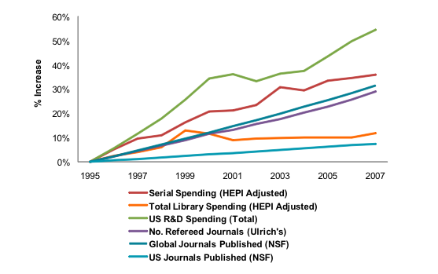
Explosion in Scholarly Output
U.S. Library Spending, R&D Spending, and Journals 1995-2007
From Outsell’s Open Access Primer (Public Version), December 2009

Slide 6
Declining use of
Physical Collections
Source: NCES Academic Libraries Survey, http://nces.ed.gov/surveys/libraries/academic.asp
2012 Digest of Education, http://nces.ed.gov/programs/digest/

Slide 7
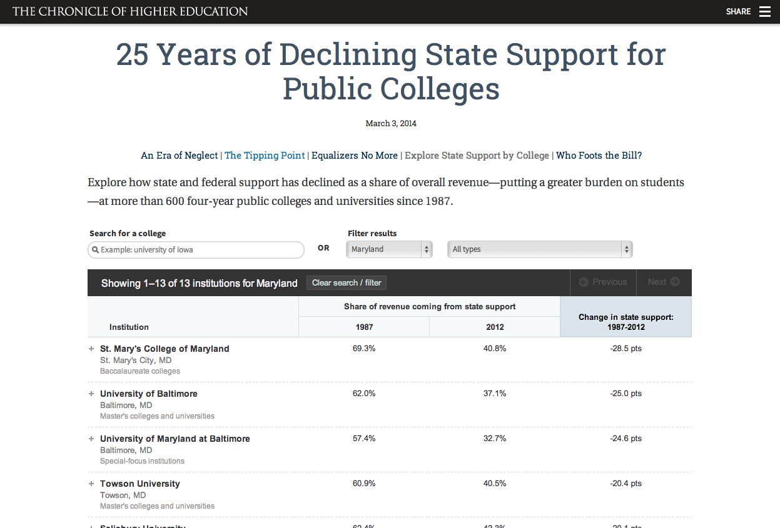
Declining Support for Higher Education

Slide 8

Smaller Piece of the Pie for
Academic Libraries
CC BY 2.0 / Robert S. Donovan / http://www.flickr.com/photos/booleansplit/3036470963/sizes/l/in/photostream/

Slide 9
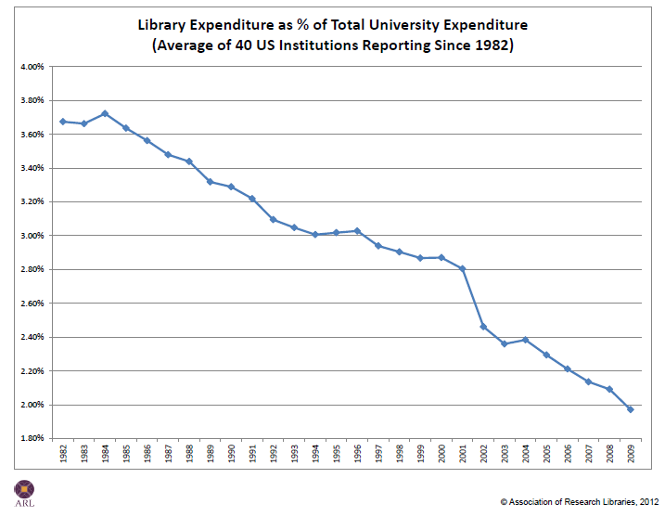
Smaller Piece of the Pie for
Academic Libraries
http://www.arl.org/bm~doc/library-expenditures-as-a-percent-of-total-university-expenditures-1982-2009-40-universities.pdf/ Downloaded April 11, 2012

Slide 10
But, at the same time…

Slide 11
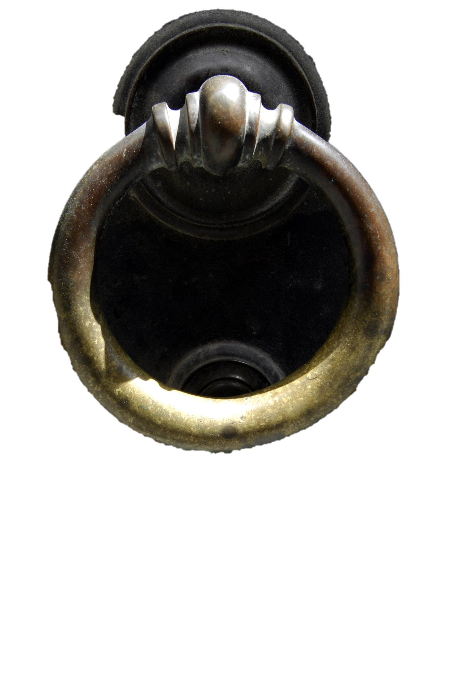
Opportunity is Knocking
CC BY-NC / Pim Stouten / http://www.flickr.com/photos/pimgmx/4904649873/sizes/l/

Slide 12
Opportunity is Knocking
Technology
  Internet
  Mass Digitization
  Proliferation of Online resources
Providing the opportunity to think differently about libraries.
CC BY-NC / Pim Stouten / http://www.flickr.com/photos/pimgmx/4904649873/sizes/l/

Slide 13
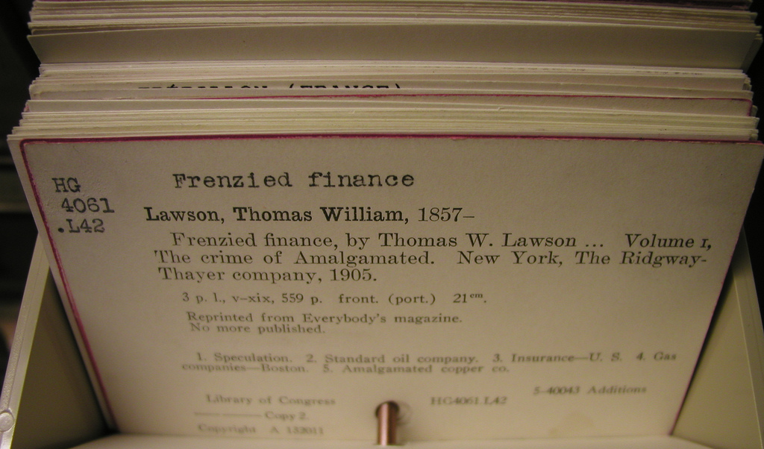
In the Past:
CC BY 2.0 / dfulmer /http://www.flickr.com/photos/annarbor/4349874915/sizes/l/in/photostream/

Slide 14
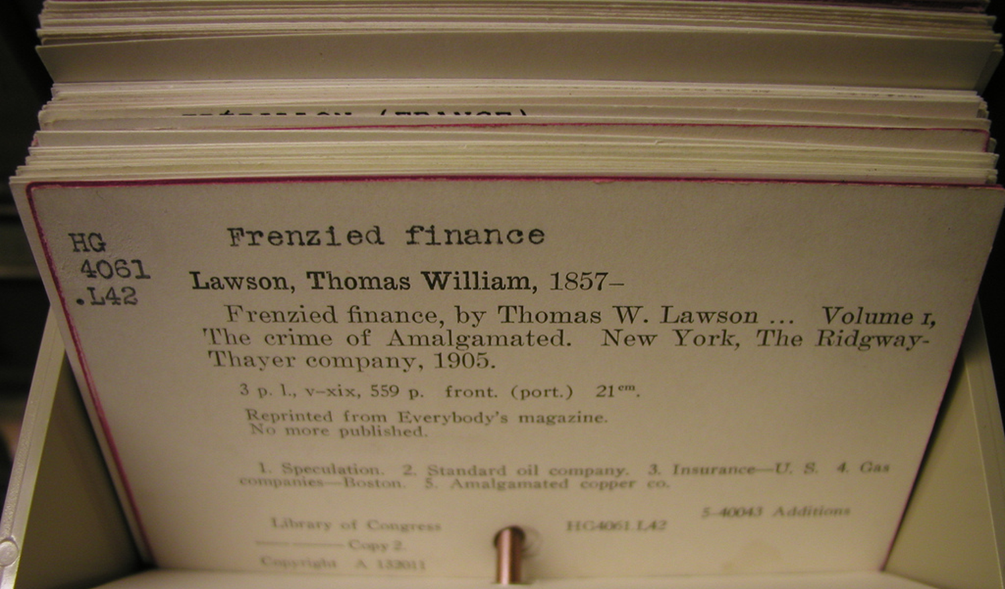
In the Past:
We Built Stand-Alone Collections
CC BY 2.0 / dfulmer /http://www.flickr.com/photos/annarbor/4349874915/sizes/l/in/photostream/

Slide 15

Difficult to Know what Others Owned
CC BY 2.0 / Karin Dalziel /http://www.flickr.com/photos/nirak/2035550177/sizes/l/in/photostream/

Slide 16
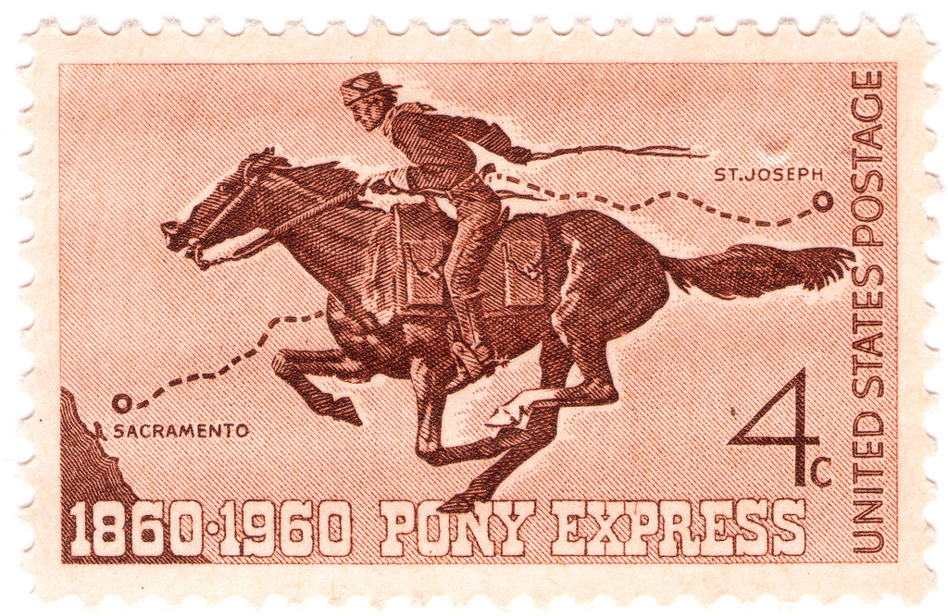
Expensive and Time Consuming to Get Items from Other Libraries
CC BY-NC 2.0 / Rob Weir /http://www.flickr.com/photos/rcweir/5286185440/sizes/l/in/photostream/
Notes:
This is why so much value was placed on collection counts in the past.

Slide 17

Purchased Just in Case…
Attempted to anticipate needs
Tried to build comprehensive collections
  Why volume count was so important
CC BY-NC-SA 2.0 / Random Letters / http://www.flickr.com/photos/jessiemoore/3192090799/sizes/l/in/photostream/
Notes:
Libraries built these collections by working with faculty, studying what was being taught by the university and by examining what was used by library patrons. Based on those things they would go out and identify what they thought were the books most likely to be used.

Slide 18
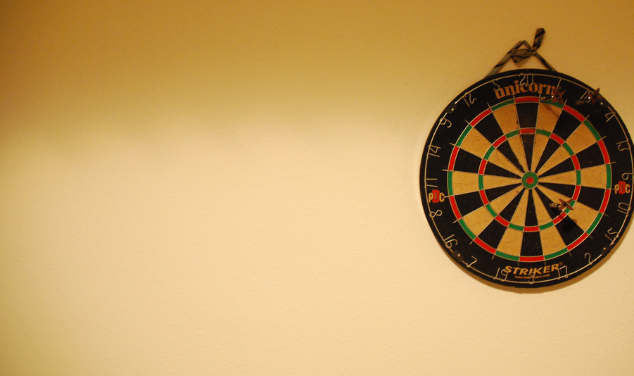
The Problem
We’re not good at guessing…
Kent Study: 40% of books never circulated
Cornell: 55% of books published since 1990
SCS Monographs Index: 42%
  75% 3 or fewer circs
Kent, Allen. 1979. Use of library materials: the University of Pittsburgh study. New York: M. Dekker.
Report of the Collection Development Executive Committee Task Force on Print Collection Usage.
Cornell University Library, http://staffweb.library.cornell.edu/system/files/CollectionUsageTF_ReportFinal11-22-10.pdf
Lugg, Rick. January, 2017. The SCS Monographs Index, https://www.oclc.org/en/sustainable-collections/resources.html
CC BY-NC 2.0 / Liam Gallagher / http://www.flickr.com/photos/23026122@N07/2209377175/sizes/l/in/photostream/
Notes:
Even when we do everything right, we’re not very good at guessing.

Slide 19
The Problem
And it’s expensive to keep these things on our shelves
Myth of the one-time cost
  $4.26 per year per volume
  Costing us time, space, money and opportunity
Council on Library and Information Resources. 2010. The idea of order: transforming research collections for 21st century scholarship. Washington, D.C.: Council on Library and Information Resources.
CC BY-NC 2.0 / Liam Gallagher / http://www.flickr.com/photos/23026122@N07/2209377175/sizes/l/in/photostream/
Notes:
Even when we do everything right, we’re not very good at guessing.

Slide 20
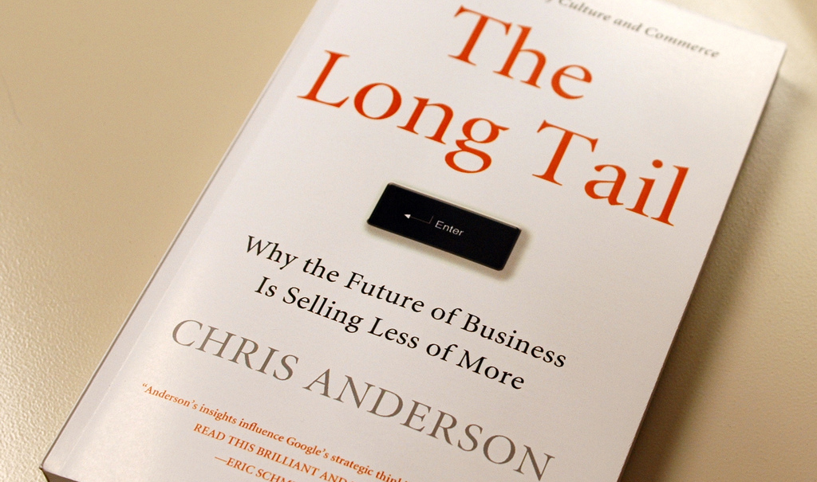
Complicating Things:
How Collections are Used
CC BY-NC 2.0 / Gene Han / http://www.flickr.com/photos/larimdame/1450114840/sizes/l/in/photostream/

Slide 21
Complicating Things:
How Collections are Used
Not a new concept in libraries
  Trueswell’s 80-20 rule
  Updated in 2011 by an OhioLink study
    80-6 rule
CC BY-NC 2.0 / Gene Han / http://www.flickr.com/photos/larimdame/1450114840/sizes/l/in/photostream/
Trueswell, Richard. 1969. “Some Behavioral Patterns of Library Users: The 80/20 Rule. Wilson Library Bulletin, 43 (5), 458-61.
Edward T. O’Neill, and Julia Gammon. 2011. OhioLINK—OCLC collection and circulation analysis project 2011. Online Computer Library Center. http://www.oclc.org/resources/research/publications/library/2011/2011-06.pdf

Slide 22
Complicating Things:
How Collections are Used
6% of books in Academic Libraries account for 80% of the use
CC BY-NC 2.0 / Gene Han / http://www.flickr.com/photos/larimdame/1450114840/sizes/l/in/photostream/
Notes:
We’re spending time and money on books, many of which are never even used. And when they’re used they’re used only once or twice. Think of all the things we could be doing if we weren’t guessing.

Slide 23
Instead of Building Collections…
Libraries today must figure out how to provide access to the resources people want and need.
Efficiently
^

Slide 24

How are some libraries doing this?
http://www.flickr.com/photos/horiavarlan/4273168957/

Slide 25
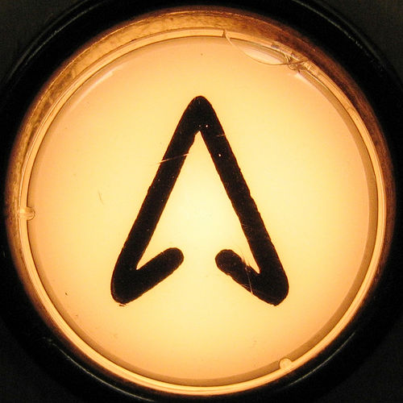
Exploiting eBooks
Overcome limits of time and place
Can be more cost effective
  Bundles
  Data Driven Models
CC BY-NC 2.0 / Eden Politte / http://www.flickr.com/photos/selva/1093152/sizes/m/in/photostream/

Slide 26
Exploiting eBooks
Not without limits
  DRM
  Licensing restrictions
  User preference
CC BY-NC 2.0 / Eden Politte / http://www.flickr.com/photos/selva/1093152/sizes/m/in/photostream/

Slide 27
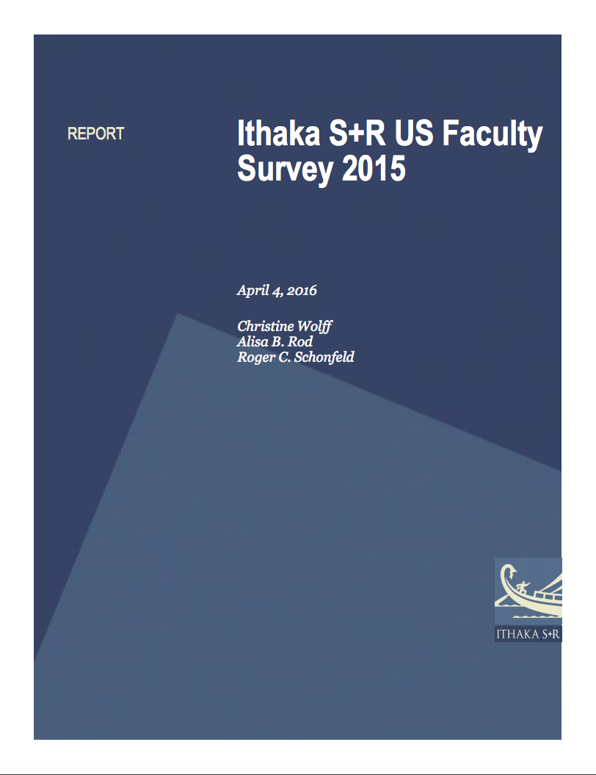
“There is no observable trend towards a format transition for monographs.
Faculty members’ preference for using scholarly monographs in various ways in print format rather than digital format has, if anything, increased since the previous cycle of the survey.”
Christine Wolff, Alisa B. Rod and Roger C. Schonfeld, Ithaka S+R U.S. Faculty Survey 2015 (April 4, 2016), http://www.sr.ithaka.org/wp-content/uploads/2016/03/SR_Report_US_Faculty_Survey_2015040416.pdf.

Slide 28
What They Say vs.
What They Do

Slide 29
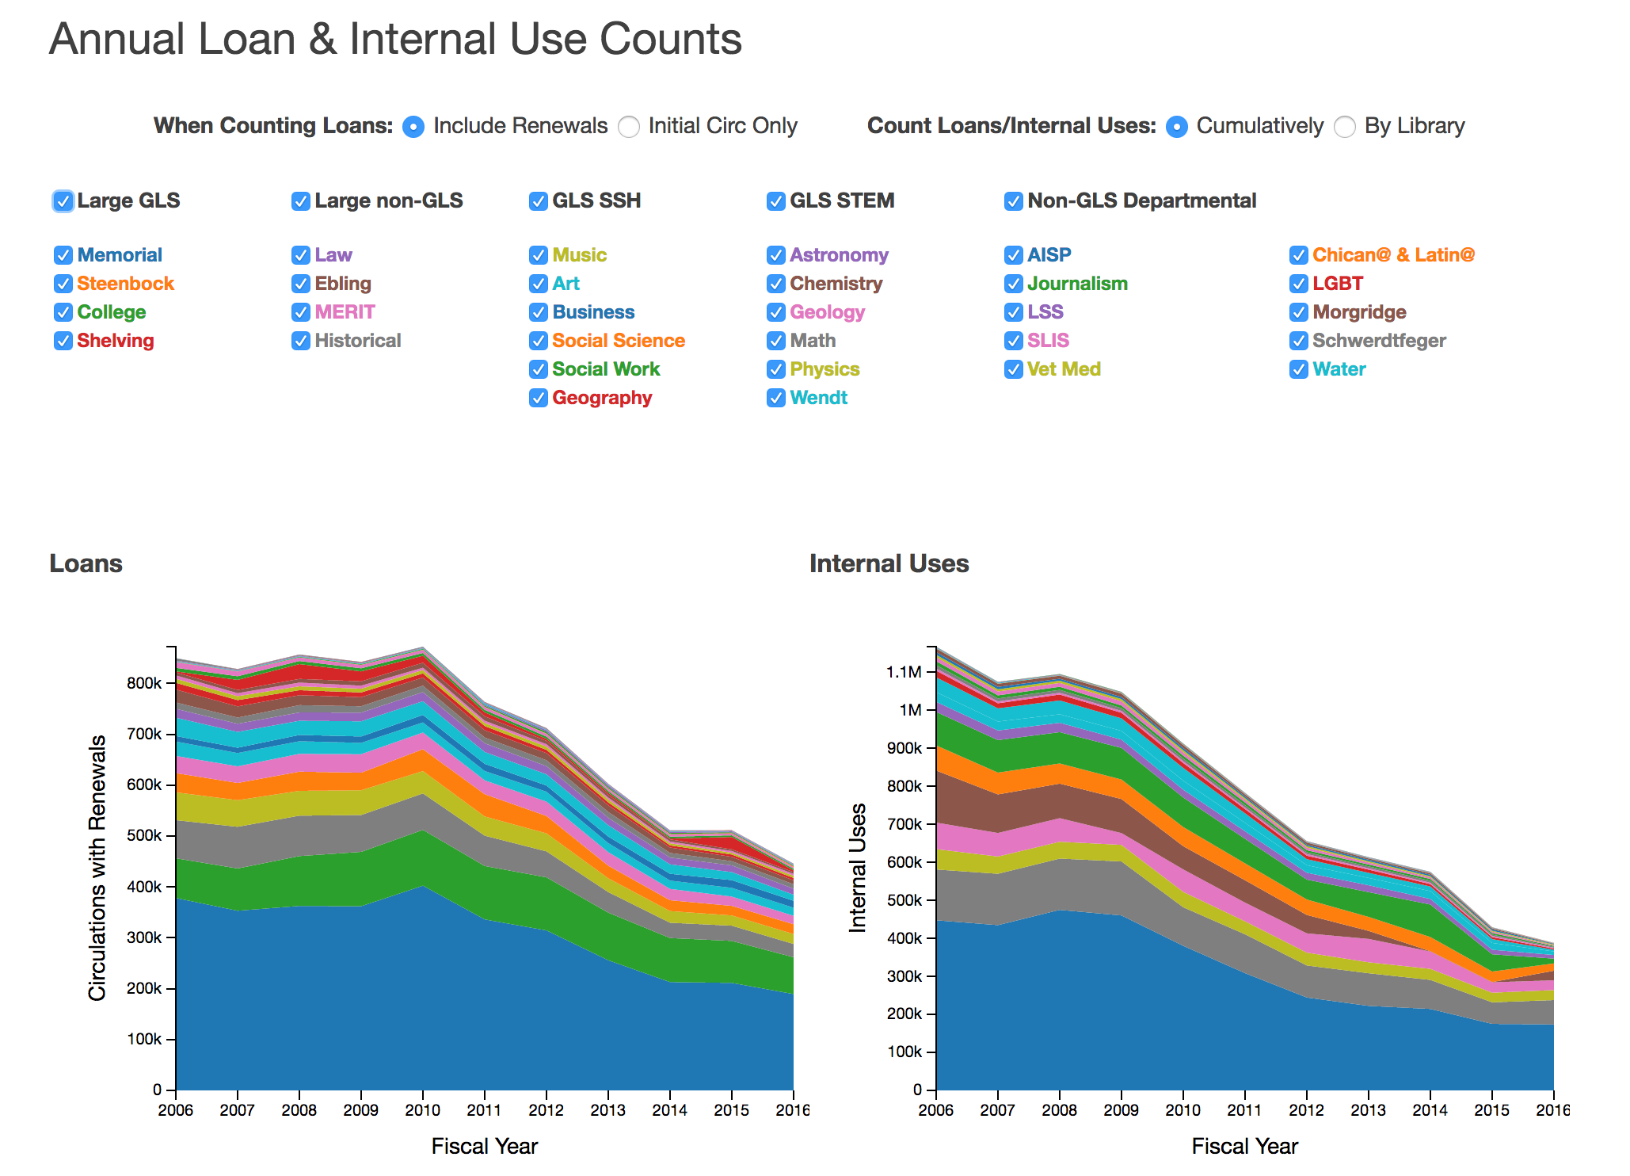

Slide 30
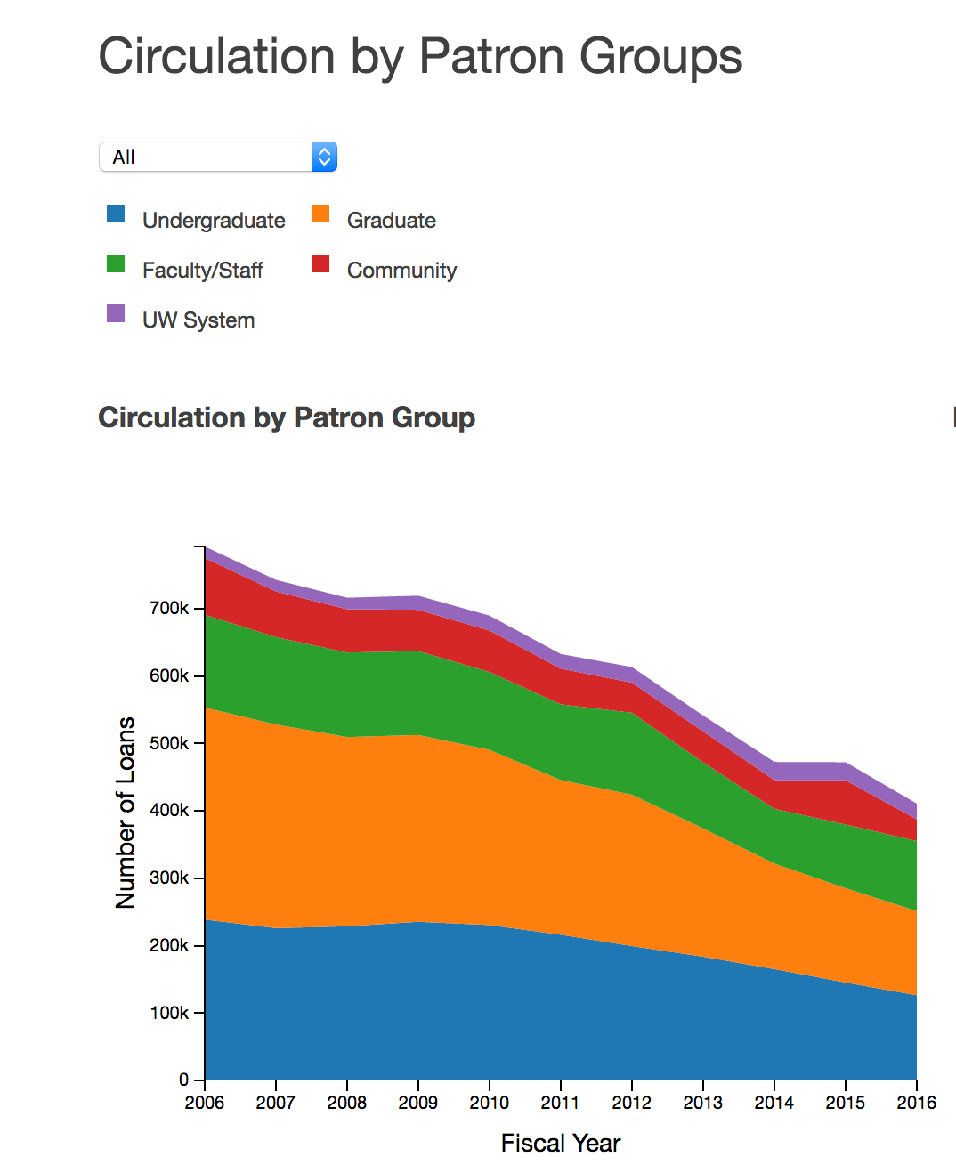
Faculty: Down 24%
Undergrads: Down 47%
Grad Students: Down 60%

Slide 31
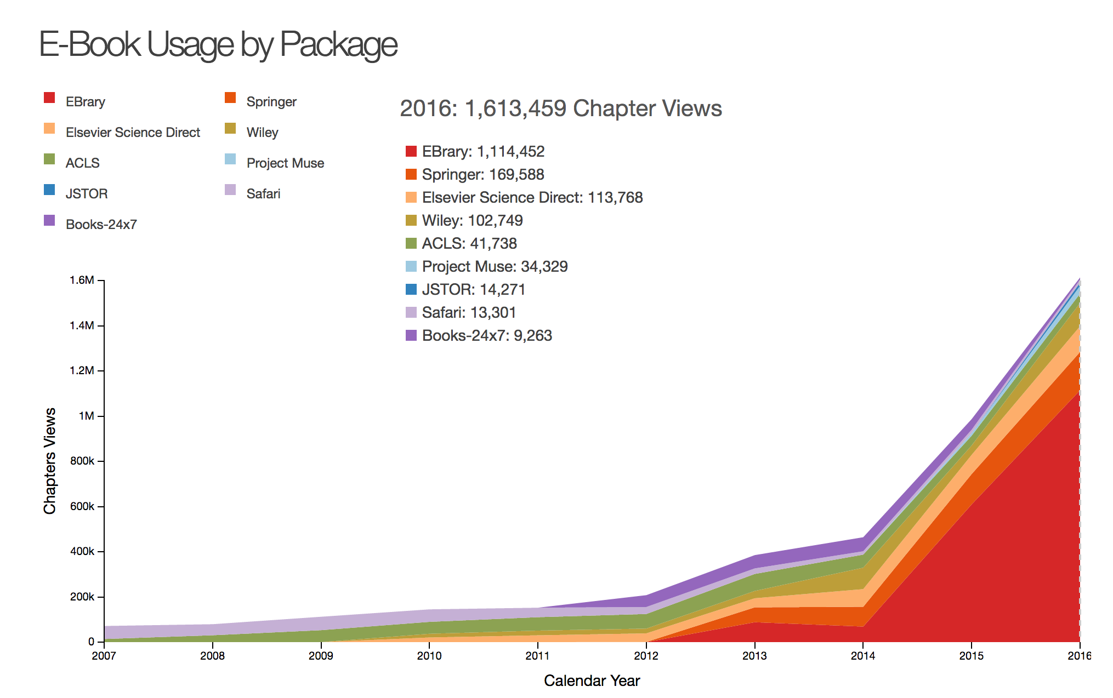

Slide 32

Moving Away from
Title-by-Title Selection
Just-in-case collecting not effective
Increasing and emerging demands on librarians
Technology making this model obsolete
CC BY-SA 2.0 / Eric Skiff / http://www.flickr.com/photos/93132003@N00/384448091/

Slide 33
Moving Toward
Just-in-Time Purchasing
Purchase on Demand
  Libraries have been doing this for a long time
    Patron Requests
    ILL Requests
Technology is the difference

Slide 34

Just-in-Time Purchasing
CC BY-NC-SA 2.0 / Guillermo Esteves / http://www.flickr.com/photos/gesteves/2217350999/sizes/l/in/photostream/

Slide 35
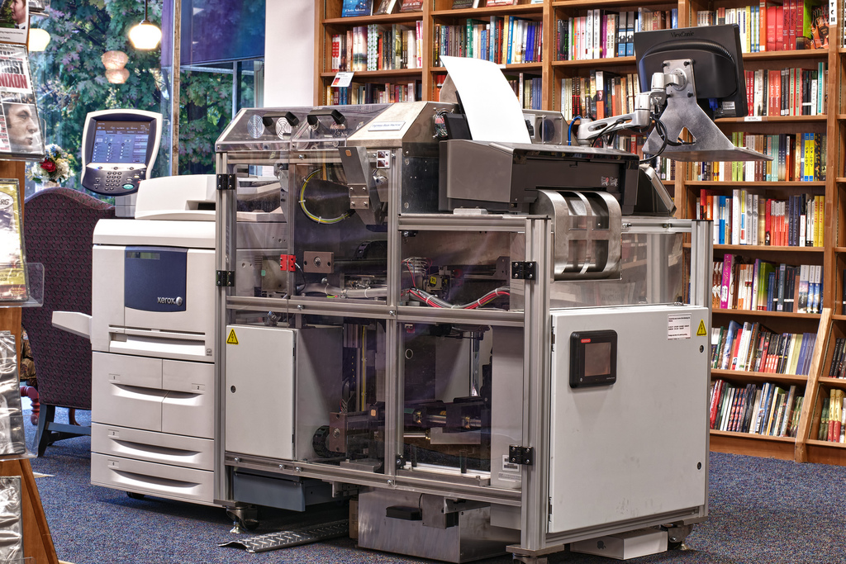
Just-in-Time Purchasing
CC BY-SA 2.0 / Politics and Prose Bookstore / http://www.flickr.com/photos/politicsandprose/6256317164/sizes/l/in/photostream/

Slide 36

Just-in-Time Purchasing
Ebook Patron-Driven Acquisitions
  Immediate & seamless access
  Cost effective
CC BY 2.0 / Arbron / http://www.flickr.com/photos/arbron/56216464/sizes/l/in/photostream/

Slide 37

But what about print books?
CC BY / Brenda Starr / http://www.flickr.com/photos/brenda-starr/5076790282/sizes/l/in/photostream/

Slide 38

Two Percentages…
50%
  Even if we wanted to, we cannot solely rely on ebooks
  Print remains necessary
CC BY-SA 2.0 / badjonni / http://www.flickr.com/photos/38834306@N00/380432546/

Slide 39
Two Percentages…
6%
  We need to make sure users have immediate access
  For the rest…?
CC BY-SA 2.0 / badjonni / http://www.flickr.com/photos/38834306@N00/380432546/

Slide 40

Cooperative Collections Strategies
Libraries Cooperating Nothing New
  Resource Sharing
  Union Catalogs
  Delivery Systems
  Not done in a systematic fashion
CC BY-NC-SA 2.0 / Richard Asia / http://www.flickr.com/photos/bamboo-adventure/3530133273/

Slide 41
Cooperative Collections Strategies
Systematic Approach
  Entire Life-cycle—Selection to Withdrawal
Cooperative Collection Management
  Legacy Collections
Coordinated Collection Development
  Prospective Collecting
CC BY-NC-SA 2.0 / Richard Asia / http://www.flickr.com/photos/bamboo-adventure/3530133273/

Slide 42
Cooperative Collection Management

Slide 43

Programs for the Management of Legacy Collections
“Shared Print”
  Libraries commit to retain a limited number of widely held items to allow other libraries to withdraw their matching holdings
Two models
  Centralized or Decentralized
Most projects have focused on journals or monographs
CC BY-SA / Ginnerobot / http://www.flickr.com/photos/ginnerobot/2549674296/

Slide 44
Programs for the Management of Legacy Collections
Journals
  Print retention (WEST, CIC, CRL, JSTOR projects)
  Electronic preservation
    Portico, LOCKSS, CLOCKSS
  Leveraging electronic surrogates for access
CC BY-SA / Ginnerobot / http://www.flickr.com/photos/ginnerobot/2549674296/

Slide 45
Programs for the Management of Legacy Collections
Monographs
  Challenges
    Digital surrogates not available (for access)
      Copyright an issue
    Editions
  Opportunity is huge
CC BY-SA / Ginnerobot / http://www.flickr.com/photos/ginnerobot/2549674296/

Slide 46
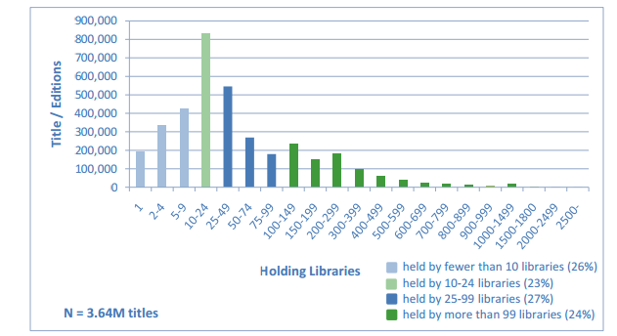
Opportunity
System-wide distribution of library holdings for titles in HathiTrust Digital Library (June 2010)
74%
of books in HathiTrust are held by 10 or more libraries
Constance Malpas, Cloud-sourcing Research Collections: Managing Print in the Mass-digitized Library Environment http://www.oclc.org/resources/research/publications/library/2011/2011-01.pdf

Slide 47

Opportunity
Monographs Index (January, 2017)
212 Libraries
82 million holdings
75% of titles held by more than 100 libraries
1% of titles held by fewer than 5 libraries
https://www.oclc.org/sustainable-collections/resources.en.html

Slide 48
Shared Print Monograph Projects in the United States
Regional projects to date
Moving to National projects
  HathiTrust Shared Print
    More than 15 Million volumes

Slide 49
Coordinated Collection Development

Slide 50

Changing Acquisition Models
Coordinating acquisitions to minimize duplication
Relying on partners for access
CC BY / Emiliano Horcado / http://www.flickr.com/photos/emilianohorcada/3700445647/sizes/o/

Slide 51
Changing Acquisition Models
Existing programs today
  Shared approval plans
  Threshold models
Significant opportunity to do even more
CC BY / Emiliano Horcado / http://www.flickr.com/photos/emilianohorcada/3700445647/sizes/o/

Slide 52

What Should We Be
Looking Toward?
Data-driven approach
  Identify high demand titles (The 6%)
    Efficiently acquire them
  Leverage common systems and predictive analytics
CC BY-NC-ND 2.0 / Tobias Leeger / http://www.flickr.com/photos/61212260@N00/1098106984/

Slide 53
What Should We Be
Looking Toward?
Data-driven approach
Tighter Integration
  Policies & Loan Periods
  Facilitating Discovery
CC BY-NC-ND 2.0 / Tobias Leeger / http://www.flickr.com/photos/61212260@N00/1098106984/

Slide 54
What Should We Be
Looking Toward?
Data-driven approach
Tighter Integration
Investing in Delivery
CC BY-NC-ND 2.0 / Tobias Leeger / http://www.flickr.com/photos/61212260@N00/1098106984/

Slide 55
What Should We Be
Looking Toward?
Data-driven approach
Tighter Integration
Investing in Delivery
What we gain, not what we will lose
  Libraries are our own worst enemies
    Unwillingness to give up local control
    Fear of the unknown
CC BY-NC-ND 2.0 / Tobias Leeger / http://www.flickr.com/photos/61212260@N00/1098106984/

Slide 56
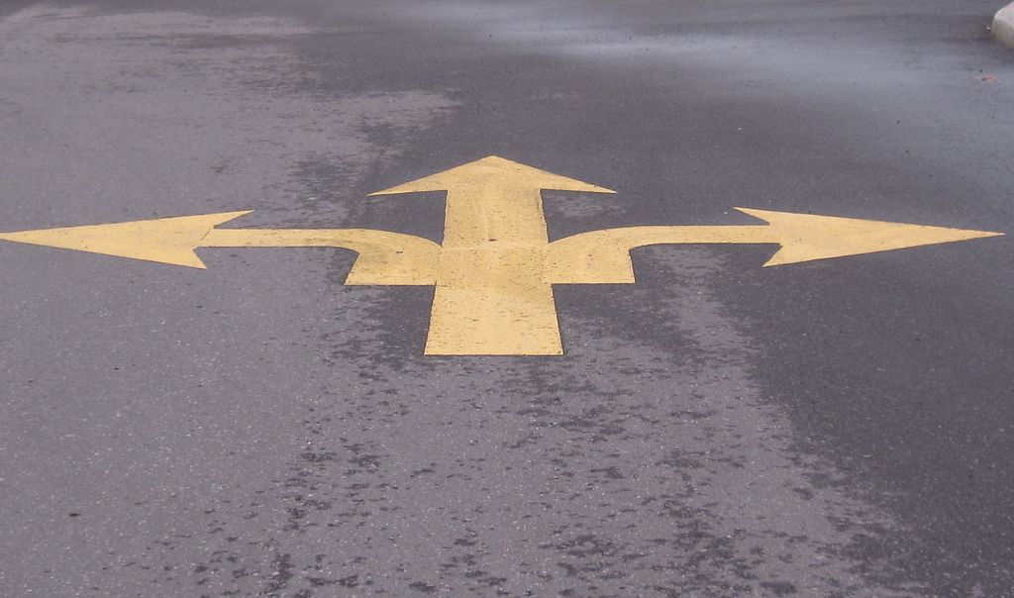
The Reality:
We’re at a Crossroads
CC BY / Pat Pilon / http://www.flickr.com/photos/59836631@N06/5773953057/

Slide 57

We can Continue on this Path
CC BY-NC-SA / Dean Ayres / http://flic.kr/p/76DjLt

Slide 58

or we can chart our own course
CC BY-SA / Mukumbura / http://www.flickr.com/photos/11738433@N03/4092900623/

Slide 59

Taking Advantage of Technology
CC BY-NC-SA / Jhon C. Williams / http://www.flickr.com/photos/purewightphotography/8197548940/sizes/l/in/photostream/

Slide 60
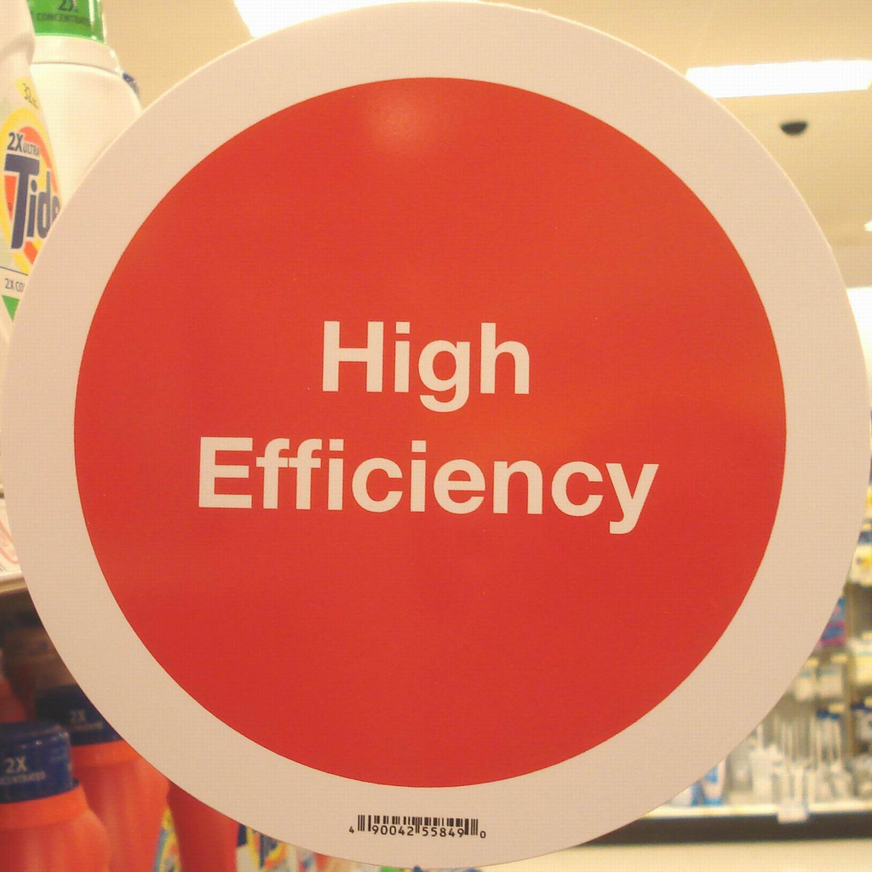
Embracing More Efficient Collections Practices
CC-BY-NC-SA / Contemplative Imaging / http://www.flickr.com/photos/thomas-merton/3687690283/
CC-BY-NC-SA / Tom Magliery / http://www.flickr.com/photos/50318388@N00/2554698603/

Slide 61
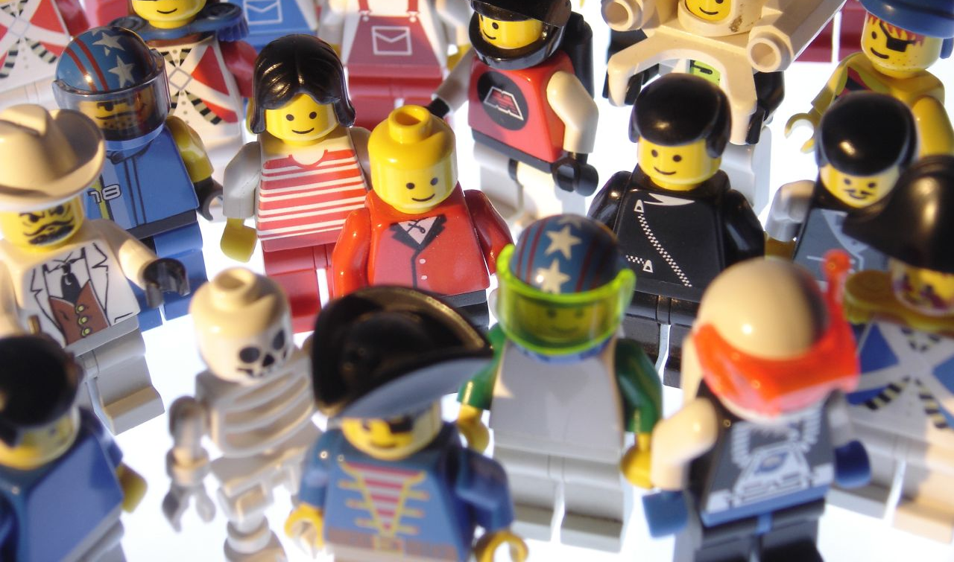
Working Together to Provide Access to Resources
CC-BY-NC-SA / Scoobay / http://www.flickr.com/photos/64461923@N00/224565711/

Slide 62

You Create Savings
CC BY / Andrew Magill / http://flic.kr/p/68vjKV

Slide 63
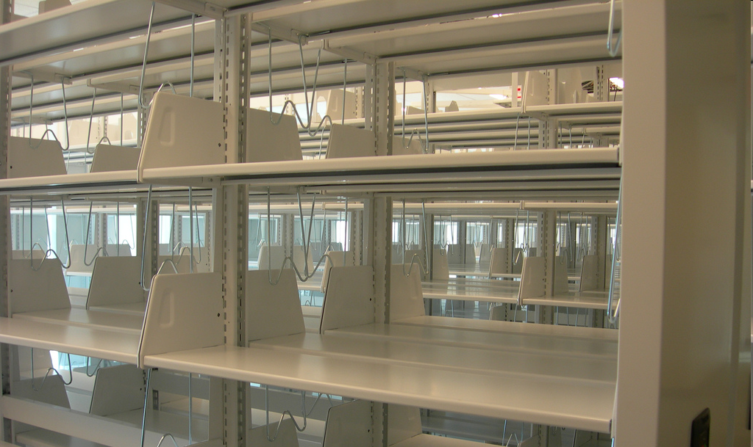
You Create Savings
CC BY-NC-SA 2.0 / Spinstah / http://www.flickr.com/photos/thedoubleduchess/493867848/

Slide 64

You Create Savings
CC BY –NC-SA / Herr Kaczmarek / http://flic.kr/p/6dc9bp

Slide 65
All of Which Adds up to…

Slide 66
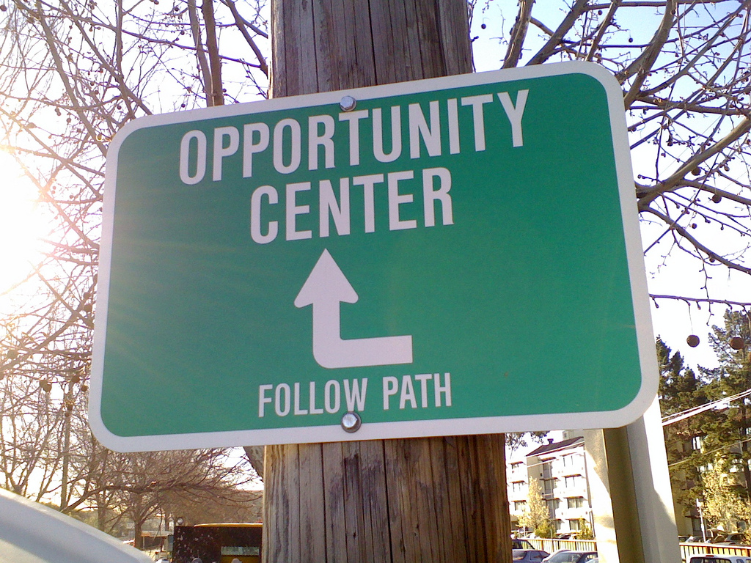
All of Which Adds up to…

Slide 67
Opportunity for the
New
Unknown
programs
Spaces
SERVICES
Possibilities

Slide 68

Questions?
CC BY-NC 2.0 / rbbaird / http://www.flickr.com/photos/rbbaird/5245985787/
doug.way@wisc.edu
works.bepress.com/doug_way

