Slide 1

Model predictive control of an assistive robotic arm for shared autonomy implementation
by Anton Kim
Notes:
30s

Slide 2
Outline
Introduction
Model Predictive Control
Related work
Methodology
Implementation
Results
Future Work
References
Notes:
30s

Slide 3
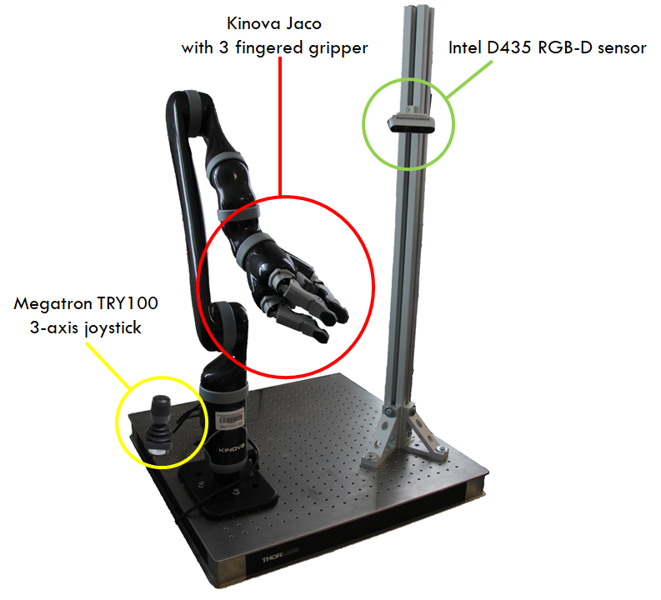
Introduction
Why MPC?
  Focus on a control
  Shared autonomy as a next step
What changed:
  Jacobian based system model
  Dynamic weighting matrices
  Grasping pose estimation
Notes:
120s
Why MPC and not a shared autonomy? Finishing MPC was harder than expected
What changed

Slide 4
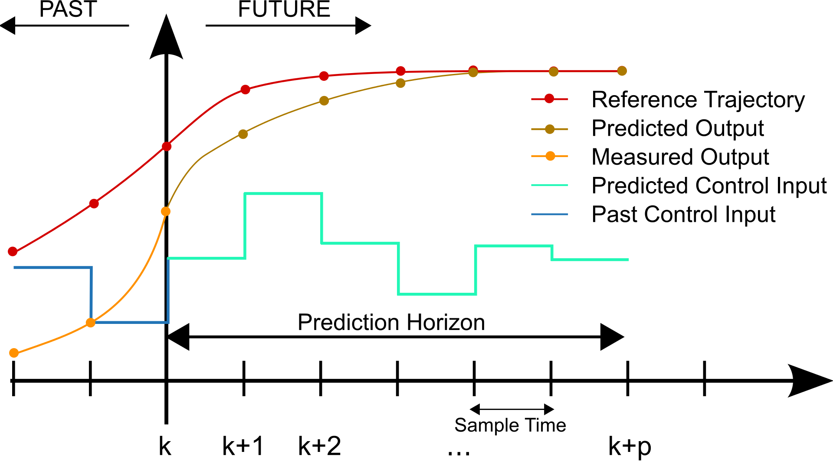
Model Predictive Control
Dynamic system model
Quadratic cost function
Newton-type optimization
Optimization on each time step
Optimize on [t, t+T], T = dt*N
Use past solution as initial state
en.wikipedia.org/wiki/Model_predictive_control
Notes:
Model predictive controllers rely on dynamic models of the process, most often linear empirical models obtained by system identification. The main advantage of MPC is the fact that it allows the current timeslot to be optimized, while keeping future timeslots in account. This is achieved by optimizing a finite time-horizon, but only implementing the current timeslot and then optimizing again, repeatedly, thus differing from Linear-Quadratic Regulator (LQR)

Slide 5
Related Work
Model Predictive Control
  Long history and extensive use in different areas (Michele,2011; Eaton,1992; Kazmierkowski,2018; Ricker,1988)
  MPC in robotics:
    Drones (Falanga,2018; Kamel,2017)
    Manipulators (Rubagotti,2019; Zube,2015)
    And mobile robots (Quirynen,2020)
  Easy to formulate and deploy:
    ACADO Toolkit (Houska,2011)
    CASADI (Andersson,2019)
    pNMPC (Rathai,2020)
Notes:
120s: MPC and pose estimation
MPC: long history and extensive use in different areas such as chemistry, power transmissions and manufacturing processes
In robotics MPC is actively used for drones, manipulators and mobile robots.
In the past sampling time was on the order of hours
Thanks to the fast modern CPUs, MPC based controllers are capable of executing feedback loop in just a few milliseconds
MPC easy to deploy thanks to ACADO. More recent CASADi framework, pNMPC for fast real time embedded systems.

Slide 6
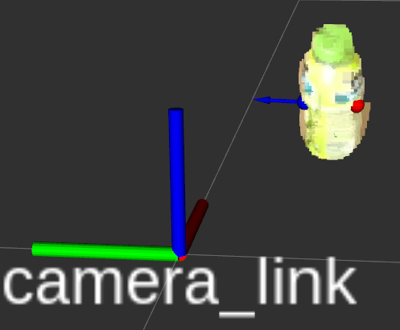
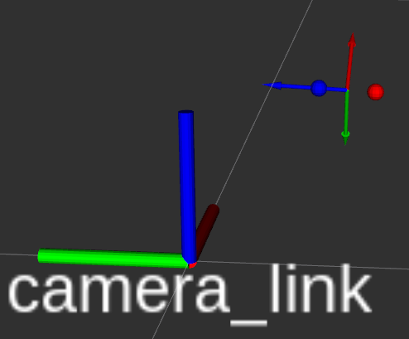
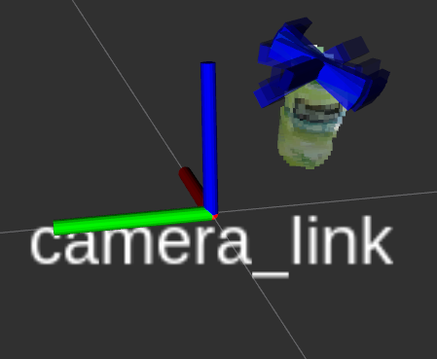
Related Work
Tried two different pose estimation:
  geograsp (Zapata-Impata,2019)
  gpd (ten Pas,2017)
Shared autonomy:
  Blending
    X=(1-𝛼)X_{robot} + 𝛼X_{human}
  Markov processes
    Resembles state machine transitions
  Visualization
geograsp
gpd
Notes:
120s: pose estimation and shared autonomy
For grasp pose estimation I currently use geograsp by Zapata-Impata and others. Before I used gpd algorithm but it had several problems: 1) slow, because works with neural networks, 2) (main problem) not easily configurable, designed for a camera looking down for a boxpicking problem.
No such problems with geograsp, while it is also faster and uses less resources. So I stopped on the geograsp.
I would like to briefly describe current state of shared autonomy algorithms

Slide 7
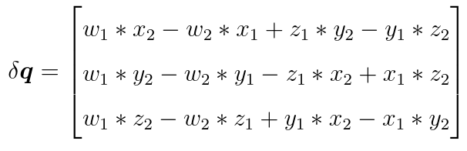
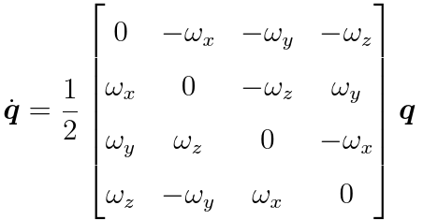
Methodology. Quaternions
Efficient rotation representation of the form
  q = w + ix + jy + kz or short version q = [w,x,y,z]
Given two frame rotations q₁ = [w₁,x₁,y₁,z₁] and q₂ = [w₂,x₂,y₂,z₂], one can express error between q₁ and q₂ as the following (Yuan,1988):
And given frame angular velocity [𝜔_{x},𝜔_{y},𝜔_{z}], quaternion rate of change can be estimated as the following (Sola,2017):
Notes:
60s: Quaternions
120s: System model and MPC formulation

Slide 8
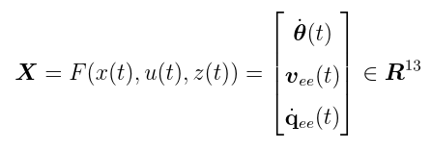
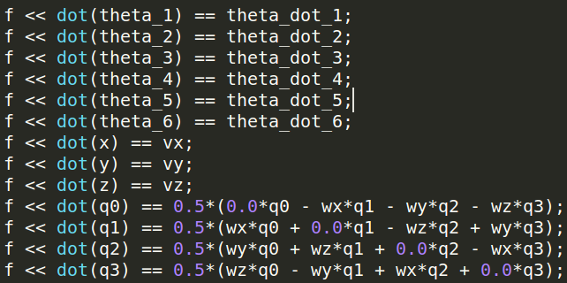

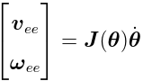
Methodology. System model
System model is described by a set of nonlinear differential equations
  J(𝜃) is the Jacobian matrix derived from FK of Jaco (Kinova User Guide,2018)
Notes:
60s: Quaternions
120s: System model and MPC formulation

Slide 9
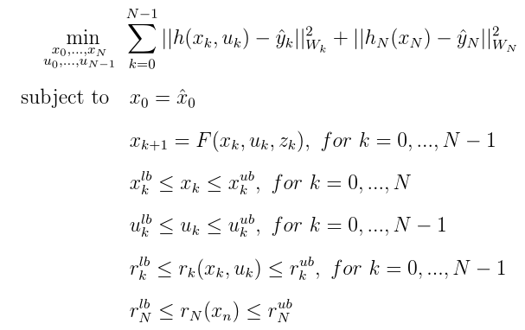
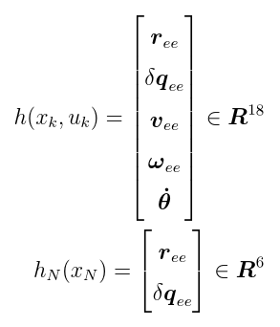
Methodology. MCP formulation
The NMPC is formulated in ACADO Toolkit as the following:
The reference functions are the following
Notes:
60s MPC formulation
with number of discretization steps N = 10 and sampling time Ts = 0.1s. y ˆ k and y ˆ N denote real-time dynamic reference and Wk ∈ R18×18 and WN ∈ R6×6 are diagonal variable weighting matrices. rk (kk , uk ) and rN (xn ) are the path and point constraints. Superscripts lb and ub denote lower and upper bounds. F (xk , uk , zk ) is the discretized system model

Slide 10
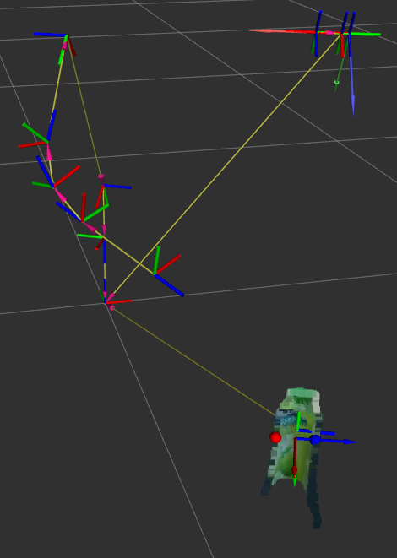
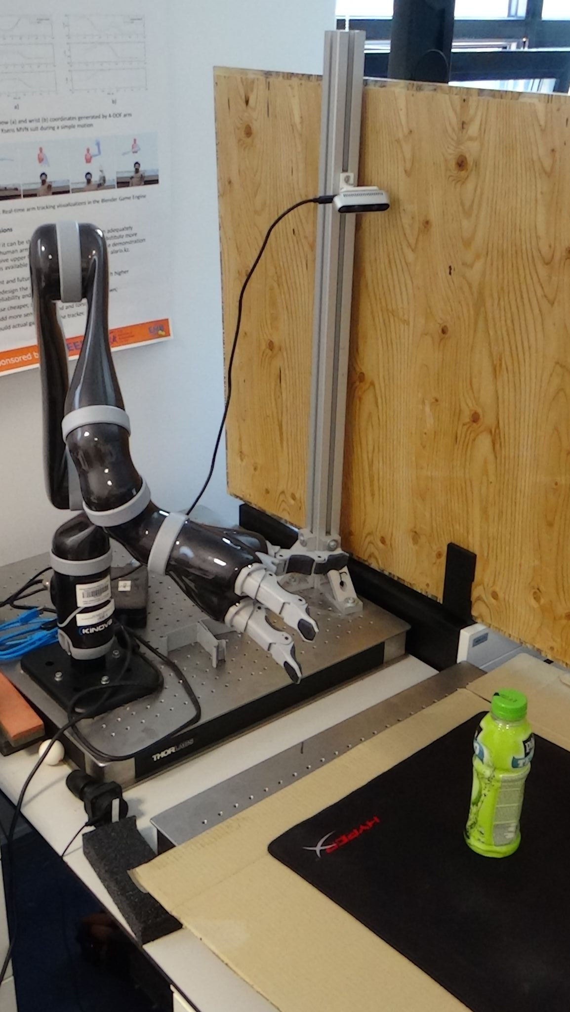
Implementation. Grasp estimation
Transform estimated grasp from camera frame to the robot frame
Build visualizable transform tree
Rotate the estimated grasp for easier reaching
Notes:
60s: Hardware setup calibration and grasp estimation
90s: Joystick modes and Intuitive frame
90s: MPC constraints and weights

Slide 11
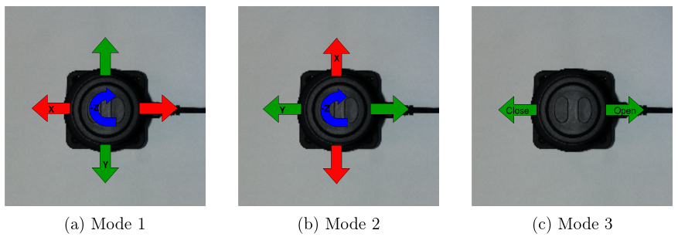
Implementation. Joystick modes
- | Linear velocity | Angular velocity | Finger control
User limit | 0.2 m/s | 0.4 rad/s | N/A
Solver limit | 0.4 m/s | 0.8 rad/s | N/A
Notes:
60s: Hardware setup calibration and grasp estimation
90s: Joystick modes and Intuitive frame
90s: MPC constraints and weights

Slide 12
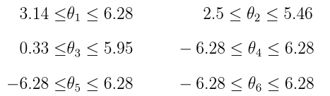

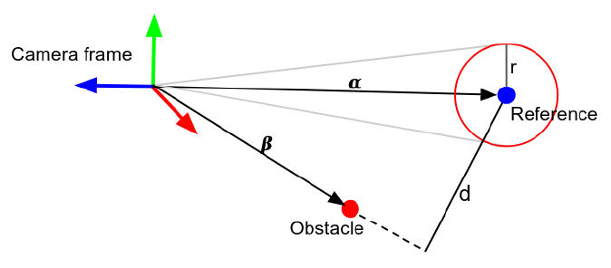
Implementation. NMPC constraints
Angular position constraints
Angular velocities constraint
  0.8 rad/s
Ground constraint
  5 cm
Visual constraints
Notes:
60s: Hardware setup calibration and grasp estimation
90s: Joystick modes and Intuitive frame
90s: MPC constraints and weights
Here I will show constraints that were chosen for the solver

Slide 13
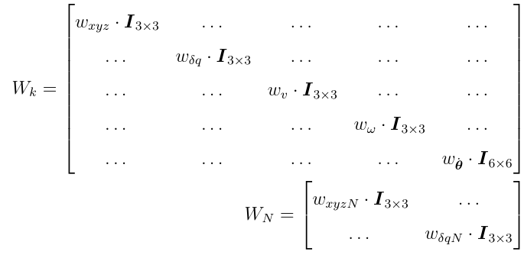
Implementation. NMPC weights
 | Teleop v | Teleop 𝛚 | Auto
w_{xyz} | 5e⁻⁴ | 3e⁴ | 5e⁻⁴
w_{δq} | 5e⁻¹ | 5e⁻⁴ | 5e⁻⁴
w_{v} | 5e⁴ | 1e² | 1e⁻³
w_{𝜔} | 1e² | 5e⁴ | 5e⁻³
wׅ_{𝜃} | 1e⁻⁸ | 1e⁻⁸ | 1e⁻⁸
w_{xyzN} | 1e⁻⁶ | 1e⁻³ | 1e⁻⁶
w_{δqN} | 1e⁻³ | 1e⁻⁶ | 1e⁻⁶

Slide 14
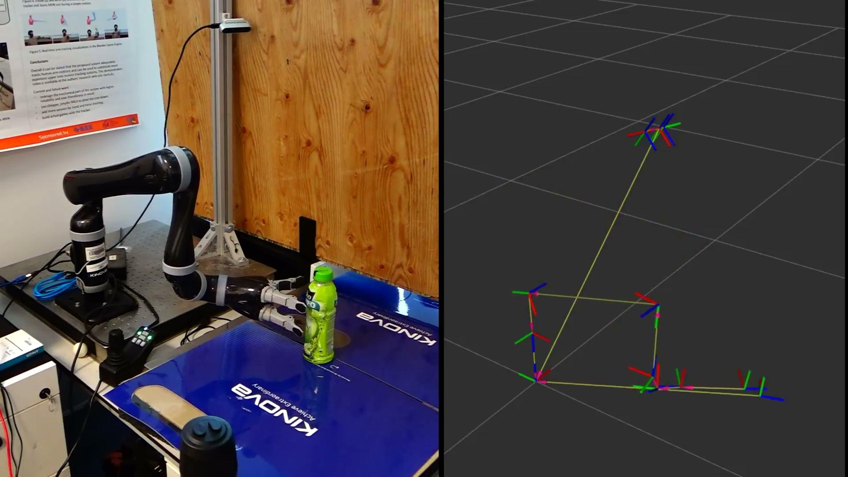
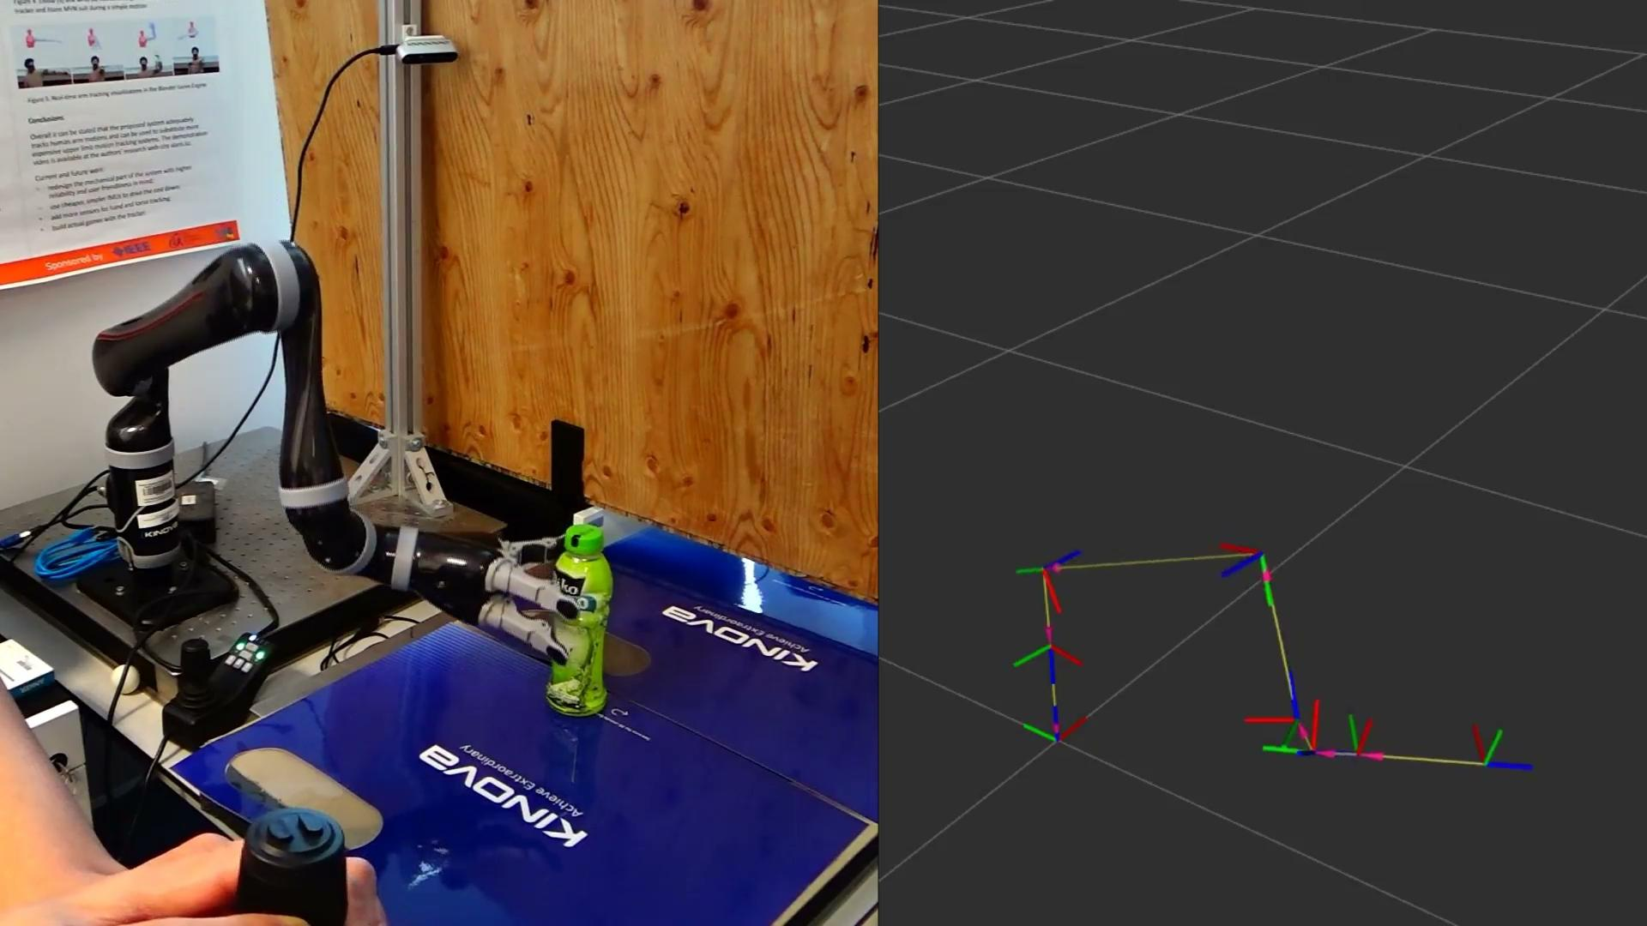
Implementation video
Automatic reaching Teleoperated reaching
Notes:
90s

Slide 15
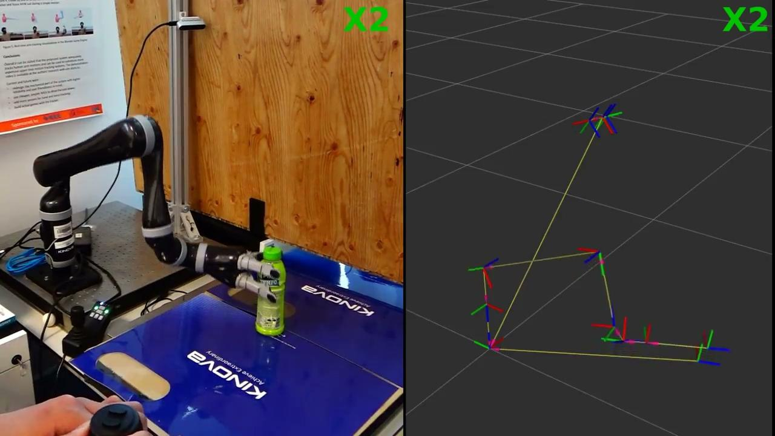
Implementation video
Mixed reaching

Slide 16
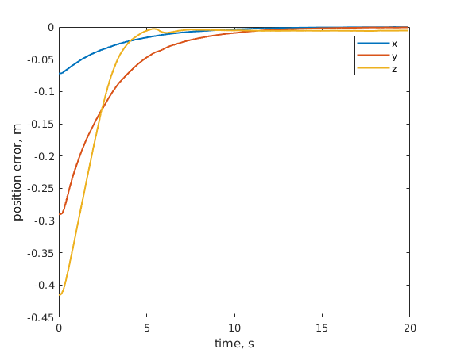
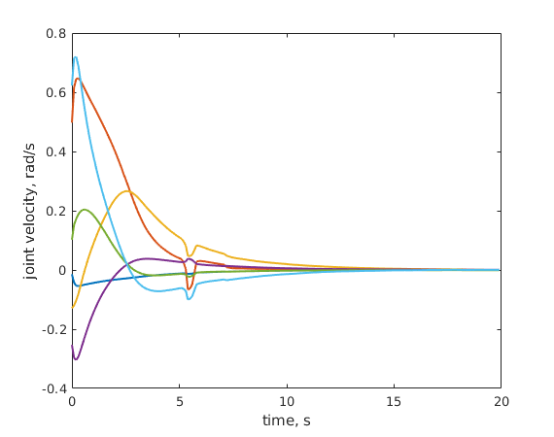
Results. Autonomous reaching
Position error Joint velocities

Slide 17
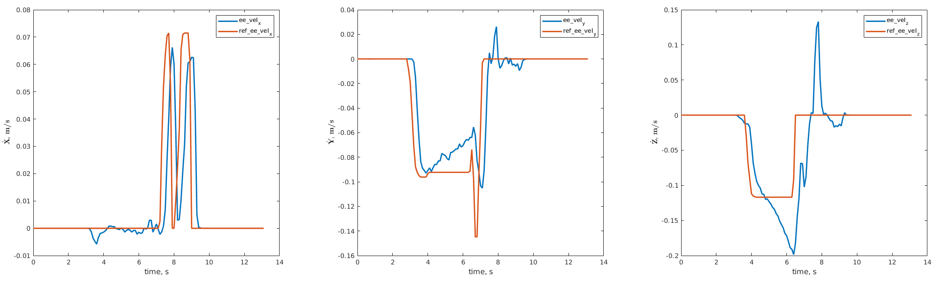
Results. Teleoperated reaching
Reference and actual end-effector linear velocity

Slide 18
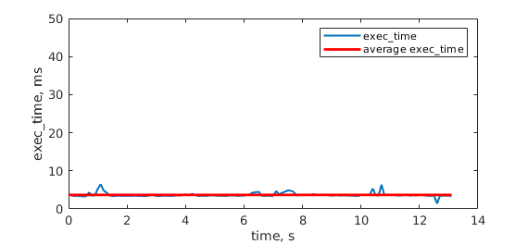
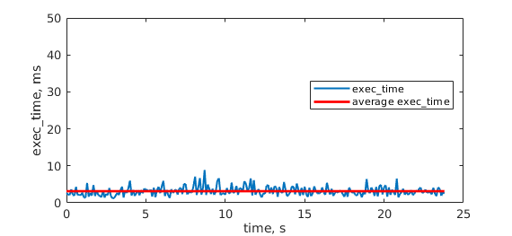
Results. Execution time
Average control loop execution time is approximately 3 ms
Teleoperated reaching Autonomous reaching

Slide 19
Future Work
Increase controller frequency
Clean and optimize the code
Implement shared autonomy
Conduct experiments
Notes:
120s: Present graphics
60: Discussion and future work

Slide 20
References
Arnold, Michele, and Göran Andersson. "Model predictive control of energy storage including uncertain forecasts." Power Systems Computation Conference (PSCC), Stockholm, Sweden. Vol. 23. 2011.
Eaton, John W., and James B. Rawlings. "Model-predictive control of chemical processes." Chemical Engineering Science 47.4 (1992): 705-720.
Kazmierkowski, Marian P. "Model Predictive Control of High Power Converters and Industrial Drives [Book News]." IEEE Industrial Electronics Magazine 12.3 (2018): 55-56.
Ricker, N. Lawrence, T. Subrahmanian, and T. Sim. "Case studies of model-predictive control in pulp and paper production." IFAC Proceedings Volumes 21.4 (1988): 13-22.
Falanga, Davide, et al. "Pampc: Perception-aware model predictive control for quadrotors." 2018 IEEE/RSJ International Conference on Intelligent Robots and Systems (IROS). IEEE, 2018.
Kamel, Mina, Michael Burri, and Roland Siegwart. "Linear vs nonlinear MPC for trajectory tracking applied to rotary wing micro aerial vehicles." IFAC-PapersOnLine 50.1 (2017): 3463-3469.
Rubagotti, Matteo, et al. "Semi-autonomous robot teleoperation with obstacle avoidance via model predictive control." IEEE Robotics and Automation Letters 4.3 (2019): 2746-2753.
Zube, Angelika. "Cartesian nonlinear model predictive control of redundant manipulators considering obstacles." 2015 IEEE International Conference on Industrial Technology (ICIT). IEEE, 2015.
Quirynen, Rien, et al. "Integrated Obstacle Detection and Avoidance in Motion Planning and Predictive Control of Autonomous Vehicles." 2020 American Control Conference (ACC). IEEE, 2020.
Houska, Boris, Hans Joachim Ferreau, and Moritz Diehl. "ACADO toolkit—An open‐source framework for automatic control and dynamic optimization." Optimal Control Applications and Methods 32.3 (2011): 298-312.
Andersson, Joel AE, et al. "CasADi: a software framework for nonlinear optimization and optimal control." Mathematical Programming Computation 11.1 (2019): 1-36.
Rathai, Karthik Murali Madhavan, Mazen Alamir, and Olivier Sename. "pNMPC-A Code Generation Software Tool for Implementation of Derivative Free Parameterized NMPC Scheme for Embedded Control Systems." (2020).
Zapata-Impata, Brayan S., et al. "Fast geometry-based computation of grasping points on three-dimensional point clouds." International Journal of Advanced Robotic Systems 16.1 (2019): 1729881419831846.
ten Pas, Andreas, et al. "Grasp pose detection in point clouds." The International Journal of Robotics Research 36.13-14 (2017): 1455-1473.
Yuan, J. S. "Closed-loop manipulator control using quaternion feedback." IEEE Journal on Robotics and Automation 4.4 (1988): 434-440.
Sola, Joan. "Quaternion kinematics for the error-state Kalman filter." arXiv preprint arXiv:1711.02508 (2017).
Kinova, KINOVA™Ultra lightweight robotic arm, User Guide. 2018. Retrieved from www.kinovarobotics.com/sites/default/files/ULWS-RA-JAC-UG-INT-EN%20201804-1.0%20(KINOVA%E2%84%A2%20Ultra%20lightweight%20robotic%20arm%20user%20guide)_0.pdf

