Slide 1

Towards automated molecular search in drug space
Co-supervisor: Siamac Fazli
Co-supervisor: Vsevolod A. Peshkov
External Examiner: Ferdinand Molnar

Slide 2
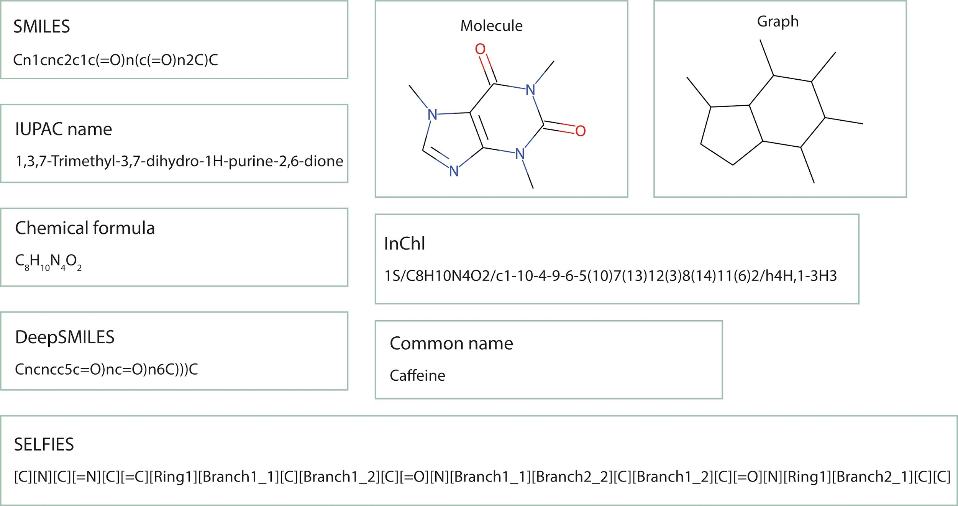
Molecular representations

Slide 3
Early drug discovery - Combinatorial approach
Uses expert knowledge
Knowledge about possible reactions

Slide 4
Early drug discovery - Databases of chemical compounds
Use substructure search to find molecules with suitable structural patterns
Use similarity search to find molecular analogues

Slide 5
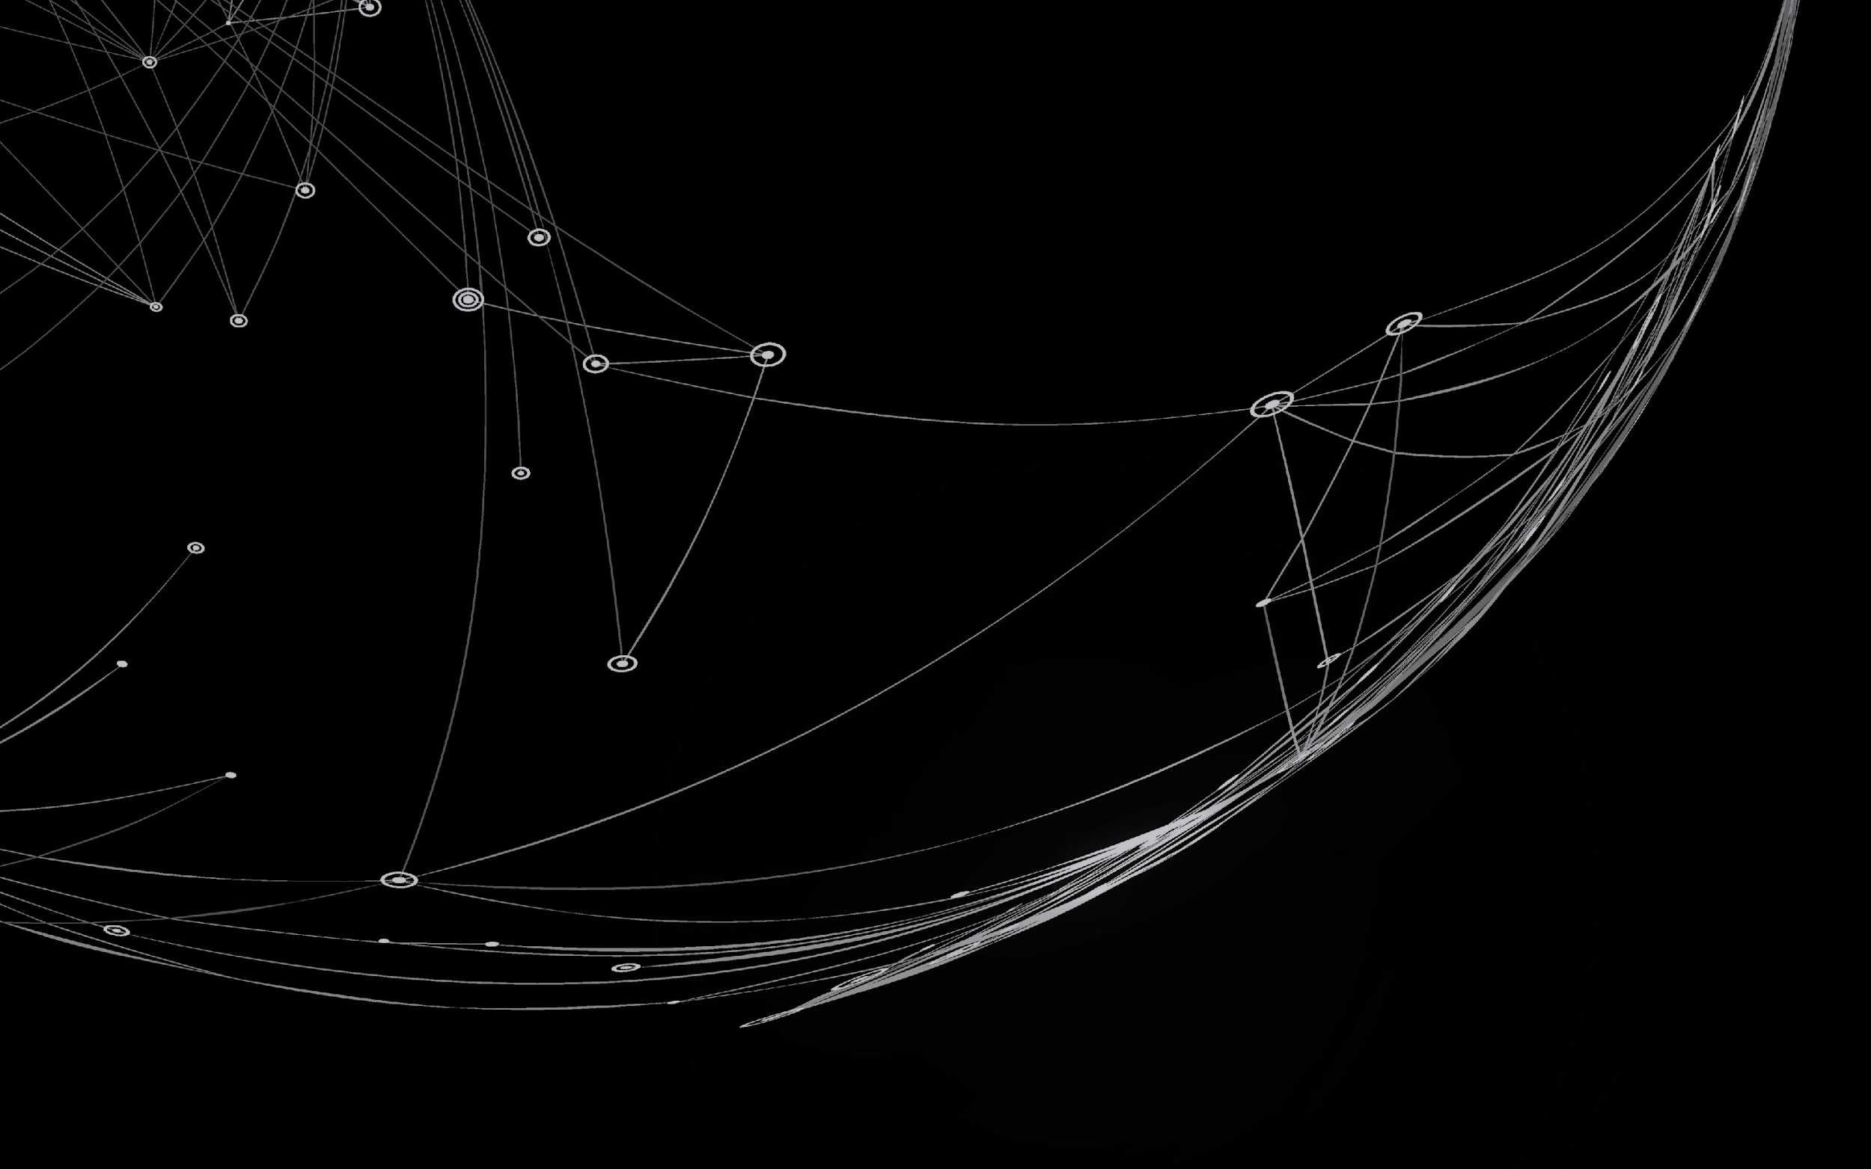
The Advent of deep learning
GAN-based algorithms
Autoencoder-based algorithms
RNN-based algorithms
Attention-based algorithms

Slide 6
cheML.io: an online database of
ML-generated molecules
Rustam Zhumagambetov, Daniyar Kazbek, Mansur Shakipov, Daulet Maksut, Vsevolod A. Peshkov, and Siamac Fazli. cheml.io: an online database of ml-generated molecules. RSC Adv., 10:45189–45198, 2020. Reproduced with permission from the Royal Society of Chemistry.

Slide 7
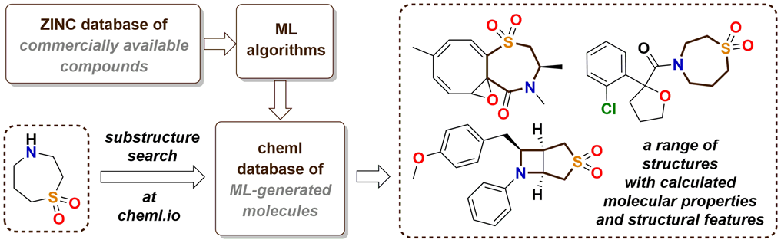
Graphical abstract

Slide 8
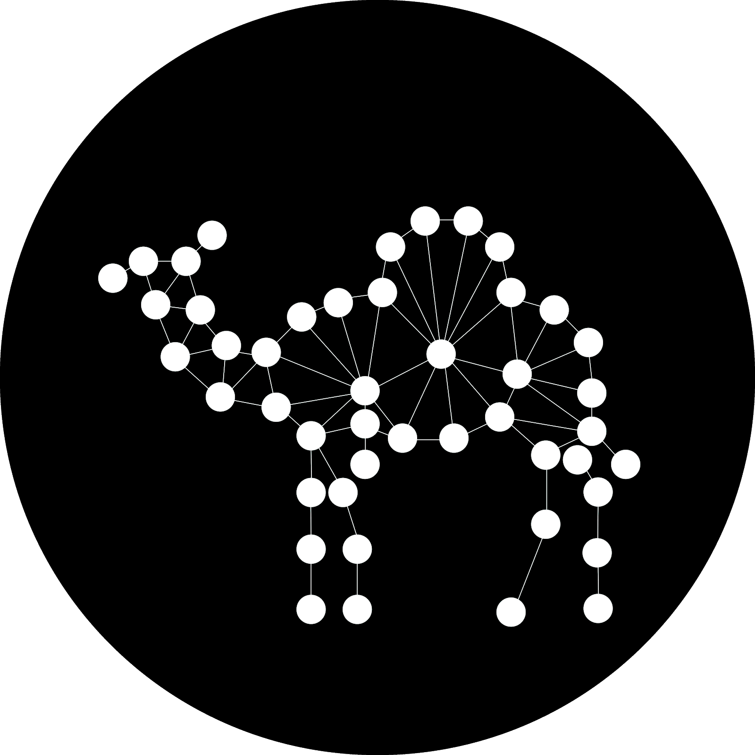
Goals
Implement, validate, and compare the ML algorithms for de novo molecular generation
Create a web application that allows browsing, searching (substructure and similarity)
Allow generation of molecules on demand

Slide 9
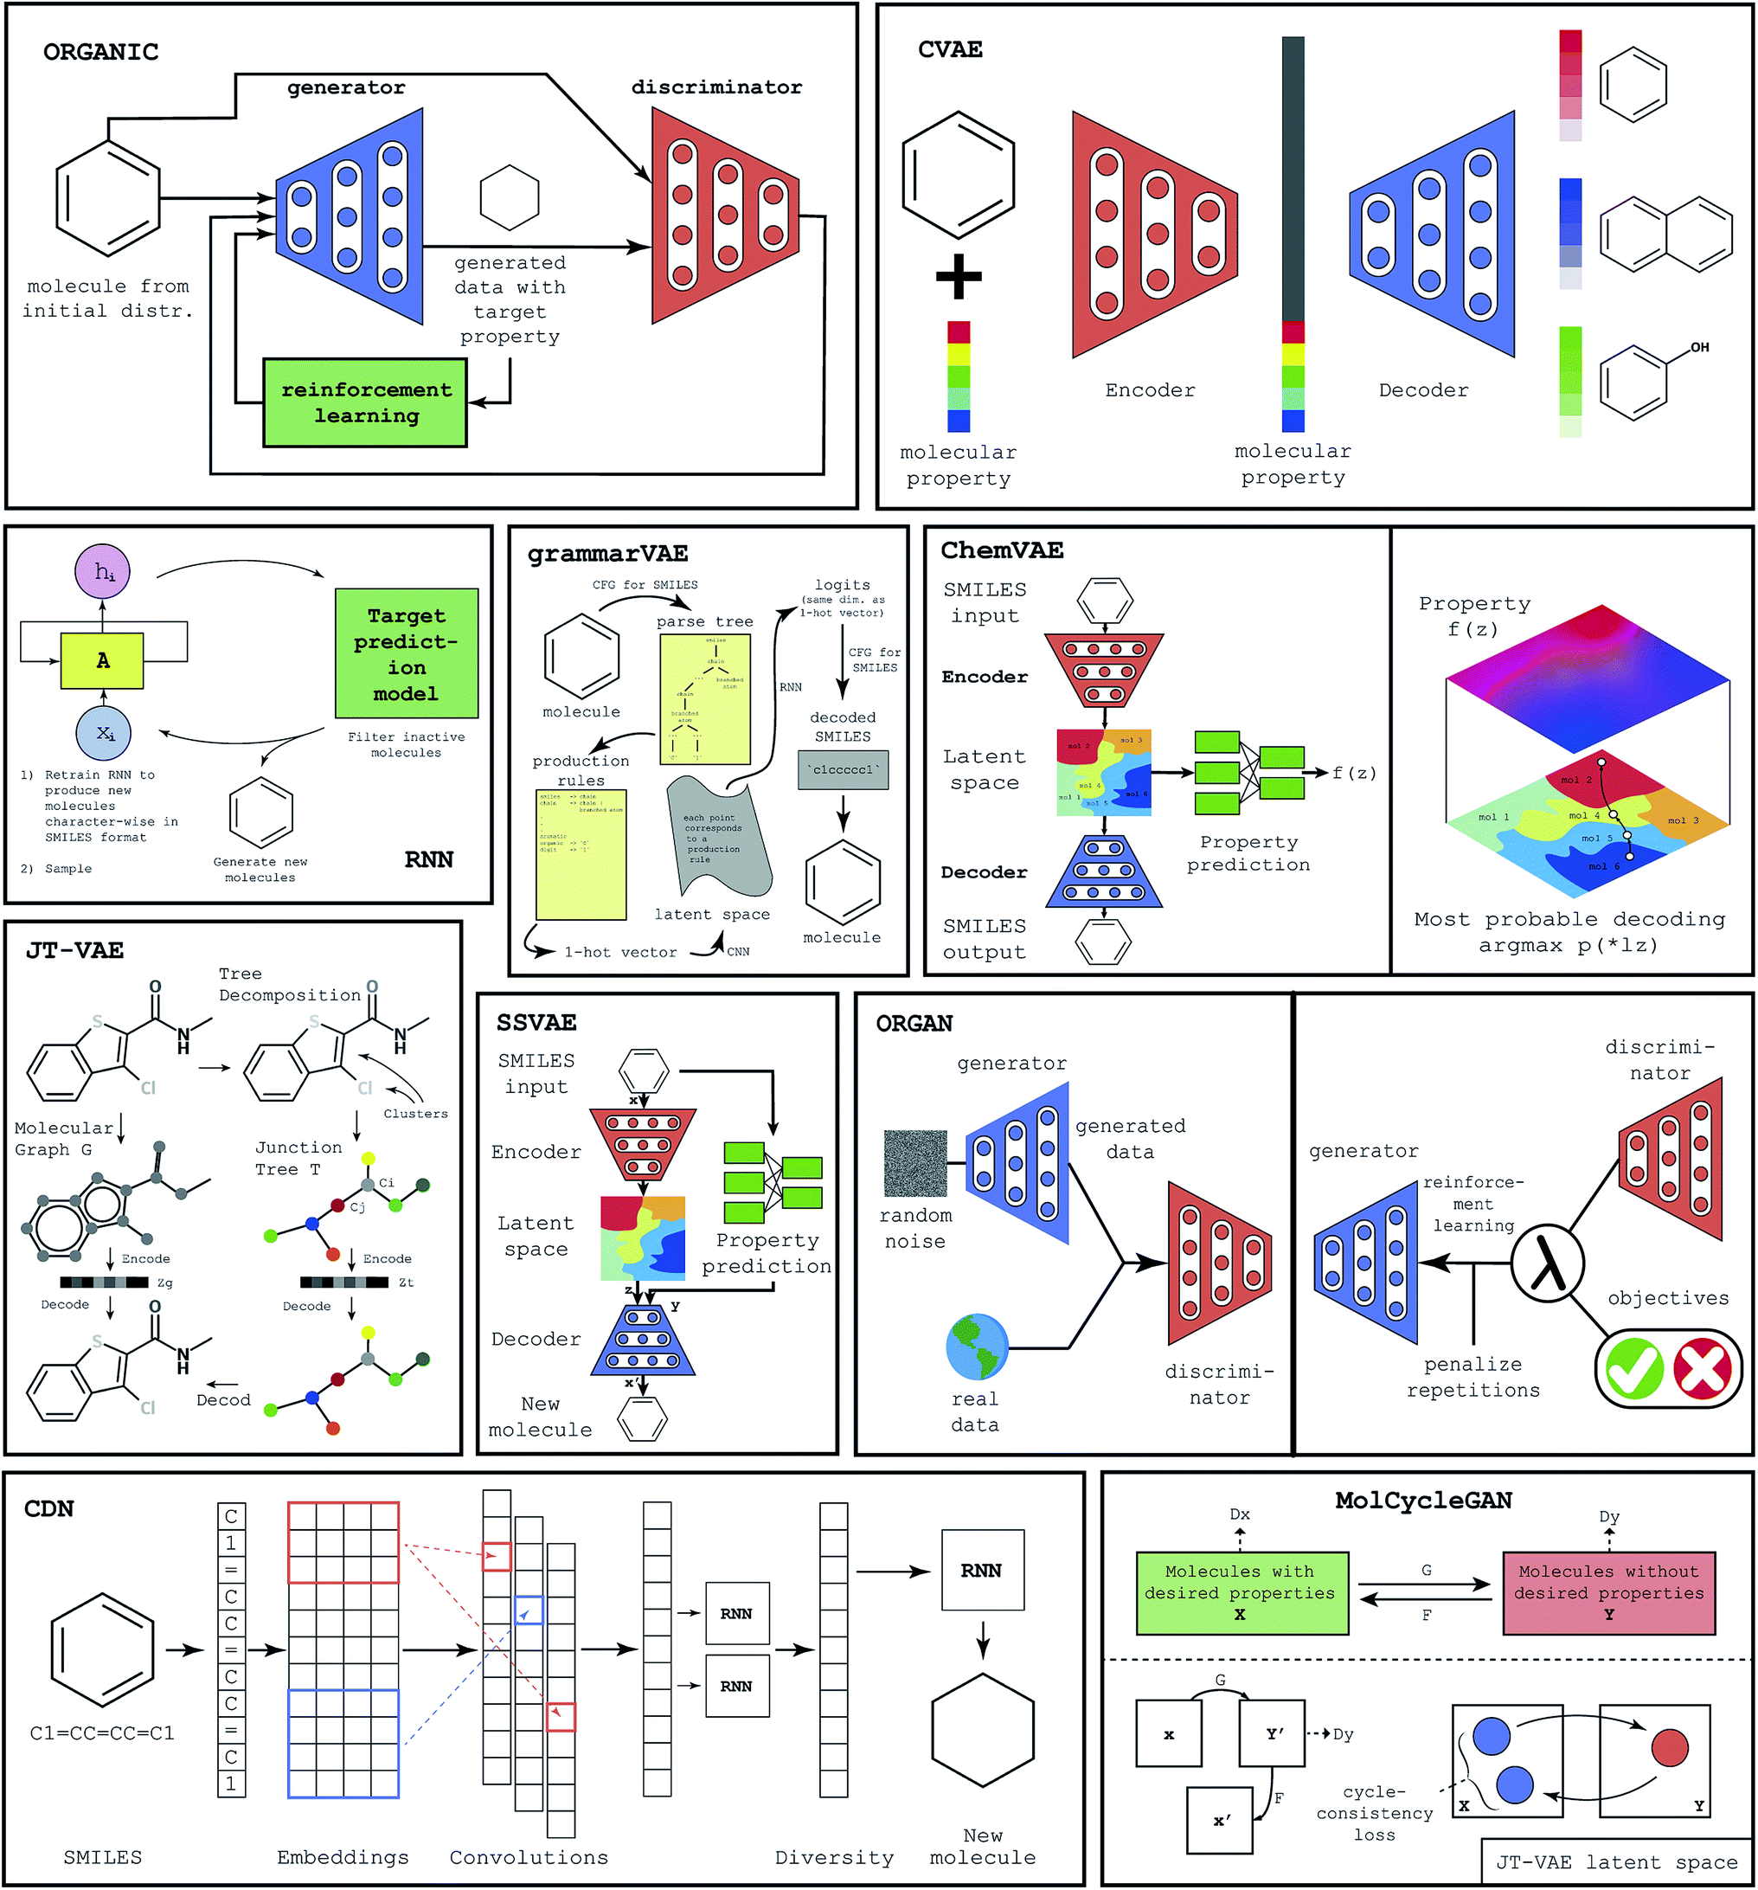
ML algorithms
Autoencoder-based methods
RNN-based methods
GAN-based methods

Slide 10
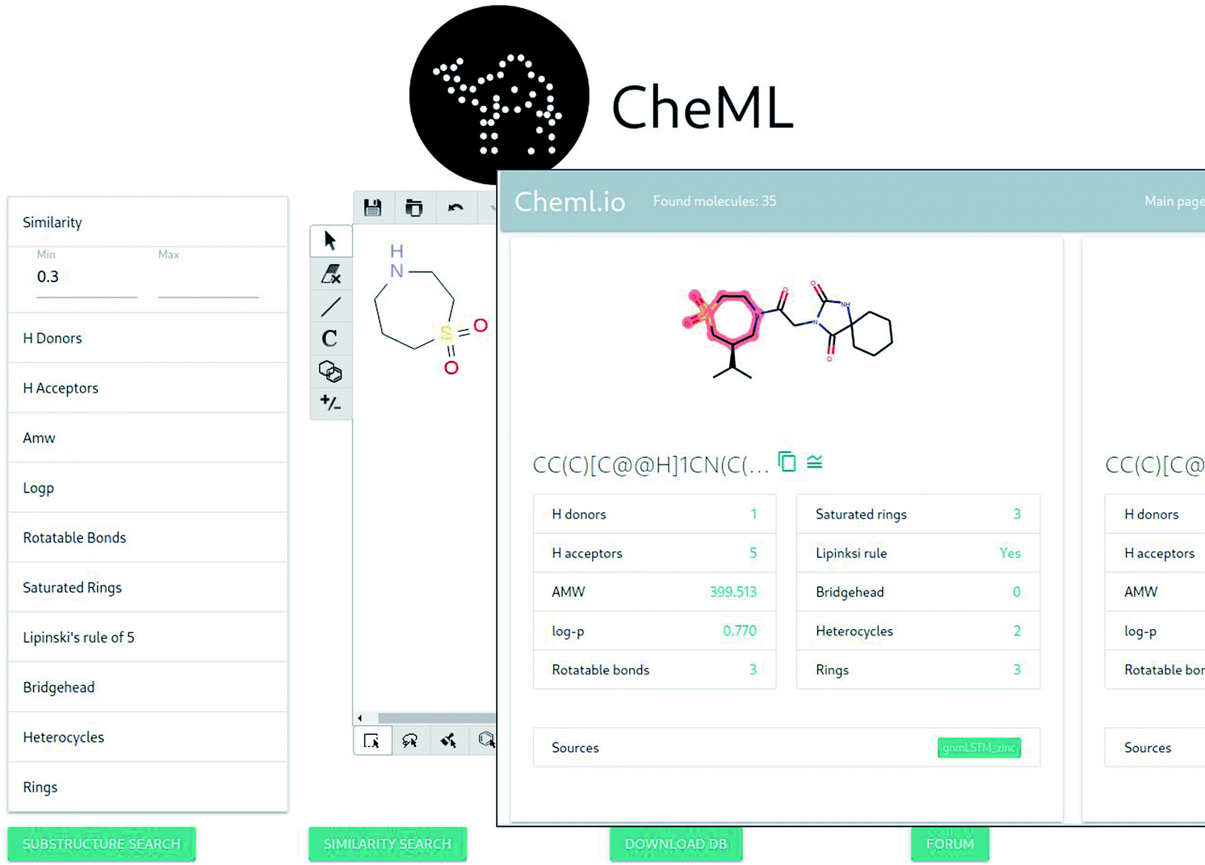
Screenshots of the website

Slide 11
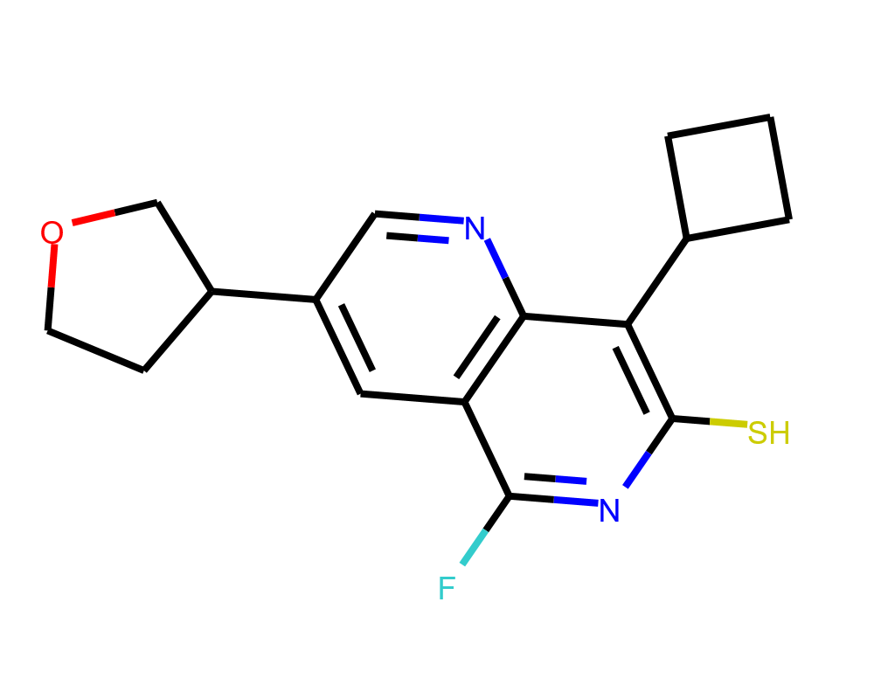
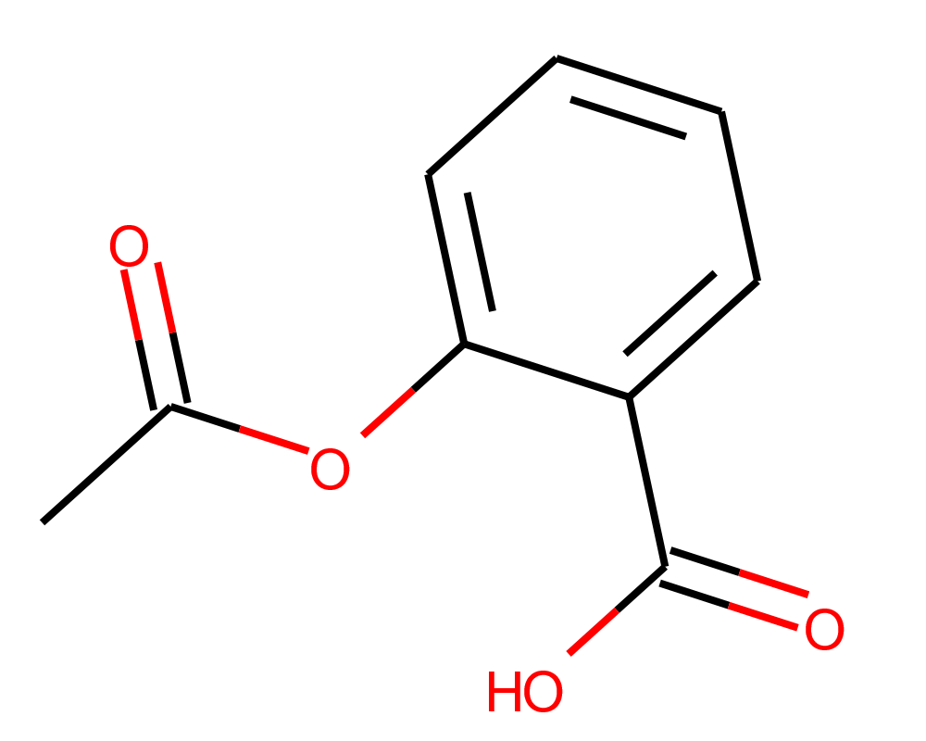
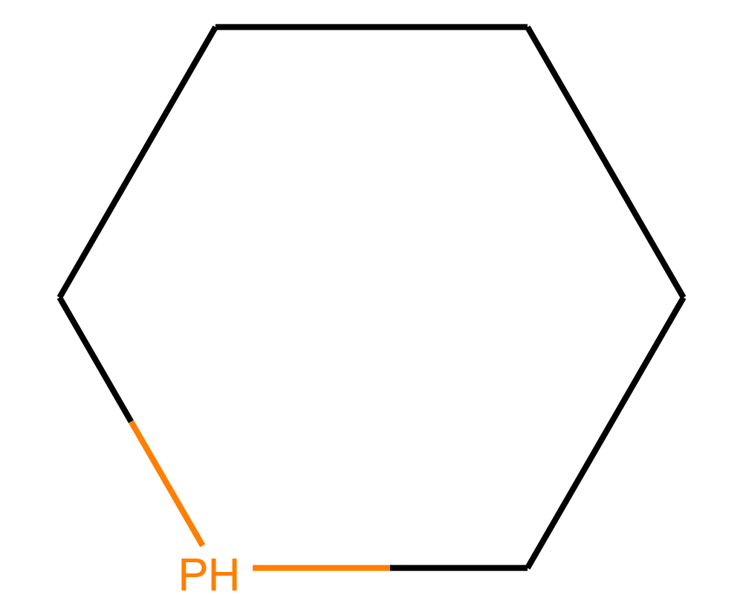
Generation on demand
Conditional Diversity Networks (CDN)
With optimizations:
  3 trainings using training dataset sampled from ZINC, Chembl and cheML.io
  Use of similarity, substructure, and both
  Then sample molecules from these resulting models

Slide 12
Qualitative overview of the algorithms
Model | Architecture | Learning technique | Molecule representation | Property targeting | Computational costs | Training dataset size
JT-VAE | VAE | Autoencoder | Graph | Yes | Medium | 250k
RNN | RNN | Direct flow | SMILES | No | Low | 250k
GrammarVAE | VAE | Autoencoder | SMILES | No | High | 250k
ChemVAE | VAE | Autoencoder | SMILES | Yes | Medium | 250k
MolCycleGan | GAN | Direct flow | Latent vector | Yes | Medium | 250k
ORGAN | GAN | RL | SMILES | Yes | High | 1 million
ORGANIC | GAN | RL | SMILES | Yes | High | 250k
SSVAE | VAE | Autoencoder | SMILES | Yes | Medium | 310k
CDN | VAE | Autoencoder | SMILES | No | Low | 250k
CVAE | VAE | Autoencoder | SMILES | Yes | Medium | 500k

Slide 13
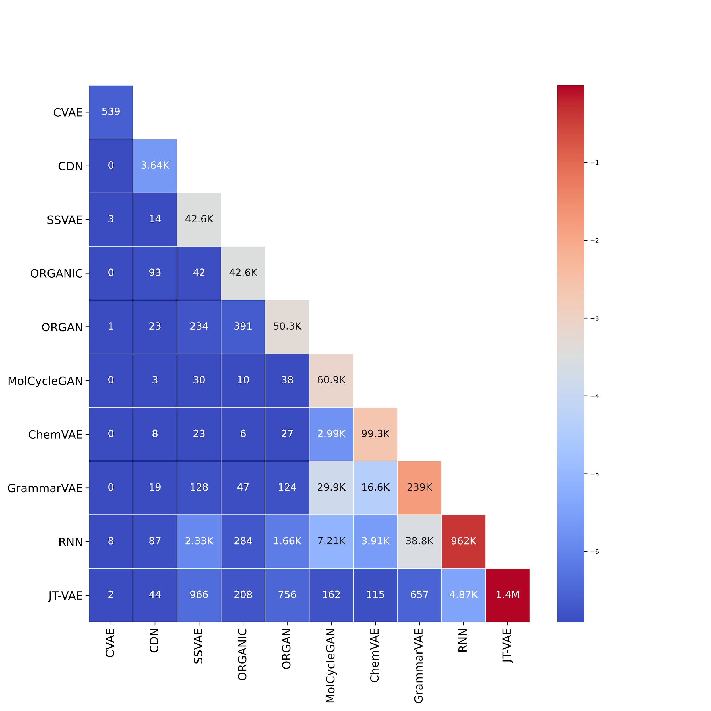
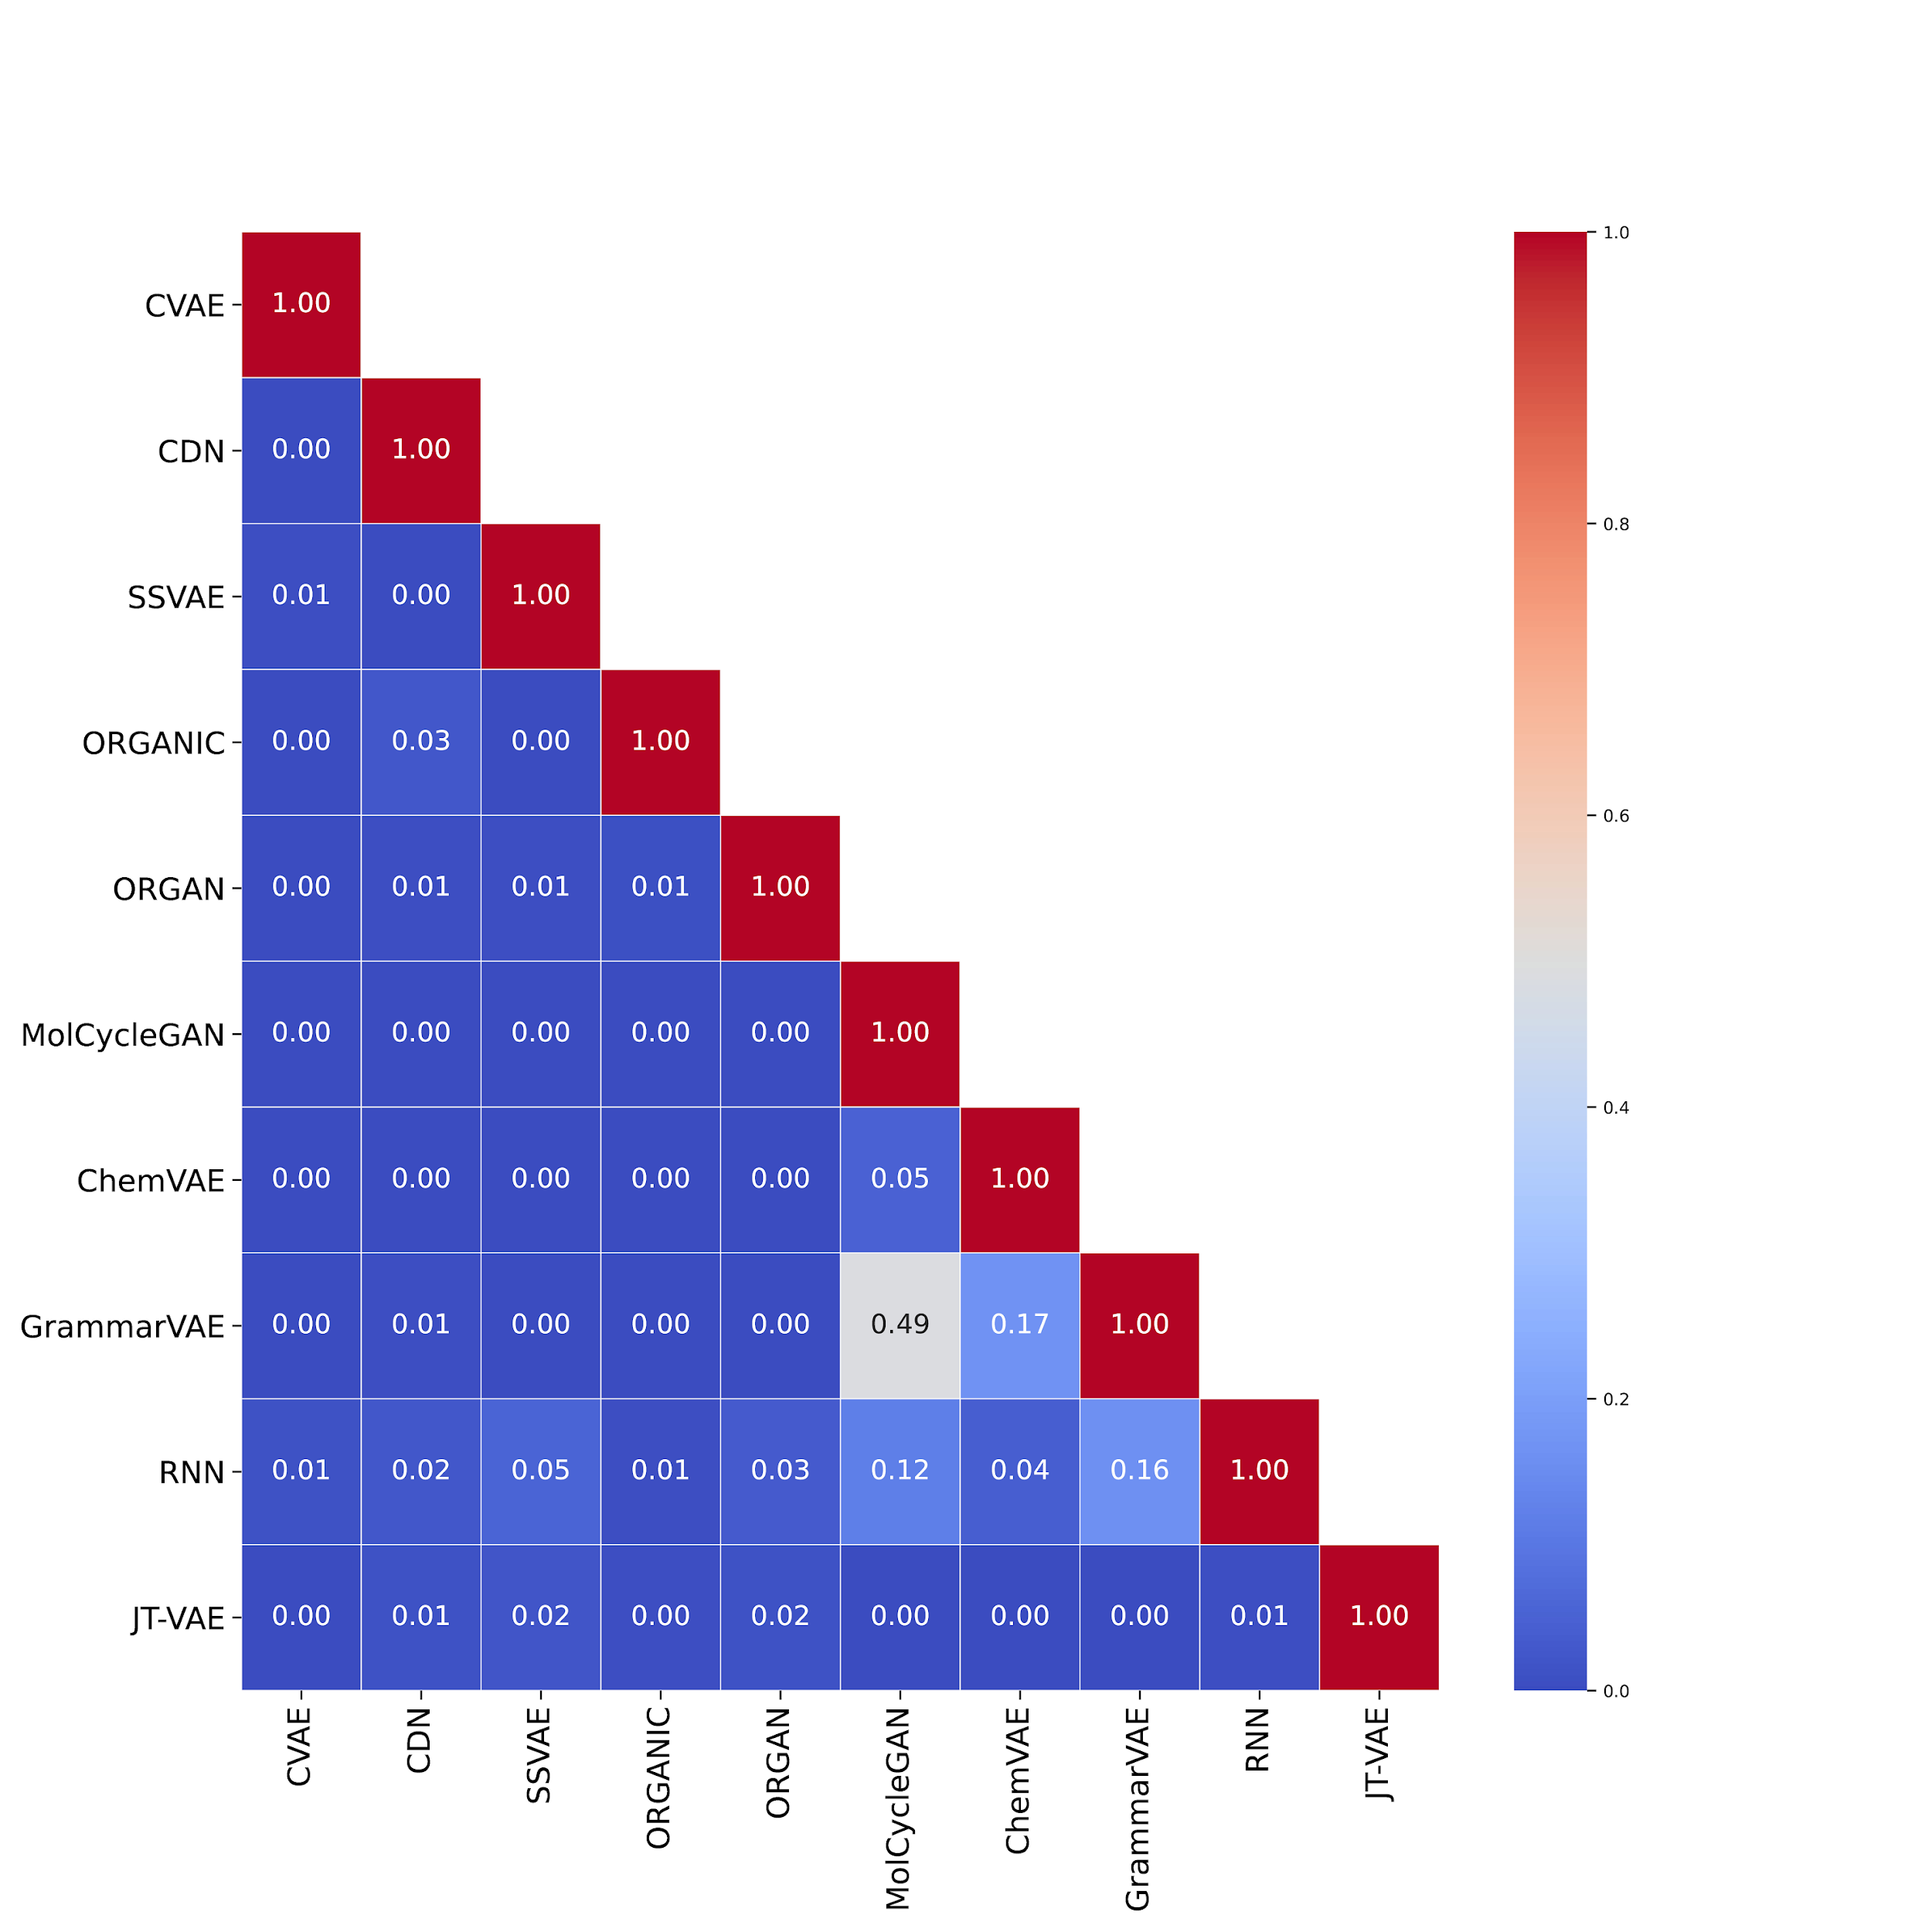
Diversity analysis
(Left) The diagonal of the matrix illustrates total number of molecules generated by each method. Intersections below the diagonal show number of same molecules that were generated by both methods. (Right) Each entry shows the proportion of shared molecules between each method.

Slide 14
Transmol: Repurposing a language
model for molecular generation
Rustam Zhumagambetov, Vsevolod A. Peshkov, and Siamac Fazli. Transmol: Repurposing Language Model for Molecular Generation. 4 2021. Preprint. Submitted.

Slide 15
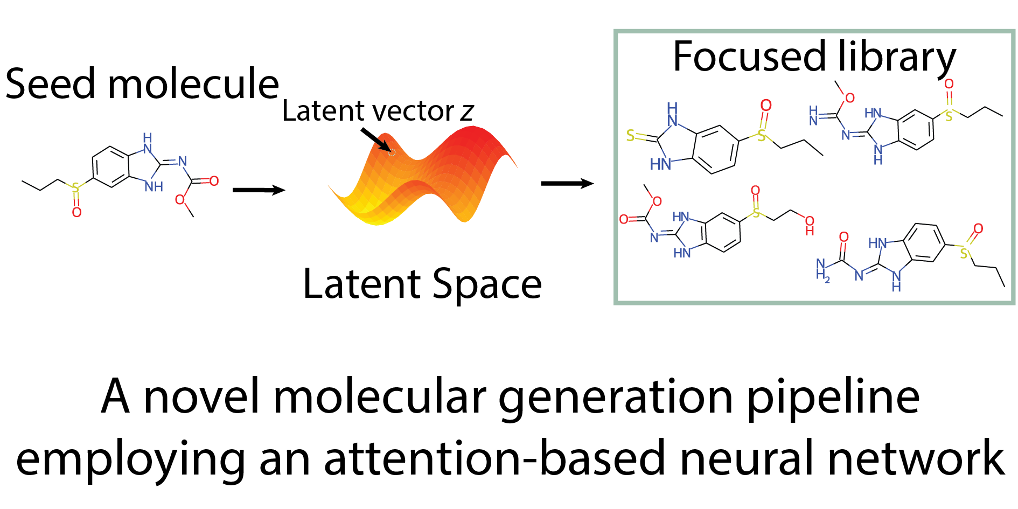
Graphical abstract

Slide 16
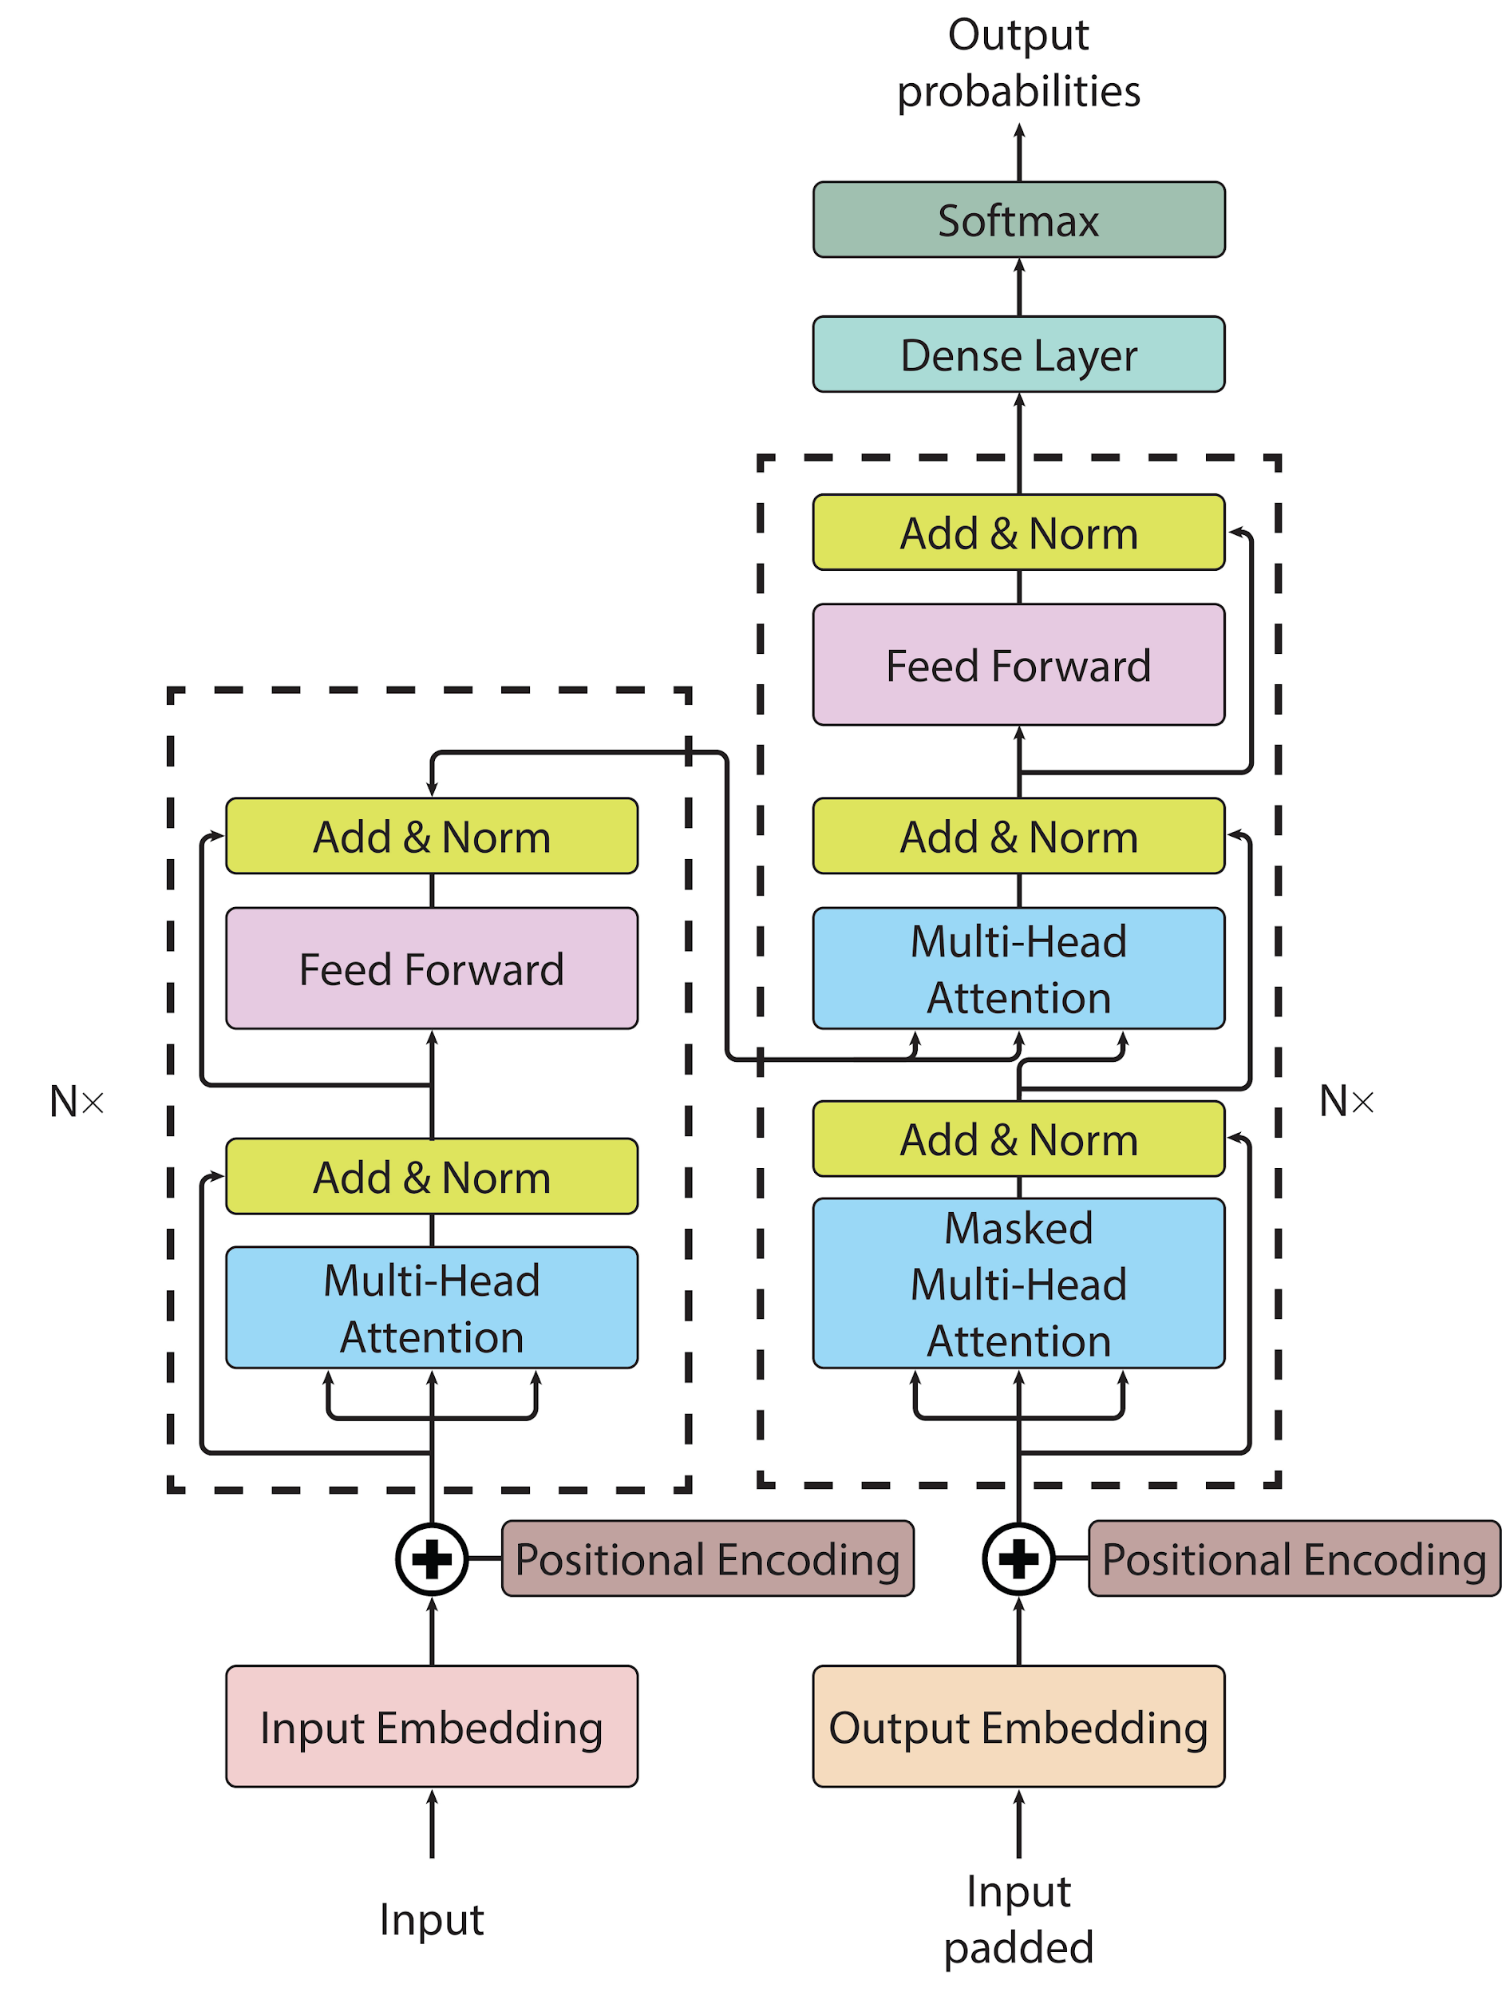
Transformer
Seq2seq model
Uses encoder and decoder networks
Uses attention mechanisms

Slide 17
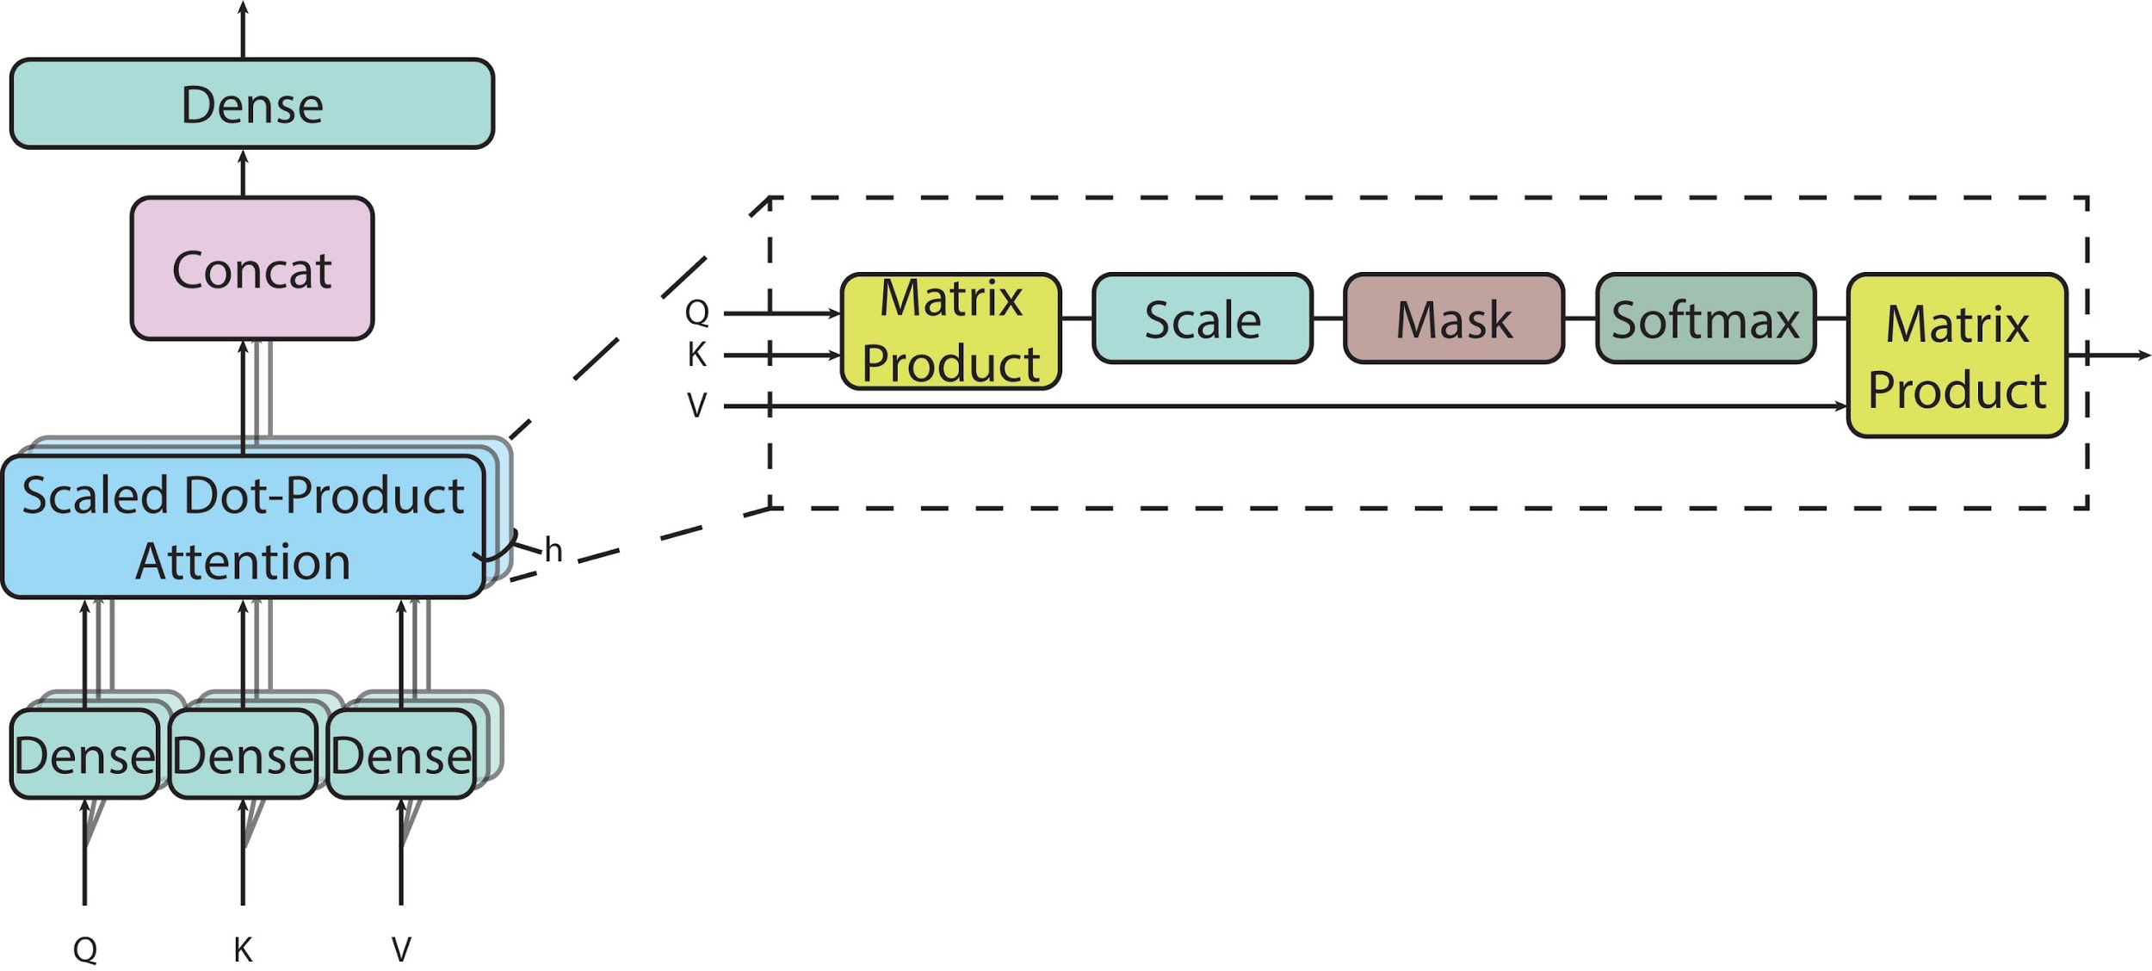
Multi-head attention

Slide 18
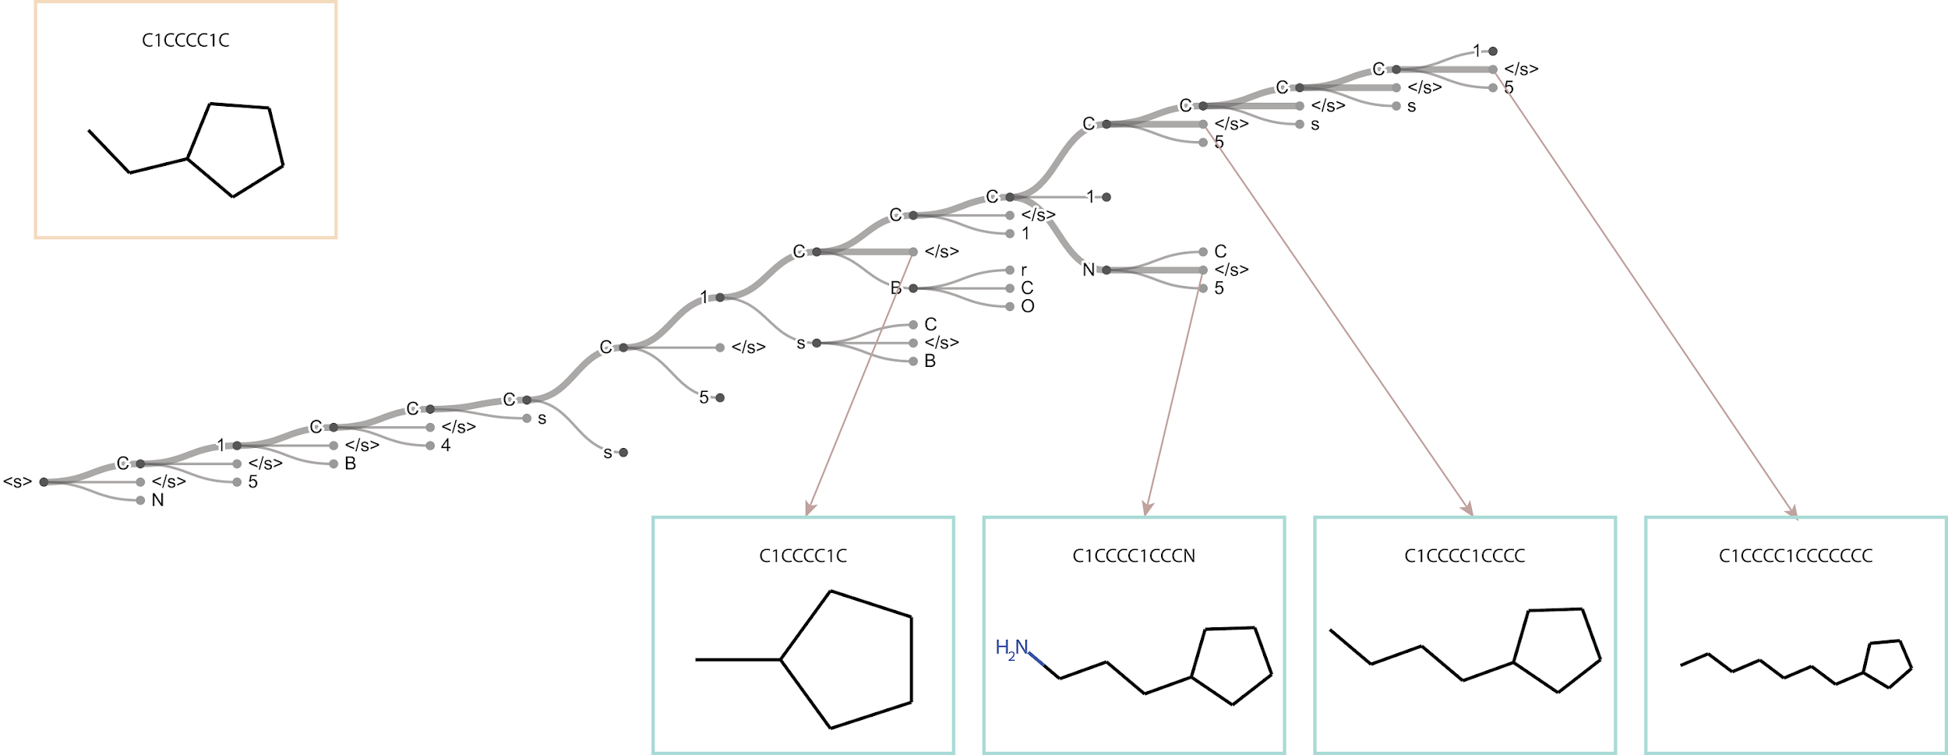
Beam Search
Improved greedy search
Instead of 1 probable symbol, picks N
Guided by reward function

Slide 19
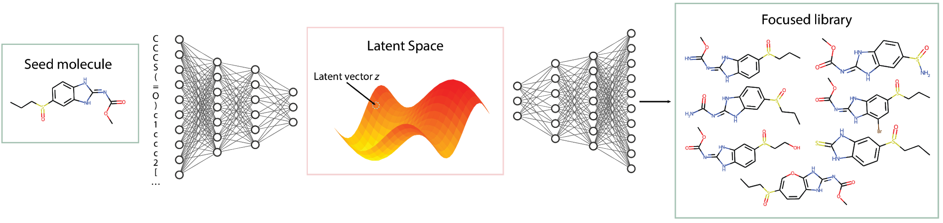
Generation pipeline

Slide 20
Moses benchmark
Model | Valid (↑) | Unique@1k (↑) | Unique@10k (↑) | IntDiv (↑) | IntDiv2 (↑) | Filters (↑) | Novelty (↑)
Train | 1 | 1 | 1 | 0.8567 | 0.8508 | 1 | 1
HMM | 0.076±0.0322 | 0.623±0.1224 | 0.5671±0.1424 | 0.8466±0.0403 | 0.8104±0.0507 | 0.9024±0.0489 | 0.9994±0.001
NGram | 0.2376±0.0025 | 0.974±0.0108 | 0.9217±0.0019 | 0.8738±0.0002 | 0.8644±0.0002 | 0.9582±0.001 | 0.9694±0.001
Combinatorial | 1.0±0.0 | 0.9983±0.0015 | 0.9909±0.0009 | 0.8732±0.0002 | 0.8666±0.0002 | 0.9557±0.0018 | 0.9878±0.0008
CharRNN | 0.9748±0.0264 | 1.0±0.0 | 0.9994±0.0003 | 0.8562±0.0005 | 0.8503±0.0005 | 0.9943±0.0034 | 0.8419±0.0509
AAE | 0.9368±0.0341 | 1.0±0.0 | 0.9973±0.002 | 0.8557±0.0031 | 0.8499±0.003 | 0.996±0.0006 | 0.7931±0.0285
VAE | 0.9767±0.0012 | 1.0±0.0 | 0.9984±0.0005 | 0.8558±0.0004 | 0.8498±0.0004 | 0.997±0.0002 | 0.6949±0.0069
JTN-VAE | 1.0±0.0 | 1.0±0.0 | 0.9996±0.0003 | 0.8551±0.0034 | 0.8493±0.0035 | 0.976±0.0016 | 0.9143±0.0058
LatentGAN | 0.8966±0.0029 | 1.0±0.0 | 0.9968±0.0002 | 0.8565±0.0007 | 0.8505±0.0006 | 0.9735±0.0006 | 0.9498±0.0006
Transmol | 0.0694±0.0004 | 0.9360±0.0036 | 0.9043±0.0036 | 0.8819±0.0003 | 0.8708±0.0002 | 0.8437±0.0015 | 0.9815±0.0004

Slide 21
Moses benchmark
Model | FCD (↓) |  | SNN (↑) |  | Frag (↑) |  | Scaf (↑)
 | Test | TestSF | Test | TestSF | Test | TestSF | Test | TestSF
Train | 0.008 | 0.4755 | 0.6419 | 0.5859 | 1 | 0.9986 | 0.9907 | 0
HMM | 24.4661±2.5251 | 25.4312±2.5599 | 0.3876±0.0107 | 0.3795±0.0107 | 0.5754±0.1224 | 0.5681±0.1218 | 0.2065±0.0481 | 0.049±0.018
NGram | 5.5069±0.1027 | 6.2306±0.0966 | 0.5209±0.001 | 0.4997±0.0005 | 0.9846±0.0012 | 0.9815±0.0012 | 0.5302±0.0163 | 0.0977±0.0142
Combinatorial | 4.2375±0.037 | 4.5113±0.0274 | 0.4514±0.0003 | 0.4388±0.0002 | 0.9912±0.0004 | 0.9904±0.0003 | 0.4445±0.0056 | 0.0865±0.0027
CharRNN | 0.0732±0.0247 | 0.5204±0.0379 | 0.6015±0.0206 | 0.5649±0.0142 | 0.9998±0.0002 | 0.9983±0.0003 | 0.9242±0.0058 | 0.1101±0.0081
AAE | 0.5555±0.2033 | 1.0572±0.2375 | 0.6081±0.0043 | 0.5677±0.0045 | 0.991±0.0051 | 0.9905±0.0039 | 0.9022±0.0375 | 0.0789±0.009
VAE | 0.099±0.0125 | 0.567±0.0338 | 0.6257±0.0005 | 0.5783±0.0008 | 0.9994±0.0001 | 0.9984±0.0003 | 0.9386±0.0021 | 0.0588±0.0095
JTN-VAE | 0.3954±0.0234 | 0.9382±0.0531 | 0.5477±0.0076 | 0.5194±0.007 | 0.9965±0.0003 | 0.9947±0.0002 | 0.8964±0.0039 | 0.1009±0.0105
LatentGAN | 0.2968±0.0087 | 0.8281±0.0117 | 0.5371±0.0004 | 0.5132±0.0002 | 0.9986±0.0004 | 0.9972±0.0007 | 0.8867±0.0009 | 0.1072±0.0098
Transmol | 4.3729±0.0466 | 5.3308±0.0428 | 0.6160±0.0005 | 0.4614±0.0007 | 0.9564±0.0009 | 0.9496±0.0009 | 0.7394±0.0009 | 0.0183±0.0065

Slide 22
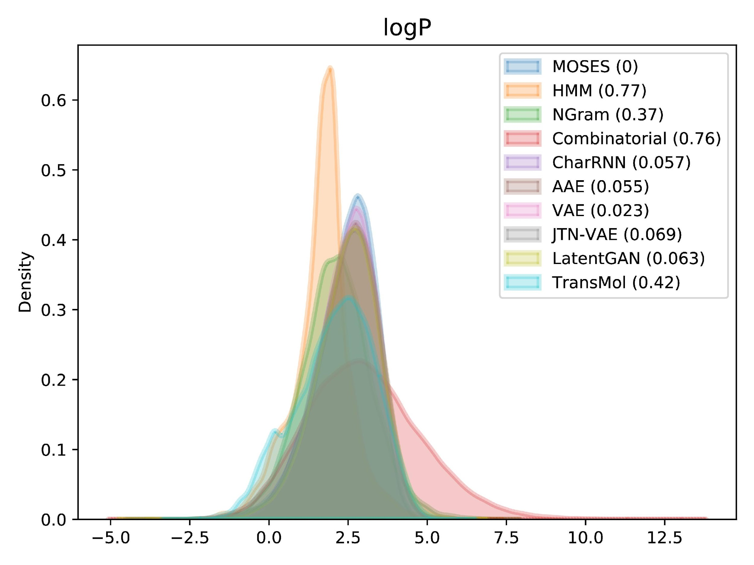
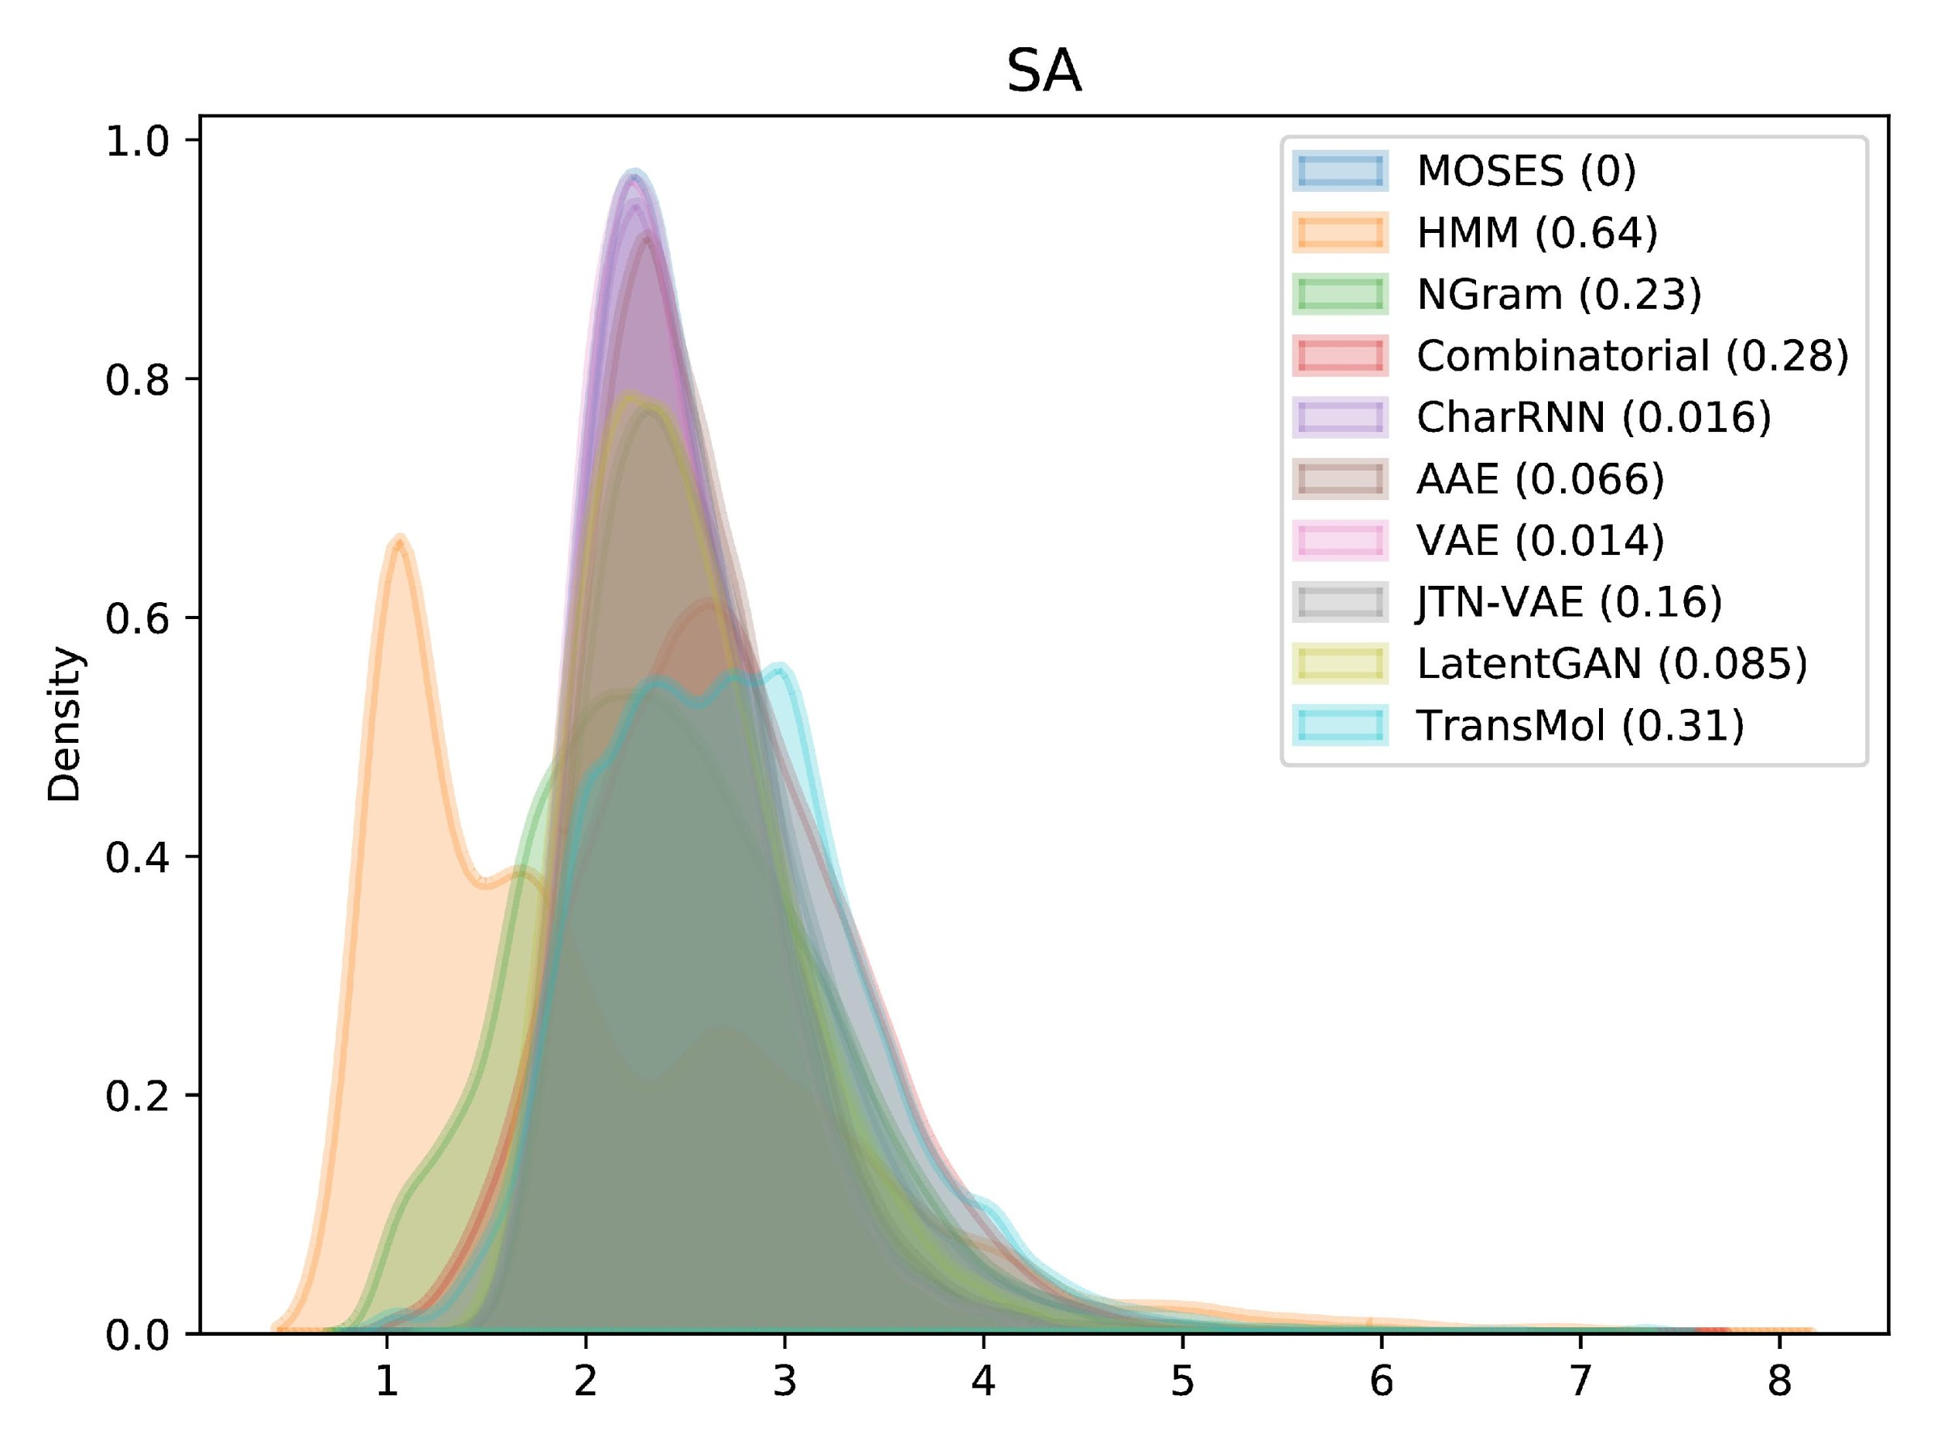
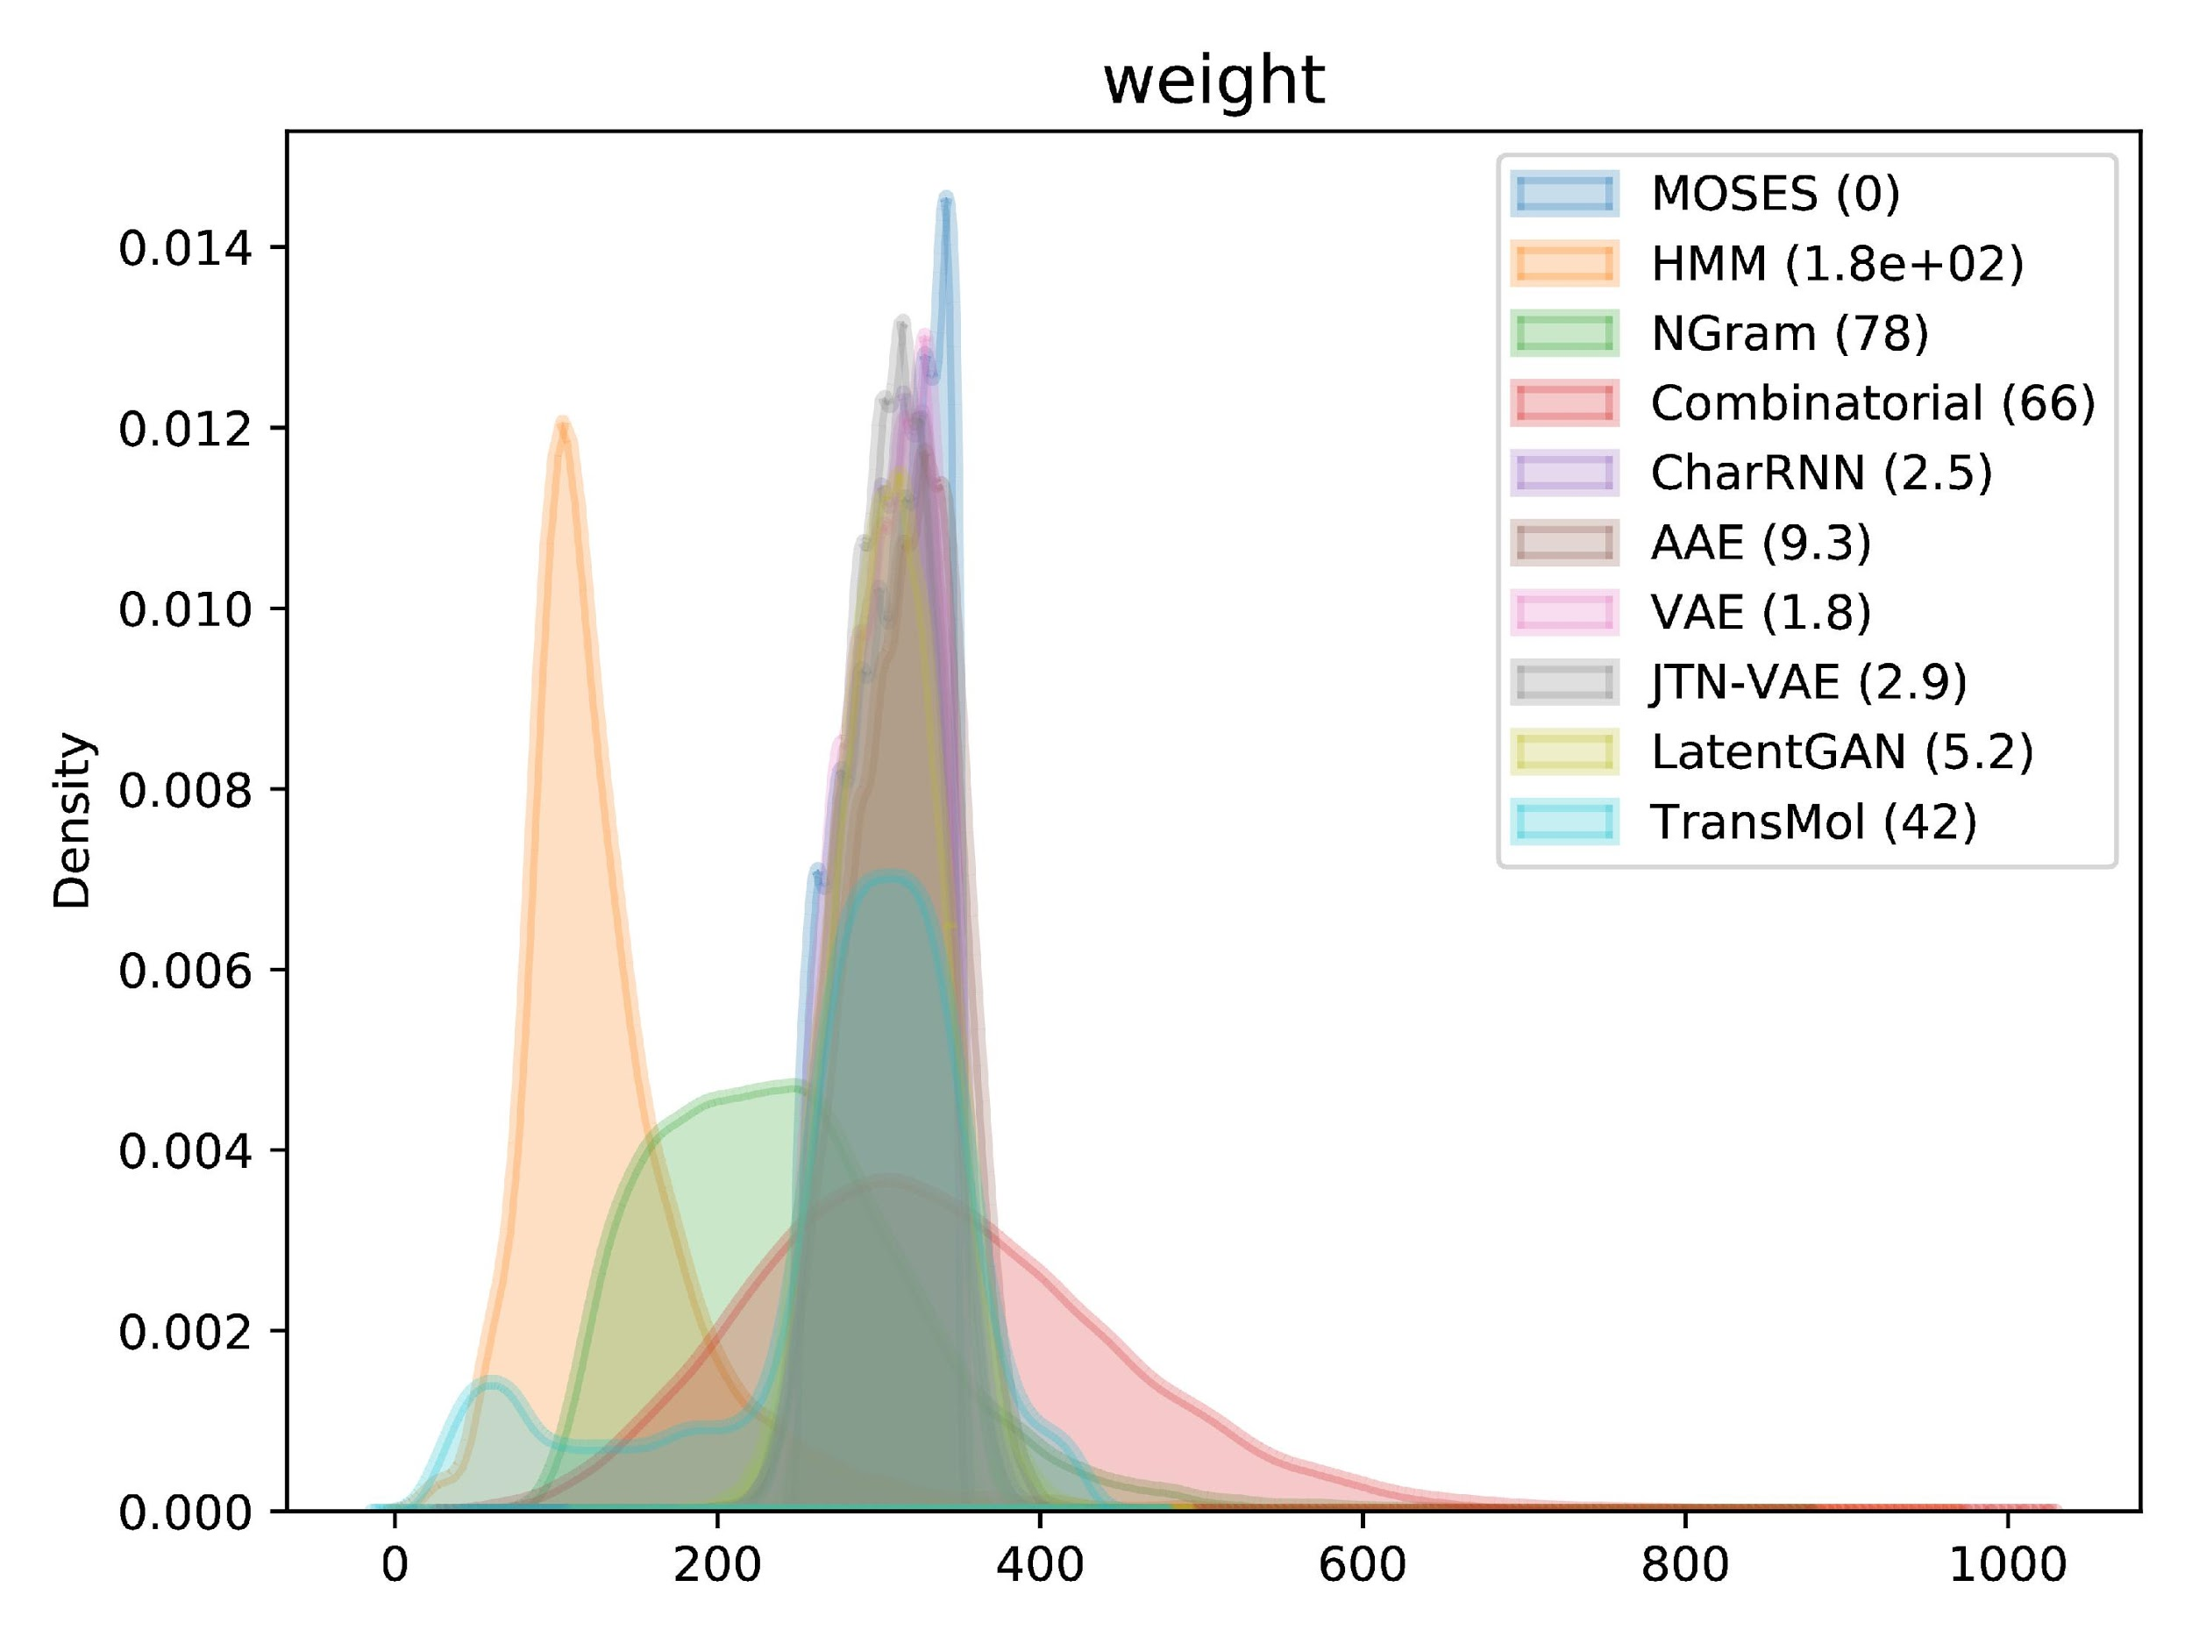
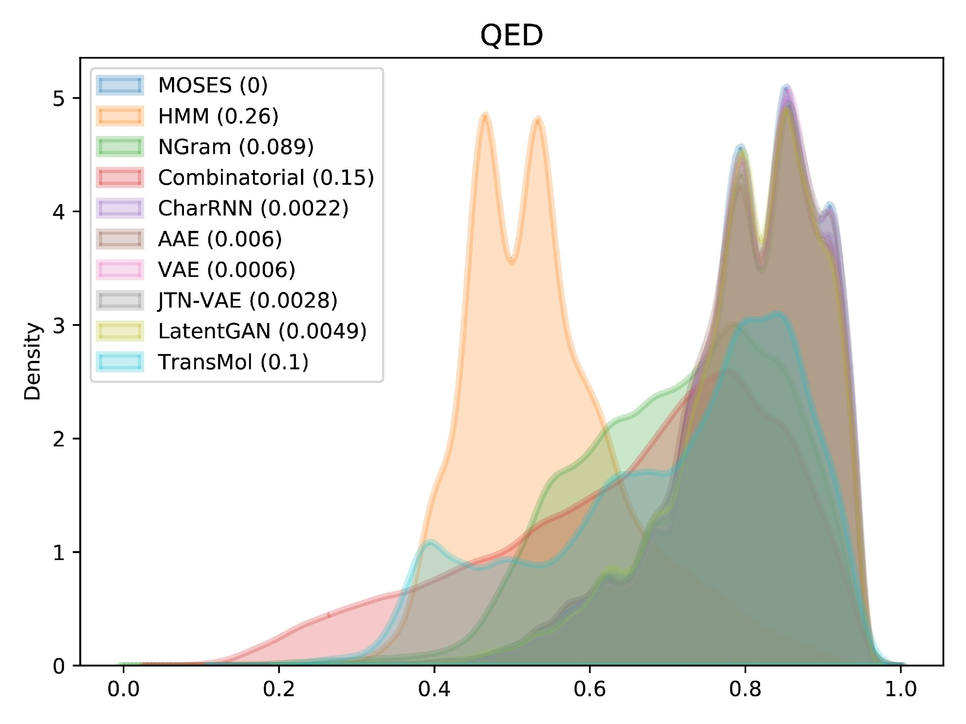
Moses benchmark
Distribution plots
Similar to the histograms
Wasserstein-1 distance

Slide 23
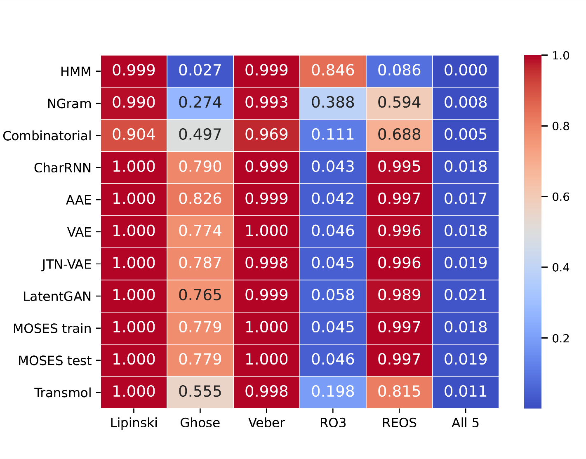
Filters
Heuristics used in drug development
Among the neural baselines Transmol has the highest proportion of molecules that satisfy the rule of 3

Slide 24
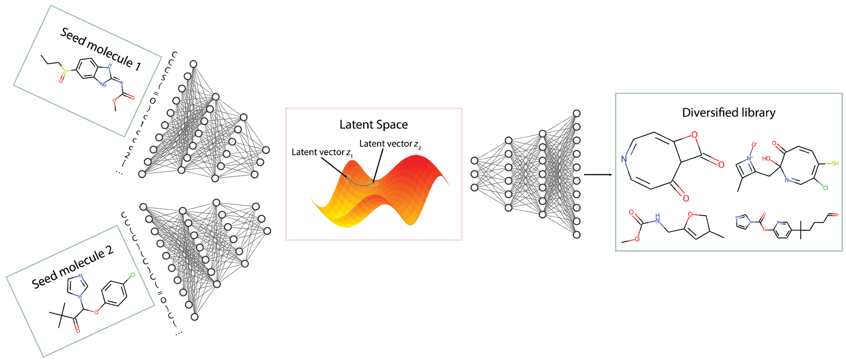
Generating molecular library with 2 seeds

Slide 25
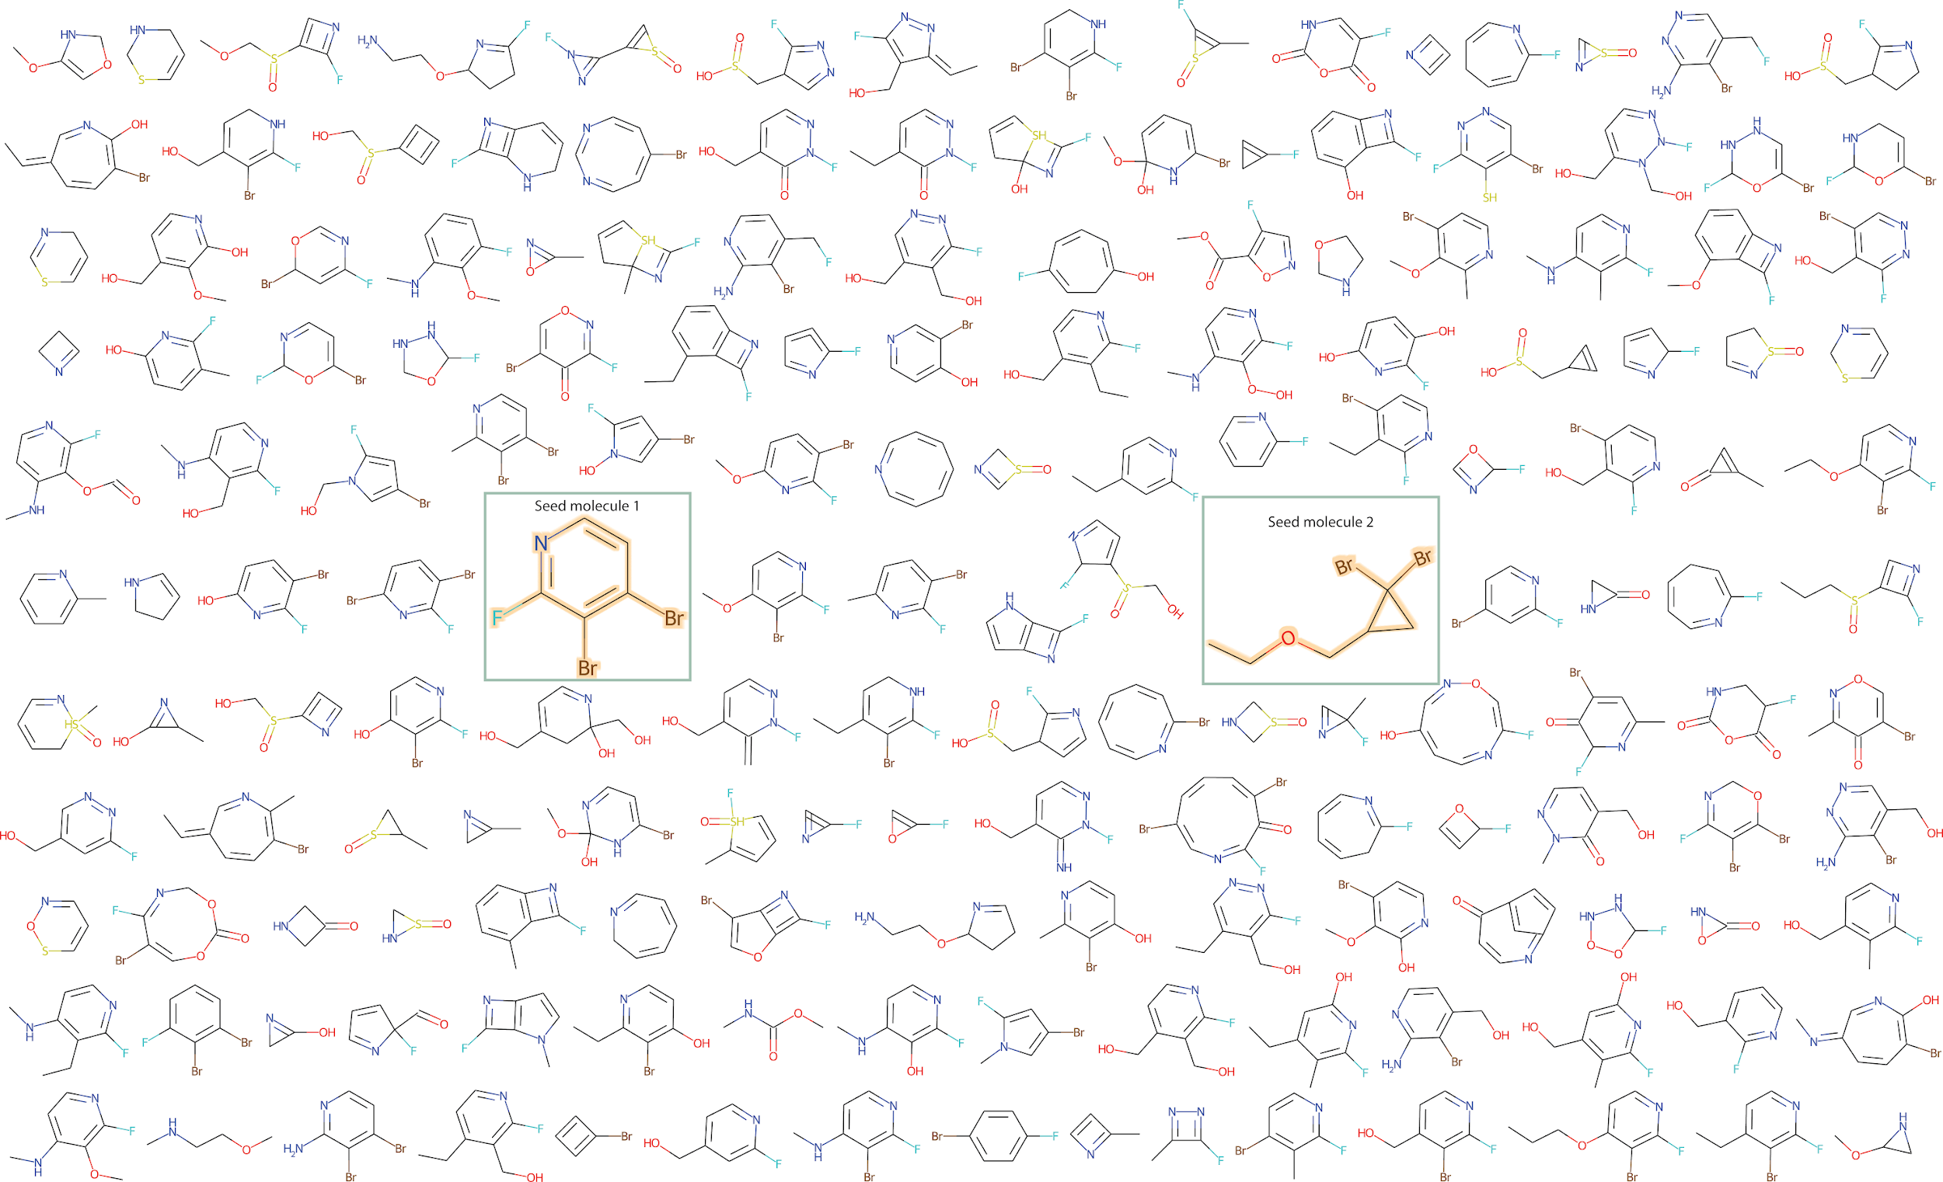
Exemplar molecular grid

Slide 26
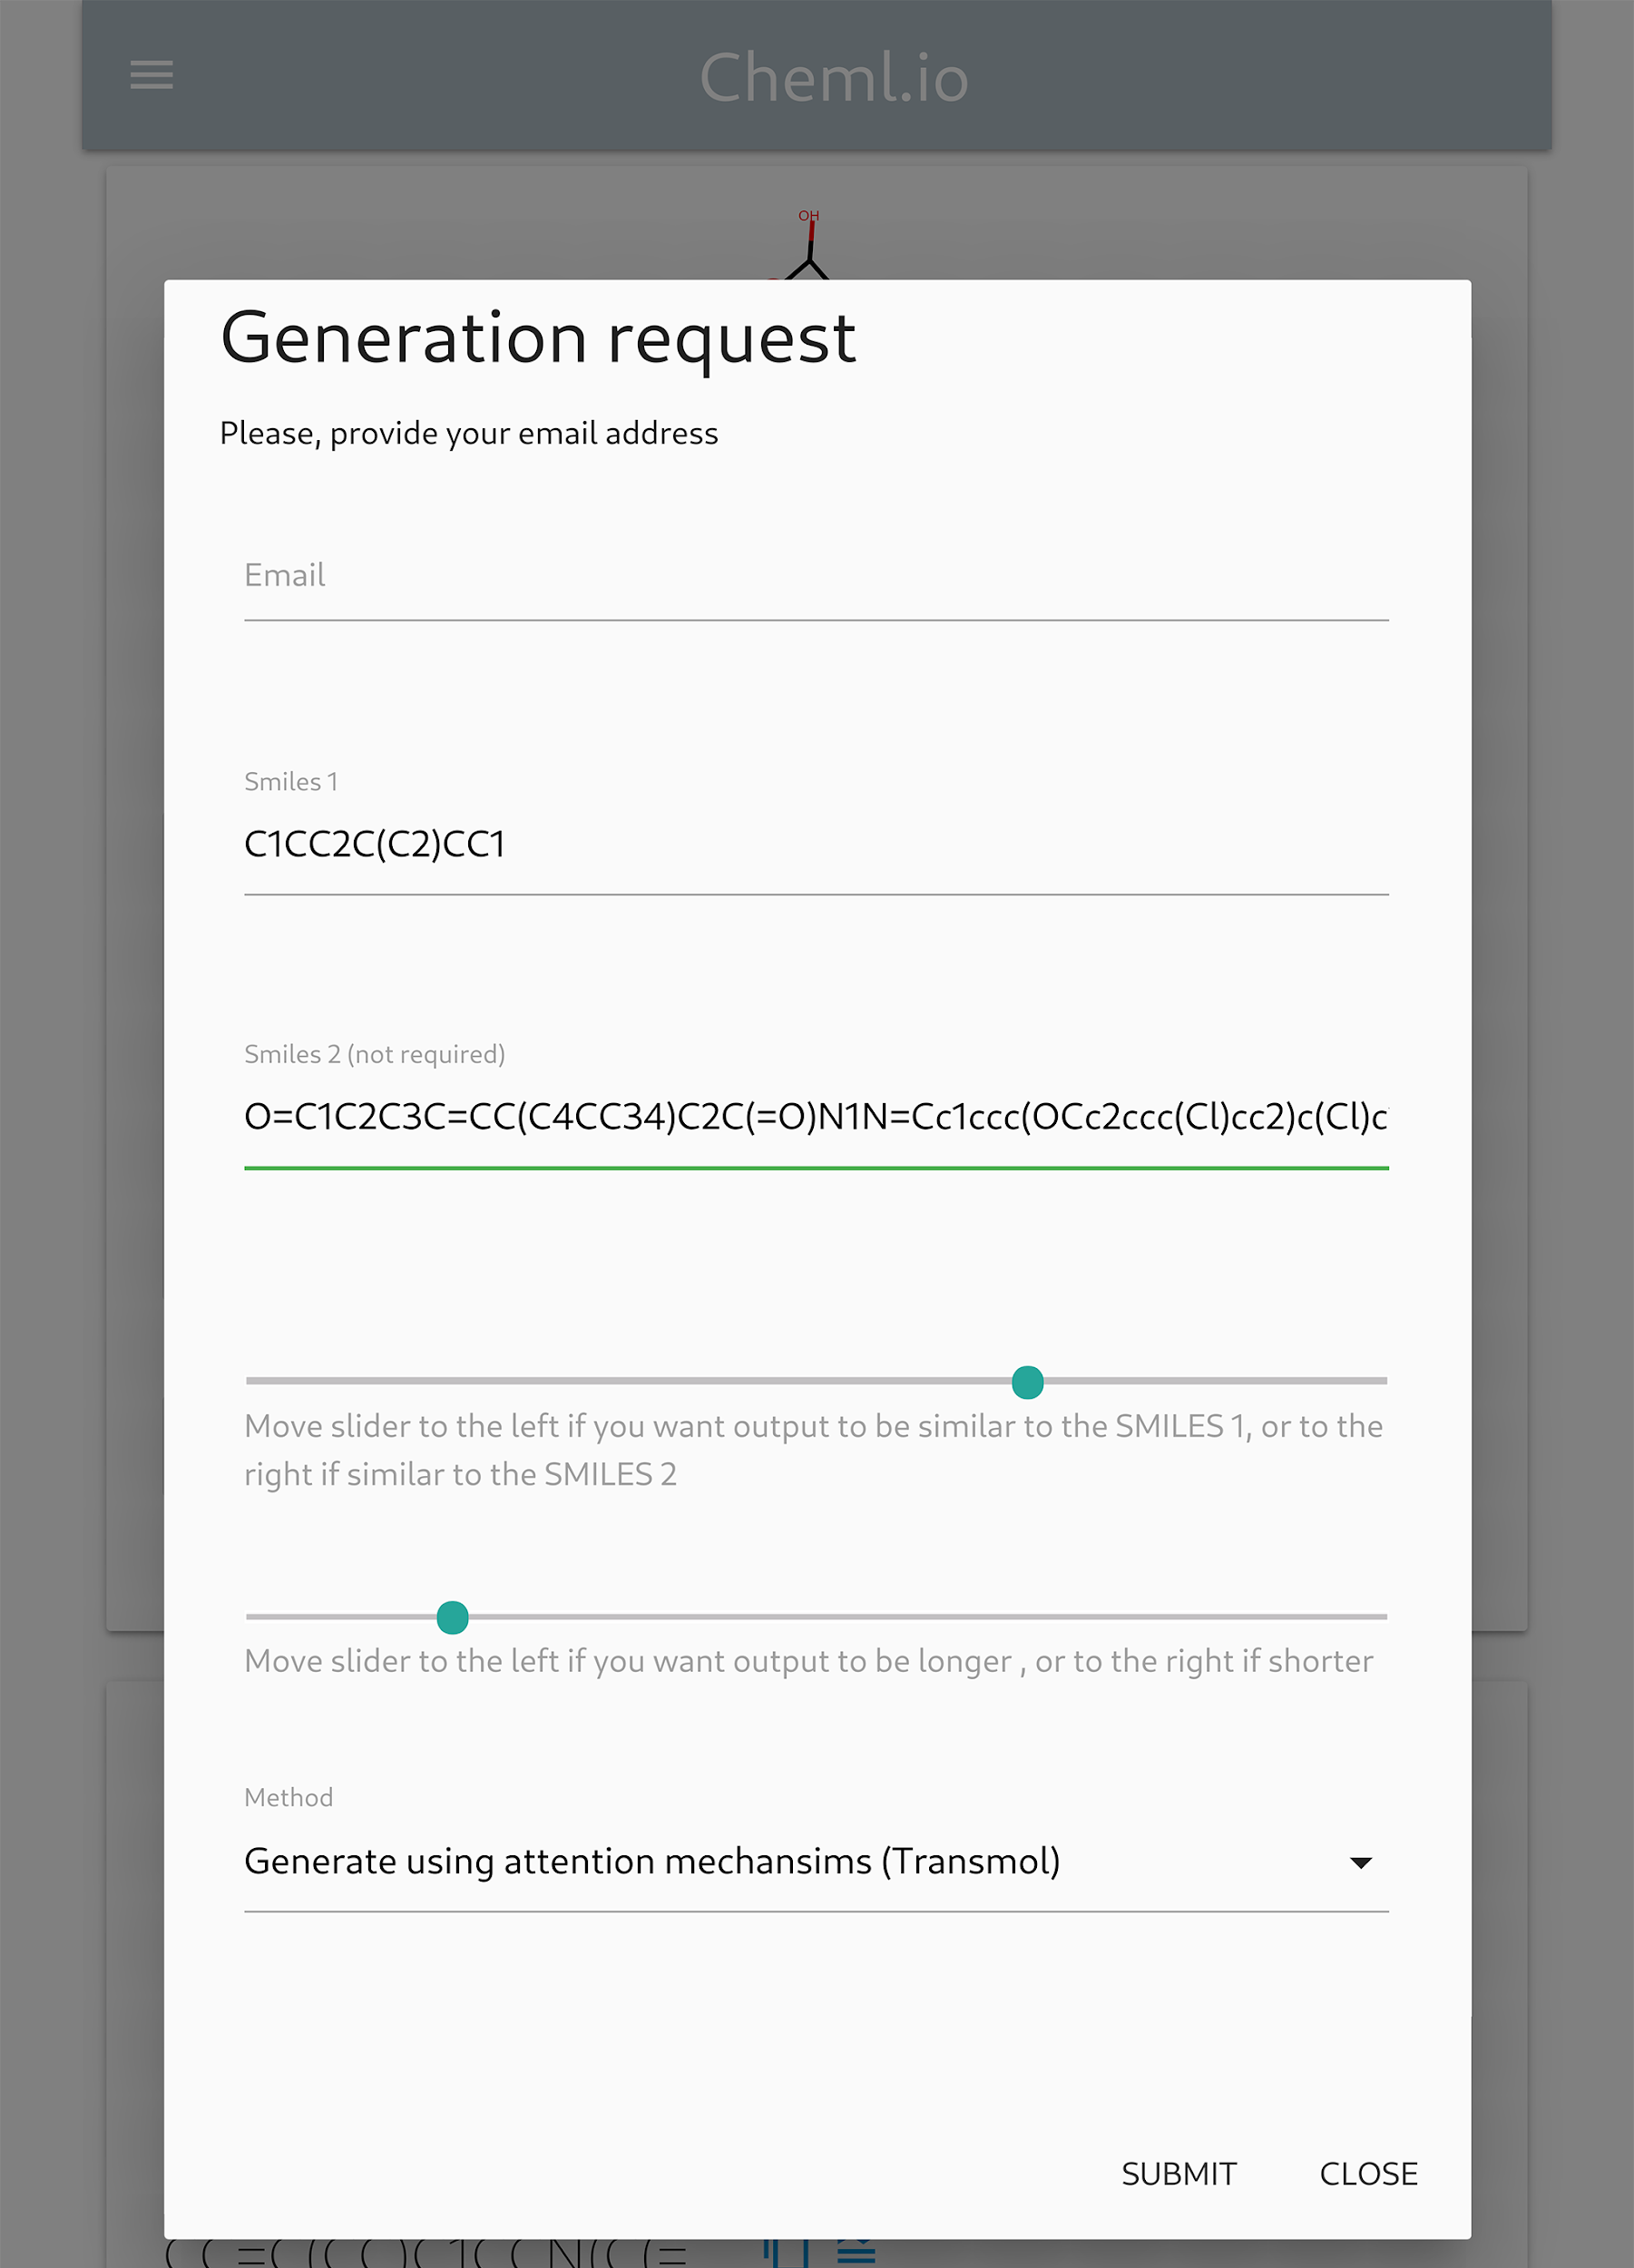
Added to cheML.io

Slide 27





Conclusions
Investigated machine learning algorithms for molecular generation
Created a web database of molecular compounds
Found the gap in the literature
Developed a machine learning pipeline for generation of virtual molecules using attention mechanisms
Provided a novel perspective on the generation of molecular libraries using two (n) seed(s) approaches.

