Slide 1
School of Engineering and Digital Sciences
-Thesis-
Address Standardization and Geocoding using NLP
Meiirgali Mussylmanbay
Thesis-supervisor: Prof. Adnan Yazıcı
27.07.2022

Slide 2
Table of Contents
01
02
Introduction
Methodology
Background Information
Motivation for this Thesis
Purpose of the Thesis
Related research
Data set
Methods of binding geodata to addresses
Sequence-to-Sequence models
03
04
Experiments & Results
Conclusion

Slide 3
01
Introduction
- Background information
- Motivation for this Thesis
- Purpose of the Thesis
- Related works

Slide 4
Address identification of the fixed location of a property (Cetl, 2018)
Tax collection
Postal delivery
Utility services
Customer relationship management
Credit application
Addressing cannot be standardized internationally because addresses have a strong cultural connotation and addressing is governed by the laws of a particular country (Cetl, 2018)

Slide 5
GEOCODING
the process of converting a locational description to geographic representation (Goldberg, 2007)
Administrative & social governmental services
Route planning
Emergency crime analysis
Computer science
Health care
Political science

Slide 6
1
The input data
The main elements or attributes of the address data must be present
3 levels of Address standardization
2
Address normalization
Identifying the component parts or attributes of an address
3
Address standardization
Conversion of an address from one normalized format into another

Slide 7
Motivation for the Thesis
Geospatial Analysis
The geospatial analytics market is expected to reach 256 billion USd by 2028 (Meticulous, 2018)
crime analysis logistics market segmentation
location planning asset management
Addresses are stored in unstructured formats
Address databases of the RK
Address Register - produce, accumulate, and process data on addresses in Kazakhstan
due to lacking geocoding information, may hardly be used in geospatial analysis

Slide 9
Purpose of the Thesis
To present a practical solution for address standardization and binding geodata to the non-standard address written in an arbitrary form in Russian and Kazakh languages using advanced NLP methods.
To develop a ML model which will predict a standardized address to a given non-standard address written in the arbitrary form in Russian or Kazakh languages.

Slide 10
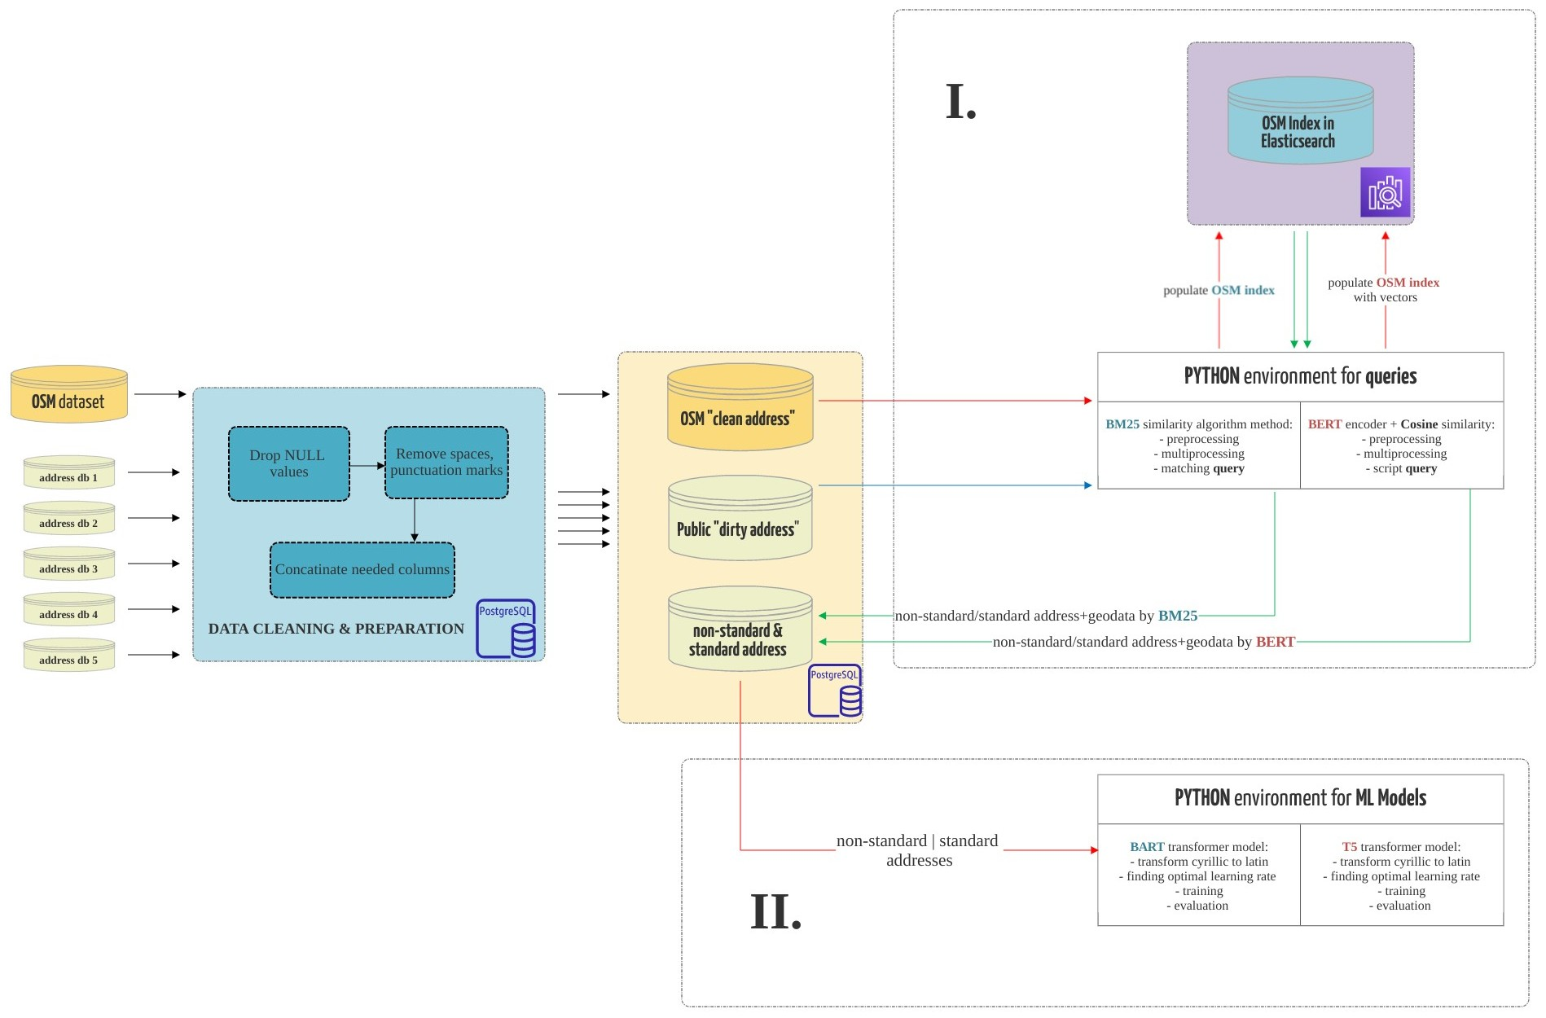
Work plan:

Slide 11
Related Works
Christen (2015): the most prevalent method for address standardization is the manual specification of transformation and parsing rules (AutoStan)
Yu (2019) presents an address normalization approach on the basis of the Bayes probability model and Cosine similarity
Abbasi (2005) has analyzed numerous information extraction techniques and discussed information extraction techniques, such as RAPIER, GRID , and HMM can be utilized to address standardization
Lu (2019): the current address standardization methods are divided into 2 types: address matching based address normalization methods and NLP-based address standardization methods
Higuera (2017) made a research conclusion that, in contrast, to address matching algorithms, algorithms based on NLP demand models and data of a higher quality

Slide 12
02
Methodology
- Data set
- Methods of binding geodata to addresses
- Sequence-to-Sequence models

Slide 13





Data set:
Dirty addresses are addresses from different public sources that we use as input data that will need to be standardized and geolocations defined for each address.
Clean addresses are an Open Street Map (OSM) standardized addresses with geolocation, which we will take as the "gold standard"

Slide 14
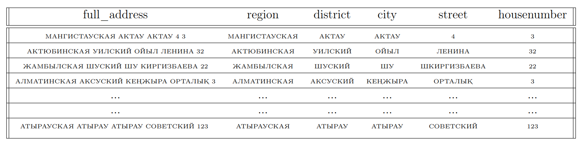
Data collection:
Dirty addresses:
from 5 different open public sources
each of the tables of dirty address source consists of six columns (full_address, region, district and etc.)
about 300,000 records, for a total of 1,500,000 addresses
Clean addresses:
the OSM data with Kazakhstani addresses were downloaded in .osm.pbf
total of 663,679 addresses
“osm2pgsql” command-line tool for importing to Postgres

Slide 15
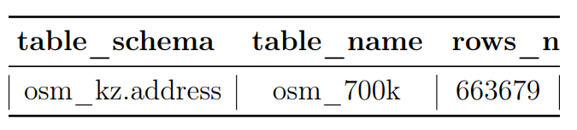
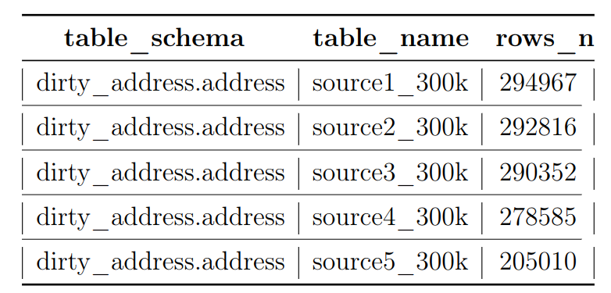
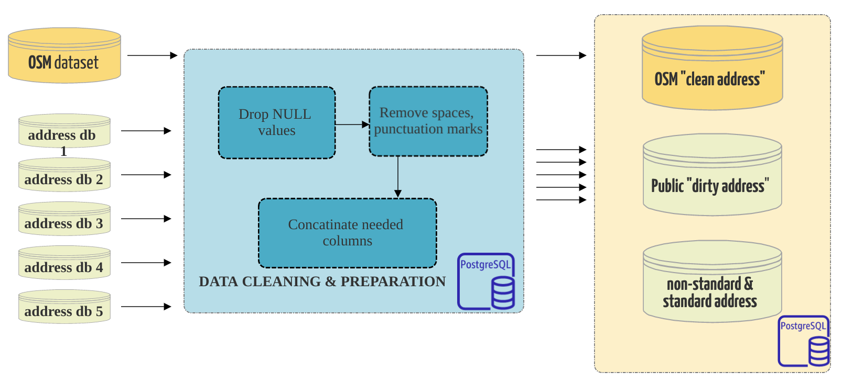
Data cleaning and preparation:
Dirty addresses (public dbs):
drop NULL values
remove punctuation marks("!!", "*"),
spaces ("\_", "-"), others ("no address", "\#\#\#")
concatinate columns (region+district, city+street)
create city_street_vectors column
Clean addresses (OSM):
st_contains and st_distance functions to get the rest of the data
drop NULL values
concatinate columns (region+district, city+street)

Slide 16
Method for binding geodata to address:
In this stage:
- dirty addresses need to be brought into a standard form with geodata
- this received dataset with dirty and
corresponding clean addresses will be
used in our proposed ML model
Proposed Methods:
BM25 in Elasticsearch
Sentence Embedding

Slide 17
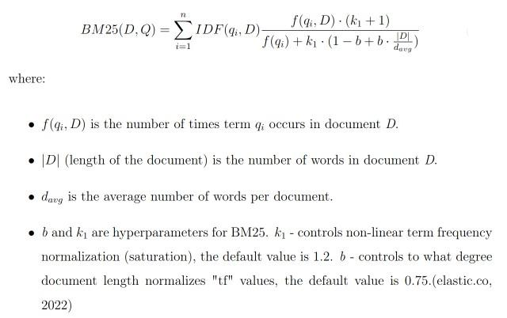
BM25 similarity algorithm
Okapi BM25 similarity algorithm is a ranking function that search engines as Elasticsearch employ to determine the relevance of documents to a particular search query.
BM is an acronym that stands for best matching.
BM25 is the configuration that is now used by default in Elasticsearch.
It is a TF-IDF-based similarity.
For instance, in “Mangylik-el street Baikonyr district”
Street & district — in all document
Mangylyk-el & Baikonyr — more specific of a small subset of documents

Slide 18
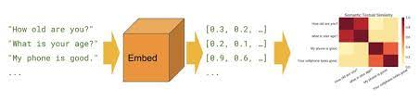
Sentence embedding
Sentence embedding approaches portray sentences as continuous vectors in a low dimensional space(Lamsiyah, 2019)
BERT encoder + Cosine similarity

Slide 19
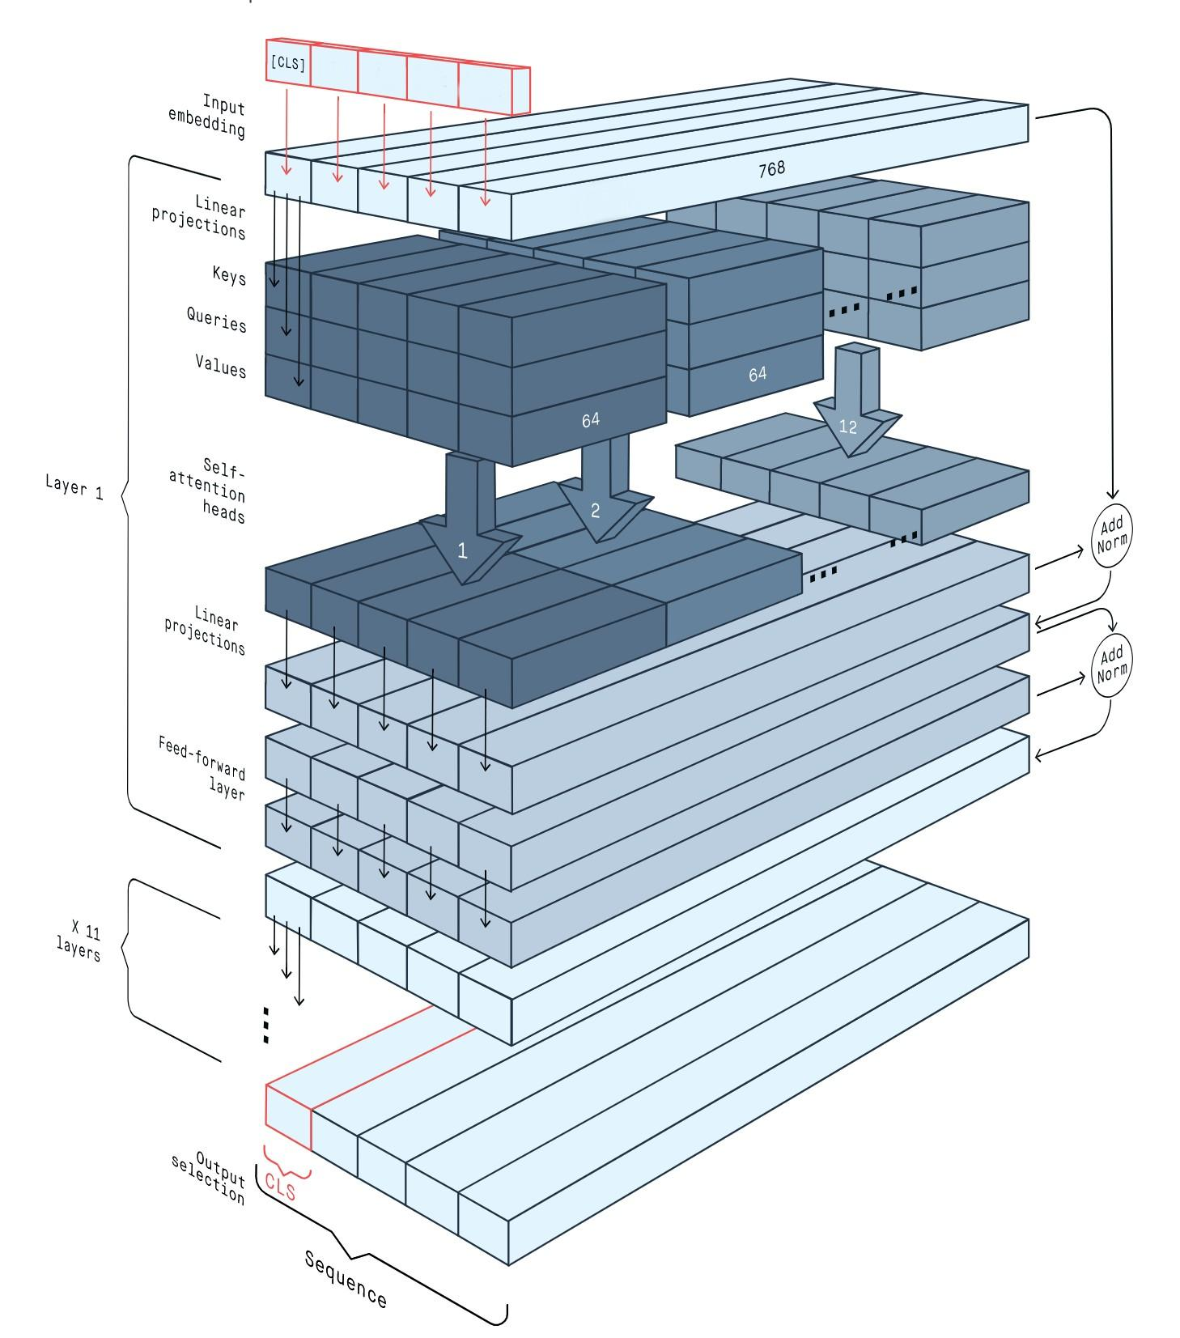
The BERT encoder:
BERT pushes the state of the art in NLP by combining two powerful technologies (Wang et al., 2018):
It is based on a deep Transformer encoder network, a type of network that can process long text efficiently by using self-attention
It is bidirectional, meaning that it uses the whole text passage to understand the meaning of each word
BERT is constructed out of 12 layers of consecutive transformers, each of which has 12 attention heads. It is estimated that there are 110 million parameters in all.
Each of these tokens within "Sequence" has a value of 768.
Pooling method (to convert "Sequence" into one vector) will take the average of all token embeddings and compress them into a single 768 vector space, so producing a 'sentence vector'.

Slide 20
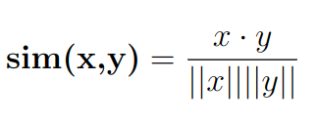
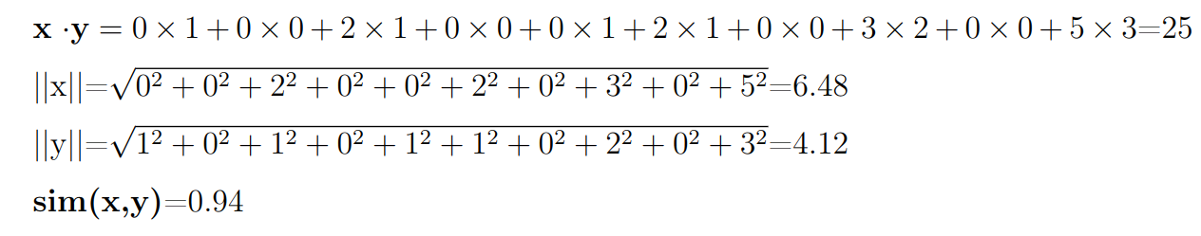
Cosine similarity:
Cosine similarity evaluates the similarity between two inner product space vectors (Han et al., 2012)
Cosine similarity is superior to Euclidean distance because even if two text documents are separated by a vast Euclidean distance, there is a possibility that they are contextually near (Kanani et al., 2019)
Simple Cosine similarity example where x=(0,0,2,0,0,2,0.3.0.5) and y=(1,0,1,0,1,1,0,1,0,3)

Slide 21
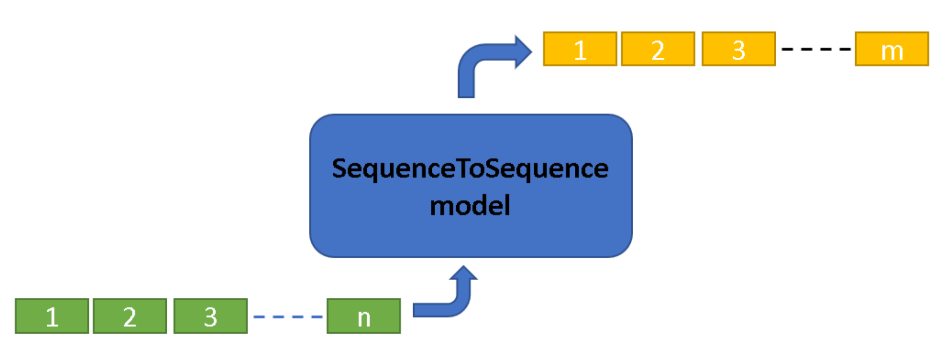
II. Seq2Seq models:
Sequence Translation - translating an input sequence into an output sequence of any length
We use SequenceToSequence model which provided by the Arcgis (2022)
Huggingface transformers library - state-of-the-art Machine Learning for PyTorch, TensorFlow.
The Transformer was initially demonstrated to be useful for machine translation, but it has since been implemented in several NLP (Devlin, 2018)
BART Transformer based Seq2seq model (baseline)
T5 Transformer based Seq2seq model (proposed)

Slide 22
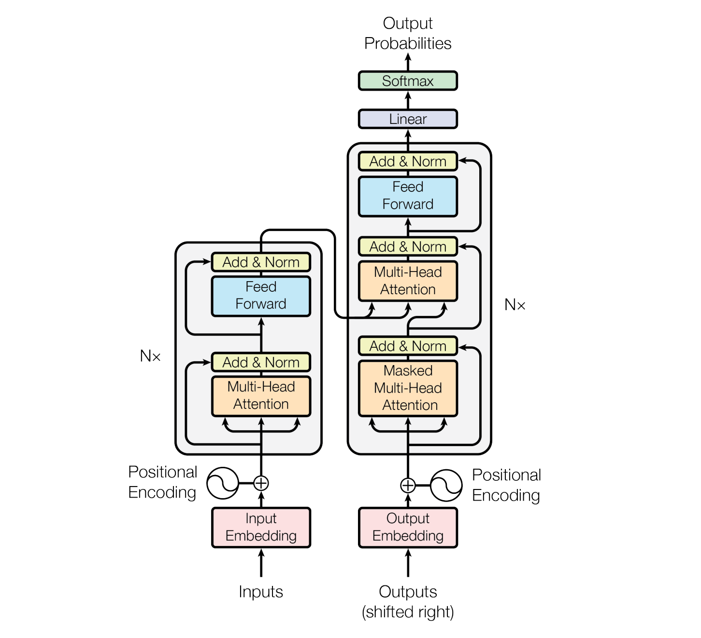
The Original Transformer model (Vaswani et. al, 2017):

Slide 23
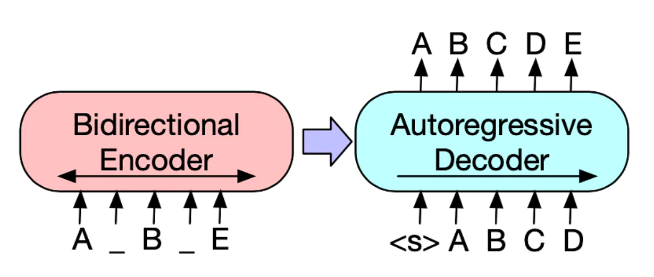
BART Transformer model (Lewis et. al, 2019):
BART uses the standard Seq2Seq2 Transformer architecture from Vaswani et. al ,2017. That is Original Transformer model.
Consists of generalizing BERT (due to the bidirectional encoder), GPT (with the left-to-right decoder).

Slide 24
T5 Transformer model (Raffel et al., 2020):
The basic architecture is Transformer, which was proposed by Vaswani et. al, 2017.
It achieves state-of-the-art on multiple tasks, which shows the power of the large pre-training model and Seq2Seq paradigm (Singh et al., 2019)
T5 is basically comparable to the original Transformer with the difference of relocating the layer normalization outside the residual route, and employing a new position embedding strategy.
T5 trained on Colossal Clean Crawled Corpus(C4), and it comes in different sizes:
T5-small (60m parameters, 6 layers),
T5-base (220 m parameters, 12 layers),
T5-large (770m parameters, 24 layers) and etc.

Slide 25
Evaluation metric - BLEU:
Bilingual Evaluation Understudy (BLEU) - is an algorithm to assess machine-translated text quality and is knowns as an inexpensive and automated metric (Huggingface, 2022)
It is one of the first metrics to correlate highly with how people evaluated quality (Huggingface, 2022)
In our work we use get_model_metrics method of SeqtoSeq to show BLEU scores.

Slide 26
03
Experiments & Results

Slide 27
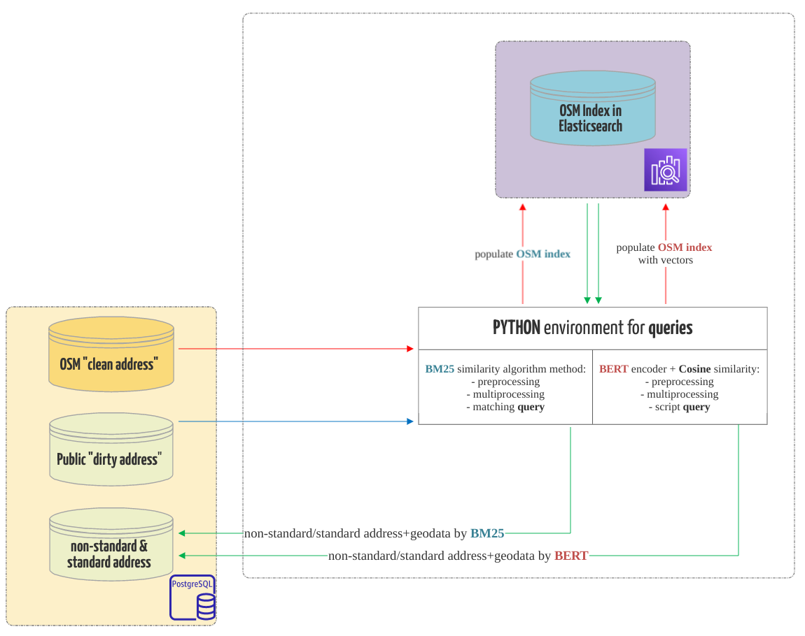
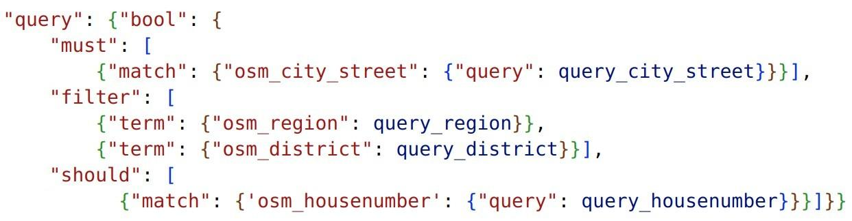
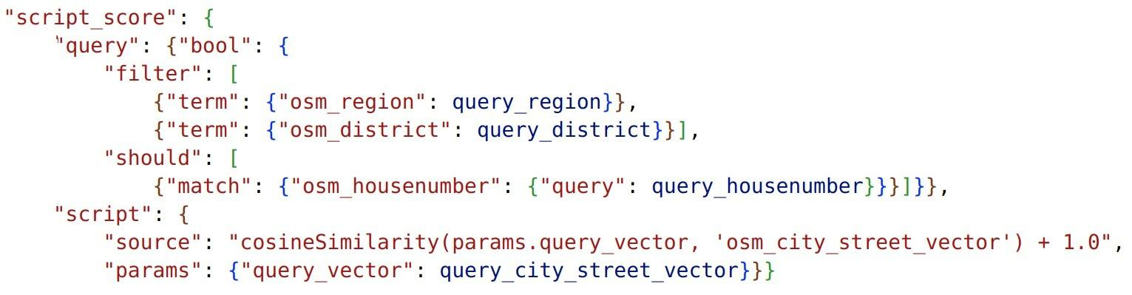
Text similarity method
BM25 query:
BERT+Cosine similarity query:

Slide 28
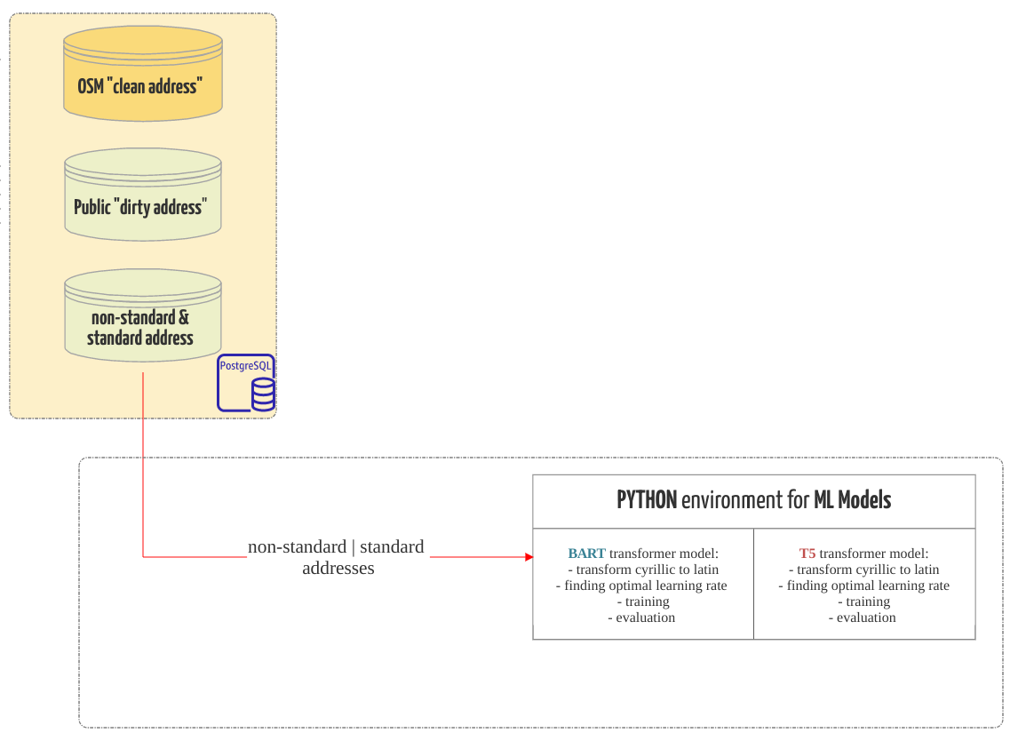
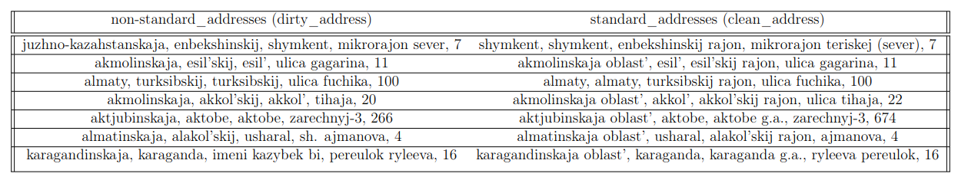
Seq2Seq models
BART Transformer model - 5-3eps and 7-5 eps parameters
T5 Transformer model - 5-3eps, 7-5eps, 10-5eps, and 20-10 eps parameters
Input addresses:

Slide 29
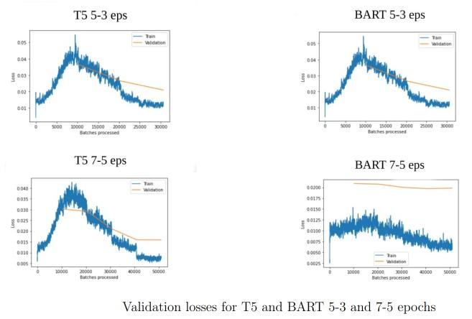
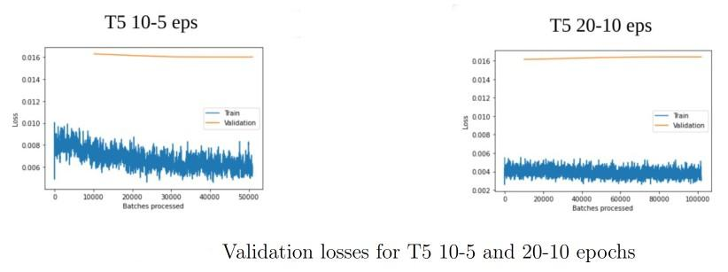
Experiments: Seq2Seq models

Slide 30
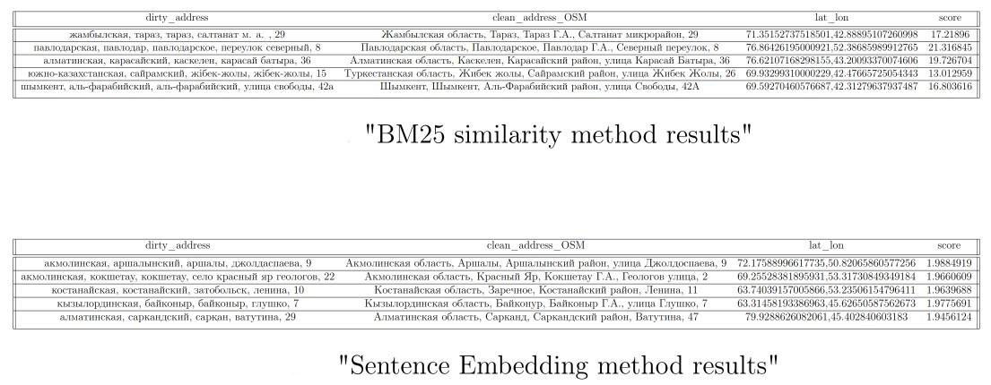
Results: Text similarity method

Slide 31
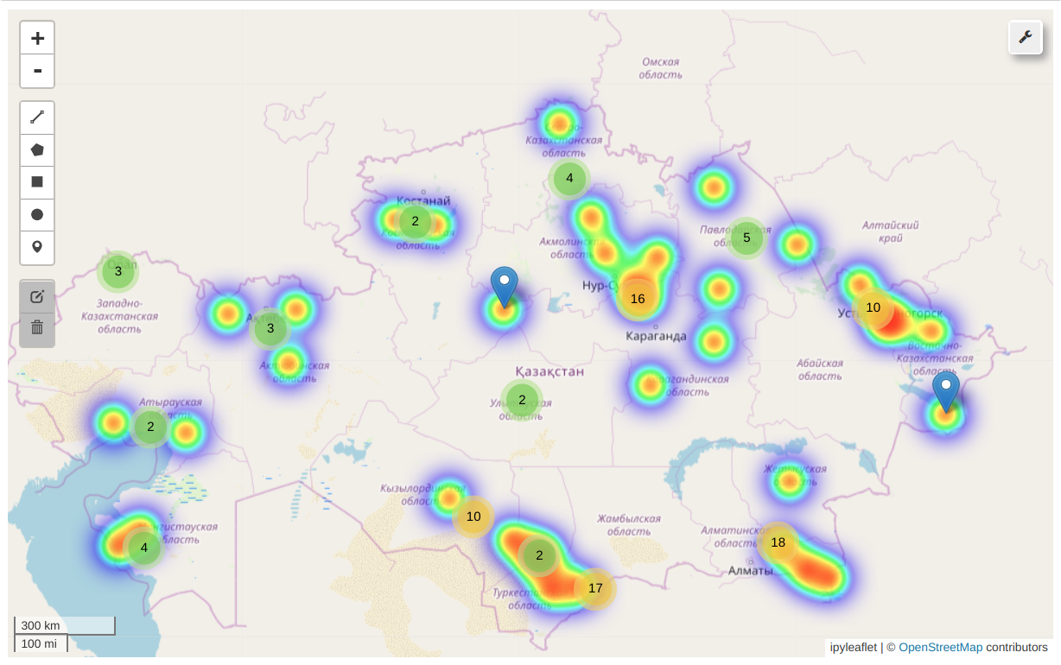
Results: Text similarity method

Slide 32
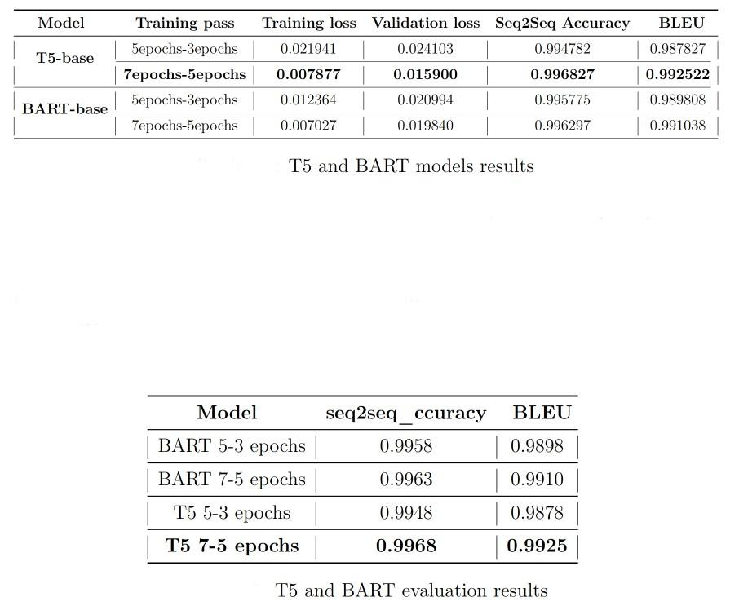
Results: Seq2Seq models

Slide 33
04
Conclusion

