Slide 1
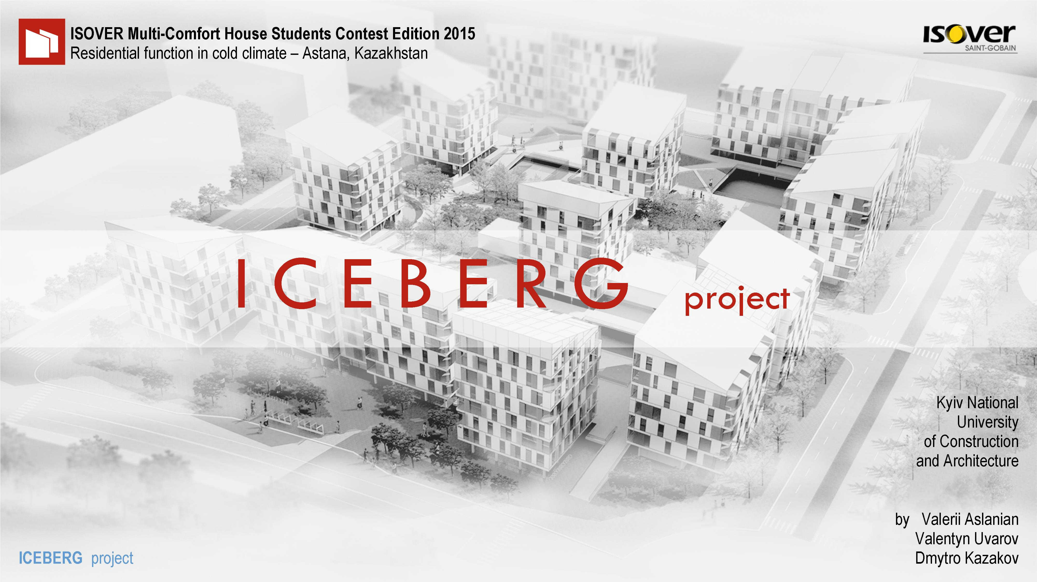

Notes:
Hello, dear jury members
and participants.

Slide 2
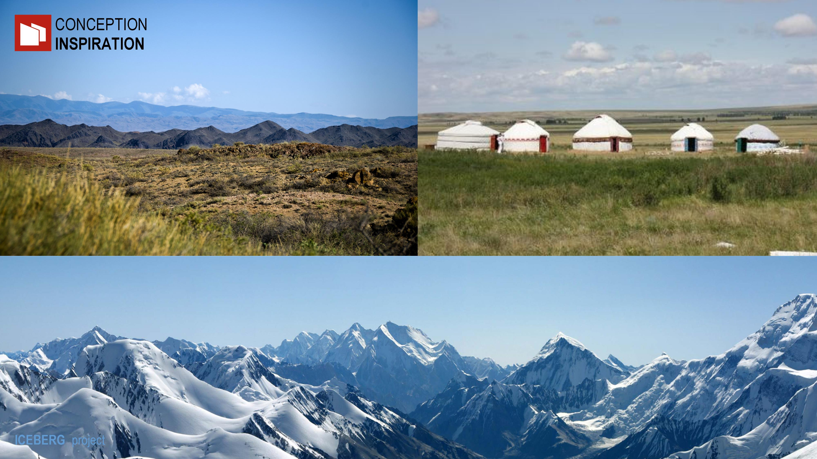
Notes:
The specific climate of Kazakhstan
creates contrast environment:
acute massive mountain glaciers
and vast windy steppe.
This became the basis
of the project concept.

Slide 3
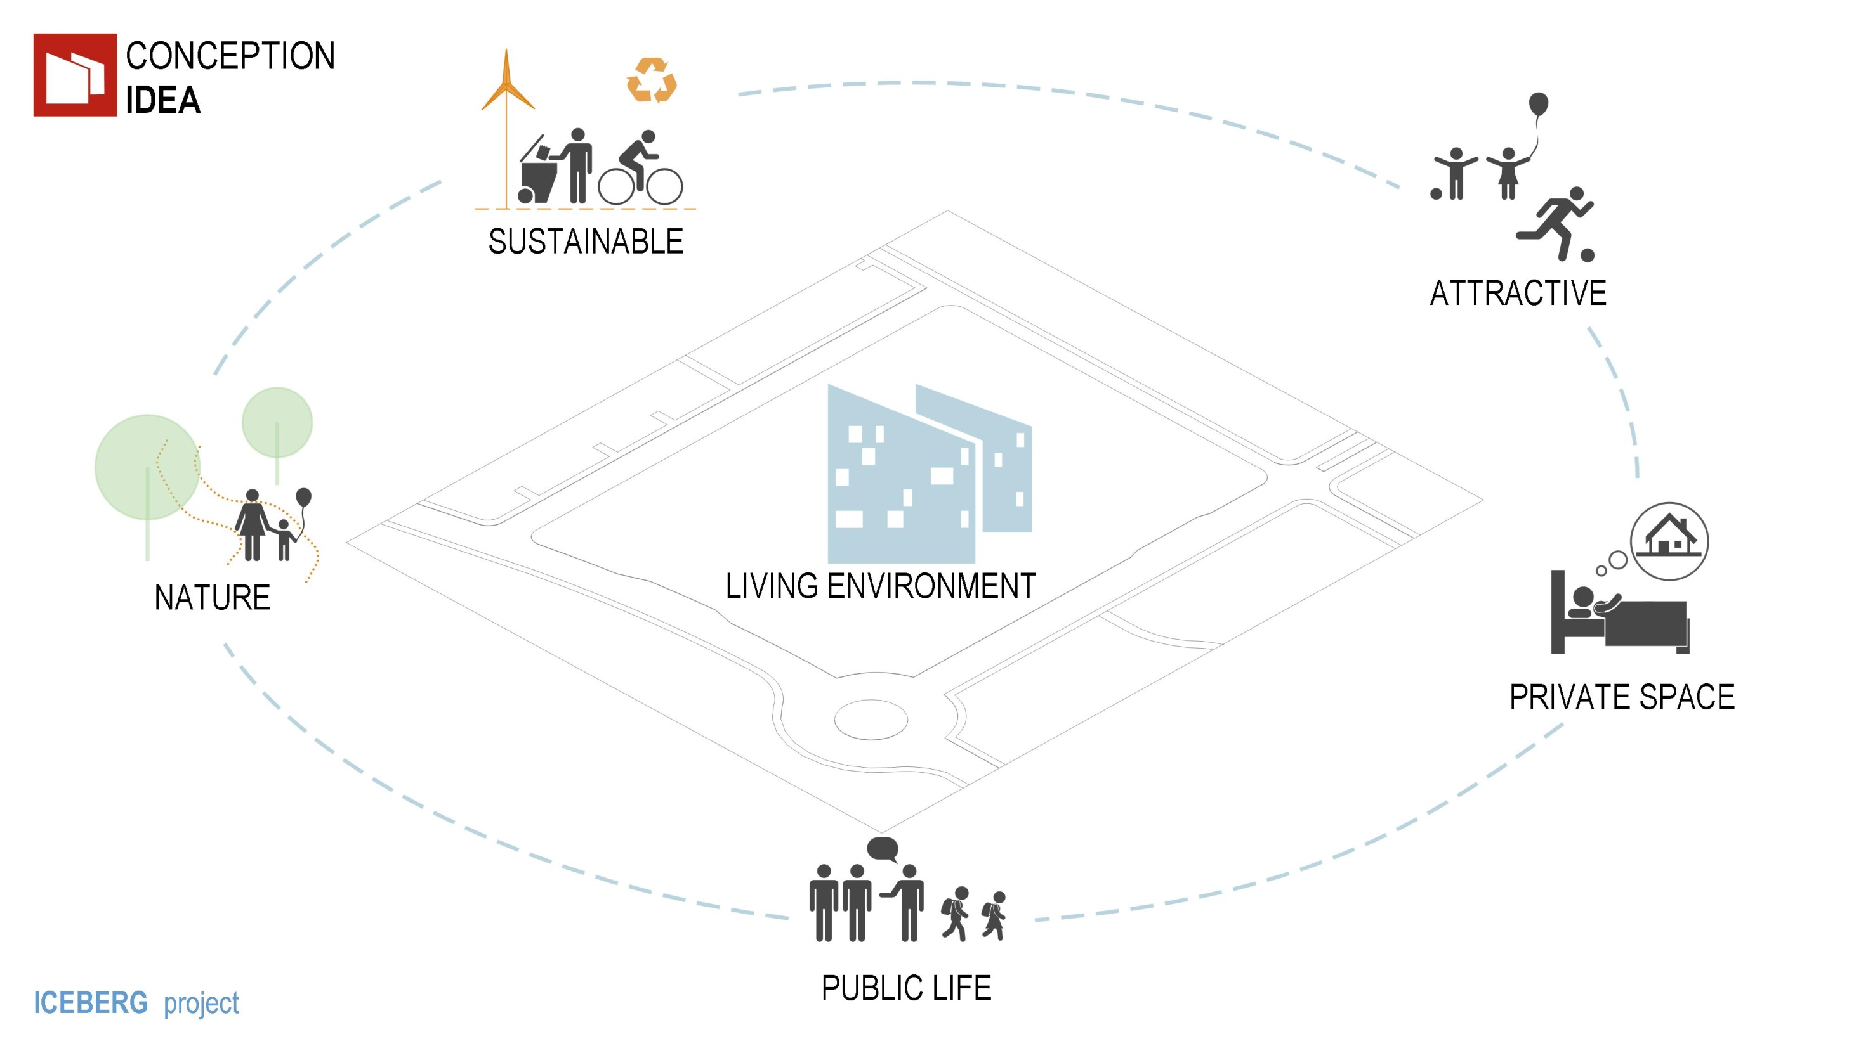
Notes:
For the formation of the
living environment,
we started with 5 factors :
sustainable development,
relationship with nature,
separation of public and private spaces,
attractiveness of the residence.

Slide 4
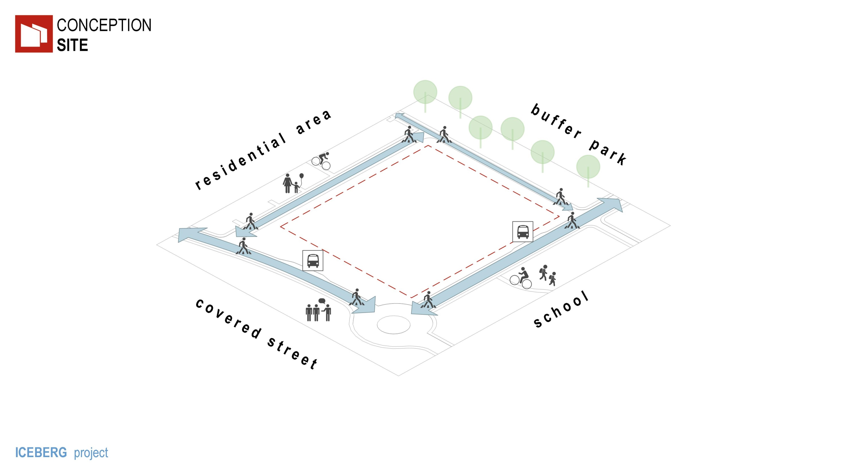
Notes:
The project is in close
relation with the environment.

Slide 5
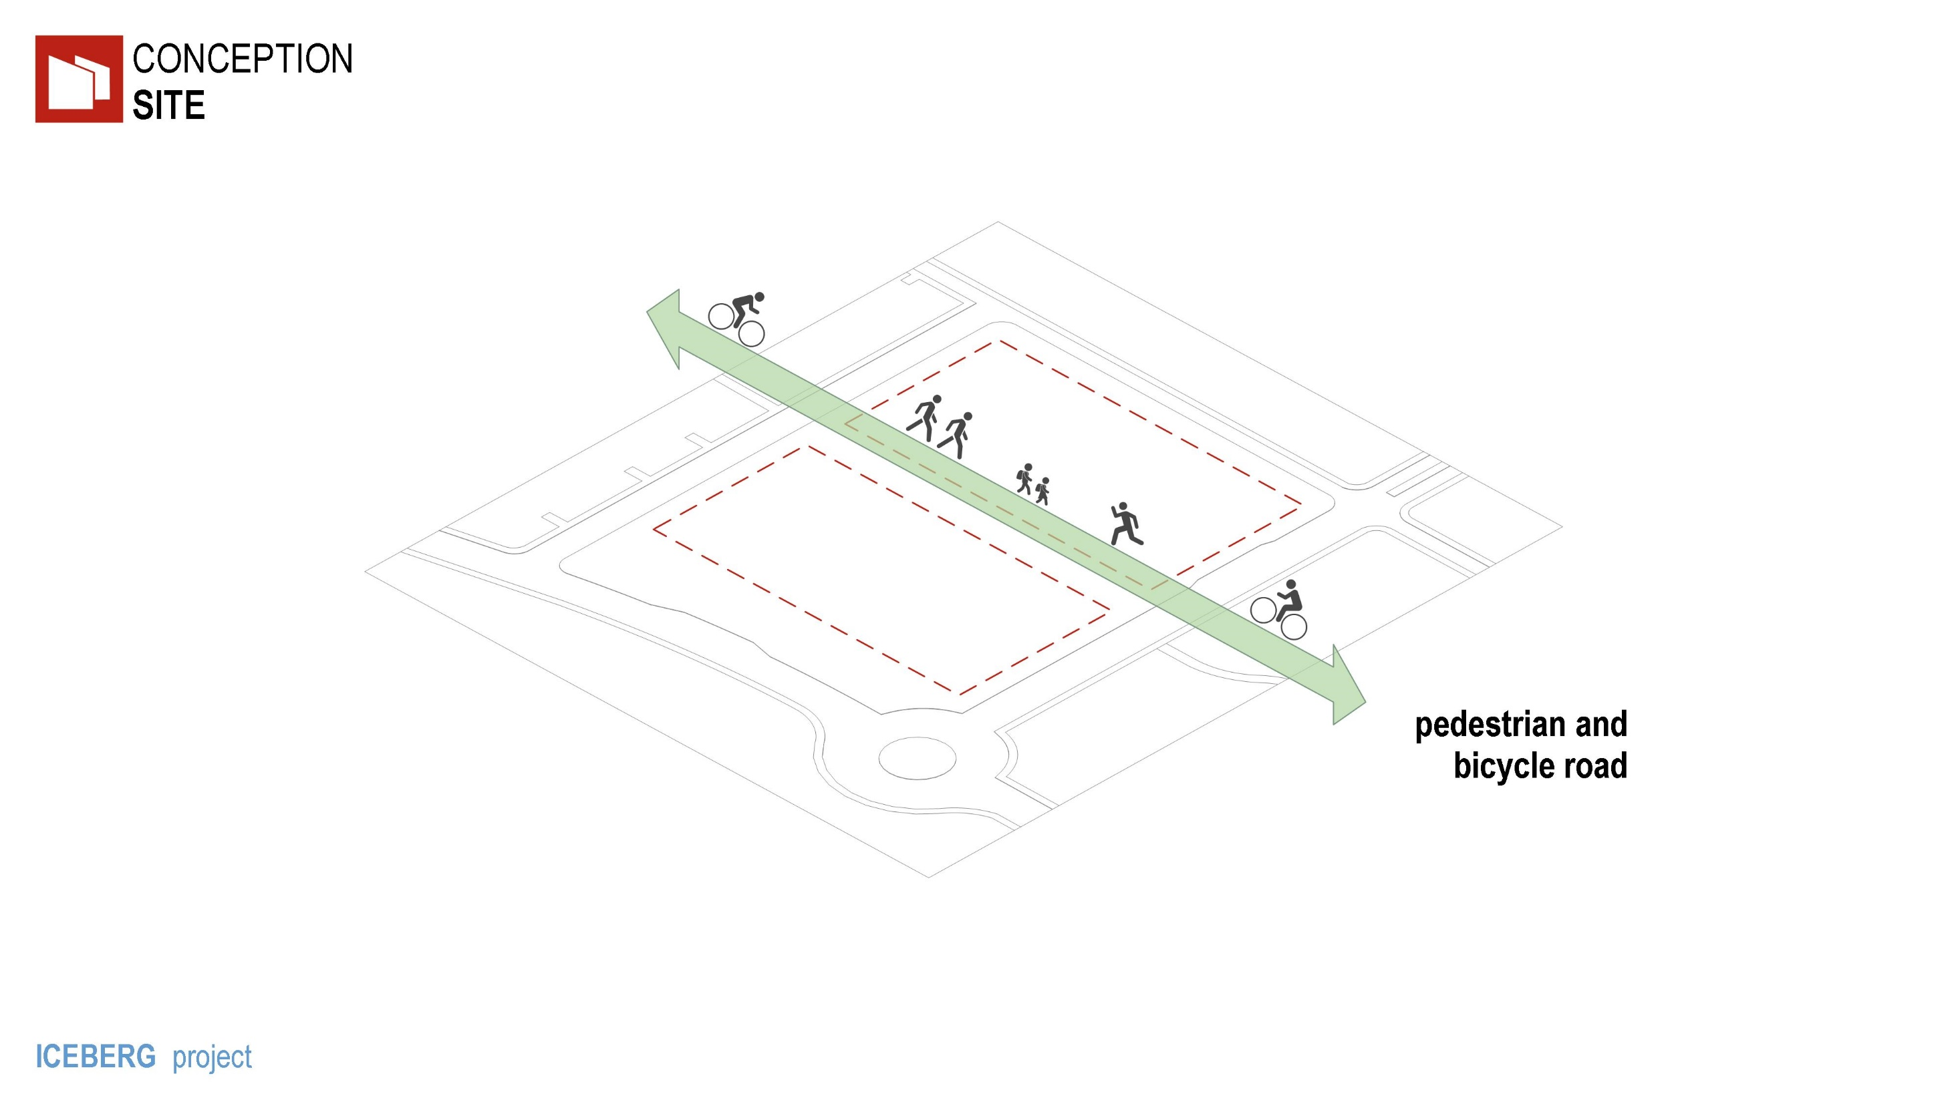
Notes:
Bicycle-pedestrian street
divides the site into two parts.

Slide 6
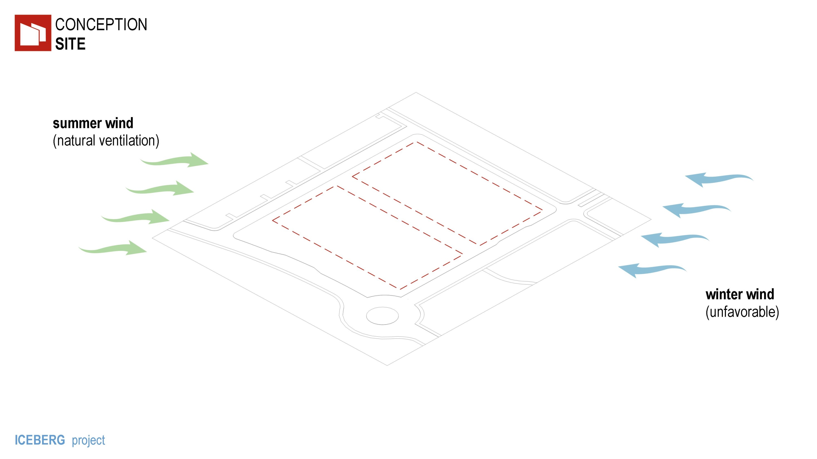
Notes:
The prevailing wind direction
in winter and summer periods
have influenced the location of houses.

Slide 7
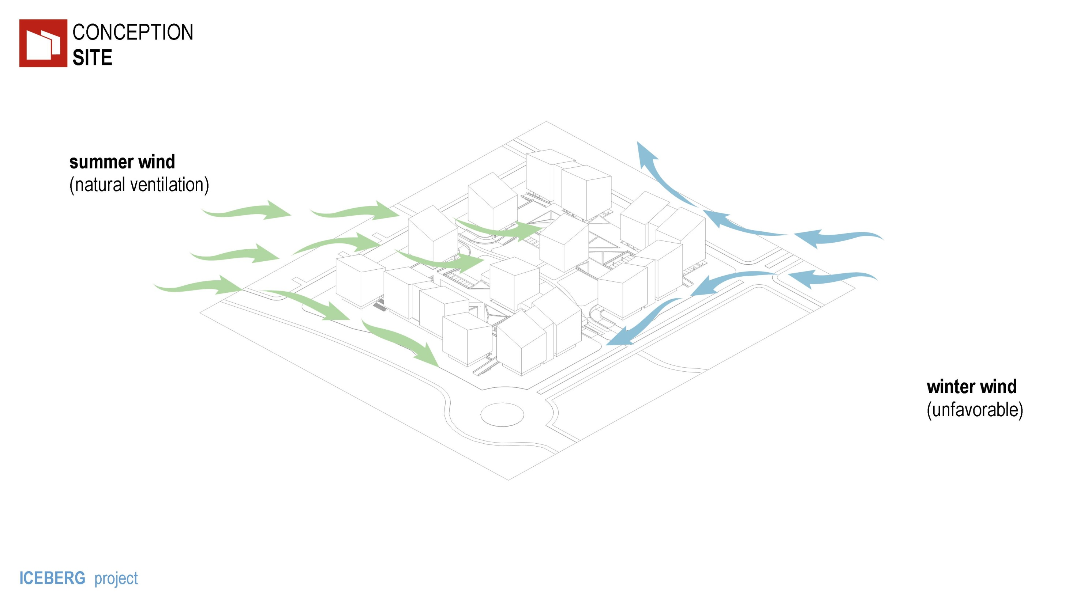
Notes:
On the South- West
a protective barrier
against gusty winter wind
was formed.
The East side (on the contrary)
is open for ventilation in summer.
This solution creates
a favorable microclimate in the courtyard.

Slide 8
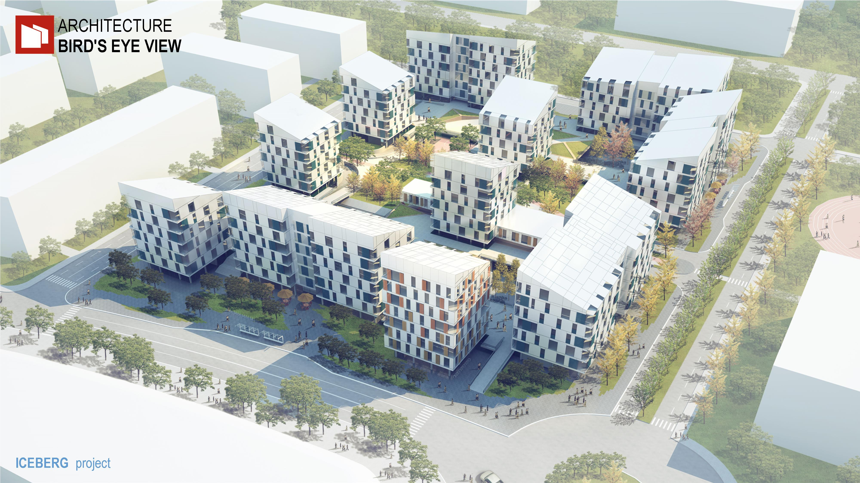
Notes:
Balancing between perimetrical and the insular buildings,
frequent alternation of volumes and voids –
provides living space nice views,
sun exposure and lighting.

Slide 9
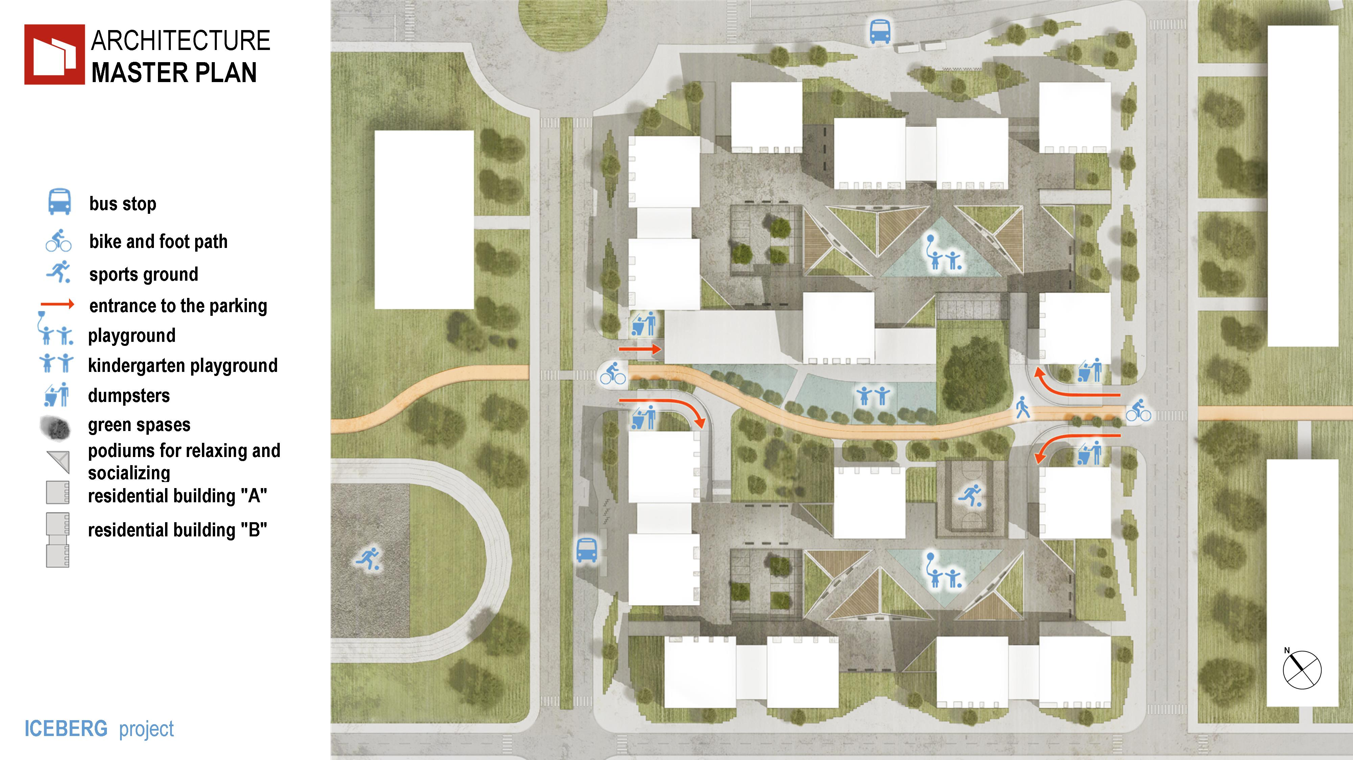
Notes:
At the site there is space for
active and quiet recreation ,
the territory of the kindergarten,
waste collection points,
provided entrances to the parking load.

Slide 10
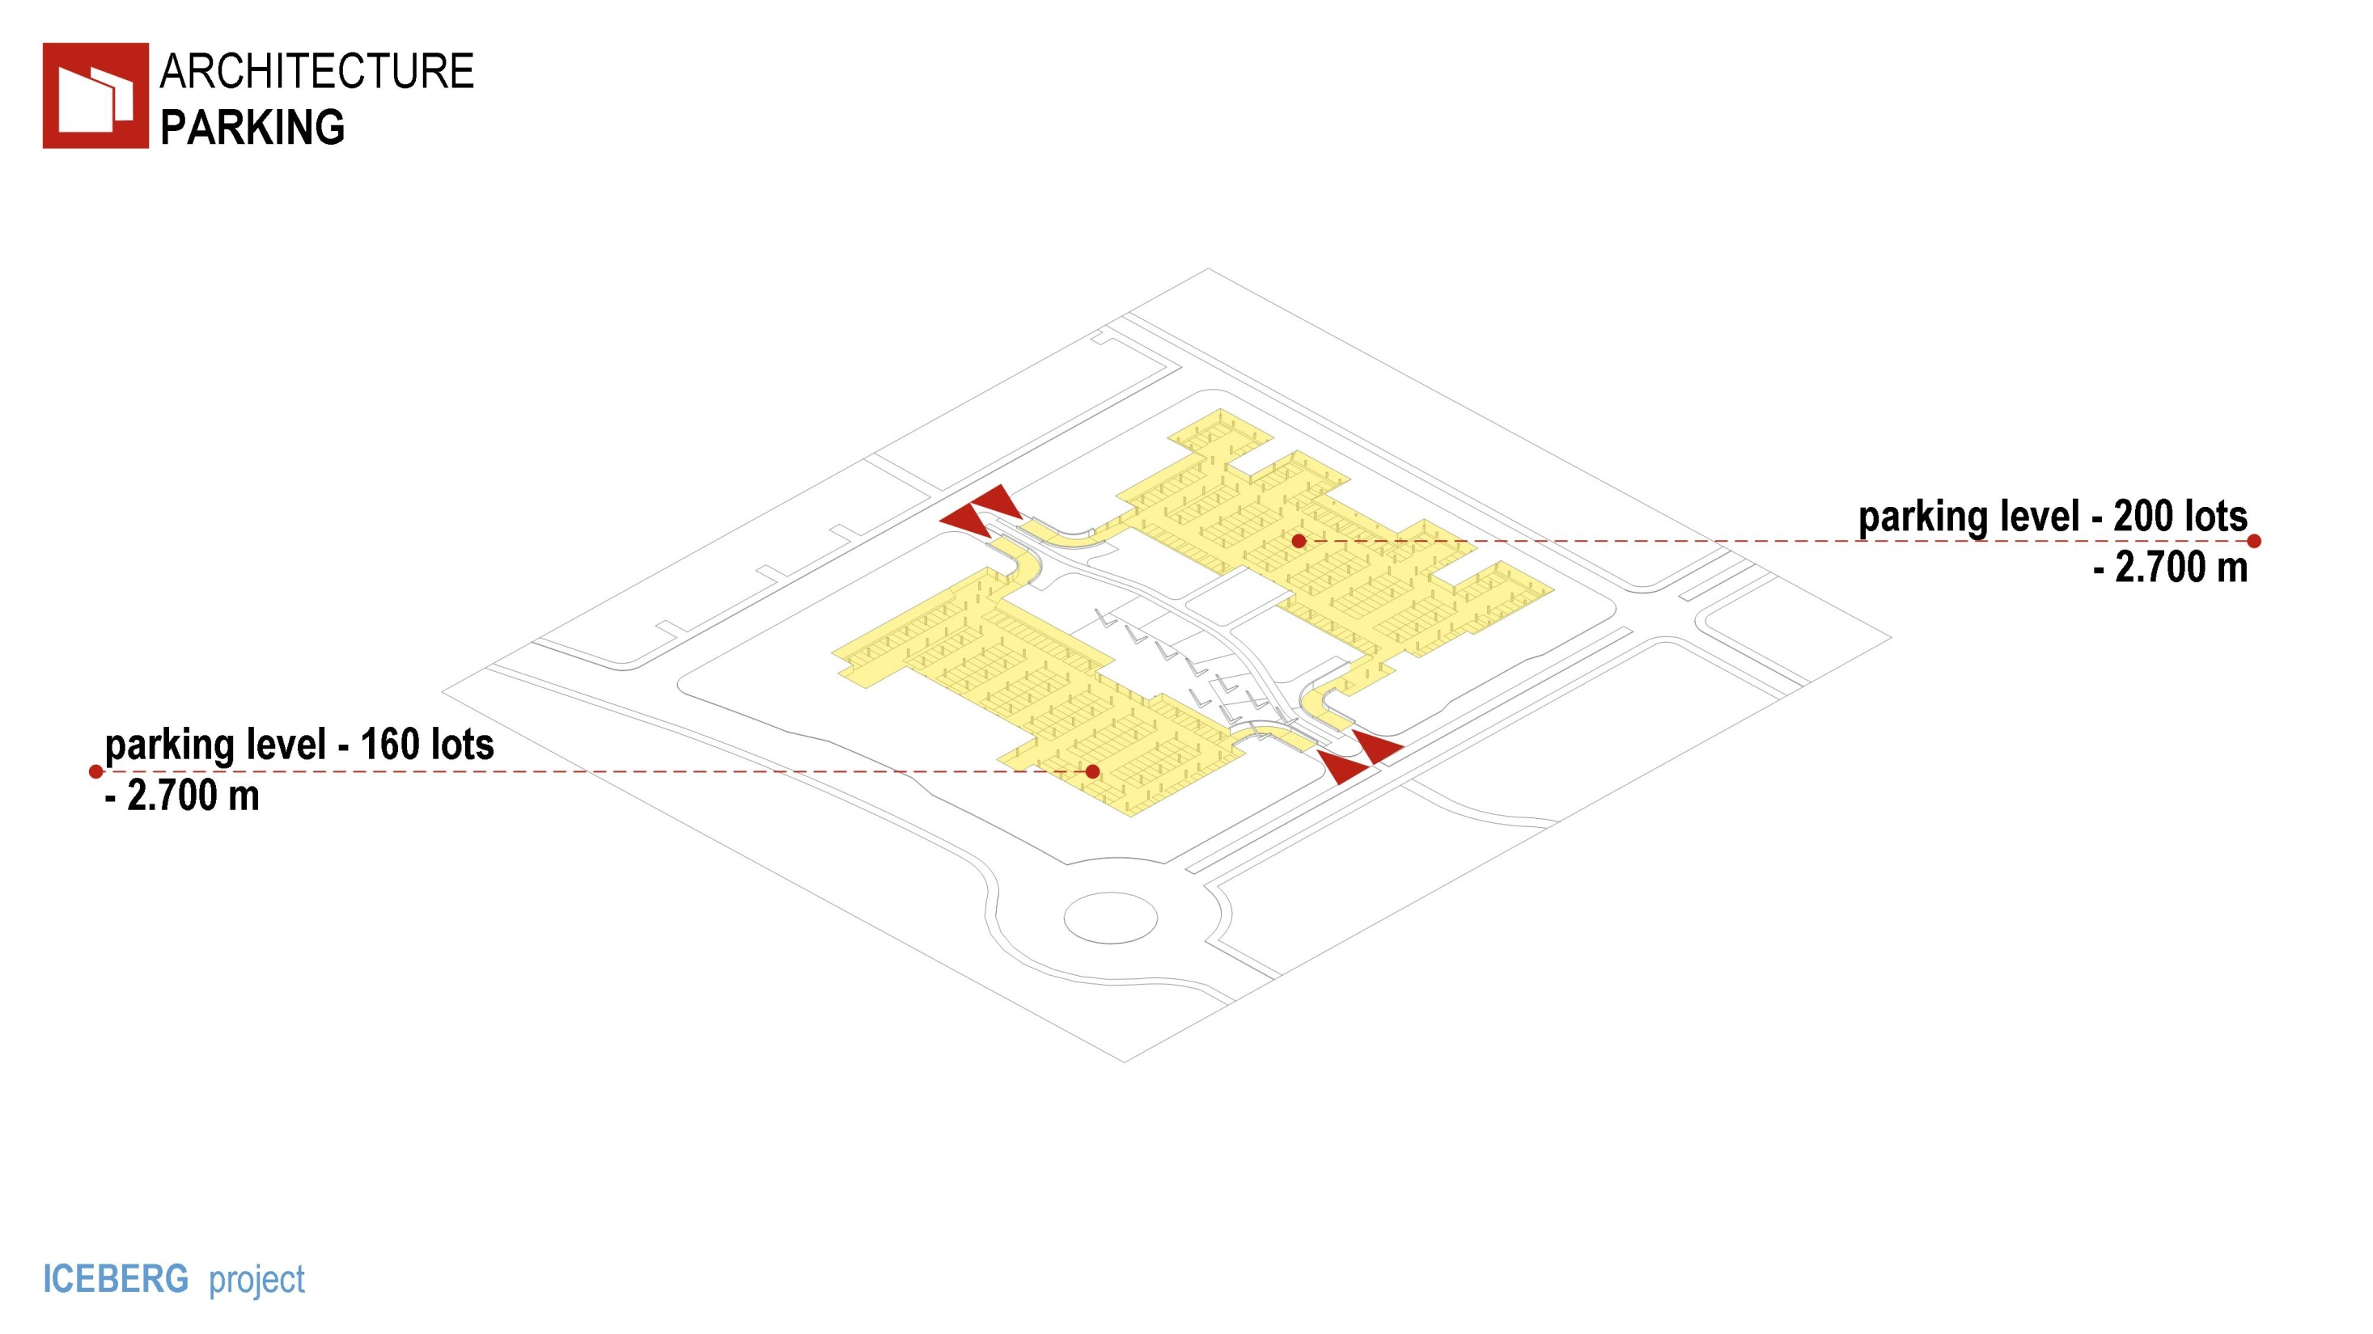
Notes:
Parking floor recessed below
the earth to 2,7 meters.
That partially provides natural lighting.

Slide 11
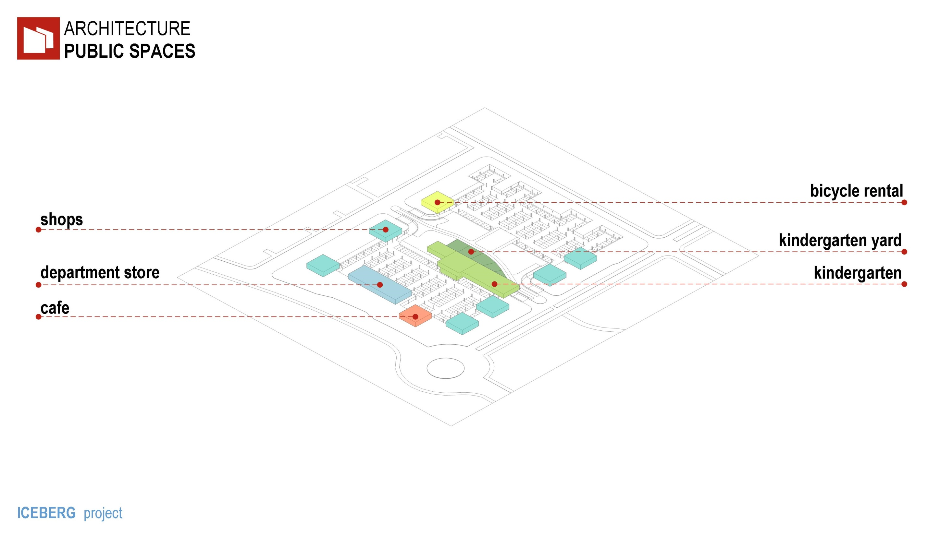
Notes:
On the first floors there are
commercial and public space
that enhances the comfort
and attractiveness of life in
the complex and forms the street.

Slide 12
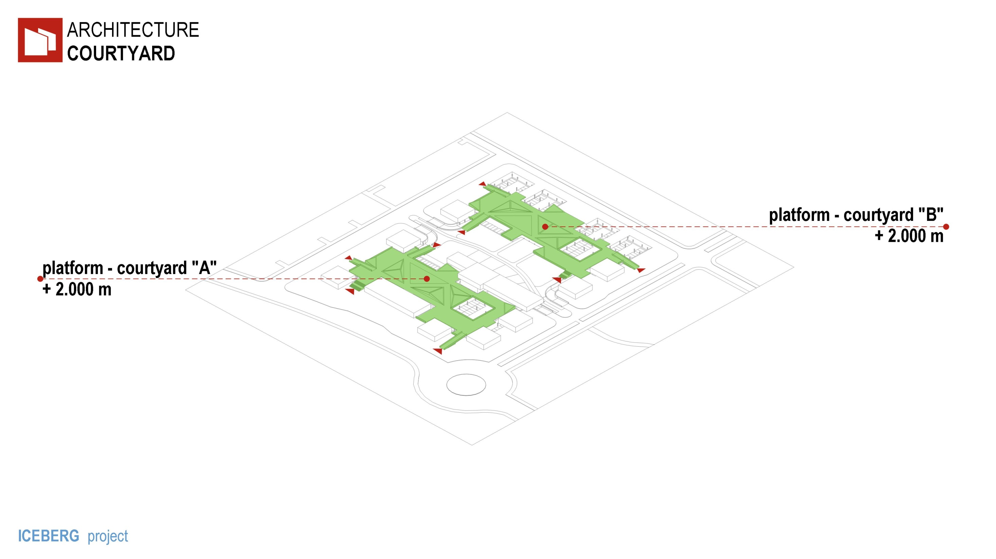
Notes:
Courtyard is pick up
on platforms above ground level
to separate private and public space.

Slide 13
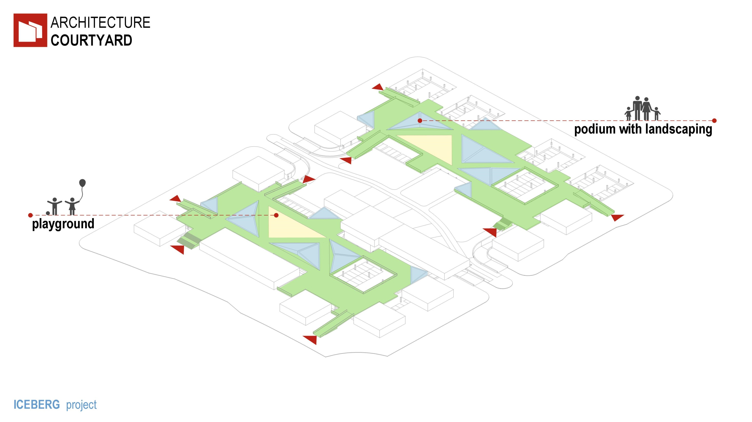
Notes:
Places for children to play
and relax are located in the courtyard.

Slide 14
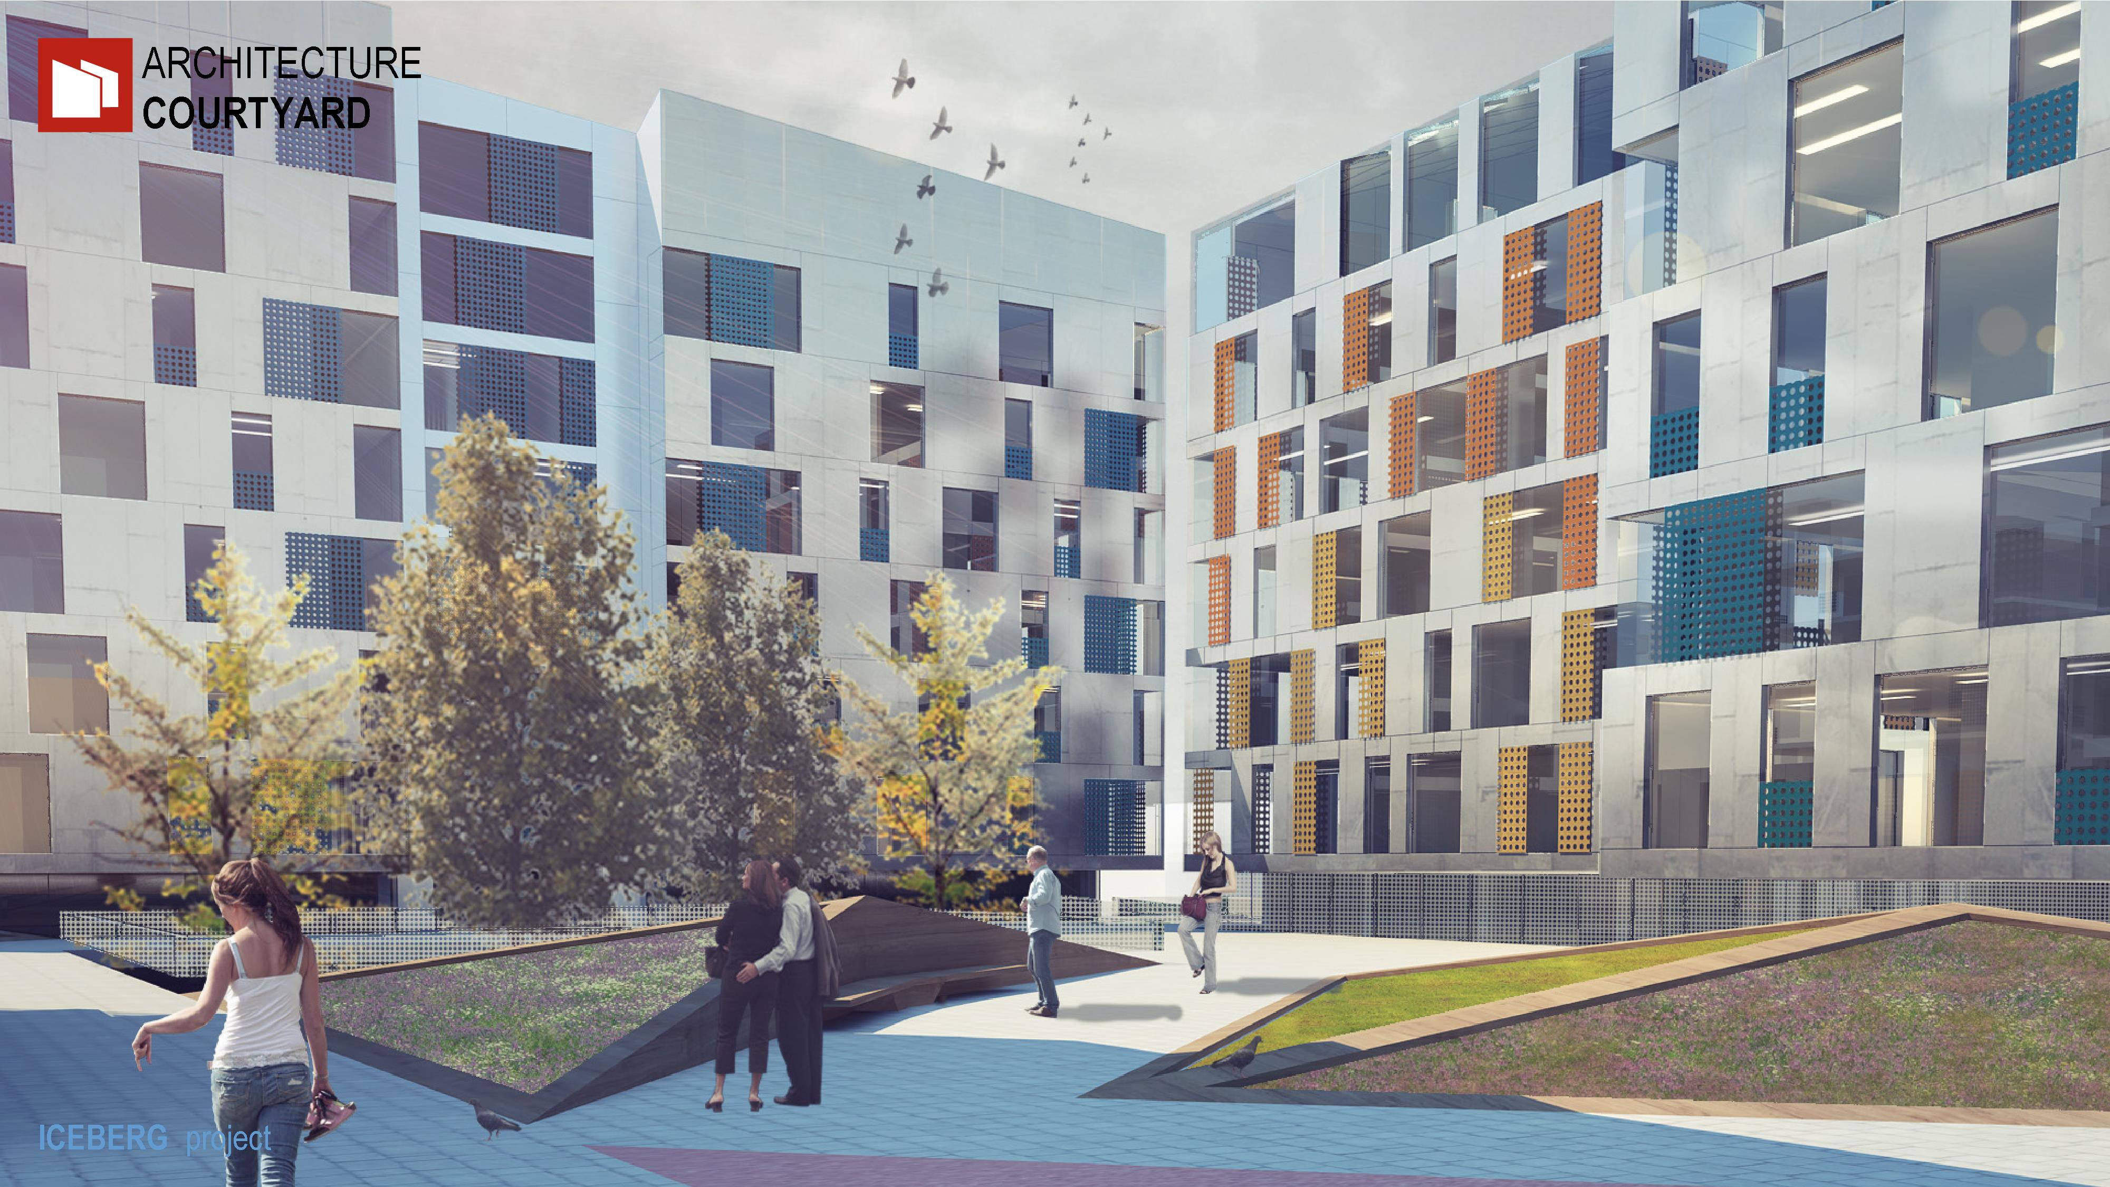
Notes:
Landscaped podiums
are designed for communication and recreation.
Their form protects against wind and noise.

Slide 15
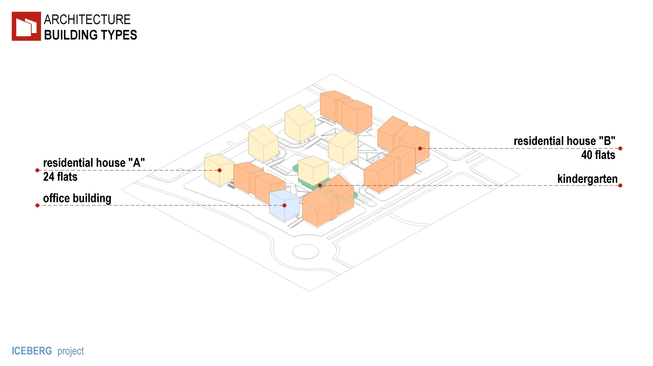
Notes:
In perfect harmony housing
is side by side with offices, shops, kindergarten.
Each component
by its very nature is aimed at creating an environment
where city life is in full swing

Slide 16
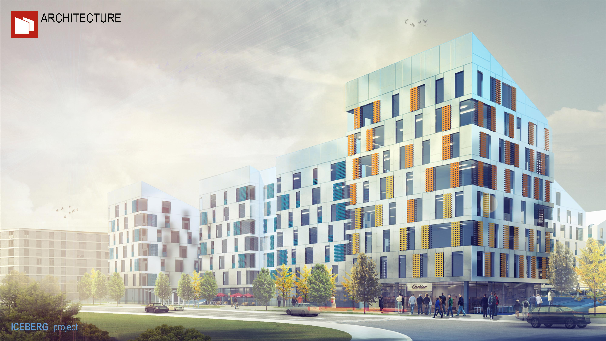
Notes:
This in combination with a
variety of solutions of
facades housing and offices
creates a pleasant living environment.

Slide 17
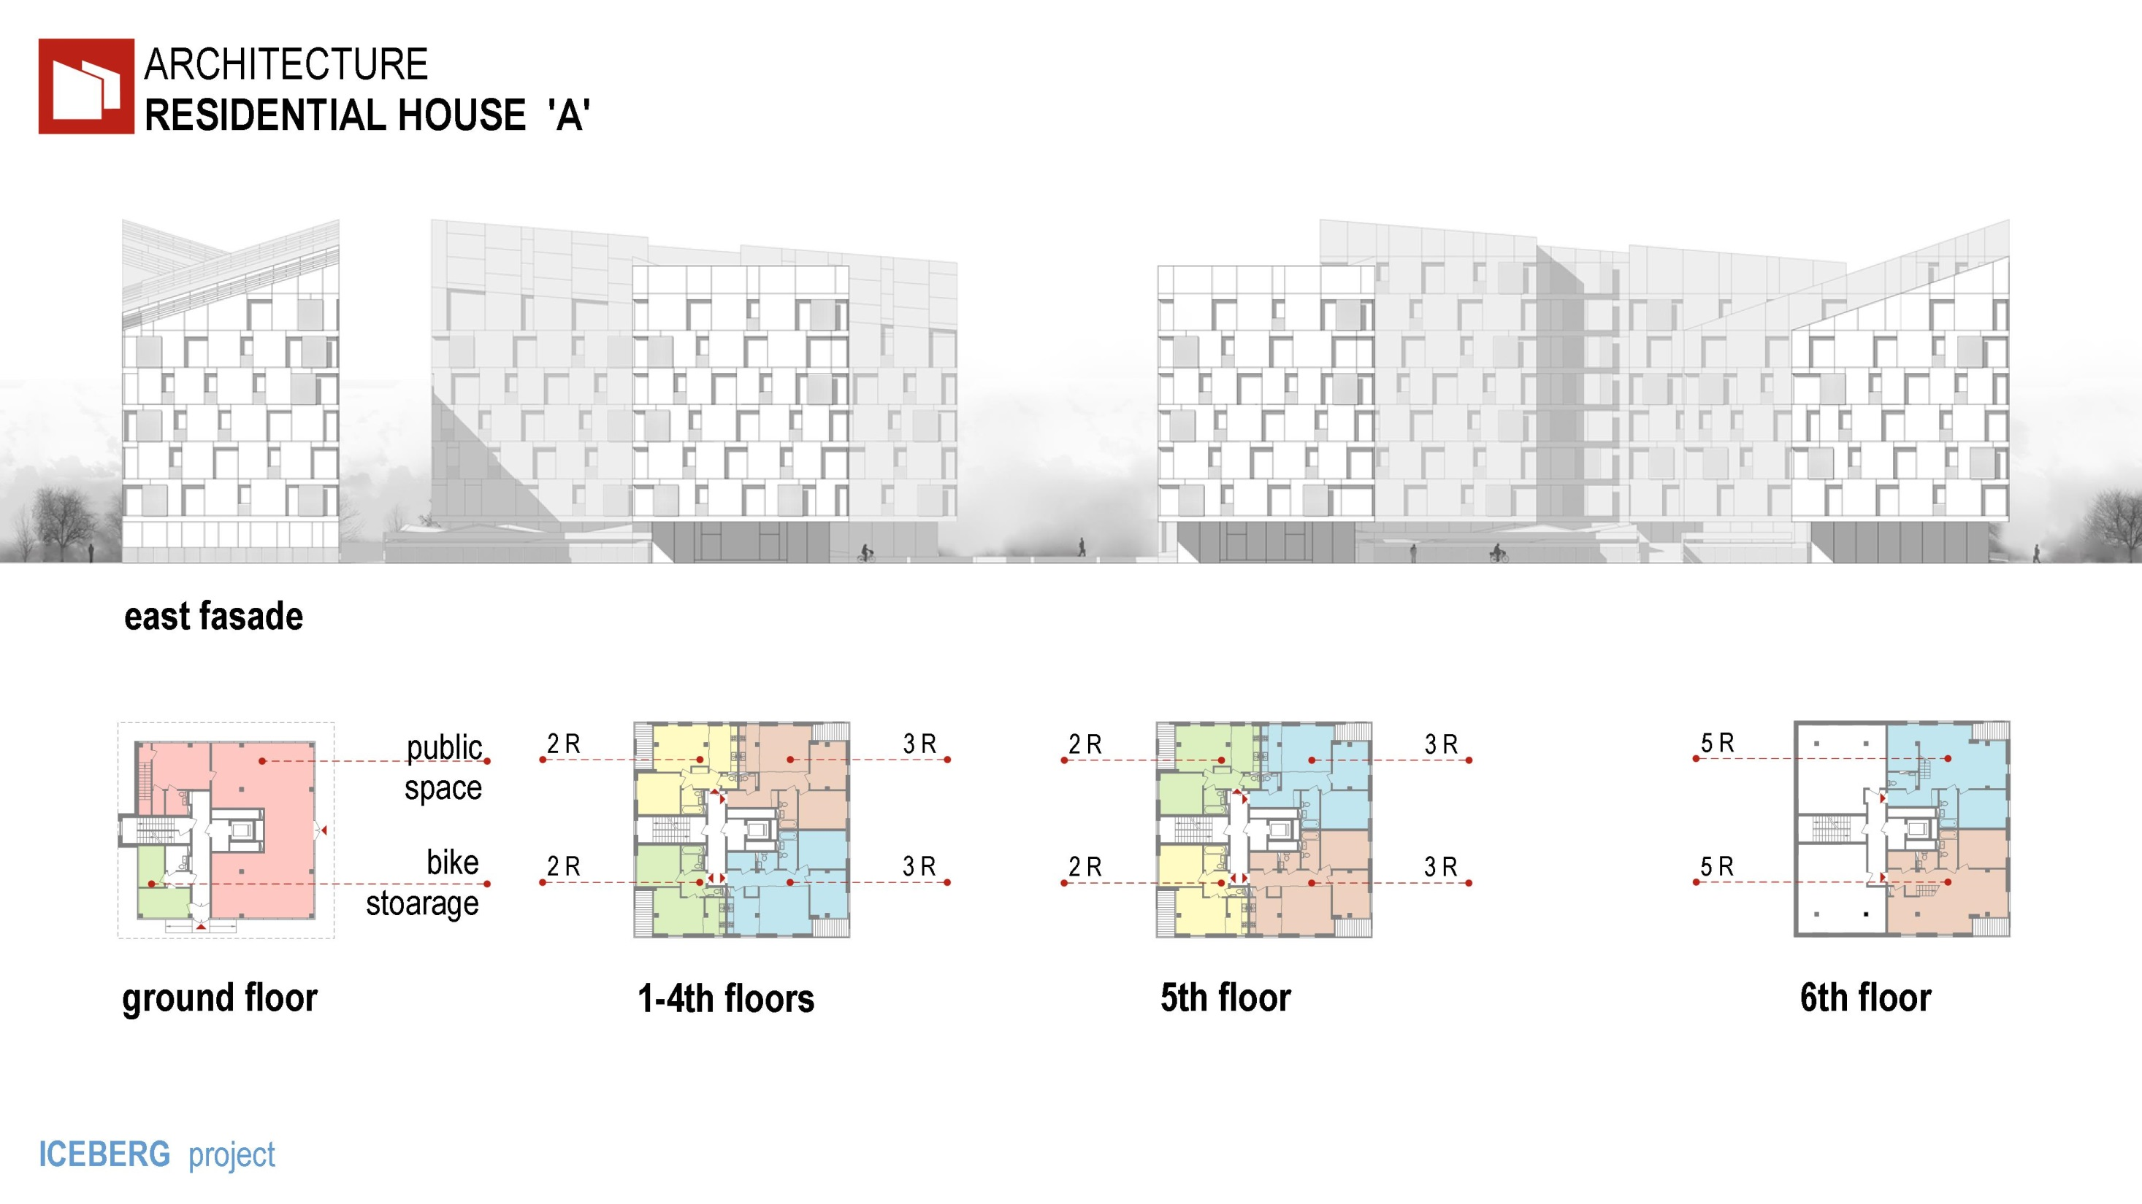
Notes:
In a residential building Type A
designed comfortable 2,3,5 bedroom apartments,
with double-sided orientation.

Slide 18
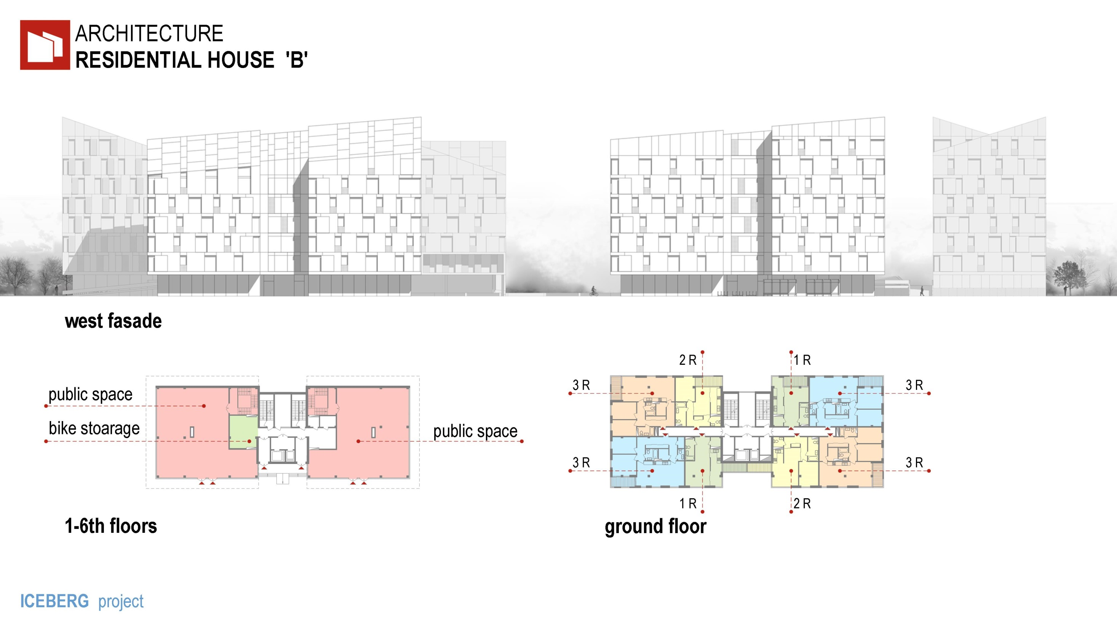
Notes:
The house type B - 1,2,3,5 bedroom apartments,
also with double-sided orientation.

Slide 19
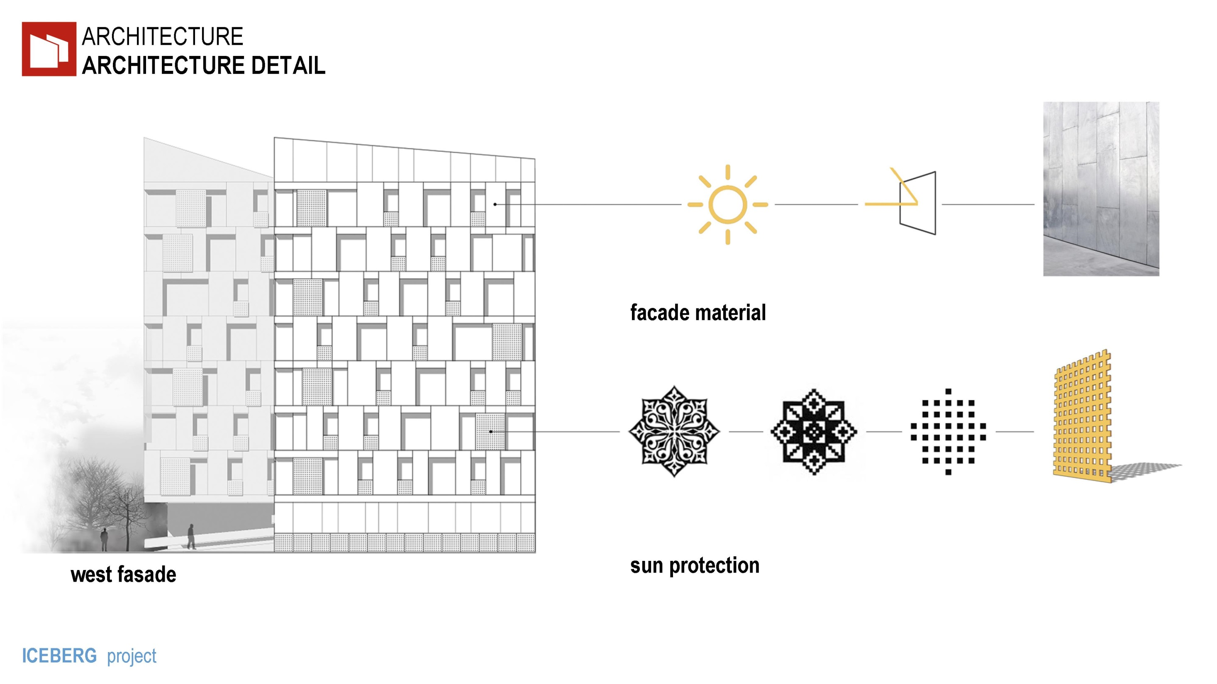
Notes:
The facade reflects the harsh climate
and traditions of the region.
The styling of the Kazakh national ornament
gave a sunscreen element.

Slide 20
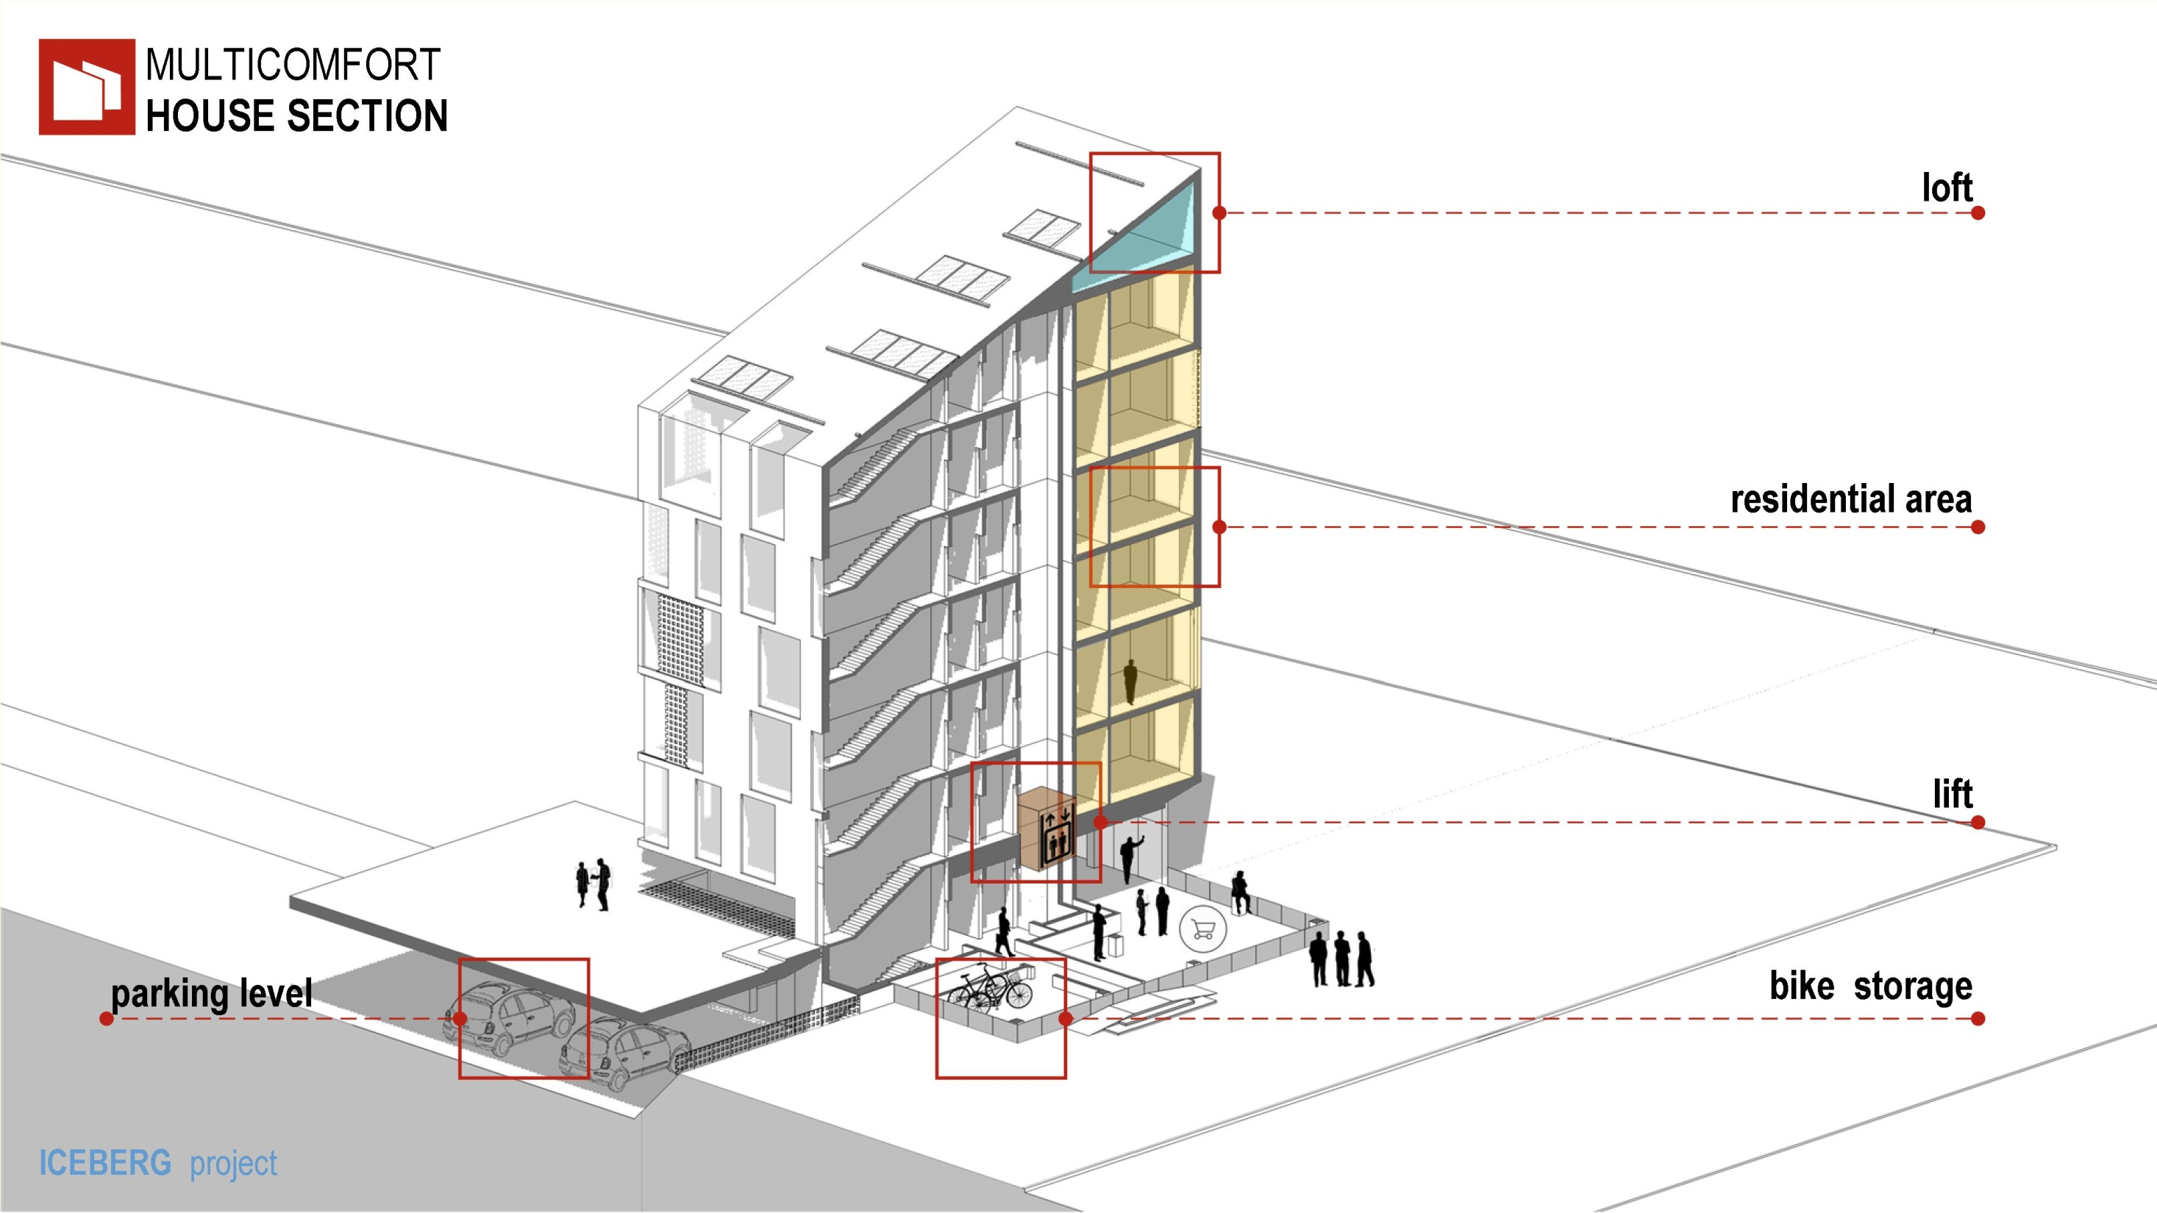
Notes:
At the main entrance to the house
from the street is a room to store bicycles.
Entrance lobby provides communication with Parking,
courtyard platform
and apartments.

Slide 21
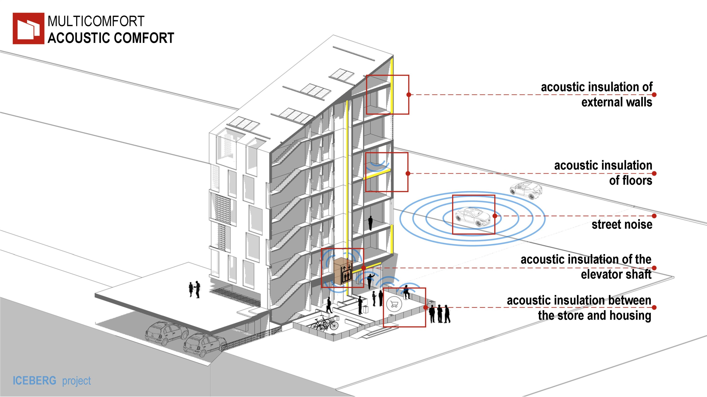
Notes:
Exterior walls, floors,
internal partitions and
Elevator shaft are Soundproofed
to provide acoustic comfort.

Slide 22
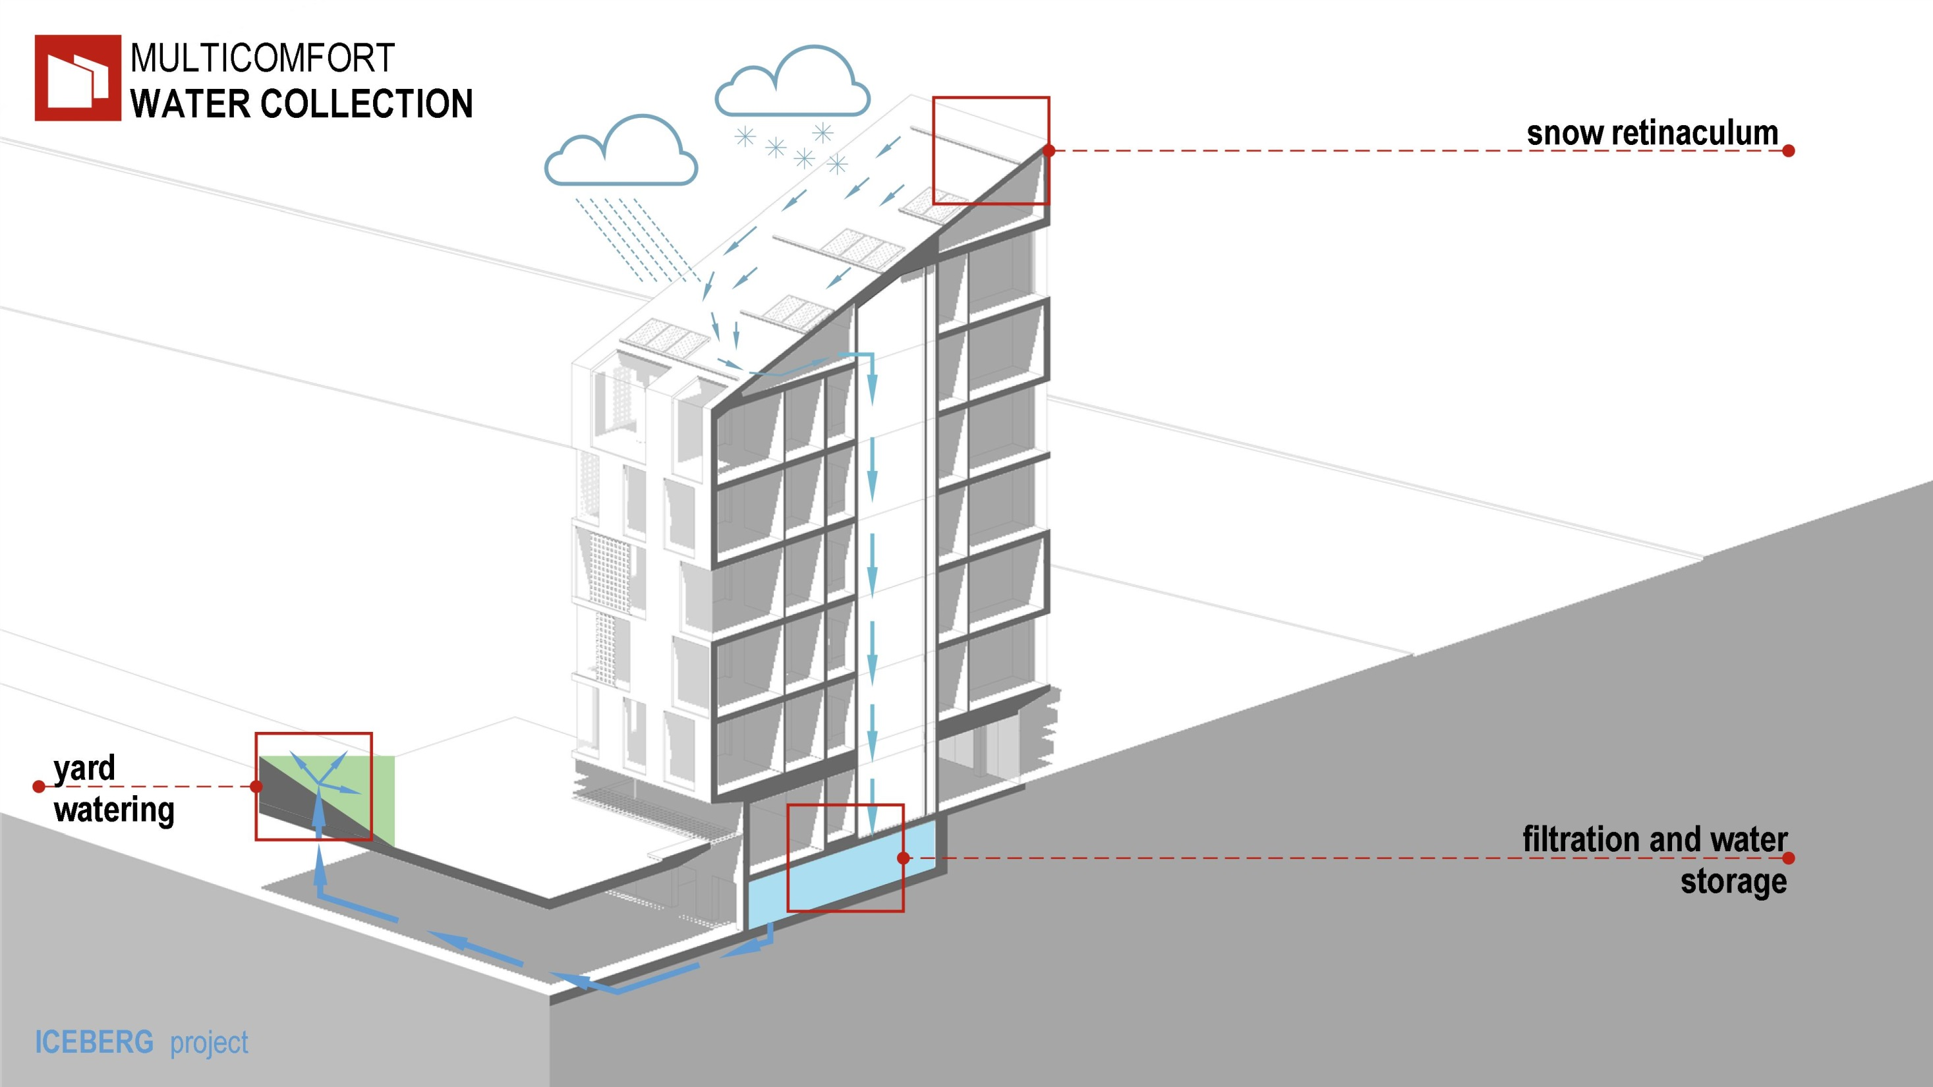
Notes:
Rainwater is used for watering
the landscaping of the courtyard.

Slide 23
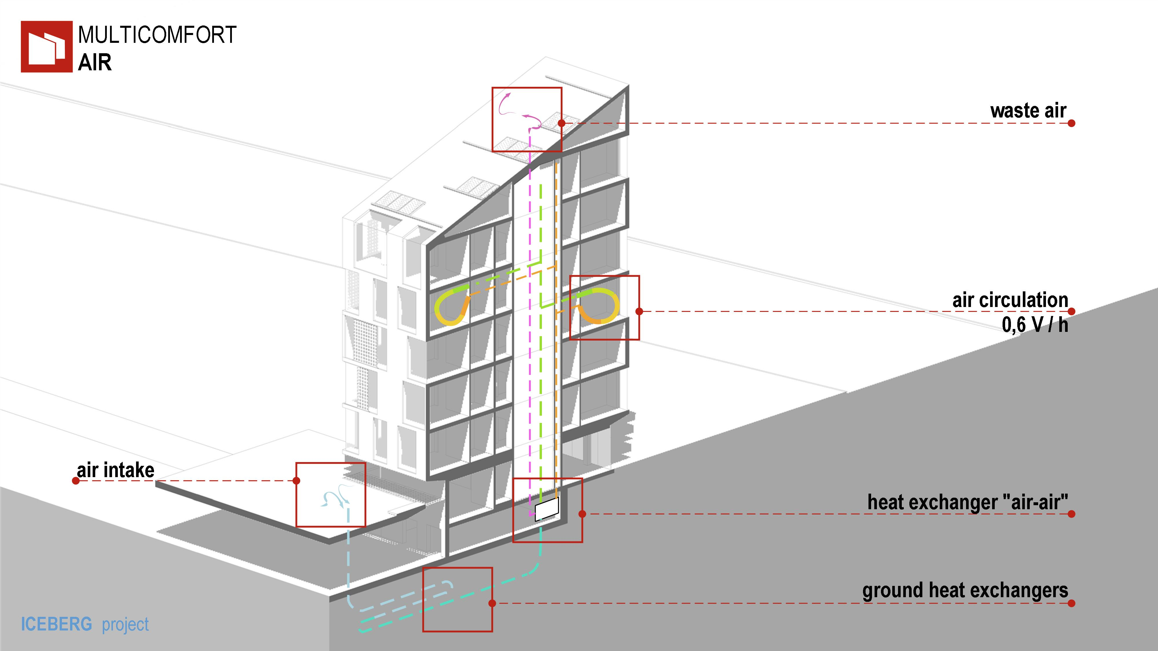
Notes:
Recovery system air minimizes heat loss.

Slide 24
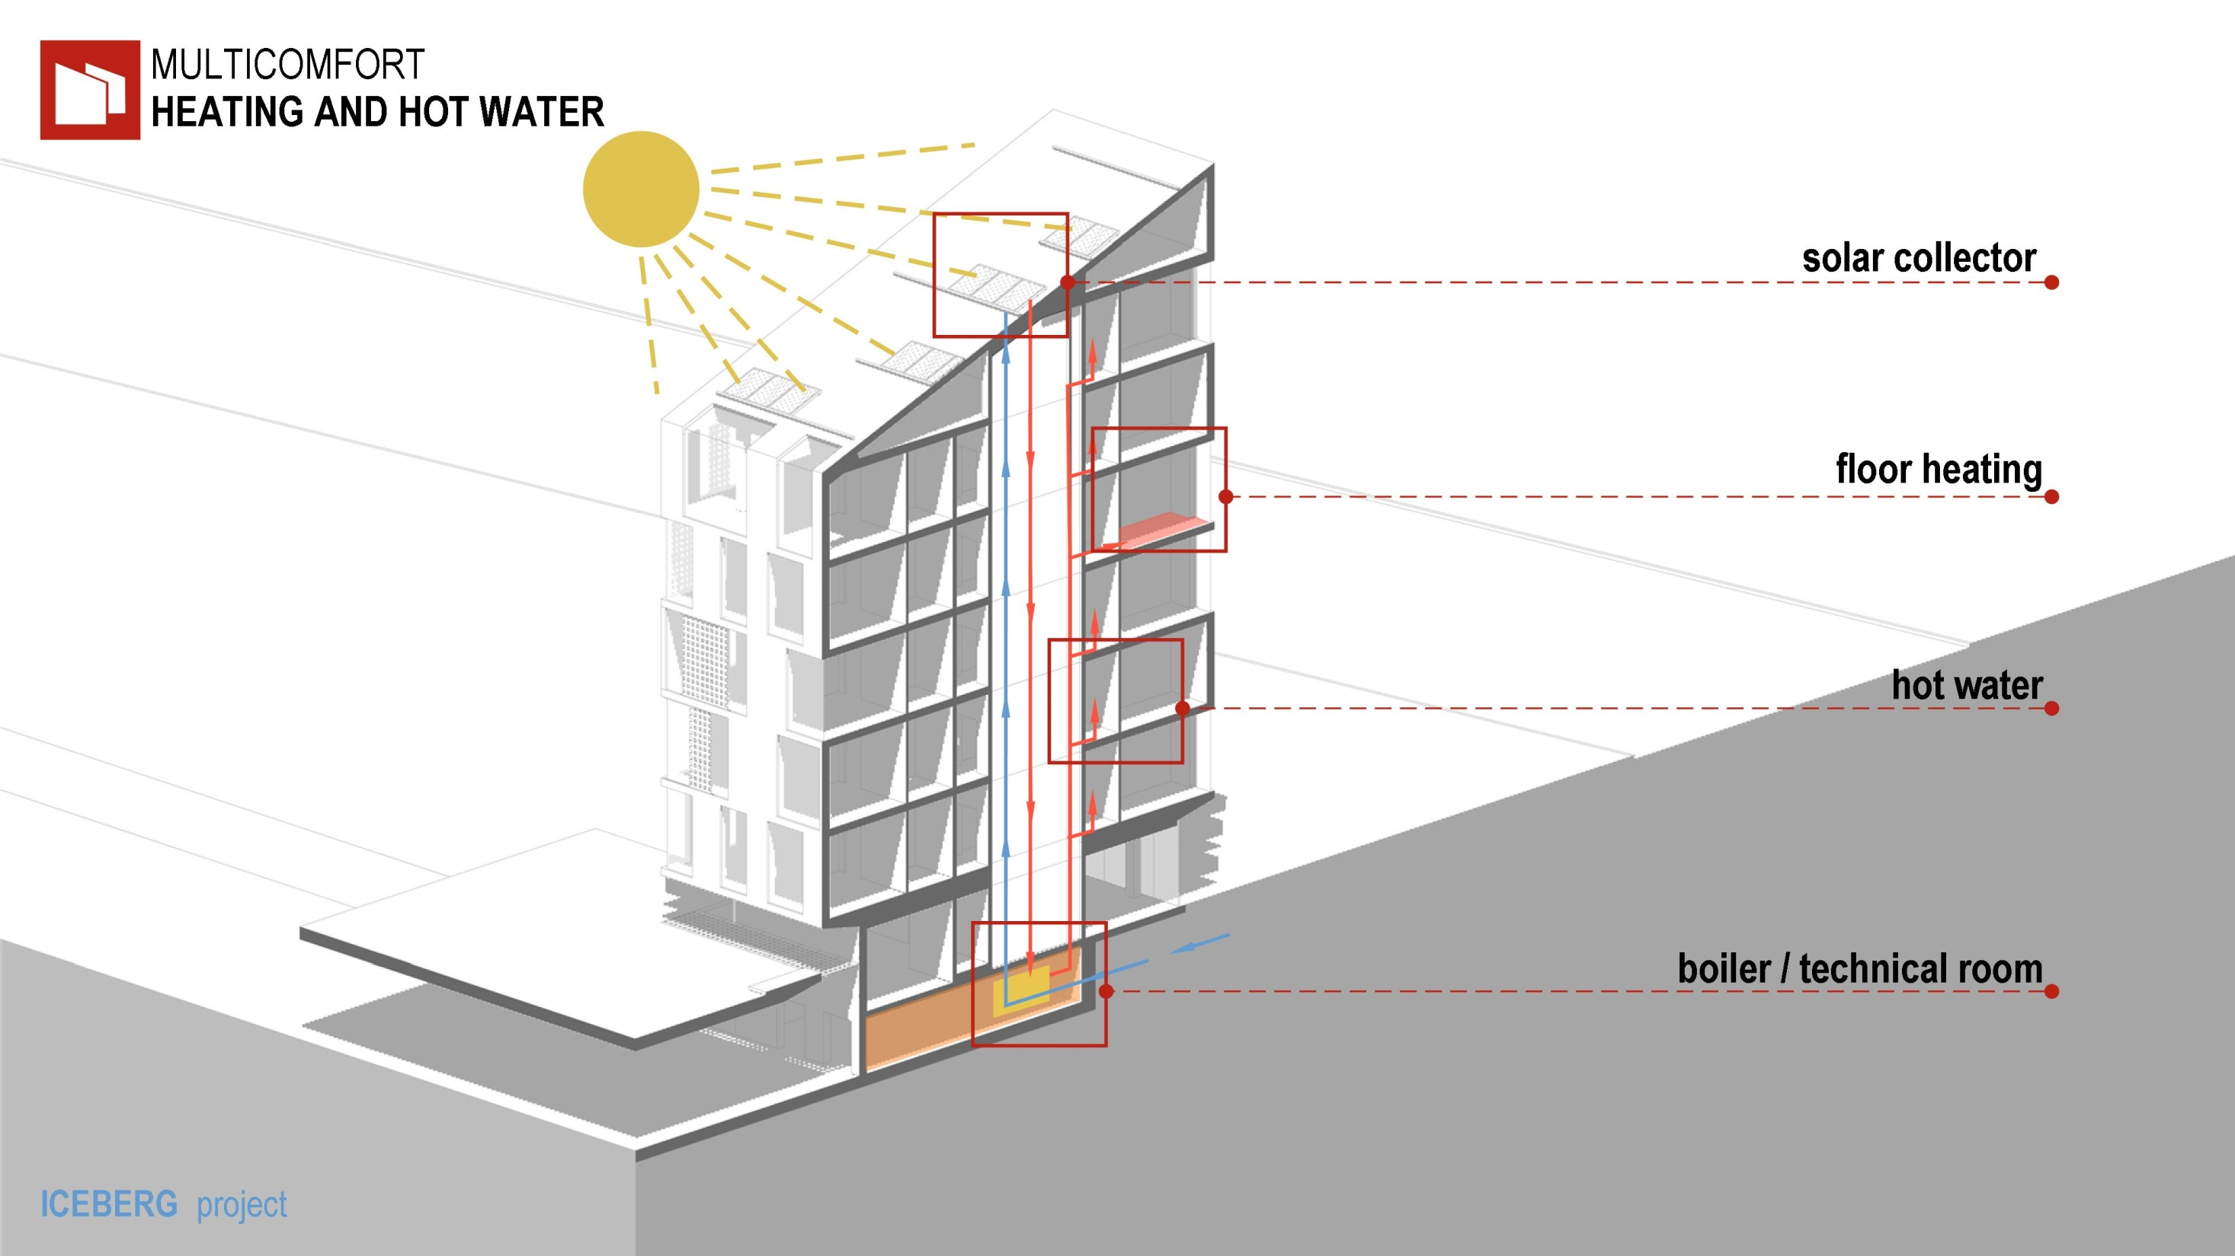
Notes:
System of solar collectors used for heating
and water heating.

Slide 25
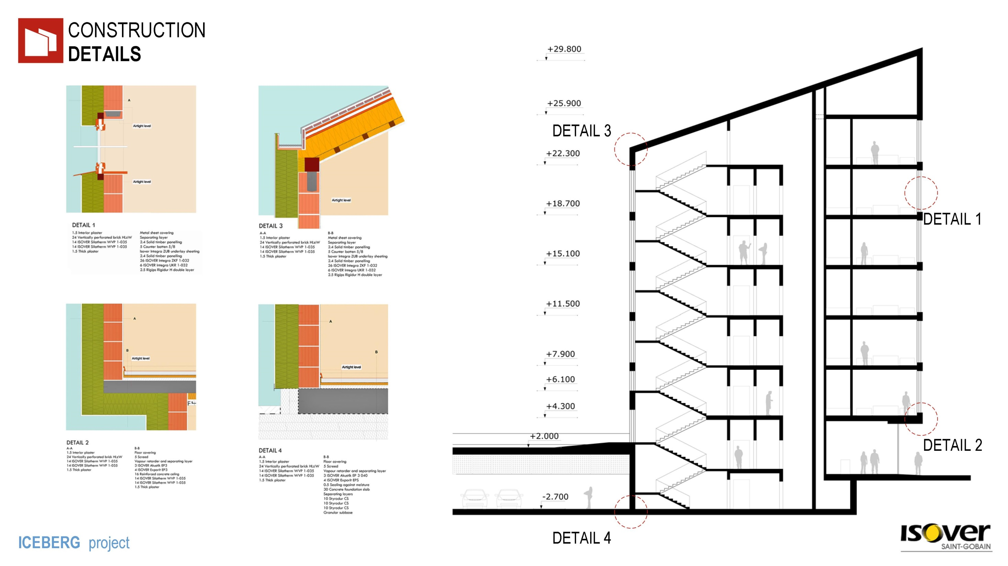
Notes:
ISOVER constructive solutions allow
to eliminate thermal bridges.

Slide 26
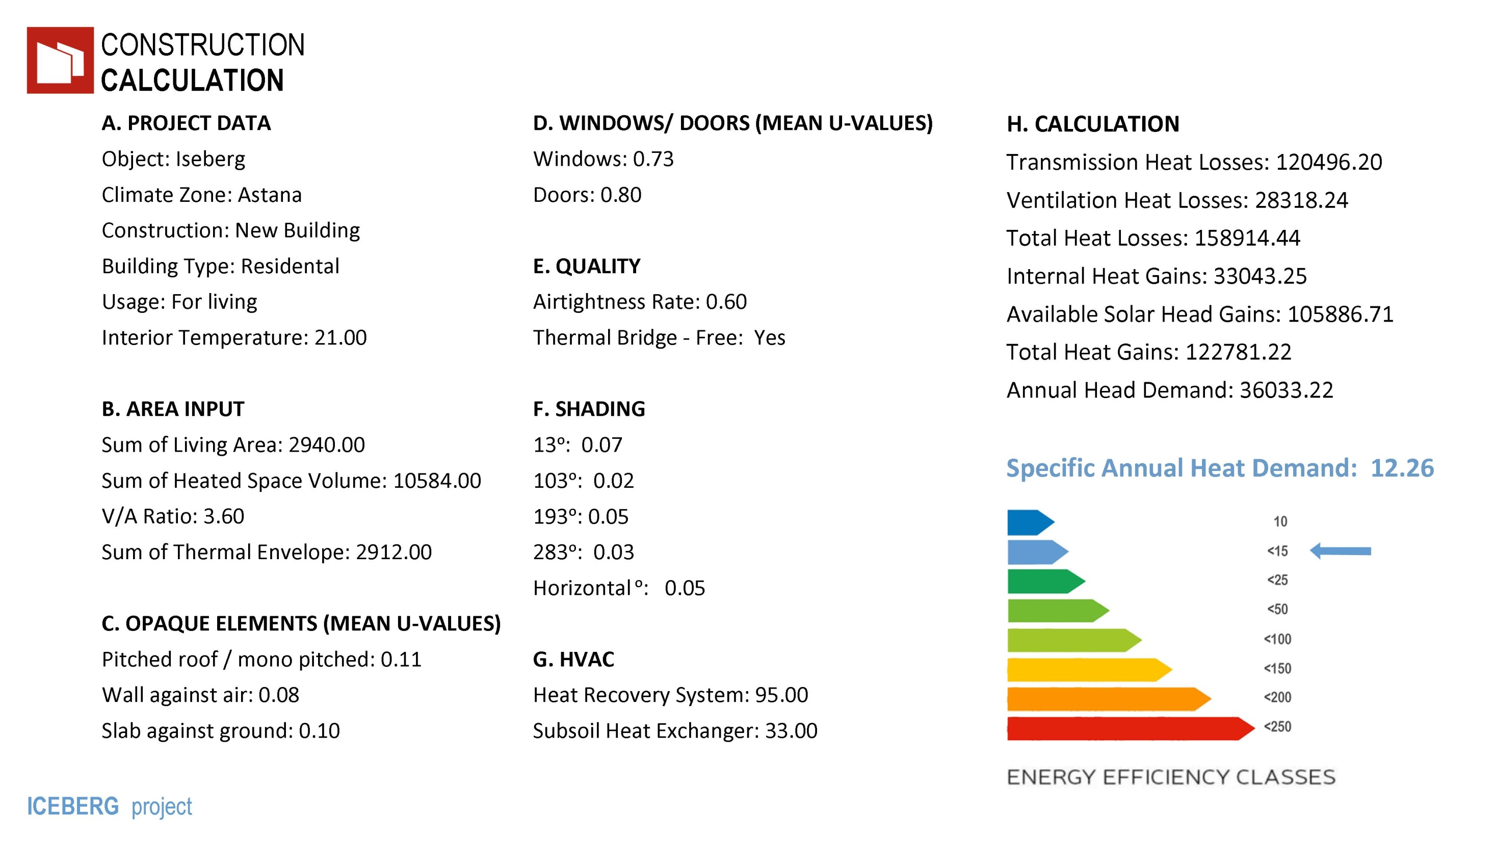
Notes:
Based on calculations, energy consumption rate is 12 kW*g/sq. m. per year.
(kilowatt per square meter a year)

Slide 27
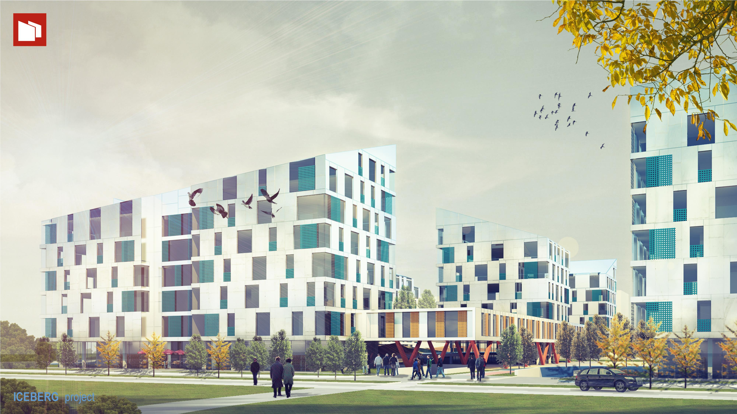
Notes:
Inspired by nature ,
given the characteristics of life in the city,
separating public and private spaces ,
following the principles of multi-comfort –
we have created the whole living environment.

Slide 28

Notes:
Thank you for your time and attention.

