Slide 1
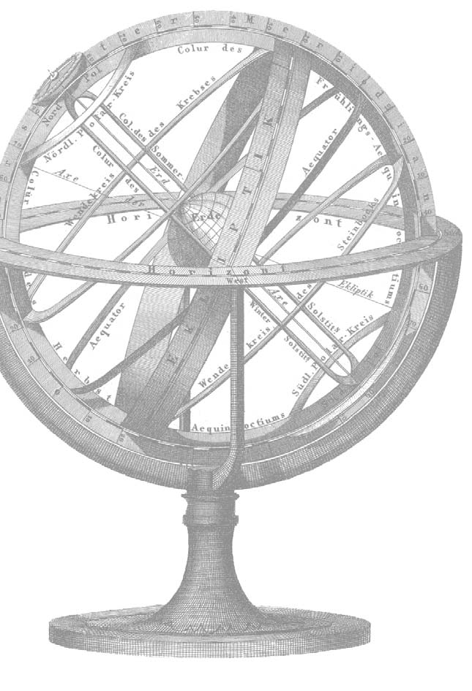
Preparing for Accreditation: An Introduction for Librarians
Alovidin Bakhovidinov
abakhovidinov@nu.edu.kz
Alina Batkayeva abatkayeva@nu.edu.kz
October 20 – November 6, 2014
http://library.nu.edu.kz

Slide 2
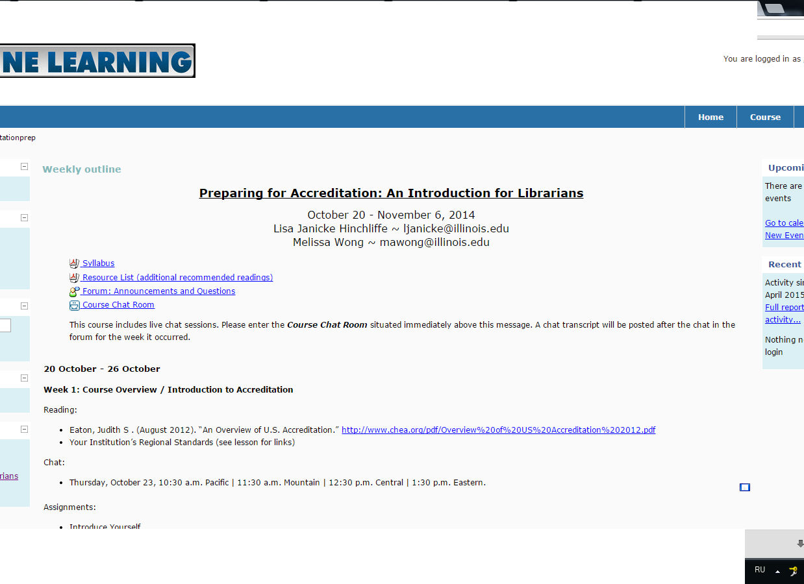
Preparing for Accreditation
October 20 – November 6, 2014
Instructors:
Lisa Janicke Hinchliffe
Coordinator for Information Literacy Services and Instruction/Professor in the University Library at the University of Illinois at Urbana-Champaign
Melissa Autumn Wong
adjunct instructor in the Graduate School of Library and Information Science at the University of Illinois at Urbana-Champaign.

Slide 3
Preparing for Accreditation
Goals of the course:
1. to assist librarians in preparing for accreditation
2. to introduce concepts of integrated planning, outcomes assessment, evidence, and data-driven decision-making
3 weeks on-line course
1 week: Introduction to Accreditation
2 week: Meeting the Standards
3 week: Creating an Accreditation Plan

Slide 4
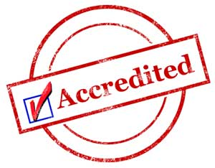
Preparing for Accreditation
An Accreditation is the process in which certification of competency, authority, or credibility is presented.
Organizations that issue credentials or certify third parties against official standards are themselves formally accredited by accreditation bodies (such as UKAS); hence they are sometimes known as "accredited certification bodies". The accreditation process ensures that their certification practices are acceptable, typically meaning that they are competent to test and certify third parties, behave ethically and employ suitable quality assurance.
Overview of Accreditation - Wikipedia
Accreditation is a voluntary process that ensures the quality and credibility of an institution based on peer review and meeting agreed upon standards. The primary accreditation of an institution is through one of the regional accrediting agencies, which in turn are authorized by U.S. Department of Education and the Council for Higher Education Accreditation (CHEA)

Slide 5
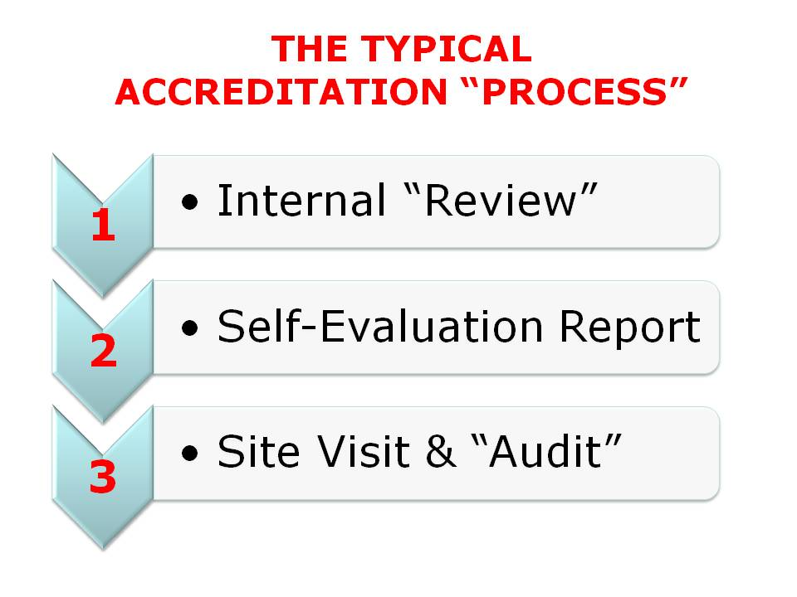
Preparing for Accreditation
Self-study;
Peer review;
Accreditation decision;

Slide 6
THE OVERVIEW OF 3 STAGES
The process of accreditation essentially is comprised of three parts: self-study, peer review, and the accreditation decision. This process is repeated periodically and, depending on the accreditation agency and the accreditation status of the institution, the cycle typically occurs every three to ten years.
In the self-study, the institution reviews itself relative to the standards, presenting evidence as well as documenting past progress and plans for continued improvement. The self-study is a collaborative effort on campus, usually led through the office of the chief academic officer and involving many committees of faculty, staff, students, and educational administrators

Slide 7
Preparing for Accreditation
The self-study report forms the basis of this process because that is where the institution documents (and cites evidence for) how well it meets each accreditation standard. The role of the visiting team is to verify the content of the self-study, confirm that the institution meets each standard, and make recommendations for how the institution can improve
Although self-studies differ from region to region and school to school, a self study report typically consists of the following parts:
Institutional Background - The self-study will start with a description of the institution’s history, mission, student profile and current educational programs.
Responses to Past Recommendations - The self-study will summarize the institution’s accreditation history and discuss how it has responded to recommendations from the past visiting team.
Eligibility Requirements - The accrediting commission will have eligibility requirements that the institution must meet in order to quality for application for accreditation. These requirements tend to be very straightforward, and are meant to ensure you are a legitimate institution of higher education with currently enrolled students. In this section, the institution will respond to each requirement with a short statement and evidence that confirms it meets the requirement.
Standards - standards are more complex and set forth details about what the institution must do to maintain its accreditation. The standards generally cover expectations for mission, governance, educational programs, support services (student affairs, library, tutoring, etc.), human resources, technology, facilities, and financial operations.

Slide 8
CONTINUING….
The peer review process typically involves a visiting team of external faculty and administrators who have been trained by the accrediting agency to review the self-study and to gather and judge evidence of quality.
Finally, the accreditation decision is made by the accrediting agency based on the self-study and the peer review report. The decision is to accredit, to accredit with conditions, or to deny accreditation
READ: “An Overview of U.S. Accreditation” If you haven’t already, read Judith Eaton’s “An Overview of U.S. Accreditation at http://www.chea.org/pdf/Overview%20of%20US%20Accreditation%202012.pdf.

Slide 9
Preparing for Accreditation factors influenced to the accreditation decision:
Discussion - A narrative description of how the institution meets the standard. These descriptions range from a paragraph to a few pages, depending on the complexity of the standard.
Evaluation - An analysis of how well or to what extent the institution meets the standard.
Self-Recommendations - If the institution does not completely meet the standard, a statement of what will be done to improve.
Evidence - A list of documents that support the claims made in the discussion. This evidence must be made available as paper or electronic files for the visiting team to review

Slide 10
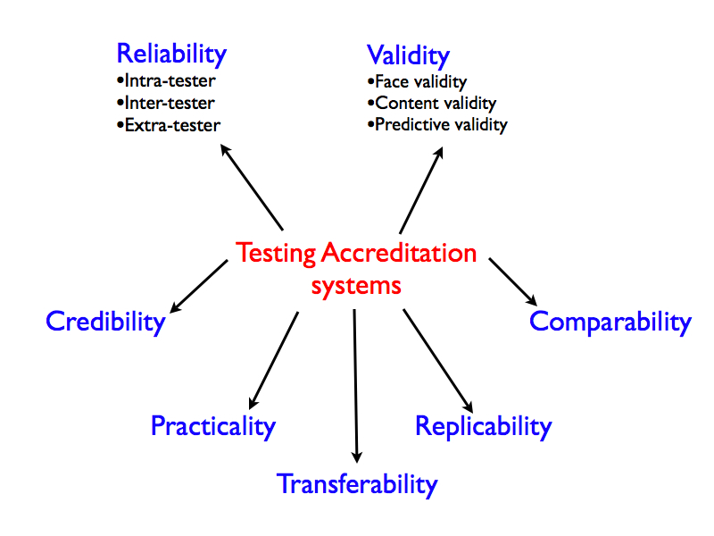
Preparing for Accreditation

Slide 11
Preparing for Accreditation
Themes in the Standards:
Integrated Planning;
Outcomes Assessment;
Evidence;
Data-Driven Decision-Making;

Slide 12
Regardless of which regional accreditation standards apply to your institution, you will notice the overwhelming emphasis on integrated planning, outcomes assessment, providing evidence, and data driven decision-making
• Integrated Planning: the institution should have a strategic plan, educational plan, financial plan and facilities plan that lay out the institution’s goals and the resources necessary to achieve those goals; these plans should support the mission of the institution, be cohesive, and be used to direct the institution’s annual budget and operations
• Outcomes Assessment: the institution should have articulated student learning outcomes at the course, program and institution level (outcomes are a statement of what students should know or be able to do as a result of their education); these outcomes should be assessed on a regular basis to determine if students are learning what the institution intends for them to learn
• Evidence: the institution should systematically document its activities, including the results of assessment; evidence typically includes statistics, reports, meeting minutes and similar documents; this evidence should be referenced in writing the self study and provided to visiting teams during site visits
• Data-Driven Decision-Making: the institution should use assessment results and other relevant data in making decisions

Slide 13
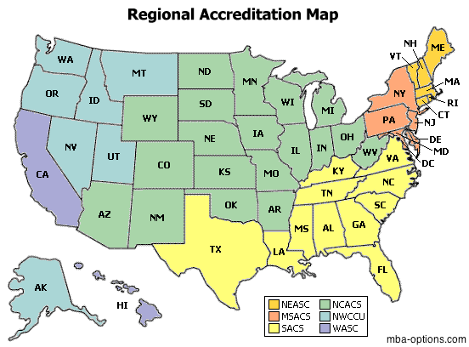
Preparing for Accreditation
US Accreditation Agencies

Slide 14
Preparing for Accreditation
Council for Higher Education Accreditation - http://chea.org/search/default.asp
Middle States Association of Colleges and Schools – http://www.msche.org
New England Association of Schools and Colleges Commission on Institutions of Higher Education - http://cihe.neasc.org
North Central Association of Colleges and Schools - The Higher Learning Commission - http://www.ncahlc.org/
Northwest Commission on Colleges and Universities - http://www.nwccu.org/
Southern Association of Colleges and Schools - http://www.sacscoc.org/
Western Association of Schools and Colleges o Accrediting Commission for Community and Junior Colleges http://www.accjc.org/
Accrediting Commission for Senior Colleges and Universities
http://www.wascsenior.org/

Slide 15
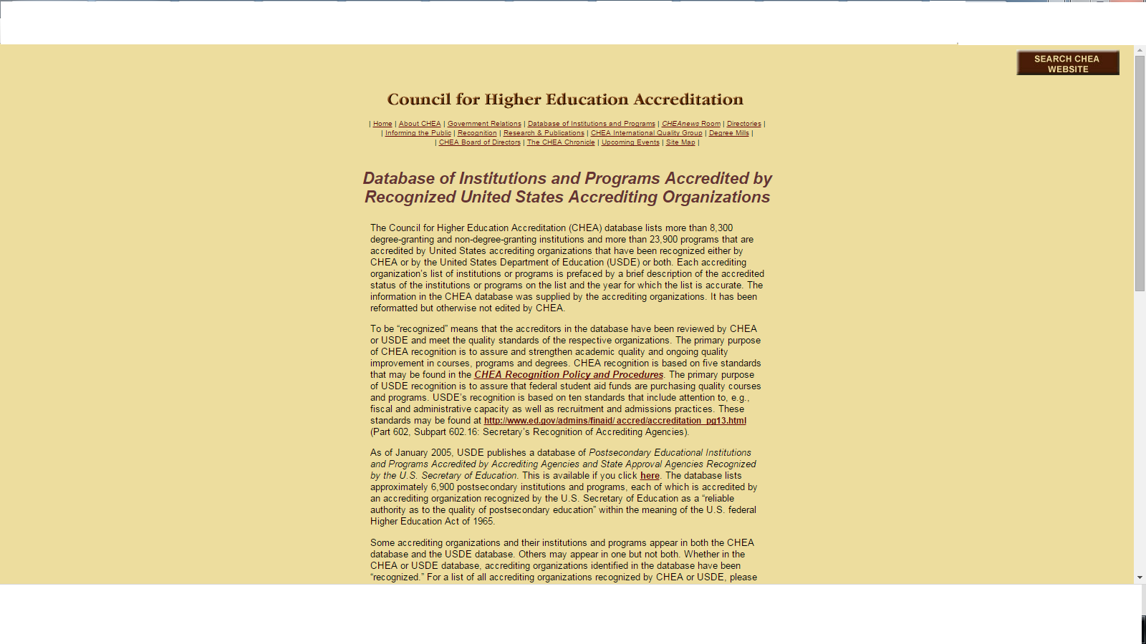
Preparing for Accreditation
Council for Higher Education Accreditation

Slide 16
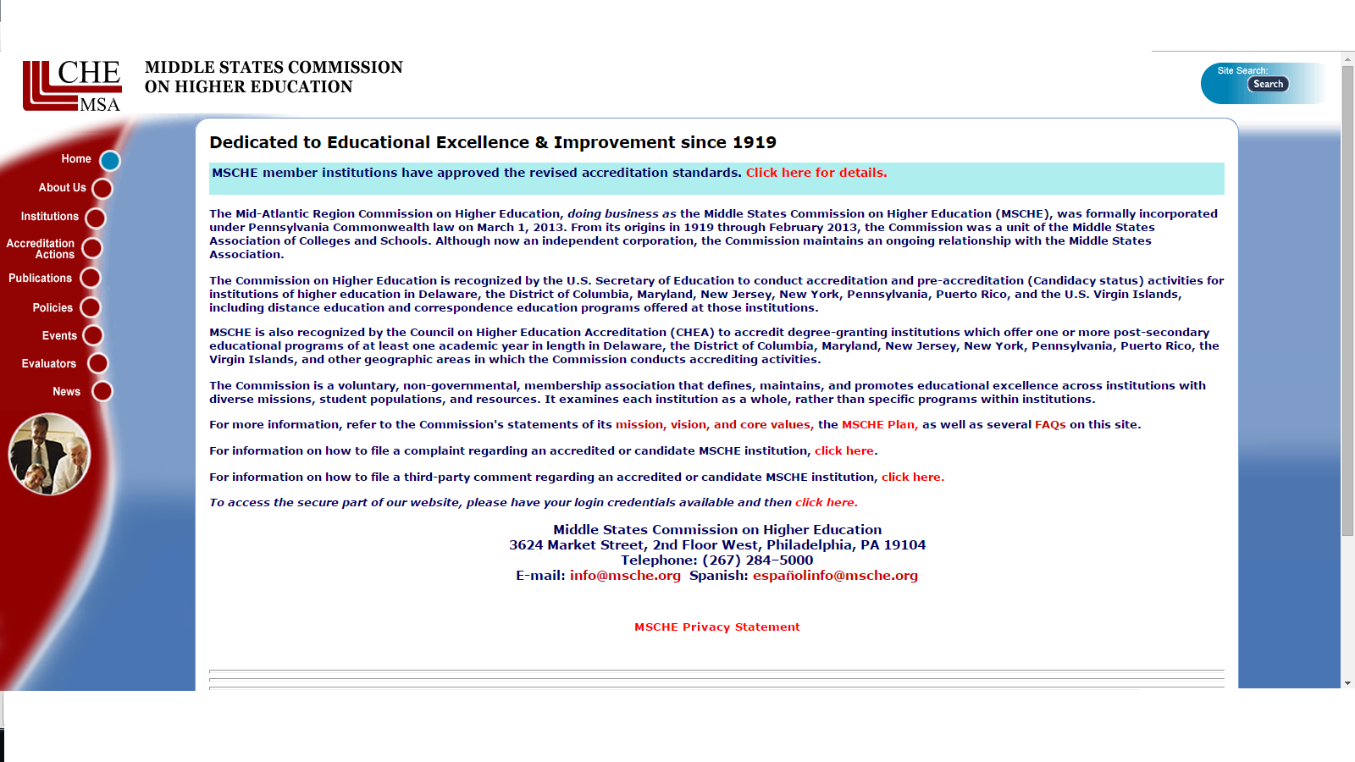
Preparing for Accreditation
Middle States Association of Colleges and Schools

Slide 17
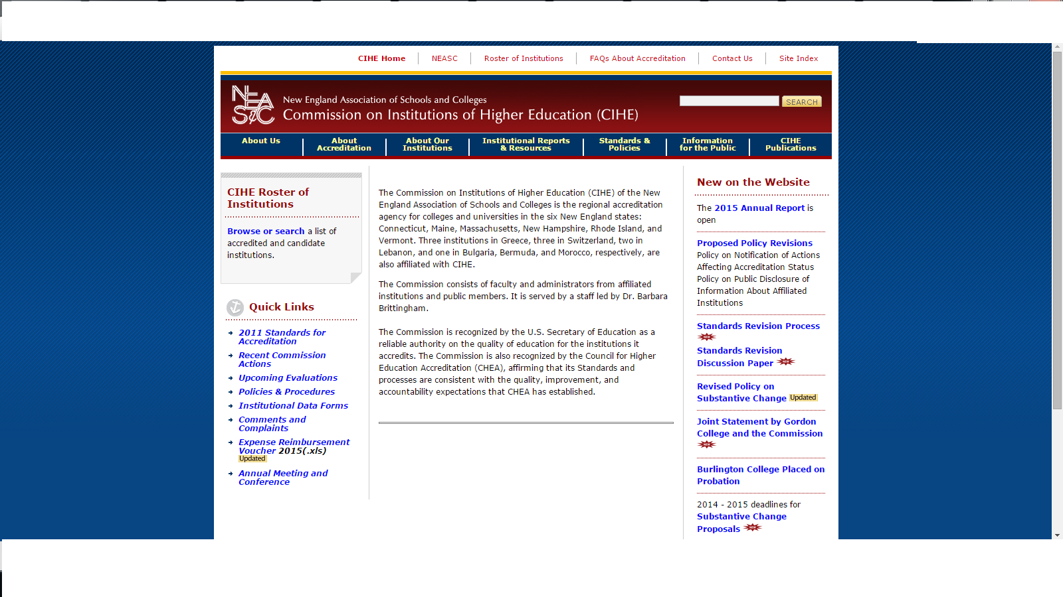
Preparing for Accreditation
New England Association of Schools and Colleges
Commission on Institutions of Higher Education

Slide 18
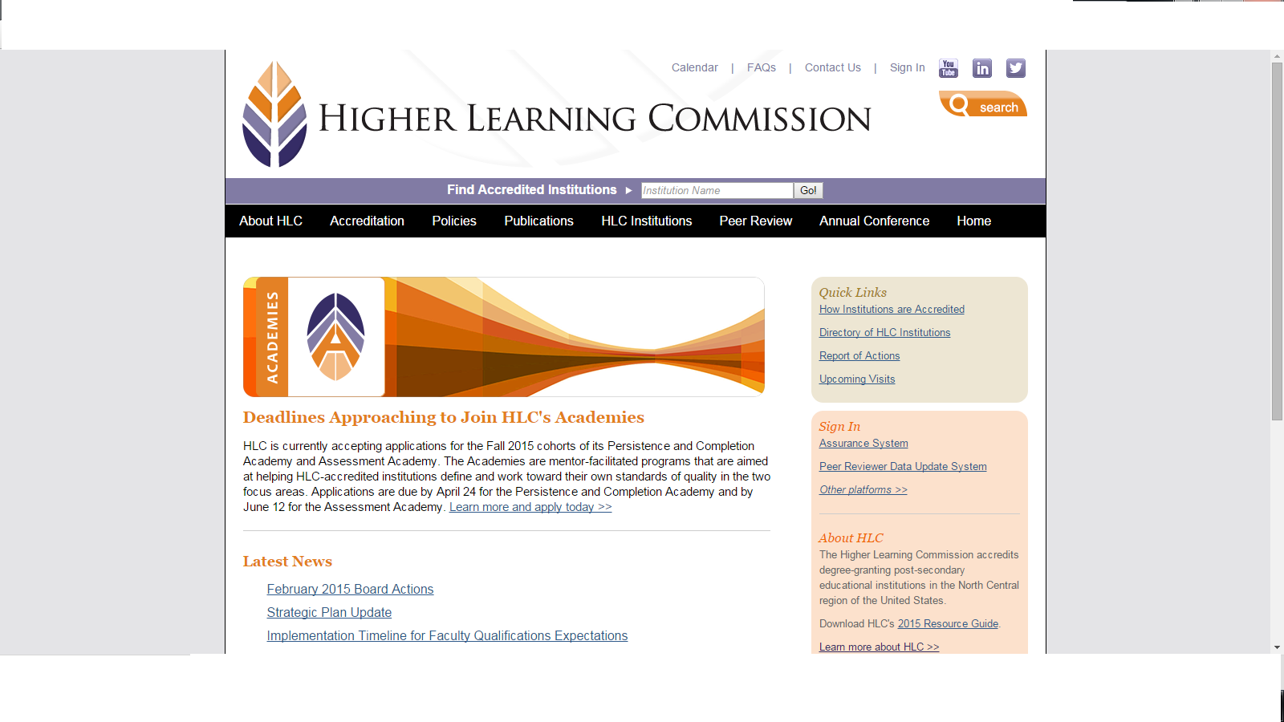
Preparing for Accreditation
North Central Association of Colleges and Schools – The Higher Learning Commission

Slide 19
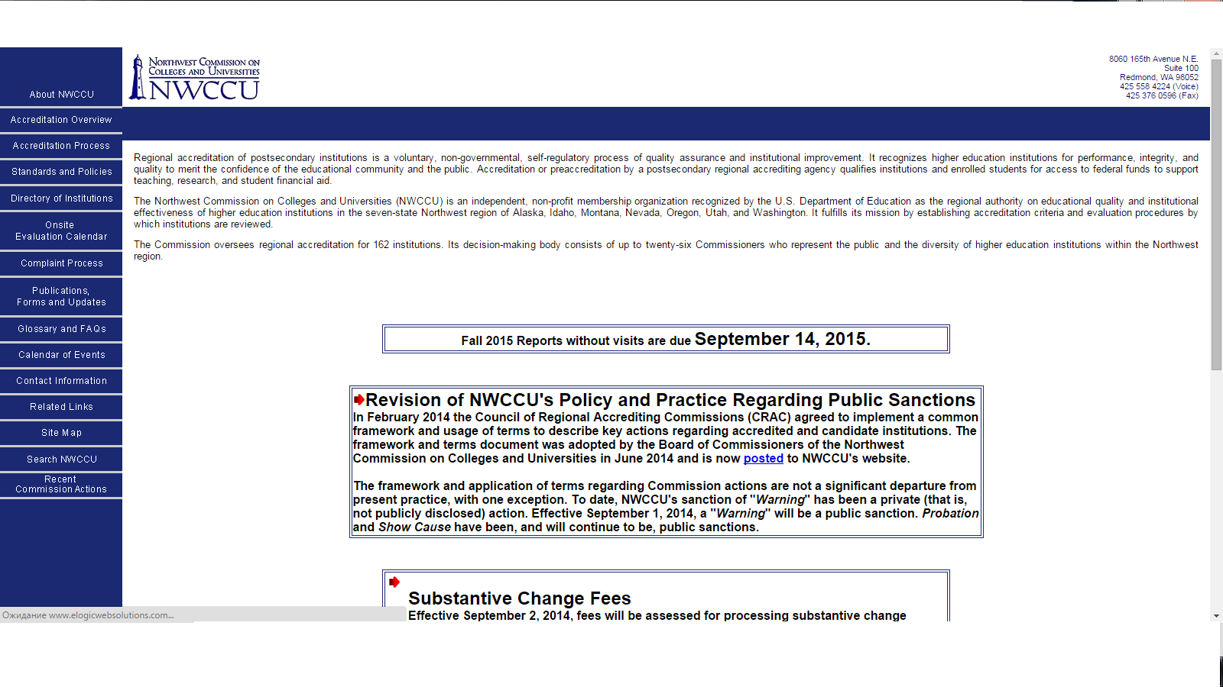
Preparing for Accreditation
Northwest Commission on Colleges and Universities

Slide 20
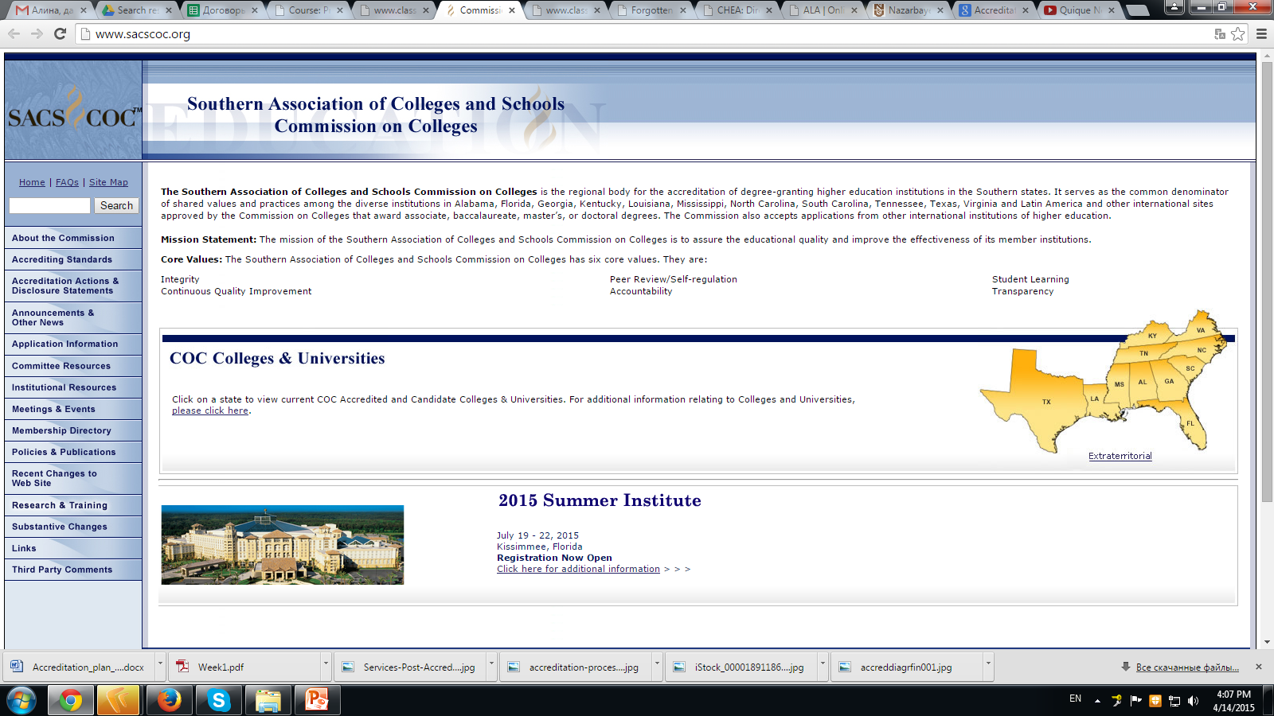
Preparing for Accreditation
Southern Association of Colleges and Schools

Slide 21
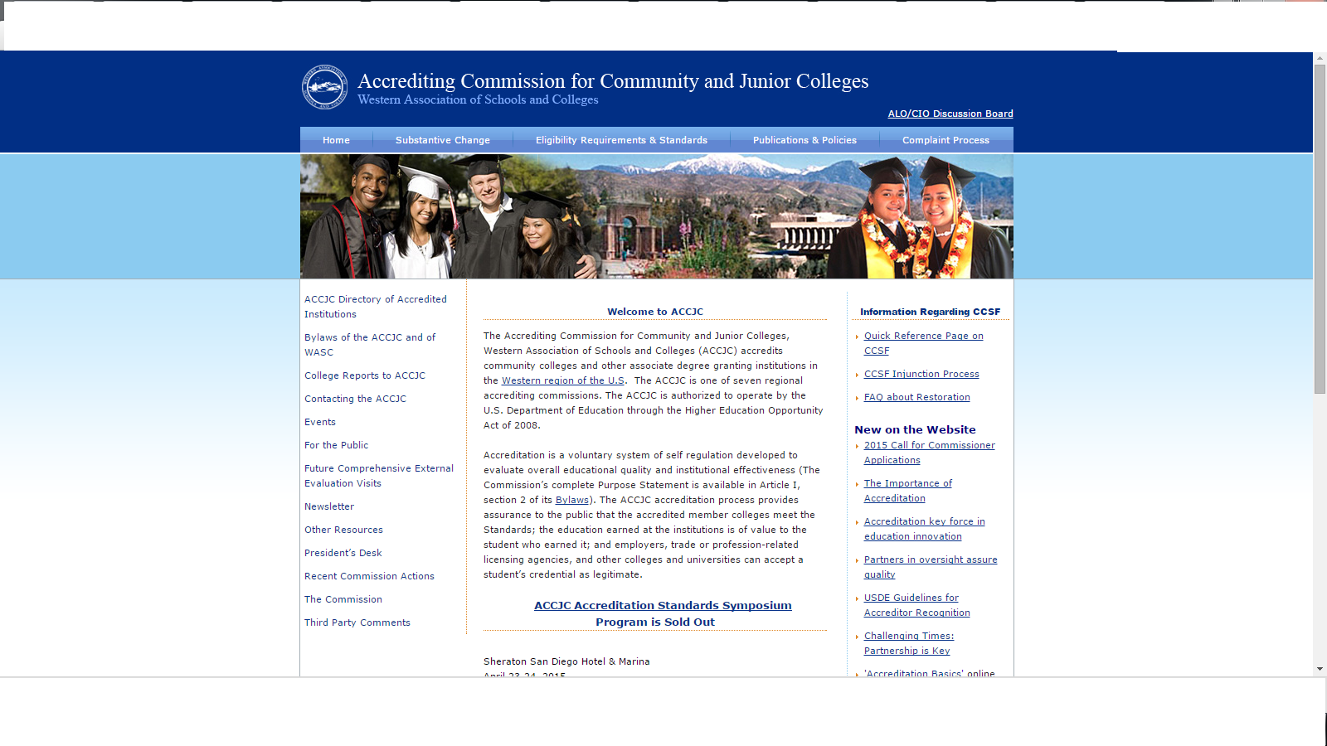
Preparing for Accreditation
Accrediting Commission for Community and Junior Colleges

Slide 22
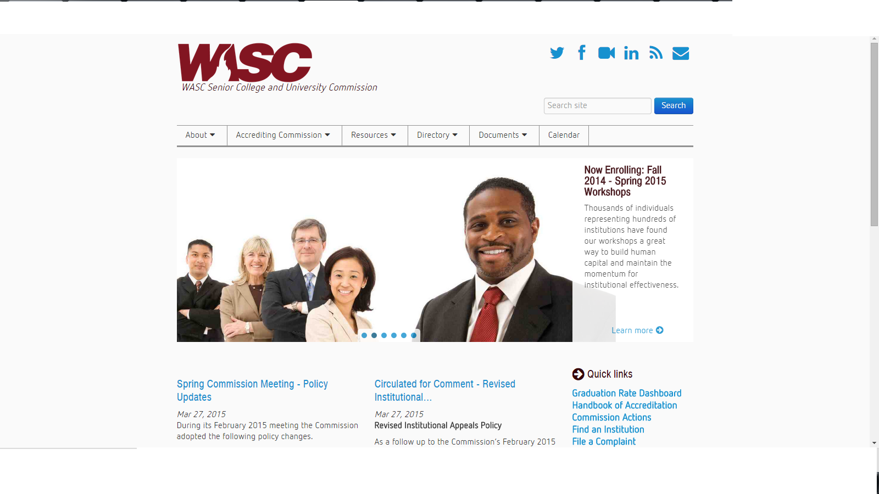
Preparing for Accreditation
Accrediting Commission for Senior Colleges and Universities

