Slide 1



Durability and Mechanical Properties of Hybrid Concrete blended with Ground Granulated Blast Furnace Slag, Metakaolin, and Silica Fume
Presenter: Madiyar Mardenov
Supervisor: Jong Ryeol Kim
Co-supervisor: Chang Seon Shon

Slide 2
Outline
Durability and Mechanical Properties of Hybrid Concrete blended with Ground Granulated Blast Furnace Slag, Metakaolin, and Silica Fume
Introduction
Research methodology
  Experimental program
  Mix design
  Test Procedures
Results and Discussion
Conclusion

Slide 3
Durability and Mechanical Properties of Hybrid Concrete blended with Ground Granulated Blast Furnace Slag, Metakaolin, and Silica Fume
Introduction
GGBFS is a by-product of iron production, which is obtained from a blast furnace by rapid cooling, drying, and grinding. GGBFS is hydraulic material and consists of granular and vitreous particles (Meyer, 2009).
MK is produced by calcining kaolin clay at a temperature of at least 600 degrees. MK is a pozzolan material with very small particles and is used when low permeability and high strength are required(Wilson & Kosmatka, 2011).
SF is a by-product of ferrosilicon alloys and silicon metals. SF is a pozzolan material with extremely fine spherical particles, making it highly effective in achieving high-strength concrete and high water resistance (Wilson & Kosmatka, 2011).

Slide 4
Durability and Mechanical Properties of Hybrid Concrete blended with Ground Granulated Blast Furnace Slag, Metakaolin, and Silica Fume
Introduction (cont’d)
Research problems
The cement industry generates around 5% of global CO₂ emissions annually.
Cement typically used in KZ: blended cement with 20% slag. Possibly low durability and mechanical properties of blended cement under severe weather conditions.
Solution
Improve cement properties by using supplementary cementitious materials such as Metakaolin (MK) and Silica fume (SF)

Slide 5
Durability and Mechanical Properties of Hybrid Concrete blended with Ground Granulated Blast Furnace Slag, Metakaolin, and Silica Fume
Introduction (cont’d)
Research goals
Investigate the potential for improving the durability and mechanical properties of blended concrete consisting of 20% GGBFS applied to severe Kazakhstani weather conditions
Evaluate mechanical and durability properties of hybrid concrete blended with ground granulated blast furnace slag, metakaolin, and silica fume

Slide 6
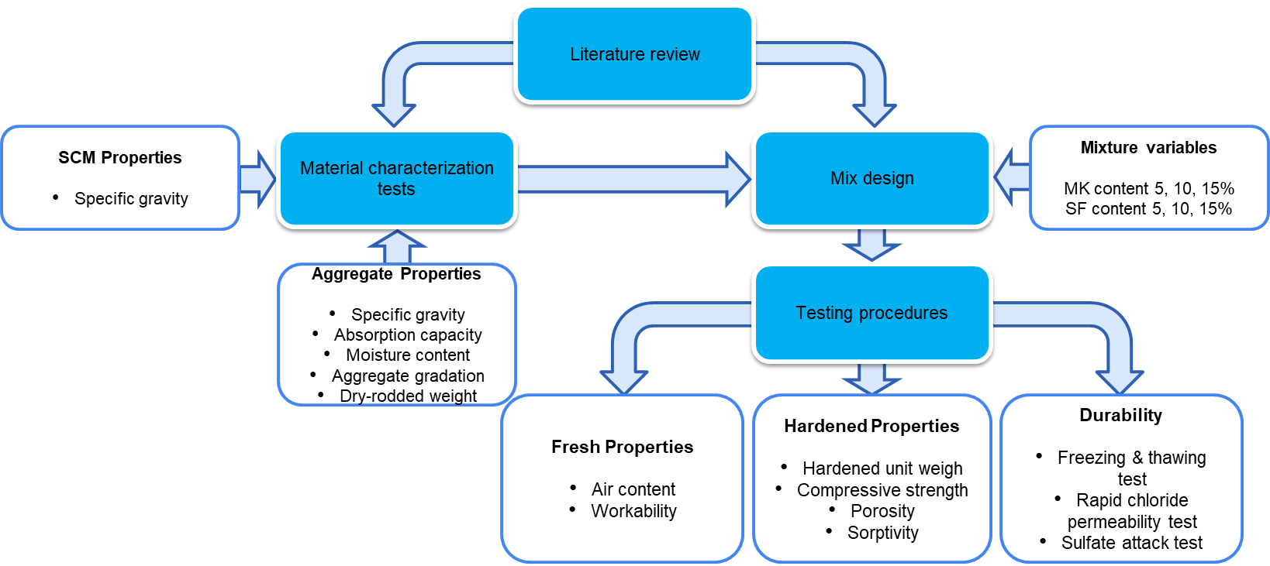
Experimental program
Durability and Mechanical Properties of Hybrid Concrete blended with Ground Granulated Blast Furnace Slag, Metakaolin, and Silica Fume
Fig 1. An experimental program to evaluate durability and mechanical properties of hybrid concrete

Slide 7
Mix design
Durability and Mechanical Properties of Hybrid Concrete blended with Ground Granulated Blast Furnace Slag, Metakaolin, and Silica Fume
Table 1. Mixture design
Mix № | Mixture ID | Cement [kg/m³] | MK [kg/m³] | SF [kg/m³] | RS [kg/m³] | LS [kg/m³] | Water [kg/m³] | SP (%) | AE (%)
1 | 100% OPC | 528.74 | - | - | 535.75 | 966.11 | 184 | 0.29 | 0.17
2 | 100% BC | 528.74 | - | - | 535.75 | 966.11 | 184 | 0.29 | 0.17
3 | 95% BC + 5% MK | 502.3 | 26.44 | - | 531.09 | 966.11 | 184 | 0.25 | 0.14
4 | 90% BC + 10% MK | 475.86 | 52.87 | - | 526.43 | 966.11 | 184 | 0.37 | 0.13
5 | 85% BC + 15% MK | 449.43 | 79.31 | - | 521.77 | 966.11 | 184 | 0.5 | 0.17
6 | 95% BC + 5% SF | 502.3 | - | 26.44 | 531.09 | 966.11 | 184 | 0.25 | 0.14
7 | 90% BC + 10% SF | 475.86 | - | 52.87 | 526.43 | 966.11 | 184 | 0.41 | 0.25
8 | 85% BC + 15% SF | 449.43 | - | 79.31 | 521.77 | 966.11 | 184 | 0.53 | 0.25

Slide 8
Durability and Mechanical Properties of Hybrid Concrete blended with Ground Granulated Blast Furnace Slag, Metakaolin, and Silica Fume
Test procedures
Fresh Properties
  Air content
  Workability
Hardened properties
  Hardened unit weight
  Compressive strength
  Porosity
  Sorptivity

Slide 9
Durability and Mechanical Properties of Hybrid Concrete blended with Ground Granulated Blast Furnace Slag, Metakaolin, and Silica Fume
Test procedures (cont’d)
Durability properties
  Freezing-thawing
  Rapid chloride permeability
  Non-steady-state migration
  Sulfate attack

Slide 10
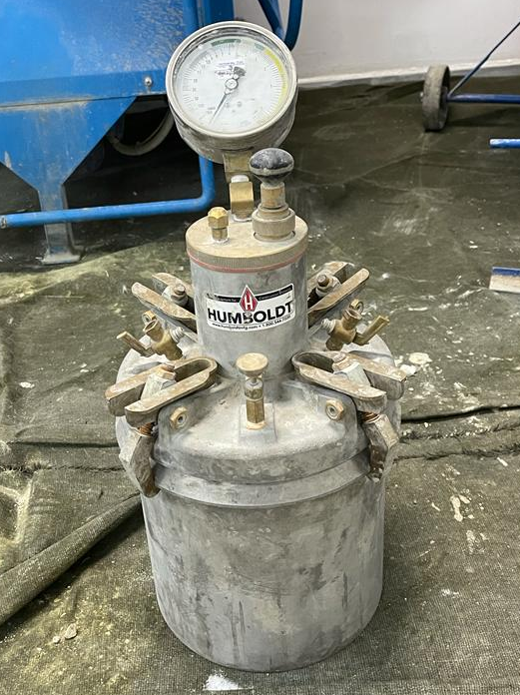
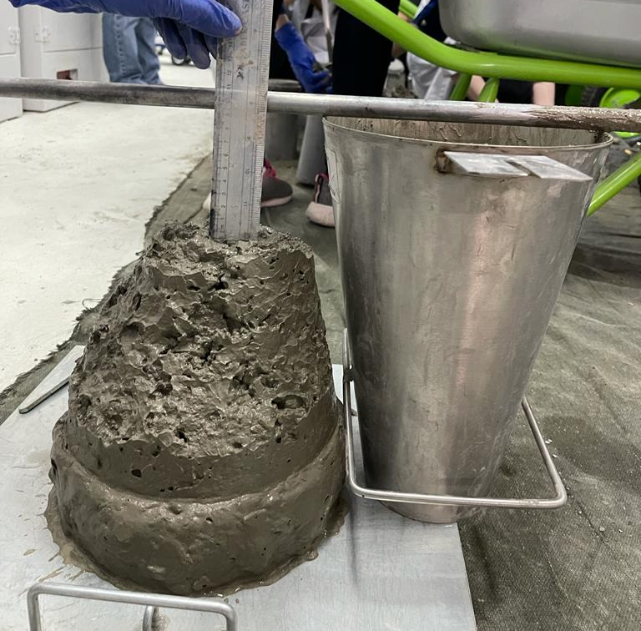
Fresh properties
Durability and Mechanical Properties of Hybrid Concrete blended with Ground Granulated Blast Furnace Slag, Metakaolin, and Silica Fume
Conducted in accordance with ASTM C231 and ASTM C143.
a
b
Fig 2. Apparatus for determining fresh properties; a – air meter, b – mold for slump test

Slide 11

Hardened unit weight
Durability and Mechanical Properties of Hybrid Concrete blended with Ground Granulated Blast Furnace Slag, Metakaolin, and Silica Fume
Formula for density were used.
$$ρ=\frac{m}{V}$$
Where:
$ρ$ = the specimen density, kg/m³,
$m$ = the specimen mass, kg,
V = the specimen volume, m³.

Slide 12
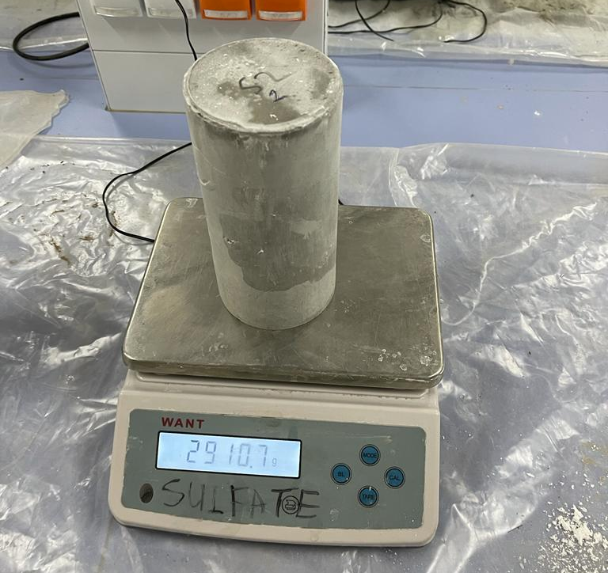
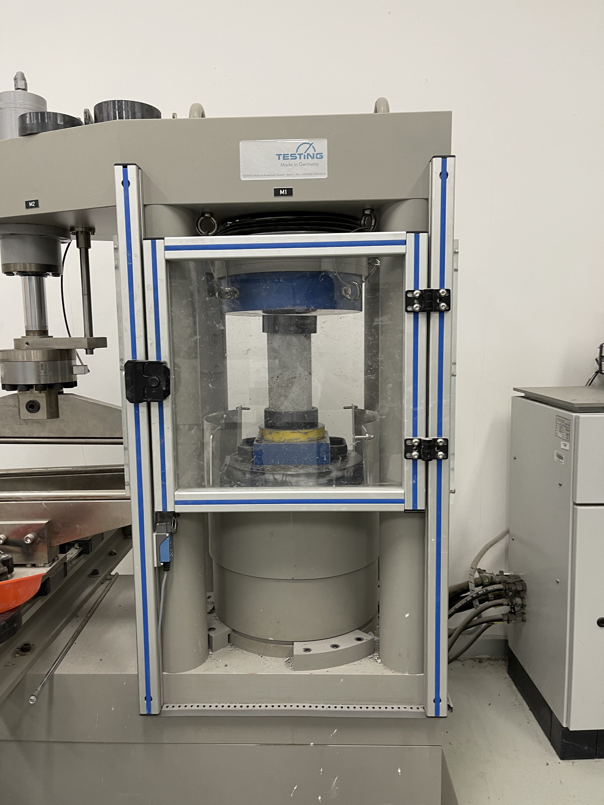
Compressive strength
Durability and Mechanical Properties of Hybrid Concrete blended with Ground Granulated Blast Furnace Slag, Metakaolin, and Silica Fume
Conducted in accordance with ASTM C39.
a
b
Fig 3. Compressive strength equipment; a – testing machine, b – weight measurement of samples to calculate density

Slide 13

Porosity
Durability and Mechanical Properties of Hybrid Concrete blended with Ground Granulated Blast Furnace Slag, Metakaolin, and Silica Fume
Conducted in accordance with ASTM C642.
Absorption after immersion, % = $\left[\left(B−A\right)/A\right]∗100$
Absorption after immersion and boiling, % = $\left[\left(C−A\right)/A\right]∗100$
Bulk density, dry, g₁ = $\left[A/(C−D)\right]∗ρ$
Bulk density after immersion = $\left[B/(C−D)\right]∗ρ$
Bulk density after immersion and boiling = $\left[C/(C−D)\right]∗ρ$
Apparent density, g₂ = $\left[A/(A−D)\right]∗ρ$
Volume of permeable pore space (voids), % = $(g_{2}−g_{1})/g_{2}∗100$

Slide 14
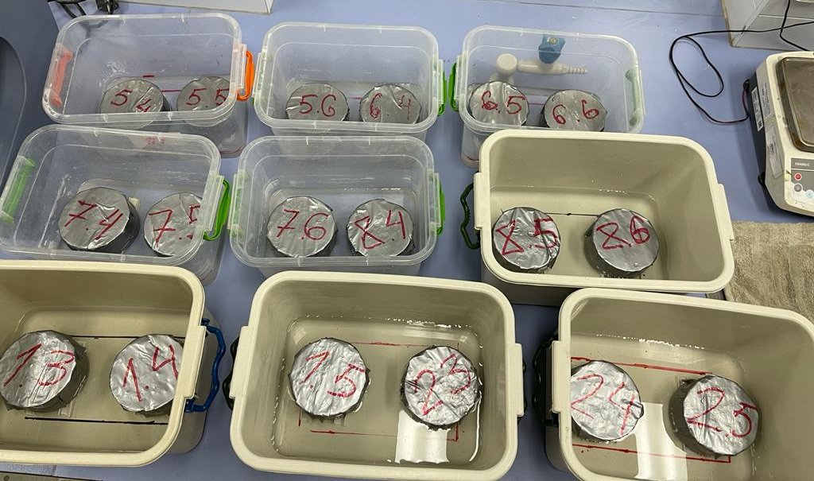

Sorptivity
Durability and Mechanical Properties of Hybrid Concrete blended with Ground Granulated Blast Furnace Slag, Metakaolin, and Silica Fume
Conducted in accordance with ASTM C1585.
a
$$I=\frac{m_{t}}{a∗d}$$
Where:
I = the absorption,
m_{t} = the change in specimen mass in grams, at the time t,
a = the exposed area of the specimen, in mm²,
d = the density of the water in g/mm³.
Fig 4. Specimens partially immersed in water

Slide 15
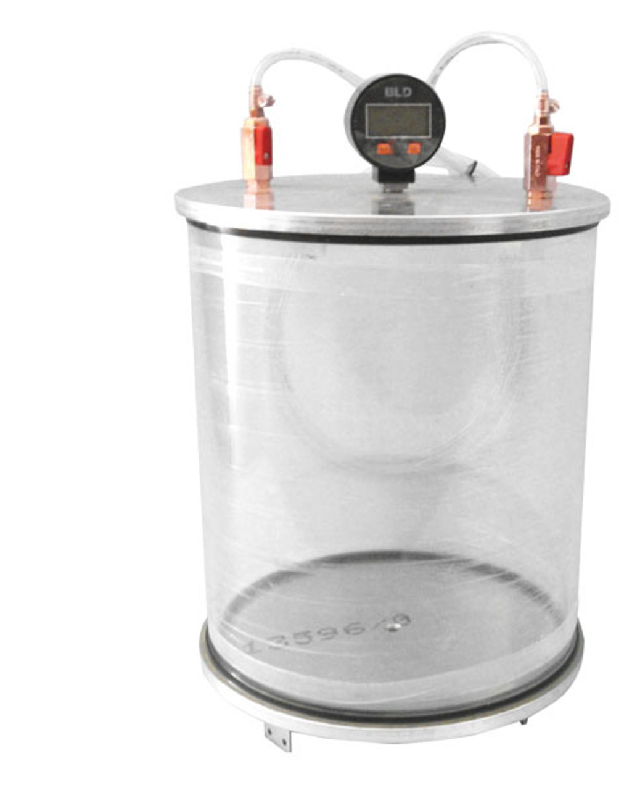
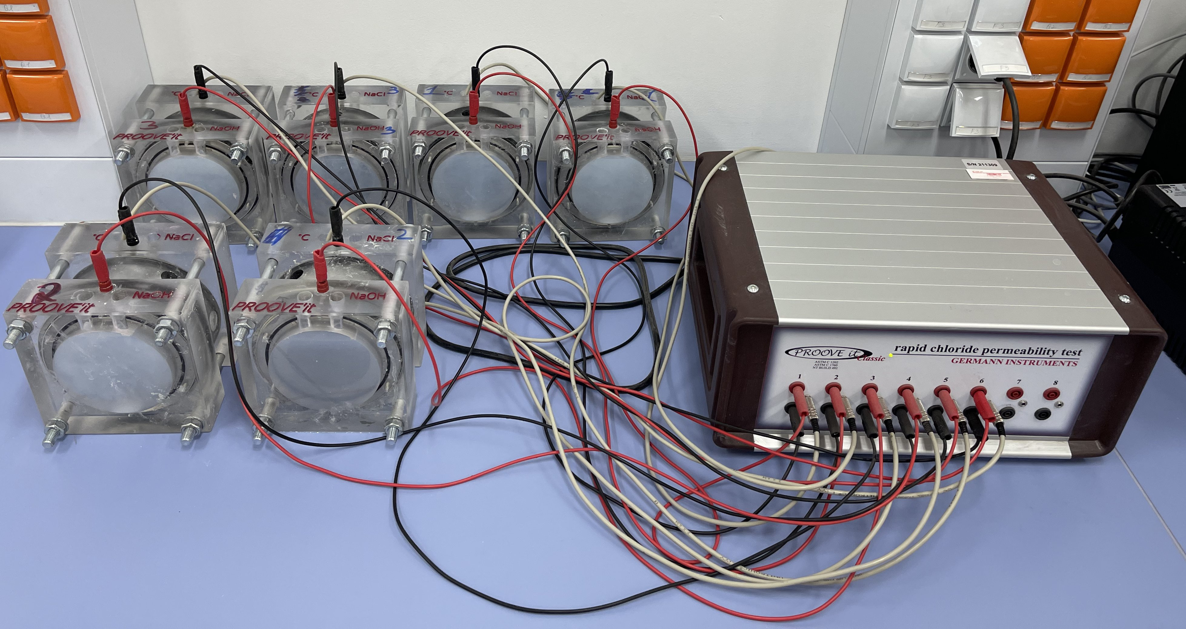
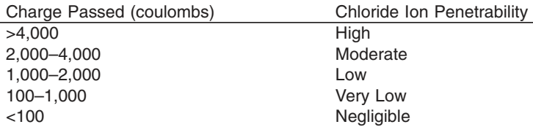
Rapid chloride permeability
Durability and Mechanical Properties of Hybrid Concrete blended with Ground Granulated Blast Furnace Slag, Metakaolin, and Silica Fume
Conducted in accordance with ASTM C1202.
a
b
c
Fig 5 Rapid chloride permeability equipment; a – vacuum chamber for samples, b – rapid chloride permeability apparatus, c – chloride ion penetrability based on charge passed

Slide 16
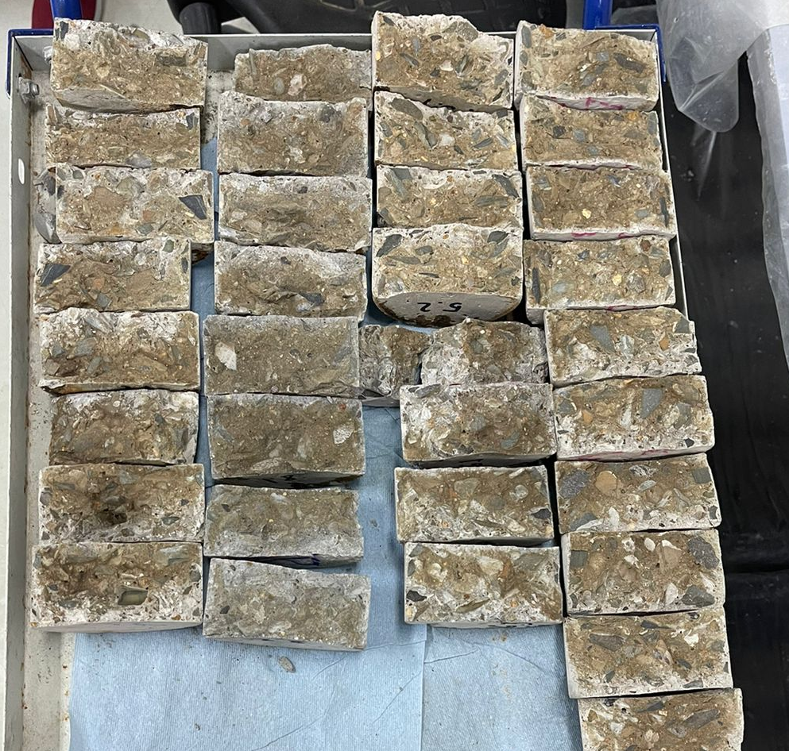
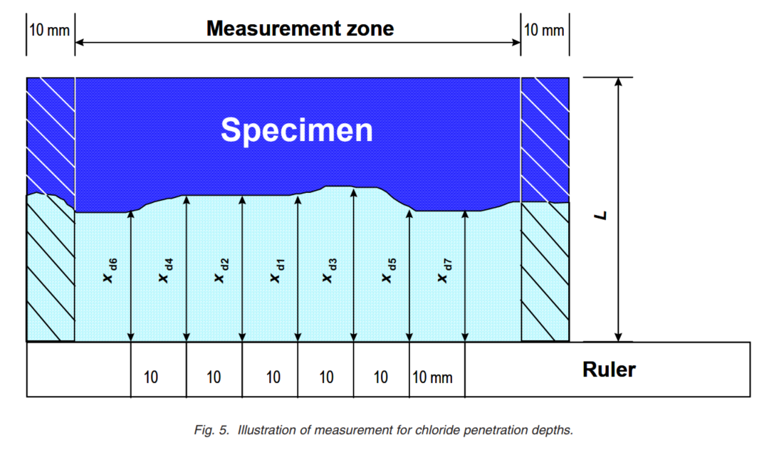

Non-steady-state migration
Durability and Mechanical Properties of Hybrid Concrete blended with Ground Granulated Blast Furnace Slag, Metakaolin, and Silica Fume
Conducted in accordance with NT BUILD 492.
$$D_{nssm}=\frac{0.0239∗\left(273+T\right)∗L}{\left(U−2\right)∗t}\left(x_{d}−0.0238\sqrt{\frac{(273+T){∗L∗x}_{d}}{U−2}}\right)∗100$$
Where:
$D_{nssm}$ = non-steady-state migration coefficient, ×10^{–12} m²/s,
U = absolute value of the applied voltage, V,
T = average value of the initial and final temperatures in the anolyte solution, °C,
L = thickness of the specimen, mm,
x_{d} = average value of the penetration depths, mm,
t = test duration, hour.
a
b
Fig 5. Equipment; a – split specimens, b – illustration of measurement for chloride penetration depths

Slide 17
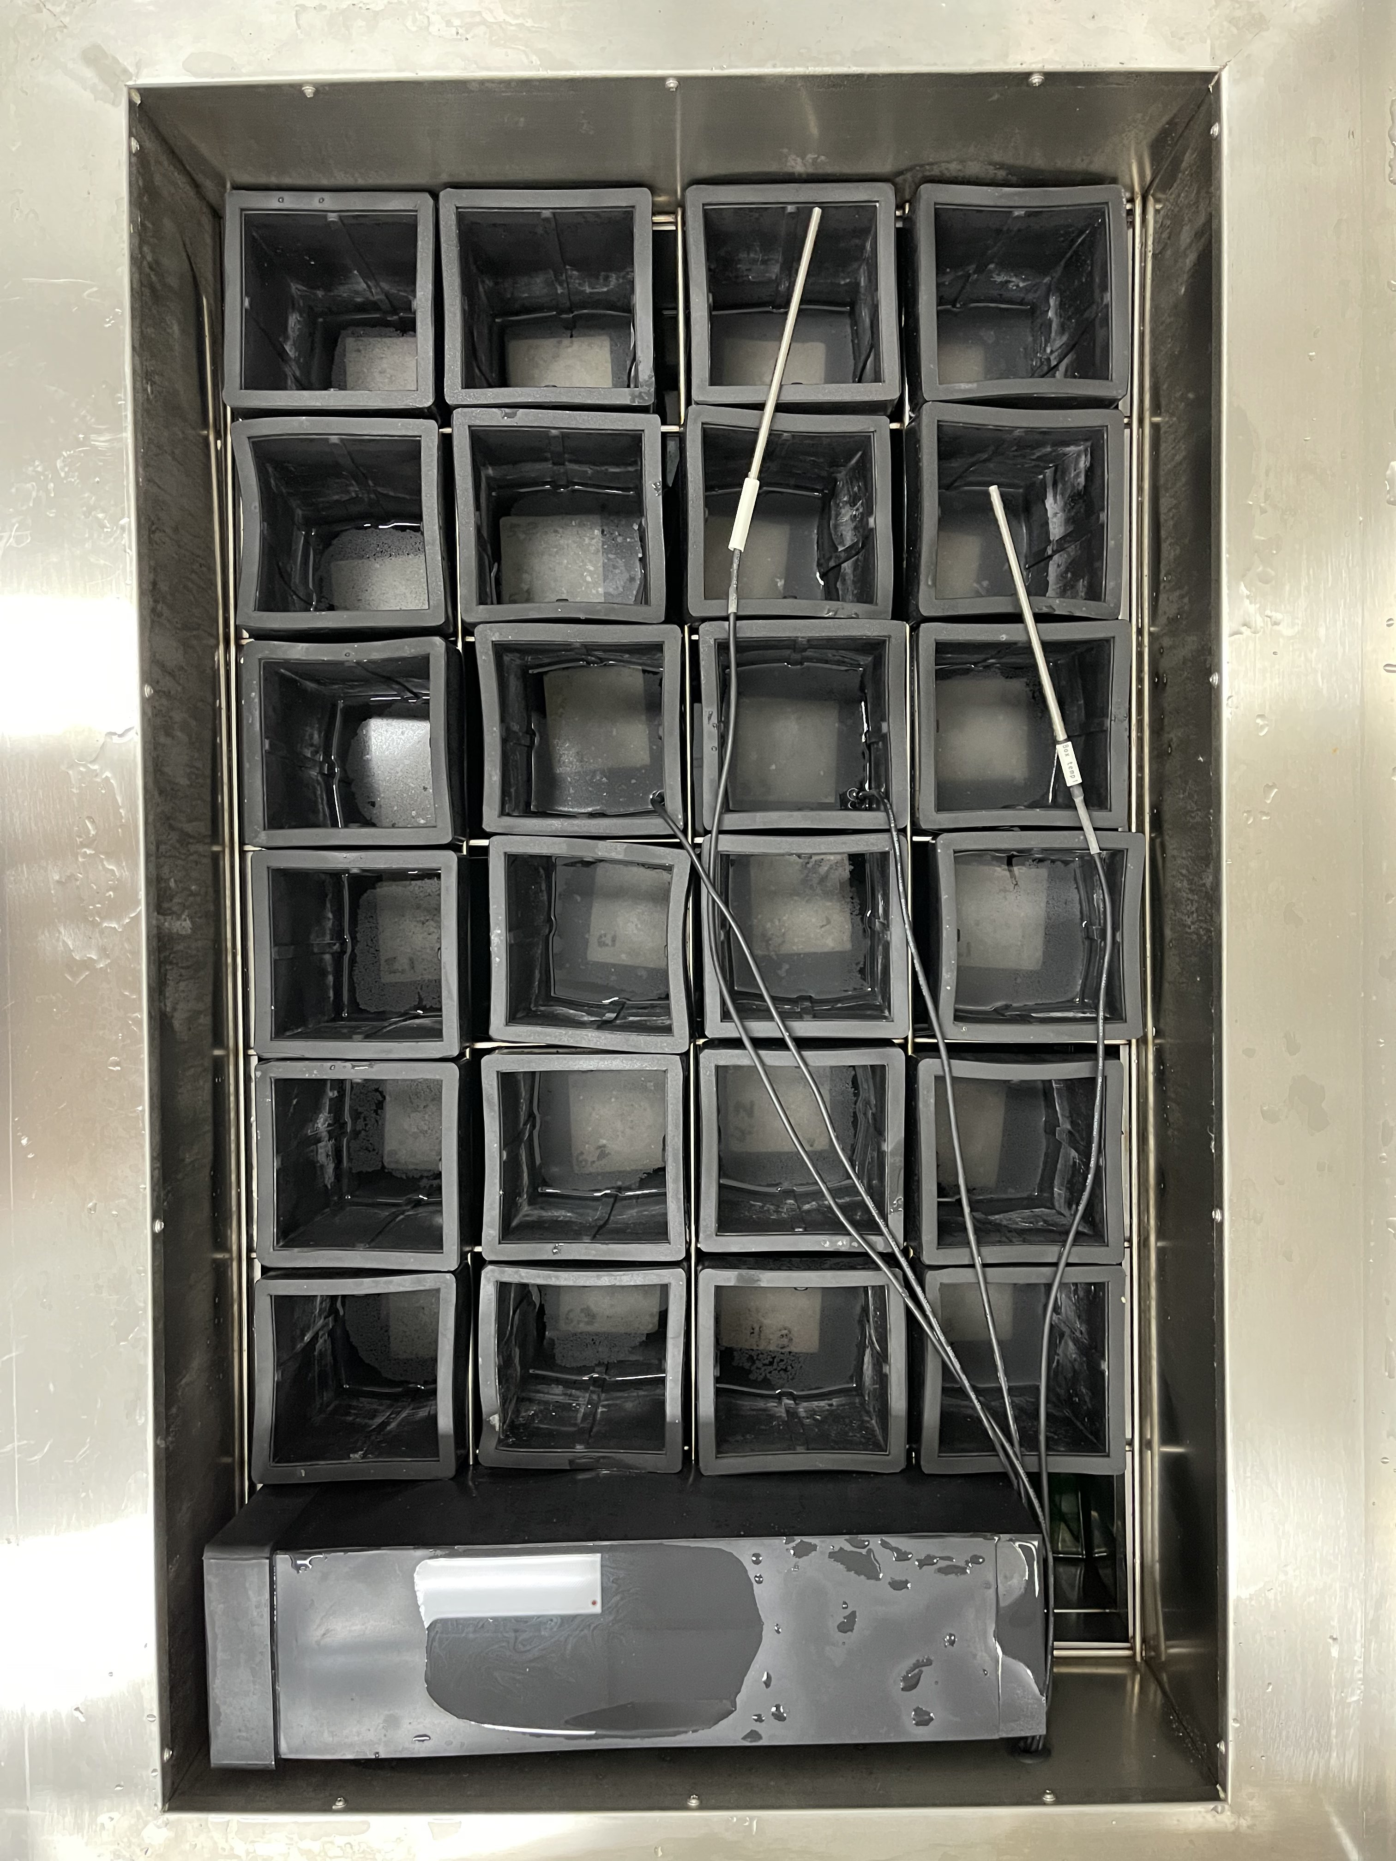
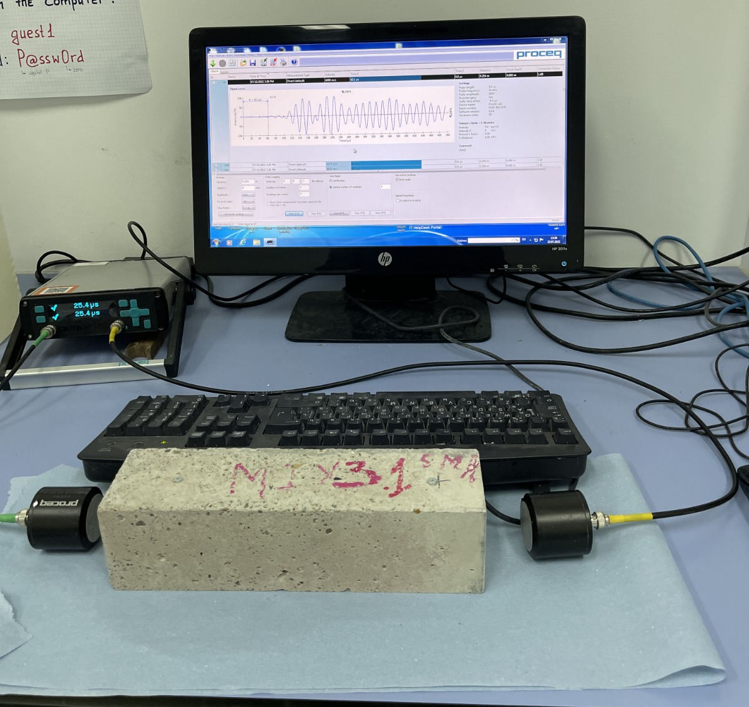
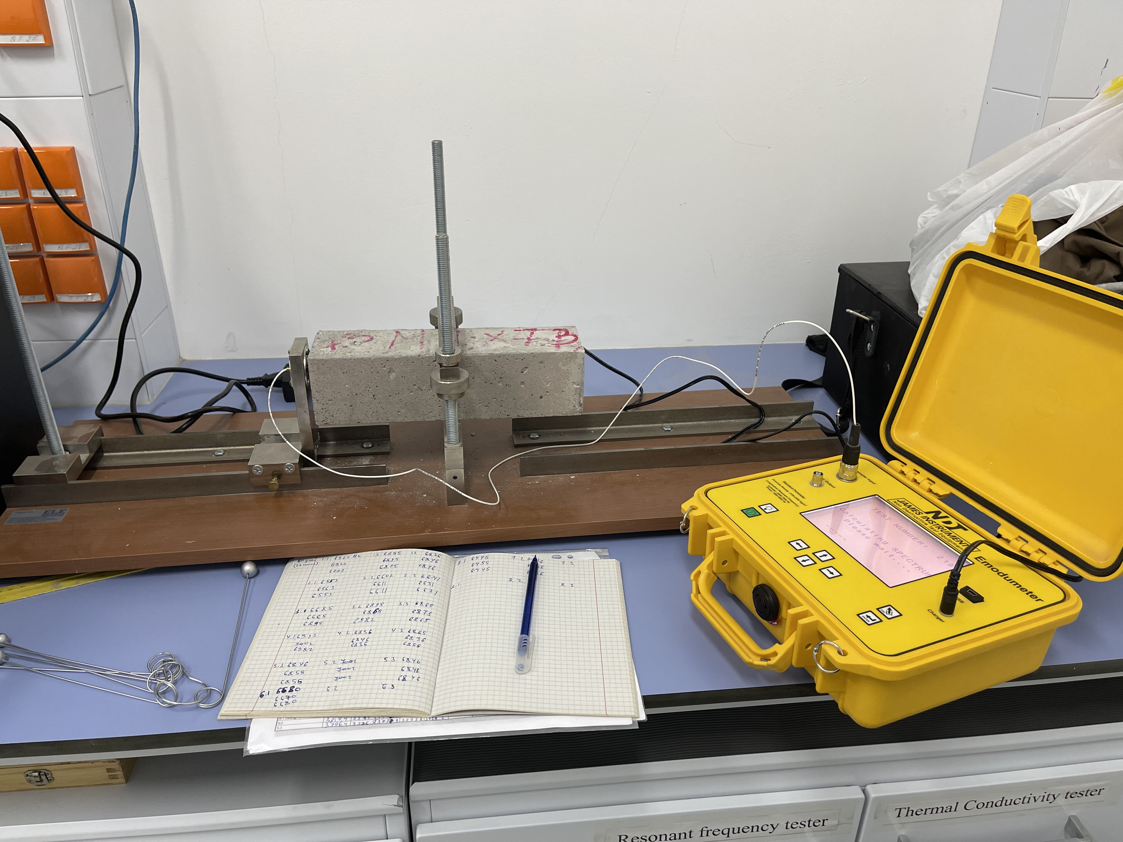

Freezing-Thawing
Durability and Mechanical Properties of Hybrid Concrete blended with Ground Granulated Blast Furnace Slag, Metakaolin, and Silica Fume
Conducted in accordance with ASTM C666.
$$P_{c}=\left(\frac{n_{1}^{2}}{n^{2}}\right)∗100$$
Where:
P_{c} = relative dynamic modulus of elasticity, after c cycles of freezing and thawing, percent;
n = fundamental transverse frequency at 0 cycles of freezing and thawing;
$n_{1}$= fundamental transverse frequency after c cycles of freezing and thawing.
The threshold value of this number is 60%
a
b
c
Fig 6. Freeze-Thaw equipment; a – freeze-thaw chamber, b – ultrasonic pulse velocity apparatus, c - resonant frequency meter

Slide 18
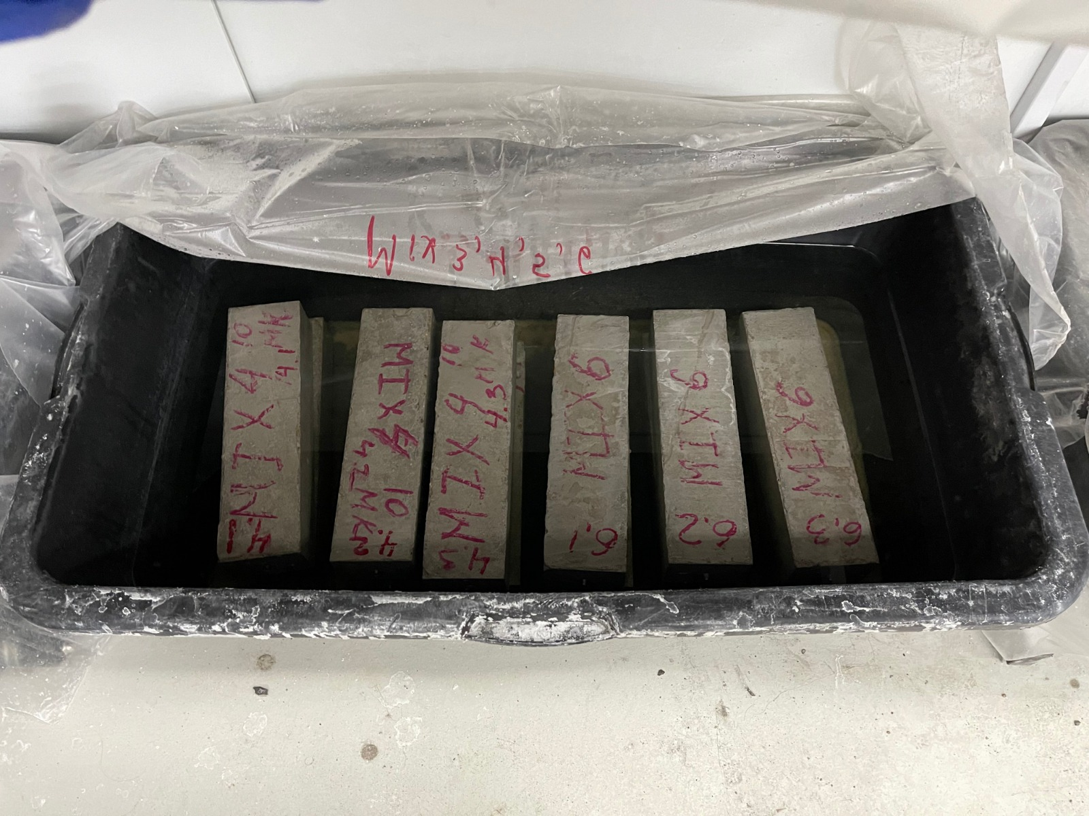
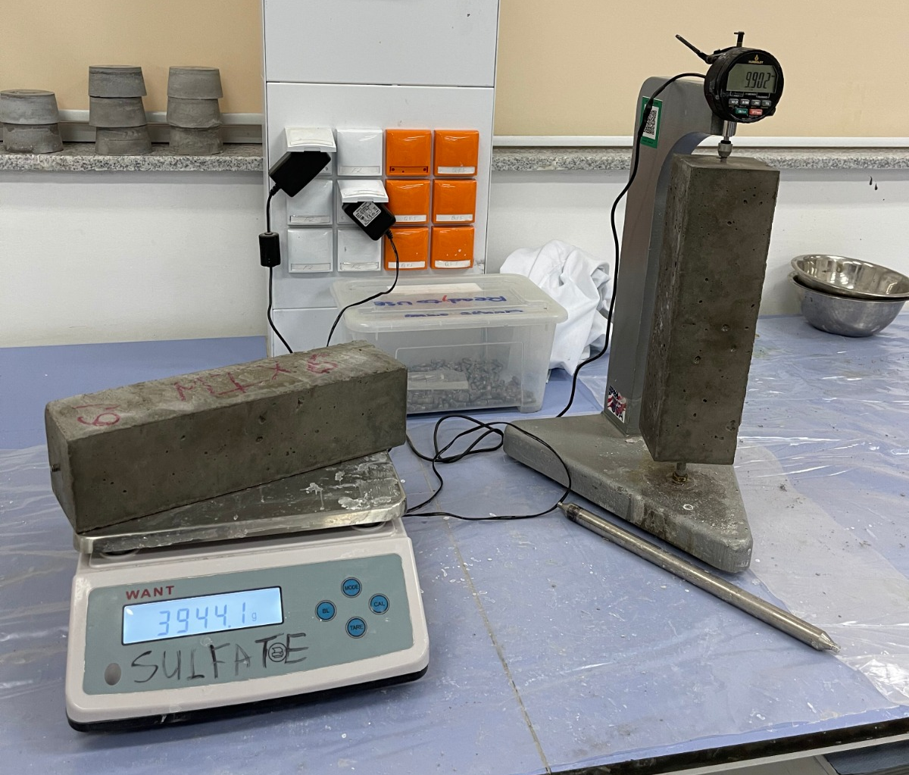
Sulfate attack
Durability and Mechanical Properties of Hybrid Concrete blended with Ground Granulated Blast Furnace Slag, Metakaolin, and Silica Fume
Conducted in accordance with ASTM C1012.
a
b
Length change of less than 0.10% at 6 months indicates moderate sulfate resistance and a length change of less than 0.05% at 6 months (or less than 0.10% at 12 months) indicates high sulfate resistance
Fig 7. Sulfate attack equipment; a – curing in sulfate solution, b – length and weight change measurement of bars submerged into sulfate solution

Slide 19
Results and Discussion
Durability and Mechanical Properties of Hybrid Concrete blended with Ground Granulated Blast Furnace Slag, Metakaolin, and Silica Fume
Fresh Properties
  Air content
  Workability
Durability properties
  Compressive strength
  Freezing-thawing
  Non-steady-state migration
  Sulfate attack

Slide 20
Durability and Mechanical Properties of Hybrid Concrete blended with Ground Granulated Blast Furnace Slag, Metakaolin, and Silica Fume
Results and Discussion (cont’d)
Durability properties
  Freezing-thawing
  Rapid chloride permeability and non-steady-state migration
  Sulfate attack

Slide 21
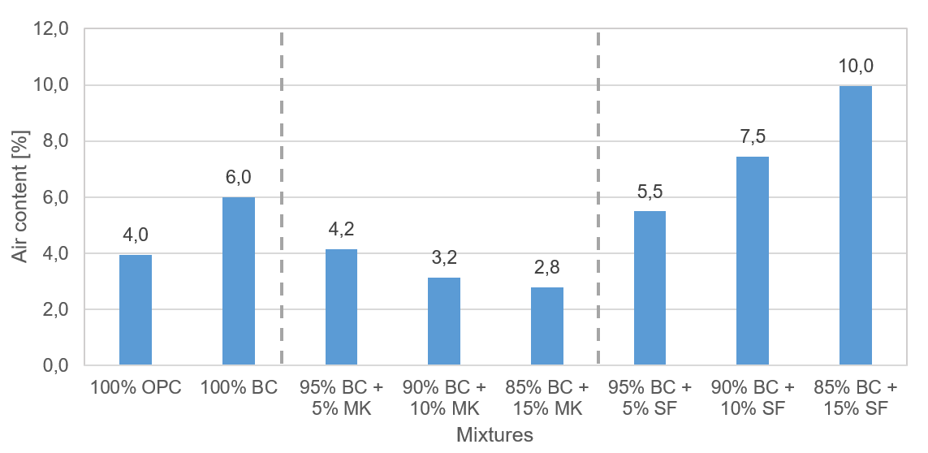
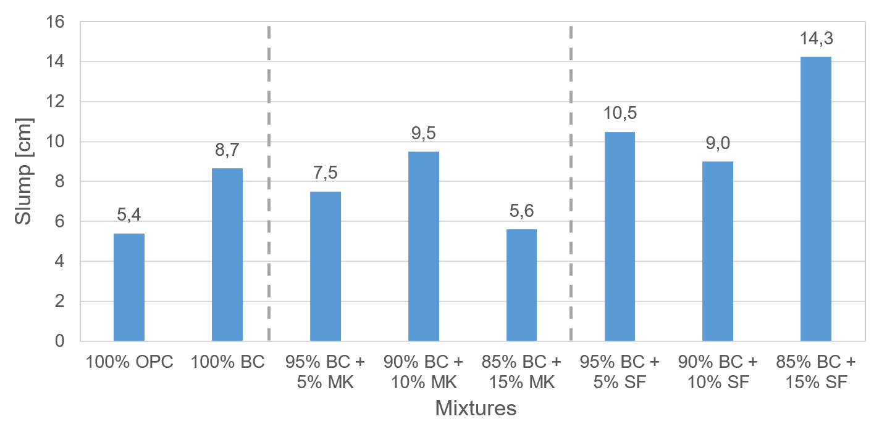
Fresh properties
Durability and Mechanical Properties of Hybrid Concrete blended with Ground Granulated Blast Furnace Slag, Metakaolin, and Silica Fume
Fig 8. Air content and Slump of concrete mixtures

Slide 22
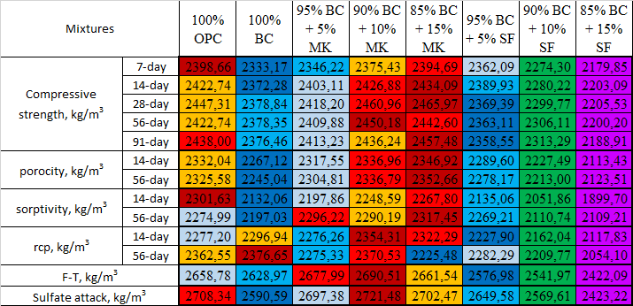
Hardened unit weight
Durability and Mechanical Properties of Hybrid Concrete blended with Ground Granulated Blast Furnace Slag, Metakaolin, and Silica Fume
Table 2. Density of all specimens by concrete mixtures and tests
Fig 9. Color-density value from most dense to least dense from left to right

Slide 23
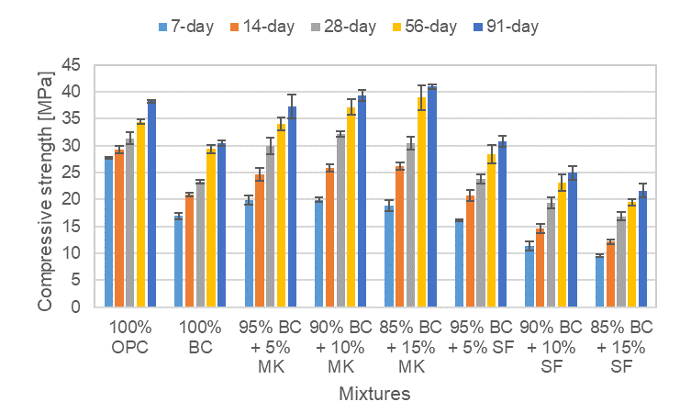
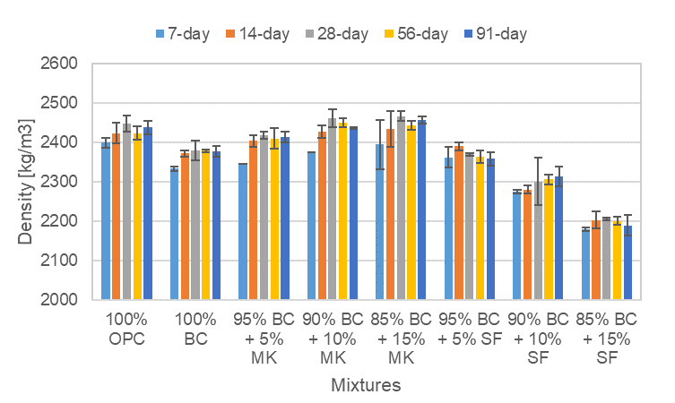
Compressive strength
Durability and Mechanical Properties of Hybrid Concrete blended with Ground Granulated Blast Furnace Slag, Metakaolin, and Silica Fume
(a)
(b)
Fig 10. Concrete mixtures results: (a) compressive strength; (b) density

Slide 24
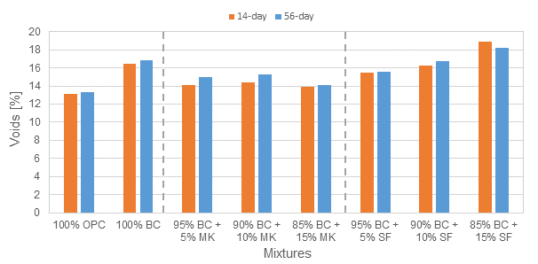
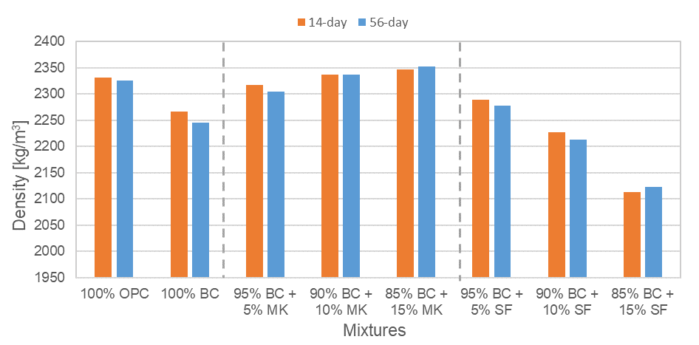
Porosity
Durability and Mechanical Properties of Hybrid Concrete blended with Ground Granulated Blast Furnace Slag, Metakaolin, and Silica Fume
(a)
(b)
Fig 11. Porosity results of the hardened mixtures: (a) voids in %; (b) density

Slide 25
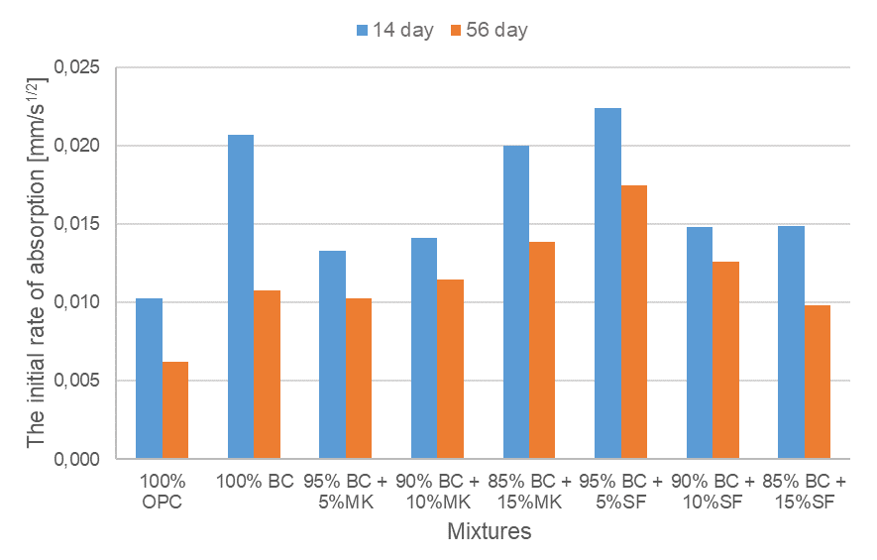
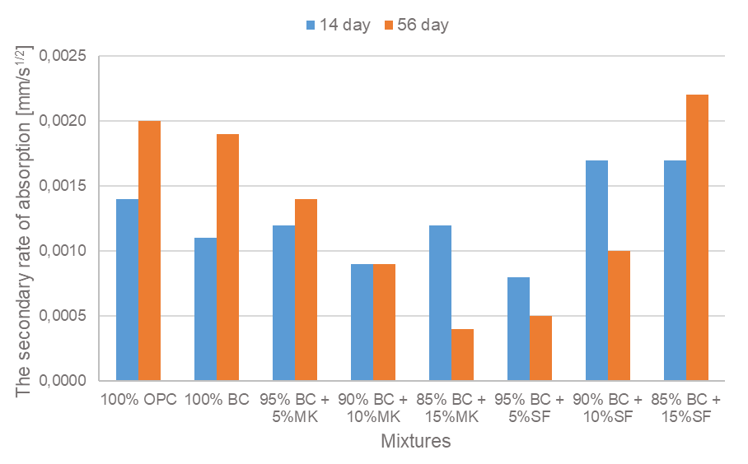
Sorptivity
Durability and Mechanical Properties of Hybrid Concrete blended with Ground Granulated Blast Furnace Slag, Metakaolin, and Silica Fume
(a)
(b)
Fig 12. Sorptivity results of the mixtures: (a) the initial rate of absorption of 14 and 56-day specimens; (b) the secondary rate of absorption of 14 and 56-day specimens

Slide 26
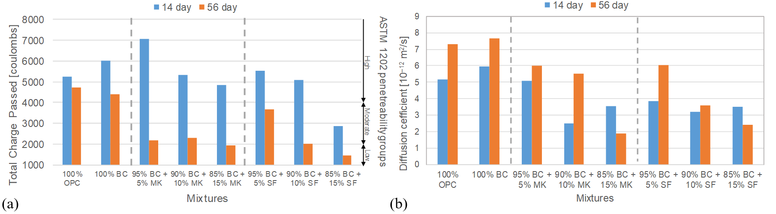
Rapid chloride permeability and non-steady-state migration
Durability and Mechanical Properties of Hybrid Concrete blended with Ground Granulated Blast Furnace Slag, Metakaolin, and Silica Fume
(a)
(b)
Fig 13. Results of the concrete mixtures: (a) total charge passed through 14 and 56-day specimens; (b) non-steady-state migration coefficient of 14 and 56-day specimens

Slide 27
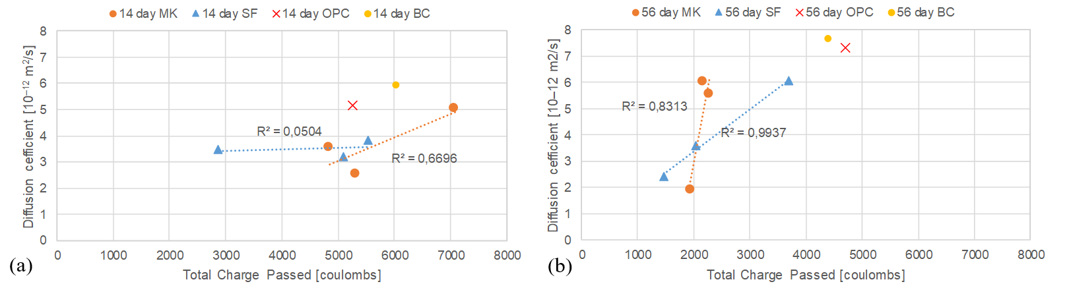
Rapid chloride permeability and non-steady-state migration (cont’d)
Durability and Mechanical Properties of Hybrid Concrete blended with Ground Granulated Blast Furnace Slag, Metakaolin, and Silica Fume
(a)
(b)
Fig 14. Non-steady-state migration coefficient vs total charge passed: (a) MK and control mixtures cured for 14 days; (b) SF and control mixtures cured for 56-days

Slide 28
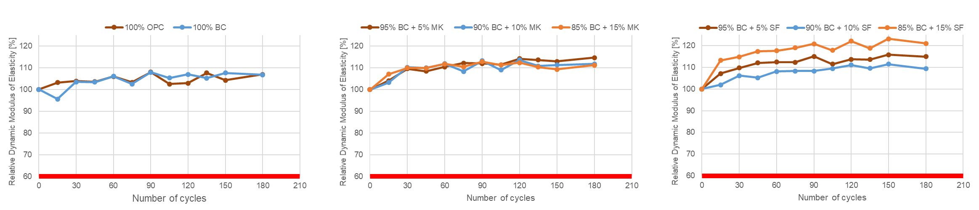
Freezing-thawing
Durability and Mechanical Properties of Hybrid Concrete blended with Ground Granulated Blast Furnace Slag, Metakaolin, and Silica Fume
(a)
(b)
(c)
Fig 15. F-T test results of mixture groups: (a) ultrasonic pulse velocity of control mixtures; (b) ultrasonic pulse velocity of MK mixtures; (c) ultrasonic pulse velocity of SF mixtures

Slide 29
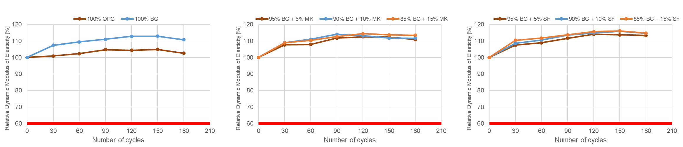
Freezing-thawing(cont’d)
Durability and Mechanical Properties of Hybrid Concrete blended with Ground Granulated Blast Furnace Slag, Metakaolin, and Silica Fume
(a)
(b)
(c)
Fig 16. F-T test results of mixture groups: (a) transverse frequency of control mixtures; (b) transverse frequency of MK mixtures; (c) transverse frequency of SF mixtures

Slide 30
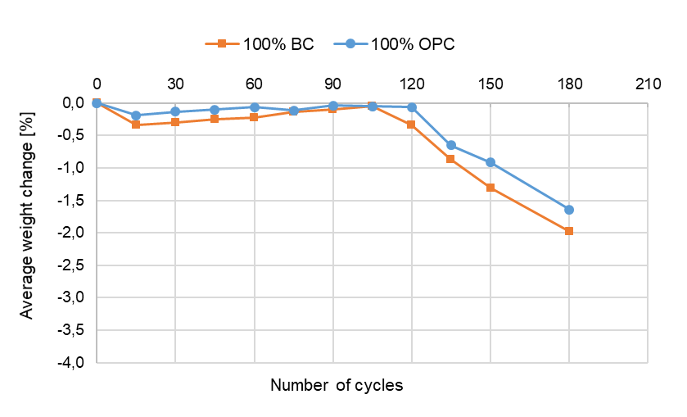
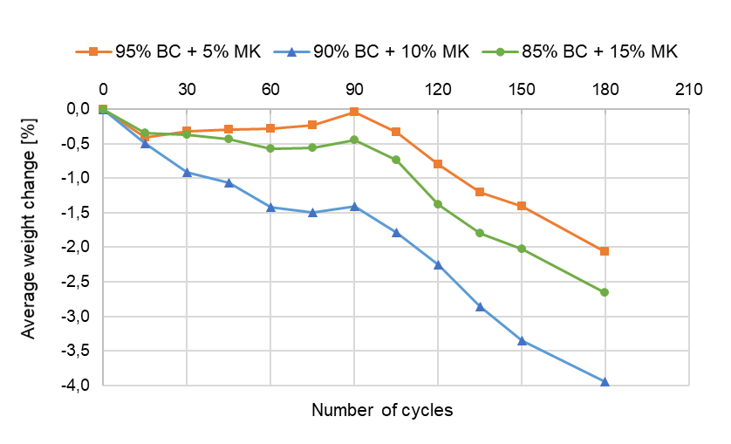
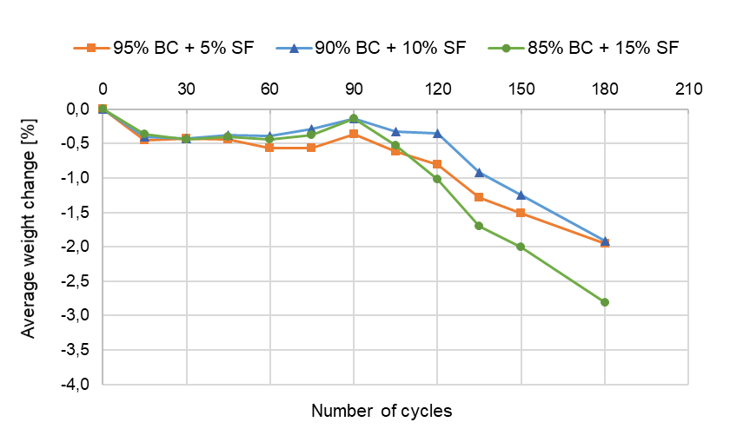
Freezing-thawing(cont’d)
Durability and Mechanical Properties of Hybrid Concrete blended with Ground Granulated Blast Furnace Slag, Metakaolin, and Silica Fume
(a)
(b)
(c)
Fig 17. F-T test results of mixture groups: (a) weight change of control mixtures; (b) weight change of MK mixtures; (c) weight change of SF mixtures

Slide 31
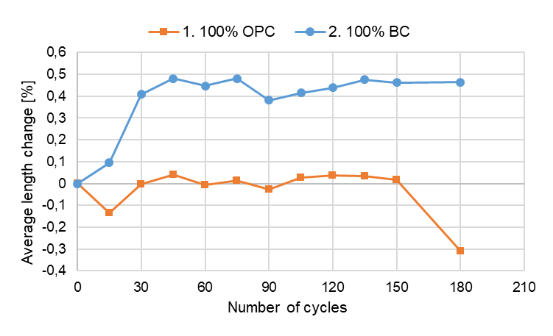
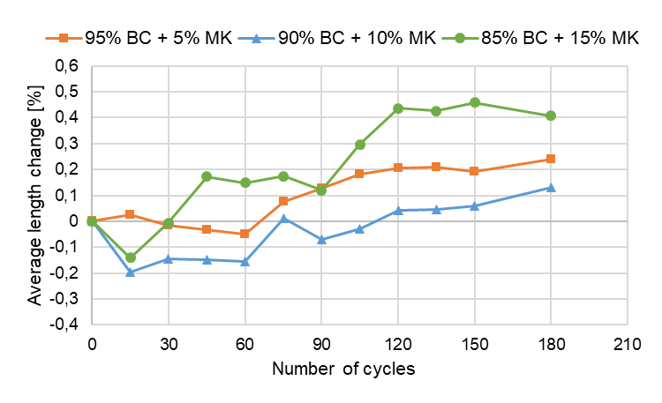
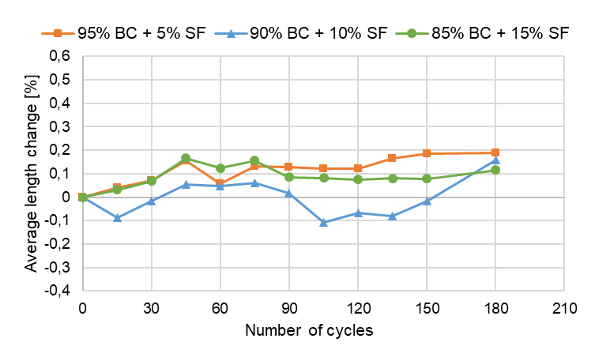
Freezing-thawing(cont’d)
Durability and Mechanical Properties of Hybrid Concrete blended with Ground Granulated Blast Furnace Slag, Metakaolin, and Silica Fume
(a)
(b)
(c)
Fig 18. F-T test results of mixture groups: (a) length change of control mixtures; (b) length change of MK mixtures; (c) length change of SF mixtures

Slide 32
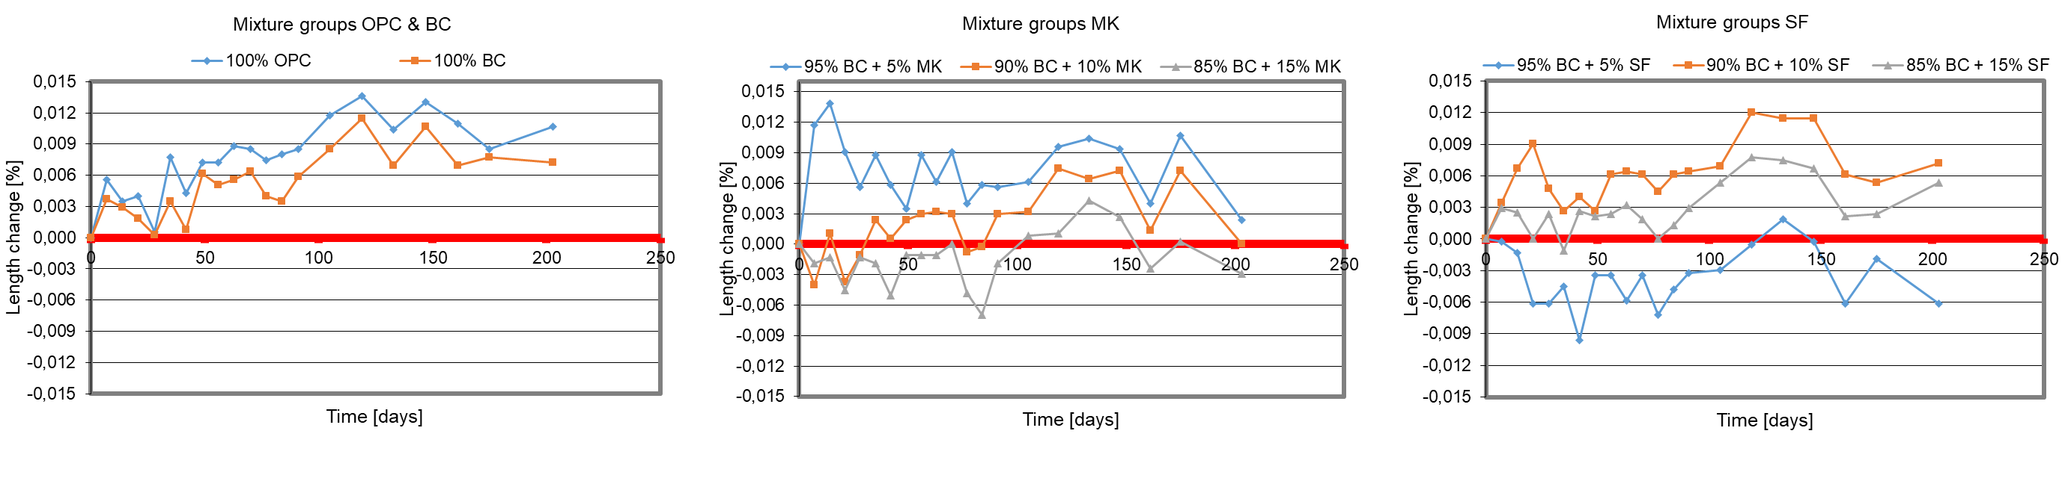
Sulfate attack
Durability and Mechanical Properties of Hybrid Concrete blended with Ground Granulated Blast Furnace Slag, Metakaolin, and Silica Fume
(a)
(b)
(c)
Fig 19. Length change in % of concrete specimens during sulfate attack: (a) control mixtures; (b) MK mixtures; (c) SF mixtures

Slide 33
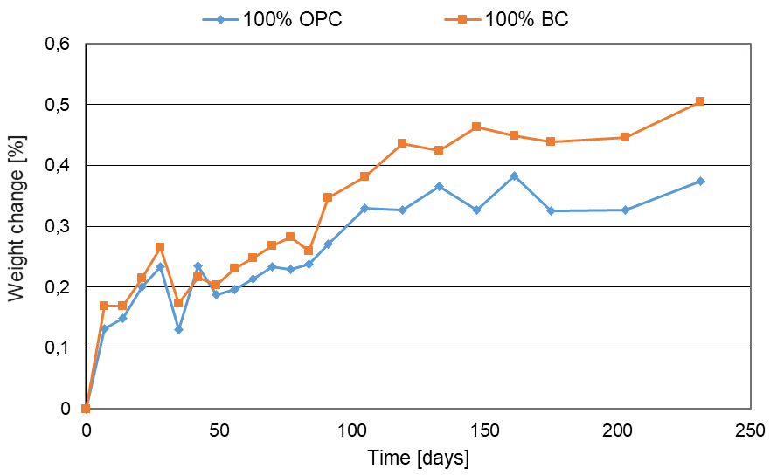
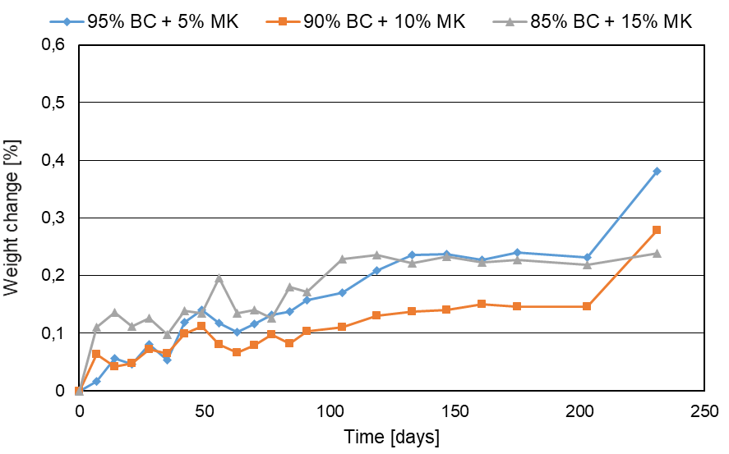
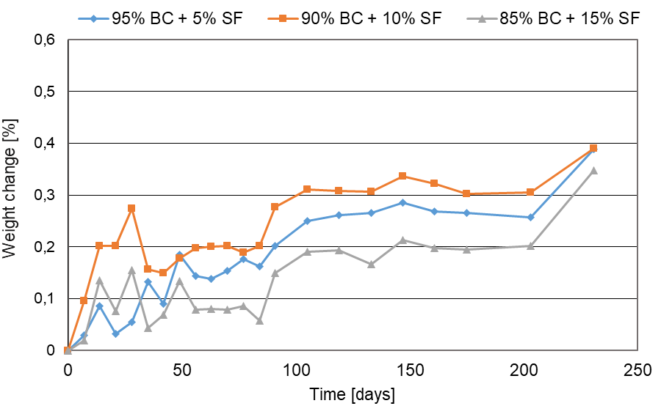
Sulfate attack (cont’d)
Durability and Mechanical Properties of Hybrid Concrete blended with Ground Granulated Blast Furnace Slag, Metakaolin, and Silica Fume
(a)
(b)
(c)
Fig 20. Weight change in % of concrete specimens during sulfate attack: (a) control mixtures; (b) MK mixtures; (c) SF mixtures

Slide 34
Durability and Mechanical Properties of Hybrid Concrete blended with Ground Granulated Blast Furnace Slag, Metakaolin, and Silica Fume
Conclusion
In comparison with the control mixtures (OPC and BC), concrete with added metakaolin and silica fume generally improved performance, considering the severe Kazakhstani weather conditions.
Mixtures with MK completely improved mechanical and durability properties of concrete specimens, however, for mixtures with SF, improved partially and in the field of durability properties, but not mechanical, except for a mixture of 5% SF.

Slide 35
Durability and Mechanical Properties of Hybrid Concrete blended with Ground Granulated Blast Furnace Slag, Metakaolin, and Silica Fume
References
ASTM, C. (2017). Standard test method for compressive strength of cylindrical concrete specimens. C39/C39M – 17b
ASTM, C. (2015). Standard test method for resistance of concrete to rapid freezing and thawing. C666/C666M – 15
ASTM, C. (2017). Standard test method for compressive strength of cylindrical concrete specimens. C39/C39M − 17b
ASTM, C. (2018). Standard test method for length change of hydraulic-cement mortars exposed to a sulfate solution. C1012/C1012M – 18b
ASTM, C. (2019). Standard test method for electrical indication of concrete’s ability to resist chloride ion penetration. C1202 – 19
Meyer, C. (2009, September). The greening of the concrete industry. Cement and Concrete Composites, 31(8), 601–605. https://doi.org/10.1016/j.cemconcomp.2008.12.010
Wilson, M. L., & Kosmatka, S. H. (2011, January 30). Design and Control of Concrete Mixtures (15th ed.). Portland Cement Assn.

Slide 36
Thank you for your attention!

