Slide 1


MSc Thesis Title:
Transformer Fault Prognosis using Vibration Signature and Forecasting Techniques
Student:
Askat Kural
Supervisor:
Mehdi Bagheri
Co-supervisor:
Amin Zollanvari
Notes:
https://pixabay.com/en/achievement-agreement-business-3481967/

Slide 2
MSc Thesis Presentation Outline
Introduction
01
Aims and objectives
02
Literature review
03
Vibration Modeling
04
Methodology
05
Experimental Studies
06
Results & Discussion
07
Conclusion and Future Works
08
References
09
Notes:
https://pixabay.com/en/books-science-shelf-library-book-408220/

Slide 3
Introduction
01
02
03
Asset Management
Power Transformer
Transformer Faults
Catastrophic collapses and failures
Mechanical and electrical stresses
Real-time monitoring and prognosis

Slide 4

Aims & Objectives
01
To study and develop a technique for transformer condition and fault prognosis using vibration signature and forecasting techniques
02
Transformer faults: voltage excitations (over and under excitations) and intern-turn short-circuit
Notes:
https://pixabay.com/en/book-library-a-collection-of-892136/

Slide 5
Aims & Objectives
01
To provide in detail an analytical approach for transformer vibration modeling
02
To perform the transformer under- and over-voltage excitation conditions along with the inter-turn short-circuit fault using experimental setup for data collection
03
To develop an algorithm for predicting the fault using vibration signal data
04
To develop a prognosis and predictive model for transformer faults using Convolutional Neural Network (CNN)
Notes:
https://pixabay.com/en/book-library-a-collection-of-892136/

Slide 6
Literature Review
01
Offline Frequency Response Analysis for transformer winding vibration analysis [1]. On top of that FRA can be performed in online basis [2].
The acceleration is common choice as a parameter of interest for vibration analysis to make a proper decision as the mechanical parameter for analyzing and modelling vibration signature of transformer [2].
02
Other methods: online transformer sound analysis [11], short circuit impedance measurement [12], deformation coefficient [13] Lissajous Figure and a locus diagram-based methods for winding deformation detection of transformer [14],[15].
03
04
According to [16], Relative absolute error (RAE) of LSTM model for voltage excitation and short-intern fault were 0.56% and 17.58%, respectively.
Notes:
https://pixabay.com/en/thumbs-up-okay-good-well-done-2056022/

Slide 7
Literature Review
Ref. | Conclusion
[1]-[5] | Frequency response analysis was studied to investigate transformer fault recognition.
[6]-[10] | Transformer fault detection using vibration modeling analysis was investigated.
[16]-[24] | Machine Learning techniques applied on transformer and motor fault detection.

Slide 8
Vibration Modeling
Cause of vibration
Deformation of core material due to Magnetostriction
The Electromagnetic force created by the leakage magnetic flux
A ferromagnetic core sheet is exposed to the magnetic field
The spring-force model
The fundamental frequency is proportional to injected voltage frequency [8]
The fundamental frequency is proportional to injected current frequency [8]
Vibration model assumption
Vibration dependency
Figure 1. Transformer core and winding vibration modeling conclusion.

Slide 9
Methodology
Convolutional
Neural
Network
Data
Acquisition and
Preparation
Model
Selection
One dimensional Convolutional Neural Network (1D-CNN)
Small electrical grid system for data acquisition. Two scenarios: voltage excitations and short-circuit fault.
Construction of CNN model over new obtained data.

Slide 10
Convolutional Neural Networks
Convolution layer
Convolution layer
Input
Pooling layer
Pooling layer
Fully connected layer
Convolution
Subsampling
Convolution
Subsampling
Figure 2. General structure of 2D-CNN.

Slide 11
1D-Convolutional Neural Networks
Input
Convolution layer
Pooling layer
Convolution layer
Pooling layer
Fully connected layer
Convolution
Convolution
Subsampling
Subsampling
Figure 3. General structure of 1D-CNN.

Slide 12
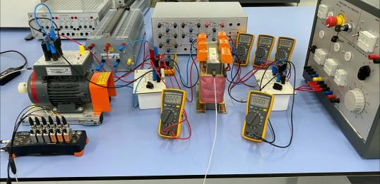
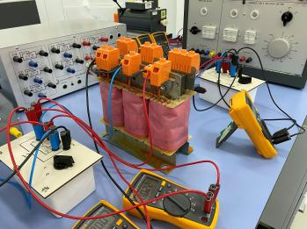
Case Study 1: Experimental Setup
Figure 4. Experimental test set-up with three-phase transformer with active and reactive loads.

Slide 13
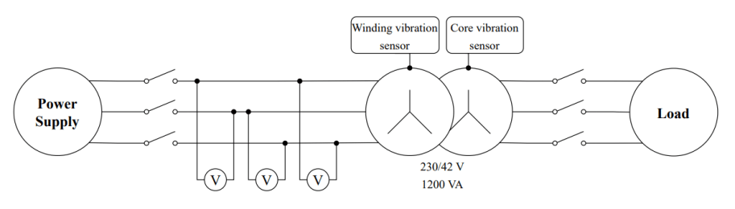
Case Study 1: Experimental Setup
Figure 5. Schematic diagram of experimental setup for Case Study 1.

Slide 14
Case Study 1: Data Acquisition
Data collection process was conducted as following:
Setting the injected voltage to 80% of transformer rated input
Recording all data for 30 seconds for undervoltage and 10 seconds for overvoltage
Step up the injected voltage to 5% of rated input and repeat steps 2 and 3 until the injected voltage value reaches 110% of rated voltage
Table 1. Under and over excitation voltages of experimental transformer.
Excitation Voltage, % | 80 | 85 | 90 | 95 | 100 | 105 | 110
Injected Voltage, V | 320 | 340 | 360 | 380 | 400 | 420 | 440

Slide 15

Case Study 2: Experimental Setup
Vibration sensor
Vibration sensor
Winding 3
Variable resistor
Winding 1
Winding 2
Variable load
Figure 6. Single-phase transformer fault emulation scheme.

Slide 16
Case Study 2: Data Acquisition
01
02
Non-fault state: until 11 A
Faulty condition: 11 to 15 A
Table 2. Different loads and its values passing through experimental transformer including turn-to-turn short circuit current.
Load [p.u] | 0.71 | 0.95 | 1 | 1.19 | 1.31 | 1.42 | 1.66 | 1.9
Load current [A] | 3 | 4 | 4.2 | 5 | 5.5 | 6 | 7 | 8
Load [p.u] | 2 | 2.14 | 2.26 | 2.38 | 2.61 | 2.85 | 3.09 | 3.57
Load current [A] | 8.4 | 9 | 9.5 | 10 | 11 | 12 | 13 | 15

Slide 17
Data Preparation
The list of the features is shown below:
Transformer winding vibration signals
Transformer core vibration signals
Transformer injected voltage (under, rated and over voltage values)
Figure 7. Transformer core and winding vibration signals under full load: (a) 80%, (b) 85% of rated voltage injected to transformer.

Slide 18
Data Preparation
(a) (b)
Figure 8. Transformer (a) core and (b) winding vibration signals in frequency domain.

Slide 19
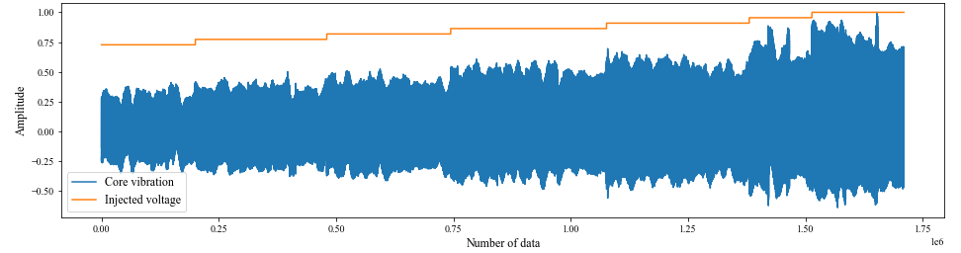
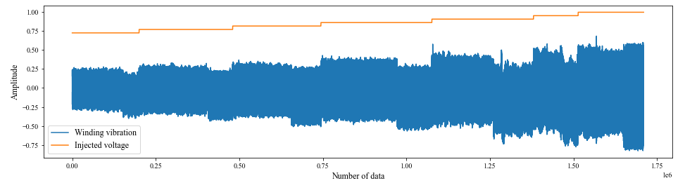
Data Preparation
01
Down sampled from 20 kHz to 3 kHz
02
Some ranges of data values were dropped: transition steps
03
Data was normalized between -1 and 1
(a) (b)
Figure 9. Normalized (a) core and (b) winding vibration signals with normalized injected voltage.

Slide 20
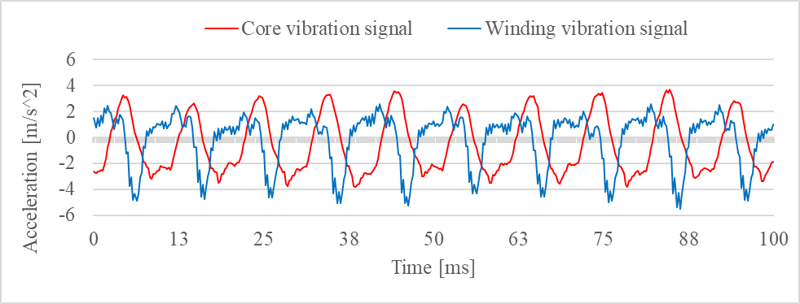
Data Preparation
Each segment is 0.0167 sec and 50 observations
01
Data was segmented by 50 samples
02
1 segment = 0.0167 seconds
1 second = 60 segments
03
1 segment = 2 cycles, approximately
Figure 10. Segmentation process for a portion of collected vibration waveforms for 80% excitation.

Slide 21
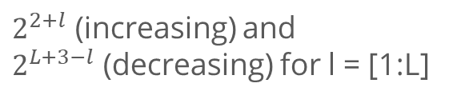
Model Construction
01
The batch sizes:
04
The number of convolutional layers (L):
32 and 64
from 1 to 6
02
The epoch numbers:
05
The number of filters in each layer:
from 1 to 150 (without early stopping)
$2^{2+l}$ (increasing) and
$2^{L+3−l}$ (decreasing) for l = [1:L]
03
The learning rates:
06
Kernel size:
0.001 and 0.0001
with Adam optimizer
from 2 to 7

Slide 22
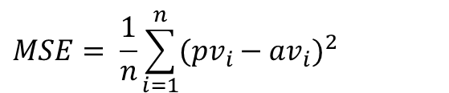
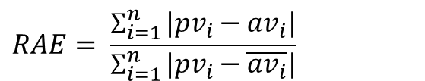
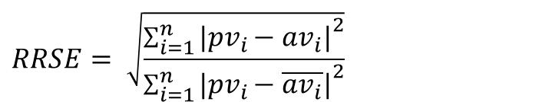
Model Selection & Validation Results
01
Mean Squared Error:
$$MSE= \frac{1}{n}\sum_{i=1}^{n}{{(pv_{i}−{av}_{i})}^{2}}$$
02
Root Relative Squared Error:
$$RRSE= \sqrt{\frac{{\sum_{i=1}^{n}{|{pv}_{i}−{av}_{i}|}}^{2}}{{\sum_{i=1}^{n}{|{pv}_{i}−\overline{{av}_{i}}|}}^{2}}}$$
03
Relative Absolute Error:
$$RAE= \frac{\sum_{i=1}^{n}{|{pv}_{i}−{av}_{i}|}}{\sum_{i=1}^{n}{|{pv}_{i}−\overline{{av}_{i}}|}}$$

Slide 23
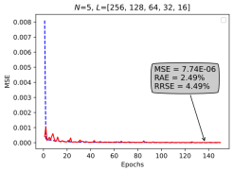
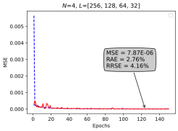
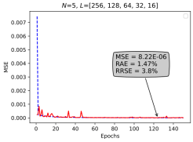
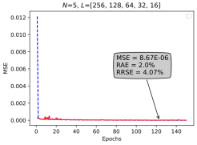
Model Selection & Validation Results
01
The best epoch between 100 and 150
02
Train and validation losses
03
Validation loss (MSE)
Figure 11. Performance of the best 4 1D-CNN models from Table 5.1 with arrows showing the best models.

Slide 24
Model Selection & Validation Results
Table 3. The selected 1D-CNN architecture for transformer excitation based on lowest MSE on the validation set .
Layer size, N | Filter number, L | Batch size | Kernel size | Adam optimizer | MSE | RRSE | RAE
5 | [256, 128, 64, 32, 16] | 32 | 6 | 0.001 | 7.7364E-06 | 4.4938 | 2.4863
4 | [256, 128, 64, 32] | 32 | 7 | 0.001 | 7.8655E-06 | 4.1612 | 2.7553
5 | [256, 128, 64, 32, 16] | 32 | 5 | 0.001 | 8.2211E-06 | 3.7985 | 1.4734
5 | [256, 128, 64, 32, 16] | 64 | 6 | 0.001 | 8.6697E-06 | 4.0723 | 2.0035
6 | [256, 128, 64, 32, 16, 8] | 32 | 5 | 0.001 | 9.2483E-06 | 3.7092 | 2.2312
5 | [256, 128, 64, 32, 16] | 64 | 7 | 0.001 | 9.3912E-06 | 3.9514 | 2.6350
4 | [256, 128, 64, 32] | 32 | 6 | 0.001 | 9.4796E-06 | 5.3838 | 3.1683
6 | [256, 128, 64, 32, 16, 8] | 64 | 7 | 0.001 | 9.4955E-06 | 4.6614 | 3.1618
6 | [256, 128, 64, 32, 16, 8] | 32 | 6 | 0.001 | 1.0342E-05 | 3.8244 | 2.0618
5 | [256, 128, 64, 32, 16] | 32 | 4 | 0.001 | 1.0545E-05 | 5.1230 | 3.1113

Slide 25
Model Selection & Validation Results
Table 4. The selected 1D-CNN architecture for transformer inter-turn fault based on highest accuracy on the validation set.
Layer size | Filter number, L | Batch size | Kernel size | Adam optimizer | Accuracy, %
1 | [256] | 64 | 3 | 0.001 | 99.8629
4 | [256, 128, 64, 32] | 32 | 3 | 0.0001 | 99.8458
3 | [256, 128, 64] | 64 | 5 | 0.001 | 99.8458
4 | [8, 16, 32, 64] | 32 | 6 | 0.001 | 99.8458
3 | [256, 128, 64] | 32 | 2 | 0.0001 | 99.8287
2 | [256, 128] | 32 | 2 | 0.0001 | 99.8287
1 | [256] | 64 | 7 | 0.001 | 99.8287
3 | [8, 16, 32] | 64 | 6 | 0.001 | 99.8287
2 | [256, 128] | 64 | 3 | 0.0001 | 99.8115
2 | [256, 128] | 32 | 4 | 0.0001 | 99.8115

Slide 26
Discussion
01
Transformer vibration spectrum has higher harmonic order
02
The impressive result: 0.0167 sec of recorded vibration signals for decision-making
03
Better model performances comparing previous studies

Slide 27
Conclusion and Future Work
01
1D-CNN architecture was considered to train 43 200 models for predicting transformer voltage and inter-turn short circuit fault in early stages.
02
The best predictive model of the case 1 (transformer voltage excitation) revealed RRSE value of 4.49% and RAE value of 2.49%. The accuracy of the predictive model of case 2 was obtained also for 99.86%.
03
To improve the performance of the transformer voltage excitation prediction.
To develop a pipeline and system to be able to analyze the transformer vibration signal for fault prognosis

Slide 28
References
[1] M. H. Samimi and S. Tenbohlen, ‘‘FRA interpretation using numerical indices: State-of-the-art,’’ Int. J. Electr. Power Energy Syst., vol.
89, pp. 115–125, Jul. 2017.
[2] M. Bagheri and B. T. Phung, “Frequency response and vibration analysis in transformer winding turn-to-turn fault recognition,” in
2016 International Conference on Smart Green Technology in Electrical and Information Systems (ICSGTEIS), pp. 10–15, 2016.
[3] M. F. M. Yousof, C. Ekanayake, and T. K. Saha, “Frequency response analysis to investigate deformation of transformer winding,”
IEEE Transactions on Dielectrics and Electrical Insulation, vol. 22, no. 4, pp. 2359–2367, 2015.
[4] Z. Zhao, C. Yao, C. Li, and S. Islam, “Detection of power transformer winding deformation using improved FRA based on binary
morphology and extreme point variation,” IEEE Transactions on Industrial Electronics, vol. 65, no. 4, pp. 3509–3519, 2018.
[5] M. Bagheri, M. S. Naderi, T. Blackburn, and T. Phung, “Frequency response analysis and short-circuit impedance measurement in
detection of winding deformation within power transformers,” IEEE Electrical Insulation Magazine, vol. 29, no. 3, pp. 33–40, 2013.
[6] M. Bagheri, A. Zollanvari and S. Nezhivenko, "Transformer Fault Condition Prognosis Using Vibration Signals Over Cloud
Environment," in IEEE Access, vol. 6, pp. 9862-9874, 2018, doi: 10.1109/ACCESS.2018.2809436.
[7] T.-T. He, J-D. Wang, J. Guo, H. Huang, X.-X. Chen, and J. Pan, ‘‘A vibration based condition monitoring system for power
transformers,’’ in Proc. Asia–Pacific Power Energy Eng. Conf. (APPEEC), 2009, pp. 1–4.
[8] M. Bagheri, S. Nezhivenko, M. Naderi, and A. Zollanvari, “A new vibration analysis approach for transformer fault prognosis over
cloud environment,” International Journal of Electrical Power and Energy Systems, vol. 100, pp. 104–116, Sept. 2018.
[9] B. Garcia, J. Burgos, and A. Alonso, “Transformer tank vibration modeling as a method of detecting winding deformations-part i:
theoretical foundation,” IEEE Transactions on Power Delivery, vol. 21, no. 1, pp. 157–163, 2006.
[10] J. Shengchang, L. Yongfen, and L. Yanming, “Research on extraction technique of transformer core fundamental frequency
vibration based on olcm,” IEEE Transactions on Power Delivery, vol. 21, no. 4, pp. 1981– 1988, 2006.

Slide 29
References
[11] N. Shu, C. Zhou, F. Hu, Q. Liu, and L. Zheng, ‘‘Study on ultrasonic measurement device for transformer winding deformation,’’ in
Proc. Int. Conf. Power Syst. Tech. (PowerCon), vol. 3. 2002, pp. 1401–1404.
[12] E. Arri, A. Carta, F. Mocci, and M. Tosi, ‘‘Diagnosis of the state of power transformer windings by on-line measurement of stray
reactance,’’ IEEE Trans. Instrum. Meas., vol. 42, no. 2, pp. 372–378, Apr. 1993.
[13] M. A. Hejazi, G. B. Gharehpetian, G. Moradi, H. A. Alehosseini, and M. Mohammadi, ‘‘Online monitoring of transformer winding
axial displacement and its extent using scattering parameters and k-nearest neighbour method,’’ IET Generat., Transmiss. Distrib.,
vol. 5, no. 8, pp. 824–832, Aug. 2011.
[14] A. Abu-Siada and S. Islam, ‘‘A novel online technique to detect power transformer winding faults,’’ IEEE Trans. Power Del., vol. 27,
no. 2, pp. 849–857, Apr. 2012.
[15] Y. X. Liao, T. Y. Zhu, Y. Q. Sun, J. Zhang, T. Cheng, and Y. Wang, ‘‘Load influence on lissajous figure for online transformer winding
diagnosis,’’ in Proc. IEEE Int. Conf. High Voltage Eng. Appl. (ICHVE), Sep. 2016, pp. 1–4.
[16] A. Zollanvari, K. Kunanbayev, S. Akhavan Bitaghsir and M. Bagheri, "Transformer Fault Prognosis Using Deep Recurrent Neural
Network Over Vibration Signals," in IEEE Transactions on Instrumentation and Measurement, vol. 70, pp. 1-11, 2021, Art no.
2502011, doi: 10.1109/TIM.2020.3026497.
[17] C.-L. Liu, W.-H. Hsaio, and Y.-C. Tu, “Time series classification with multivariate convolutional neural network,” IEEE Transactions on
Industrial Electronics, vol. 66, no. 6, pp. 4788–4797, 2019.
[18] T. Ince, S. Kiranyaz, L. Eren, M. Askar, and M. Gabbouj, “Realtime motor fault detection by 1-d convolutional neural networks,” IEEE
Transactions on Industrial Electronics, vol. 63, no. 11, pp. 7067–7075, 2016.
[19] E. Frank, Y. Wang, S. Inglis, G. Holmes, and I. H. Witten, “Using model trees for classification,” Machine learning, vol. 32, no. 1, pp.
63–76, 1998.

Slide 30
References
[20] Z. Boger and H. Guterman, “Knowledge extraction from artificial neural network models,” in 1997 IEEE International Conference
on Systems, Man, and Cybernetics. Computational Cybernetics and Simulation, vol. 4, pp. 3030–3035, IEEE, 1997.
[21] R. Di Stefano, S. Meo, and M. Scarano, “Induction motor faults diagnostic via artificial neural network (ann),” in Proceedings of
1994 IEEE International Symposium on Industrial Electronics (ISIE’94), pp. 220– 225, IEEE, 1994.
[22] B. Li, M.-Y. Chow, Y. Tipsuwan, and J. C. Hung, “Neural-network-based motor rolling bearing fault diagnosis,” IEEE transactions on
industrial electronics, vol. 47, no. 5, pp. 1060–1069, 2000.
[23] C. T. Kowalski and T. Orlowska-Kowalska, “Neural networks application for induction motor faults diagnosis,” Mathematics and
computers in simulation, vol. 63, no. 3-5, pp. 435–448, 2003.
[24] B.-S. Yang, M.-S. Oh, A. C. C. Tan, et al., “Fault diagnosis of induction motor based on decision trees and adaptive neuro-fuzzy
inference,” Expert Systems with Applications, vol. 36, no. 2, pp. 1840–1849, 2009.

Slide 31

Questions?
Notes:
https://pixabay.com/en/question-mark-labyrinth-lost-maze-2648236/

