Slide 1


Open Access:
The Key Driver To Address Grand Challenges
Ашық қолжетімділік: үлкен мәселелерді шешуге арналған негізгі драйвер
Hacettepe University
Department of Information Management
Yaşar Tonta
Hacettepe University Department of Information Management
https://yunus.hacettepe.edu.tr/~tonta/
yasartonta@gmail.com
@yasartonta
11th Eurasian Academic Libraries Conference, October 27-28, 2022, Nazarbayev University, Kazakhstan
Notes:
Good afternoon.
KÜNIÑIZ JAQSI ÖTSIN
I am extremely honored to be with you as part of the celebration of the International Open Access Week. Thank you for the invitation.
МЕНІҢ АТЫМ ЯШАР ТОНТА
As you all know, the main theme of the International Open Access Week this year is Open for Climate Justice.
The last year’s theme was also related with justice:
“It Matters How We Open Knowledge: Building Structural Equity”.
Justice, equity and equality draw attention in recent years in terms of getting access to knowledge.

Slide 2
Plan
Covid 19 Vaccine and Open Access
Knowledge as a Commons
Relationship between Science and Property
Vicious Circle of Affordability, Replication, and Functionality Crises
The Way Forward: Open Science and Open Access

Slide 3
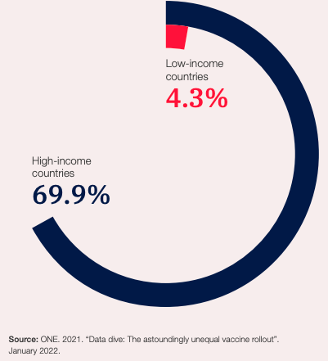
% of the Population Who Are Fully Vaccinated
Source: The Global Risks Report, 2022, p. 83.
https://www3.weforum.org/docs/WEF_The_Global_Risks_Report_2022.pdf
Notes:
The equity of access to Covid 19 vaccination is also a big issue.
More than two thirds of the population of high income countries have been fully vaccinated so far, whereas less than 5% of low income countries did so.

Slide 4
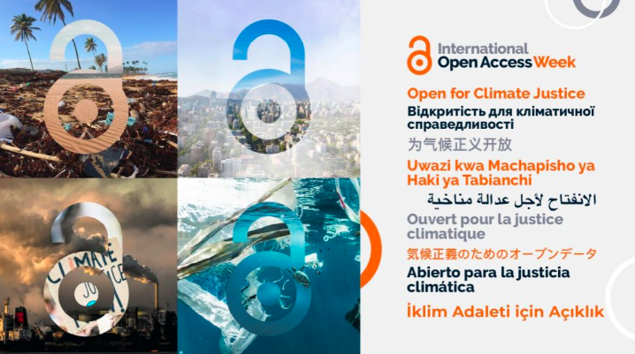
Open Access (OA) Week 2022:
Open for Climate Justice
. . .the impacts of the climate crisis are “not be[ing] borne equally or fairly, between rich and poor, women and men, and older and younger generations”
It affects “communities’ abilities to produce, disseminate, and use knowledge around the climate crisis”
“Openness can create pathways to more equitable knowledge sharing and serve as a means to address the inequities that shape the impacts of climate change and our response to them”
Source:https://ae2022.acikerisim.org/
Source: https://www.openaccessweek.org/theme/en
Notes:
Similarly, there is a rift of climate justice (or rather injustice) between rich and poor, women and men, and older and younger people.
Openness can help reduce this gap considerably.
Today I’m going to talk about how open access and open science can help tackle the grand challenges such as Covid 19 and climate crisis.
More specifically, I am going to talk about how open access speeded up the process of developing vaccine against Covid 19 pandemics and finding a cure to thereto.

Slide 5
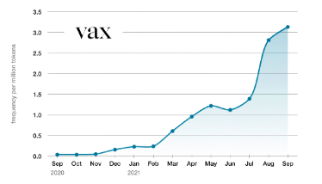
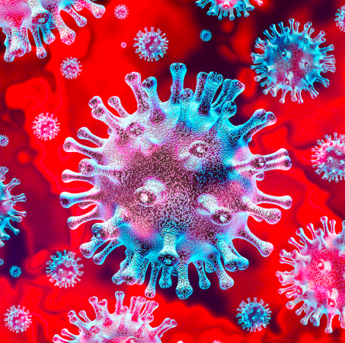
Word of the Year 2021: “vax”
Source: https://languages.oup.com/word-of-the-year/2021/
Source: Shutterstock
Notes:
The publisher Oxford University Press chose the word “vax” as the word of the year for 2021.
Because 2021 was an “unprecedented” year in that scientists all over the world worked hard to develop the Covid 19 vaccine.

Slide 6
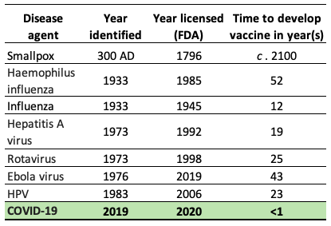
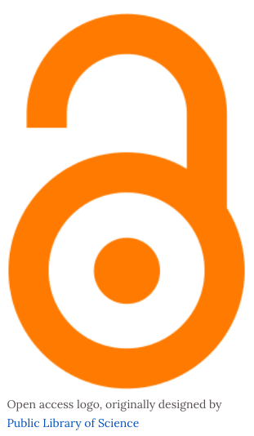
Time it Took to Develop Vaccines for Diseases
Source: Adapted from Table 1 in: Saleh, A. et al. (2021, July 26). Vaccine Development Throughout History.
Cureus, 13(7):e16635. doi: 10.7759/cureus.16635.
Source: https://www.wikiwand.com/en/Open_access
Notes:
What you see in this slide is the time it took to develop vaccines against various infectious diseases in the history.
2021 was an “unprecedented year” in that scientists developed vaccines (yes more than one vaccines!) for an infectious disease in less than a year for the first time in history.

Slide 7
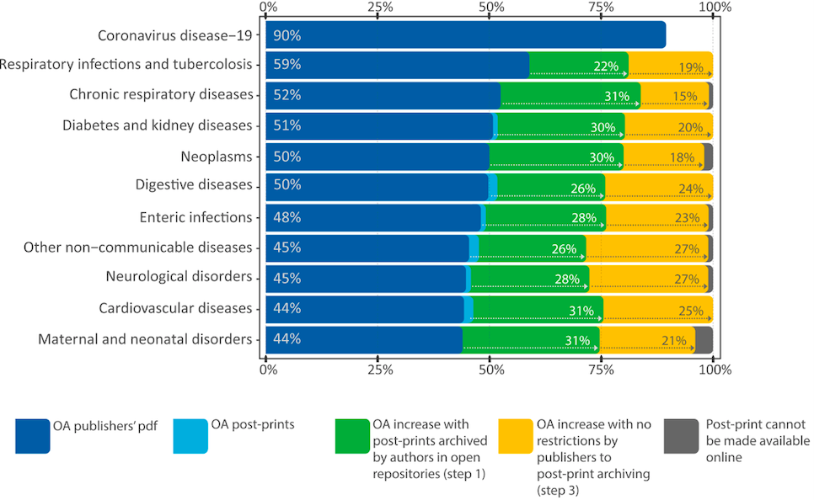
OA Rates for Papers on Covid 19 & Other Diseases
Source: Capocasa, M., et al. (2022). A light in the dark: open access to medical literature and the COVID-19 pandemic. Information Research, 27(2), paper 929. http://InformationR.net/ir/27-2/paper929.html
Notes:
What you see in this slide is the comparative Open Access rates for papers on Covid 19 and other diseases.
Thanks to publishers’ opening up their Covid 19 related papers and the data to the use of all scientists, it took less than a year to develop the Covid vaccine.
As the slide shows, over 90% of all Covid related papers were accessible.
This was unprecedented because open access rates for papers on other diseases were much lower, which prolonged the process of finding a cure to those diseases.
Immediate and full sharing of new scientific evidence could play a decisive role in contrasting outbreaks of infectious diseases (Centers for Disease Control and Prevention, 2003; King et al., 2012).
The case in point is the vaccine against the Ebola virus.
“…the Ebola virus outbreak in Liberia in 1982 remained hidden to some public health institutions because the paper reporting this information was published in a subscription-only journal (Knobloch et al., 1982)
A more timely dissemination of this study would likely have led to faster and more effective actions to reduce the scale of the epidemics that occurred later in 2014 (Smith et al., 2017).

Slide 8
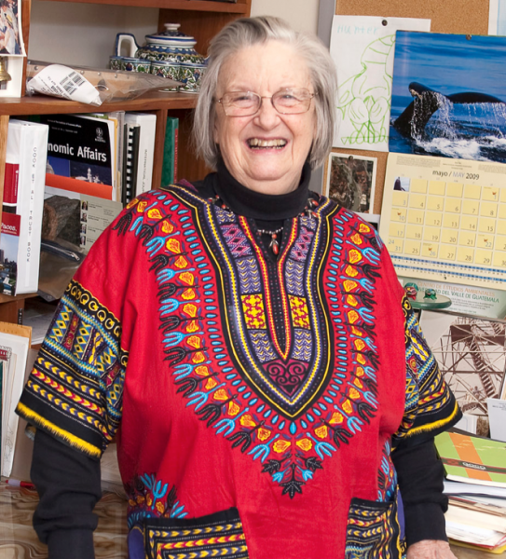
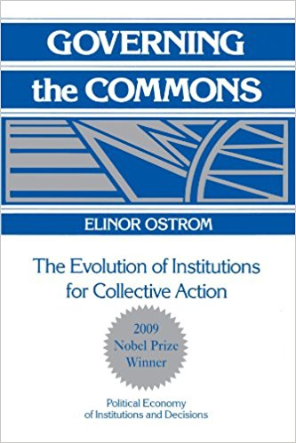
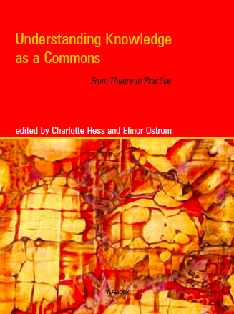
Elinor Ostrom (1933-2012)
Source: http://www.bollier.org/category/tags/commons-theory
Notes:
This brings us to the fact that scientific knowledge should be considered as a “commons”.
Elinor Ostrom, who was the first Nobel prize winning women economist, did pioneering work on how to manage the “commons”.
You see, up until Ostrom’s work, commons such as pastures, water resources, fishing rights, etc. can easily be exhausted because everybody wants to benefit most from common resources.
She showed that this was not the case and commons can be governed effectively as well.
She later wrote a book on knowledge as a commons.

Slide 9
Knowledge as a “Commons”
The amount and value of knowledge is not diminished when shared (non-subtractable, non-rivalrous)
Exluding a certain person or a group is difficult and costly (non-excludable)
Notes:
Ostrom defined knowledge as a commons according whether its value be diminished when used (subtractability) and whether its use can be restricted to a certain person or a group (excludability).
For example, my benefiting from useful knowledge (i.e. learning Kazakh language) will not diminish the value of somebody else’s learning Kazakh language.

Slide 10
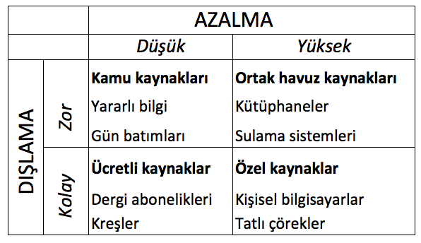
Types of Resources
SUBTRACTABILITY
Low
High
Commons
Common-pool resources
Difficult
Useful knowledge
Irrigation systems
EXCLUDABILITY
Paid resources
Private resources
Easy
Licensed journals
Personal computers
Source: Adapted from: Hess ve Ostrom, 2007, p. 9
Notes:
Ostrom classified resources based on these two axes, as seen here.
For instance, foreign language learning is low on subtractability and difficult to exclude other from learning foreign languages.
Contrary to physical resources, my using a digital resource will not diminish its value for others.
Yet, it is easy to exclude others because of the licensing mechanisms that are in place today.
Which must be changed, if we wish to accelerate the process of finding vaccines against infectious diseases or find solutions to grand challenges such as climate crisis.

Slide 11
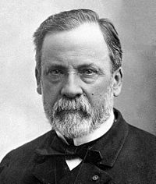

Louis Pasteur (1822-1895)
“Science knows no bounds,
because knowledge belongs to humanity, and it is the torch that illuminates the world.”
Notes:
Louis Pasteur was the first to acknowledge the crucial importance of knowledge as being a “commons”, although he didn’t use the word “commons”, that is open to everyone:
He said:

Slide 12
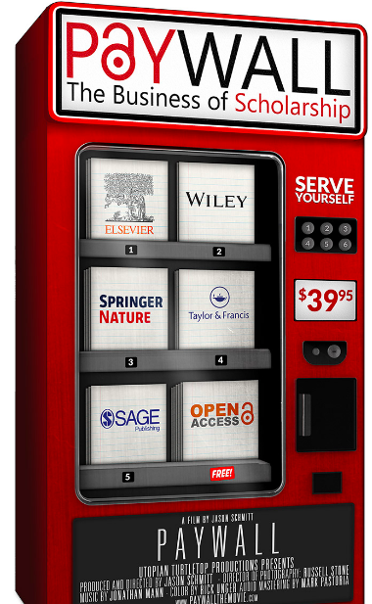
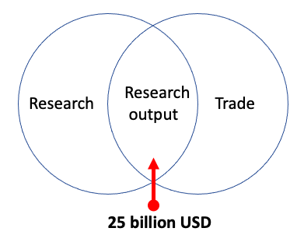
Relationship between Science and Trade
paywallthemovie.com
Source: Adapted from: Regazzi, J.J. (2015). Scholarly communications:
A history from content as king to content as kingmaker. Rowman & Littlefield. p. 1
Notes:
The reason why science is not open to everyone is because scientific output such as papers, data, etc. became a lucrative industry especially within the last 30 years.
Scientific publishers make more than 25 billion of dollars annually off of scientific papers, which they neither funded, nor paid for the salaries of researchers who carry out research or for the quality usually done by the very same researchers free of charge.
Yet, they put these publications behind the paywalls or impose embargoes, which prevent the very same researchers from accessing them.
This slows down the whole scientific process.
If you are further interested in this topic, pls take a look at the documentary film called “Paywall: The Business of Scholarship”, readily available at paywallthemovie.com

Slide 13
Relationship between Science and Property
Intellectual property rights (IPR) cause a decrease of 30% in scientific research and product development
Curtails the knowledge use and innovation creation
Traditional IPRs based on copying hinder the use of digital information
How should IPR work for digital commons (scientific knowledge and inventions) that can be shared with others without diminishing their value and are not restricted to use of a particular group?
Source: Williams, H.L. (2013). Intellectual Property Rights and Innovation: Evidence from the Human Genome. Journal of Political Economy, 121(1): 1-27;
Brown, C. (2009). Ayresian technology, Schumpeterian innovation, and the Bayh-Dole Act. Journal of Economic Issues, 43(2): 477-486; Pearce, J.M. (2013). Open-source nanotechnology: Solutions to a modern intellectual property tragedy. Nano Today, 8(4): 339-341.
Notes:
Several studies showed that the existing intellectual property rights are detrimental to the process of scientific developments and innovations.

Slide 14
Vicious Circle
Affordability crisis
Functionality crisis
Replication crisis
Source: Brembs, B. et al. (2022). Replacing academic journals. https://zenodo.org/record/5793611
Notes:
Due, in large part, to existing intellectual property rights, we are in what is called a vicious circle.
Many scientists and institutions cannot afford to provide all the scientific resources because of their high licensing costs.
This is called affordability crisis.
Publishing industry is also slow to incorporate digital developments.
For instance, the publishing process can be speeded up by opening up the reviewing process (eg, open reviewing or post-print reviewing), data and re-use.
This is called functionality crisis.
Moreover, paywalled access also created what is called a replication crisis, as it is diffcult to replicate the findings when the publications, data, and methods are not open to everyone.

Slide 15
OA thru Transformative Agreements vs OA Archives
TAs (Licensed access to journals + OA publishing):
  “shift costs from authors to institutions”
  provide additional revenues to publishers
OA Archives (aka “Green Road”)
  “does not risk increasing the costs that should be paid by institutions to publishers”
  “does not suffer from the uncertainties and latency of negotiation processes”
  “poses no equity problem, whereas transformative agreements can be more or less advantageous, depending on the negotiating strength of institutions or their consortia with the publishers”
Source: Capocasa, M., et al. (2022). A light in the dark: open access to medical literature and the COVID-19 pandemic. Information Research, 27(2), paper 929. http://InformationR.net/ir/27-2/paper929.html; Butler, L-A. et al. (2022). The Oligopoly's Shift to Open Access. How For-Profit Publishers Benefit from Article Processing Charges (Version v1). Zenodo. https://doi.org/10.5281/zenodo.7057144
Notes:
“Recently, an intense debate has arisen about the feasibility of increasing access to scientific literature through transformative agreements;
contracts negotiated between publishers and institutions that combine subscription access to journals with the possibility of open access publishing,
shifting costs from authors to institutions (Borrego et al., 2021; Farley et al., 2021).”
“It is worth noting that the green road has three fundamental advantages over the transformative agreements:
firstly, it does not risk increasing the costs that should be paid by institutions to publishers, which is a concern for countries with limited financial research support (European Research Council, 2020);
secondly, it does not suffer from the uncertainties and latency of negotiation processes;
thirdly, the green road poses no equity problem, whereas transformative agreements can be more or less advantageous, depending on the negotiating strength of institutions or their consortia with the publishers.”

Slide 16
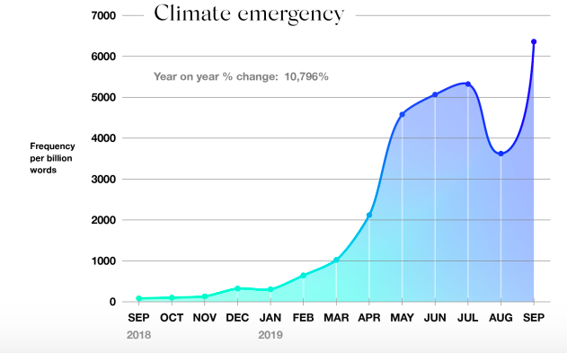
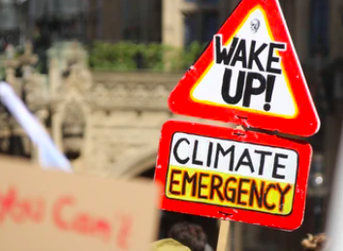
Word of the Year 2019: “climate emergency”
Source: https://languages.oup.com/word-of-the-year/2019/
Source: Shutterstock
Notes:
Getting back to the role of open access helping tackle grand challenges: in 2019, two years before “vax” was selected as the word of the year by the OUP, the word of the year was “climate emergency”.

Slide 17
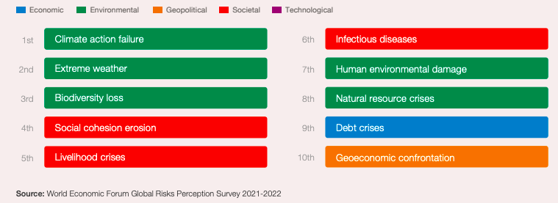
“Identify the most severe risks on a global scale over the next 10 years”
Source: The Global Risks Report, 2022, p. 14. https://www3.weforum.org/docs/WEF_The_Global_Risks_Report_2022.pdf
Notes:
According to World Economic Forum’s Global Risks Report of 2022, people identify the climate related issues and biodiversity loss due to climate crisis are seen the most severe risks over the next 10 years.
In fact, they see the climate crisis as the most severe risk in the next 0 to 2 years, and 2 to 5 years as well.
Yet, we did almost nothing within the last three years to confront the climate emergency problem.
Climate emergency is one of the “wicked problems”.
Wicked problems are those challenges that are complex to define, let alone to solve.
I am aware of the economic and political pressures regarding reducing temperatures.
I am aware of the “right” to pollute air and its trading over the years, ie, less polluting countries selling their polluting rights to more polluting ones.
But, despite the existing inequities getting access to the vaccine, if we were able to find a vaccine against Covid 19 virus in less than a year,
we can also take immediate measures against the looming climate crisis.

Slide 18

The Way Forward: Open Science
Scientific papers
Data
Methods
Open Access
Open Data
Open Source Software
Source: Open Science by Design, 2018, p. 24
Notes:
I think one of the things we can do relatively easily is to embrace the need for radical change.
We can embrace open science consisting of open access, open data, open source software, open infrastructure, open reviewing, open licensing etc.
before it is too late.
Açık bilimi kabaca araştırma sonunda yayımlanan çıktılara (kitap, makale vs.), araştırma sırasında toplanan verilere ve bu verileri işlemek, analiz etmek için kullanılan yönetmlere, bilgisayar programlarına vs. herkesin erişebilmesi, bunlardan yararlanabilmesi ve bu bilgileri/verileri vs. yeniden kullanabilmesi anlamına gelmektedir.
Günümüzde açık bilimle ilgili tartışma bilimsel yayınlar üzerinde yoğunlaşmakta. (Diğer ikisine daha sonra döneceğiz)

Slide 19
Open Access:
The Key Driver To Address Grand Challenges
Ашық қолжетімділік: үлкен мәселелерді шешуге арналған негізгі драйвер
Hacettepe University
Department of Information Management
Yaşar Tonta
Hacettepe University Department of Information Management
https://yunus.hacettepe.edu.tr/~tonta/
yasartonta@gmail.com
@yasartonta
11th Eurasian Academic Libraries Conference, October 27-28, 2022, Nazarbayev University, Kazakhstan
Notes:
Thank you for your attention.
НАЗАРЫҢЫЗҒА РАҚМЕТ.

