Slide 1

Small-Signal Modelling of GaN HEMT using ANN, SVR, GPR and Tree-Based Supervised Models
Abishkozha Amangeldin, MSc Student
School of Engineering and Digital Sciences
Electrical and Computer Engineering
Nazarbayev University
April 26, 2022

Slide 2
Outline
Introduction
GaN HEMT
Objectives
Model Development
Preprocessing
Artificial Neural Network
Support Vector Regression
Gaussian Process Regression
Decision Trees
Random Forest
ADA Boost
Hyperparameter Optimization
Loss function
Results
Discussions
Conclusion

Slide 3
GaN HEMT
High electron saturation velocity
Electron mobility
Breakdown voltage
Operating temperature

Slide 4
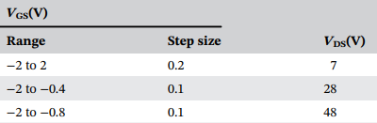
 | Range | Step size
T(ºC) | 25-175 | 25
F(GHz) | 0.1-26 | 0.06475

Slide 5
Objectives
To explore ML algorithms for the development of Small-signal modelling
To develop ANN, SVR, GPR, DT, RFs and Boosting based models
To develop ANN models based on Keras, Scikit-learn and PyTorch libraries
To find the optimal architecture of all the developed models
To compare the models based on MSE, MAE, R² and simulation curves
Finally, elucidate and discuss the overall comparison

Slide 6
Preprocessing
Splitting the dataset into training and testing sets
Checking for missing data
Feature scaling

Slide 7
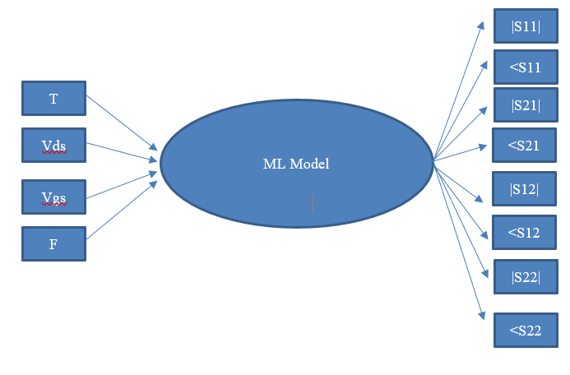
Proposed architecture of the models

Slide 8

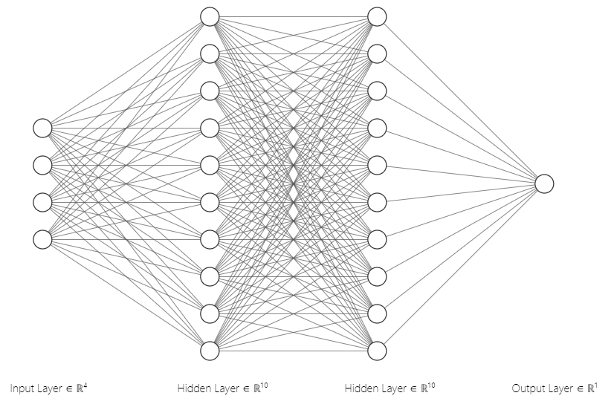
Artificial Neural Network

Slide 9
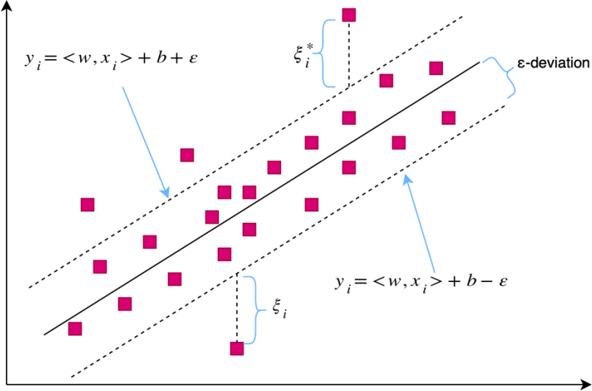
Support Vector Regression

Slide 10
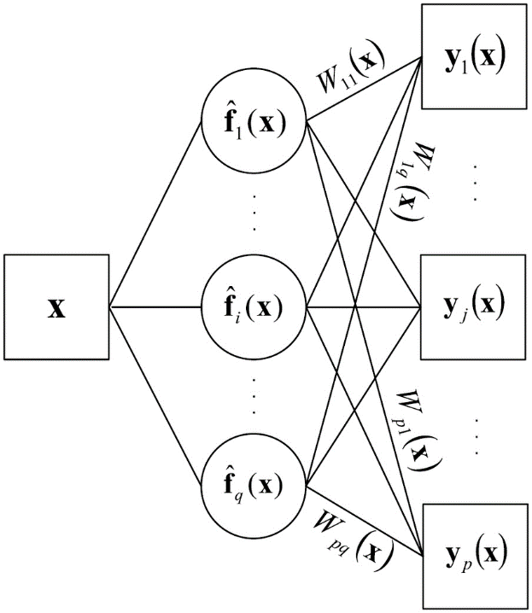
Gaussian Process Regression

Slide 11
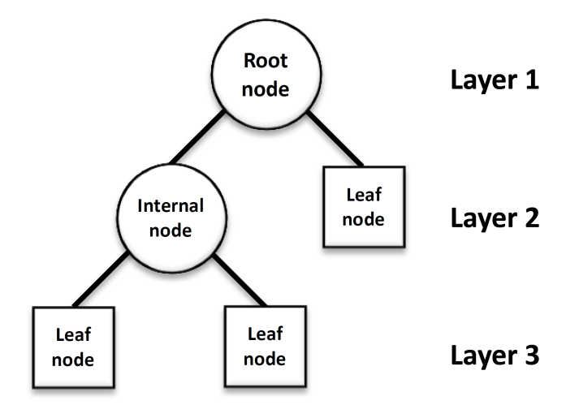
Decision Trees

Slide 12
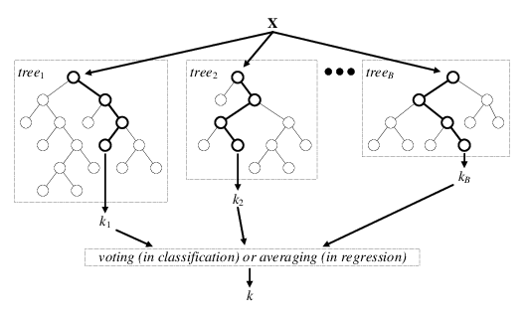
Random Forest

Slide 13
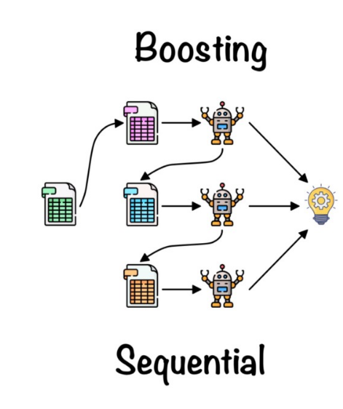
ADA Boost

Slide 14
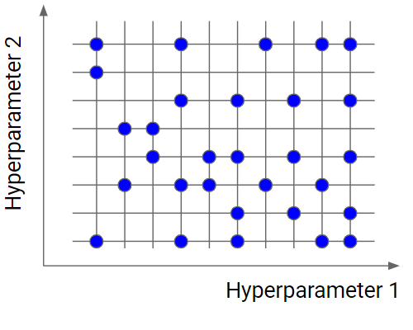
Hyperparameter Optimization

Slide 15
Loss function
MAE
MSE
R²

Slide 16
Keras ANN Model Error Estimators, Testing set
Testing | MSE | MAE | R²
ReS11 | 2.6516e-05 | 0.0029 | 0.9978
ImS11 | 6.9419e-03 | 0.0041 | 0.9968
ReS21 | 1.6516e-04 | 0.0051 | 0.9945
ImS21 | 9.1848e-04 | 0.0046 | 0.9936
ReS12 | 2.6785e-05 | 0.0030 | 0.9978
ImS12 | 5.0125e-06 | 0.0031 | 0.9942
ReS22 | 9.5171e-05 | 0.0041 | 0.9971
ImS22 | 4.5291e-05 | 0.0045 | 0.9950

Slide 17
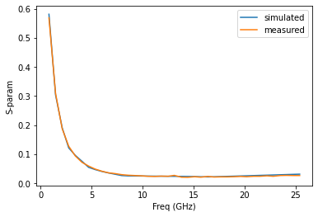
ReS11 parameter

Slide 18
Scikit-learn ANN Model Error Estimators, Testing set
Testing | MSE | MAE | R²
ReS11 | 4.8561e-03 | 0.0549 | 0.9918
ImS11 | 7.5614e-03 | 0.0167 | 0.9904
ReS21 | 3.8752e-02 | 0.0579 | 0.9913
ImS21 | 5.6846e-03 | 0.1358 | 0.9805
ReS12 | 4.6487e-03 | 0.0456 | 0.9935
ImS12 | 5.9845e-02 | 0.0845 | 0.9714
ReS22 | 2.3516e-03 | 0.0641 | 0.9945
ImS22 | 9.1965e-02 | 0.1469 | 0.9913

Slide 19
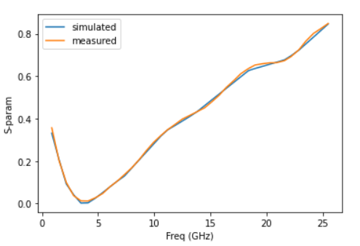
ImS22 parameter

Slide 20
PyTorch ANN Model Error Estimators, Testing set
Testing | MSE | MAE | R²
ReS11 | 6.6841e-03 | 0.0629 | 0.9918
ImS11 | 7.6324e-03 | 0.0746 | 0.9904
ReS21 | 3.8496e-02 | 0.0483 | 0.9913
ImS21 | 4.8217e-03 | 0.0496 | 0.9805
ReS12 | 5.6324e-03 | 0.0145 | 0.9935
ImS12 | 7.4485e-02 | 0.0674 | 0.9714
ReS22 | 8.7436e-03 | 0.0465 | 0.9945
ImS22 | 6.0080e-02 | 0.0784 | 0.9913

Slide 21
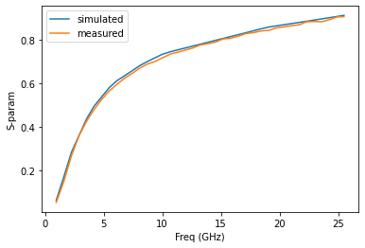
ImS11 parameter

Slide 22
SVR Model Error Estimators, Testing set
Testing | MSE | MAE | R²
ReS11 | 0.0023 | 0.0015 | 0.9907
ImS11 | 0.0168 | 0.0110 | 0.9157
ReS21 | 0.0054 | 0.0026 | 0.9548
ImS21 | 0.0067 | 0.0031 | 0.9059
ReS12 | 0.0130 | 0.0085 | 0.9261
ImS12 | 0.0128 | 0.0080 | 0.9345
ReS22 | 0.0130 | 0.0199 | 0.9790
ImS22 | 0.0258 | 0.0205 | 0.9782

Slide 23
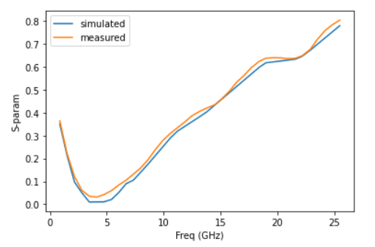
ReS22 parameter

Slide 24
GPR Model Error Estimators, Testing set
Testing | MSE | MAE | R²
ReS11 | 0.0142 | 0.0475 | 0.9867
ImS11 | 0.0156 | 0.0674 | 0.9841
ReS21 | 0.0247 | 0.0504 | 0.9852
ImS21 | 0.0263 | 0.0582 | 0.9782
ReS12 | 0.0337 | 0.0699 | 0.9701
ImS12 | 0.0316 | 0.0961 | 0.9718
ReS22 | 0.0094 | 0.0518 | 0.9910
ImS22 | 0.0157 | 0.0989 | 0.9807

Slide 25
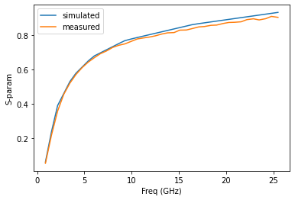
ReS21 parameter

Slide 26
DT Model Error Estimators, Testing set
Testing set | MSE | MAE | R²
ReS11 | 0.0071 | 0.0284 | 0.9924
ImS11 | 0.0090 | 0.0501 | 0.9909
ReS21 | 0.0635 | 0.0572 | 0.9259
ImS21 | 0.0319 | 0.0498 | 0.9634
ReS12 | 0.0397 | 0.0912 | 0.9547
ImS12 | 0.0314 | 0.0954 | 0.9642
ReS22 | 0.0191 | 0.0668 | 0.9777
ImS22 | 0.0036 | 0.0385 | 0.9923

Slide 27
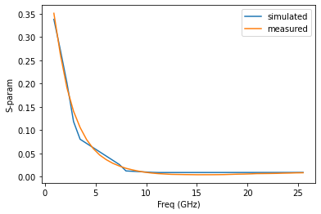
ImS21 parameter

Slide 28
RF Model Error Estimators, Testing set
Testing | MSE | MAE | R²
ReS11 | 0.0102 | 0.0338 | 0.9892
ImS11 | 0.0106 | 0.0531 | 0.9891
ReS21 | 0.0457 | 0.0417 | 0.9459
ImS21 | 0.0199 | 0.0414 | 0.9718
ReS12 | 0.0179 | 0.0593 | 0.9940
ImS12 | 0.0098 | 0.0503 | 0.9903
ReS22 | 0.0082 | 0.0413 | 0.9910
ImS22 | 0.0045 | 0.0384 | 0.9948

Slide 29
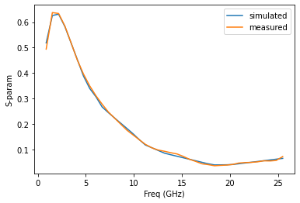
ReS12 parameter

Slide 30
Boosting Model Error Estimators, Testing set
Testing | MSE | MAE | R²
ReS11 | 0.0193 | 0.0063 | 0.9823
ImS11 | 0.0084 | 0.0155 | 0.9887
ReS21 | 0.0062 | 0.0078 | 0.9546
ImS21 | 0.0194 | 0.0044 | 0.9936
ReS12 | 0.0153 | 0.0055 | 0.9945
ImS12 | 0.0087 | 0.0063 | 0.9932
ReS22 | 0.0089 | 0.0074 | 0.9912
ImS22 | 0.0184 | 0.0181 | 0.9952

Slide 31
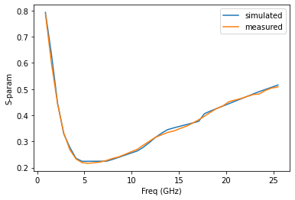
ImS12 parameter

Slide 32
ANN Models MSE, Testing set
Testing | Keras | Scikit-Learn | PyTorch
ReS11 | 2.6516e-05 | 4.8561e-03 | 6.6841e-03
ImS11 | 6.9419e-03 | 7.5614e-03 | 7.6324e-03
ReS12 | 1.6516e-04 | 3.8752e-02 | 3.8496e-02
ImS12 | 9.1848e-04 | 5.6846e-03 | 4.8217e-03
ReS21 | 5.5785e-05 | 4.6487e-03 | 5.6324e-03
ImS21 | 5.0125e-06 | 5.9845e-02 | 7.4485e-02
ReS22 | 9.5171e-05 | 2.3516e-03 | 8.7436e-03
ImS22 | 4.5291e-05 | 9.1965e-02 | 6.0081e-02

Slide 33
Time comparison
 | DT | Ada boost | RF | PyTorch ANN | Scikit-Learn ANN | Keras ANN | SVR | GPR
Training Time (min) | 0.2 | 1 | 2.96 | 4 | 7 | 16 | 34 | 72

Slide 34
Models R2, Testing set
Testing | ANN | SVR | DT | RF | Boosting | GPR
ReS11 | 0.9978 | 0.9907 | 0.9924 | 0.9892 | 0.9823 | 0.9867
ImS11 | 0.9968 | 0.9157 | 0.9909 | 0.9891 | 0.9887 | 0.9841
ReS12 | 0.9945 | 0.9548 | 0.9259 | 0.9459 | 0.9546 | 0.9852
ImS12 | 0.9936 | 0.9059 | 0.9634 | 0.9718 | 0.9936 | 0.9782
ReS21 | 0.9978 | 0.9261 | 0.9547 | 0.9800 | 0.9945 | 0.9701
ImS21 | 0.9942 | 0.9345 | 0.9642 | 0.9903 | 0.9932 | 0.9718
ReS22 | 0.9971 | 0.9790 | 0.9777 | 0.9910 | 0.9912 | 0.9910
ImS22 | 0.9950 | 0.9782 | 0.9923 | 0.9948 | 0.9952 | 0.9807

Slide 35
Conclusions
We observed that all the tested models have been able to predict well over a wide range of frequency
The DT model is the fastest, followed by the Boosting, RF, PyTorch ANN, Scikit-Learn ANN, Keras ANN, SVR, and GPR models.
Keras's ANN model was shown to be the most efficient.
The proposed models can be integrated into CAD software for analysis and simulation.

Slide 36
Future Works
Explore different libraries for other ML models
Combination of ML models

Slide 37
Bibliography
F. Zeng et al., “A Comprehensive Review of Recent Progress on GaN High Electron Mobility Transistors: Devices, Fabrication and Reliability,” Electronics, vol. 7, no. 12, p. 377, Dec. 2018.
C. Carpineto, Concept Data Analysis: Theory and Applications, 1st ed. Wiley, 2004.
A. Verikas, E. Vaiciukynas, A. Gelzinis, J. Parker and M. Olsson, "Electromyographic Patterns during Golf Swing: Activation Sequence Profiling and Prediction of Shot Effectiveness", Sensors, vol. 16, no. 4, p. 592, 2016.

