Slide 1


MCH “Gemini”
Architectural Form Follows
for the Climate.
Charles Correa

Slide 2

5 external factors :
Air
Water
Earth
Sun
Greenery

Slide 3
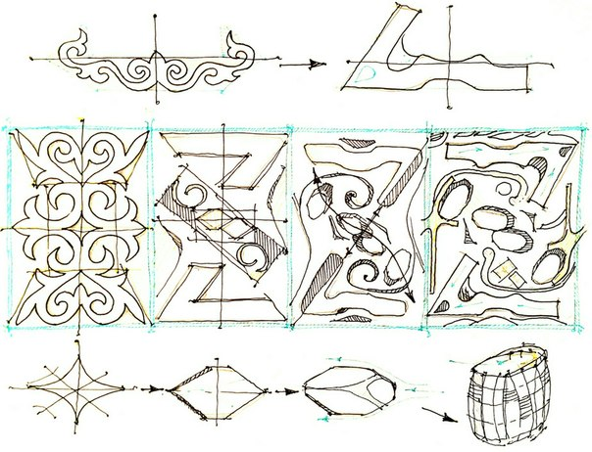
Conception
Kazakh native ornament as a source for site plan idea
Building form a silhouette that creates an imitation of complicated terrain
Different floor levels (East architecture principles)
Climate wall

Slide 4
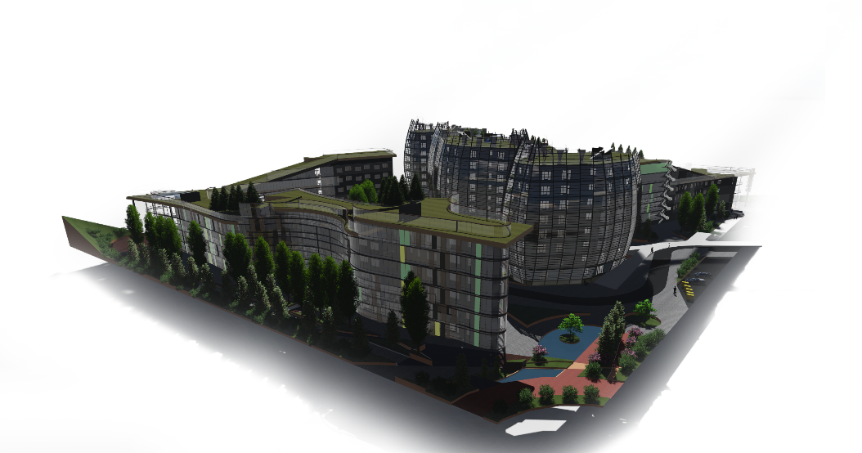
Wind protection
Supporting walls with compound configuration
Green wind protecting lanes with strong winds path correction
Landscape channels, walls
Special streamlined building configuration

Slide 5
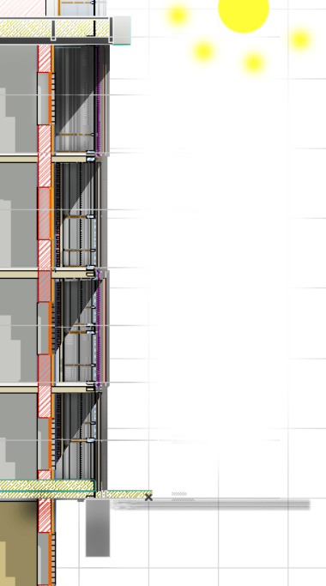
Thermal insulation
Climate wall (A spaces between it and living area works like a vestibule)
Streamlined form
Full absence of cold bridges
Isover materials

Slide 6
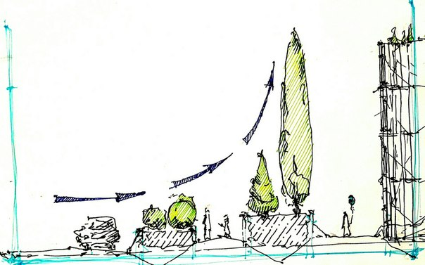
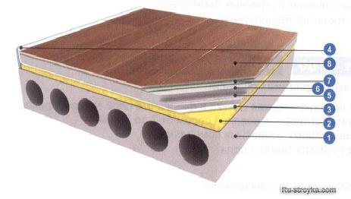
Soundproofing
Triple glazing
Climate wall
Floating floors
Green plantings as a noise reflector
wind
noise

Slide 7
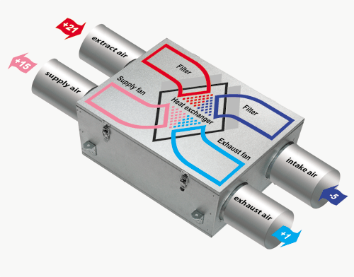
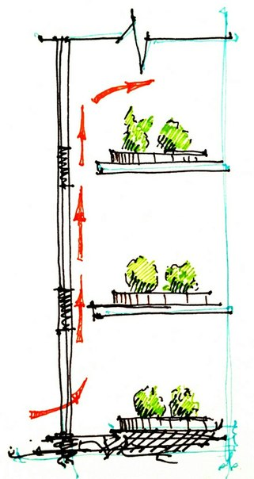
Air quality
Recuperation
Air updrafts as natural ventilation

Slide 8
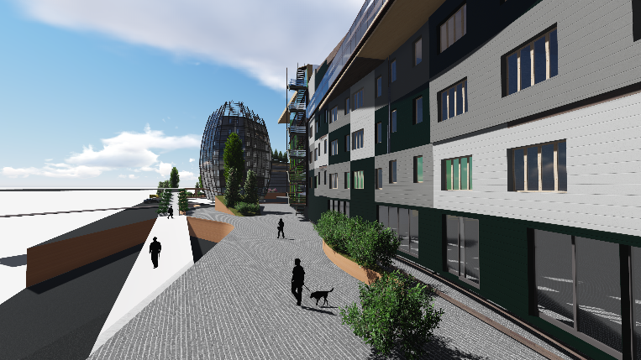
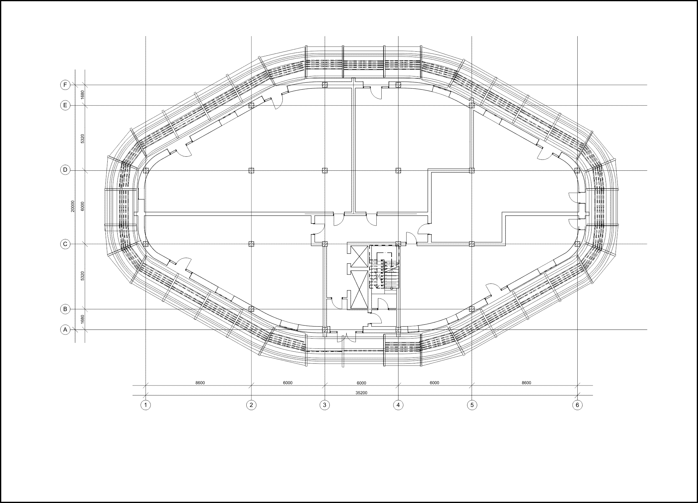
Fire protection
Exterior fire ladders
Interior ladders with fire protection spaces

Slide 9
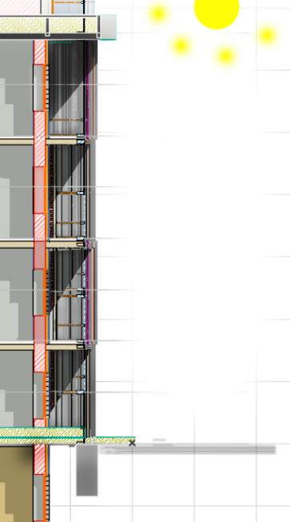
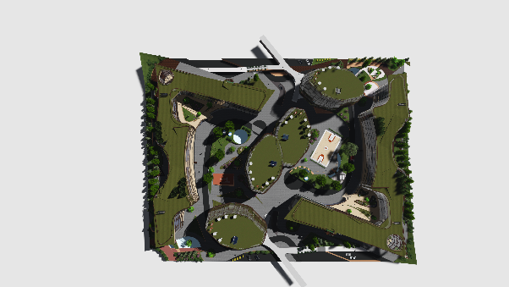
Insolation
N
Placement of the building to the cardinal
Enough number of window glazing
Heat protection (visors)

Slide 10
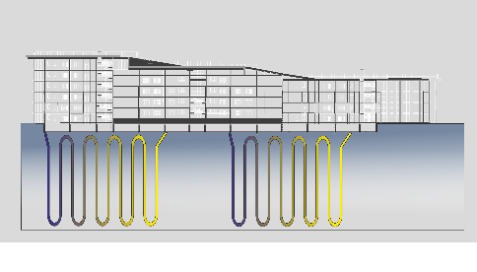
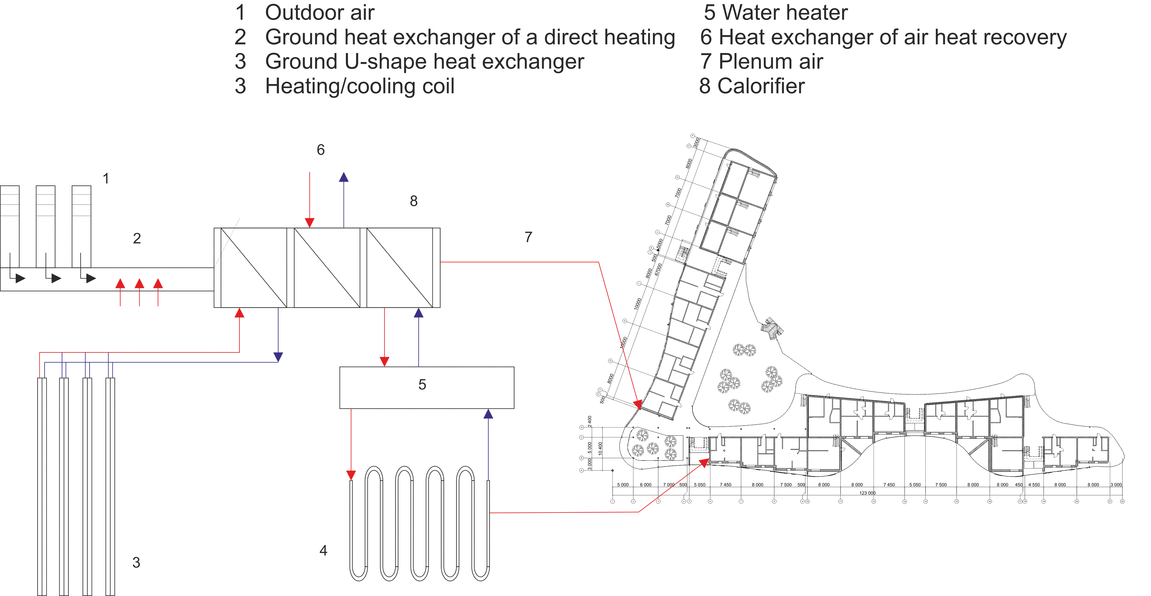
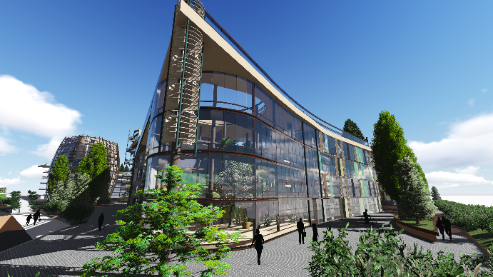
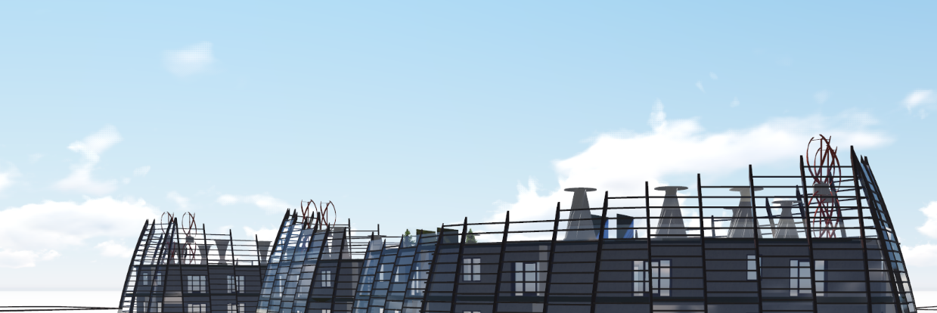
Alternative energy sources
Geothermal energy
Vertical windmills on the roof and built in construction windmills

Slide 11
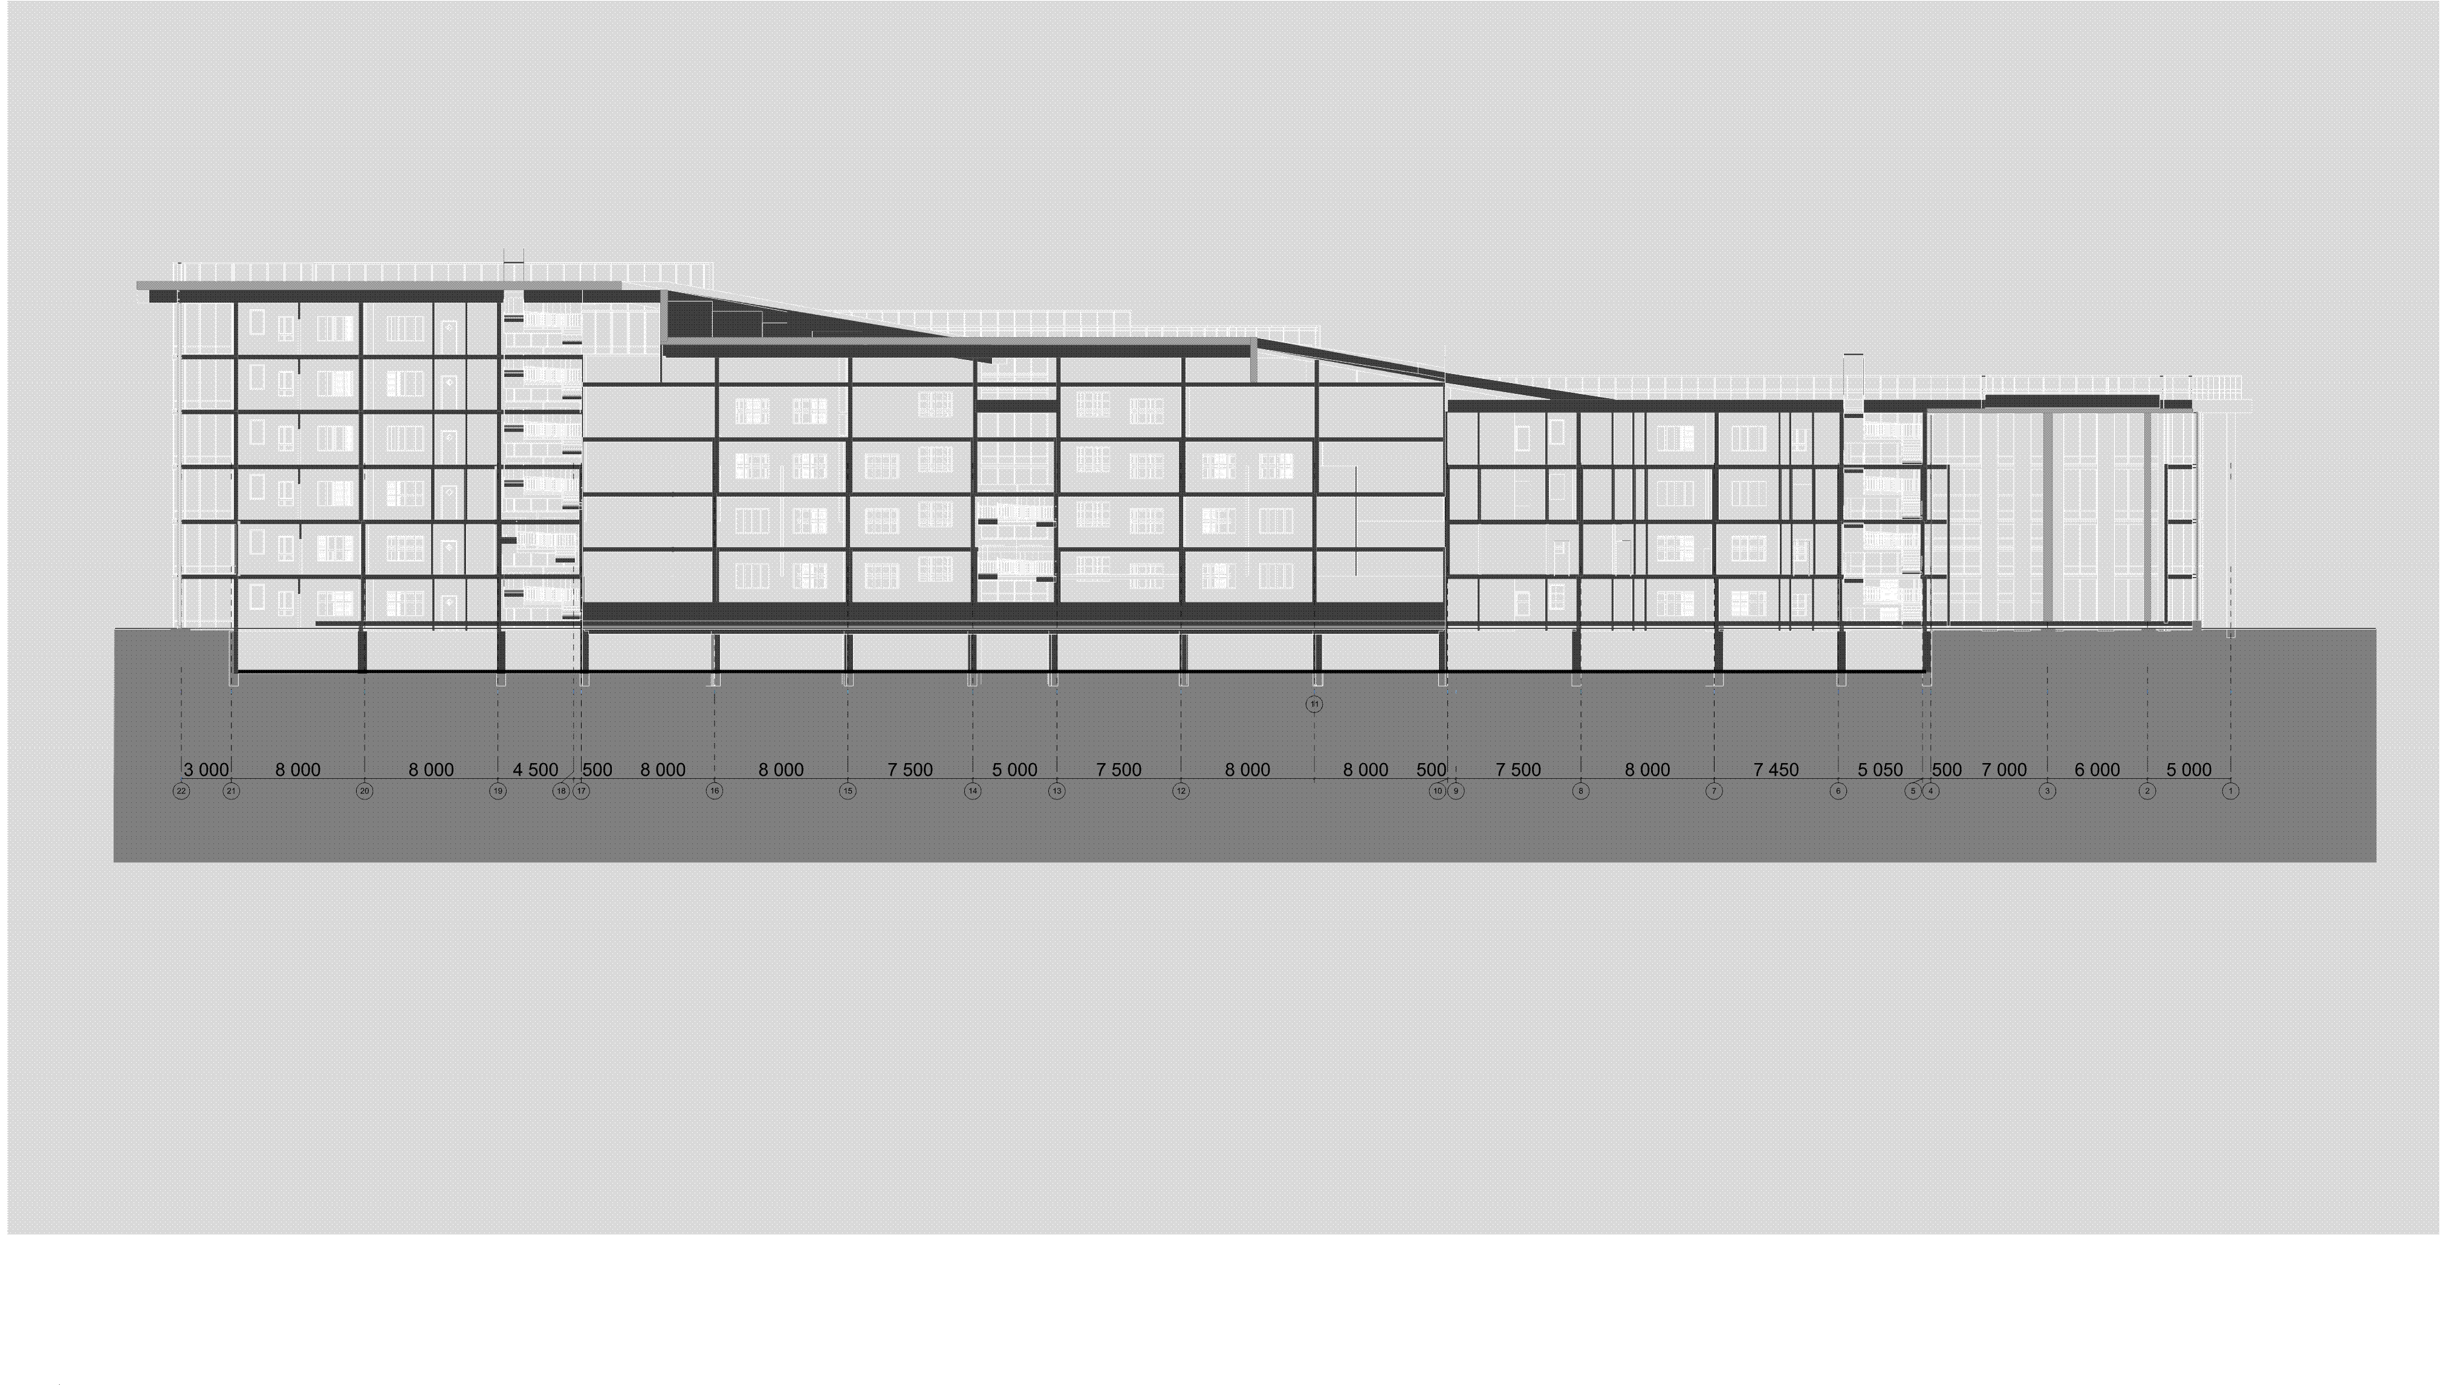
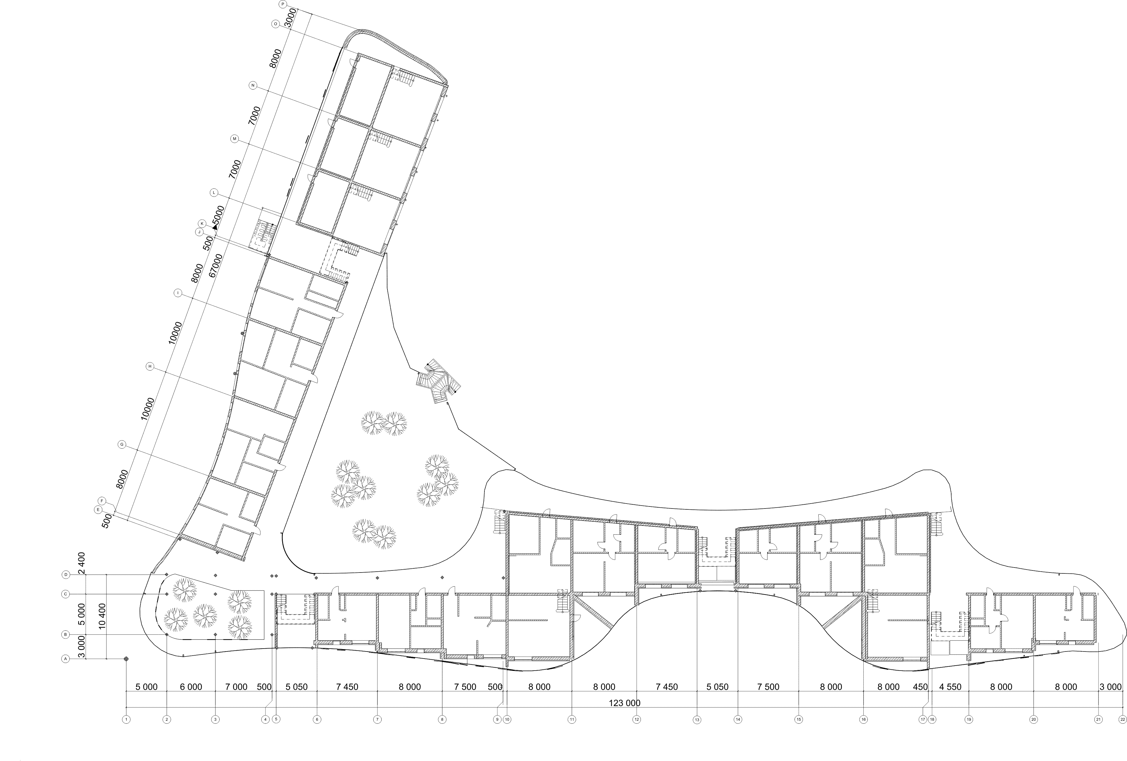
Gallery house

Slide 12
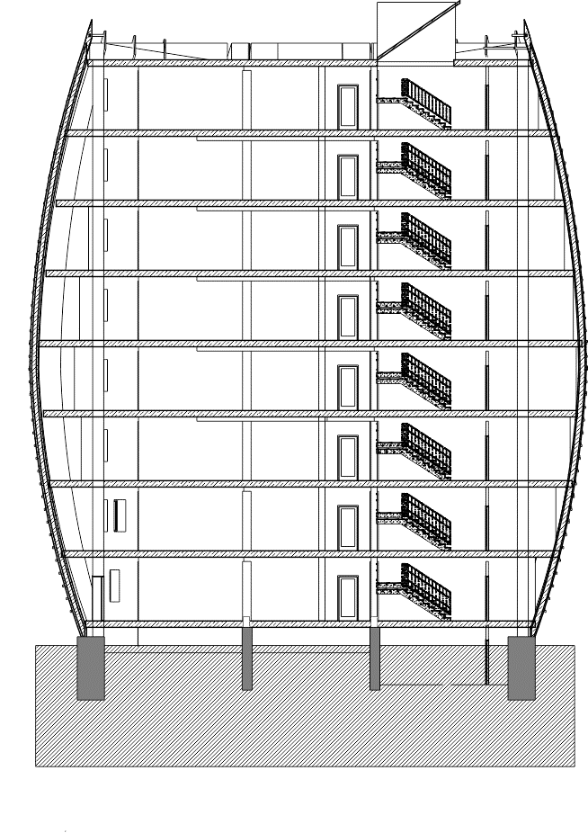
Section house

Slide 13
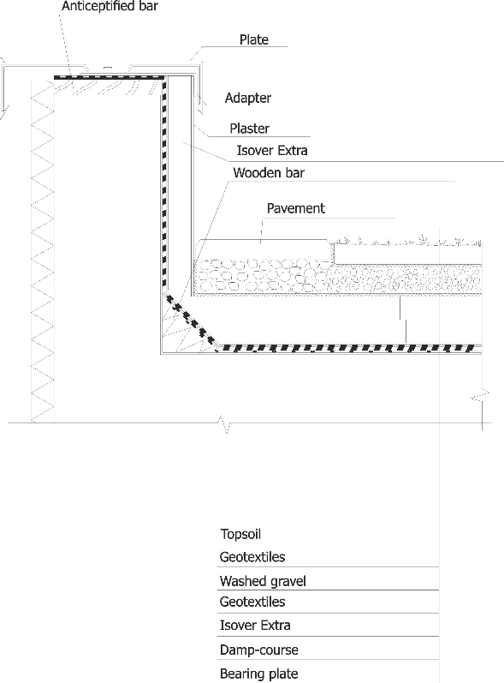
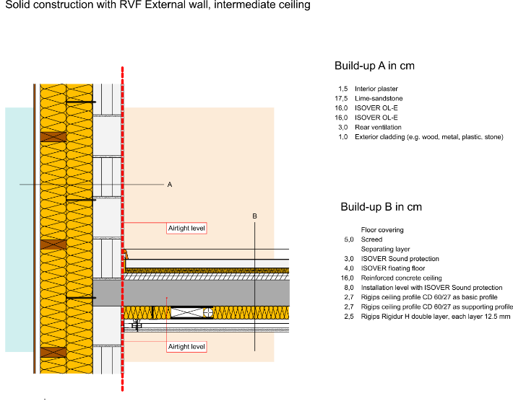
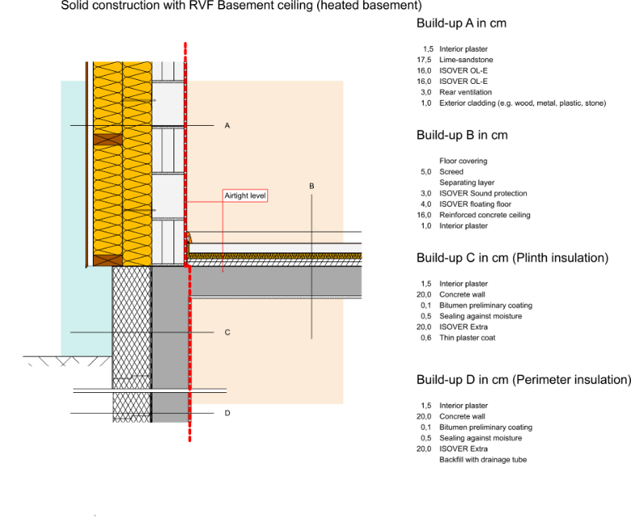
Materials used
Isover OL-E (walls against air)
Isover Extra (walls against ground, roof)
Isover floating floors
Isover noise reduction
Isover vario (bathroom ceiling)

Slide 14
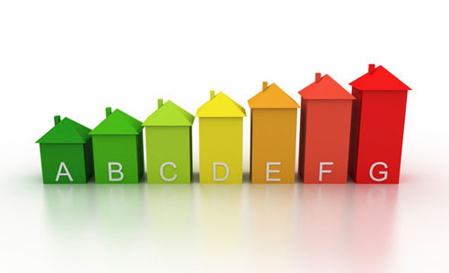
Results
Gallery house Section house
15.01 kWh/(m2a)
10.85 kWh/(m2a)

Slide 15
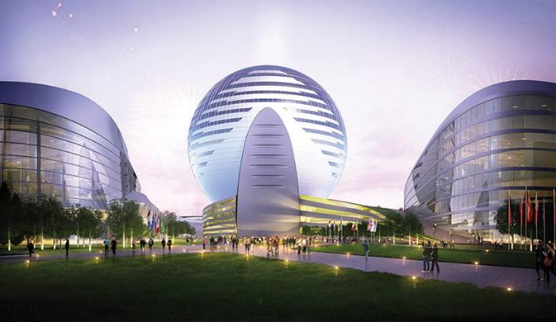
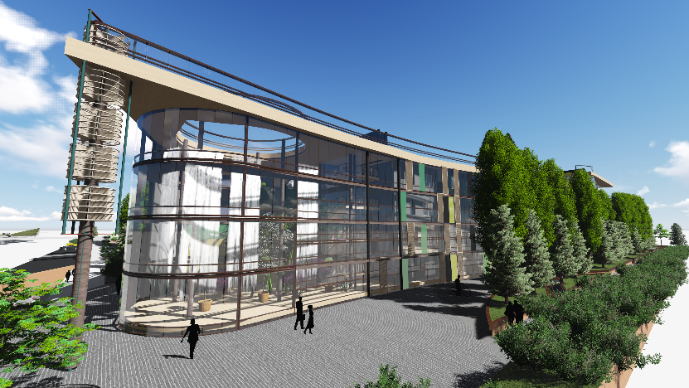
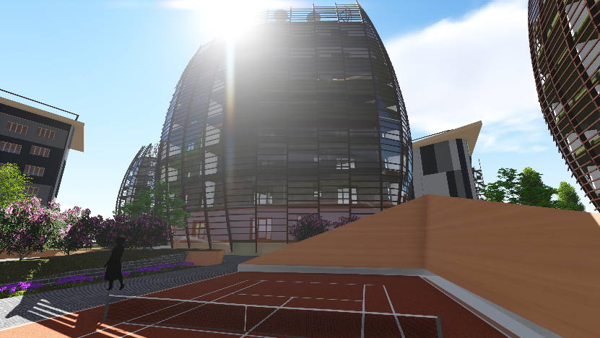
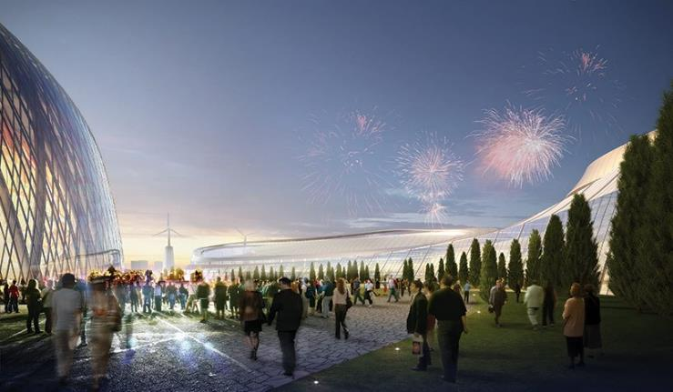
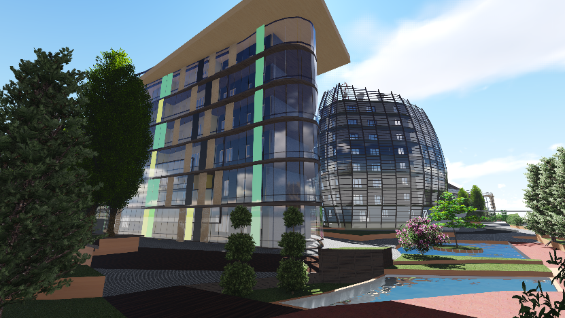
Expo 2017 – «Gemini»

Slide 16
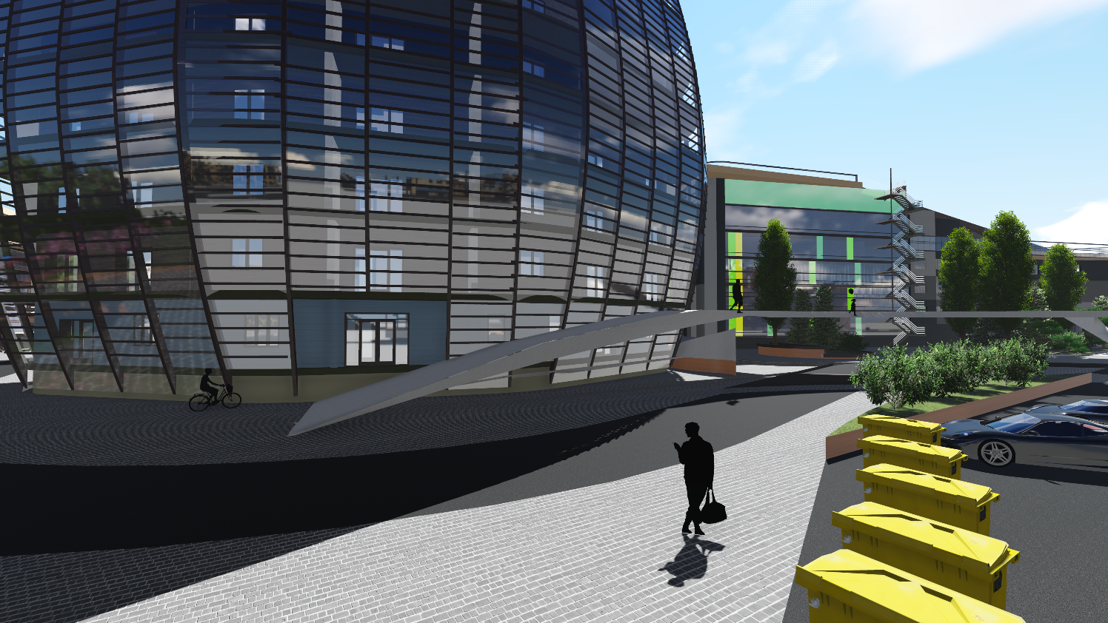

Slide 17
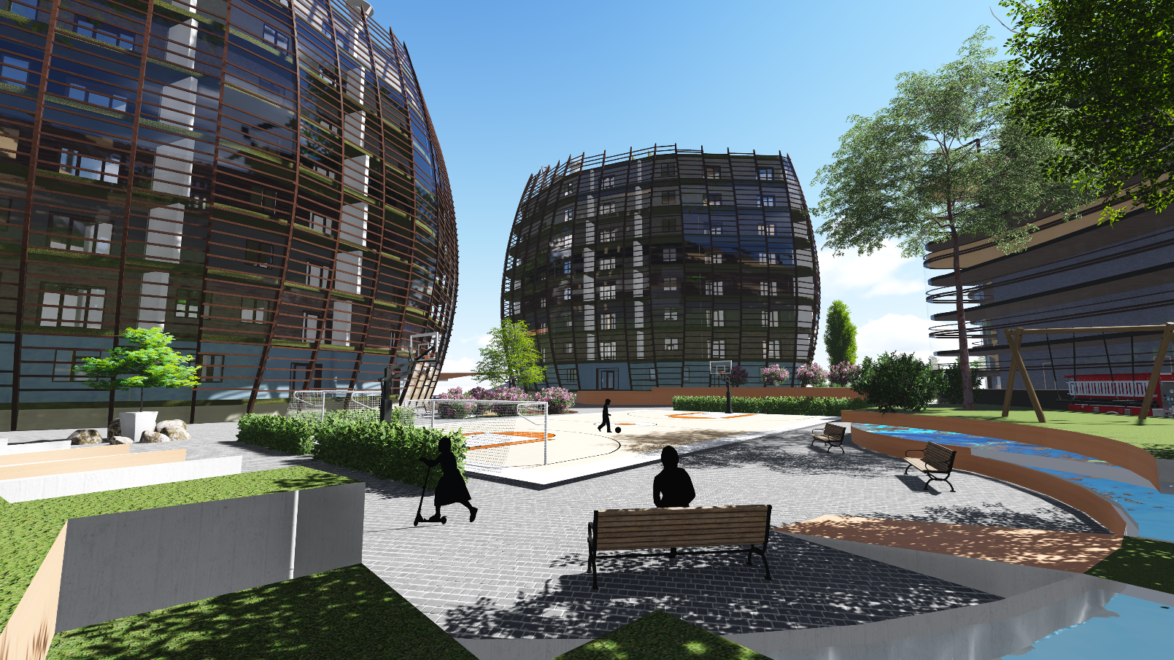

Slide 18
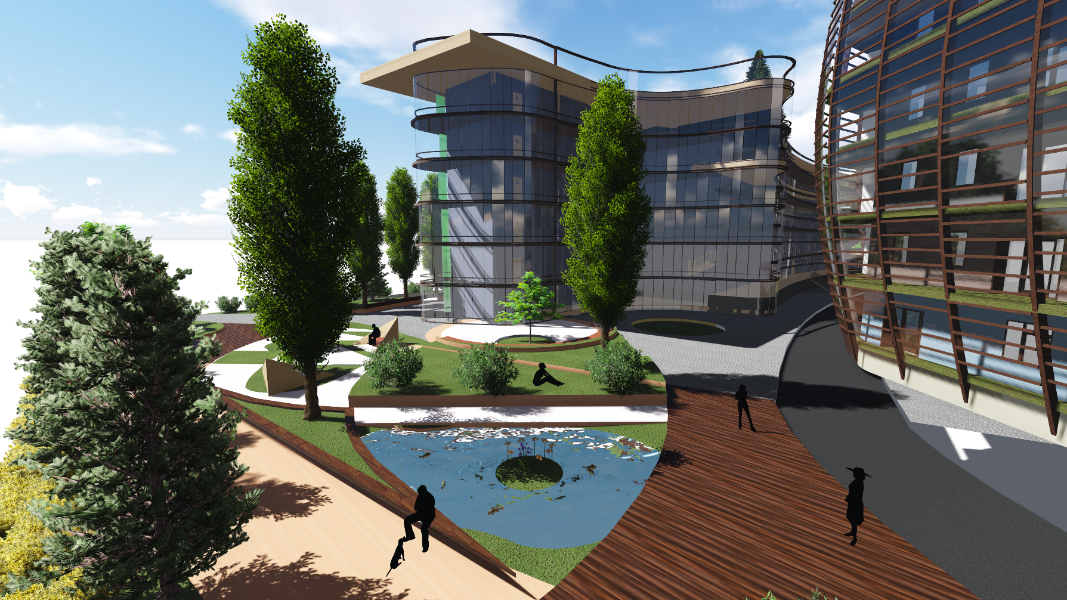

Slide 19
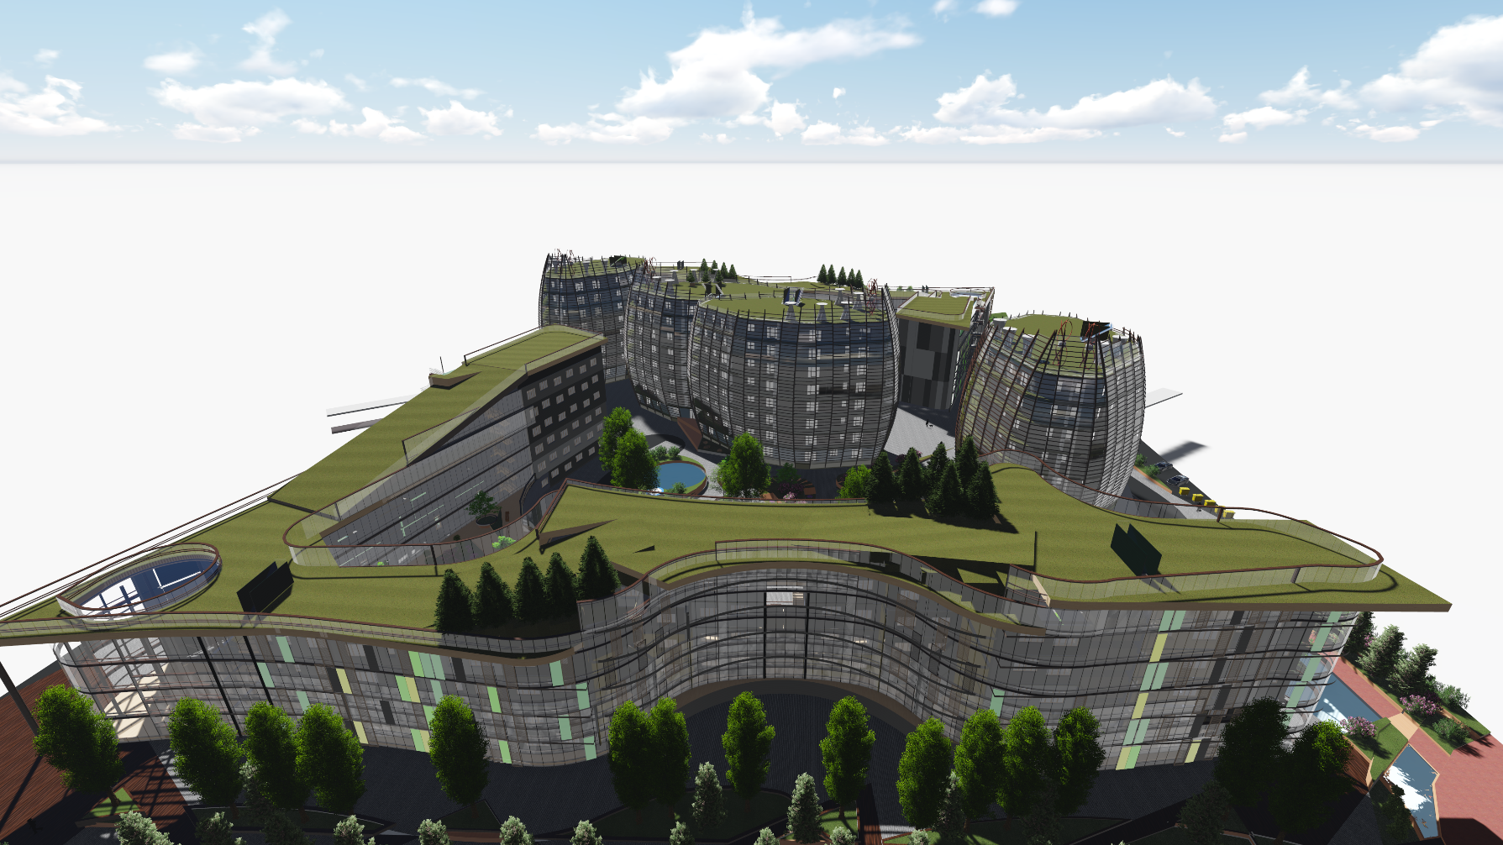

Slide 20

Thank you for attention!

