Slide 1
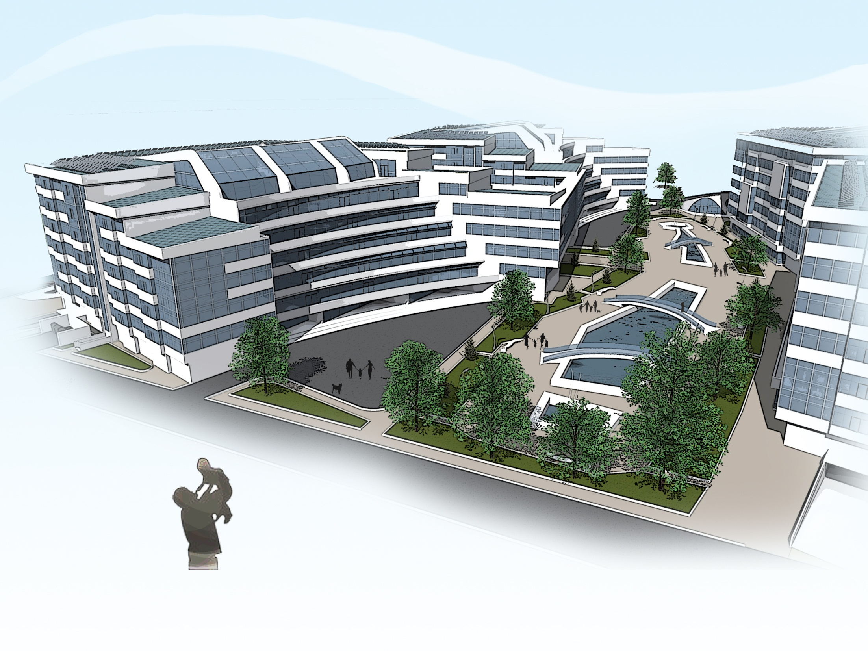



“ Designing Multi-Comfort House ISOVER- 2015:
Residential area for cold climates - Astana, Kazakhstan "”
Expo-2017 Astana

Slide 2
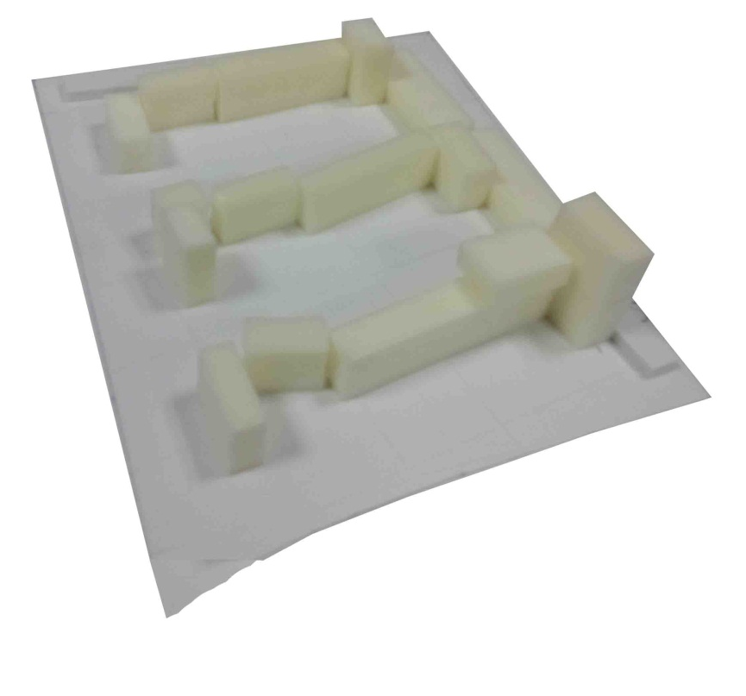
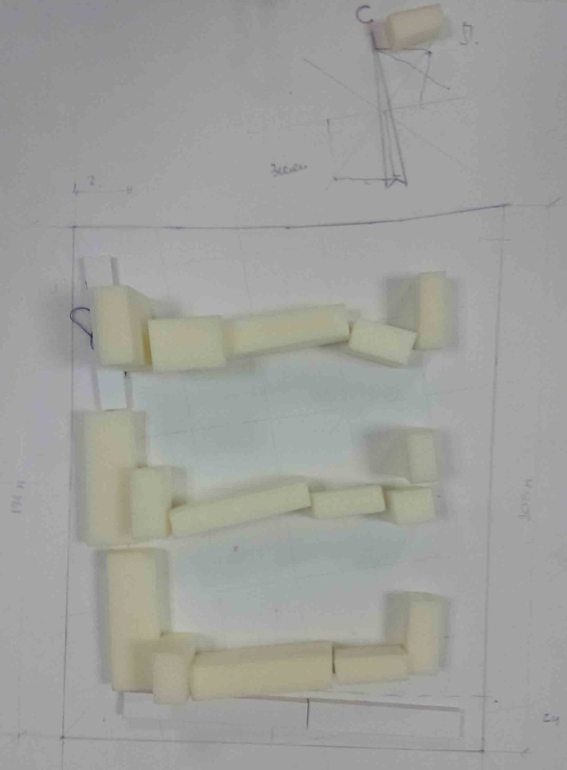
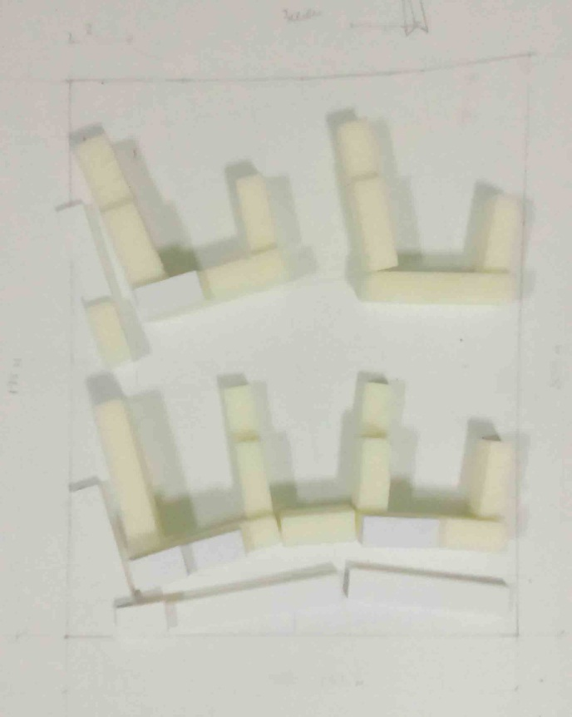
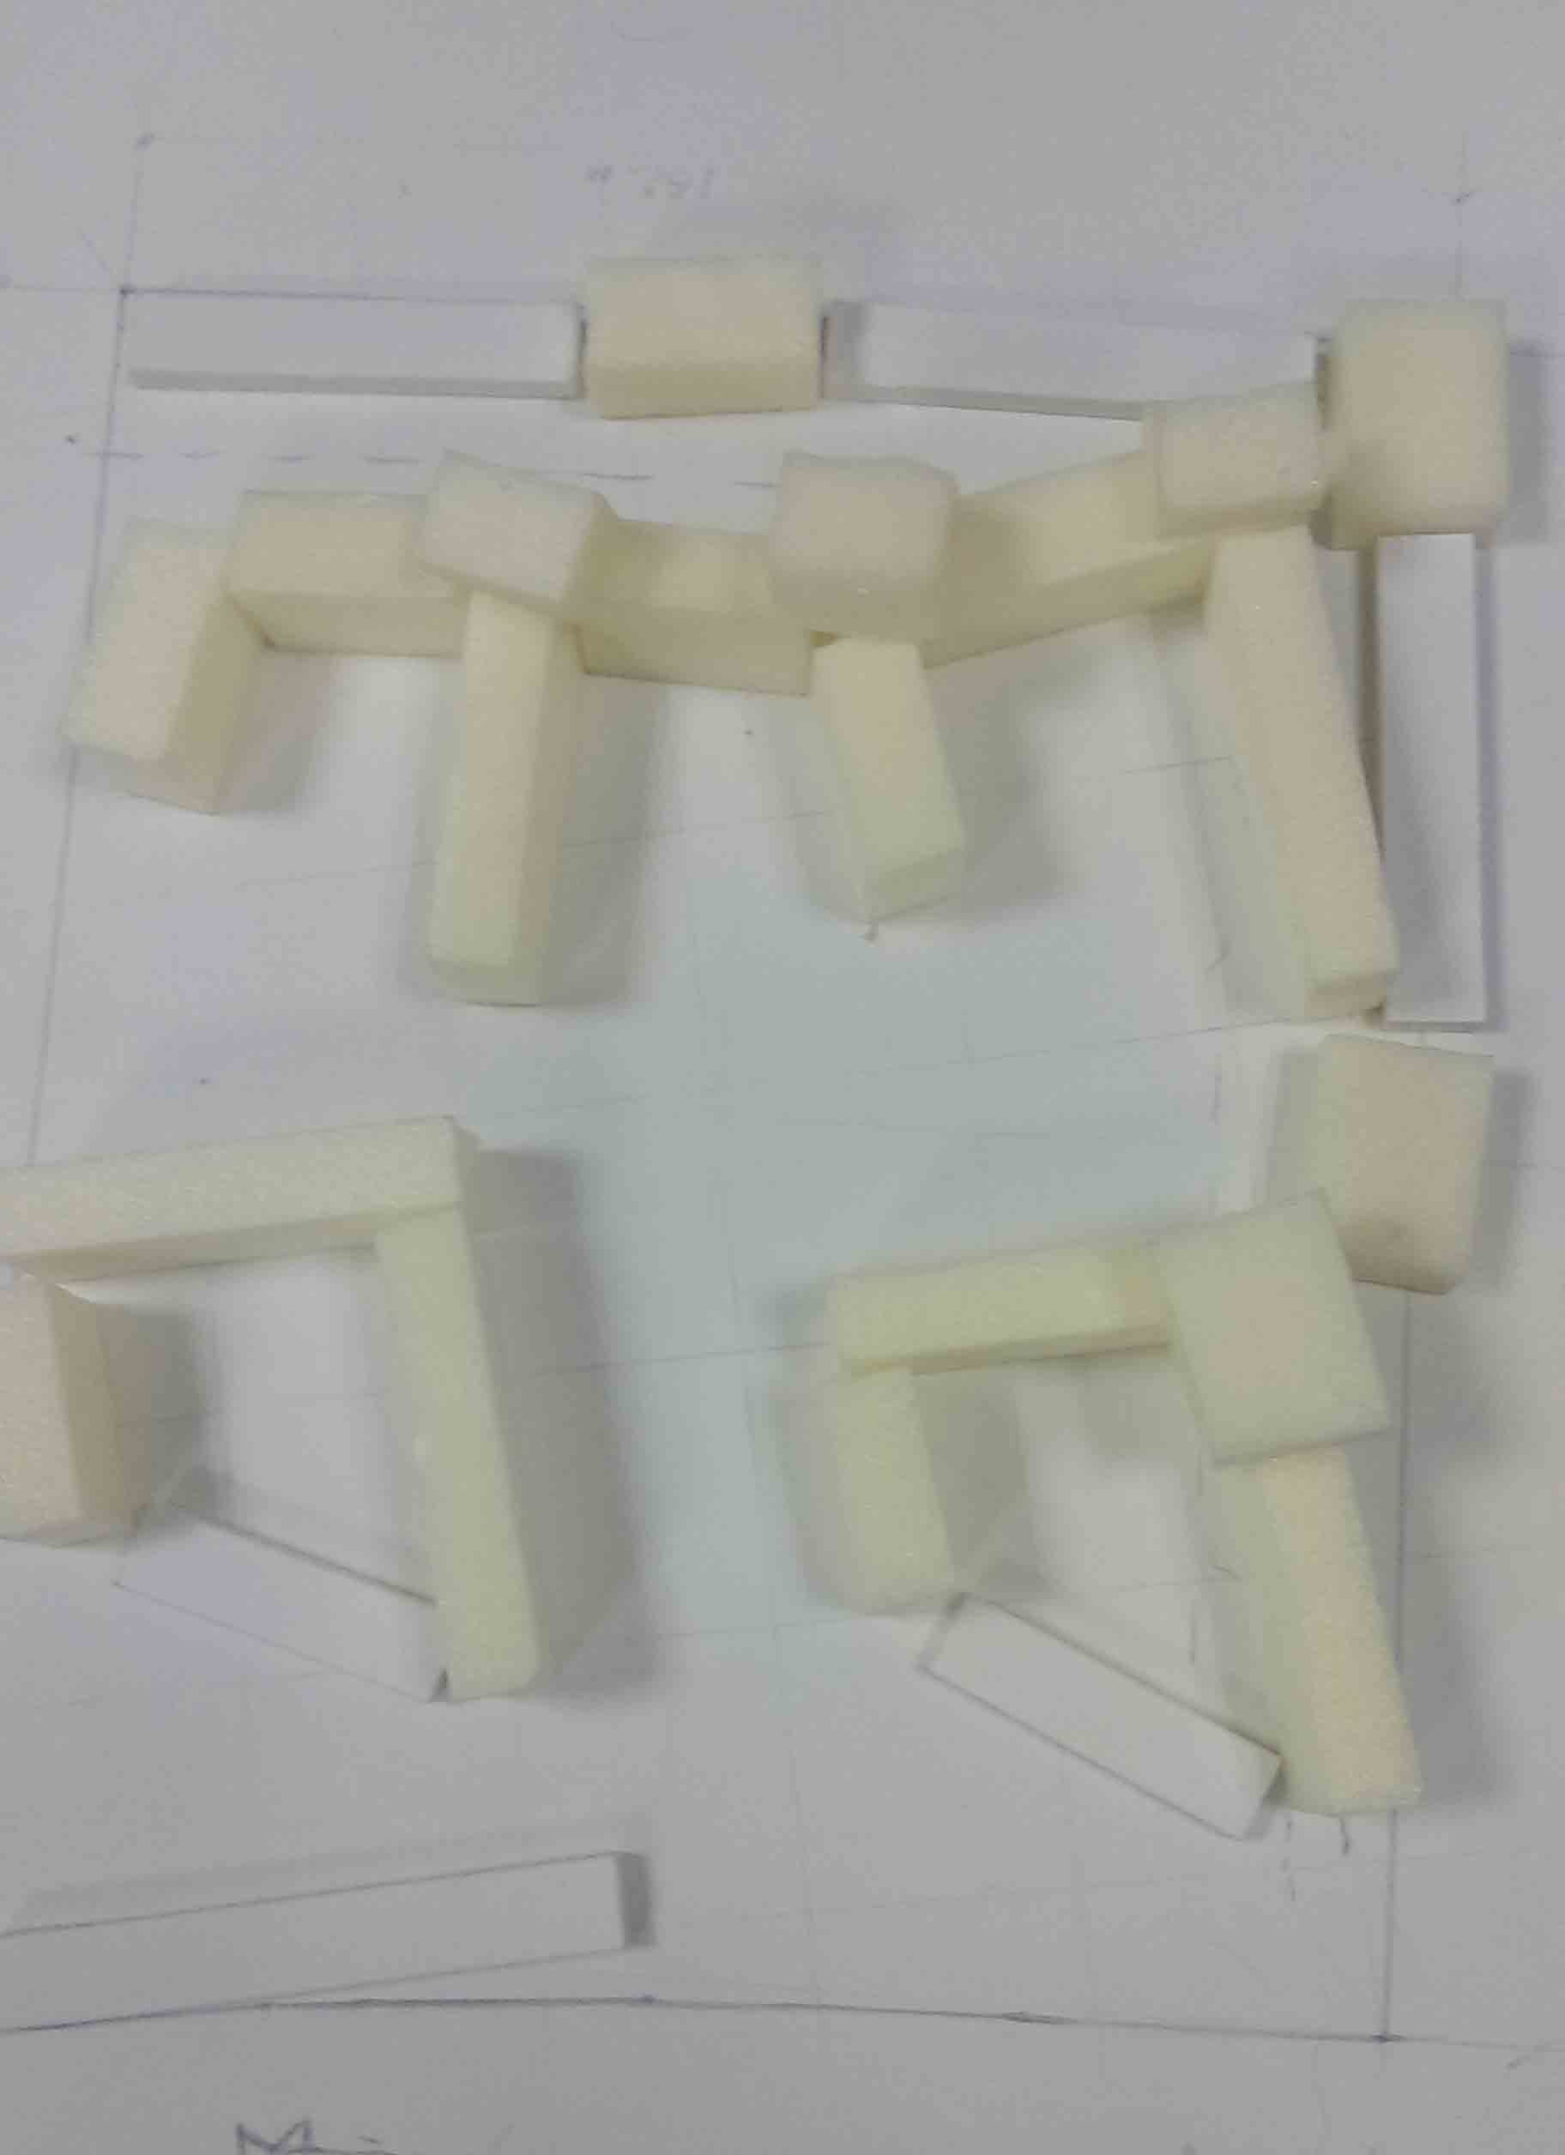
search ideas

Slide 3
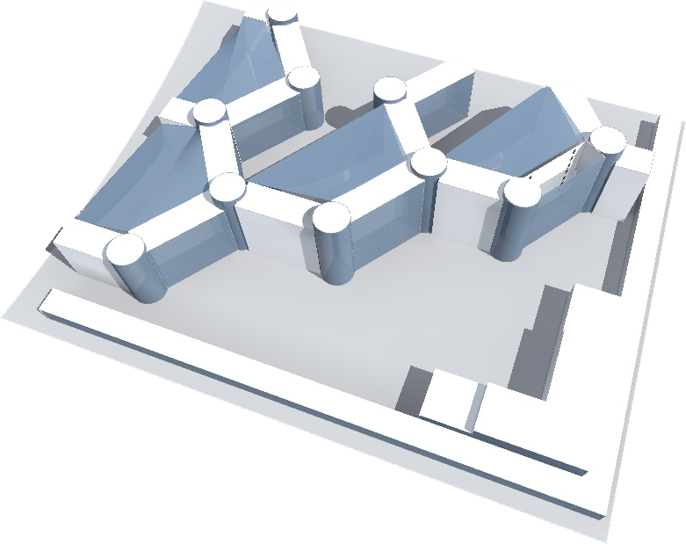
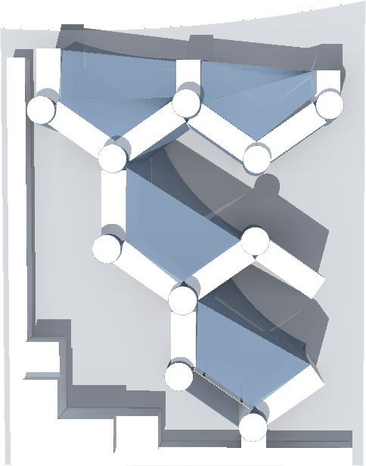
search ideas

Slide 4
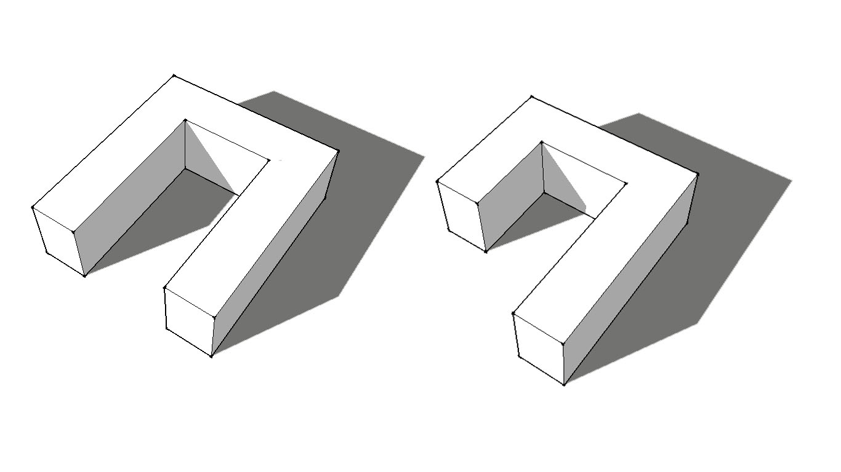
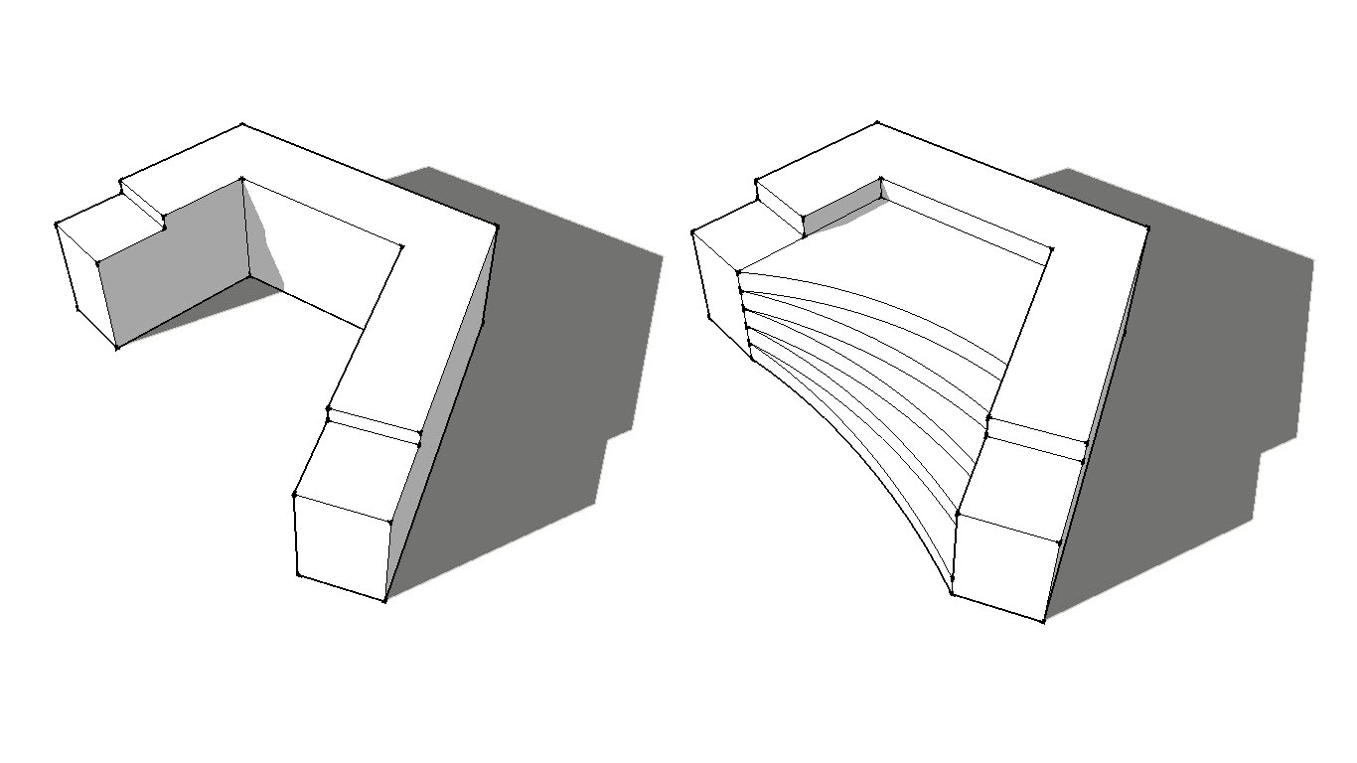

Slide 5
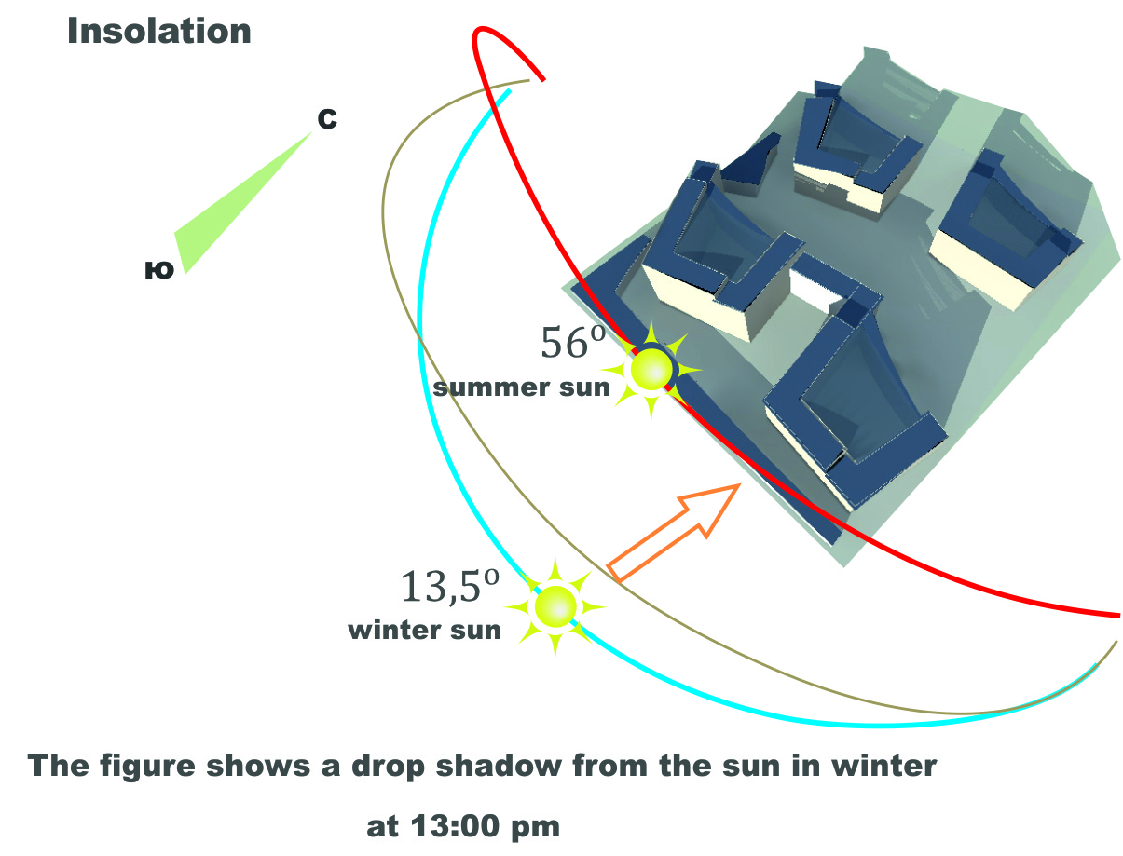
N
S

Slide 6
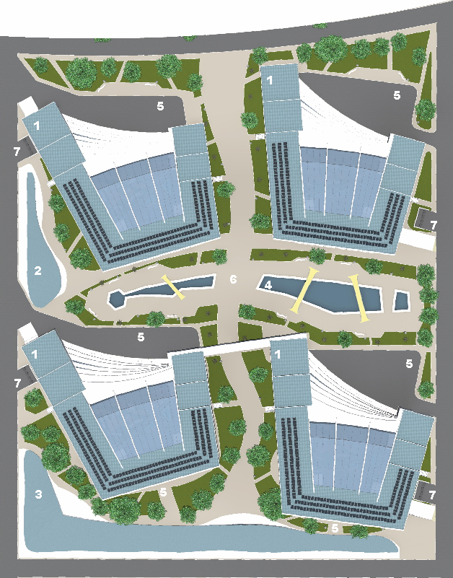
Экспо-2017 Астана
"Proposed General project Multi-Comfort House ISOVER- 2015: The residential quarter for cold climate - Astana, Kazakhstan "
8
8
Legend:
1. Residential building
2. Paragraph bike rental
3. Pavilion Serviced
4. The Central Fountain
5. Parking
6. Walk
7. collecting points
8. Atrium
8
8

Slide 7
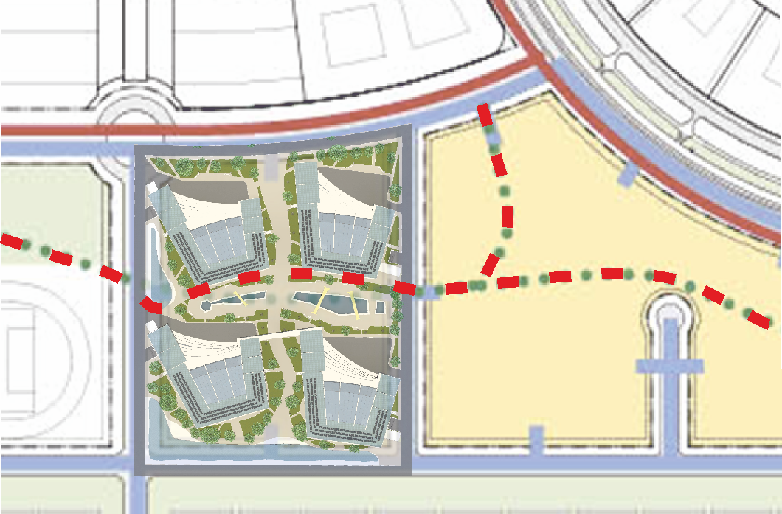

Сycle paths

Slide 8
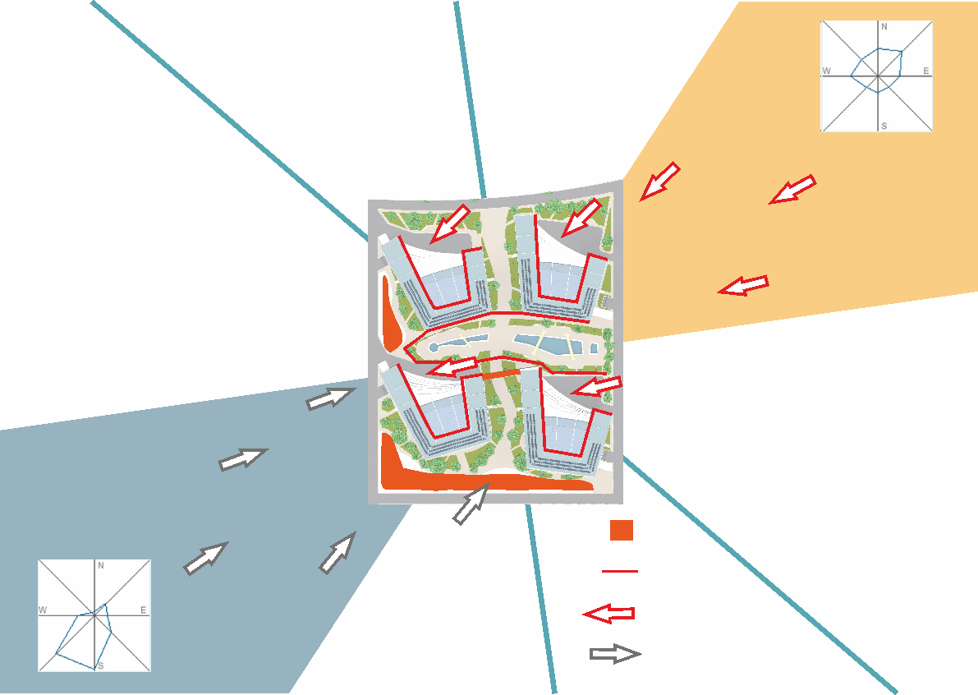
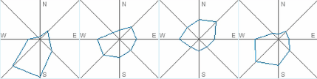
N
windshield
Summer Wind
E
W
Winter wind
Protection from winter winds
Orientation yards to the summer wind
Summer wind
S
Winter wind

Slide 9
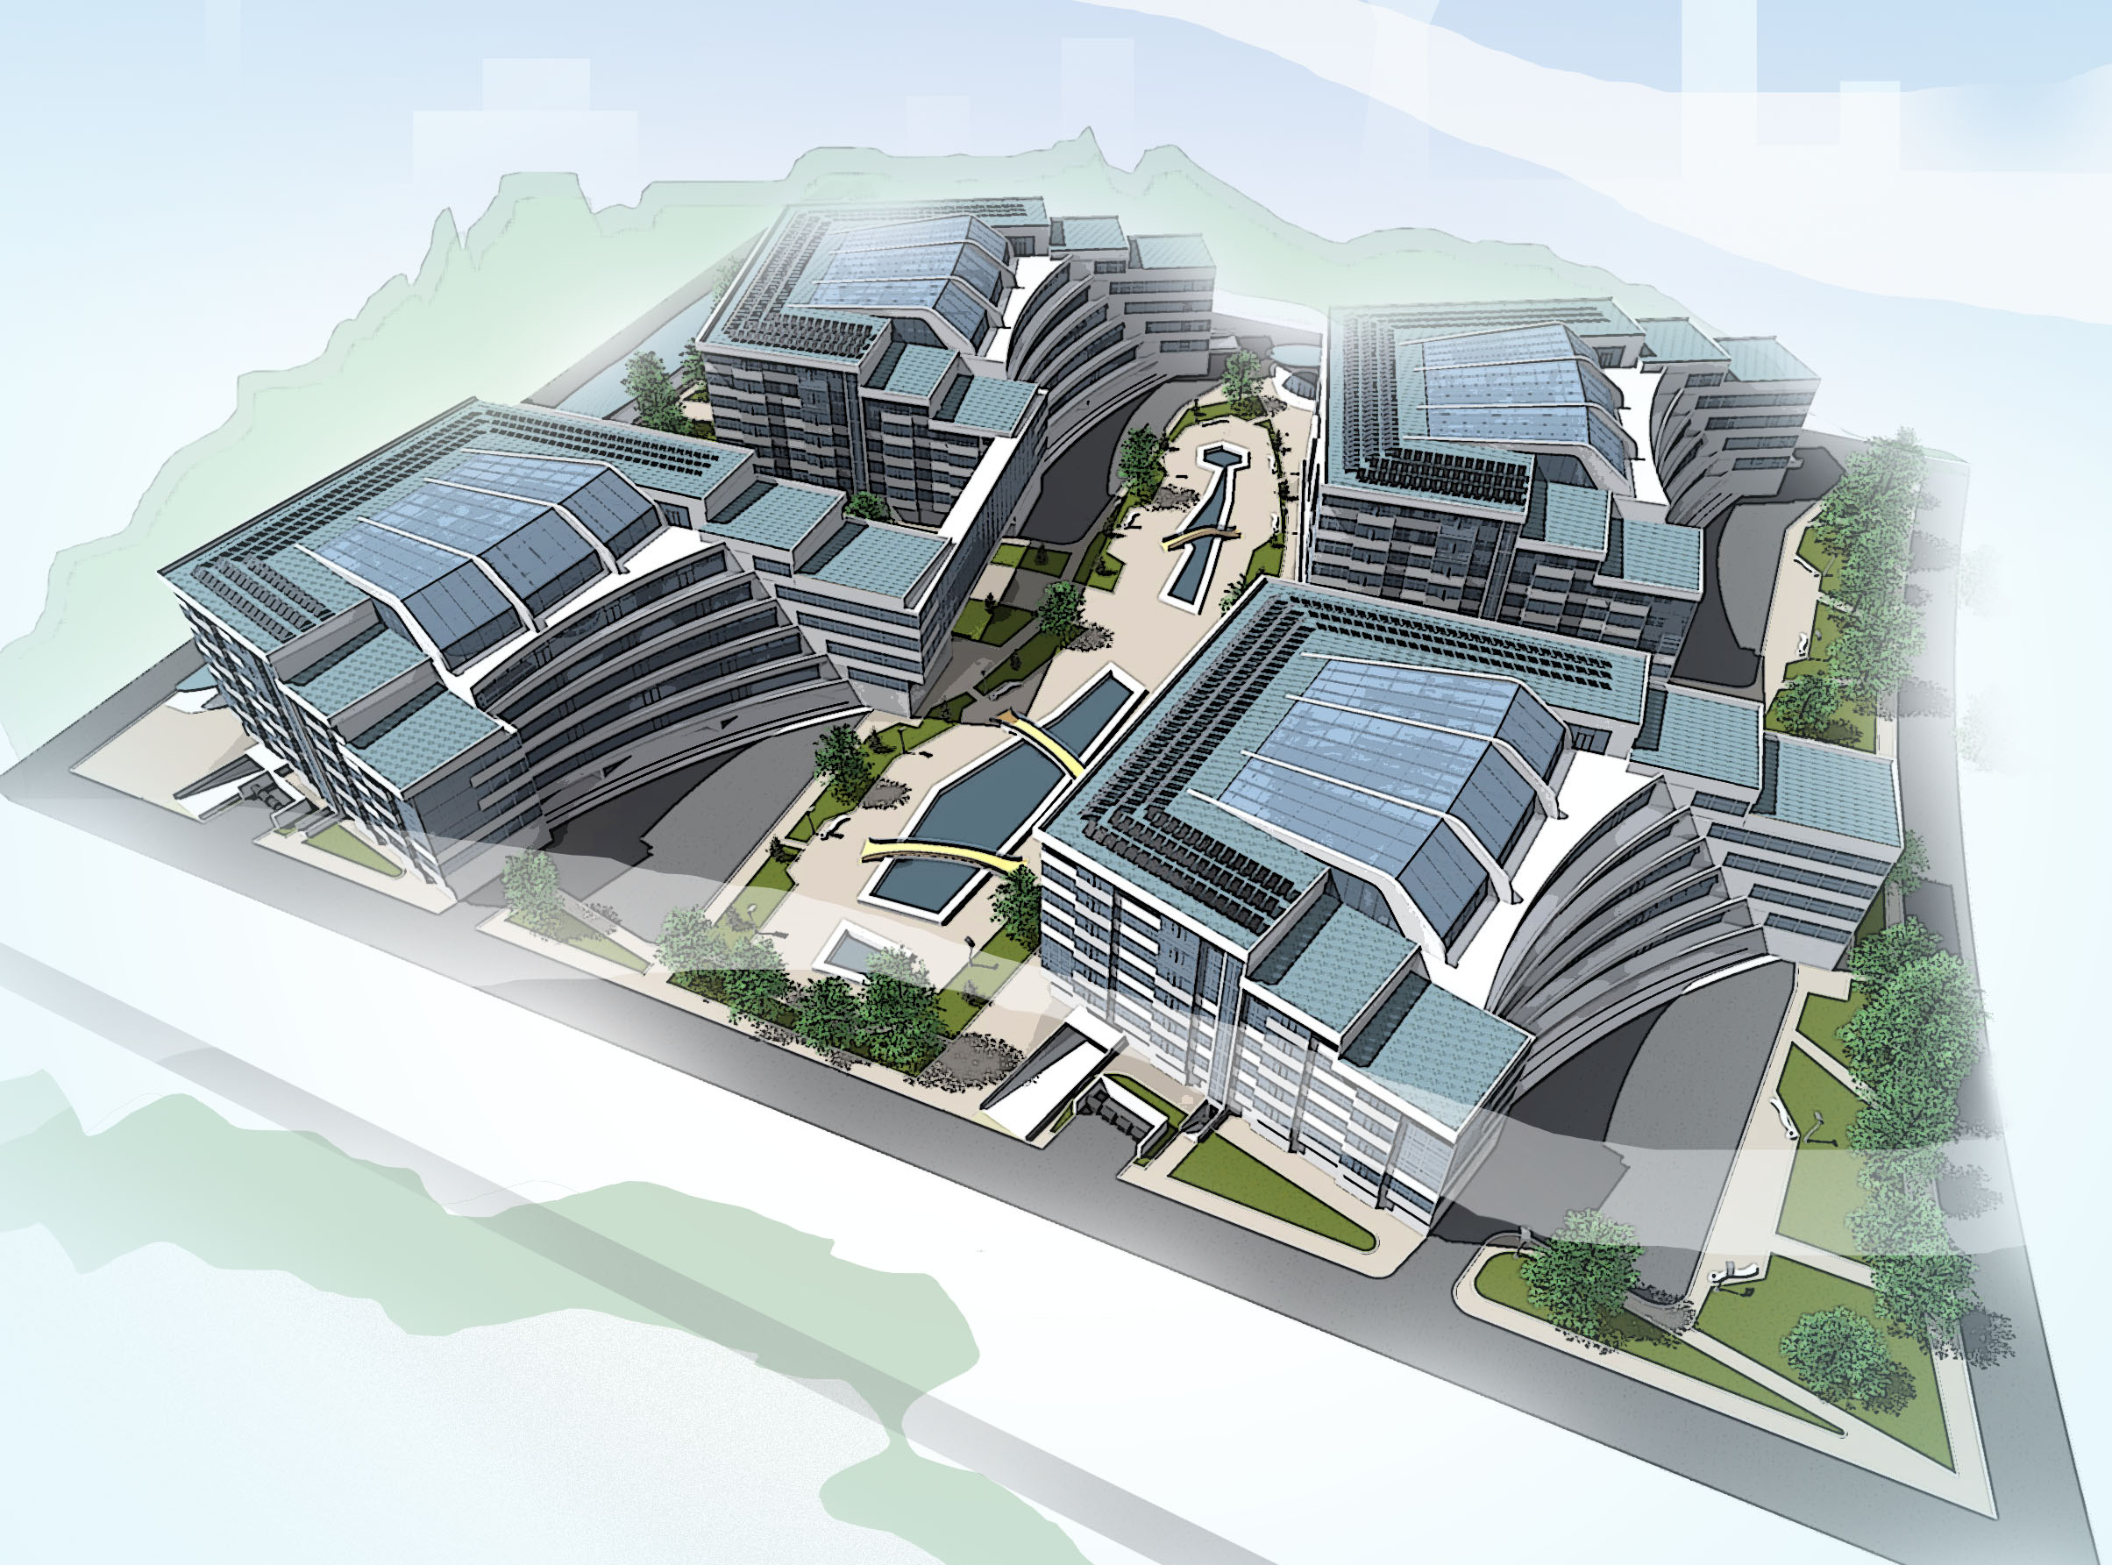

Slide 10
Walk inside the complex

Slide 11
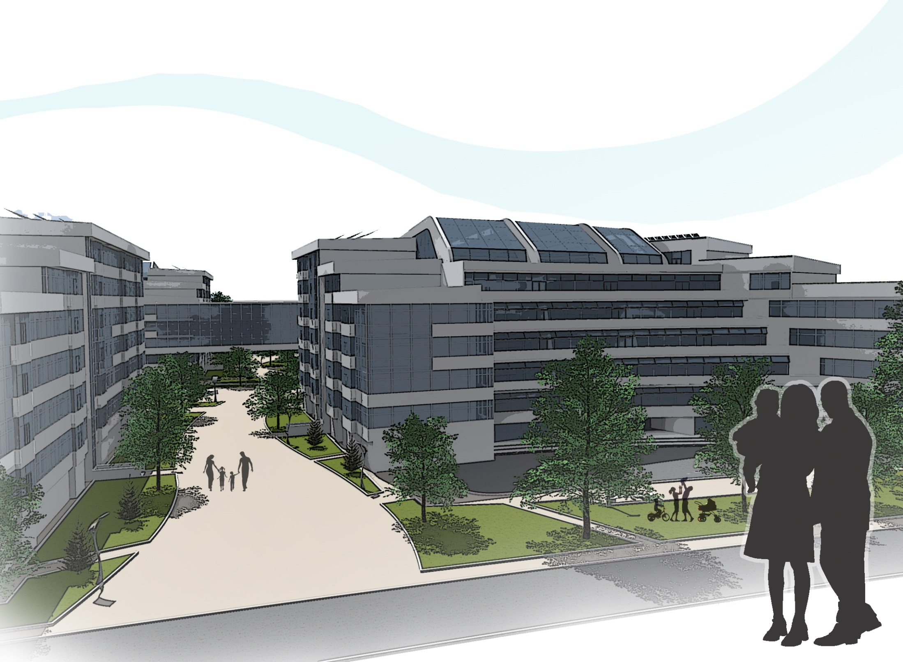
Walkup

Slide 12
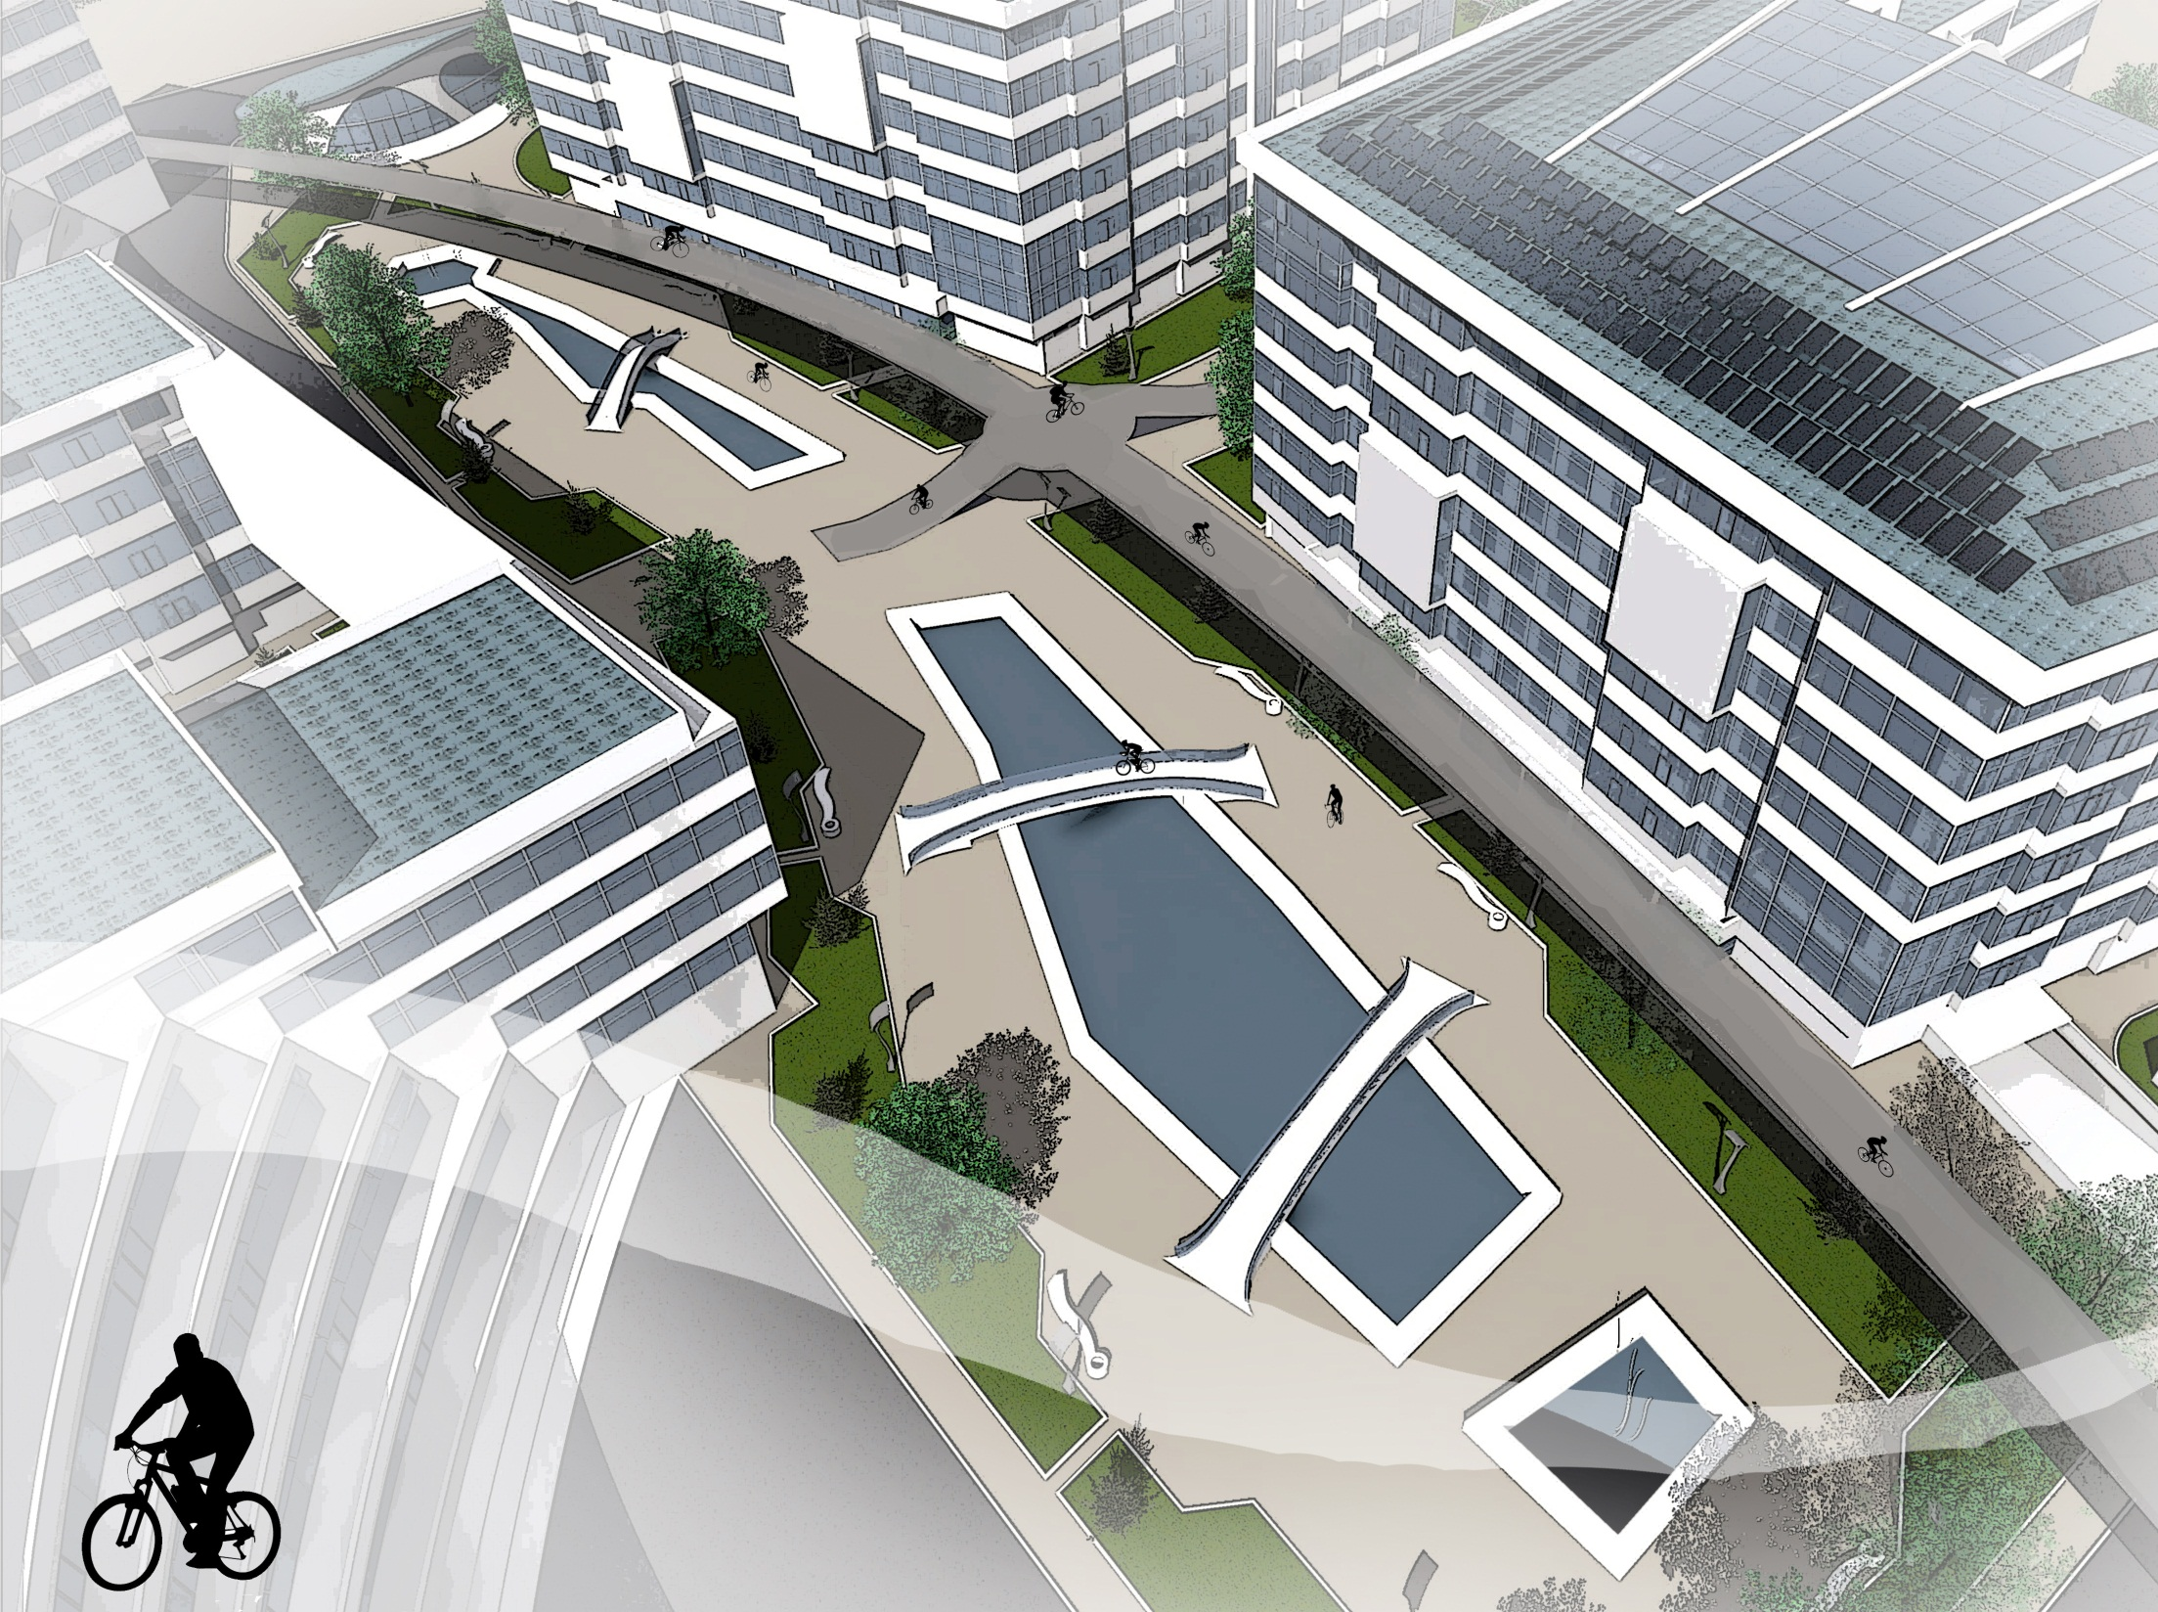
Сycle paths

Slide 13
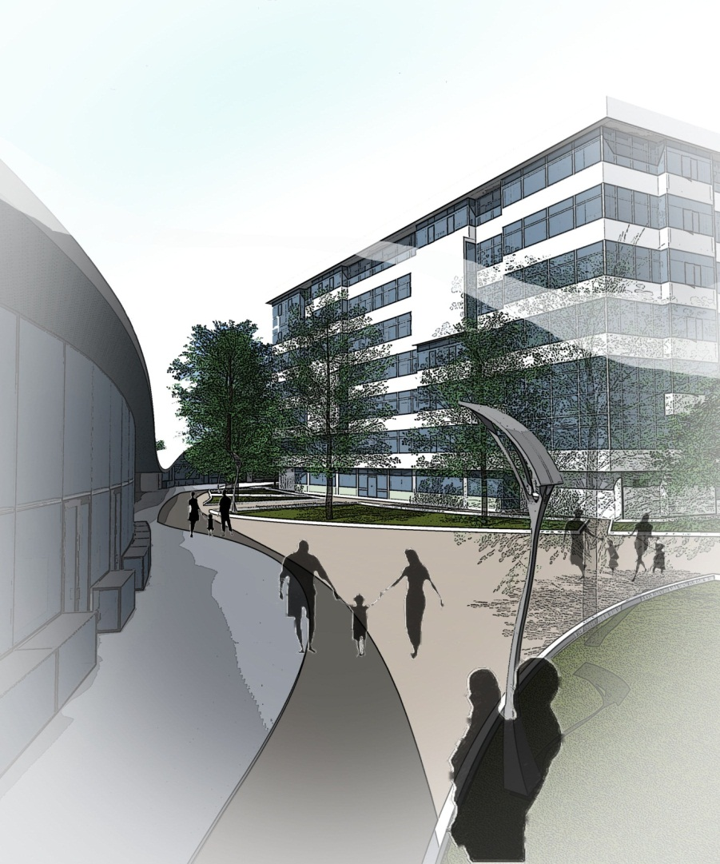
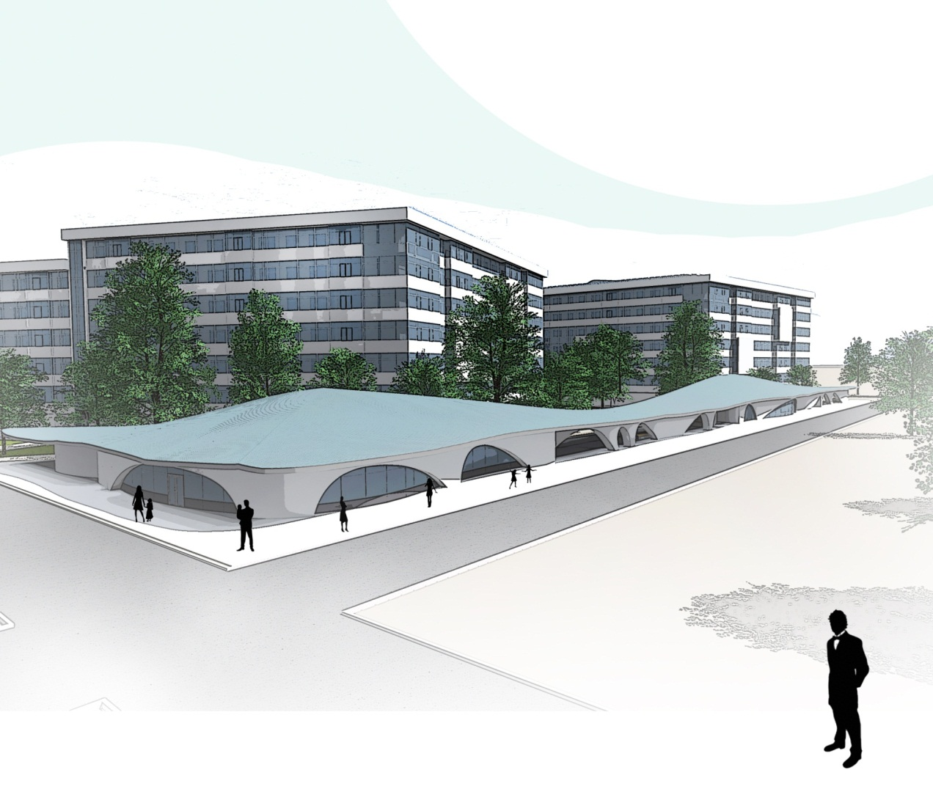
pavilion with service

Slide 14
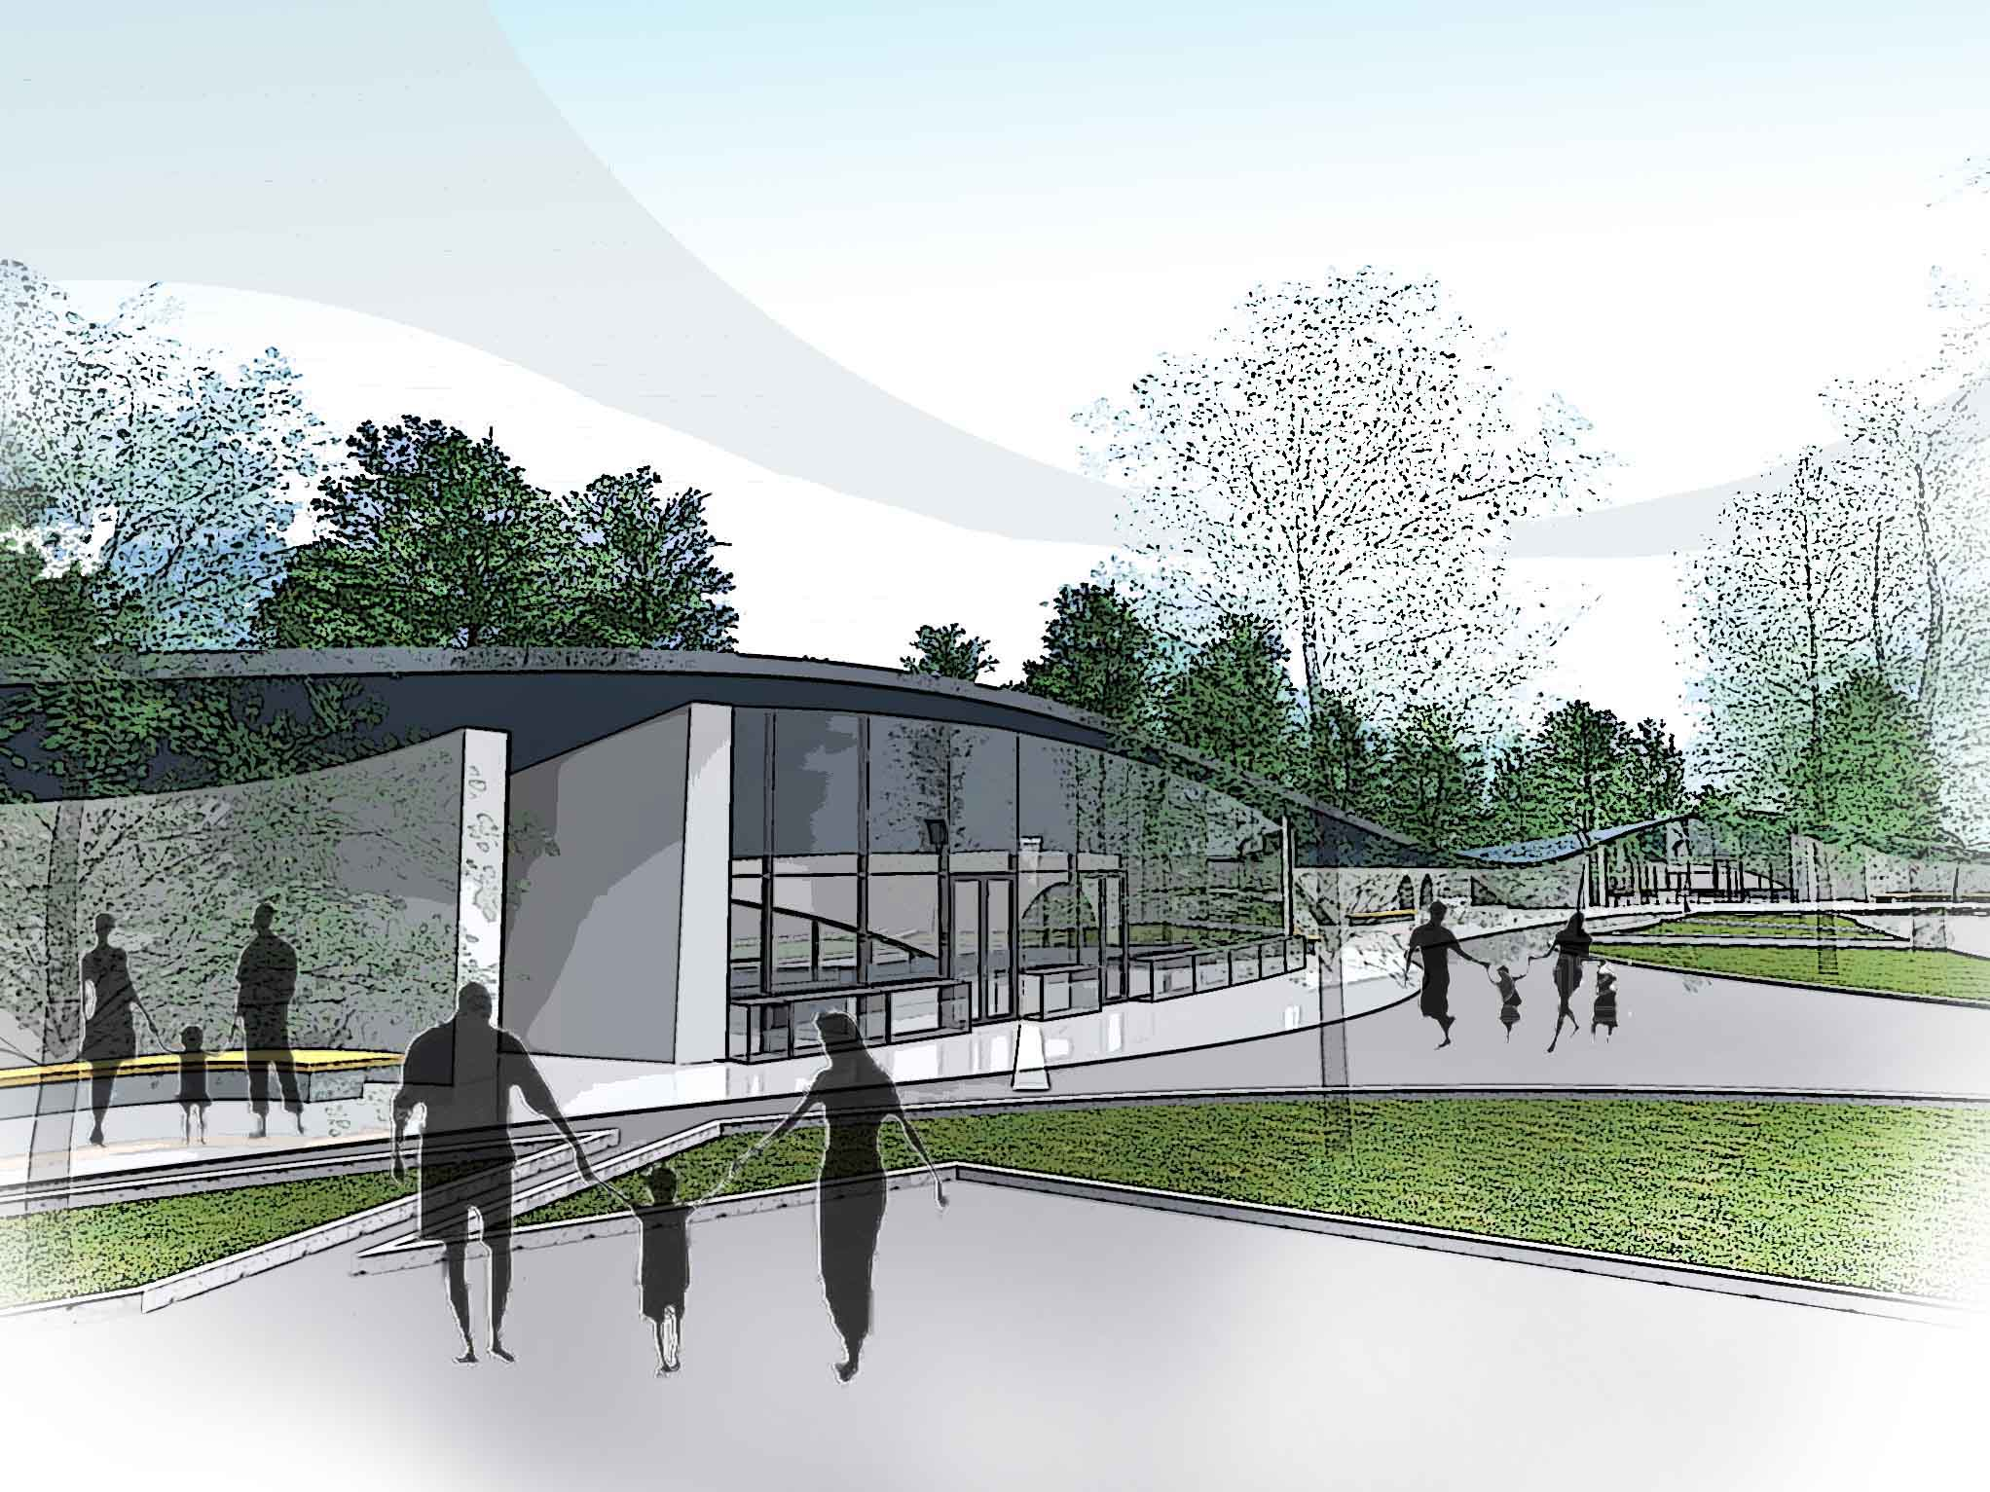

Slide 15
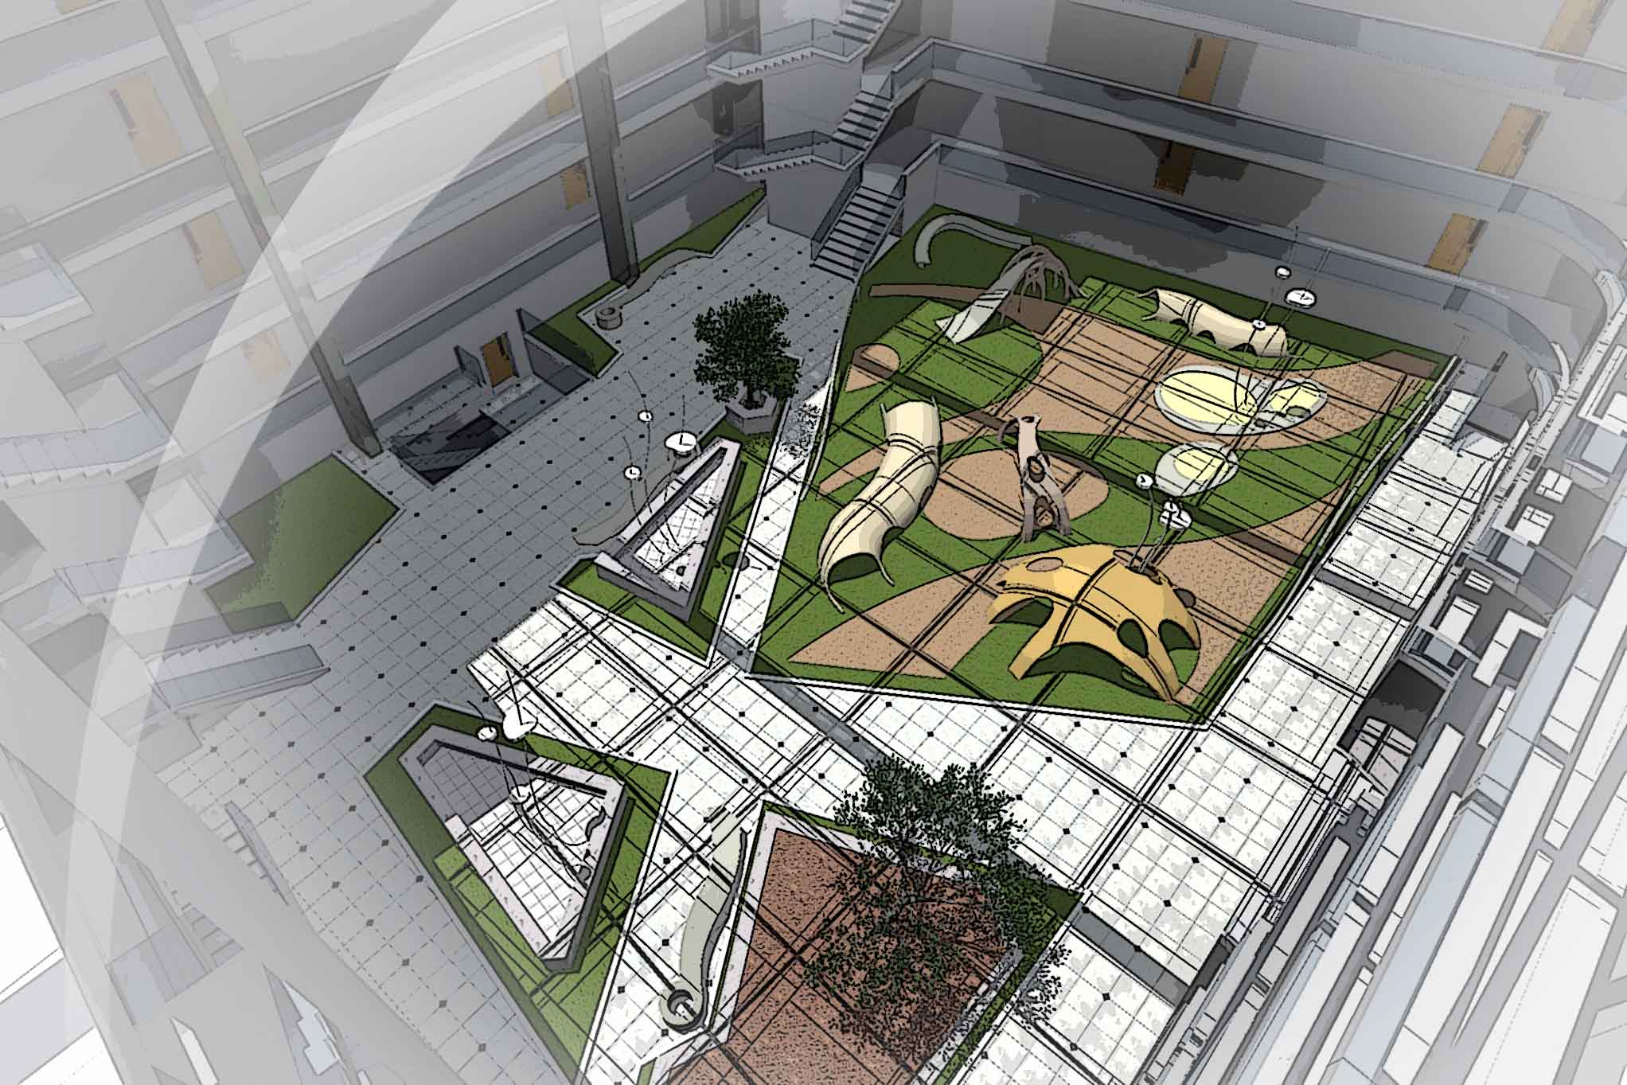
Atrium

Slide 16
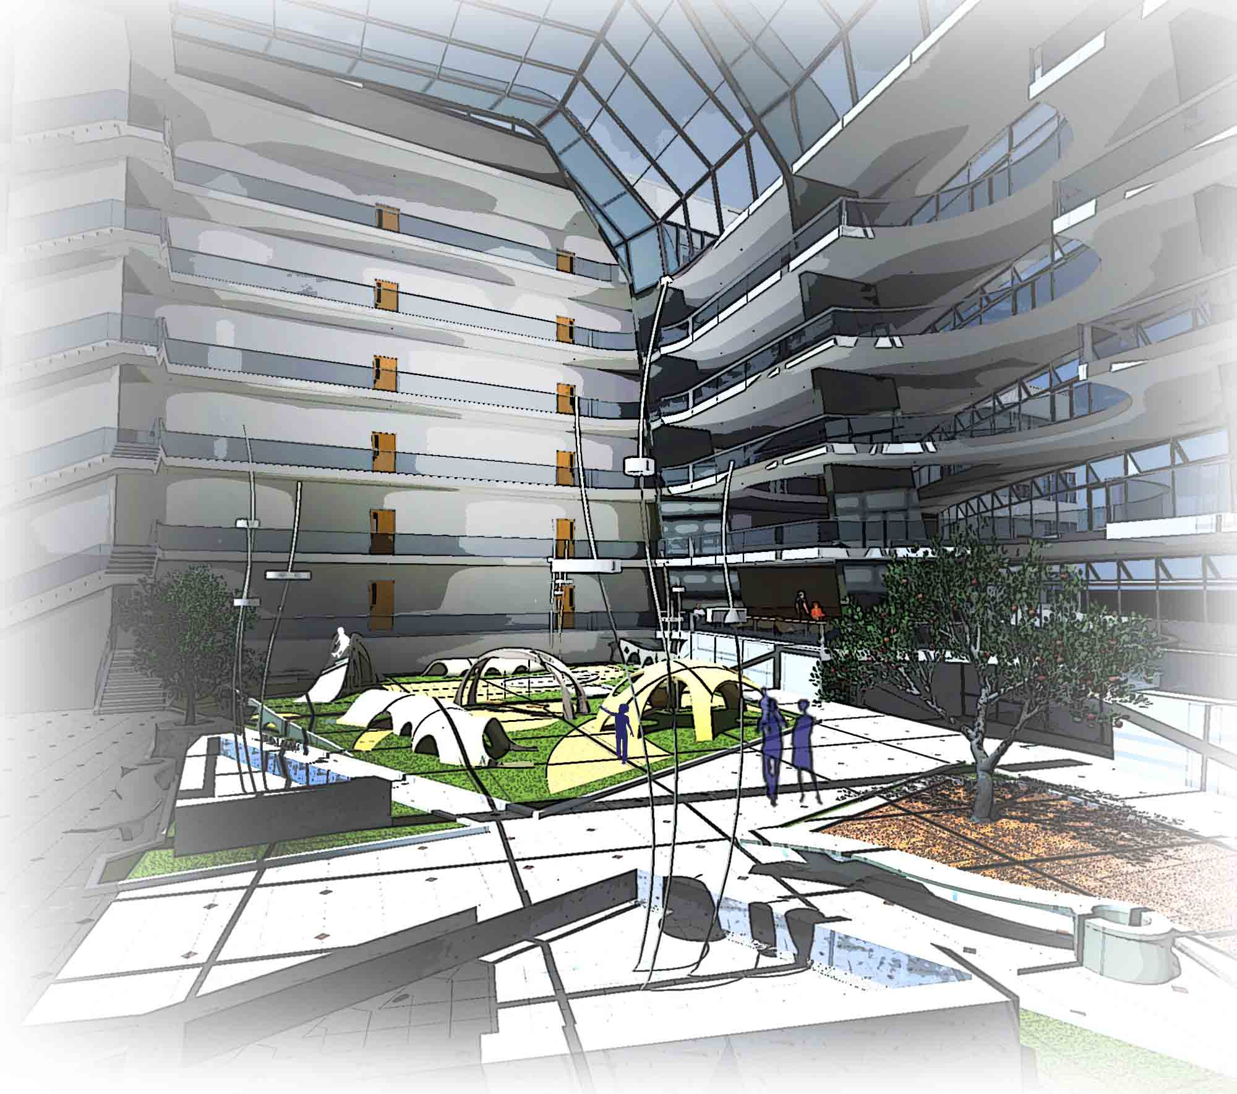

Slide 17
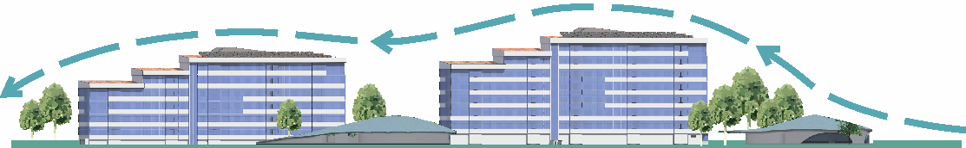
Aeration winter winds
SW

Slide 18
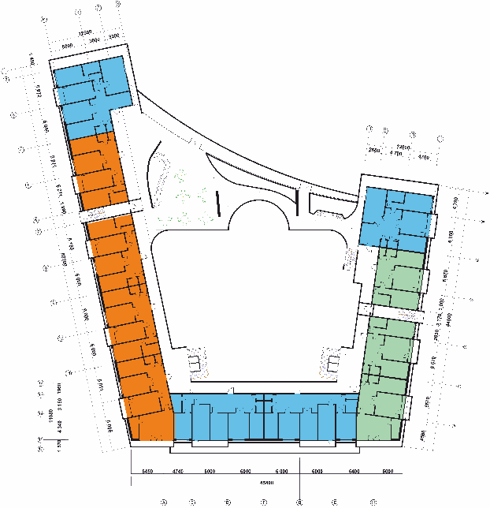

Apartments:
4-room apartments
3-room apartments
2-room apartments

Slide 19
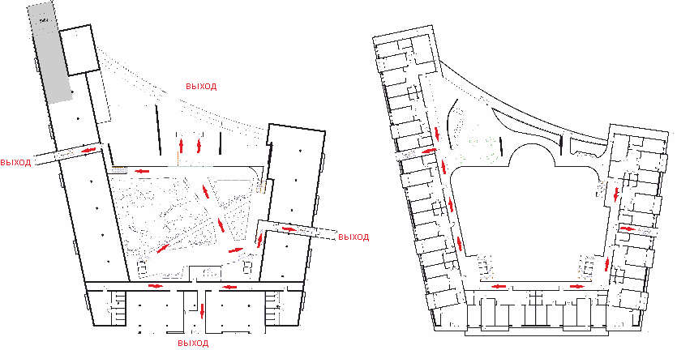
Fire safety and evacuation of the building
ground floor
Typical floor

Slide 20
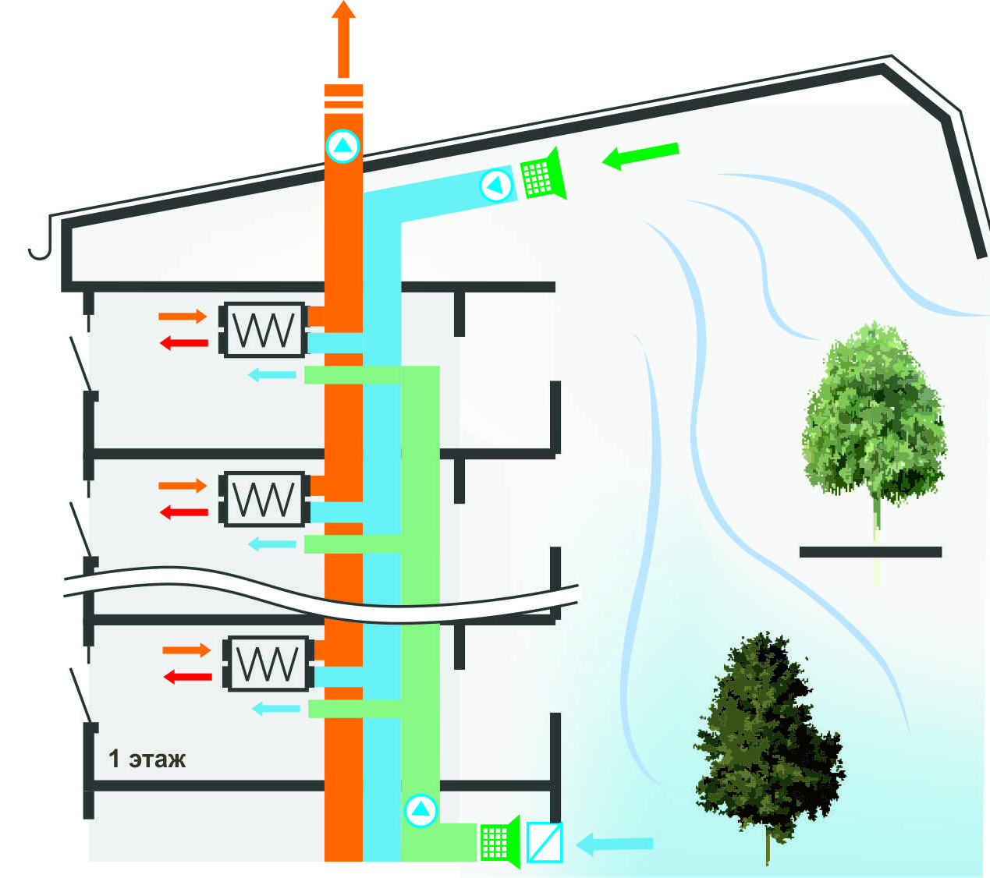



Ventilation air heat recovery
Fresh air atrium with daylight saving time
Fresh air from the atrium during winter
The exhaust warm air from the room
Preheated fresh air into the room
Recovery
filter
fan

Slide 21
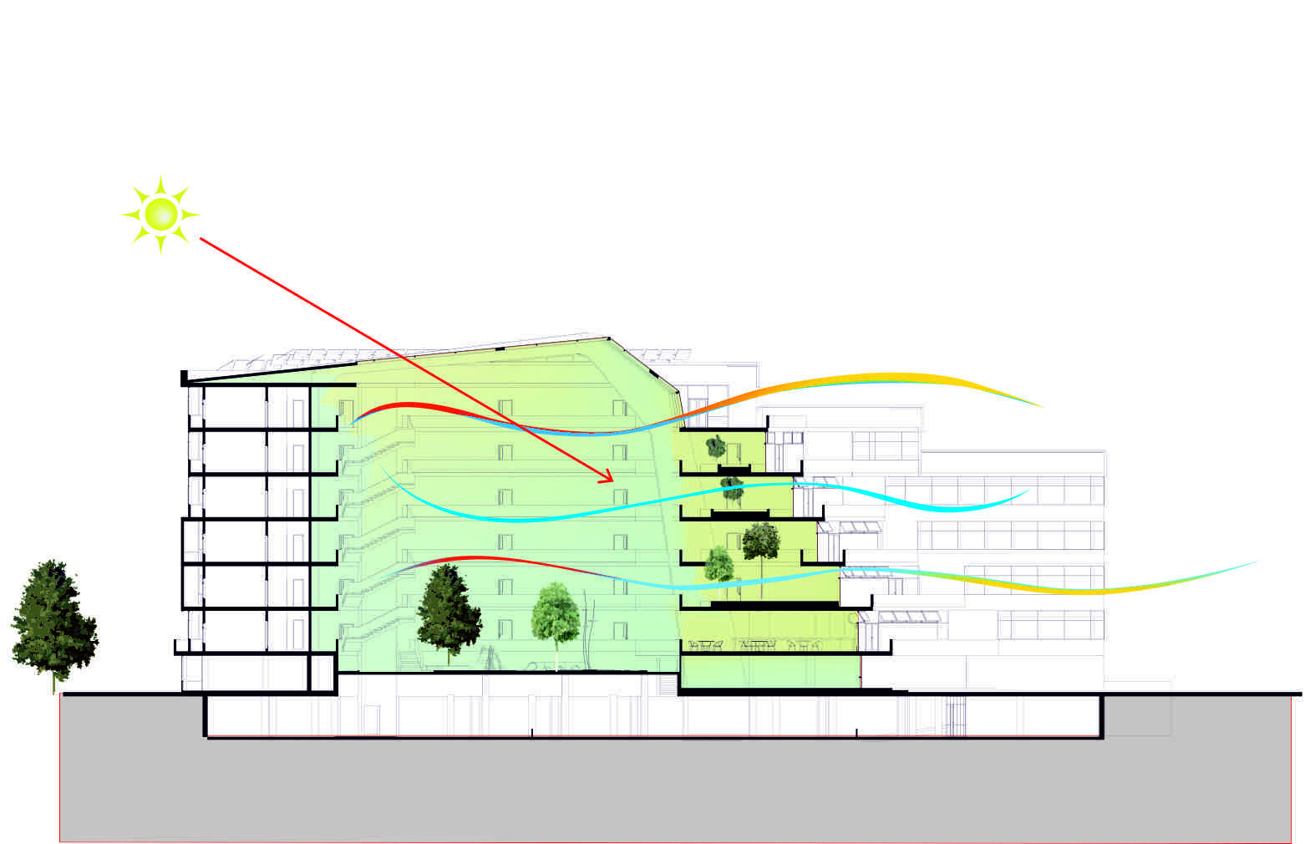
Natural ventilation in winter

Slide 22
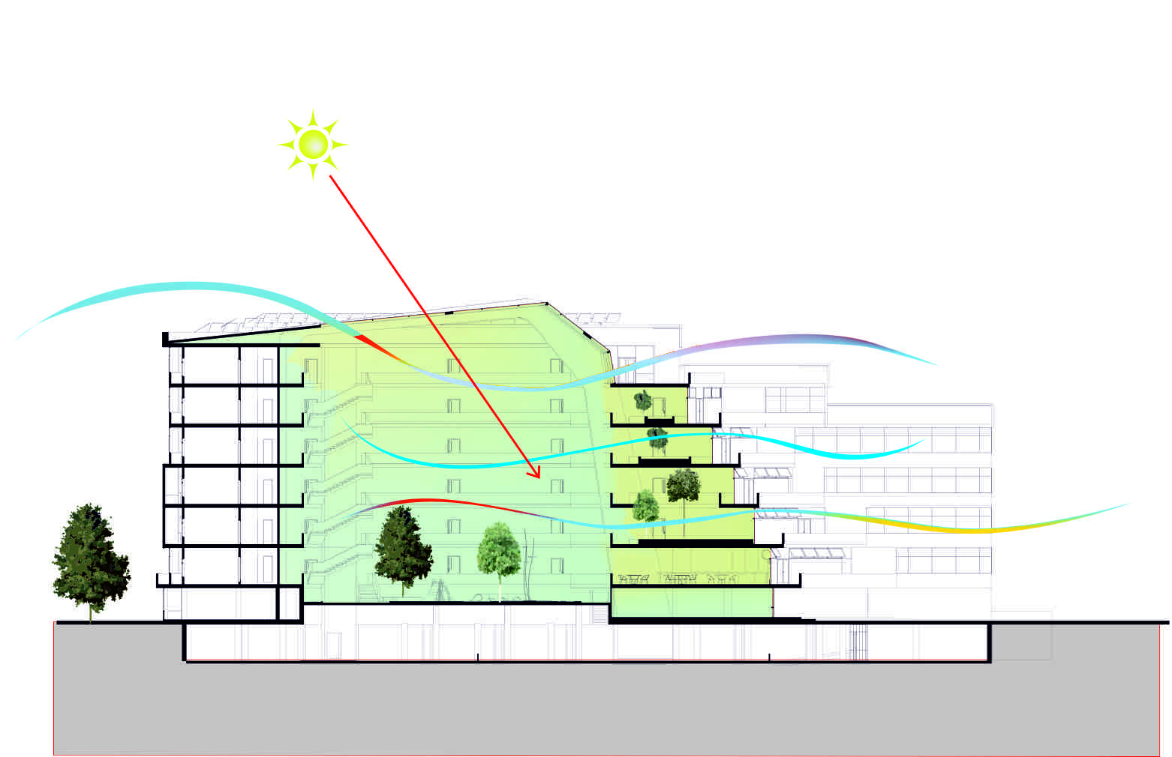
Natural ventilation in summer

Slide 23
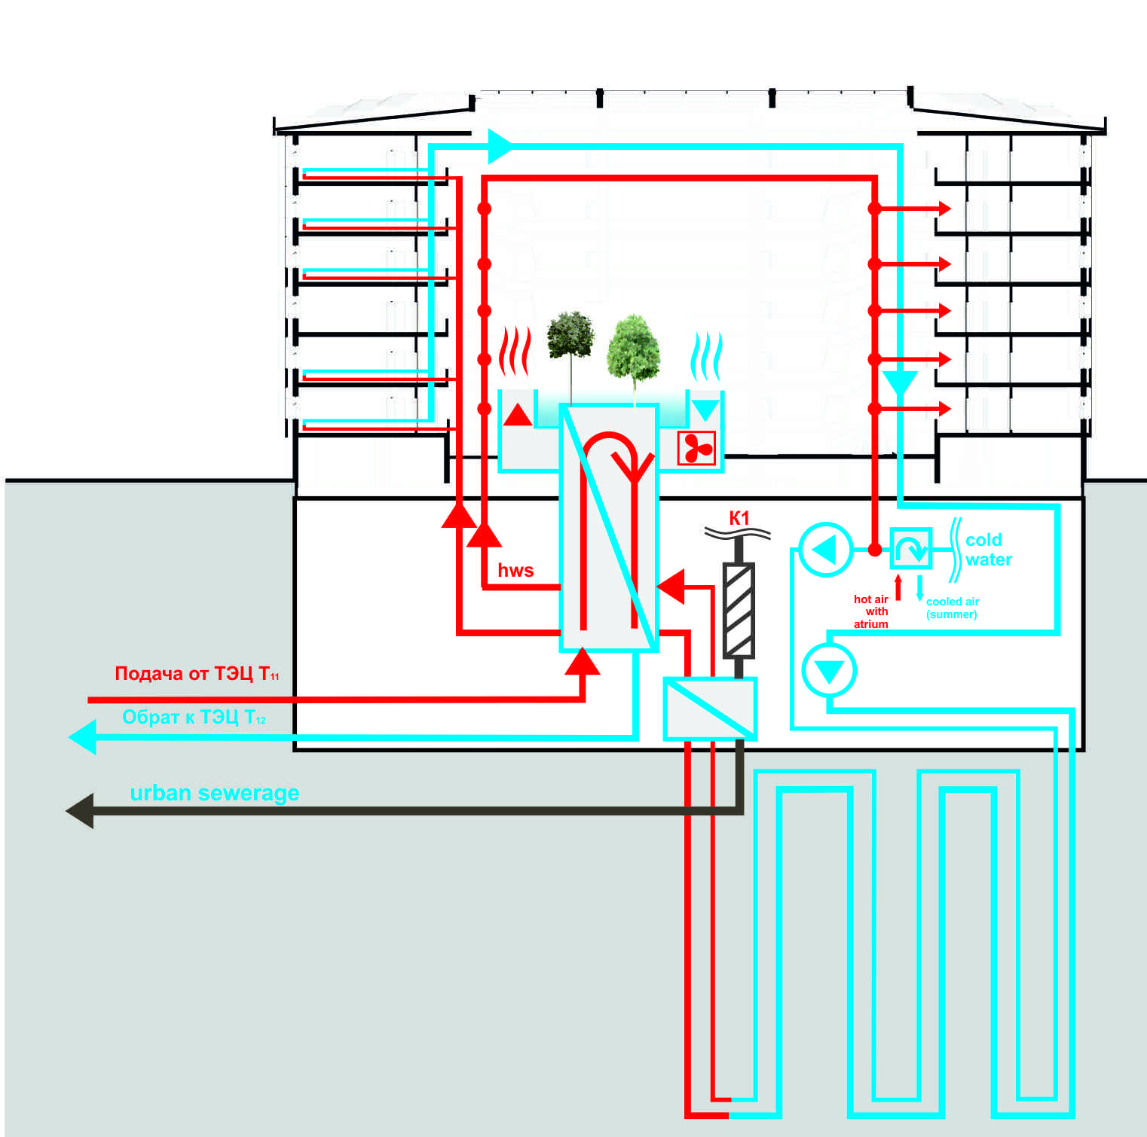
Схема использование тепла земли утепления пола
и подогрева воды каллорифером

Slide 24
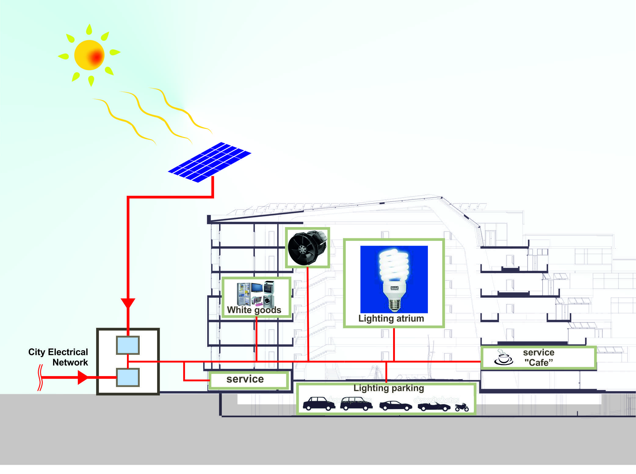

Slide 25
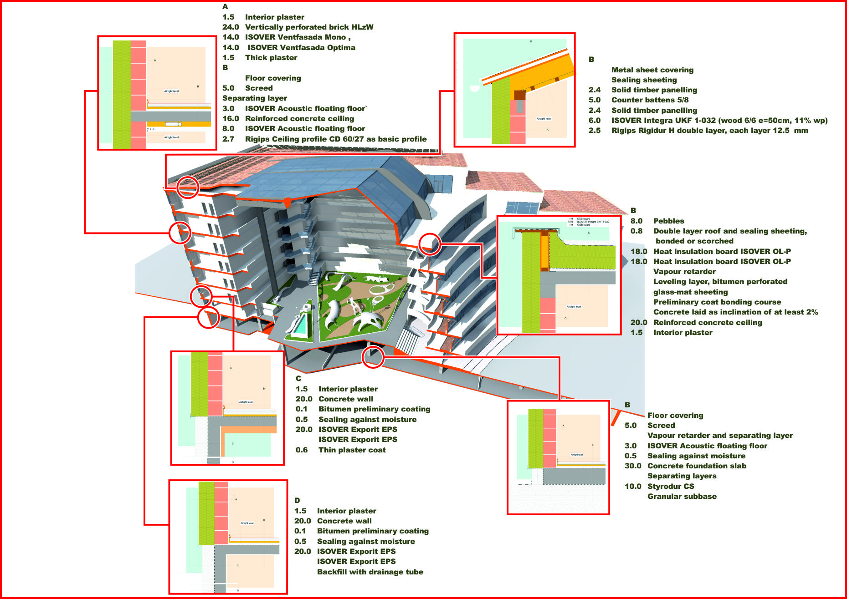

Slide 26
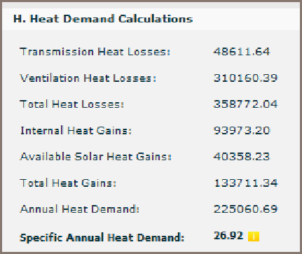
Calculations on energy efficiency
energy efficiency class
10
<15
<20
<50
<100
<150
<200
<250

