Slide 1
Open Access and Open Educational Resources in Kyrgyzstan:
Developments and Perspectives
Jyldyz Bekbalaeva
Director of Library
American University of Central Asia

Slide 2
Kyrgyzstan
OPEN
Occasional initiatives in early 2000
Countrywide movement in 2014
Open Access
Open Educational Resources
Creative Commons

Slide 3
OPEN in Kyrgyzstan
COLLABORATION
EDUCATIONAL INSTITUTIONS
AGENCIES
LOCAL ORGANIZATIONS
AGENDA, POLICY, COPYRIGHT REFORM, NATIONAL REPOSITORY

Slide 4
National Level
AGENDA
LIFELONG LEARNING, ACCESSIBILITY, AFFORDABILITY, E-LEARNING
POLICY
-PROGRAM FOR DEVELOPMENT OF EDUCATION 2021-2040
-NATIONAL CONCEPT OF E-LEARNING
COPYRIGHT
-MARRAKESH TREATY
-CREATIVE COMMONS, PUBLIC FUNDING
REPOSITORY
-700 TEXTBOOKS & CURRICULUM MATERIALS
-600 DISSERTATIONS; 1000 RARE BOOKS lib.kg

Slide 5
Institutions
Universities
OA, OER Development and Implementation
Libraries
OA, OER Awareness & Promotion, Open Repositories
NGOs
OA, OER Awareness & Promotion, Content
Donors
Grants, Training, Capacity Building

Slide 6
OA, OER and CC Awareness at universities - 2020
Higher awareness of OER (75.9%) than open licenses (58.4%)
Higher awareness of open licenses among librarians
General awareness of Open Access is high (58.9%)
Knowledge of characteristics of Open Access varies

Slide 7
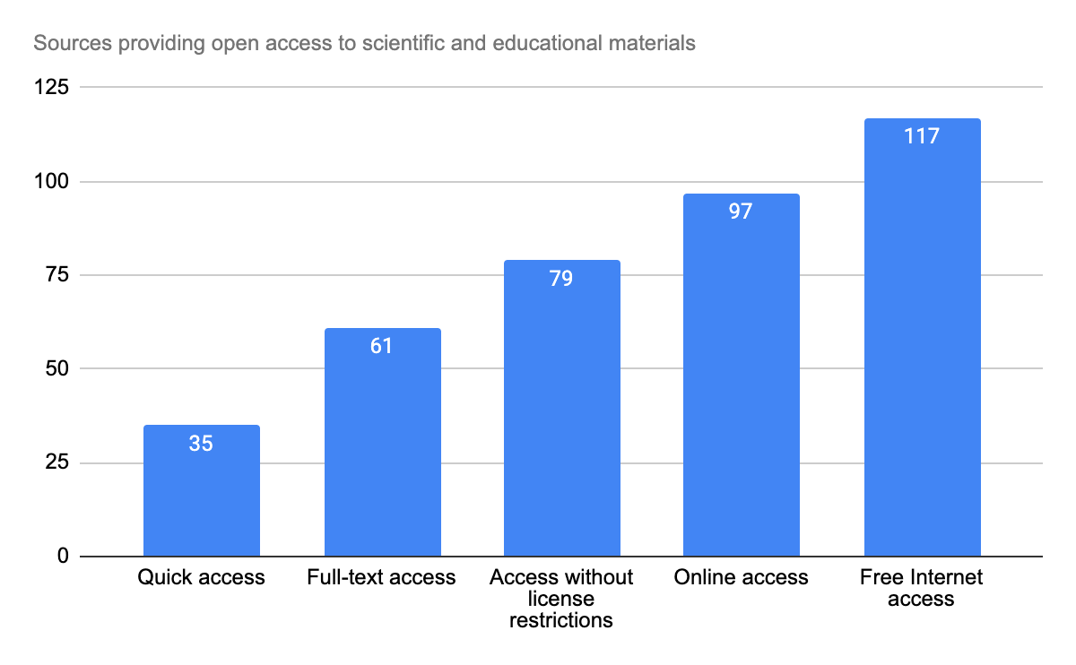
OA awareness at universities

Slide 8
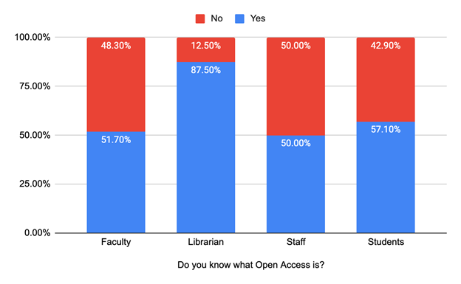
OA awareness at universities

Slide 9
Open Access Repositories
KyrlibNet Open Archive http://arch.kyrlibnet.kg/
American University of Central Asia Digital Repository
https://dspace.auca.kg/
Rare Books and Manuscripts https://manuscript.bizdin.kg
Institutional Repository OSCE Academy https://mt.osce-academy.kg/

Slide 10
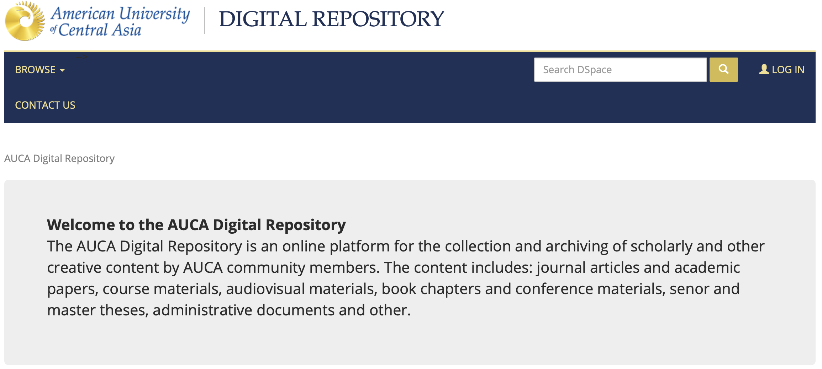
Repositories
https://dspace.auca.kg/

Slide 11
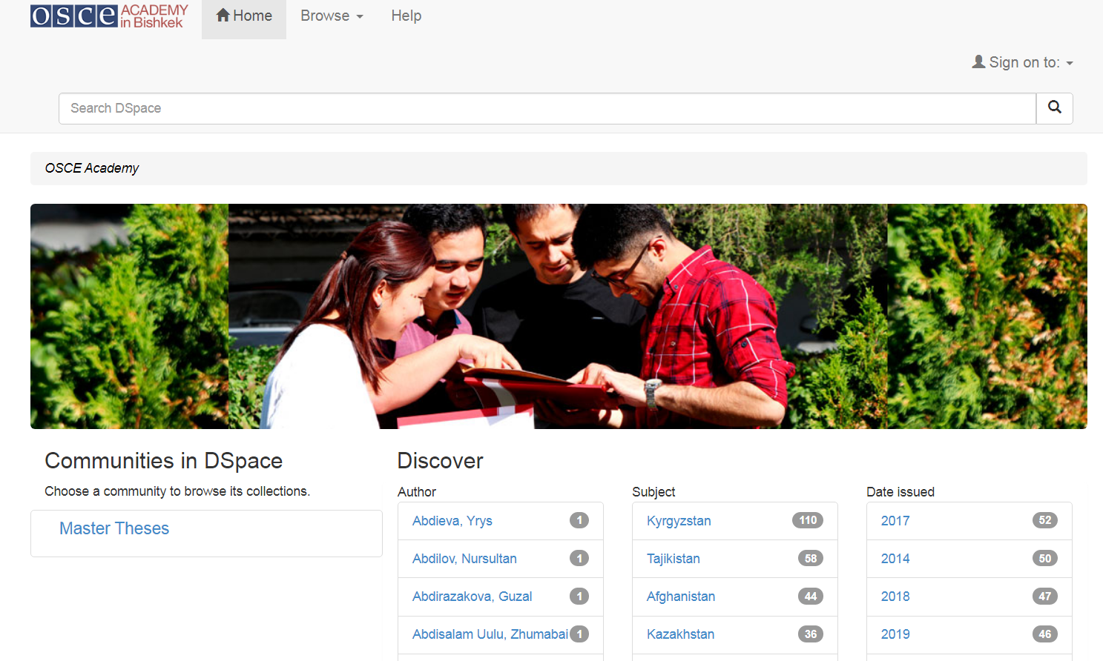
OSCE ACADEMY https://mt.osce-academy.kg/

Slide 12

KyrlibNet Open Archive http://arch.kyrlibnet.kg/

Slide 13
DOAJ
MANAS : Journal of Engineering
ISSN: 1694-7398 (Online) http://journals.manas.edu.kg/mjen/index.php Blind peer review
Subject: Technology: Engineering (General). Civil engineering (General).
Eurasian Journal of Business and Economics
ISSN: 1694-5948 (Print); 1694-5972 (Online) http://www.ejbe.org/ Double blind peer review
Subject: Social Sciences: Commerce: Business.
Heart Vessels and Transplantation
1694-7886 (PRINT) / 1694-7894 (ONLINE) http://hvt-journal.com/ Double blind peer review
Subject: Medicine: Internal medicine: Specialties of internal medicine: Diseases of the circulatory (Cardiovascular) system.

Slide 14

Open Access Training in June 2022

Slide 15
Further steps
OA awareness (Library Consortium, EIFL)
OA policies (Institutions)
Repositories (Institutions)
OA promotion at the national level (Ministry of Education, Library Consortium, Institutions)

