Slide 1
Design optimization of a knee joint for the gait rehabilitation exoskeleton
Presenter: Shyngys Dauletbayev
Supervisor: Aibek Niyetkaliyev
Co-supervisor: Prashant Kumar Jamwal
Examiner: Shane Quan Xie

Slide 2
Table of contents
Introduction
Related works
Design concept selection
Methodology
Knee joint concept kinematics
Knee joint design with gear teeth
Knee joint design with ball bearings
Results
Design validation in CAD software
Practical design validation
Discussion
Conclusion
References

Slide 3
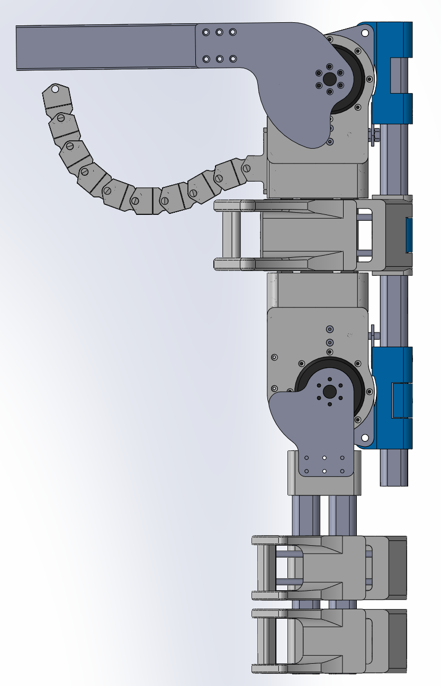
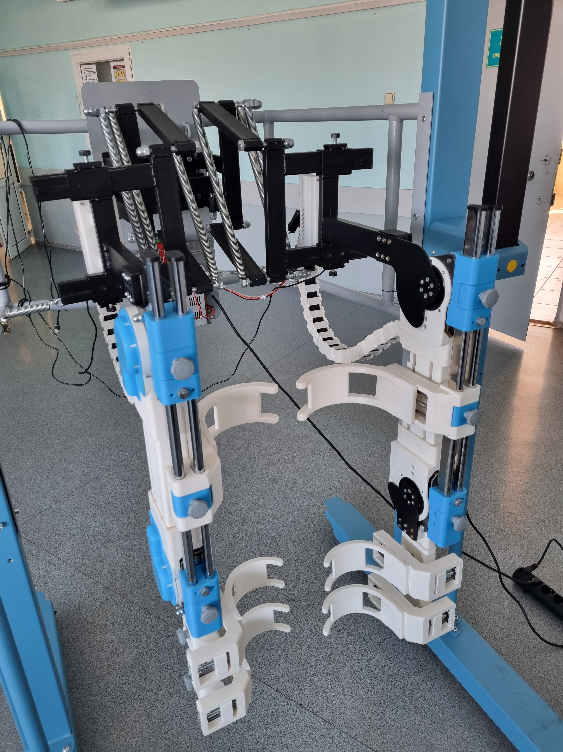
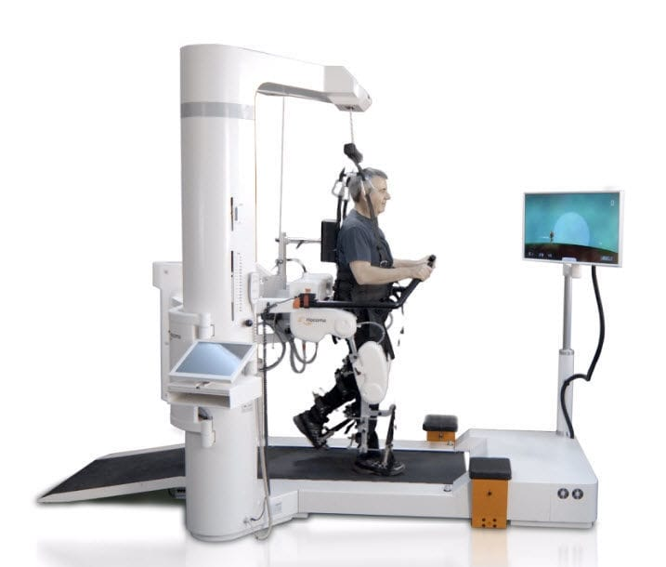
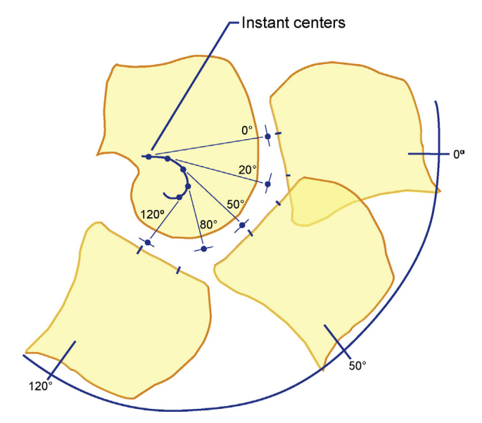
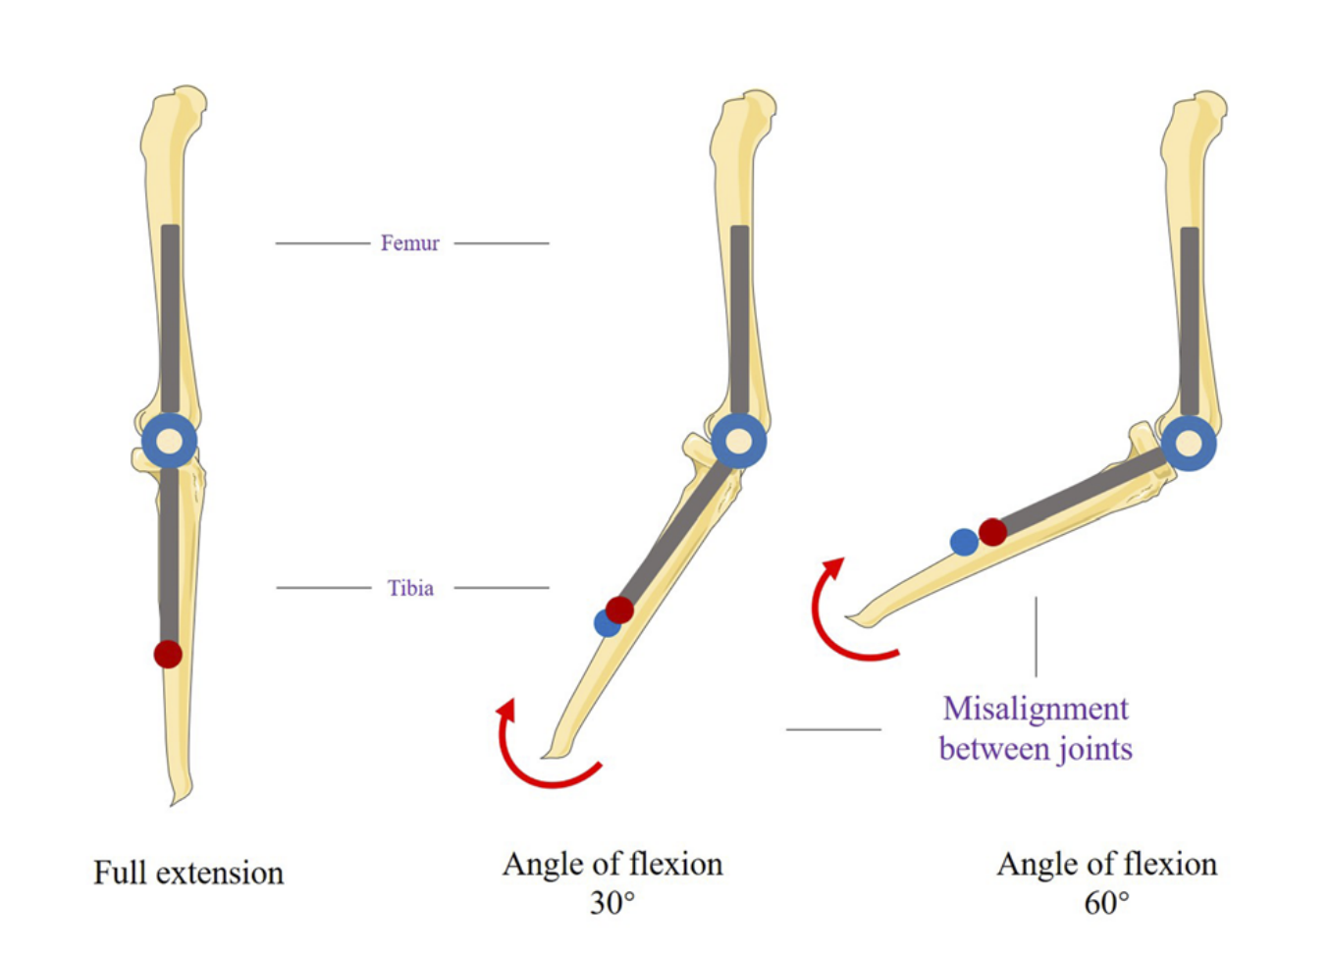
Introduction
- Role of the exoskeletons in recovery process
- Problem of misalignment
- Optimization of exoskeleton’s knee joint mechanism
- Testing the concepts

Slide 4
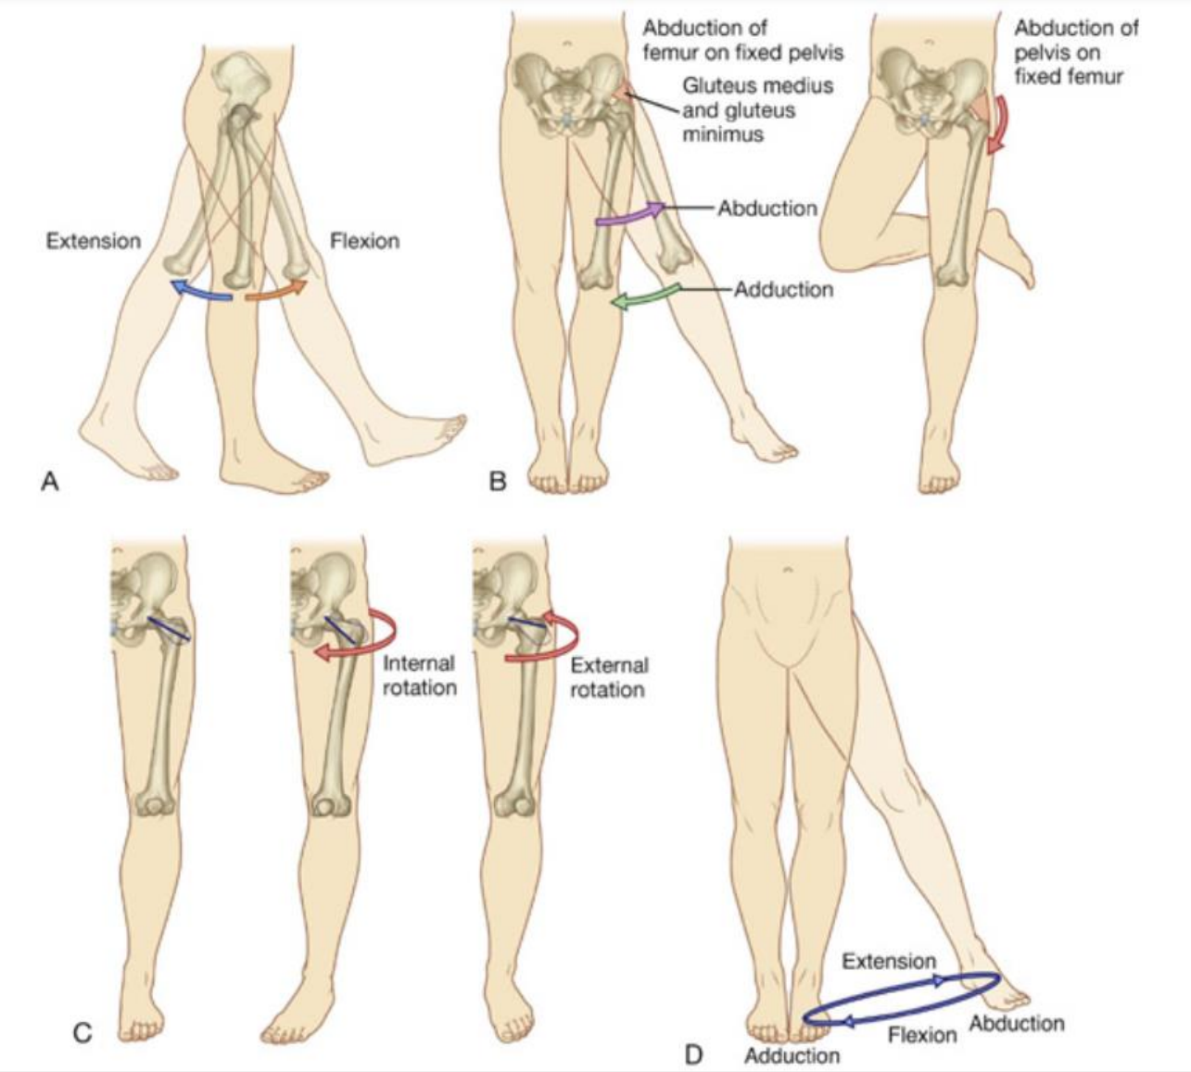
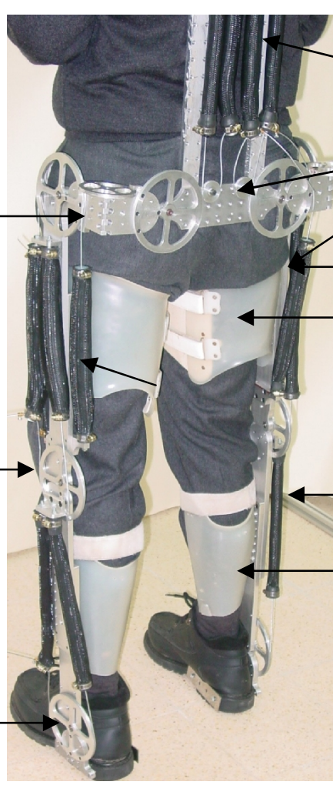
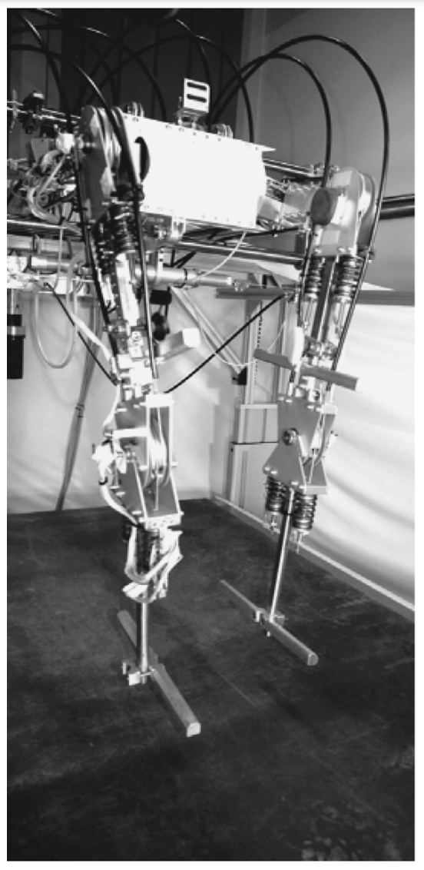
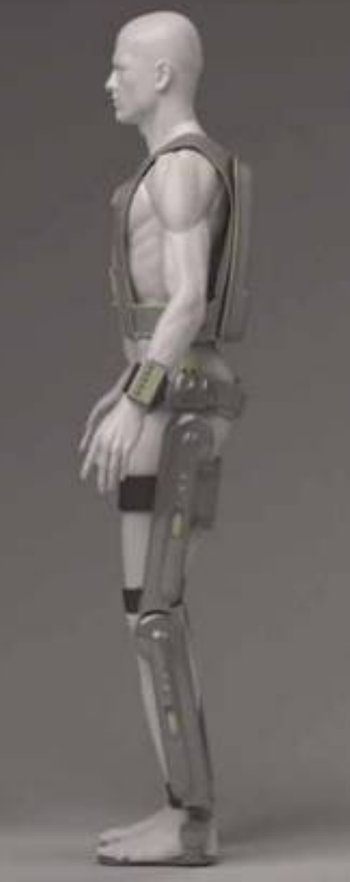
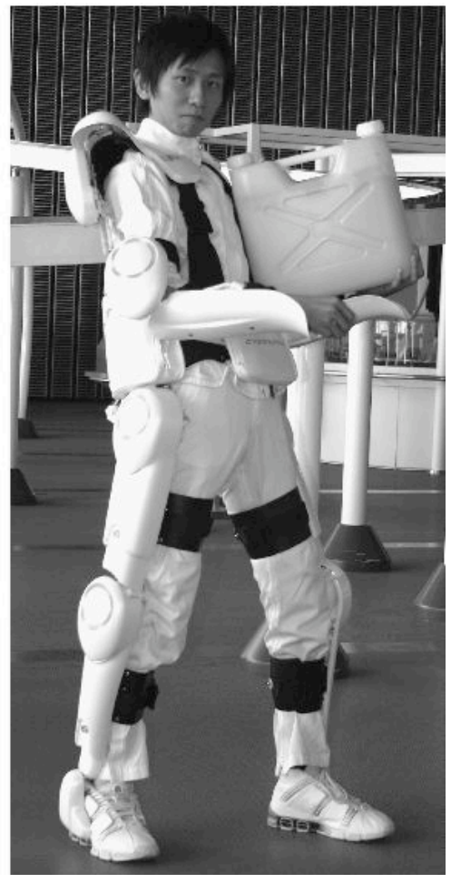
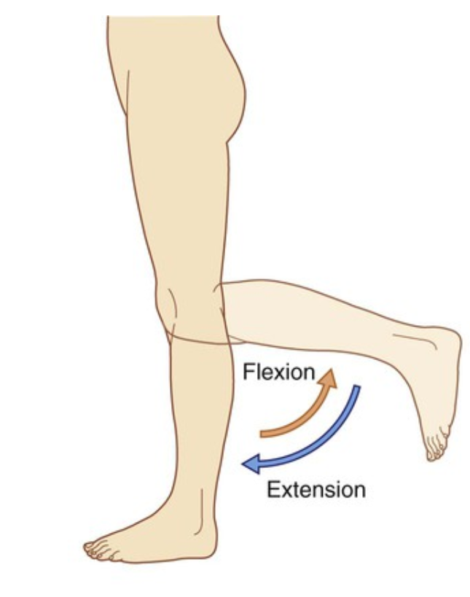
Related works
State-of-the art overview papers – [1][2]
Human lower limb biomechanics – [3][8]
Existing gait rehabilitation exoskeleton examples – [4-7][9-12][15-23]
Optimized knee joint mechanism design – [13][14][24-27]
Knee joint MRI – [28]
3D printing – [29]

Slide 5
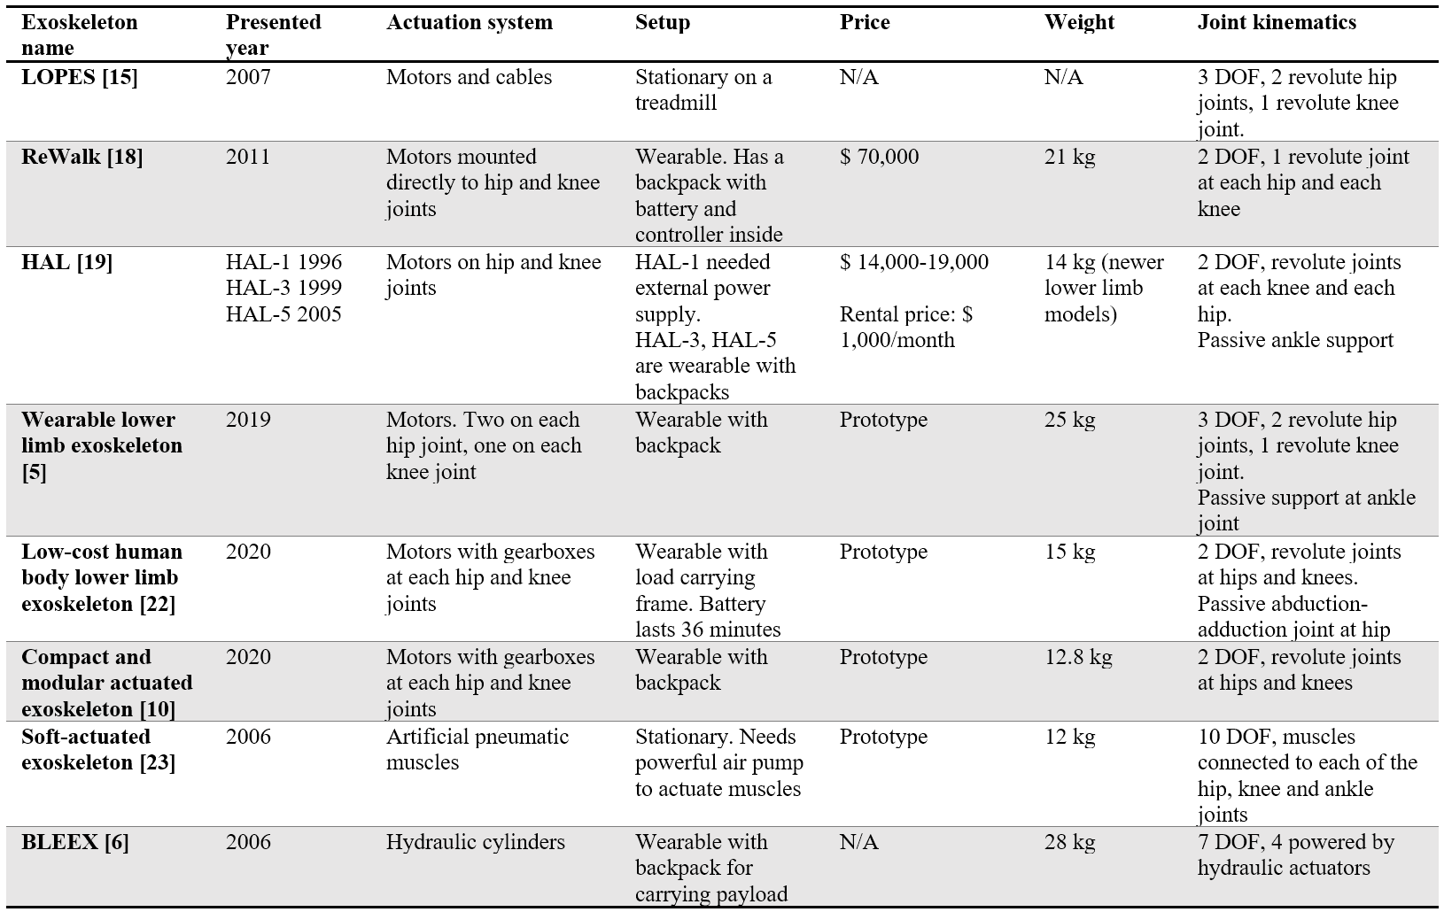
Related works

Slide 6
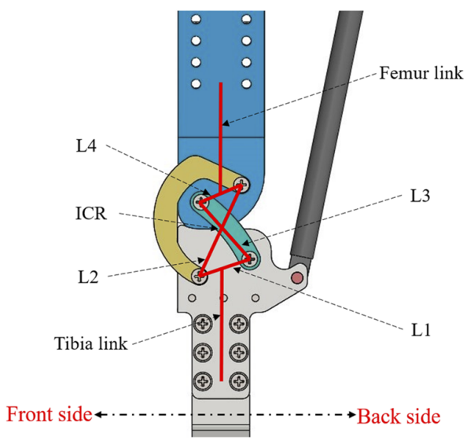
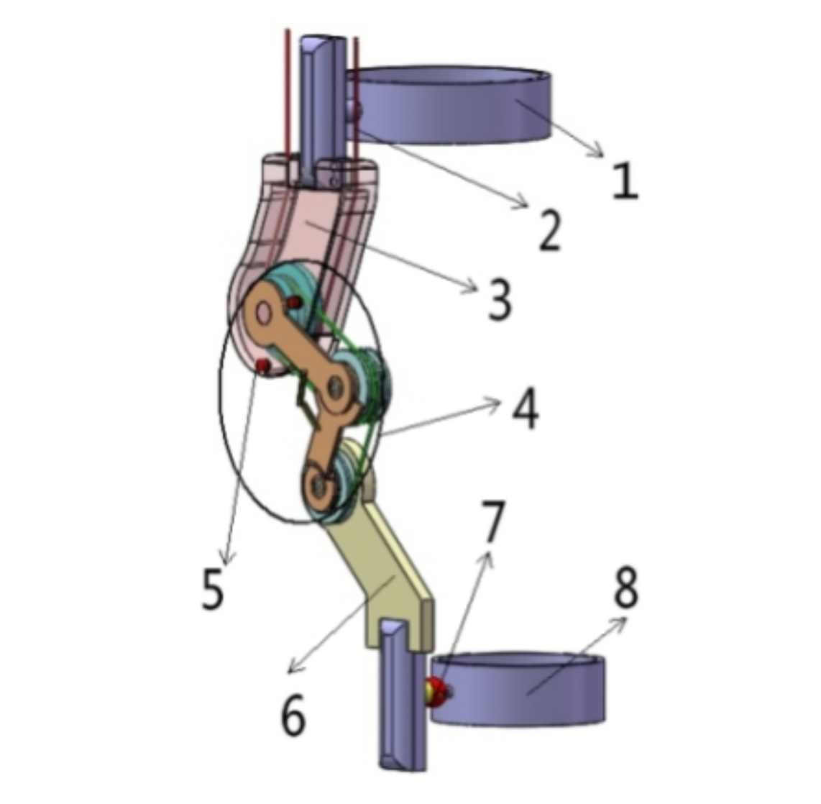
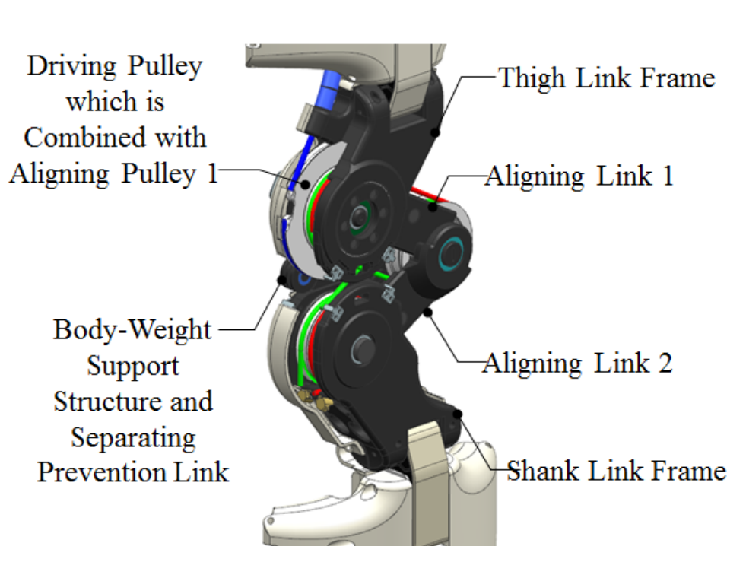
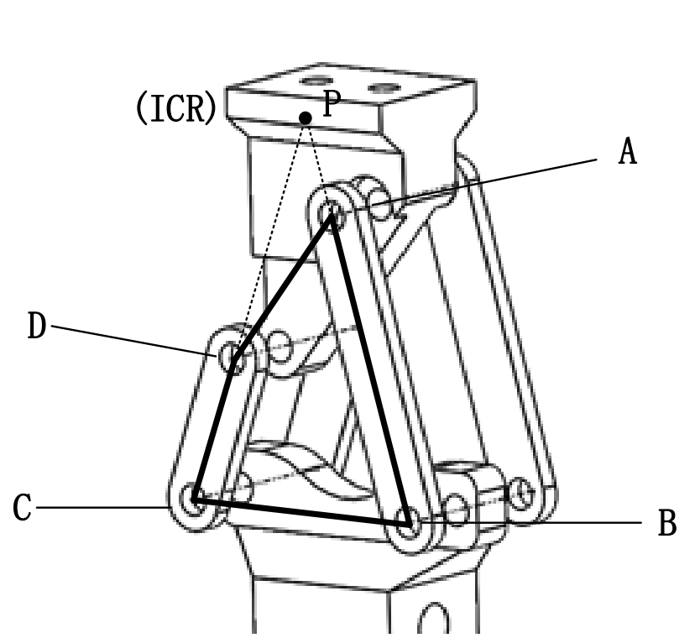
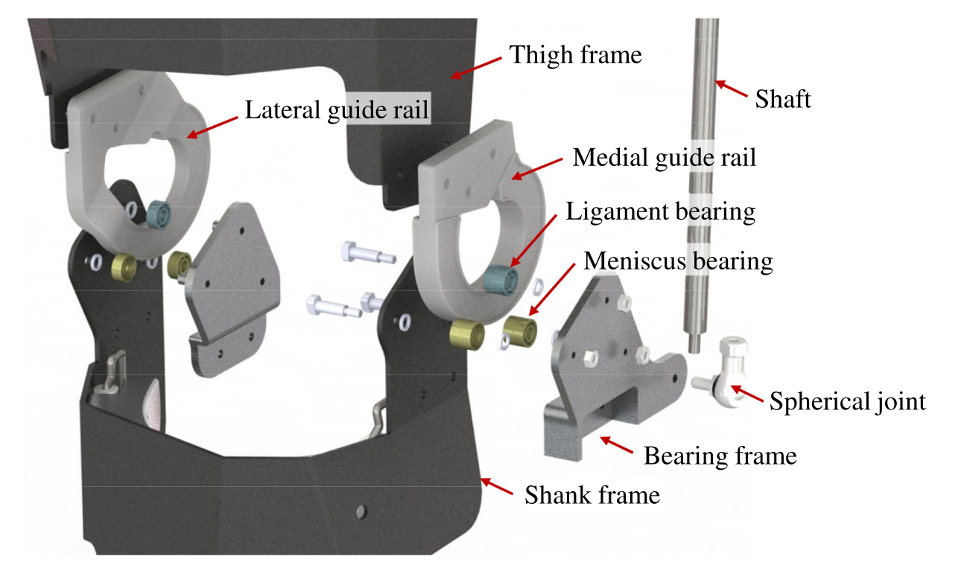
Design concept selection
Four-bar linkage knee joints [24][25]
Self-aligning knee joints [26][27]
Bio-inspired knee joint [14]

Slide 7
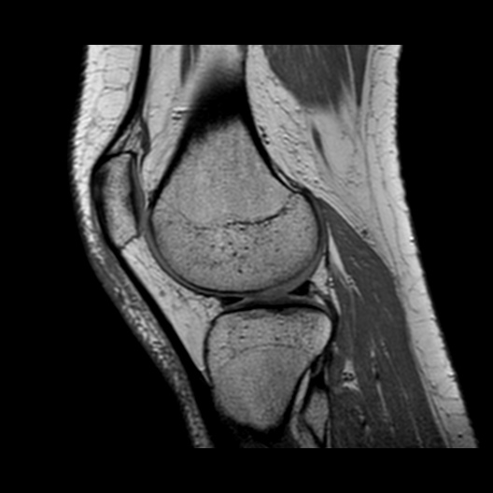
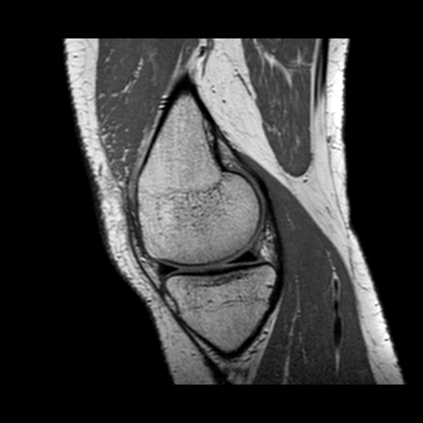
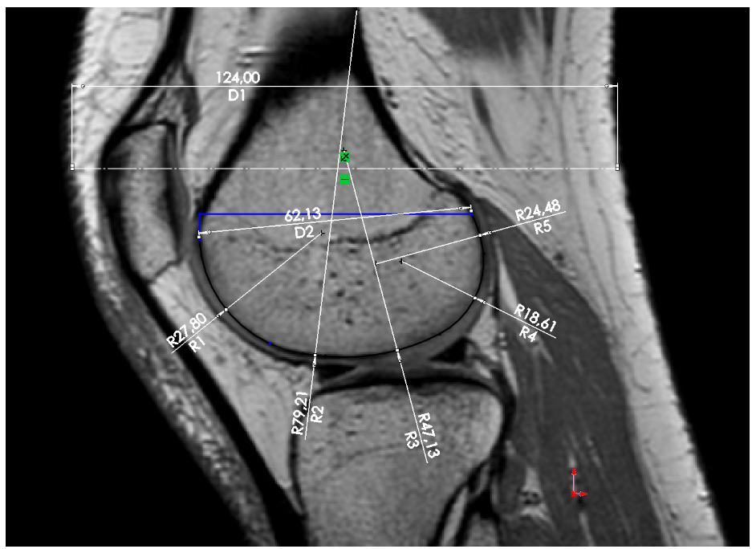
Methodology
Knee joint concept kinematics
Knee joint design with gear teeth
Knee joint design with ball bearings
MRI pictures of knee joint. Left: Lateral condyle. Right: Medial condyle [28]

Slide 8
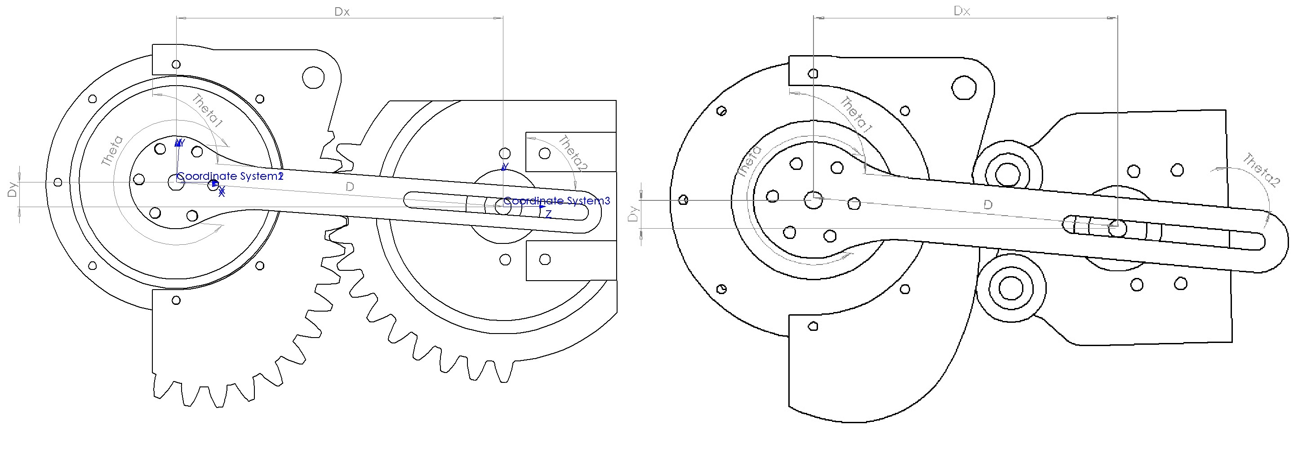
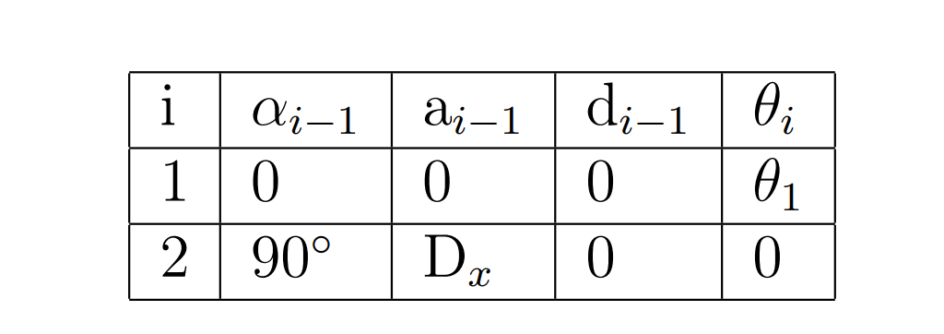
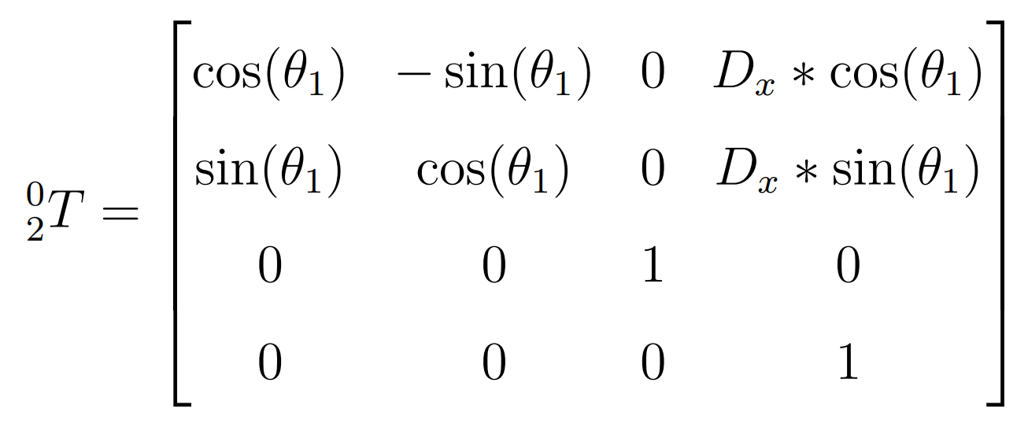
Methodology: Knee joint concept kinematics

Slide 9
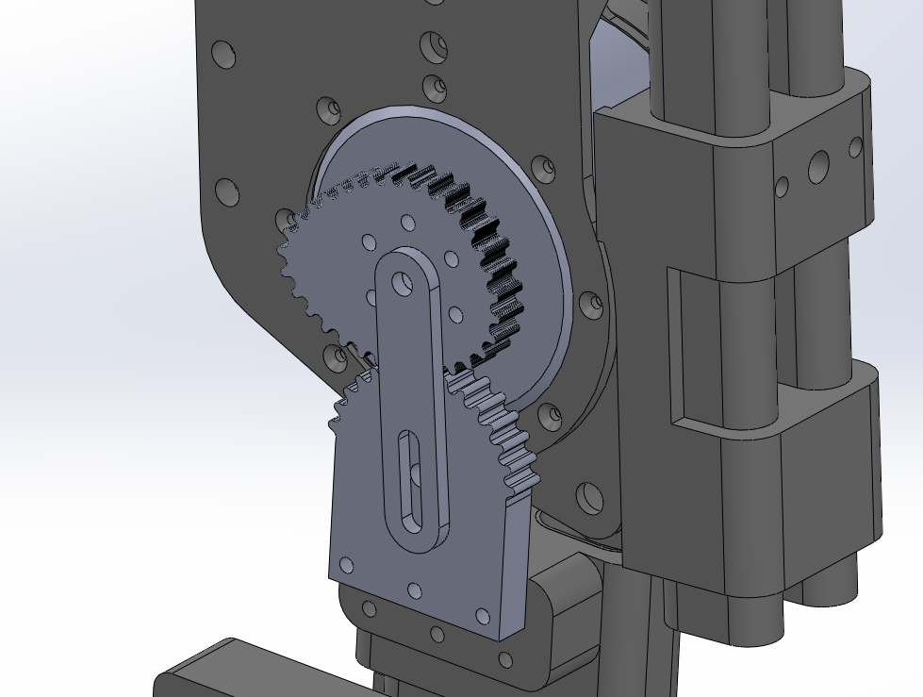
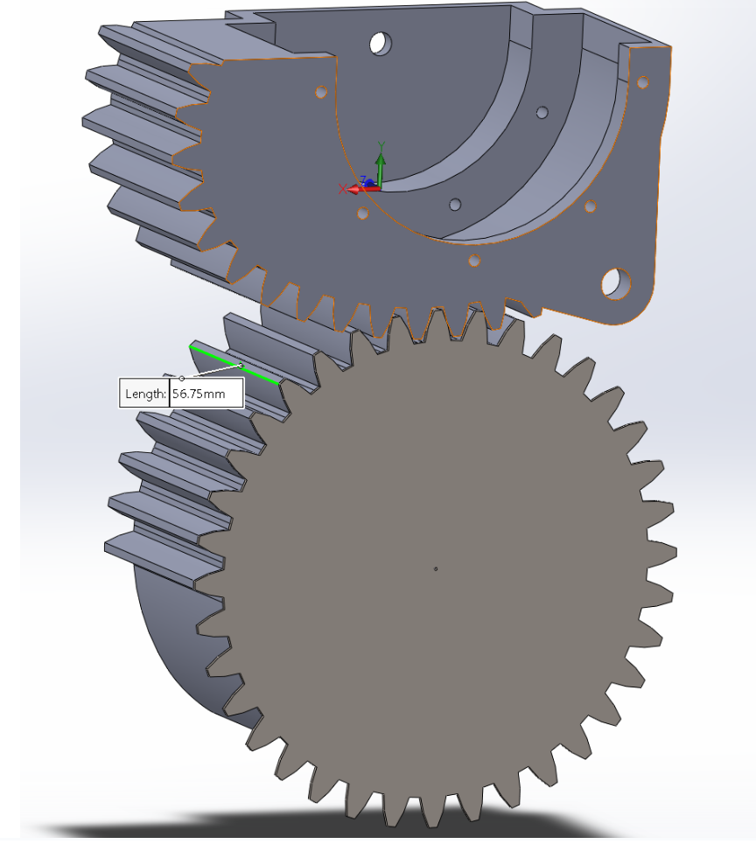
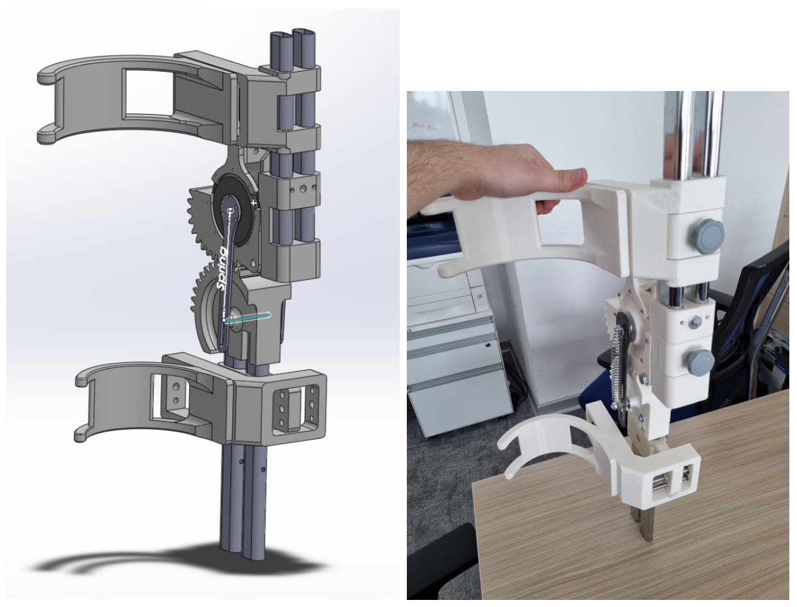
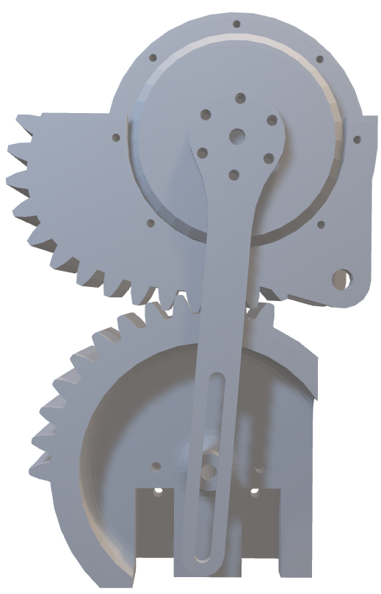
Methodology: Knee joint design with gear teeth
Module – 3,5
# of teeth – 36
Pressure angle – 20
According to the size of femur’s lateral condyle
Scaled up to be compatible with AK80-64 motor

Slide 10
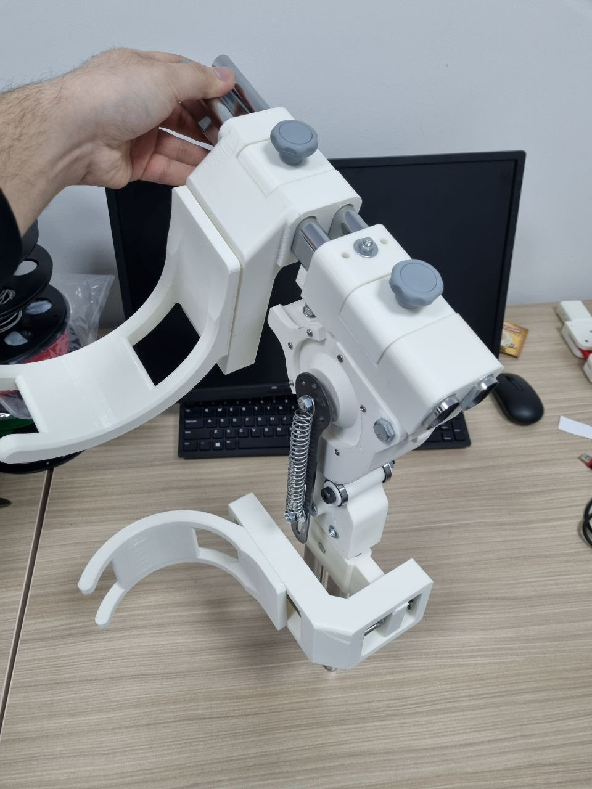
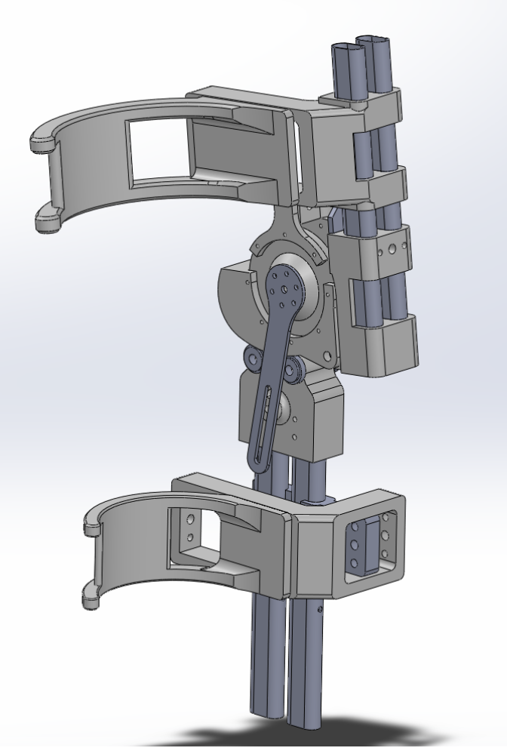
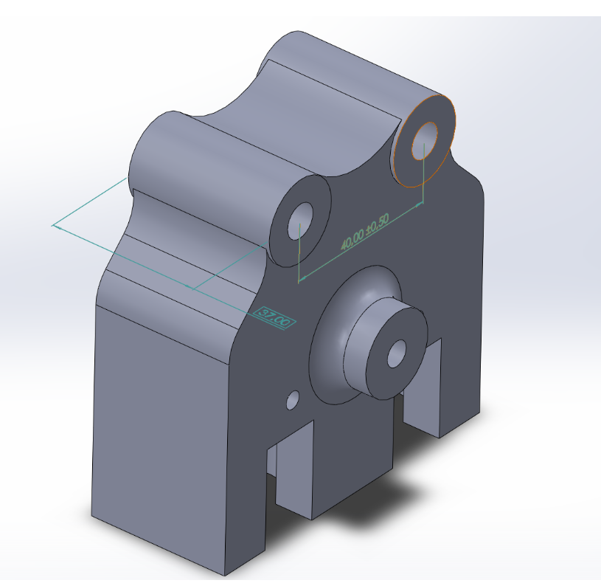
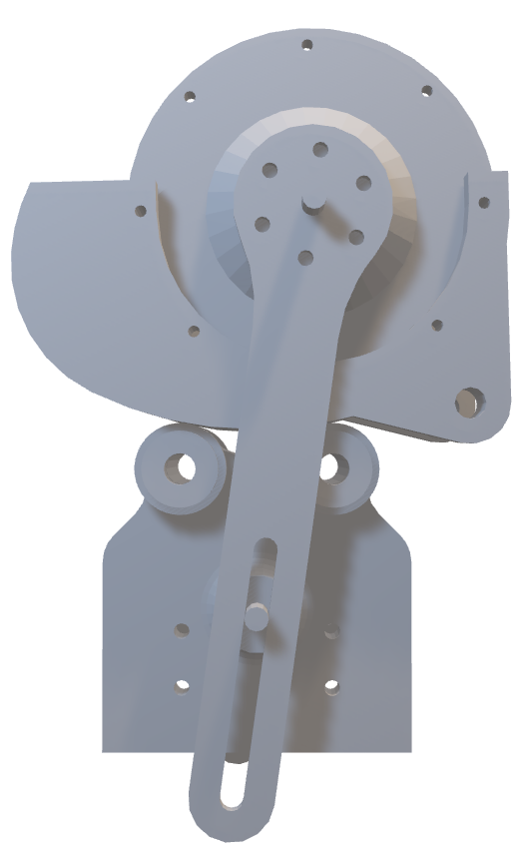
Methodology: Knee joint design with ball bearings
4 steel ball bearings
Plastic bushings

Slide 11
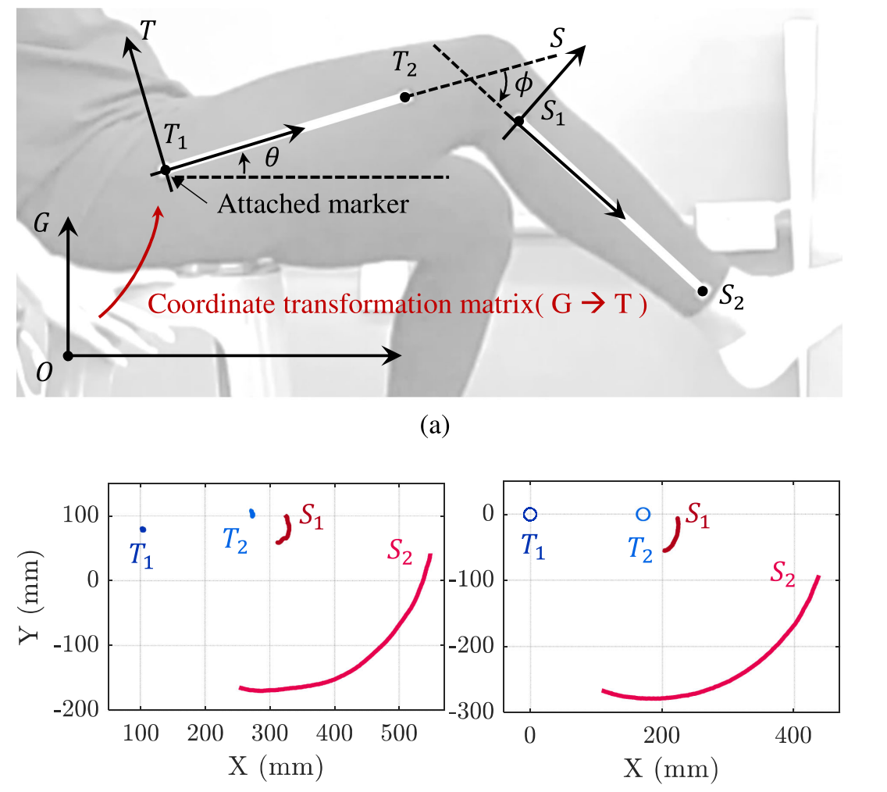
Results: Design validation in CAD software
Trajectory tracking of points in SolidWorks Motion Analysis tool
Comparison with human lower limb motion trajectory during flexion [14]

Slide 12
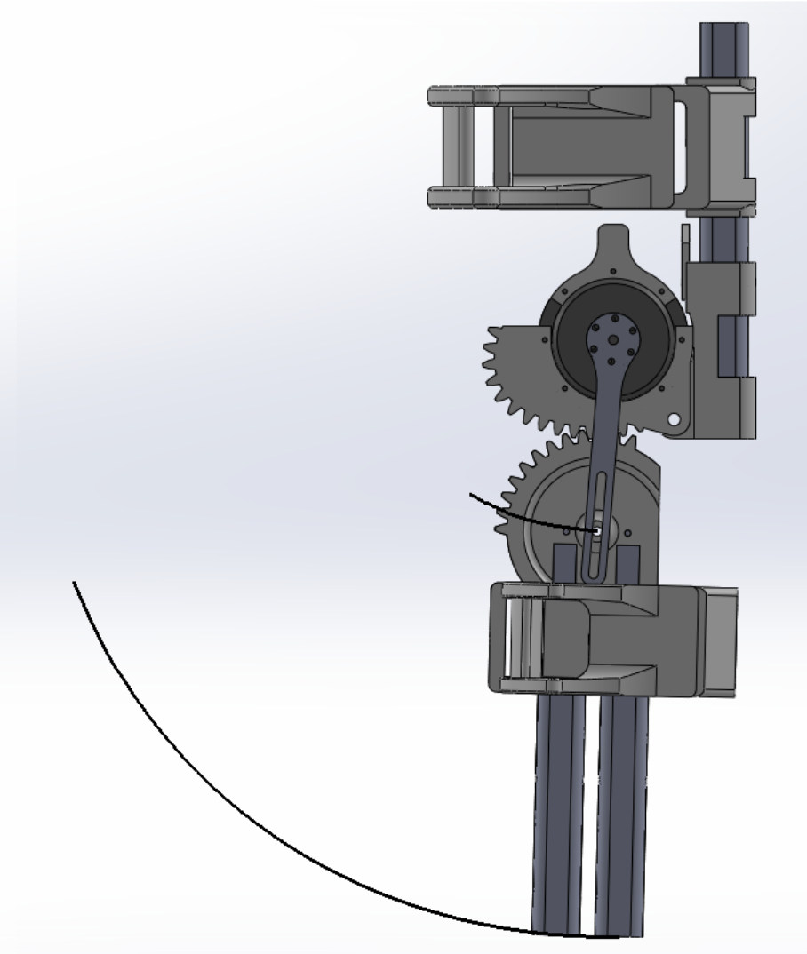
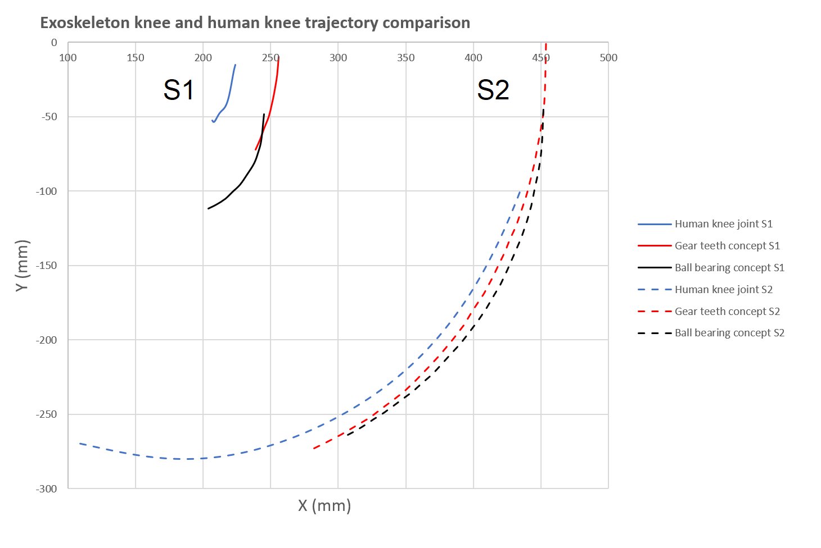
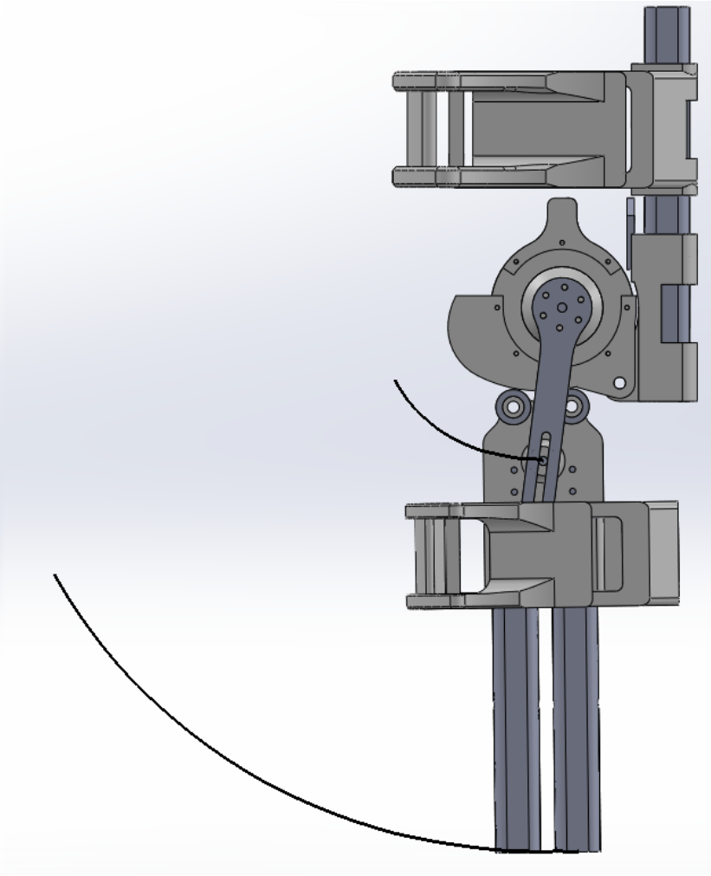
Results: Design validation in CAD software

Slide 13
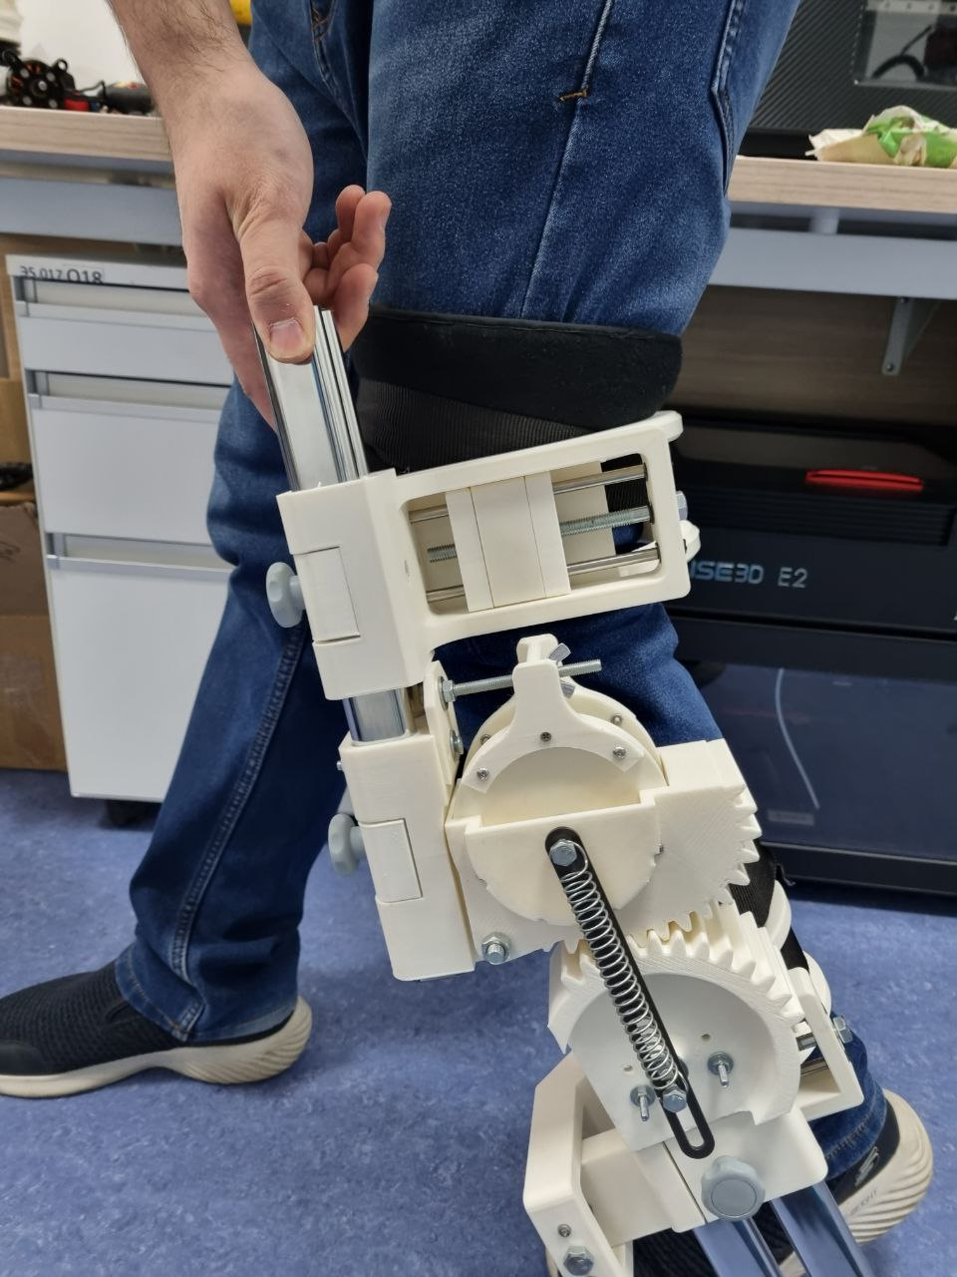
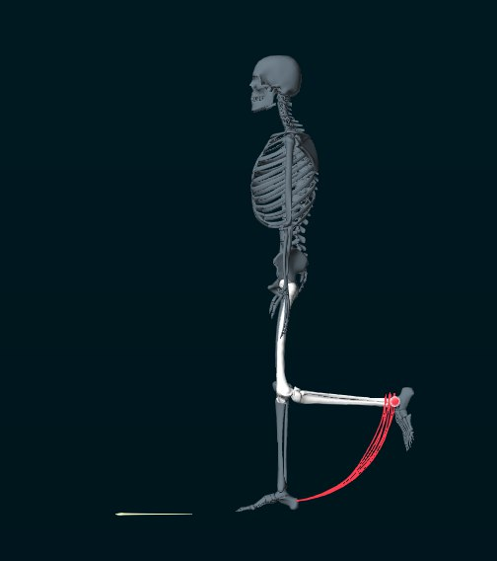
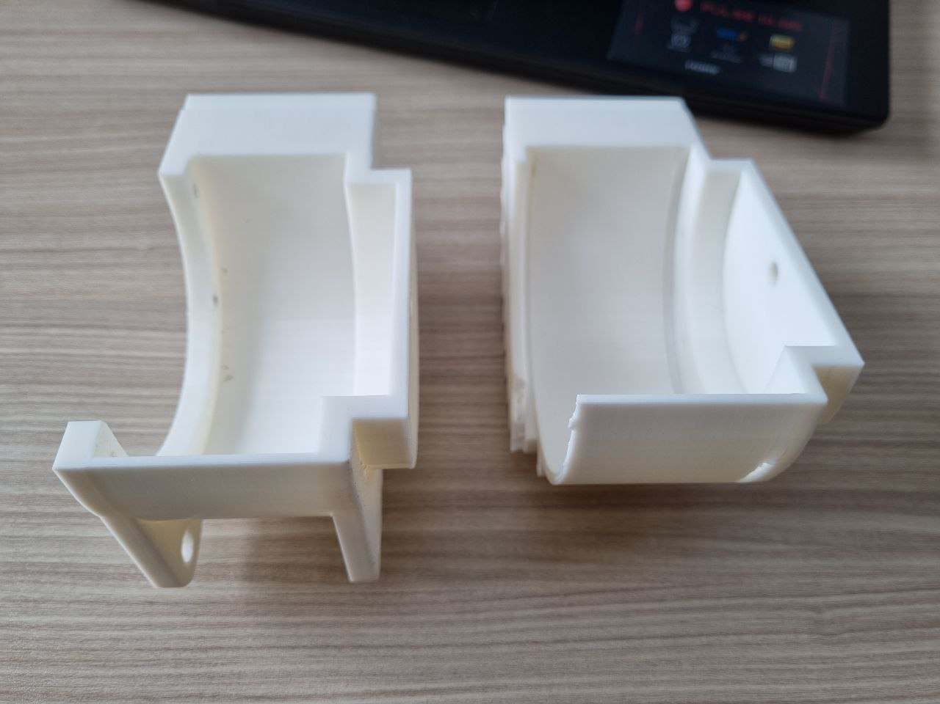
Results: Practical design validation
Evaluation of comfort by wearing the prototype models in practice
Determining the flaws of the prototypes
Using Noraxon’s motion capture technology to compare trajectories in practice

Slide 14
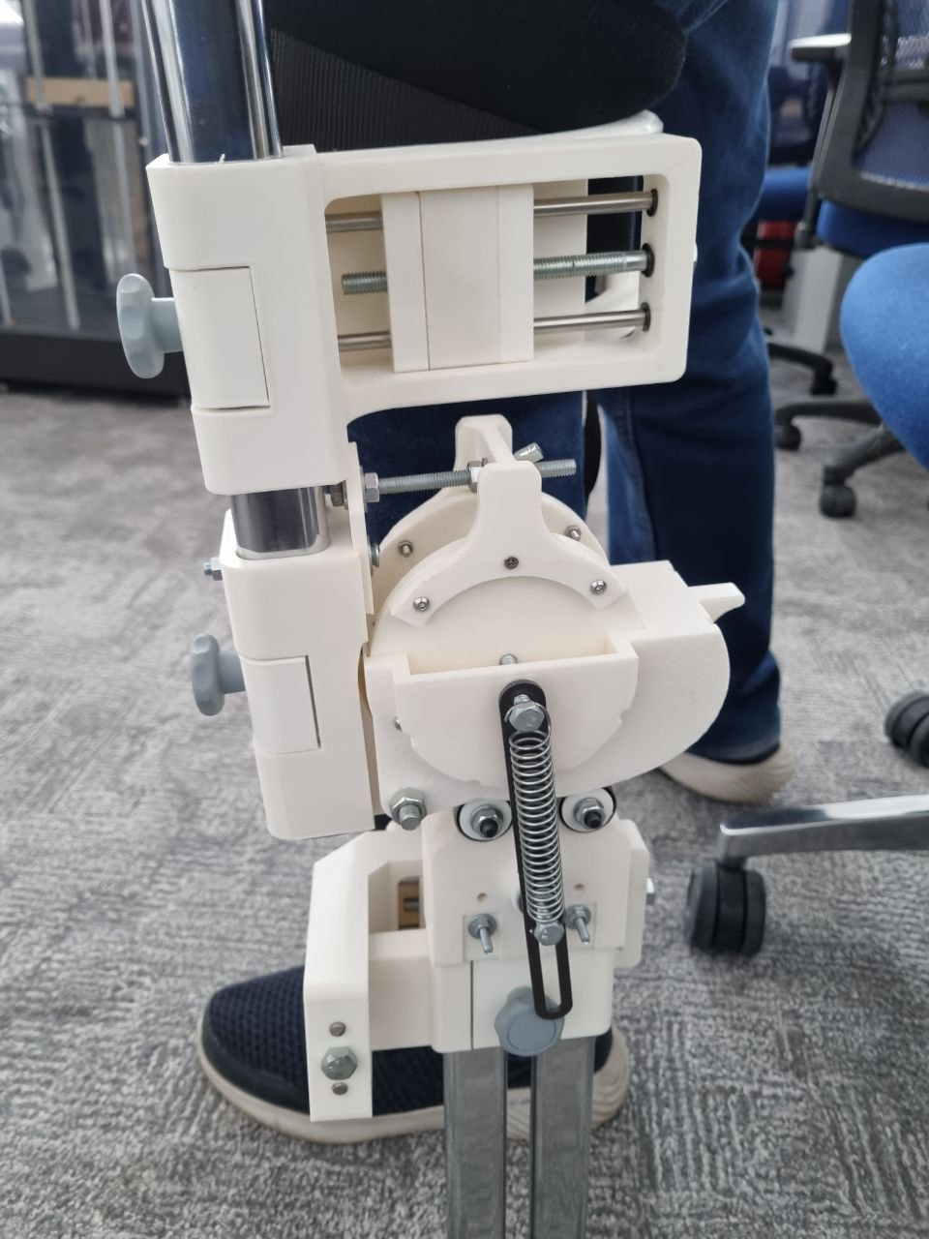
Results: Practical design validation

Slide 15
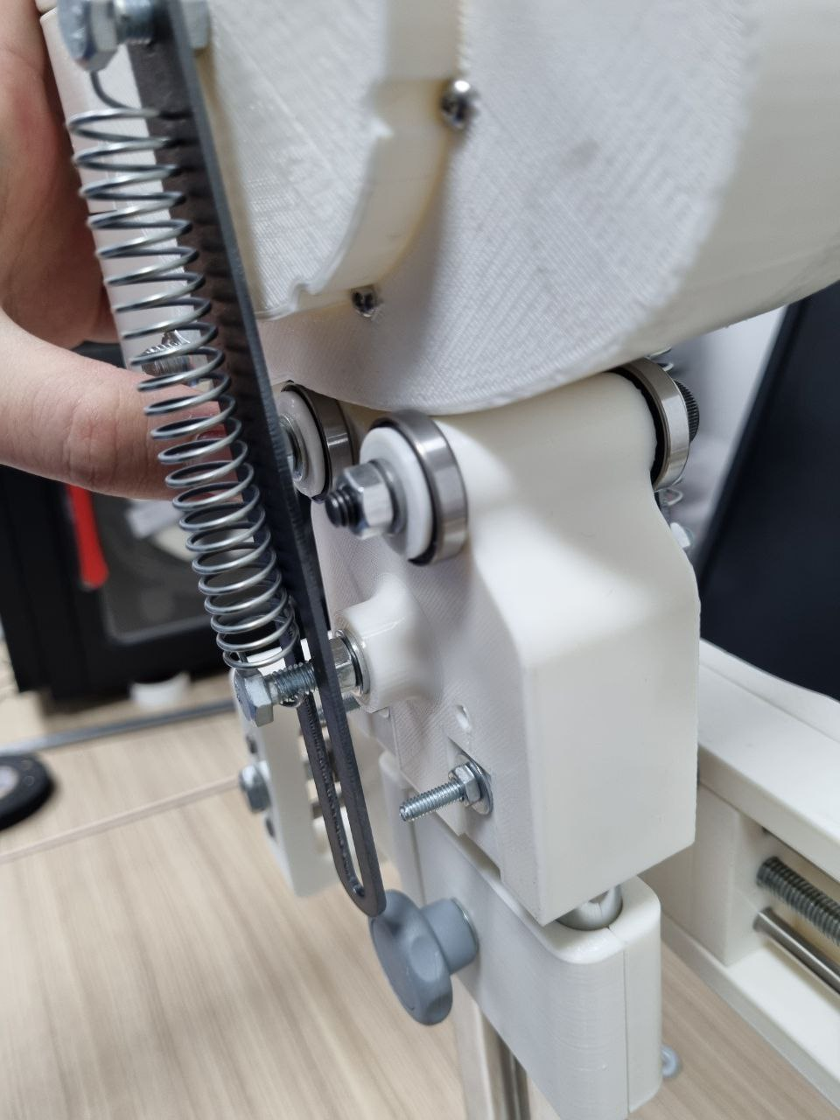
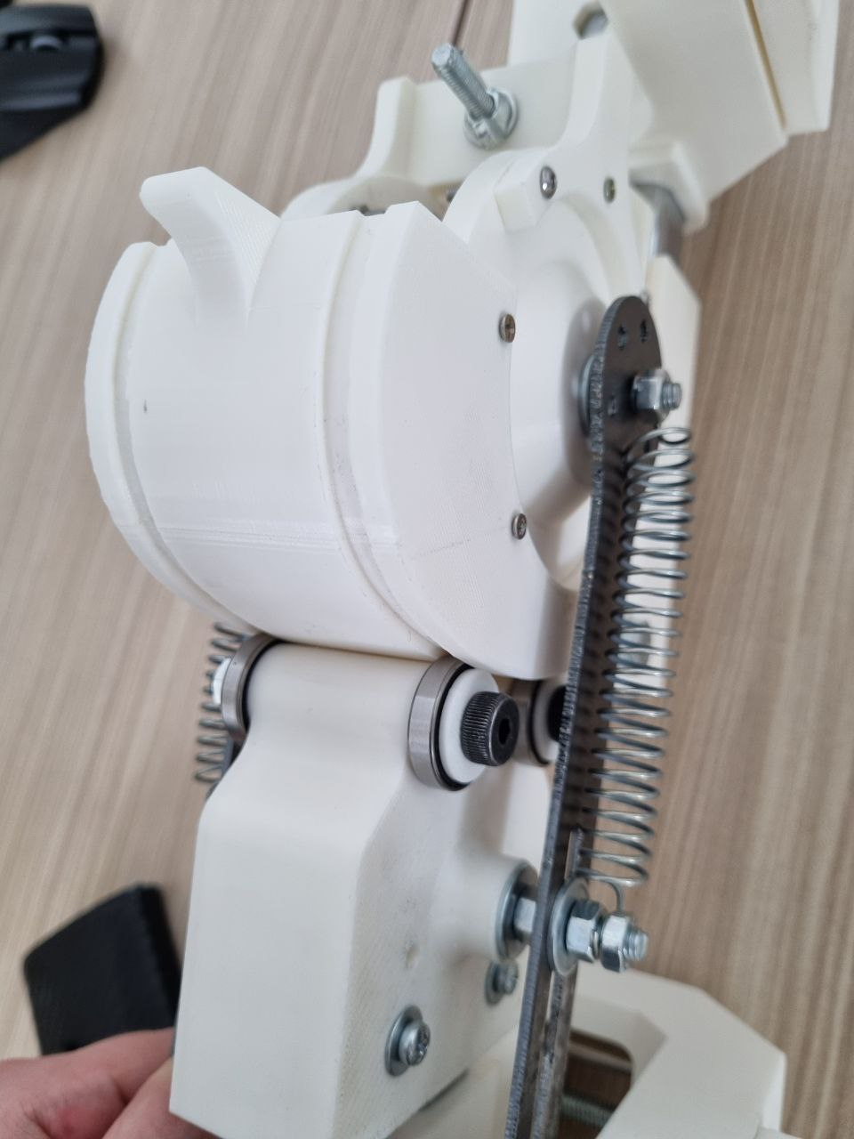
Results: Practical design validation

Slide 16
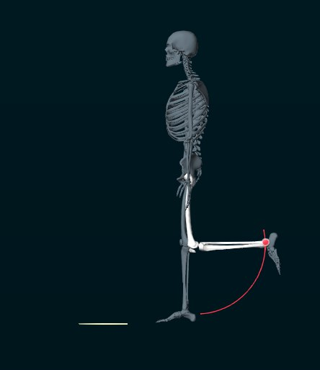
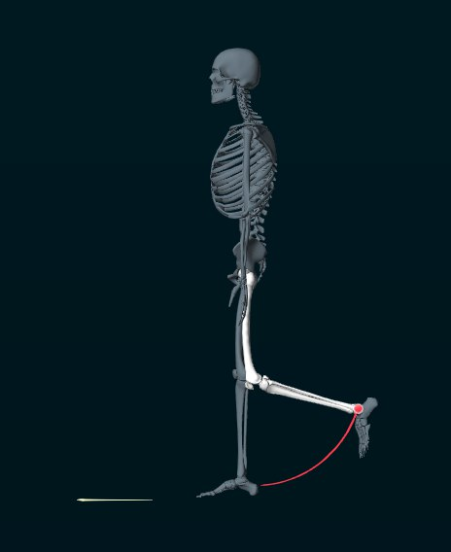
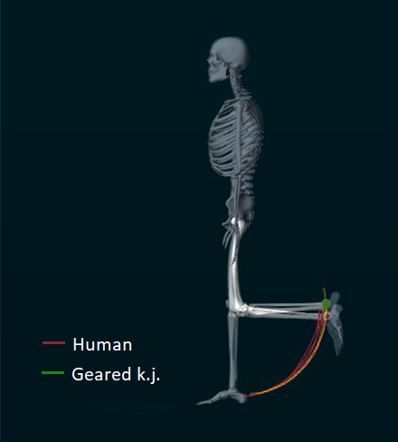
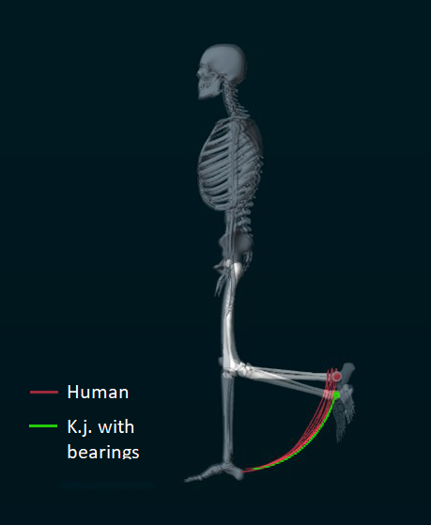
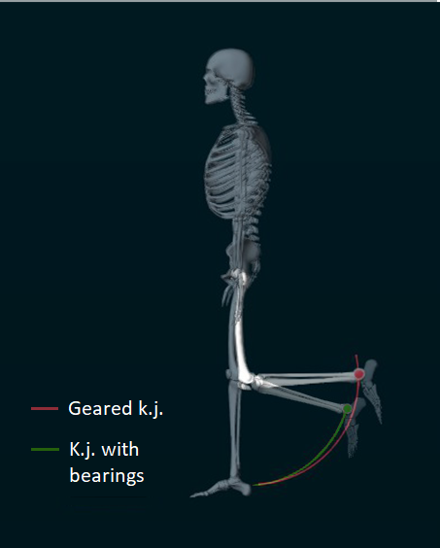
Results: Practical design validation
Human
Gear teeth concept
Ball bearings concept

Slide 17
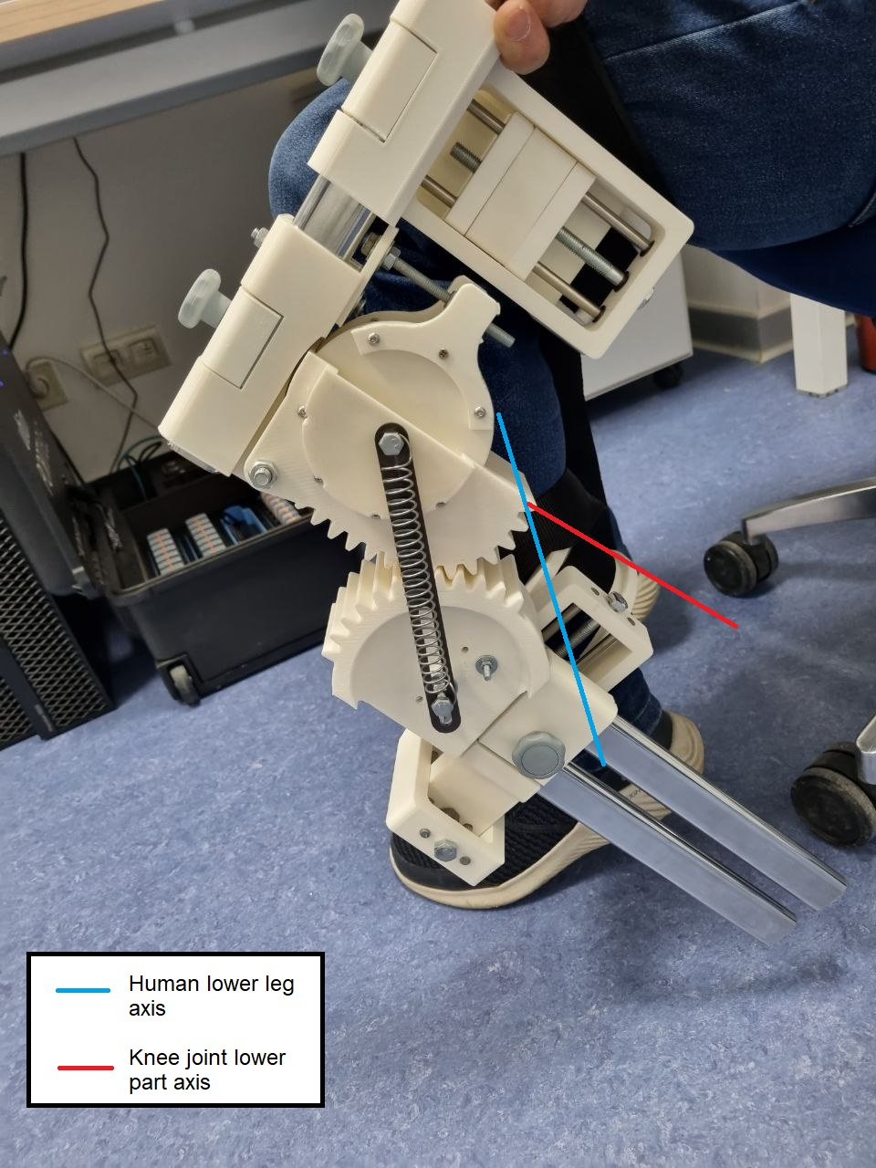
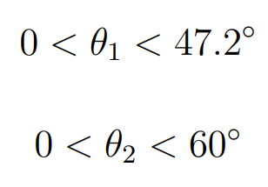

Discussion
Curvature profile of lateral condyle is valid for designing the aligned knee joint
Additional experiments with more subjects are needed
The concept with gear teeth causes overbending after certain flexion angles (unequal number of teeth)
For gait cycle rehabilitation with low swing amplitude both models are valid. For more intense exercises only a design with ball bearings should be used (at this stage)
Gear ratio $=\frac{N2}{N1}=\frac{14}{12}=1.28$
rotation angle of rotor
rotation angle of lower gear

Slide 18
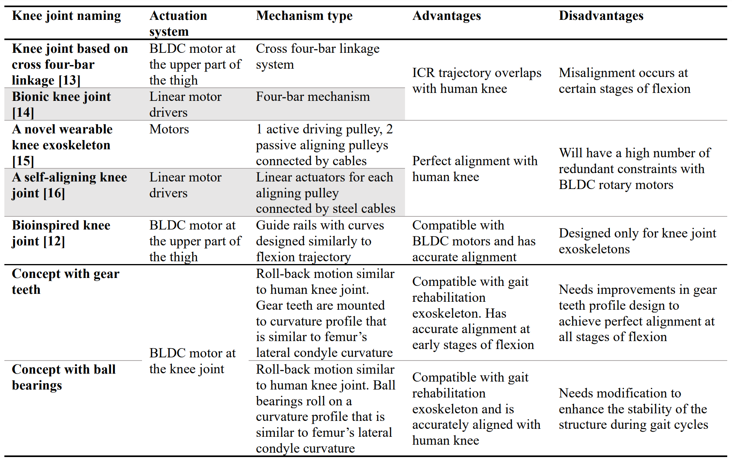
Discussion

Slide 19
Conclusion
Properly aligned knee joint concept was created
Design flaws were identified
The concept with gear teeth needs modification of the design to solve an overbending issue
More clinical trials on test subjects are needed

Slide 20
Thank you for attention!
Q/A?
Special thanks to Aibek Niyetkaliyev, Prashant Jamwal,
Daulet Sagidoldin and Yeltay Rakhmanov!

Slide 21
References
[1] D. Calafiore, F. Negrini, N. Tottoli, F. Ferraro, O. Ozyemisci-Taskiran, and A. de Sire, “Efficacy of robotic exoskeleton for gait rehabilitation in patients with subacute stroke: A systematic review.,” European Journal of Physical and Rehabilitation Medicine, vol. 58, no. 1, pp. 1–8, 2021.
[2] P. K. Jamwal, S. Hussain, and M. H. Ghayesh, “Robotic orthoses for gait rehabilitation: An overview of mechanical design and control strategies,” Proceedings of the Institution of Mechanical Engineers, Part H: Journal of Engineering in Medicine, vol. 234, no. 5, pp. 444–457, 2020.
[3] F. F. Buechel and M. J. Pappas, Principles of human joint replacement: design and clinical application. Springer, 2015.
[4] K. Shamaei, M. Cenciarini, A. A. Adams, K. N. Gregorczyk, J. M. Schiffman, and A. M. Dollar, “Design and evaluation of a quasi-passive knee exoskeleton for investigation of motor adaptation in lower extremity joints,” IEEE Transactions on Biomedical Engineering, vol. 61, no. 6, pp. 1809–1821, 2014.
[5] L. Luo, Y. Yuan, and Z. Li, “Design and development of a wearable lower limb exoskeleton robot,” in 2019 IEEE 4th International Conference on Advanced Robotics and Mechatronics (ICARM), IEEE, 2019, pp. 599–604.
[6] A. B. Zoss, H. Kazerooni, and A. Chu, “Biomechanical design of the berkeley lower extremity exoskeleton (bleex),” IEEE/ASME Transactions on mechatronics, vol. 11, no. 2, pp. 128–138, 2006.
[7] S. Zhou, Z. Chen, W. Song, S. Zhu, L. Jin, and J. Gu, “Design and gait realization of power-assisted lower limbs exoskeleton,” in 2019 IEEE International Conference on Cybernetics and Intelligent Systems (CIS) and IEEE Conference on Robotics, Automation and Mechatronics (RAM), IEEE, 2019, pp. 101–106.

Slide 22
References
[8] R. Drake, A. W. Vogl, and A. W. Mitchell, Gray’s anatomy for students E-book. Elsevier Health Sciences, 2009.
[9] J. Wang, Y. Pang, X. Chang, W. Chen, and J. Zhang, “Mechanical design and optimization on lower limb exoskeleton for rehabilitation,” in 2019 14th IEEE Conference on Industrial Electronics and Applications (ICIEA), IEEE, 2019, pp. 137–142.
[10] Y. Li, X. Guan, X. Han, et al., “Design and preliminary validation of a lower limb exoskeleton with compact and modular actuation,” IEEE access, vol. 8, pp. 66 338–66 352, 2020.
[11] J. Gao, Y. Zhang, and J. Liu, “A novel human lower limb simulation test system for gravity-counteracting exoskeletons,” in 2021 4th International Conference on Intelligent Robotics and Control Engineering (IRCE), IEEE, 2021, pp. 16–19.
[12] M. G. Mckinley, Design of lightweight assistive exoskeletons for individuals with mobility disorders. University of California, Berkeley, 2014.
[13] I. D. Geonea and D. Tarnita, “Design and evaluation of a new exoskeleton for gait rehabilitation,” Mechanical Sciences, vol. 8, no. 2, pp. 307–321, 2017.
[14] T. Kim, M. Jeong, and K. Kong, “Bioinspired knee joint of a lower-limb exoskeleton for misalignment reduction,” IEEE/ASME Transactions on Mechatronics, vol. 27, no. 3, pp. 1223–1232, 2021.
[15] J. F. Veneman, R. Kruidhof, E. E. Hekman, R. Ekkelenkamp, E. H. Van Asseldonk, and H. Van Der Kooij, “Design and evaluation of the lopes exoskeleton robot for interactive gait rehabilitation,” IEEE Transactions on neural systems and rehabilitation engineering, vol. 15, no. 3, pp. 379–386, 2007.

Slide 23
References
[16] D. J. Reinkensmeyer, D. Aoyagi, J. L. Emken, et al., “Tools for understanding and optimizing robotic gait training,” Journal of rehabilitation research and development, vol. 43, no. 5, p. 657, 2006.
[17] H. Schmidt, C. Werner, R. Bernhardt, S. Hesse, and J. Krüger, “Gait rehabilitation machines based on programmable footplates,” Journal of neuroengineering and rehabilitation, vol. 4, no. 1, pp. 1–7, 2007.
[18] A. Esquenazi, M. Talaty, A. Packel, and M. Saulino, “The rewalk powered exoskeleton to restore ambulatory function to individuals with thoracic-level motor-complete spinal cord injury,” American journal of physical medicine & rehabilitation, vol. 91, no. 11, pp. 911–921, 2012.
[19] G. Zeilig, H. Weingarden, M. Zwecker, I. Dudkiewicz, A. Bloch, and A. Esquenazi, “Safety and tolerance of the rewalk™ exoskeleton suit for ambulation by people with complete spinal cord injury: A pilot study,” The journal of spinal cord medicine, vol. 35, no. 2, pp. 96–101, 2012.
[20] Y. Sankai, “Hal: Hybrid assistive limb based on cybernics,” in Robotics Research: The 13th International Symposium ISRR, Springer, 2011, pp. 25–34.
[21] H. Kawamoto and Y. Sankai, “Power assist system hal-3 for gait disorder person,” in Computers Helping People with Special Needs: 8th International Conference, ICCHP 2002 Linz, Austria, July 15–20, 2002 Proceedings 8, Springer, 2002, pp. 196–203.
[22] Y. Pirjade, D. Londhe, N. Patwardhan, A. Kotkar, T. Shelke, and S. Ohol, “Design and fabrication of a low-cost human body lower limb exoskeleton,” in 2020 6th International Conference on Mechatronics and Robotics Engineering (ICMRE), IEEE, 2020, pp. 32–37.
[23] N. Costa and D. G. Caldwell, “Control of a biomimetic" soft-actuated" 10dof lower body exoskeleton,” in The First IEEE/RAS-EMBS International Conference on Biomedical Robotics and Biomechatronics, 2006. BioRob 2006., IEEE, 2006, pp. 495–501.

Slide 24
References
[24] M. Gao, Z. Wang, S. Li, et al., “Design and optimization of exoskeleton structure of lower limb knee joint based on cross four-bar linkage,” AIP Advances, vol. 11, no. 6, p. 065 124, 2021.
[25] Y. Xiao, X. Ji, H. Wu, X. Zhai, X. Fu, and J. Zhao, “Bionic knee joint structure and motion analysis of a lower extremity exoskeleton,” in 2020 4th International Conference on Robotics and Automation Sciences (ICRAS), IEEE, 2020, pp. 91– 95.
[26] X. Tang and L. Chen, “Structural design of a novel wearable knee exoskeleton,” in 2018 8th International Conference on Manufacturing Science and Engineering (ICMSE 2018), Atlantis Press, 2018, pp. 348–353.
[27] B. Choi, Y. Lee, J. Kim, et al., “A self-aligning knee joint for walking assistance devices,” in 2016 38th Annual International Conference of the IEEE Engineering in Medicine and Biology Society (EMBC), IEEE, 2016, pp. 2222–2227.
[28] T. Lujikx, “Normal knee mri,” in Case study, Radiopaedia.org, 2023.
[29] E. E. Cho, H. H. Hein, Z. Lynn, S. J. Hla, and T. Tran, “Investigation on influence of infill pattern and layer thickness on mechanical strength of pla material in 3d printing technology,” J. Eng. Sci. Res, vol. 3, no. 2, pp. 27–37, 2019.

