Slide 1
Real-time Speech Emotion Recognition (RSER) in Wireless Multimedia Sensor Networks
Supervisor:
Dr. Adnan Yazici
adnan.yazici@nu.edu.kz
Co-supervisor:
Dr. Enver Ever
eever@metu.edu.tr
Serik Zhilibayev
serik.zhilibayev@nu.edu.kz

Slide 2
Presentation Outline
Introduction
Databases
Methodology
  Preprocessing
  Acoustic Features
  Voice Activity Detection
  Speech Emotion Recognition Models
  Hardware Setup
  Real time Prediction Scenarios in WMSN
Results
  Feature Extraction Results
  Modelling Results
  Real time Prediction Scenarios in WMSN results
Conclusion

Slide 3
Introduction

Slide 4
Wireless Multimedia Sensor Network (WMSN)
Collection of sensing devices that can communicate wirelessly.
Advantages:
  Scalable
  Simple
  Resilient
Disadvantages
  Hardware Constraints
  Energy Constraints
  Bandwidth

Slide 5
Real-time Speech Emotion Recognition in WMSN
Human emotions are one of the significant indicators of the state of mind and health.
Speech Emotion Recognition is highly important in fields such as client service, healthcare, self-driving cars.
State-of-the-art researches:
  Considering only performance in terms of accuracy and precision
  Not considering Quality of Service in constrained devices

Slide 6
Aim
Test recent SER models on Constrained Devices
Propose fast and simple speaker independent Speech Emotion Recognition Model
Show that Real-time Speech Emotion Recognition on Edge is efficient in terms of QoS.

Slide 7
Databases

Slide 8
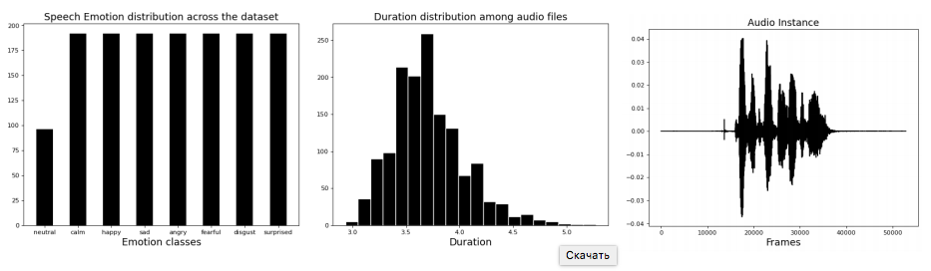
RAVDESS [7]
1440 utterances (12 male, 12 female)
English language
8 Emotion Classes

Slide 9
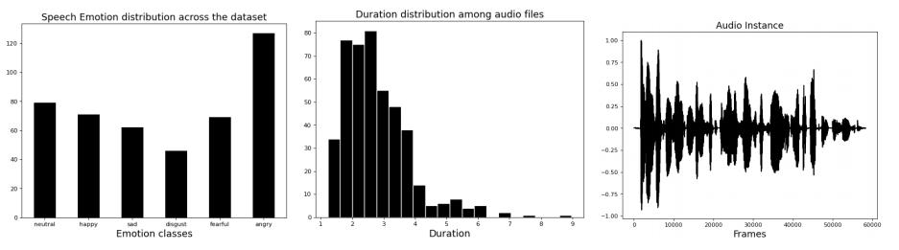
EMODB[6]
535 utterances (5 male, 5 female)
German language
6 emotion classes

Slide 10
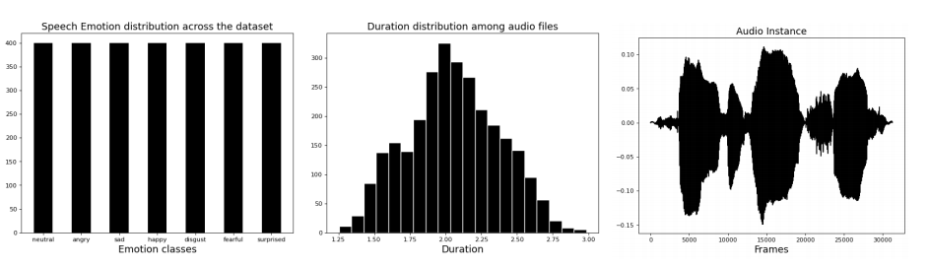
IMEOCAP[5]
2800 utterances (only 2 speakers)
English language
7 emotion classes

Slide 11
Methodology

Slide 12
Preprocessing
Silence Removal
Data Augmentation
  Adding Noise
  Shift the Audio
  Stretch

Slide 13
Acoustic Features
Spectral Features
  Chroma
  Tonnetz
  Spectral Contrast
  Mel-Spectrogram
  MFCC
Common Standards (Low Level Descriptors)
  eGeMAPS
  ComparE
  GeMAPS

Slide 14
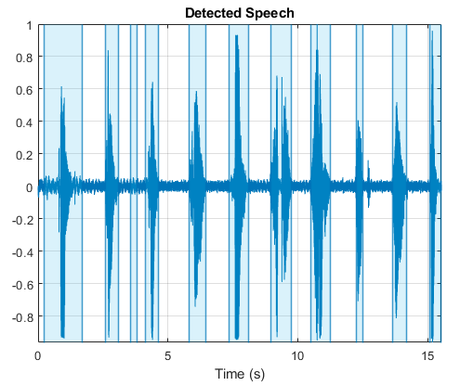
Voice Activity Detection
Voice activity detection is an algorithm that segments speech regions from the audio stream.

Slide 15
Voice Activity Detection Algorithm Features
Spectral flatness - provides a way to quantify how tone-like a sound is, as opposed to being noise-like. The probability that a sound is a noise. Threshold is less than 5%.
Short Term Energy - it is measured with Decibels (dB). Perceptible loudness indicator. Threshold is more than -40Db.
Most dominant Frequency Component - the frequency level with the maximum magnitude. Threshold is more than 158Hz.
If at least one conditions is satisfied with thresholds, given frame is labeled as a speech frame [1].

Slide 16
Speech Emotion Recognition Models
4 Models are proposed to be tested and analysed
1D CNN Model
2D CNN Model
1D LSTM Model
1D Self-Attention Model

Slide 17
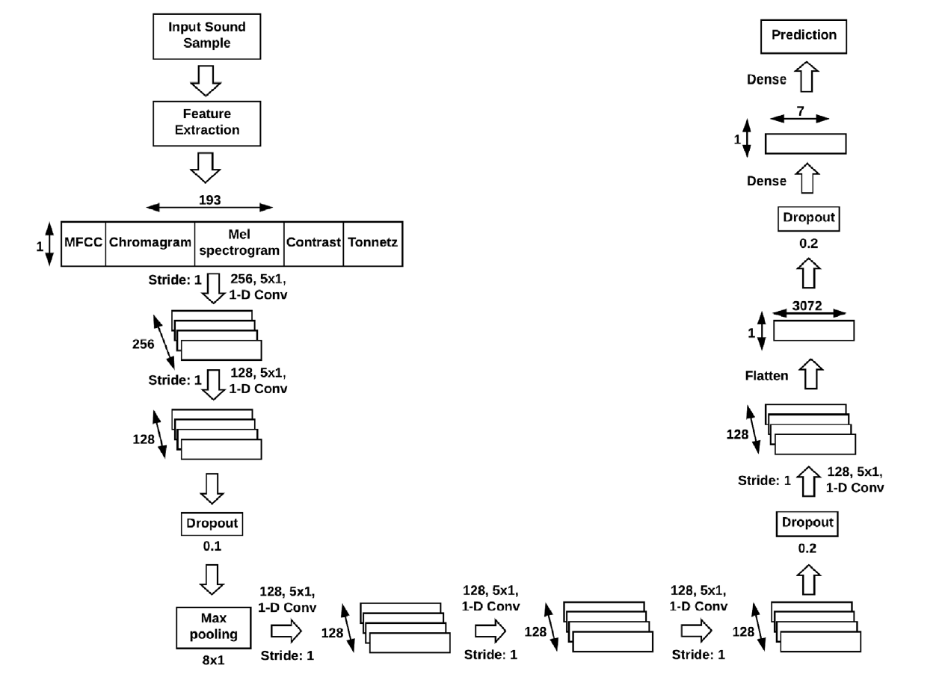
1D CNN Model
Model is proposed by Issa et al. [2]
Input: mean([MFCC, Spectral Contrast, Mel-Spectrogram, Chroma, Tonnetz], axis=’time’)

Slide 18
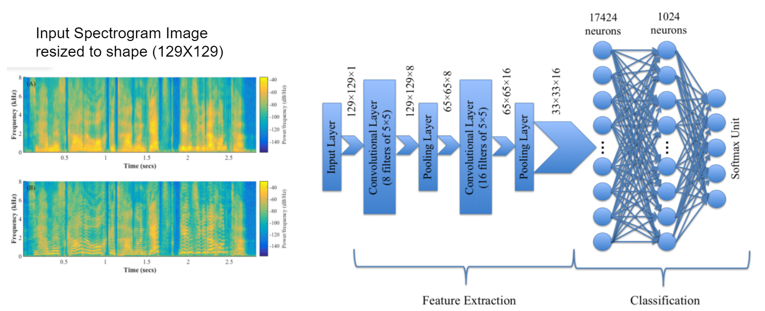
2D CNN Model

Slide 19
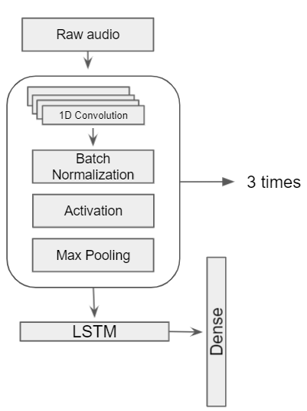
1D LSTM CNN Model
Model is proposed by Zhao et al. [3]
Input: Raw Audio

Slide 20
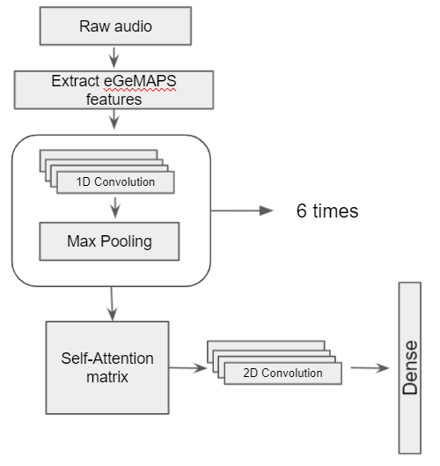
1D Self-Attention CNN Model
Model is proposed by Tarantino et al. [4]
Input: eGeMAPS feature set

Slide 21

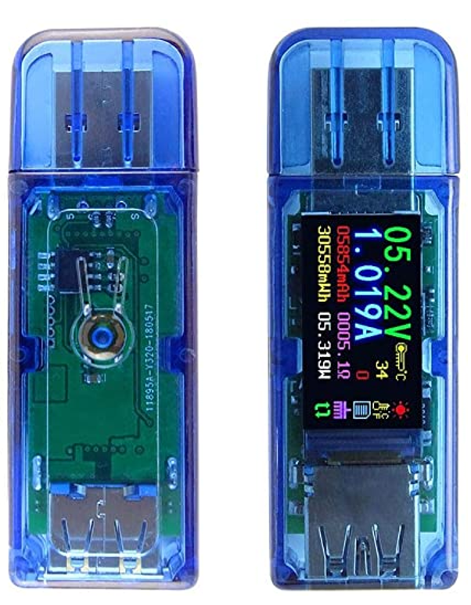
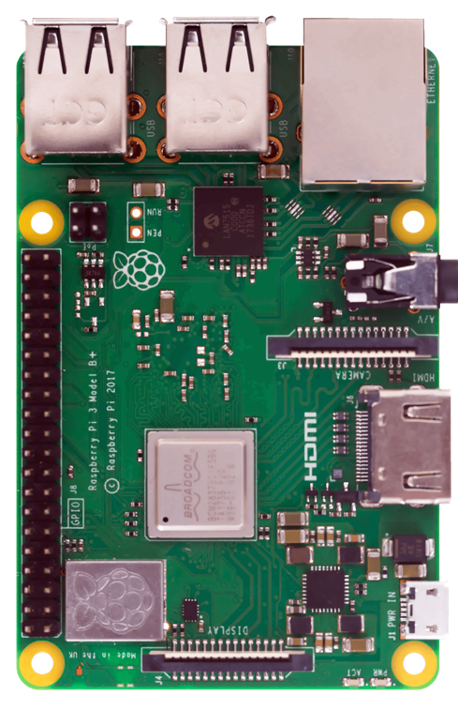
Hardware Setup
Raspberry PI 3B+
Coral TPU USB Accelerator
Raspberry PI 3B+

Slide 22
Real-time SER in WMSN Scenarios
EDGE
Scenario 1.
Speech Samples
Remote Server
Voice Activity Detection
Model prediction
Results
EDGE
Remote Server
Speech Samples
Model prediction
Scenario 2.
Voice Activity Detection
Remote Server
Edge
Audio segments
Speech Samples
Scenario 3.
Voice Activity Detection
Model prediction

Slide 23
Results

Slide 24
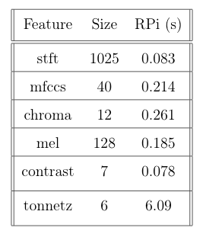
Feature Extraction Results
Spectral Feature Extraction Speed test

Slide 25
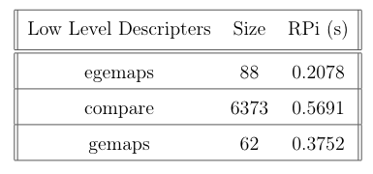
Feature Extraction Results
LLD Feature Extraction Speed test

Slide 26
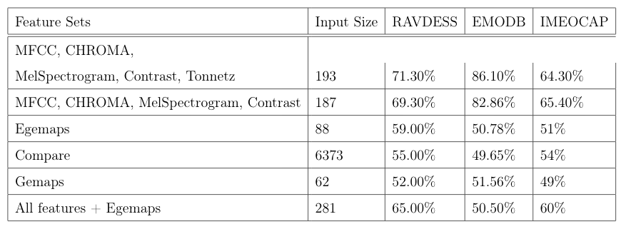
1D CNN Model
Model Accuracy Results

Slide 27
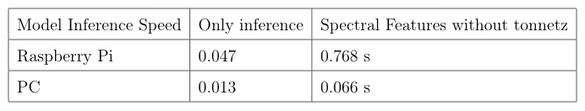
1D CNN Model Speed Test
Speed Test Results

Slide 28

2D CNN Model
Model Accuracy Results

Slide 29
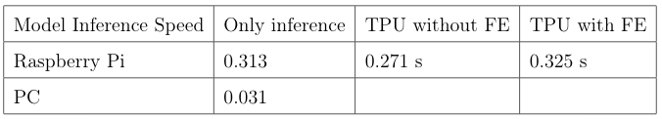
2D CNN Model Speed test
Speed Test Results

Slide 30

1D LSTM CNN Model
Model Accuracy Results

Slide 31
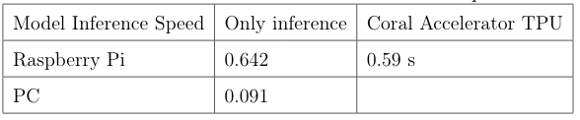
1D LSTM CNN Model Speed test
Speed Test Results

Slide 32

1D Self-Attention CNN Model
Model Accuracy Results

Slide 33
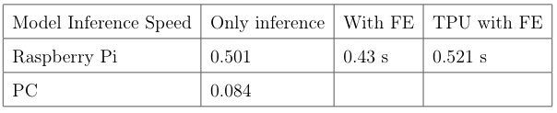
1D Self-Attention CNN Model Speed Test
Speed Test Results

Slide 34

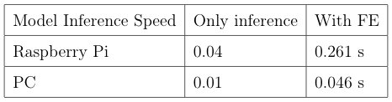
Modified 1D CNN Model
Model Accuracy Results
Speed Test Results

Slide 35
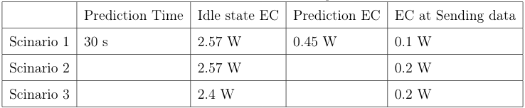
Results of Real-time SER in WSMN Scenarios
Testbed:
196 speech samples were combined to a single stream
Overall single stream contains 800 seconds of an audio
Speed Test and Energy consumption of RSER in WMSN Scenarios

Slide 36
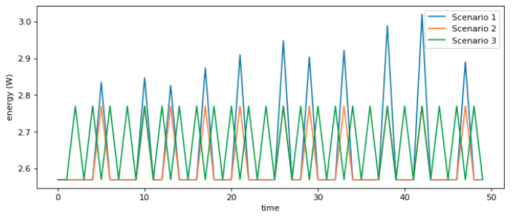
Energy Consumption Behaviour

Slide 37
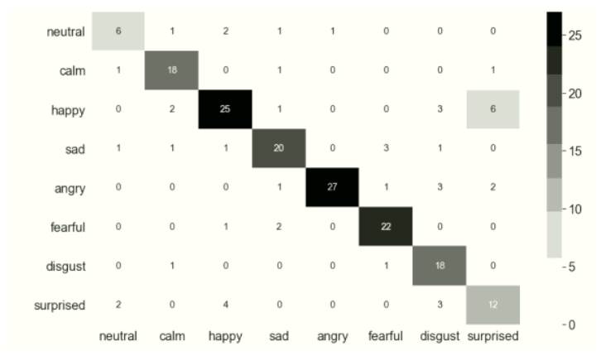

Slide 38
Conclusion

Slide 39
Conclusion
Feature extraction methods and amount of data play crucial role on improvement simple and fast SER Model. We could achieve 82.3% of accuracy with combined data.
MFCC Features are effective in Recognizing Emotions with large amount of data.
CNN models are working very effectively than LSTM and Self-Attention Models.
The Proposed Real-Time SER algorithm appears to be efficient in terms of QoS (Energy Consumption and Speed) in Scenario 1 (all processing on edge).

Slide 40
Thank you, for your attention

Slide 41
Bibliography
[1] M. H. Moattar and M. M. Homayounpour, "A simple but efficient real-time Voice Activity Detection algorithm," 2009 17th European Signal Processing Conference, 2009, pp. 2549-2553.
[2] D. Issa, M. Fatih Demirci, A. Yazici, Speech emotion recognition with deep convolutional neural networks, Biomedical Signal Processing and Control, 59, May 2020, 101894.
[4] Tarantino, P.N. Garner, A. Lazaridis, Self-attention for speech emotion recognition, Proc. Interspeech 2019 (2019) 2578–2582.
[5] C. Busso, M. Bulut, C.-C. Lee, A. Kazemzadeh, E. Mower, S. Kim, J. N. Chang, S. Lee, and S. S. Narayanan, “IEMOCAP: Interactive emotional dyadic motion capture database,” Lang. Resour. Eval., vol. 42, no. 4, pp. 335–359, Dec. 2008, doi: 10.1007/s10579-008-9076-6.
[6] F. Burkhardt, A. Paeschke, M. Rolfes, W. Sendlmeier, and B. Weiss, “A database of German emotional speech,” in Proc. 9th Eur. Conf. Speech Commun. Technol., 2005, pp. 1–4.
[7] S.R. Livingstone, F.A. Russo, The ryerson audio-visual database of emotional speech and song (ravdess): a dynamic, multimodal set of facial and vocal expressions in North American English, PLOS ONE 13 (2018) e0196391.

