Slide 1



THREE SISTERS
THREE SISTERS
EMA KIABOVA
ROMAN RUHIG
SLOVAKIA
2nd prize

Slide 2


1. philosophy
2. ENERGY
past
future
solution

Slide 3
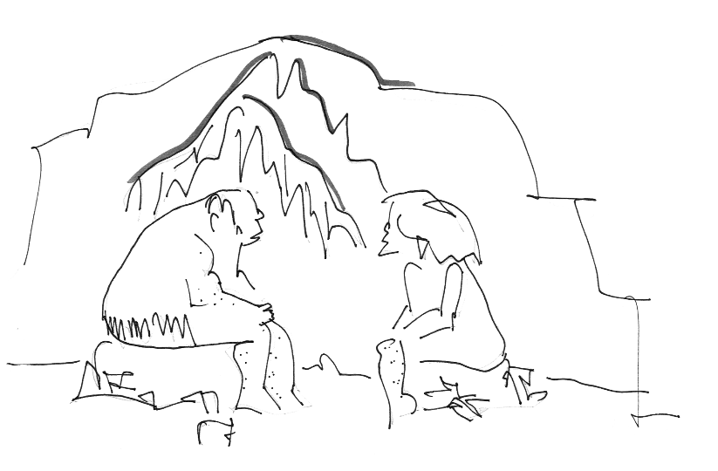
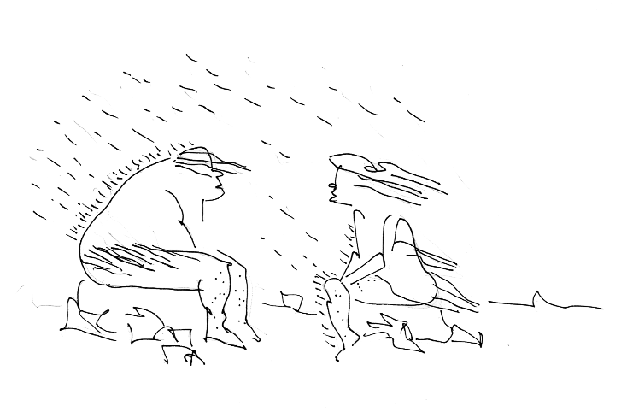
1. philosophy

Slide 4
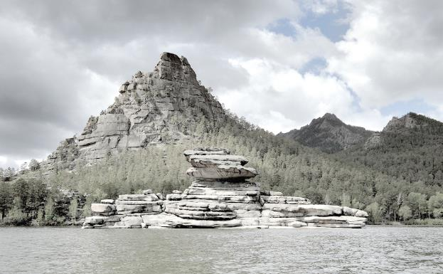
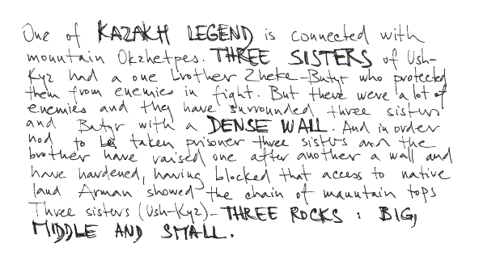
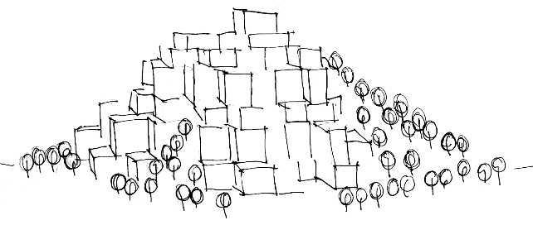
1. philosophy

Slide 5

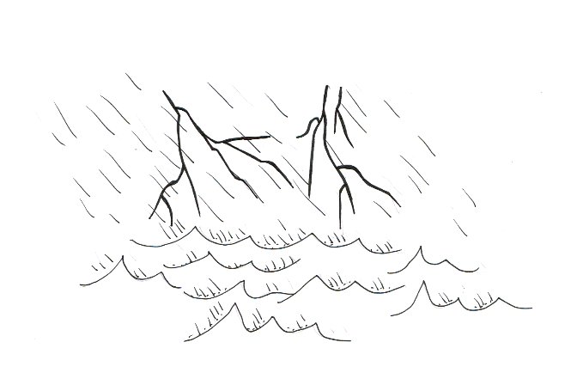
1. philosophy

Slide 6
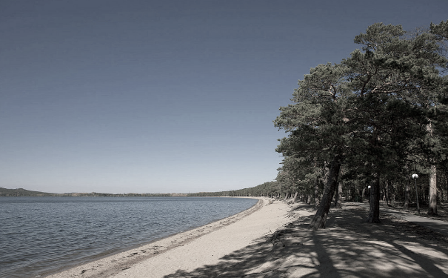
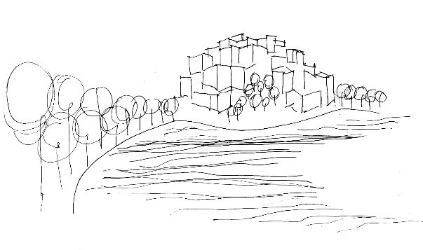
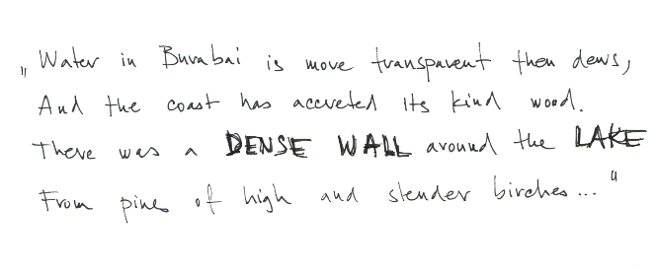
1. philosophy

Slide 7
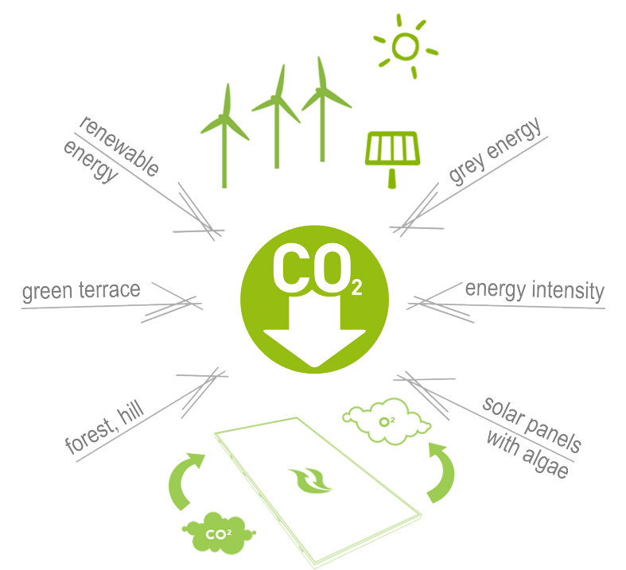

2. ENERGY

Slide 8
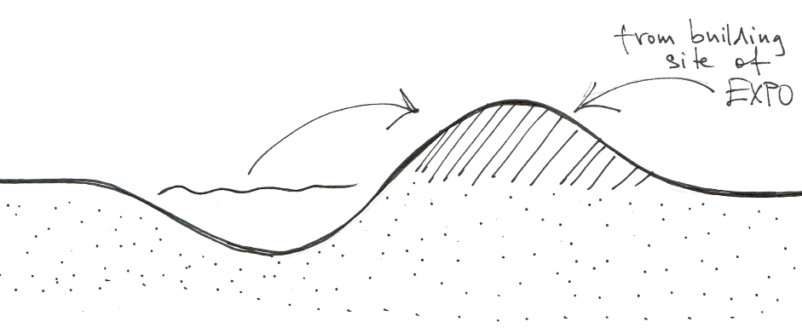
2. ENERGY

Slide 9
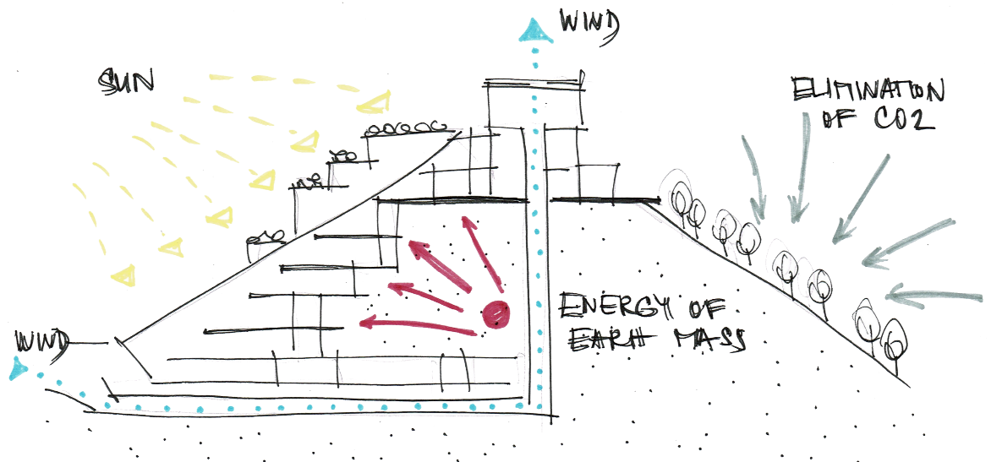
2. ENERGY

Slide 10
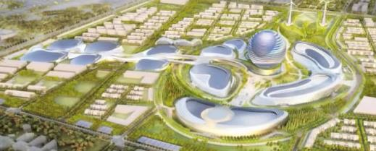
reaction to EXPO

Slide 11

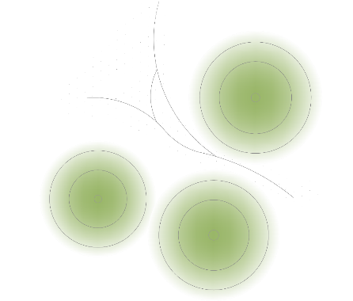
expo
3.
1.
2.
reaction to EXPO

Slide 12

expo
8 floor
7 floor
6 floor
reaction to EXPO

Slide 13
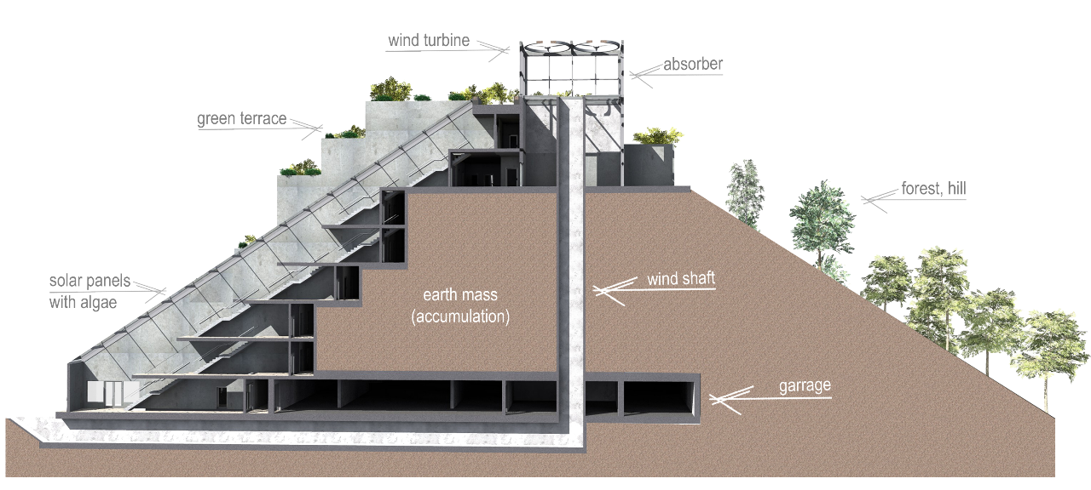
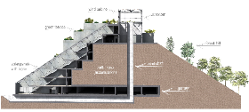
future
solution

Slide 14
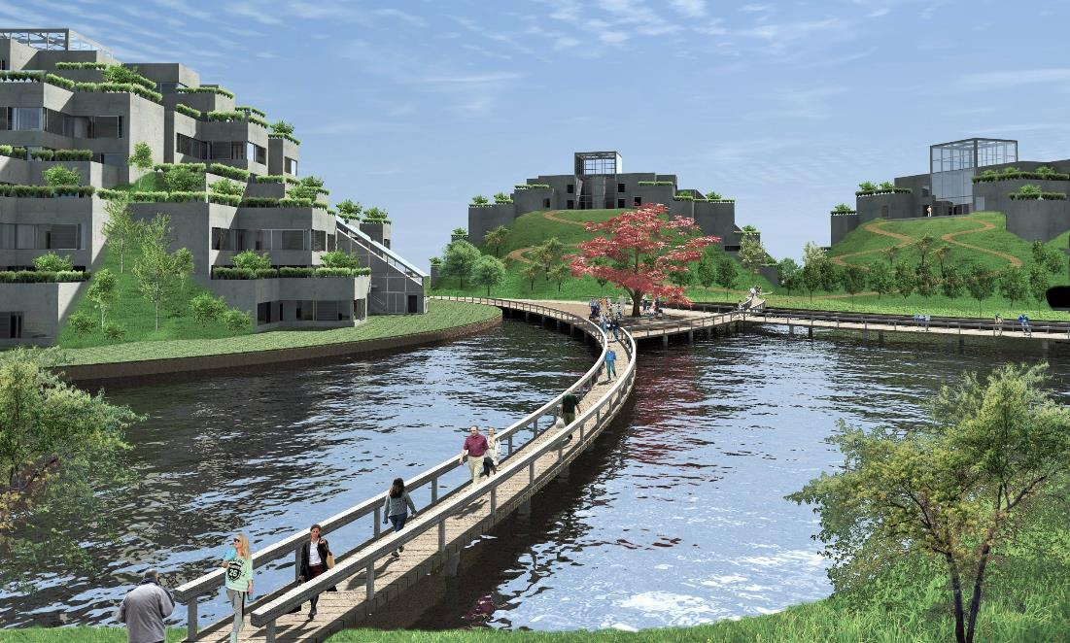

past
future
solution

Slide 15


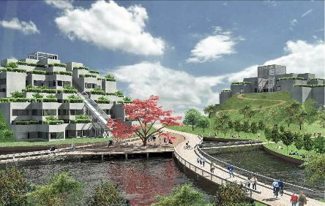
past
future
solution

Slide 16
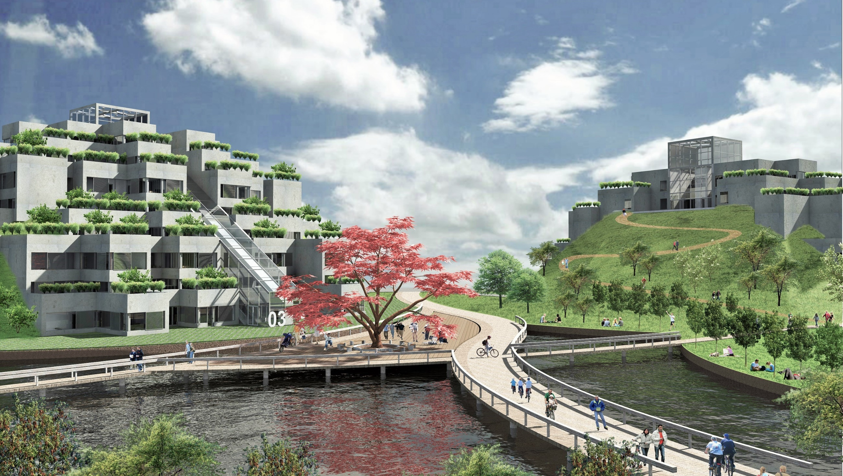
thanks for your attention
past
future
solution

