Slide 1
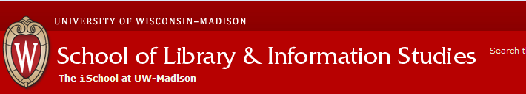


Experience in University of Wisconsin – Madison
University of Wisconsin Digital Collections Center
School of library and information studies
20 August 2014 to 21 December 2014
Tolkyn Jangulova,
Senior manager at Digital Center,
Nazarbayev University Library
tolkyn.dzhangulova@nu.edu.kz
http://library.nu.edu.kz

Slide 2
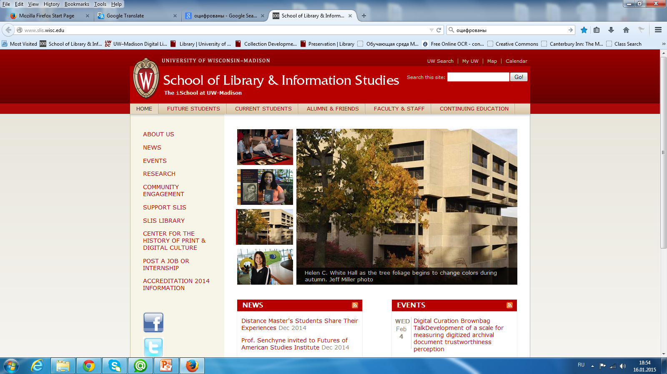
http://www.slis.wisc.edu/

Slide 3
The Wisconsin Library School was founded as a summer school under the Wisconsin Free Library Commission in 1895.
By 1906 it was a full-time professional program. Three years later it became affiliated with the University of Wisconsin.

Slide 4
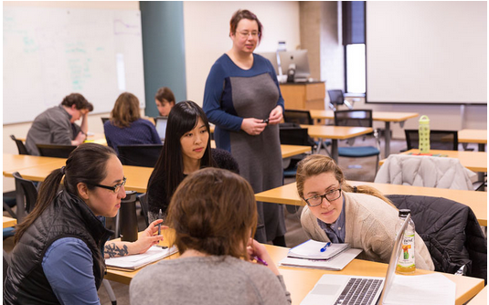
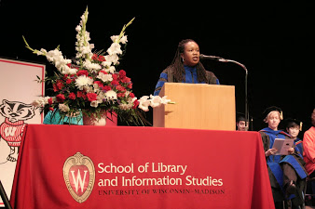
The mission at the School of library and information studies (SLIS), is to:
educate responsible leaders, critical thinkers, and creative innovators in the information professions.

Slide 5
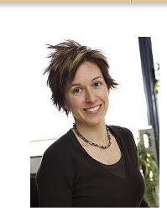
Kristin Eschenfelder
PhD 2000, Syracuse University School of Information Studies
Professor and Director at the School of Library and Information Studies at the University of Wisconsin-Madison.
4238 Helen C. White Hall
(608) 263-2105
eschenfelder@wisc.edu
http://www.slis.wisc.edu

Slide 6
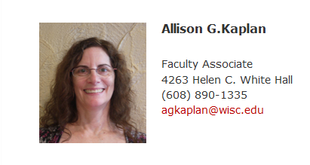
LIS 620: “Field Project in Library and Information Agencies”.
Instructor: Allison G. Kaplan, Ed.D., Faculty Associate
Course Description:
Understand the relationships between theory and practice and demonstrate a critical thinker as an individual or a team as appropriate to the institution.
Practice place: University of Wisconsin Digital Collections Center

Slide 7
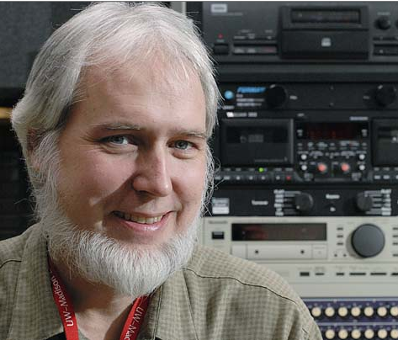
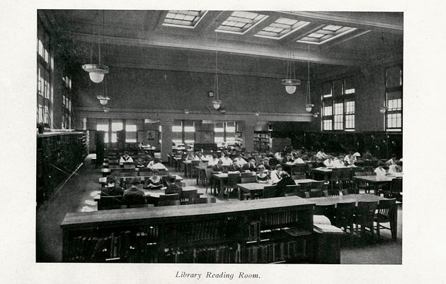
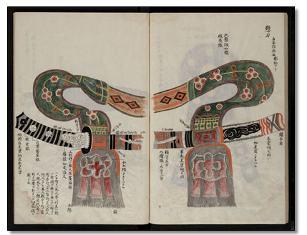
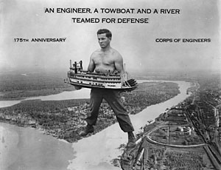
Peter Gorman,
head of the University of Wisconsin Digital Collections Center (UWDCC)
Practice Instructor

Slide 8
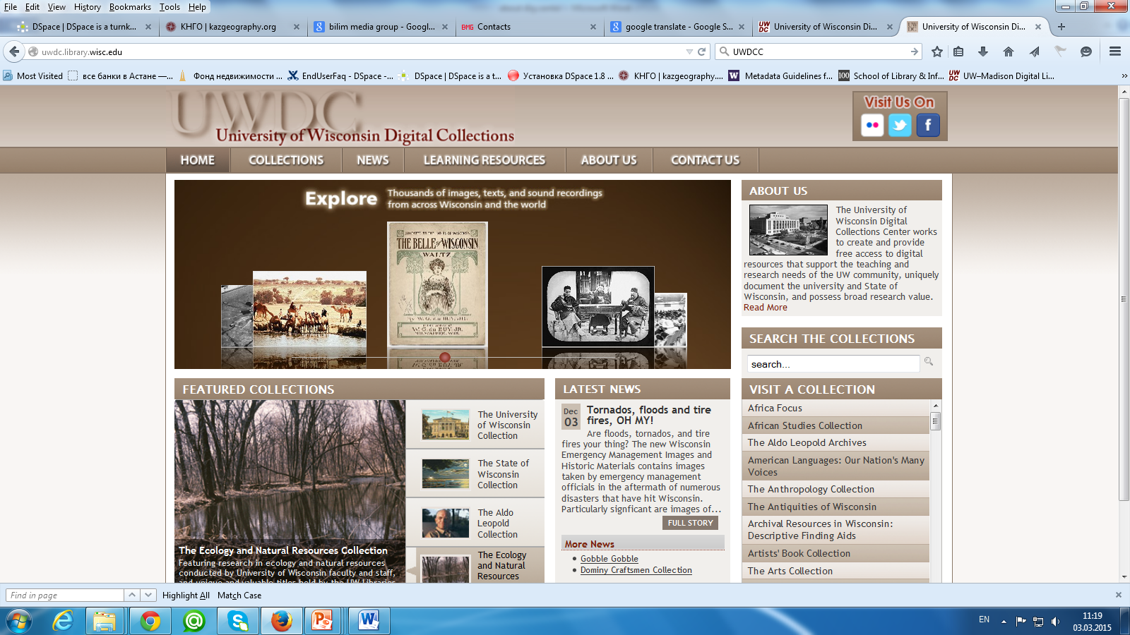

Slide 9
The University of Wisconsin Digital Collections (UWDC) were established in the summer of 2001.
The Council of University of Wisconsin Libraries (CUWL) and UW System's Office of Learning & Information Technology created the UWDC to provide quality digital resources from its academic libraries to UW faculty, staff and students, citizens of the state.

Slide 10
University of Wisconsin Digital Collections Center (UWDCC)
Library Technology Group
Conservation Laboratory
Special Collections
department
Microforms/Media Center

Slide 11
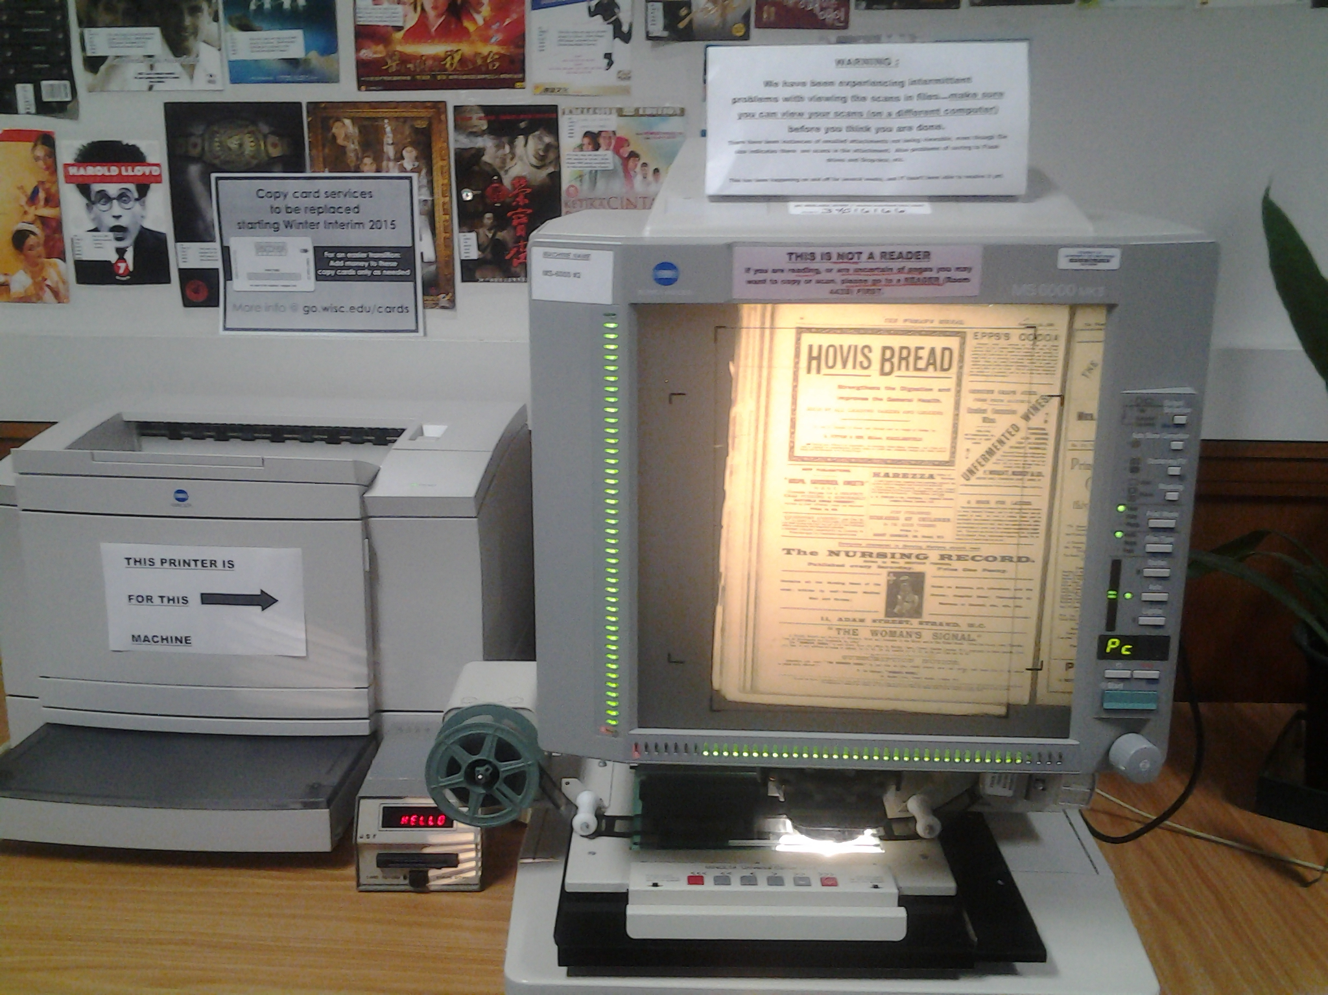
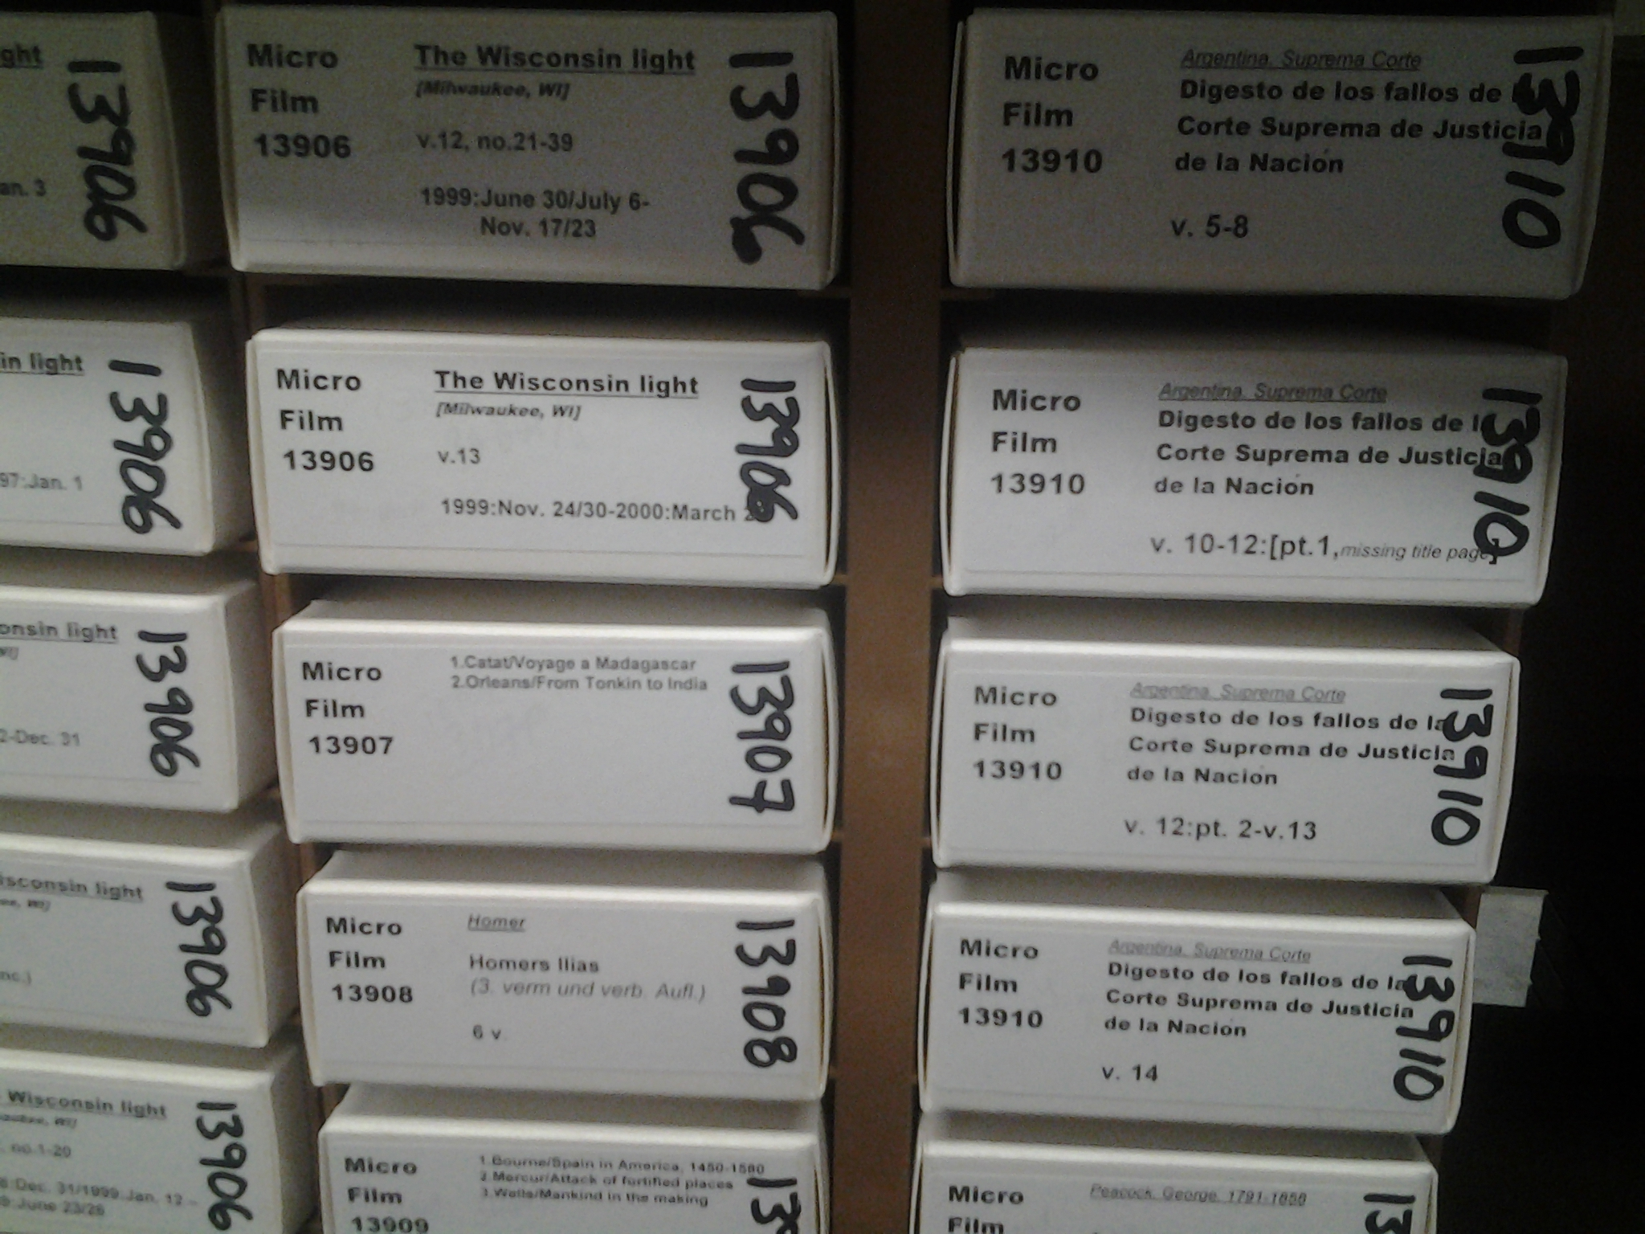
Microforms/Media Center (MMC)

Slide 12
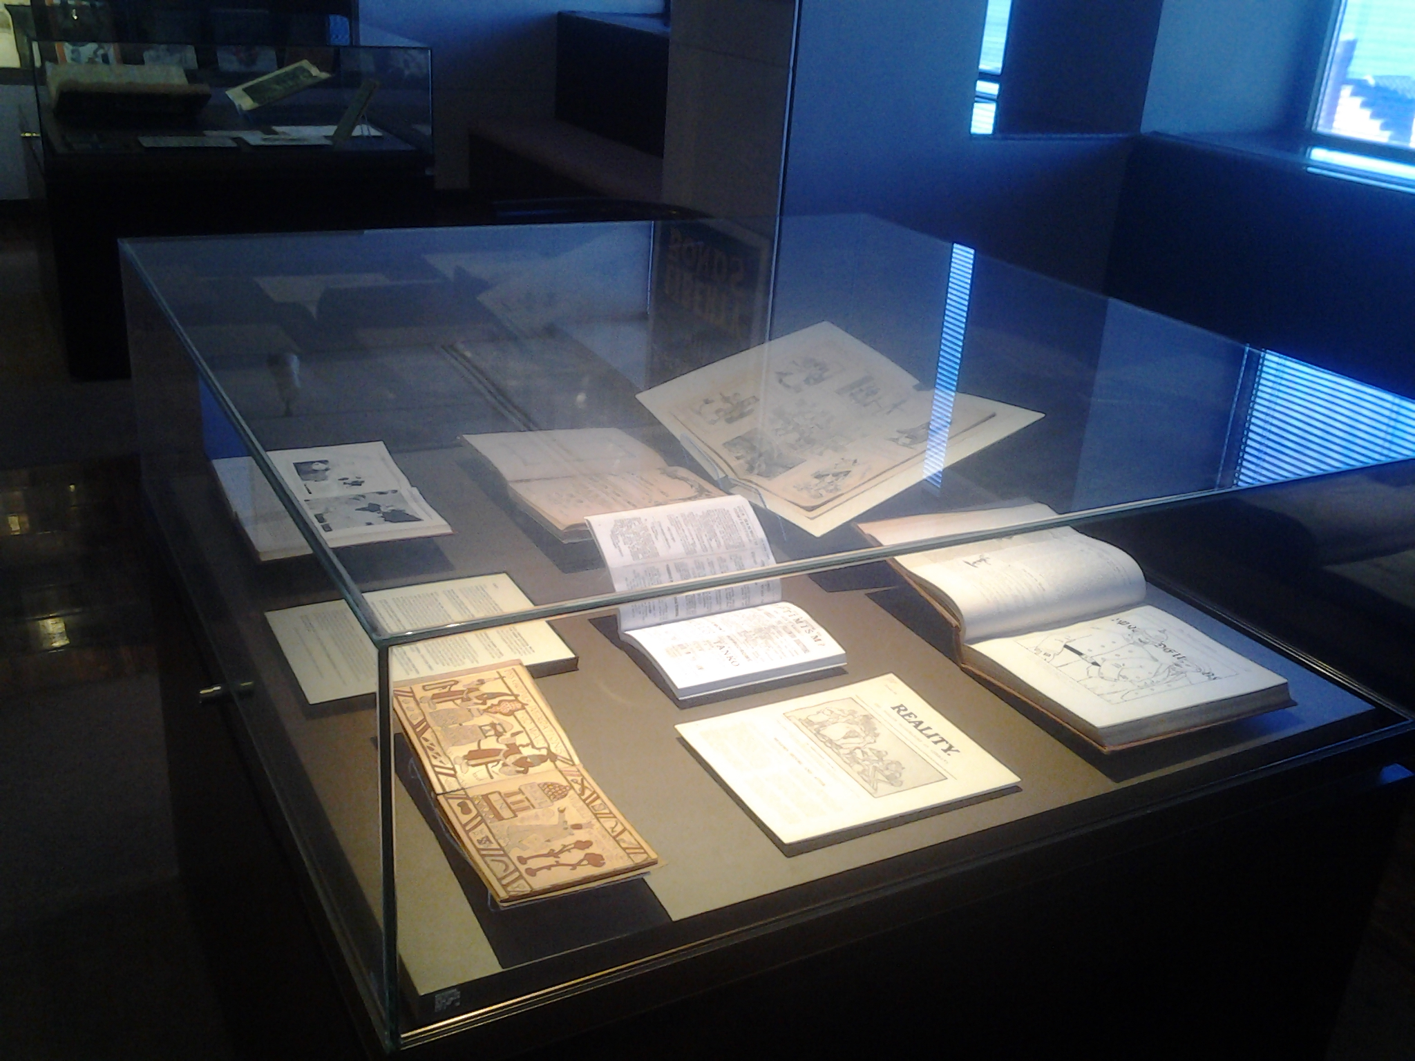
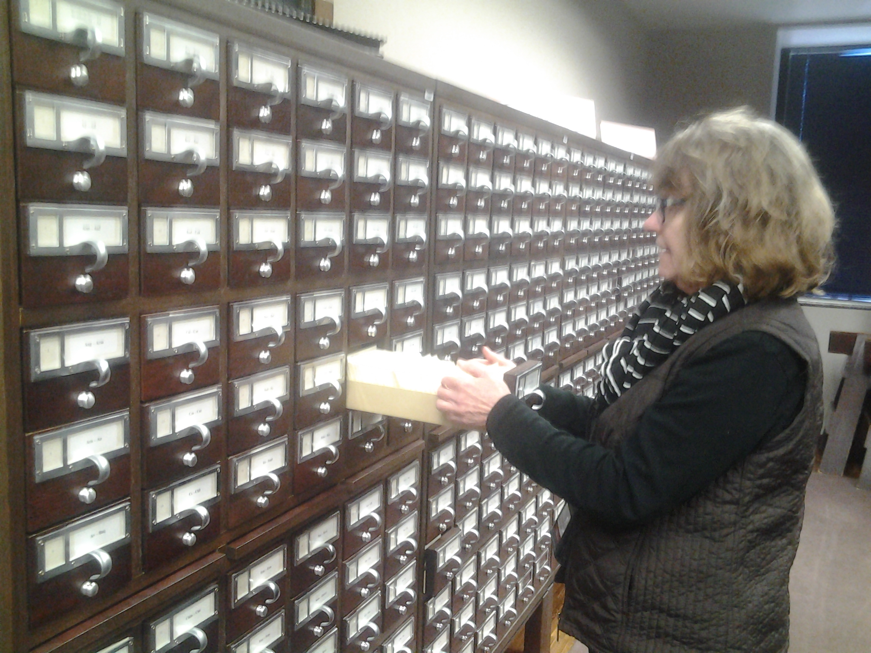
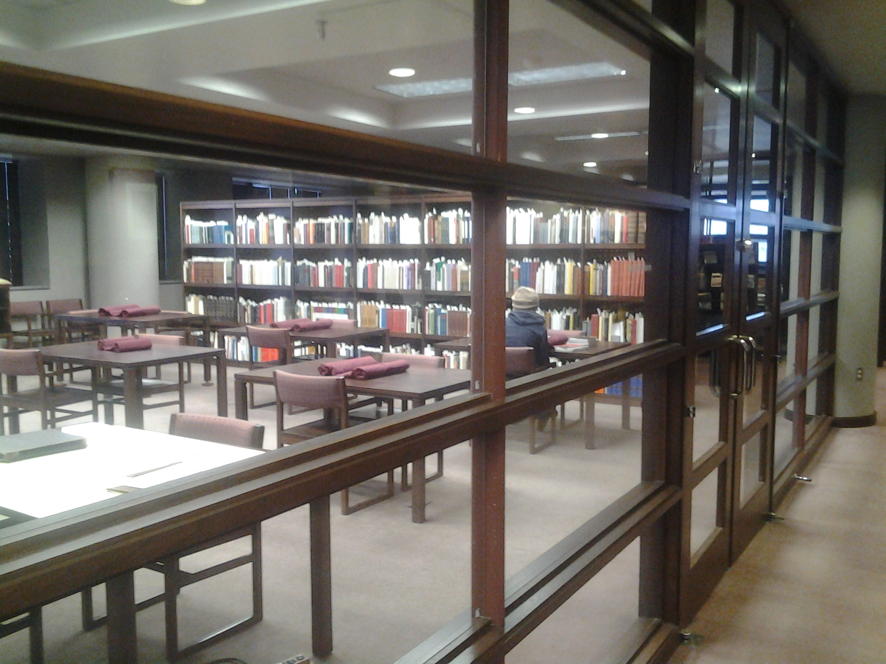
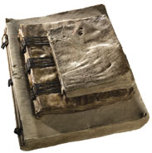
Special Collections

Slide 13
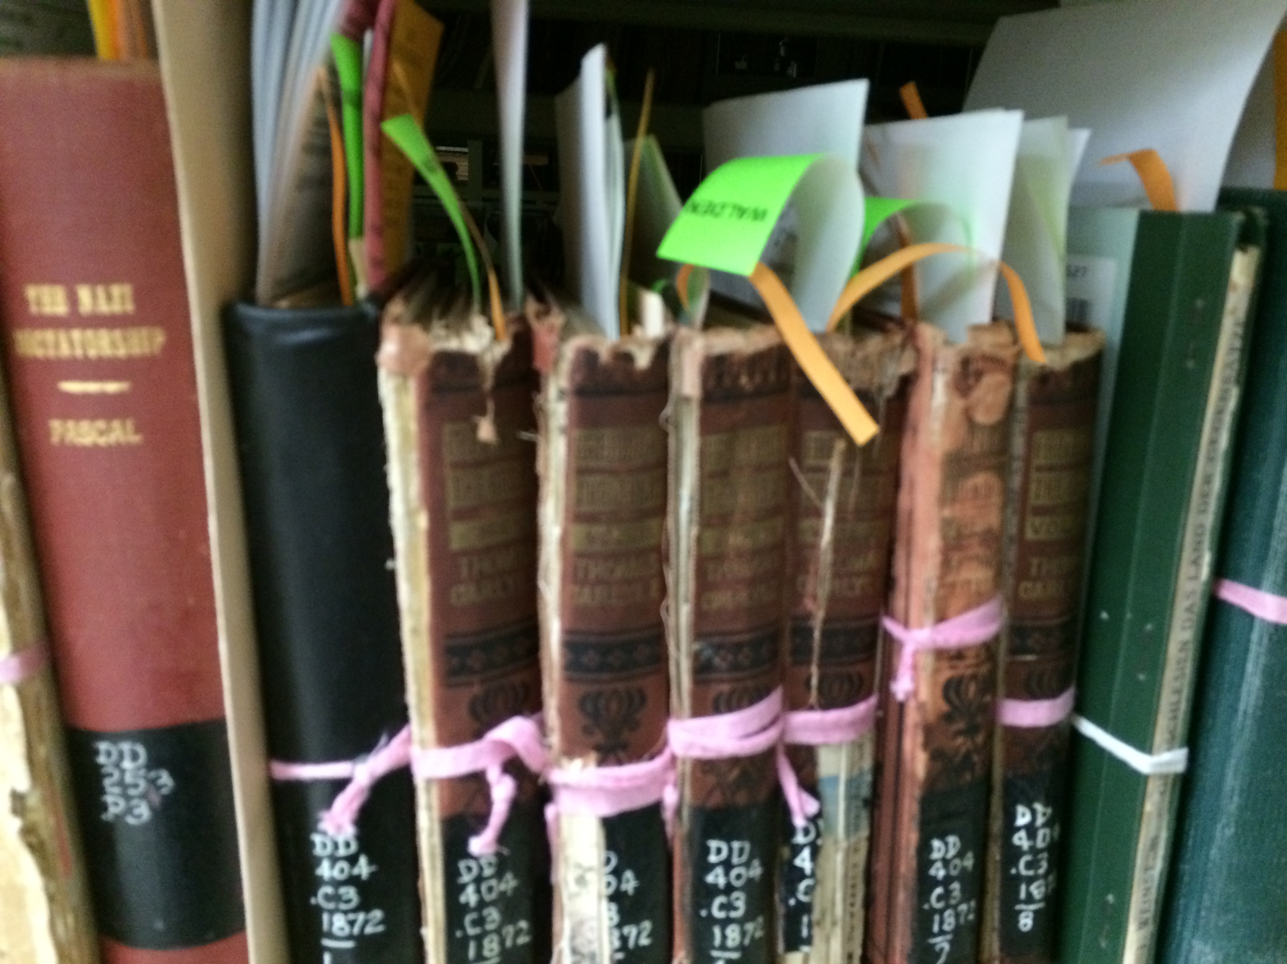
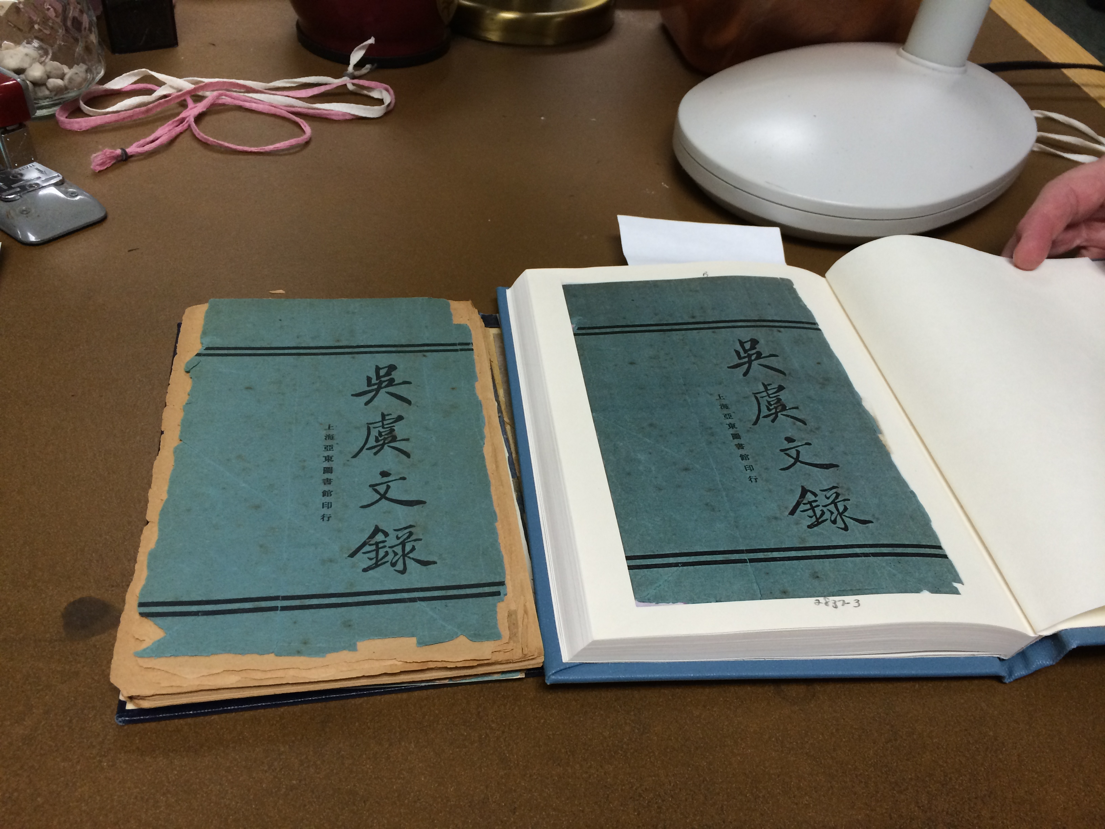
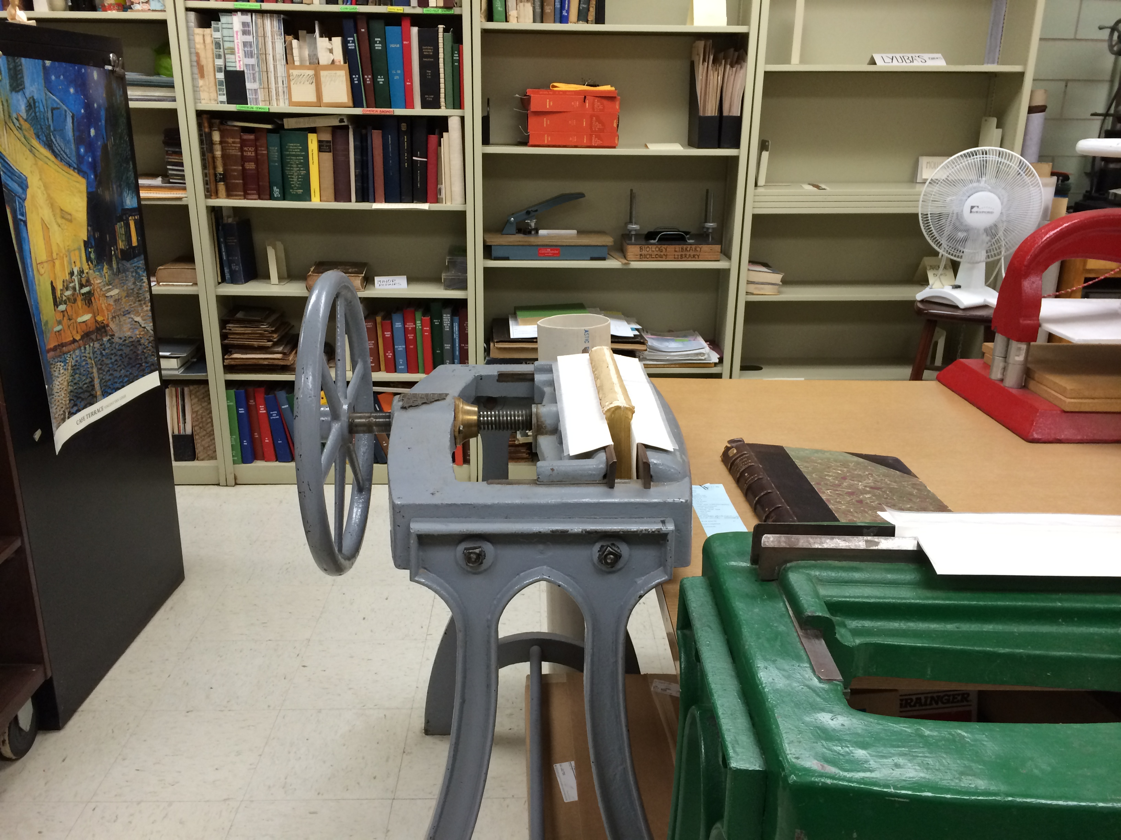
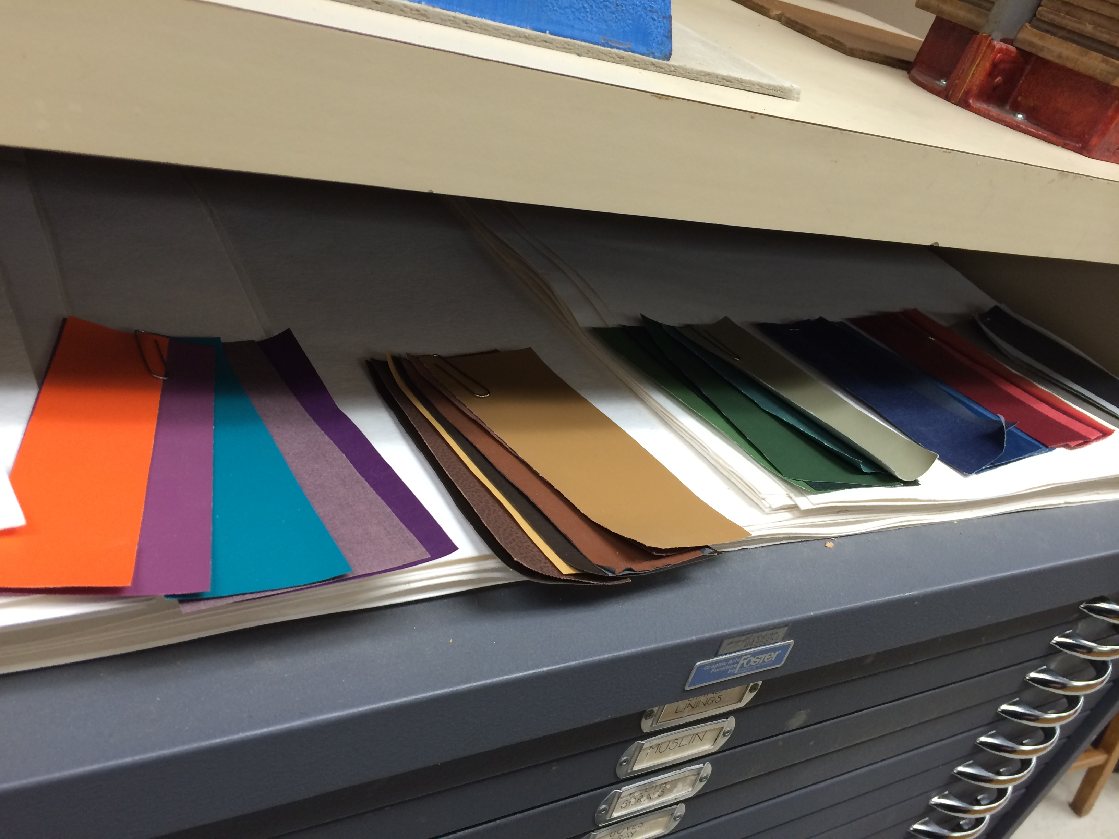
Conservation Laboratory

Slide 14
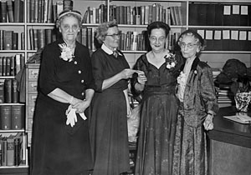
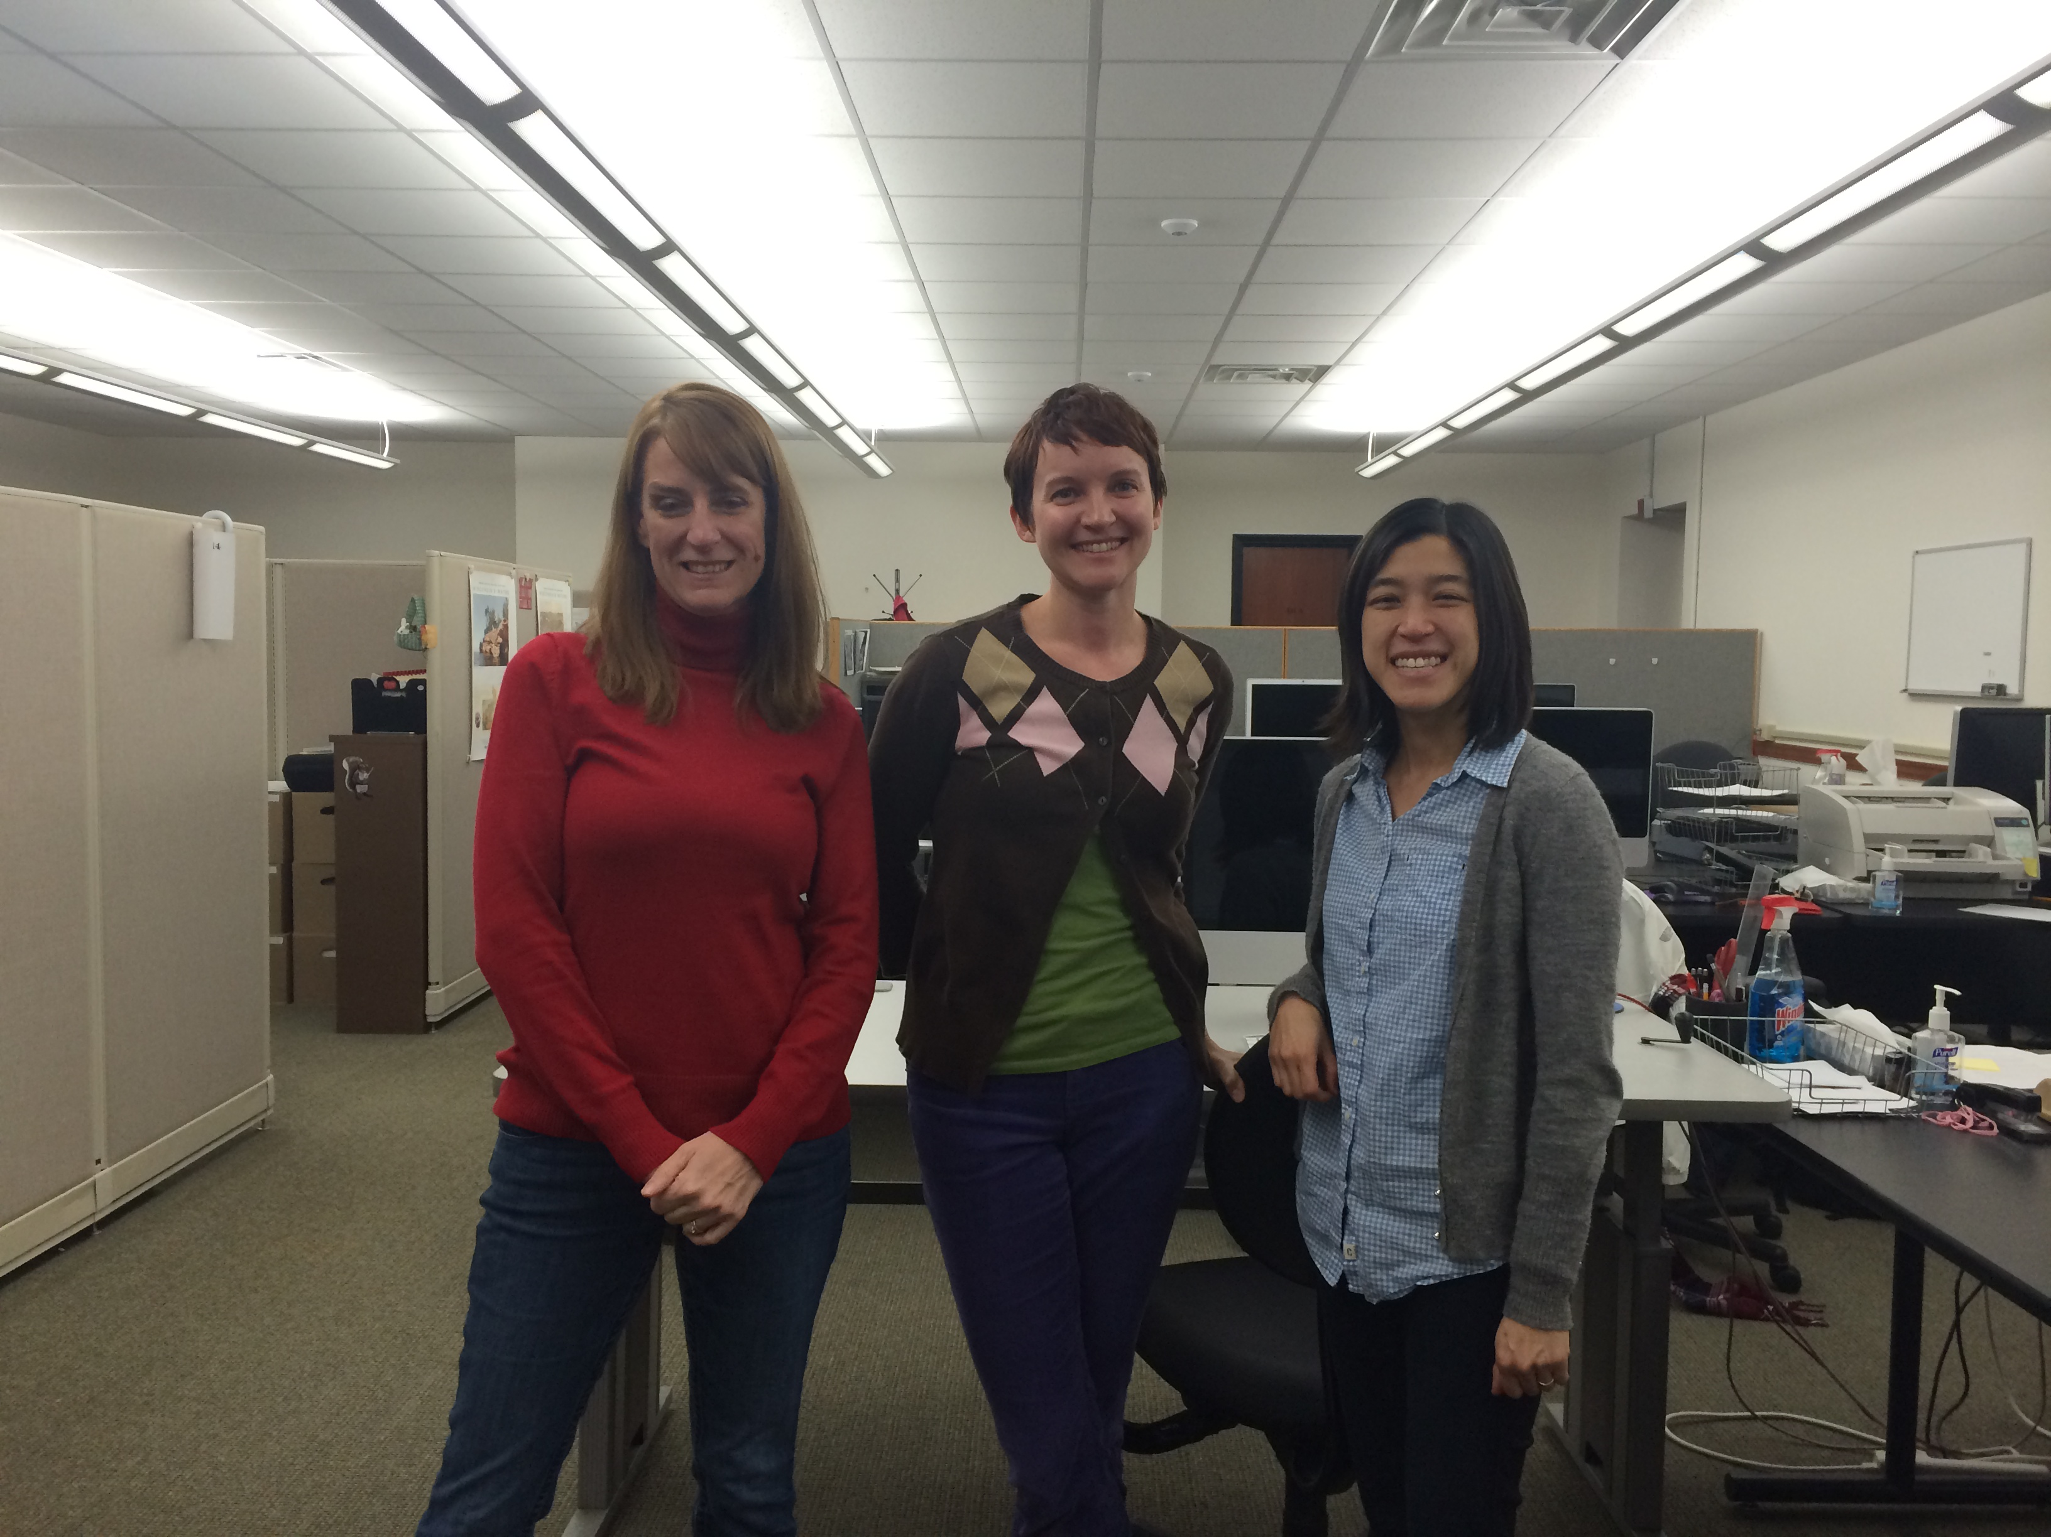
The UWDCC is:
  7 full time and 10-15 student staff
  Librarians, technology specialists, and other information professionals
  located in Memorial Library
  Two administrative bodies
  oversee and fund projects:
  UW System
  UW-Madison Libraries

Slide 15
UWDCC provide over 60 collections about
art, ecology, literature, history, music,
natural resources, science, social sciences,
the State of Wisconsin and the University of Wisconsin.
Resources in the collections are free and publicly accessible online.

Slide 16
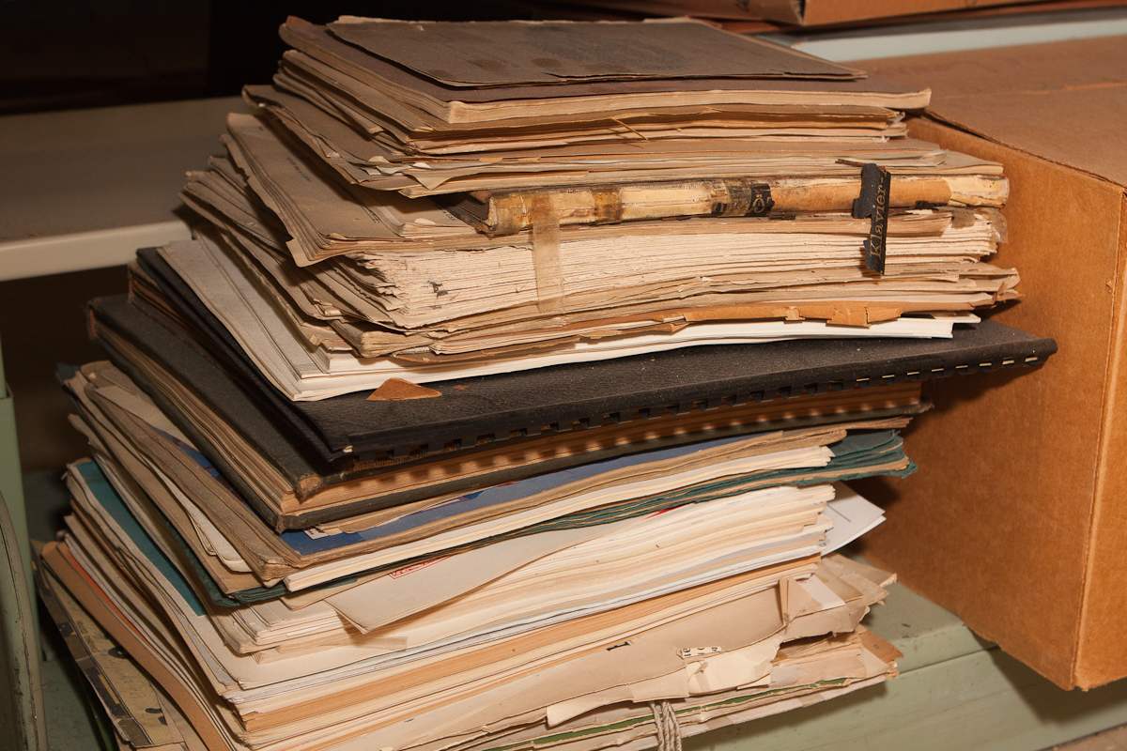
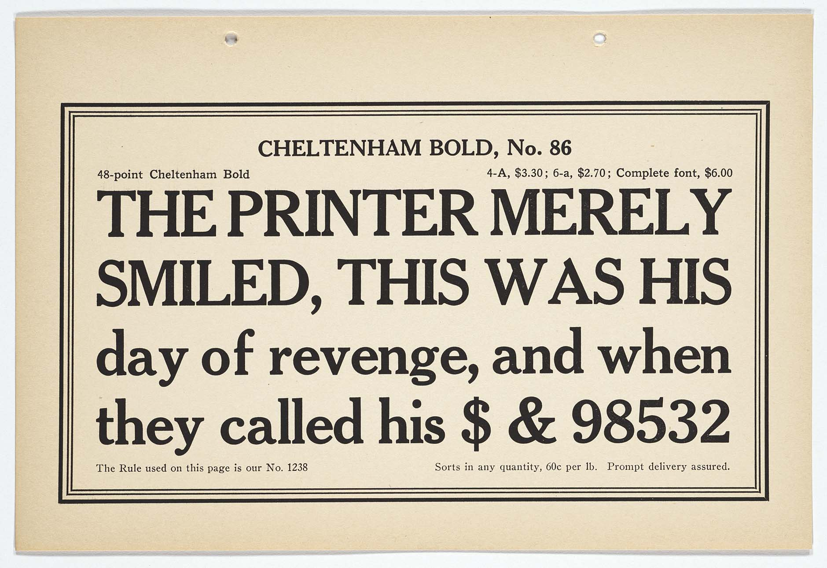
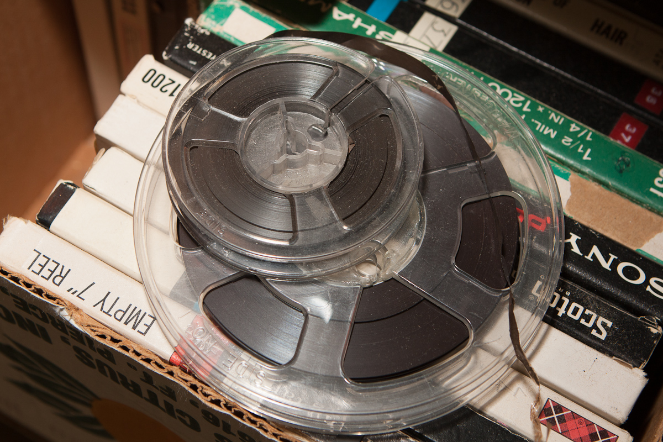
What they have:
  Nearly 100,000 audio and video minutes
  200,000 images (photographs, slides, etc.)
  2.3 million pages

Slide 17
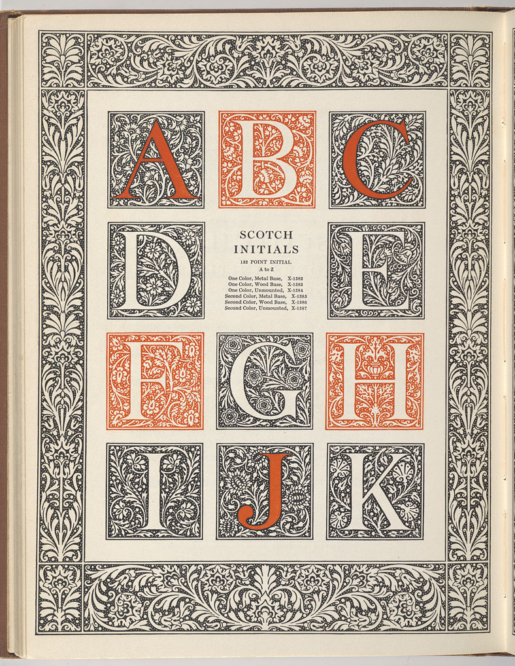
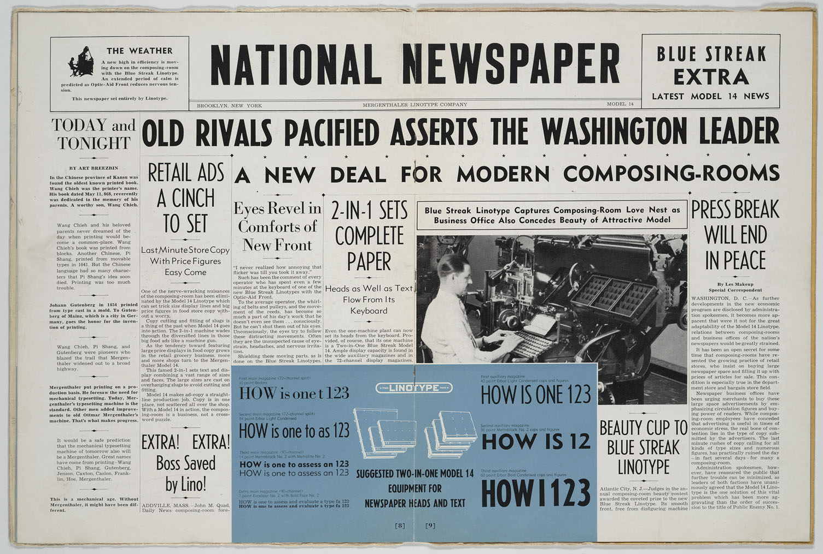
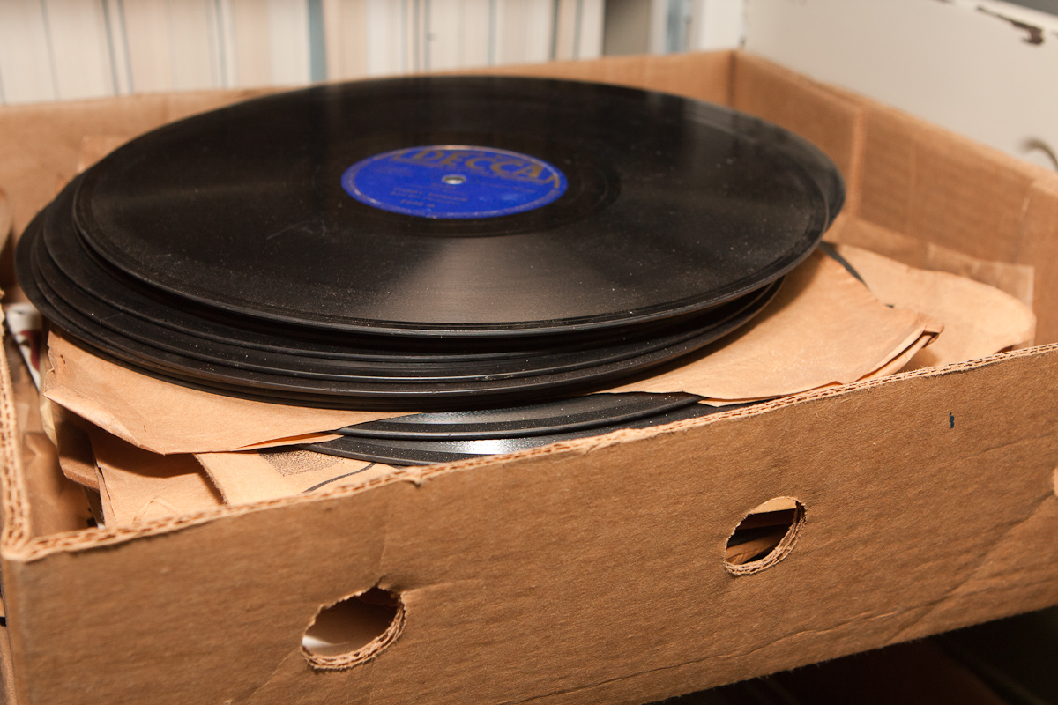
What they do:
Create digital resources to support instruction and research from:
  rare, non-circulating, and high-use library and archival materials
  materials not previously digitized not available on the Internet
  books, journals, archival collections, slides, photos, art illustrations, maps, audio, and video

Slide 18
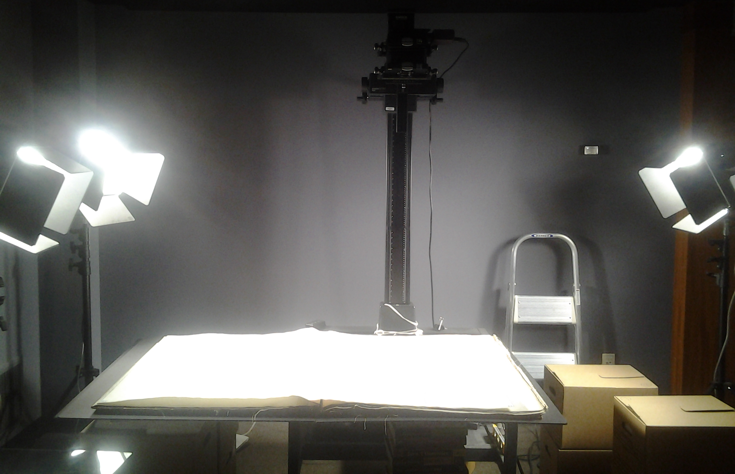
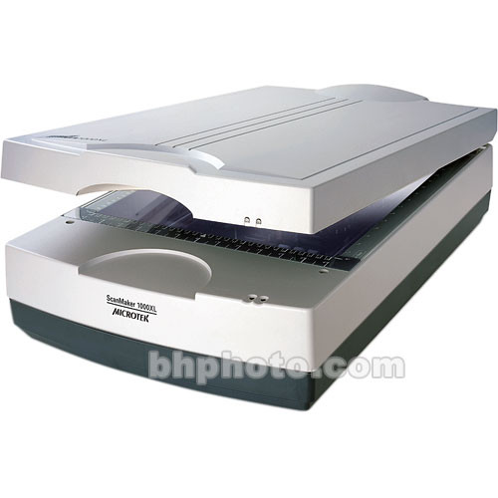
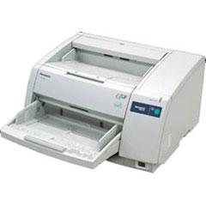
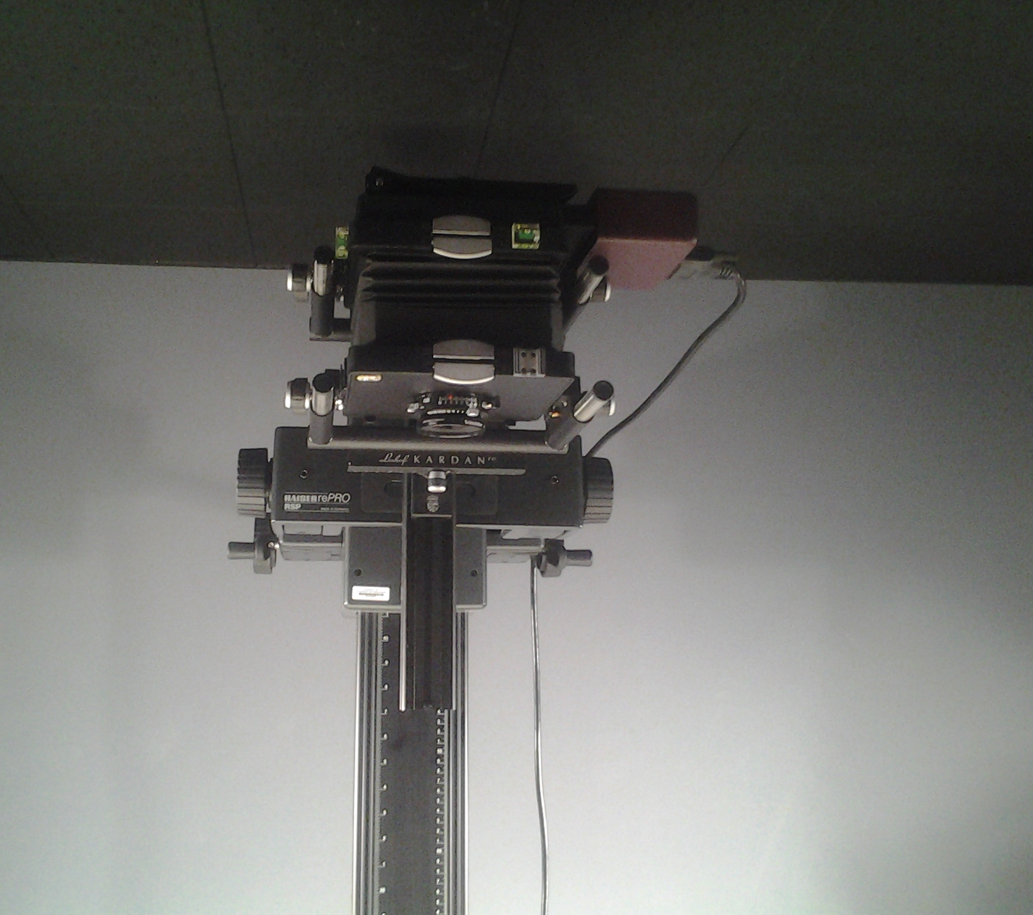
Reformatting equipment in the UWDCC (6 scanners)
4 Microtek flat-bed & transparency scanner
PULNiX planetary scanner
1 Panasonic high speed scanner
BetterLight digital camera

Slide 19
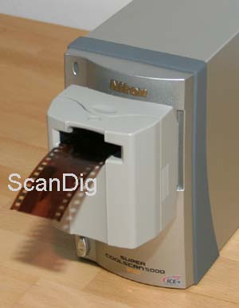
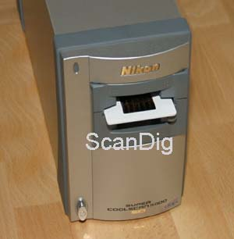
Nikon 35 mm film and slide scanner

Slide 20
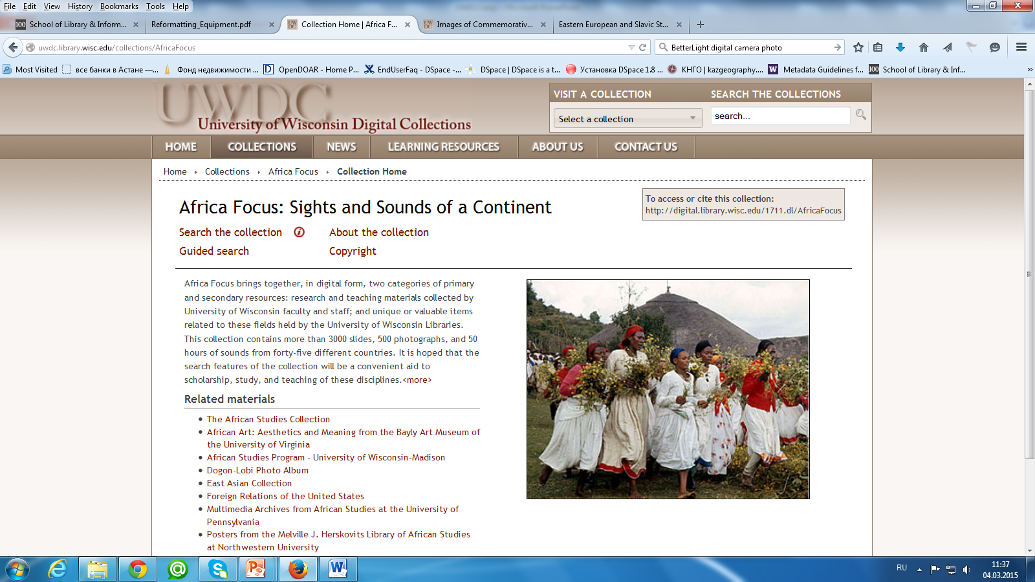

Slide 21
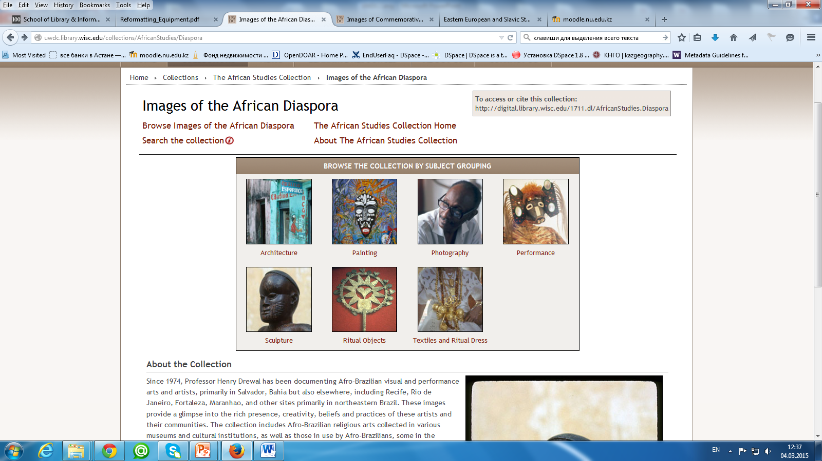
First multi-media project was Africa Focus
This collection contains more than 3000 slides, 500 photographs, and 50 hours of sounds from forty-five different countries.

Slide 22
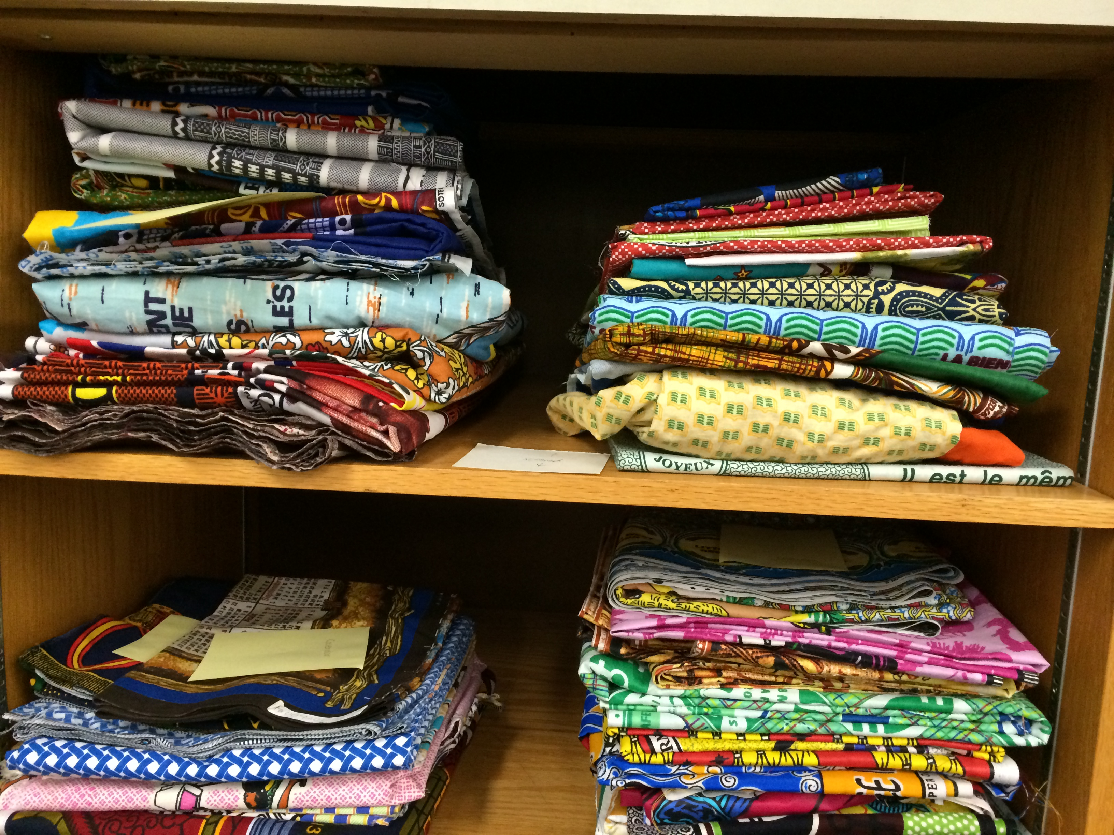
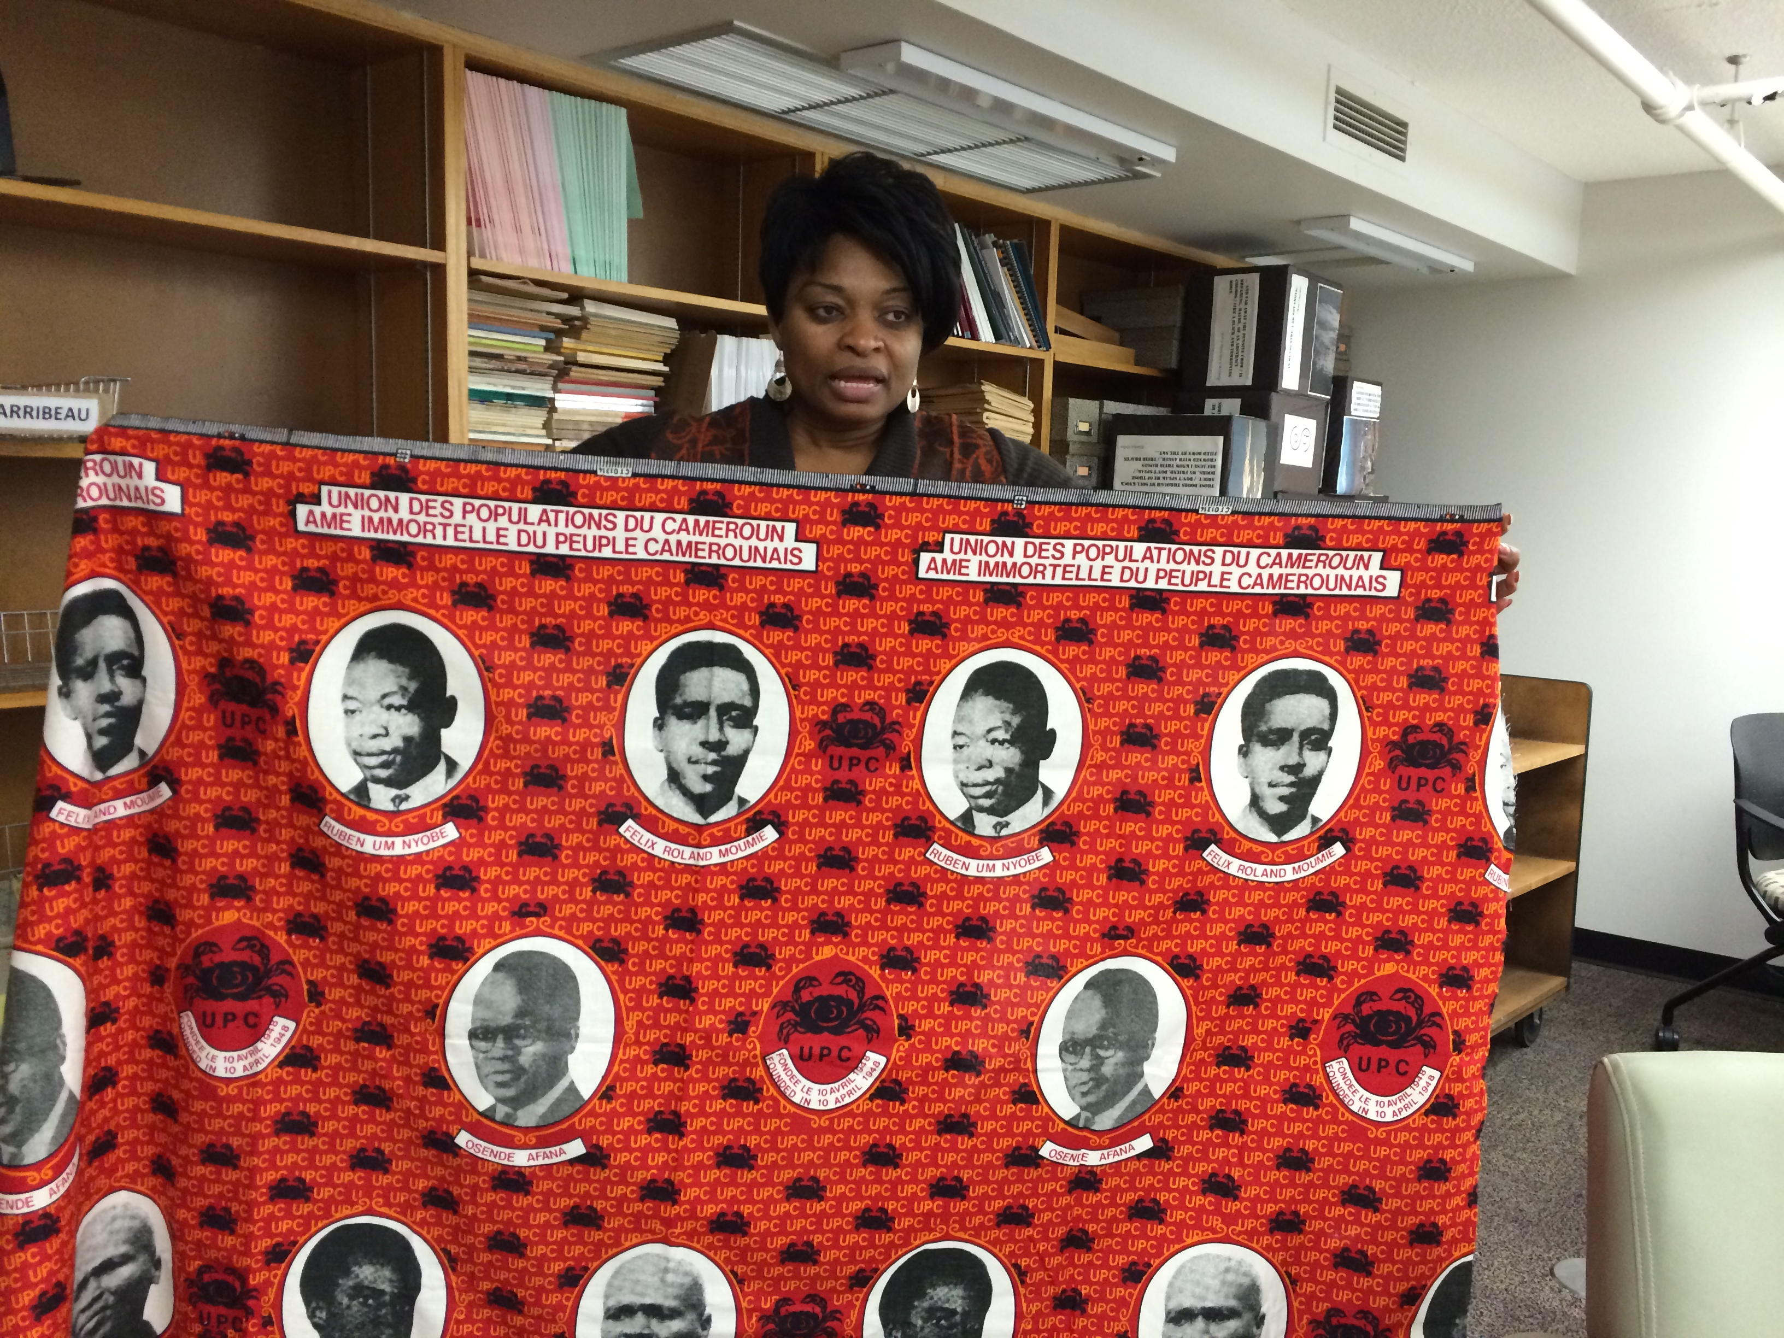
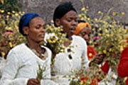
Africa Focus, African Studies Collection
African Commemorative Fabrics is a collection of machine-made commemorative textiles from various African countries.
This collection provides access to digitized fabrics with images and text of historical, political, religious аnd sociological significance to African societies.

Slide 23
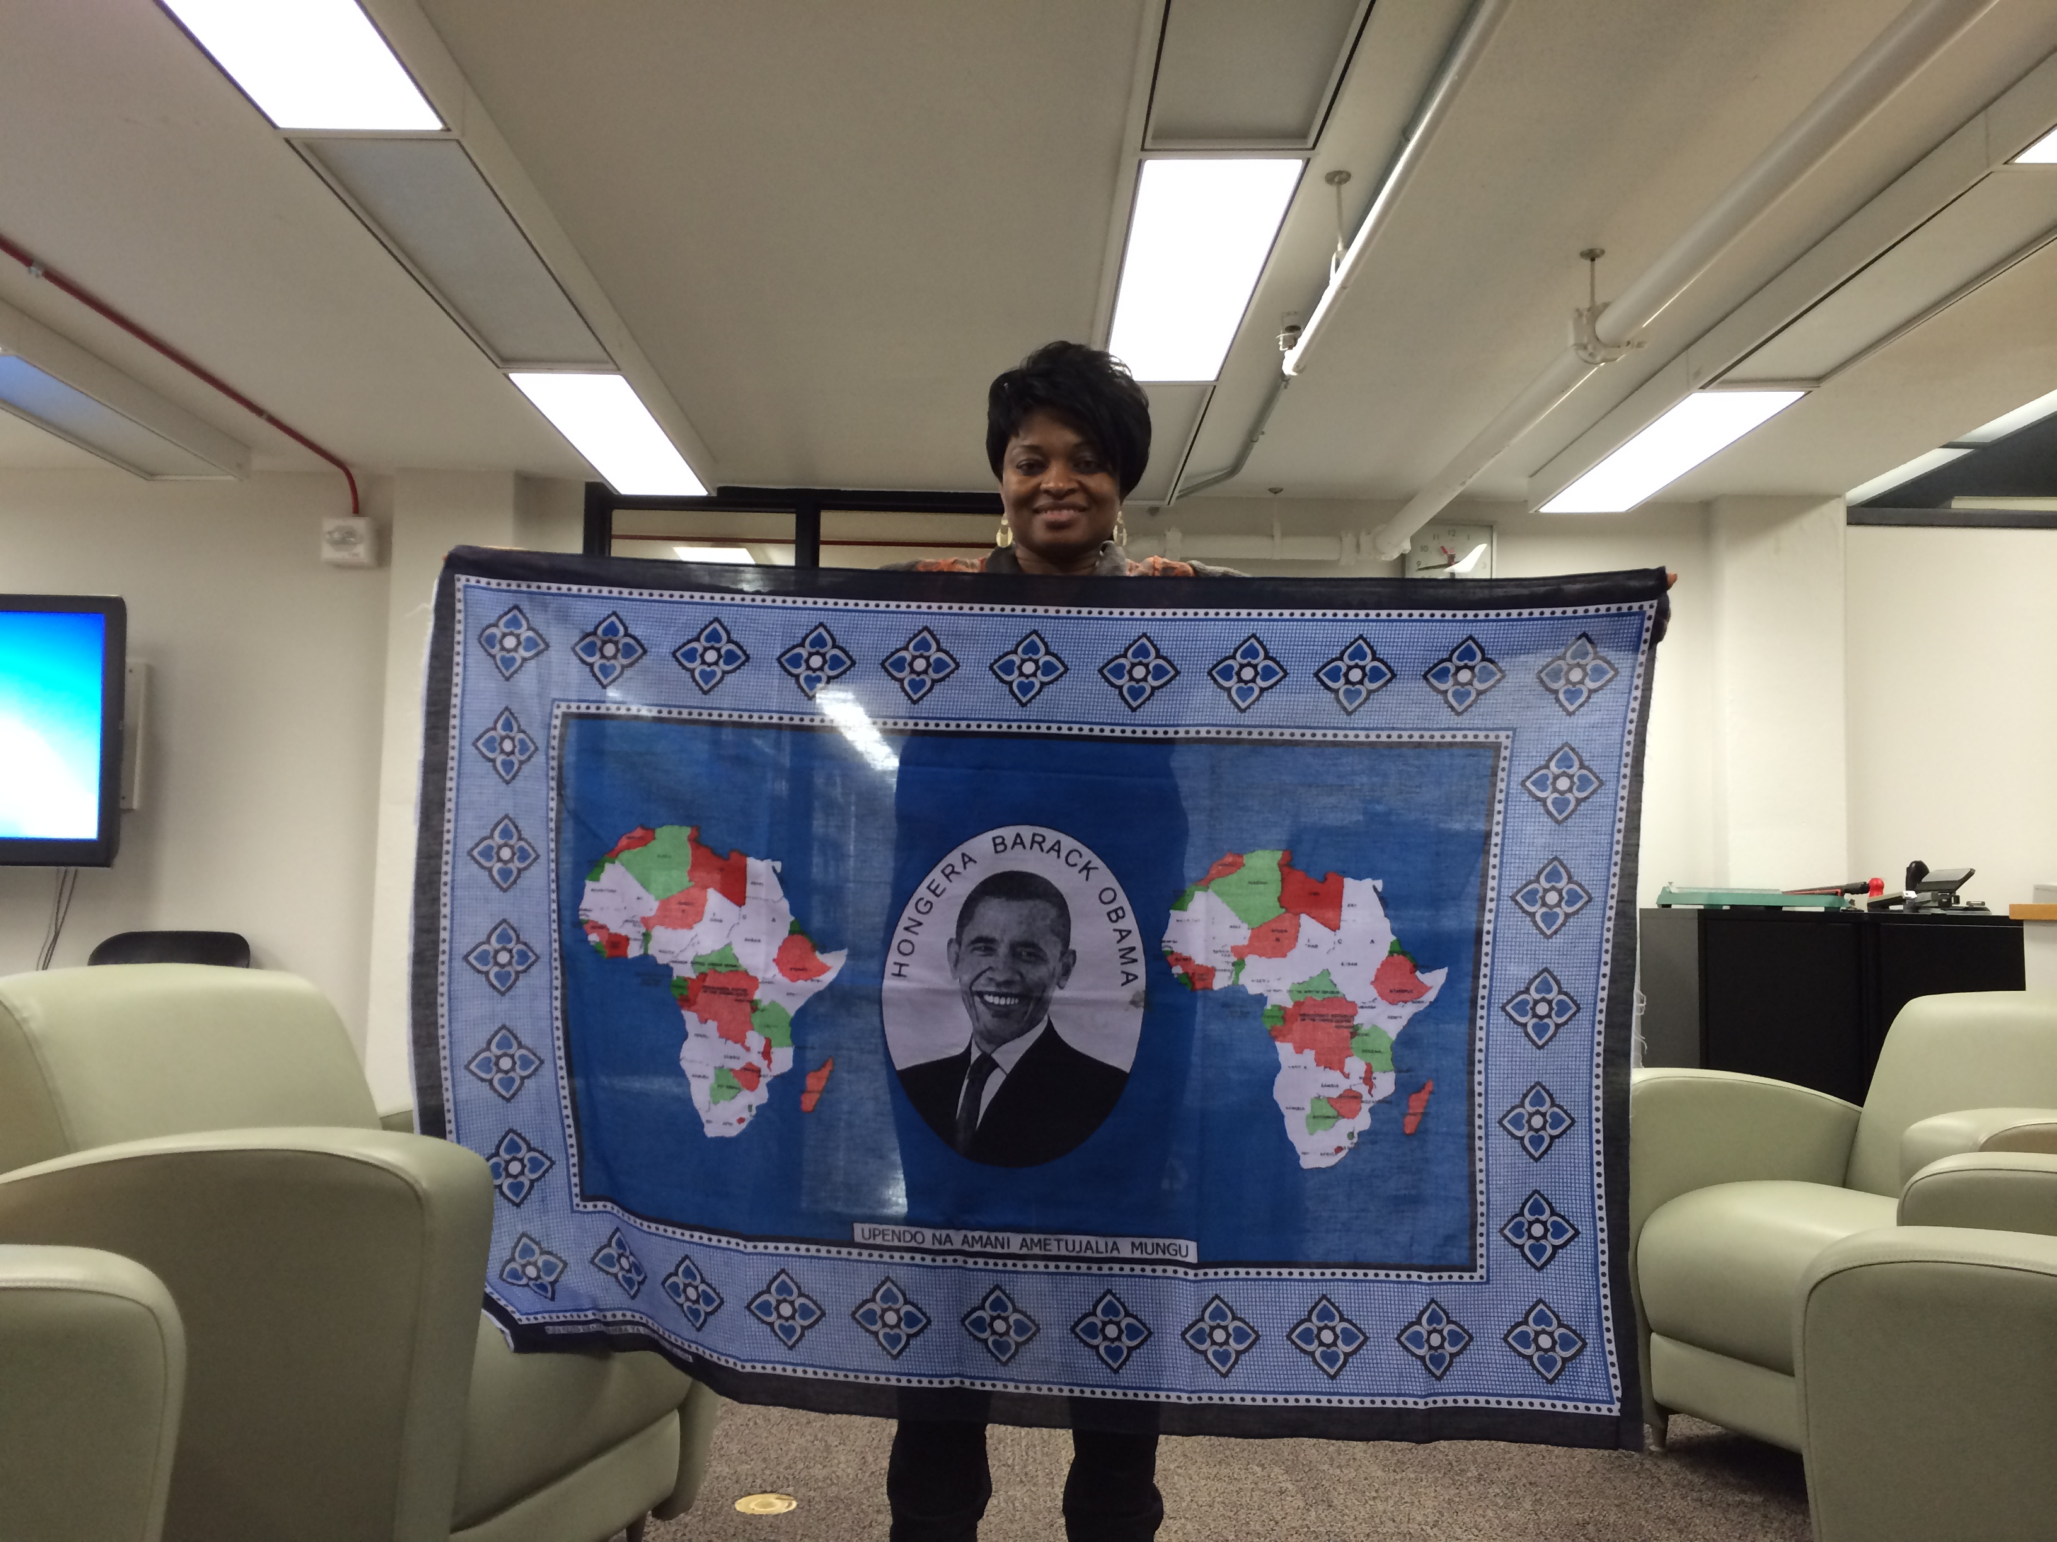
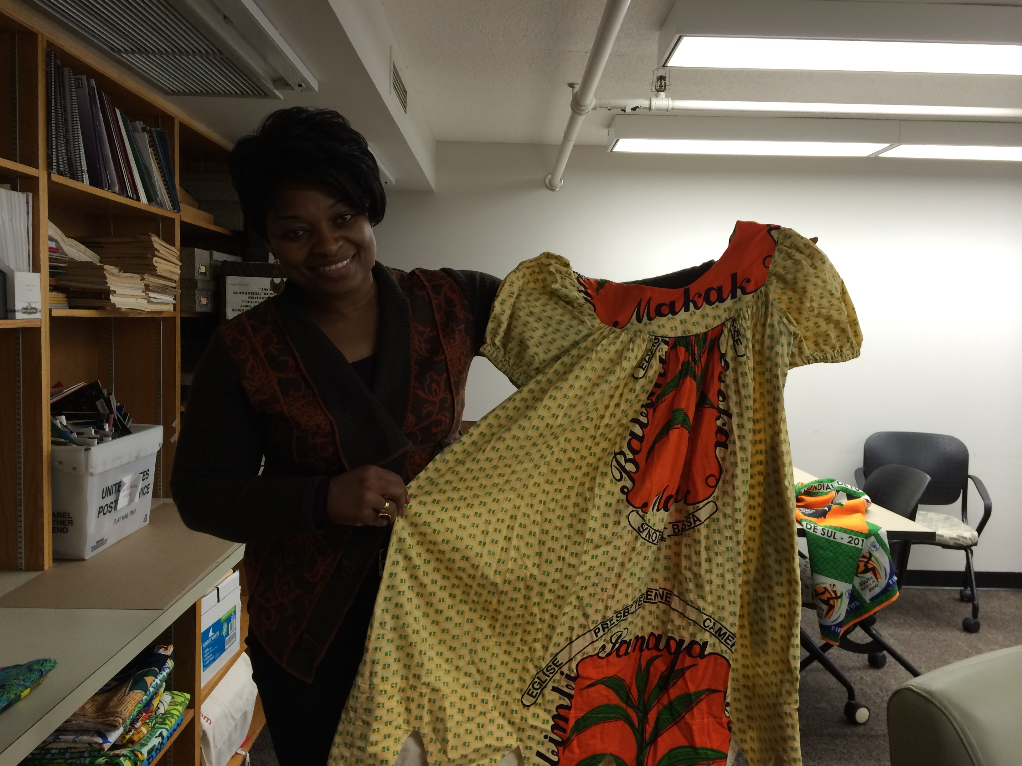
African Studies Collection. Images of Commemorative Fabrics from Africa
Emilie Ngo-Nguidjol Songolo – Bibliographer, Social Sciences. Subject librarian

Slide 24

How they create digital collection?

Slide 25
UWDCC digital project development process consists of series of steps:
Pre-Production Production
Post-Production Promotion
culminating in a brief Memorandum of Understanding between content providers and the UWDCC.

Slide 26
UWDCC received project proposal from:
UW administration, faculty, staff and students.
The following criteria:
research needs, rare books, unique and high use regularly
requested by UW faculty and students.
Subject librarians support the creating of digital collection.
Faculty, staff Subject librarians UWDCC
(Сontent providers = Subject librarians = UWDCC)

Slide 27
Content provider should consider the following criteria before submitting a digital project proposal:
Who is the audience for this digital project?
How will users interact with this material?
Is the material already digitized and available online?
Do you have permission to digitize and publish online, this material?
Content provider should create descriptive metadata for project materials.

Slide 28
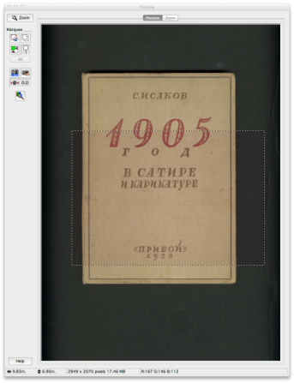
«Eastern European and Slavic Studies Collection».
The Eastern European Collection brings together, in digital form, primary and secondary materials relating to the study of this region including its history, literature, language, political science and more.
Creating digital project for book:
«1905 год в сатире и карикатуре» С. Исаков,
1928 год.
This book is donation from faculty member.
Subject librarian: Andy Spencer
Bibliographer for Slavic, East European,
Central Asian and Middle Eastern Studies

Slide 29
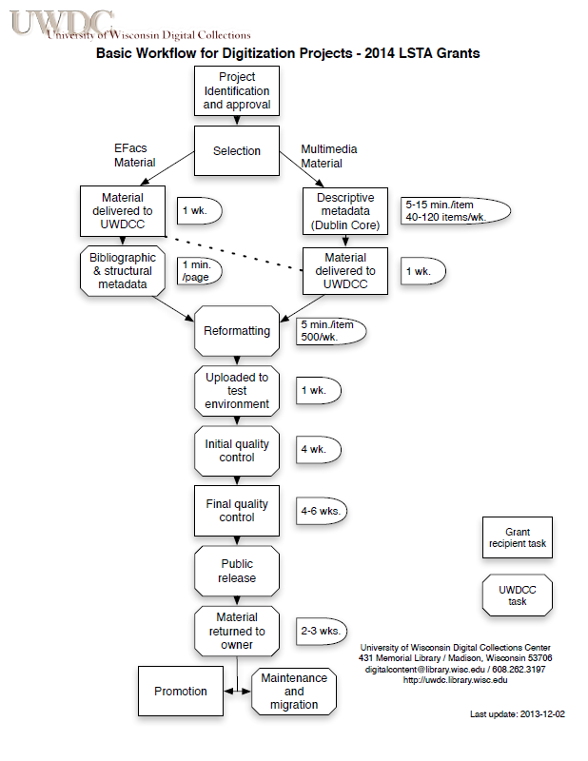
Typical digital
project workflow

Slide 30
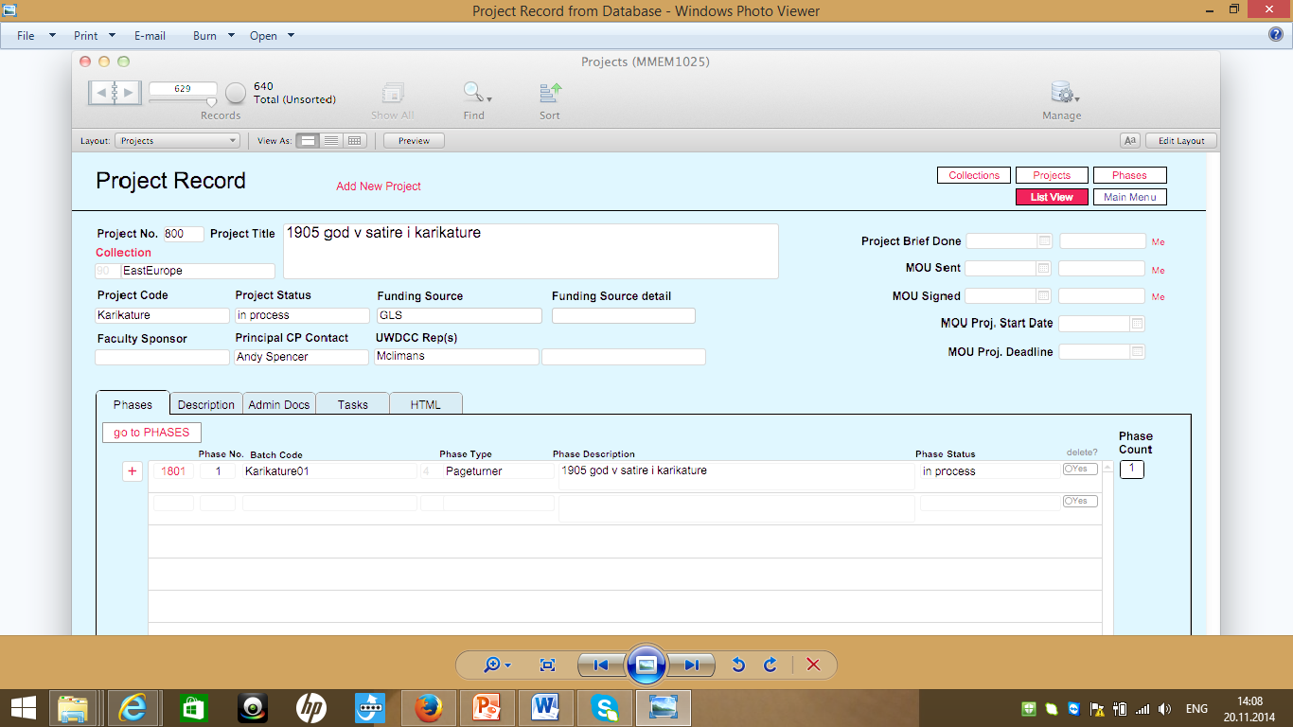

Slide 31
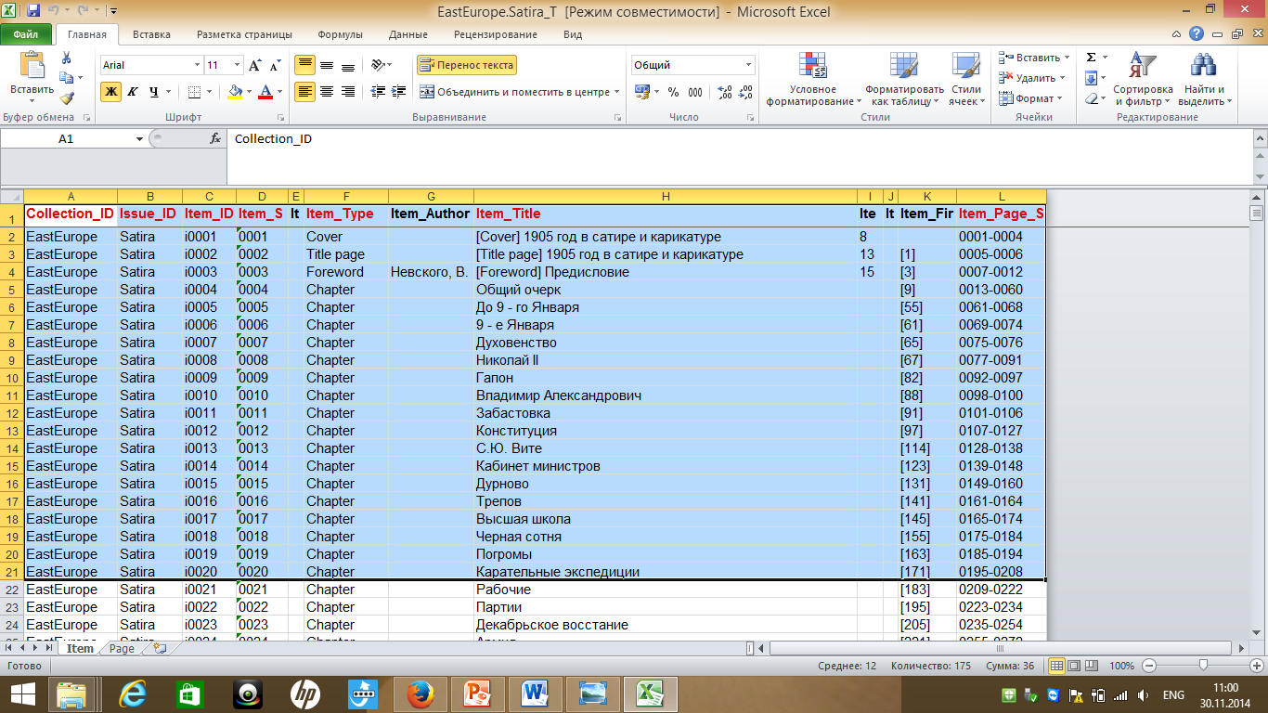
Item-level metadata

Slide 32
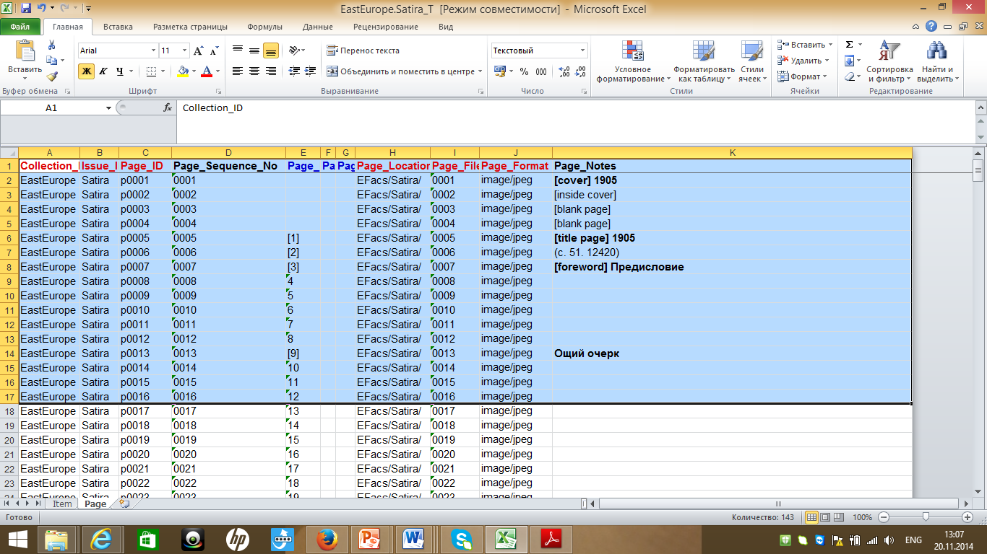
Page-level metadata

Slide 33
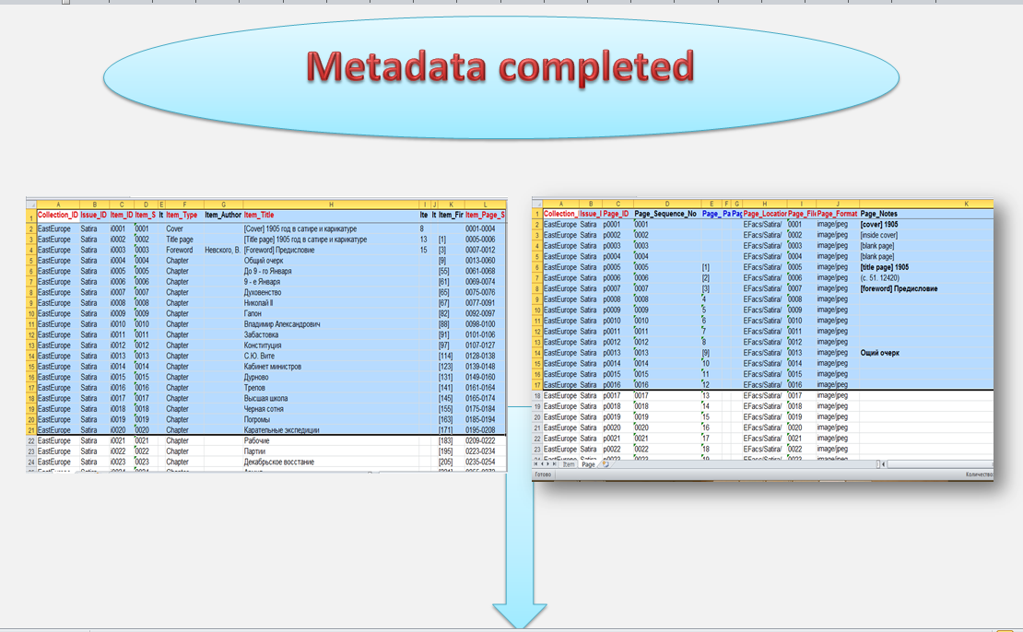

Slide 34
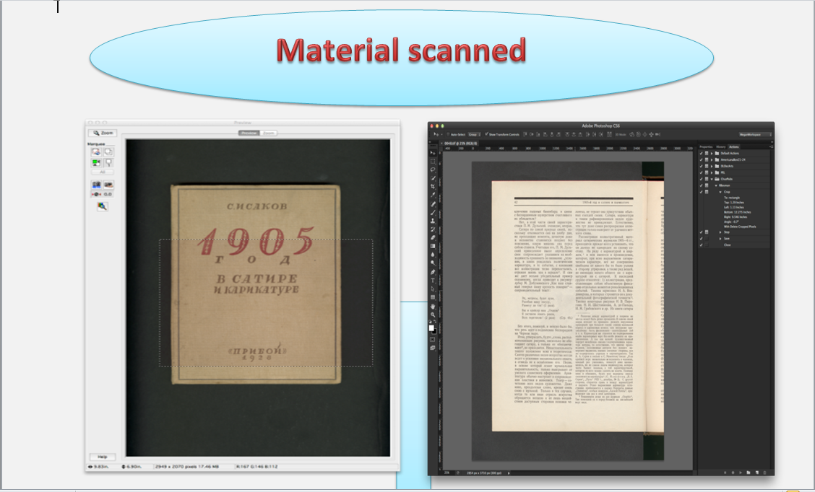

Slide 35
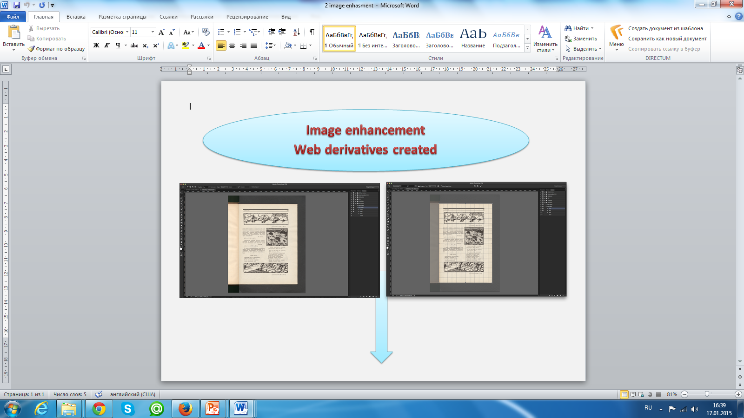

Slide 36


Slide 37


Slide 40
http://digital.library.wisc.edu/1711.dl/EastEurope.Satira

Slide 41
Software for creating digital collection:
Efacs = Electronic Facsimile = Pageturner = TEXT.
Optical Character Recognition (OCR) software
Multimedia/bibliographic databases (Dublin Core – photo, audio, video)
MSAccess or Filemaker Pro (SGML)

Slide 42

Integration with the Library Catalog

Slide 43
MINDS@UW - Institutional repository

Slide 44


Institutional repository and data services

Slide 45
Institutional repository (Minds@UW)
MINDS@UW uses DSpace software
Store, index, distribute, and preserve digital materials
Deposited directly by UW faculty or staff
Research papers, pre-prints, datasets, photographs, videos, learning objects, theses, student projects, conference papers

Slide 46
Before submitting journals articles Author should check permission on the database of publisher policies SHERPA/ROMEO or the publisher’s own website
The MINDS@UW license is non-exclusive, meaning that author give MINDS@UW permission to preserve and display content.

Slide 47
Suggestions for creating digital collection in NU
Create own web-site for digital collections
Create collections about:
Collection World Languages, Literature and Culture
The Anthropology collection
The Science collection

Slide 48
very interested!
Software training for students and staff
(free technology classes from the Division of information Technology).
- Photoshop
- HTML/CSS
- Wordpress
Study areas for quiet or group work, as well as spaces designed to meet your technological and research needs.
Cafeteria in the reading rooms of the library ☺

Slide 49

Study areas, Study rooms!

Slide 50


Slide 51



Slide 52



Slide 53

“Study room”
“Study room”, which you can reserve and see the schedule.

Slide 54


Slide 55


Slide 56


Slide 57


Slide 58
Thank you!

