Slide 1
Designing a New
Data Collection Approach
Marat Isteleyev
Supervisor: Martin Lukac
Notes:
Hello everyone!
Thank you for your time and attendance in today’s presentation.
I appreciate the opportunity to present my work to you.
Today, I’m going to present you my thesis work with a title “Designing a new data collection approach”
My name is Marat Isteleyev, and my thesis supervisor is prof. Martin Lukac.

Slide 2
Content
INTRODUCTION
SYSTEM DESIGN AND ARCHITECTURE
PROPOSED METHOD
COLLECTED DATASET
EVALUATION
CONCLUSION
Notes:
Firstly, I’d like to go through the plan of today's presentation.
1.
We’ll start with an Introduction where I’ll talk about the problem description and thesis motivation
2.
Next, I’ll explain the System Design and Architecture
3.
Then, we’ll move to the Proposed Method where a new system design and architecture will be discussed
4.
After that, we’ll see the collected dataset followed by Evaluation of new approach section
5.
And I’ll finish with Conclusion and Future Work slides

Slide 3
Introduction

Slide 4
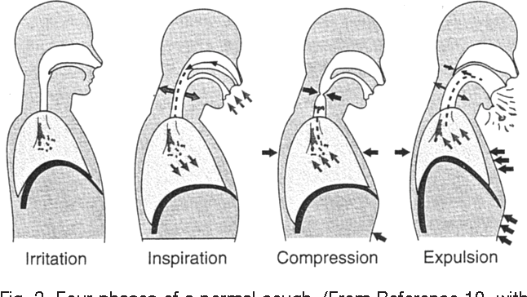
Human cough
What is a human cough?
It is an act that clears the throat and breathing passages
It involves three phases:
  Inspiration
  Compression
  Expulsion
Cough phases
Notes:
Cough is an act that clears the throat and breathing passages, and it involves 3 phases.
It starts with an inspiratory phase, than transforms into expiratory effort against a closed glottis and concludes with an expiratory airflow against an open glottis
The last phase is typically accompanied by what is called a cough sound. Several additional partial glottis closures cause extra voiced sounds, namely a cough sequence.

Slide 5
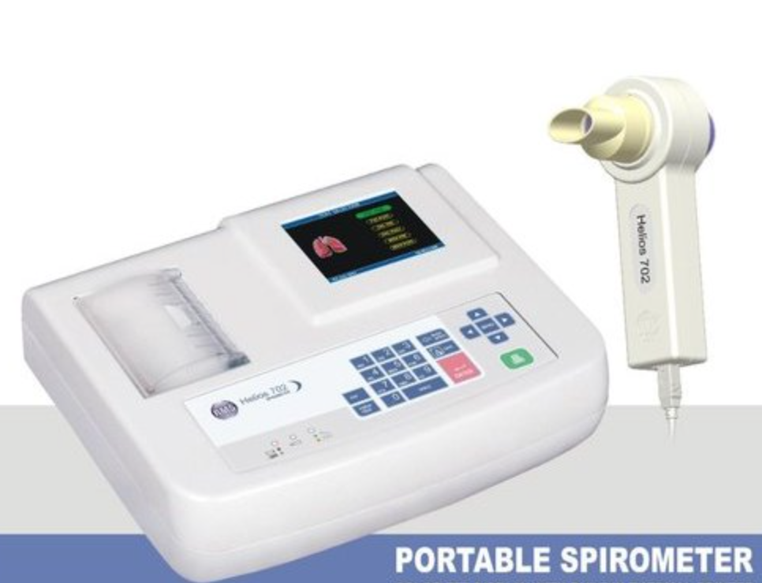
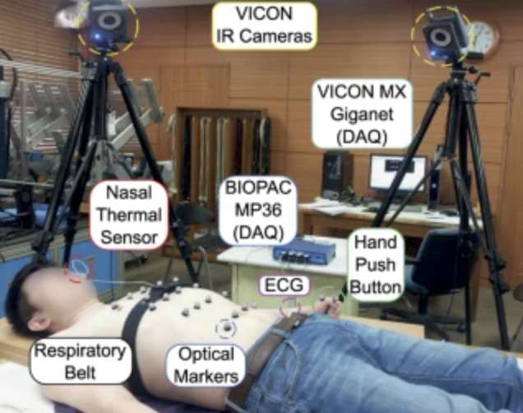
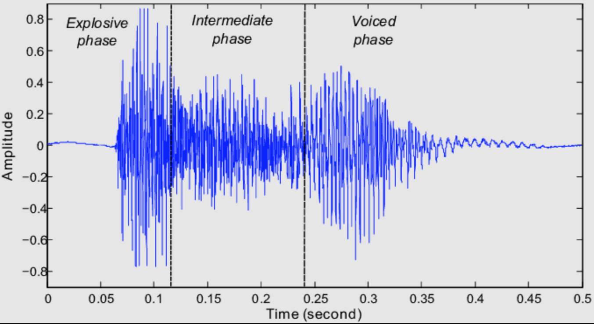
Cough Monitoring Approaches
Three main approaches exist so far:
Airflow measurement
Chest movement signature
Analysis of cough sounds
Notes:
There are three main approaches that have been introduced so far which help to monitor human coughs.
1.
The first one includes an airflow measurement at the mouth to extract the flow dynamics of cough. This approach proved itself highly inconvenient, since it is difficult to integrate in the normal environment.
2.
The next one relies upon registering the chest movement signature. It also was not adopted due to the requirement of continuous control from the researchers.
3.
The last and the most up-to-date one is more comprehensive due to the evolution of technology. It involves the analysis of cough sounds.

Slide 6
Existing Cough Audio Datasets
COUGHVID by EPFL
  20000+ entries
  Expert-labelled 2000 entries by 3 pulmonologists
COSWARA by Indian Institute of Science in Bangalore
  2000+ entries
  Breathing sound, cough sound, phonation of sustained vowels
Cough Analyzer by Nazarbayev University
  1100+ entries
  Cough sound, cough type, smoking status, diagnosis and other details
Notes:
1.
The COUGHVID dataset is a crowdsourced dataset that contains >20000 cough records. The database was collected between April and September 2020 through a web application created by École Polytechnique Fédérale de Lausanne (EPFL), Switzerland. COUGHVID also contains 2000 expert-labeled cough recordings.
Three pulmonologists manually revised 1000 recordings each, and selected the predefined options like Audio Quality, Type of cough, Audible nasal congestion, etc. It took about 10 hours for experts to label the given data.
Each cough recording inside the dataset consists of two identically named files, but with different extensions. First part is the actual audio signal in either WEBM or OGG formats, whereas second part is the JSON file with accompanying encoded metadata.
2.
The COSWARA project by Indian Institute of Science (IISc) in Bangalore is focused on building a crowdsourced dataset too. The dataset contains 34 fields of information such as gender, age, date, location, covid status, smoking status, etc
Currently, as of July 7, 2021, it contains 1986 entries. Interesting point is that on August 7, 2020 the project had 941 entries meaning that the dataset nearly doubled in size since then. The COSWARA project general strategy consists of three stages: Data collection followed by Model construction, and implementation of a Diagnostic Tool stage. Thus, it makes COSWARA projects' strategy and objectives very similar to what Cough Analyzer Project is heading towards and implementing at the moment.
3.
Cough Analyzer project by Nazarbayev University aims to build a database using a mobile app and create an AI-based system for detecting, recognizing, and analyzing human cough sounds. Another goal is to improve telemedicine and connect app users to healthcare professionals regarding their concerns related to infectious and respiratory diseases.
At this moment, the Cough Analyzer database contains 1100+ entries and the data collection is progressing. Although the COSWARA project goals closely intersect with the current project, the Cough Analyzer project aims to be different by providing a local expert-annotated human cough recordings dataset particularly from the Central Asian region, thus, it will contribute to the existing available datasets list in this sense. This thesis study is performed as part of the Cough Analyzer project.

Slide 7
Challenges of Remote Collection of Cough Data
Challenging to attract users to participate -> slow momentum
Tightly coupled with users’ general digital literacy
Cough detail forms are often filled randomly

Slide 8
Motivation & Goal
Human cough is believed to be the foremost symptom in most respiratory diseases, often overlooked for many high risk diseases
No commonly accepted standard for diagnosis and assessment
Cough sound is different in various parts of the world
Our goal is to build a reliable expert-labelled dataset and a data collection tool for cough assessment
Notes:
This brought us to the motivation of the current work.

Slide 9
System Design and Architecture

Slide 10
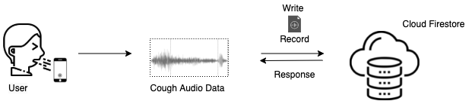
Initial System Design
Notes:
It can be separated into 3 main parts: A user, a mobile application and a database.
User initiates the participation in the experiment by interacting with a mobile app. Then, the application uses some database at the back-end for storing user data. A simple, straightforward and effective way.
One can see that Google's Cloud Firestore is selected as the database of choice. And the type of data that the app saves is the actual voice recording (with an accompanying Cough Details form).

Slide 11



Technology Stack
Flutter Framework
  Uses Dart programming language to build apps for Android and iOS
Google Firebase
  App backend (functions) and hosting
Cloud Firestore
  NoSQL document-based database
Notes:
This section describes the main backend technology stack that was used in order to build and support the Cough Analyzer mobile and web apps.
1. Flutter
Flutter is a new mobile app development framework that was first released in mid 2017 by Google, however in started to gain more public interest very recently only.
Software developers who use Flutter need to write the code in Dart programming language, which is being compiled into native ARM by Flutter runtime engine
2. Google Firebase
Firebase is a platform that is also provided by Google Inc. with a motivation to help creating and hosting mobile and web applications in the cloud. It helps developers to build real-time applications and synchronize data across the various devices. Firebase contains such features as Firebase SDK, Firebase RestApi, Admin SDK, Firebase Cloud Messaging and etc. It offers a secure authentication procedure with a list of multiple sign-in providers.
3. Cloud Firestore
One of the key technological toolsets that Firebase provides is Cloud Firestore. It is a NoSQL database that provides offline-support and is managed (and scaled) for developers by Google. It is a fast and reliable document-based cloud storage that securely interacts with mobile, web and server applications. It allows to store files, documents that are organized in collections,

Slide 12
Limitations of Initial System Design
Low audio data quality -> often noisy cough audio signal
User forms are filled randomly -> unreliable annotation
User authentication is an additional complication
Coughing at someone’s phone is not an option

Slide 13
Proposed Method

Slide 14
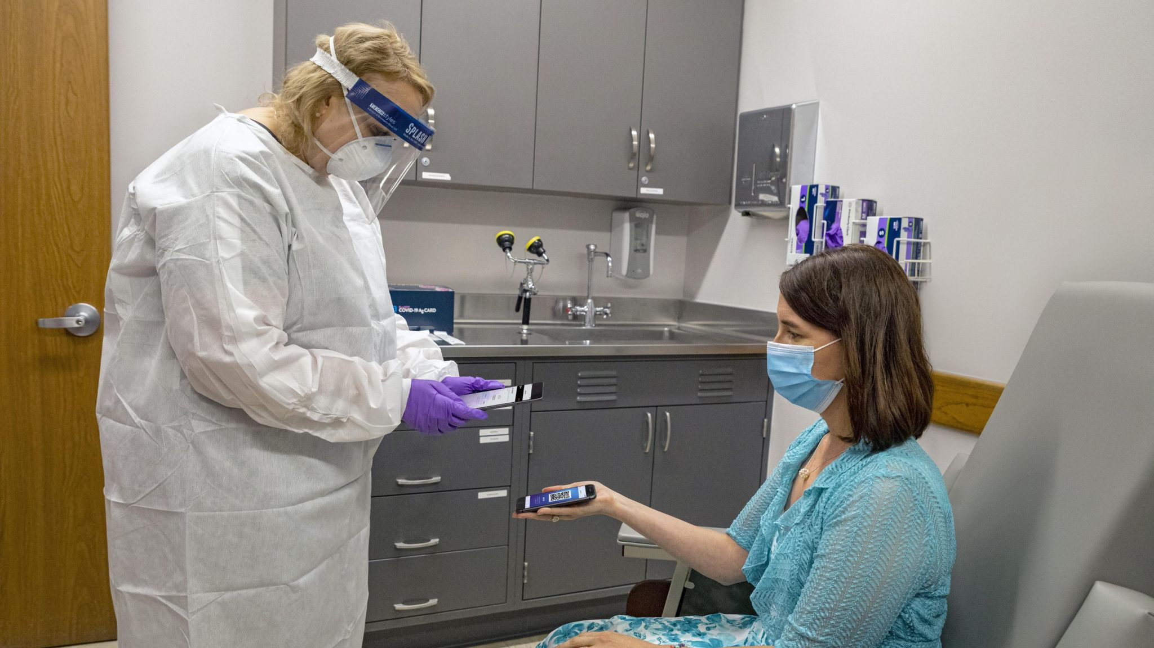
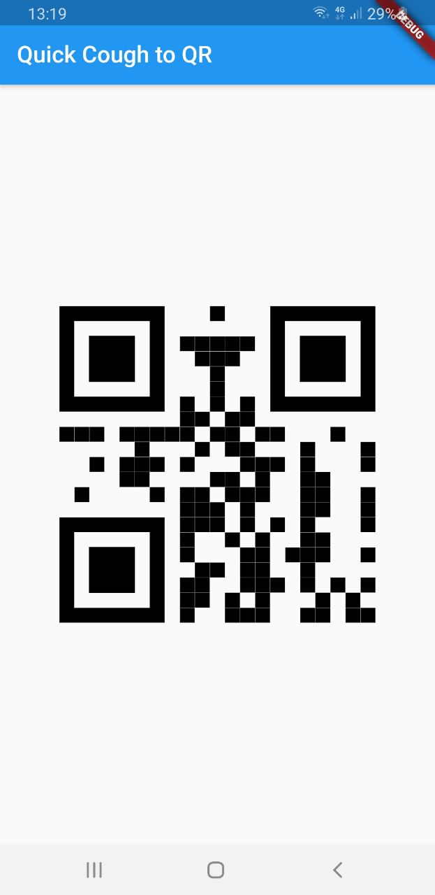
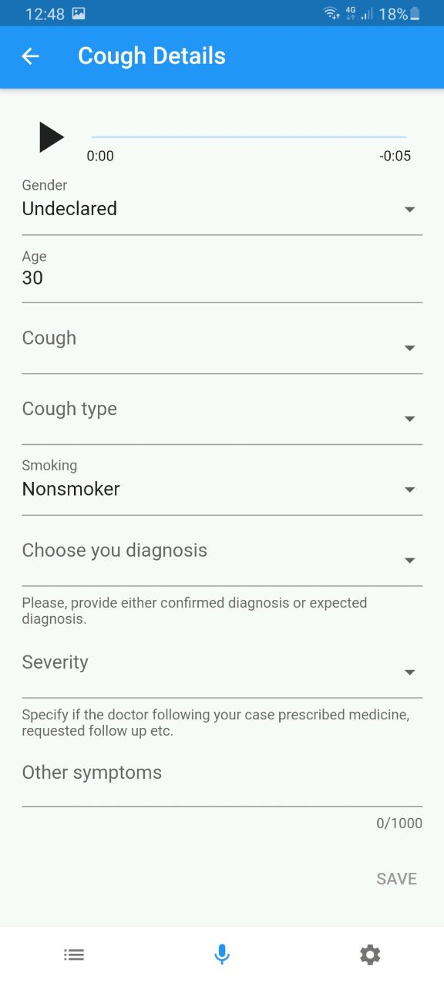
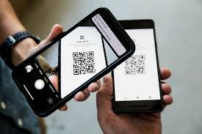
Proposed Use Case
Patient
Healthcare Professional
Image source: https://tinyurl.com/4r75d8xh
Notes:
The proposed method exploits the use of two mobile devices, a patient and HP’s phones.
Here, in the picture on the right hand side, you can see a Healthcare Professional scanning something on Patients phone.
Here you may notice that this concept relies upon scanning of a QR code.

Slide 15
Proposed Method
Healthcare professional (HP) instructs a patient to download a Cough Analyzer app from the app store.
Patient opens the app and selects Cough-to-QR method
Patient coughs at their own phone and displays the generated QR code to HP
HP scans the QR code with their own phone and fills the cough details form
HP submits cough details data to the database
Notes:
So the proposed method may be split into five basic steps.
In starts with a HP asking a patient to download …
Next, Patient opens the app …
Then, Patient coughs at … and displays the QR code …
HP scans the QR code … and fills the Cough Details form
HP submits the data

Slide 16
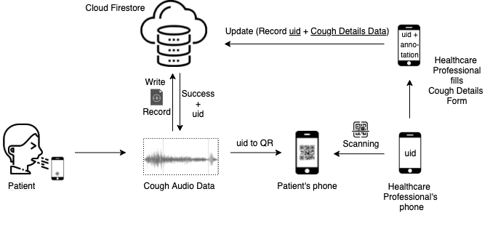

Proposed System Design
Notes:
This graph represents the design of the proposed data collection process.

Slide 17
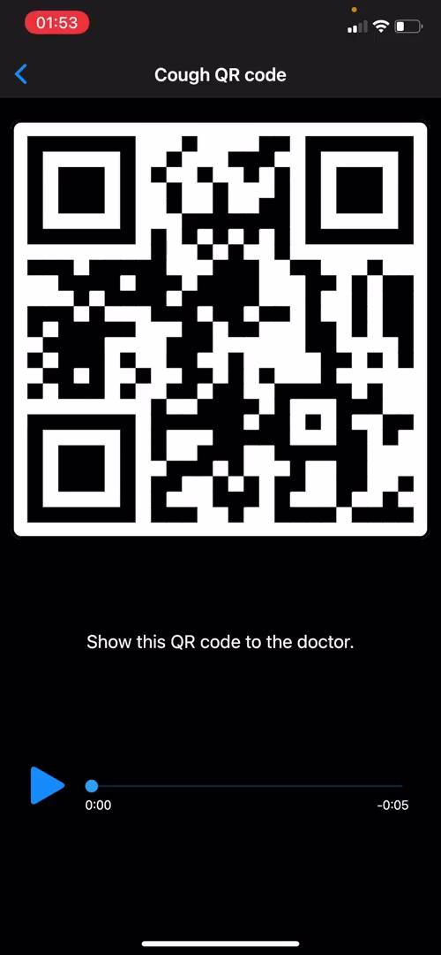

Demo
Patient
User
Medical professional
Notes:
Now I’d like to quickly show you the demo of three user scenarios of the updated data collection method.

Slide 18
Collected Dataset

Slide 19
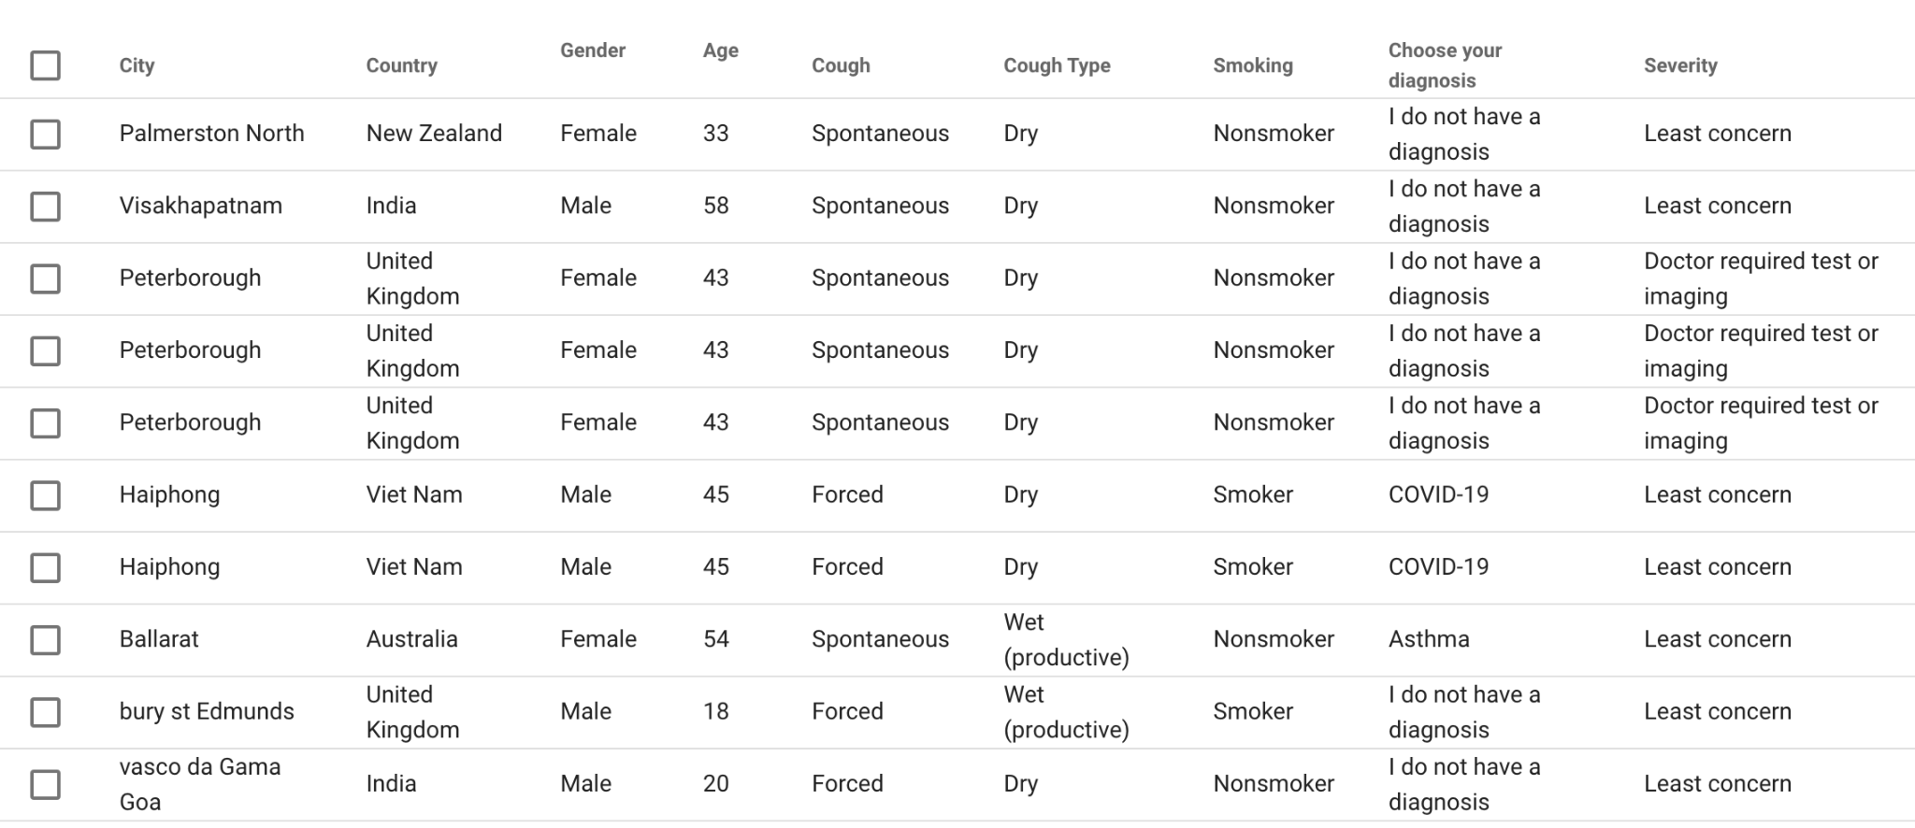
Current Dataset and Results
Snapshot of collected data
Notes:
This slide represents a tiny snapshot of the information that we ask from the users. You can see here we collect a data such as age, gender, cough type, smoking status, etc.

Slide 20
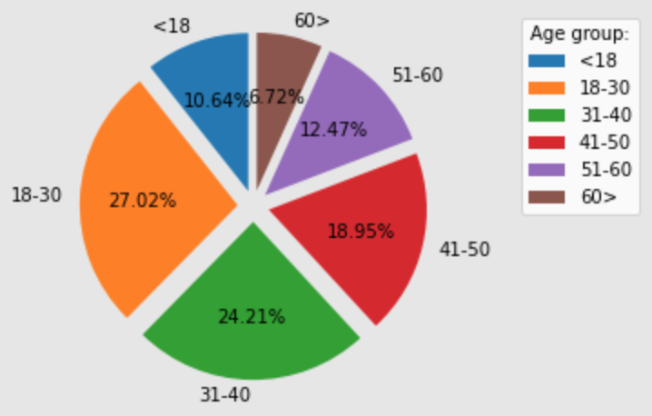
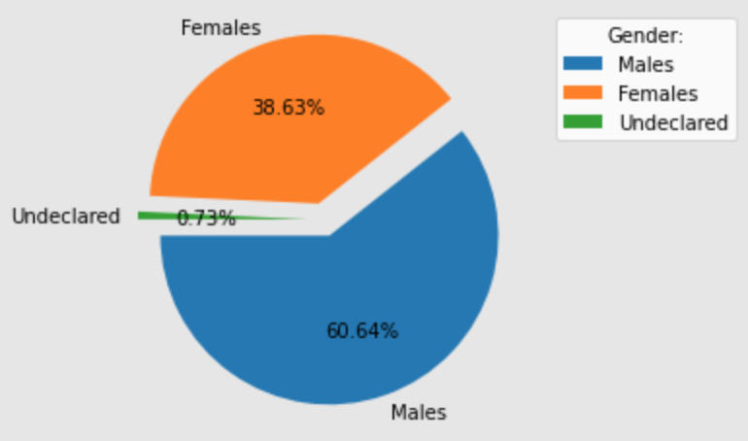
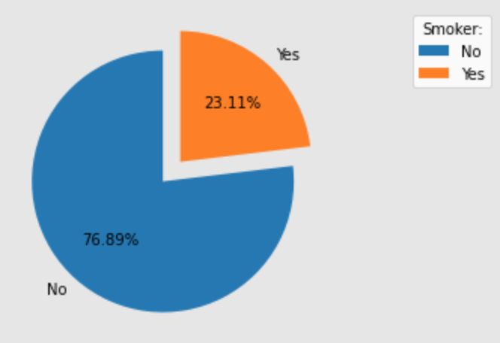
Demographics
Notes:
This slide represents a high level overview of the collected data. I’d like to quickly show you some interesting insights from it.
From left to right.
First graph shows the age distribution of the users. Here we can say that the age distribution is more or less balanced among the group.
Next, the percentage of female and male participants. Which is around 40 and 60 percent respectively.
Last graph shows the smoking status of the users who submitted their data. We can see that three quarters of the experiment participants declared themselves as non-smokers.

Slide 21
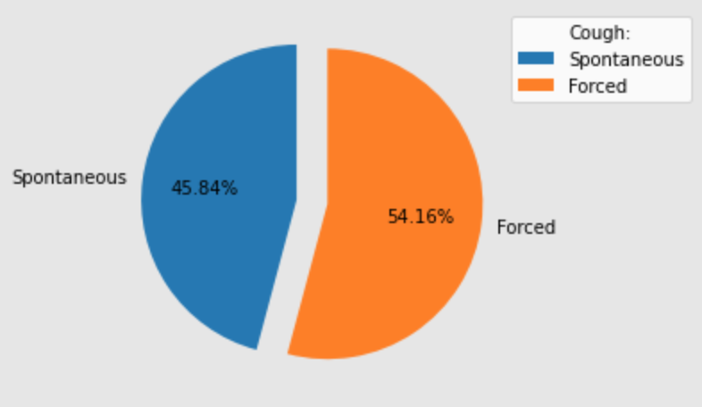
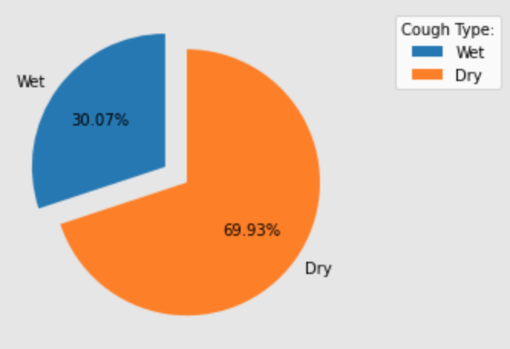
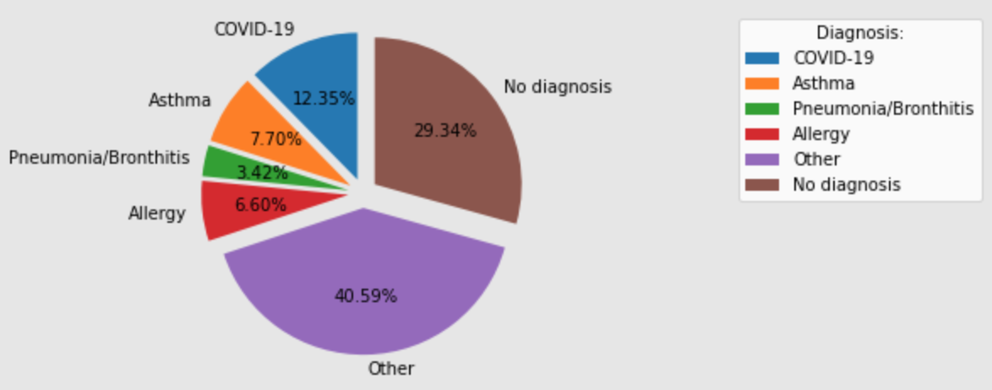
Cough Data Description
Notes:
This slide continues the previous overview.
From left to right.
First graph represents the cough nature. Forced type in other words can be understood as a healthy, and spontaneous is the one that is not faked. Usually sick people would have one.
Next, the percentage of dry and wet type of cough. Which is around 70 and 30 percent respectively.
Last graph shows the diagnosis of the our users (if they have one)

Slide 22
Evaluation

Slide 23
Experts Review
An expert review is a type of evaluation that is used to find usability issues with a product or service.
Experts perform the review in which they carefully examine the app in search of potential usability concerns.
This expert evaluation is one of the few approaches used in the user-centered design process that does not involve the end users.
There were two UX experts invited for coffee on two different days.
They were given a mobile phone with an app installed on it and asked to use it to identify any usability issues.
The reviews were audio recorded for later analysis.
After each review a list of changes was compiled.
Notes:
In order to evaluate the proposed data collection tool, it was decided to perform an Experts Review as well as to design and conduct a Usability Test with potential users of the Cough Analyzer application.
This section represents the results of the in-person interviews with two User Experience (UX) engineers working in industry. The experts were invited for coffee and were given a mobile phone with the Cough Analyzer application installed on it. After each review we compiled a list of changes to be made to the data collection tool.
The meetings with two UX experts were held on two different days. The experts were asked to use the application and to identify any usability issues. The reviews were audio recorded for later analysis.

Slide 24
Issues and Suggestions by the Experts
to add instructions that the cough should be at least 3 seconds long;
to add instructions to prepare a napkin or tissue to wipe the screen after the cough;
to display the system status that the cough was collected successfully and to thank the user for their time;
to add edit, trim and delete buttons to be able to modify the recording before saving it in a dataset;
to have an option to retrieve unsaved recordings when the "back" button is pressed;
to color the timer to indicate that a minimum duration of 3 seconds has not yet passed, when it has passed and when the recording is long enough;
to rename the title of the screen from Cough Details to "Please fill in the form";
to populate some of the form's fields with existing account details such as sex, age, and other personal information;
such pre-populated details to be editable;
to provide the options to edit, trim, and delete cough data within the Cough Details screen;
to allow the questions to be left unanswered as well as to decrease the amount of questions as some of these questions might be difficult to answer.

Slide 25
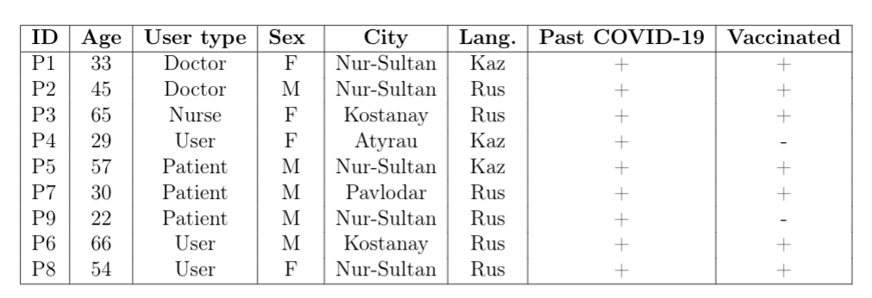
Usability Testing
One of the main goals of Usability Testing is to collect and analyze the user experience feedback regarding the data collection approach, its ease of use, convenience and efficiency. Guidelines suggest that a good baseline for the number of subjects is b/w 5-10 users.
There were three type of users: healthcare professionals, patients and general users.
Notes:
To investigate whether the proposed updates in a user interface are efficient, convenient and potentially could contribute to a better data collection, a usability testing was designed in which participants were expected to interact with the application and provide a feedback by filling in the questionnaire using Qualtrix tool or printed paper application.
The usability test was designed in a way that would draw meaningful results in terms of people's attitude towards the application functionality and user interface.
The table below represents the demographics of the participants.

Slide 26
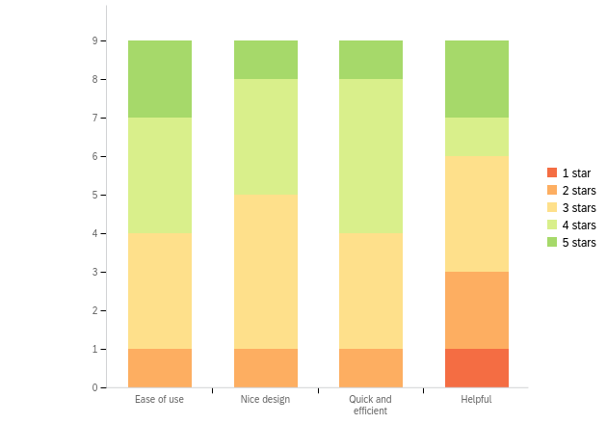
User Perception of the Cough Analyzer App
People rated the app in terms of its Ease of use, Design, Speed and Efficiency, and Helpfulness:
The mean rating for ease of use was 3.67 out of 5.
Medical professionals rated the application slightly less than other user types.
An average score of 3.44 was given for the design of the application. Again, medical professionals gave a slightly worse rating (only 3.0 in comparison to 3.67 given by the other two user groups).
The score for the application’s speed and efficiency was 3.67 on average with patients giving it the highest score of 4.0 on average.
Finally, the helpfulness of the application was rated at 3.33 score with the same trend of medical professionals giving it the lowest rating.

Slide 27
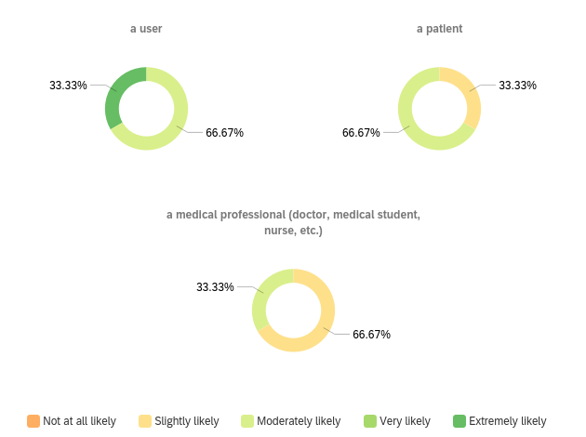
Q: “How likely are you to use it again?”
The answers were grouped by the user type:
Users were the most positive about using it again in comparison to other user types.
Medical professionals were least positive about using it again and responded that they are slightly likely to use it again.
Most patients were moderately likely to use it again.

Slide 28
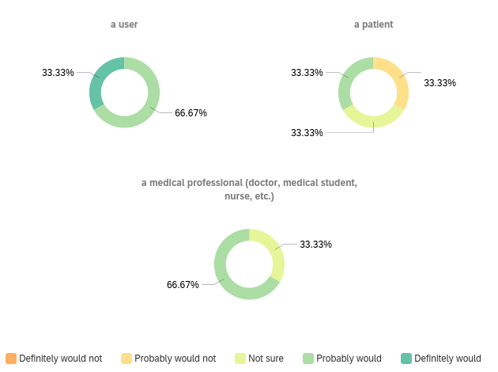
Q: “Would you recommend it to a friend, family member or colleague?”
The answers are grouped by the user type:
Most users and medical professionals responded that they probably would recommend it.
The least enthusiastic were the patients whose scores distributed equally from 2 to 4.

Slide 29
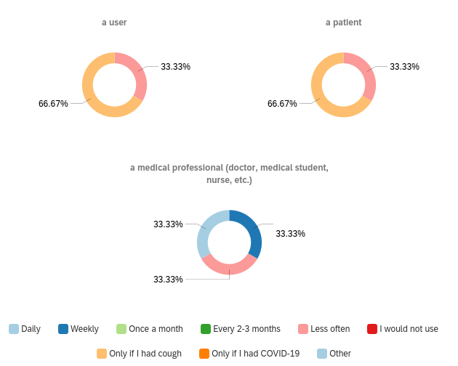
Q: “How often would you use the app?”
Answers were grouped by user type:
Most users and patients responded that they would use it only if they had cough.
Medical professionals responded that they would use it on daily or weekly basis.

Slide 30
Issues and Suggestions by the Users:
the font in red was too small to read during signing up process ("Password must be at least eight characters long and contain at least one uppercase letter, one lowercase letter and one number or special character"). It was suggested to increase the font.
absence of email address made it impossible to sign up. It was suggested to allow signing up using a phone number.
email verification was sent in English (no Russian or Kazakh translations were provided). It was suggested to sent this email in three languages or a selected language.
there were comments that some icons were not easy to understand and it suggested to work a bit more on the design of the application.
the need for the complex password made it time-consuming to register. The suggestion was to simplify this step.
the need to install the application on their smartphones. It was suggested to provide a web-based version of the application to use it without installing it on their phones.
cough details were too time-consuming to enter. On the other hand, a medical professional suggested to add some questions on the temperature and saturation.
the need to enter personal details (e.g. sex, age) when entering details for the cough when they could be simply pre-populated from the previously submitted information.

Slide 31
Conclusions
A new approach to cough data collection
Evaluation included experts review and usability testing
The application received positive comments on its:
  Minimalistic Design
  Easy Navigation
  Quick Cough Submission
  Localization
Issues and suggestions for improvements:
  Registration process should be simplified (e.g. using a phone number)
  Editing, deleting, trimming the recorded cough sound before submission
  Display of system status should be added (e.g. coloring the timer, thanking the user)
  Pre-populate the form with user details such as gender, age, etc.
  Leaving some questions unanswered or to decrease the amount of questions in the form
  Instructions to users to cough for at least 3 seconds, prepare the napkin, etc.
Notes:
So this lead us to the last to slide where I’d like to conclude my thesis work.
Firstly,
The new data collection approach was created
Evaluation tests experts review and usability testing
THe application received positive feedback on ….
While the issues and suggestions included improvements such as to
Simplify the registration process (for instance to use a phone number instead of the email address)
To allow to edit, trim, …
To add extra system status notifications such as
To pre-populate the form.
To allow to leave some questions unanswered.
To instruct users make a recording of at least 3 seconds.

Slide 32
Future Work
To integrate suggestions to improve usability of the CoughAnalyzer application;
To continue data collection.
To experiment with various machine learning techniques in order to classify the cough data.
To combine multiple existing datasets (COUGHVID, Coswara, CoughAnalyzer) to explore them for transfer learning to improve classification accuracy.

Slide 33
Thank you
for your attention!

