Slide 1



FINAL PRESENTATION
Using Machine Learning to Predict Food Prices
Project Advisor: Prof. Michael Lewis
Aruzhan Kassymova
Dilnaz Olzhabayeva
Sherkhan Umurzak
Amina Ismailova
Ainur Zhumay
01
CSCI 409

Slide 2

FINAL PRESENTATION
Project Overview
Our project aims to develop a food price prediction system based on machine learning. Food prices often change due to different factors, such as economic crises, production problems, or high demand. Our model will use and analyze historical data and inflation rates to predict how prices might change. This will help people, businesses, and government to plan and make better decisions.
02
CSCI 409

Slide 3


OBJECTIVES AND GOALS
Objectives and goals
  Collect datasets on food prices and relevant economic indicators (inflation rates, GDP in current US dollars, consumer price index, loan interest rates, unemployment rate, exchange rate to the US dollar, GDP growth, share of urban population)
  Data preprocessing: clean the collected data to extract relevant information, including food product names, countries and country codes, cities, currency types, longitude, latitude, and more
  Develop predictive models using machine learning algorithms, such as
XGBoost, LightGBM, Prophet, and ARIMA
  Monitor model performance
  Provide data visualization
03
CSCI 409

Slide 4

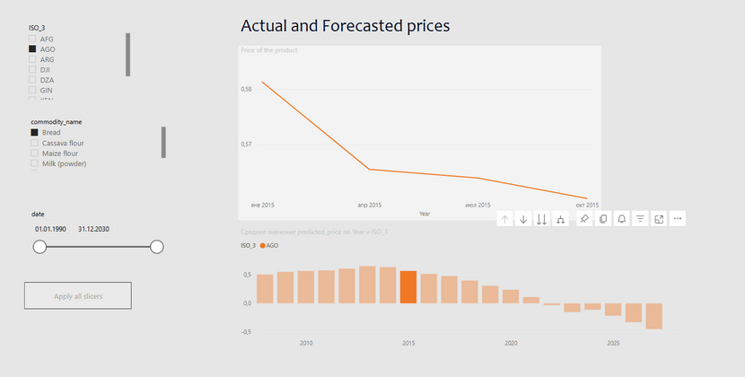

DESCRIPTION OF WORK DONE
Description of Work Done
  Data collection:
    Gathered global product price data (~600,401 entries);
    Collected inflation statistics across countries;
  Data pre-processing:
    Cleaned and deduplicated dataset (20,000 quarterly records);
    Performed basic normalization;
  Data visualization:
    Created interactive dashboards for insights;
  Machine Learning Framework:
    Predicted food prices using macroeconomic indicators (inflation, GDP, urban population);
    Algorithms used: XGBoost, LightGBM, Prophet, N-BEATS;
04
CSCI 409

Slide 5
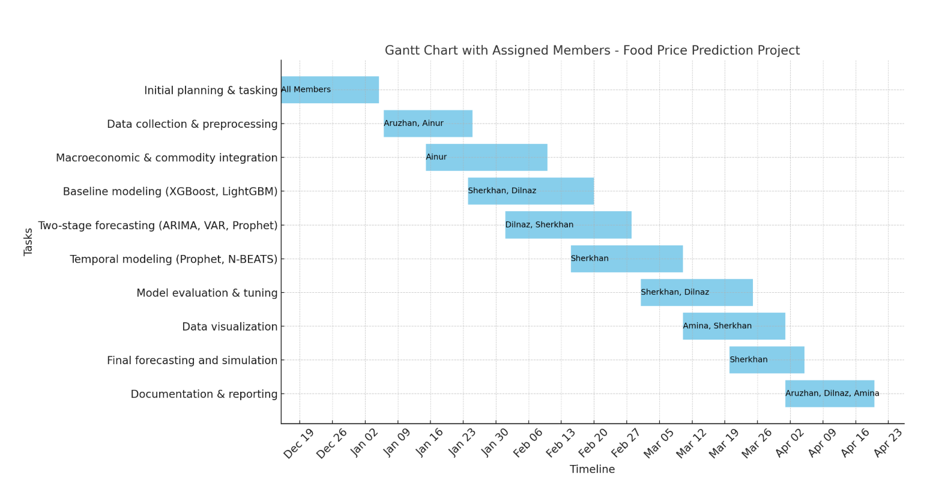

Slide 6
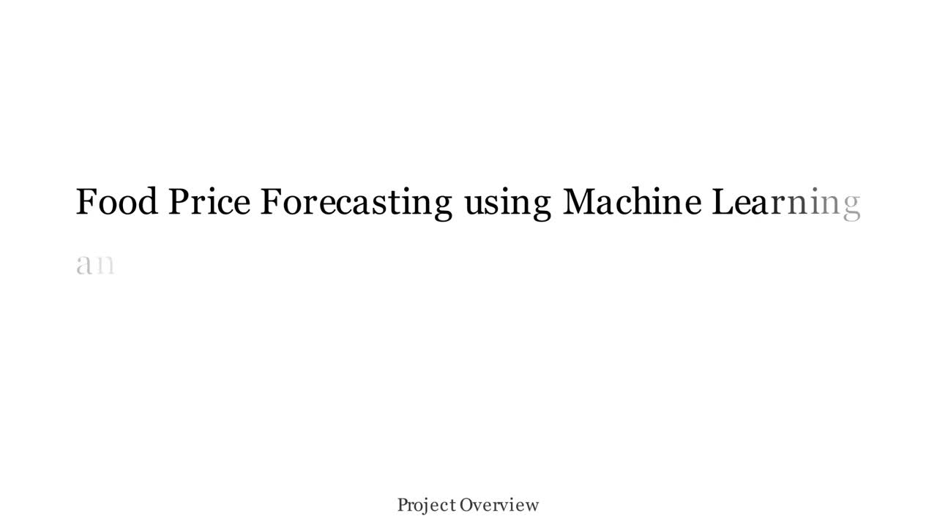
DESCRIPTION OF WORK DONE
04
CSCI 409

Slide 7




DESCRIPTION OF WORK DONE
Data Sources
  Macroeconomic indicators (GDP, inflation, GDP per capita, etc.) were collected via the World Bank API using the wbdata library.
  Commodity prices:
  Oil and fuel prices — from Yahoo Finance
  Wheat and agricultural prices — also from Yahoo Finance
04
CSCI 409

Slide 8
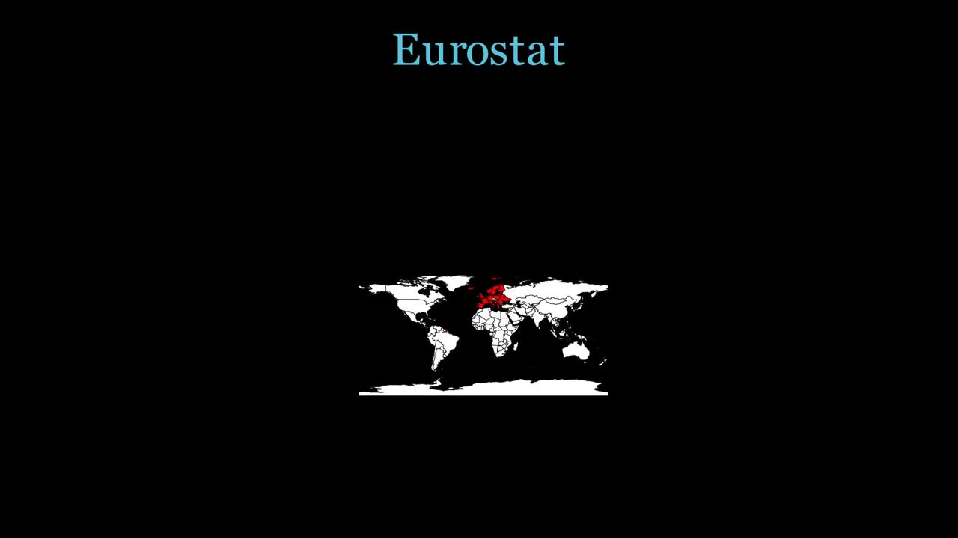
PROGRESS THIS SEMESTER
12
CSCI 409

Slide 9


ISSUES ENCOUNTERED
Issues Encountered
  inconsistent historical data with missing values;
  need for real-time forecasting with minimal latency;
  selecting appropriate machine learning models for accurate predictions;
To address these issues, we implemented data preprocessing techniques to handle missing values, integrated geospatial coordinates for regional price variations, and selected efficient models such as XGBoost and LightGBM.
05
CSCI 409

Slide 10






TOOLS AND TECHNOLOGIES
Tools and Technologies
  Data Processing:
    pandas, pycountry, scikit-learn
  Modeling & Forecasting:
    xgboost, lightgbm, statsmodels (ARIMA, VAR), Prophet, N-BEATS (via darts)
  Feature Engineering:
    Lag features, rolling stats, categorical encoding, log transforms
  Validation & Tuning:
    GridSearchCV, rolling window splits, chunk-based validation
  Visualization:
    matplotlib
  Deep Learning Framework:
    PyTorch Lightning (with GPU acceleration)
06
CSCI 409

Slide 11



TOOLS AND TECHNOLOGIES
Tools and Technologies
  pandas: Data manipulation and preprocessing (e.g., cleaning, aggregating time series)
  scikit-learn: Feature engineering, data splitting, and model evaluation
  pycountry: Standardized country codes (ISO-3) for consistent data merging
  xgboost / lightgbm: High-performance gradient boosting for tabular price prediction
  statsmodels (ARIMA, VAR): Classical time-series models for forecasting macro indicators
  Prophet: Captures trends and seasonality in country-product time series
  N-BEATS (via darts): Deep learning-based time series forecasting model
  GridSearchCV: Hyperparameter tuning for boosting models
  matplotlib: Visualizing trends, forecasts, and model performance
  PyTorch Lightning: Efficient deep learning training with GPU support
07
CSCI 409

Slide 12
DESCRIPTION OF WORK DONE
04
CSCI 409

Slide 13
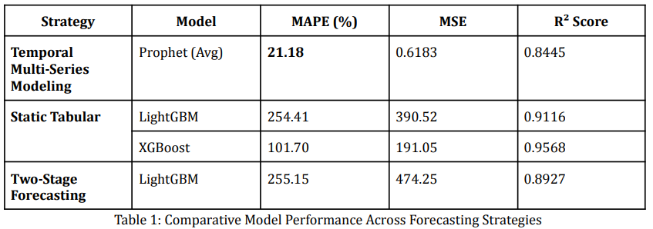
EVALUATION
Evaluation
08
CSCI 409

Slide 14
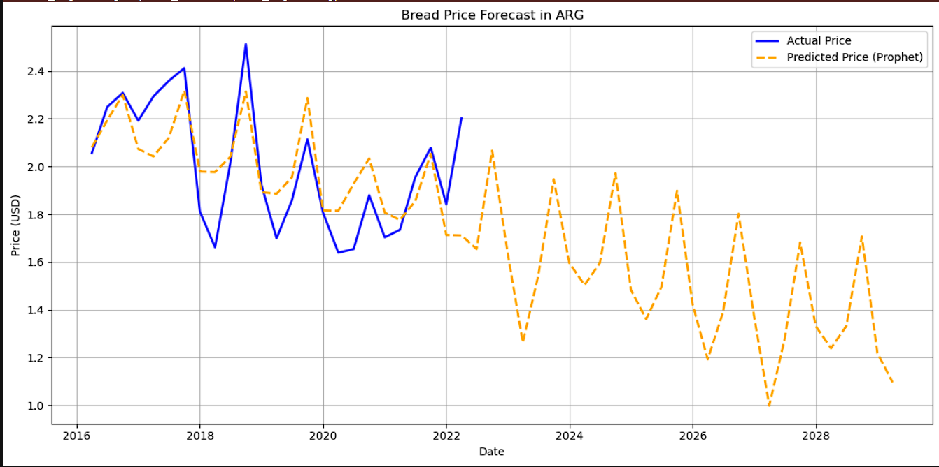
EVALUATION
Evaluation
PROPHET MODEL PERFORMANCE (ACTUAL VS PREDICTED BREAD PRICES)
09
CSCI 409

Slide 15
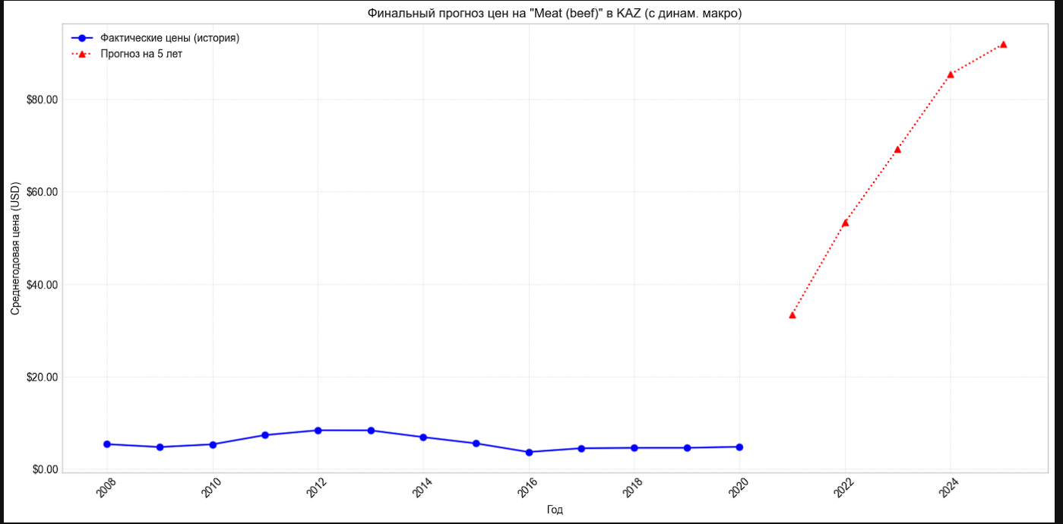
EVALUATION
Evaluation
STATIC TABULAR LIGHTGBM
10
CSCI 409

Slide 16
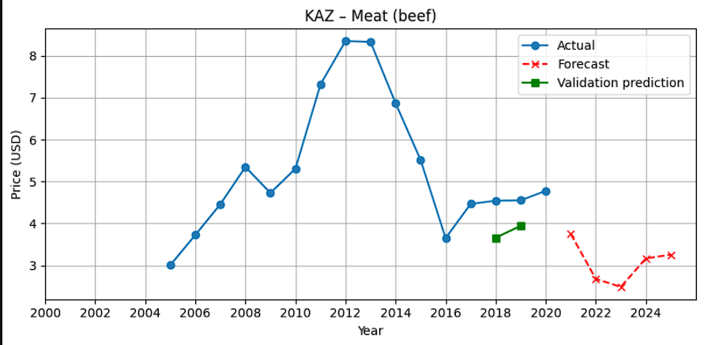
EVALUATION
Evaluation
ARIMA + LIGHTGBM
11
CSCI 409

Slide 17
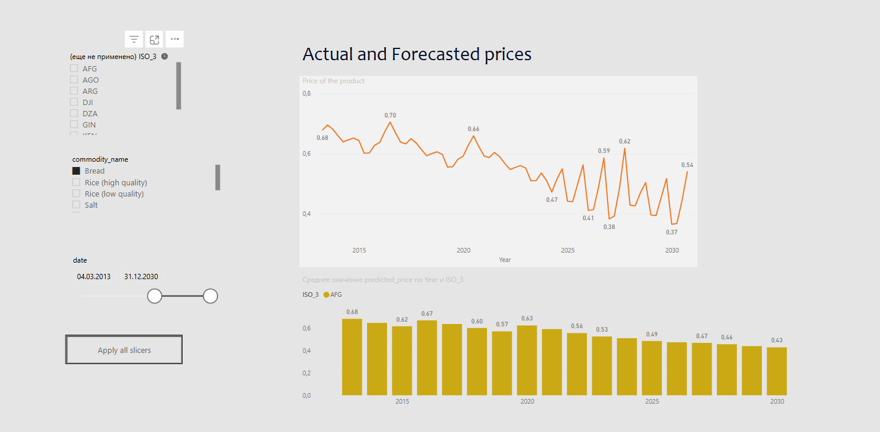
EVALUATION
Power BI dashboard
11
CSCI 409

Slide 18
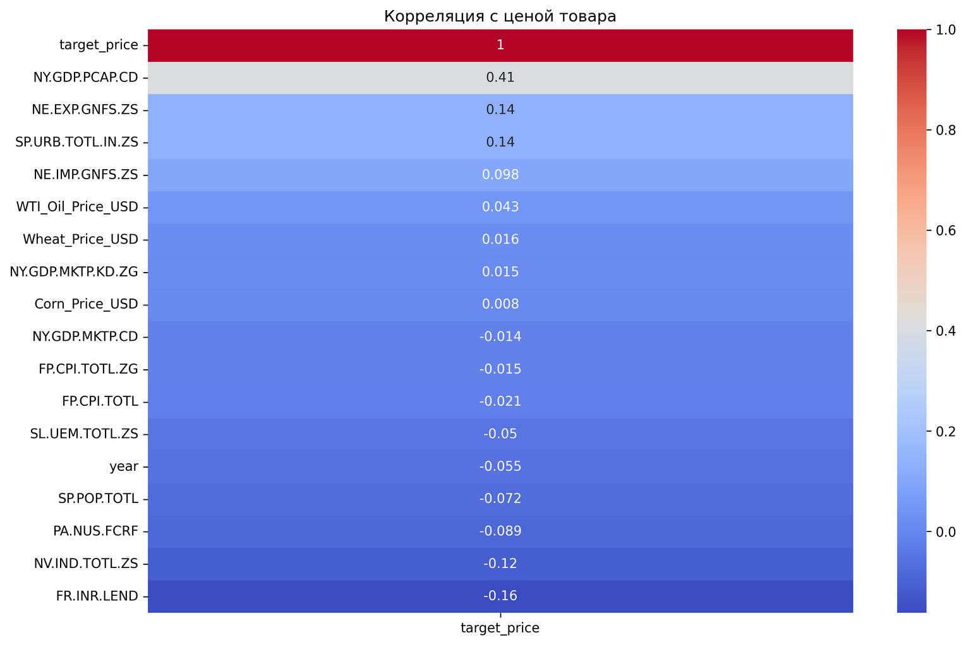
DESCRIPTION OF WORK DONE
Correlation Heatmap Summary
  GDP per capita (NY.GDP.PCAP.CD) shows the strongest positive correlation with product prices (r = 0.41), indicating that higher income levels may lead to higher food prices.
  Most other indicators show weak or no correlation, suggesting non-linear or lagged effects.
  Interest rate (FR.INR.LEND) has the strongest negative correlation (r = -0.16), possibly reflecting its impact on inflation and demand.
  Commodity prices (Wheat, Corn, Oil) exhibit surprisingly low correlations, highlighting the complexity of market dynamics.
04
CSCI 409

Slide 19
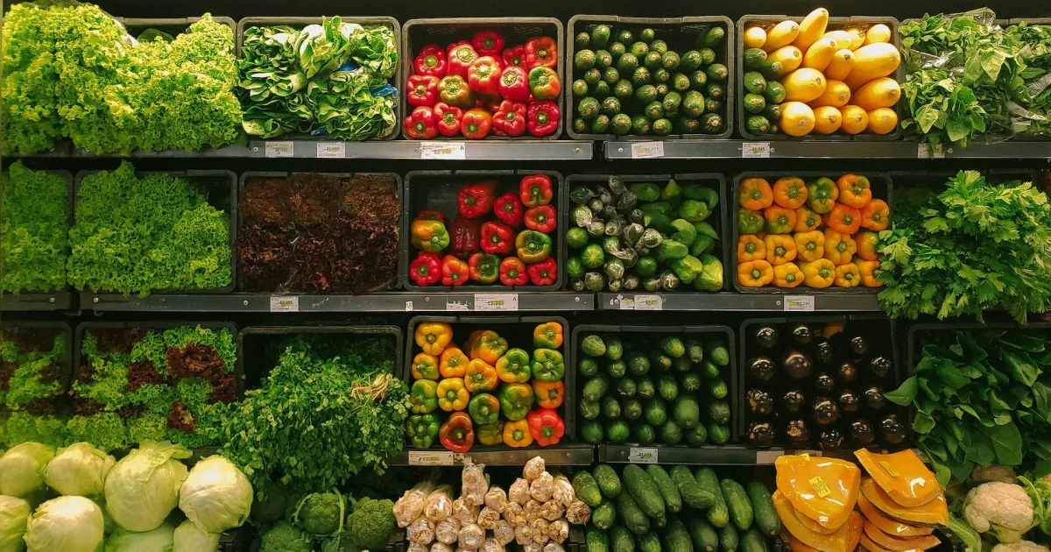
FINAL PRESENTATION
Conclusion & Future Work
  Our ML solution successfully predicts prices through data-driven forecasts.
Future Enhancements:
  Cloud Deployment: Transition to an online, interactive platform for global access.
  Real-Time Integration: Live data feeds for oil prices, weather, and geopolitical events.
13
CSCI 409

Slide 20

REFERENCES
  https://stat.gov.kz/en/
  https://ieeexplore.ieee.org/stamp/stamp.jsp?tp=&arnumber=10386082&tag=1
  https://ieeexplore.ieee.org/document/10695286
  https://doi.org/10.3390/economies12010011
  https://www.imf.org/en/Data
  http://dx.doi.org/10.1109/ICRITO51393.2021.9596527
  https://ceur-ws.org/Vol-3680/S3Paper1.pdf
  https://www.iamo.de/fileadmin/user_upload/dp183.pdf
  https://data.humdata.org/dataset/?dataseries_name=WFP+-+Food+Prices
  https://hapi.humdata.org
  https://databank.worldbank.org/source/food-prices-for-nutrition
  https://lintar.untar.ac.id/repository/penelitian/buktipenelitian_10805001_4A200524135353.pdf
  https://github.com/HercoZauZau/Dumbanengue
13
CSCI 409

