Slide 1

Reflections & Directions on Scholarly Communications:
A Library Leadership Perspective
Carol E. Smith,
University Librarian
Colorado School of Mines
October 27, 2022
Image attribution: https://bluesyemre.com/2022/01/25/the-other-diversity-in-scholarlypublishing/
Notes:
1:00
Hello everyone! First item to share with you: - I am not a Scholarly Communications Librarian – I am someone who really admires them and greatly appreciates the exciting ways in which they’re shaping the future of libraries, and therefore how they are shaping my own work…as a library leader!
Today I’m going to provide an overview of the recent scholarly communications landscape from my perspective - the distinctive, firsthand perspective of an academic library director. There is value in this as a reflective exercise for three reasons:
To provide scholarly communications librarians with a better understanding of how their daily work influences the efforts of their academic library directors.
To consider how scholarly communications influences my own work as a library director
To encourage other library directors like myself to consider how scholarly communications is shaping the broader direction of all academic libraries.

Slide 2
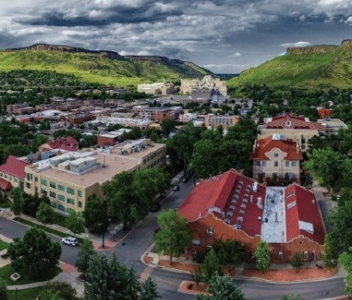
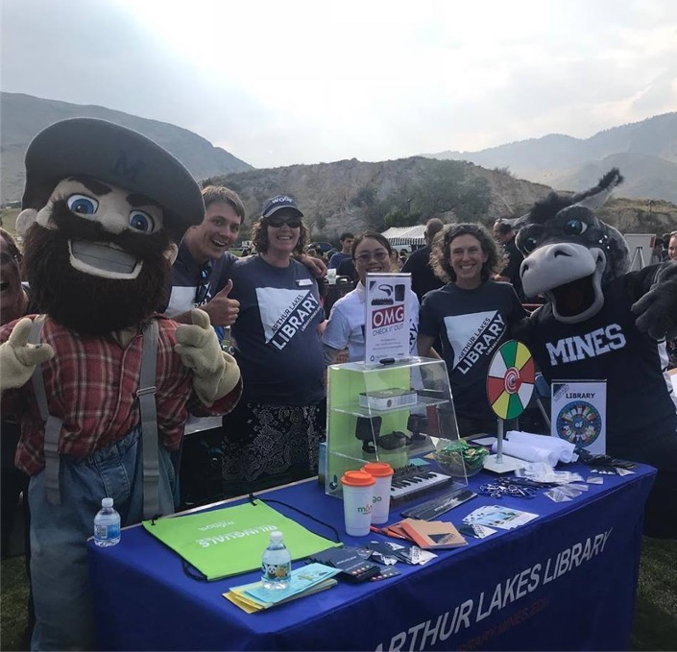
Colorado School of Mines & Arthur Lakes Library
STEM Intensive R1 Institution
Rocky Mountain West
~7,100 Students
  8.3% international from 80 countries
USN&WR:
  #89 National Universities
  #38 Top Public Colleges
  #1 Public College in Colorado
Programs of note
  Mining Engineering: #1 in world (2021, QS)
  Space Resources (MS, PhD)
Library faculty and staff: 20
Notes:
1:00
First: A brief snapshot of the Colorado School of Mines. ”Mines”, as we affectionately refer to it, is not a large comprehensive university. We are medium-sized at just over 7,000 students, and our programs focus on science and engineering.
We’re located in a beautiful part of the Rocky Mountain West, and we encourage everyone to come visit us.
Mines is relatively small, but we have an outsized global reputation. We function at the highest Carnegie level of research activity – R1. We are a destination for international students, and we are very competitively ranked. We have programs that are ranked #1 globally as well as new and highly innovative programs like our Space Resources graduate programs that are receiving international media attention.
Given the modest size of our student body, our library size is also relatively small – there are just 20 faculty and staff. And yet we are very active in scholarly communications.

Slide 3
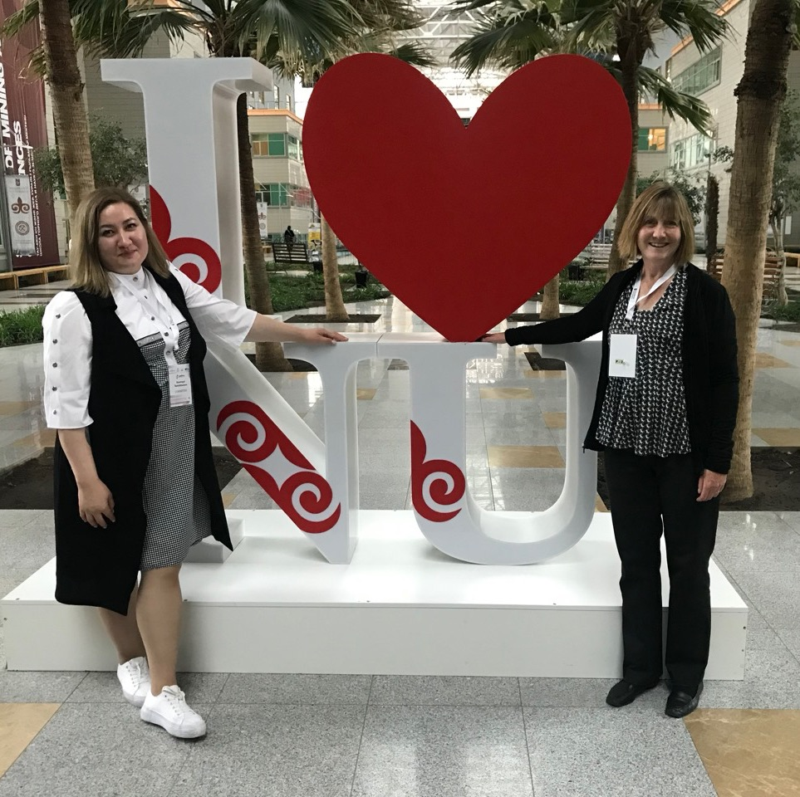
Role of the
Library Leader
Direction setter
Resource gatherer
Problem solver
Champion
Diplomat
Conductor
Asema Temirkhanova, NU 2019
Notes:
1:00
Librarians are the ones who serve on the front lines of scholarly communications every day. So as a library director, what is my role in scholarly communications anyway? It is to be…
A direction setter: To collaboratively establish the library’s strategic goals and initiatives.
A resource gatherer: Doing whatever is needed to garner the resources to realize those goals, including money, space, technology, and human resources;
A problem solver: To navigate the library’s goals around any obstacles encountered (and there are plenty of them);
A champion for the work of the team across campus and to celebrate their achievements;
A diplomat: Advocating for the work of librarians with university administration
A conductor: Coordinating the work of schol comm librarians with all the many other efforts of the full library team.
Being a leader is not not always easy, but it is extremely rewarding work to facilitate the success of librarians.

Slide 4
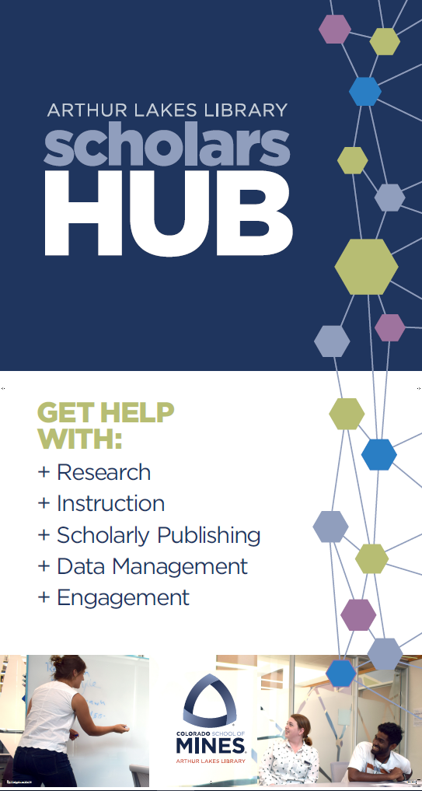
Early Days: 2016-2017
Aug 2016: Hired first Scholarly Communications Librarian
Crash course
Awareness building
  Campus administration and faculty
Learning:
  Library faculty and staff
Spring 2017: Campus lunch discussions
Summer 2017: Strategic planning
Notes:
2:00
So first I’d like to reflect on my library’s initial years of active focus on scholarly communications, and how those years influenced my leadership.
In 2016, our library hired its first Scholarly Communications Librarian. This position was created opportunistically. With no advance notice we suddenly found ourselves with a new specialist creating a scholarly communications role from scratch. And they had me, a new library director with zero prior experience in scholarly communications. Scholarly communications was new to each of us at some point in time, right?
So it was time for a crash course! I spent my first few months as a new director in an intensive learning period with the Scholarly Communications Librarian. She developed position papers and we’d discuss them. She assembled a committee of key administrators and faculty to build support for schol comm initiatives. I joined this group, and that was instrumental to advancing my ability to effectively champion scholarly communications initiatives with university leaders.
Once I was up to speed, I then needed to support the work of our scholarly communications librarian. I organized several campuswide discussion sessions to gather input for library strategic planning. We dedicated multiple sessions to scholarly communications, gathering feedback from the campus on what resonated most with them.
Our library faculty and staff also needed a fuller understanding of scholarly communications, to understand how scholarly communications intersected with their own roles within the library, and to be able to advocate for it more effectively in their daily conversations across campus. So I asked our scholarly communications librarian to lead several in-service sessions to help our team better understand her work.
All of these early learning efforts quickly brought myself, the library team, and key campus stakeholders up to speed on the full power and potential of scholarly communications.

Slide 5
2017-2020 Strategic Plan
GOAL 5: BECOME THE CAMPUS NEXUS FOR SCHOLARLY COMMUNICATION:
STRATEGY 5-1. RESEARCH IMPACT – Enhance the visibility and impact of research and scholarship created at Mines or by members of the Mines community.
STRATEGY 5-2. OPEN SCHOLARSHIP – Provide leadership, resources, and services to foster open access publishing, research data management and sharing, reproducible research, open educational resources, and best practices in digital workflow across the research lifecycle.
STRATEGY 5-3. INSTITUTIONAL REPOSITORY – Expand the Mines institutional repository and connect it to the broader research information ecosystem with the goal of enabling new forms of academic inquiry and discovery through the creative and dynamic use and reuse of the digital assets of the university. The repository will preserve and disseminate the intellectual output of the university’s faculty, staff, and students as well as the digitized versions of the library’s special collections, archives, and the collection of Mines Geology Museum.
Notes:
1:00
These efforts also helped to solidify scholarly communications as a central direction for our library.
Scholarly communications became one of just 6 high-level goals in our library’s 2017-2020 strategic plan. We developed three main objectives relating to scholarly communications:
Research Impact: We wanted to contribute to the impact of research and scholarship at Mines
Open Scholarship: We wanted to advance open alternatives to the traditional and highly problematic publishing model
And we wanted to foster access to and preservation of that scholarship by expanding our institutional repository, which was fairly modest at the time
Explicitly defining these strategic goals enabled me, in my work as a library leader, to better focus our team’s collective efforts and resources toward achieving them. It was our high-level roadmap for scholarly communications.

Slide 6
Early Days: 2017-2019
Reorganization
  Library faculty and staff
  Physical centers
    Digital Lab
    Scholars Hub (Fall 2019)
Expansion of scholarly communications services
Branding and marketing
Faculty relationship building
Notes:
2:00
Okay, so we had our crash course learning period and we’d established our scholarly communications strategic goals. To successfully accomplish those goals, I recognized that the library needed to first undergo substantial organizational and physical restructuring:
As just one example of organizational change, to rapidly grow the library’s fledgling institutional repository, I transitioned a circulation desk staff member into an entirely new role as a dedicated Digital Initiatives Specialist.
I established a new, well-equipped digitization lab to facilitate the work of this new position.
I had to orchestrate a series of carefully planned and sequenced office renovations and relocations over several years in order to create a new, highly visible center for our scholarly communications and other public-facing library initiatives.
And I had to raise the funding to accomplish these many library space projects, from both campus and external donor sources.
The resulting Scholars Hub center debuted in Fall 2019 and serves as a pivotal moment in our library’s rapidly developing suite of scholarly communications services. It really accelerated campus recognition of these services. Once we had a center to house them, our services grew rapidly to include: copyright consultations, authors rights advising, scholarly identity support, research data management plan consultations, Open Access publishing initiatives, Open Educational Resource initiatives, research workflow and citation management tools, educational workshops, more.
Faculty awareness, appreciation, and use of these services was steadily growing as well, thanks to intentional branding, intensive marketing, and authentic faculty relationship building.
So as a library leader I wasn’t doing any of the actual daily scholarly communications work. But I was very busy in those days, laying the necessary foundations and clearing the path for our scholarly communications team to meet with optimal success.

Slide 7
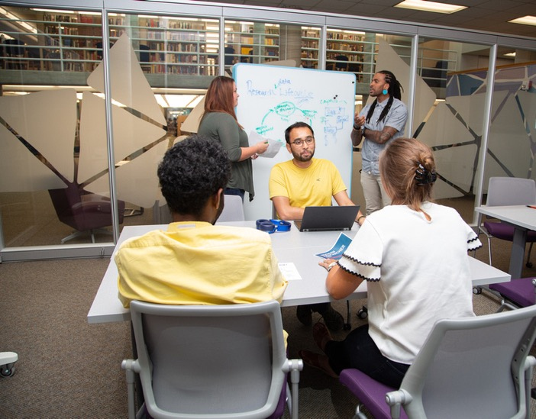
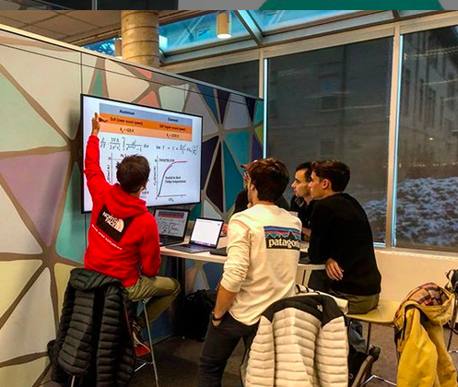
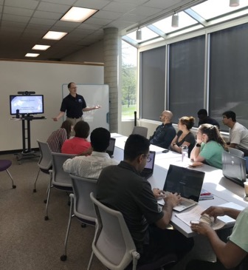
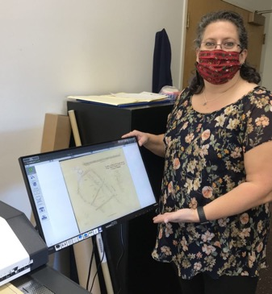
Notes:
:15
Here’s some screen shots of the Scholars Hub in action, and of our Digital Lab with our new Digital Initiatives Specialist. These are all new spaces and roles that came about in the period just before COVID.

Slide 8





Maturation of Services: 2020-Present
COVID-19: The Big Pivot
Reframing of the library mission
Successful initiatives:
  Open Educational Resources (OER)
  Open Access (OA) incentives
  Electronic reserves as Zero Textbook Cost (ZTC)
  Repository growth
  Workshops (graduate and undergraduate)
  Data Research Management
  Suite of services for scholarly impact and identity
Notes:
2:00
COVID-19, of course, introduced unexpected disruptions to all of higher education, including our library’s scholarly communications initiatives. On the whole, though, I believe the global pandemic actually accelerated our progress. Thanks to our many initiatives, our library was able to readily pivot to a digital learning environment. Many faculty encountered our scholarly communications services for the very first time as they had to rapidly adapt to remote instruction. Scholarly communications efforts that expanded significantly during the pandemic years include Open Educational Resources (OER); institutional repository adoption; electronic course reserves integrated within the campus learning management system (“Course Readings”), which you’ll hear all about in the next presentation; and more.
So here we are! Just six short years after hiring our first ever dedicated Scholarly Communications Librarian, it is fair to state that the Arthur Lakes Library more than accomplished our initial high level strategic goals:
We established a recognized campus center for scholarly communications services and are increasingly recognized as academic partners across most aspects of the research lifecycle.
We fostered deep and impactful relationships with key faculty that we can now leverage to further widen the campus audience for scholarly communications services.
We are recognized as campus leaders in promoting equitable access to information.
Our institutional repository now contains over 15,000 items and is growing by 50-100 items weekly.
We offer a robust suite of both undergraduate instruction and graduate workshops to educate our students about scholarly identity, research workflow tools, and other key aspects of scholarly communications.
I’m really proud of the work of our librarians in bringing these scholarly communications initiatives to fruition. And I’m proud of my ongoing work as a library leader, to support them with resources and to champion their work to the best of my ability through what were some very difficult years.

Slide 9
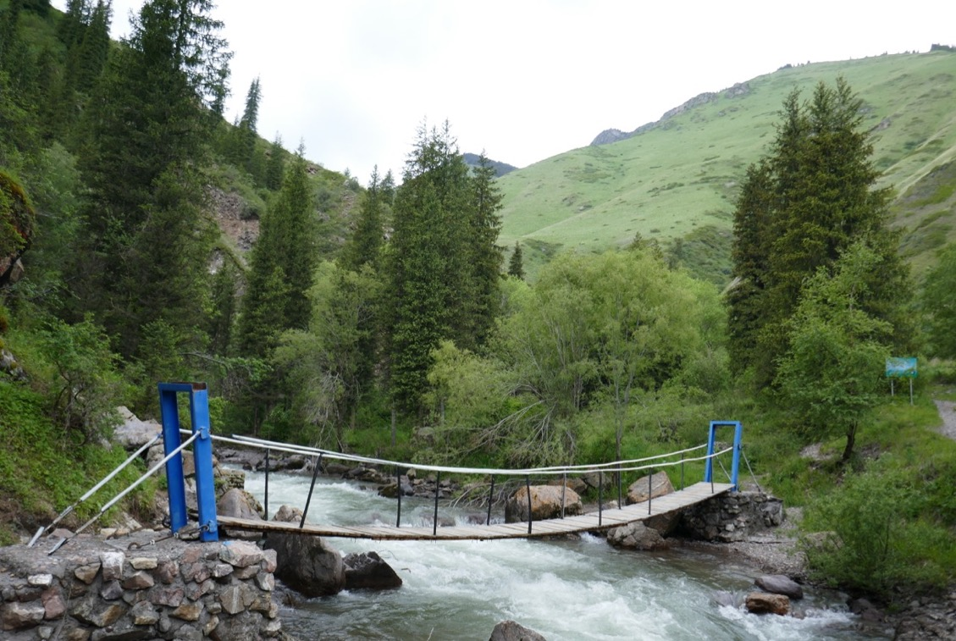
Challenges
Librarian retention
Resource constraints
Team integration
Unsuccessful initiatives (so far!)
  Research Information Management System (RIMS)
Turgen Gorge, East of Almaty, KZ
Notes:
1:30
All of this is not to suggest that we did not encounter obstacles!
We’ve had great challenges retaining our schol comm librarians - they are in high demand! We are currently on our third Scholarly Communications Librarian in as many years. Rapid turnover makes it difficult to ensure continuity of services and we’ve needed to rebuild essential faculty relationships with each new hire. But each of them has also brought particular strengths to the role. So challenges can have silver linings…
I would of course prefer to retain our talent, so much of my recent time as a library leader has shifted to advocating for competitive salaries and making the case for increasing the size of our team. It is no easy task for a library leader to grow services in the face of perennial competition for scarce campus resources.
As I work on these advocacy efforts, I’ve had to counsel our talented, ambitious librarians to temper their expectations and ambitions, so as to avoid frustration or burnout.
Another challenge is balancing schol comm with the important work of the rest of the library, and this has been difficult during the pandemic. One of my current goals is to better connect schol comm to other library initiatives. It’s about striking the right balance, and a library leader is responsible for maintaining that balance.
We have also had unsuccessful initiatives. After years of carefully building campus support for a Research Information Management System (or RIMS) the initiative was not approved due to cost. We still believe it to be important and we will try again. Perseverance in reaching lofty goals is also the responsibility of a library leader.

Slide 10
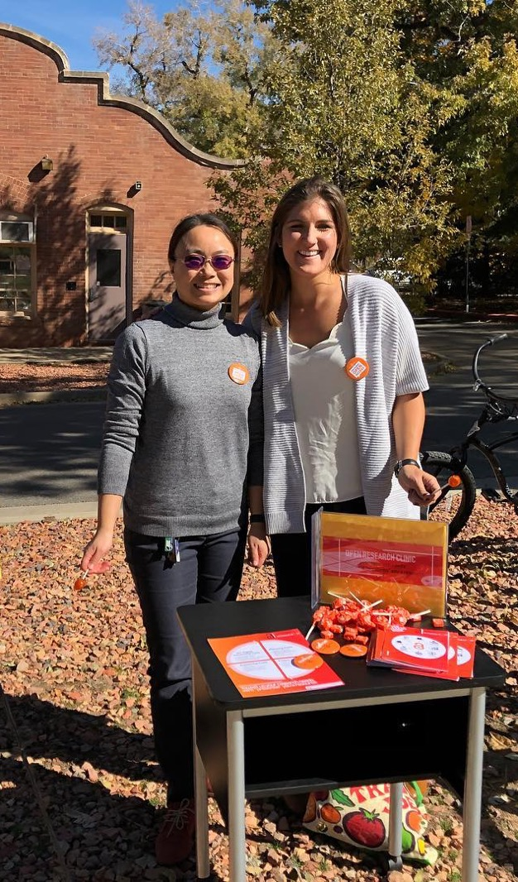
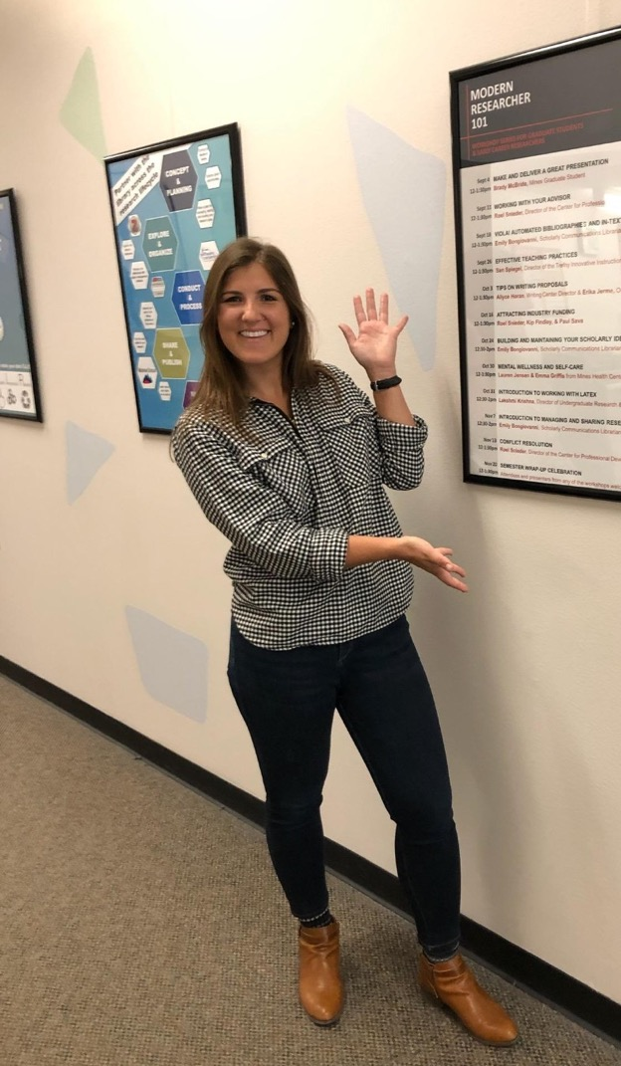
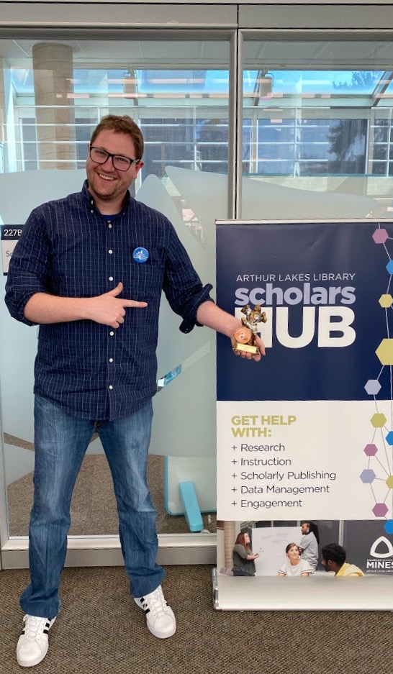
Notes:
:15
Here’s a quick shot of the three very talented Scholarly Communications Librarians we’ve had at Mines: Ye, Emily, and now Seth. Three different Schol Comm Librarians in just six years is quite a bit of turnover! But they’ve each contributed uniquely to our program, and we so appreciate them!

Slide 11
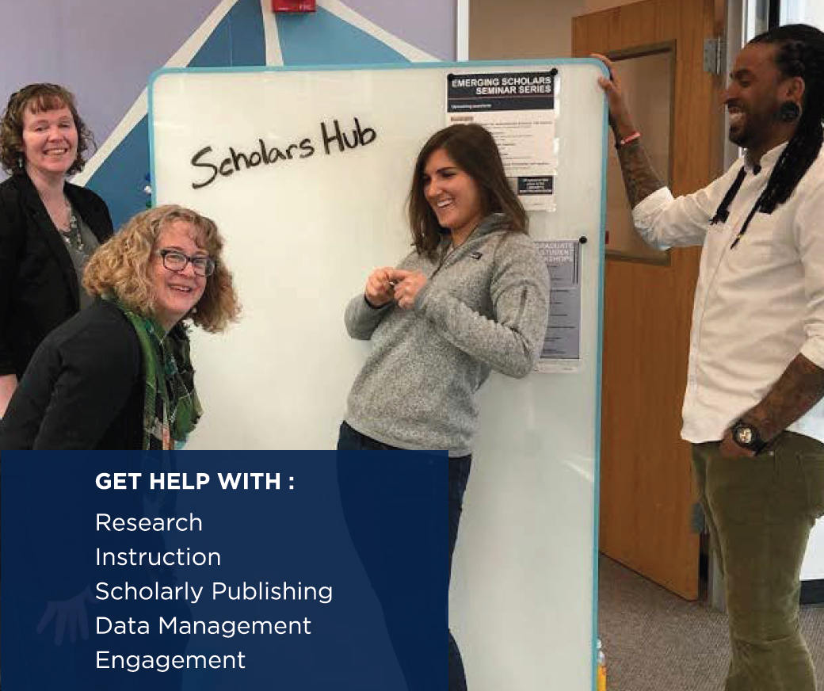
Benefits and Opportunities
Recasting the campus role of academic libraries
Contributions to accessibility – physical and fiscal
Reshaping the publishing model
Positive impact across all library operations
Notes:
(1:30)
Our many scholarly communications initiatives have introduced powerful and sometimes unanticipated benefits and opportunities.
From a leadership perspective, scholarly communications has generated a justifiable degree of library pride and a greater campus awareness of new and emerging roles of academic libraries. Overcoming traditional library stereotypes is a perennial challenge for all library leaders. Librarians have always been full-fledged academic partners across teaching, learning, scholarly impact and identity, and the entire research lifecycle, but scholarly communications has been instrumental in reshaping this as the campus-wide understanding of our role.
Our scholarly communications accomplishments to dramatically reduce the cost of curricular materials via our OER, OA, and Course Readings initiatives are particularly recognized by the campus as a significant contribution to the accessibility of higher education for our students, and one that is reshaping the entire academic publishing model.
Our accomplishments in scholarly communications have fostered greater success in more traditional areas of library work and are opening entirely new doors for the library to contribute to the curricular and co-curricular life of our faculty and students. It has been instrumental for cultivating a virtuous cycle across all library operations. Scholarly communications has become central and indispensable to the ongoing work of library leaders.

Slide 12
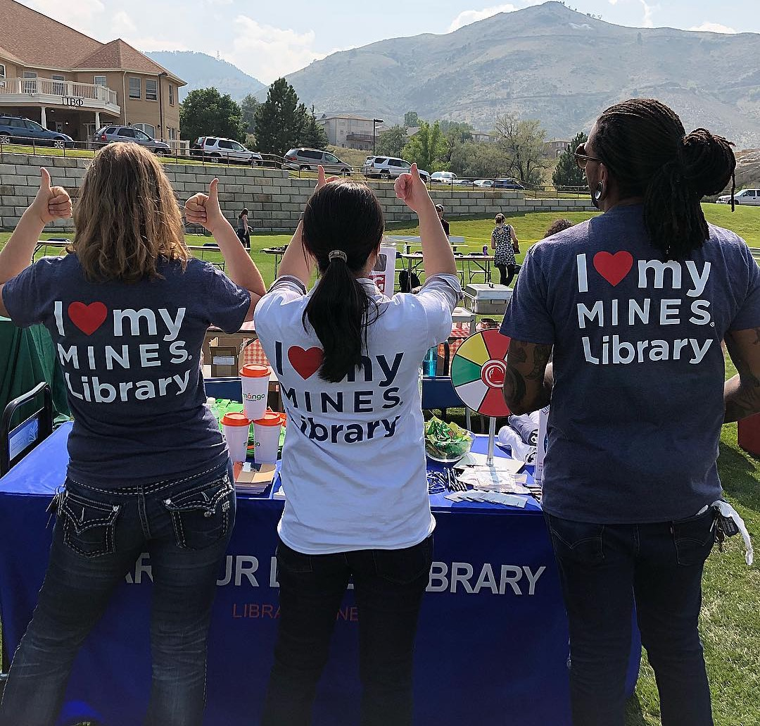
Looking Ahead
Closer integration across library teams
Broader campus diffusion
Scaling of existing services…resources!
New services
Notes:
1:30
Taking leadership stock of the state of scholarly communications, I can clearly identify several areas of focus that will occupy my time in the coming few years:
As previously mentioned, I need to ensure that our existing scholarly communications initiatives integrate as effectively as possible with our broader library team efforts. I can see paths forward for this, as an emerging trend is for scholarly communications to become increasingly diffused throughout most library services and operations.
While many of our disciplinary faculty are now actively engaging with our scholarly communications services, there are other professors we still need to reach. As a leader, I therefore need to continue to cultivate new partnerships and raise awareness of our library team’s impactful work.
Raising fiscal support for an expanded scholarly communications team is also essential if we are to further scale our existing services as well as move into entirely new areas such as data services.
So – there’s still a great deal of work ahead of us. Fortunately for the state of Colorado, we have a governor who already champions scholarly communications. I and other library leaders in our state can point to his good example as we strive to further advance scholarly communications in the years to come.

Slide 13

Notes:
Thank you!

