Slide 1
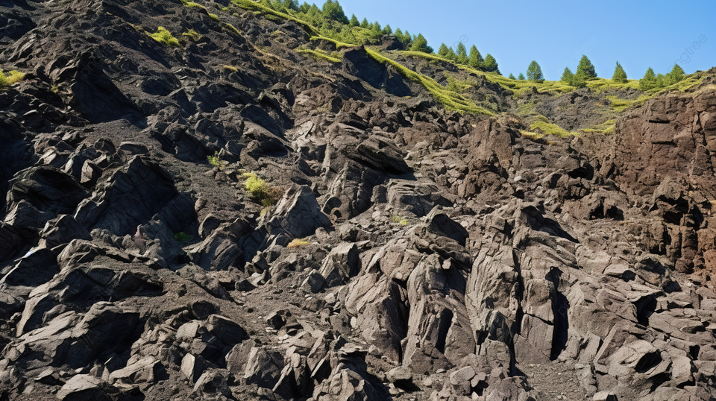

High-Suction Polymer Sensor for Measurement of Soil-Water Characteristics Curve
Gerarldo Davin Aventian (202183830)
Supervisor : Dr. Alfrendo Satyanaga
Co-supervisor : Prof. Jong Kim
April 25th 2024

Slide 2

Table of content
01
Introduction
02
Literature Review
03
Applicable Theories
04
Methodologies
05
Results & Analyses
06
Conclusion

Slide 3


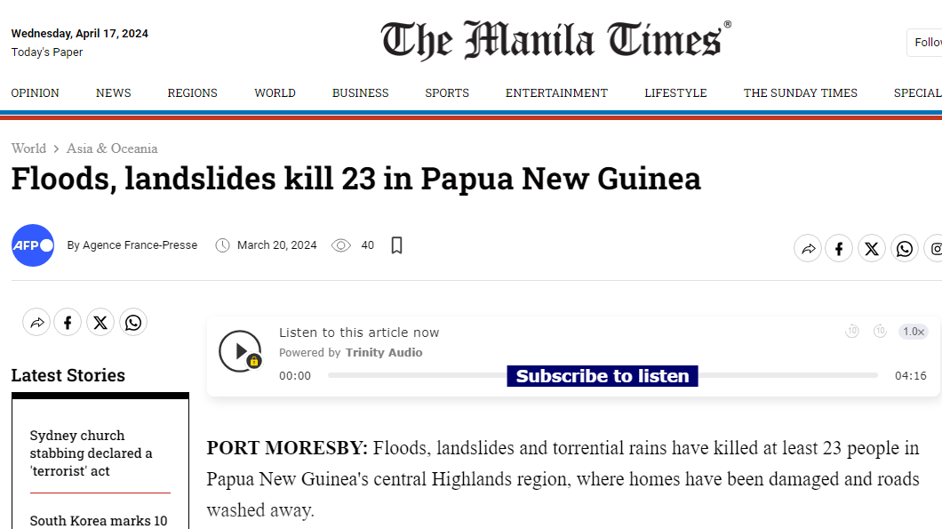
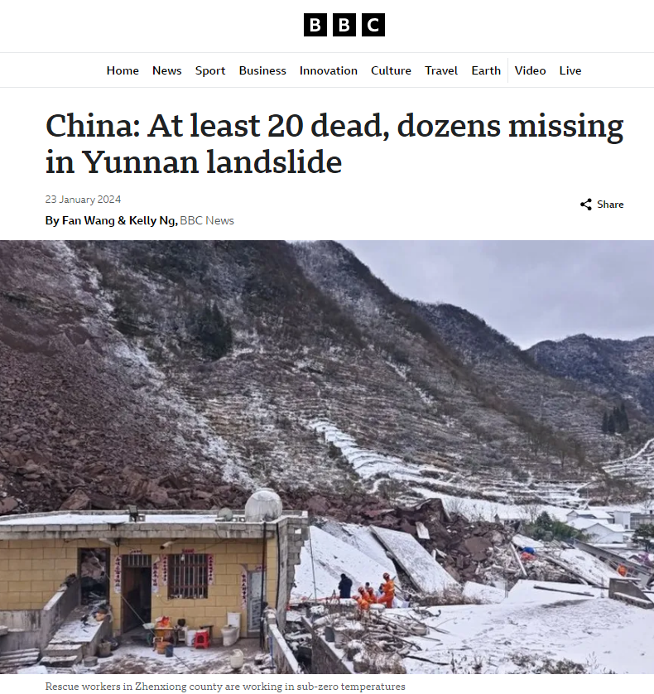

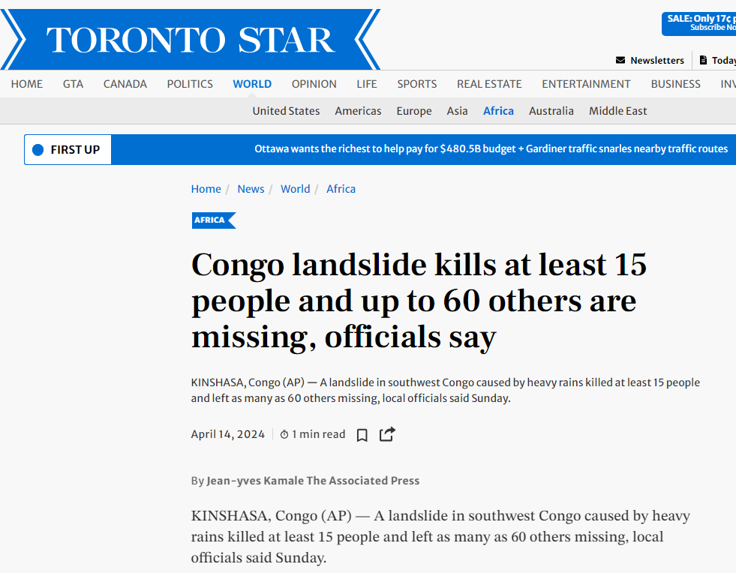
Background

Slide 4
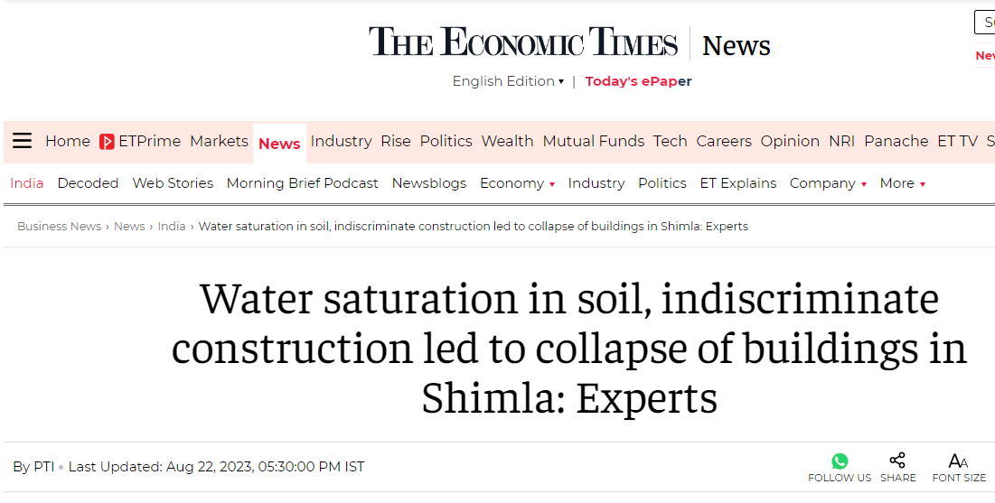
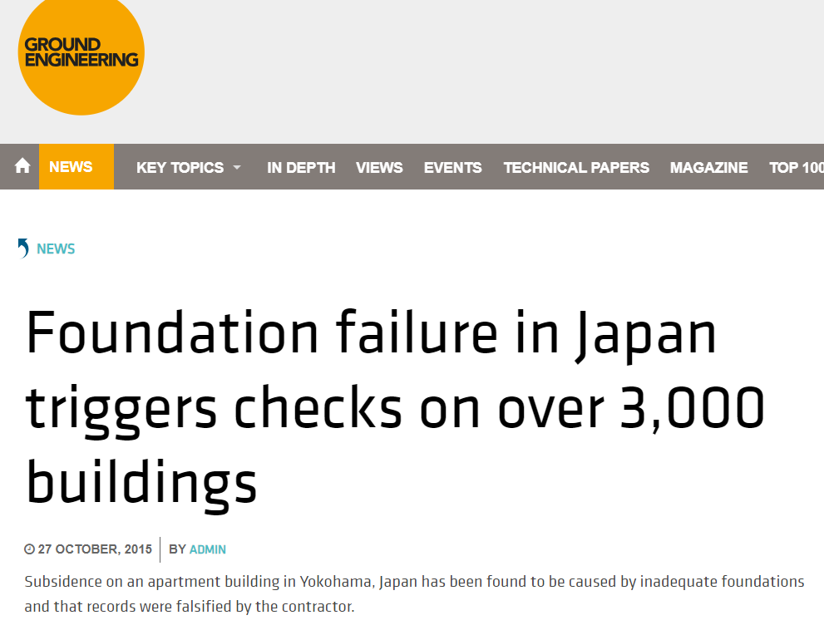
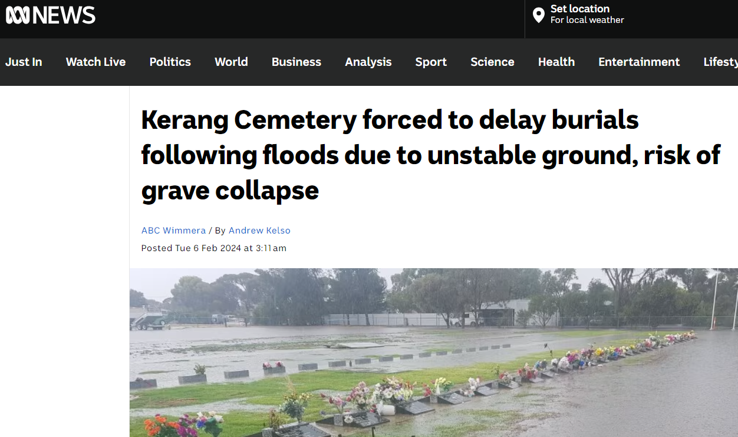

Background
Unsaturated soil mechanics plays an important role to ensure the failure would not happen
Most important parameter: negative pore-water pressure (soil suction)

Slide 5
Research problems
01
Conventional measurement is costly, time-consuming, and complicated (Abeykoon et al., 2017; Rahardjo et al. 2019).
02
Many devices have a limited range of measurement (Liu et al. 2021).
03
Osmotic principality has been seen as an alternative in measuring soil suction

Slide 6
Hypothesis
Objectives
This study emphasizes a continuous soil suction measurement over an extensive range of temperatures using a high-suction polymer sensor (HSPS).
Several polymers were investigated to find the best one for application in HSPS. Furthermore, novel polymers with superabsorbent properties were developed to examine their potential for suction detection.
The HSPS is an advanced apparatus that can measure soil suction over a wide range of condition without deteriorating.

Slide 7
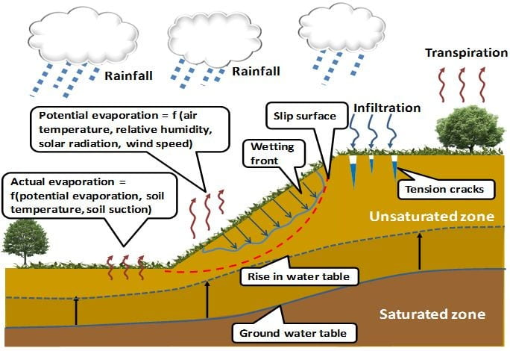
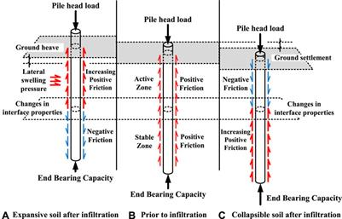
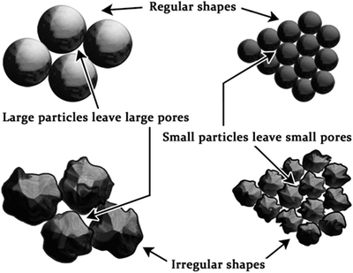
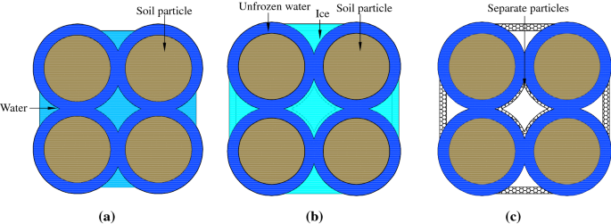
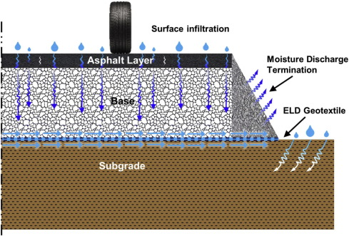
Research significance
Soil suction, $\left(u_{a}−u_{w}\right)$ practical applications:
IMPORTANCE:
Astana soil has a high frost susceptibility with a high groundwater location, affecting the stability of structures and construction (Zhussupbekov & Shakhmov, 2015)
Figure 1. Slope stability (Rahardjo et al. 2012)
Figure 2. Pile foundation (Liu et al. 2022)
Figure 3. Physical behavior of soil (Osman, 2012)
Additional for cold regions:
Figure 4. Frost heave (Bai et al. 2020)
Figure 5. Resilient modulus on pavement (Zornberg et al. 2017)

Slide 8
Scope of works
Literature review of previous polymer utilization, sensor technology, cavitation, and unsaturated soil mechanics.
Preparation of soil specimen, HSPS, and climatic chamber.
Polymer synthesis to be implemented in HSPS.
Experimental works in laboratory with polymer and soil.
Data validation with the verified devices of unsaturated testing.
Publication of the research outcomes in prestigious journals.

Slide 9
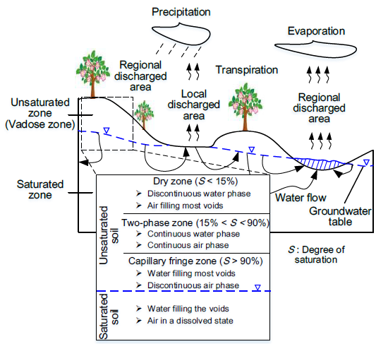
Unsaturated soil mechanics
Relies on the concept of soil-water characteristics curves (SWCC)
Mercer et al. (2019) states that the soil type, soil structure, and the organic content affect the SWCC type.
The difference with classical soil mechanics is that the unsaturated soil comprised of two stress-state variables, which are net-normal stress and soil suction (Fredlund & Morgenstern, 1977).
Figure 6. Unsaturated zone (Ren, 2019)

Slide 10
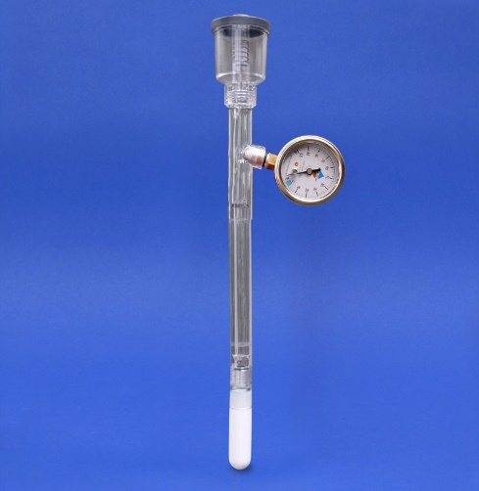
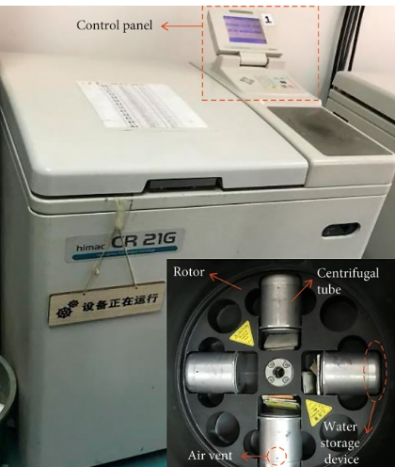
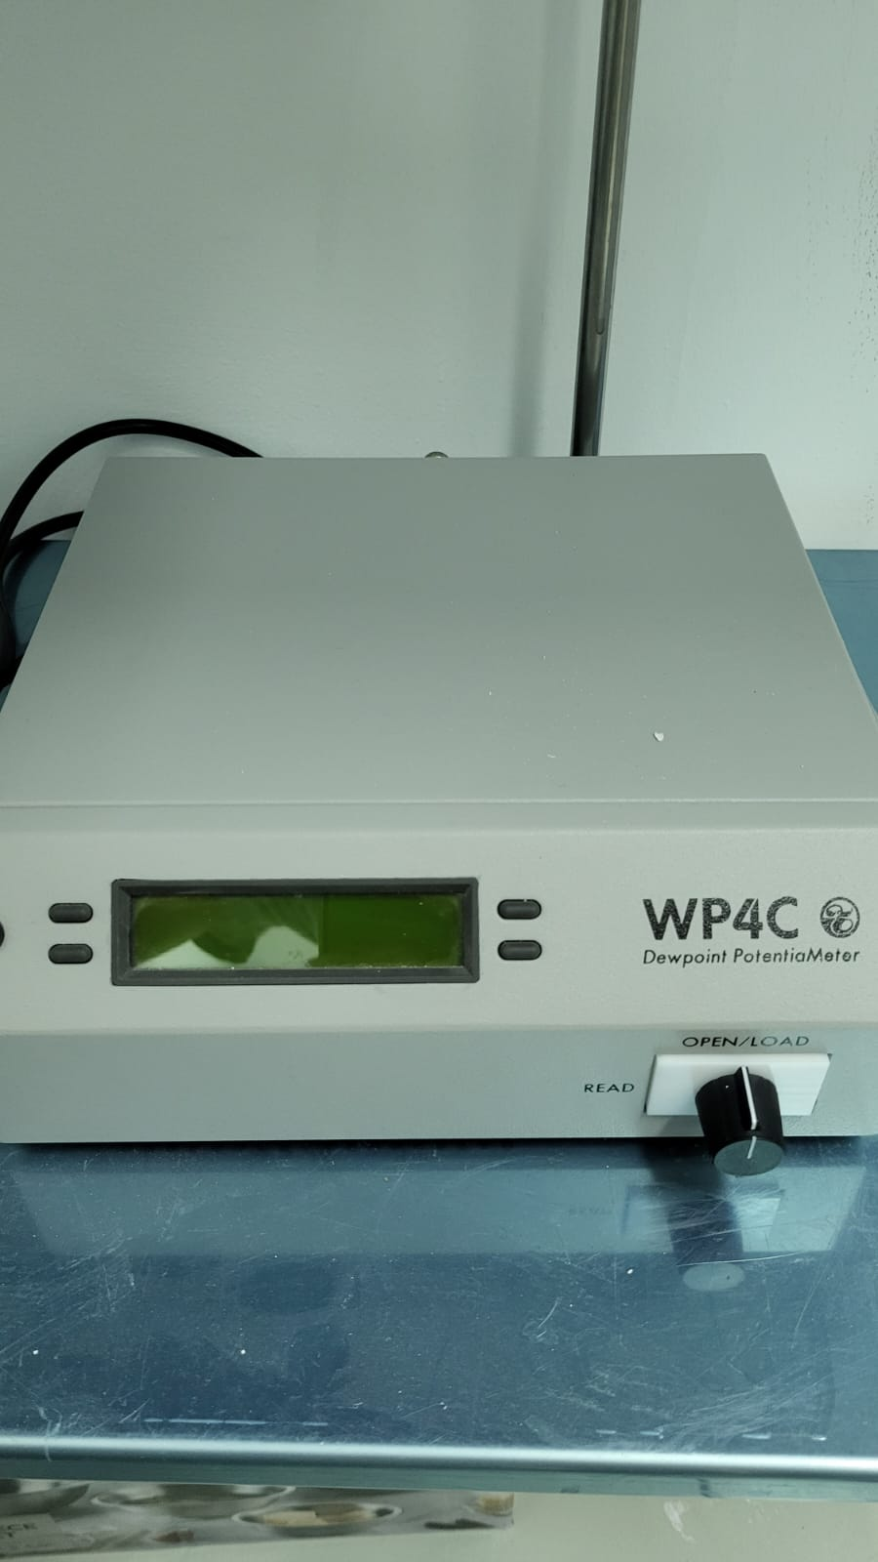
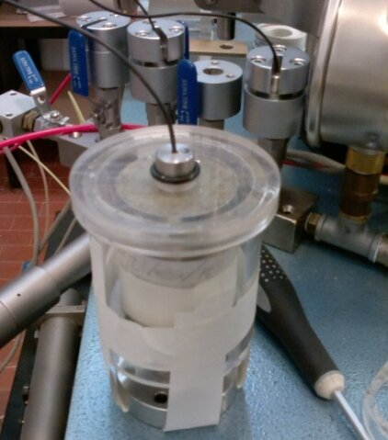
Limitation of existing technology measurement
Suction up to 100 kPa due to cavitation
Suction up to 800 kPa and it requires high-speed machine to provide greater suction (Rahardjo et al. 2018).
Figure 7. Tensiometer (Soilmoisture, 2024)
Figure 8. Centrifuge (Niu et al. 2021)
Suction from 0.5 to 200 MPa, yet it can only measure accurately at suction higher more than 1.5 MPa (Liu et al. 2022).
Developed initially by Ridley & Burland (1993)
Suction up to 1.5 MPa, yet it is temperature-dependent (Mendes et al. 2020; Liu et al. 2022).
Figure 9. WP4C
Figure 10. High-capacity tensiometer (Pedone et al. 2022)

Slide 11
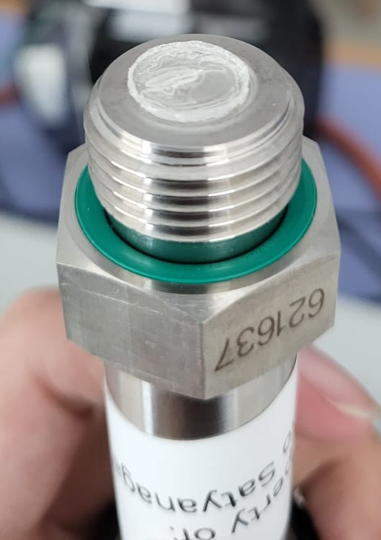
Polymer utilization
Polyethylene glycol
Peck & Rabbidge (1966, 1969)
Produced biased and unstable data
Polyethyleneglycol
Polyvinylpyrolidone
Bakker et al. (2007); van der ploeg (2008)
Had a fast pressure-temperature dependent response
Polyacrylamide (PAM)
Produced 400 kPa without pressure decay
Liu et al. (2021)
Sodium polyacrylate (NaPA)
Hamdany et al. (2022); Liu et al. (2022)
Produced 600 kPa with a presence of pressure decay
Figure 11. Polymer application

Slide 12
Summary
Reviewed a total of 70 journal papers.
Many instruments have been developed to measure SWCC; yet, the existing devices are limited owing to cavitation, limited range, time-consuming procedures, and the complexities of the techniques.
Polymer utilization has recently been recognized as a substitute.
Many polymers have been investigated, yet the highest potential is only polyacrylamide (PAM).
PAM polymer was employed to evaluate its effectiveness in measuring suction at various temperatures. Furthermore, novel polymers with superabsorbent properties, such as polyvinyl alcohol (PVA) and polyvinyl alcohol-copolymer-acrylamide (PVA-co-AAm), were developed to examine their potential for suction detection.

Slide 13
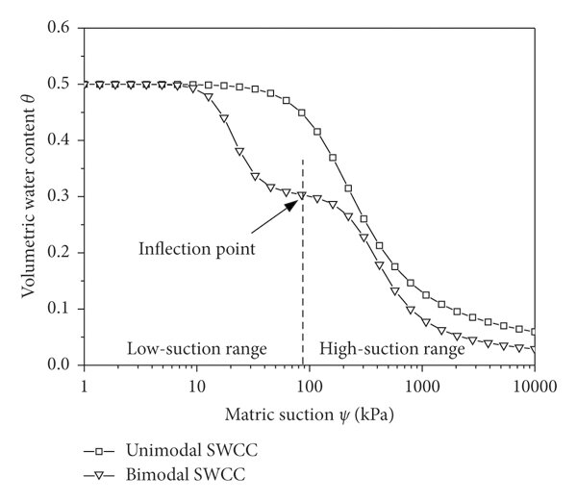
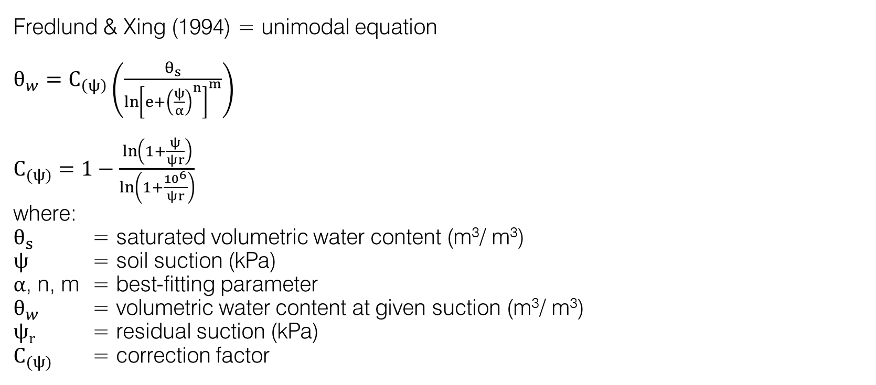
Applicable Theories
Fredlund & Xing (1994) = unimodal equation
$θ_{w}=C_{\left(ψ\right)}\left(\frac{θ_{s}}{{\ln\left[e+{\left(\frac{ψ}{α}\right)}^{n}\right]}^{m}}\right)$
$C_{(ψ)}=1−\frac{\ln\left(1+\frac{ψ}{ψr}\right)}{\ln\left(1+\frac{{10}^{6}}{ψr}\right)}$
where:
$θ_{s}$ = saturated volumetric water content (m³/ m³)
$ψ$ = soil suction (kPa)
$α$, n, m = best-fitting parameter
$θ_{w}$ = volumetric water content at given suction (m³/ m³)
$ψr$ = residual suction (kPa)
$C_{(ψ)}$ = correction factor
Figure 12. Sigmoidal curves of SWCC (Quan et al. 2022)

Slide 14
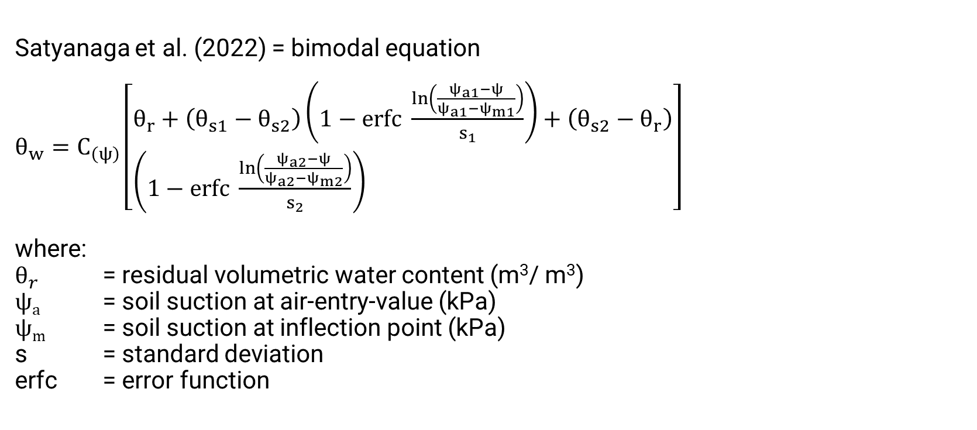
Applicable Theories
Satyanaga et al. (2022) = bimodal equation
$θ_{w}=C_{\left(ψ\right)}\left[\begin{aligned}&θ_{r}+\left(θ_{s1}−θ_{s2}\right)\left(1−erfc \frac{\ln\left(\frac{ψ_{a1}−ψ}{ψ_{a1}−ψ_{m1}}\right)}{s_{1}}\right)+\left(θ_{s2}−θ_{r}\right) \\ &\left(1−erfc \frac{\ln\left(\frac{ψ_{a2}−ψ}{ψ_{a2}−ψ_{m2}}\right)}{s_{2}}\right)\end{aligned}\right]$
where:
$θ_{r}$ = residual volumetric water content (m³/ m³)
$ψa$ = soil suction at air-entry-value (kPa)
$ψm$ = soil suction at inflection point (kPa)
s = standard deviation
erfc = error function
Figure 12. Sigmoidal curves of SWCC (Quan et al. 2022)

Slide 15
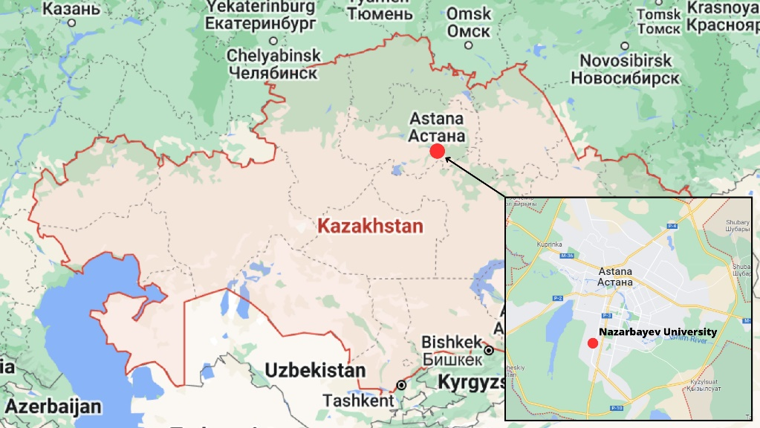
Soil specimen
Two samples:
60% sand 40% kaolin (60S40K) as engineering soil
Nazarbayev University (NU) soil as natural soil (disturbed condition)
Table 1. Index soil properties
Index Property Experiment | ASTM Code
Natural water content | D2216-10
Specific gravity | D854-02
Atterberg Limit | D4318-00
Grain size distribution | D422-63
Soil classification (USCS) | D2487-00
Compaction test | D698-07
Figure 13. Location of soil sample

Slide 16
Polymer synthesis
Table 2. Chemical materials – (a) PAM; (b) PVA and PVA-co-AAm
a
b
Materials | Function
Acrylamide | Monomer
N,N'-methylenebisacrylamide (MBA) | Crosslinker
Benzoin/ Potassium persulfate | Initiator
Materials | Function
Polyvinyl alcohol | Monomer
Glutaraldehyde | Crosslinker
Acrylamide | Copolymerization
Potassium persulfate | Initiator

Slide 17
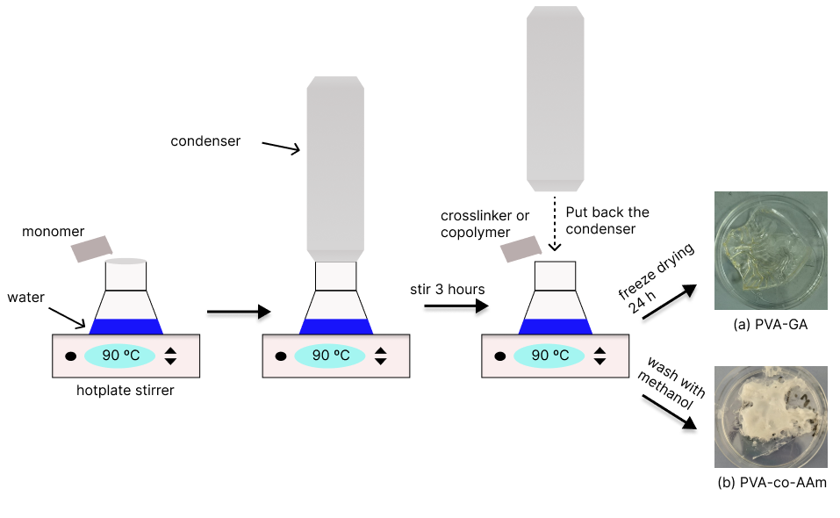
Polymer synthesis
Polyvinyl alcohol (PVA) & PVA-copolymer- acrylamide (PVA-co-AAm)
Table 3. Synthesis detail – (a) PVA; (b) PVA-co-AAM
a
Crosslinking concentration | Amount (ml)
2% | 0.75
2.5% | 0.95
3% | 1.15
b
Ratio | Amount of PVA (gr) | Amount of acrylamide (gr)
1:1 | 3.084 | 3.084
1:2 | 3.084 | 6.16
2:1 | 4 | 2
Figure 14. Schematic diagram for PVA & PVA-co-AAM synthesis

Slide 18
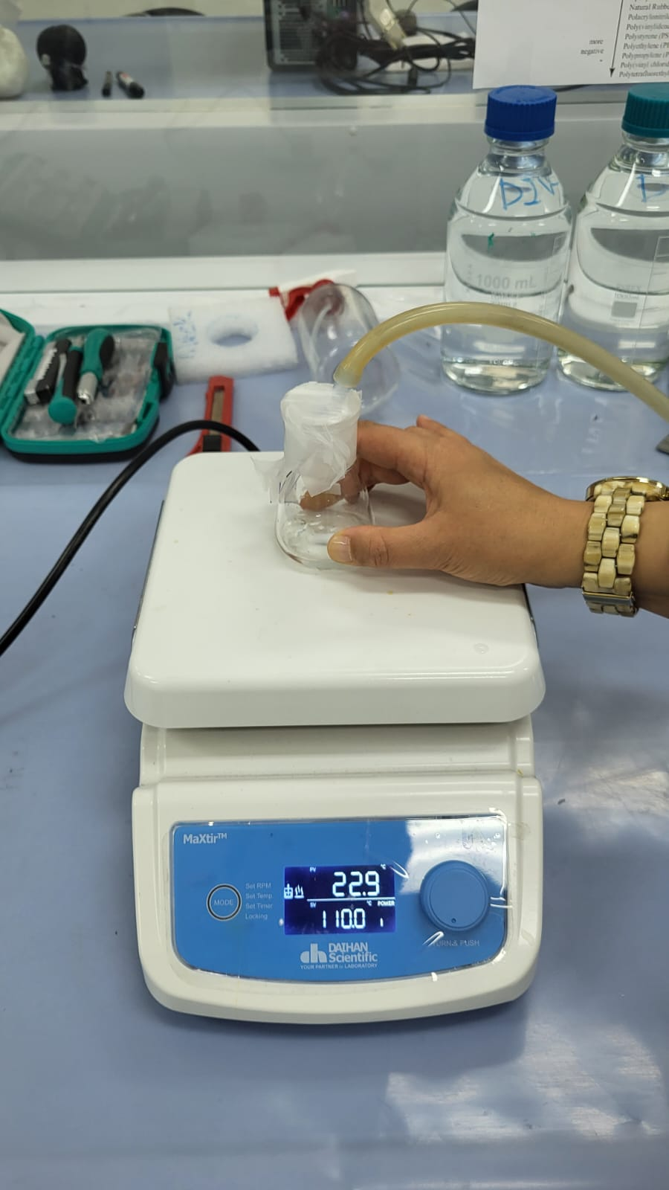
Polymer synthesis
Polyacrylamide (PAM)
The PAM concentration that is used in this study is 5% as it has the most stable with the highest suction potential (Liu et al. 2021).
Acrylamide = 5 gram
MBA = 0.25 gram
Benzoin = 2 miligram
The synthesis was conducted with argon gas and with the method that was described by Liu et al. (2021).
Argon gas
Sample
Magnetic stirrer
Figure 15. Experimental setup for PAM

Slide 19
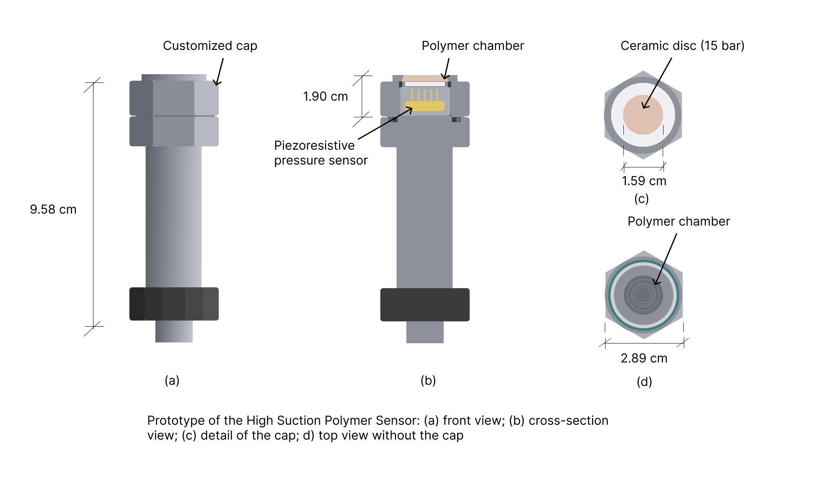
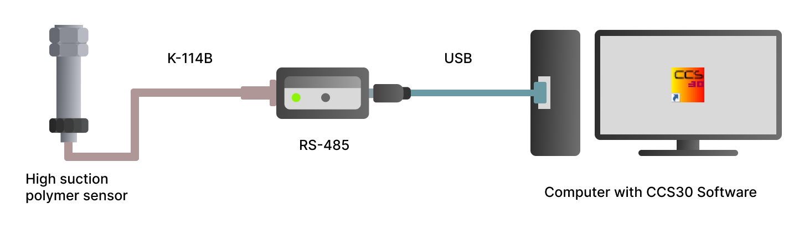
HSPS preparation
Manufactured by KELLER with the 35X series.
Table 4. HSPS specification (KELLER, 2022)
Temperature accuracy | < ±2ºC
Temperature ranges | -40 to 125 ºC
Pressure accuracy | < ±0.05% error
Pressure ranges | 0 – 3000 kPa
a
b
Figure 16. Schematic diagram for HSPS – (a) dimension; (b) connectivity

Slide 20
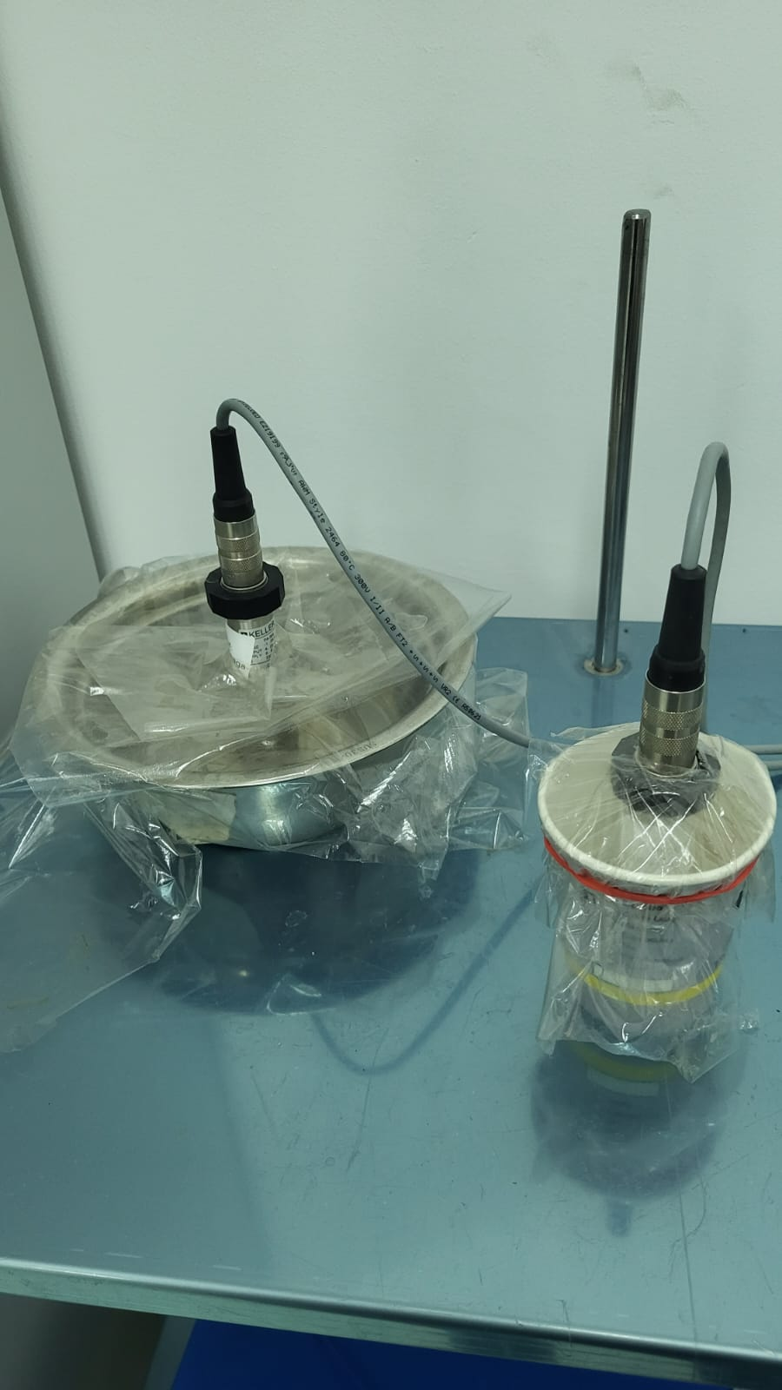
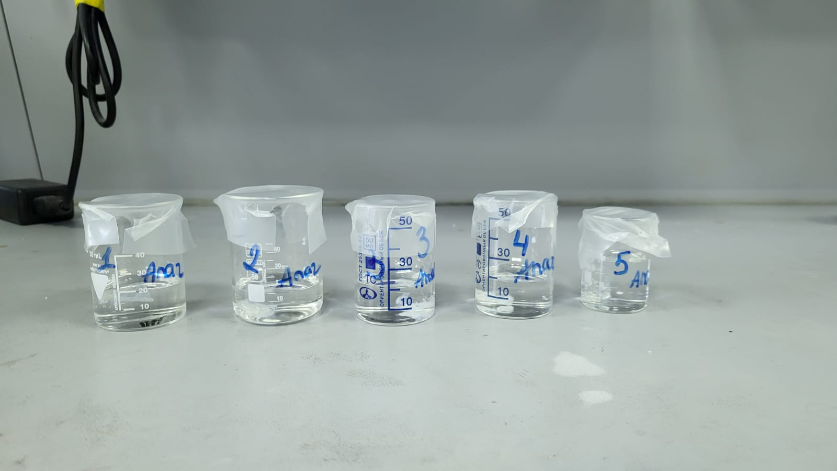
Durability test
Swelling test
Figure 17. Durability test
Figure 18. Swelling test
Procedure referred to Hamdany et al. (2022).
The test was performed since November 2022 – January 2024.
Procedure referred to Heidari et al. (2018).
Conducted for 5 days

Slide 21
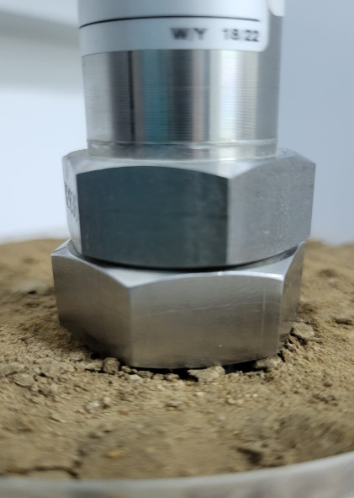
Soil suction test
Table 5. Temperature sequence
NU soil:
S-1 = maximum dry density (MDD) under freeze-thaw cycles
S-2 = 95% MDD under freeze-thaw cycles
S-3 = room temperature (25ºC)
60S40K:
S-4 = room temperature (25ºC)
Sequence | Freezing cycles (ºC) | Thawing cycles (ºC)
1 | 5 | N/A
2 | 0 | -10
3 | -2 | -8
4 | -4 | -6
5 | -6 | -4
6 | -8 | -2
7 | -10 | 0
8 | -15 | 5
Figure 19. HSPS-soil interaction

Slide 22
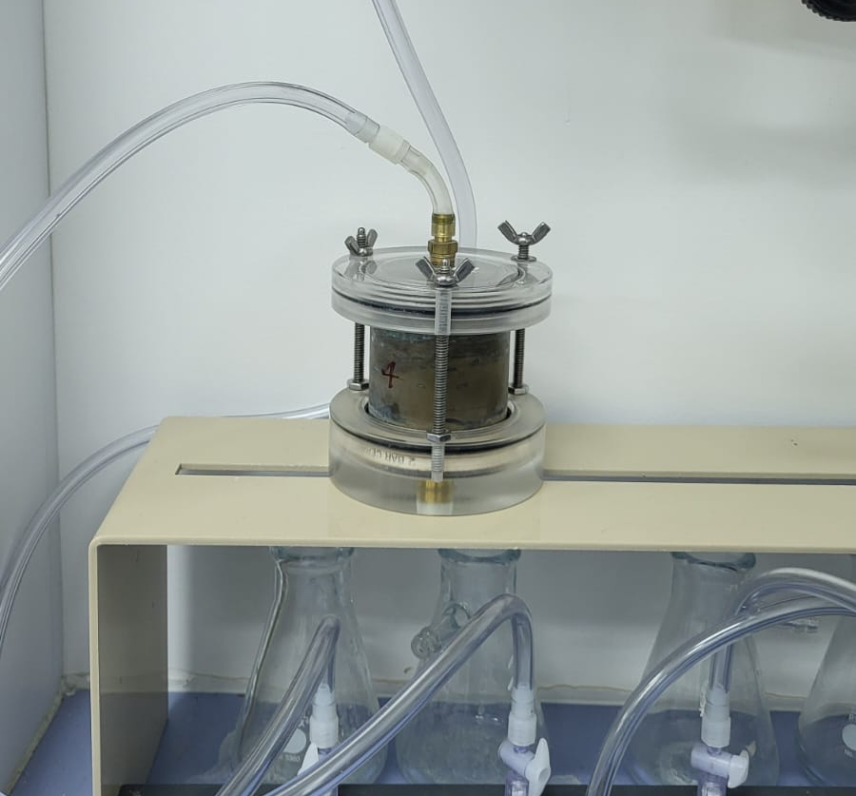
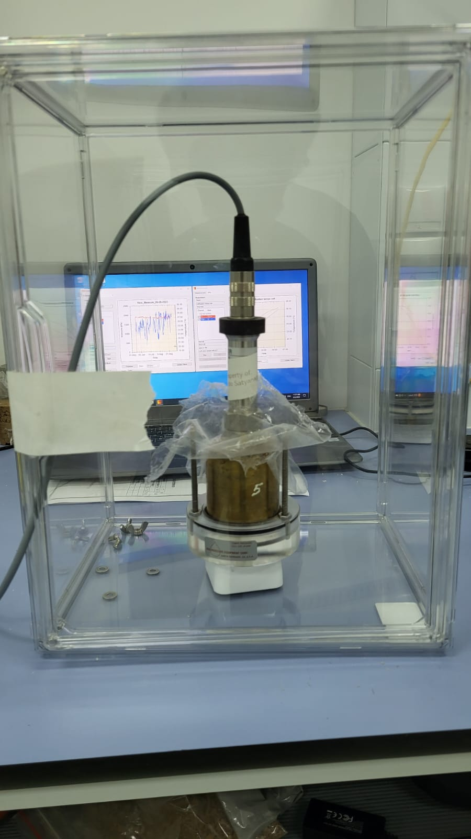
Data verification
To validate the data from HSPS by employing a verified unsaturated device, i.e., a Tempe Cell.
Tempe Cell method is referred to Satyanaga et al. (2019).
Imposed suction
After each suction measurement
HSPS
Tempe Cell sample
Tempe Cell sample
Figure 20. Validation method

Slide 23
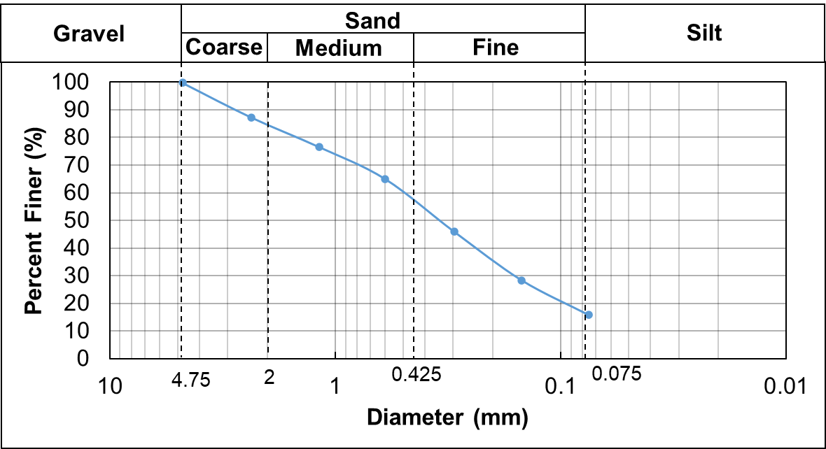
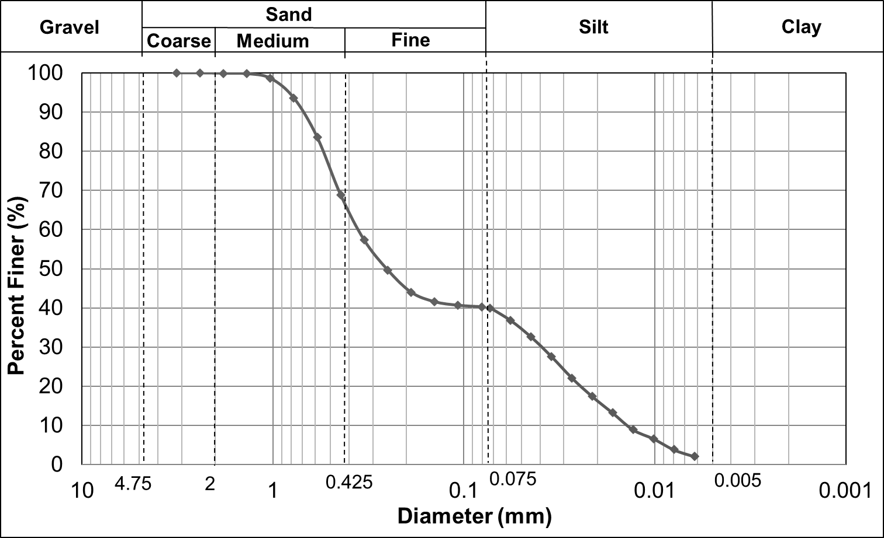
Soil properties
Table 6. Index properties result
NU soil
Index Property | NU soil | 60S40K
Water content, w (%) | 2.19 | 0
Specific gravity, Gs | 2.50 | 2.6
Plastic limit, PL (%) | 19.33 | 13.4
Liquid limit, LL (%) | 39.58 | 23.0
Plasticity index, PI | 20.25 | 9.6
Gravel (%) | 0 | 0
Sand (%) | 87.26 | 60
Fines (%) | 12.64 | 40
Soil category | SC | SC-SM
60S40K
Figure 21. Grain size distribution

Slide 24
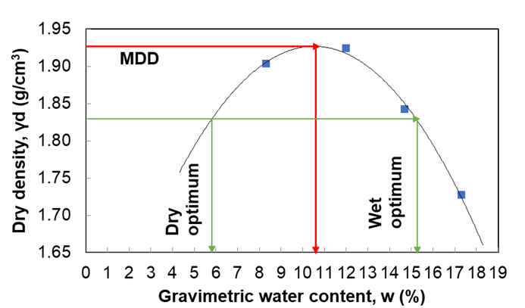
Soil properties
a
b
Figure 22. Compaction curve – (a) NU soil; (b) 60S40K

Slide 25
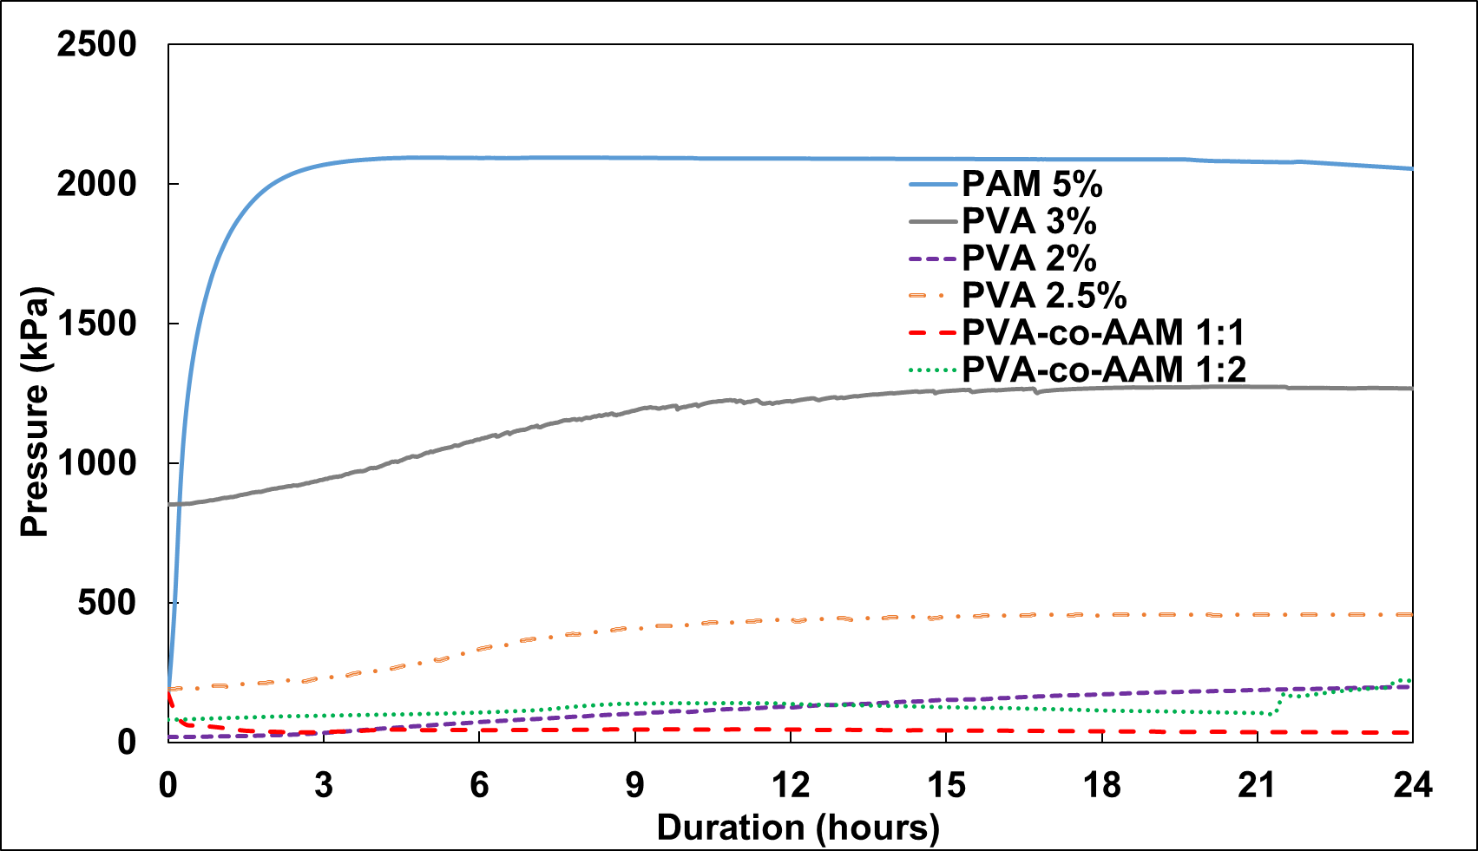
Pressure variation (in water)
6 samples were incorporated inside HSPS to assess its potential
PVA-co-AAM 2:1 was not used as it dissolves when in contact with water
Figure 23. Pressure variation

Slide 26
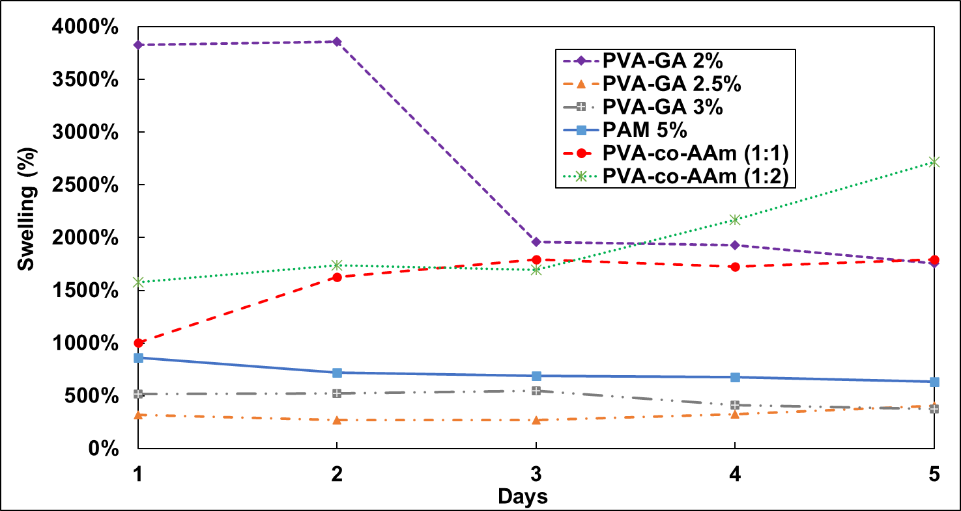
Swelling test
PAM still has the greatest potential as the swelling is more stable compared to the others, followed by PVA 2.5%, PVA 3%, and the rest.
Many samples were transformed into hydrogel (unstable)
Figure 24. Swelling variation

Slide 27
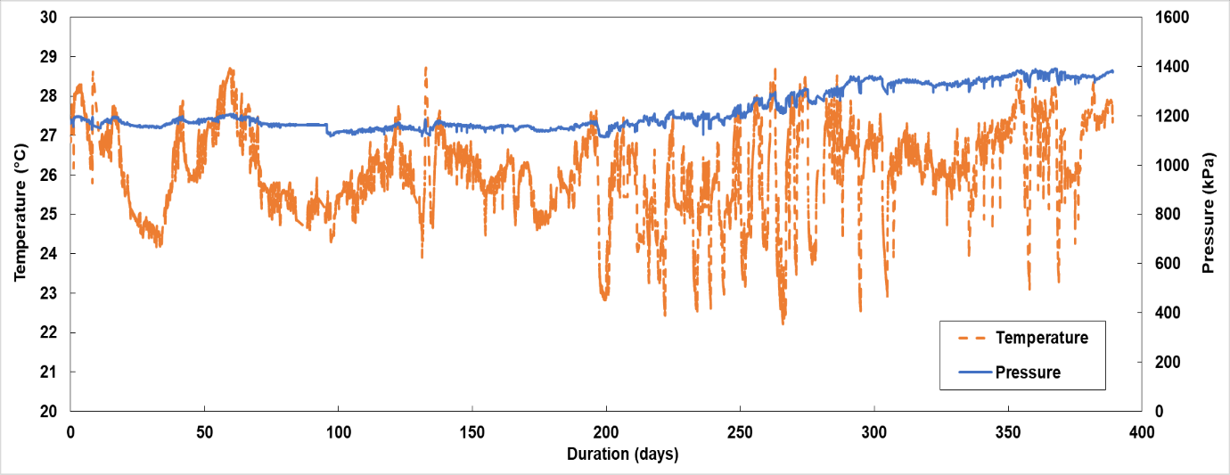
Durability test
Figure 25. Durability test

Slide 28
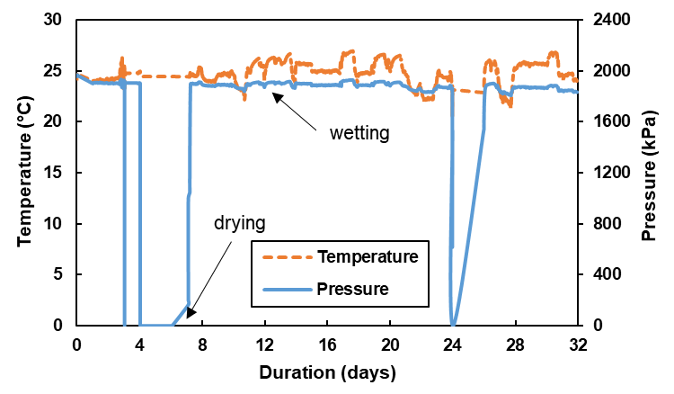
Durability test
Figure 26. Durability after drying-wetting cycles

Slide 29
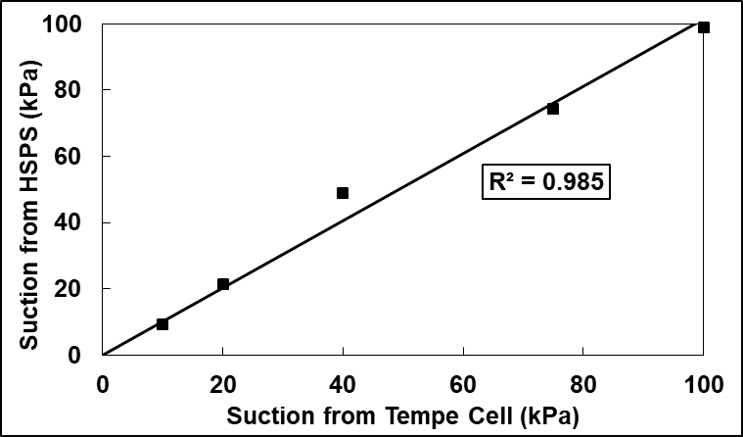
HSPS Verification
HSPS verification for suction > 500 kPa has not been conducted since WP4C compartment is too small and the lack of pressure plate equipment.
Figure 27. Verification of HSPS

Slide 30
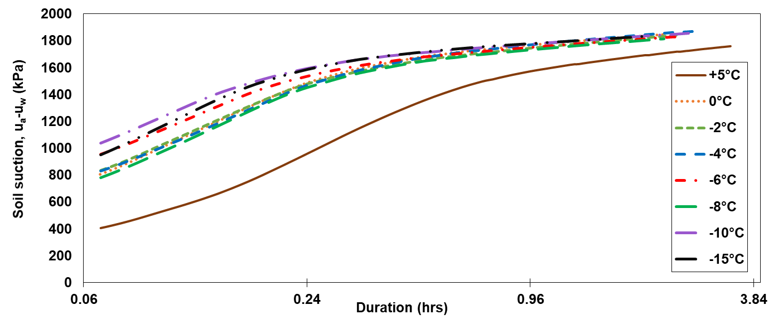
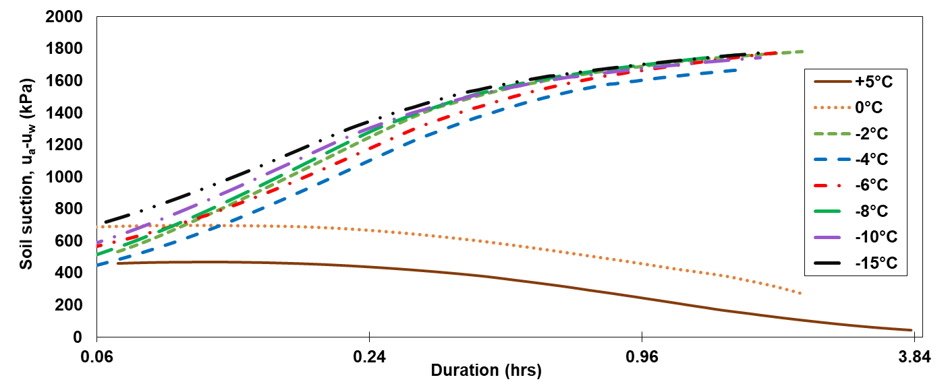
Soil suction during freezing
a
Figure 28. Suction variation during freezing – (a) sample 1; (b) sample 2
b

Slide 31
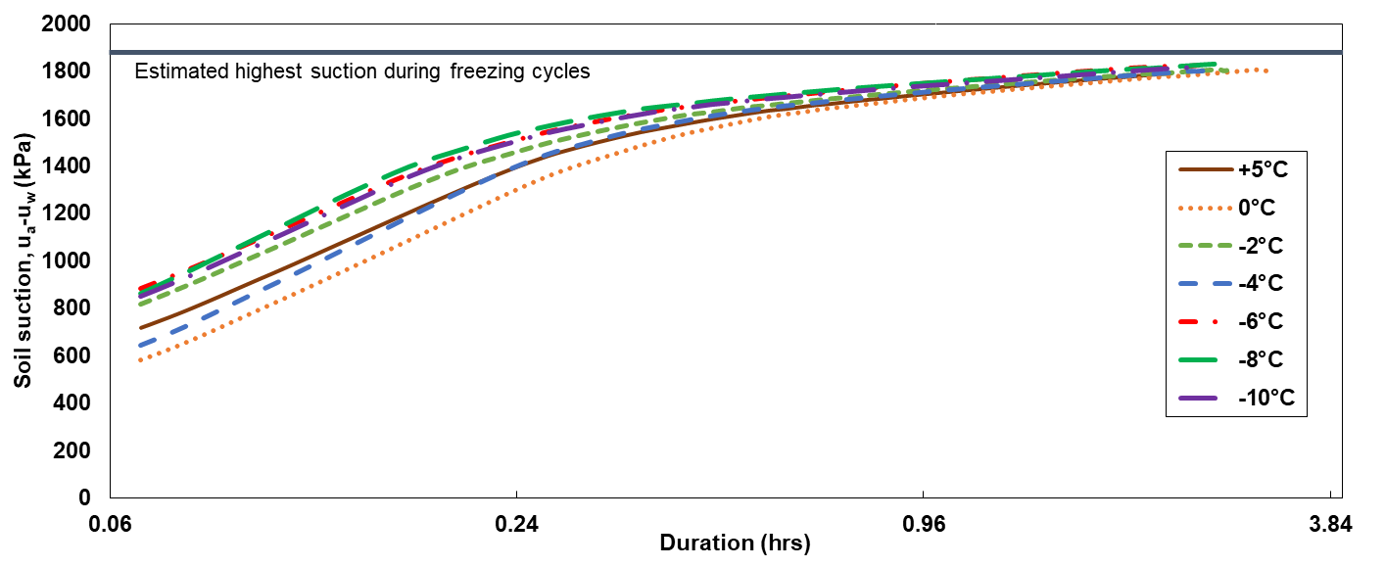
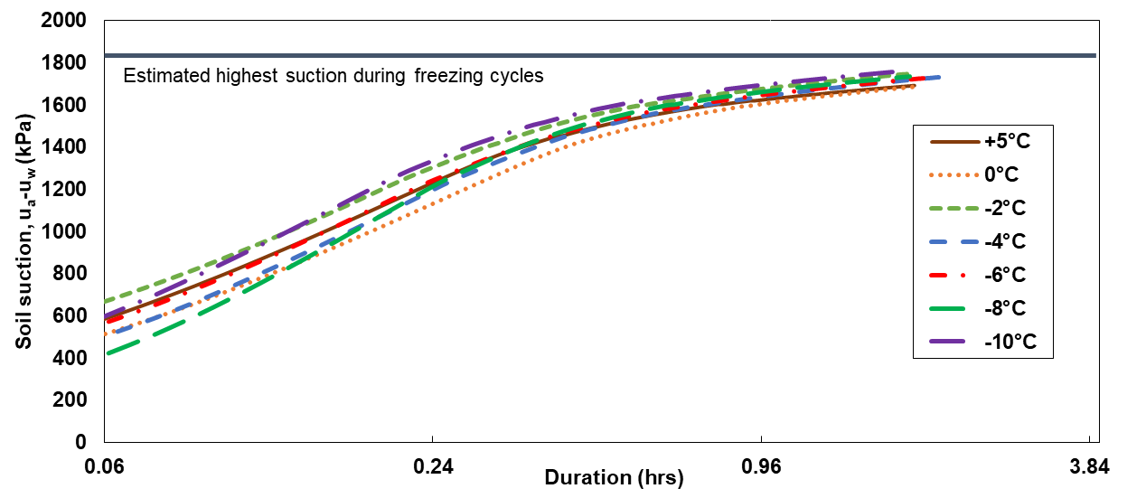
Soil suction during thawing
a
Figure 29. Suction variation during thawing – (a) sample 1; (b) sample 2
b

Slide 32
SWCC Best-Fitting
Table 8. Satyanaga et al. (2022) parameters
Soil Type | w – SWCC |  | θ_{w} – SWCC |  | S – SWCC
NU soil | w_{s1} | 14.5% | θ_{s1} | 0.28 | S_{s1} | 1.00
 | ψ_{a1} | 45 kPa | ψ_{a1} | 45 kPa | ψ_{a1} | 47 kPa
 | ψ_{m1} | 300 kPa
 | s₁ | 1.6 | s₁ | 1.8 | s₁ | 1.8
 | w_{s2} | 6.8% | θ_{s2} | 0.12 | S_{s2} | 0.45
 | ψ_{a2} | 20000 kPa
 | ψ_{m2} | 45000 kPa
 | s₂ | 1.3 | s₂ | 1.3 | s₂ | 1.8
 | ψ_{r} | 100000 kPa
 | w_{r} | 5% | θ_{r} | 0.07 | S_{r} | 0.19
 | R² | 0.95 | R² | 0.99 | R² | 0.95
Table 7. Fredlund & Xing (1994) parameters
Soil Type | Parameters | w – SWCC | θ – SWCC | S – SWCC
NU soil | a | 100 | 370.38 | 403.18
 | n | 50 | 0.7 | 0.78
 | m | 0.05 | 1.07 | 0.98
 | ψ_{r} | 100 | 100 | 1
 | R² | 0.999 | 0.998 | 0.977
60S40K | a | 36.13 | 36.13 | 37.58
 | n | 6.58 | 6.59 | 7.01
 | m | 0.23 | 0.23 | 0.23
 | ψ_{r} | 99.34 | 99.22 | 142.25
 | R² | 0.998 | 0.994 | 0.972

Slide 33
SWCC Best-Fitting (continued)
Table 8. Satyanaga et al. (2022) parameters
Soil Type | w-SWCC |  | θ_{w}-SWCC |  | S-SWCC
60S40K
 | w_{s1} | 0.26 | θ_{s1} | 0.456 | S_{s1} | 1.00
 | ψ_{a1} | 28.1 kPa | ψ_{a1} | 28 kPa | ψ_{a1} | 28.16 kPa
 | ψ_{m1} | 35 kPa | ψ_{m1} | 35 kPa | ψ_{m1} | 47.40 kPa
 | s₁ | 2 | s₁ | 2.1 | s₁ | 0.5
 | w_{s2} | 0.15 | θ_{s2} | 0.25 | S_{s2} | 0.604
 | ψ_{a2} | 200 kPa | ψ_{a2} | 200 kPa | ψ_{a2} | 178.41 kPa
 | ψ_{m2} | 1500 kPa | ψ_{m2} | 2000 kPa | ψ_{m2} | 1000.01 kPa
 | s₂ | 2
 | ψ_{r} | 9000 kPa | ψ_{r} | 15000 kPa | ψ_{r} | 12000 kPa
 | w_{r} | 0.003 | θ_{r} | 0.04 | S_{r} | 0.12
 | R² | 0.997 | R² | 0.99 | R² | 0.99

Slide 34
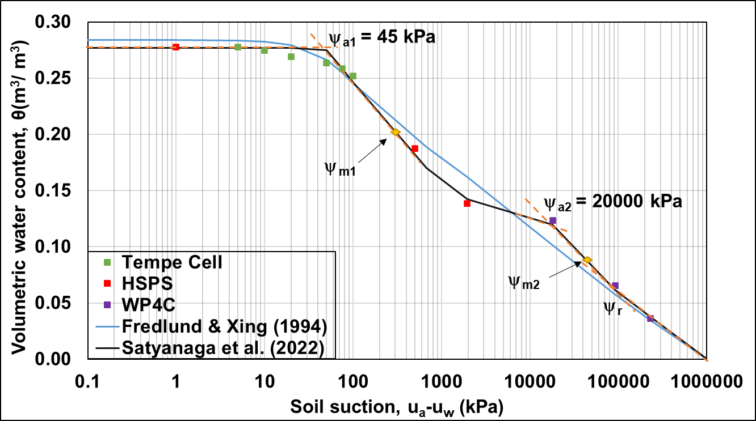
SWCC
NU SOIL
Figure 30. θ-SWCC

Slide 35
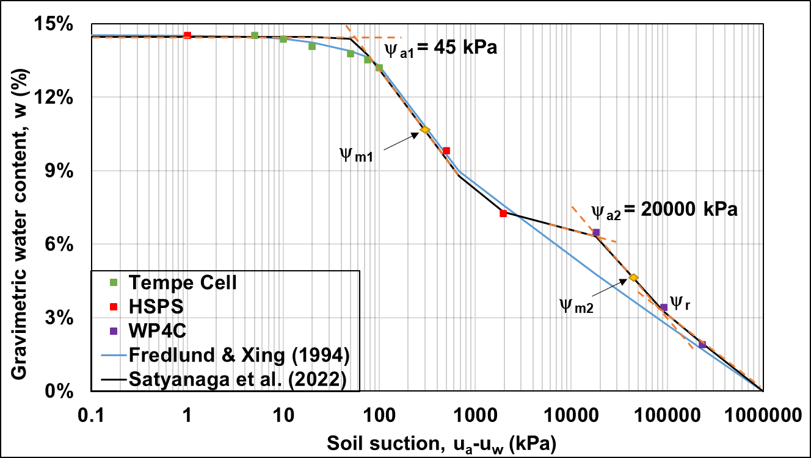
SWCC
NU SOIL
(continued)
Figure 31. w-SWCC

Slide 36
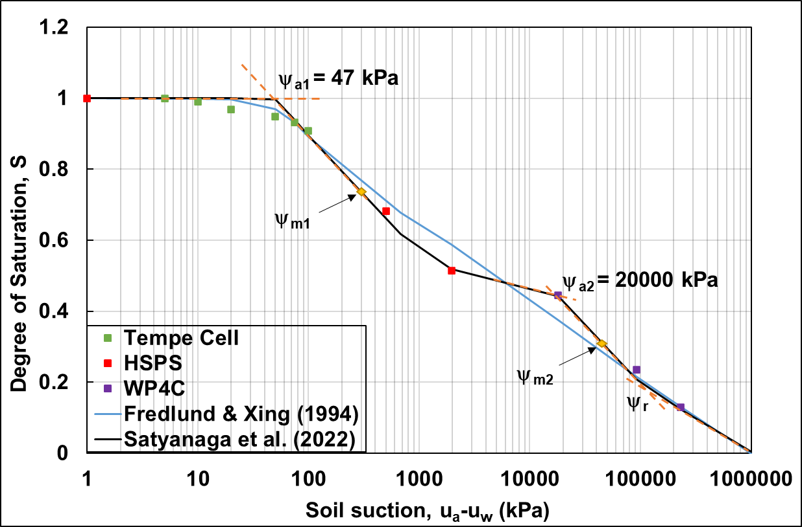
SWCC
NU SOIL
(continued)
Figure 32. S-SWCC

Slide 37
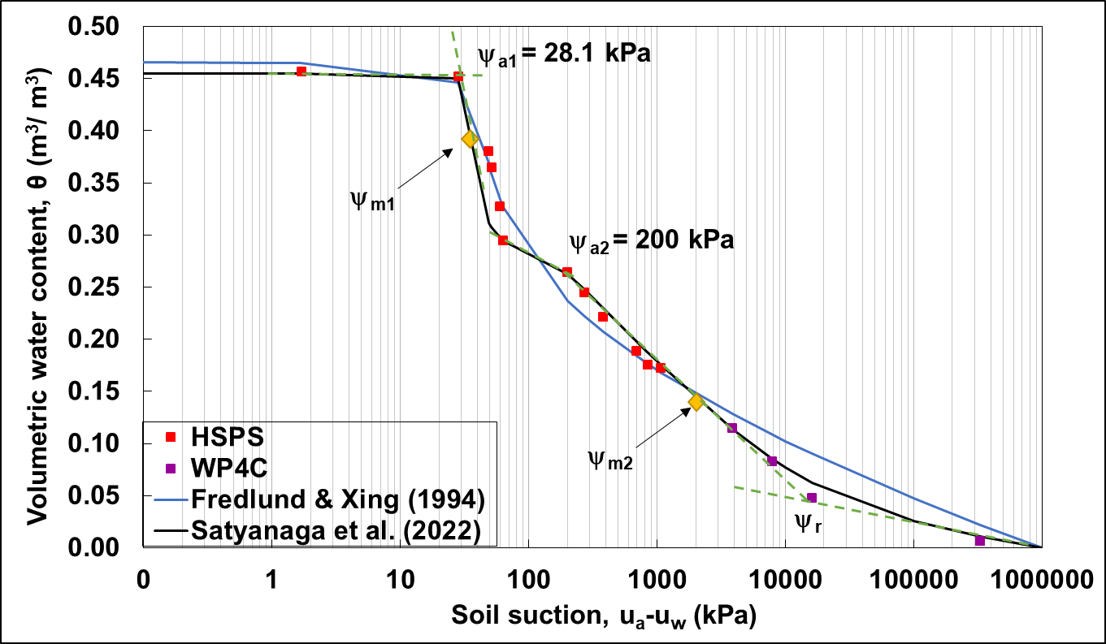
SWCC
60S40K SOIL
Figure 33. θ -SWCC

Slide 38
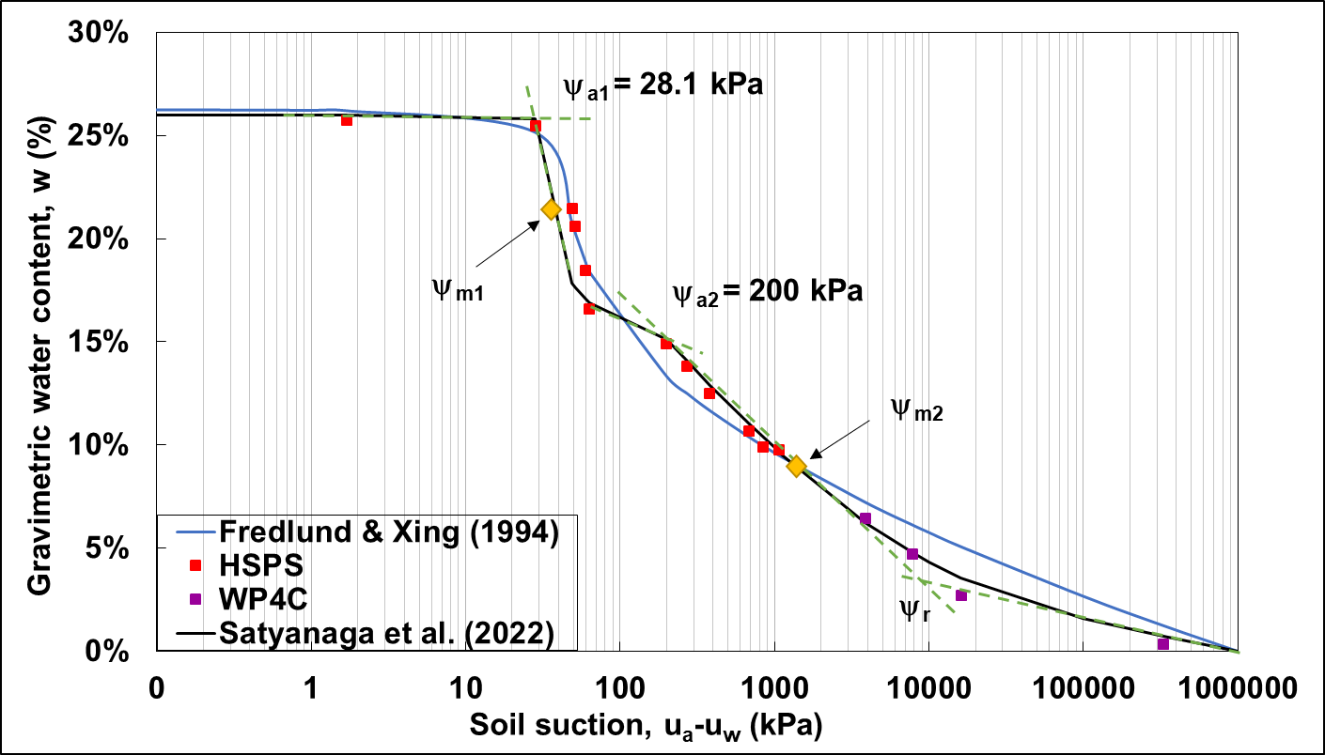
SWCC
60S40K SOIL
(continued)
Figure 34. w-SWCC

Slide 39
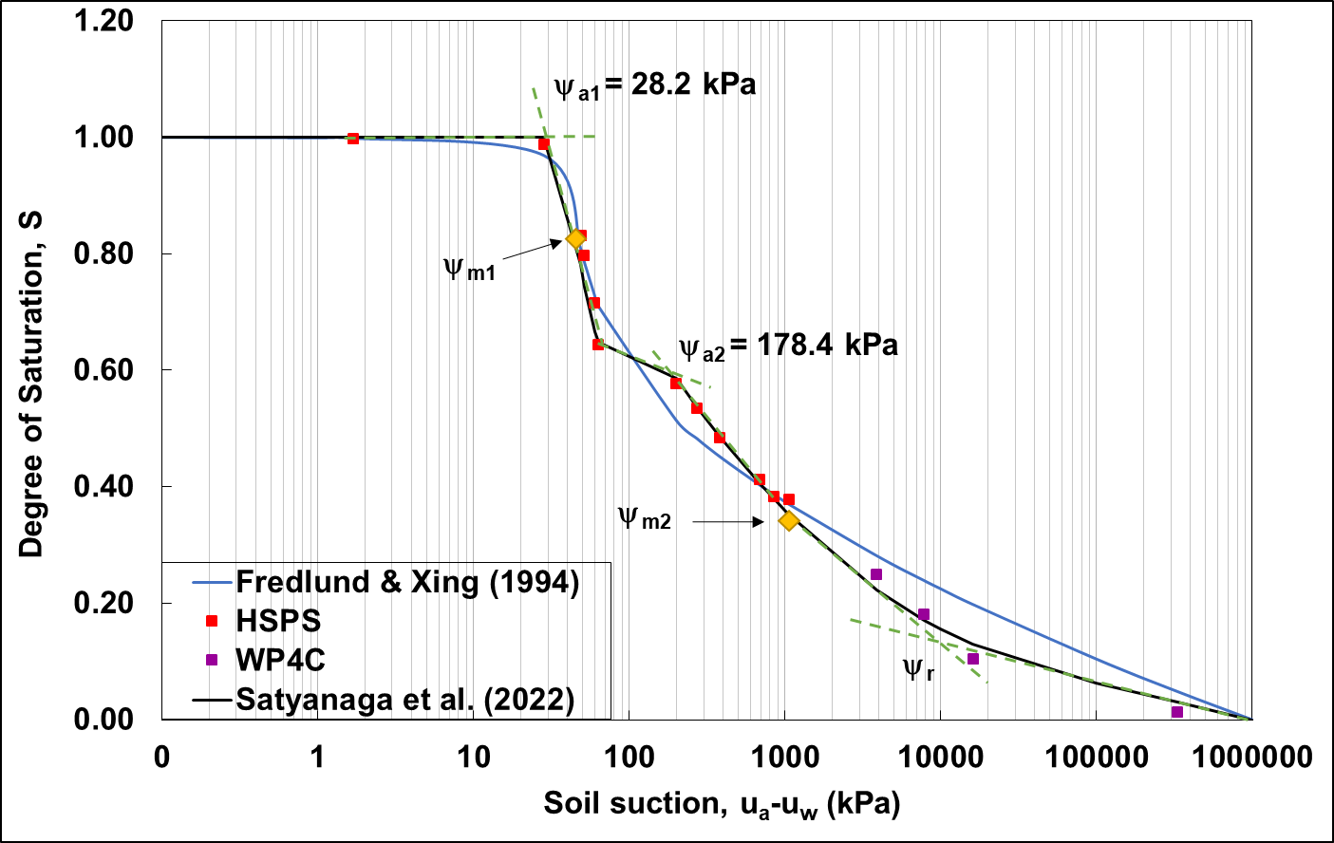
SWCC
60S40K SOIL
(continued)
Figure 35. S-SWCC

Slide 40
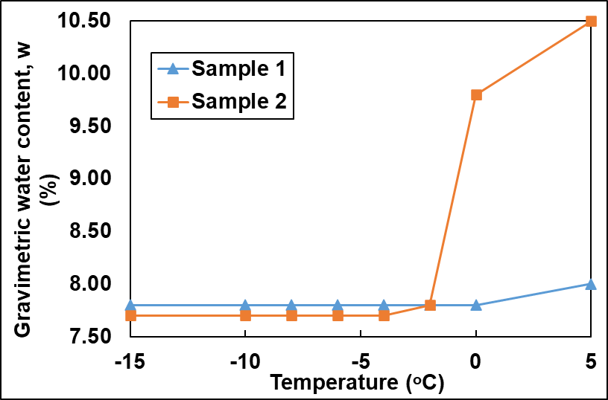

Estimated unfrozen water content (NU soil)
Estimation is used as the frozen soil suction has a similarity to typical soil suction in SWCC due to physical process similarities (Ren et al. 2017).
Unfrozen water content in coarse-grained should decrease significantly until -2ºC before it becomes constant (Ren et al. 2017).
a
Figure 36. Unfrozen water content –(a) freezing; (b) thawing
b

Slide 41

Proposed
Framework for SWCC Measurement
Figure 37. Proposed framework

Slide 42
Conclusion
PAM generated the highest pressure and the most stable swelling among all. Thus, it has the biggest potential to be used for soil suction monitoring for a long duration (from durability testing, it can withstand for more than a year).
HSPS produced a comparable suction result to the Tempe Cell, yet the validation with suction > 500 kPa has not been conducted.
Both samples are considered bimodal soil as the SWCC consisted of two sigmoidal curves.
In NU soil, sample 1 produced an average of 1.27% higher soil suction during freezing. In contrast, sample 2 has an average of 18.78% lower suction during freezing. This is due to the difference in soil porosity, which affects the freezing duration that it takes to penetrate the soil pores
In terms of unfrozen water content, it remains in the range of 7.6 to 7.8% at temperatures ranging from -5 to -15°C. This result is logical considering the sample is a coarse-grained material.

Slide 43
Recommendation
Many limitations persist in this study, thus several recommendation are suggested for further study.
HSPS should be verified for suction > 500 kPa with the support of a pressure plate.
Polymer research should be expanded to improve the pressure capability for detecting soil suction until high-suction range (> 2000 kPa)
The swelling test should be performed at a variety of temperatures to evaluate the polymer's behavior and stability.
Soil suction monitoring should be carried out across a number of freezing and thawing cycles with various humidity to imitate field conditions and assess suction variance in each cycle.
A moisture sensor should be ingrained in the sample during frozen soil suction monitoring to compare the result with the estimation of unfrozen water content.

Slide 44


Research Outputs
b
Figure 38. Publications – (a) Journal paper; (b) Conference paper
a
First author
Q1 publication (91% percentile)
Under review:
Aventian, G.D., Satyanaga, A., Arinova, A., Kalimuldina, G., Moon, S-W., & Kim, J. (2024). Variability of polymer for determination of soil-water characteristic curves. Submitted to Journal of Rock Mechanics and Geotechnical Engineering (Q1; 99% percentile).

Slide 45
References
[1] Fredlund, D. G., and Rahardjo, H., 1993, Soil Mechanics for Unsaturated Soils, John Wiley & Sons, Inc.
[2] Zhai, Q., Rahardjo, H., Satyanaga, A., Dai, G., and Du, Y., 2020, “Estimation of the Wetting Scanning Curves for Sandy Soils,” Eng Geol, 272, p. 105635.
[3] Fatahi, B., Pathirage, U., Indraratna, B., Pallewattha, M., and Khabbaz, H., 2015, “The Role of Native Vegetation in Stabilizing Formation Soil for Transport Corridors: An Australian Experience,” Ground Improvement Case Histories: Chemical, Electrokinetic, Thermal and Bioengineering Methods, pp. 591–628.
[4] Rahardjo, H., Kim, Y., and Satyanaga, A., 2019, “Role of Unsaturated Soil Mechanics in Geotechnical Engineering,” International Journal of Geo-Engineering, 10(8), pp. 1–23.
[5] Filho, O. A., and Fernandes, M. A., 2019, “Landslide Analysis of Unsaturated Soil Slopes Based on Rainfall and Matric Suction Data,” Bulletin of Engineering Geology and the Environment, 78(6), pp. 4167–4185.
[6] Sagu, A., Satyanaga, A., Gofar, N., Irawan, S., Khamitov, R., Moon, S. W., and Kim, J., 2023, “Influence of Suction on Capacity of Pile Foundation,” Applied Sciences, 13(6), pp. 1–21.
[7] Vanapalli, S. K., and Taylan, Z. N., 2012, “Design of Single Piles Using the Mechanics of Unsaturated Soils,” GEOMATE Journal, 2(3), pp. 197–204.
[8] Satyanaga, A., Bairakhmetov, N., Kim, J. R., and Moon, S. W., 2022, “Role of Bimodal Water Retention Curve on the Unsaturated Shear Strength,” Applied Sciences 2022, Vol. 12, Page 1266, 12(3), p. 1266.
[9] de Oliveira, R. A., Ramos, M. M., and de Aquino, L. A., 2015, “Irrigation Management,” Sugarcane: Agricultural Production, Bioenergy and Ethanol, pp. 161–183.
[10] Rai, R. K., Singh, V. P., and Upadhyay, A., 2017, “Soil Analysis,” Planning and Evaluation of Irrigation Projects, pp. 505–523.

Slide 46
References
[11] Peck, A. J., and Rabbidge, R. M., 1969, “Design and Performance of an Osmotic Tensiometer for Measuring Capillary Potential,” Soil Science Society of America Journal, 33(2), pp. 196–202.
[12] Zhussupbekov, A., and Shakhmov, Z., 2015, “Experimental Investigations of Freezing Soils at Ground Conditions of Astana,” Sci Cold Arid Reg, 7(4).
[13] Fredlund, D. G., 2006, “Unsaturated Soil Mechanics in Engineering Practice,” Journal of Geotechnical and Geoenvironmental Engineering, 132(3), pp. 286–321.
[14] Croney, D., Coleman, J. D., and Black, W. P., 1958, “Movement and Distribution of Water in Soil in Relation to Highway Design and Performance,” Highway Research Board Special Report, (40).
[15] Fredlund, D. G., Rahardjo, H., and Fredlund, M. D., 2012, Unsaturated Soil Mechanics in Engineering Practice, John & Wiley Sons, New York.
[16] Zhai, Q., Rahardjo, H., and Satyanaga, A., 2016, “Variability in Unsaturated Hydraulic Properties of Residual Soil in Singapore,” Eng Geol, 209, pp. 21–29.
[17] Zhai, Q., and Rahardjo, H., 2012, “Determination of Soil–Water Characteristic Curve Variables,” Comput Geotech, 42, pp. 37–43.
[18] Mercer, K., Rahardjo, H., and Satyanaga, A., 2019, Unsaturated Soils Guidelines – Volume 1: Soil-Water Characteristic Curves for Materials Classified According to the Unified Soil Classification System, Australian Center for Geomechanics, University of Western Australia, Crawley, Western Australia.
[19] Ren, J., 2019, “Interpretation of the Frozen Soils Behavior Extending the Mechanics of Unsaturated Soils,” Dissertation, University of Ottawa.
[20] Fredlund, D. G., and Morgenstern, N. R., 1977, “Stress State Variables for Unsaturated Soils,” Journal of Geotechnical and Geoenvironmental Engineering, 103(GT5).
[21] Machmer, B., 2012, “Understanding the Behavior of a Pile Foundation in Unsaturated Soils Subjected to Lateral Loading,” Clemson University.
[22] Abeykoon, T., Udukumburage, R. S., Gallage, C., and Uchimura, T., 2017, “Comparison of Direct and Indirect Measured Soil-Water Characteristic Curves for a Silty Sand,” International Journal of GEOMATE, 13(39), pp. 9–16.

Slide 47
References
[23] Gardner, R., 1937, “A Method of Measuring the Capillary Tension of Soil Moisture over a Wide Moisture Range,” Soil Sci, 43(4), pp. 277–284.
[24] Ren, X., Kang, J., Ren, J., Chen, X., and Zhang, M., 2020, “A Method for Estimating Soil Water Characteristic Curve with Limited Experimental Data,” Geoderma, 360, p. 114013.
[25] Liu, H., Rahardjo, H., Satyanaga, A., and Du, H., 2022, “Use of Osmotic Tensiometers in the Determination of Soil-Water Characteristic Curves,” Eng Geol, 312.
[26] Bulut, R., Lytton, R., and Wray, Warren. K., 2001, “Soil Suction Measurements by Filter Paper,” Geo-Institute Shallow Foundation and Soil Properties, C. Vipulanandan, M.B. Addison, and M. Hasen, eds., ASCE, Houston, pp. 243–261.
[27] Bocking, K. A., and Fredlund, D. G., 1980, “Limitations of the Axis-Translation Technique,” Fourth International Conference on Expansive Soils, Denver, pp. 1–19.
[28] Rahardjo, H., Satyanaga, A., Mohamed, H., Yee Ip, S. C., and Shah, R. S., 2019, “Comparison of Soil–Water Characteristic Curves from Conventional Testing and Combination of Small-Scale Centrifuge and Dew Point Methods,” Geotechnical and Geological Engineering, 37(2), pp. 659–672.
[29] Bagheri, M., Rezania, M., and Mousavi Nezhad, M., 2018, “Cavitation in High-Capacity Tensiometers: Effect of Water Reservoir Surface Roughness,” Geotechnical Research, 5(2), pp. 81–95.
[30] Marinho, F. A. M., Take, W. A., and Tarantino, A., 2008, “Measurement of Matric Suction Using Tensiometric and Axis Translation Techniques,” Geotechnical and Geological Engineering, 26(6), pp. 615–631.
[31] Ridley, A. M., Dineen, K., Burland, J. B., and Vaughan, P. R., 2003, “Soil Matrix Suction: Some Examples of Its Measurement and Application in Geotechnical Engineering,” Géotechnique, 53(2), pp. 241–253.
[32] Tripathy, S., Al-Khyat, S., Cleall, P. J., Baille, W., and Schanz, T., 2016, “Soil Suction Measurement of Unsaturated Soils with a Sensor Using Fixed-Matrix Porous Ceramic Discs,” Indian Geotechnical Journal, 46(3), pp. 252–260.

Slide 48
References
[33] Rahardjo, H., Nong, X. F., Lee, D. T. T., Leong, E. C., and Fong, Y. K., 2018, “Expedited Soil-Water Characteristic Curve Tests Using Combined Centrifuge and Chilled Mirror Techniques,” Geotechnical Testing Journal, 41(1), pp. 207–217.
[34] Mendes, J., Gallipoli, D., Boeck, F., and Tarantino, A., 2020, “A Comparative Study of High Capacity Tensiometer Designs,” Physics and Chemistry of the Earth, Parts A/B/C, 120, p. 102901.
[35] Maček, M., Smolar, J., and Ana, P., 2013, “Extension of Measurement Range of Dew-Point Potentiometer and Evaporation Method Extension of Measurement Range of Dew-Point Potentiometer and Evaporation Method,” 18 Th International Conference on Soil Mechanics and Geotechnical Engineering, Paris, pp. 1137–1142.
[36] Sun, M. Y., Shi, B., Zhang, C. C., Zheng, X., Guo, J. Y., Wang, Y. Q., He, M. N., and Liu, J., 2021, “Quasi-Distributed Fiber-Optic in-Situ Monitoring Technology for Large-Scale Measurement of Soil Water Content and Its Application,” Eng Geol, 294.
[37] Yan, G., Bore, T., Li, Z., Schlaeger, S., Scheuermann, A., and Li, L., 2021, “Application of Spatial Time Domain Reflectometry for Investigating Moisture Content Dynamics in Unsaturated Loamy Sand for Gravitational Drainage,” Applied Sciences, 11(7).
[38] Xu, Q., Zhu, Y., Xiang, Y., Yu, S., Wang, Z., Yan, X., Du, T., and Cheng, Q., 2022, “A Novel Frequency-Domain Integrated Sensor for in-Situ Estimating Unsaturated Soil Hydraulic Conductivity,” J Hydrol (Amst), 610.
[39] Genuchten, M. Th. van, 1980, “A Closed-Form Equation for Predicting the Hydraulic Conductivity of Unsaturated Soils,” Soil Science Society of America Journal, 44(5), pp. 892–898.
[40] Campbell, G. S., 1974, “A Simple Method for Determining Unsaturated Conductivity from Moisture Retention Data,” Soil Sci, 117(6), pp. 311–314.
[41] Wang, C., Lai, Y., and Zhang, M., 2017, “Estimating Soil Freezing Characteristic Curve Based on Pore-Size Distribution,” Appl Therm Eng, 124, pp. 1049–1060.
[42] Ren, J., and Vanapalli, S. K., 2020, “Effect of Freeze–Thaw Cycling on the Soil-Freezing Characteristic Curve of Five Canadian Soils,” Vadose Zone Journal, 19(1).
[43] Peck, A. J., and Rabbidge, R. M., 1966, “Soil-Water Potential: Direct Measurement by a New Technique,” Science (1979), 151(3716), pp. 1385–1386.

Slide 49
References
[44] Bakker, G., van der Ploeg, M. J., de Rooij, G. H., Hoogendam, C. W., Gooren, H. P. A., Huiskes, C., Koopal, L. K., and Kruidhof, H., 2007, “New Polymer Tensiometers: Measuring Matric Pressures Down to the Wilting Point,” Vadose Zone Journal, 6(1), pp. 196–202.
[45] Kalita, A., Chakraborty, M., and Biswas, K., 2017, “A Comparative Study of Polymer Coated Capacitive Sensors for Soil Moisture Sensing,” I2MTC 2017 - 2017 IEEE International Instrumentation and Measurement Technology Conference, Proceedings, Institute of Electrical and Electronics Engineers Inc.
[46] Liu, H., Rahardjo, H., Satyanaga, A., and Du, H., 2021, “Use of Synthesised Polymers for the Development of New Osmotic Tensiometers,” Geotechnique.
[47] Hamdany, A. H., Shen, Y., Satyanaga, A., Rahardjo, H., Lee, T. T. D., and Nong, X., 2022, “Field Instrumentation for Real-Time Measurement of Soil-Water Characteristic Curve,” International Soil and Water Conservation Research, 10(4), 586–596.
[48] Bajpai, P., 2018, “Papermaking Chemistry,” Biermann’s Handbook of Pulp and Paper, Elsevier, pp. 207–236.
[49] Kuckling, D., Doering, A., Krahl, F., and Arndt, K. F., 2012, “Stimuli-Responsive Polymer Systems,” Polymer Science: a Comprehensive Reference, 8, pp. 377–413.
[50] Subramani, R., Izquierdo-Alvarez, A., Bhattacharya, P., Meerts, M., Moldenaers, P., Ramon, H., and Van Oosterwyck, H., 2020, “The Influence of Swelling on Elastic Properties of Polyacrylamide Hydrogels,” Front Mater, 7.
[51] Zhang, H.-P., Cao, J.-J., Jiang, W.-B., Yang, Y.-Q., Zhu, B.-Y., Liu, X.-Y., Wu, Y., Sun, X., Essouma, A. F. B. E., and Liu, J., 2022, “Synthesis and Mechanical Properties of Polyacrylamide Gel Dope with Graphene Oxide,” Energies (Basel), 15, 1–20.
[52] Aouada, F. A., Moura, M. R. De, Lopes Da Silva, W. T., Muniz, E. C., and Mattoso, L. H. C., 2011, “Preparation and Characterization of Hydrophilic, Spectroscopic, and Kinetic Properties of Hydrogels Based on Polyacrylamide and Methylcellulose Polysaccharide,” J Appl Polym Sci, 120(5), pp. 3004–3013.
[53] Voronova, M. I., Surov, O. V., Afineevskii, A. V., and Zakharov, A. G., 2020, “Properties of Polyacrylamide Composites Reinforced by Cellulose Nanocrystals,” Heliyon, 6(11), pp. 1–13.

Slide 50
References
[54] Halder, B. K., Palomino, A. M., and Hicks, J., 2018, “Influence of Polyacrylamide Conformation on Fabric of ‘Tunable’ Kaolin–Polymer Composite,” Canadian Geotechnical Journal, 55(9), pp. 1295–1312.
[55] Fredlund, D. G., and Xing, A., 1994, “Equations for the Soil-Water Characteristic Curve,” Canadian Geotechnical Journal, 31(4), pp. 521–532.
[56] Satyanaga, A., Moon, S.-W., and Kim, J. R., 2022, “Stability Analyses of Dual Porosity Soil Slope,” Geomechanics and Engineering, 28(1), pp. 77–87.
[57] Guan, G. S., Rahardjo, H., and Choon, L. E., 2009, “Shear Strength Equations for Unsaturated Soil under Drying and Wetting,” Journal of Geotechnical and Geoenvironmental Engineering, 136(4), pp. 594–606.
[58] Heidari, S., Esmaeilzadeh, F., Mowla, D., and Ghasemi, S., 2018, “Synthesis of an Efficient Copolymer of Acrylamide and Acrylic Acid and Determination of Its Swelling Behavior,” J Pet Explor Prod Technol, 8(4), pp. 1331–1340.
[59] KELLER, 2022, Data Sheet Series 35X Pressure Transmitter, Winterthur.
[60] Abraham, R. E., and Puri, M., 2020, “Nano-Immobilized Cellulases for Biomass Processing with Application in Biofuel Production,” Methods Enzymol, 630, pp. 327–346.
[61] Daéid, N. N., 2005, “Systematic Drug Identification,” Encyclopedia of Analytical Science: Second Edition, 471–480.
[62] Nandiyanto, A. B. D., Oktiani, R., and Ragadhita, R., 2019, “How to Read and Interpret FTIR Spectroscope of Organic Material,” Indonesian Journal of Science and Technology, 4(1), pp. 97–118.
[63] Coates, J., 2006, “Interpretation of Infrared Spectra, A Practical Approach,” Encyclopedia of Analytical Chemistry.
[64] van der Ploeg, M. J., 2008, “Polymer Tensiometers to Characterize Unsaturated Zone Processes in Dry Soils,” Doctoral Thesis, Wageningen University.
[65] Satyanaga, A., Rahardjo, H., Koh, Z. H., and Mohamed, H., 2019, “Measurement of a Soil-Water Characteristic Curve and Unsaturated Permeability Using the Evaporation Method and the Chilled-Mirror Method,” Journal of Zhejiang University: Science A, 20(5), pp. 368–374.

Slide 51
References
[66] Naka, K., 2015, “Inorganic Polymers: Overview,” Encyclopedia of Polymeric Nanomaterials, pp. 995–1000.
[67] Kumar, V., Meenakshi, Shukla, S. K., and Thakur, N., 2021, Carbon-Based Materials Approach for Environmental Sensing, Elsevier.
[68] Ren, J., Vanapalli, S. K., and Han, Z., 2017, “Soil Freezing Process and Different Expressions for the Soil-Freezing Characteristic Curve,” Sci Cold Arid Reg, 9(3), pp. 221–228.
[69] Williams, P., 1967, Properties and Behavior of Freezing Soil.
[70] Zhou, X., Zhou, J., Kinzelbach, W., and Stauffer, F., 2014, “Simultaneous Measurement of Unfrozen Water Content and Ice Content in Frozen Soil Using Gamma Ray Attenuation and TDR,” Water Resour Res, 50(12), pp. 9630–9655.

Slide 52

THANK YOU FOR YOUR ATTENTION

