Slide 1
SURFACE MODIFICATION OF TITANIUM ALLOY FOR BIOCOMPATIBILITY
Salikh Omarov
2nd Year Master in Mechanical and Aerospace Engineering
Supervisor: Assistant Professor Asma Perveen
Co-Supervisor: Associate Professor Didier Talamona

Slide 2
Outline
Introduction
Methodology
Results
Discussion
Conclusion

Slide 3
Outline
Introduction
Methodology
Results
Discussion
Conclusion

Slide 4
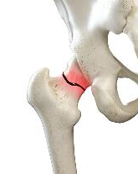
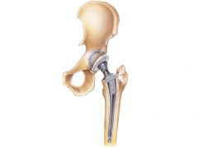
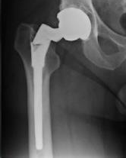

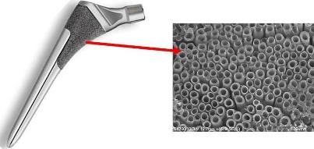
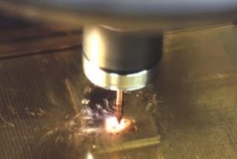


Introduction: Background Information
Bone injuries
Implant application
Problems
Surface modification
Mechanical properties
Composition
Morphology
Surface treatment: EDM
Notes:
To begin with, nowadays, bone issues are one of the common problems in biomedicine. In fact, people older than 40 years suffer from bone diseases which may require bone replacement. In order to do that implant application was developed. However, it still has some drawback such as implant cracks and cell biocompatibility. Surface treatment is one of the solutions in providing better surface biocompatibility. There are 3 aspects which are mechanical properties, corrosion resistance and morphology. One of the methods that can do that is EDM.
https://zehrcenter.com/wp-content/uploads/2020/07/hip-fracture-900x600-1.jpg
https://www.healio.com/~/media/images/news/print/orthopedics-today/2021/05_may/grandrounds0521_figure1.jpg?la=en
Surface treatment: Laser, Coating, Chemical, Jet Polishing,

Slide 5
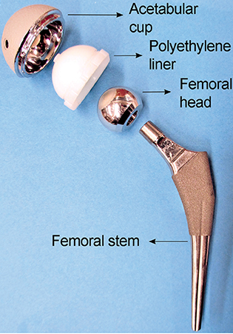
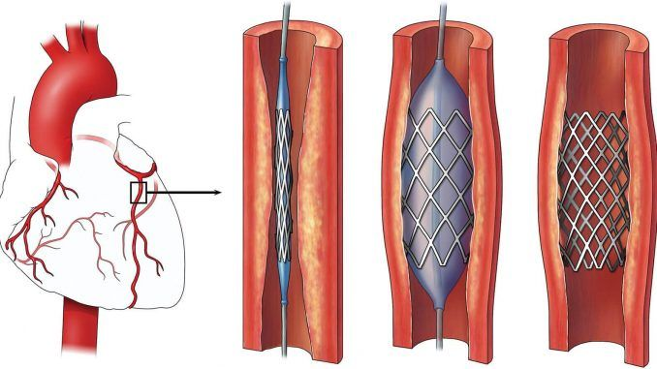
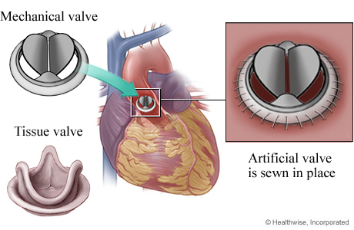
Introduction: Biomedical Implants
Types of implant materials
Metallic
Ceramic
Polymeric
Composite
Metallic implant materials
Cobalt-Chromium
Stainless steel 316L
Titanium
Ti-6Al-4V
Good biocompatibility
High corrosion resistance
Appropriate mechanical properties

Slide 6

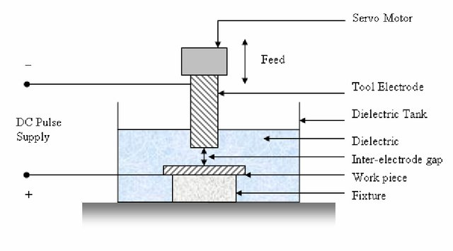



Introduction: EDM
Non-conventional machining
No mechanical contact
Electric discharges
Tool electrode (cathode) and workpiece (anode)
Mechanism of EDM
Notes:
EDM is non-conventional machining technique which applies electric discharges. When voltage is applied, due to the flow of electrons between the tool electrode and conductive workpiece, the electrostatic field is occurred. This depletes dielectric into positive ions and electrons. The decreased resistance in dielectric medium results in spark which melts the surface of the workpiece. The figure shows the basic mechanism of EDM.

Slide 7
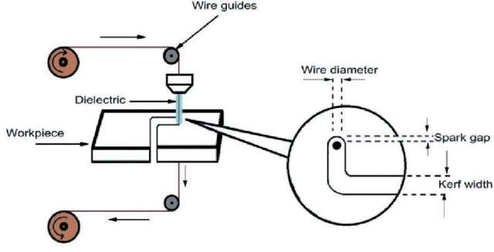
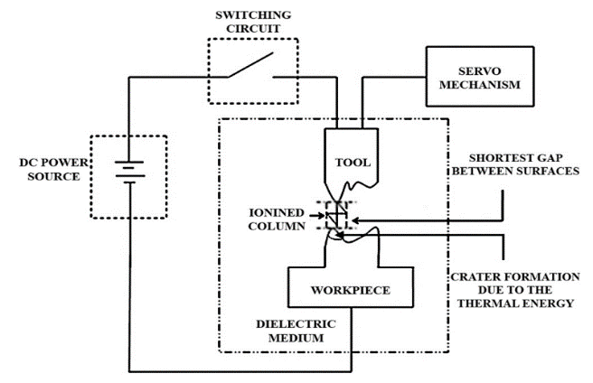

Introduction: EDM
Discharge energy
$$E=IUt=\frac{CU^{2}}{2}$$
Wire Electro Discharge Machining
Electro Discharge Machining

Slide 8
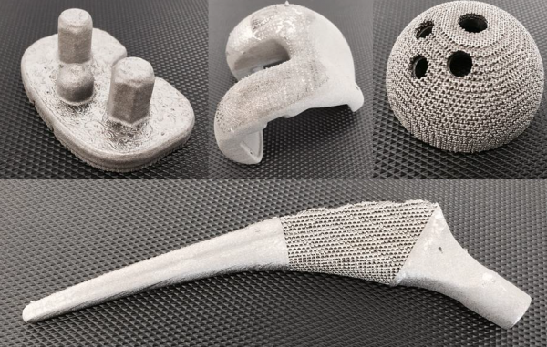
Introduction: SLM printing
Selective Laser Melting (SLM)
Additive manufacturing process of 3D objects
Layer-by-layer building of CAD models
Complex and unique shapes

Slide 9

Introduction:
Aims Objective
Investigate machining parameters on Ti-6Al-4V
Difference between casted and SLM printed alloys
Evaluate surface properties
Observe effects on bacteria adhesion and biofilm formation
Surface treatment by EDM in macro scale
____________________
Surface treatment by EDM in micro scale
____________________
INVESTIGATION EDM TECHNIQUE FOR BIOCOMPATIBILITY OF TI ALLOY IMPLANT
Notes:
The aims of the thesis are to do surface treatment by EDM in macro scale and micro scale. So that EDM technique for better biocompatibility of ti alloy implant is observed. In order to do that there are several objectives which are investigation machining parameters, optimizing MRR and SR, after conducting the experiments test analysis is to be done.

Slide 10
Introduction: Scope and Constraints
Out of the scope
In the scope
Scope:
EDM surface treatment for better biocompatibility
Constraints:
Drilling EDM, and micro EDM
Electrode
Dielectric fluid
Ti-6Al-4V SLM printed and casted
Dental Application
Spine Application
Laser
Coating
Chemicals
Powder EDM
Load bearing hard tissue (hip and knee) replacement
Drilling EDM
Micro EDM
Printed and casted alloy
Notes:
About scope, I will be focusing on EDM test for biocompatibility if TNTZ alloy. Also, due to the complexity of human body, the scope of the application is replacement of load bearing hard tissues such as hips and knees. Contrary, dental application is also related to bone, but its requirements are not as crucial as for load bearing bones. As well, there are many surface treatment techniques, but I will stick with EDM without powder additives. Then there are several limitations which are three machine which are …., and electrode dielectric fluid and workpiece will be unchanged.

Slide 11
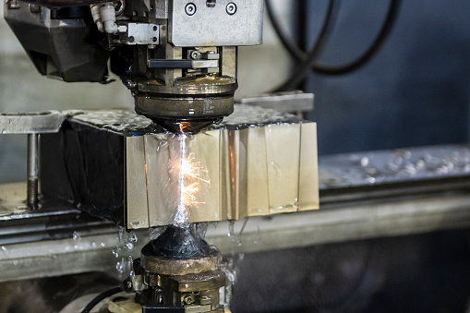
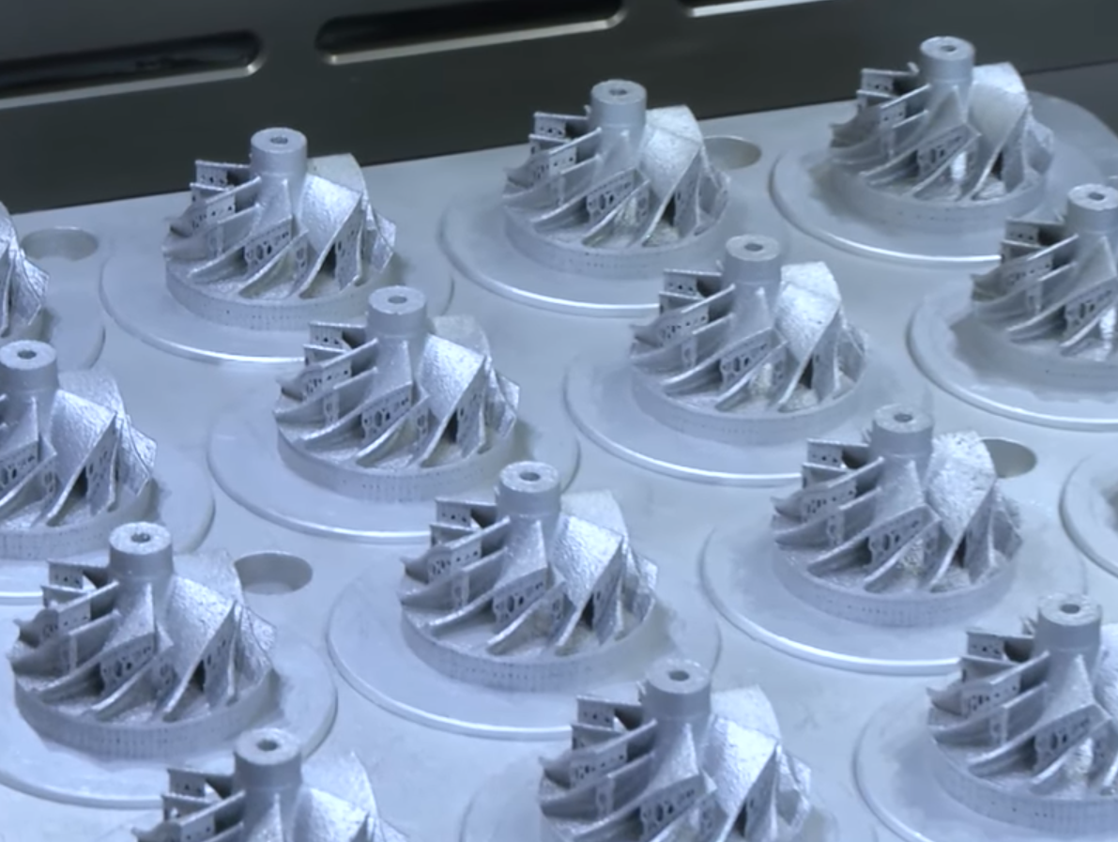
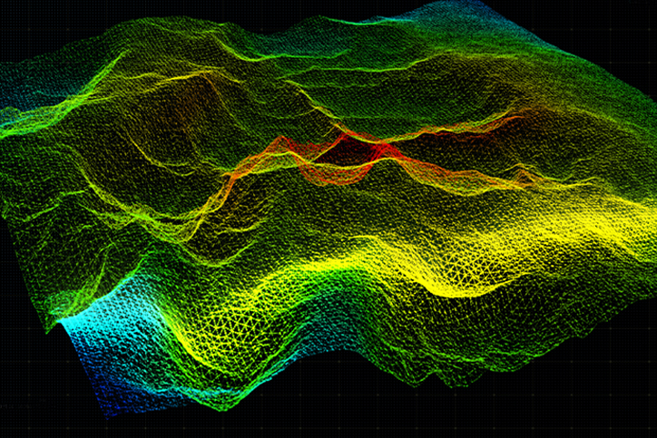
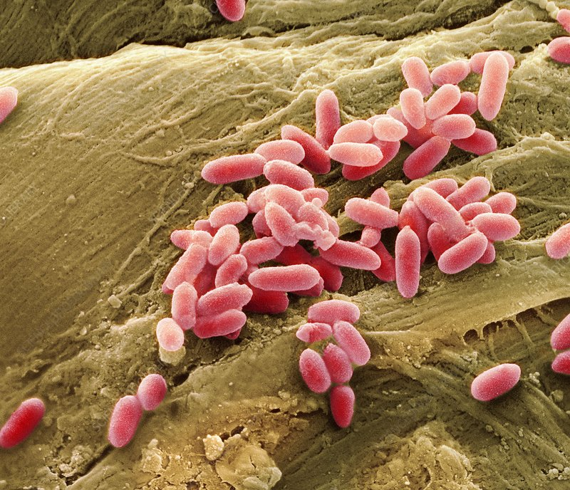

Methodology: Overview
Machines:
Drilling EDM
Micro EDM
Materials:
Casted Ti-6Al-4V
SLM printed Ti-6Al-4V
Size: 20*20*3 mm
Properties:
MRR, Overcut/Kerf width, Hardness, Crater size, SR, Contact angle
Tests:
Bacteria response of Pseudomonas Aeruginosa
Statistical analysis:
Taguchi
ANOVA

Slide 12
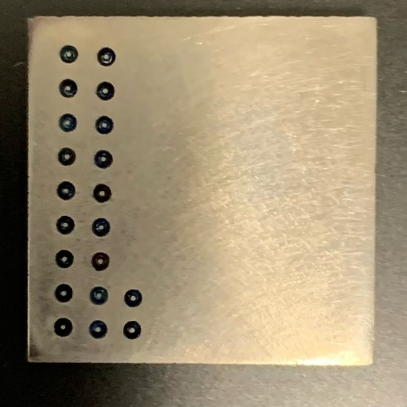
Methodology: Drilling EDM
List of experiments based on orthogonal array for drilling EDM
Machining parameters:
Gap voltage (2, 5, 8)
Pulse current (2, 5, 8)
Time on (2, 5, 8)
Time off (2, 5, 8)
Other Experimental Parameters:
Feed rate: 4
Flushing pressure: 10MPa
Material: Ti-6Al-4V casted
Brass tube electrode: d=1mm
Hole depth: 1 mm
Experimental set: 9
No. exp. | Pulse Current | Time-On | Time-Off | Gap Voltage
1 | 2 | 2 | 2 | 2
2 | 2 | 5 | 5 | 5
3 | 2 | 8 | 8 | 8
4 | 5 | 2 | 5 | 8
5 | 5 | 5 | 8 | 2
6 | 5 | 8 | 2 | 5
7 | 8 | 2 | 8 | 5
8 | 8 | 5 | 2 | 8
9 | 8 | 8 | 5 | 2

Slide 13
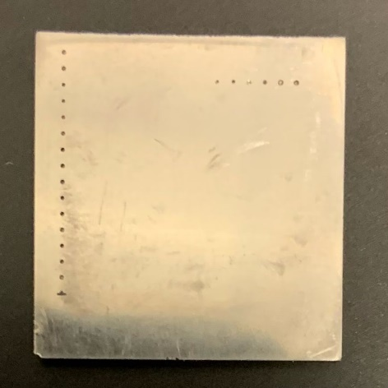
Methodology: Micro Drilling EDM
List of experiments based on orthogonal array for micro EDM
Machining parameters:
Gap voltage (90 V, 100 V, 110 V)
Capacitance (1 nF, 10 nF, 100 nF)
Tool rotation speed (750 rpm, 1000 rpm, 1250 rpm)
Other Experimental Parameters:
Feed rate 0,06 mm/min
Material: Ti-6Al-4V casted
Tungsten carbide electrode
Electrode diameter 0,268 mm
Depth of cut: 0,15 mm
Experimental set: 9
No. exp. | Gap voltage, V | Capacitance, nF | Spindle speed, rpm
1 | 90 | 1 | 750
2 | 90 | 10 | 1000
3 | 90 | 100 | 1250
4 | 100 | 1 | 1000
5 | 100 | 10 | 1250
6 | 100 | 100 | 750
7 | 110 | 1 | 1250
8 | 110 | 10 | 750
9 | 110 | 100 | 1000

Slide 14
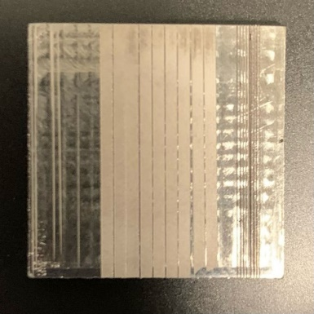
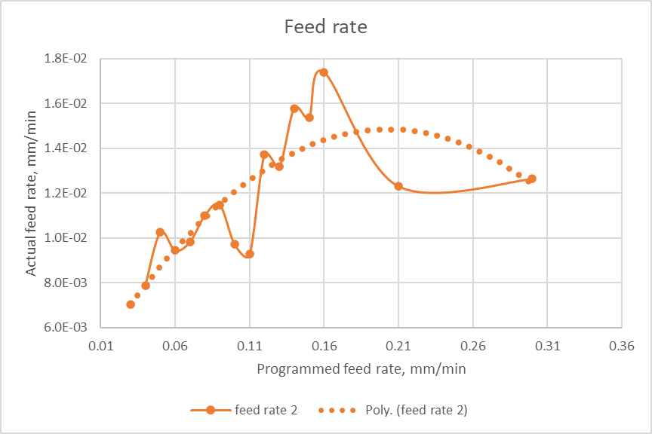
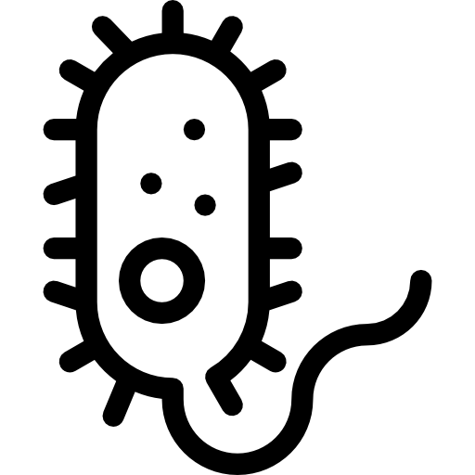
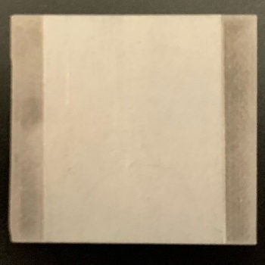
Methodology: Micro Wire EDM
List of experiments based on orthogonal array for micro wire EDM
Mechanical Tests
Machining parameters:
Gap voltage (90 V, 100 V, 110 V)
Capacitance (1 nF, 10 nF, 100 nF)
Other Experimental Parameters:
Feed rate 0,16 mm/min
Material: Ti-6Al-4V casted and printed
Tungsten carbide electrode
Wire diameter 0,05 mm
Depth of cut: 0,15 mm
Wire tension: 10%
Wire speed: 20%
Experimental set: 9
No. exp. | Gap voltage, V | Capacitance, nF
1 | 90 | 1
2 | 90 | 10
3 | 90 | 100
4 | 100 | 1
5 | 100 | 10
6 | 100 | 100
7 | 110 | 1
8 | 110 | 10
9 | 110 | 100
Biological Tests

Slide 15
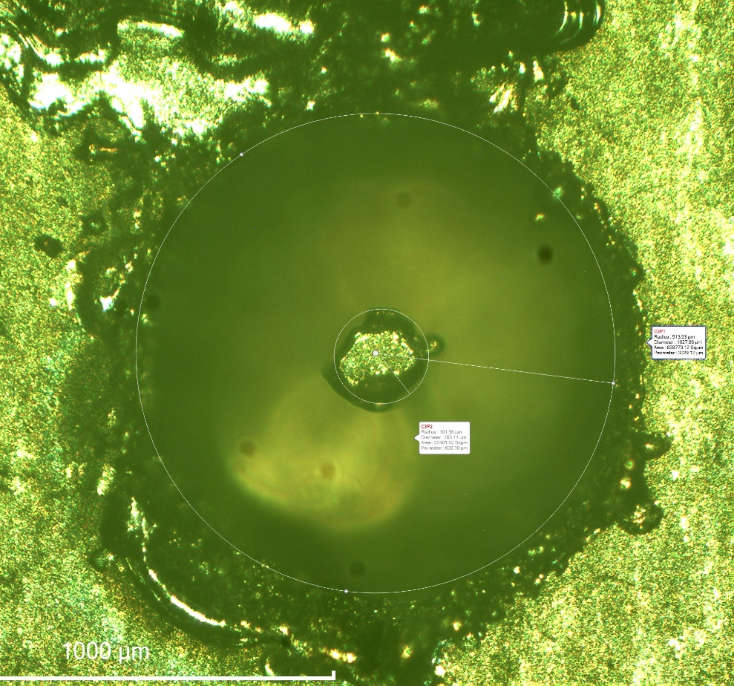
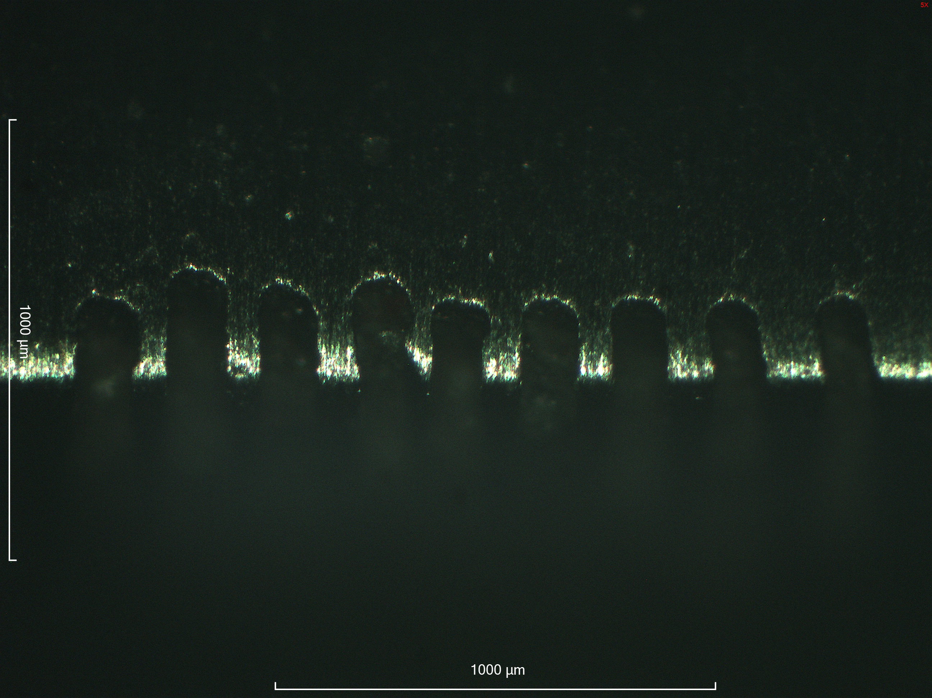
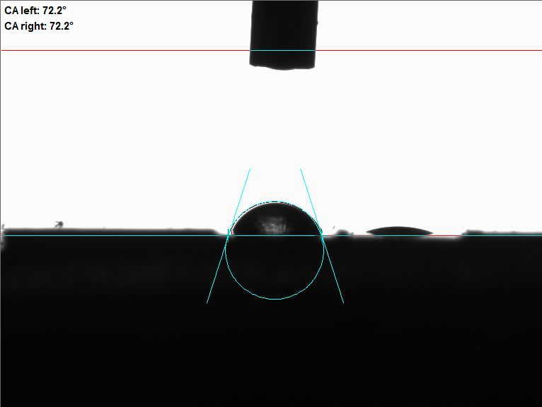
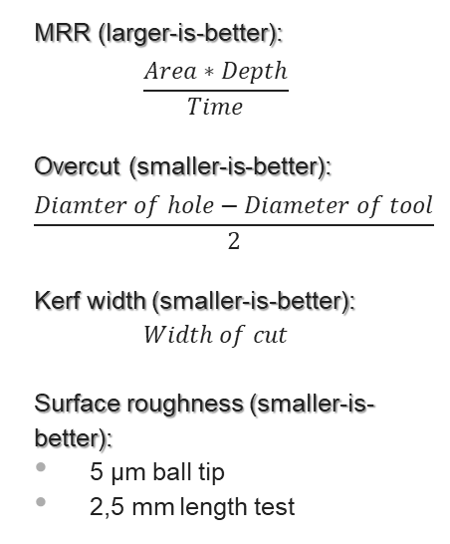
Methodology: Measurements
MRR (larger-is-better):
$$\frac{Area∗Depth}{Time}$$
Overcut (smaller-is-better):
$$\frac{Diamter of hole−Diameter of tool}{2}$$
Kerf width (smaller-is-better):
$$Width of cut$$
Surface roughness (smaller-is-better):
5 µm ball tip
2,5 mm length test
Hardness (higher-is-better):
Crater Size (smaller-is-better):
Contact angle (larger-is-better):
3-phase sessile drop test
0,5 mm tube
1 drop
deionized water
Vickers 2,5 kg untreated
Vickers 0,2 kg untreated
Vickers 0,2 kg treated
SEM photo
ImageJ calculation
Area to diameter

Slide 16
Methodology: Bacteria Response
Cleaning titanium plates
Culturing Pseudomonas Aeruginosa in liquid
Put samples into the mixture
Shake for 48 hours
Mark attached colonies with crystal violet
Rinse and dry the plates
Microscope images

Slide 17
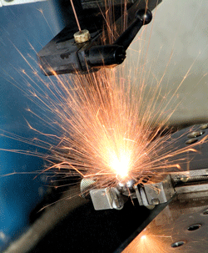
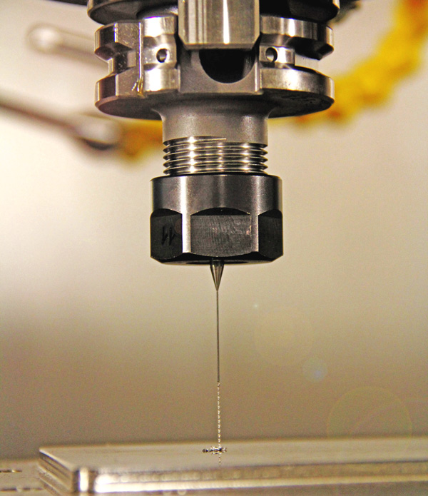
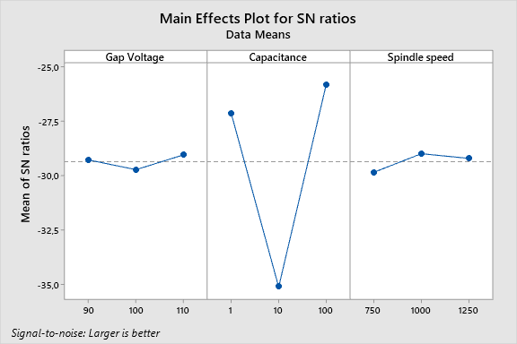
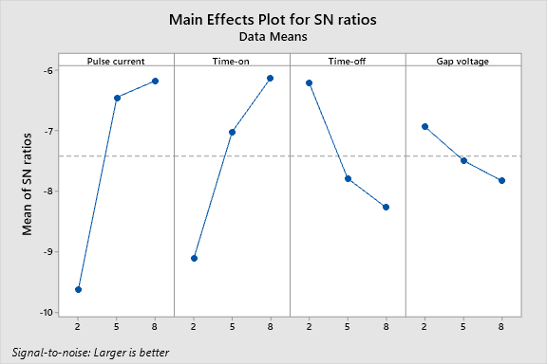

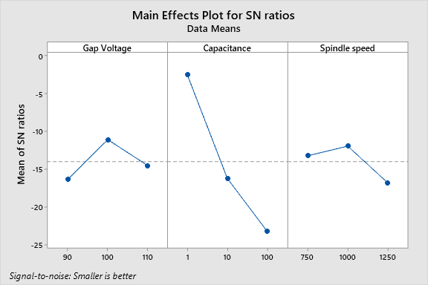
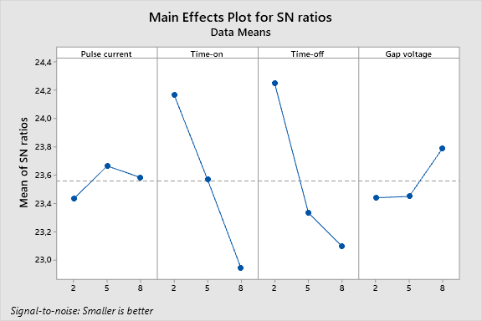
Results: Drilling EDM and Micro Drilling EDM
Graph 1. MRR for micro drilling EDM
Graph 2. MRR for drilling EDM
Parameters: MRR (LB) and Overcut (SB)
Observations:
High discharge energy – high MRR
Low discharge energy – small overcut
Spindle speed affects the type of flow
Graph 3. Overcut for micro drilling EDM
Graph 4. Overcut for drilling EDM

Slide 18
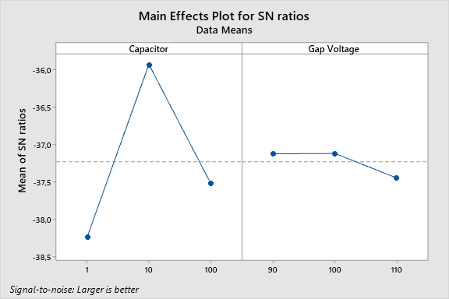
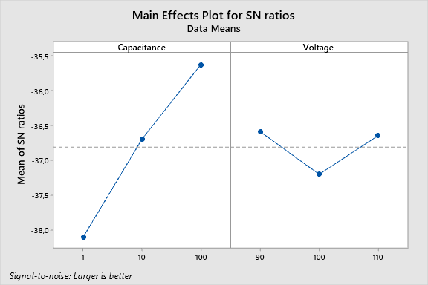
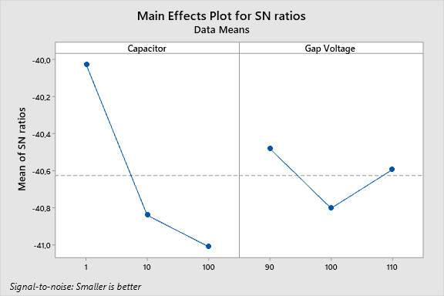
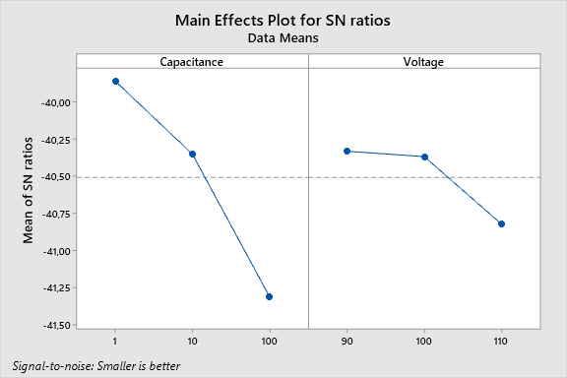
Results: Micro Wire EDM (MRR and Kerf Width)
Graph 5. MRR for casted alloy
Graph 6. MRR for printed alloy
Parameters: MRR (LB) and Kerf Width (SB)
Materials: casted and printed Ti-6Al-4V alloys
Observations:
High discharge energy – high MRR
Low discharge energy – small kerf width
Graph 7. Kerf width for casted alloy
Graph 8. Kerf width for printed alloy

Slide 19
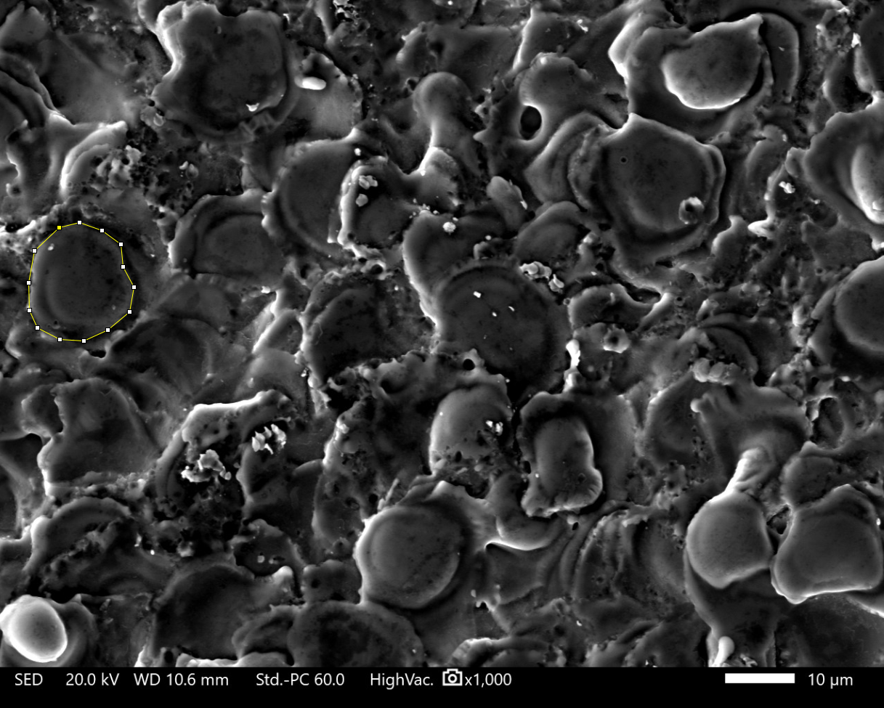
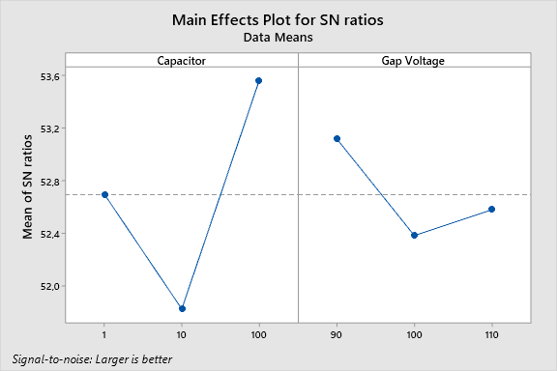
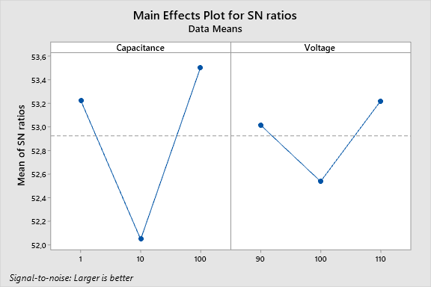
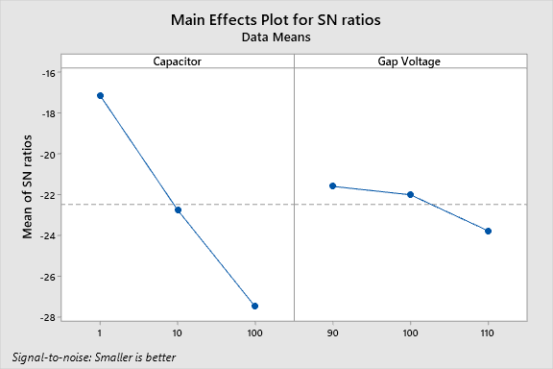
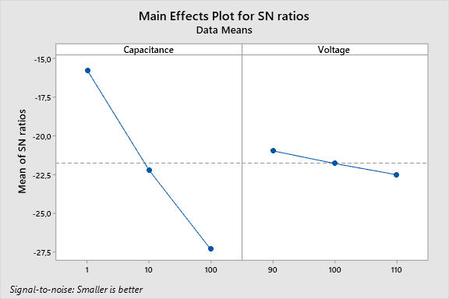
Results: Micro Wire EDM (Hardness and Crater Size)
Graph 9. Hardness for casted alloy
Graph 10. Hardness for printed alloy
Parameters: Hardness (LB) and Crate Size (SB)
Materials: casted and printed Ti-6Al-4V alloys
Observations:
High discharge energy – high hardness, except medium energy
Low discharge energy – small crater size
Graph 11. Crater size for casted alloy
Graph 12. Crater size for printed alloy

Slide 20
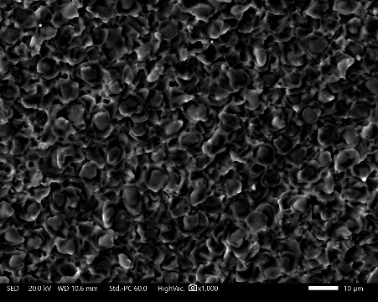
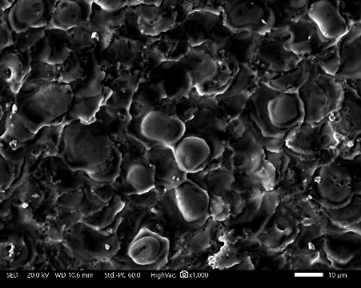
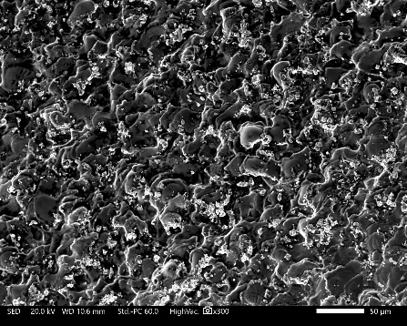
Results: Micro Wire EDM (Crater Size)
4,05 µJ 50 µJ 605 µJ

Slide 21
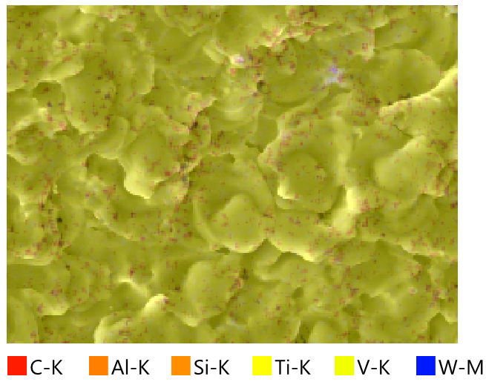
Results: Micro Wire EDM (EDS for casted)
Element | Line | Mass% | Atom%
C | K | 11.21±0.02 | 32.85±0.05
Al | K | 4.15±0.01 | 5.41±0.02
Ti | K | 80.41±0.05 | 59.08±0.04
V | K | 3.41±0.02 | 2.36±0.01
W | M | 0.68±0.02 | 0.13±0.00
Total |  | 100.00 | 100.00
Map_001_wholespectrum |  | Fitting ratio 0.0053

Slide 22
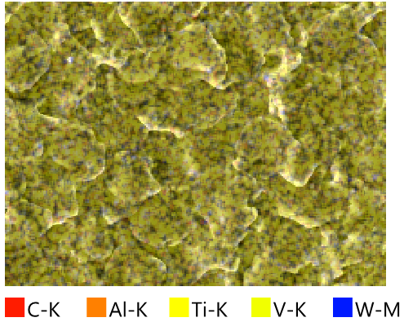
Results: Micro Wire EDM (EDS for printed)
Element | Line | Mass% | Atom%
C | K | 7.94±0.03 | 25.08±0.11
Al | K | 3.94±0.04 | 5.53±0.05
Ti | K | 84.51±0.22 | 66.93±0.17
V | K | 3.18±0.06 | 2.37±0.05
W | M | 0.43±0.06 | 0.09±0.01
Total |  | 100.00 | 100.00
Map_002_wholespectrum |  | Fitting ratio 0.0078

Slide 23
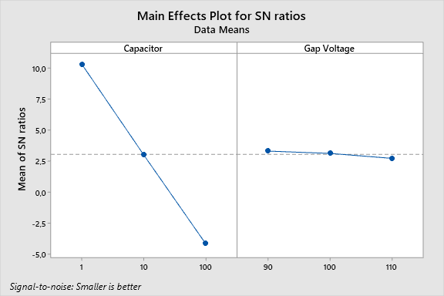
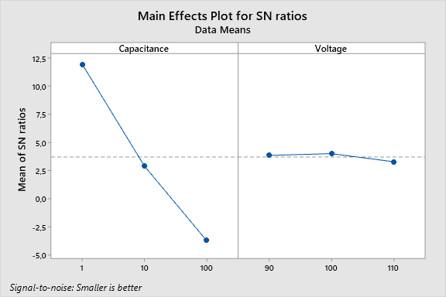
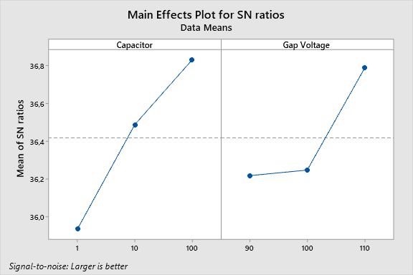

Results: Micro Wire EDM (SR and Contact Angle)
Graph 13. SR for casted alloy
Graph 14. SR for printed alloy
Parameters: SR (SB) and Contact Angle (LB)
Materials: casted and printed Ti-6Al-4V alloys
Observations:
Low discharge energy – small SR
Low discharge energy – low contact angle
Graph 15. Contact angle for casted alloy
Graph 16. Contact angle for printed alloy

Slide 24





Results: Micro Wire EDM (Bacteria Response)
Casted, Low Energy
Casted, Low Energy
Casted, High Energy
Casted, High Energy
Printed, Low Energy
Printed, High Energy
Parameters: Pseudomonas Aeruginosa
Observations:
Low discharge energy – high biofilm formation
Printed alloy – less bacteria strain
Notes:
Casted Printed
Low L 1 5 0,013% 0,017%
Low R 2 6 3,120% 0%
High L 3 7 0,021% 0,140%
High R 4 8 0,113% 0,017%

Slide 25
Results: Overall
Printed alloy
MRR
Kerf Width
Crater Size
SR
Optimal values of output parameters according to S/N analysis
Output | Type of S/N ratio | Casted | Printed
 |  | Value | Value
MRR | LB | 0.016241 mm³/s | 0.017148 mm³/s
Kerf Width | SB | 98.63 µm | 96.26 µm
Hardness | LB | 499.8 HV | 488.0 HV
Crater Size | SB | 5.592 µm | 4.571 µm
SR | SB | 0.2644 µm | 0.1630 µm
Contact Angle | LB | 72.22⸰ | 71.34⸰
Casted alloy
Hardness
Contact Angle

Slide 26




Discussion
Bigger Discharge Energy
Bigger Sparks
Higher
● MRR
● Kerf Width
● Crate Size
● Surface Roughness
Lower Contact Angle
Thickness of recast layer
Material deposition
Porosity
Hardness

Slide 27




Conclusion
Ti-6Al-4V has a strong resistance to the Pseudomonas Aeruginosa bacteria adhesion
SLM printed titanium alloy plates have less biofilm formation comparing to casted plates
Smaller discharge energy (4,05 µJ) lead to higher bacteria attachment than higher discharge energy (605 µJ)
Macro EDM
Micro EDM
Ti-6Al-4V
Casted and SLM printed
MRR, Crater Size
Overcut/Kerf Width
Hardness, SR
Contact Angle
Bacteria response of Pseudomonas Aeruginosa
Study observations

Slide 28
Thank you for your attention!

Slide 29
References
[1] A. T. Sidambe, "Biocompatibility of advanced manufactured titanium implants-A review," Materials, Review vol. 7, no. 12, pp. 8168-8188, 2014.
[2] X. Liu, P. K. Chu, and C. Ding, "Surface modification of titanium, titanium alloys, and related materials for biomedical applications," Materials Science and Engineering: R: Reports, vol. 47, no. 3, pp. 49-121, 2004/12/24/ 2004.
[3] T. Muthuramalingam and B. Mohan, “A review on influence of electrical process parameters in EDM process,” Archives of Civil and Mechanical Engineering, vol. 15, no. 1, pp. 87–94, 2015.
[4] M. Kaur and K. Singh, "Review on titanium and titanium based alloys as biomaterials for orthopaedic applications," Materials Science and Engineering: C, vol. 102, pp. 844-862, 2019/09/01/ 2019.
[5] C. Prakash, H. K. Kansal, B. S. Pabla, S. Puri, and A. Aggarwal, "Electric discharge machining - A potential choice for surface modification of metallic implants for orthopedic applications: A review," Proceedings of the Institution of Mechanical Engineers, Part B: Journal of Engineering Manufacture, Review vol. 230, no. 2, pp. 331-353, 2016.
[6] M. S. Baltatu et al., "Biocompatible titanium alloys used in medical applications," vol. 70, no. 4, pp. 1302-1306, 2019.
[7] A. Mahajan, S. Devgan, and S. S. Sidhu, "Surface alteration of biomedical alloys by electrical discharge treatment for enhancing the electrochemical corrosion, tribological and biological performances," Surface and Coatings Technology, vol. 405, p. 126583, 2021/01/15/ 2021.
[8] G. Singh, T. R. Ablyaz, E. S. Shlykov, K. R. Muratov, A. S. Bhui, and S. S. Sidhu, "Enhancing Corrosion and Wear Resistance of Ti6Al4V Alloy Using CNTs Mixed Electro-Discharge Process," Micromachines, vol. 11, no. 9, 2020.

