Slide 1

CSCI 409 - Senior Project II
24 April 2025
TalentEngine: AI-Powered Recruitment System
Team members: Aimurat Zhetkizgenov, Alfiya Lugma, Dastan Kozhabayev, Dias Sagatov, Yerassyl Myrzakhanov
Project Advisor: Prof. Michael Lewis
Notes:
Welcome to our presentation on TalentEngine, an AI-powered platform designed to transform the hiring process.

Slide 2





Team Members
Aimurat Zhetkizgenov
Backend Developer
Yerassyl Myrzakhanov
AI-ML Developer
Dastan Kozhabayev
AI-ML Developer
Dias Sagatov
Frontend Developer
Alfiya Lugma
Frontend Developer
Notes:
Here’s the team: united by a shared goal to improve the hiring process.

Slide 3
Project Motivation -> Market Evaluation
Feature | Iris by Qureos | X0PA AI | HeroHunt.ai | hireEZ | TalentEngine
Candidate Management | ✔️ | ✔️ | ✔️ | ✔️ | ✔️
Automated Communication | ✔️ | ❌ | ✔️ | ❌ | ✔️
Dynamic Career Site & ATS | ✔️ | ❌ | ❌ | ✔️ | ✔️
Candidate Ranking | Basic | Proprietary | Basic | Basic | Advanced ML model
Notes:
When starting the project, we looked at what other solutions offered, saw where they fell short—like in automated communication and smart candidate ranking—and used that as an inspiration to build something better.

Slide 4

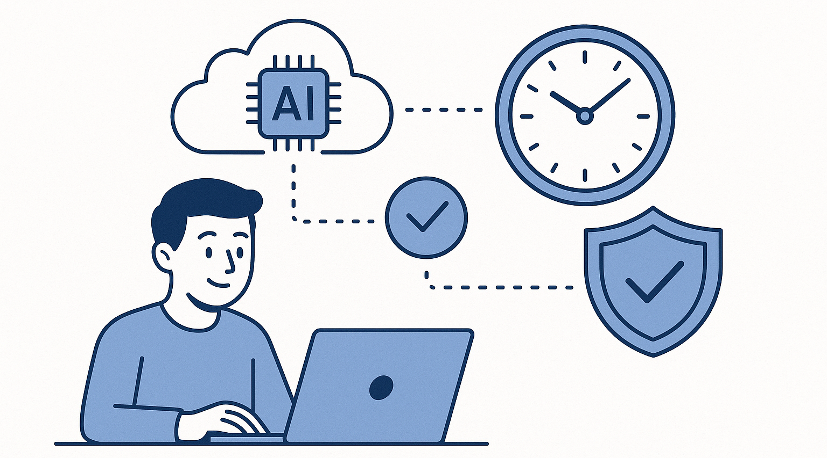
TalentEngine: AI-Powered Recruitment System
Simplifying hiring with smart automation
Automates candidate screening and communication.
Saves time for HR teams and improves candidate experience.
Uses AI, NLP, and scalable cloud infrastructure.
Notes:
Recruitment today is often slow and tedious, both for HR managers and candidates. TalentEngine aims to address this by automating key tasks. By leveraging AI and scalable cloud technology, our goal is to save time, improve accuracy, and create a better experience for everyone involved.

Slide 5




Project Goals
Goal 1: Use AI to automate applicant screening and ranking.
Goal 2: Integrate messaging platforms for automated communication.
Goal 3: Build a secure, scalable, and efficient system.
Goal 4: Ensure an intuitive interface for recruiters and candidates.
Notes:
TalentEngine is guided by four main goals. First, we use AI to automate candidate screening and ranking, which reduces manual effort and enhances accuracy. Second, we streamline recruiter-candidate communication. Third, we prioritize scalability and security to ensure reliable performance. And finally, we aim to provide a user-friendly interface for both HR teams and job seekers

Slide 6
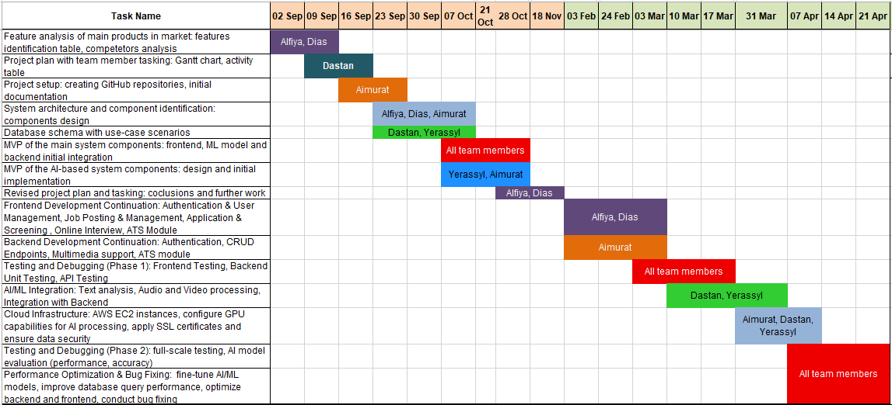
Project Timeline
Notes:
Here as it can be seen most of the work was done in parallel, so our workflow was efficient and smooth. The project progress was steady, which gave us an opportunity to maturely develop and roll out the solution in time, while maintaining quality testing and optimization.

Slide 7
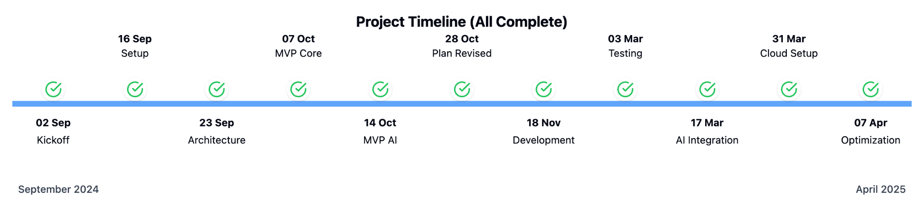
Project Progress
Completed:
Backend with all required functionality (jobs, candidates, applications).
Complete frontend for job posting and candidate management.
AI model using traditional semantic analysis and LLM for candidate ranking.
Prior challenge:
Keyword-based semantic analysis lacked context, affecting accuracy.
Notes:
This semester, our focus was on building the foundation of TalentEngine. We developed a backend system with core entities like jobs and applications, a basic frontend that allows job postings and candidate management, and an AI prototype for candidate ranking. However, we faced a challenge with our semantic analysis approach. Using traditional keyword-based methods, the AI often struggled to understand the context, leading to less accurate candidate rankings. This realization has shaped our plans for spring

Slide 8
Killer Features
The system provides:
2FA authentication and AES-256 encryption
Provides all standard interview question types, including custom media (audio, video) questions that get transcripted and analyzed by our AI model
Robust and scalable backend
Intuitive frontend and convenient data visualisation of our AI ranking
Notes:
Let’s take a quick look at what we’ve built so far. The backend allows HR managers to create and manage job postings, as well as to view candidate applications. The frontend provides an interface for these tasks. Our AI prototype ranks candidates based on a job description and resume semantic analysis. While it’s not perfect yet, this demonstration highlights the potential of TalentEngine to simplify and enhance the recruitment process

Slide 9
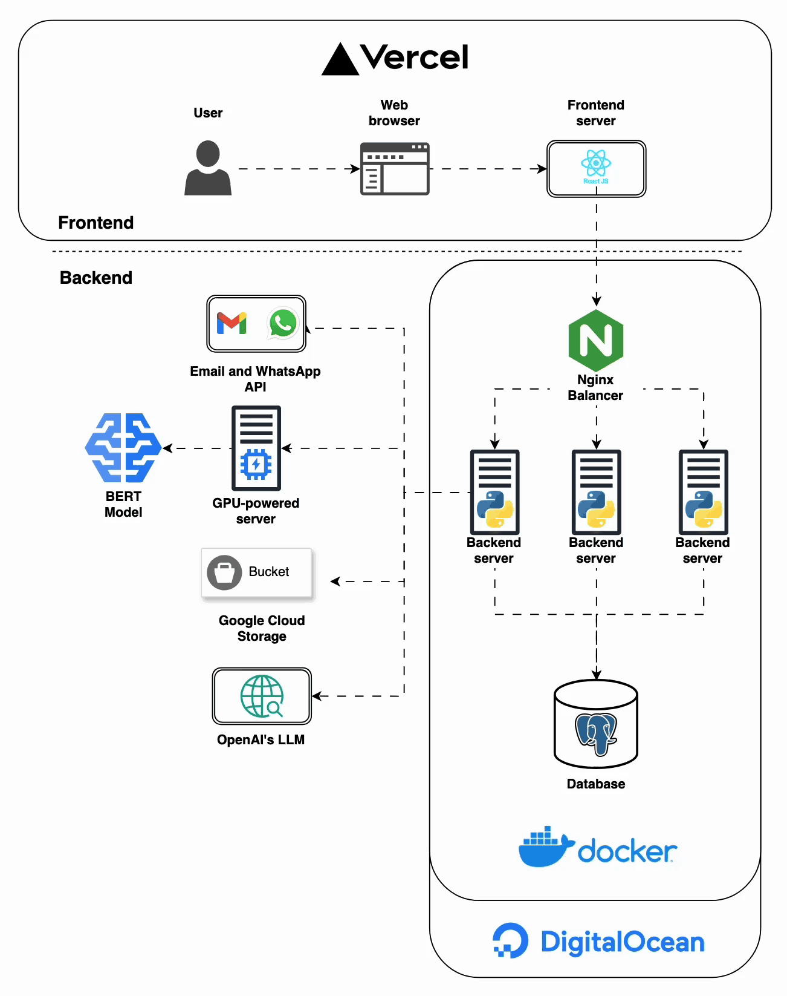
Backend Demonstration
FastAPI: APIs for job postings, applications, and candidate management.
PostgreSQL DB connecting key entities:
Users, Organizations, Applicants, Vacancies, Applications, Interviews, and Answers.
Google Cloud Storage to store CVs, video and audio answers
Notes:
The backend serves as the foundation of TalentEngine, enabling seamless data management and system operations. We’ve built a robust API that supports job postings, candidate tracking, and application management. Powered by FastAPI and PostgreSQL, this backend ensures scalability and reliability, laying a strong groundwork for our platform

Slide 10
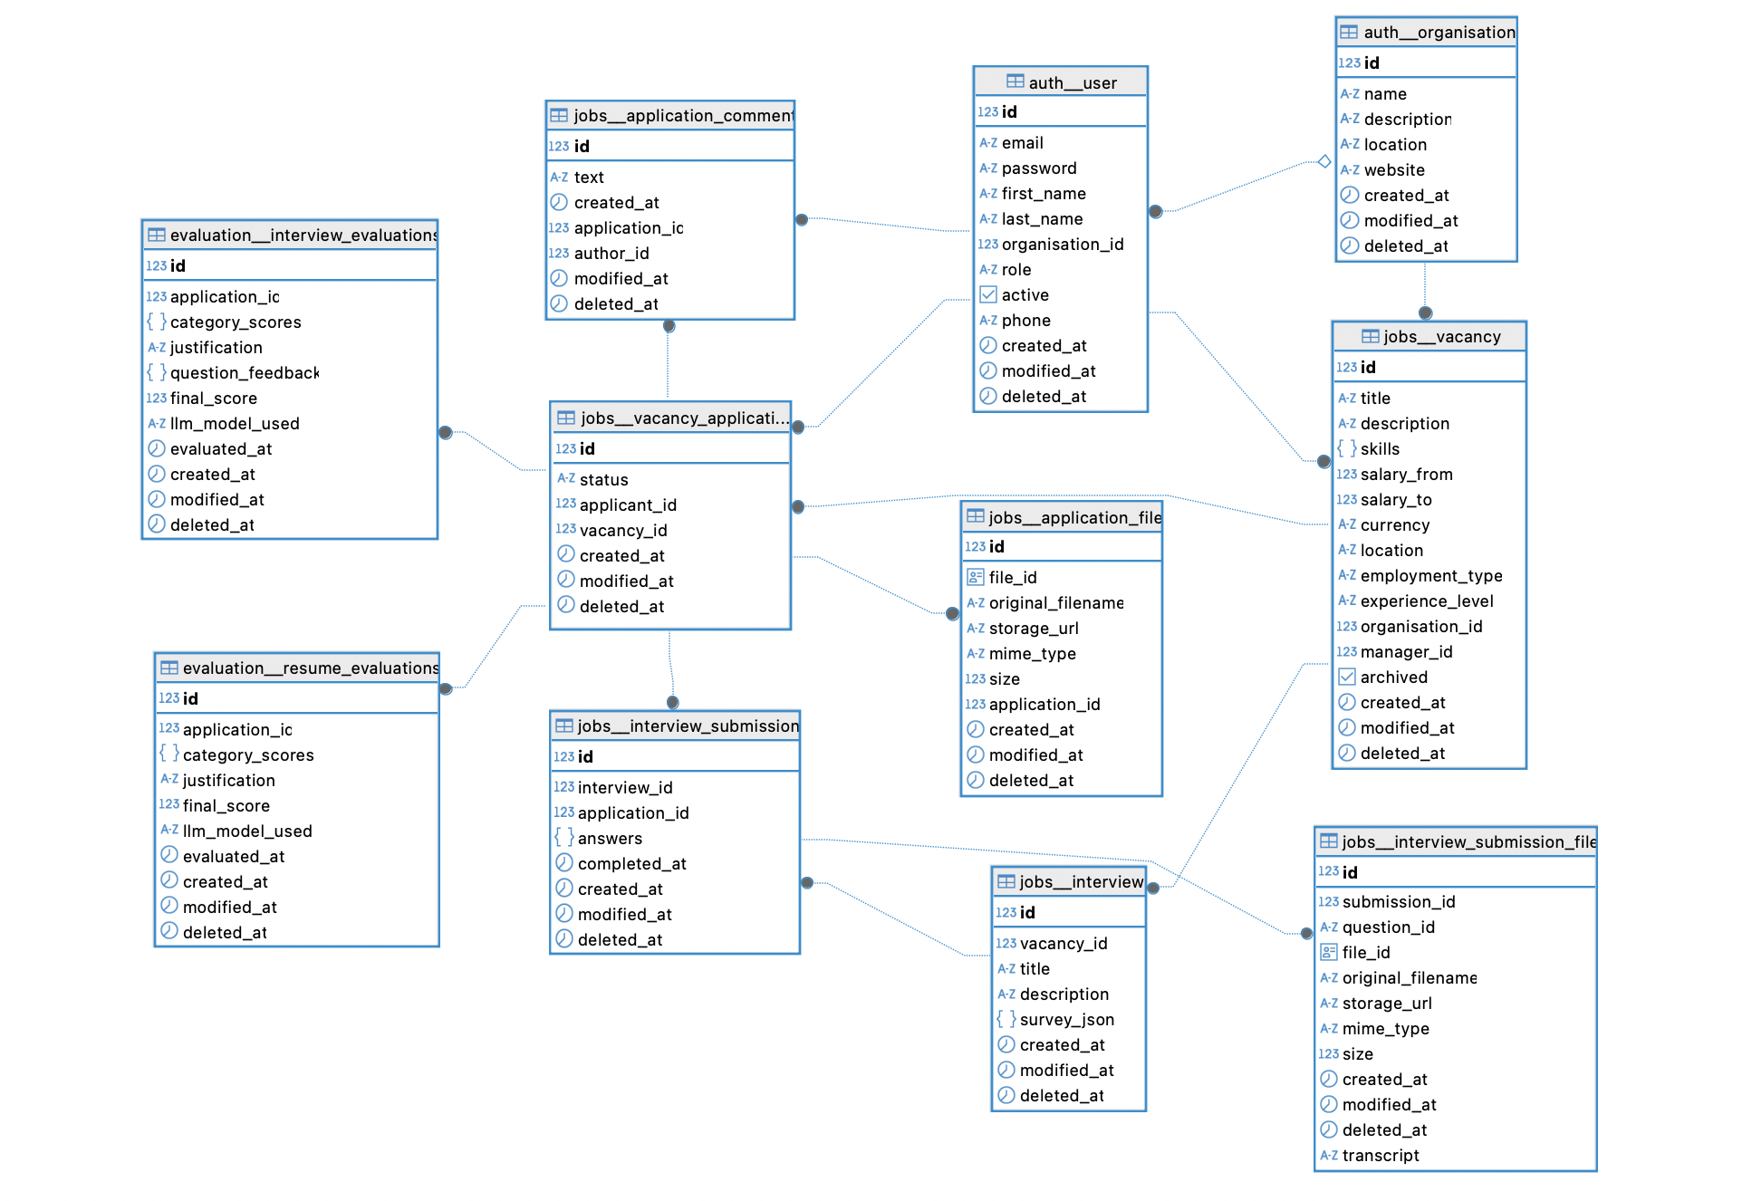
Database Schema
Database schema for Authentication, Application and Vacancy posting systems.
Database was populated using data from kaggle.com
Notes:
This slide represents TalentEngine's current database schema. At its core, the system connects Users and Organizations with Applicants through structured Vacancies and Applications. The Interview module supports detailed question and answer tracking, enabling robust candidate evaluation. This schema ensures that all recruitment activities are seamlessly integrated and efficiently managed, providing the foundation for scalable and reliable performance

Slide 11
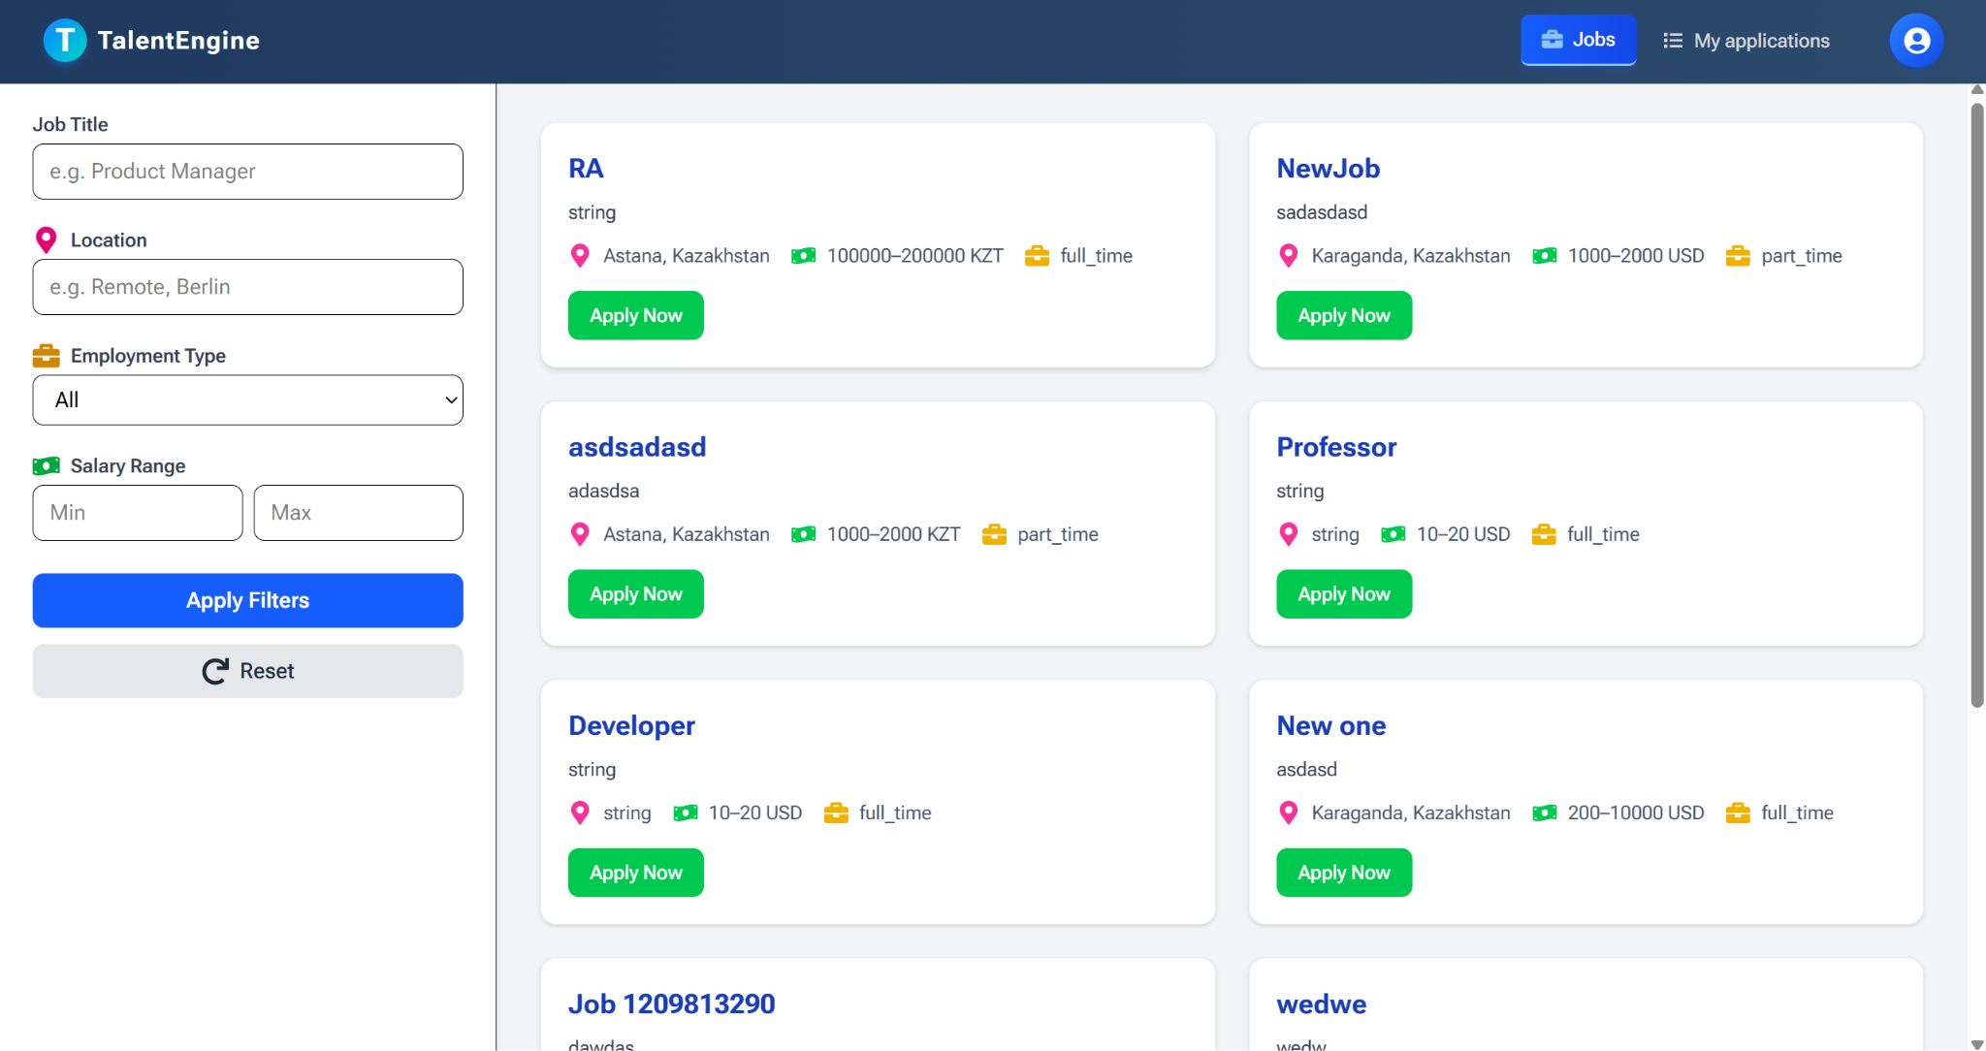
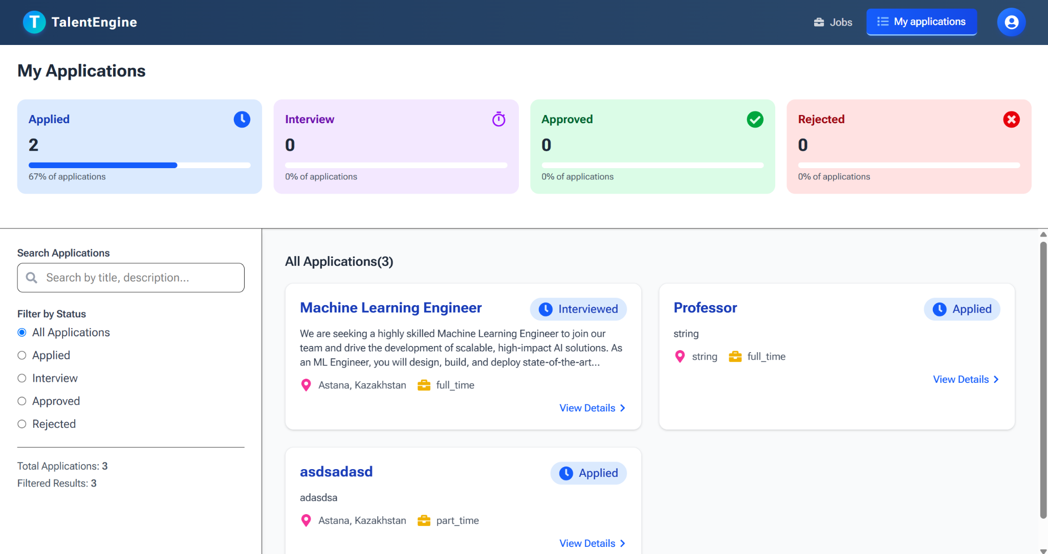
Frontend Demonstration
Intuitive interface for HR teams to post jobs and track candidates.
Candidate portal for managing applications.
Built with React JS and Next JS for responsive and dynamic user experiences.
Candidate ranking visualization
Notes:
Our frontend focuses on delivering a user-friendly experience for both HR teams and candidates. The HR dashboard allows recruiters to post jobs, view candidate profiles, and track application statuses effortlessly. For candidates, the portal simplifies job application management. Built with ReactJS and NextJS, the frontend ensures responsiveness and interactivity

Slide 12
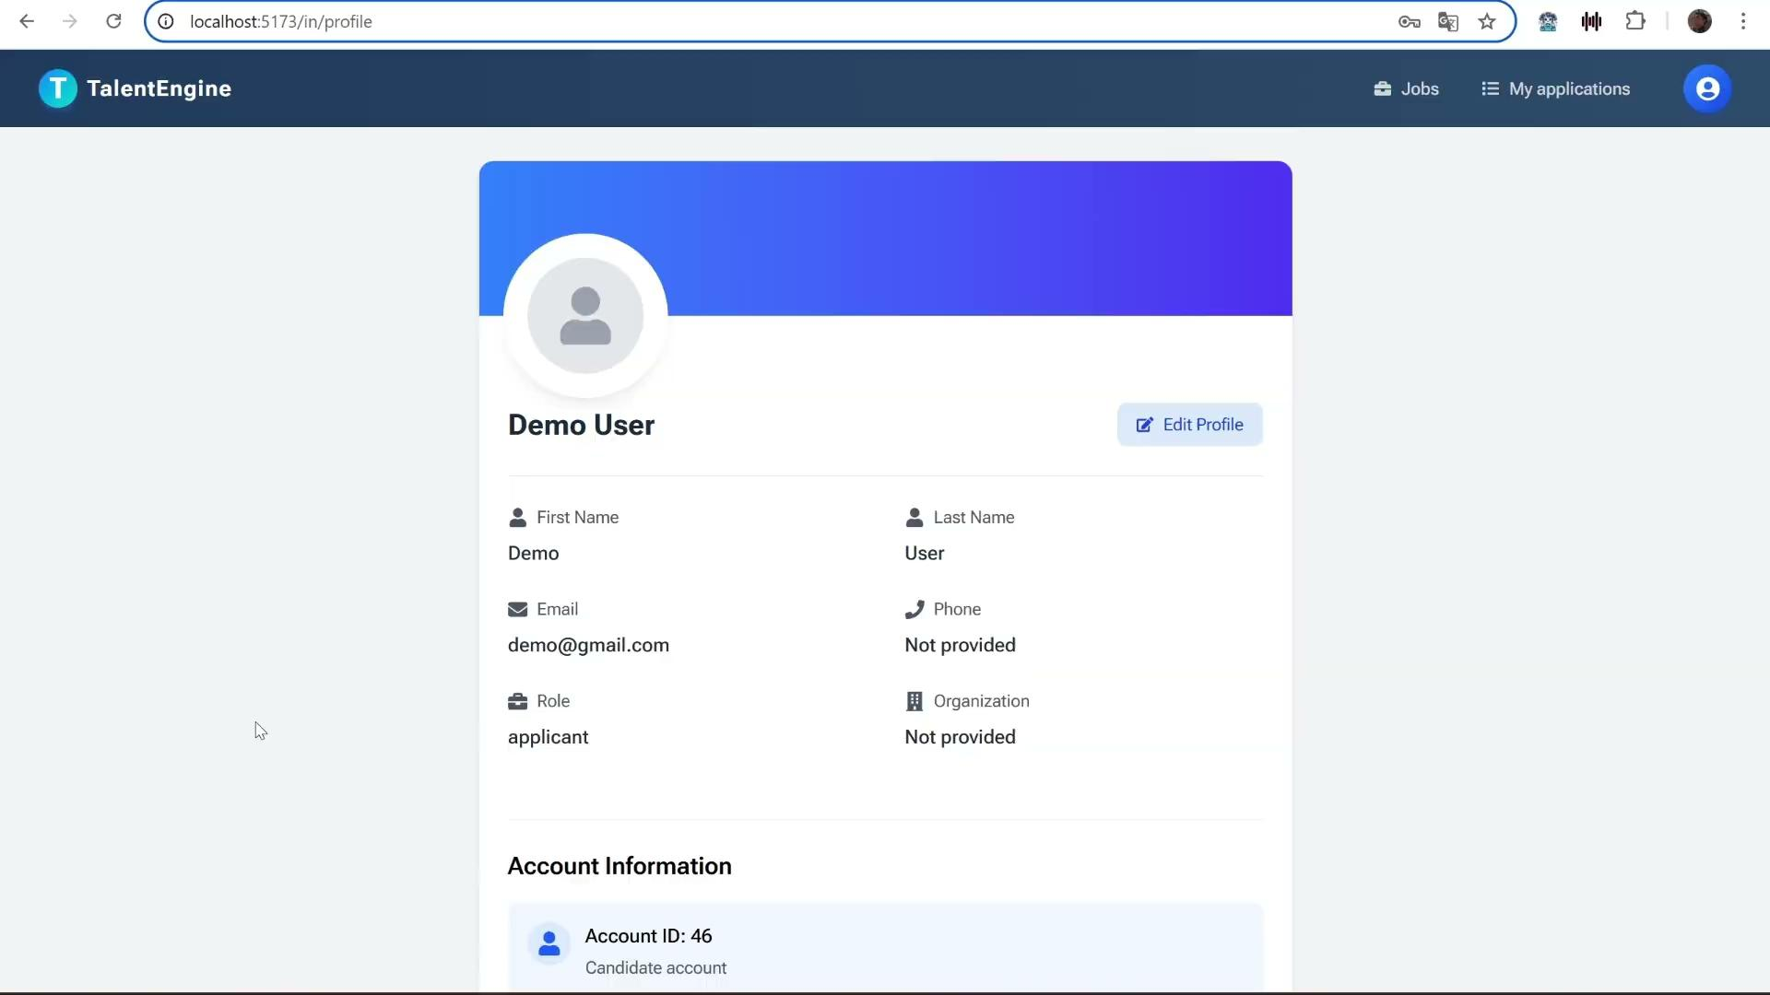
Candidate view
See vacancies
Sort, search
See own applications and statuses
Take Interviews
Change profile details
Notes:
Our frontend focuses on delivering a user-friendly experience for both HR teams and candidates. The HR dashboard allows recruiters to post jobs, view candidate profiles, and track applications effortlessly. For candidates, the portal simplifies job application management. Built with ReactJS and NextJS, the frontend ensures responsiveness and interactivity

Slide 13
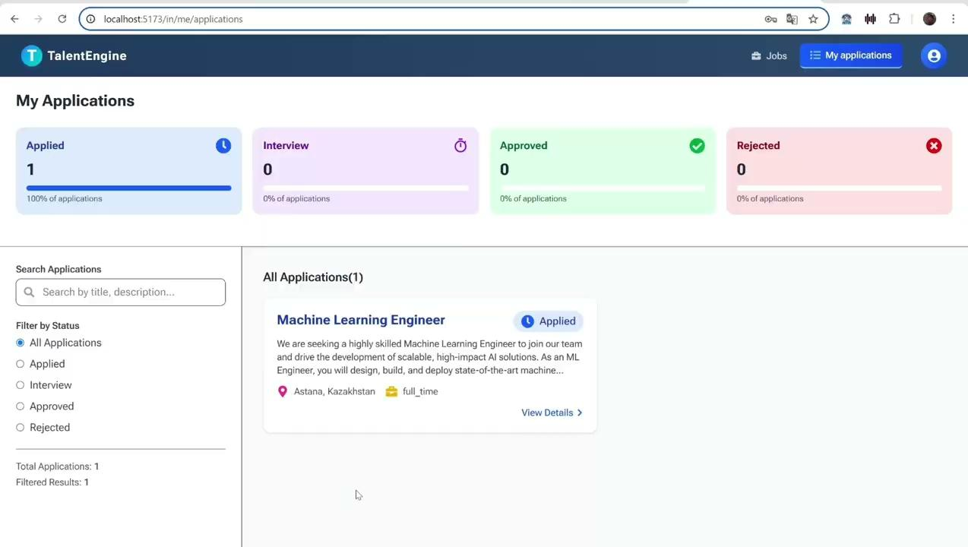
Interview Completion
Complete written interview questions
Complete audio/video interview questions
Notes:
Our frontend focuses on delivering a user-friendly experience for both HR teams and candidates. The HR dashboard allows recruiters to post jobs, view candidate profiles, and track applications effortlessly. For candidates, the portal simplifies job application management. Built with ReactJS and NextJS, the frontend ensures responsiveness and interactivity

Slide 14

HR view
Vacancy management
Application management
Creating interviews
Ranking and full report
Notes:
Our frontend focuses on delivering a user-friendly experience for both HR teams and candidates. The HR dashboard allows recruiters to post jobs, view candidate profiles, and track application statuses effortlessly. For candidates, the portal simplifies job application management. Built with ReactJS and NextJS, the frontend ensures responsiveness and interactivity

Slide 15
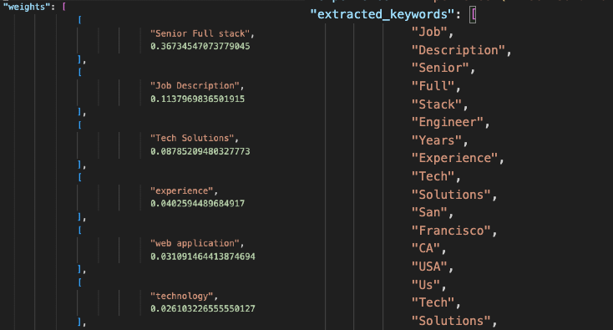
AI Model Demonstration
First-stage:
Embeddings based (SBERT model) AI prototype for ranking candidates using semantic analysis.
Challenges faced with keyword-based analysis and its lack of contextual understanding.
Proposed solution: Apply LLMs for better context.
Result in JSON file: sorted keywords in descending order and extracted keywords
Notes:
Our AI prototype is designed to rank candidates by analyzing resumes and job descriptions. As mentioned, our AI ranks candidates using a keyword-based model, but struggles with context. Moving forward, we plan to transition to advanced LLM-based models to achieve greater precision in candidate ranking

Slide 16
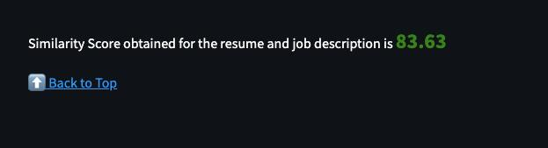
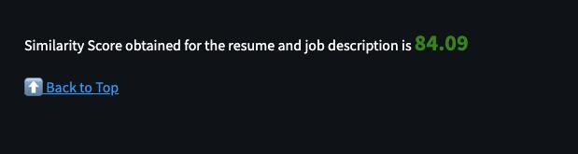
Embeddings based Ranking system
For “Full-stack position” vacancy:
Frontend developer for “Fullstack” vacancy
Full-stack developer for “Fullstack” vacancy
Full-stack developer received more than Frontend developer.
Frontend developer received high score, because “Full-stack = Frontend + Backend”
Notes:
For demonstration of ranking system, we have two resumes: from a frontend developer and a fullstack developer both applying for a fullstack position. As you can see, fullstack received higher score than frontend developer. But frontend developer received high score too, because Fullstack is basically combination of Frontend and Backend.

Slide 17
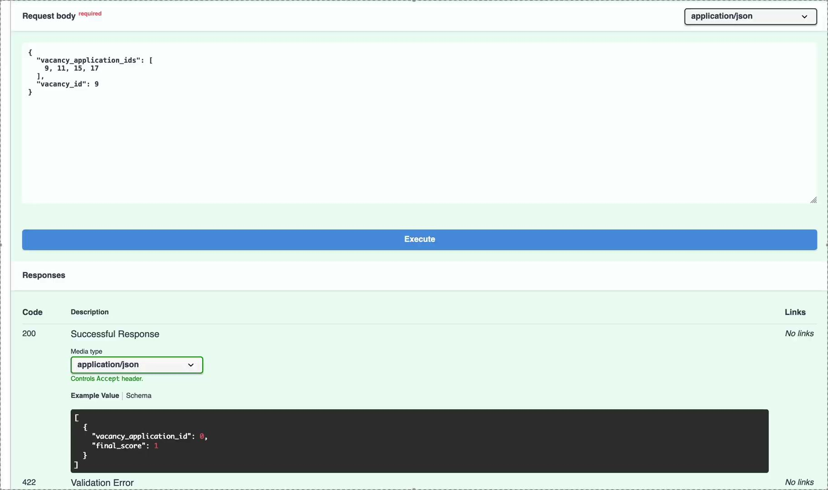
Resume Evaluation (BERT)
Calculate matching score by “all-MiniLM-L6-v2” BERT model. Evaluate “keyword matching”.
Notes:
For demonstration of ranking system, we have two resumes: from a frontend developer and a fullstack developer both applying for a fullstack position. As you can see, fullstack received higher score than frontend developer. But frontend developer received high score too, because Fullstack is basically combination of Frontend and Backend.

Slide 18
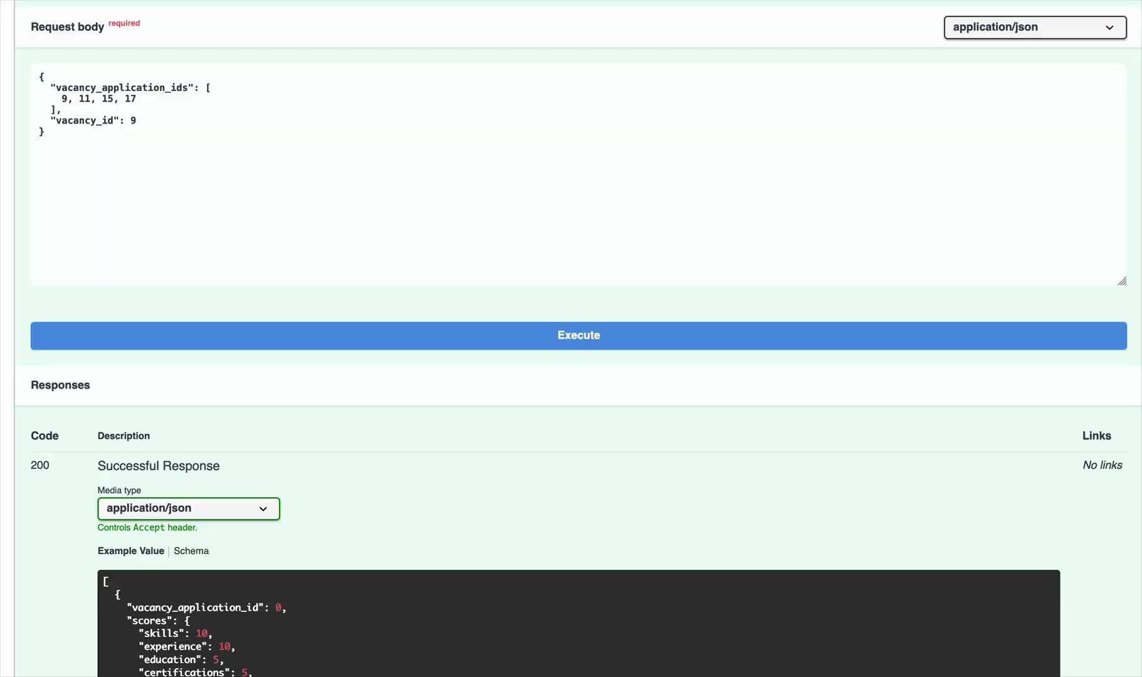
BERT Model Enhancement with LLM
Second-stage:
Apply LLM (OpenAI’s gpt-4.1) on the BERT evaluation.
Better understand the context behind the resumes and vacancy details.
General flow:
BERT “keyword-matching” -> LLM “context”
-> Final Matching score
Result:
Accurate matching with contextual understanding, detailed examination
Demonstration of work (BERT + LLM):
Notes:
Our AI prototype is designed to rank candidates by analyzing resumes and job descriptions. As mentioned, our AI ranks candidates using a keyword-based model, but struggles with context. Moving forward, we plan to transition to advanced LLM-based models to achieve greater precision in candidate ranking

Slide 19
System Evaluation and Results
Key evaluation areas: AI model performance, system efficiency, user experience.
Data collection:
  Quantitative methods: AI model accuracy, screening time efficiency, system response time.
  Qualitative methods: User feedback, questionnaires.
Results: AI model accuracy: 92% recall rate, screening time: reduced by 60%, system response time: 2-5 seconds.
Notes:
For demonstration of ranking system, we have two resumes: from a frontend developer and a fullstack developer both applying for a fullstack position. As you can see, fullstack received higher score than frontend developer. But frontend developer received high score too, because Fullstack is basically combination of Frontend and Backend.

Slide 20
Challenges and Solutions
Challenge: Handling multimodal data, particularly audio and video responses.
  Solution: Processing audio and video responses required both transcription and the development of fair scoring logic, teaching us how to convert raw media into structured.
Challenge: Accurately evaluate candidates beyond basic keyword matching.
  Solution: Early model limitations in understanding context led us to adopt SBERT and LLMs, revealing the importance of semantic analysis over simple keyword matching.
Notes:
One major challenge we faced was the limited accuracy of traditional keyword-based semantic analysis, sometimes ranking irrelevant candidates higher than relevant ones. To address this, we plan to integrate a large language model-based semantic analysis next semester. This shift to advanced NLP techniques will help us better interpret candidate information and significantly improve ranking accuracy

Slide 21
Wrap-Up and Vision
The TalentEngine project successfully delivers a fully functional, AI-powered recruitment platform that automates and enhances every stage of the hiring process.
Future Work:
Fine-tune LLM models using recruiter feedback to improve contextual understanding and scoring accuracy
Expand domain-specific hiring capabilities (healthcare, education sector, etc.)
Conduct large-scale usability tests with real users to refine UX and performance under real-word conditions
Notes:
In conclusion, TalentEngine is designed to make recruitment faster and smarter for HR teams while ensuring fairness and transparency for candidates. By combining cutting-edge AI with thoughtful design, we believe TalentEngine can set a new standard in hiring. Thank you for your time and valuable feedback, which will help us refine and improve as we move forward.

Slide 22
CSCI 409 - Senior Project II
Thank you for your time!

